Slide 1


Network QoS
Draft Intermediate report(OMC Audits part)
October 28th, 2023

Slide 2
Introduction
This part of report presents:
A RAN network audit for MTN BENIN aiming to identify weak points as well as suggest proposals to improve the network quality and so the final user perception.
  Audit is based on Performance Measurement data mainly between 19th September to 04th October 2023 and Configuration settings of 4th October
This intermediate report incudes the PM audit, CM audit is ongoing
Comments and recommendation may be enriched on final report using CM audit findings

Slide 3
Summary
OMC Network Configuration Overview | 03
Executive Summary | Ongoing
PM Data Audit | 05
1- Traffic Distribution 07
2- Network Availability 10
3- Network Retainability 12
4- Network Accessibility 17
5- Network Mobility 22
6- Network Throughputs 24
7- Interference 27
8- Bottlenecks 29
9- ARCEP OMC KPI 33
CM Data Audit | Ongoing

Slide 4
0
OMC AUDIT Network Configuration Overview

Slide 5
Cell Band Distribution
Below Graphs are an overview on the current Network configuration overview

Slide 6
I
PM Audit

Slide 7
I 1
Traffic Distribution

Slide 8
CS Traffic Distribution
- CS Traffic is almost shares equitably by the two technologies
- Recommended to target to have speech traffic carried by 3G due to the better quality offered by this technology.
- Around ¾ of 2G speech traffic is on Half rate which impact the call quality

Slide 9
PS Traffic Distribution
- Almost 80% of PS Traffic is carried on LTE
- Recommended push traffic as much as possible to LTE layer in order to have better end user throughput
- Almost all Data traffic on 3G is carried over HS service which provide better experience than the R99service

Slide 10
I 2
Availability

Slide 11
Network Availability
- This Graphs represents the cumulative unavailability time expressed in numbers of hours per day for each technology
Availability issue is one of the major contributor factor of quality degradation producing lack of coverage, Lower throughput, Increase in Drops and rejections
Extra Radio reasons should be checked such as Power, Hardware Transmission

Slide 12
I 3
Retainability

Slide 13
Retainability
This Graphs represents the daily drop rate for each technology
Drop Rate are having stable trends within good range

Slide 14
2G Drop Reasons
Drops due to bad quality are around 10% which is a good range and means that the frequency plan is quite clean
The main reasons are Due to lows and Sudden Loss which means a lack of coverage issues
Drops due to TA are very low, Recommended to check if cells are not excessively downtilted so they may impact the coverage
Tx and Hw Issues may be also a reason for the sudden loss

Slide 15
3G Drop Reasons
Main reason contributor is Ul Synch Lost : Radio coverage condition is the main reasons
Drops due to SHO are around 40% Need to check neighboring
* Drop due to IRAT reasons are not included since counter is not activated
We recommend to activate all counters relative to drop reasons in order to get a complete view for analysis

Slide 16
4G Drop Reasons
90% of drops are MME drops while 10% are radio
Main drop contributor is Ue Lost which means a coverage condition issues

Slide 17
I 4
Accessibility

Slide 18
Accessibility Trends
Voice accessibility remain within acceptable ranges
A peak of SD cong is observed on 24/09 then back to normal
3G RRC and RAB PS are stable within acceptable ranges
4G RRC and RAB are fluctuating along the days
Accuracy of Counters related to 4G RRC&RAB is suspected since some values are unusual: Data source and collection process need to be checked

Slide 19
2G Congestion
Around 10% of cells (280) are having daily congestion exceeding 0,5%
2,7% of cells (82) are having daily congestion exceeding 1%
0,62% of cells (20) are having daily congestion exceeding 2%
0,16% of cells (4) are having daily congestion exceeding 5%
Need to check the possibility of TRX addition/Activation after confirming that traffic balancing is well performed and cells and its surrounded are not having Hw and availability issue

Slide 20
3G Congestion
The graphs illustrate the count of cells with number of RRC rejection per day
- Most of rejection reasons are due to limited code and Power resources
Its not possible to perform the RAB rejections reason analysis since the related counters are not available, We recommend to activate them in order to get a complete clear picture regarding RAB Fails reasons on the radio network

Slide 21
4G Congestion
The graphs illustrate the count of cells with high daily RRC failure rate
Recommend to perform license/HUP increase for cells with high rejection
Below list is having 100% RRC Failure rate
4G CELL
LBT06A
LBT09A
LDS09A
LDS13A
LDS18A
LTC06A
LTC15A
67 cells are not carrying any users and need to be checked
LBT06A;LBT09A;LDS09A;LDS13A;LDS18A;LTC06A;LTC15A;LDJ11A;LDJ11B;LDJ11C;LDJ11G;LDJ11H;LDJ11I;LTB01A;LTB01B;LTB01C;LTB01G;LTB01H;LTB01I;LDS23A;LDS23B;LDS23C;LDS23D;LDS23E;LDS23F;LDS23G;LDS23H;LDS23I;LDS23J;LDS23K;LDS23L;LCB02A;LCB02B;LCB02C;LCB02G;LCB02H;LCB02I;LNK05A;LNK05B;LNK05C;LNK05G;LNK05H;LNK05I;LMG01A;LMG01B;LMG01C;LMG01G;LMG01H;LMG01I;LNK06A;LNK06B;LNK06C;LNK06G;LNK06H;LNK06I;LMT01A;LMT01B;LMT01C;LMT01D;LMT01E;LMT01F;LMT01G;LMT01H;LMT01I
215 cells have more than 150 RRC connected users @BH
772 cells have more than 100 RRC connected users @BH
High number of user impact the accessibility and throughput

Slide 22
I 5
Mobility

Slide 23
Mobility status
4G Intrafreq HO is having some slight fluctuation in its trend
2G HO is stable within acceptable range
3G SHO is stable within acceptable range
4G Inertfreq HO is slightly degraded

Slide 24
I 6
Throughput

Slide 25
Data Throughput trends
Speed trend is calculated using MTN Formula while Throughput is calculated using user throughput formula
Speed trend correspond in fact to cell throughput and not user throughput
3G HS throughput is less than 900Kbps,
Counters for RBS Eul throughput are missed, we recommend to activate them

Slide 26
4G PRB Usage and Modulation
Few cells are observed with high PRB usage which impact directly the throughput
Less than 2% of Ue are using 256QAM modulation which provides better throughput
40 % are using the lowest modulation QPSK
Modulation is guaranteed according to radio
condition and Ue capability

Slide 27
I 7
Interference

Slide 28
3G UL RSSI
Table presents the worst cell lest in terms of UL Rssi, values are 16 days average which mean that the problem is persistent in these cells
High UL RSSI is due to External Interference or Hw/installation issue
We recommend to do measurements using spectrum analyzer near these cells after excluding cells suffering from Hw/Installation Issues

Slide 29
I 8
Bottlenecks

Slide 30
Transmission Bottleneck : Iub Limiting Ratio
Table presents the worst cell lest in terms of IubLimiting ratio, values are 2Weeks sum
The presence of Iub Limiting ratio means a problem in Transmission link capacity to carry all the traffic requested by the Radio node
Transmission links corresponding to these sites need to be checked in terms of capacity and also configuration and quality that may impact capacity as well

Slide 31
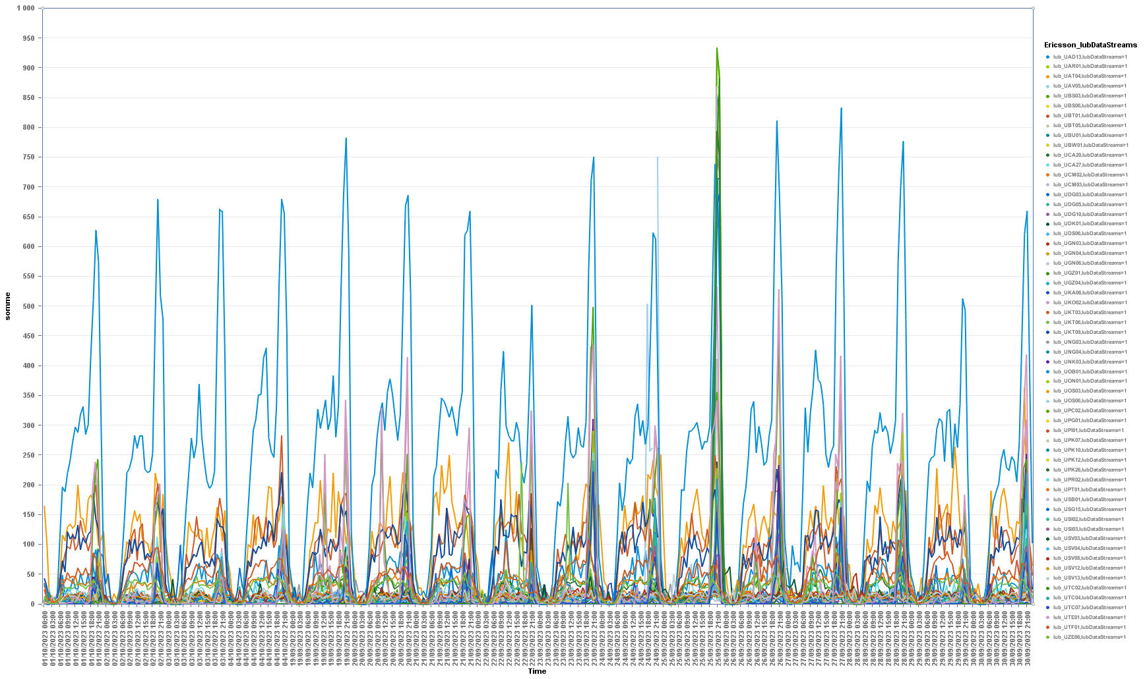
Iub Limiting Ratio
Sites having similar trend and values at same range belong generally to same Tx link

Slide 32
Transport Bottleneck :IuCS & IuPS
- IuCS Is almost 100% all the time
Slight fluctuation is observed on 25th on DCERNC3
- IuPS Values are fluctuating all days and fluctuation is impacting all RNCs
Transport Links and routers need to be checked in order to clean the situation
- IuPS fluctuation is concerning all sites and have a negative impact on all data service

Slide 33
I 9
ARCEP OMC KPI

Slide 34
Network KPI
Speed trend is calculated using MTN Formula while Throughput is calculated using user throughput formula
Speed trend correspond in fact to cell throughput and not user throughput

Slide 35
Departments ARCEP 2G KPI
Department | ALIBORI | ATACORA | ATLANTIQUE | BORGOU | COLLINES | COUFFO | DONGA | LITTORAL | MONO | OUEME | PLATEAU | ZOU | Threshold
2G Call Success Rate% | 99,28 | 99,25 | 99,24 | 99,26 | 99,31 | 96,77 | 99,29 | 99,37 | 99,51 | 99,07 | 98,85 | 99,13 | >99
2G Call blocking rate BH% | 0,002 | 0,001 | 0,127 | 0,033 | 0,028 | 0,154 | 0,030 | 0,018 | 0,003 | 0,083 | 0,282 | 0,062 | <1
2G Voice Drop Rate (%) | 0,38 | 0,43 | 0,18 | 0,37 | 0,36 | 0,24 | 0,38 | 0,24 | 0,12 | 0,38 | 0,43 | 0,37 | <1
2G DOWNTIME in Hours | 0,080 | 0,051 | 0,024 | 0,026 | 0,011 | 0,034 | 0,109 | 0,006 | 0,001 | 0,007 | 0,001 | 0,007 | <4
Couffo and Plateau are under the ARCEP threshold in terms of 2G call success rate

Slide 36
Departments ARCEP 3G KPI
3G KPI | Voice Call Success Rate% | Speech Access Failure Rate% | Voice Drop Rate% | PS Call Success Rate% | HS Drop Rate% | DL_RBS_Throughput Kbps | UL_RBS Throughput Kbps | Avg CellDowntimeAuto in Hours
ALIBORI | 99,83 | 0,03 | 0,14 | 98,62 | 0,47 | 1223 | 287 | 0,072
ATACORA | 99,76 | 0,04 | 0,20 | 98,19 | 0,54 | 1560 | 278 | 0,051
ATLANTIQUE | 99,59 | 0,13 | 0,28 | 99,40 | 0,67 | 578 | 147 | 0,028
BORGOU | 99,81 | 0,05 | 0,13 | 98,78 | 0,37 | 1132 | 261 | 0,032
COLLINES | 99,66 | 0,07 | 0,27 | 98,05 | 0,59 | 1280 | 251 | 0,012
COUFFO | 99,59 | 0,17 | 0,24 | 97,41 | 0,76 | 964 | 218 | 0,028
DONGA | 99,72 | 0,06 | 0,22 | 98,18 | 0,68 | 1218 | 247 | 0,131
LITTORAL | 99,71 | 0,11 | 0,19 | 99,63 | 0,36 | 832 | 144 | 0,009
MONO | 99,64 | 0,08 | 0,28 | 99,37 | 0,50 | 832 | 202 | 0,001
OUEME | 99,72 | 0,09 | 0,19 | 99,46 | 0,41 | 791 | 200 | 0,010
PLATEAU | 99,71 | 0,08 | 0,21 | 99,20 | 0,63 | 816 | 197 | 0,002
ZOU | 99,69 | 0,09 | 0,23 | 98,21 | 0,64 | 890 | 222 | 0,008
Threshold | >99 | <1 | <1 | >96 | <3 | 450 | 70 | <4H
All Departments met the target

Slide 37
Departments ARCEP 4G KPI
Department | ALIBORI | ATACORA | ATLANTIQUE | BORGOU | COLLINES | COUFFO | DONGA | LITTORAL | MONO | OUEME | PLATEAU | ZOU | Threshold
4G Data Access Failure Rate% | 0,02 | 4,27 | 0,95 | 1,40 | 0,56 | 1,73 | 0,18 | 0,45 | 1,80 | 0,94 | 1,83 | 2,38 | <3
ERAB Drop rate% | 0,76 | 0,80 | 0,56 | 0,82 | 0,67 | 0,80 | 0,46 | 0,39 | 0,60 | 0,59 | 0,86 | 0,70 | <3
4G DL Speed Mbps | 13,27 | 11,97 | 12,07 | 12,44 | 11,64 | 10,52 | 11,73 | 13,23 | 11,13 | 12,06 | 11,91 | 11,49 | >5
4G DL_Throughput Mbps | 12,71 | 14,45 | 6,27 | 8,89 | 14,55 | 10,78 | 11,77 | 7,75 | 11,92 | 7,37 | 11,79 | 8,40
4G UL_Speed Mbps | 1,96 | 1,87 | 2,46 | 2,21 | 1,72 | 1,63 | 1,76 | 2,98 | 2,01 | 2,67 | 1,98 | 2,08 | >2
4G Ul_ Throughput Mbps | 1,34 | 1,44 | 1,29 | 1,42 | 1,25 | 0,96 | 1,01 | 2,01 | 1,31 | 1,62 | 1,25 | 1,25
4G Avg CellDowntimeAuto in Hours | 0,053 | 0,027 | 0,014 | 0,011 | 0,011 | 0,009 | 0,114 | 0,007 | 0,001 | 0,004 | 0,001 | 0,006 | <4
Speed trend is calculated using MTN Formula while Throughput is calculated using user throughput formula
Speed trend correspond in fact to cell throughput and not user throughput
Atacora is under the ARCEP threshold in terms of 4G data access failure rates
Accuracy of Counters related to 4G RRC&RAB is suspected since some values are unusual: Data source and collection process need to be checked

