Slide 1


Network QoS
Intermediate report
Octobre 30st, 2023

Slide 2
Summary
Context & Report objectives | 03
Scope of Work | 05
Drive tests Activity, Current Status & Progress | 08
Executive Summary | 12
KPIs & Network settings Analysis | 18
Benchmarking on Cotonou area | 67
Next steps | 107

Slide 3
01
Context & Report objectives

Slide 4
Context & Report objectives
MTN Benin is a leading mobile operator in Benin with more than 60% market share.
It operates a network comprising of 675 2G, 3G and LTE sites across Benin.
MTN Benin wants an independent assessment and benchmarking of its radio network through drive tests
MTN Benin also wants to ascertain network assurance and capacities
1
2
3
4
Overview of the NW QoS assessment scope
A comprehensive drive testing exercise to determine customer perceived radio network quality of MTN Benin’s 2G, 3G and LTE network with that of the competition and the KPIs required by the regulator.
Objectives of the assignment
Detailed scope
2G/3G/4G MTN Networks KPIs audit based on OSS counters
Parameters settings audit of 2G/3G/4G MTN network
Capacity audit of 2G/3G/4G MTN network
Evaluate and benchmark Quality levels offered by MTN to MOOV mobiles networks and regulator defined KPIs levels based on Drive Test measurements results
Formulate drive test methodology and coverage
Recommendations for network improvement
Finalize reporting format and KPIs to be measured
6
1
2
Benchmark key KPIs between MTN, competition and regulator defined KPIs levels
5
4
3
Conduct drive tests for MTN Benin and competitor’s network
Validate results with MTN Benin’s radio planning team

Slide 5
02
Scope of Work

Slide 6
Scope of work (i/ii)
Conduct OSS Audit
  2G/3G/4G MTN Networks KPIs audit based on OSS counters
  Parameters settings audit of 2G/3G/4G MTN network
  Capacity audit of 2G/3G/4G MTN network
Kick-off
Prerequisites
Data collection
Hourly KPI review
HW / Alarms review
RAN Parameters
RAN Features
Neighbors
HW/licensing
Result analysis
Suggest Recommendations
audit report written
Presentation and actions
Close out report
Early KPI
warning
Configuration Audit
Performance Analysis
Dimensioning
Preparation
Reporting
Evaluate and benchmark Quality levels offered by MTN to MOOV mobiles networks and regulator’s defined KPIs levels based on Drive Test measurements results
  Voice service quality and SMS (one team with Drive test tool)
  3G Data FTP DL/UL and HTTP Browsing (one team with Drive test tool)
  4G Data FTP DL/UL and HTTP Browsing (one team with Drive test tool)
Kick-off
Prerequisites
Drive Test route preparation
Drive Test execution
Post processing and report preparation
Deep Analysis and
Recommendations
Presentation
Network Data Collection
Post Processing
Events and layer 3 analysis
Preparation
Reporting

Slide 7


Scope of Work (ii/ii)
Cost
Cost
Cities to be covered
Drive Test KPI
18 thousand samples to analyze
19 indicators to analyze
Data KPIs (2G/3G/LTE)
Voice KPIs
HTTP IP-Service Access Success Ratio
HTTP Data Transfer Success Ratio
Session Setup time
HTTP mean data rate
FTP Session Success Rate
FTP UL/DL Throughput
Call blocking rate
Call drop rate
Call completetion success rate
Call completetion, with perfect quality, rate
Call completetion, with good quality, rate
Voice Quality (MOS)
Coverage rate (2G/3G/LTE)
SMS
Outoor Coverage rate
Indoor coverage rate
Incar coverage rate
MO SMS delivery success rate
MT SMS delivery success rate

Slide 8
03
Drive tests Activity, Current Status & Progress

Slide 9
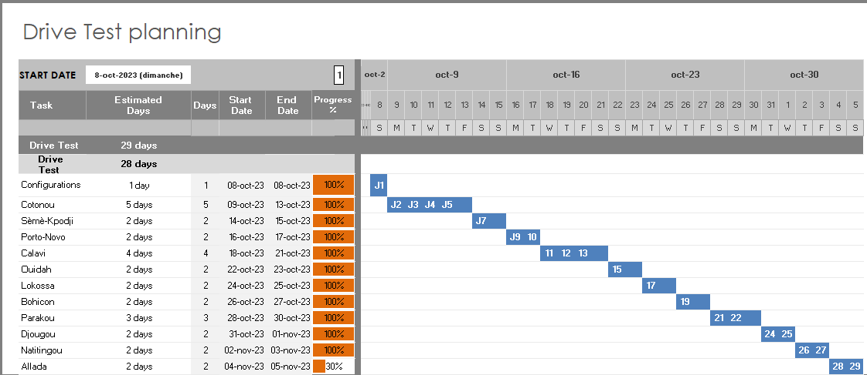
Drive tests Activity, Current Status & Progress
Drive test and Benchmark evaluation is on track according to initial plan
The Drive Test execution is ongoing as initially planned
We have processed more than 90% of Cotonou and SEME data

Slide 10
Intermediate report
Scope of this report
1. A RAN network audit for MTN BENIN, aiming to identify weak points as well as suggests proposals to improve the network quality, and so the final user perception
  Current parameterization was analyzed and recommendations provided where appropriate, regarding RF environment, settings, design, etc.
  Analyzed cells which belong to:
    RNCs : HOERNC1 ,HOERNC2, BHERNC4 and DCERNC3
    BSCs : BHBSC05, BHEBSC6, DCBSC04, HOBSC02, HOBSC03.
  Network configuration and different performance measurements based on data from December 10th to 26th, 2018
  2. Network benchmarking results between MTN and MOOV on Cotonou area.

Slide 11
04
Executive Summary

Slide 12
Executive Summary – Benchmarking (i/iii)
MTN and MOOV Networks QoS are comparable. A resource optimization enables to meet ARCEP requirements and to outperform competition’s NW QoS
TECHNOLOGY
KEY RECOMMENDATIONS
KEY FINDINGS
Coverage :
MTN coverage rate (99,97%) is comparable with its competitor's MOOV (99,99%) CELTISS (99,97%)
All operators meets ARCEP 2G coverage obligation.
Voice service :
Accessibility: MTN is better than MOOV and slightly lower than CELTISS.
All operators failed to meet ARCEP 2G coverage obligation.
Retainability: MTN is slightly lower than MOOV and CELTISS.
All operators meets ARCEP 2G coverage obligation.
Integrity: MTN is slightly lower than MOOV and CELTISS.
All operators meets ARCEP 2G coverage obligation.
SMS service :
MTN is better than MOOV and lower than CELTISS.
All operators failed to meet ARCEP 2G coverage obligations.
2G
RF optimization (Physical and logical) is needed to improve 2G MTN coverage.
Actions to improve accessibility are already proposed.

Slide 13
Executive Summary - Benchmarking (ii/iii)
MTN network QoS is globally better than the MOOV’s. A design optimization can enable a better network QoS on all KPIs
TECHNOLOGY
KEY RECOMMENDATIONS
KEY FINDINGS
Coverage :
3G MTN coverage rate (99,55%) is comparable with its competitor's MOOV (99,21%) CELTISS (99,74%)
All operators meets ARCEP 3G coverage obligation.
Voice service :
Accessibility: MTN is slightly lower than MOOV and CELTISS.
All operators failed to meet ARCEP accessibility obligation
Retainability: : MTN is better than MOOV and slightly lower than CELTISS.
Only MTN and CELTISS meets ARCEP retainability obligation
Integrity: MTN is slightly lower than MOOV and CELTISS.
All operators meets ARCEP integrity obligation
SMS service :
MTN is better than MOOV and slightly lower than CELTISS.
All operators failed to meet ARCEP 3G coverage obligation.
Data service :
MTN throughput (DL:2,2M/UL:1,04M) is slightly lower than MOOV (DL:3,3M/UL:1,01M) and CELTISS (DL:4,6M/UL:4,1M) .
All operators meets ARCEP 3G throughput obligations.
3G
RF optimization (Physical and logical) is needed to improve 3G MTN coverage.
Actions to improve accessibility are presented in the previous chapter

Slide 14
Executive Summary - Benchmarking (iii/iii)
Ther 4G network coverage rate is comparable among all operators.
MTN network mean throughput UL is better than MOOV’s and CELTISS’s. A Radio extension of the MTN network will enable outperforming competition’s 4G coverage and capacity
TECHNOLOGY
KEY RECOMMENDATIONS
KEY FINDINGS
Coverage :
4G MTN coverage rate (99,28%) is comparable with MOOV’s (99,96%) and CELTISS’s (99,54)
All operators meets ARCEP 4G coverage obligation.
Data service :
MTN i 4G throughput DL (13,1M) is better than CELTISS’s (11,7M) and lower than MOOV’s(20,8M)
MTN i 4G throughput UL (15,1M) is better than MOOVS’s (9,4M) and CELTISS’s(12,4M)
All operators meets ARCEP 4G coverage obligation
4G
It is recommended to deploy more 4G sites in order to have a continuous 4G coverage; better than competitors

Slide 15
Benchmarking Key Results – Coverage
MTN & MOOV & CELTISS have a close 2G /3G coverage but 4G coverage of MTN is lower than MOOV’s and CELTISS. 4G Network extension is needed in Cotonou to reach MOOV coverage
KPI |  | ARCEP Threshorlds | MTN |  | MOOV |  | CELTISS |  | MTN Ranking
 |  |  | Value | Conformity | Value | Conformity | Value | Conformity
2G Coverage Rate | Incar | More than 70% with Incar: Rxlev >-87 dBm | 99,97% | OK | 99,99% | OK | 99,97% | OK | 2
 | Outdoor | More than 70% with Outdoor: Rxlev >-92 dBm | 99,70% | OK | 99,63% | OK | 99,74% | OK | 2
 | Indoor | More than 70% with Outdoor: Rxlev >-74 dBm
3G Coverage Rate | Incar | More than 90% with RSCP <-85 dBm | 96,00% | OK | 85,35% | NOK | 98,55% | OK | 2
 | Outdoor | More than 90% with RSCP <-85 dBm | 69,74% | OK | 70,00% | OK | 87,35% | OK | 3
 | Indoor | More than 90% with RSCP <-85 dBm
4G Coverage Rate | Incar | More than 60% with RSRP <-90 dBm* | 72,30% | OK | 93,34% | OK | 93,21% | OK | 3
 | Outdoor | More than 60% with RSRP <-95 dBm* | 28,16% | NOK | 79,22% | OK | 85,92% | OK | 3
 | Indoor | More than 60% with RSRP <-78 dBm*

Slide 16
Benchmarking Key Results – 2G/3G voice and SMS Summary
MTN network in retainability CDR (%) meets ARCEP requirements,
MTN is leading in accessibility but slightly exceeds ARCEP threshold,
MTN needs to improve its Voice Quality MOS and SMS Send duration.
KPI | ARCEP Threshorlds | MTN |  | MOOV |  | CELTISS |  | MTN Ranking
 |  | Value | Conformity | Value | Conformity | Value | Conformity
Accesibility: Blocking rate | <1% | 1,03% | NOK | 1,62% | NOK | 1,77 | NOK | 1
Retainability: Call drop rate | <1% | 0,46% | OK | 2,21% | NOK | 0,33% | OK | 2
Integrity: Voice quality | Note requise> 2,8 | 3,66 | OK | 3,85 | OK | 3,94 | OK | 3
SMS sending success rate % (E2E delivery Time<6 sec) | >99% | 92,50% | NOK | 80,59% | NOK | 95,01% | NOK | 2
SMS receving success rate % | >99% | 96,87% | NOK | 96,30% | NOK | 97,66% | NOK | 2

Slide 17
Benchmarking Key Results – 3G Data Summary
MTN network in 3G DATA meets ARCEP requirements,
MTN needs to improve its 3G Data THP compared to competitors.
Services | KPI | ARCEP Threshorlds | MTN |  | MOOV |  | CELTISS |  | MTN Ranking
 |  |  | Value | Conformity | Value | Conformity | Value | Conformity
3G DATA | 3G Availabaility | >=95% | 99,21% | OK | 99,70% | OK | 99,12% | OK | 2
3G HTTP | Successful internet connexion rate | >90% | 100,00% | OK | 100,00% | OK | 100,00% | OK | 1
 | Connexion setup time | <=30sec | 1,23 | OK | 0,65 | OK | 0,28 | OK | 3
 | Web service failure rate | <10% | 0,00% | OK | 0,00% | OK | 0% | OK | 1
3G FTP | FTP failure rate UL/DL | <20 % | 0,40%/0,36% | OK | 0,17%/0,17% | OK | 0%/0,31% | OK | 3
 | FTP Data transmission average (DL) | >= 2Mbps | 2200,6 | OK | 3337,54 | OK | 4620,2 | OK | 3
 | FTP Data transmission average (UL) | >= 1Mbps | 1045,72 | OK | 1014,22 | OK | 2151,61 | OK | 2

Slide 18
Benchmarking Key Results – 4G Data Summary
MTN’s 4G DATA network End User KPIs satisfy ARCEP requirements,
MTN is ranked second in 4G DL THP after MOOV’s ,
MTN is outperforming MOOV’s & CELTISS in 4G UL THP.
Services | KPI | Threshorlds* | MTN |  | MOOV |  | CELTISS |  | MTN Ranking
 |  |  | Value | Conformity | Value | Conformity | Value | Conformity
4G HTTP Browsing | Web service failure rate | <10% | 0,00% | OK | 0,00% | OK | 0,00% | OK | 1
 | Connexion setup time | <=10sec | 0,32 | OK | 0,37 | OK | 0,12 | OK | 2
4G FTP | FTP failure rate UL/DL | <10 % | 0,33%/0,35% | OK | 0,16%/0% | OK | 0%/0,16% | OK | 3
 | FTP Data transmission average (DL) | 4G >= 10 Mbps | 13142,8 | OK | 20806,2 | OK | 11794,11 | OK | 2
 | FTP Data transmission average (UL) | 4G: >= 4Mbps | 15180,9 | OK | 9449,7 | OK | 12408,7 | OK | 1

Slide 19
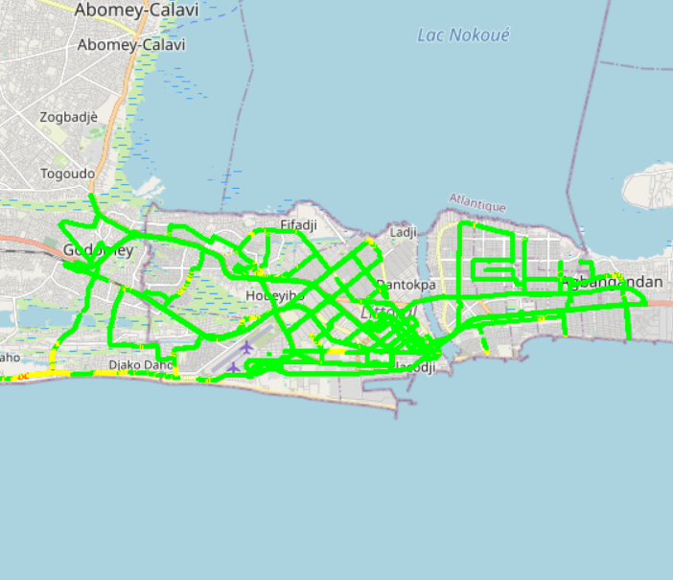
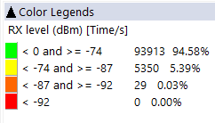

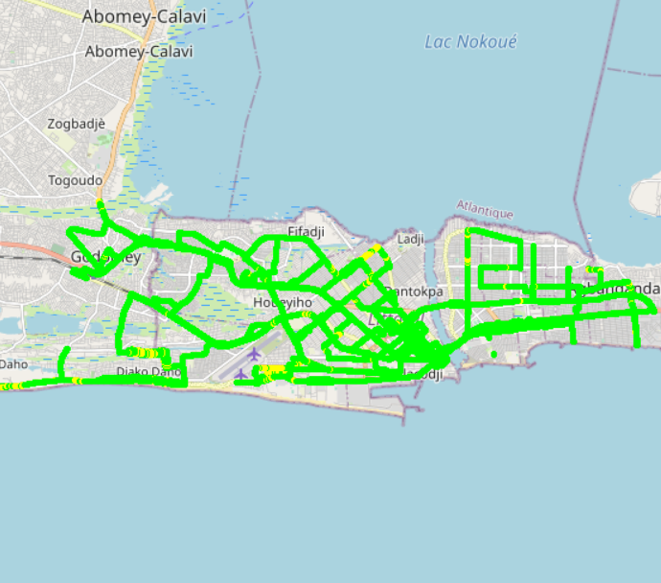
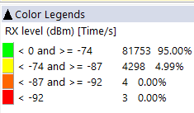

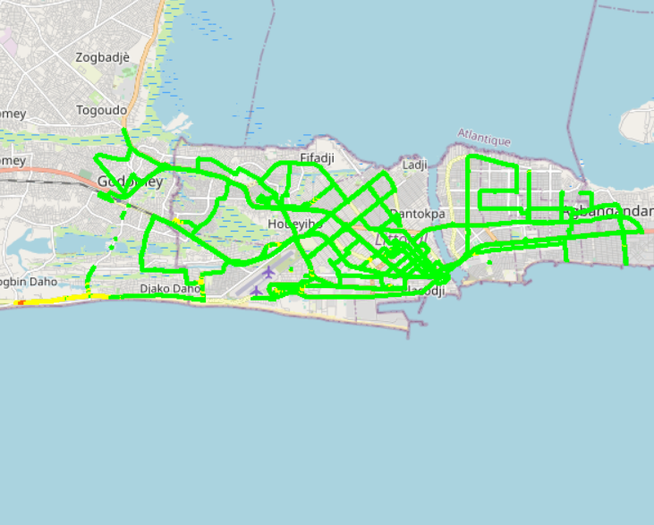
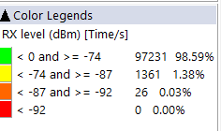

Benchmarking – 2G coverage comparison map
MOOV’s 2G coverage is very close to MTN’s
CELTISS’S 2G coverage outperforming MTN’s and MOOV’s

Slide 20
Benchmarking – 2G coverage comparison
MTN & MOOV & CELTISS’s 2G coverage meets ARCEP RxLev Threshold requirements

Slide 21
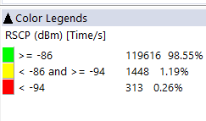
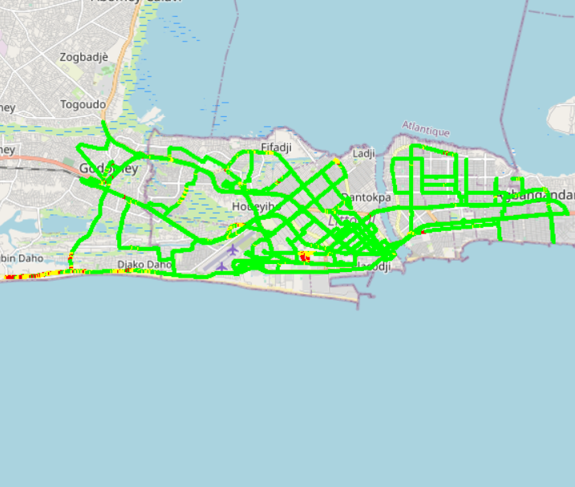
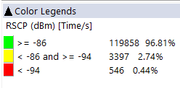
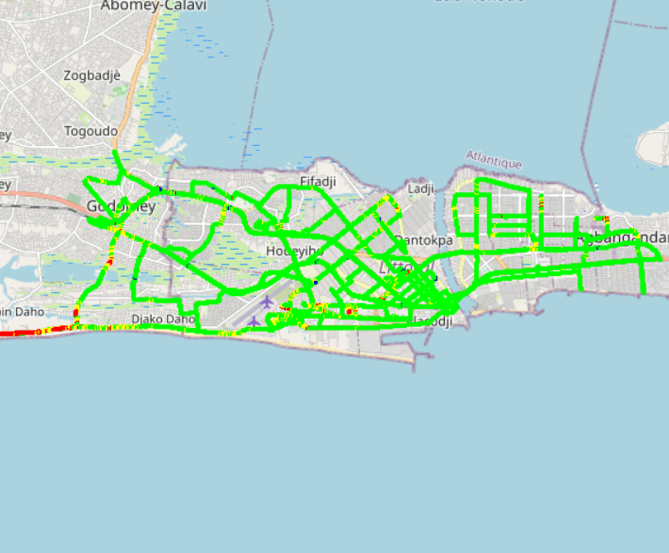
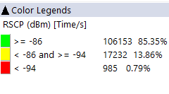
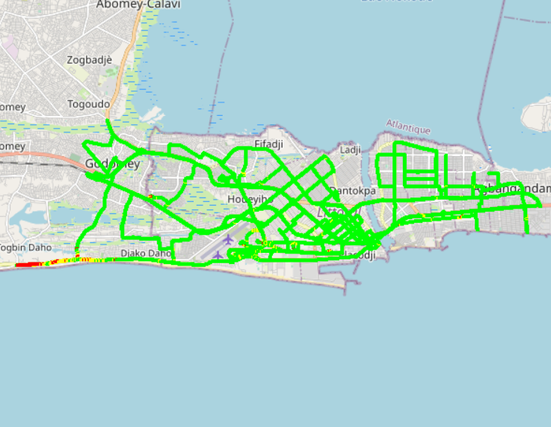

Benchmarking – 3G coverage comparison map
MTN’s 3G coverage is outperforming MOOV’s 3G coverage
MTN’s 2G coverage is very close to CELTISS’s

Slide 22
Benchmarking – 3G coverage comparison
CELTISS's 3G Radio coverage rate (99.74%) is outperforming MTN’s (99.55%) and MOOV’s (99,21%)
99.55% of DT 3G MTN Samples showing a good RSCP more than -86 which is satisfying ARCEP’s criteria

Slide 23
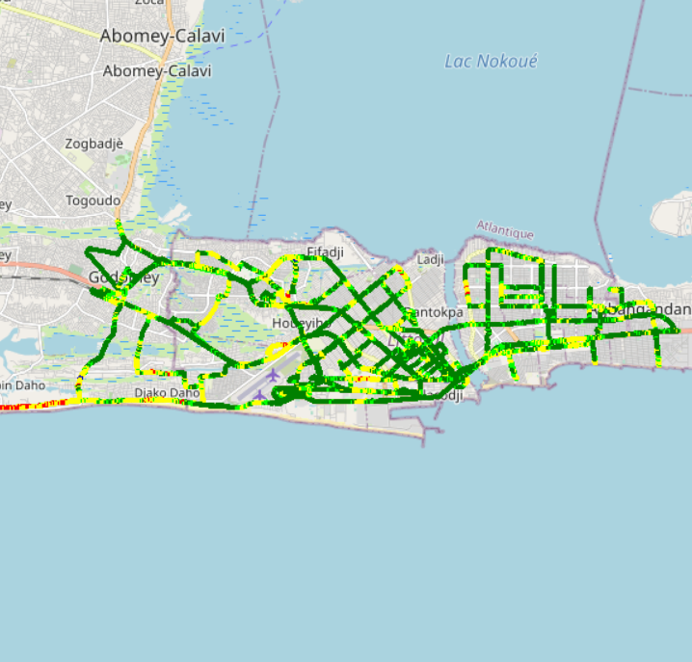
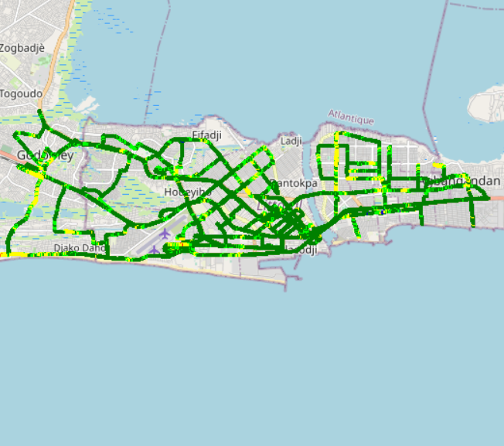
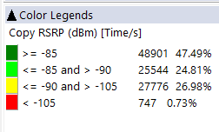
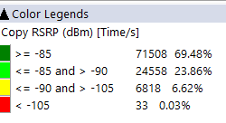
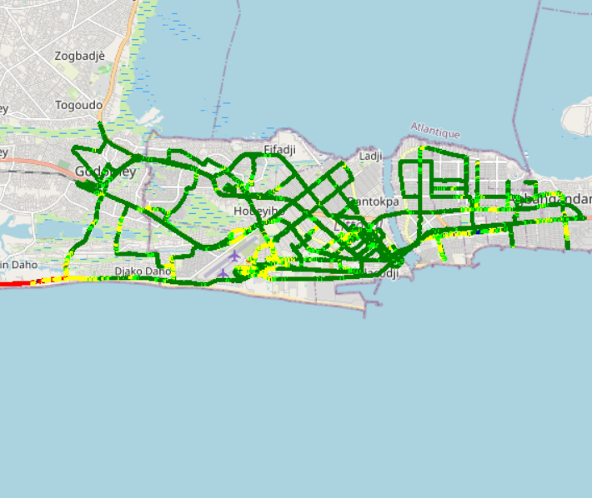

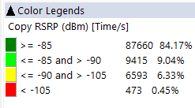
Benchmarking – 4G coverage comparison map
CELTISS’s 4G coverage is outperforming MTN’s and MOOV’s

Slide 24
Benchmarking – 4G coverage comparison
MTN's 4G Radio coverage rate (99.28%) is very close MOOV's (99.96%) and CELTISS’s (99.54%)

Slide 25
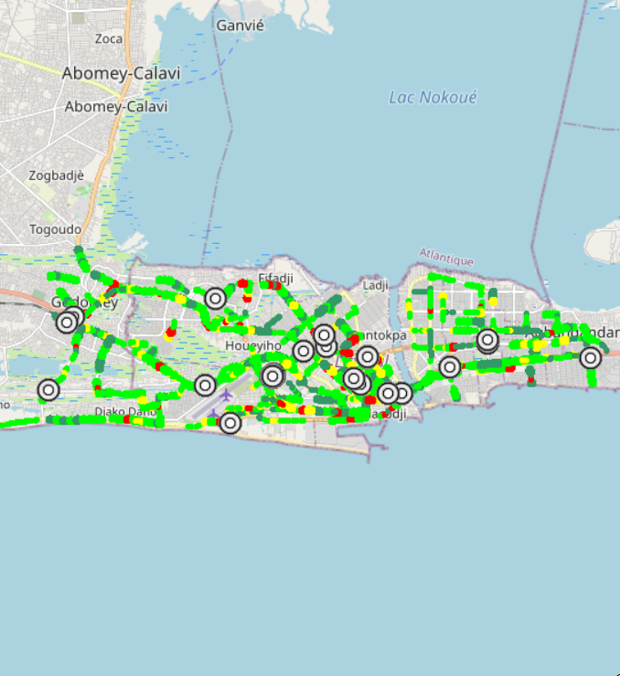
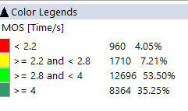
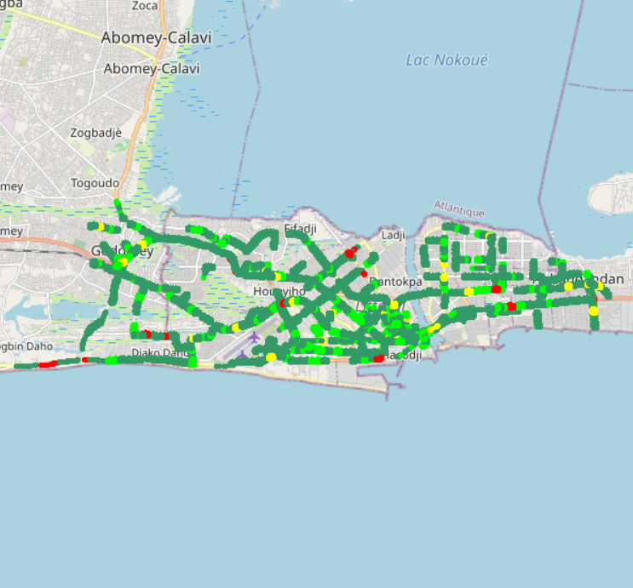

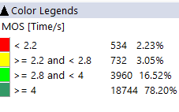
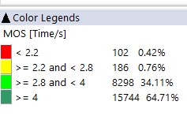
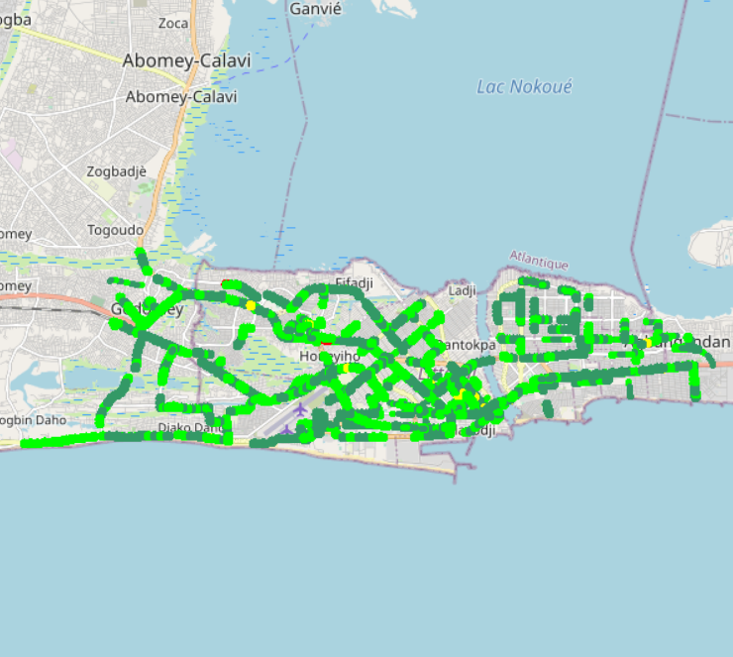
Benchmarking – Voice quality comparison (MOS) map
MOOV Voice Quality is much better & excellent compared to MTN’s and CELTISS

Slide 26
Benchmarking – Voice quality comparison (MOS)
CELTISS Voice Quality is much better & excellent compared to MTN’s and MOOV’S,
MTN needs to improve its voice quality MOS.

Slide 27
Benchmarking – Voice quality MOS by technology
Voice Quality MOS by technology

Slide 28
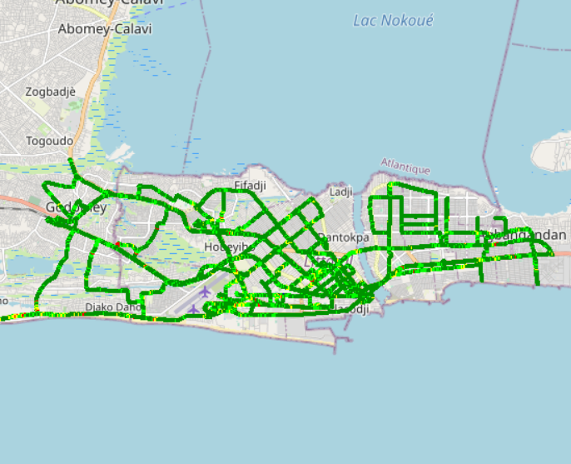
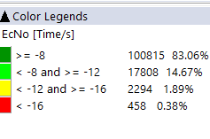
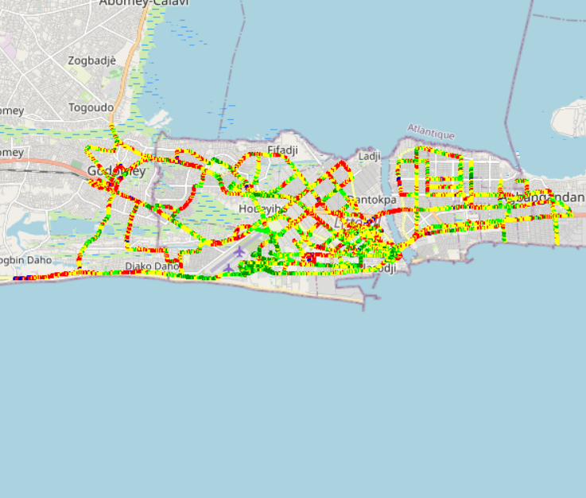
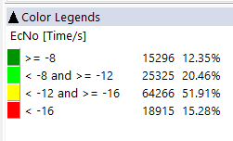

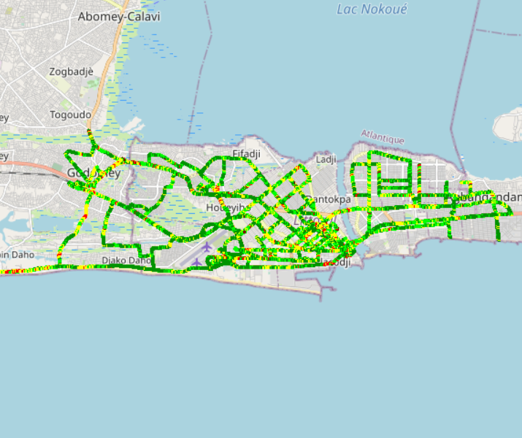
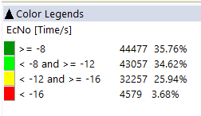
Benchmarking – EC/NO comparison map
3G MOOV’s and CELTISS’s Quality is outperforming MTN’s. MTN network design needs to be optimized

Slide 29
Benchmarking – EC/NO comparison
12,35% of drive test samples are showing a very low level of EcNo for 3G MTN network. A physical design optimization is needed

Slide 30
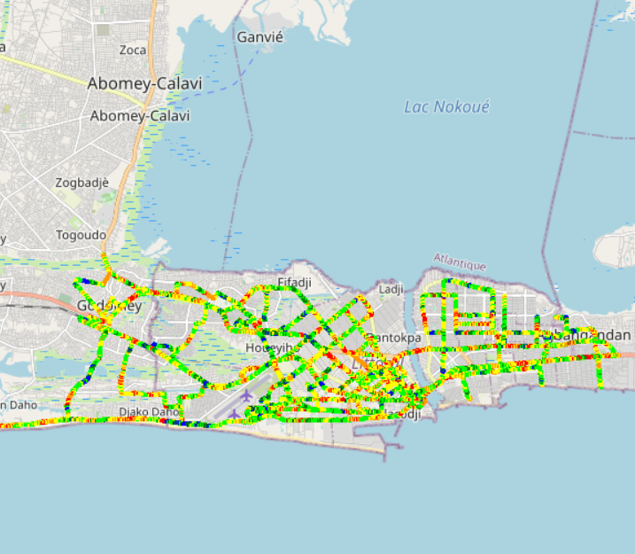
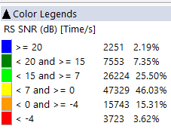
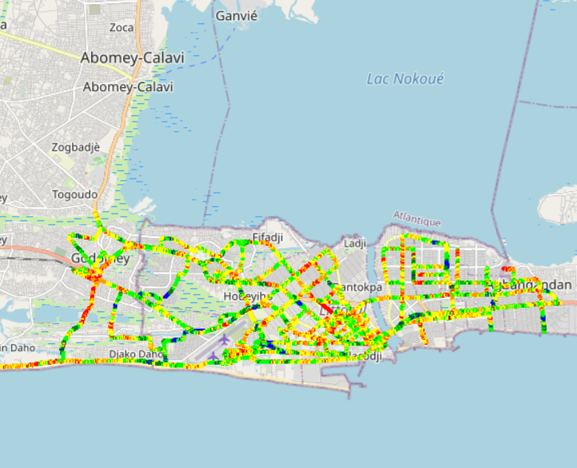
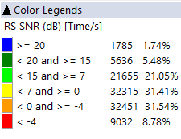

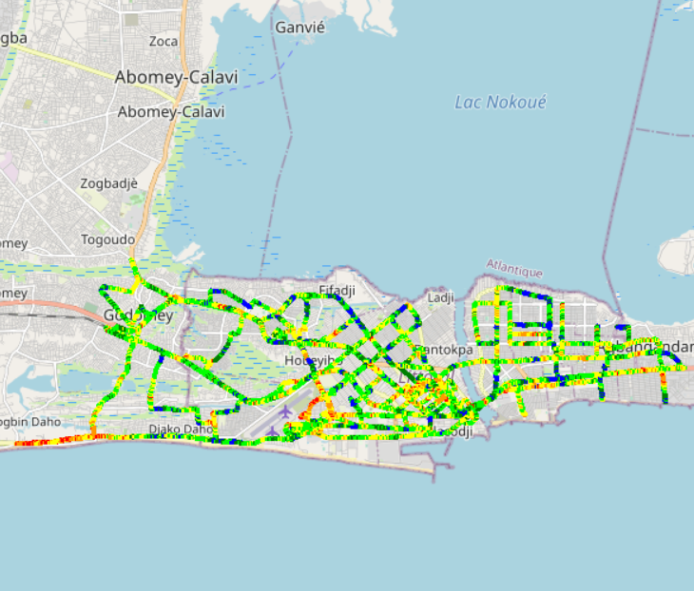
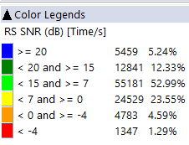
Benchmarking – SNIR comparison map
4G CELTISS Signal of quality is outperforming MTN’s and MOOV’s

Slide 31
Benchmarking – SNIR comparison
Drive tests are showing a low level of MTN Network SINR.

Slide 32
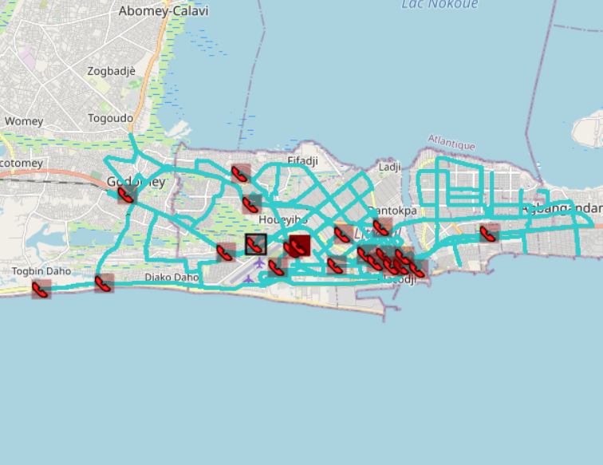

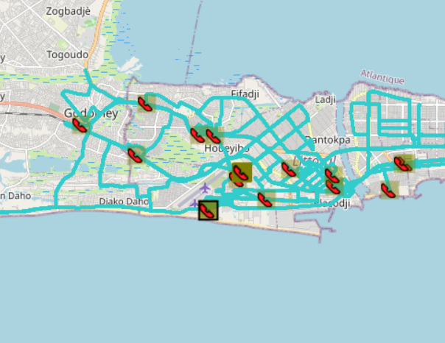
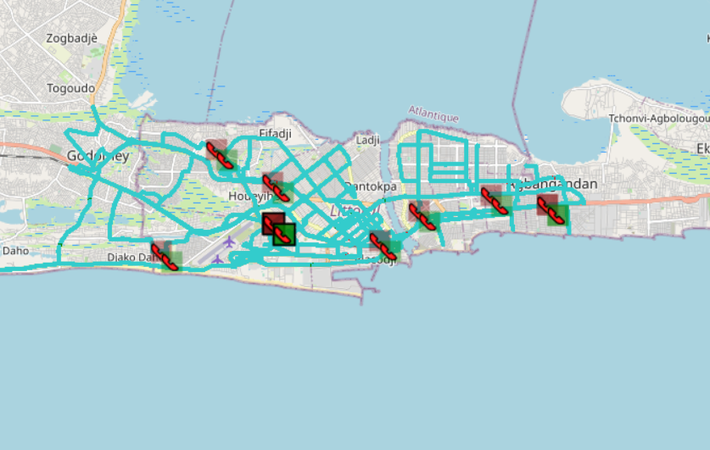
Benchmarking – BLOCKED CALLS EVENTS map
All operators MTN & MOOV & CELTISS are not satisfying ARCEP CSSR/CBR requirements

Slide 33
Benchmarking – BLOCKED CALLS per Technology
MTN has a high rate of blocked calls for 3G network

Slide 34
Benchmarking – 2G/3G CALL SETUP TIME
MTN Call setup time is outperforming MOOV’s and CELTISS’s
All operators MTN & MOOV & CELTISS’s have a high call setup time

Slide 35
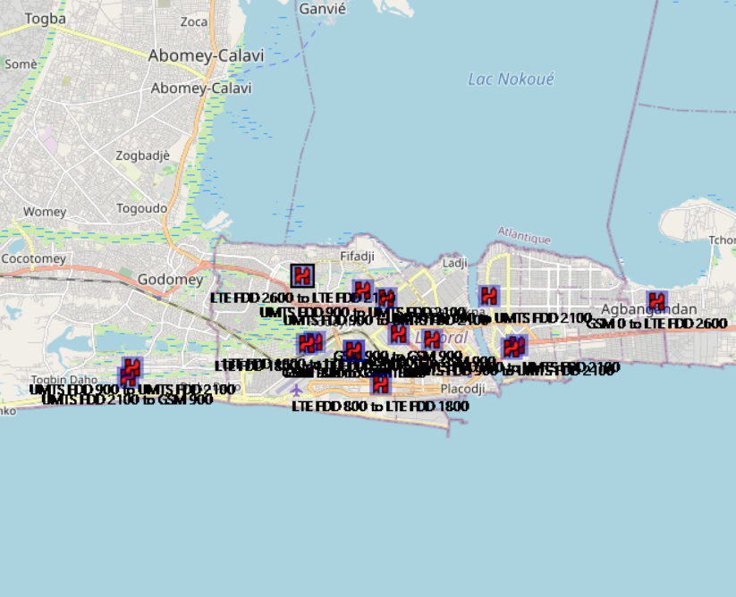

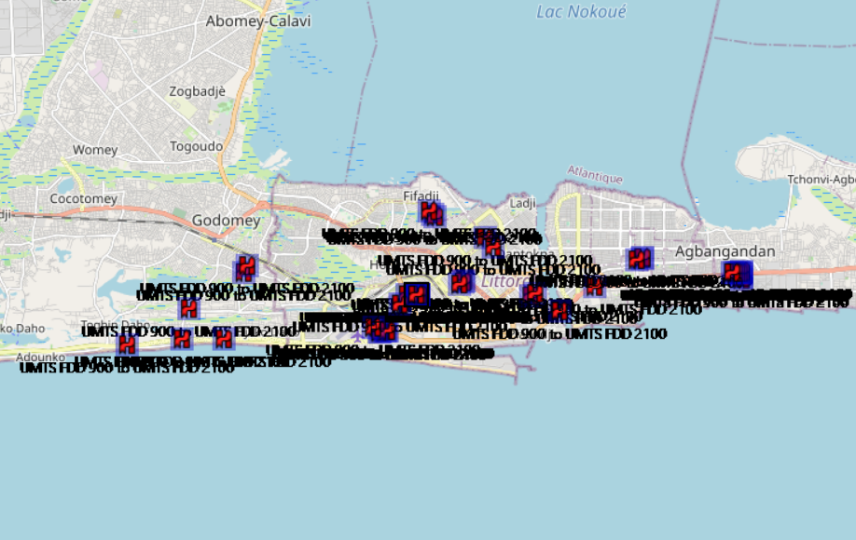
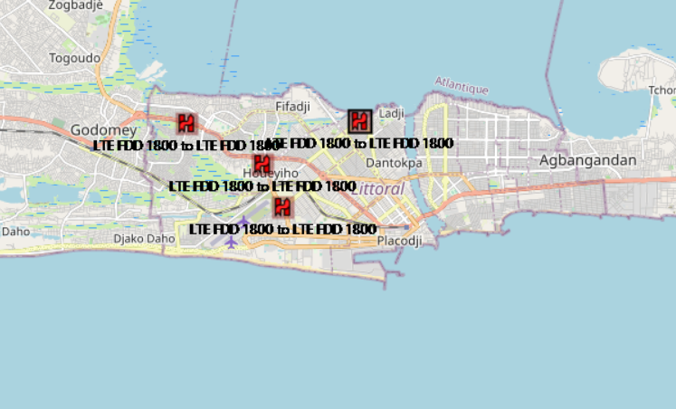
Benchmarking – HANDOVER FAILURE EVENTS map

Slide 36
Benchmarking – HANDOVER FAILURE
MTN’s and CELTISS’s Network Handover success rate are perfect compared to MOOV’s

Slide 37
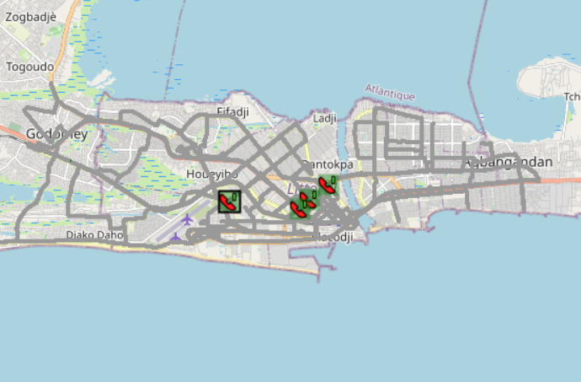
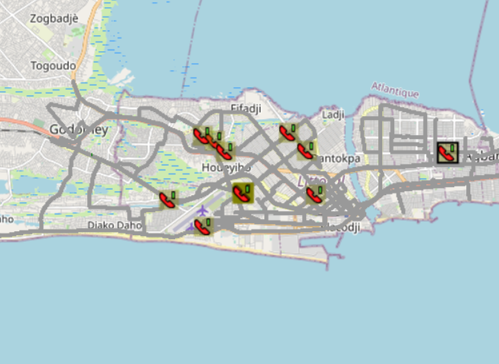
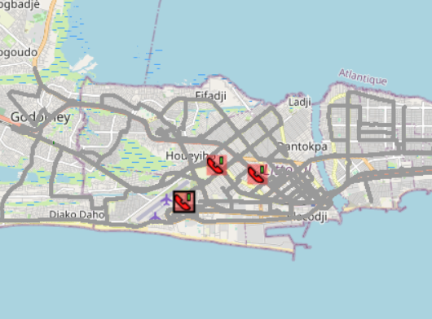

Benchmarking – DROPPED CALLS EVENTS map
Voice Session Continuity of MTN and CELTISS network is outperforming MOOV’s

Slide 38
Benchmarking – 2G/3G DROPPED CALLS
MTN & CELTISS CDR are satisfying ARCEP threshold Compared to MOOV’s CDR network which is bad

Slide 39
Benchmarking – DROPPED CALLS per technology
MTN & CELTISS network has an excellent drop rate compared to MOOV’s network that has a bad drop rate for 3G technology

Slide 40
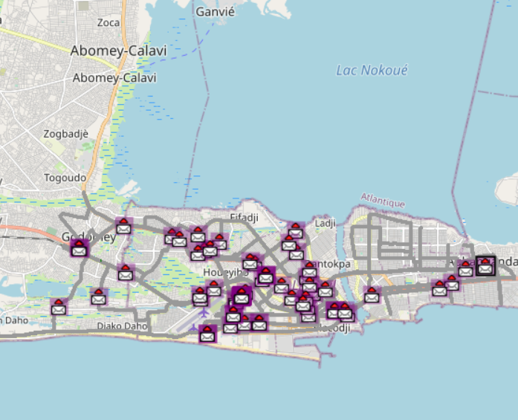


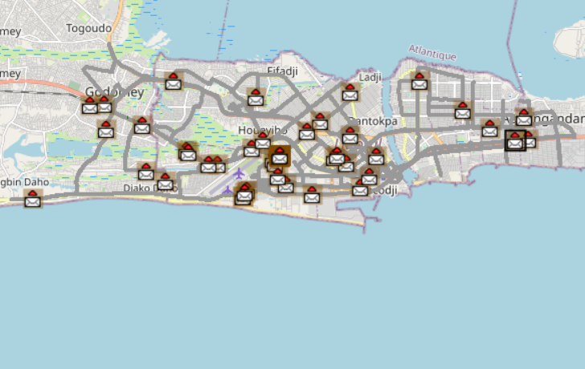

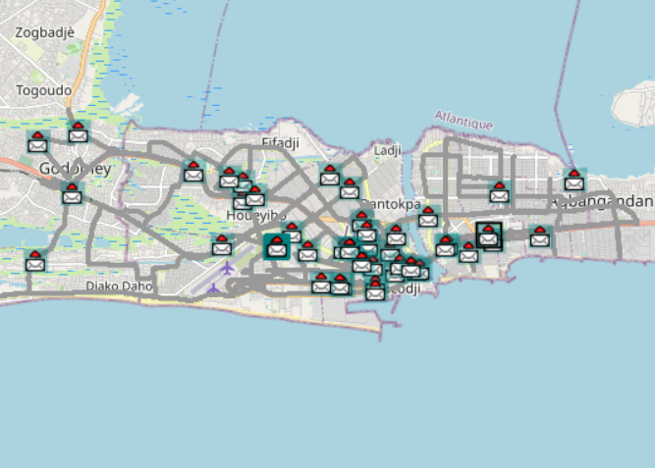

Benchmarking – SMS SENDING FAILURE EVENTS map
CELTISS SMS SETUP/RESPONSE is much better than MTN’s & MOOV’s

Slide 41
Benchmarking – SMS SENDING FAILURE
CELTISS SMS SETUP/RESPONSE is outperforming MTN’s & MOOV’s. SMS service KPIs of the three operators are not compliant with the ARCEP requirements
MTN SMS sending/Receiving SR in MTN is excellent compared to MOOV’s
The Samples done in this DT not fulfils the ARCEP requirement for MTN.

Slide 42
Benchmarking – DATA 3G
All operators have a good rate of successful Internet connection

Slide 43
Benchmarking – DATA 3G
All operators have very good web service success rate. MTN have high PS connection setup time
PS Connection setup is High in MTN compared to MOOV and CELTISS.

Slide 44
Benchmarking – DATA 3G
All operators have good downlink and uplink FTP success rate
All operators MTN & MOOV & CELTISS satisfy ARCEP criteria of FTP success rate more than 80%.

Slide 45
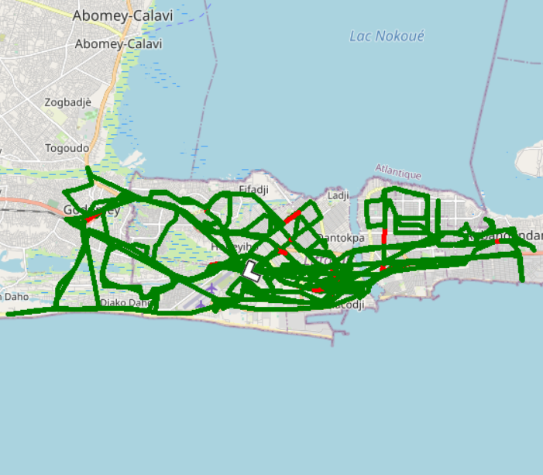






Benchmarking – 3G FTP MEAN THROUGHPUT comparison map
Excellent Throughput in MTN network and very close MOOV’s & CELTISS

Slide 46
Benchmarking – 3G FTP MEAN THROUGHPUT comparison
Excellent Throughput in MTN network compared to MOOV’s
MTN FTP DL AVERAGE Throughout is less than MOOV and CELTISS DL Throughout
DL Throughput mean for all operators satisfies ARCEP thresholds
MTN FTP UL AVERAGE Throughout is less than CELTISS UL Throughout
UL Throughput mean for all operators satisfy ARCEP thresholds

Slide 47
Benchmarking – 3G FTP THROUGHPUT comparison
All operators MTN & MOOV & CELTISS satisfy ARCEP criteria reaching DL/UL Average throughputs target

Slide 48
Benchmarking – 4G HTTP Browsing
All operators have very good HTTP Browsing success rate

Slide 49
Benchmarking – 4G FTP THROUGHPUT comparison
All operators have acceptable FTP success rate

Slide 50






Benchmarking – 4G FTP THROUGHPUT comparison map
MOOV’s average throughput DL rate is better than MTN’s & CELTISS’s

Slide 51
Benchmarking – 4G FTP THROUGHPUT comparison
MTN FTP DL AVERAGE Throughput is outperforming CELTISS’s. MTN FTP UL AVERAGE Throughput is outperforming MOOV’s & CELTISS

Slide 52
Benchmarking – BAND and TECHNOLOGY UTILISATION
LTE MTN network uses mostly 2600 band
MOOV’s uses both the 800 band and 2600 band
CELTIS uses mostly 1800 band

Slide 53
07
Next steps

Slide 54
Next steps
Complete 2G & 3G drive tests: Remaining areas (north area of Benin)
Conduct deep analysis on drive tests results
Complete cross analysis on KPIs and OSS parameters with drive tests results and call traces
Issue final report and recommendations on February 10th, 2019

Slide 55

Deloitte fait référence à un ou plusieurs cabinets membres de Deloitte Touche Tohmatsu Limited, société de droit anglais (« private company limited by guarantee »), et à son réseau de cabinets membres constitués en entités indépendantes et juridiquement distinctes. Pour en savoir plus sur la structure légale de Deloitte Touche Tohmatsu Limited et de ses cabinets membres, consulter www.deloitte.com/about.
Fort d’un réseau de firmes membres dans plus de 150 pays, Deloitte allie des compétences de niveau international à des expertises locales pointues, afin d’accompagner ses clients dans leur développement partout où ils opèrent. Nos 264 000 professionnels sont animés par un objectif commun, faire de Deloitte la référence en matière d’excellence de service.
Au Bénin, Deloitte mobilise un ensemble de compétences diversifiées pour répondre aux enjeux de ses clients, de toutes tailles et de tous secteurs – des grandes entreprises multinationales aux microentreprises locales, en passant par les entreprises moyennes.
Le présent document et ses annexes sont confidentiels et réservés à l’usage interne exclusif du destinataire. Toute reproduction ou toute divulgation partielle ou totale à des tiers en est interdite, sauf accord écrit préalable de Deloitte Bénin.
© 2019 Deloitte Bénin SARL. Société du réseau Deloitte

