Slide 1


Network QoS
Intermediate report
January 21st, 2019

Slide 2
Summary
Context & Report objectives | 03
Scope of Work | 05
Drive tests Activity, Current Status & Progress | 08
Executive Summary | 12
KPIs & Network settings Analysis | 18
Benchmarking on Cotonou area | 67
Next steps | 107

Slide 3
01
Context & Report objectives

Slide 4
Context & Report objectives
MTN Benin is a leading mobile operator in Benin with more than 60% market share.
It operates a network comprising of 675 2G, 3G and LTE sites across Benin.
MTN Benin wants an independent assessment and benchmarking of its radio network through drive tests
MTN Benin also wants to ascertain network assurance and capacities
1
2
3
4
Overview of the NW QoS assessment scope
A comprehensive drive testing exercise to determine customer perceived radio network quality of MTN Benin’s 2G, 3G and LTE network with that of the competition and the KPIs required by the regulator.
Objectives of the assignment
Detailed scope
2G/3G/4G MTN Networks KPIs audit based on OSS counters
Parameters settings audit of 2G/3G/4G MTN network
Capacity audit of 2G/3G/4G MTN network
Evaluate and benchmark Quality levels offered by MTN to MOOV mobiles networks and regulator defined KPIs levels based on Drive Test measurements results
Formulate drive test methodology and coverage
Recommendations for network improvement
Finalize reporting format and KPIs to be measured
6
1
2
Benchmark key KPIs between MTN, competition and regulator defined KPIs levels
5
4
3
Conduct drive tests for MTN Benin and competitor’s network
Validate results with MTN Benin’s radio planning team

Slide 5
02
Scope of Work

Slide 6
Scope of work (i/ii)
Conduct OSS Audit
  2G/3G/4G MTN Networks KPIs audit based on OSS counters
  Parameters settings audit of 2G/3G/4G MTN network
  Capacity audit of 2G/3G/4G MTN network
Kick-off
Prerequisites
Data collection
Hourly KPI review
HW / Alarms review
RAN Parameters
RAN Features
Neighbors
HW/licensing
Result analysis
Suggest Recommendations
audit report written
Presentation and actions
Close out report
Early KPI
warning
Configuration Audit
Performance Analysis
Dimensioning
Preparation
Reporting
Evaluate and benchmark Quality levels offered by MTN to MOOV mobiles networks and regulator’s defined KPIs levels based on Drive Test measurements results
  Voice service quality and SMS (one team with Drive test tool)
  3G Data FTP DL/UL and HTTP Browsing (one team with Drive test tool)
  4G Data FTP DL/UL and HTTP Browsing (one team with Drive test tool)
Kick-off
Prerequisites
Drive Test route preparation
Drive Test execution
Post processing and report preparation
Deep Analysis and
Recommendations
Presentation
Network Data Collection
Post Processing
Events and layer 3 analysis
Preparation
Reporting

Slide 7

Scope of Work (ii/ii)
Cost
Cost
Cities to be covered
Drive Test KPI
12 thousand samples to analyze
19 indicators to analyze
Cities | Samples
 | Voice 2G/3G | SMS/MMS | Data 3G | Data 4G
Cotonou | 1000 | 500 | 500 | 300
Sèmè-Kpodji | 400 | 200 | 200 | -
Porto-Novo | 600 | 300 | 300 | 200
Calavi | 800 | 400 | 400 | 200
Ouidah | 400 | 200 | 200 | -
Lokossa | 400 | 200 | 200 | -
Bohicon | 400 | 200 | 200 | -
Parakou | 600 | 300 | 300 | -
Djougou | 600 | 300 | 300 | -
Natitingou | 400 | 200 | 200 | -
Allada | 400 | 200 | 200 | -
Data KPIs (2G/3G/LTE)
Voice KPIs
HTTP IP-Service Access Success Ratio
HTTP Data Transfer Success Ratio
Session Setup time
HTTP mean data rate
FTP Session Success Rate
FTP UL/DL Throughput
Call blocking rate
Call drop rate
Call completetion success rate
Call completetion, with perfect quality, rate
Call completetion, with good quality, rate
Voice Quality (MOS)
Coverage rate (2G/3G/LTE)
SMS
Outoor Coverage rate
Indoor coverage rate
Incar coverage rate
MO SMS delivery success rate
MT SMS delivery success rate
MMS
MO MMS delivery success rate
MT MMS delivery success rate

Slide 8
03
Drive tests Activity, Current Status & Progress

Slide 9
Drive tests Activity, Current Status & Progress
OSS Audit is executed in all regions simultaneously, we reached the last phase, which is a deep analysis

Slide 10
Drive tests Activity, Current Status & Progress
Drive test and Benchmark evaluation is on track according to initial plan
The Drive Test execution is ongoing as initially planned
We have processed more than 90% of Cotonou and SEME data

Slide 11
Intermediate report
Scope of this report
1. A RAN network audit for MTN BENIN, aiming to identify weak points as well as suggests proposals to improve the network quality, and so the final user perception
  Current parameterization was analyzed and recommendations provided where appropriate, regarding RF environment, settings, design, etc.
  Analyzed cells which belong to:
    RNCs : HOERNC1 ,HOERNC2, BHERNC4 and DCERNC3
    BSCs : BHBSC05, BHEBSC6, DCBSC04, HOBSC02, HOBSC03.
  Network configuration and different performance measurements based on data from December 10th to 26th, 2018
  2. Network benchmarking results between MTN and MOOV on Cotonou area.

Slide 12
04
Executive Summary

Slide 13
Executive Summary – Benchmarking (i/iii)
MTN and MOOV Networks QoS are comparable. A resource optimization enables to meet ARCEP requirements and to outperform competition’s NW QoS
TECHNOLOGY
KEY RECOMMENDATIONS
KEY FINDINGS
Coverage :
MTN coverage rate (98,3%) is slightly lower than MOOV (99,5%)
Both operators meets ARCEP 2G coverage obligation.
Voice service :
Accessibility: MTN is slightly lower than MOOV.
Both operators meets ARCEP 2G coverage obligation.
Retainability: MTN is better than MOOV.
Both operators meets ARCEP 2G coverage obligation.
Integrity: MTN is better than MOOV.
Both operators meets ARCEP 2G coverage obligation.
SMS service :
MTN is better than MOOV.
Both operators meets ARCEP 2G coverage obligations.
2G
RF optimization (Physical and logical) is needed to improve 2G MTN coverage.
Actions to improve accessibility are already proposed.

Slide 14
Executive Summary - Benchmarking (ii/iii)
MTN network QoS is globally better than the MOOV’s. A design optimization can enable a better network QoS on all KPIs
TECHNOLOGY
KEY RECOMMENDATIONS
KEY FINDINGS
Coverage :
3G MTN coverage rate (97,8%) is better than MOOV (94,9%)
Both operators meets ARCEP 3G coverage obligation.
Voice service :
Accessibility: MTN is slightly lower than MOOV.
Both operators failed to meet ARCEP accessibility obligation
Retainability: MTN is better than MOOV.
Only MTN meets ARCEP retainability obligation
Integrity: MTN is better than MOOV.
Only MTN meets ARCEP integrity obligation
SMS service :
MTN is better than MOOV.
Both operators meets ARCEP 3G coverage obligation.
Data service :
MTN is providing better throughput (DL:3,5M/UL:1,45M) than MOOV (DL:2,5M/UL:1,26M).
Both operators meets ARCEP 3G throughput obligations.
3G
RF optimization (Physical and logical) is needed to improve 3G MTN coverage.
Actions to improve accessibility are presented in the previous chapter

Slide 15
Executive Summary - Benchmarking (iii/iii)
MOOV 4G network coverage rate is better than that the one of MTN. MTN network mean throughput is better than MOOV's. A Radio extension of the MTN network will enable outperforming competition’s 4G coverage and capacity
TECHNOLOGY
KEY RECOMMENDATIONS
KEY FINDINGS
Coverage :
4G MTN coverage rate (82,5%) is lower than MOOV (94,1%)
ARCEP obligation are not available
Data service :
MTN is providing better 4G throughput (DL: 13.5M / UL: 5.07M) than MOOV (DL: 9.4M / UL: 6,4M).
ARCEP obligations are not available
4G
It is recommended to deploy more 4G sites in order to have a continuous 4G coverage; better than competitors

Slide 16
Benchmarking Key Results – Coverage
MTN and MOOV have a close 2G /3G coverage but 4G coverage of MTN is lower than MOOV’s. 4G Network extension is needed in Cotonou to reach MOOV coverage
Services | KPI | ARCEP Threshorlds | MTN |  | MOOV |  | MTN Ranking
 |  |  | Value | Conformity | Value | Conformity
2G Coverage | 2G Coverage Rate | More than 90% with Incar: Rxlev >-87 dBm | 98,3% | OK | 99,5% | OK | 2
3G coverage | 3G Coverage Rate | Less than 10% with RSCP <-94 dBm | 2,2% | OK | 5,1% | OK | 1
4G coverage | 4G Coverage Rate | Less than 10% with RSCP <-90 dBm* | 17,5% | NA | 5,9% | NA | 2
* No ARCEP Thresholds Available

Slide 17
Benchmarking Key Results – 2G/3G voice and SMS Summary
MTN network is outperforming MOOV’s in voice quality and CDR level and meets ARCEP requirements. But not in accessibility where optimization is needed to reach ARCEP requirements.
Services | KPI | ARCEP Threshorlds | MTN |  | MOOV |  | MTN Ranking
 |  |  | Value | Conformity | Value | Conformity
2G/3G Voice | Accesibility: Blocking rate | <2% | 5,9% | NOK | 5,5% | NOK | 2
 | Retainability: Call drop rate | <2% | 1% | OK | 5,9 | NOK | 1
 | Integrity: Voice quality | >95% (Rate of MOS>4.0) | 95,6% | OK | 87,4% | NOK | 1
2G/3G SMS | SMS sending success rate % | >99% | 99,23% | OK | 98,32% | OK | 1
 | SMS receving success rate % | >99% | 99,70% | OK | 98,4% | OK | 1

Slide 18
Benchmarking Key Results – 3G Data Summary
MTN network is outperforming MOOV’s in 3G throughput and meets ARCEP requirements
Services | KPI | ARCEP Threshorlds | MTN |  | MOOV |  | MTN Ranking
 |  |  | Value | Conformity | Value | Conformity
3G DATA | 3G Availabaility | >=95% | 98,87% | OK | 99,7% | OK | 2
3G HTTP | Successful internet connexion rate | >90% | 98,82% | OK | 99,22% | OK | 2
 | Connexion setup time | <=30sec | 2,12 | OK | 5,07 | OK | 1
 | Web service failure rate | <10% | 1,8% | OK | 0,7% | OK | 2
3G FTP | FTP failure rate UL/DL | <20 % | 15,9/0,8% | OK | 16,7%/1% | OK | 1
 | FTP Data transmission average (DL) | 3G: >=384kbps 3G+: >= 2Mbps | 3534,47 | OK | 2533,97 | OK | 1
 | FTP Data transmission average (UL) | 3G: >= 144kbps 3G+ : >= 1mbps | 1449,2 | OK | 1261,01 | OK | 1

Slide 19
Benchmarking Key Results – 4G Data Summary
MTN’s 4G downlink throughput is outperforming MOOV’s. But for uplink throughput MOOV’s is higher due to a better 4G coverage
Services | KPI | Threshorlds* | MTN |  | MOOV |  | MTN Ranking
 |  |  | Value | Conformity | Value | Conformity
4G HTTP | Web service failure rate | <10% | 0,36% | N/A | 0,36% | N/A | 1
 | Connexion setup time | <=10sec | 2,3 | N/A | 3,4 | N/A | 1
4G FTP | FTP failure rate UL/DL | <10 % | 10,2/2,4% | N/A | 10,2/3,3% | N/A | 1
 | FTP Data transmission average (DL) | 4G >= 10 Mbps | 13540,01 | N/A | 9374,5 | N/A | 1
 | FTP Data transmission average (UL) | 4G: >= 4Mbps | 5067,69 | N/A | 6385,15 | N/A | 2
* No ARCEP Thresholds Available

Slide 20
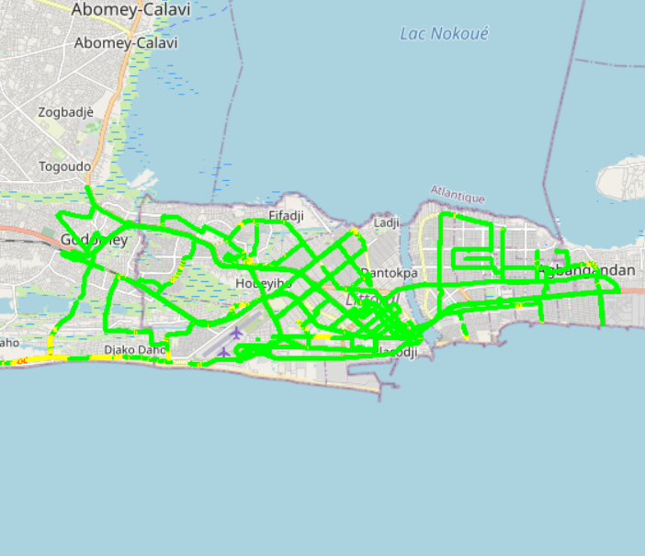
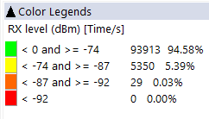

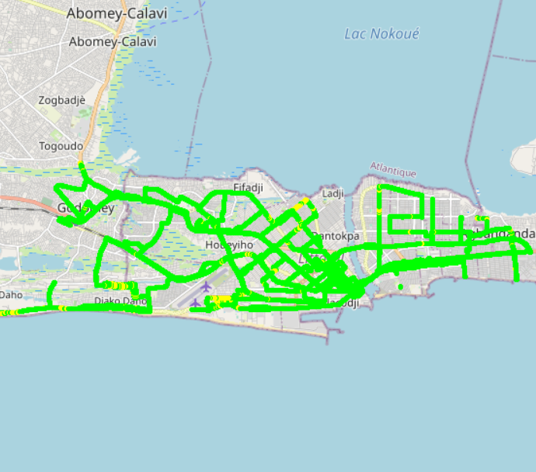

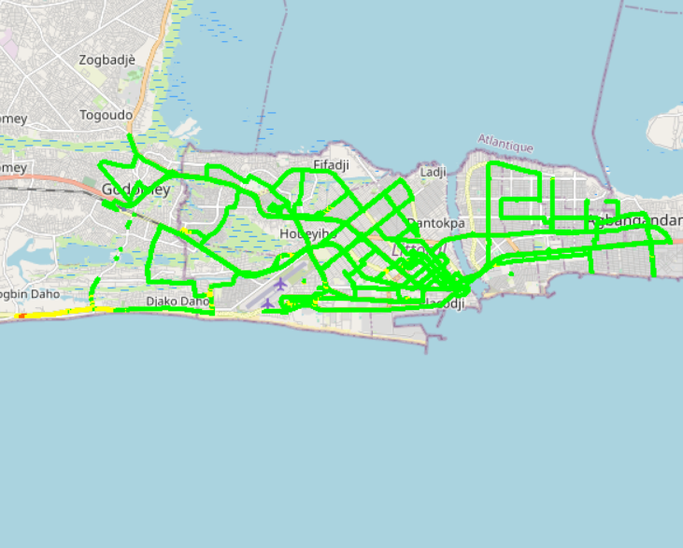
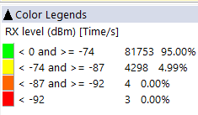
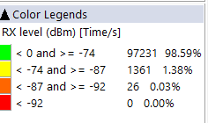

Benchmarking – 2G coverage comparison map
MOOV’s 2G coverage is very close to MTN’s

Slide 21
Benchmarking – 2G coverage comparison
MTN & MOOV & CELTISS’s 2G coverage meets ARCEP RxLev Threshold requirements

Slide 22
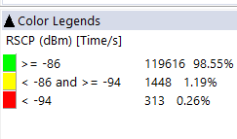
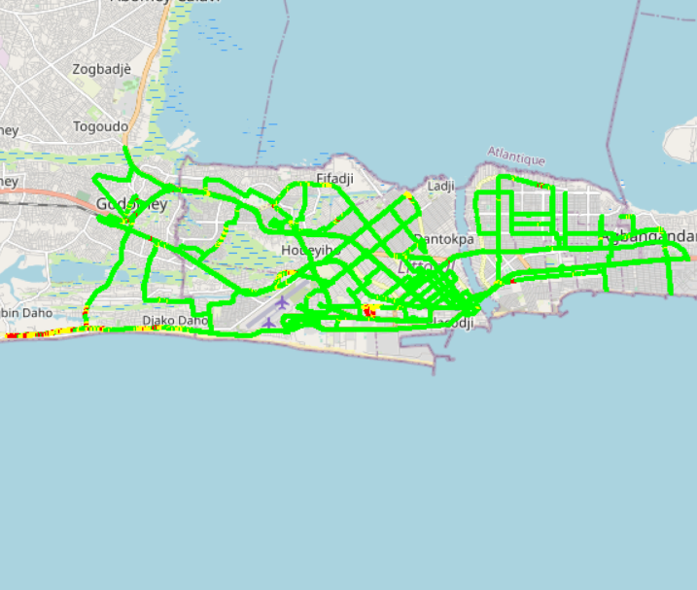
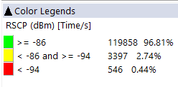
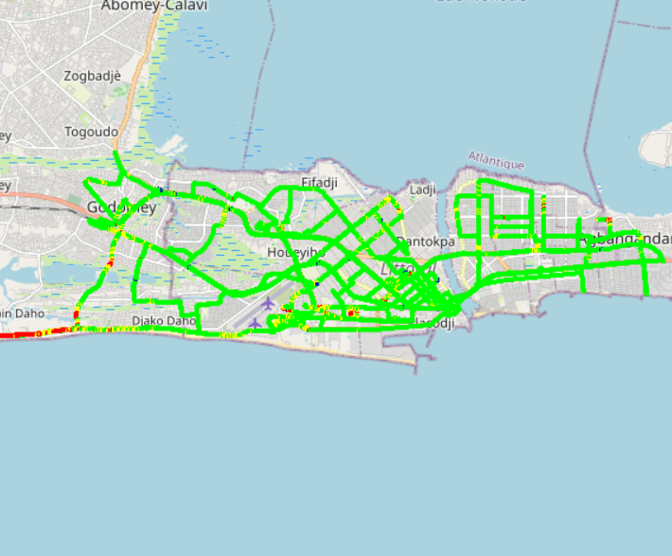
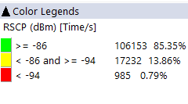
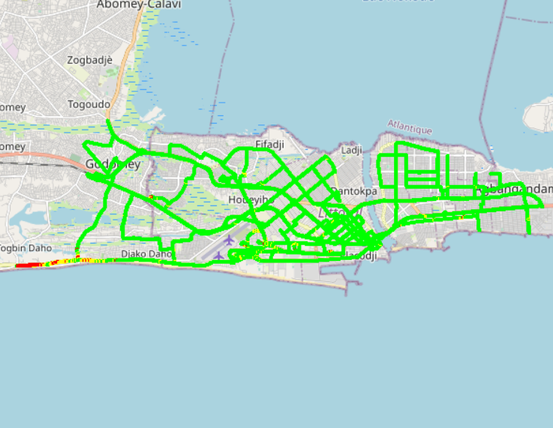

Benchmarking – 3G coverage comparison map
MTN’s 3G coverage is outperforming MOOV’s 3G coverage

Slide 23
Benchmarking – 3G coverage comparison
CELTISS's 3G Radio coverage rate (99.74%) is outperforming MTN’s (99.55%) and MOOV’s (99,21%)
99.55% of DT 3G MTN Samples showing a good RSCP more than -86 which is satisfying ARCEP requirement compared to MOOV 3G RSCP results

Slide 24
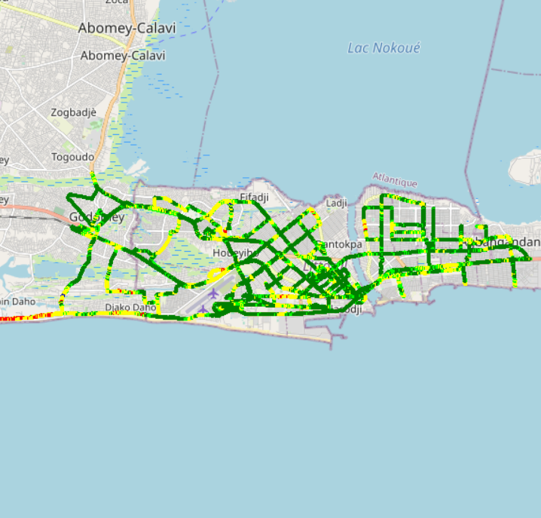
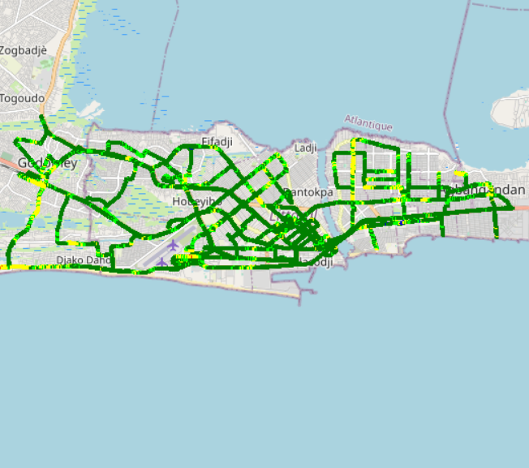
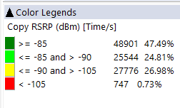
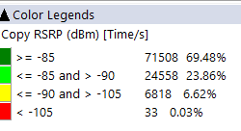
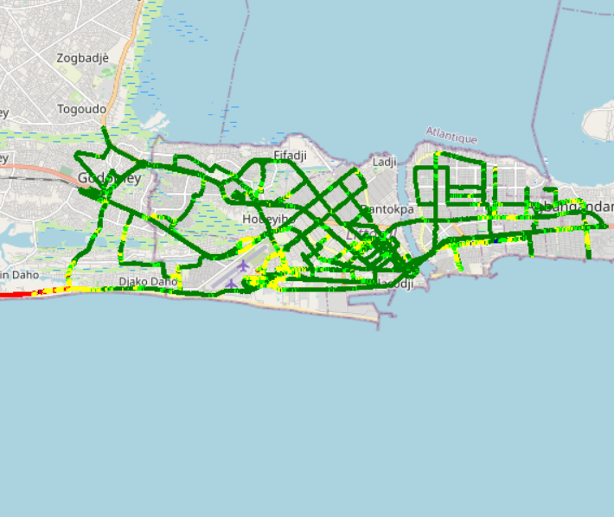

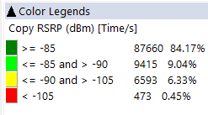
Benchmarking – 4G coverage comparison map
MOOV’s 4G coverage is outperforming MTN’s

Slide 25
Benchmarking – 4G coverage comparison
MTN's 4G Radio coverage rate (82.5%) is lower than MOOV's (94.1%)

Slide 26
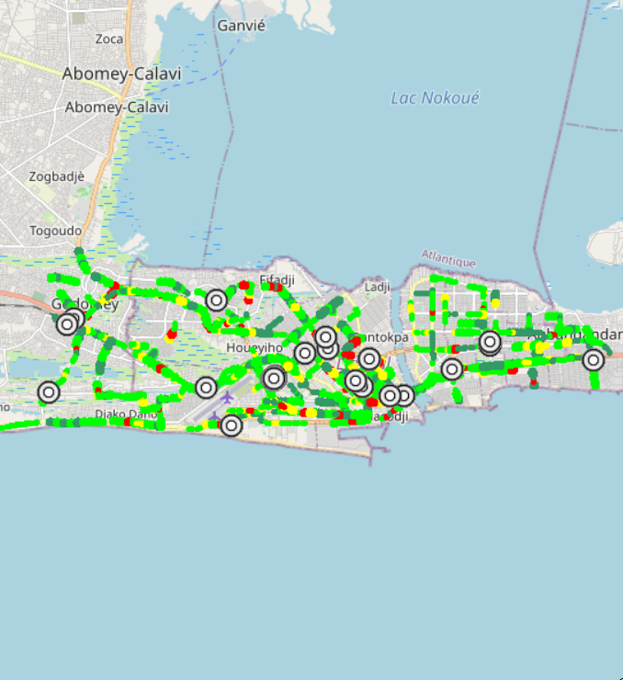
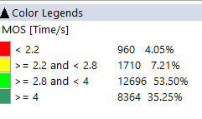
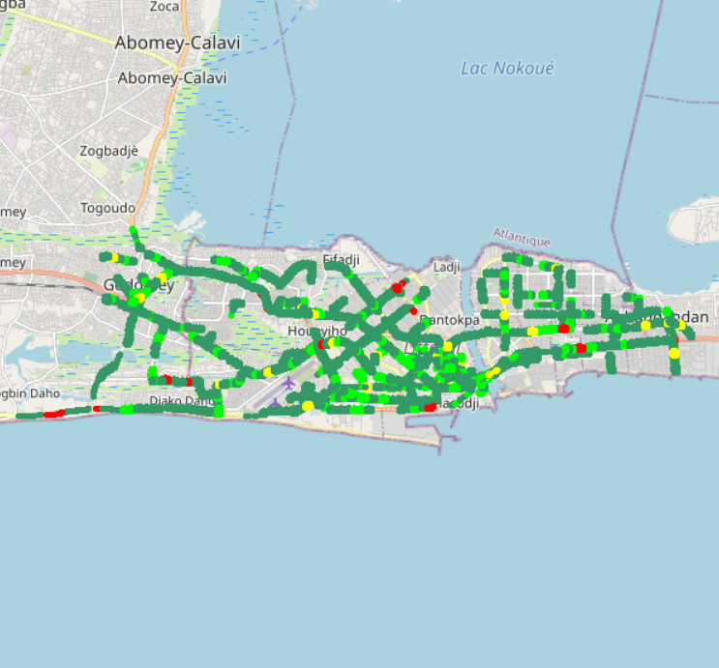

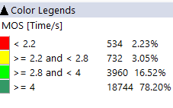
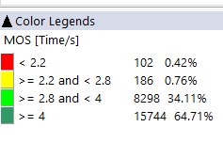
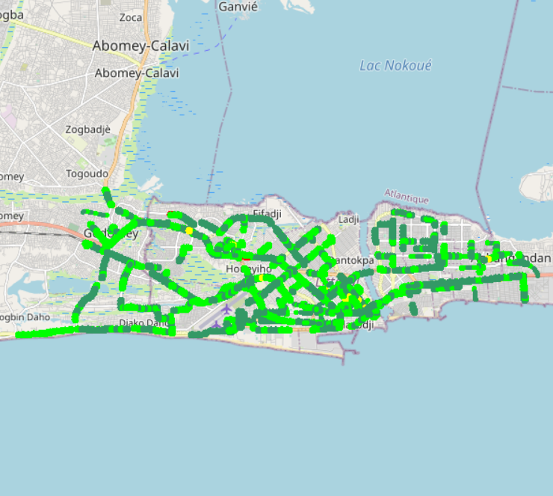
Benchmarking – Voice quality comparison (MOS) map
MTN Voice Quality is much better & excellent compared to MOOV’s

Slide 27
Benchmarking – Voice quality comparison (MOS)
MTN Voice Quality is much better & excellent compared to MOOV’s
2G/3G MTN Voice Quality is very good compared to 2G/3G MOOV Voice Quality: Majority of MTN MOS samples fulfills ARCEP’s criteria & threshold of Local related to an Excellent Voice Quality

Slide 28
Benchmarking – Voice quality
MTN Speech Quality is better than MOOV’s (high usage of AMR codec)

Slide 29
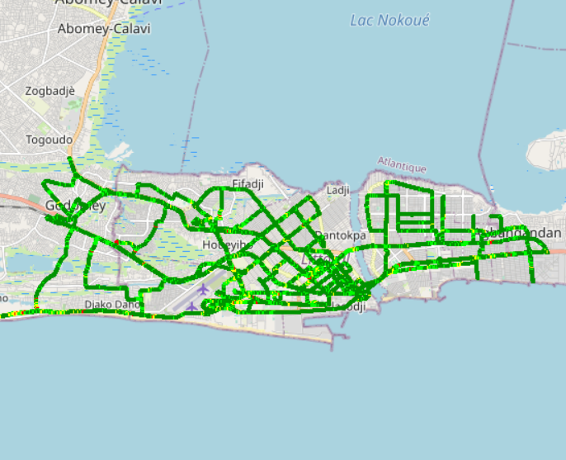
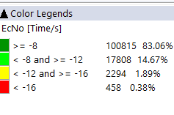
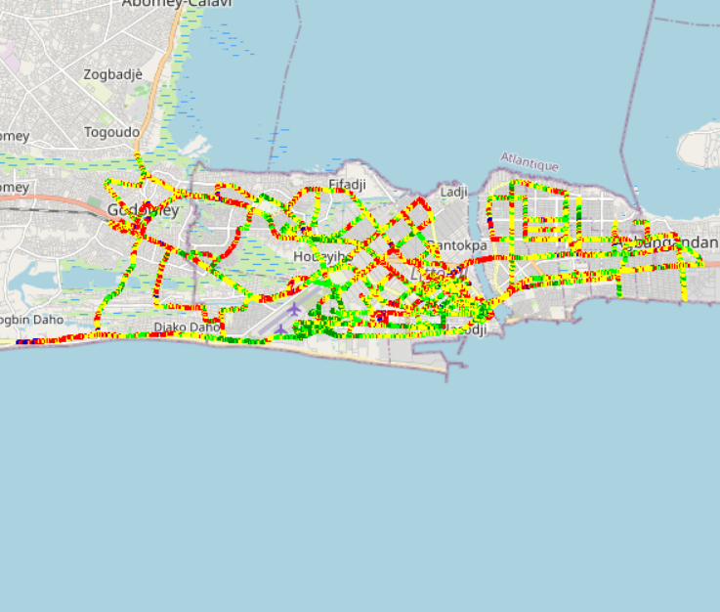
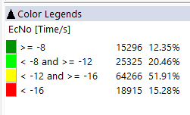

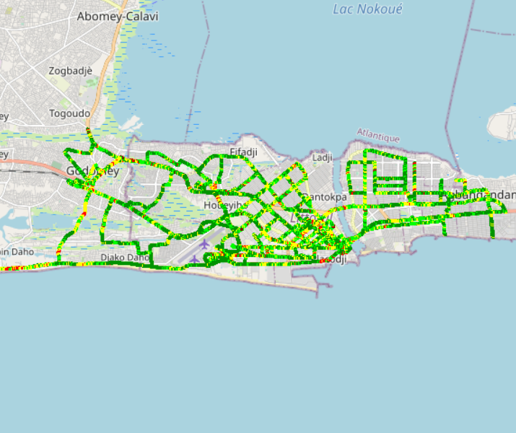
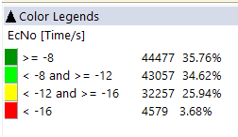
Benchmarking – EC/NO comparison map
3G MOOV’s Quality is outperforming MTN’s. MTN network design needs to be optimized

Slide 30
Benchmarking – EC/NO comparison
29,9% of drive test samples are showing a very low level of EcNo for 3G MTN network. A physical design optimization is needed

Slide 31
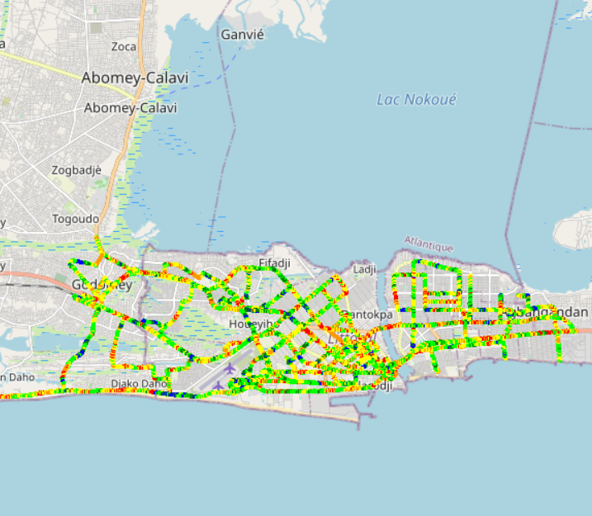
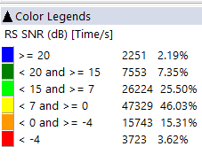
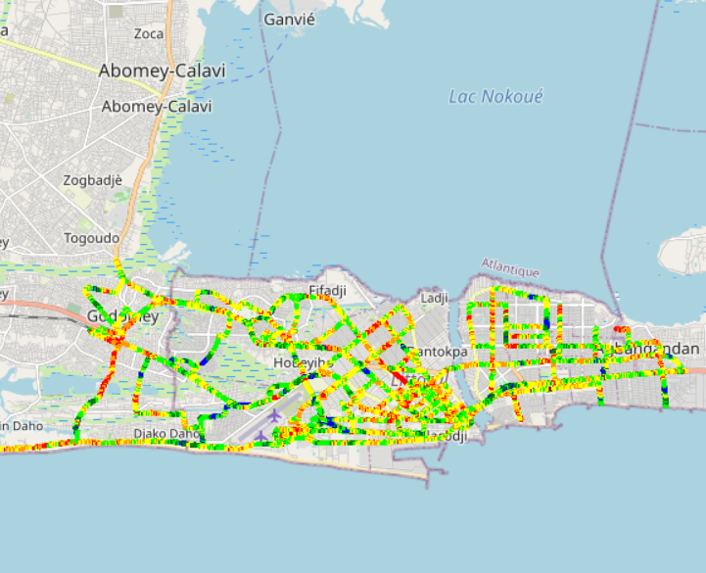
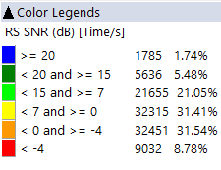

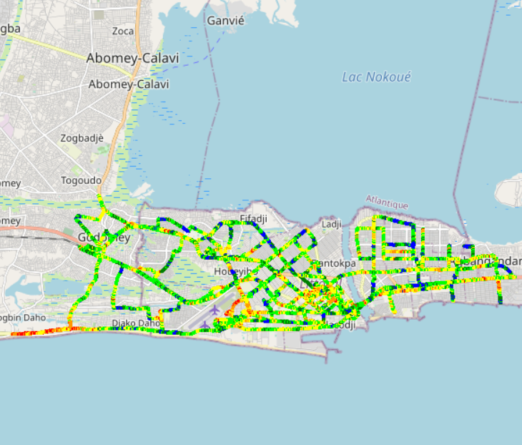
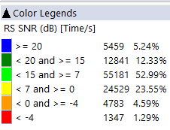
Benchmarking – SNIR comparison map
4G MOOV Signal of quality is outperforming MTN’s

Slide 32
Benchmarking – SNIR comparison
Drive tests are showing a low level of MTN Network SINR. 4G network extension should improve this value

Slide 33
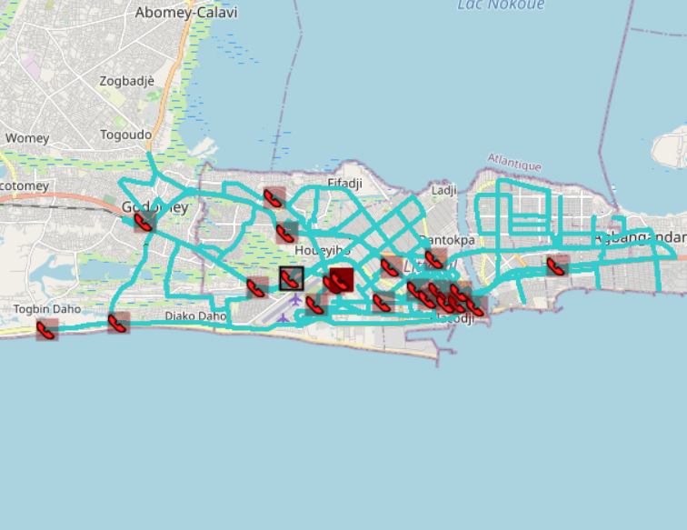

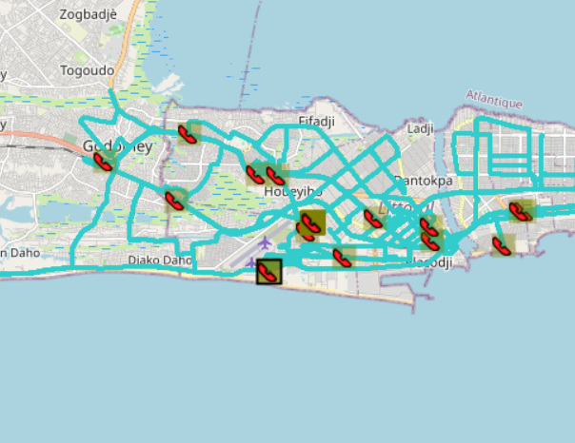
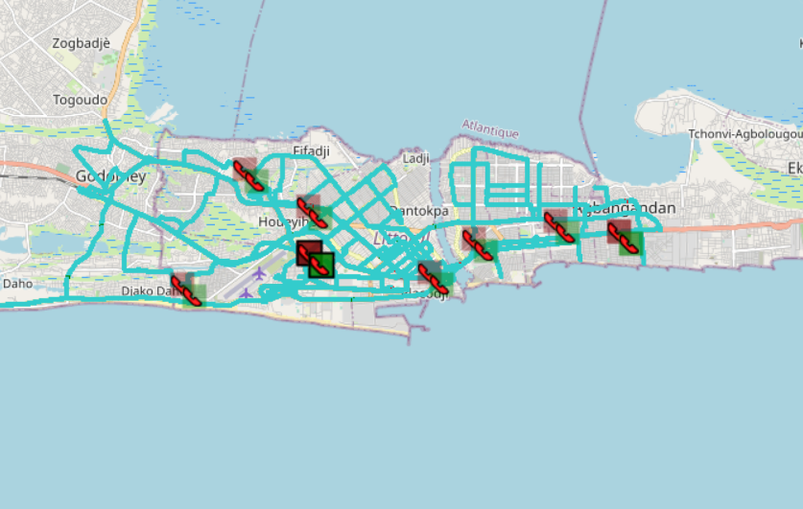
Benchmarking – BLOCKED CALLS EVENTS map
Both operators MTN & MOOV are not satisfying ARCEP CSSR/CBR requirements

Slide 34
Benchmarking – BLOCKED CALLS per Technology
MTN has a high rate of blocked calls for 3G network

Slide 35
Benchmarking – 2G/3G CALL SETUP TIME
Both operators MTN & MOOV have a high call setup time

Slide 36
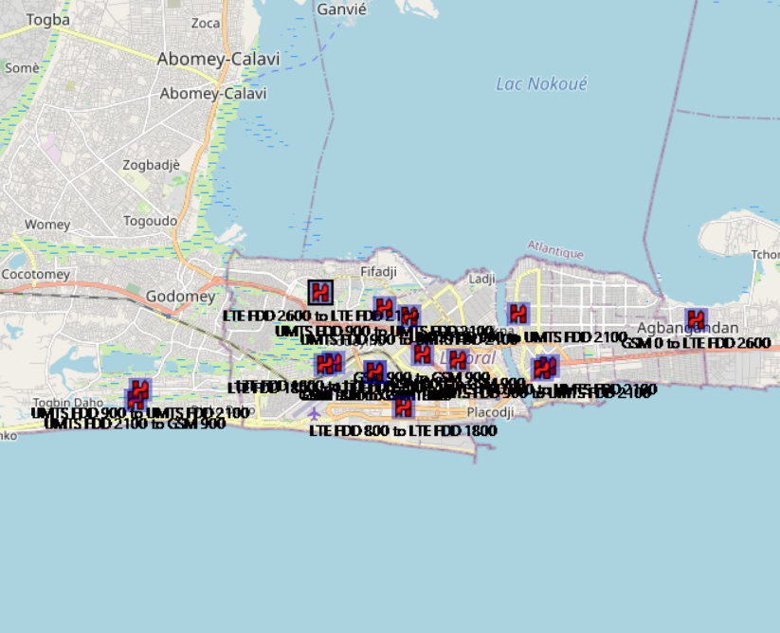

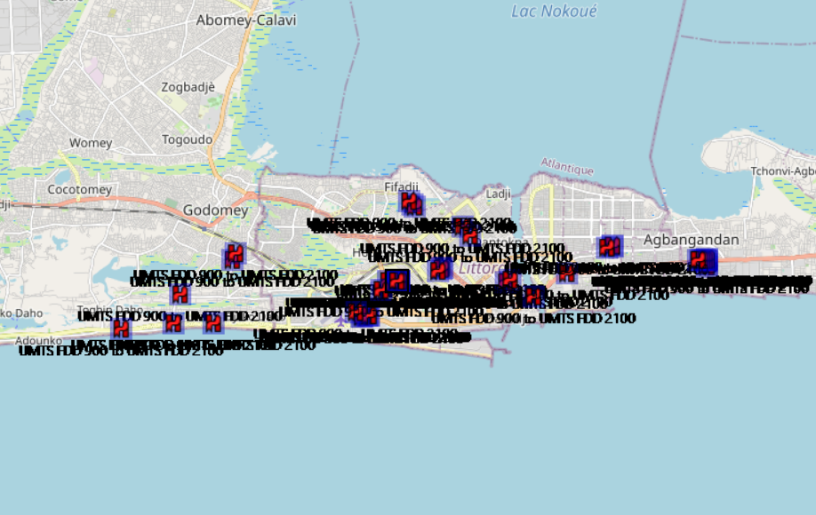
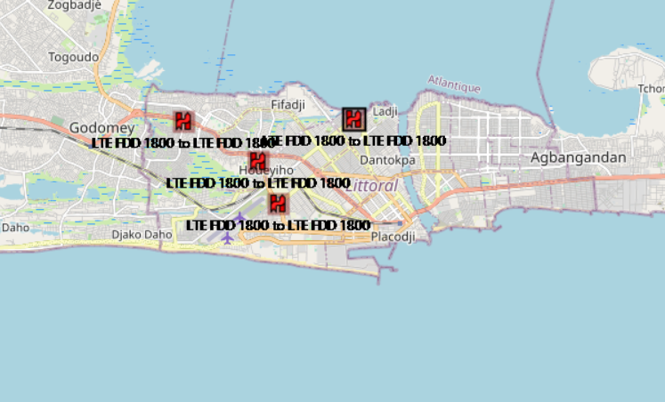
Benchmarking – HANDOVER FAILURE EVENTS map
MTN’s Network Handover is perfect compared to MOOV’s who is having many drops with UE release cause

Slide 37
Benchmarking – HANDOVER FAILURE
MTN’s Network Handover is perfect compared to MOOV’s that is having many drops with UE release cause

Slide 38
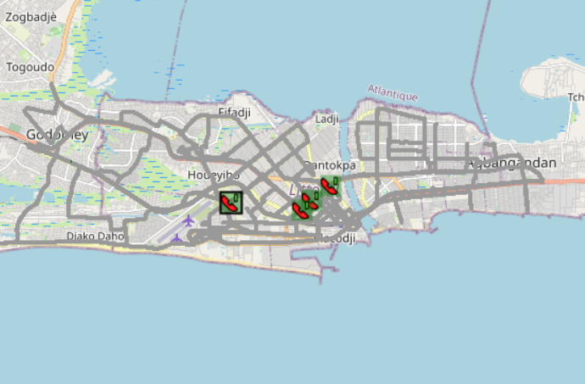
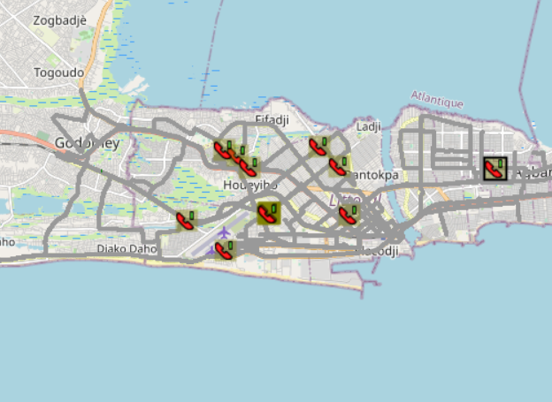
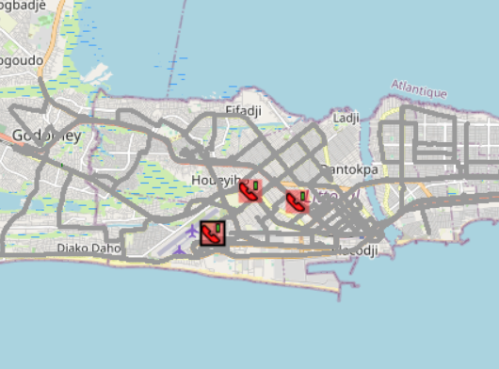

Benchmarking – DROPPED CALLS EVENTS map
Voice Session Continuity of MTN network is outperforming MOOV’s

Slide 39
Benchmarking – 2G/3G DROPPED CALLS
MTN CDR is satisfying ARCEP threshold Compared to MOOV’s CDR network which is very bad

Slide 40
Benchmarking – DROPPED CALLS per technology
MTN network has an excellent drop rate compared to MOOV’s network that has a bad drop rate for 3G technology

Slide 41
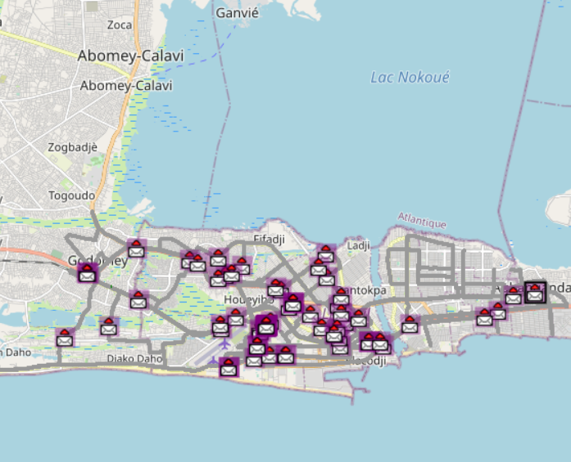


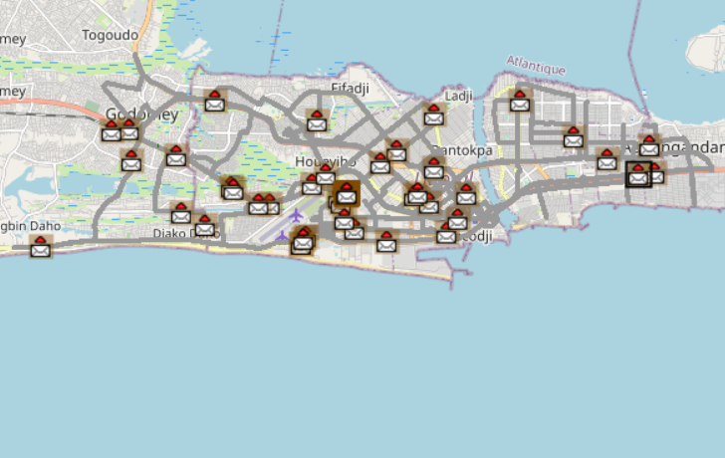

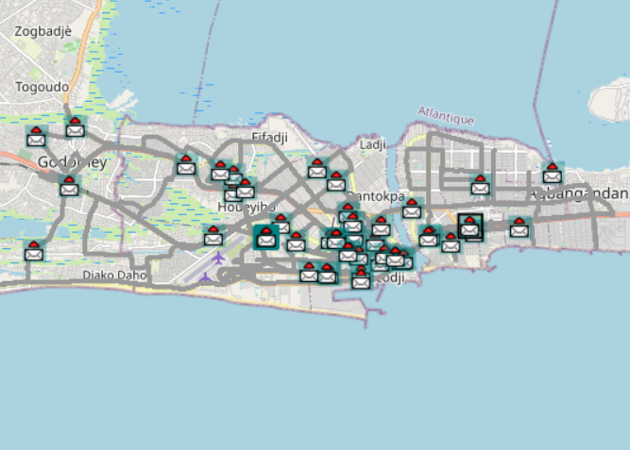

Benchmarking – SMS SENDING FAILURE EVENTS map
MTN SMS SETUP/RESPONSE is much better than MOOV’s

Slide 42
Benchmarking – SMS SENDING FAILURE
MTN SMS SETUP/RESPONSE is outperforming MOOV’s. SMS service KPIs of the two operators are almost compliant with the ARCEP requirements
MTN SMS sending/Receiving SR in MTN is excellent compared to MOOV’s
The Samples done in this DT fulfils the ARCEP requirement for MTN.

Slide 43
Benchmarking – DATA 3G
All operators have a good rate of successful Internet connection

Slide 44
Benchmarking – DATA 3G
Both operators have acceptable web service success rate. MTN have better connection setup time
PS Connection setup is excellent in MTN compared to MOOV and fulfils ARCEP requirements.
Both operators MTN & MOOV satisfy ARCEP criteria of successful internet connection rate more than 90%

Slide 45
Benchmarking – DATA 3G
Both operators have good downlink FTP success rate
Both operators MTN & MOOV satisfy ARCEP criteria of FTP success rate more than 80%.

Slide 46
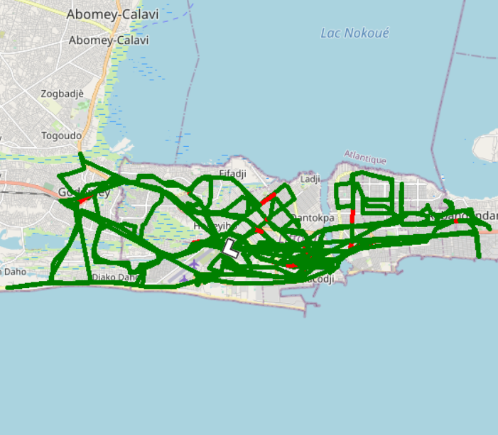
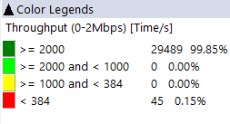





Benchmarking – 3G FTP MEAN THROUGHPUT comparison map
Excellent Throughput in MTN network compared to MOOV’s

Slide 47
Benchmarking – 3G FTP MEAN THROUGHPUT comparison
Excellent Throughput in MTN network compared to MOOV’s
MTN FTP DL AVERAGE Throughout is much better than MOOV DL Throughout
DL Throughput mean for both operators satisfies ARCEP thresholds
MTN FTP UL AVERAGE Throughout is much better than MOOV UL Throughout
UL Throughput mean for both operators satisfy ARCEP thresholds

Slide 48
Benchmarking – 3G FTP THROUGHPUT comparison
Both operators MTN & MOOV & CELTISS satisfy ARCEP criteria reaching DL/UL Average throughputs target

Slide 49
Benchmarking – 4G HTTP Browsing
Both operators have good downlink HTTP success rate

Slide 50
Benchmarking – 4G FTP THROUGHPUT comparison
All operators have acceptable FTP success rate

Slide 51






Benchmarking – 4G FTP THROUGHPUT comparison map
MTN average throughput DL rate is better than MOOV’s

Slide 52
Benchmarking – 4G FTP THROUGHPUT comparison
MTN FTP DL AVERAGE Throughput is outperforming MOOV’s. MTN FTP UL AVERAGE Throughput is similar to MOOV’s

Slide 53
Benchmarking – BAND and TECHNOLOGY UTILISATION
LTE MTN network uses both of 800 and 2600 bands while MOOV’s uses only the 800 band

Slide 54
07
Next steps

Slide 55
Next steps
Complete 2G & 3G drive tests: Remaining areas (north area of Benin)
Conduct deep analysis on drive tests results
Complete cross analysis on KPIs and OSS parameters with drive tests results and call traces
Issue final report and recommendations on February 10th, 2019

Slide 56

Deloitte fait référence à un ou plusieurs cabinets membres de Deloitte Touche Tohmatsu Limited, société de droit anglais (« private company limited by guarantee »), et à son réseau de cabinets membres constitués en entités indépendantes et juridiquement distinctes. Pour en savoir plus sur la structure légale de Deloitte Touche Tohmatsu Limited et de ses cabinets membres, consulter www.deloitte.com/about.
Fort d’un réseau de firmes membres dans plus de 150 pays, Deloitte allie des compétences de niveau international à des expertises locales pointues, afin d’accompagner ses clients dans leur développement partout où ils opèrent. Nos 264 000 professionnels sont animés par un objectif commun, faire de Deloitte la référence en matière d’excellence de service.
Au Bénin, Deloitte mobilise un ensemble de compétences diversifiées pour répondre aux enjeux de ses clients, de toutes tailles et de tous secteurs – des grandes entreprises multinationales aux microentreprises locales, en passant par les entreprises moyennes.
Le présent document et ses annexes sont confidentiels et réservés à l’usage interne exclusif du destinataire. Toute reproduction ou toute divulgation partielle ou totale à des tiers en est interdite, sauf accord écrit préalable de Deloitte Bénin.
© 2019 Deloitte Bénin SARL. Société du réseau Deloitte

