Slide 1


Network QoS
Benchmarking final report
February 6th, 2019

Slide 2
Summary
Scope of Work | 03
Executive Summary | 06
Benchmarking | 12
QoS Ranking | 33
QoE Global Scoring and Ranking | 56

Slide 3
01
Scope of Work

Slide 4

Scope of Work (i/ii): a high level of analysed samples giving a good accuracy
Cost
Cities to be covered
Cities | Proposed Samples
 | Voice 2G/3G | SMS | Data 3G | Data 4G
Cotonou | 1000 | 500 | 500 | 300
Sèmè-Kpodji | 400 | 200 | 200 | -
Porto-Novo | 600 | 300 | 300 | 200
Calavi | 800 | 400 | 400 | 200
Ouidah | 400 | 200 | 200 | -
Lokossa | 400 | 200 | 200 | -
Bohicon | 400 | 200 | 200 | -
Parakou | 600 | 300 | 300 | -
Djougou | 600 | 300 | 300 | -
Natitingou | 400 | 200 | 200 | -
Allada | 400 | 200 | 200 | -
Highways | - | - | - | -
Realized Samples
Voice 2G/3G | SMS | Data 3G (FT DL) | Data 4G
1006 | 3525 | 1910 | 840
401 | 1356 | 697 | -
604 | 1973 | 1073 | 288
814 | 2263 | 1104 | 532
429 | 283 | 379 | -
451 | 531 | 270 | -
413 | 1210 | 532 | -
622 | 1484 | 687 | -
600 | 997 | 466 | -
421 | 593 | 270 | -
415 | 666 | 263 | -
688 | 2389 | 1236 | -

Slide 5

Scope of Work (ii/ii)
Cost
Drive Test KPI (ARCEP KPIs)
Data KPIs (3G/LTE)
Voice KPIs
HTTP service Failure Ratio
HTTP Session Setup time
FTP UL/DL Session Failure Rate
FTP UL/DL Throughput
3G Availability Rate
Successful Internet Connexion Rate
Call blocking rate
Call drop rate
Call completetion, with perfect quality, rate (MOS)
Coverage rate (2G/3G/LTE)
SMS
Incar coverage rate
MO SMS delivery success rate
MT SMS delivery success rate

Slide 6
02
Executive Summary

Slide 7
Executive Summary – Benchmarking coverage 2G/3G/4G
MTN is leading in terms of 2G Indoor coverage with 96,64% against 95,21% for MOOV and 95,46% for CELTISS,
MTN is in second position for Incar morphology and in third position for outdoor coverage but closely similar to competitors,
Only MTN meets ARCEP requirements for all morphologies in all regions except in roads,
MTN is leading in terms of 3G coverage rate with (94,60%) against (91,33%) for MOOV and (93,81%) for CELTISS,
MTN failed to meet ARCEP 3G coverage only in ALLADA and major roads,
MOOV is clear leader in terms of 4G coverage by having the first position in all morphologies,
MTN is in the second position in terms of 4G coverage rate for Incar and Outdoor morphologies but meets ARCEP thresholds,
All operators failed to satisfied the ARCEP threshold for indoor coverage for 4G network.
TECHNOLOGY
KEY RECOMMENDATIONS
KEY FINDINGS
Coverage 2G/3G/4G
Design optimization is needed to improve 2G MTN coverage. Especially for the highways (Sites expansion, Repeaters, Swap to feeder less, power increase...)
Tune and align power settings mainly in 3G/4G. Actual setting may impact the coverage strength specially at Indoor locations
Review the design at the coverage and quality blackspots
We highlight that 4G ARCEP coverage Thresholds are aggressive

Slide 8
Executive Summary – Benchmarking voice service 2G/3G
TECHNOLOGY
KEY RECOMMENDATIONS
KEY FINDINGS
Voice service 2G/3G
Accessibility: MTN is leading in terms of accessibility to voice service by having the best Call Blocked ratio with 1,35% against 1,94% for MOOV and 1,89% for CELTISS,
All operators failed to meet ARCEP accessibility thresholds,
Retainability: MTN is ranked first in term of retainability better than MOOV and CELTISS,
MTN's Call Drop Rate is 0.93% compared to 2.19% for MOOV and 1.34% for CELTISS. Only MTN’s network satisfys ARCEP requirements in terms of retainability,
Integrity: MTN is in third position in terms of voice quality with an average Mean Opinion Score equal to 3,81 lower than MOOV 4,03 and better than CELTISS 3,9.
To improve its voice quality, it is recommended for MTN To:
  Reduce the utilization of 2G technology: Voice quality is always better in 3G due to its better codec rate (HD-voice with AMR-WB) , we recommend to push as much as possible the voice traffic to 3G,
  Improve radio parameters Ec/No, Drive test results are showing that MTN has a bad Ec/No, by improving this radio parameter we can improve further the voice quality MOS.
To improve the accessibility to voice service MTN needs to…………………………………
For update

Slide 9
Executive Summary – Benchmarking SMS service
TECHNOLOGY
KEY RECOMMENDATIONS
KEY FINDINGS
SMS service 2G/3G
There is no issue in radio accessibility that could be correlated to the SMS high delivery time.
End to End investigation need to be performed to analyses the high delivery time including mainly Core/SMS parts: SMSserver...
MTN is ranked first in terms of SMS performance by having the best SMS send/Receive Success ratio,
All operators failed to meet ARCEP requirements for SMS Send Success with End To End Delivery Time who should be less than < 6 sec as defined by ARCEP.

Slide 10
Executive Summary – Benchmarking 4G Data service
TECHNOLOGY
KEY RECOMMENDATIONS
KEY FINDINGS
Performance is stable in terms of accessibility for 4G data service, and all operators meet ARCEP's requirements,
MTN is leading in terms of 4G DL throughput with 34.12 Mbps, better than MOOV 20.74Mbps and CELTISS 12.28Mbps,
MTN needs to improve its 4G End Users throughput in the followings regions: Cotonou, SEME KAPODJI, Porto Novo and CALAVI,
MTN is ranked first in terms of 4G UL throughput with 16.05Mbps, as opposed to 10.60Mbps for MOOV and 11.46Mbps for CELTISS,
MTN has the best 4G UL throughput in all regions,
For 4G network, all operators meet ARCEP End User Throughput obligation in download and upload.
Data service 4G
MTN has an excellent performance in term of 4G KPIs.

Slide 11
Executive Summary – Benchmarking 3G Data service
Performance is stable in terms of accessibility for 3G data service, and all operators meet ARCEP's requirements.
CELTISS is ranked first in terms of FTP DL/UL throughput,
MTN is in third position for 3G DL throughput with 3.56 Mbps, compared to 4.62 Mbps for MOOV and 7.29 Mbps for CELTISS,
MTN is ranked second in term of 3G UL throughput with 1.64 Mbps against 1.19 Mbps for MOOV and 2.02Mbps for CELTISS,
All operators meet ARCEP’s 3G End User Throughput obligation for download and upload,
All operators meet ARCEP’s web browsing service accessibility thresholds.
TECHNOLOGY
KEY RECOMMENDATIONS
KEY FINDINGS
Data service 3G
Increasing the utilization of HSPA-DC can improve 3G throughput,
Review RF Conditions by eliminating any poor EcNo region (cleaning any interference, RTWP…), Drive tests results are showing that MTN has a bad Ec/No distribution,
Review HSPA Carriers settings: number and used strategy, less handover between carriers will help overall user experience and get a higher throughput,
IuB / IuPS: whether it’s over IP or ATM; If the utilization is OK,
CE & Power Utilization: if there’s congestion, one option is to expand board,
Reduce INTER an IRAT Neighbors,
PDSCH Codes: number per cell. Maximize it to 15 per cell,
HSDPA Users: maximum number (configured),
Review HSDPA Scheduling Algorithm,
ACK/NACK Power Optimization: seeking to find NACK failure, acceptable values are about 10%,
HSPA+ Features : mainly 64QAMand Load Balancing (enabled),
Equipment and License: if there are available license on the NodeB,
Its recommended to push as much as possible the data traffic to 4G in order to Offload the 3G network.

Slide 12
03
Benchmarking

Slide 13

Benchmarking – 2G Coverage-Outdoor
All operators has a simular 2G coverage and meet largily ARCEP requirements for outdoor morphology except in roads,
MOOV is ranked first in terms of 2G outdoor coverage and slightly better than MTN and
CELTISS.
More than 90% with Outdoor: Rxlev >-92 dBm

Slide 14
Benchmarking – 2G Coverage-Incar
All operators has a simular 2G coverage and meet largily ARCEP requirements for In Car morphology except in roads,
MOOV is ranked first in terms of 2G Incar coverage and slightly better than MTN and
CELTISS.
More than 90% with Incar: Rxlev >-87 dBm

Slide 15
Benchmarking – 2G-Indoor
MTN is leading in 2G Indoor coverage for over all, MTN meets ARCEP requirements except in SEME KAPODJI and major roads.
MTN has outperformed its competitors in 5/12 regions.
More than 90% with Indoor: Rxlev >-74 dBm

Slide 16
Benchmarking – 3G COVERAGE
MTN is leading in term of 3G coverage by having the best ratio in over all with 94,6% against 91,33% for MOOV and 93,81% for CELTISS
MTN meets ARCEP requirements in all regions except in major roads.

Slide 17
Benchmarking – 4G COVERAGE-Outdoor
MTN is ranked second in overall 4G coverage for outdoor morphology,
All operators meet ARCEP requirements for outdoor 4G coverage in all regions except in roads,
More than 90% with RSRP >-95 dBm

Slide 18
Benchmarking – 4G COVERAGE-Incar
MOOV is clear leader in term of 4G coverage for incar morphology and has the best coverage in most regions,
MTN needs to improve its 4 coverage in the following regions: OUIDAH, PARAKOU, ALLADA and major roads in order to satisfy ARCEP obligation.

Slide 19
Benchmarking – 4G Coverage-Indoor
MOOV is ranked first in terms of Indoor 4G coverage in overall,
All operators failed to meets ARCEP requirements for Indoor morphology,
MTN is ranked second in overall and neesds to improve its mostly in OUIDAH, ALLADA and major roads.

Slide 20
Benchmarking – voice service Accessibilty
MTN has outperformed its competitors in term of accessibility by having the best call blocked rate in all regions except in DJOUGOU, but exceeds slightly ARCEP requirements.

Slide 21
Benchmarking – voice service Retainability
MTN is ranked first in terms of retainability in overall, has the best call drop rate in 7/12 regions, only MTN’s network meets ARCEP requirements in overall by having a Call Drop Rate less than 1%.

Slide 22
Benchmarking – Integrity Voice Quality
MTN is offering an acceptable voice quality and meets ARCEP requirements, but it is ranked third and outperfomed by competitors in terms Mean Opinion Score.

Slide 23
Benchmarking – SMS Service
MTN is ranked first in terms of SMS send/receive succes ratio and outperforms largely MOOV and CELTISS in over all and in the most regions, but all operators failed to meet ARCEP requirements due to the low E2E delivery time as defined by ARCEP (<6sec).

Slide 24
Benchmarking – 3G Internet Connexion/ Web Service Success Rate
MTN is leading in terms of accessibilty to data service in over all,
MTN has the best accessibility to web service. All operators meet ARCEP requirement for both KPIs except in major roads.

Slide 25
Benchmarking – 3G/4G HTTP Connexion Setup Time
MTN is clear leader in HTTP connexion Setup Time,
All operators meet ARCEP requirements.

Slide 26
Benchmarking – 3G FTP Service
All operators meet the ARCEP target for FTP sucees ratio,
CELTISS is ranked first in overall for FTP DL/UL sucess ratio and slightly better than MTN.

Slide 27
Benchmarking – 3G FTP service DL/UL throughput
CELTISS is clear leader in terms of FTP End User DL throughput in over all,
MTN meets ARCEP requirements, but needs to improve its FTP DL/UL throughput.

Slide 28
Benchmarking – 4G Web Service
MTN is ranked first in terms of web service by having the best succes ratio in all regions except in SEME KAPODJI.

Slide 29
Benchmarking – 4G FTP service
MTN is leading in terms of 4G FTP DL/UL success rate and meets ARCEP requirements except for FTP UL succes rate in major roads.

Slide 30
Benchmarking – 4G FTP service DL/UL throughput
MTN is clear leader in terms of 4G DL/UL throughput and has an excellent performance compared to its competitors. MTN is ranked first for FTP UL throughput in all regions.
MTN is outperformed by CELTISS in Cotonou, SEME KAPODJI, Porto Novo and CALAVI.

Slide 31
04
QoE Global Scoring and Ranking

Slide 32
QoE Scoring and Ranking based on Deloitte proposed weights
Category | Technology | Weight | KPI Item | Lower | Upper
 |  |  |  |  |  | KPI Value | KPI Value | Score | Score
PS Experience | 4G | 10 | Coverage (RSCP>=-105 dbm) | 80% | 100% | 74.6% | 83.7% | 0.00 | 1.85
 | 3G | 20 | Coverage (RSCP>=-94 dbm) | 85% | 100% | 73.9% | 70.52% | 0 | 0
 | 4G | 15 | Average FTP DL THP (kbps) | 5000 | 40000 | 14588 | 10915 | 7.85 | 6.17
 | 3G | 25 | Average FTP DL THP (kbps) | 2000 | 10000 | 3167 | 2615 | 9.55 | 6.93
 | 4G | 5 | Average FTP UL THP (kbps) | 2000 | 10000 | 6313 | 6895 | 3.67 | 3.91
 | 3G | 5 | Average FTP UL THP (kbps) | 1000 | 5000 | 1233 | 1068 | 1.21 | 0.65
 | 4G | 5 | Accessibility Rate (%) | 90% | 100% | 98.57% | 99.65% | 4.29 | 4.83
 | 3G | 5 | Accessibility Rate (%) | 90% | 100% | 99.17% | 95.58% | 4.59 | 2.79
 | 4G | 5 | Average HTTP Connexion Setup Time (s) | 1 | 3 | 3.47 | 2.60 | 0.00 | 2.24
 | 3G | 5 | Average HTTP Connexion Setup Time (s) | 2 | 5 | 2.96 | 4.00 | 4.12 | 2.89
 | 3G/4G | 100 | Total Score |  |  |  |  | 35.27 | 30.40
MTN is number 1 for mobile internet capacity through its 3G/4G Network

Slide 33
QoE Scoring and Ranking based on Deloitte proposed weights
Category | Technology | Weight | KPI Item | Lower | Upper
 |  |  |  |  |  | KPI Value | KPI Value | KPI Value | Score | score | score
CS Experience | 2G | 25 | Coverage (RxLev>=-87 dbm) | 90% | 100% | 99.44% | 99.51% | 99.37% | 23,60 | 23.98 | 23.43
 | 3G | 25 | Coverage (RSCP>=-94 dbm) | 85% | 100% | 94.60% | 91.33% | 93.81% | 16.00 | 10.55 | 14.86
 | 2G/3G | 15 | Call blocking rate | 90% | 100% | 98.65% | 98.06% | 98.11% | 12.98 | 12.09 | 12.17
 | 2G/3G | 15 | Call drop rate | 5% | 1% | 0.93% | 2.19% | 1.36% | 15 | 10.54 | 13.73
 | 2G/3G | 20 | Mean Opinion Score | 0 | 5 | 3.83 | 4.03 | 3,9 | 17,46 | 17.96 | 17.66
 | 2G/3G | 100 | Total Score |  |  |  |  |  | 85.02 | 74.91 | 81.66
MTN is number 1 for voice communication quality of Experience

Slide 34
05
Mean KPIs By Districts

Slide 35
Benchmarking – MTN 4G FTP DL throughput by districts
For MTN’network, 97% of districts having DL End User throughput better than 5Mbps and meet ARCEP requirements.

Slide 36
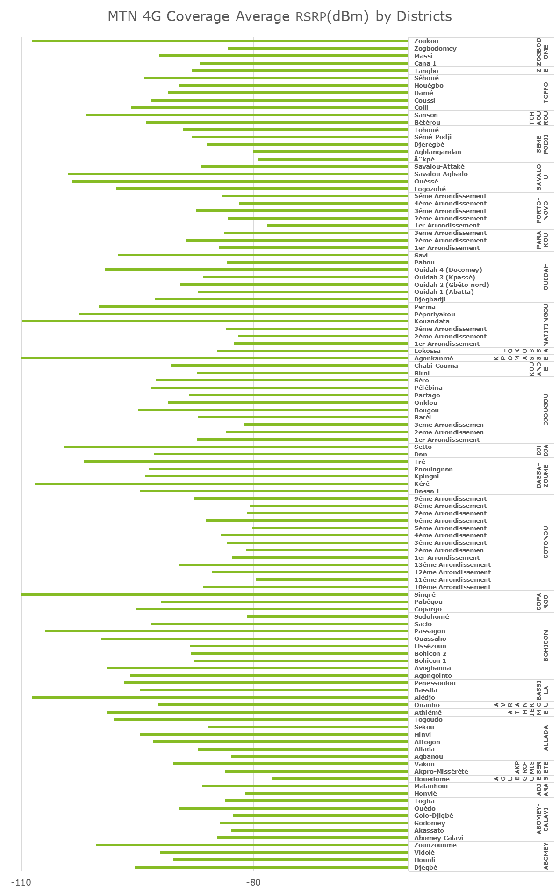
Benchmarking – MTN 4G coverage by districts
For MTN’network, 73,79% of districts having an average RSRP better than -95dBm,

Slide 37
Benchmarking – MTN 2G coverage by districts
For MTN’s 2G coverage 95,45% of districts have an average Rxlev better than -95dBm
And meet ARCEP requirements.

Slide 38
Benchmarking – MTN 3G coverage by districts
For MTN’s 2G coverage 84% of districts with average RSCP better than -90dBm.

Slide 39

Deloitte fait référence à un ou plusieurs cabinets membres de Deloitte Touche Tohmatsu Limited, société de droit anglais (« private company limited by guarantee »), et à son réseau de cabinets membres constitués en entités indépendantes et juridiquement distinctes. Pour en savoir plus sur la structure légale de Deloitte Touche Tohmatsu Limited et de ses cabinets membres, consulter www.deloitte.com/about.
Fort d’un réseau de firmes membres dans plus de 150 pays, Deloitte allie des compétences de niveau international à des expertises locales pointues, afin d’accompagner ses clients dans leur développement partout où ils opèrent. Nos 264 000 professionnels sont animés par un objectif commun, faire de Deloitte la référence en matière d’excellence de service.
Au Bénin, Deloitte mobilise un ensemble de compétences diversifiées pour répondre aux enjeux de ses clients, de toutes tailles et de tous secteurs – des grandes entreprises multinationales aux microentreprises locales, en passant par les entreprises moyennes.
Le présent document et ses annexes sont confidentiels et réservés à l’usage interne exclusif du destinataire. Toute reproduction ou toute divulgation partielle ou totale à des tiers en est interdite, sauf accord écrit préalable de Deloitte Bénin.
© 2019 Deloitte Bénin SARL. Société du réseau Deloitte

