Slide 1


Network QoS
LOKOSSA Benchmarking report
November 7th, 2023

Slide 2
Summary
INTRODUCTION | 5
1- Context & Report objectives 6
2- Scope of Work 7
3- Scope of intermediate Report 8
PART1 Drive Test Results: Cotonou Benchmark | 12
PART2 OMC Audits | 65

Slide 3
PART1 Summary
Drive tests Activity, Current Status & Progress | 12
Executive Summary | 15
Benchmarking Key Results | 21
Benchmarking Coverage | 26
Benchmarking Voice Service | 33
Benchmarking Data Service | 43
Next Steps | 63

Slide 4
PART2 Summary
OMC Network Configuration Overview | 73
Executive Summary | Ongoing
PM Data Audit | 70
1- Traffic Distribution 71
2- Network Availability 74
3- Network Retainability 76
4- Network Accessibility 81
5- Network mobility 83
6- Network Throughputs 85
7- Interference 88
8- ARCEP OMC KPI 90
Capacity Audit | 95
1 - 2G Capacity 96
2 – 3G Capacity 98
3 – 4G Capacity 101
4 – Bottleneck 104
CM Data Audit | Ongoing

Slide 5
01
Introduction: Context & Report objectives

Slide 6
Context & Report objectives
MTN Benin holds a prominent position as a leading mobile operator in Benin, with a market share of over 60%.
MTN Benin wants an independent assessment and benchmarking of its radio network through drive tests
1
2
It operates a network comprising of 675 2G, 3G and LTE sites across Benin.
3
4
MTN Benin also wants to ascertain network assurance and capacities
Overview of the NW QoS assessment scope
A comprehensive drive testing exercise to assess customer-perceived radio network quality in MTN Benin's 2G, 3G, and LTE network compared to competitors and as required by the regulator.
Objectives of the assignment
Detailed scope
2G/3G/4G MTN Networks KPIs audit based on OSS counters
Parameters settings audit of 2G/3G/4G MTN network
Capacity audit of 2G/3G/4G MTN network
Evaluate and benchmark Quality levels offered by MTN to MOOV mobiles networks and regulator defined KPIs levels based on Drive Test measurements results
Formulate drive test methodology and coverage
Recommendations for network improvement
Finalize reporting format and KPIs to be measured
6
1
2
Benchmark key KPIs between MTN, competition and regulator defined KPIs levels
5
4
3
Conduct drive tests for MTN Benin and competitor’s network
Validate results with MTN Benin’s radio planning team

Slide 7
02
Introduction: Scope of Work

Slide 8
Scope of work (i/ii)
Conduct OSS Audit
  2G/3G/4G MTN Networks KPIs audit based on OSS counters
  Parameters settings audit of 2G/3G/4G MTN network
  Capacity audit of 2G/3G/4G MTN network
Kick-off
Prerequisites
Data collection
Hourly KPI review
HW / Alarms review
RAN Parameters
RAN Features
Neighbors
HW/licensing
Result analysis
Suggest Recommendations
audit report written
Presentation and actions
Close out report
Preparation
Early KPI
warning
Configuration Audit
Performance Analysis
Dimensioning
Reporting
Evaluate and benchmark Quality levels offered by MTN to MOOV mobiles networks and regulator’s defined KPIs levels based on Drive Test measurements results
  Voice service quality and SMS (one team with Drive test tool)
  3G Data FTP DL/UL and HTTP Browsing (one team with Drive test tool)
  4G Data FTP DL/UL and HTTP Browsing (one team with Drive test tool)
Kick-off
Prerequisites
Drive Test route preparation
Drive Test execution
Post processing and report preparation
Deep Analysis and
Recommendations
Presentation
Preparation
Network Data Collection
Post Processing
Events and layer 3 analysis
Reporting

Slide 9


Scope of Work (ii/ii)
Cost
Cost
Cities to be covered
Drive Test KPI
18 thousand samples to analyze
16 indicators to analyze
Data KPIs (2G/3G/LTE)
Voice KPIs
HTTP Browsing Success Ratio
Session Setup time
FTP Session Success Rate
FTP UL/DL Throughput
Call blocking rate
Call drop rate
Call completion success rate
Call completion, with perfect quality, rate
Call completion, with good quality, rate
Voice Quality (MOS)
Coverage rate (2G/3G/LTE)
SMS
Outoor Coverage rate
Indoor coverage rate
Incar coverage rate
MO SMS delivery success rate
MT SMS delivery success rate

Slide 10
03
Introduction: Scope of Benchmarking Report « LOKOSSA »

Slide 11
Benchmarking report
Scope of this report
  1. Network benchmarking results for the LOKOSSA area between MTN, MOOV, and CELTISS from September 9th to September 13th, 2023..
2. A RAN network audit for MTN BENIN, aiming to identify weak points as well as suggests proposals to improve the network quality, and so the final user perception
  Audit is based on Performance Measurement data mainly between 19th September to 04th October 2023 and Configuration settings of 4th October
  This intermediate report includes the PM and capacity audit, CM audit is ongoing
  Comments and recommendations may be enriched on final report using CM audit findings

Slide 12
Part1
Drive Test Results: Competitive Netwrk Benchmaring LOKOSSA

Slide 13
01
Drive tests Activity, Current Status & Progress

Slide 14


Drive tests Activity, Current Status & Progress
Drive test and Benchmark evaluation is on track according to initial plan
The Drive Test execution is ongoing as initially planned
We have processed more than 100%

Slide 15
02
Benchmarking Executive Summary

Slide 16
Executive Summary – Benchmarking coverage 2G/3G/4G
updated
MTN has outperformed its competitors in terms of 2G coverage for outdoor and Indoor morphologies ,
For 2G RF coverage, Only MTN meets ARCEP obligation for all morphologies,
MTN is leading in terms of 3G coverage rate with (94,09%) against (86,16%) for CELTISS and (88,98%) for MOOV
Only MTN meets ARCEP 3G coverage obligation
MTN is in the second position in terms of 4G coverage rate for Incar and Outdoor morphologies but meets ARCEP thresholds,
All operators failed to satisfied the ARCEP threshold for indoor coverage for 4G network.
TECHNOLOGY
KEY RECOMMENDATIONS
KEY FINDINGS
Coverage 2G/3G/4G
Tune and align power settings mainly in 3G/4G. Actual setting may impact the coverage strength specially at Indoor locations
Review the design at the coverage and quality blackspots
We highlight that 4G ARCEP coverage Thresholds are aggressive
* Final recommendations will be shared in the final report including details and findings from ongoing Configuration Audit

Slide 17
Executive Summary – Benchmarking voice service 2G/3G
further
updated
TECHNOLOGY
Accessibility: MTN is leading in terms of accessibility to voice service by having the best Call Blocked ratio with 0,58% against 0,86% for MOOV and 0,84% for CELTISS,
All operators failed to meet ARCEP accessibility thresholds,
Retainability: MTN is ranked first in term of retainability better than MOOV and CELTISS,
MTN's Call Drop Rate is 0.38% compared to 0.78% for CELTISS and 0.55% for MOOV.All operators meet ARCEP retainabilty requirements,
Integrity: MTN is in second position in terms of voice quality with average Mean Opinion Score equal to 4,02 lower than MOOV 4,21 and better than CELTISS 3,94
In LOKOSSA the MTN’s MOS value is better than other area, because the voice quality is carried out mainly over 3G unlike other areas .
KEY RECOMMENDATIONS
KEY FINDINGS
Voice service 2G/3G
Voice quality is always better in 3G due to its better codec rate , we recommend to push as much as possible the voice traffic to 3G,
Drive test results are showing that MTN has a bad Ec/No, by improving this radio parameter we can improve further the voice quality MOS.

Slide 18
Executive Summary – Benchmarking SMS service
updated
TECHNOLOGY
KEY RECOMMENDATIONS
KEY FINDINGS
SMS service 2G/3G
There is no issue in radio accessibility that could be correlated to the SMS high delivery time.
End to End investigation need to be performed to analyses the high delivery time including mainly Core/SMS parts: SM Sserver...
* Final recommendations will be shared in the final report including details and findings from ongoing Configuration Audit
All operators failed to meet ARCEP for SMS Send Success with End To End Delivery Time who should be less than < 6 sec as defined by ARCEP.
MTN is better than MOOV and lower than CELTISS.

Slide 19
Executive Summary – Benchmarking 4G Data service
updated
Performance is stable in terms of accessibility for 4G data service, and all operators meet ARCEP's requirements.
MTN is leading in terms of 4G DL throughput with 57.41Mbps, better than MOOV 27.51Mbps and CELTISS 12.93Mbps.
MTN is ranked first in terms of 4G UL throughput with 18.74Mbps, as opposed to 13.53Mbps for MOOV and 11.47Mbps for CELTISS.
For 4G network, all operators meet ARCEP’s End User Throughput obligation in download and upload.
TECHNOLOGY
KEY RECOMMENDATIONS
KEY FINDINGS
Data service 4G
In LOKOSSA, MTN has an excellent performance in term of 4G KPIs.

Slide 20
Executive Summary – Benchmarking 3G Data service
updated
Performance is stable in terms of accessibility for 3G data service, and all operators meet ARCEP's requirements.
MTN is in third position for 3G DL throughput with 2.2Mbps, compared to 4.62Mbps for CELTISS and 3.33Mbps for MOOV.
MTN is ranked second in term of 3G UL throughput with 1.04 Mbps against 1.01 Mbps for MOOV and 2.15Mbps for CELTISS,
All operators meets ARCEP’s 3G End User Throughput obligation for download and upload.
All operators meet ARCEP’s web browsing service accessibility thresholds.
TECHNOLOGY
KEY RECOMMENDATIONS
KEY FINDINGS
Data service 3G
Its recommended to push as much as possible the data traffic to 4G in order to:
- Improve end user perception, Both DT and stats are showing that users in average are served with an excellent throughput in 4G,
- Offload the 3G network which will improve the 3G throughput and the 3G radio quality
Increasing the utilization of 3G data technology HSPA-DC can improve 3G throughput,
Some features and parameters need to be tuned and aligned
To ensure that no throughput limitation is applied on users profiles

Slide 21
03
Benchmarking Key Results

Slide 22
Benchmarking Key Results – Coverage
For 2G RF coverage, Only MTN meets ARCEP obligation for all morphologies,
In LOKOSSA, MTN has recorded the best RF 3G coverage,
MTN is ranked second in term of RF 4G coverage for Incar and outdoor morphologies,
All operators failed to meet ARCEP requirements for 4G indoor coverage.
updated
KPI |  | ARCEP Threshorlds | MTN |  | MOOV |  | CELTISS |  | MTN Ranking
 |  |  | Value | Conformity | Value | Conformity | Value | Conformity
2G Coverage Rate | Incar | More than 90% with Incar: Rxlev >-87 dBm | 98,11% | OK | 98,48% | OK | 98,06% | OK | 2
 | Outdoor | More than 90% with Outdoor: Rxlev >-92 dBm | 99,97% | OK | 99,73% | OK | 99,62% | OK | 1
 | Indoor | More than 90% with Outdoor: Rxlev >-74 dBm | 91,02% | OK | 88,82% | NOK | 86,16% | NOK | 1
3G Coverage Rate | Incar,Indoor,Outdoor | More than 90% with RSCP <-85 dBm | 94,09% | OK | 88,98% | NOK | 86,69% | NOK | 1
4G Coverage Rate | Incar | More than 90% with RSRP <-90 dBm* | 90,75% | OK | 91,91% | OK | 78,56% | NOK | 2
 | Outdoor | More than 90% with RSRP <-95 dBm* | 97,32% | OK | 99,36% | OK | 93,38% | OK | 2
 | Indoor | More than 90% with RSRP <-78 dBm* | 58,04% | NOK | 59,69% | NOK | 64,80% | NOK | 3

Slide 23
Benchmarking Key Results – 2G/3G voice and SMS Summary
MTN is leading in accessibility and retainability in LOKOSSA,
MTN is ranked second in terms of voice quality MOS but satisfys ARCEP requirements,
MTN needs to improve its SMS Send duration,
All operators failed to meet ARCEP requirements for SMS service due to due to the timeout of sending duration that should be less than (< 6s).
updated
KPI | ARCEP Threshorlds | MTN |  | MOOV |  | CELTISS |  | MTN Ranking
 |  | Value | Conformity | Value | Conformity | Value | Conformity
Accesibility: Blocking rate | <1% | 0,58% | OK | 0,86% | OK | 0,84 | OK | 1
Retainability: Call drop rate | <1% | 0,38% | OK | 0,55% | OK | 0,78% | OK | 1
Call Completetion Rate (%) | =<98% | 99,04% | OK | 98,56% | OK | 98,38% | OK | 1
Integrity: Voice quality | Note requise> 2,8 | 4,02 | OK | 4,21 | OK | 3,94 | OK | 2
SMS sending success rate % (E2E delivery Time<6 sec) | >99% | 97,51% | NOK | 91,80% | NOK | 98,89% | NOK | 2
SMS receving success rate % | >99% | 96,33% | NOK | 89,01% | NOK | 96,46% | NOK | 2

Slide 24
Benchmarking Key Results – 3G Data Summary
MTN network in 3G DATA meets ARCEP requirements,
MTN has the lowest FTP DL/UL throughput.
updated
Services | KPI | ARCEP Threshorlds | MTN |  | MOOV |  | CELTISS |  | MTN Ranking
 |  |  | Value | Conformity | Value | Conformity | Value | Conformity
3G HTTP | Successful internet connexion rate | >96% | 100,00% | OK | 99,92% | OK | 100,00% | OK | 1
 | Connexion setup time | <=10sec | 6,09 | OK | 6,12 | OK | 5,87 | OK | 2
 | Web service failure rate | <3% | 2,42% | OK | 0,45% | OK | 1,89% | OK | 3
3G FTP | FTP failure rate UL/DL | <3 % | 0,85%/1,77% | OK | 0,43%/4,98% | OK/NOK | 0%/1,23% | OK | 2
 | FTP Data transmission average (DL) | >= 2Mbps | 3,482 | OK | 4,651 | OK | 7,631 | OK | 3
 | FTP Data transmission average (UL) | >= 1Mbps | 1,156 | OK | 1,272 | OK | 1,986 | OK | 3

Slide 25
Benchmarking Key Results – 4G Data Summary
MTN’s 4G DATA End User KPIs satisfy extensively ARCEP requirements,
MTN is ranked first in terms of FTP DL/UL throughput,
MTN has an excellent FTP DL throughput with 57,41Mbps against 27,51Mbps for MOOV and 12,93Mbps for CELTISS.
updated
Services | KPI | Threshorlds* | MTN |  | MOOV |  | CELTISS |  | MTN Ranking
 |  |  | Value | Conformity | Value | Conformity | Value | Conformity
4G HTTP Browsing | Web service failure rate (%) | <3% | 0,00% | OK | 0,00% | OK | 0,00% | OK | 1
 | Connexion setup time | <=3sec | 0,47 | OK | 0,58 | OK | 0,62 | OK | 1
4G FTP | FTP failure rate UL/DL | <3 % | 0%/0,87% | OK | 0%/0,47% | OK | 0%/0% | OK | 3
 | FTP Data transmission average (DL) | 4G >= 5 Mbps | 57,419 | OK | 27,516 | OK | 12,933 | OK | 1
 | FTP Data transmission average (UL) | 4G: >= 2Mbps | 18,741 | OK | 13,537 | OK | 11,474 | OK | 1

Slide 26
04
Benchmarking 2G/3G/4G coverage

Slide 27
Benchmarking: 2G coverage
Only MTN’s 3G coverage meets ARCEP RxLev thresholds for all morphologies Indoor, Incar and outdoor,
MTN has the best 2G coverage for Indoor and outdoor categories and closely simular to competitors for Incar category.
updated

Slide 28
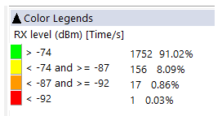
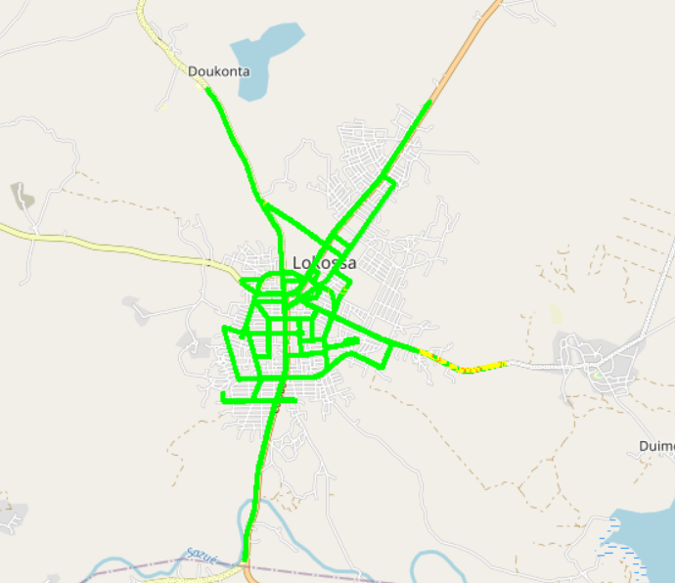
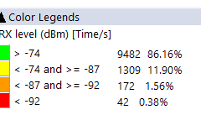



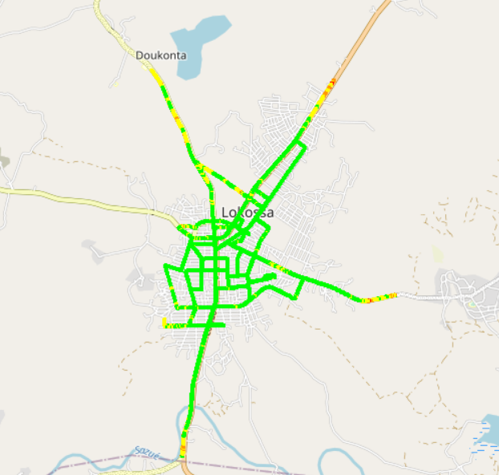
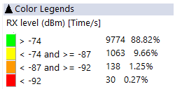
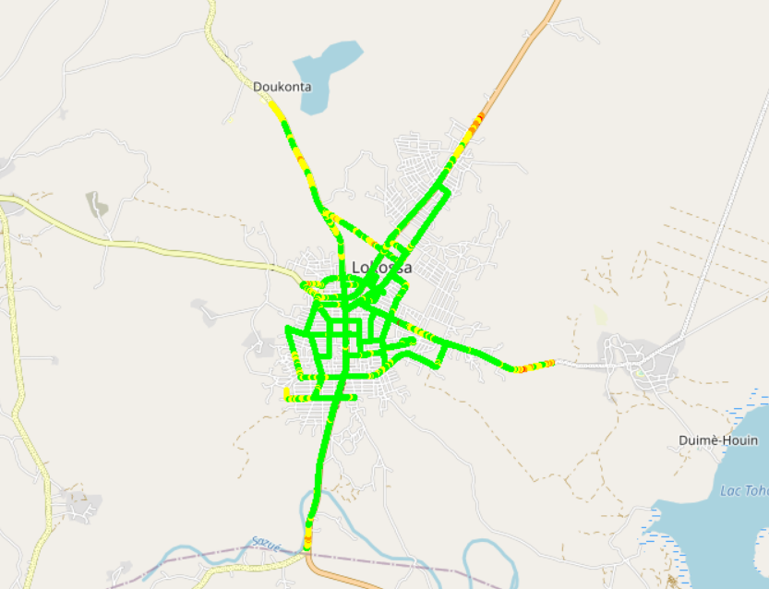
Benchmarking: 2G coverage - Maps
In LOKOSSA, MTN has 91,02% of samples better than -74dBm against 88,82% for MOOV and 86,16% for CELTISS.
updated

Slide 29
Benchmarking: 3G coverage
In LOKOSSA, MTN is clair leader in terms of 3G coverage and alone satisfys the ARCEP requirements.
updated

Slide 30
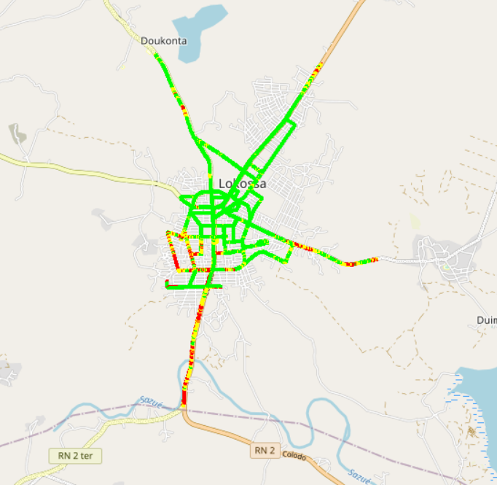
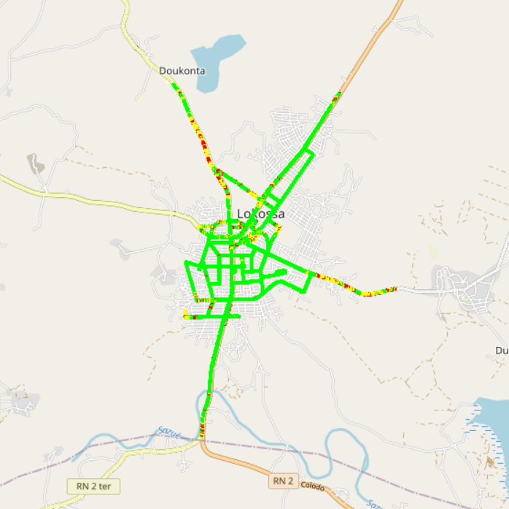
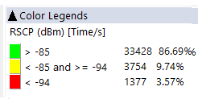

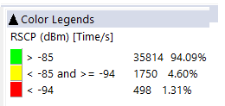
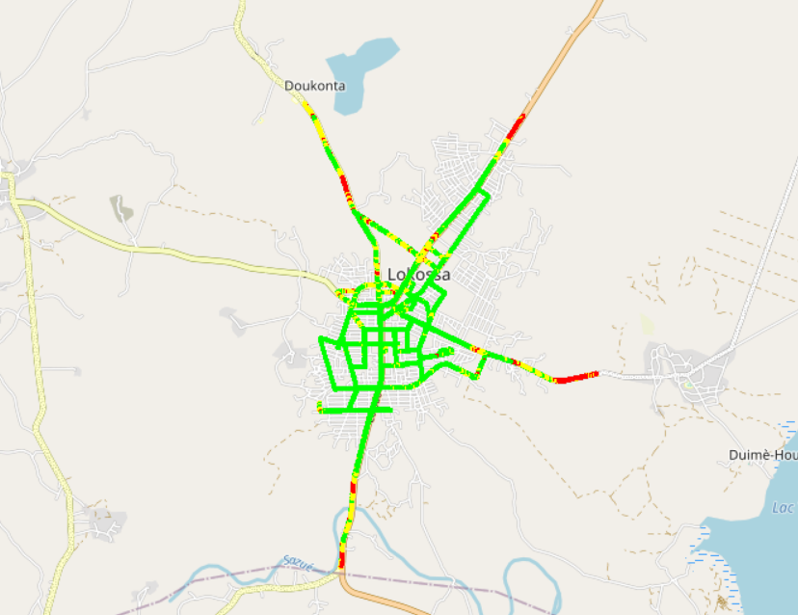
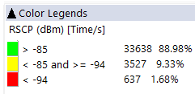
Benchmarking: 3G coverage-Maps
In LOKOSSA, MTS offers the best 3G coverage.
updated

Slide 31
Benchmarking: 4G coverage
MTN is ranked second for 4G coverage for Incar and Outdoor morphologies and meets ARCEP requirements, but all operators failed to meet ARCEP threshold for Indoor category.
updated

Slide 32
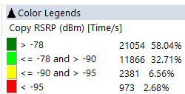
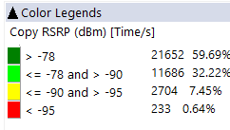
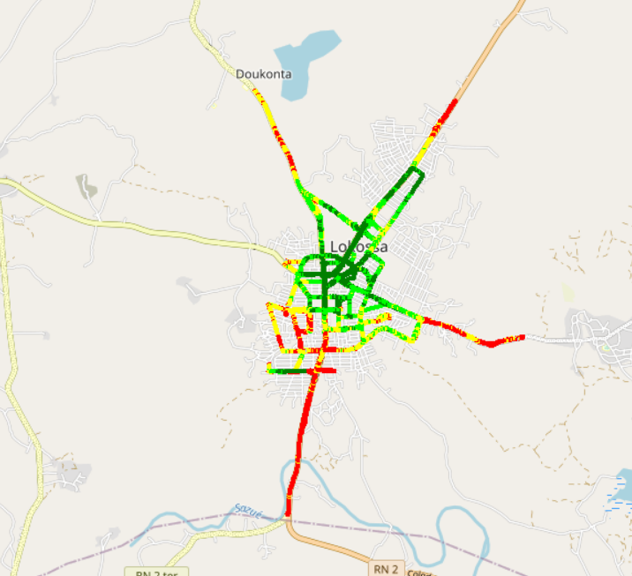
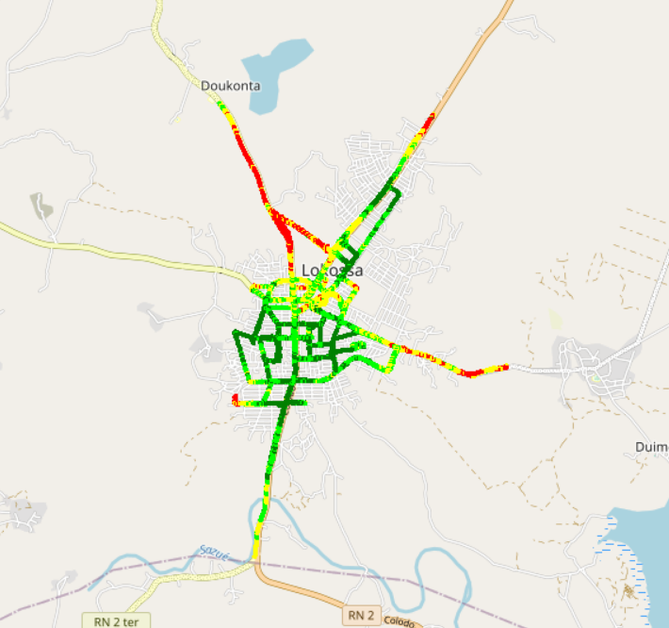

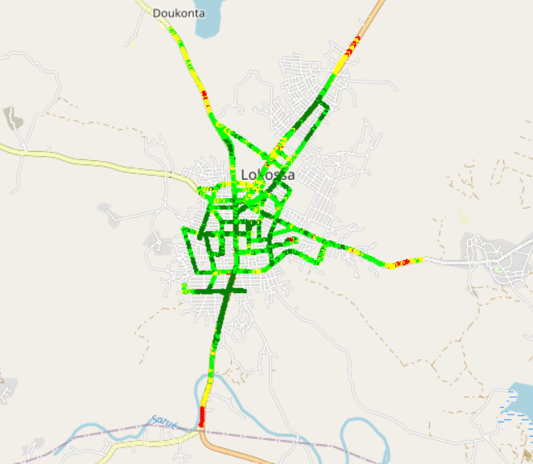
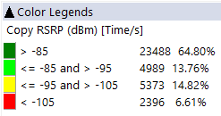
Benchmarking – 4G coverage - Maps
MTN’s 4G coverage is lower than MOOV’s and CELTISS,
Low 4G coverage was recorded near to the road to Doukonta.
updated

Slide 33
04
Benchmarking voice service

Slide 34
Benchmarking: CS Accessibility 2G/3G BLOCKED CALLS
MTN has the best accessibility to voice service compared to competitors,
All operators satisfy ARCEP requirements.
Updated

Slide 35
Benchmarking: CS Integrity Voice quality Mean Opinion Score
In LOKOSSA, MTN has the best ratio of excellent and good Voice Quality samples compared to CELTISS’s and MOOV’S. MTN is ranked second in terms of voice quality with an average MOS equal to 4,02 opposed to 4,21 for MOOV and 3,94 for CELTISS.
updated

Slide 36
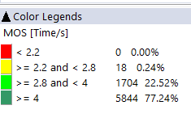
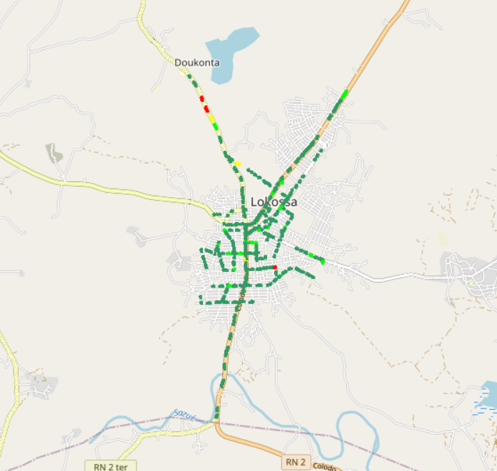
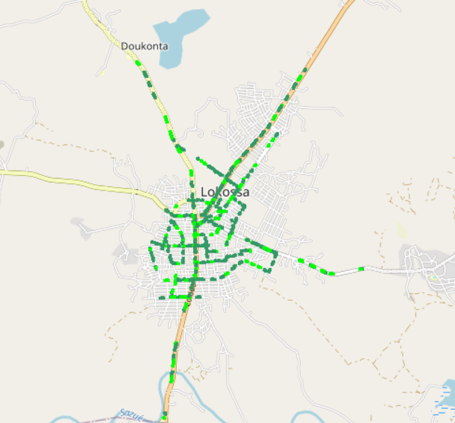
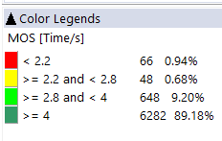
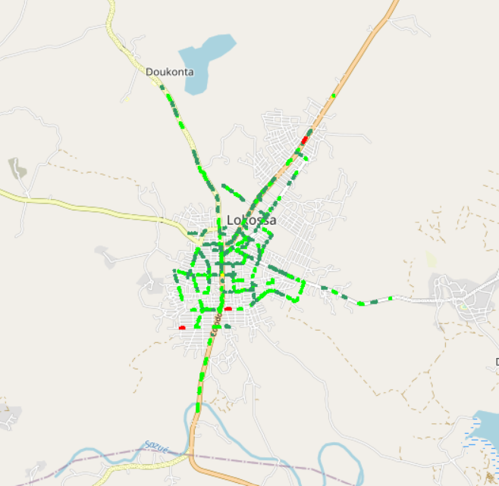

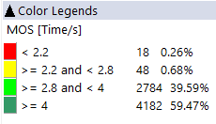
Benchmarking – CS Integrity Voice quality maps (MOS)
MTN has around 99,76% of MOS samples better than 2.8 against 98,38% for MOOV and 99,1% for CELTISS.
3d
updated

Slide 37
Benchmarking: CS Retainability 2G/3G DROPPED CALLS
MTN is clair leader in term of retainability by having the lowest Call Drop Rate,
All operators meets ARCEP requirements.
updated

Slide 38
Benchmarking Voice service Band usage(%)
All operators have more than 97% of voice calls carried out over 3G,
All operators use mainly UMTS2100 band.
updated

Slide 39
Benchmarking: Radio parameters EC/NO comparison
7,42% of drive test samples are showing a very low level of EcNo for 3G MTN opposed to MOOV with 4,63% and CELTISS with 4,88%.
updated

Slide 40
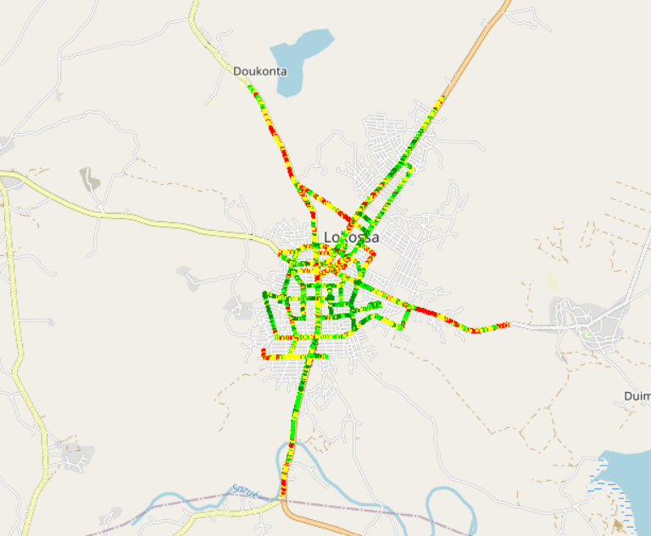
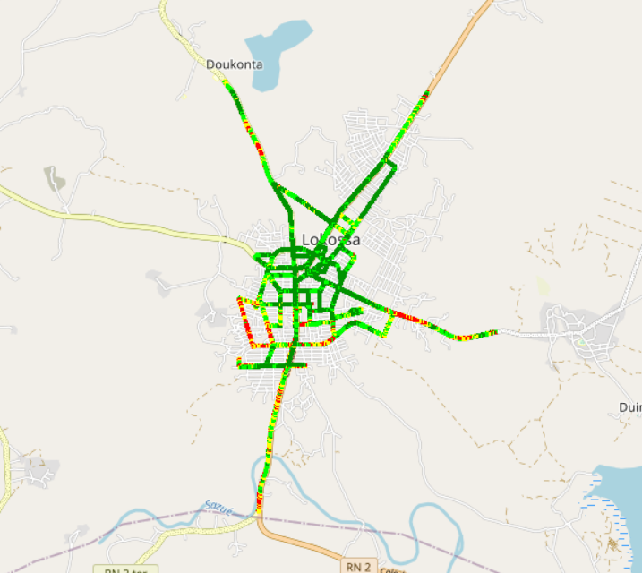
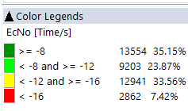
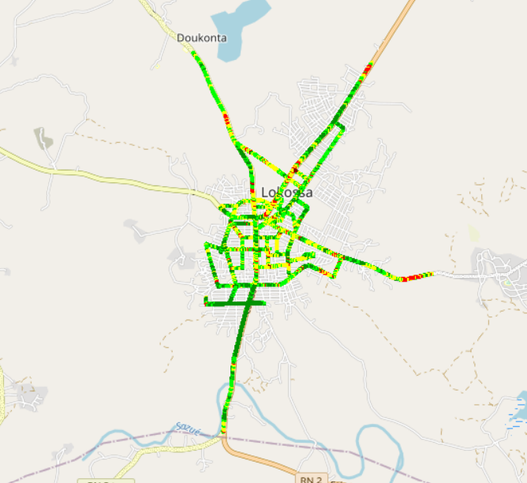
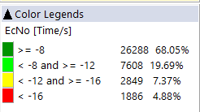
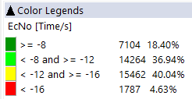
Benchmarking: Radio parameters EC/NO
MTN has the highest ratio of very bad Ec/No samples (<-16db).
updated

Slide 41
Benchmarking – 2G/3G CALL SETUP TIME
MTN is clear leader in terms of Call Setup Time.
Updated

Slide 42
Benchmarking – SMS Service
MTN’s SMS SEND/RECEIVE SR(%) is better than MOOV and less than CELTISS . SMS service KPIs for all operators are not compliant with the ARCEP requirements due to the timeout of sending duration (< 6s).
Updated

Slide 43
04
Benchmarking Data service

Slide 44
Benchmarking – DATA 3G
All operators have a good rate of successful Internet connection.
Updated

Slide 45
Benchmarking – DATA 3G Web Browsing service
MTN has the lowest HTTP browsing success, All operators meet ARCEP requirement for web service.
Updated

Slide 46
Benchmarking – DATA 3G FTP service
Only MTN and CELTISS meet ARCEP requirements for FTP DL/UL success ratio. CELTISS has the best FTP DL/UL success ratio.
Updated

Slide 47
Benchmarking – 3G FTP MEAN THROUGHPUT
MTN 3G Throughput DL/UL is less than MOOV’s and CELTISS’s, but satisfys ARCEP requirements.

Slide 48
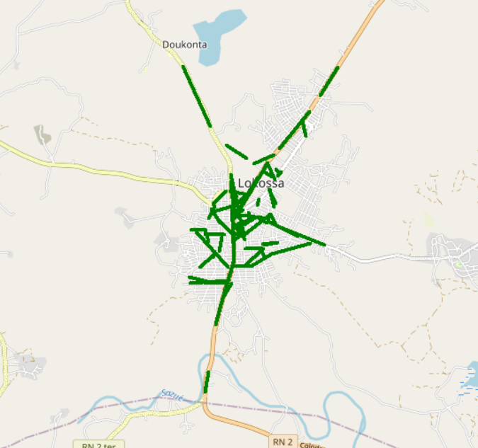


Benchmarking – 3G FTP MEAN THROUGHPUT comparison map
All operators meets ARCEP requirements with 100% of throughput samples better than 2Mbps.
Updated

Slide 49
Benchmarking – 4G HTTP Browsing
All operators have very good HTTP Browsing success rate.
Updated

Slide 50
Benchmarking – 4G FTP service
All operators have an excellent FTP DL/UL success ratio for 4G network.
Updated

Slide 51
Benchmarking – 4G FTP THROUGHPUT comparison
In LOKOSSA, MTN is leading in terms of FTP DL/UL AVERAGE Throughput,
MTN has outperformed its competitors with an excellent DL/UL speed.
Updated

Slide 52
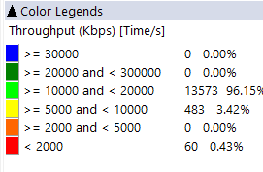
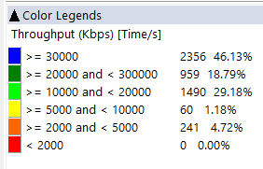
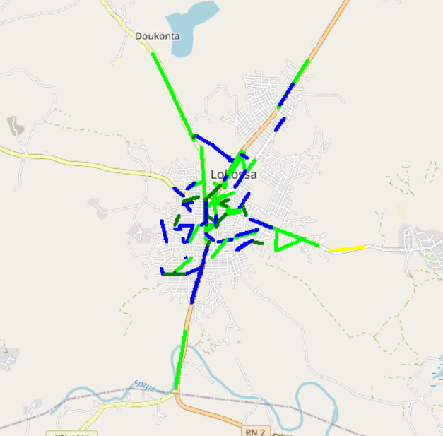
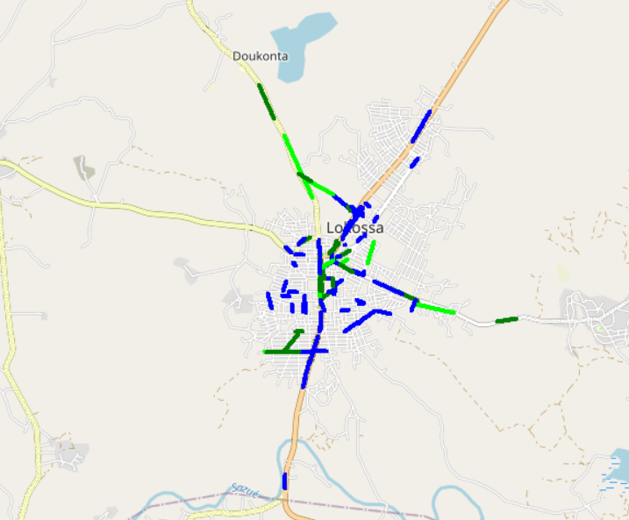
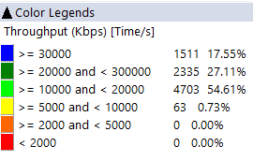
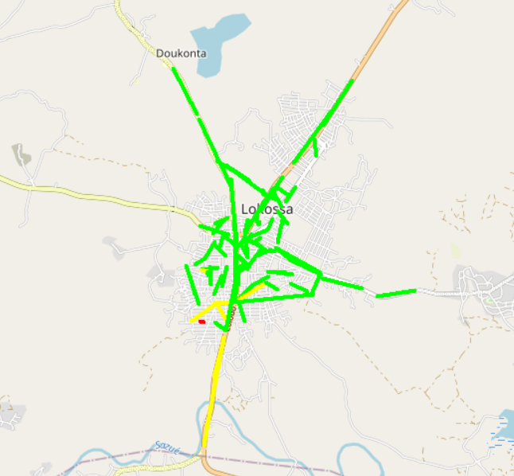
Benchmarking – 4G FTP THROUGHPUT comparison map
In LOKOSSA, MTN has an excellent end user throughput with more than 46,13% of samples better than 30Mbps .
Updated

Slide 53
Benchmarking – BAND and TECHNOLOGY UTILISATION
Most of MTN’s and MOOV’s LTE samples are carried out over LTE 2600 as first carrier,
Most of CELTISS’s samples are carried out over LTE 1800 as first carrier,
For all operators,most of 3G samples are carried out over U2100, but MTN has the highest ratio of U900 usage.
Updated

Slide 54
Benchmarking – Data TECHNOLOGY Usage(%)
MTN has the highest LTE CA Carrier Aggregation usage with 83,12% against 52,89% for MOOV and 50,75% for CELTISS.
Updated

Slide 55
Benchmarking – SINR comparison
For 4G Network Drive tests are showing that MTN has the best ratio of acceptable SINR.
Updated

Slide 56
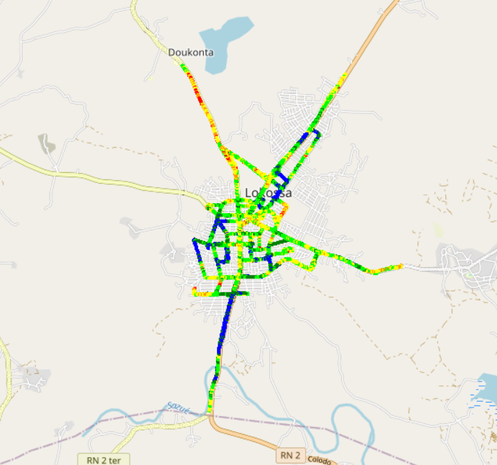
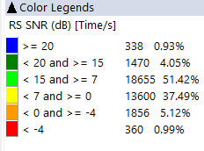

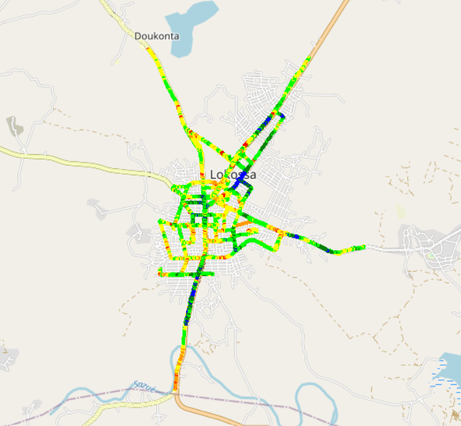
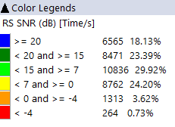
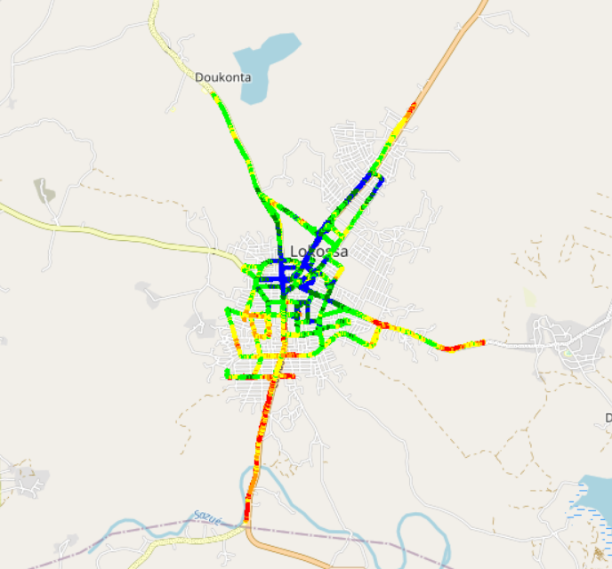
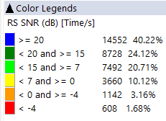
Benchmarking – SNIR comparison map
MTN has the better quality of signal compared to MOOV and CELTISS.

Slide 57
05
Next steps

Slide 58
Next steps
Complete 2G & 3G drive tests: Remaining areas (north area of Benin)
Conduct deep analysis on drive tests results
Complete cross analysis on KPIs and OSS parameters with drive tests results and call traces
Issue final report and recommendations

Slide 59

Deloitte fait référence à un ou plusieurs cabinets membres de Deloitte Touche Tohmatsu Limited, société de droit anglais (« private company limited by guarantee »), et à son réseau de cabinets membres constitués en entités indépendantes et juridiquement distinctes. Pour en savoir plus sur la structure légale de Deloitte Touche Tohmatsu Limited et de ses cabinets membres, consulter www.deloitte.com/about.
Fort d’un réseau de firmes membres dans plus de 150 pays, Deloitte allie des compétences de niveau international à des expertises locales pointues, afin d’accompagner ses clients dans leur développement partout où ils opèrent. Nos 264 000 professionnels sont animés par un objectif commun, faire de Deloitte la référence en matière d’excellence de service.
Au Bénin, Deloitte mobilise un ensemble de compétences diversifiées pour répondre aux enjeux de ses clients, de toutes tailles et de tous secteurs – des grandes entreprises multinationales aux microentreprises locales, en passant par les entreprises moyennes.
Le présent document et ses annexes sont confidentiels et réservés à l’usage interne exclusif du destinataire. Toute reproduction ou toute divulgation partielle ou totale à des tiers en est interdite, sauf accord écrit préalable de Deloitte Bénin.
© 2019 Deloitte Bénin SARL. Société du réseau Deloitte

