Slide 1


Network QoS
Intermediate report
November 7th, 2023

Slide 2
Summary
INTRODUCTION | 5
1- Context & Report objectives 6
2- Scope of Work 7
3- Scope of intermediate Report 8
PART1 Drive Test Results: Cotonou Benchmark | 12
PART2 OMC Audits | 65

Slide 3
PART1 Summary
Drive tests Activity, Current Status & Progress | 12
Executive Summary | 15
Benchmarking Key Results | 21
Benchmarking Coverage | 26
Benchmarking Voice Service | 33
Benchmarking Data Service | 48
Next Steps | 63

Slide 4
PART2 Summary
OMC Network Configuration Overview | 73
Executive Summary | Ongoing
PM Data Audit | 70
1- Traffic Distribution 71
2- Network Availability 74
3- Network Retainability 76
4- Network Accessibility 81
5- Network mobility 83
6- Network Throughputs 85
7- Interference 88
8- ARCEP OMC KPI 90
Capacity Audit | 95
1 - 2G Capacity 96
2 – 3G Capacity 98
3 – 4G Capacity 101
4 – Bottleneck 104
CM Data Audit | Ongoing

Slide 5
01
Introduction: Context & Report objectives

Slide 6
Context & Report objectives
MTN Benin holds a prominent position as a leading mobile operator in Benin, with a market share of over 60%.
MTN Benin wants an independent assessment and benchmarking of its radio network through drive tests
1
2
It operates a network comprising of 675 2G, 3G and LTE sites across Benin.
3
4
MTN Benin also wants to ascertain network assurance and capacities
Overview of the NW QoS assessment scope
A comprehensive drive testing exercise to assess customer-perceived radio network quality in MTN Benin's 2G, 3G, and LTE network compared to competitors and as required by the regulator.
Objectives of the assignment
Detailed scope
2G/3G/4G MTN Networks KPIs audit based on OSS counters
Parameters settings audit of 2G/3G/4G MTN network
Capacity audit of 2G/3G/4G MTN network
Evaluate and benchmark Quality levels offered by MTN to MOOV mobiles networks and regulator defined KPIs levels based on Drive Test measurements results
Formulate drive test methodology and coverage
Recommendations for network improvement
Finalize reporting format and KPIs to be measured
6
1
2
Benchmark key KPIs between MTN, competition and regulator defined KPIs levels
5
4
3
Conduct drive tests for MTN Benin and competitor’s network
Validate results with MTN Benin’s radio planning team

Slide 7
02
Introduction: Scope of Work

Slide 8
Scope of work (i/ii)
Conduct OSS Audit
  2G/3G/4G MTN Networks KPIs audit based on OSS counters
  Parameters settings audit of 2G/3G/4G MTN network
  Capacity audit of 2G/3G/4G MTN network
Kick-off
Prerequisites
Data collection
Hourly KPI review
HW / Alarms review
RAN Parameters
RAN Features
Neighbors
HW/licensing
Result analysis
Suggest Recommendations
audit report written
Presentation and actions
Close out report
Preparation
Early KPI
warning
Configuration Audit
Performance Analysis
Dimensioning
Reporting
Evaluate and benchmark Quality levels offered by MTN to MOOV mobiles networks and regulator’s defined KPIs levels based on Drive Test measurements results
  Voice service quality and SMS (one team with Drive test tool)
  3G Data FTP DL/UL and HTTP Browsing (one team with Drive test tool)
  4G Data FTP DL/UL and HTTP Browsing (one team with Drive test tool)
Kick-off
Prerequisites
Drive Test route preparation
Drive Test execution
Post processing and report preparation
Deep Analysis and
Recommendations
Presentation
Preparation
Network Data Collection
Post Processing
Events and layer 3 analysis
Reporting

Slide 9


Scope of Work (ii/ii)
Cost
Cost
Cities to be covered
Drive Test KPI
18 thousand samples to analyze
16 indicators to analyze
Data KPIs (2G/3G/LTE)
Voice KPIs
HTTP Browsing Success Ratio
Session Setup time
FTP Session Success Rate
FTP UL/DL Throughput
Call blocking rate
Call drop rate
Call completion success rate
Call completion, with perfect quality, rate
Call completion, with good quality, rate
Voice Quality (MOS)
Coverage rate (2G/3G/LTE)
SMS
Outoor Coverage rate
Indoor coverage rate
Incar coverage rate
MO SMS delivery success rate
MT SMS delivery success rate

Slide 10
03
Introduction: Scope of Intermediate Report

Slide 11
Intermediate report
Scope of this report
  1. Network benchmarking results for the Cotonou area between MTN, MOOV, and CELTISS from September 9th to September 13th, 2023..
2. A RAN network audit for MTN BENIN, aiming to identify weak points as well as suggests proposals to improve the network quality, and so the final user perception
  Audit is based on Performance Measurement data mainly between 19th September to 04th October 2023 and Configuration settings of 4th October
  This intermediate report includes the PM and capacity audit, CM audit is ongoing
  Comments and recommendations may be enriched on final report using CM audit findings

Slide 12
Part1
Drive Test Results: Cotonou Benchmark

Slide 13
01
Drive tests Activity, Current Status & Progress

Slide 14


Drive tests Activity, Current Status & Progress
Drive test and Benchmark evaluation is on track according to initial plan
The Drive Test execution is ongoing as initially planned
We have processed more than 100%

Slide 15
02
Benchmarking Executive Summary

Slide 16
Executive Summary – Benchmarking coverage 2G/3G/4G
TECHNOLOGY
2G MTN coverage rate (99,97%) is closely comparable with its competitors MOOV (99,99%) and CELTISS (99,97%)
All operators meet ARCEP 2G coverage obligation.
3G MTN coverage rate (96,11%) is lower than CELTISS (98,20%) and better than MOOV with (86,14%),
Only MTN and CELTISS meet ARCEP 3G coverage obligation
4G MTN coverage rate (98,29%) is comparable with MOOV’s (99,59%) and CELTISS’s (99,07),
All operators meets outdoor and incar ARCEP 4G coverage obligation however, none of the operators satisfied the indoor coverage ARCEP threshold.
KEY RECOMMENDATIONS
KEY FINDINGS
Coverage 2G/3G/4G
Tune and align power settings mainly in 3G/4G. Actual setting may impact the coverage strength specially at Indoor locations
Review the design at the coverage and quality blackspots
We highlight that 4G ARCEP coverage Thresholds are aggressive
* Final recommendations will be shared in the final report including details and findings from ongoing Configuration Audit

Slide 17
Executive Summary – Benchmarking voice service 2G/3G
TECHNOLOGY
Accessibility: MTN is ranked first for the accessibility to voice service , better than CELTISS and MOOV, but slightly exceeds ARCEP requirements.
All operators failed to meet ARCEP accessibility thresholds,
Retainability: MTN is ranked second in term of retainability better than MOOV and slightly lower than CELTISS,
MTN's Call Drop Rate is 0.46% compared to 0.33% for CELTISS and 2.21% for MOOV.Only MTN and CELTISS meet ARCEP retainabilty requirements,
Integrity: MTN is in third position in terms of voice quality lower than MOOV and CELTISS with average Mean Opinion Score 3.66 as opposed to 3.85 for CELTISS and 3.94 for MOOV.
KEY RECOMMENDATIONS
KEY FINDINGS
Voice service 2G/3G
Voice quality is always better in 3G due to its better codec rate , we recommend to push as much as possible the voice traffic to 3G.
Actual selection/reselection/Irat parameters need to be reviewed and aligned.
2G Full Rate/Half Rate settings need to be tuned in order to improve Full rate penetration
* Final recommendations will be shared in the final report including details and findings from ongoing Configuration Audit

Slide 18
Executive Summary – Benchmarking SMS service
TECHNOLOGY
KEY RECOMMENDATIONS
KEY FINDINGS
SMS service 2G/3G
All operators failed to meet ARCEP for SMS Send Success with End To End Delivery Time < 6 sec,
MTN is better than MOOV and lower than CELTISS.
There is no issue in radio accessibility that could be correlated to the SMS high delivery time.
End to End investigation need to be performed to analyses the high delivery time including mainly Core/SMS parts: SM Sserver...
* Final recommendations will be shared in the final report including details and findings from ongoing Configuration Audit

Slide 19
Executive Summary – Benchmarking 4G Data service
Performance is stable in terms of accessibility for 4G data service, and all operators meet ARCEP's requirements.
MTN is ranked second in terms of 4G DL throughput with 13.1Mbps, which is better than CELTISS's 11.7Mbps but lower than MOOV's 20.8Mbps.
MTN is ranked first in terms of 4G UL throughput with 15.1Mbps, as opposed to 9.4Mbps for MOOV and 12.4Mbps for CELTISS.
All operators meet ARCEP's 4G End User Throughput obligation for download and upload.
TECHNOLOGY
KEY RECOMMENDATIONS
KEY FINDINGS
Data service 4G
MTN spectrum need to be used with a better efficiency, Some features and parameters need to be tuned and aligned
To ensure that no throughput limitation is applied on users profiles
* Some of 4G received counters need to be confirmed in order to finalize the OMC statistic output.
* Final recommendations will be shared in the final report including details and findings from ongoing Configuration Audit

Slide 20
Executive Summary – Benchmarking 3G Data service
Performance is stable in terms of accessibility for 3G data service, and all operators meet ARCEP's requirements.
MTN is in third position for 3G DL throughput with 2.2Mbps, compared to 4.62Mbps for CELTISS and 3.33Mbps for MOOV.
MTN is ranked second in term of 3G UL throughput with 1.04 Mbps against 1.01 Mbps for MOOV and 2.15Mbps for CELTISS,
All operators meets ARCEP’s 3G End User Throughput obligation for download and upload.
All operators meet ARCEP’s web browsing service accessibility thresholds.
TECHNOLOGY
KEY RECOMMENDATIONS
KEY FINDINGS
Data service 3G
Its recommended to push as much as possible the data traffic to 4G in order to:
- Improve end user perception, Both DT and stats are showing that users in average are served with up to 700% better throughput in 4G than in 3G
- Offload the 3G network which will improve the 3G throughput and the 3G radio quality
Some features and parameters need to be tuned and aligned
To ensure that no throughput limitation is applied on users profiles
* Final recommendations will be shared in the final report including details and findings from ongoing Configuration Audit

Slide 21
03
Benchmarking Key Results

Slide 22
Benchmarking Key Results – Coverage
MTN, MOOV, and CELTISS have similar 2G and 3G coverage, but MTN's 4G coverage is lower than that of MOOV and CELTISS. The expansion of the 4G network is necessary in Cotonou to match MOOV's coverage
KPI |  | ARCEP Threshorlds | MTN |  | MOOV |  | CELTISS |  | MTN Ranking
 |  |  | Value | Conformity | Value | Conformity | Value | Conformity
2G Coverage Rate | Incar | More than 90% with Incar: Rxlev >-87 dBm | 99,87% | OK | 99,31% | OK | 98,68% | OK | 1
 | Outdoor | More than 90% with Outdoor: Rxlev >-92 dBm | 99,99% | OK | 99,97% | OK | 99,92% | OK | 1
 | Indoor | More than 90% with Outdoor: Rxlev >-74 dBm | 81,62% | NOK | 77,48% | NOK | 81,48% | NOK | 1
3G Coverage Rate | Incar,Indoor,Outdoor | More than 90% with RSCP <-85 dBm | 91,68% | OK | 83,54% | NOK | 86,35% | NOK | 1
4G Coverage Rate | Incar | More than 90% with RSRP <-90 dBm* | 91,63% | OK | 89,24% | NOK | 77,64% | NOK | 1
 | Outdoor | More than 90% with RSRP <-95 dBm* | 96,10% | OK | 95,73% | OK | 92,24% | OK | 1
 | Indoor | More than 90% with RSRP <-78 dBm* | 52,55% | NOK | 50,09% | NOK | 46,93% | NOK | 1

Slide 23
Benchmarking Key Results – 2G/3G voice and SMS Summary
MTN network in retainability CDR (%) meets ARCEP requirements,
MTN is leading in accessibility but slightly exceeds ARCEP threshold,
MTN needs to improve its Voice Quality MOS and SMS Send duration.
KPI | ARCEP Threshorlds | MTN |  | MOOV |  | CELTISS |  | MTN Ranking
 |  | Value | Conformity | Value | Conformity | Value | Conformity
Accesibility: Blocking rate | <1% | 1,63% | NOK | 2,05% | NOK | 1,72 | NOK | 1
Retainability: Call drop rate | <1% | 0,23% | OK | 1,66% | NOK | 0,24% | OK | 1
Call Completetion Rate (%) | =<99% | 98,14% | NOK | 96,17% | NOK | 98,00% | NOK | 1
Integrity: Voice quality | Note requise> 2,8 | 3,70 | OK | 3,92 | OK | 3,85 | OK | 3
SMS sending success rate % (E2E delivery Time<6 sec) | >99% | 90,22% | NOK | 84,43% | NOK | 96,63% | NOK | 2
SMS receving success rate % | >99% | 96,51% | NOK | 98,10% | NOK | 92,86% | NOK | 2

Slide 24
Benchmarking Key Results – 3G Data Summary
MTN network in 3G DATA meets ARCEP requirements.
Services | KPI | ARCEP Threshorlds | MTN |  | MOOV |  | CELTISS |  | MTN Ranking
 |  |  | Value | Conformity | Value | Conformity | Value | Conformity
3G HTTP | Successful internet connexion rate | >96% | 100,00% | OK | 100,00% | OK | 100,00% | OK | 1
 | Connexion setup time | <=10sec | 5,96 | OK | 6,01 | OK | 6,89 | OK | 1
 | Web service failure rate | <4% | 1,80% | OK | 4,78% | NOK | 15,3% | NOK | 1
3G FTP | FTP failure rate UL/DL | <3 % | 0,00%/1,47% | OK | 0,64%/2,31% | OK | 1,07%/0,0% | OK | 1
 | FTP Data transmission average (DL) | >= 2Mbps | 2,107 | OK | 2,007 | OK | 2,083 | OK | 1
 | FTP Data transmission average (UL) | >= 1Mbps | 1,022 | OK | 1,009 | OK | 1,002 | OK | 1

Slide 25
Benchmarking Key Results – 4G Data Summary
MTN’s 4G DATA End User KPIs satisfy ARCEP requirements,
MTN is ranked second in 4G DL THP after MOOV’s ,
MTN is outperforming MOOV’s & CELTISS in 4G UL THP.
Services | KPI | Threshorlds* | MTN |  | MOOV |  | CELTISS |  | MTN Ranking
 |  |  | Value | Conformity | Value | Conformity | Value | Conformity
4G HTTP Browsing | Web service failure rate (%) | <3% | 1,67% | OK | 1,22% | OK | 2,29% | OK | 2
 | Connexion setup time | <=3sec | 0,41 | OK | 0,77 | OK | 0,22 | OK | 2
4G FTP | FTP failure rate UL/DL | <3 % | 0%/1,47% | OK | 0,64%/2,31% | OK | 1,07%/0% | OK | 1
 | FTP Data transmission average (DL) | 4G >= 5 Mbps | 16,025 | OK | 19,923 | OK | 12,973 | OK | 2
 | FTP Data transmission average (UL) | 4G: >= 2Mbps | 14,533 | OK | 9,630 | OK | 11,336 | OK | 1

Slide 26
04
Benchmarking 2G/3G/4G coverage

Slide 27
Benchmarking: 2G coverage
MTN, MOOV and CELTISS’s 2G coverage meets ARCEP RxLev thresholds.

Slide 28
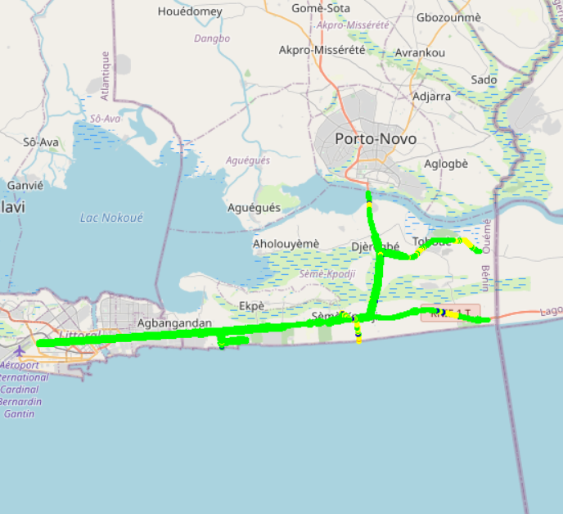
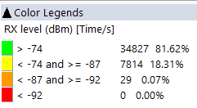
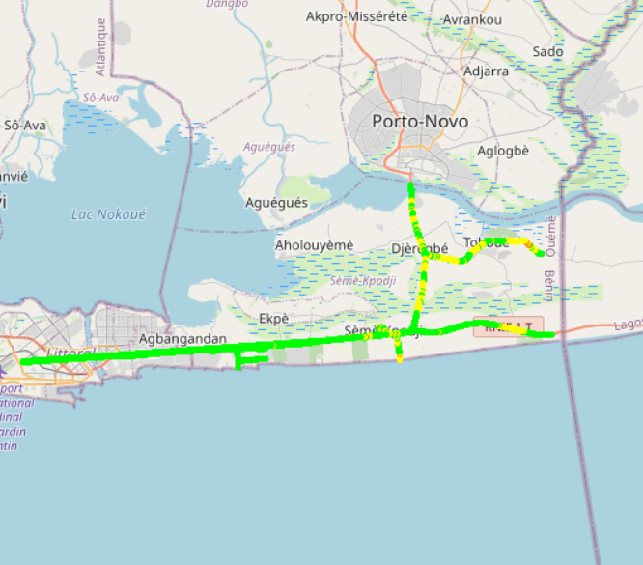

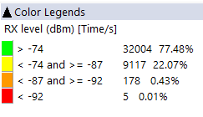
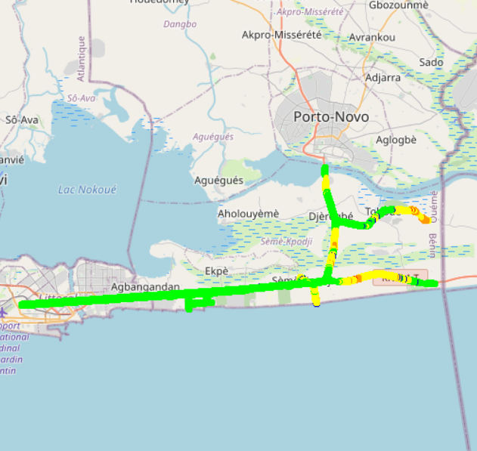


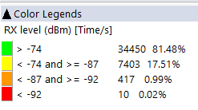
Benchmarking: 2G coverage - Maps
MTN’s 2G coverage is better than MOOV’s and CELTISS’s.

Slide 29
Benchmarking: 3G coverage
MTN’s 3G coverage meets ARCEP requirements and is closely similar with competitors.

Slide 30
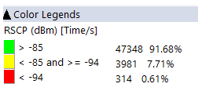
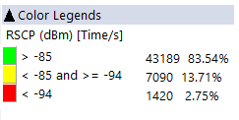
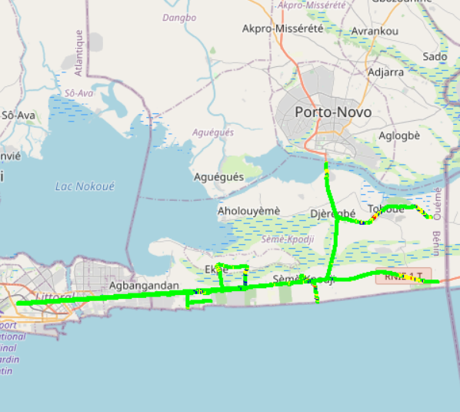
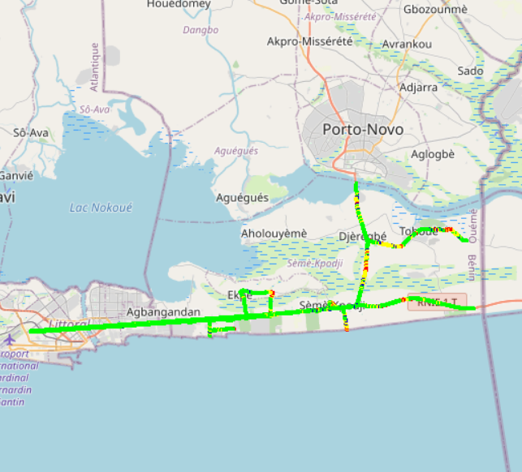
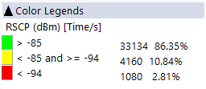
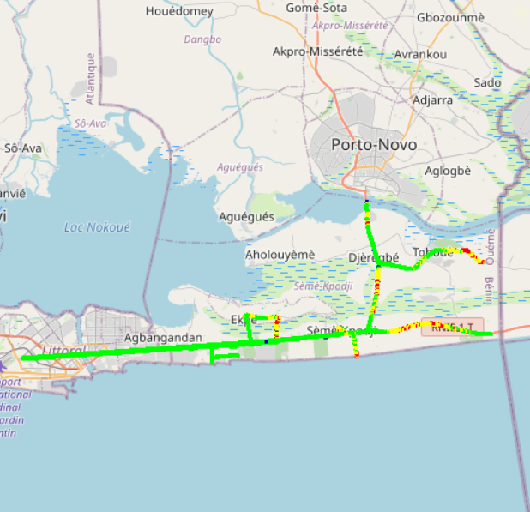

Benchmarking: 3G coverage-Maps
MTN’s 3G coverage is better than MOOV’s and CELTISS’s.

Slide 31
Benchmarking: 4G coverage
MTN's 4G Radio coverage meets ARCEP requirements.

Slide 32
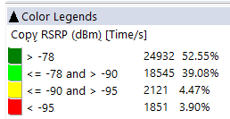
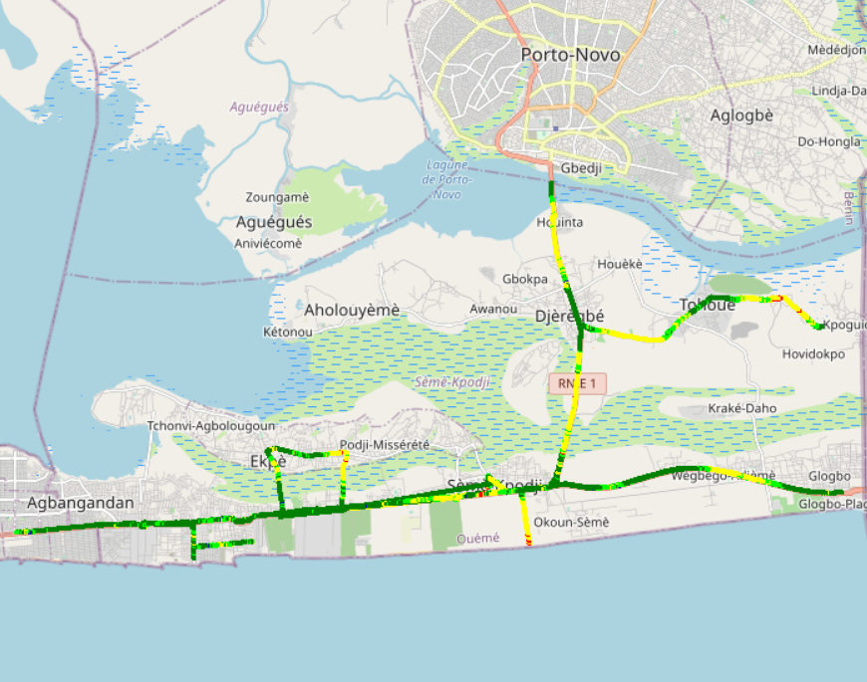
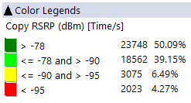
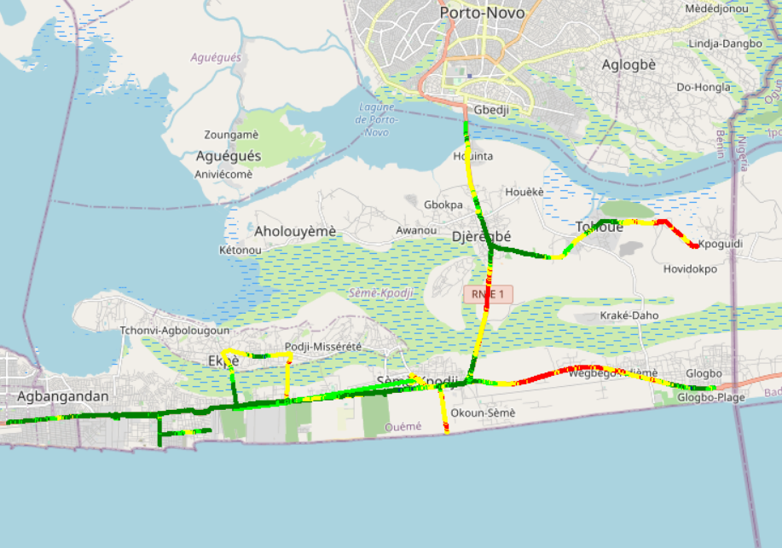
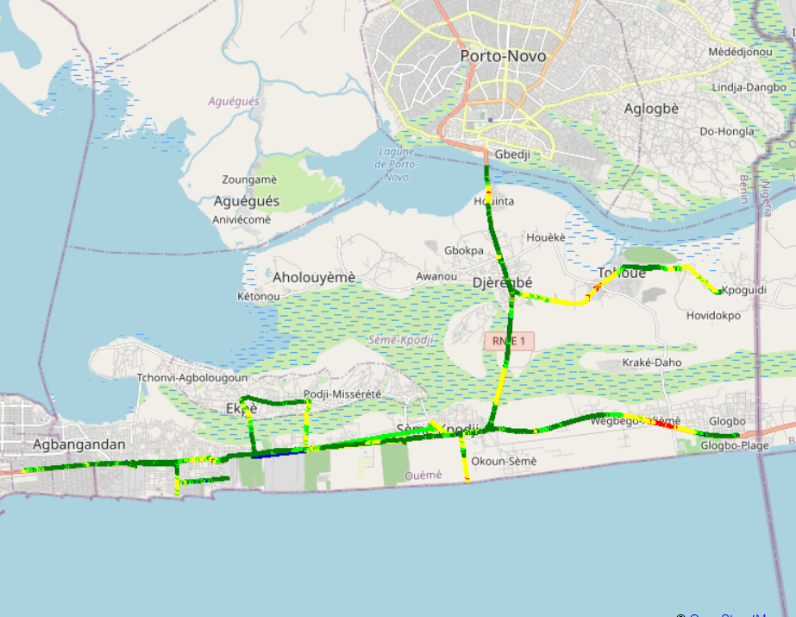
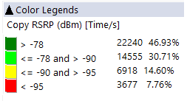

Benchmarking – 4G coverage - Maps
MTN’s 4G coverage is better than MOOV’s and CELTISS.

Slide 33
04
Benchmarking voice service

Slide 34
Benchmarking: CS Accessibility 2G/3G BLOCKED CALLS
MTN has the best accessibility to voice service compared to competitors,
MTN exceeds slightly ARCEP requirements.

Slide 35
Benchmarking: CS Integrity Voice quality Mean Opinion Score
CELTISS has the best ratio of excellent and good Voice Quality samples compared to MTN’s and MOOV’S,MTN needs to improve its voice quality MOS by pushing CS traffic to 3G and increase 2G full rate penetration.

Slide 36
Benchmarking: CS Retainability 2G/3G DROPPED CALLS
MTN and CELTISS satisfy ARCEP thresholds regarding Call Drop Rate.

Slide 37
Benchmarking Voice service Band usage(%)
MTN has 40% of voice calls carried by 2G,
CELTISS and MOOV have more than 98% of voice calls carried by 3G,
Recommended for MTN to reduce 2G utilization and increase 3G penetration for better audio quality.
MTN's 2G band usage: 76,57% GSM 900 and 23,43% GSM 1800 Mhz,
3G band usage: MTN uses mainly UMTS2100, CELTISS uses mainly UMTS900 and MOOV has an equitable utilization for both bands U2100 and U900.

Slide 38
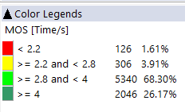
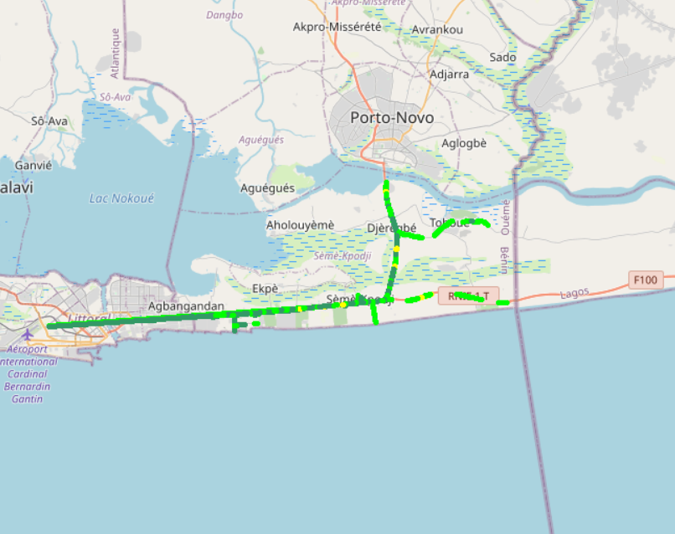
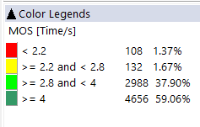

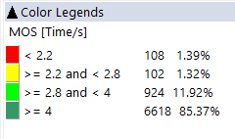
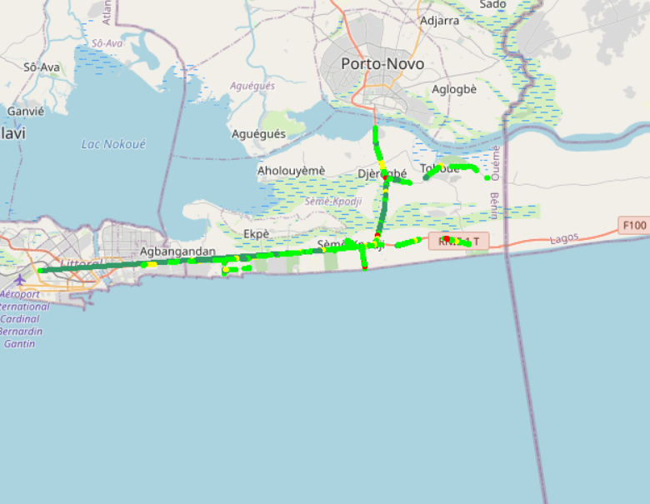
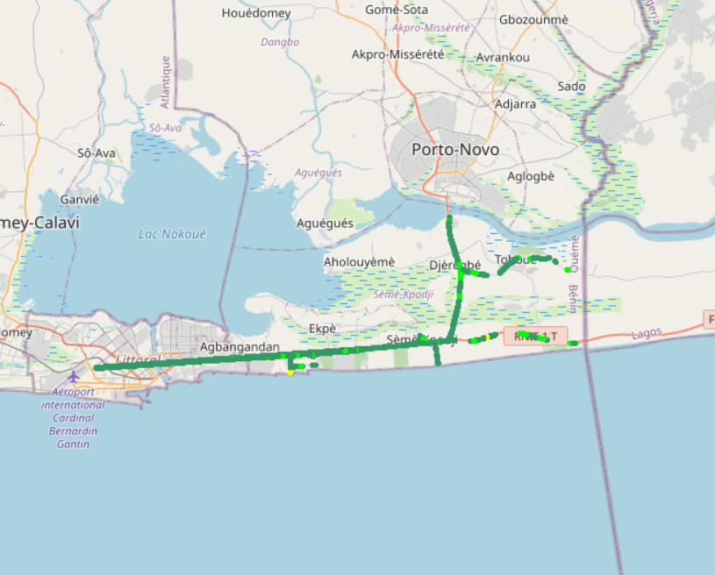
Benchmarking – CS Integrity Voice quality maps (MOS)
MTN has around 4% of MOS samples lower than 2.2,
Values lower than 2,2 pose risk of bad users perceived voice quality
3d

Slide 39
Benchmarking: Radio parameters EC/NO comparison
12,35% of drive test samples are showing a very low level of EcNo for 3G MTN.
This is correlated to the number of 3G carriers : MTN is using 2 carriers against 3 and 4 for CELTISS and MOOV respectively. Also3G traffic is carried mainly by U2100 for competitors while it’s distributed over U900 and U2100 for MTN.

Slide 40
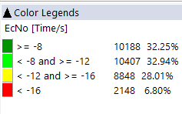
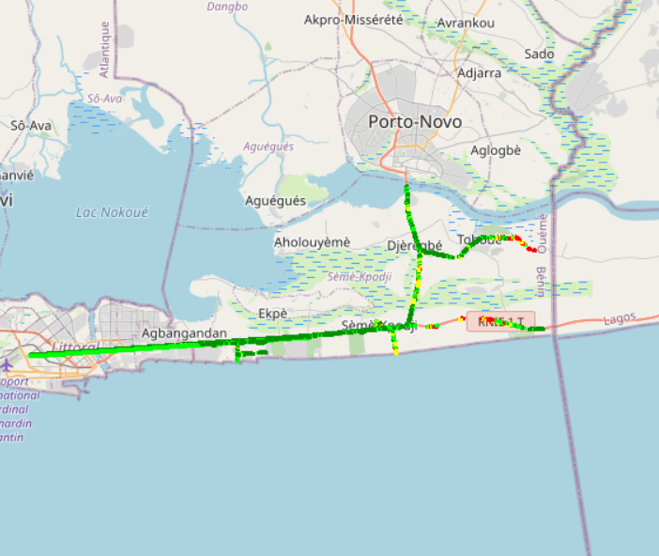
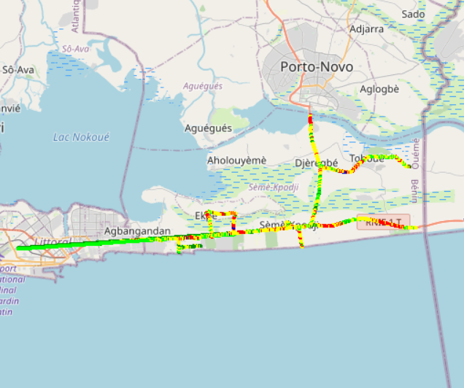
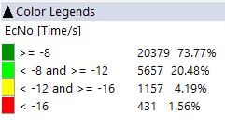
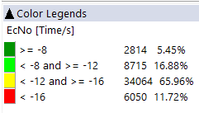
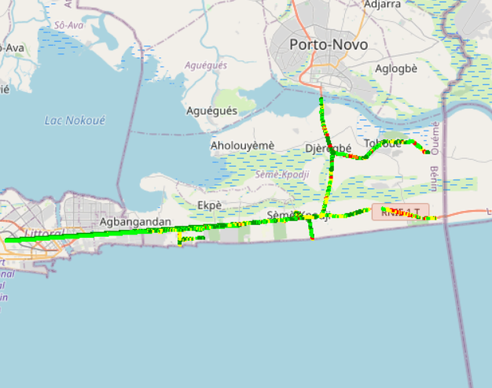

Benchmarking: Radio parameters EC/NO
3G MOOV’s and CELTISS’s EC/N0 is better than MTN’s due to the number of 3G used carriers .

Slide 41
Benchmarking – SINR comparison
Drive tests are showing a acceptable level of MTN Network SINR.

Slide 42
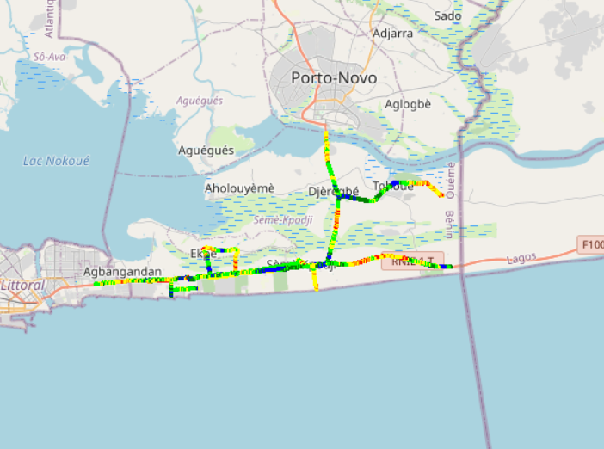
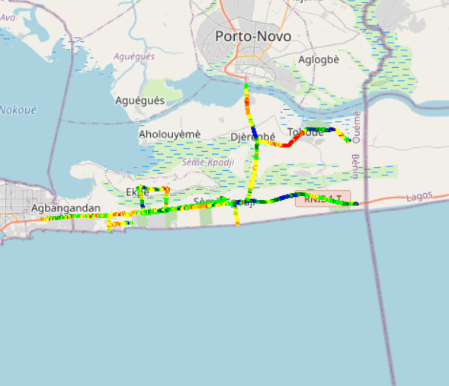
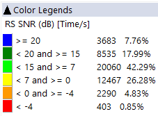
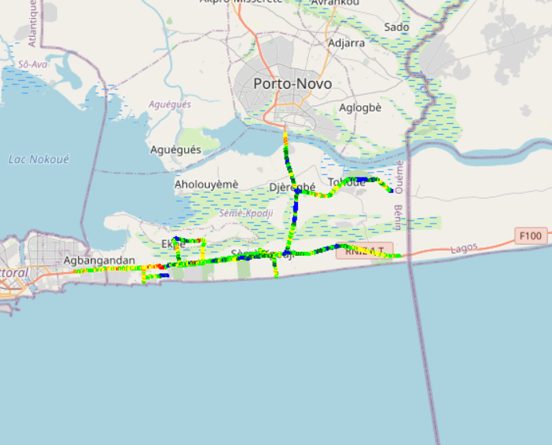
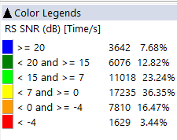
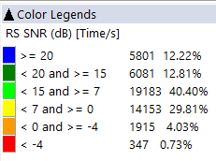

Benchmarking – SNIR comparison map
4G CELTISS has the better Signal of quality compared to MTN’s and MOOV’s.

Slide 43
Benchmarking – 2G/3G CALL SETUP TIME
MTN has the best Call setup time.

Slide 44
Benchmarking – CALL SETUP TIME/Call Mode
MTN has the best 4G CSBF Call setup Time,
Call setup time 2G is higher than in 3G/4G.

Slide 45
Benchmarking – SMS SENDING FAILURE
CELTISS SMS SETUP/RESPONSE is better than MTN’s & MOOV’s. SMS service KPIs of the three operators are not compliant with the ARCEP requirements because of the 6s criteria.

Slide 46
04
Benchmarking Data service

Slide 47
Benchmarking – DATA 3G
All operators have a good rate of successful Internet connection

Slide 48
Benchmarking – DATA 3G
All operators have very good web service success rate. MTN have high PS connection setup time

Slide 49
Benchmarking – DATA 3G
All operators have good downlink and uplink FTP success rate.

Slide 50
Benchmarking – 3G FTP MEAN THROUGHPUT
MTN 3G Throughput DL/UL is less than MOOV’s and CELTISS’s
MTN FTP DL AVERAGE Throughout is less than MOOV and CELTISS DL Throughout
DL Throughput mean for all operators satisfies ARCEP thresholds
MTN FTP UL AVERAGE Throughout is less than CELTISS’s MOOV’s
UL Throughput mean for all operators satisfy ARCEP thresholds

Slide 51
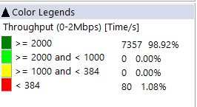
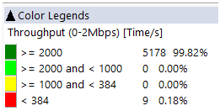
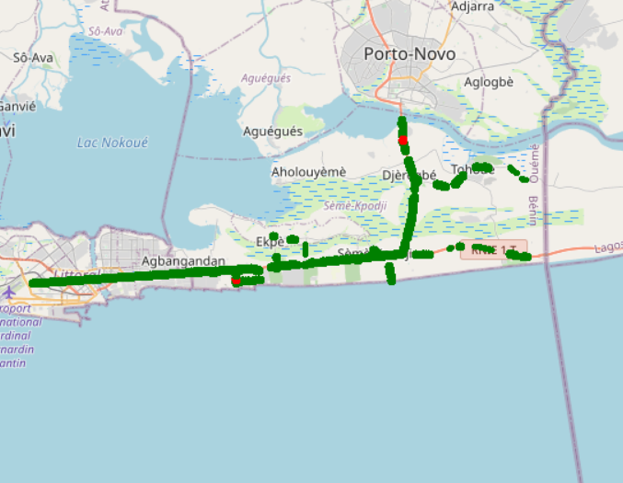
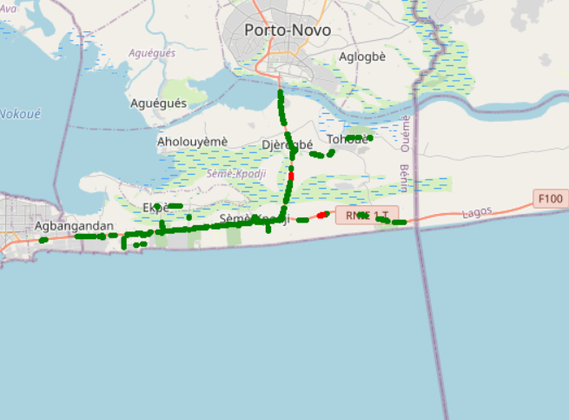
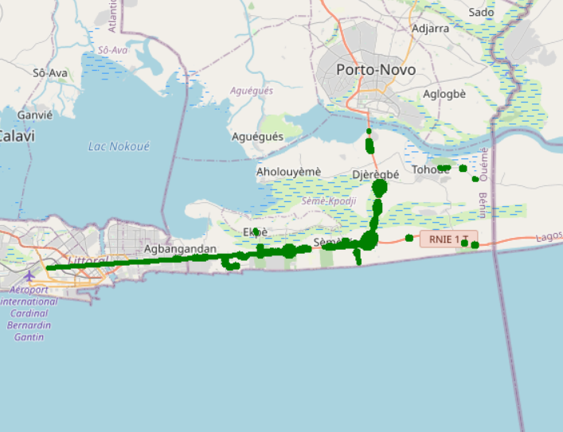
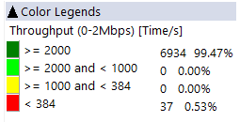

Benchmarking – 3G FTP MEAN THROUGHPUT comparison map
MTN Throughput distribution is very close to MOOV & CELTISS.

Slide 52
Benchmarking – 4G HTTP Browsing
All operators have very good HTTP Browsing success rate.

Slide 53
Benchmarking – 4G FTP THROUGHPUT comparison
All operators have acceptable FTP success rate.

Slide 54
Benchmarking – 4G FTP THROUGHPUT comparison
MTN FTP DL AVERAGE Throughput is better than CELTISS. MTN FTP UL AVERAGE Throughput is better than MOOV & CELTISS.

Slide 55
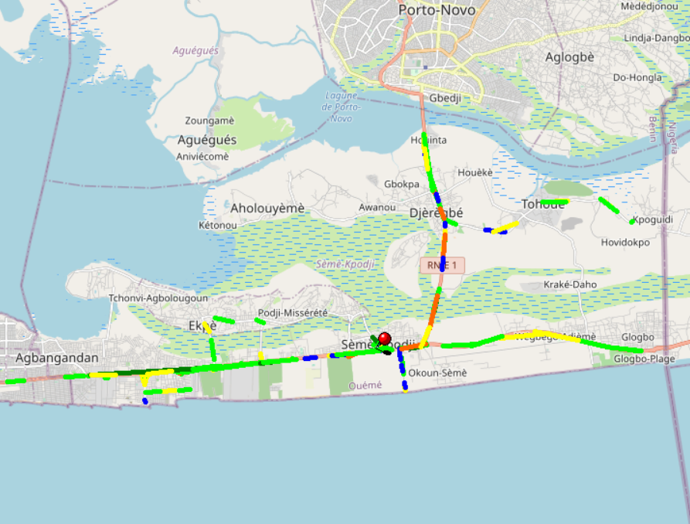
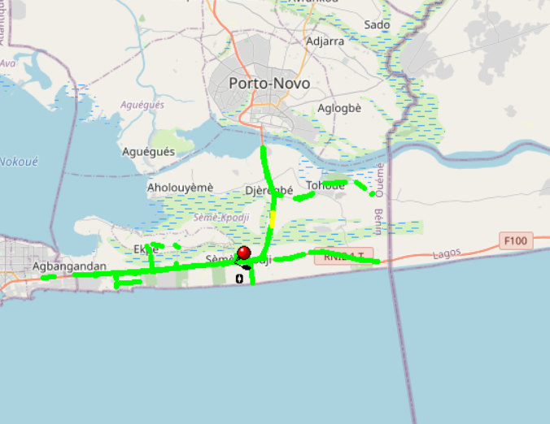
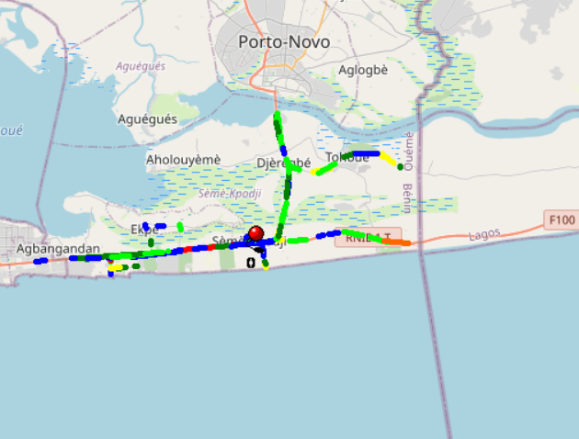
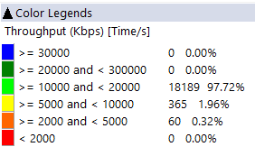
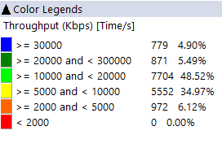
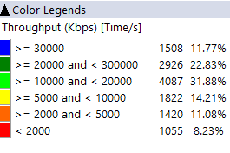
Benchmarking – 4G FTP THROUGHPUT comparison map
MOOV’s average throughput DL rate is better than MTN and CELTISS.

Slide 56
Benchmarking – BAND and TECHNOLOGY UTILISATION
Most of MTN LTE samples in Cotonou are in 2600 band.
Most of MOOV LTE samples in Cotonou are in 800 band and 2600 band.
Most of MOOV LTE samples in Cotonou are in 1800 band.
Usage of 3G U900 is very low for competitors.

Slide 57
Benchmarking – Data TECHNOLOGY Usage(%)
MTN has the highest LTE CA Carrier Aggregation usage.
HSDPA-DC not used for MTN.

Slide 58

Deloitte fait référence à un ou plusieurs cabinets membres de Deloitte Touche Tohmatsu Limited, société de droit anglais (« private company limited by guarantee »), et à son réseau de cabinets membres constitués en entités indépendantes et juridiquement distinctes. Pour en savoir plus sur la structure légale de Deloitte Touche Tohmatsu Limited et de ses cabinets membres, consulter www.deloitte.com/about.
Fort d’un réseau de firmes membres dans plus de 150 pays, Deloitte allie des compétences de niveau international à des expertises locales pointues, afin d’accompagner ses clients dans leur développement partout où ils opèrent. Nos 264 000 professionnels sont animés par un objectif commun, faire de Deloitte la référence en matière d’excellence de service.
Au Bénin, Deloitte mobilise un ensemble de compétences diversifiées pour répondre aux enjeux de ses clients, de toutes tailles et de tous secteurs – des grandes entreprises multinationales aux microentreprises locales, en passant par les entreprises moyennes.
Le présent document et ses annexes sont confidentiels et réservés à l’usage interne exclusif du destinataire. Toute reproduction ou toute divulgation partielle ou totale à des tiers en est interdite, sauf accord écrit préalable de Deloitte Bénin.
© 2019 Deloitte Bénin SARL. Société du réseau Deloitte

