Slide 1


Network QoS
Benchmarking report ALL ROADS
November 30th, 2023

Slide 2
Summary
Scope of Intermediate Report | 3
Executive Summary | 5
Benchmarking Key Results | 11
Benchmarking Coverage | 16
Benchmarking Voice Service | 23
Benchmarking Data Service | 33

Slide 3
01
Introduction: Scope of Benchmarking Report «

Slide 4
Intermediate report
Scope of this report
  1. Network benchmarking results for the ALL ROADS area between MTN, MOOV, and CELTISS from September 9th to October 31th, 2023..

Slide 5
02
Benchmarking Executive Summary

Slide 6
Executive Summary – Benchmarking coverage 2G/3G/4G
MTN has outperformed its competitors in terms of 2G coverage for outdoor and Indoor morphologies ,
For 2G RF coverage, Only MTN meets ARCEP obligation for all morphologies,
MTN is leading in terms of 3G coverage rate with (94,09%) against (86,16%) for CELTISS and (88,98%) for MOOV
Only MTN meets ARCEP 3G coverage obligation
MTN is in the second position in terms of 4G coverage rate for Incar and Outdoor morphologies but meets ARCEP thresholds,
All operators failed to satisfied the ARCEP threshold for indoor coverage for 4G network.
TECHNOLOGY
KEY RECOMMENDATIONS
KEY FINDINGS
Coverage 2G/3G/4G
Tune and align power settings mainly in 3G/4G. Actual setting may impact the coverage strength specially at Indoor locations
Review the design at the coverage and quality blackspots
We highlight that 4G ARCEP coverage Thresholds are aggressive
* Final recommendations will be shared in the final report including details and findings from ongoing Configuration Audit

Slide 7
Executive Summary – Benchmarking voice service 2G/3G
further
TECHNOLOGY
Accessibility: MTN is leading in terms of accessibility to voice service by having the best Call Blocked ratio with 0,58% against 0,86% for MOOV and 0,84% for CELTISS,
All operators failed to meet ARCEP accessibility thresholds,
Retainability: MTN is ranked first in term of retainability better than MOOV and CELTISS,
MTN's Call Drop Rate is 0.38% compared to 0.78% for CELTISS and 0.55% for MOOV.All operators meet ARCEP retainabilty requirements,
Integrity: MTN is in second position in terms of voice quality with average Mean Opinion Score equal to 4,02 lower than MOOV 4,21 and better than CELTISS 3,94
In LOKOSSA the MTN’s MOS value is better than other area, because the voice quality is carried out mainly over 3G unlike other areas .
KEY RECOMMENDATIONS
KEY FINDINGS
Voice service 2G/3G
Voice quality is always better in 3G due to its better codec rate , we recommend to push as much as possible the voice traffic to 3G,
Drive test results are showing that MTN has a bad Ec/No, by improving this radio parameter we can improve further the voice quality MOS.

Slide 8
Executive Summary – Benchmarking SMS service
TECHNOLOGY
KEY RECOMMENDATIONS
KEY FINDINGS
SMS service 2G/3G
There is no issue in radio accessibility that could be correlated to the SMS high delivery time.
End to End investigation need to be performed to analyses the high delivery time including mainly Core/SMS parts: SM Sserver...
* Final recommendations will be shared in the final report including details and findings from ongoing Configuration Audit
All operators failed to meet ARCEP for SMS Send Success with End To End Delivery Time who should be less than < 6 sec as defined by ARCEP.
MTN is better than MOOV and lower than CELTISS.

Slide 9
Executive Summary – Benchmarking 4G Data service
Performance is stable in terms of accessibility for 4G data service, and all operators meet ARCEP's requirements.
MTN is leading in terms of 4G DL throughput with 57.41Mbps, better than MOOV 27.51Mbps and CELTISS 12.93Mbps.
MTN is ranked first in terms of 4G UL throughput with 18.74Mbps, as opposed to 13.53Mbps for MOOV and 11.47Mbps for CELTISS.
For 4G network, all operators meet ARCEP’s End User Throughput obligation in download and upload.
TECHNOLOGY
KEY RECOMMENDATIONS
KEY FINDINGS
Data service 4G
In LOKOSSA, MTN has an excellent performance in term of 4G KPIs.

Slide 10
Executive Summary – Benchmarking 3G Data service
Performance is stable in terms of accessibility for 3G data service, and all operators meet ARCEP's requirements.
MTN is in third position for 3G DL throughput with 2.2Mbps, compared to 4.62Mbps for CELTISS and 3.33Mbps for MOOV.
MTN is ranked second in term of 3G UL throughput with 1.04 Mbps against 1.01 Mbps for MOOV and 2.15Mbps for CELTISS,
All operators meets ARCEP’s 3G End User Throughput obligation for download and upload.
All operators meet ARCEP’s web browsing service accessibility thresholds.
TECHNOLOGY
KEY RECOMMENDATIONS
KEY FINDINGS
Data service 3G
Its recommended to push as much as possible the data traffic to 4G in order to:
- Improve end user perception, Both DT and stats are showing that users in average are served with an excellent throughput in 4G,
- Offload the 3G network which will improve the 3G throughput and the 3G radio quality
Increasing the utilization of 3G data technology HSPA-DC can improve 3G throughput,
Some features and parameters need to be tuned and aligned
To ensure that no throughput limitation is applied on users profiles

Slide 11
03
Benchmarking Key Results

Slide 12
Benchmarking Key Results – Coverage
MTN, MOOV, and CELTISS have similar 2G and 3G coverage, but MTN's 4G coverage is lower than that of MOOV and CELTISS. The expansion of the 4G network is necessary in Cotonou to match MOOV's coverage
KPI |  | ARCEP Threshorlds | MTN |  | MOOV |  | CELTISS |  | MTN Ranking
 |  |  | Value | Conformity | Value | Conformity | Value | Conformity
2G Coverage Rate | Incar | More than 90% with Incar: Rxlev >-87 dBm | 79,37% | NOK | 82,94% | NOK | 75,36% | NOK | 2
 | Outdoor | More than 90% with Outdoor: Rxlev >-92 dBm | 87,70% | NOK | 91,34% | OK | 87,60% | NOK | 2
 | Indoor | More than 90% with Outdoor: Rxlev >-74 dBm | 64,56% | NOK | 65,42% | NOK | 57,95% | NOK | 2
3G Coverage Rate | Incar,Indoor,Outdoor | More than 90% with RSCP <-85 dBm | 62,65% | NOK | 68,50% | NOK | 65,52% | NOK | 3
4G Coverage Rate | Incar | More than 90% with RSRP <-90 dBm* | 57,40% | NOK | 55,43% | NOK | 49,51% | NOK | 1
 | Outdoor | More than 90% with RSRP <-95 dBm* | 81,20% | NOK | 73,78% | NOK | 67,63% | NOK | 1
 | Indoor | More than 90% with RSRP <-78 dBm* | 28,99% | NOK | 28,35% | NOK | 25,32% | NOK | 1

Slide 13
Benchmarking Key Results – 2G/3G voice and SMS Summary
MTN network in retainability CDR (%) meets ARCEP requirements,
MTN is leading in accessibility but slightly exceeds ARCEP threshold,
MTN needs to improve its Voice Quality MOS and SMS Send duration.
KPI | ARCEP Threshorlds | MTN |  | MOOV |  | CELTISS |  | MTN Ranking
 |  | Value | Conformity | Value | Conformity | Value | Conformity
Accesibility: Blocking rate | <1% | 5,88% | NOK | 7,64% | NOK | 9,58% | NOK | 1
Retainability: Call drop rate | <1% | 6% | NOK | 10,32% | NOK | 9,56% | NOK | 1
Call Completetion Rate (%) | =<98% | 88,12% | NOK | 82,04% | NOK | 80,86% | NOK | 1
Integrity: Voice quality | Note requise> 2,8 | 3,79 | OK | 3,95 | OK | 3,91 | OK | 2
SMS sending success rate % (E2E delivery Time<6 sec) | >99% | 92,20% | NOK | 89,50% | NOK | 91,12% | NOK | 1
SMS receving success rate % | >99% | 90,09% | NOK | 88,14% | NOK | 90,67% | NOK | 1

Slide 14
Benchmarking Key Results – 3G Data Summary
MTN network in 3G DATA meets ARCEP requirements.
Services | KPI | ARCEP Threshorlds | MTN |  | MOOV |  | CELTISS |  | MTN Ranking
 |  |  | Value | Conformity | Value | Conformity | Value | Conformity
3G HTTP | Successful internet connexion rate | >96% | 95,25% | NOK | 91,22% | NOK | 93,47% | NOK | 1
 | Connexion setup time | <=10sec | 7,29 | OK | 8,30 | OK | 8,77 | OK | 1
 | Web service failure rate | <3% | 6,67% | NOK | 12,11% | NOK | 11,7% | NOK | 1
3G FTP | FTP failure rate UL/DL | <3 % | 4,58%/6,08% | NOK | 6,34%/2,27% | NOK/OK | 1,32%/7,04% | OK/NOK | 2
 | FTP Data transmission average (DL) | >= 2Mbps | 4,432 | OK | 3,134 | OK | 5,867 | OK | 2
 | FTP Data transmission average (UL) | >= 1Mbps | 1,867 | OK | 1,352 | OK | 1,792 | OK | 1

Slide 15
Benchmarking Key Results – 4G Data Summary
MTN’s 4G DATA End User KPIs satisfy ARCEP requirements,
MTN is ranked second in 4G DL THP after MOOV’s ,
MTN is outperforming MOOV’s & CELTISS in 4G UL THP.
Services | KPI | Threshorlds* | MTN |  | MOOV |  | CELTISS |  | MTN Ranking
 |  |  | Value | Conformity | Value | Conformity | Value | Conformity
4G HTTP Browsing | Web service failure rate (%) | <3% | 2,92% | OK | 3,67% | NOK | 4,74% | NOK | 1
 | Connexion setup time | <=3sec | 1,37 | OK | 1,48 | OK | 1,52 | OK | 1
4G FTP | FTP failure rate UL/DL | <3 % | 0,59%/6,87% | OK/NOK | 6,74%/9,21% | NOK | 12,5%/8,97% | NOK | 1
 | FTP Data transmission average (DL) | 4G >= 5 Mbps | 39,681 | OK | 10,525 | OK | 10,351 | OK | 1
 | FTP Data transmission average (UL) | 4G: >= 2Mbps | 13,135 | OK | 7,045 | OK | 9,103 | OK | 1

Slide 16
04
Benchmarking 2G/3G/4G coverage

Slide 17
Benchmarking: 2G coverage
All operators failed to meet ARCEP thresholds except CELTIIS IN outdoor.

Slide 18
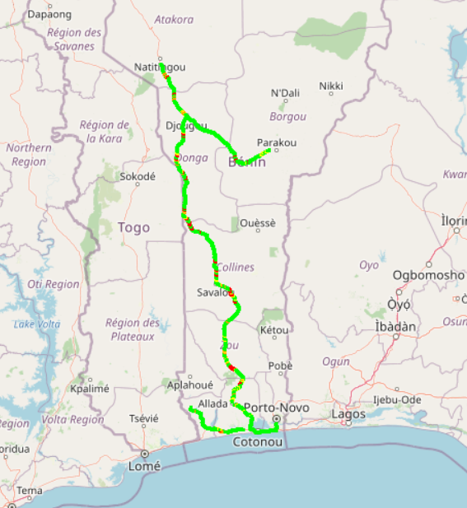
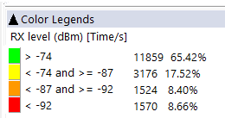
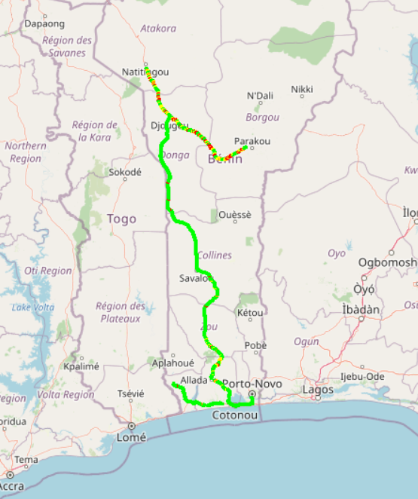
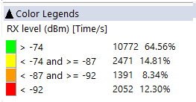



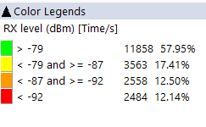
Benchmarking: 2G coverage - Maps
MTN’s 2G coverage is very close than MOOV’s and better than CELTISS’s.

Slide 19
Benchmarking: 3G coverage
All operators failed to meet ARCEP thresholds.

Slide 20
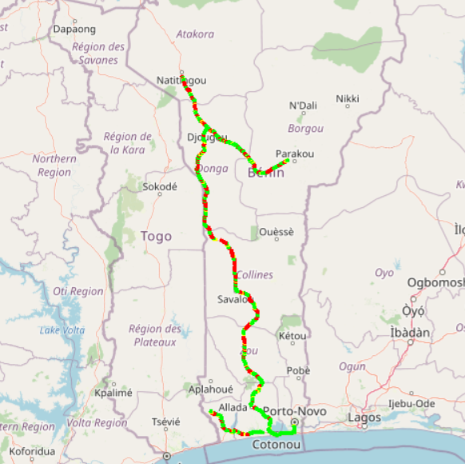

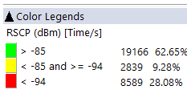
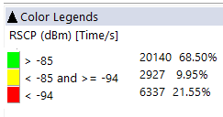
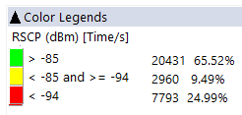
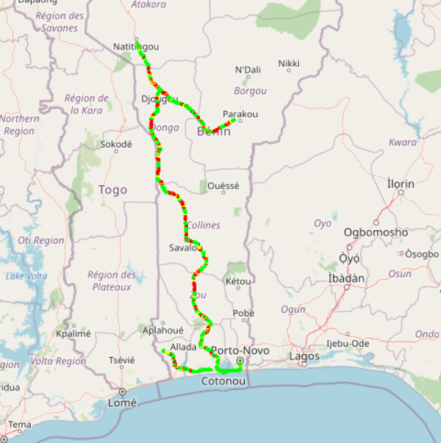
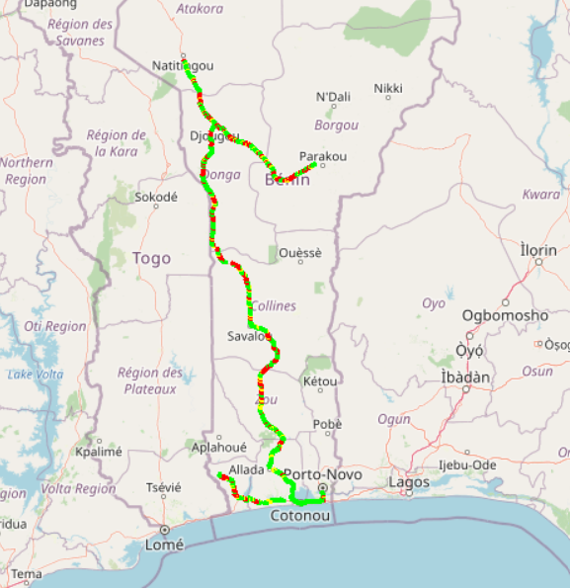
Benchmarking: 3G coverage-Maps
MTN’s 3G coverage is lower than CELTISS’s and MOOV’s.

Slide 21
Benchmarking: 4G coverage
All operators failed to meet ARCEP thresholds.

Slide 22
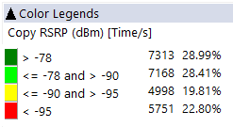
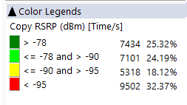
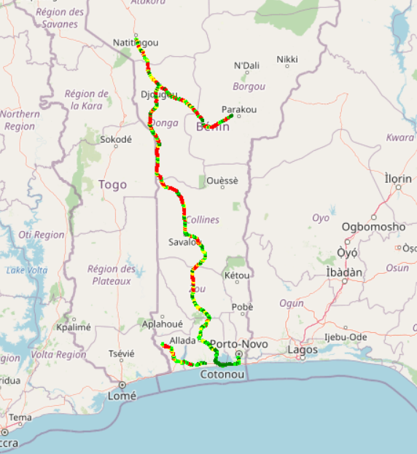
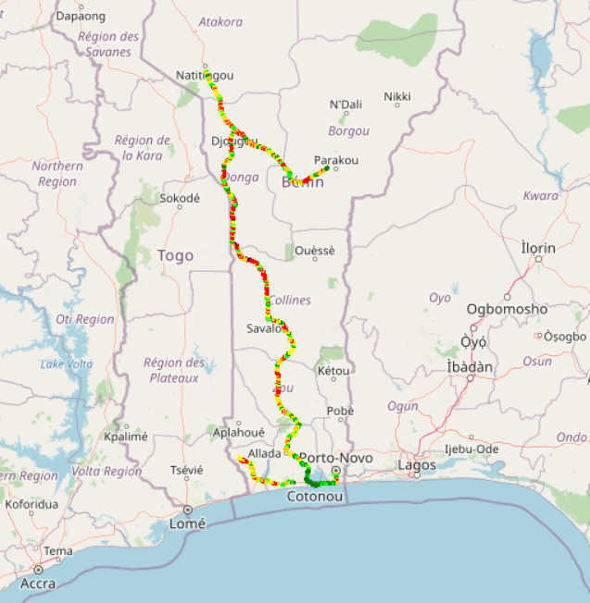

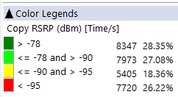
Benchmarking – 4G coverage - Maps
MTN’s 4G coverage is better than MOOV’s and CELTISS.

Slide 23
04
Benchmarking voice service

Slide 24
Benchmarking: CS Accessibility 2G/3G BLOCKED CALLS
MTN has the best accessibility to voice service compared to competitors,
All operators failed to meet ARCEP thresholds.

Slide 25
Benchmarking: CS Retainability 2G/3G DROPPED CALLS
All operators failed to meet ARCEP thresholds.

Slide 26
Benchmarking Voice service Band usage(%)
All operators have more than 88% of voice calls carried out over 3G,
All operators use mainly UMTS900 band.

Slide 27
Benchmarking: CS Integrity Voice quality Mean Opinion Score
MOOV has the lower ratio of excellent and good Voice Quality samples compared to MTN’s and CELTISS’S,MTN needs to improve its voice quality MOS by pushing CS traffic to 3G and increase 2G full rate penetration.

Slide 28
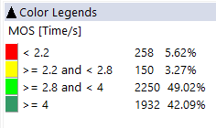
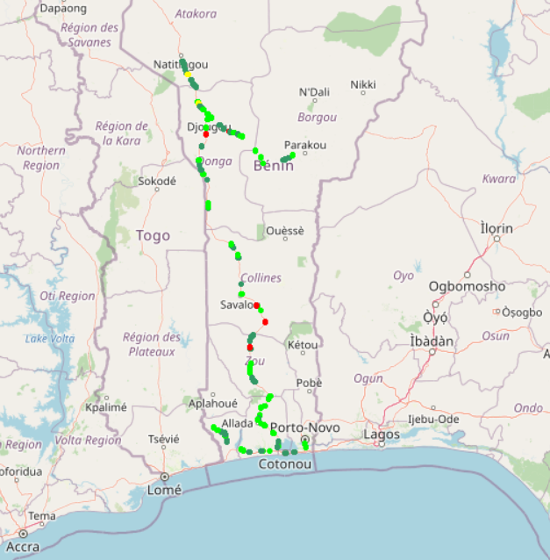
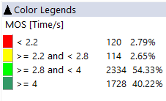

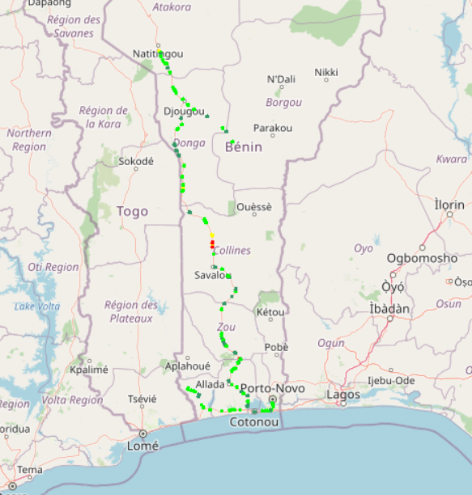
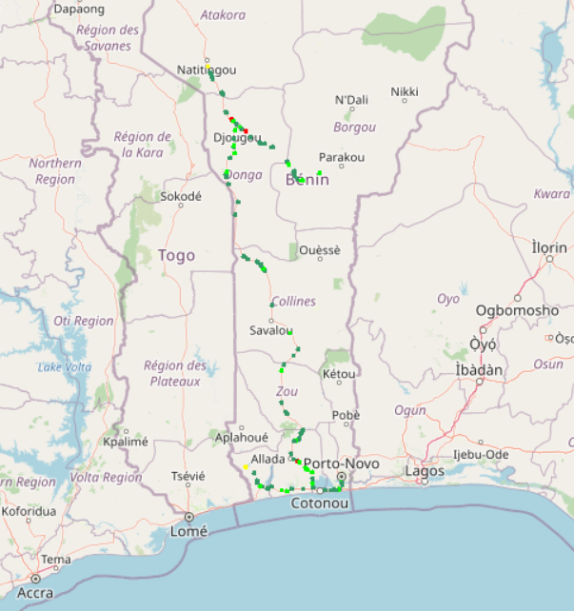
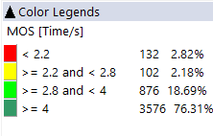
Benchmarking – CS Integrity Voice quality maps (MOS)
In All roads, MTN has the lower ratio of excellent and good Voice Quality samples compared to CELTISS’s and MOOV’S. MTN is ranked third in terms of voice quality with an average MOS equal to 3,79 opposed to 3,95 for MOOV and 3,91 for CELTISS.
3d

Slide 29
Benchmarking: Radio parameters EC/NO comparison
18,57% of drive test samples are showing a very low level of EcNo for 3G MTN MOOV with 18,57% and CELTISS with 23,55%.

Slide 30
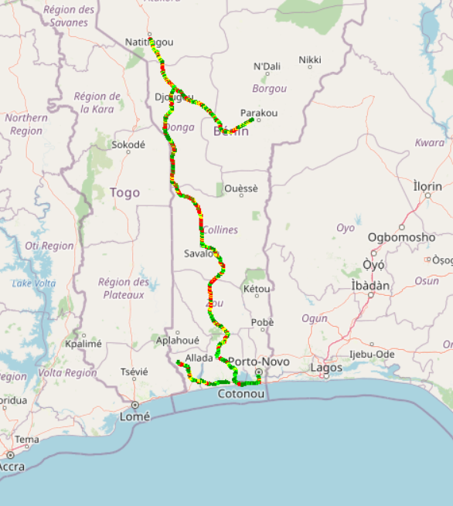
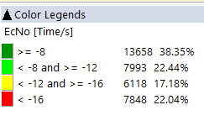
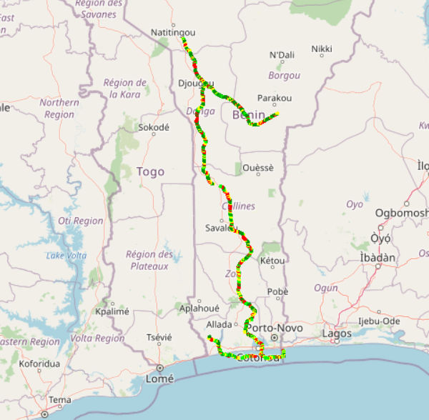
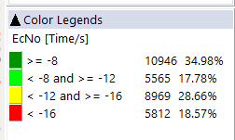
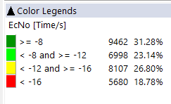
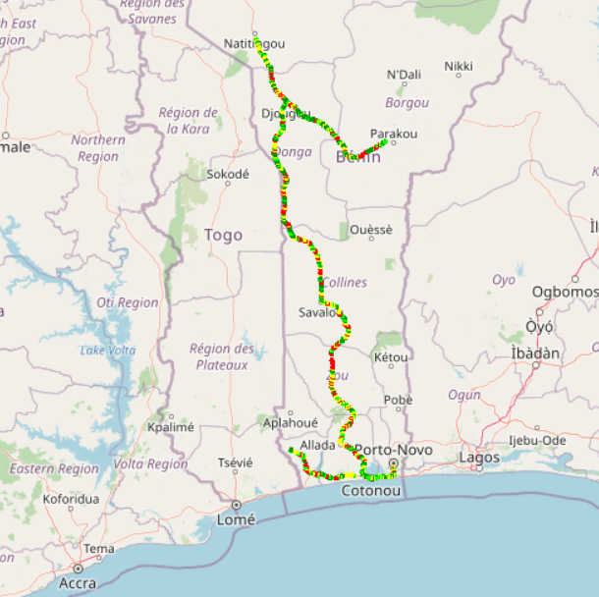
Benchmarking: Radio parameters EC/NO
MTN has the highest ratio of very bad Ec/No samples (<-16db).

Slide 31
Benchmarking – 2G/3G CALL SETUP TIME
MTN is clear leader in terms of Call Setup Time.

Slide 32
Benchmarking – SMS SENDING FAILURE
MTN’s SMS SEND/RECEIVE SR(%) is better than MOOV and less than CELTISS . SMS service KPIs for all operators are not compliant with the ARCEP requirements due to the timeout of sending duration (< 6s).

Slide 33
04
Benchmarking Data service

Slide 34
Benchmarking – DATA 3G
All operators failed to meet ARCEP thresholds.

Slide 35
Benchmarking – DATA 3G
MTN has the lowest HTTP browsing success, All operators failled to meet ARCEP requirement for web service.

Slide 36
Benchmarking – DATA 3G
Only CELTISS meet ARCEP requirements for FTP DL success ratio.
Only MOOV meet ARCEP requirements for FTP UL success ratio.

Slide 37
Benchmarking – 3G FTP MEAN THROUGHPUT
MTN 3G Throughput DL is better than MOOV’s and CELTISS’s.
MTN 3G Throughput UL is better than MOOV’s and less than CELTISS’s.
All operators meet ARCEP thresholds.

Slide 38
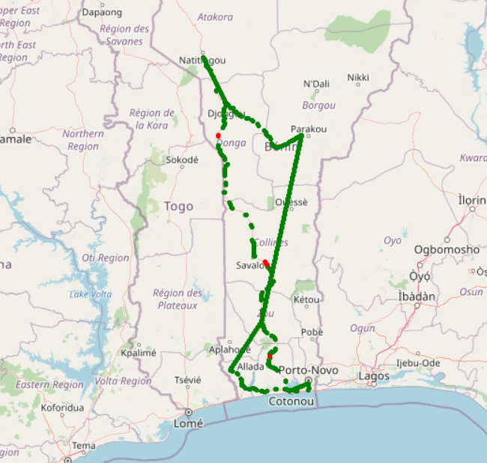

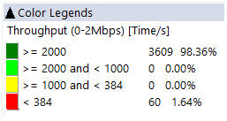
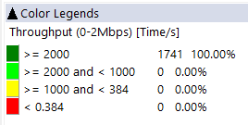
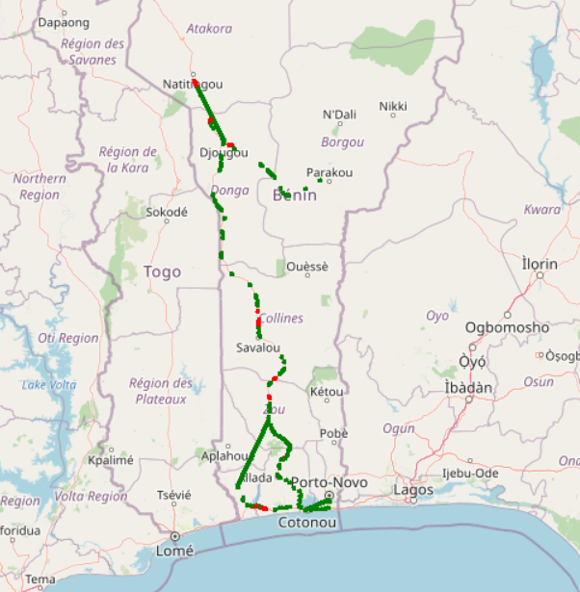
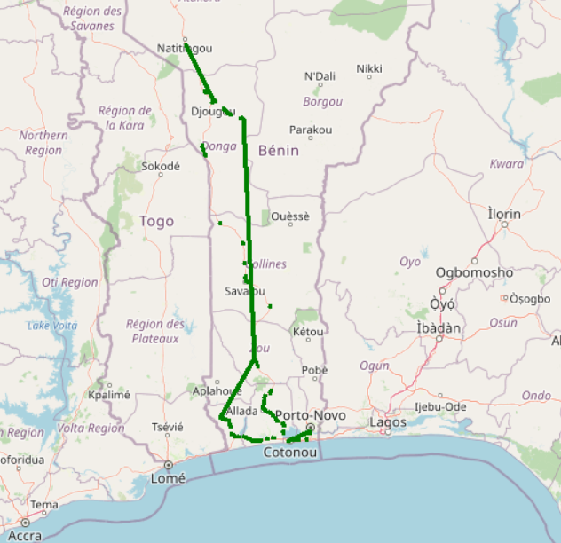
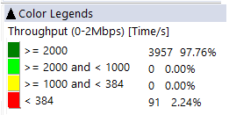
Benchmarking – 3G FTP MEAN THROUGHPUT comparison map
MTN Throughput distribution is better to MOOVand less than CELTISS.

Slide 39
Benchmarking – 4G HTTP Browsing
MTN’s HTTP Browsing success rate is best than MOOV’s and CELTISS’s.
Only MTN meets ARCEP threasholds.

Slide 40
Benchmarking – 4G FTP THROUGHPUT comparison
Only MTN meets ARCEP threasholds in FTP succes rate DL.
All operetors failled to meet ARCEP threasholds in FTP succes rate UL.

Slide 41
Benchmarking – 4G FTP THROUGHPUT comparison
MTN FTP DL AVERAGE Throughput is better than CELTISS. MTN FTP UL AVERAGE Throughput is better than MOOV & CELTISS.

Slide 42
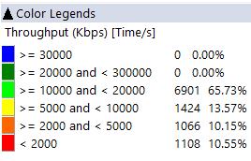
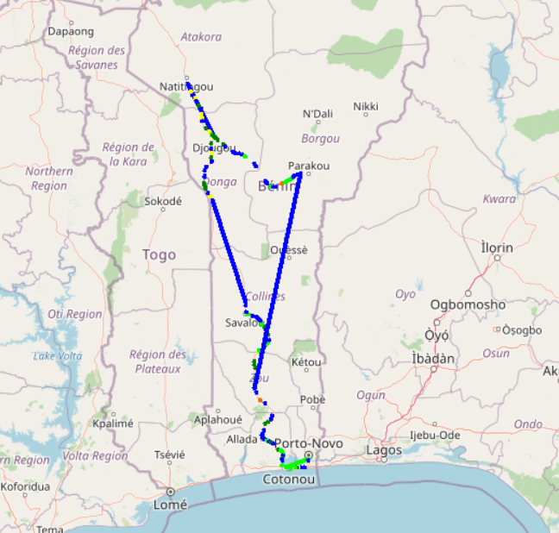
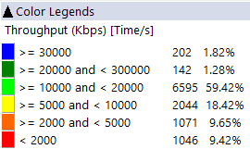
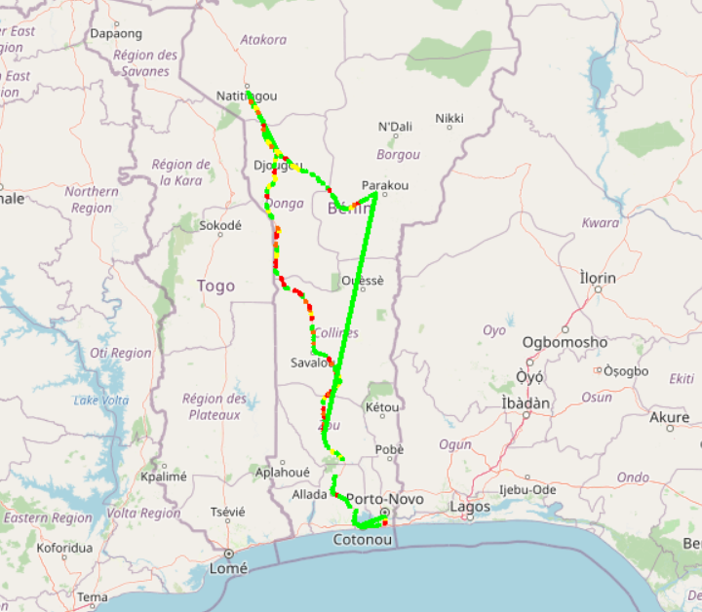
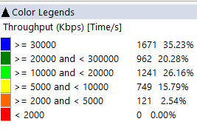
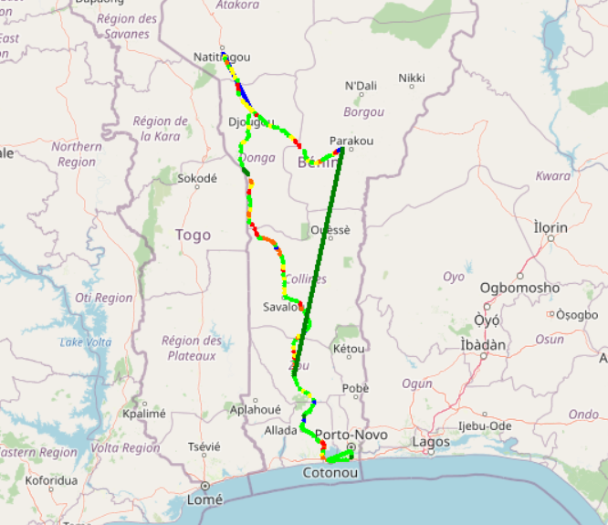
Benchmarking – 4G FTP THROUGHPUT comparison map
In LOKOSSA, MTN has an excellent end user throughput with more than 35,23% of samples better than 30Mbps .

Slide 43
Benchmarking – BAND and TECHNOLOGY UTILISATION
Most of MTN’s LTE samples are carried out over LTE 2600 as first carrier,
Most of MOOV’s andCELTISS’s samples are carried out over LTE 800 as first carrier,
For all operators,most of 3G samples are carried out over U2100, but MOOV has the highest ratio of U900 usage.

Slide 44
Benchmarking – Data TECHNOLOGY Usage(%)
MTN has the highest LTE CA Carrier Aggregation usage with 81,79% against 46,12% for MOOV and 47,56% for CELTISS.

Slide 45
Benchmarking – SINR comparison
Drive tests are showing a acceptable level of MTN Network SINR.

Slide 46

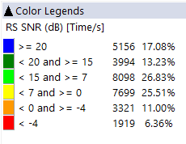
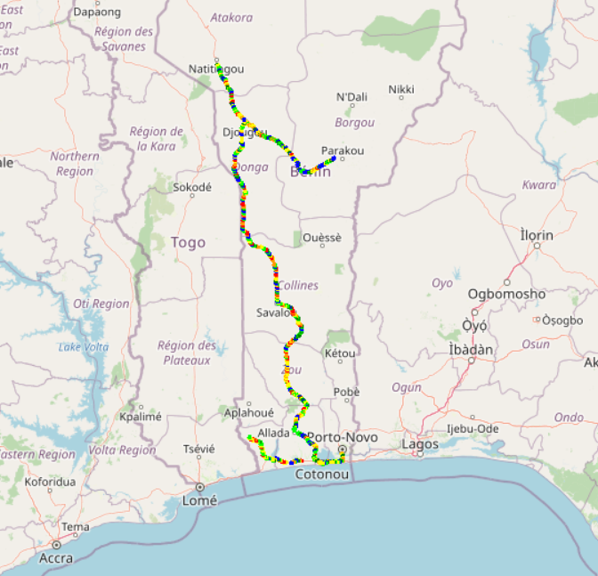
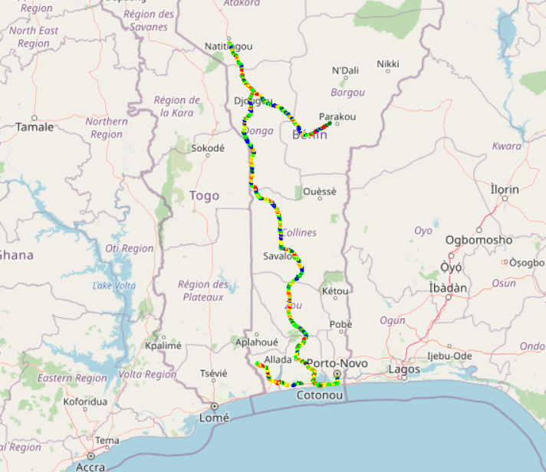
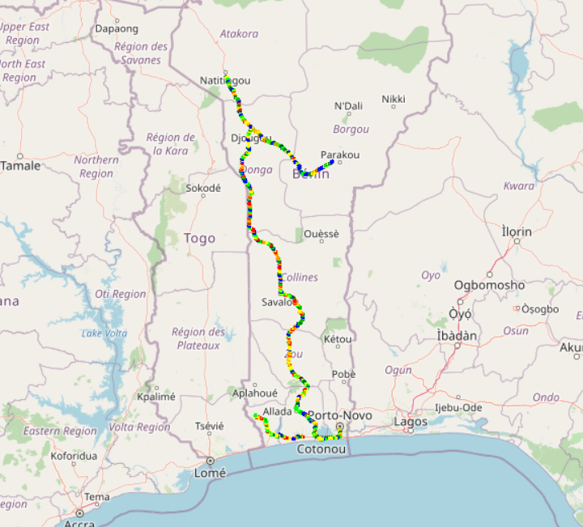
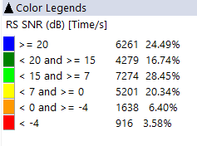
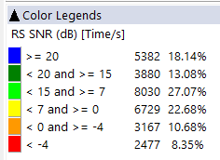
Benchmarking – SNIR comparison map
4G MTN has the better Signal of quality compared to MOOV’s and CELTISS’s.

Slide 47

Deloitte fait référence à un ou plusieurs cabinets membres de Deloitte Touche Tohmatsu Limited, société de droit anglais (« private company limited by guarantee »), et à son réseau de cabinets membres constitués en entités indépendantes et juridiquement distinctes. Pour en savoir plus sur la structure légale de Deloitte Touche Tohmatsu Limited et de ses cabinets membres, consulter www.deloitte.com/about.
Fort d’un réseau de firmes membres dans plus de 150 pays, Deloitte allie des compétences de niveau international à des expertises locales pointues, afin d’accompagner ses clients dans leur développement partout où ils opèrent. Nos 264 000 professionnels sont animés par un objectif commun, faire de Deloitte la référence en matière d’excellence de service.
Au Bénin, Deloitte mobilise un ensemble de compétences diversifiées pour répondre aux enjeux de ses clients, de toutes tailles et de tous secteurs – des grandes entreprises multinationales aux microentreprises locales, en passant par les entreprises moyennes.
Le présent document et ses annexes sont confidentiels et réservés à l’usage interne exclusif du destinataire. Toute reproduction ou toute divulgation partielle ou totale à des tiers en est interdite, sauf accord écrit préalable de Deloitte Bénin.
© 2019 Deloitte Bénin SARL. Société du réseau Deloitte

