Slide 1


Network QoS
Benchmarking report SEMEKPODJI
November23th, 2023

Slide 2
Summary
Scope of Intermediate Report | 3
Executive Summary | 5
Benchmarking Key Results | 11
Benchmarking Coverage | 16
Benchmarking Voice Service | 23
Benchmarking Data Service | 33

Slide 3
01
Introduction: Scope of Benchmarking Report

Slide 4
Intermediate report
Scope of this report
  1. Network benchmarking results for the SEME-KOPODJI area between MTN, MOOV, and CELTISS from October 12th to October 14th, 2023..

Slide 5
02
Benchmarking Executive Summary

Slide 6
Executive Summary – Benchmarking coverage 2G/3G/4G
TECHNOLOGY
MTN has outperformed its competitors in terms of 2G coverage for all morphologies Indoor, outdoor and Incar,
All operators meet ARCEP 2G coverage obligation, except for Indoor morphology,
3G MTN coverage rate is equal to 91,68%is, better than CELTISS with 86,35% and MOOV with 83,54%,
Only MTN meets ARCEP 3G coverage obligation,
4G MTN coverage rate is better than MOOV’s and CELTISS’s coverage for outdoor and Indoor morphologies,
Only MTN and CELTISS meet outdoor and incar ARCEP 4G coverage obligation however, none of the operators satisfied the indoor coverage ARCEP threshold.
KEY RECOMMENDATIONS
KEY FINDINGS
Coverage 2G/3G/4G
Tune and align power settings mainly in 3G/4G. Actual setting may impact the coverage strength specially at Indoor locations,,
Review the design at the coverage and quality blackspots,
We highlight that 4G ARCEP coverage Thresholds are aggressive.
* Final recommendations will be shared in the final report including details and findings from ongoing Configuration Audit

Slide 7
Executive Summary – Benchmarking voice service 2G/3G
TECHNOLOGY
Accessibility: MTN is ranked first for the accessibility to voice service , better than CELTISS and MOOV, but slightly exceeds ARCEP requirements.
All operators failed to meet ARCEP accessibility thresholds,
Retainability: MTN is ranked first in term of retainability in SEMEKPODJI better than MOOV and slightly lower than CELTISS,
MTN has an excellent Call Drop Rate with 0.23% compared to 0.24% for CELTISS and 1.66% for MOOV.Only MTN and CELTISS meet ARCEP retainabilty requirements,
Integrity: MTN is in third position in terms of voice quality lower than MOOV and CELTISS with average Mean Opinion Score 3.7 as opposed to 3.85 for CELTISS and 3.92 for MOOV.
KEY RECOMMENDATIONS
KEY FINDINGS
Voice service 2G/3G
Voice quality is always better in 3G due to its better codec rate , we recommend to push as much as possible the voice traffic to 3G.
Actual selection/reselection/Irat parameters need to be reviewed and aligned.
2G Full Rate/Half Rate settings need to be tuned in order to improve Full rate penetration
* Final recommendations will be shared in the final report including details and findings from ongoing Configuration Audit

Slide 8
Executive Summary – Benchmarking SMS service
TECHNOLOGY
KEY RECOMMENDATIONS
KEY FINDINGS
SMS service 2G/3G
All operators failed to meet ARCEP for SMS Send Success with End To End Delivery Time < 6 sec,
MTN is better than MOOV and lower than CELTISS.
There is no issue in radio accessibility that could be correlated to the SMS high delivery time.
End to End investigation need to be performed to analyses the high delivery time including mainly Core/SMS parts: SM Sserver...
* Final recommendations will be shared in the final report including details and findings from ongoing Configuration Audit

Slide 9
Executive Summary – Benchmarking 4G Data service
Performance is stable in terms of accessibility for 4G data service, and all operators meet ARCEP's requirements.
MTN is ranked second in terms of 4G DL throughput with 16.02 Mbps, which is better than CELTISS’s 12.97Mbps but lower than MOOV’s 19.92Mbps.
MTN is ranked first in terms of 4G UL throughput with 14.53Mbps, as opposed to 9.63Mbps for MOOV and 11.33Mbps for CELTISS.
All operators meet ARCEP's 4G End User Throughput obligation for download and upload.
TECHNOLOGY
KEY RECOMMENDATIONS
KEY FINDINGS
Data service 4G
MTN spectrum need to be used with a better efficiency, Some features and parameters need to be tuned and aligned,
MTN needs to optimize the carrier aggregation, MIMO and modulation in order to improve 4G throughput,
To ensure that no throughput limitation is applied on users profiles,
* Some of 4G received counters need to be confirmed in order to finalize the OMC statistic output.
* Final recommendations will be shared in the final report including details and findings from ongoing Configuration Audit

Slide 10
Executive Summary – Benchmarking 3G Data service
Performance is stable in terms of accessibility for 3G data service for MTN,
MTN is ranked first for 3G DL throughput with 2.10Mbps, compared to 2.08Mbps for CELTISS and 2.00Mbps for MOOV.
MTN is ranked first in term of 3G UL throughput with 1.04 Mbps against 1.00 Mbps for MOOV and CELTISS,
All operators meets ARCEP’s 3G End User Throughput obligation for download and upload.
Only MTN meets ARCEP’s web browsing service accessibility thresholds.
TECHNOLOGY
KEY RECOMMENDATIONS
KEY FINDINGS
Data service 3G
Its recommended to push as much as possible the data traffic to 4G in order to:
- Improve end user perception, Both DT and stats are showing that users in average are served with up to 700% better throughput in 4G than in 3G
- Offload the 3G network which will improve the 3G throughput and the 3G radio quality
Some features and parameters need to be tuned and aligned (HSPA-DC),
To ensure that no throughput limitation is applied on users profiles
* Final recommendations will be shared in the final report including details and findings from ongoing Configuration Audit

Slide 11
03
Benchmarking Key Results

Slide 12
Benchmarking Key Results – Coverage
In SEMEKPODJI, MTN has the best 2G coverage for all morphologies,
MTN has the best 3G coverage and alone satisfys ARCEP requirements,
MTN has the best 4G coverge for outdoor morphology,
All operators failed to meet ARCEP requirements for Indoor 4G coverage.
KPI |  | ARCEP Threshorlds | MTN |  | MOOV |  | CELTISS |  | MTN Ranking
 |  |  | Value | Conformity | Value | Conformity | Value | Conformity
2G Coverage Rate | Incar | More than 90% with Incar: Rxlev >-87 dBm | 99,87% | OK | 99,31% | OK | 98,68% | OK | 1
 | Outdoor | More than 90% with Outdoor: Rxlev >-92 dBm | 99,99% | OK | 99,97% | OK | 99,92% | OK | 1
 | Indoor | More than 90% with Outdoor: Rxlev >-74 dBm | 81,62% | NOK | 77,48% | NOK | 81,48% | NOK | 1
3G Coverage Rate | Incar,Indoor,Outdoor | More than 90% with RSCP <-85 dBm | 91,68% | OK | 83,54% | NOK | 86,35% | NOK | 1
4G Coverage Rate | Incar | More than 90% with RSRP <-90 dBm* | 91,63% | OK | 89,24% | NOK | 95,73% | OK | 2
 | Outdoor | More than 90% with RSRP <-95 dBm* | 96,10% | OK | 95,73% | OK | 92,24% | OK | 1
 | Indoor | More than 90% with RSRP <-78 dBm* | 52,55% | NOK | 50,09% | NOK | 46,93% | NOK | 1

Slide 13
Benchmarking Key Results – 2G/3G voice and SMS Summary
MTN network is clear leader in retainability CDR (%) and meets ARCEP requirements,
MTN is leading in accessibility but slightly exceeds ARCEP threshold,
MTN needs to improve its Voice Quality MOS and SMS Send duration.
KPI | ARCEP Threshorlds | MTN |  | MOOV |  | CELTISS |  | MTN Ranking
 |  | Value | Conformity | Value | Conformity | Value | Conformity
Accesibility: Blocking rate | <1% | 1,63% | NOK | 2,05% | NOK | 1,72 | NOK | 1
Retainability: Call drop rate | <1% | 0,23% | OK | 1,66% | NOK | 0,24% | OK | 1
Call Completetion Rate (%) | =<98% | 98,14% | OK | 96,17% | NOK | 98,04% | OK | 1
Integrity: Voice quality | Note requise> 2,8 | 3,70 | OK | 3,92 | OK | 3,85 | OK | 3
SMS sending success rate % (E2E delivery Time<6 sec) | >99% | 90,22% | NOK | 84,43% | NOK | 96,63% | NOK | 2
SMS receving success rate % | >99% | 88,51% | NOK | 82,10% | NOK | 92,86% | NOK | 2

Slide 14
Benchmarking Key Results – 3G Data Summary
MTN is ranked first for all 3G data services,
Only MTN’s network in 3G DATA meets ARCEP requirements.
Services | KPI | ARCEP Threshorlds | MTN |  | MOOV |  | CELTISS |  | MTN Ranking
 |  |  | Value | Conformity | Value | Conformity | Value | Conformity
3G HTTP | Successful internet connexion rate | >96% | 100,00% | OK | 100,00% | OK | 100,00% | OK | 1
 | Connexion setup time | <=10sec | 5,96 | OK | 6,01 | OK | 6,89 | OK | 1
 | Web service failure rate | <4% | 1,80% | OK | 4,78% | NOK | 15,3% | NOK | 1
3G FTP | FTP failure rate UL/DL | <3 % | 0,00%/1,47% | OK | 0,64%/2,31% | OK | 1,07%/0,0% | OK | 1
 | FTP Data transmission average (DL) | >= 2Mbps | 2,107 | OK | 2,007 | OK | 2,083 | OK | 1
 | FTP Data transmission average (UL) | >= 1Mbps | 1,022 | OK | 1,009 | OK | 1,002 | OK | 1

Slide 15
Benchmarking Key Results – 4G Data Summary
MTN’s 4G DATA End User KPIs satisfy ARCEP requirements,
MTN is ranked second in 4G DL THP after MOOV’s ,
MTN has outperformed its competitors in 4G UL THP.
Services | KPI | Threshorlds* | MTN |  | MOOV |  | CELTISS |  | MTN Ranking
 |  |  | Value | Conformity | Value | Conformity | Value | Conformity
4G HTTP Browsing | Web service failure rate (%) | <3% | 1,67% | OK | 1,22% | OK | 2,29% | OK | 2
 | Connexion setup time | <=3sec | 0,41 | OK | 0,77 | OK | 0,22 | OK | 2
4G FTP | FTP failure rate UL/DL | <3 % | 0%/1,47% | OK | 0,64%/2,31% | OK | 1,07%/0% | OK | 1
 | FTP Data transmission average (DL) | 4G >= 5 Mbps | 16,025 | OK | 19,923 | OK | 12,973 | OK | 2
 | FTP Data transmission average (UL) | 4G: >= 2Mbps | 14,533 | OK | 9,630 | OK | 11,336 | OK | 1

Slide 16
04
Benchmarking 2G/3G/4G coverage

Slide 17
Benchmarking: 2G coverage
MTN, MOOV and CELTISS’s 2G coverage meets ARCEP RxLev thresholds for Incar and outdoor categories but not satisfy ARCEP requirements for Indoor category,
MTN has the best 2G coverage for all categories Indoor, Incar and outdoor.

Slide 18
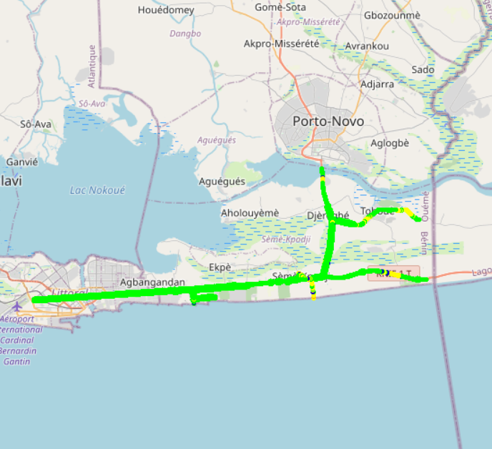
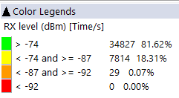
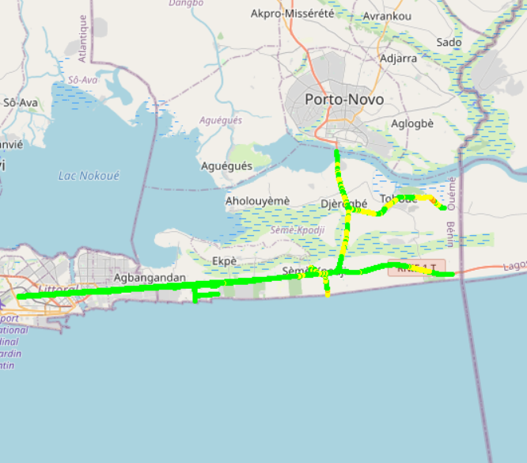

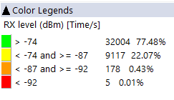
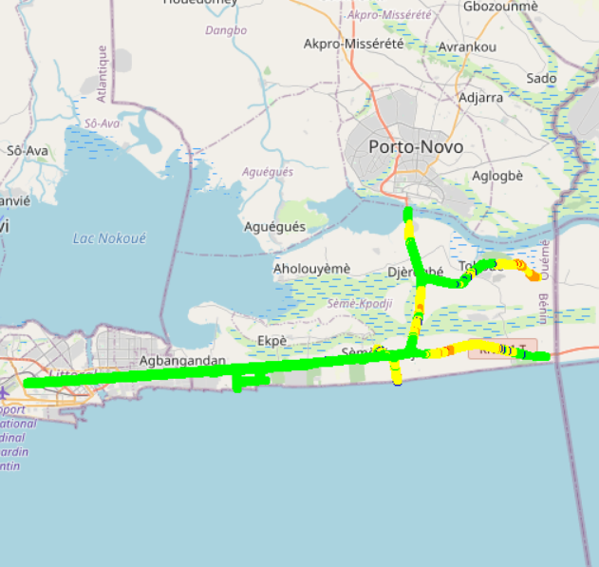


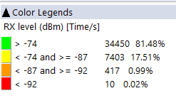
Benchmarking: 2G coverage - Maps
MTN’s 2G coverage is better than MOOV’s and CELTISS’s.

Slide 19
Benchmarking: 3G coverage
Only MTN’s 3G coverage meets ARCEP requirements compared to competitors,
MTN has the best 3G coverage in SEMEKPODJI city.

Slide 20
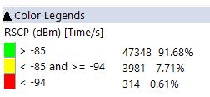
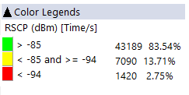
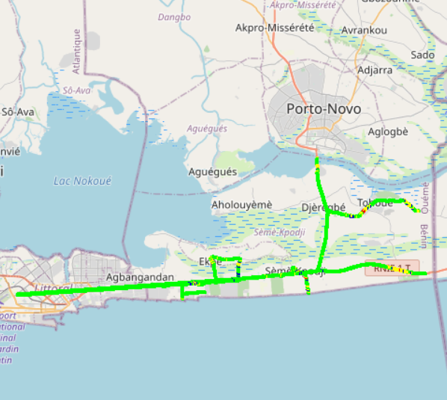
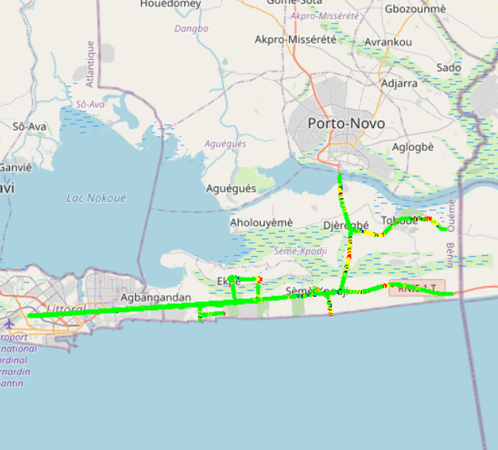
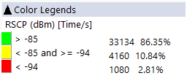
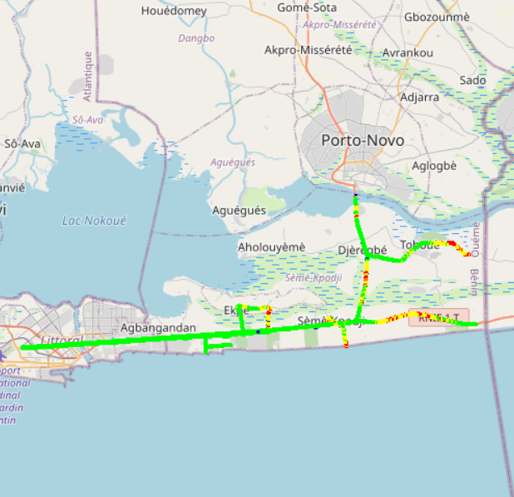

Benchmarking: 3G coverage-Maps
MTN’s 3G coverage is better than MOOV’s and CELTISS’s.

Slide 21
Benchmarking: 4G coverage
MTN's 4G Radio coverage meets ARCEP requirements except Indoor morphology.
MTN has better 4G coverage than its competitors in SEMEKPODJI

Slide 22
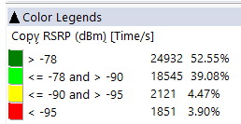
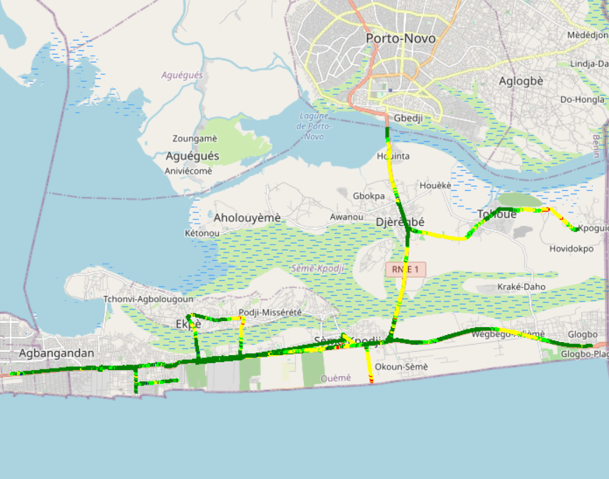
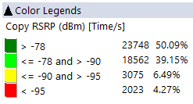
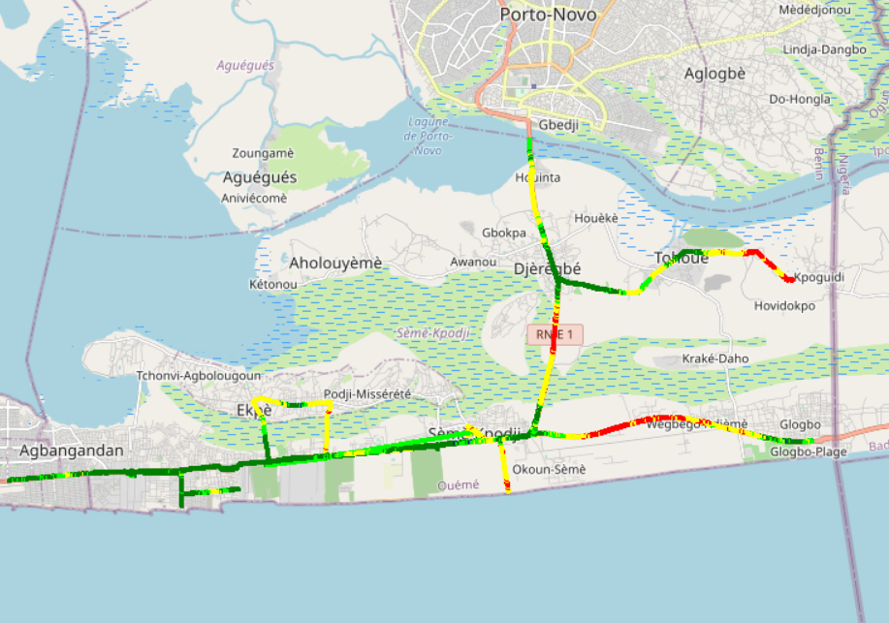
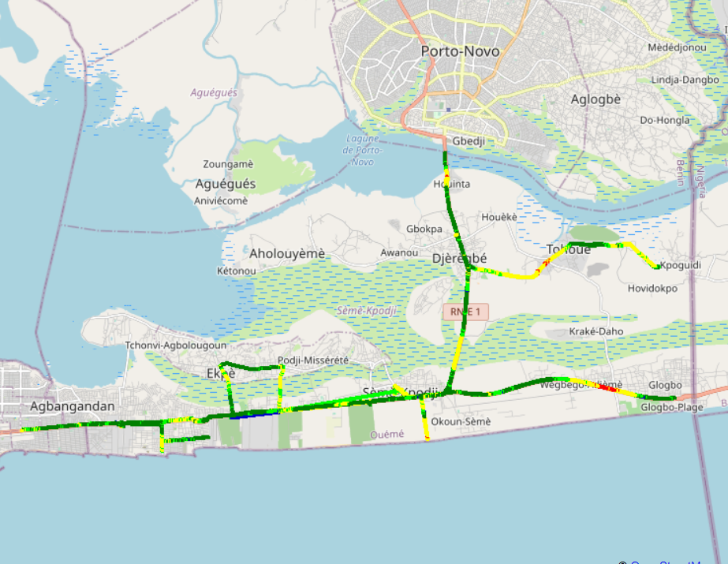
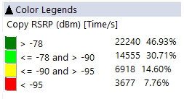

Benchmarking – 4G coverage - Maps
MTN’s 4G coverage is better than MOOV’s and CELTISS’s.

Slide 23
05
Benchmarking voice service

Slide 24
Benchmarking: CS Accessibility 2G/3G BLOCKED CALLS
MTN has the best accessibility to voice service compared to competitors,
All operators exceed ARCEP requirements.

Slide 25
Benchmarking: CS Retainability 2G/3G DROPPED CALLS
MTN is leading in retainability by having the lowest Call Drop Rate in SEMEKPODJI,
MTN and CELTISS largely satisfied ARCEP thresholds regarding Call Drop Rate.

Slide 26
Benchmarking: CS Integrity Voice Quality Mean Opinion Score
MOOV has the best speech quality MOS and ratio of excellent and good Voice Quality samples compared to MTN’s and CELTISS’S,MTN needs to improve its voice quality MOS by pushing CS traffic to 3G and increase 2G full rate penetration.
Updated

Slide 27
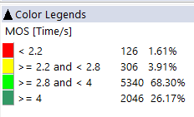
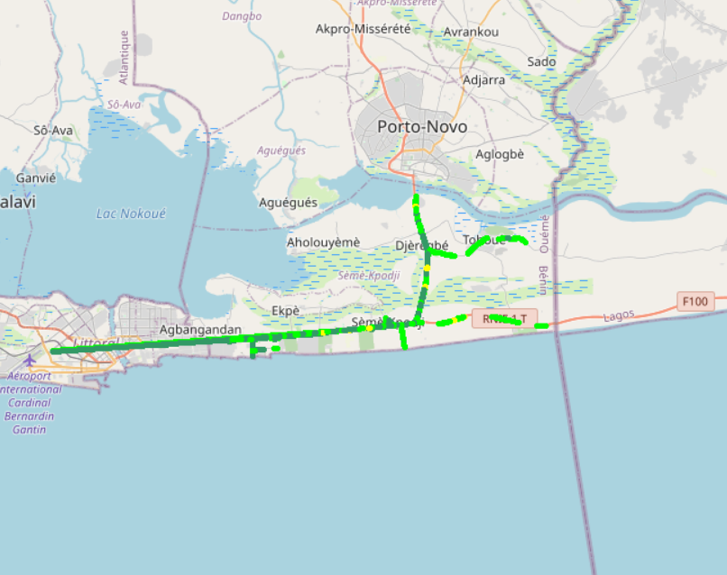
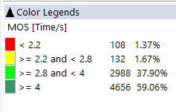

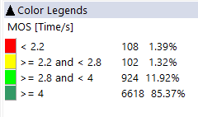
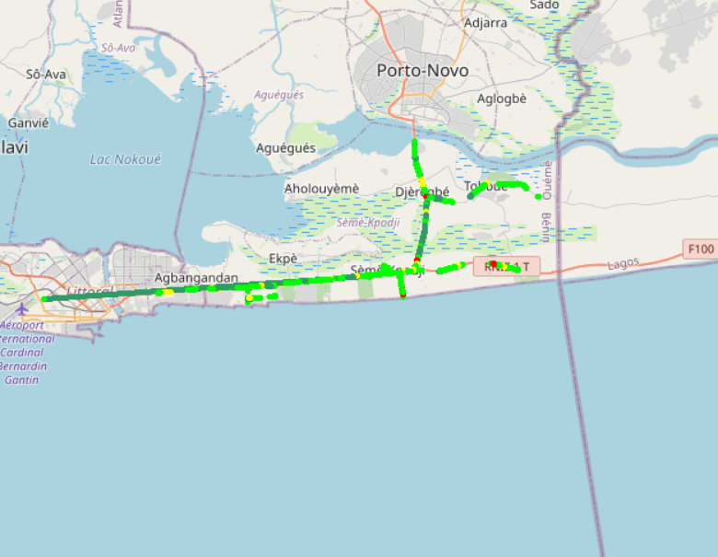
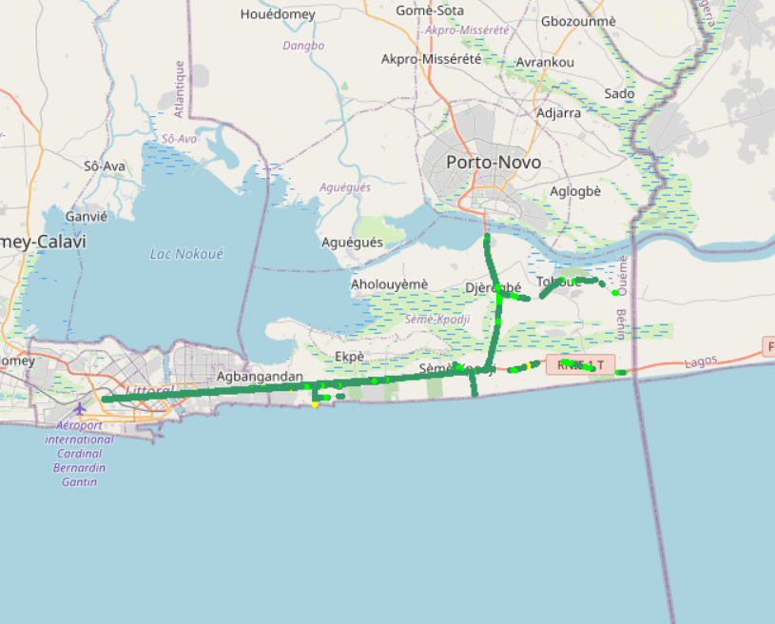
Benchmarking – CS Integrity Voice quality maps (MOS)
MTN has around 5,52% of MOS samples lower than 2.8, against 2,71% for MOOV and 3,04% for CELTISS.
3d

Slide 28
Benchmarking Voice service Band usage(%)
MTN has 30,96%% of voice calls carried out over 2G,
CELTISS and MOOV have more than 98% of voice calls carried out over 3G,
MTN needs to reduce 2G usage and increase 3G penetration for better audio quality,
MTN's 2G band usage: 71,54% on GSM 900 and 23,43% on GSM 1800,
3G band usage: MOOV and CELTISS use mainly U900 but MTN has an equitable utilization for both 3G bands.

Slide 29
Benchmarking: Radio parameters Ec/No comparison
11,72% of drive test samples are showing a very low level of EcNo for 3G MTN.
This is correlated to the number of 3G carriers : MTN is using 2 carriers against 3 and 4 for CELTISS and MOOV respectively. Also 3G traffic is carried mainly by U2100 for competitors while it’s distributed over U900 and U2100 for MTN.

Slide 30
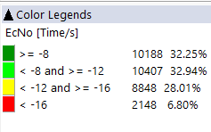
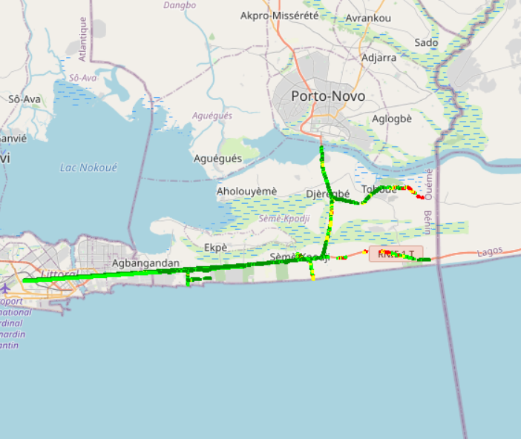
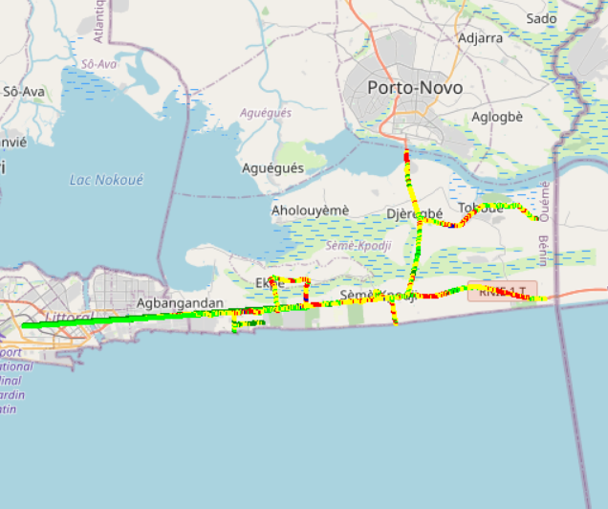
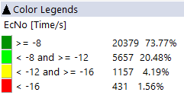
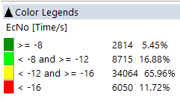
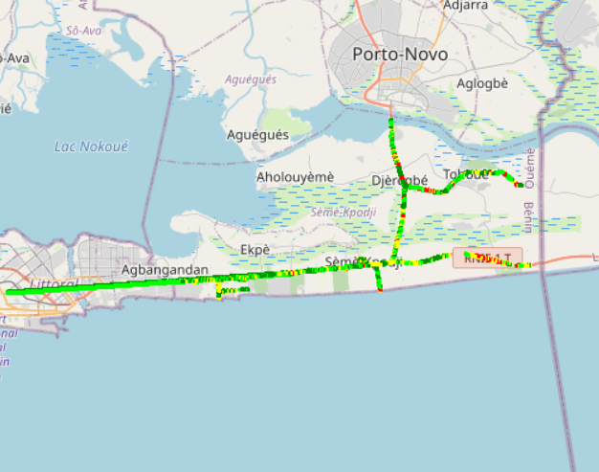

Benchmarking: Radio parameters EC/NO
3G MOOV’s and CELTISS’s EC/N0 is better than MTN’s due to the number of 3G used carriers .

Slide 31
Benchmarking – 2G/3G CALL SETUP TIME
MTN has outperformed its competitors in terms of Call setup time in SEMEKPODJI.
MTN has the best 4G CSBF Call setup Time,
Call setup time 2G is higher than in 3G/4G.

Slide 32
Benchmarking – SMS SENDING FAILURE
CELTISS SMS SETUP/RESPONSE is better than MTN’s & MOOV’s. SMS service KPIs of all operators are not compliant with the ARCEP requirements due to the timeout of sending duration (< 6s).

Slide 33
06
Benchmarking Data service

Slide 34
Benchmarking – DATA 3G
All operators have a good rate of successful Internet connection.

Slide 35
Benchmarking – DATA 3G Web Browsing service
MTN has outperformed its competitors in terms of web service performance,
Only MTN meets ARCEP requirements for web service failure rate.

Slide 36
Benchmarking – DATA 3G FTP service
MTN has an excellent FTP DL succes ratio,
All operators meet ARCEP requirements for FTP DL/UL succes ratio (>97%).

Slide 37
Benchmarking – 3G FTP MEAN THROUGHPUT
MTN has outperformed its competitors in terms of 3G FTP DL and UL throughput,
All operators are slightly satisfied ARCEP requirements,
MTN needs to improve its 3G DL throughput by increasing HSPA-DC utilization.

Slide 38
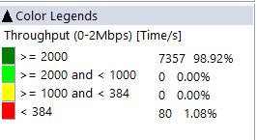
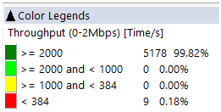
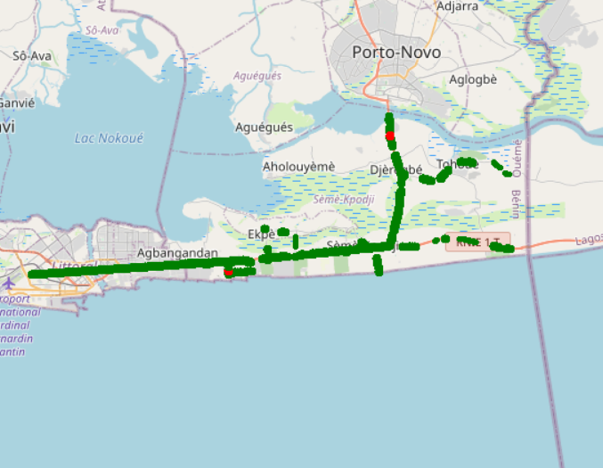
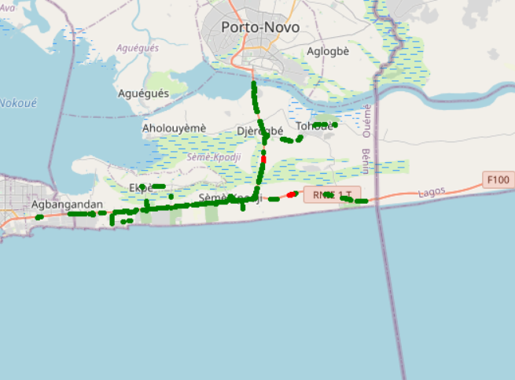
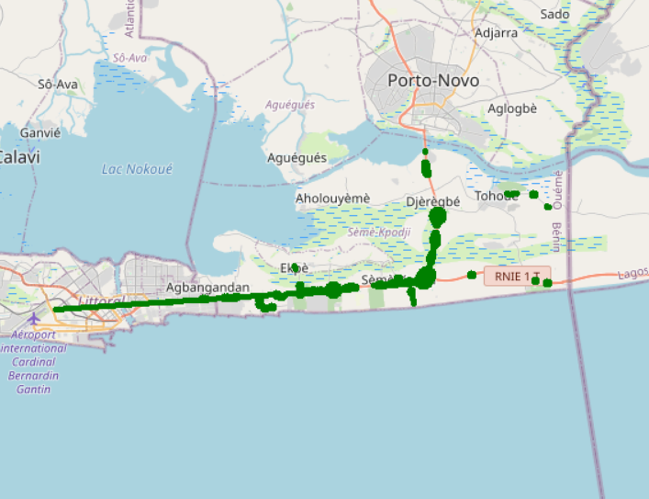
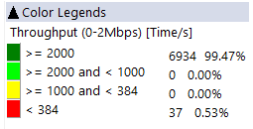

Benchmarking – 3G FTP MEAN THROUGHPUT maps
MTN Throughput distribution is very close to MOOV & CELTISS.

Slide 39
Benchmarking – 4G DATA Web Browsing service
All operators have a good HTTP Browsing success rate,
All operators meet ARCEP requirements.

Slide 40
Benchmarking – 4G FTP service
All operators have an excellente performance in terms of FTP success ratio.

Slide 41
Benchmarking – 4G FTP MEAN THROUGHPUT
MTN is ranked second in terms of FTP DL throughput,
MTN has outperformed its competitors in terms of FTP UL throughput,
All operators meet ARCEP requirements for 4G DL/UL throughput.

Slide 42
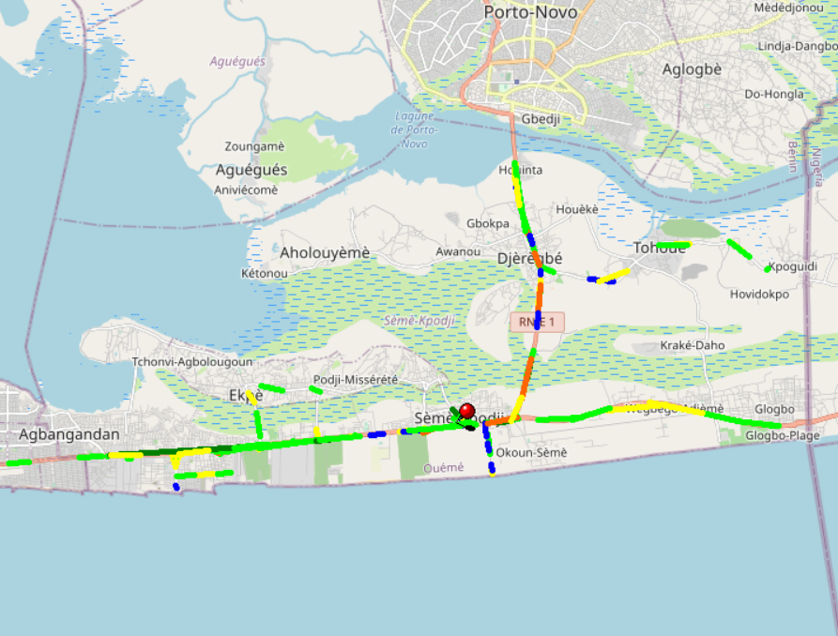
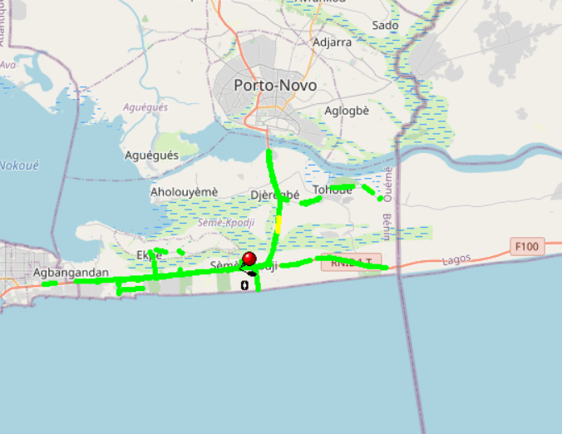
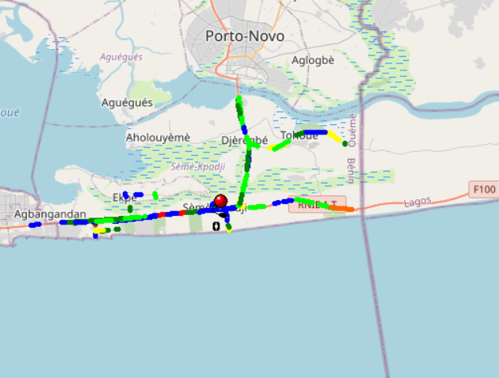
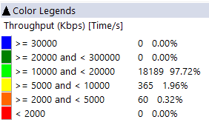
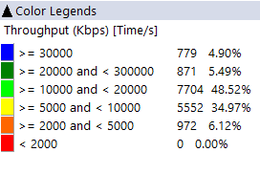
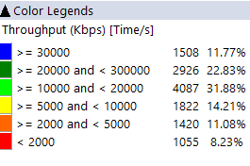
Benchmarking – 4G FTP THROUGHPUT comparison maps
MOOV’s average DL throughput DL is better than MTN and CELTISS.

Slide 43
Benchmarking – BAND and TECHNOLOGY UTILISATION
Most of MTN’s LTE samples are carried out over LTE 2600 as first carrier,
Most of CELTISS’s samples are carried out over LTE 1800 as first carrier,
Most of MOOV’s and CELTISS’s 3G samples are carried out over U2100, against a use of both 3G bands for MTN.

Slide 44
Benchmarking – Data TECHNOLOGY Usage(%)
MTN has the highest LTE Carrier Aggregation usage,
3G HSDPA-DC data technology not used for MTN,
High UMTS R99 usage for MTN compared to its competitors,
To improve 3G throughput it is recommended for MTN to activate HSPA-DC.

Slide 45
Benchmarking – Radio parameter SINR comparison
Drive tests are showing that MTN has the best ratio of acceptable level of SINR.

Slide 46
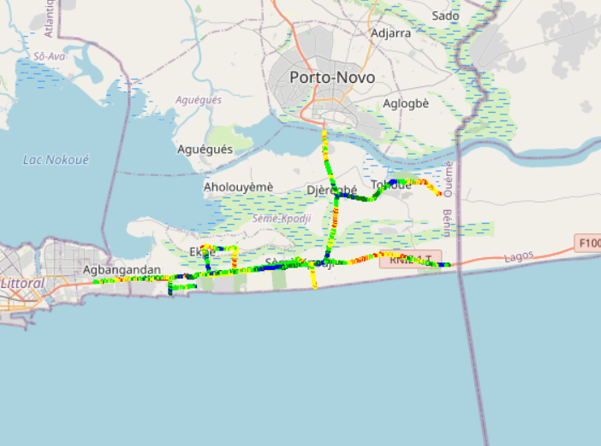
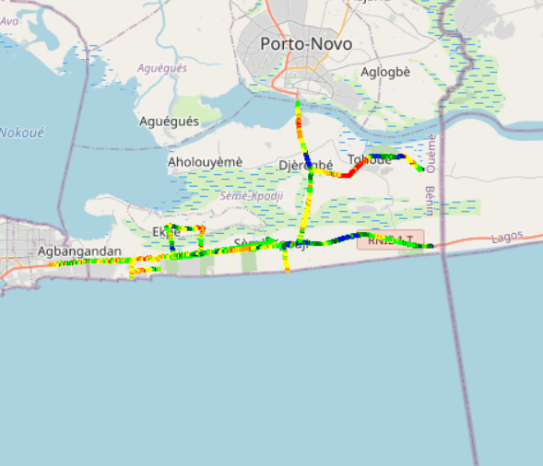
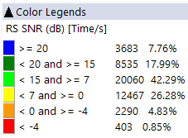
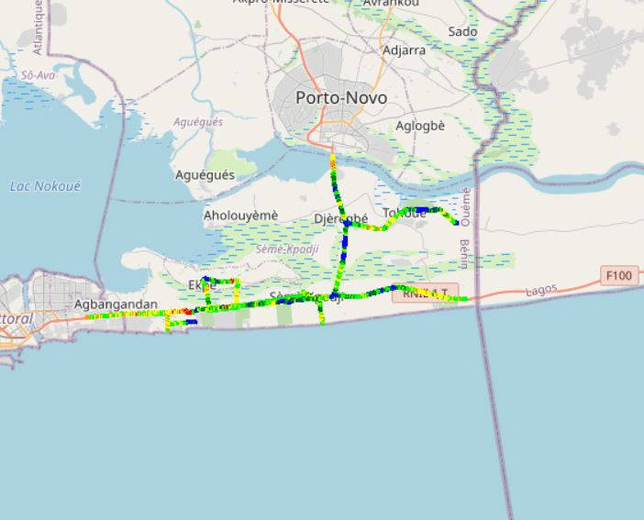
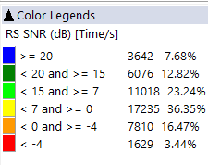
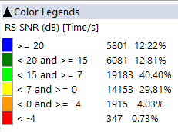

Benchmarking – Radio parameter SNIR comparison maps
4G CELTISS has the better Signal of quality compared to MTN’s and MOOV’s.

Slide 47

Deloitte fait référence à un ou plusieurs cabinets membres de Deloitte Touche Tohmatsu Limited, société de droit anglais (« private company limited by guarantee »), et à son réseau de cabinets membres constitués en entités indépendantes et juridiquement distinctes. Pour en savoir plus sur la structure légale de Deloitte Touche Tohmatsu Limited et de ses cabinets membres, consulter www.deloitte.com/about.
Fort d’un réseau de firmes membres dans plus de 150 pays, Deloitte allie des compétences de niveau international à des expertises locales pointues, afin d’accompagner ses clients dans leur développement partout où ils opèrent. Nos 264 000 professionnels sont animés par un objectif commun, faire de Deloitte la référence en matière d’excellence de service.
Au Bénin, Deloitte mobilise un ensemble de compétences diversifiées pour répondre aux enjeux de ses clients, de toutes tailles et de tous secteurs – des grandes entreprises multinationales aux microentreprises locales, en passant par les entreprises moyennes.
Le présent document et ses annexes sont confidentiels et réservés à l’usage interne exclusif du destinataire. Toute reproduction ou toute divulgation partielle ou totale à des tiers en est interdite, sauf accord écrit préalable de Deloitte Bénin.
© 2019 Deloitte Bénin SARL. Société du réseau Deloitte

