Slide 1


Network QoS
NATITINGO Intermediate report
November 23rd, 2023

Slide 2
Summary
Scope of Intermediate Report | 3
Executive Summary | 5
Benchmarking Key Results | 11
Benchmarking Coverage | 16
Benchmarking Voice Service | 23
Benchmarking Data Service | 33

Slide 3
01
Introduction: Scope of Intermediate Report

Slide 4
Intermediate report
Scope of this report
  1. Network benchmarking results for the Natitingo area between MTN, MOOV, and CELTISS from October 21th to October 23th, 2023..

Slide 5
02
Benchmarking Executive Summary

Slide 6
Executive Summary – Benchmarking coverage 2G/3G/4G
TECHNOLOGY
Only MTN satisfied the ARCEP 2G Coverage requirements, MOOV, and CELTISS failed in Indoor coverage
Only MTN satisfied the ARCEP 3G Coverage requirements
MTN is ranked first in term of 4g Coverage
All operators failed to reach ARCËP 4G Indoor threshold. CELTISS failed also in Incar 4g coverage.
KEY RECOMMENDATIONS
KEY FINDINGS
Coverage 2G/3G/4G
Tune and align power settings mainly in 3G/4G. Actual setting may impact the coverage strength specially at Indoor locations
Review the design at the coverage and quality blackspots
We highlight that 4G ARCEP coverage Thresholds are aggressive

Slide 7
Executive Summary – Benchmarking voice service 2G/3G
TECHNOLOGY
MTN is ranked first in all voice tests
MTN is the only operator that satisfied all voice tests
MOOV and CELTISS failed in all voice except the voice quality
KEY RECOMMENDATIONS
KEY FINDINGS
Voice service 2G/3G
Voice quality is always better in 3G due to its better codec rate , we recommend to push as much as possible the voice traffic to 3G.
Actual selection/reselection/Irat parameters need to be reviewed and aligned.
2G Full Rate/Half Rate settings need to be tuned in order to improve Full rate penetration

Slide 8
Executive Summary – Benchmarking SMS service
TECHNOLOGY
KEY RECOMMENDATIONS
KEY FINDINGS
SMS service 2G/3G
MTN is ranked first in all SMS tests
MTN is the only operators that satisfied SMS tests ARCEP threshold
There is no issue in radio accessibility that could be correlated to the SMS high delivery time.
End to End investigation need to be performed to analyses the high delivery time including mainly Core/SMS parts: SM Sserver...

Slide 9
Executive Summary – Benchmarking 4G Data service
Performance is stable in terms of accessibility for 4G data service, and all operators met ARCEP's requirements except CELTISS in ftp failure rate.
MTN is ranked first in all kind of 4G data tests
MTN is ranked first in Both DL and UL of 4G ftp tests, with 52.66/21.18Mbps DL/UL Throughput compared to 15.47/8.07 Mbps and 14.02/10.44 Mbps for MOOV and CELTISS.
TECHNOLOGY
KEY RECOMMENDATIONS
KEY FINDINGS
Data service 4G
MTN spectrum need to be used with a better efficiency, Some features and parameters need to be tuned and aligned
To ensure that no throughput limitation is applied on users profiles

Slide 10
Executive Summary – Benchmarking 3G Data service
Performance is stable in terms of accessibility for 3G data service, and all operators met ARCEP's requirements except MOOV in Web failure Rate
MTN is ranked first in all kind of 3G data tests except ftp failure rate
MTN is in 1st position for 3G DL throughput with 6.97Mbps, compared to 6.54Mbps for CELTISS and 4.49Mbps for MOOV.
MTN is ranked first in term of 3G UL throughput with 2.63 Mbps against 1.39 Mbps for MOOV and 2.01Mbps for CELTISS,
TECHNOLOGY
KEY RECOMMENDATIONS
KEY FINDINGS
Data service 3G
Its recommended to push as much as possible the data traffic to 4G in order to:
- Improve end user perception, Both DT and stats are showing that users in average are served with up to 700% better throughput in 4G than in 3G
- Offload the 3G network which will improve the 3G throughput and the 3G radio quality
Some features and parameters need to be tuned and aligned
To ensure that no throughput limitation is applied on users profiles

Slide 11
03
Benchmarking Key Results

Slide 12
Benchmarking Key Results – Coverage
Only MTN satisfied the ARCEP 2G Coverage requirements, MOOV, and CELTISS failed in Indoor coverage
Only MTN satisfied the ARCEP 3G Coverage requirements
All operators failed to reach ARCËP 4G Indoor threshold. CELTISS failed also in Incar 4g coverage
MTN is ranked first in term of 4g Coverage
KPI |  | ARCEP Threshorlds | MTN |  | MOOV |  | CELTISS |  | MTN Ranking
 |  |  | Value | Conformity | Value | Conformity | Value | Conformity
2G Coverage Rate | Incar | More than 90% with Incar: Rxlev >-87 dBm | 99,70% | OK | 98,53% | OK | 96,39% | OK | 1
 | Outdoor | More than 90% with Outdoor: Rxlev >-92 dBm | 99,97% | OK | 99,59% | OK | 96,23% | OK | 1
 | Indoor | More than 90% with Outdoor: Rxlev >-74 dBm | 96,92% | OK | 74,82% | NOK | 69,17% | NOK | 1
3G Coverage Rate | Incar,Indoor,Outdoor | More than 90% with RSCP <-85 dBm | 92,45% | OK | 73,14% | NOK | 66,15% | NOK | 1
4G Coverage Rate | Incar | More than 90% with RSRP <-90 dBm* | 94,63% | OK | 94,12% | OK | 82,62% | NOK | 1
 | Outdoor | More than 90% with RSRP <-95 dBm* | 99,54% | OK | 98,83% | OK | 98,40% | OK | 1
 | Indoor | More than 90% with RSRP <-78 dBm* | 64,38% | NOK | 60,86% | NOK | 44,47% | NOK | 1

Slide 13
Benchmarking Key Results – 2G/3G voice and SMS Summary
MTN is ranked first in all voice and SMS tests
MTN is the only operators that satisfied all voice and SMS tests
MOOV and CELTISS failed in all voice and SMS tests except the voice quality
KPI | ARCEP Threshorlds | MTN |  | MOOV |  | CELTISS |  | MTN Ranking
 |  | Value | Conformity | Value | Conformity | Value | Conformity
Accesibility: Blocking rate | <1% | 1,06% | OK | 2,97% | NOK | 4,25 | NOK | 1
Retainability: Call drop rate | <1% | 0,40% | OK | 1,71% | NOK | 1,71% | NOK | 1
Call Completetion Rate (%) | =<98% | 98,54% | OK | 95,32% | NOK | 94,04% | NOK | 1
Integrity: Voice quality | Note requise> 2,8 | 4,03 | OK | 3,73 | OK | 3,93 | OK | 1
SMS sending success rate % (E2E delivery Time<6 sec) | >99% | 99,36% | OK | 93,59% | NOK | 85,21% | NOK | 1
SMS receving success rate % | >99% | 98,87% | OK | 90,38% | NOK | 84,44% | NOK | 1

Slide 14
Benchmarking Key Results – 3G Data Summary
All operators met the 3G Data ARCEP requirements except MOOV in Web failure Rate
MTN is ranked first in all kind of 3G data tests except ftp failure rate
Services | KPI | ARCEP Threshorlds | MTN |  | MOOV |  | CELTISS |  | MTN Ranking
 |  |  | Value | Conformity | Value | Conformity | Value | Conformity
3G HTTP | Successful internet connexion rate | >96% | 100,00% | OK | 100,00% | OK | 100,00% | OK | 1
 | Connexion setup time | <=10sec | 6,66 | OK | 6,98 | OK | 7,01 | OK | 1
 | Web service failure rate | <3% | 0,22% | OK | 4,67% | NOK | 0,94% | OK | 1
3G FTP | FTP failure rate UL/DL | <3 % | 0,44%/0,84% | OK | 1,3%/0% | OK | 0%/0,62% | OK | 2
 | FTP Data transmission average (DL) | >= 2Mbps | 6,970 | OK | 4,493 | OK | 6,544 | OK | 1
 | FTP Data transmission average (UL) | >= 1Mbps | 2,627 | OK | 1,391 | OK | 2,015 | OK | 1

Slide 15
Benchmarking Key Results – 4G Data Summary
MTN is ranked first in all kind of 4G data tests
All operators met the ARCEP thresholds except CELTISS in ftp failure rate
Services | KPI | Threshorlds* | MTN |  | MOOV |  | CELTISS |  | MTN Ranking
 |  |  | Value | Conformity | Value | Conformity | Value | Conformity
4G HTTP Browsing | Web service failure rate (%) | <3% | 1,89% | OK | 2,55% | OK | 2,12% | OK | 1
 | Connexion setup time | <=3sec | 0,88 | OK | 1,13 | OK | 1,89 | OK | 1
4G FTP | FTP failure rate UL/DL | <3 % | 0,43%/0% | OK | 0,22%/0,45% | OK | 8,33%/0% | NOK/OK | 1
 | FTP Data transmission average (DL) | 4G >= 5 Mbps | 52,666 | OK | 15,471 | OK | 14,025 | OK | 1
 | FTP Data transmission average (UL) | 4G: >= 2Mbps | 21,183 | OK | 8,075 | OK | 10,441 | OK | 1

Slide 16
04
Benchmarking 2G/3G/4G coverage

Slide 17
Benchmarking: 2G coverage
Only MTN satisfied the ARCEP 2G Coverage requirements, MOOV, and CELTISS failed in Indoor coverage

Slide 18
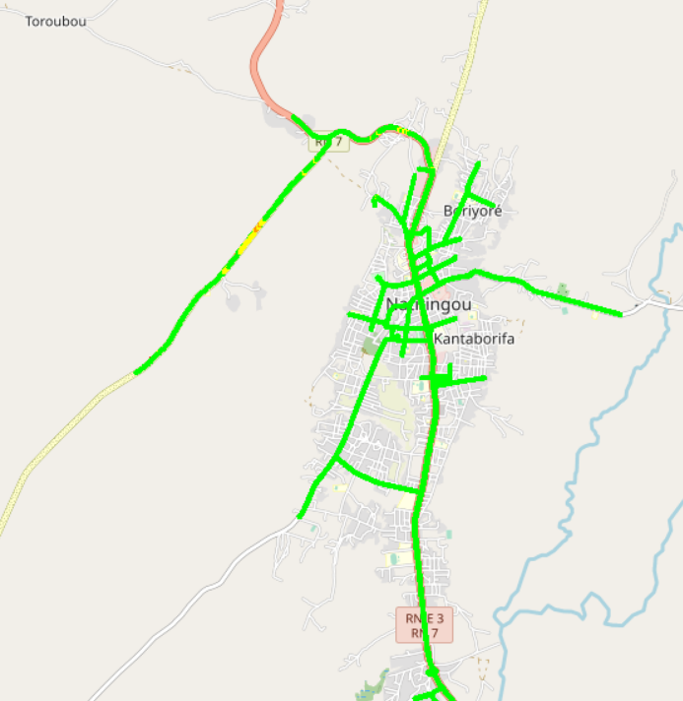
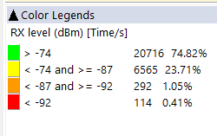

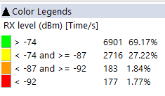
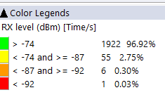


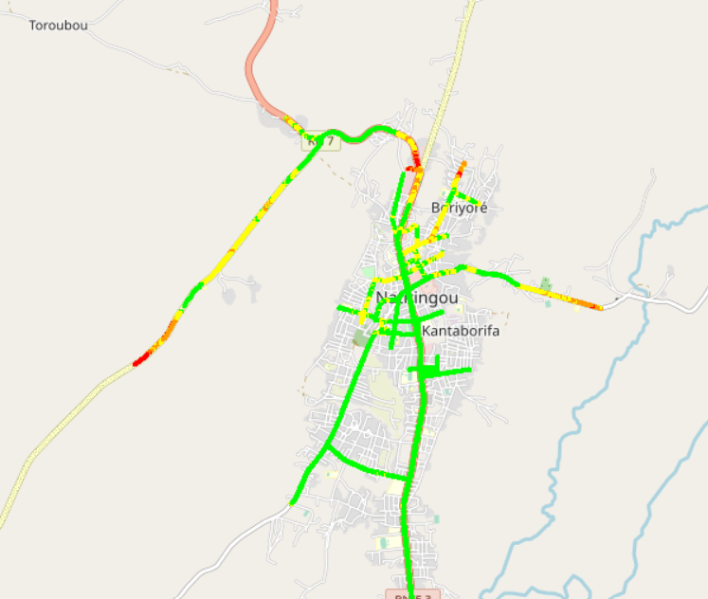
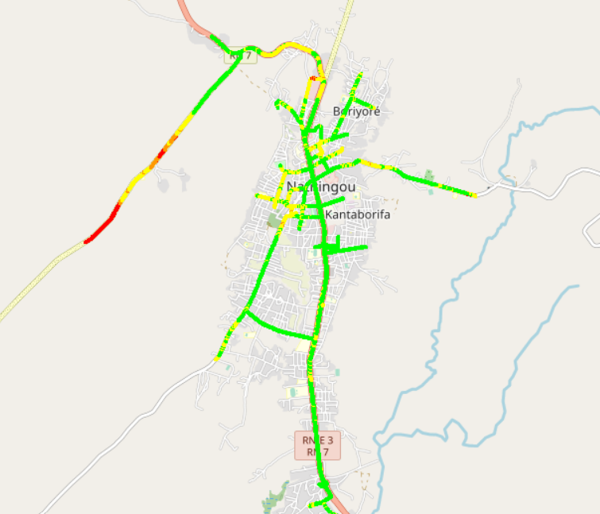
Benchmarking: 2G coverage - Maps
MTN have the best 2G coverage distribution

Slide 19
Benchmarking: 3G coverage
Only MTN satisfied the ARCEP 2G Coverage requirements

Slide 20
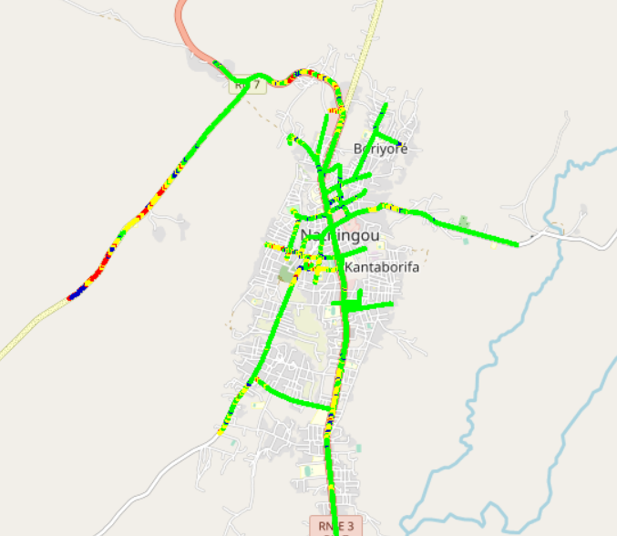

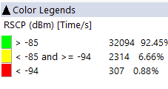
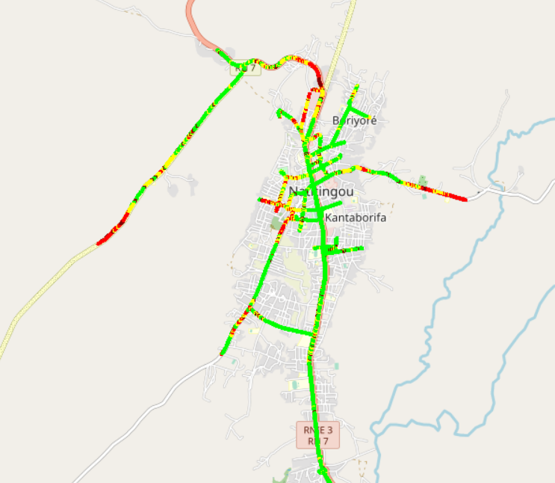
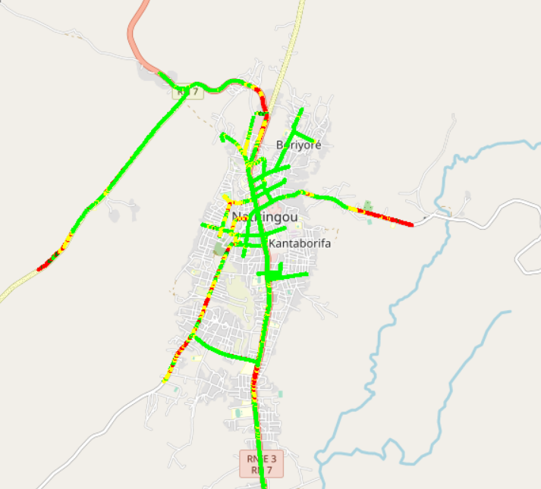
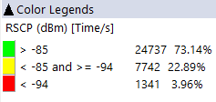
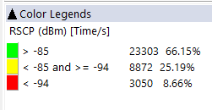
Benchmarking: 3G coverage-Maps
MTN have the best 3G coverage distribution

Slide 21
Benchmarking: 4G coverage
All operators failed to reach ARCËP 4G Indoor threshold. CELTISS failed also in Incar 4g coverage
MTN is ranked first in term of 4g Coverage

Slide 22
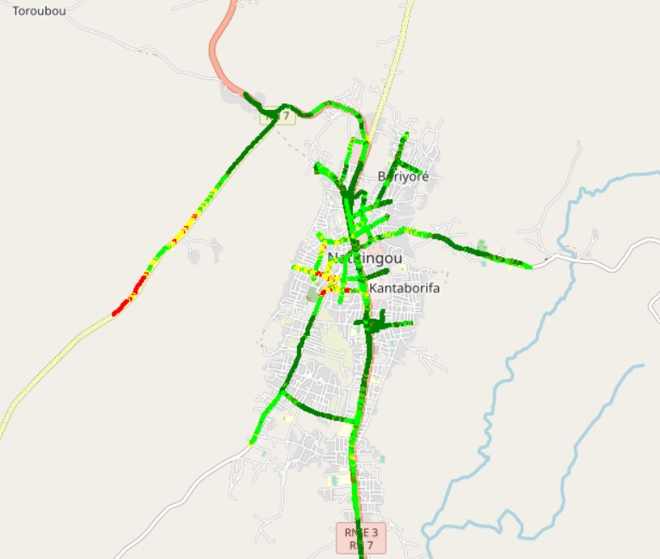
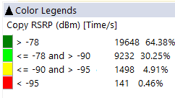
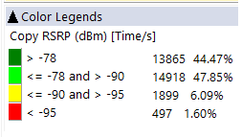
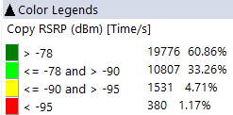
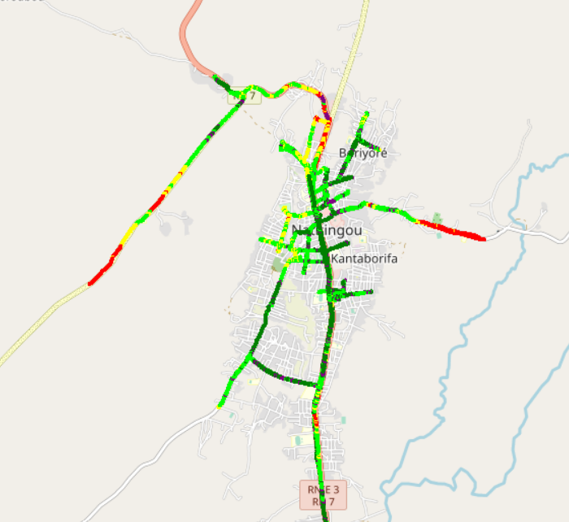

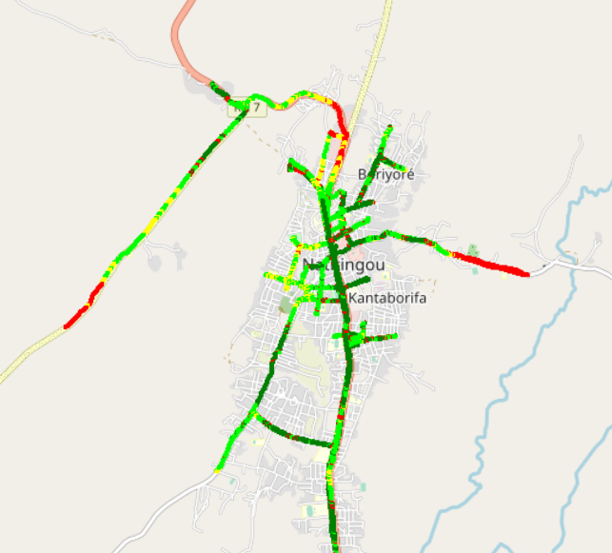
Benchmarking – 4G coverage - Maps
MTN have the best 4G coverage distribution

Slide 23
05
Benchmarking voice service

Slide 24
Benchmarking: CS Accessibility 2G/3G BLOCKED CALLS
Only MTN satisfied the ARCEP voice accessibility requirements

Slide 25
Benchmarking: CS Integrity Voice quality Mean Opinion Score
MTN have the best ratio of excellent and good Voice Quality samples and the best average MOS

Slide 26

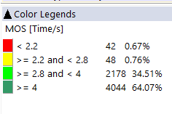
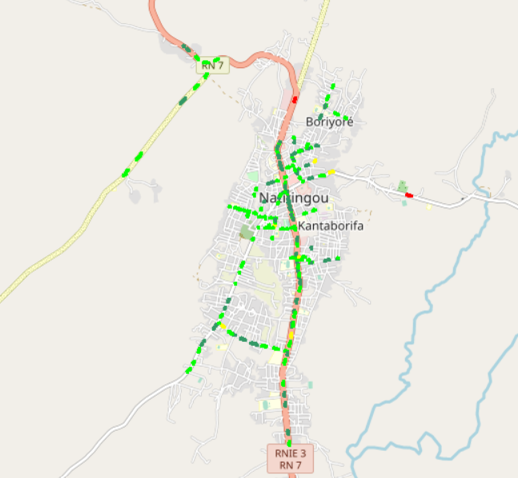
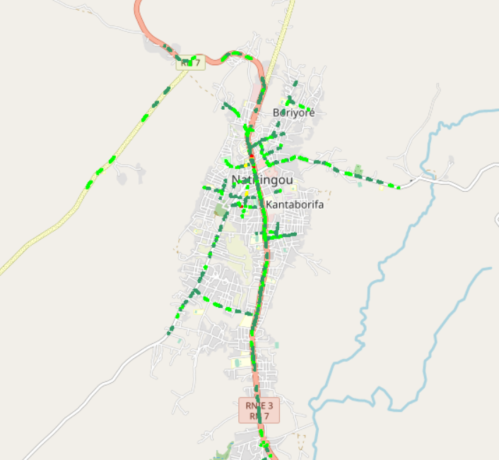
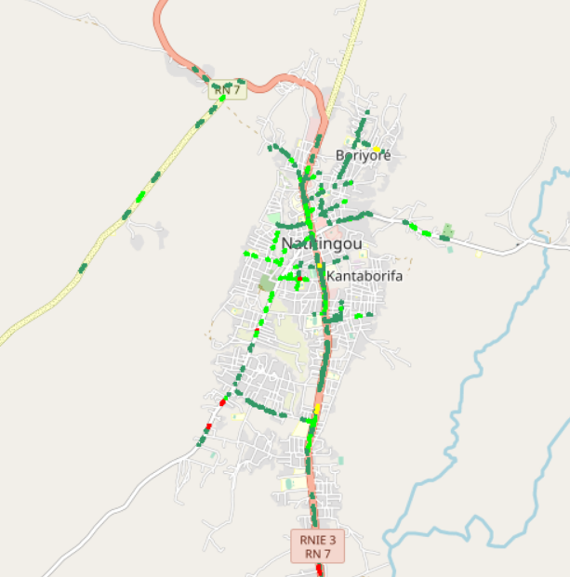
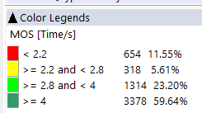
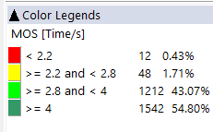
Benchmarking – CS Integrity Voice quality maps (MOS)
MTN have only 0,67% of MOS samples lower than 2.2,
Values lower than 2,2 pose risk of bad users perceived voice quality
3d

Slide 27
Benchmarking: CS Retainability 2G/3G DROPPED CALLS
Only MTN satisfied the ARCEP voice drop requirements

Slide 28
Benchmarking Voice service Band usage(%)
Voice calls are mainly carried by 3G for all operators.
MTN's 2G band usage: 100% GSM 900 and 0% DCS 1800 Mhz,
23,42 % of MTN 3G CS traffic is carried on U900 compared to 47,78% and 29,42% for MOOV and CELTISS.

Slide 29
Benchmarking: Radio parameters EC/NO comparison
CELLTIS have the best 3G EcNo samples within acceptable range while MTN have less bad samples than competitors

Slide 30
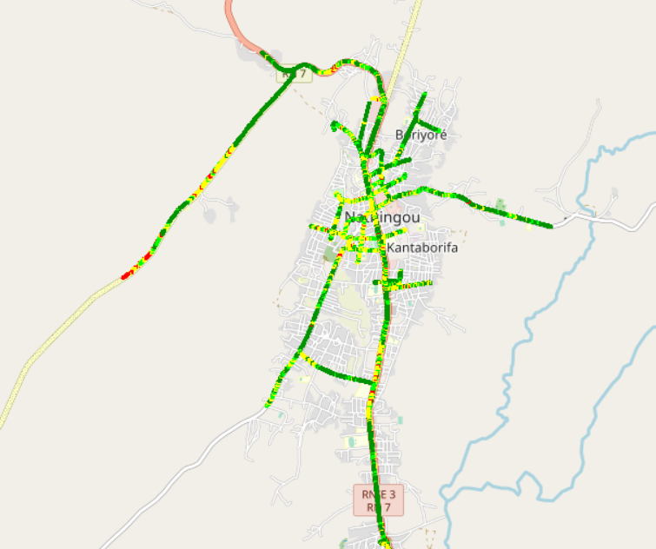
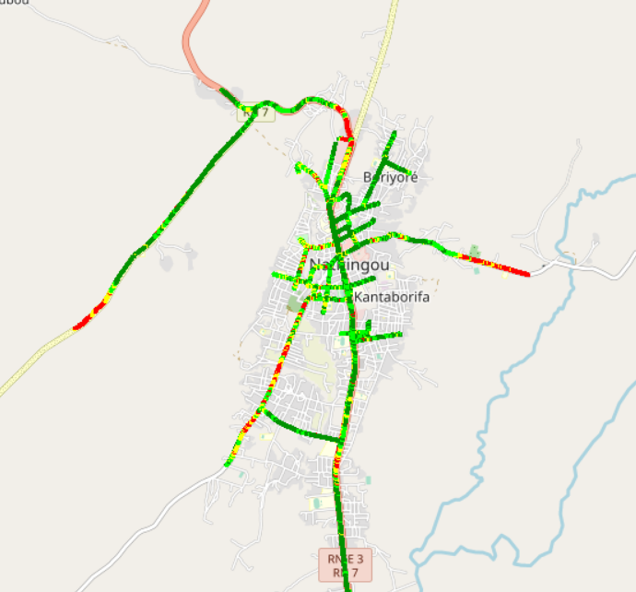
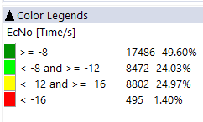
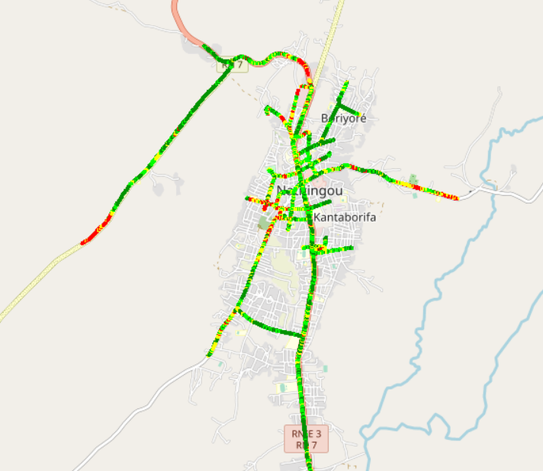
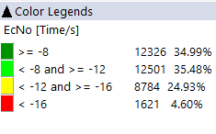
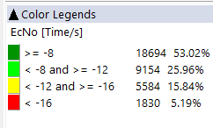
Benchmarking: Radio parameters EC/NO
MTN have less bad samples than competitors

Slide 31
Benchmarking – 2G/3G CALL SETUP TIME
MTN have the best Call setup time.
MTN have the best 4G CSBF Call setup Time,
Call setup time 2G is higher than in 3G/4G.

Slide 32
Benchmarking – SMS SENDING FAILURE
MTN is ranked first in all kind of SMS tests
MTN is the only operators that satisfied SMS tests ARCEP threshold

Slide 33
06
Benchmarking Data service

Slide 34
Benchmarking – DATA 3G
All operators have a very good rate of successful Internet connection

Slide 35
Benchmarking – DATA 3G
MOOV failed in http browsing SR

Slide 36
Benchmarking – DATA 3G
All operators have good downlink and uplink FTP success rate.

Slide 37
Benchmarking – 3G FTP MEAN THROUGHPUT
All operators met the ARCEP downlink and uplink FTP success rate thresholds
MTN Is ranked first in all kind of FTP Tests

Slide 38

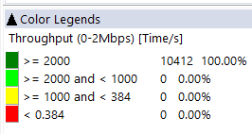
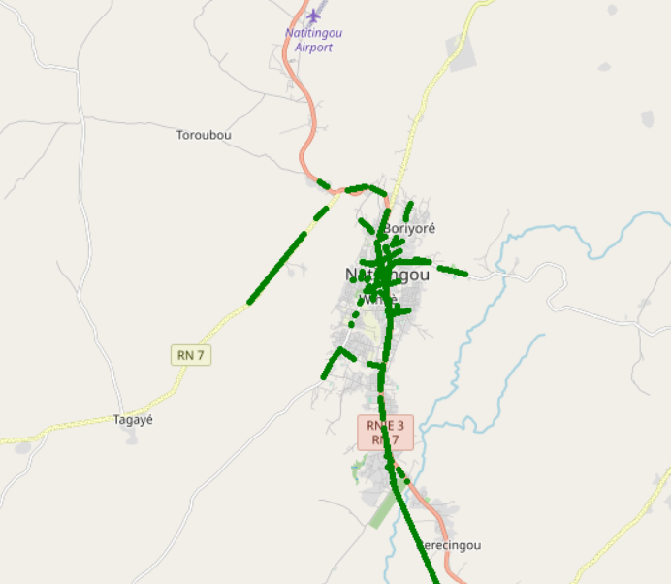
Benchmarking – 3G FTP MEAN THROUGHPUT comparison map
All samples exceed 2Mbps

Slide 39
Benchmarking – 4G HTTP Browsing
All operators have good HTTP Browsing success rate. MTN is ranked first

Slide 40
Benchmarking – 4G FTP THROUGHPUT comparison
CELLTIS failed to reach the ARCEP threshold in term of FTP SR.

Slide 41
Benchmarking – 4G FTP THROUGHPUT comparison
All operators met the ARCEP downlink and uplink FTP success rate thresholds
MTN Is ranked first in all kind of FTP Tests

Slide 42
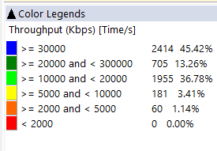
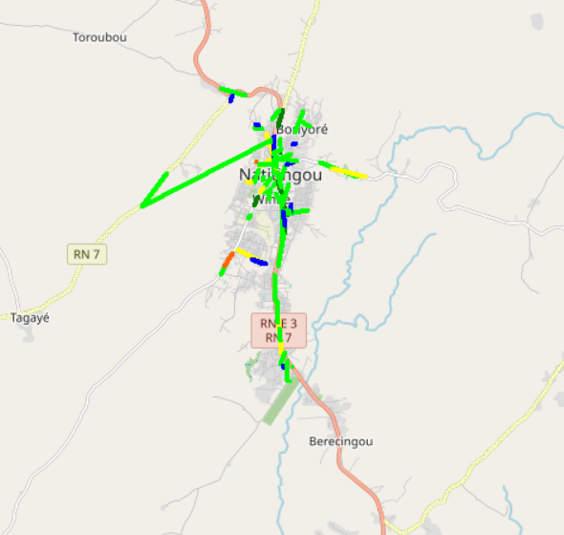
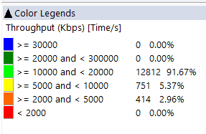
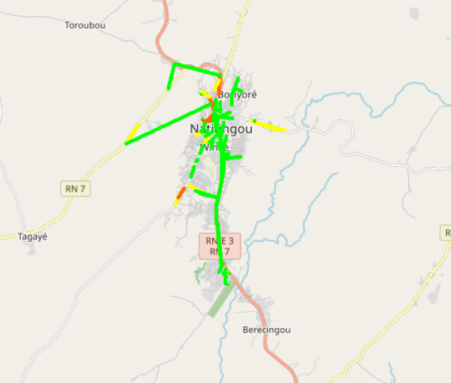
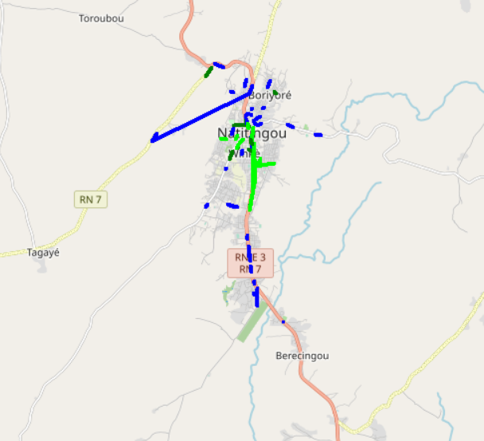
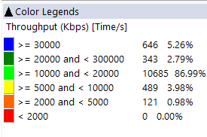
Benchmarking – 4G FTP THROUGHPUT comparison map
MTN Shows the best 4G FTP throughput samples distribution.

Slide 43
Benchmarking – BAND and TECHNOLOGY UTILISATION
Most of MTN LTE samples are in 2600 band.
Most of CELTIS LTE samples are in 800 band.
Most of MOOV LTE samples are in 800 and 2600 band
Usage of 3G U900 is lower for CELTISS

Slide 44
Benchmarking – Data TECHNOLOGY Usage(%)
MTN have the highest LTE CA Carrier Aggregation usage.

Slide 45
Benchmarking – SINR comparison
Drive tests are showing that MTN have the best acceptable level range of SINR

Slide 46
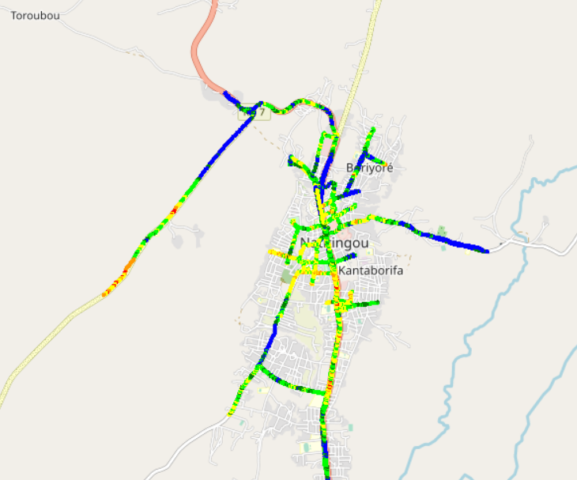
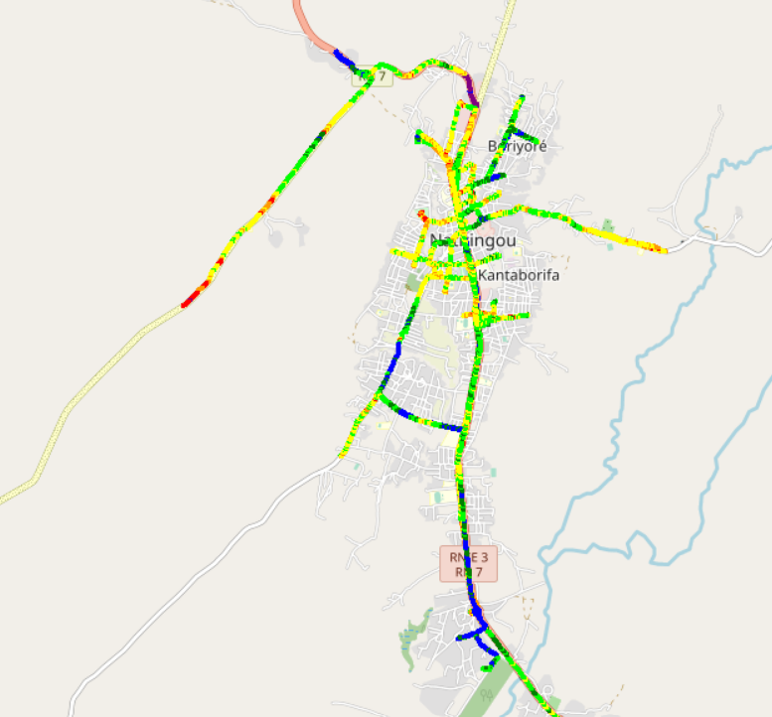
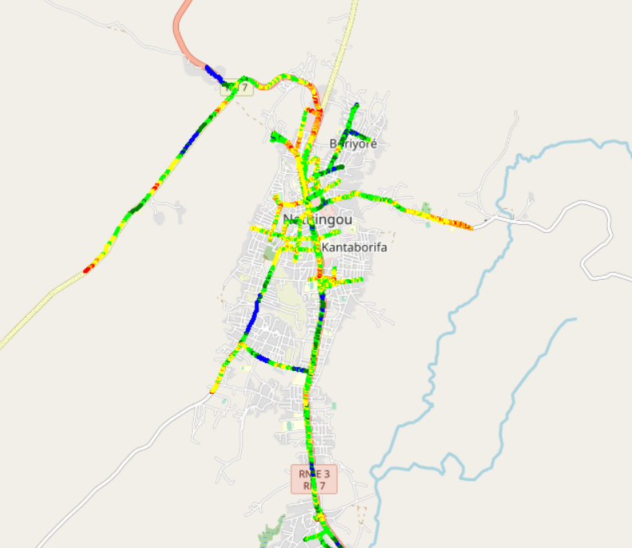

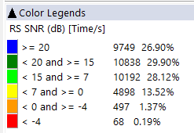
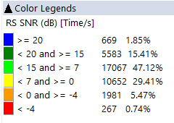
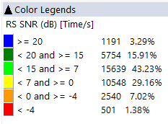
Benchmarking – SNIR comparison map
4G MTN have a better quality of signal compared to CELTISS and MOOV

Slide 47

Deloitte fait référence à un ou plusieurs cabinets membres de Deloitte Touche Tohmatsu Limited, société de droit anglais (« private company limited by guarantee »), et à son réseau de cabinets membres constitués en entités indépendantes et juridiquement distinctes. Pour en savoir plus sur la structure légale de Deloitte Touche Tohmatsu Limited et de ses cabinets membres, consulter www.deloitte.com/about.
Fort d’un réseau de firmes membres dans plus de 150 pays, Deloitte allie des compétences de niveau international à des expertises locales pointues, afin d’accompagner ses clients dans leur développement partout où ils opèrent. Nos 264 000 professionnels sont animés par un objectif commun, faire de Deloitte la référence en matière d’excellence de service.
Au Bénin, Deloitte mobilise un ensemble de compétences diversifiées pour répondre aux enjeux de ses clients, de toutes tailles et de tous secteurs – des grandes entreprises multinationales aux microentreprises locales, en passant par les entreprises moyennes.
Le présent document et ses annexes sont confidentiels et réservés à l’usage interne exclusif du destinataire. Toute reproduction ou toute divulgation partielle ou totale à des tiers en est interdite, sauf accord écrit préalable de Deloitte Bénin.
© 2023 Deloitte Bénin SARL. Société du réseau Deloitte

