Slide 1


Network QoS
Benchmarking report « DJOUGOU »
November 7th, 2023

Slide 2
Summary
Scope of Intermediate Report | 3
Executive Summary | 5
Benchmarking Key Results | 11
Benchmarking Coverage | 16
Benchmarking Voice Service | 23
Benchmarking Data Service | 33

Slide 3
01
Introduction: Scope of Intermediate Report

Slide 4
Intermediate report
Scope of this report
  1. Network benchmarking results for the DJOUGOU area between MTN, MOOV, and CELTISS from October 29th to October 31th, 2023..

Slide 5
02
Benchmarking Executive Summary

Slide 6
Executive Summary – Benchmarking coverage 2G/3G/4G
For 2G RF coverage, all operators meet ARCEP obligation for all morphologies,
MTN is ranked second in term of 2G coverage for Indoor morphology and ranked third for Incar and outdoor morphologies,
MTN is leading in terms of 3G coverage rate with (91,33%) against (90,65%) for CELTISS and (76,30%) for MOOV
Only MTN and CELTISS meet ARCEP 3G coverage obligation
MTN has the best 4G coverage for Indoor and outdoor morphologies,
All operators failed to satisfied the ARCEP threshold for indoor coverage for 4G network.
TECHNOLOGY
KEY RECOMMENDATIONS
KEY FINDINGS
Coverage 2G/3G/4G
Tune and align power settings mainly in 3G/4G. Actual setting may impact the coverage strength specially at Indoor locations
Review the design at the coverage and quality blackspots
We highlight that 4G ARCEP coverage Thresholds are aggressive
* Final recommendations will be shared in the final report including details and findings from ongoing Configuration Audit

Slide 7
Executive Summary – Benchmarking voice service 2G/3G
TECHNOLOGY
Accessibility: MTN is ranked third in terms of accessibility to voice service ,
MTN and CELTISS failed to meet ARCEP accessibility thresholds,
Retainability: MTN is ranked first in term of retainability better than MOOV and CELTISS,
MTN's Call Drop Rate is 0.44% compared to 2.96% for CELTISS and 0.55% for MOOV. Only MTN and CELTISS meet ARCEP retainabilty requirements,
Integrity: MTN is in third position in terms of voice quality lower than MOOV and CELTISS with average Mean Opinion Score 3.87 as opposed to 3.91 for CELTISS and 4.09 for MOOV.
KEY RECOMMENDATIONS
KEY FINDINGS
Voice service 2G/3G
Voice quality is always better in 3G due to its better codec rate , we recommend to push as much as possible the voice traffic to 3G.
Actual selection/reselection/Irat parameters need to be reviewed and aligned.
2G Full Rate/Half Rate settings need to be tuned in order to improve Full rate penetration
* Final recommendations will be shared in the final report including details and findings from ongoing Configuration Audit

Slide 8
Executive Summary – Benchmarking SMS service
TECHNOLOGY
KEY RECOMMENDATIONS
KEY FINDINGS
SMS service 2G/3G
In DJOUGOU, MTN has recorded an excellent performance for SMS service.
In DJOUGOU, MTN has an excellent performance for SMS service and satisfys alone the ARCEP requirements.

Slide 9
Executive Summary – Benchmarking 4G Data service
Performance is stable in terms of accessibility for 4G data service, and all operators meet ARCEP's requirements.
MTN is leading in terms of 4G DL throughput with 38.98Mbps, better than MOOV 17.04Mbps and CELTISS 12.89Mbps.
MTN is ranked first in terms of 4G UL throughput with 18.16Mbps, as opposed to 11.62Mbps for MOOV and 11.56Mbps for CELTISS.
For 4G network, all operators meet ARCEP’s End User Throughput obligation in download and upload.
TECHNOLOGY
KEY RECOMMENDATIONS
KEY FINDINGS
Data service 4G
In DJOUGOU, MTN has an excellent performance in terms of 4G End User KPIs.

Slide 10
Executive Summary – Benchmarking 3G Data service
Performance is stable in terms of accessibility for 3G data service, and all operators meet ARCEP's requirements.
MTN is in third position for 3G DL throughput with 4.62Mbps, compared to 6.82Mbps for CELTISS and 4.74Mbps for MOOV.
MTN is ranked first in terms of 3G UL throughput with 2.35 Mbps against 1.52Mbps for MOOV and 1.88Mbps for CELTISS,
All operators meets ARCEP’s 3G End User Throughput obligation for download and upload.
All operators meet ARCEP’s web browsing service accessibility thresholds.
TECHNOLOGY
KEY RECOMMENDATIONS
KEY FINDINGS
Data service 3G
Its recommended to push as much as possible the data traffic to 4G in order to:
- Improve end user perception, Both DT and stats are showing that users in average are served with up to 700% better throughput in 4G than in 3G
- Offload the 3G network which will improve the 3G throughput and the 3G radio quality
Some features and parameters need to be tuned and aligned
To ensure that no throughput limitation is applied on users profiles
* Final recommendations will be shared in the final report including details and findings from ongoing Configuration Audit

Slide 11
03
Benchmarking Key Results

Slide 12
Benchmarking Key Results – Coverage
In DJOUGOU, MOOV has the best 3G coverage for all morphologies,
MTN has the best 3G coverage,
MTN has the best 4G coverage for Indoor and outdoor morphologies,
All operators failed to meet ARCEP requirements for 4G Indoor coverage.
KPI |  | ARCEP Threshorlds | MTN |  | MOOV |  | CELTISS |  | MTN Ranking
 |  |  | Value | Conformity | Value | Conformity | Value | Conformity
2G Coverage Rate | Incar | More than 90% with Incar: Rxlev >-87 dBm | 97,87% | OK | 99,36% | OK | 99,36% | OK | 3
 | Outdoor | More than 90% with Outdoor: Rxlev >-92 dBm | 99,58% | OK | 99,98% | OK | 99,91% | OK | 2
 | Indoor | More than 90% with Outdoor: Rxlev >-74 dBm | 91,05% | OK | 96,28% | OK | 85,66% | NOK | 2
3G Coverage Rate | Incar,Indoor,Outdoor | More than 90% with RSCP <-85 dBm | 91,33% | OK | 76,30% | NOK | 90,65% | OK | 1
4G Coverage Rate | Incar | More than 90% with RSRP <-90 dBm* | 91,50% | OK | 93,39% | OK | 89,50% | NOK | 2
 | Outdoor | More than 90% with RSRP <-95 dBm* | 98,92% | OK | 96,73% | OK | 97,96% | OK | 1
 | Indoor | More than 90% with RSRP <-78 dBm* | 46,25% | NOK | 37,39% | NOK | 20,63% | NOK | 1

Slide 13
Benchmarking Key Results – 2G/3G voice and SMS Summary
MTN is ranked third in terms of accessibility to voice service ,
MTN is leading in retainability by having the lowest Call Drop Rate(%),
In DJOUGOU, MTN has an excellent performance for SMS service and satisfys alone the ARCEP requirements,
MTN is ranked third in term of voice quality MOS but satisfys ARCEP requirements.
KPI | ARCEP Threshorlds | MTN |  | MOOV |  | CELTISS |  | MTN Ranking
 |  | Value | Conformity | Value | Conformity | Value | Conformity
Accesibility: Blocking rate | <1% | 2,70% | NOK | 2,02% | NOK | 0,97 | OK | 3
Retainability: Call drop rate | <1% | 0,44% | OK | 2,96% | NOK | 0,95% | OK | 1
Call Completetion Rate (%) | =<98% | 96,86% | NOK | 95,02% | NOK | 98,02% | OK | 2
Integrity: Voice quality | Note requise> 2,8 | 3,87 | OK | 4,09 | OK | 3,91 | OK | 3
SMS sending success rate % (E2E delivery Time<6 sec) | >99% | 99,45% | OK | 92,43% | NOK | 90,84% | NOK | 1
SMS receving success rate % | >99% | 99,17% | OK | 91,33% | NOK | 88,97% | NOK | 1

Slide 14
Benchmarking Key Results – 3G Data Summary
MTN’s network in 3G DATA meets ARCEP requirements.
Services | KPI | ARCEP Threshorlds | MTN |  | MOOV |  | CELTISS |  | MTN Ranking
 |  |  | Value | Conformity | Value | Conformity | Value | Conformity
3G HTTP | Successful internet connexion rate | >96% | 98,44% | OK | 98,10% | OK | 98,58% | OK | 2
 | Connexion setup time | <=10sec | 5,78 | OK | 6,29 | OK | 6,19 | OK | 1
 | Web service failure rate | <3% | 0,35% | OK | 1,22% | OK | 0,19% | OK | 2
3G FTP | FTP failure rate UL/DL | <3 % | 0%/0% | OK | 2,06%/0,37% | OK | 0%/0,19% | OK | 1
 | FTP Data transmission average (DL) | >= 2Mbps | 4,622 | OK | 4,717 | OK | 6,828 | OK | 3
 | FTP Data transmission average (UL) | >= 1Mbps | 2,355 | OK | 1,527 | OK | 1,880 | OK | 1

Slide 15
Benchmarking Key Results – 4G Data Summary
MTN’s 4G DATA End User KPIs satisfy extensively ARCEP requirements,
MTN is ranked first in terms of FTP DL/UL throughput,
MTN has an excellent FTP DL throughput with 38,98Mbps against 17,04Mbps for MOOV and 12,89Mbps for CELTISS.
Services | KPI | Threshorlds* | MTN |  | MOOV |  | CELTISS |  | MTN Ranking
 |  |  | Value | Conformity | Value | Conformity | Value | Conformity
4G HTTP Browsing | Web service failure rate (%) | <3% | 0% | OK | 1,61% | OK | 0,92% | OK | 1
 | Connexion setup time | <=3sec | 1,07 | OK | 0,98 | OK | 1,12 | OK | 2
4G FTP | FTP failure rate UL/DL | <3 % | 0%/0% | OK | 0,33%/0,34% | OK | 0%/0% | OK | 1
 | FTP Data transmission average (DL) | 4G >= 5 Mbps | 38,987 | OK | 17,045 | OK | 12,899 | OK | 1
 | FTP Data transmission average (UL) | 4G: >= 2Mbps | 18,164 | OK | 11,628 | OK | 11,562 | OK | 1

Slide 16
04
Benchmarking 2G/3G/4G coverage

Slide 17
Benchmarking: 2G coverage
MTN’s, MOOV’s and CELTISS’s 2G coverage meets ARCEP RxLev thresholds,
MTN needs to improve its 2G indoor coverage.

Slide 18
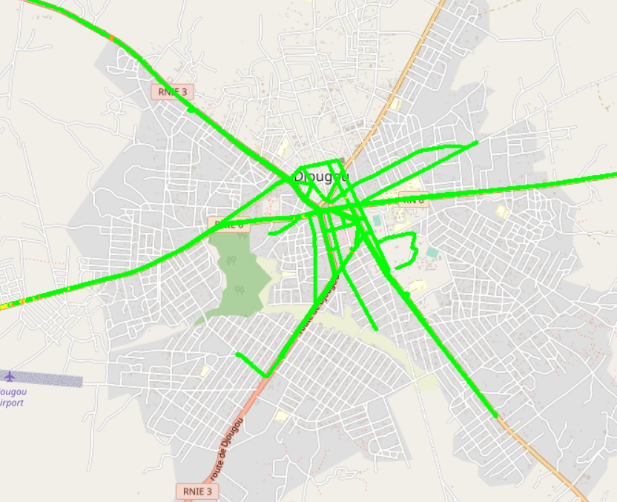
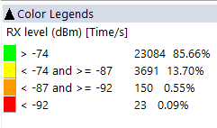
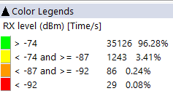
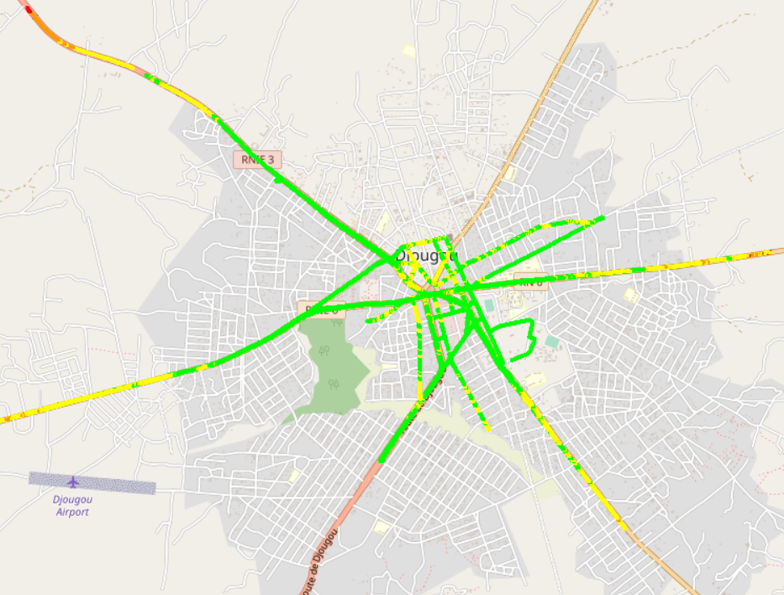

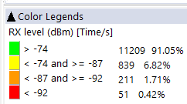
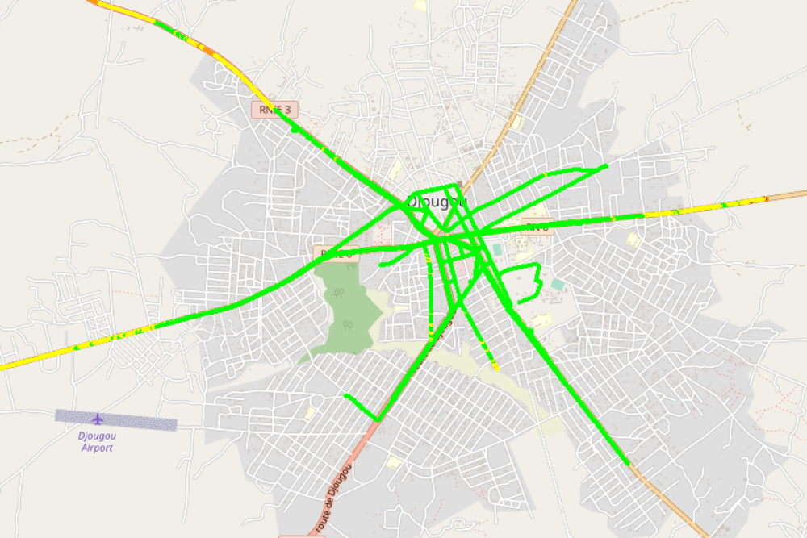


Benchmarking: 2G coverage - Maps
MOOV has the best ratio of RxLev samples great than -74dBm.

Slide 19
Benchmarking: 3G coverage
In DJOUGOU, MTN has the best 3G coverage and meets ARCEP requirements.

Slide 20
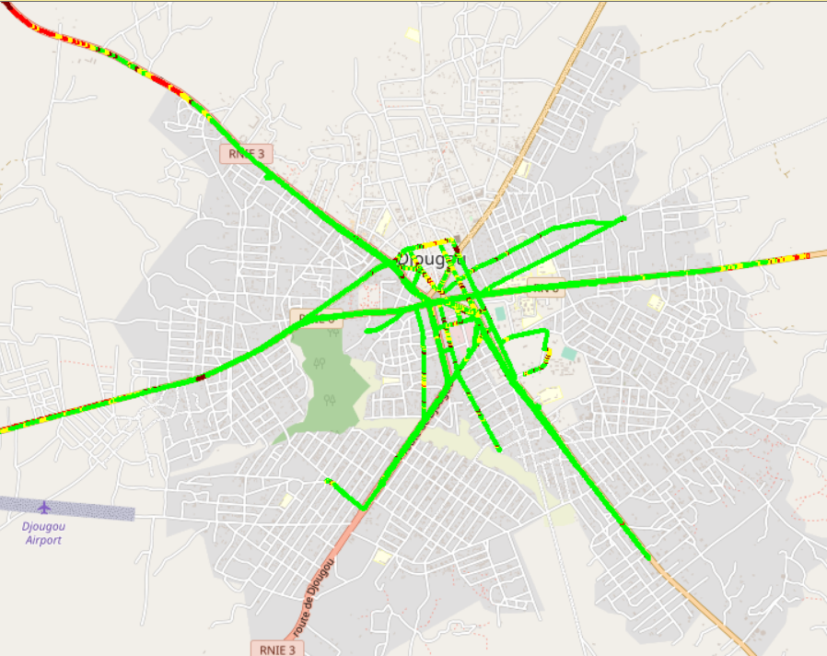

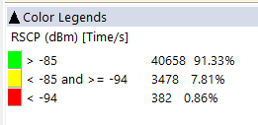
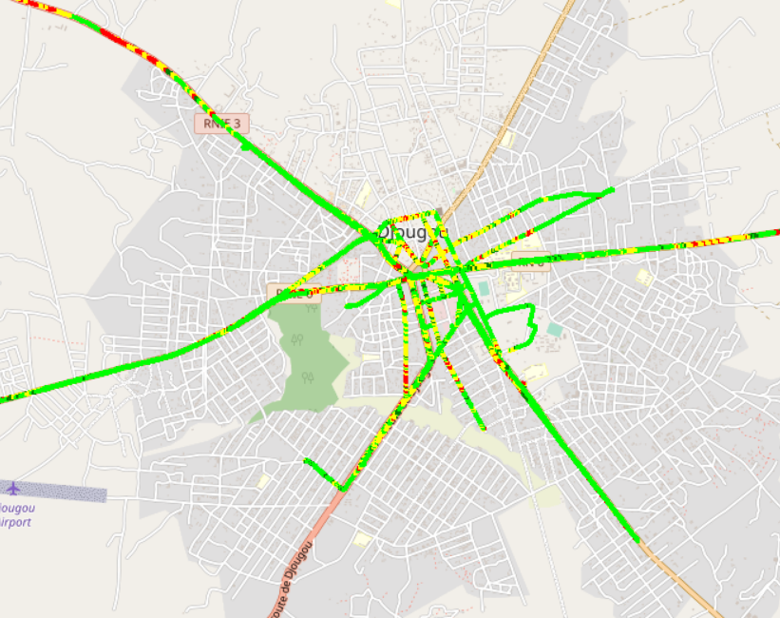
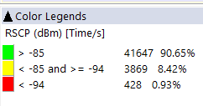
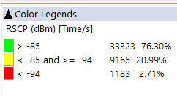
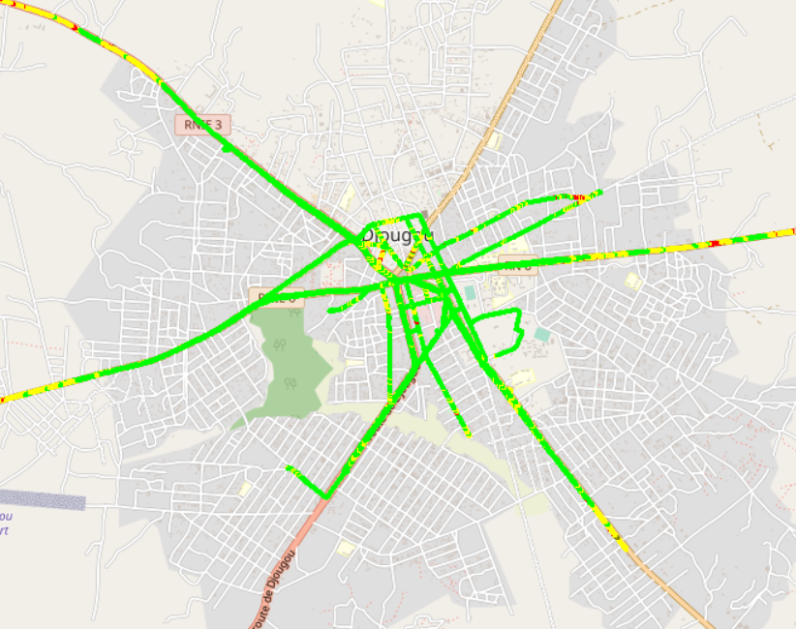
Benchmarking: 3G coverage-Maps
In DJOUGOU, MTN is clair leader in terms of 3G coverage and has the best distribution of RSCP samples.

Slide 21
Benchmarking: 4G coverage
MTN's 4G Radio coverage meets ARCEP requirements for Incar and outdoor morphologies. For Indoor coverage, all operators failed to meet ARCEP requirements but MTN has the best ratio.

Slide 22
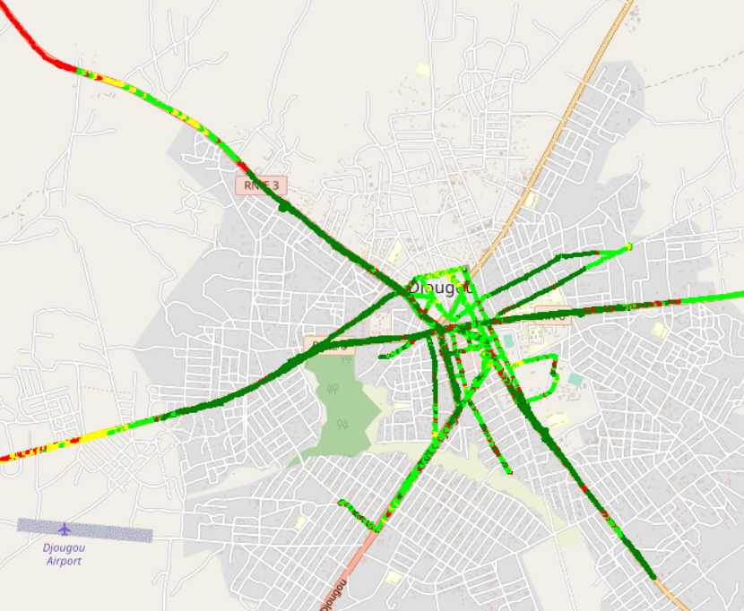

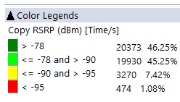
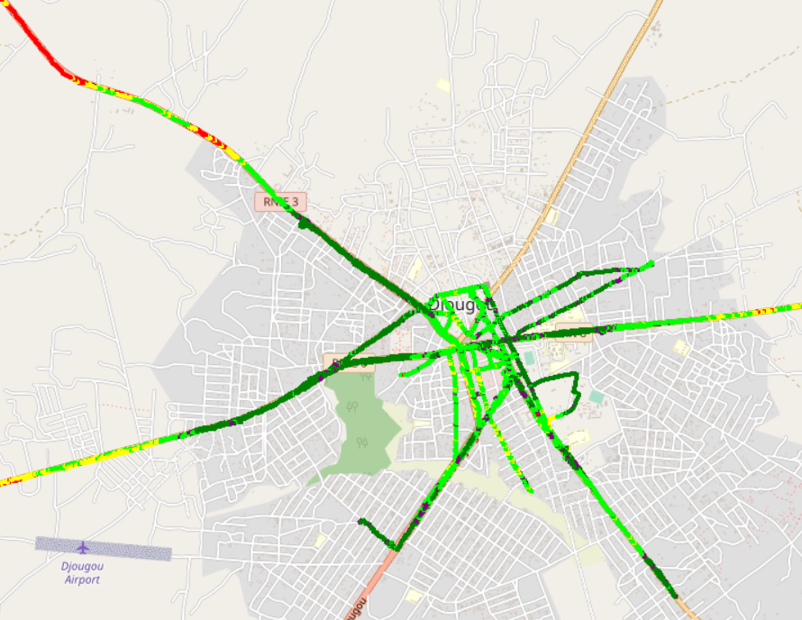
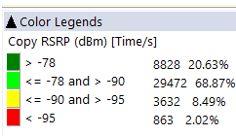
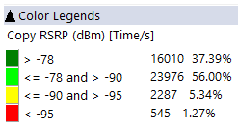
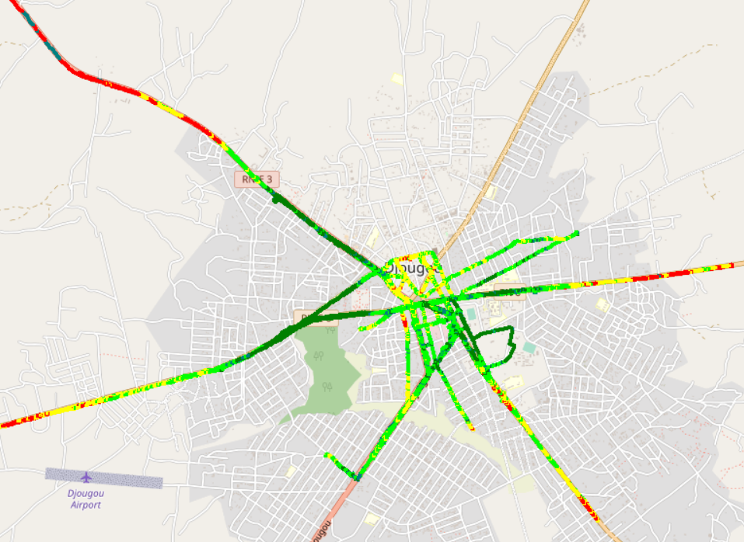
Benchmarking – 4G coverage - Maps
MTN’s 4G coverage is better than MOOV’s and CELTISS’s.

Slide 23
05
Benchmarking voice service

Slide 24
Benchmarking: CS Accessibility 2G/3G BLOCKED CALLS
In DJOUGOU, MTN has the worst accessibility to voice service compared to competitors,
MTN exceeds ARCEP requirements in terms of accessibility.

Slide 25
Benchmarking: CS Integrity Voice quality Mean Opinion Score
In DJOUGOU, CELTISS has the best ratio of excellent and good Voice Quality samples and MOS compared to MTN and MOOV.MTN needs to improve its voice quality MOS by pushing CS traffic to 3G as much as possible and improving 3G radio pamameter Ec/No.

Slide 26
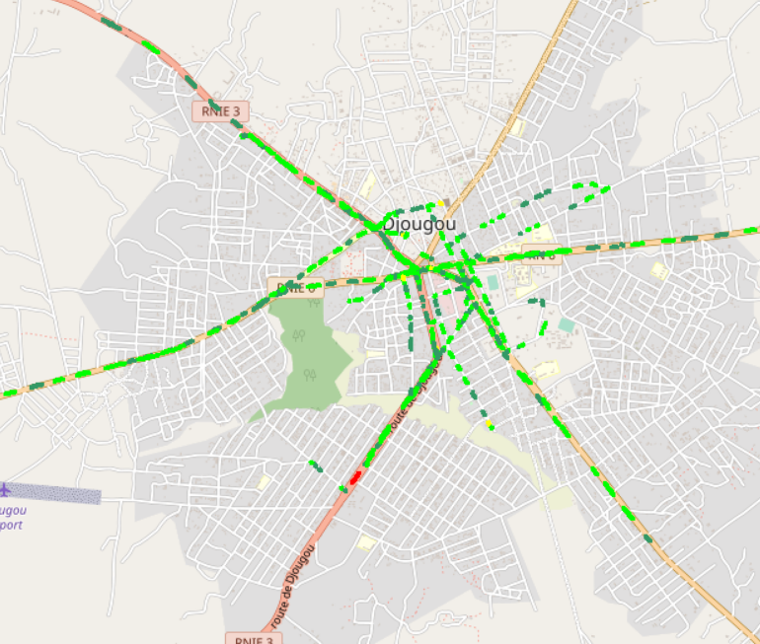
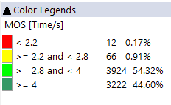
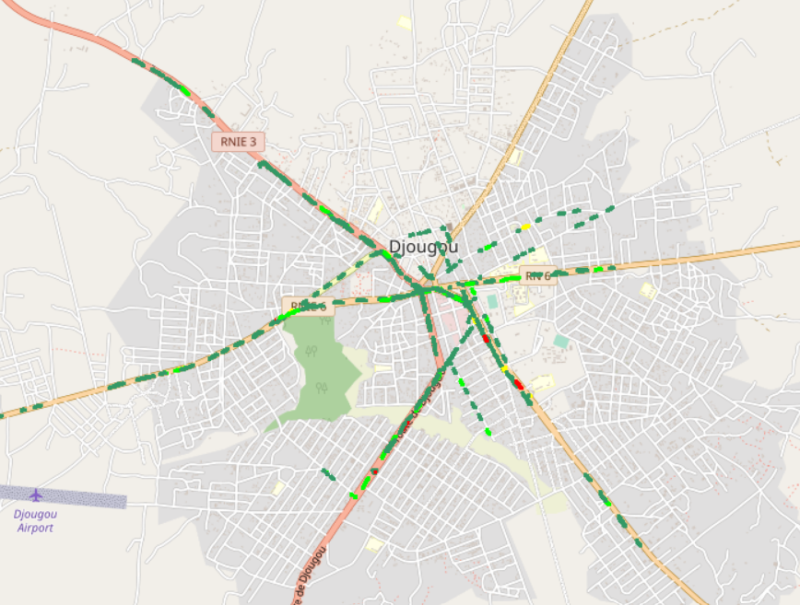
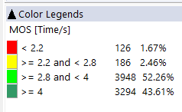
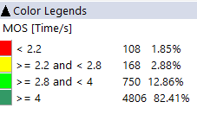
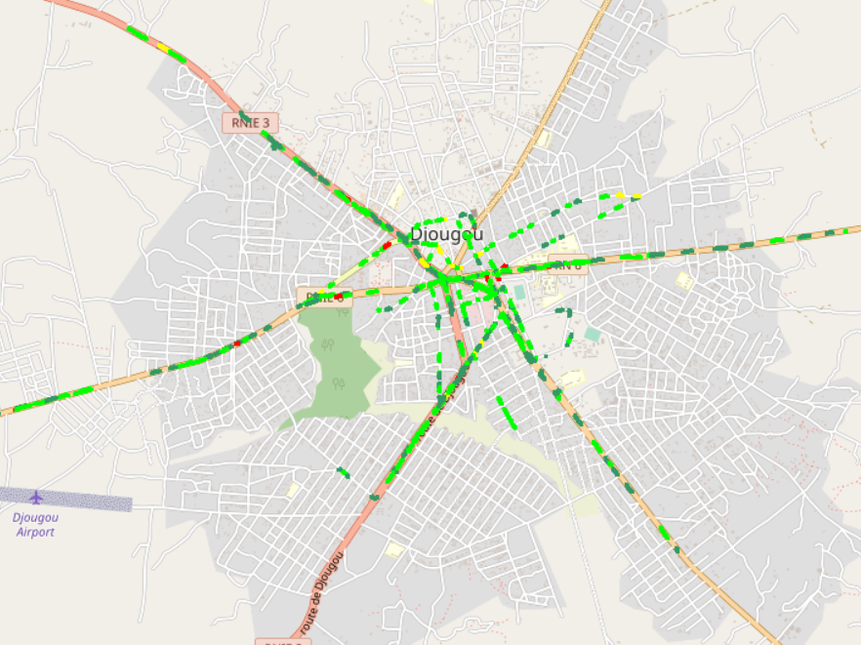

Benchmarking – CS Integrity Voice quality maps (MOS)
MTN has around 4,13% of MOS samples lower than 2.2 against 1,08% for CELTISS and 4,73 for MOOV
MOS Values lower than 2,2 pose risk of bad users perceived voice quality and silent calls.
3d

Slide 27
Benchmarking: CS Retainability 2G/3G DROPPED CALLS
MTN is clair leader in terms of retainability by having the best CDR(%),
MTN and CELTISS satisfy ARCEP thresholds regarding Call Drop Rate.

Slide 28
Benchmarking Voice service Band usage(%)
All operators have more than 96% of voice calls carried out over 3G,
MTN and CELTISS use mainly UMTS2100 (>75%).

Slide 29
Benchmarking: Radio parameters EC/NO comparison
11,39% of drive test samples are showing a very low level of EcNo for 3G MTN opposed to MOOV 5,64% and CELTISS 1,25%. MTN needs to improve its Ec/No samples ditribution in order to improve voice quality MOS.

Slide 30
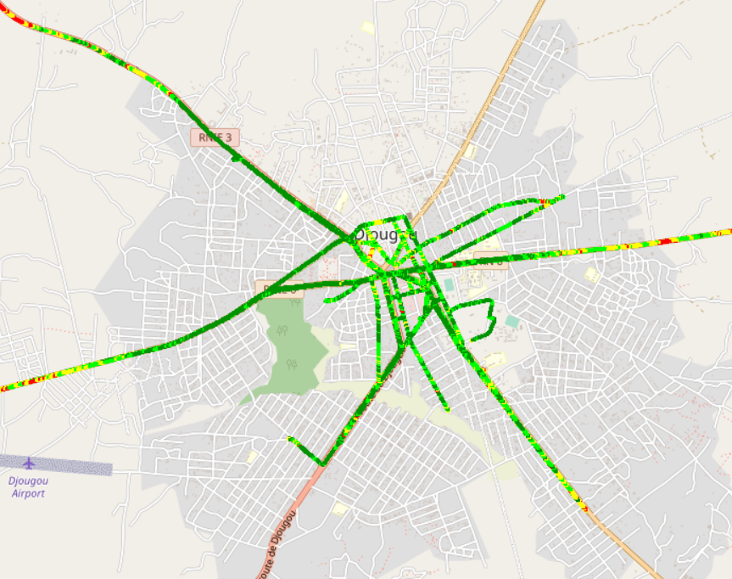
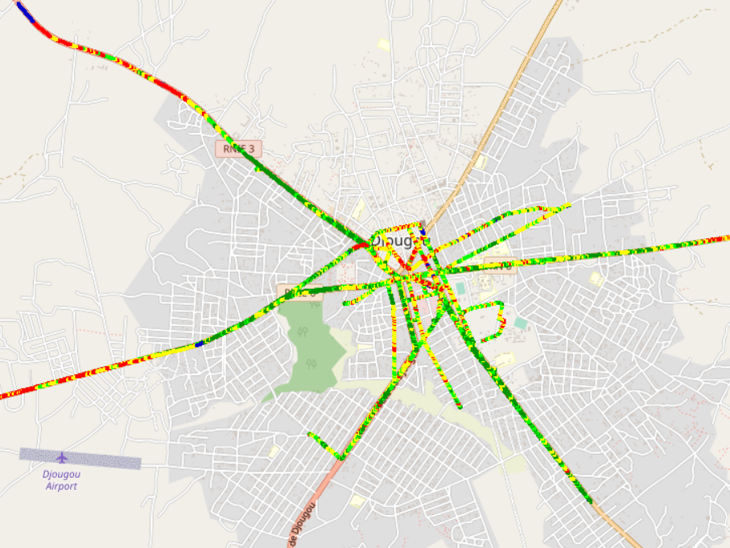
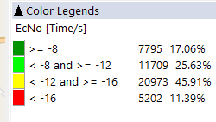
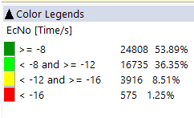
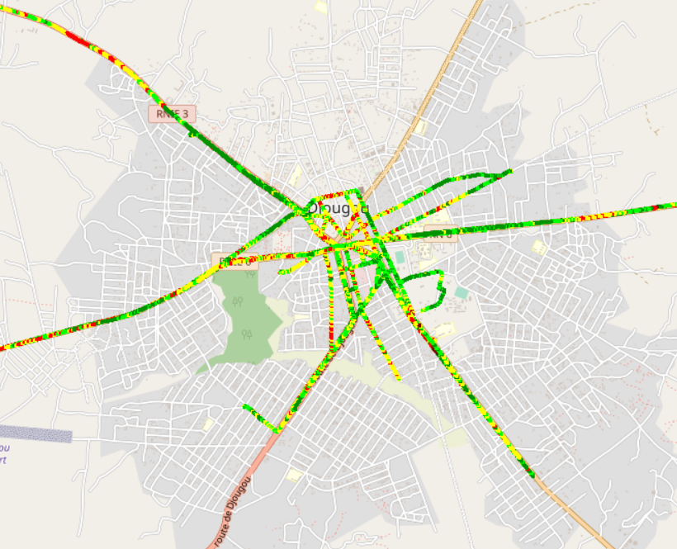
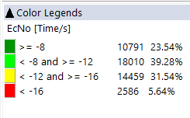
Benchmarking: Radio parameters EC/NO
3G MOOV’s and CELTISS’s EC/N0 is better than MTN’s due to the number of 3G used carriers .

Slide 31
Benchmarking – 2G/3G CALL SETUP TIME
MTN is clear leader in terms of Call Setup Time.

Slide 32
Benchmarking – SMS Service
MTN has outperformed its competitors in terms of SMS service,
In DJOUGOU, Compared to others areas, MTN has an excellent SMS performance.

Slide 33
06
Benchmarking Data service

Slide 34
Benchmarking – DATA 3G
All operators have a good rate of successful Internet connection.

Slide 35
Benchmarking – DATA 3G Web Browsing service
All operators have very good web service success rate and meet ARCEP requirements. MTN has the best PS connection setup time.

Slide 36
Benchmarking – DATA 3G
MTN has an excellent performance for downlink and uplink FTP success rate.

Slide 37
Benchmarking – 3G FTP MEAN THROUGHPUT
MTN’s 3G dowlink Throughput is less than MOOV’s and CELTISS’s,
MTN has the best 3G UL thropughput.

Slide 38
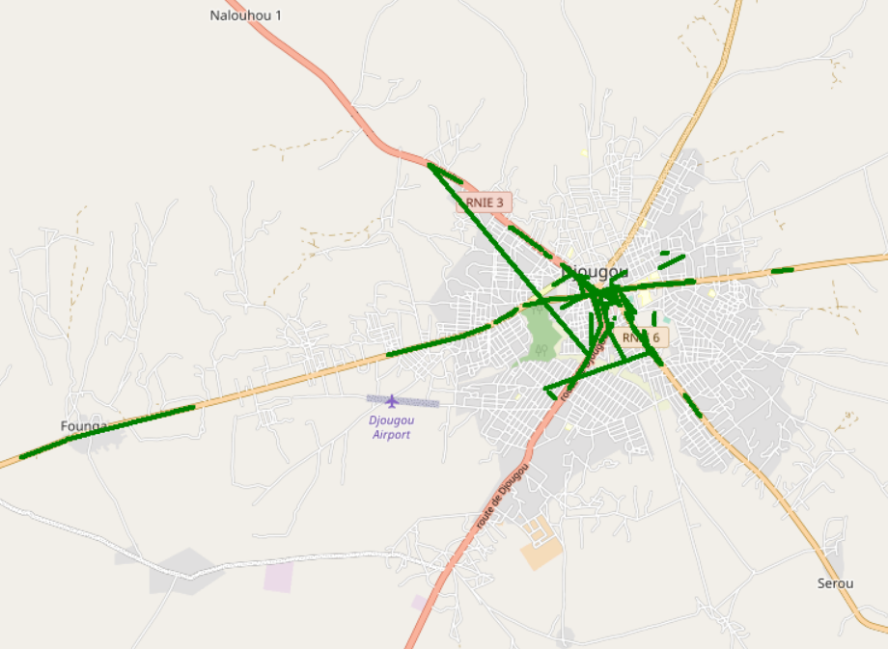

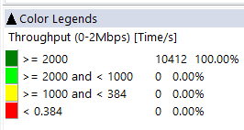
Benchmarking – 3G FTP MEAN THROUGHPUT comparison map
All operators meet ARCEP requirements by having 100% of 3G DL throughput samples better than 2Mbps.

Slide 39
Benchmarking – 4G HTTP Browsing service
All operators have very good HTTP Browsing success rate.

Slide 40
Benchmarking – 4G FTP THROUGHPUT comparison
MTN’s 4G network has an excellent FTP success rate.

Slide 41
Benchmarking – 4G FTP THROUGHPUT comparison
In DJOUGOU, MTN is leading in terms of FTP DL/UL AVERAGE Throughput,
MTN has outperformed its competitors with an excellent DL/UL speed.

Slide 42
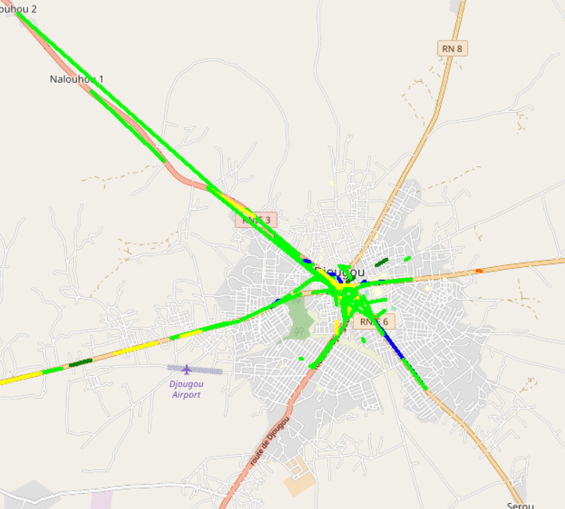
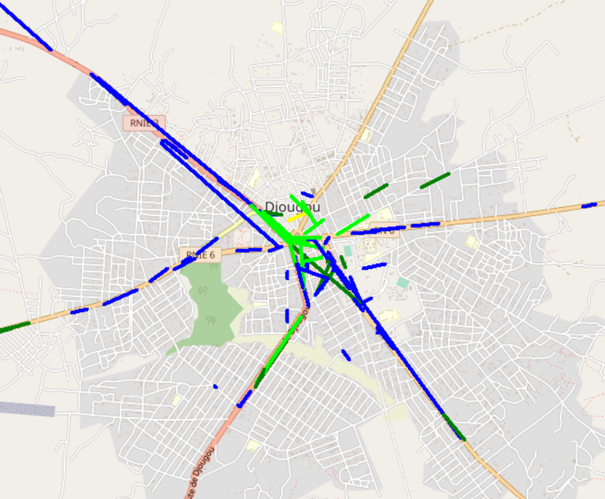
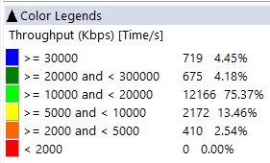
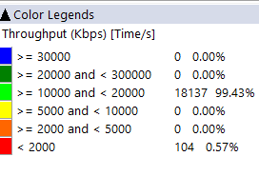
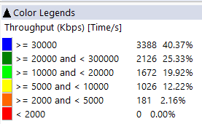
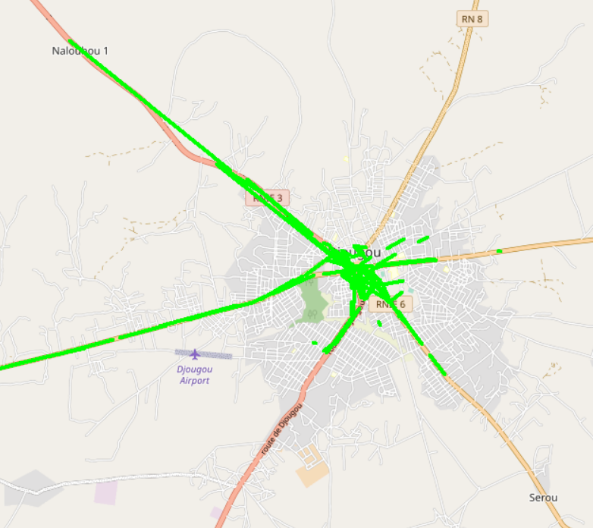
Benchmarking – 4G FTP THROUGHPUT comparison map
In DJOUGOU, MTN has an excellent end user throughput with more than 40,37% of samples better than 30Mbps .

Slide 43
Benchmarking – BAND and TECHNOLOGY UTILISATION
Most of MTN’s and MOOV’s LTE samples are carried out over LTE 2600 as first carrier,
Most of CELTISS’s samples are carried out over LTE 1800 as first carrier,
For all operators, most of 3G samples are carried out over U2100.

Slide 44
Benchmarking – Data TECHNOLOGY Usage(%)
MTN has the highest LTE CA Carrier Aggregation usage with 83,40% against 48,91% for MOOV and 50,75% for CELTISS.

Slide 45
Benchmarking – SINR comparison
Drive tests are showing a acceptable level of MTN Network SINR.

Slide 46
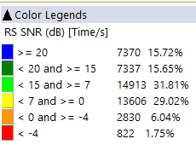
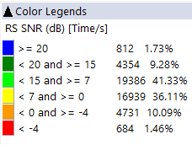
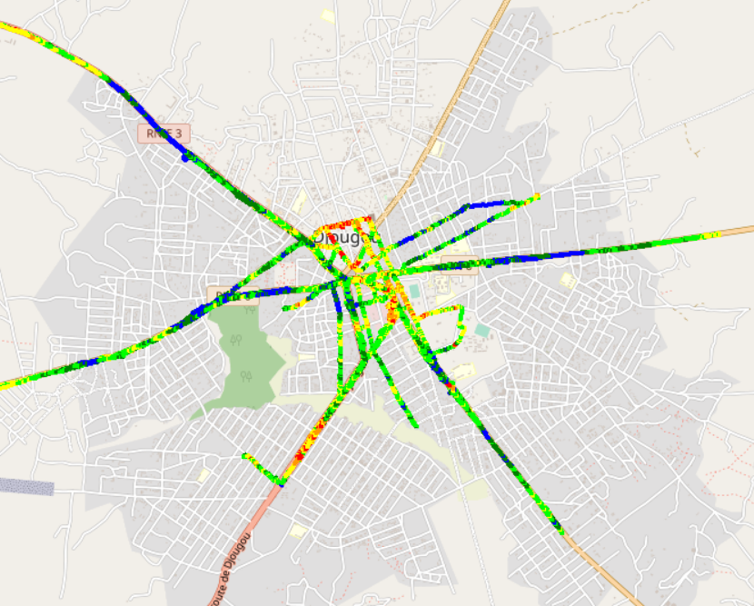
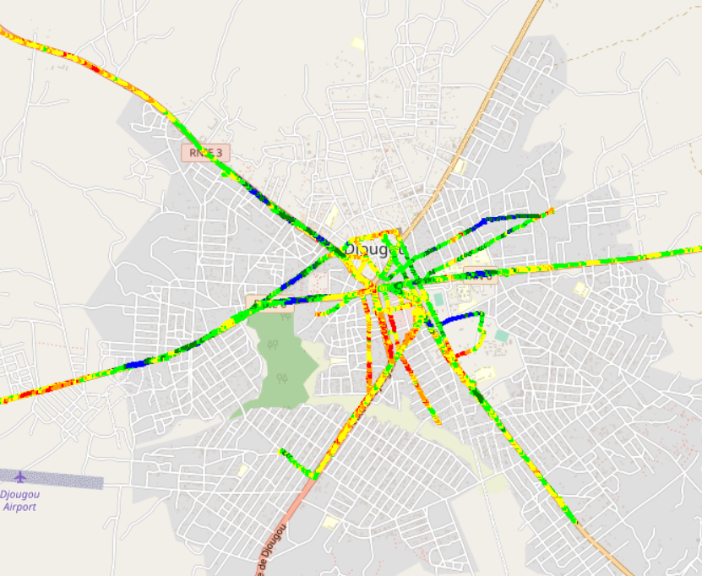
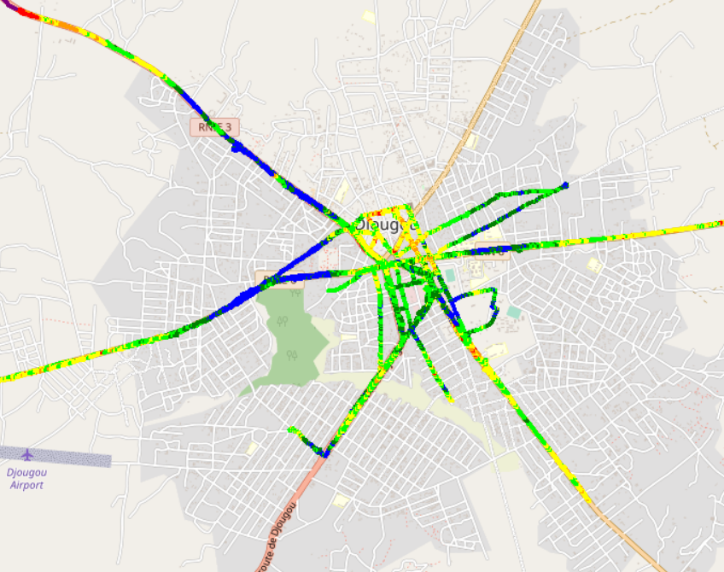

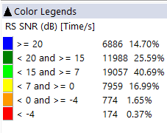
Benchmarking – SNIR comparison map
Drive tests are showing an acceptable level of MTN Network SINR.

Slide 47

Deloitte fait référence à un ou plusieurs cabinets membres de Deloitte Touche Tohmatsu Limited, société de droit anglais (« private company limited by guarantee »), et à son réseau de cabinets membres constitués en entités indépendantes et juridiquement distinctes. Pour en savoir plus sur la structure légale de Deloitte Touche Tohmatsu Limited et de ses cabinets membres, consulter www.deloitte.com/about.
Fort d’un réseau de firmes membres dans plus de 150 pays, Deloitte allie des compétences de niveau international à des expertises locales pointues, afin d’accompagner ses clients dans leur développement partout où ils opèrent. Nos 264 000 professionnels sont animés par un objectif commun, faire de Deloitte la référence en matière d’excellence de service.
Au Bénin, Deloitte mobilise un ensemble de compétences diversifiées pour répondre aux enjeux de ses clients, de toutes tailles et de tous secteurs – des grandes entreprises multinationales aux microentreprises locales, en passant par les entreprises moyennes.
Le présent document et ses annexes sont confidentiels et réservés à l’usage interne exclusif du destinataire. Toute reproduction ou toute divulgation partielle ou totale à des tiers en est interdite, sauf accord écrit préalable de Deloitte Bénin.
© 2023 Deloitte Bénin SARL. Société du réseau Deloitte

