Slide 1


Network QoS
Benchmarking report CALAVI
November 23th, 2023

Slide 2
Summary
Scope of Intermediate Report | 3
Executive Summary | 5
Benchmarking Key Results | 11
Benchmarking Coverage | 16
Benchmarking Voice Service | 23
Benchmarking Data Service | 34

Slide 3
01
Introduction: Scope of Benchmarking Report

Slide 4
Intermediate report
Scope of this report
  1. Network benchmarking results for the CALAVI area between MTN, MOOV, and CELTISS from October 16th to October 19th, 2023..

Slide 5
02
Benchmarking Executive Summary

Slide 6
Executive Summary – Benchmarking coverage 2G/3G/4G
MTN has outperformed its competitors in terms of 2G coverage for outdoor and Incar morphologies ,
For 2G RF coverage, All operators meet ARCEP obligation for all morphologies,
3G MTN’s coverage rate (90,02%) is lower than CELTISS (93,13%) and better than MOOV with (89,35%),
Only MTN and CELTISS meet ARCEP 3G coverage obligation
MTN is in third position in terms of 4G coverage rate for all morphologies,
All operators failed to satisfied the ARCEP threshold for indoor coverage.
TECHNOLOGY
KEY RECOMMENDATIONS
KEY FINDINGS
Coverage 2G/3G/4G
Tune and align power settings mainly in 3G/4G. Actual setting may impact the coverage strength specially at Indoor locations
Review the design at the coverage and quality blackspots
We highlight that 4G ARCEP coverage Thresholds are aggressive
* Final recommendations will be shared in the final report including details and findings from ongoing Configuration Audit

Slide 7
Executive Summary – Benchmarking voice service 2G/3G
TECHNOLOGY
Accessibility: MTN is ranked first for the accessibility to voice service , better than CELTISS and MOOV,
All operators meet ARCEP requirements in terms of accessibility to voice service,
Retainability: MTN is ranked second in term of retainability,
MTN's Call Drop Rate is (0.31%) better than MOOV (1.03%) and lower than CELTISS (0.15%).Only MTN and CELTISS meet ARCEP retainabilty requirements,
Integrity: MTN is in third position in terms of voice quality lower than MOOV and CELTISS with average Mean Opinion Score 3.73 as opposed to 3.85 for CELTISS and 3.87 for MOOV.
KEY RECOMMENDATIONS
KEY FINDINGS
Voice service 2G/3G
To improve its Mean Opinion Score MOS MTN needs to improve its 3G radio parameter Ec/No that is closely related to voice quality,
Voice quality is always better in 3G due to its better codec rate , we recommend to push as much as possible the voice traffic to 3G,
2G Full Rate/Half Rate settings need to be tuned in order to improve Full rate penetration.
* Final recommendations will be shared In the final report including details and findings from ongoing Configuration Audit

Slide 8
Executive Summary – Benchmarking SMS service
TECHNOLOGY
KEY RECOMMENDATIONS
KEY FINDINGS
SMS service 2G/3G
All operators failed to meet ARCEP for SMS Send Success with End To End Delivery Time < 6 sec,
In CALAVI, MTN has the best SMS send/Receive succes ratio and the best distrution for SMS send duration.
There is no issue in radio accessibility that could be correlated to the SMS high delivery time.
End to End investigation need to be performed to analyses the high delivery time including mainly Core/SMS parts: SM Sserver...
* Final recommendations will be shared in the final report including details and findings from ongoing Configuration Audit

Slide 9
Executive Summary – Benchmarking 4G Data service
Performance is stable in terms of accessibility for 4G data service, and all operators meet ARCEP's requirements.
MTN is ranked second in terms of 4G DL throughput with 19.46Mbps, which is better than CELTISS’s 12.67Mbps but lower than MOOV’s 22.70Mbps.
MTN is ranked first in terms of 4G UL throughput with 16.19Mbps, as opposed to 14.25Mbps for MOOV and 12.26Mbps for CELTISS.
All operators meet ARCEP's 4G End User Throughput obligation for download and upload.
TECHNOLOGY
KEY RECOMMENDATIONS
KEY FINDINGS
Data service 4G
MTN spectrum need to be used with a better efficiency, Some features and parameters need to be tuned and aligned,
To improve its 4G DL Throughput, MTN needs to optimize the carrier aggregation, MIMO settings and modulation,
To ensure that no throughput limitation is applied on users profiles.

Slide 10
Executive Summary – Benchmarking 3G Data service
Performance is stable in terms of accessibility for 3G data service, and all operators meet ARCEP's requirements.
MTN is in third position for 3G DL throughput with 2.96Mbps, compared to 4.20Mbps for CELTISS and 3.76Mbps for MOOV.
MTN is ranked second in term of 3G UL throughput with 1.20 Mbps against 1.16 Mbps for MOOV and 2.07Mbps for CELTISS,
All operators meets ARCEP’s 3G End User Throughput obligation for download and upload.
All operators meet ARCEP’s web browsing service accessibility thresholds.
TECHNOLOGY
KEY RECOMMENDATIONS
KEY FINDINGS
Data service 3G
To improve its 3G throughput MTN needs to activate HSPA-DC,
Its recommended to push as much as possible the data traffic to 4G in order to:
- Improve end user perception, Both DT and stats are showing that users in average are served with up to 6x better throughput in 4G than in 3G
- Offload the 3G network which will improve the 3G throughput and the 3G radio quality
Some features and parameters need to be tuned and aligned,
To ensure that no throughput limitation is applied on users profiles.

Slide 11
03
Benchmarking Key Results

Slide 12
Benchmarking Key Results – Coverage
MTN has the best 2G coverage except for Indoor morphology,
Only MTN and CELTISS meet ARCEP requirements for 3G coverage,
In CALAVI, MTN is in third position in terms of 4G coverage for all morphologies,
All operators failed to meet ARCEP requirements in Indoor 4G coverage.
KPI |  | ARCEP Threshorlds | MTN |  | MOOV |  | CELTISS |  | MTN Ranking
 |  |  | Value | Conformity | Value | Conformity | Value | Conformity
2G Coverage Rate | Incar | More than 90% with Incar: Rxlev >-87 dBm | 99,99% | OK | 99,97% | OK | 99,97% | OK | 1
 | Outdoor | More than 90% with Outdoor: Rxlev >-92 dBm | 100% | OK | 100% | OK | 100% | OK | 2
 | Indoor | More than 90% with Outdoor: Rxlev >-74 dBm | 92,73% | OK | 92,83% | OK | 96,73% | OK | 3
3G Coverage Rate | Incar,Indoor,Outdoor | More than 90% with RSCP <-85 dBm | 90,02% | OK | 89,35% | NOK | 93,13% | OK | 2
4G Coverage Rate | Incar | More than 90% with RSRP <-90 dBm* | 91,95% | OK | 97,91% | OK | 95,91% | OK | 3
 | Outdoor | More than 90% with RSRP <-95 dBm* | 97,27% | OK | 99,18% | OK | 98,73% | OK | 3
 | Indoor | More than 90% with RSRP <-78 dBm* | 50,29% | NOK | 57,29% | NOK | 57,38% | NOK | 3

Slide 13
Benchmarking Key Results – 2G/3G voice and SMS Summary
MTN’s network KPIs meet ARCEP requirements except for SMS service due to the high end to end delivery time,
MTN is leading in terms of accessibility to voice service,
MTN needs to improve its Voice Quality MOS and SMS Send duration.
KPI | ARCEP Threshorlds | MTN |  | MOOV |  | CELTISS |  | MTN Ranking
 |  | Value | Conformity | Value | Conformity | Value | Conformity
Accesibility: Blocking rate | <1% | 0,82% | OK | 0,94% | OK | 0,91 | OK | 1
Retainability: Call drop rate | <1% | 0,31% | OK | 1,03% | NOK | 0,15% | OK | 2
Call Completetion Rate (%) | =<98% | 98,87% | OK | 98,03% | OK | 98,94% | OK | 1
Integrity: Voice quality | Note requise> 2,8 | 3,73 | OK | 3,87 | OK | 3,85 | OK | 3
SMS sending success rate % (E2E delivery Time<6 sec) | >99% | 90,59% | NOK | 89,35% | NOK | 83,67% | NOK | 1
SMS receving success rate % | >99% | 88,88% | NOK | 88,10% | NOK | 82,44% | NOK | 1

Slide 14
Benchmarking Key Results – 3G Data Summary
MTN’s network in 3G DATA meets ARCEP requirements,
MTN is ranked third in term of 3G DL throughput.
Services | KPI | ARCEP Threshorlds | MTN |  | MOOV |  | CELTISS |  | MTN Ranking
 |  |  | Value | Conformity | Value | Conformity | Value | Conformity
3G HTTP | Successful internet connexion rate | >96% | 100,00% | OK | 99,27% | OK | 100,00% | OK | 1
 | Connexion setup time | <=10sec | 5,33 | OK | 6,49 | OK | 6,02 | OK | 1
 | Web service failure rate | <3% | 0,24% | OK | 2,06% | OK | 0,12% | OK | 1
3G FTP | FTP failure rate UL/DL | <3 % | 0%/0,71% | OK | 1,35%/1,89% | OK | 0,71%/0,26% | OK | 1
 | FTP Data transmission average (DL) | >= 2Mbps | 2,963 | OK | 3,762 | OK | 4,201 | OK | 3
 | FTP Data transmission average (UL) | >= 1Mbps | 1,207 | OK | 1,164 | OK | 2,078 | OK | 2

Slide 15
Benchmarking Key Results – 4G Data Summary
MTN’s 4G DATA End User KPIs satisfy ARCEP requirements,
MTN is ranked second in 4G DL THP after MOOV’s ,
MTN has outperformed its competitors in terms of 4G UL THP.
Services | KPI | Threshorlds* | MTN |  | MOOV |  | CELTISS |  | MTN Ranking
 |  |  | Value | Conformity | Value | Conformity | Value | Conformity
4G HTTP Browsing | Web service failure rate (%) | <3% | 0,09% | OK | 0,22% | OK | 0,11% | OK | 1
 | Connexion setup time | <=3sec | 0,49 | OK | 0,51 | OK | 0,66 | OK | 1
4G FTP | FTP failure rate UL/DL | <3 % | 0,43%/0,88% | OK | 0%/0,46% | OK | 0%/0,28% | OK | 3
 | FTP Data transmission average (DL) | 4G >= 5 Mbps | 19,467 | OK | 22,708 | OK | 12,677 | OK | 2
 | FTP Data transmission average (UL) | 4G: >= 2Mbps | 16,192 | OK | 14,256 | OK | 12,265 | OK | 1

Slide 16
04
Benchmarking 2G/3G/4G coverage

Slide 17
Benchmarking: 2G coverage
MTN, MOOV and CELTISS’s 2G coverage meets ARCEP RxLev thresholds,
MTN has the best 2G coverage for Incar and outdoor morphologies.

Slide 18
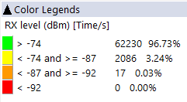

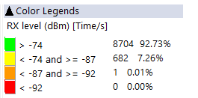
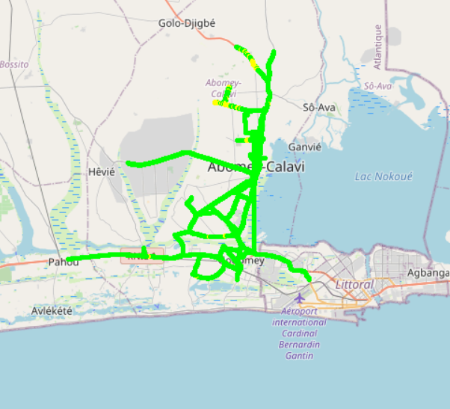
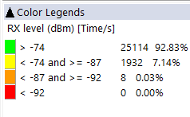
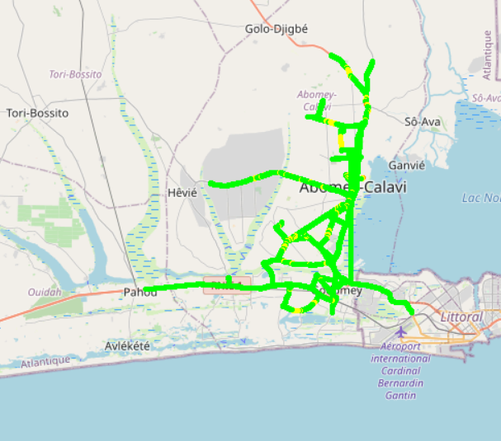


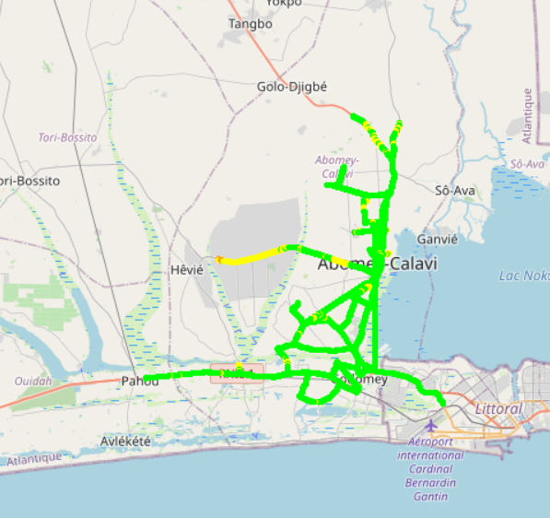
Benchmarking: 2G coverage - Maps
MTN has more than 92,73% of RxLev samples better than -74dBm,against 92,83% for MOOV and 96,73% for CELTISS.

Slide 19
Benchmarking: 3G coverage
CELTISS has the best 3G coverage,
MTN’s and CELTISS’s 3G coverage meet ARCEP requirements.

Slide 20
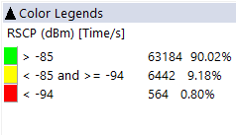
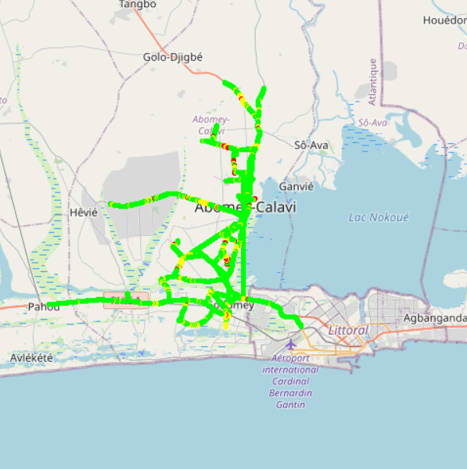
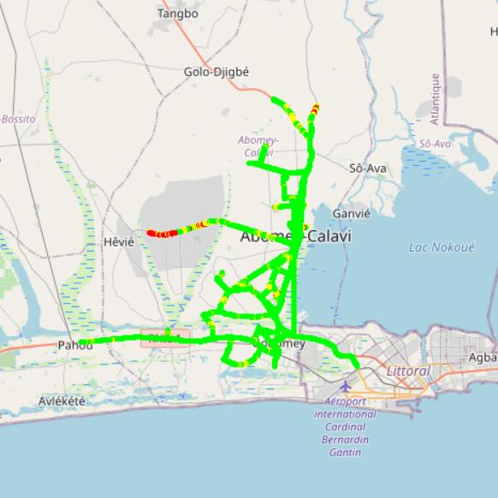
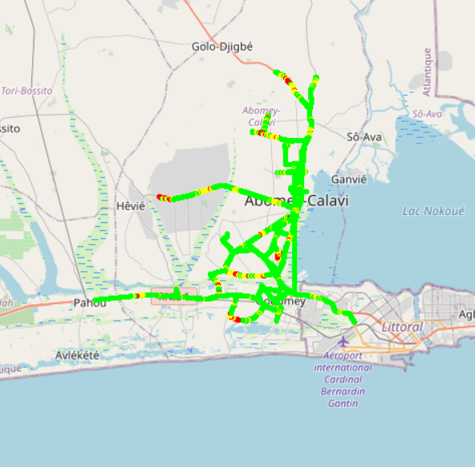
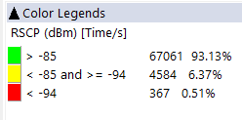

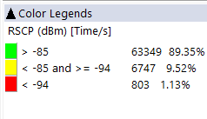
Benchmarking: 3G coverage-Maps
CELTISS has the best 3G coverage with 93,13% better than -85dBm against 90,02% for MTN and 89,35% for MOOV.

Slide 21
Benchmarking: 4G coverage
CELTISS has the best 4G coverage for incar and outdoor morphologies but all operators failed to satisfy ARCEP requirements for indoor,
MTN is ranked third in terms of 4G coverage and closely simular to competitors for outdoor morphology.

Slide 22
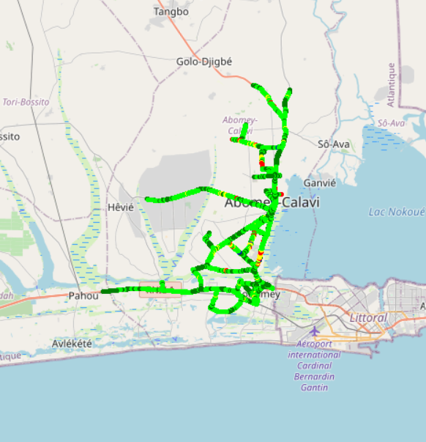
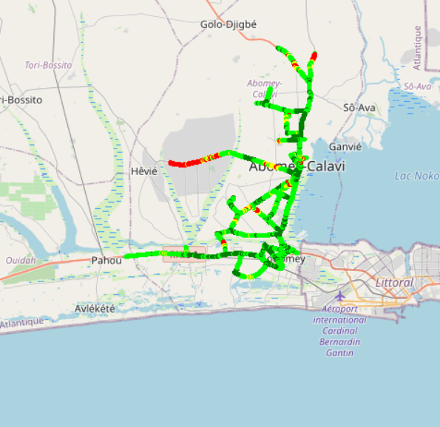

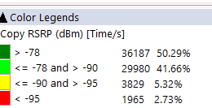
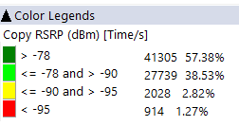
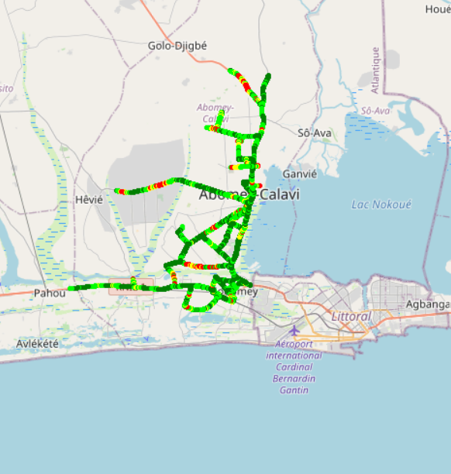
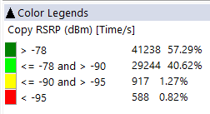
Benchmarking – 4G coverage - Maps
MTN’s 4G coverage is lower than MOOV’s and CELTISS’s.

Slide 23
05
Benchmarking voice service

Slide 24
Benchmarking: CS Accessibility 2G/3G BLOCKED CALLS
MTN has the best accessibility to voice service compared to competitors,
All operators meet ARCEP requirements in terms of accessibility.

Slide 25
Benchmarking: CS Integrity Voice quality Mean Opinion Score
CELTISS has the best ratio of excellent and good Voice Quality samples compared to MTN and MOOV,MTN needs to improve its voice quality MOS by pushing CS traffic to 3G and increase 2G full rate penetration,
MOOV has the best MOS with 3,73 opposed to 3,87 for MOOV and 3,85 for CELTISS.

Slide 26
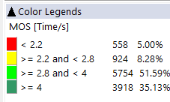
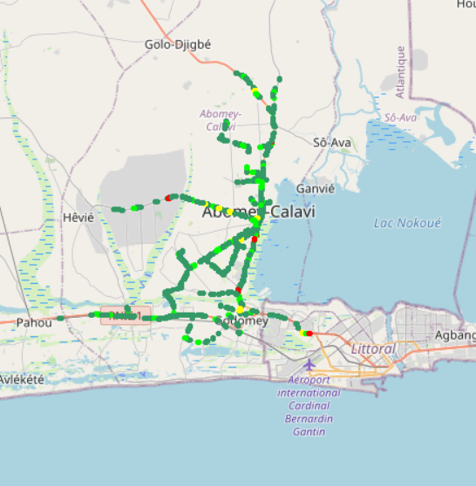
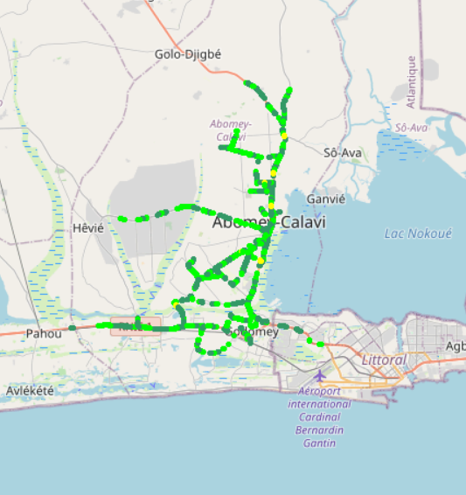
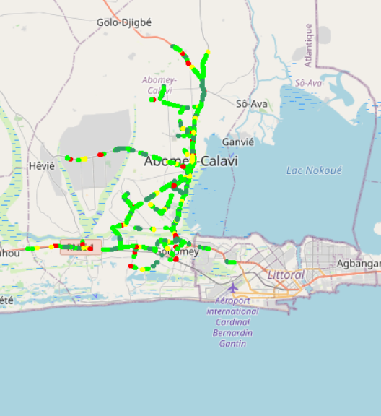
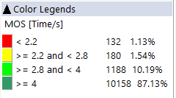

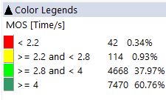
Benchmarking – CS Integrity Voice quality maps (MOS)
MTN has around 5% of MOS samples lower than 2.2 against 1,13% for MOOV and 0,34% for CELTISS.MOS Values lower than 2,2 pose risk of bad users perceived voice quality and silent call.
3d

Slide 27
Benchmarking: CS Retainability 2G/3G DROPPED CALLS
MTN and CELTISS satisfy ARCEP thresholds regarding Call Drop Rate.

Slide 28
Benchmarking Voice service Band usage(%)
MTN has the highest ratio of 2G use, 36.74% of voice calls carried out over 2G network but CELTISS and MOOV use mainily 3G,
Recommended for MTN to reduce 2G usage and increase 3G penetration for better audio quality.
MTN's 2G band usage: 77,02% GSM 900 and 22,98% GSM 1800 Mhz,
3G band usage: MTN uses mainly U900, CELTISS and MOOV use mainly U2100.

Slide 29
Benchmarking: Radio parameters EC/NO comparison
36,14% of drive test samples are showing a very low level of EcNo for 3G MTN.
This is correlated to the number of 3G carriers : MTN is using 2 carriers against 3 and 4 for CELTISS and MOOV respectively. Also 3G traffic is carried mainly by U2100 for competitors while it’s distributed over U900 and U2100 for MTN.
Bad Ec/No has great impact on voice quality.

Slide 30
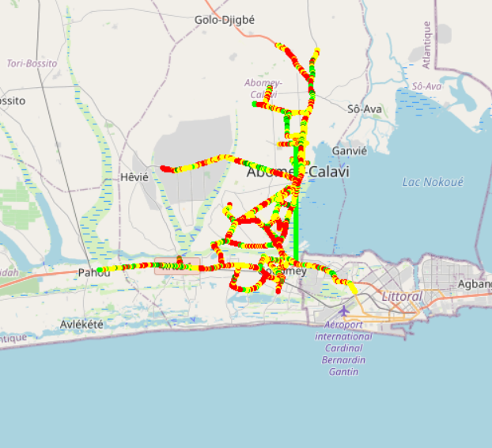
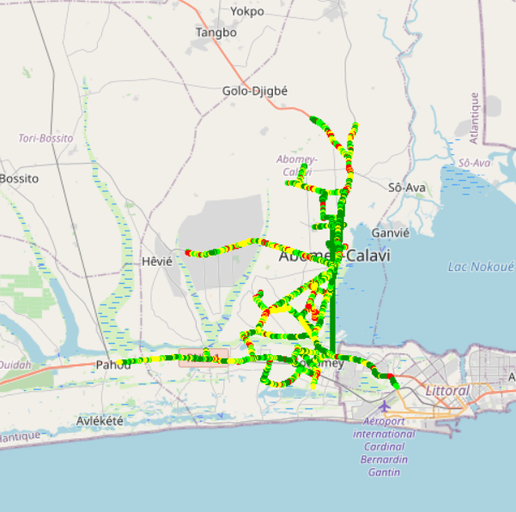
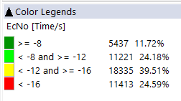
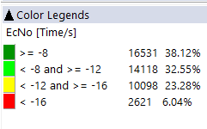
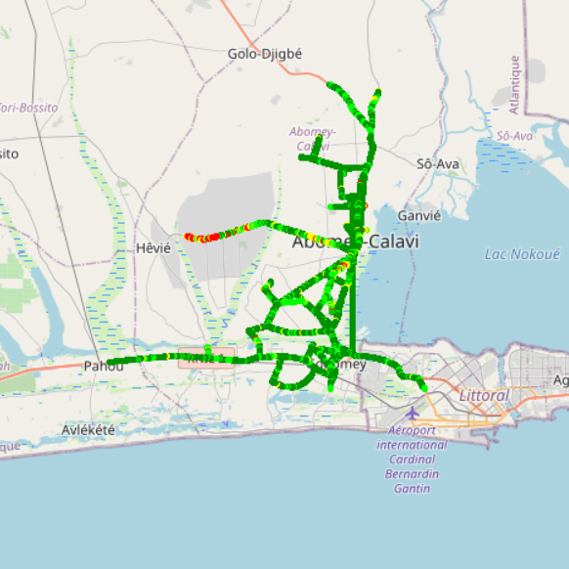
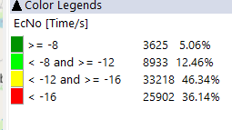
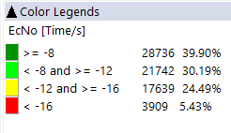
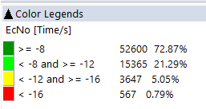

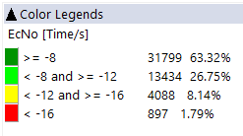
Benchmarking: Radio parameters EC/NO
3G MOOV’s and CELTISS’s EC/N0 is better than MTN’s due to the number of 3G used carriers and 3G band distribution by using mainly U900 for MTN.

Slide 31
Benchmarking – 2G/3G CALL SETUP TIME
MTN has the best Call setup time.
MTN has the best 4G CSBF Call setup Time.
Call setup time 2G is higher than in 3G/4G.

Slide 32
Benchmarking – SMS Service
In CAVALI, MTN’s SMS Send/Recieve success ratio is better than CELTISS’s & MOOV’s. SMS service KPIs for all operators are not compliant with the ARCEP requirements due to the timeout of sending duration (< 6s).

Slide 33
06
Benchmarking Data service

Slide 34
Benchmarking – DATA 3G
All operators have a good rate of successful Internet connection.

Slide 35
Benchmarking – DATA 3G Web service
All operators have an excellent web service success rate. MTN has best time to connect to web service.

Slide 36
Benchmarking – DATA 3G FTP service
All operators have a good downlink and uplink FTP success rate and meet ARCEP requirements.

Slide 37
Benchmarking – 3G FTP MEAN THROUGHPUT
All operators meet ARCEP requirement in terms of FTP DL/UL throughput,
MTN has the lowest 3G FTP DL throughput,
MTN is in the second position in terms of FTP UL Throughput.

Slide 38
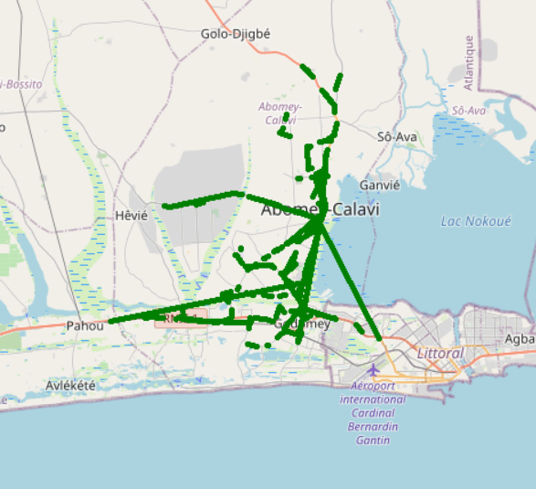
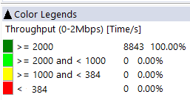
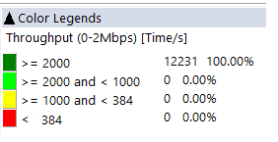

Benchmarking – 3G FTP MEAN THROUGHPUT comparison map
All operators have 100% of FTP DL Throughput samples better than 2Mbps.

Slide 39
Benchmarking – DATA 4G Web browsing service
For 4G, All operators have very good HTTP Browsing success rate and meet ARCEP requirements.

Slide 40
Benchmarking – 4G FTP THROUGHPUT comparison
All operators have acceptable FTP success rate and largely meet the ARCEP criteria.

Slide 41
Benchmarking – 4G FTP THROUGHPUT comparison
MTN is ranked second in terms of FTP DL throughput,
MTN has outperformed its competitors in terms of FTP UL throughput,
All operators meet ARCEP requirements for 4G DL/UL throughput.

Slide 42
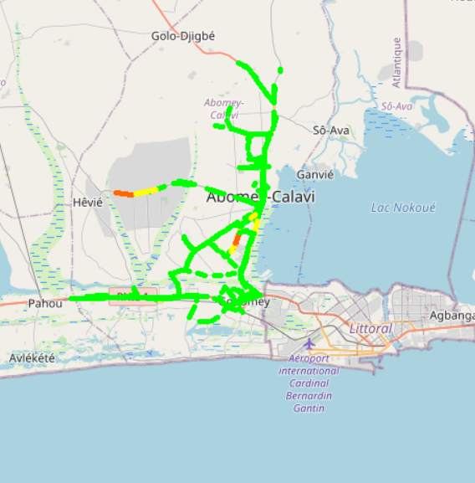
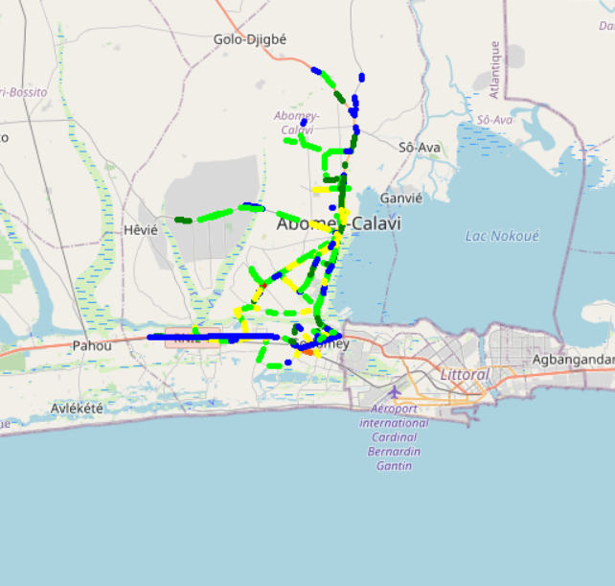
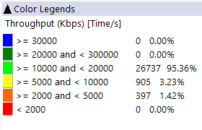
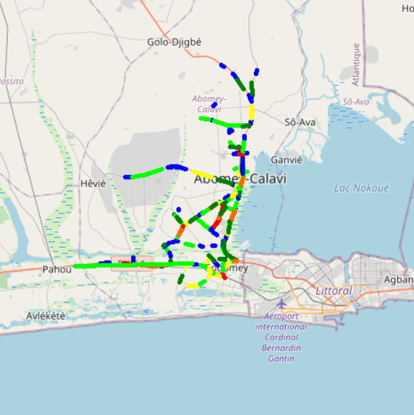
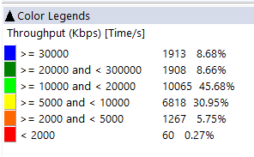
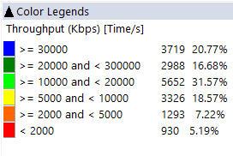
Benchmarking – 4G FTP THROUGHPUT comparison map
CELTISS has 98,78% of DL throughput samples better than 5Mbps against 93,98% for MTN and 87,59% for MOOV.

Slide 43
Benchmarking – BAND and TECHNOLOGY UTILISATION
Most of MTN’s and MOOV’s LTE samples are carried out over LTE 2600 as first carrier,
Most of CELTISS’s LTE samples in CALAVI are carried out over LTE 1800 as first carrier,
Most of CELTISS’s and MOOV’s 3G samples are carried out over U2100, but MTN has the highest ratio of U900 usage (47,67%).

Slide 44
Benchmarking – Data TECHNOLOGY Usage(%)
MTN has the highest LTE Carrier Aggregation usage, with 86,40% against 55,36% for MOOV and 51,02% for CELTISS,
MTN needs to improve its LTE CA usage to get the best 4G throughput,
To improve its 3G data throughput, its is recommended for MTN to use HSPA-DC.

Slide 45
Benchmarking – SINR comparison
Drive results are showing that MTN’s Network has the SINR distribution with the highest percentage of acceptable SINR.

Slide 46
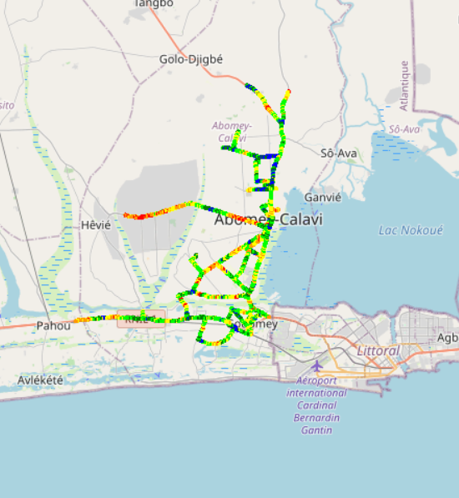
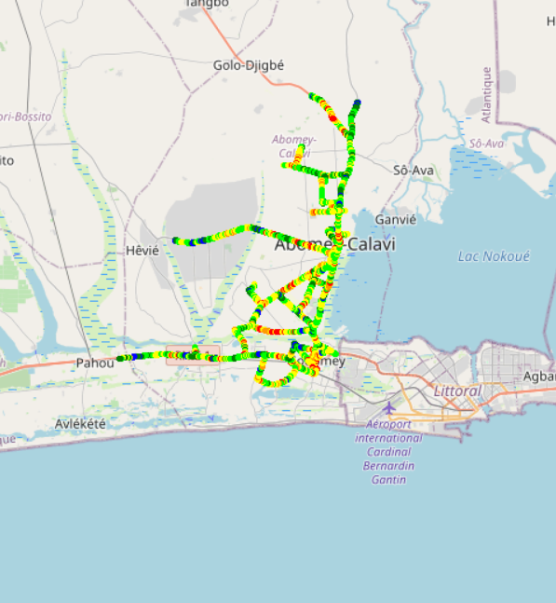
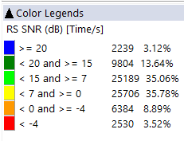
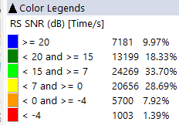

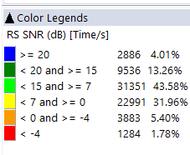
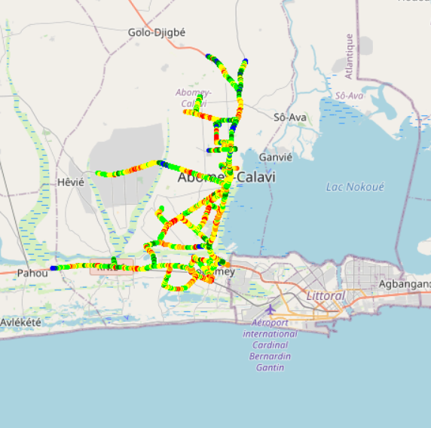
Benchmarking – SNIR comparison maps
MTN’s 4G network has the best quality of signal compared to MOOV’s and CELTISS’s.

Slide 47

Deloitte fait référence à un ou plusieurs cabinets membres de Deloitte Touche Tohmatsu Limited, société de droit anglais (« private company limited by guarantee »), et à son réseau de cabinets membres constitués en entités indépendantes et juridiquement distinctes. Pour en savoir plus sur la structure légale de Deloitte Touche Tohmatsu Limited et de ses cabinets membres, consulter www.deloitte.com/about.
Fort d’un réseau de firmes membres dans plus de 150 pays, Deloitte allie des compétences de niveau international à des expertises locales pointues, afin d’accompagner ses clients dans leur développement partout où ils opèrent. Nos 264 000 professionnels sont animés par un objectif commun, faire de Deloitte la référence en matière d’excellence de service.
Au Bénin, Deloitte mobilise un ensemble de compétences diversifiées pour répondre aux enjeux de ses clients, de toutes tailles et de tous secteurs – des grandes entreprises multinationales aux microentreprises locales, en passant par les entreprises moyennes.
Le présent document et ses annexes sont confidentiels et réservés à l’usage interne exclusif du destinataire. Toute reproduction ou toute divulgation partielle ou totale à des tiers en est interdite, sauf accord écrit préalable de Deloitte Bénin.
© 2019 Deloitte Bénin SARL. Société du réseau Deloitte

