Slide 1


Network QoS
OUIDAH Intermediate report
November 21st, 2023

Slide 2
Summary
Scope of Intermediate Report | 3
Executive Summary | 5
Benchmarking Key Results | 11
Benchmarking Coverage | 16
Benchmarking Voice Service | 23
Benchmarking Data Service | 36

Slide 3
01
Introduction: Scope of Intermediate Report

Slide 4
Intermediate report
Scope of this report
  1. Network benchmarking results for the Ouidah area between MTN, MOOV, and CELTISS from September 9th to September 13th, 2023..
  Comments and recommendations may be enriched on final report using CM audit findings

Slide 5
02
Benchmarking Executive Summary

Slide 6
Executive Summary – Benchmarking coverage 2G/3G/4G
TECHNOLOGY
2G MTN is ranked 2nd in indoor and incar and coverage rate
All operators met ARCEP 2G coverage obligation except CELTISS Indoor.
3G MTN coverage rate is ranked second
All operators met ARCEP 3G coverage obligation
4G MTN coverage rate is ranked second
All operators satisfy the 4G Coverage thresholds only for outdoor measurement .
KEY RECOMMENDATIONS
KEY FINDINGS
Coverage 2G/3G/4G
Tune and align power settings mainly in 3G/4G. Actual setting may impact the coverage strength specially at Indoor locations
Review the design at the coverage and quality blackspots
We highlight that 4G ARCEP coverage Thresholds are aggressive

Slide 7
Executive Summary – Benchmarking voice service 2G/3G
TECHNOLOGY
Accessibility: MTN is ranked first for the accessibility to voice service , better than CELTISS and MOOV
All operators satisfy the ARCEP accessibility thresholds,
Retainability: MTN is ranked second in term of retainability
Only CELTISS satisfies the retainability ARCEP thresholds
Integrity: MTN is in third position in term of voice quality lower than MOOV and CELTISS with average Mean Opinion Score of 3.85 as opposed to 3.94 for CELTISS and 4.01 for MOOV.
KEY RECOMMENDATIONS
KEY FINDINGS
Voice service 2G/3G
Voice quality is always better in 3G due to its better codec rate , we recommend to push as much as possible the voice traffic to 3G.
Actual selection/reselection/Irat parameters need to be reviewed and aligned.
2G Full Rate/Half Rate settings need to be tuned in order to improve Full rate penetration

Slide 8
Executive Summary – Benchmarking SMS service
TECHNOLOGY
KEY RECOMMENDATIONS
KEY FINDINGS
SMS service 2G/3G
All operators failed to meet ARCEP for SMS Send Success with End To End Delivery Time < 6 sec,
MTN is ranked first in SMS service tests.
There is no issue in radio accessibility that could be correlated to the SMS high delivery time.
End to End investigation need to be performed to analyses the high delivery time including mainly Core/SMS parts: SM Sserver...

Slide 9
Executive Summary – Benchmarking 4G Data service
Performance is stable in terms of accessibility for 4G data service, and all operators meet ARCEP's requirements.
MTN is ranked first in terms of 4G DL and UL average throughput with 53.33/19.15Mbps, which is better than MOOV 36.33/13.02 Mbps and CELTISS 13.94/11.94Mbps.
TECHNOLOGY
KEY RECOMMENDATIONS
KEY FINDINGS
Data service 4G
MTN spectrum need to be used with a better efficiency, Some features and parameters need to be tuned and aligned
To ensure that no throughput limitation is applied on users profiles

Slide 10
Executive Summary – Benchmarking 3G Data service
Performance is stable in terms of accessibility for 3G data service, and all operators met ARCEP's requirements.
MTN is in third position for 3G DL throughput with 3.3Mbps, compared to 5.85Mbps for MOOV and 7.93Mbps for CELTISS.
MTN is ranked third in term of 3G UL throughput with 1.15 Mbps compared yo 1.46 Mbps for MOOV and 2.16Mbps for CELTISS,
All operators met ARCEP’s 3G User Throughput obligation for download and upload.
All operators met ARCEP’s web browsing service accessibility thresholds.
TECHNOLOGY
KEY RECOMMENDATIONS
KEY FINDINGS
Data service 3G
Its recommended to push as much as possible the data traffic to 4G in order to:
- Improve end user perception, Both DT and stats are showing that users in average are served with up to 700% better throughput in 4G than in 3G
- Offload the 3G network which will improve the 3G throughput and the 3G radio quality
Some features and parameters need to be tuned and aligned
To ensure that no throughput limitation is applied on users profiles

Slide 11
03
Benchmarking Key Results

Slide 12
Benchmarking Key Results – Coverage
All operators met the different coverage thresholds except 4G Incar and Indoor and CELTISS 2G Indoor
CELTISS have the best 2G and the worst 4G Incar coverage. All remaining coverage results are within the same ranges
MTN is ranked 2nd in almost all kind of coverage except 2G outdoor where results are very similar for all operators
KPI |  | ARCEP Threshorlds | MTN |  | MOOV |  | CELTISS |  | MTN Ranking
 |  |  | Value | Conformity | Value | Conformity | Value | Conformity
2G Coverage Rate | Incar | More than 90% with Incar: Rxlev >-87 dBm | 96,41% | OK | 92,22% | OK | 99,91% | OK | 2
 | Outdoor | More than 90% with Outdoor: Rxlev >-92 dBm | 99,40% | OK | 99,63% | OK | 99,97% | OK | 3
 | Indoor | More than 90% with Outdoor: Rxlev >-74 dBm | 90,22% | OK | 90,46% | OK | 89,28% | NOK | 2
3G Coverage Rate | Incar,Indoor,Outdoor | More than 90% with RSCP <-85 dBm | 92,15% | OK | 91,56% | OK | 95,68% | OK | 2
4G Coverage Rate | Incar | More than 90% with RSRP <-90 dBm* | 88,02% | NOK | 88,33% | NOK | 60,95% | NOK | 2
 | Outdoor | More than 90% with RSRP <-95 dBm* | 96,42% | OK | 95,99% | OK | 97,94% | OK | 2
 | Indoor | More than 90% with RSRP <-78 dBm* | 24,06% | NOK | 26,88% | NOK | 23,03% | NOK | 2

Slide 13
Benchmarking Key Results – 2G/3G voice and SMS Summary
MTN is ranked first in voice accessibility
Only CELTISS satisfies the retainability ARCEP thresholds
All operators met the MOS ARCEP thresholds however MOOV and CELTISS have better average MOS
All operators fail in SMS service due to the delivery time exceeding 6s.
KPI | ARCEP Threshorlds | MTN |  | MOOV |  | CELTISS |  | MTN Ranking
 |  | Value | Conformity | Value | Conformity | Value | Conformity
Accesibility: Blocking rate | <1% | 0,24% | OK | 0,27% | OK | 0,32 | OK | 1
Retainability: Call drop rate | <1% | 1,15% | NOK | 2,44% | NOK | 0% | OK | 2
Call Completetion Rate (%) | =<99% | 98,61% | NOK | 97,29% | NOK | 99,68% | OK | 2
Integrity: Voice quality | Note requise> 2,8 | 3,85 | OK | 4,01 | OK | 3,94 | OK | 3
SMS sending success rate % (E2E delivery Time<6 sec) | >99% | 98,71% | NOK | 96,57% | NOK | 93,81% | NOK | 1
SMS receving success rate % | >99% | 97,33% | NOK | 94,51% | NOK | 91,89% | NOK | 1

Slide 14
Benchmarking Key Results – 3G Data Summary
All operators met the 3G Data ARCEP requirements.
MTN is the best in 3G HTTP service
MTN is ranked 3rd in 3G FTP service
Services | KPI | ARCEP Threshorlds | MTN |  | MOOV |  | CELTISS |  | MTN Ranking
 |  |  | Value | Conformity | Value | Conformity | Value | Conformity
3G HTTP | Successful internet connexion rate | >96% | 99,86% | OK | 98,00% | OK | 98,35% | OK | 1
 | Connexion setup time | <=10sec | 5,09 | OK | 6,31 | OK | 5,98 | OK | 1
 | Web service failure rate | <3% | 0,96% | OK | 0,28% | OK | 1,22% | OK | 2
3G FTP | FTP failure rate UL/DL | <3 % | 1,34%/0% | OK | 0,12%/0% | OK | 0,49%/0,51% | OK | 3
 | FTP Data transmission average (DL) | >= 2Mbps | 3,259 | OK | 5,853 | OK | 7,928 | OK | 3
 | FTP Data transmission average (UL) | >= 1Mbps | 1,147 | OK | 1,458 | OK | 2,163 | OK | 3

Slide 15
Benchmarking Key Results – 4G Data Summary
All operators met the 3G Data ARCEP requirements.
MTN is the best in 4G data for both HTTP and FTP
Services | KPI | Threshorlds* | MTN |  | MOOV |  | CELTISS |  | MTN Ranking
 |  |  | Value | Conformity | Value | Conformity | Value | Conformity
4G HTTP Browsing | Web service failure rate (%) | <3% | 0,00% | OK | 0,00% | OK | 0,00% | OK | 1
 | Connexion setup time | <=3sec | 0,39 | OK | 0,77 | OK | 0,29 | OK | 2
4G FTP | FTP failure rate UL/DL | <3 % | 0%/0% | OK | 0,9%/0,56% | OK | 0%/0% | OK | 1
 | FTP Data transmission average (DL) | 4G >= 5 Mbps | 53,331 | OK | 36,338 | OK | 13,943 | OK | 1
 | FTP Data transmission average (UL) | 4G: >= 2Mbps | 19,146 | OK | 13,019 | OK | 11,937 | OK | 1

Slide 16
04
Benchmarking 2G/3G/4G coverage

Slide 17
Benchmarking: 2G coverage
CELTISS’s 2G indoor coverage failed to reach the ARCEP requirement.

Slide 18
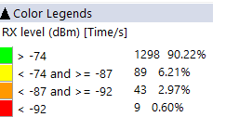
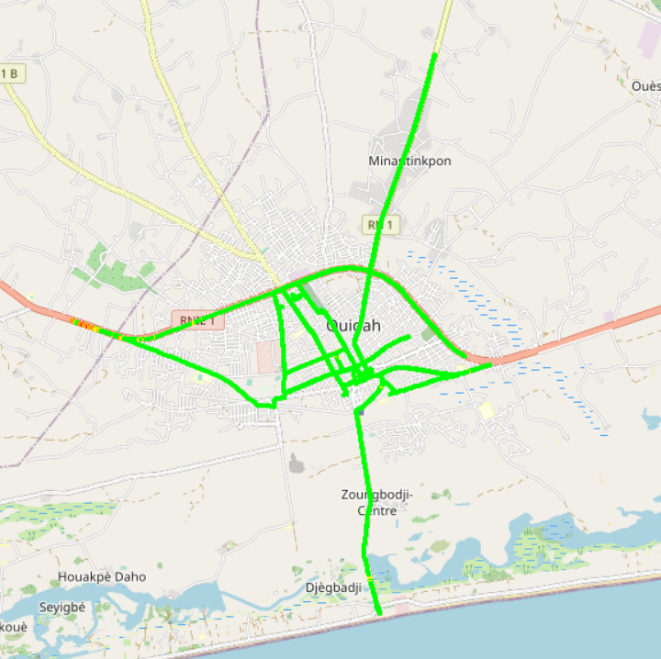

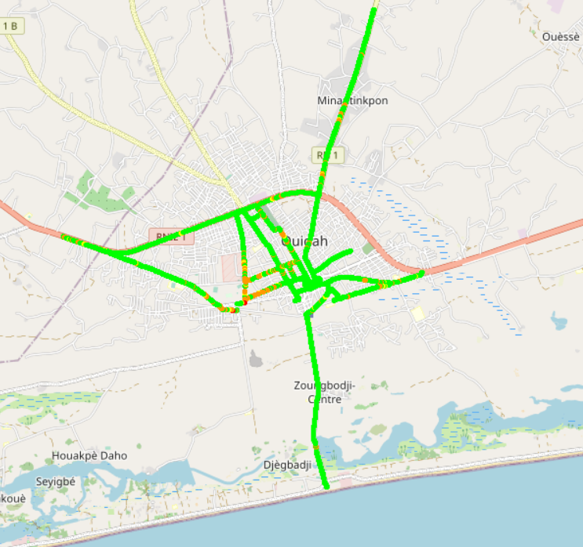
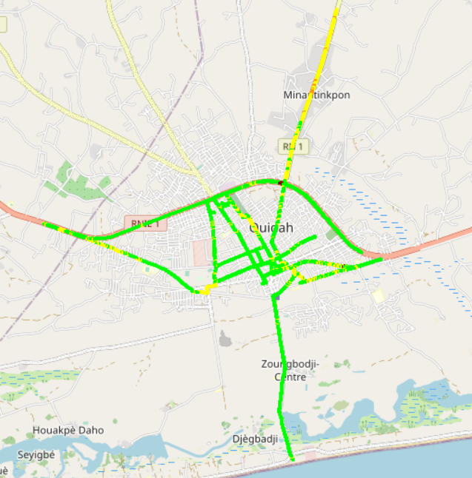

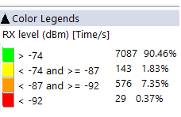

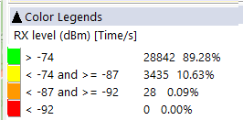
Benchmarking: 2G coverage - Maps
2G coverage plots are quite similar for the 3 operators except in few roads

Slide 19
Benchmarking: 3G coverage
All operators 3G coverage met ARCEP requirements with better average values for CELTISS.

Slide 20
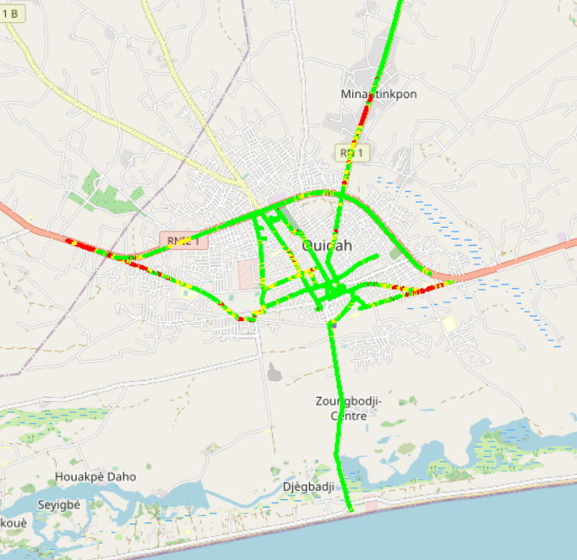
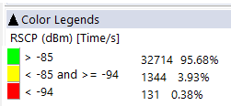

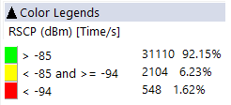
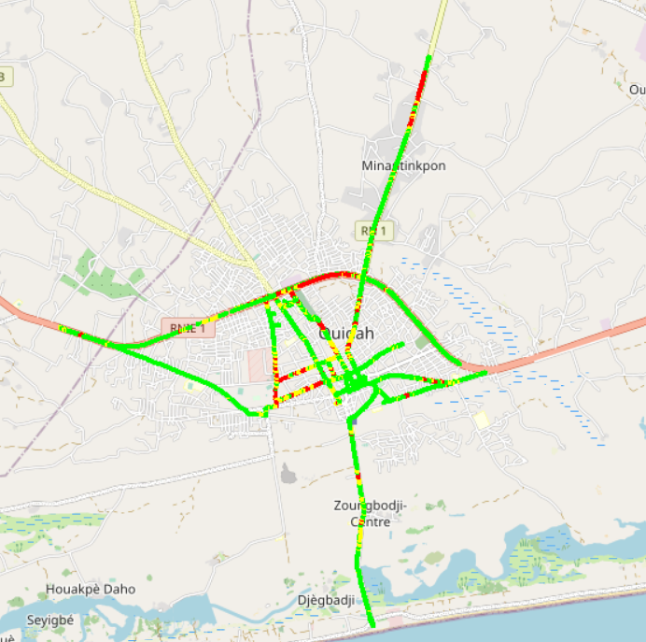
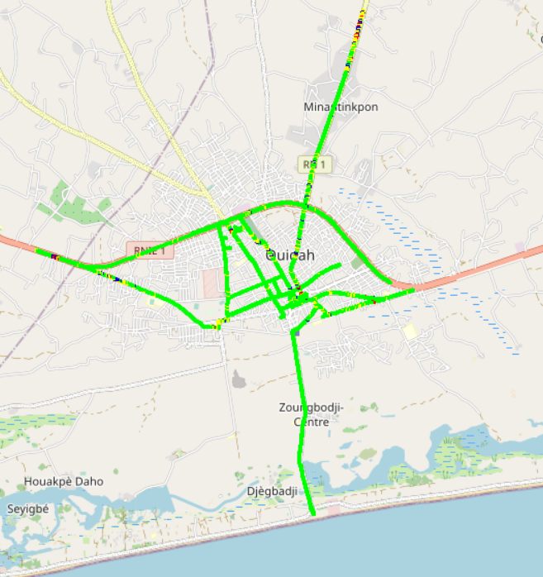
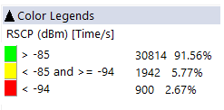
Benchmarking: 3G coverage-Maps
2G coverage plots are quite similar for the 3 operators except in few roads.

Slide 21
Benchmarking: 4G coverage
All operators failed to satisfy the 4G Indoor coverage, CELTISS failed also in 4G incar coverage.

Slide 22
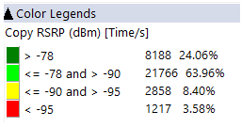
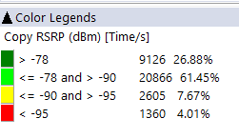
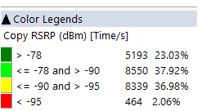
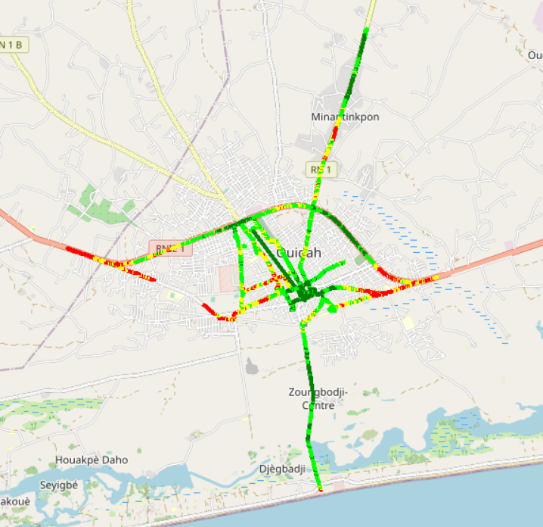
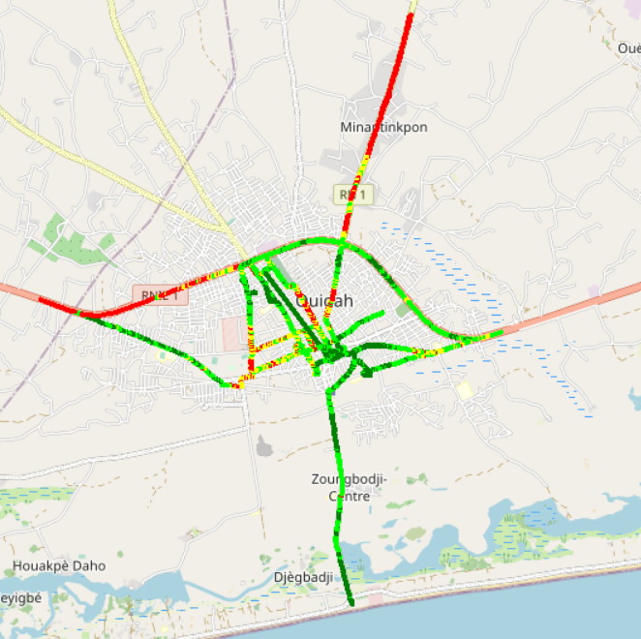

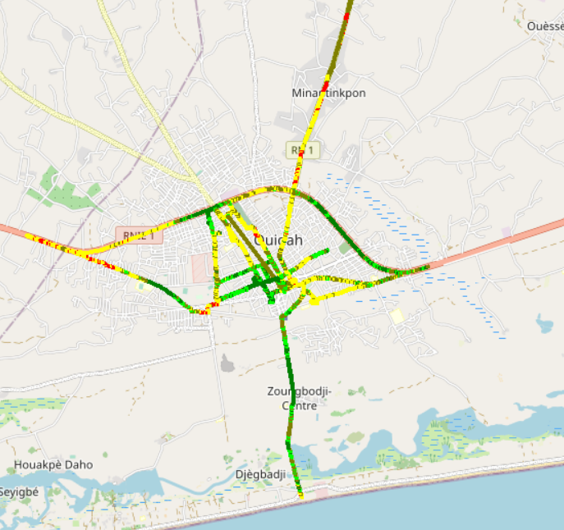
Benchmarking – 4G coverage - Maps
2G coverage plots are quite similar for the 3 operators except in few roads.

Slide 23
05
Benchmarking voice service

Slide 24
Benchmarking: CS Accessibility 2G/3G BLOCKED CALLS
MTN has the best accessibility to voice service compared to competitors,
MTN 3G blocked rate is higher than competitors

Slide 25
Benchmarking: CS Integrity Voice quality Mean Opinion Score
MOOV has the best ratio of excellent and good Voice Quality samples
MTN needs to improve its voice quality MOS by pushing CS traffic to 3G and increase 2G full rate penetration.

Slide 26
Benchmarking: CS Retainability 2G/3G DROPPED CALLS
All operators satisfy ARCEP thresholds regarding Call Drop Rate.

Slide 27
Benchmarking Voice service Band usage(%)
20% of MTN voice calls is carried by 2G while all voice traffic is carried by 3G for competitors
Its recommended for MTN to reduce 2G utilization and increase 3G penetration for better audio quality.
MTN's 2G band usage: 76,76% GSM 900 and 23,24% GSM 1800 Mhz,
43 % of MTN 3G CS traffic is carried on U900 compared to 24% and 7% for MOOV and CELTISS.

Slide 28
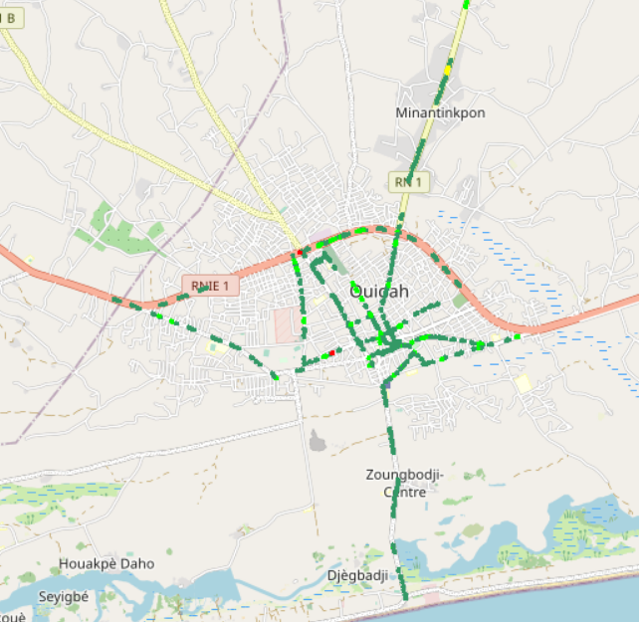
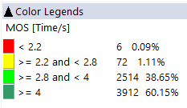
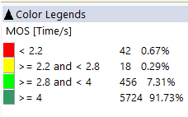

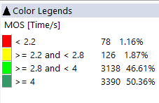
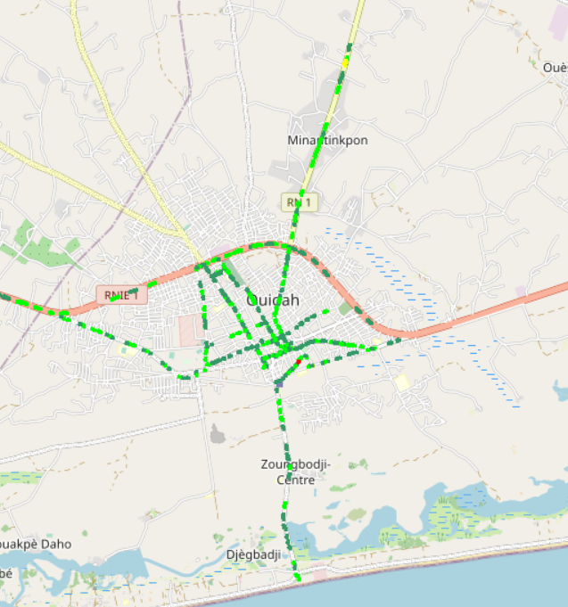
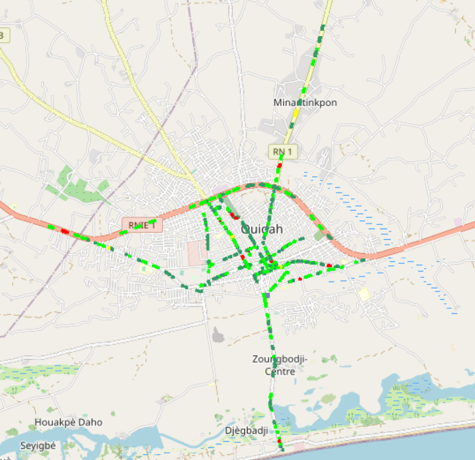
Benchmarking – CS Integrity Voice quality maps (MOS)
MTN has around 1% of MOS samples lower than 2.2,
Values lower than 2,2 pose risk of bad users perceived voice quality
3d

Slide 29
Benchmarking: Radio parameters EC/NO comparison
Only 18% of MTN 3G EcNo samples are within acceptable range compared to 73% and 95% for MOOV and CELTISS.
This is correlated to the number of 3G carriers and the fact that more than 40% of MTN 3G traffic is carried by U900

Slide 30
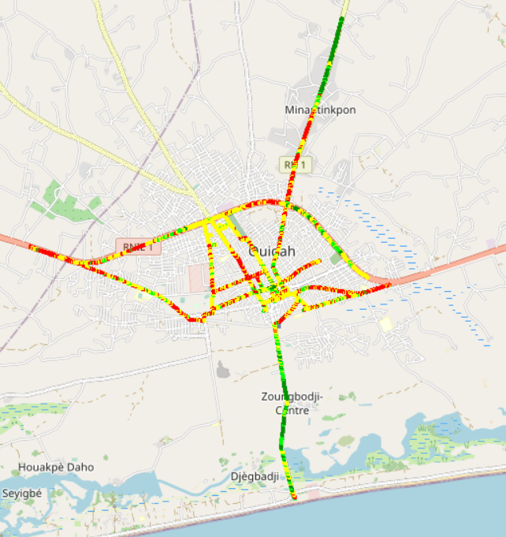
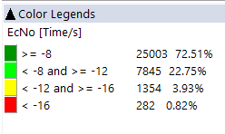
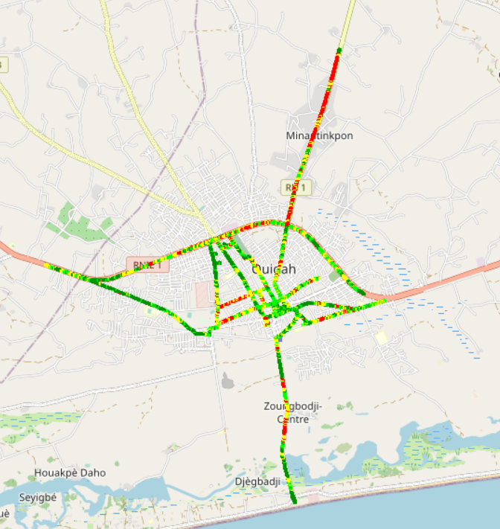
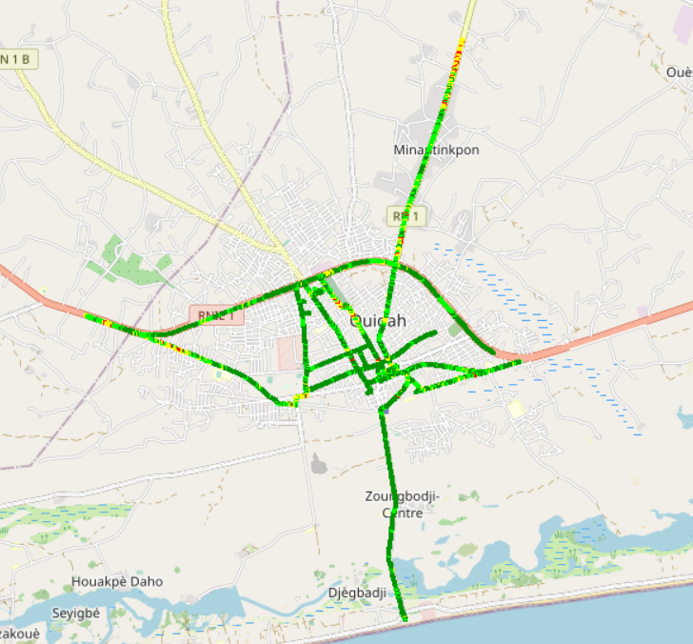
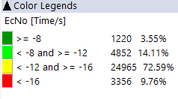
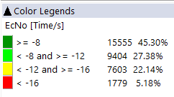
Benchmarking: Radio parameters EC/NO
3G MOOV and CELTISS EC/N0 is better than MTN

Slide 31
Benchmarking – SINR comparison
Drive tests are showing a acceptable level of MTN Network SINR.

Slide 32
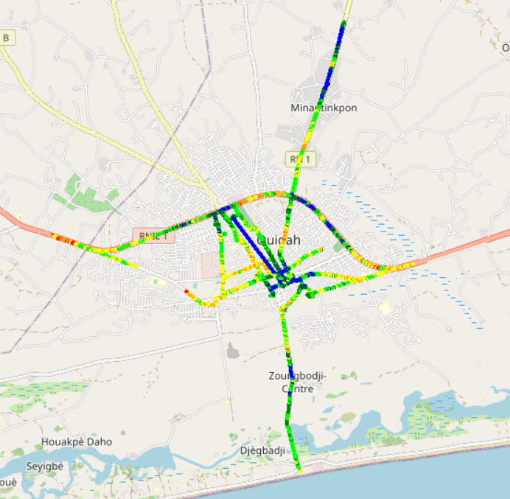

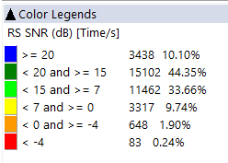
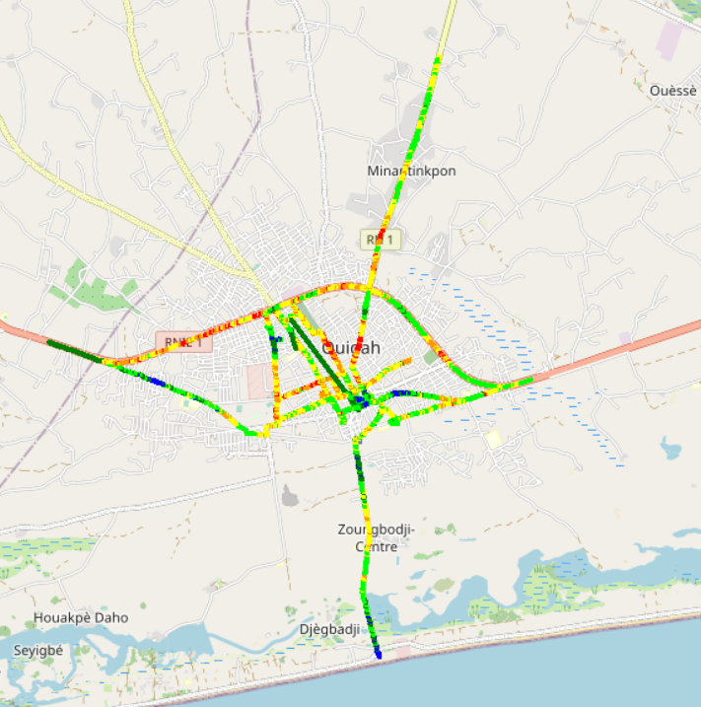
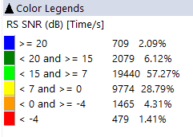
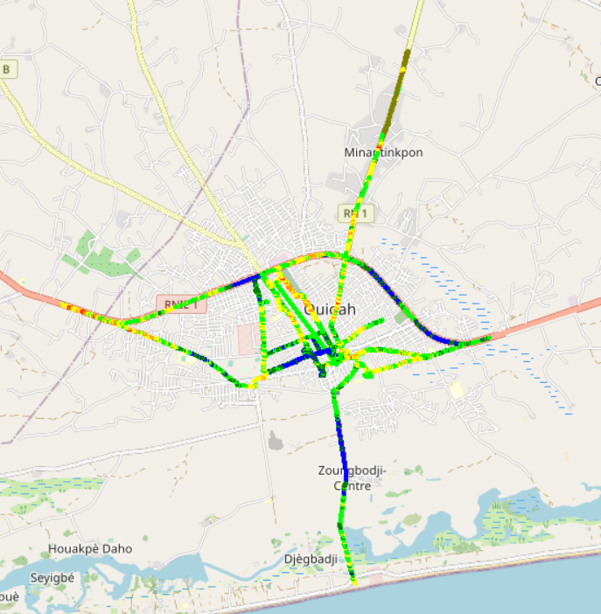
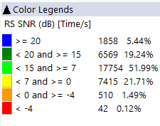
Benchmarking – SNIR comparison map
4G MOOV have more bad quality samples compared to MTN and CELTISS.

Slide 33
Benchmarking – 2G/3G CALL SETUP TIME
MTN have the best Call setup time.

Slide 34
Benchmarking – CALL SETUP TIME/Call Mode
MTN have the best 4G CSBF Call setup Time,
Call setup time 2G is higher than in 3G/4G.

Slide 35
Benchmarking – SMS SENDING FAILURE
MTN SMS SETUP/RESPONSE is better than CELTIS & MOOV.
SMS service KPIs of the three operators are not compliant with the ARCEP requirements because of the 6s criteria.

Slide 36
06
Benchmarking Data service

Slide 37
Benchmarking – DATA 3G
All operators have a good rate of successful Internet connection

Slide 38
Benchmarking – DATA 3G
All operators have a good web service success rate. MTN have best PS connection setup time

Slide 39
Benchmarking – DATA 3G
All operators have a good downlink and uplink FTP success rate.

Slide 40
Benchmarking – 3G FTP MEAN THROUGHPUT
MTN 3G Throughput DL/UL is less than MOOV’s and CELTISS’s
MTN FTP DL AVERAGE Throughout is less than MOOV and CELTISS DL Throughout
DL Throughput mean for all operators satisfies ARCEP thresholds
MTN FTP UL AVERAGE Throughout is less than CELTISS’s MOOV’s
UL Throughput mean for all operators satisfy ARCEP thresholds

Slide 41

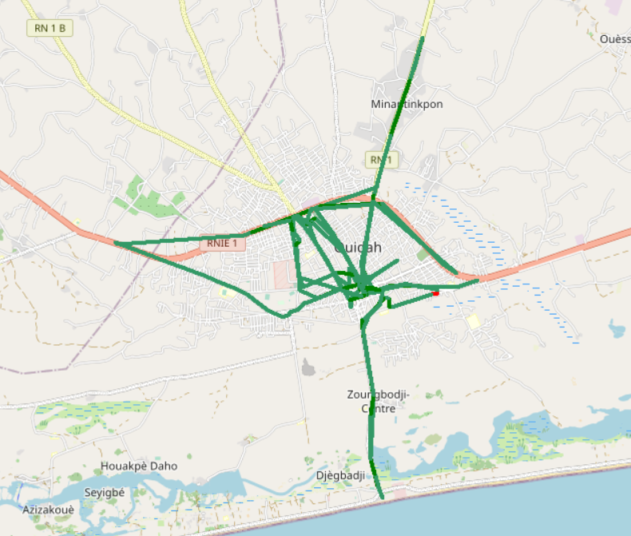

Benchmarking – 3G FTP MEAN THROUGHPUT comparison map
All samples exceed 2Mbps

Slide 42
Benchmarking – 4G HTTP Browsing
All operators have a very good HTTP Browsing success rate.

Slide 43
Benchmarking – 4G FTP THROUGHPUT comparison
All operators have a good FTP success rate.

Slide 44
Benchmarking – 4G FTP THROUGHPUT comparison
MTN FTP DL/UL AVERAGE Throughput is better than CELTISS and MOOV.

Slide 45
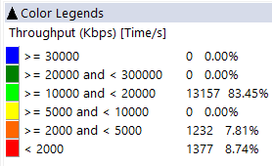
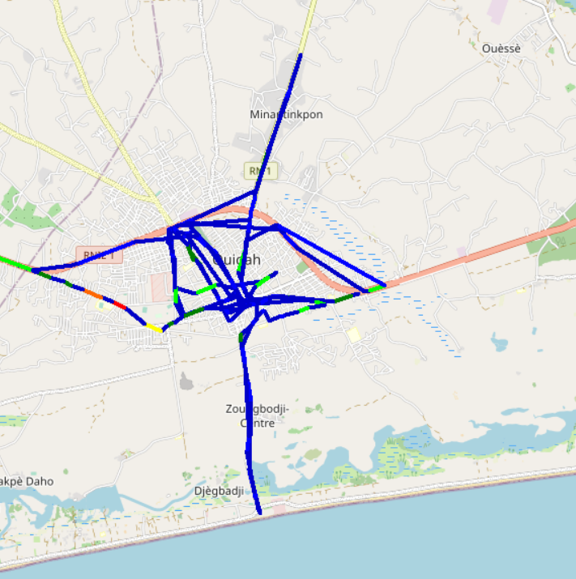
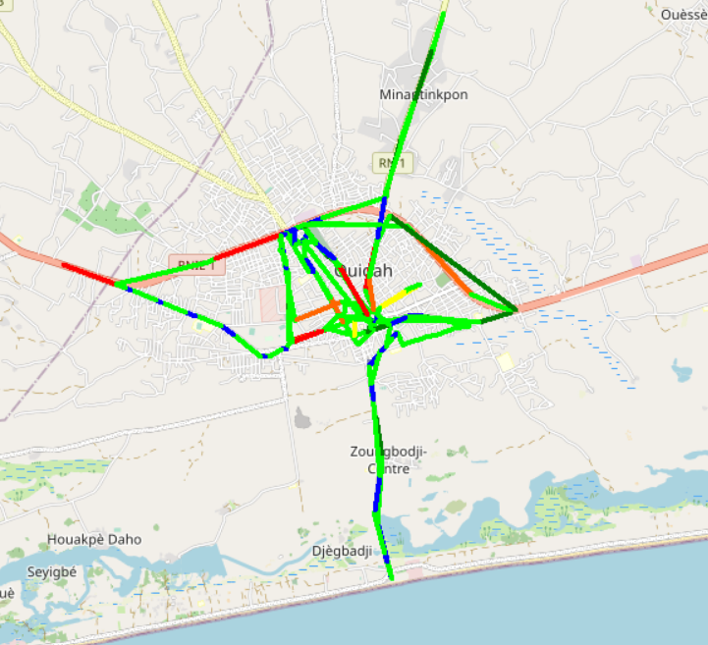
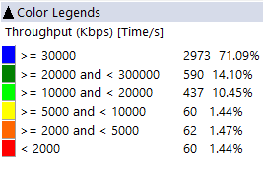
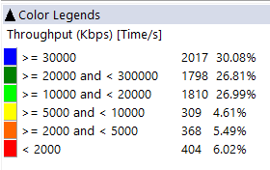
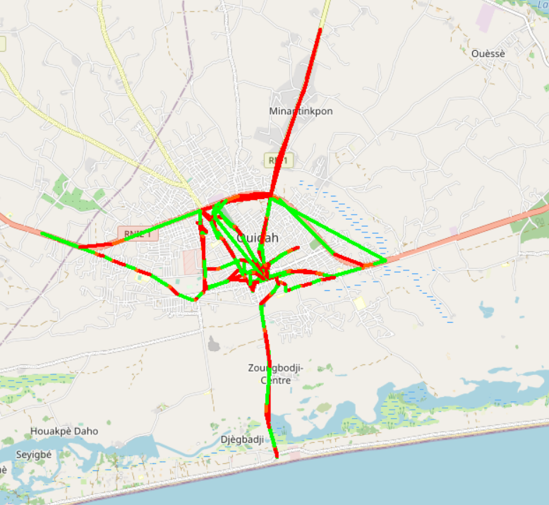
Benchmarking – 4G FTP THROUGHPUT comparison map
MOOV’s average throughput DL rate is better than MTN and CELTISS.

Slide 46
Benchmarking – BAND and TECHNOLOGY UTILISATION
Most of MTN LTE samples are in 2600 band.
Most of CELTIS LTE samples are in 1800 band.
Most of MOOV LTE samples are in 2600 and 800 bands.
Usage of 3G U900 is lower for competitors compared to MTN

Slide 47
Benchmarking – Data TECHNOLOGY Usage(%)
MTN have the highest LTE CA Carrier Aggregation usage.

Slide 48

Deloitte fait référence à un ou plusieurs cabinets membres de Deloitte Touche Tohmatsu Limited, société de droit anglais (« private company limited by guarantee »), et à son réseau de cabinets membres constitués en entités indépendantes et juridiquement distinctes. Pour en savoir plus sur la structure légale de Deloitte Touche Tohmatsu Limited et de ses cabinets membres, consulter www.deloitte.com/about.
Fort d’un réseau de firmes membres dans plus de 150 pays, Deloitte allie des compétences de niveau international à des expertises locales pointues, afin d’accompagner ses clients dans leur développement partout où ils opèrent. Nos 264 000 professionnels sont animés par un objectif commun, faire de Deloitte la référence en matière d’excellence de service.
Au Bénin, Deloitte mobilise un ensemble de compétences diversifiées pour répondre aux enjeux de ses clients, de toutes tailles et de tous secteurs – des grandes entreprises multinationales aux microentreprises locales, en passant par les entreprises moyennes.
Le présent document et ses annexes sont confidentiels et réservés à l’usage interne exclusif du destinataire. Toute reproduction ou toute divulgation partielle ou totale à des tiers en est interdite, sauf accord écrit préalable de Deloitte Bénin.
© 2023 Deloitte Bénin SARL. Société du réseau Deloitte

