Slide 1


Network QoS
BOHICON Intermediate report
November 21st, 2023

Slide 2
Summary
Scope of Intermediate Report | 3
Executive Summary | 5
Benchmarking Key Results | 11
Benchmarking Coverage | 16
Benchmarking Voice Service | 23
Benchmarking Data Service | 36

Slide 3
01
Introduction: Scope of Intermediate Report

Slide 4
Intermediate report
Scope of this report
  1. Network benchmarking results for the BOHICON area between MTN, MOOV, and CELTISS from September 9th to September 13th, 2023..

Slide 5
02
Benchmarking Executive Summary

Slide 6
Executive Summary – Benchmarking coverage 2G/3G/4G
TECHNOLOGY
All operators met ARCEP 2G coverage obligations and have comparable results.
All operators met ARCEP 3G coverage obligation
MTN is ranked first in 3G coverage
All operators failed to satisfy the ARCEP requirements in terms of Indoor 4G coverage. CELTISS fails in Incar 4G coverage as well
KEY RECOMMENDATIONS
KEY FINDINGS
Coverage 2G/3G/4G
Tune and align power settings mainly in 3G/4G. Actual setting may impact the coverage strength specially at Indoor locations
Review the design at the coverage and quality blackspots
We highlight that 4G ARCEP coverage Thresholds are aggressive

Slide 7
Executive Summary – Benchmarking voice service 2G/3G
TECHNOLOGY
MTN is ranked second in both in voice accessibility and retainability
Only CELTISS satisfies the retainability ARCEP thresholds
All operators met the MOS ARCEP thresholds
MOOV and CELTISS have better average MOS than MTN
KEY RECOMMENDATIONS
KEY FINDINGS
Voice service 2G/3G
Voice quality is always better in 3G due to its better codec rate , we recommend to push as much as possible the voice traffic to 3G.
Actual selection/reselection/Irat parameters need to be reviewed and aligned.
2G Full Rate/Half Rate settings need to be tuned in order to improve Full rate penetration

Slide 8
Executive Summary – Benchmarking SMS service
TECHNOLOGY
KEY RECOMMENDATIONS
KEY FINDINGS
SMS service 2G/3G
All operators failed to meet ARCEP for SMS Send Success with End To End Delivery Time < 6 sec,
MTN have the best SMS results,
There is no issue in radio accessibility that could be correlated to the SMS high delivery time.
End to End investigation need to be performed to analyses the high delivery time including mainly Core/SMS parts: SM Sserver...

Slide 9
Executive Summary – Benchmarking 4G Data service
Performance is stable in terms of accessibility for 4G data service, and all operators met ARCEP's requirements.
MTN is ranked first in all kinds of 4G data tests, with 37/15,5Mbps DL/UL Throughput compared to 16/9.5 Mbps and 13/14.5 Mbps for MOOV and MTN.
TECHNOLOGY
KEY RECOMMENDATIONS
KEY FINDINGS
Data service 4G
MTN spectrum need to be used with a better efficiency, Some features and parameters need to be tuned and aligned
To ensure that no throughput limitation is applied on users profiles

Slide 10
Executive Summary – Benchmarking 3G Data service
Performance is stable in terms of accessibility for 3G data service, and all operators met ARCEP's requirements.
MTN is in 2nd position for 3G DL throughput with 3.5Mbps, compared to 6.5Mbps for CELTISS and 3Mbps for MOOV.
MTN is ranked first in term of 3G UL throughput with 1.78 Mbps against 1.16 Mbps for MOOV and 1.75Mbps for CELTISS,
TECHNOLOGY
KEY RECOMMENDATIONS
KEY FINDINGS
Data service 3G
Its recommended to push as much as possible the data traffic to 4G in order to:
- Improve end user perception, Both DT and stats are showing that users in average are served with up to 700% better throughput in 4G than in 3G
- Offload the 3G network which will improve the 3G throughput and the 3G radio quality
Some features and parameters need to be tuned and aligned
To ensure that no throughput limitation is applied on users profiles

Slide 11
03
Benchmarking Key Results

Slide 12
Benchmarking Key Results – Coverage
MTN, MOOV, and CELTISS have similar2G coverage, All of them satisfy the ARCEP requirements
MTN is ranked first in 3G coverage where all operators satisfy the ARCEP requirements
All operators failed to satisfy the ARCEP requirements in terms of Indoor 4G coverage. CELTISS fails in Incar 4G coverage as well
KPI |  | ARCEP Threshorlds | MTN |  | MOOV |  | CELTISS |  | MTN Ranking
 |  |  | Value | Conformity | Value | Conformity | Value | Conformity
2G Coverage Rate | Incar | More than 90% with Incar: Rxlev >-87 dBm | 99,06% | OK | 99,97% | OK | 99,99% | OK | 3
 | Outdoor | More than 90% with Outdoor: Rxlev >-92 dBm | 99,87% | OK | 100% | OK | 99,99% | OK | 3
 | Indoor | More than 90% with Outdoor: Rxlev >-74 dBm | 95,62% | OK | 94,35% | OK | 93,70% | OK | 1
3G Coverage Rate | Incar,Indoor,Outdoor | More than 90% with RSCP <-85 dBm | 94,35% | OK | 92,33% | OK | 93,62% | OK | 1
4G Coverage Rate | Incar | More than 90% with RSRP <-90 dBm* | 90,42% | OK | 92,55% | OK | 76,75% | NOK | 2
 | Outdoor | More than 90% with RSRP <-95 dBm* | 97,25% | OK | 99,13% | OK | 93,26% | OK | 2
 | Indoor | More than 90% with RSRP <-78 dBm* | 54,17% | NOK | 71,04% | NOK | 24,53% | NOK | 2

Slide 13
Benchmarking Key Results – 2G/3G voice and SMS Summary
MTN is ranked second in both in voice accessibility and retainability
Only CELTISS satisfies the retainability ARCEP thresholds
All operators met the MOS ARCEP thresholds however MOOV and CELTISS have better average MOS
All operators failed in SMS service due to the delivery time exceeding 6s however MTN have the best SMS results
KPI | ARCEP Threshorlds | MTN |  | MOOV |  | CELTISS |  | MTN Ranking
 |  | Value | Conformity | Value | Conformity | Value | Conformity
Accesibility: Blocking rate | <1% | 0,53% | OK | 2,11% | NOK | 0,36 | OK | 2
Retainability: Call drop rate | <1% | 1,37% | NOK | 1,57% | NOK | 0% | OK | 2
Call Completetion Rate (%) | =<99% | 98,1% | NOK | 96,32% | NOK | 99,64% | OK | 1
Integrity: Voice quality | Note requise> 2,8 | 3,78 | OK | 4,02 | OK | 3,86 | OK | 3
SMS sending success rate % (E2E delivery Time<6 sec) | >99% | 95,89% | NOK | 85,50% | NOK | 89,60% | NOK | 1
SMS receving success rate % | >99% | 94,12% | NOK | 83,98% | NOK | 87,65% | NOK | 1

Slide 14
Benchmarking Key Results – 3G Data Summary
All operators met the 3G Data ARCEP requirements.
Services | KPI | ARCEP Threshorlds | MTN |  | MOOV |  | CELTISS |  | MTN Ranking
 |  |  | Value | Conformity | Value | Conformity | Value | Conformity
3G HTTP | Successful internet connexion rate | >96% | 100,00% | OK | 99,55% | OK | 98,90% | OK | 1
 | Connexion setup time | <=10sec | 5,91 | OK | 6,07 | OK | 6,10 | OK | 1
 | Web service failure rate | <3% | 1,12% | OK | 0,23% | OK | 1,74% | OK | 2
3G FTP | FTP failure rate UL/DL | <3 % | 1,42%/2,87% | OK | 1,31%/2,74% | OK | 0,42%/0,87% | OK | 3
 | FTP Data transmission average (DL) | >= 2Mbps | 3,506 | OK | 3,089 | OK | 6,459 | OK | 2
 | FTP Data transmission average (UL) | >= 1Mbps | 1,982 | OK | 1,162 | OK | 1,755 | OK | 1

Slide 15
Benchmarking Key Results – 4G Data Summary
All operators met the 4G Data ARCEP requirements.
MTN is ranked first in all kinds of 4G data tests
Services | KPI | Threshorlds* | MTN |  | MOOV |  | CELTISS |  | MTN Ranking
 |  |  | Value | Conformity | Value | Conformity | Value | Conformity
4G HTTP Browsing | Web service failure rate (%) | <3% | 1,04% | OK | 1,83% | OK | 2,12% | OK | 1
 | Connexion setup time | <=3sec | 0,97 | OK | 1,09 | OK | 1,33 | OK | 1
4G FTP | FTP failure rate UL/DL | <3 % | 0%/0% | OK | 0%/0,23% | OK | 0,68%/0% | OK | 1
 | FTP Data transmission average (DL) | 4G >= 5 Mbps | 36,956 | OK | 15882 | OK | 12,999 | OK | 1
 | FTP Data transmission average (UL) | 4G: >= 2Mbps | 15,436 | OK | 9,549 | OK | 14,439 | OK | 1

Slide 16
04
Benchmarking 2G/3G/4G coverage

Slide 17
Benchmarking: 2G coverage
MTN, MOOV and CELTISS 2G coverage met the ARCEP RxLev thresholds.

Slide 18
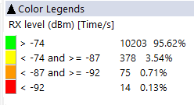
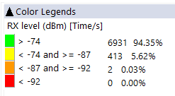
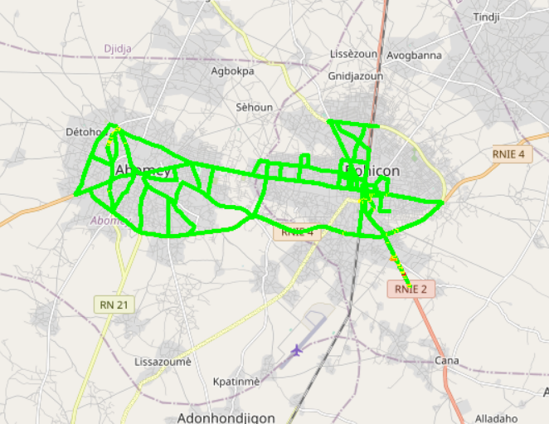

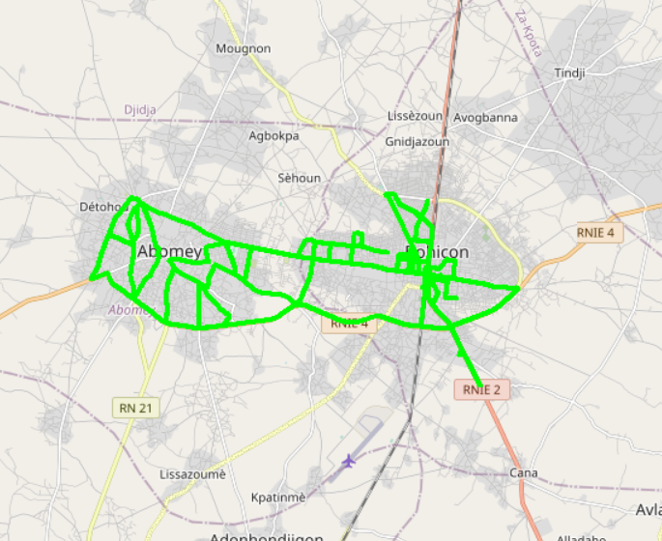


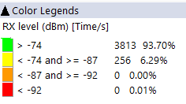
Benchmarking: 2G coverage - Maps
2G coverage plots are quite similar for the 3 operators

Slide 19
Benchmarking: 3G coverage
MTN is ranked first in 3G coverage where all operators satisfy the ARCEP requirements

Slide 20
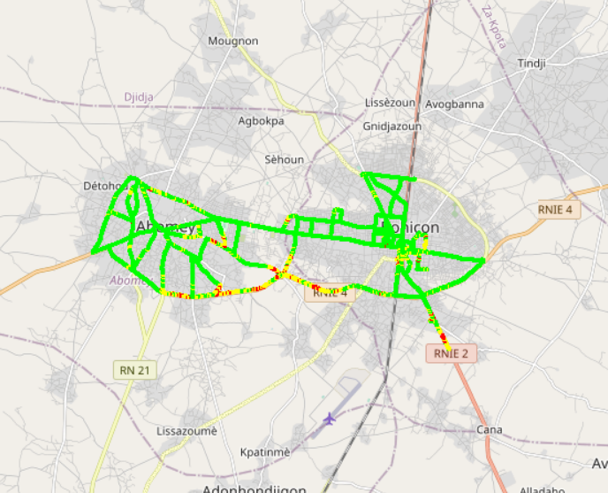
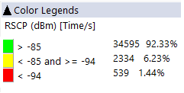
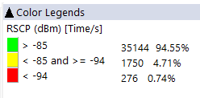
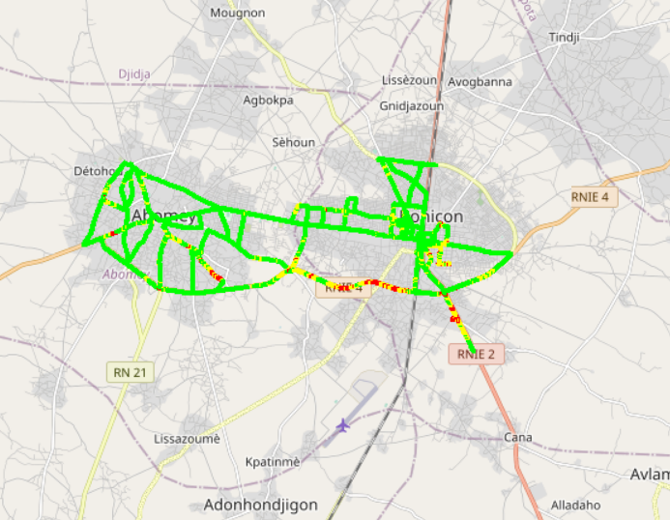
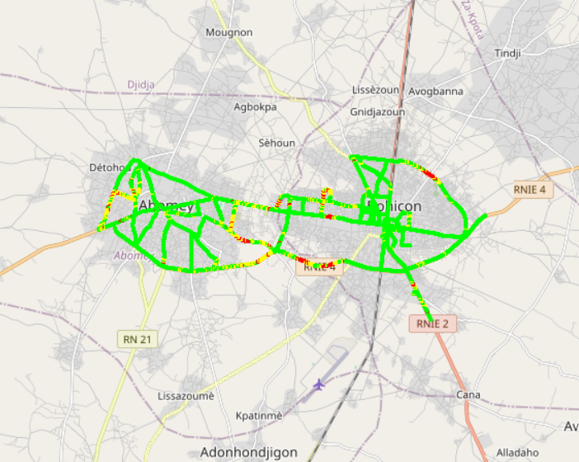

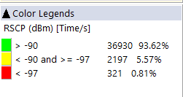
Benchmarking: 3G coverage-Maps
3G coverage plots are quite similar for the 3 operators

Slide 21
Benchmarking: 4G coverage
All operators failed to satisfy the ARCEP requirements in terms of Indoor 4G coverage. CELTISS fails in Incar 4G coverage as well

Slide 22

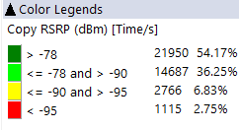
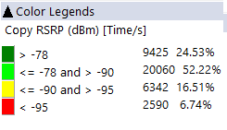
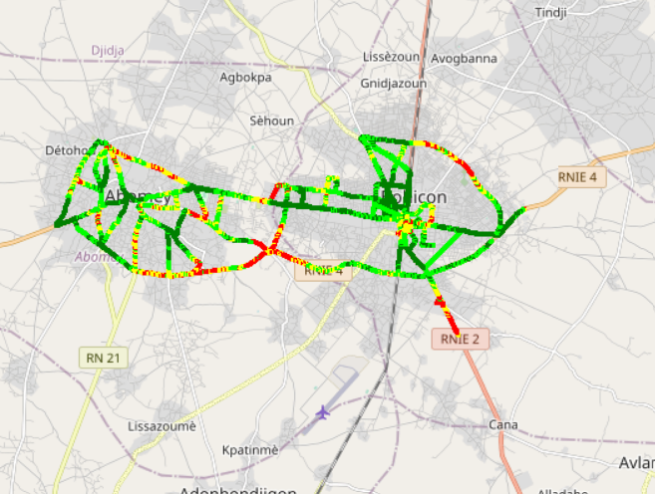
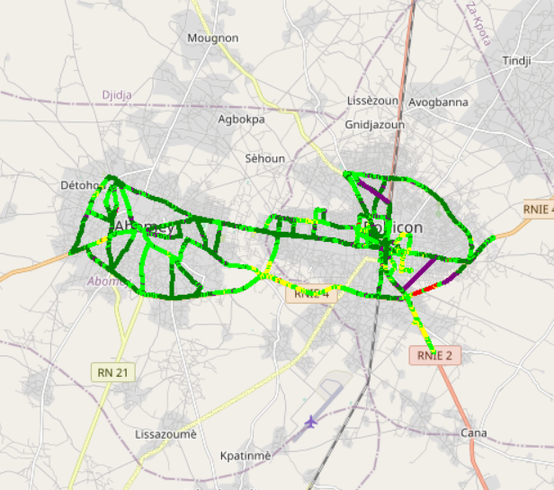
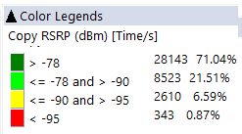
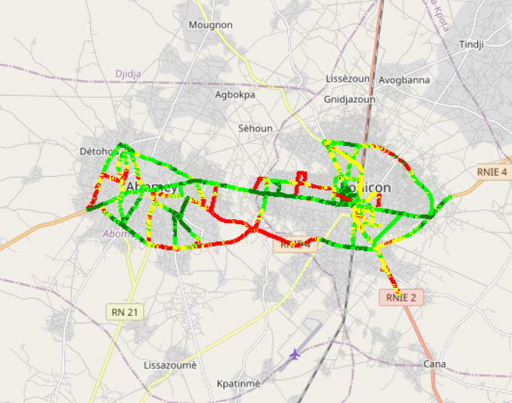
Benchmarking – 4G coverage - Maps
MOOV have a better 4G coverage plot distribution MTN and CELTISS.

Slide 23
04
Benchmarking voice service

Slide 24
Benchmarking: CS Accessibility 2G/3G BLOCKED CALLS
MTN is ranked second in voice accessibility.
MOOV failed to satisfy the ARCEP thresholds

Slide 25
Benchmarking: CS Integrity Voice quality Mean Opinion Score
MOOV have the best ratio of excellent and good Voice Quality samples
MTN needs to improve its voice quality MOS by pushing CS traffic to 3G and increase 2G full rate penetration.

Slide 26
Benchmarking: CS Retainability 2G/3G DROPPED CALLS
Only CELTISS satisfies the retainability ARCEP thresholds

Slide 27
Benchmarking Voice service Band usage(%)
12% of MTN voice calls is carried by 2G while all voice traffic is carried by 3G for competitors
Its recommended for MTN to reduce 2G utilization and increase 3G penetration for better audio quality.
MTN's 2G band usage: 76,06% GSM 900 and 23,94% GSM 1800 Mhz,
27,2 % of MTN 3G CS traffic is carried on U900 compared to 12% and 24,5% for MOOV and CELTISS.

Slide 28
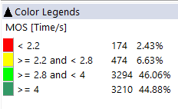
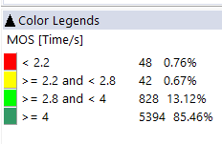
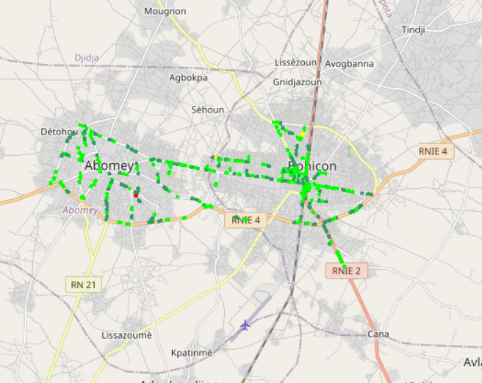
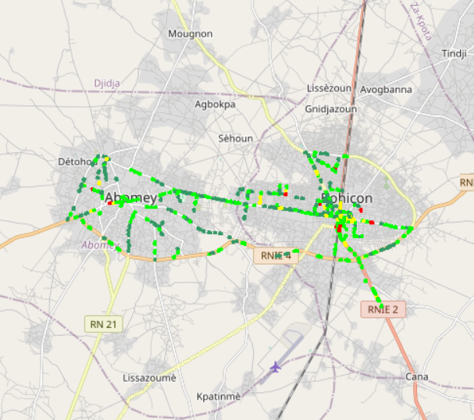

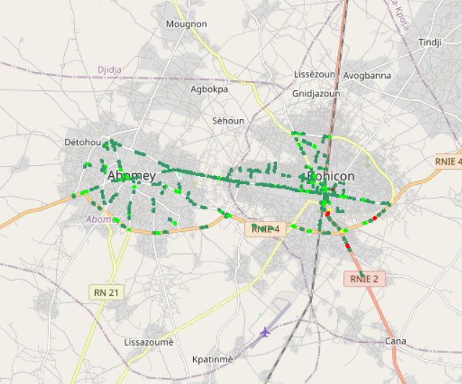
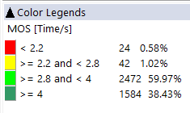
Benchmarking – CS Integrity Voice quality maps (MOS)
MTN has around 2.43% of MOS samples lower than 2.2
Values lower than 2.2 pose risk of bad users perceived voice quality
3d

Slide 29
Benchmarking: Radio parameters EC/NO comparison
CELLTIS have the best 3G EcNo samples within acceptable range

Slide 30
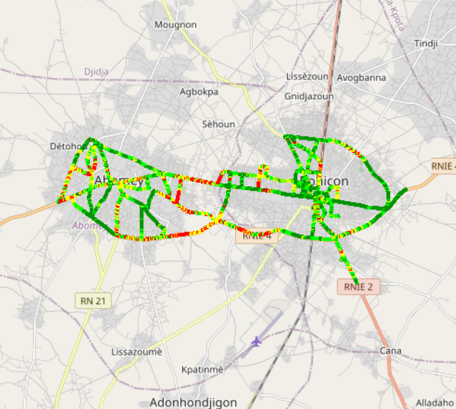
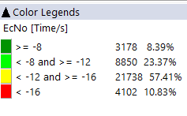
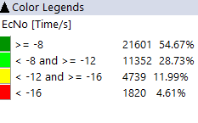
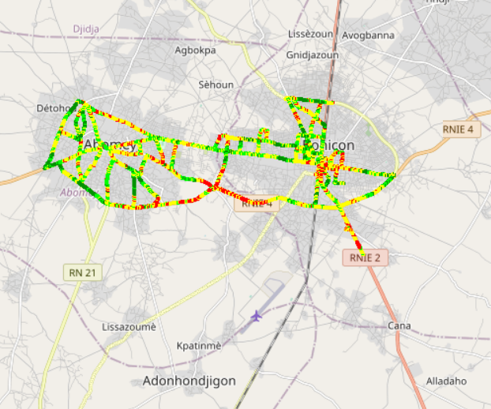
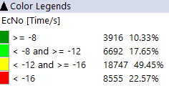
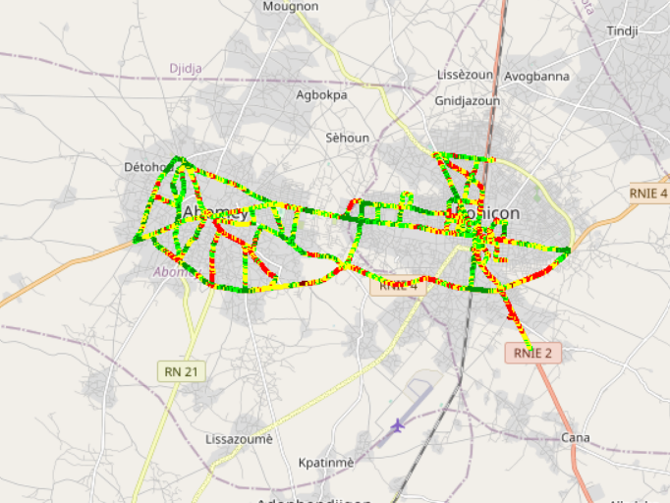
Benchmarking: Radio parameters EC/NO
CELLTIS have the best 3G EcNo samples distribution

Slide 31
Benchmarking – SINR comparison
Drive tests are showing that MTN have the best acceptable level range of SINR.

Slide 32
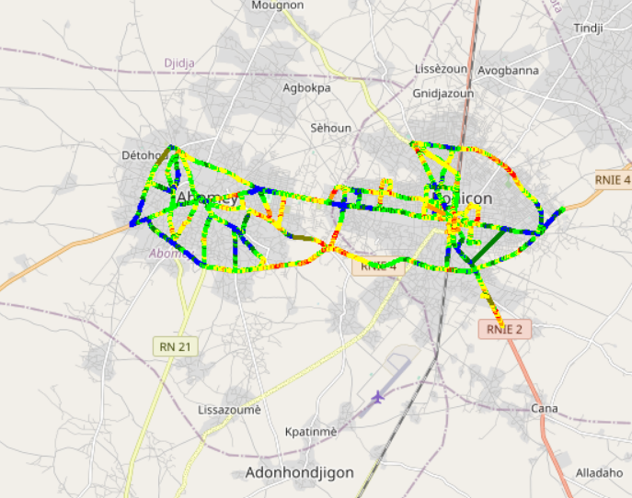
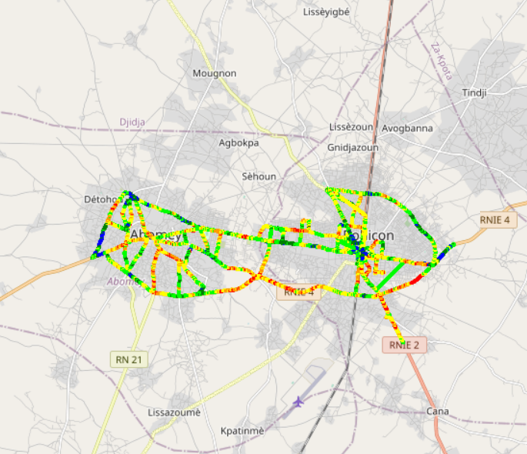

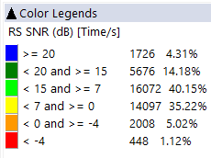
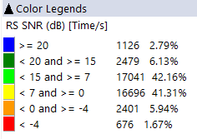
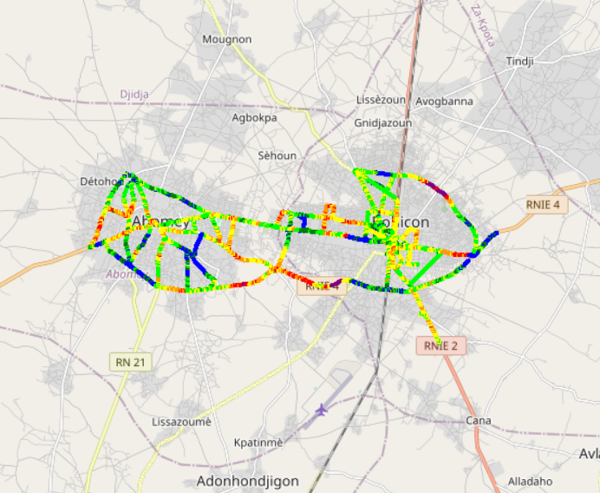
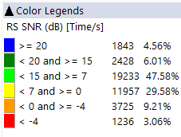
Benchmarking – SNIR comparison map
4G MTN have a better quality of signal compared to CELTISS and MOOV.

Slide 33
Benchmarking – 2G/3G CALL SETUP TIME
MTN have the best Call setup time.

Slide 34
Benchmarking – CALL SETUP TIME/Call Mode
MTN have the best 4G CSBF Call setup Time,
Call setup time 2G is higher than in 3G/4G.

Slide 35
Benchmarking – SMS SENDING FAILURE
All operators failed in SMS service due to the delivery time exceeding 6s however MTN have the best SMS results

Slide 36
04
Benchmarking Data service

Slide 37
Benchmarking – DATA 3G
All operators have a good rate of successful Internet connection

Slide 38
Benchmarking – DATA 3G
All operators have good web service success rate. MTN have the best PS connection setup time

Slide 39
Benchmarking – DATA 3G
All operators met the ARCEP downlink and uplink FTP success rate thresholds.

Slide 40
Benchmarking – 3G FTP MEAN THROUGHPUT
All operators met the ARCEP downlink and uplink FTP success rate thresholds.
MTN FTP DL AVERAGE Throughout is ranked second
MTN FTP UL AVERAGE Throughout is ranked first

Slide 41
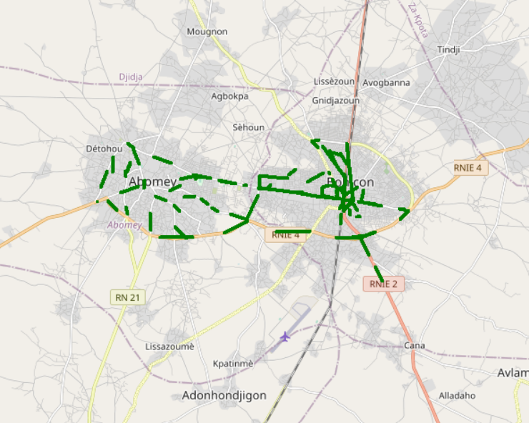


Benchmarking – 3G FTP MEAN THROUGHPUT comparison map
All samples exceed 2Mbps

Slide 42
Benchmarking – 4G HTTP Browsing
MTN Have the best HTTP Browsing success rate.

Slide 43
Benchmarking – 4G FTP THROUGHPUT comparison
All operators have a good FTP success rate.

Slide 44
Benchmarking – 4G FTP THROUGHPUT comparison
MTN is ranked first in all kinds of 4G data tests

Slide 45
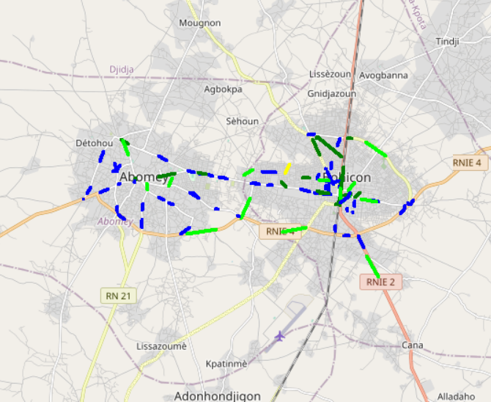
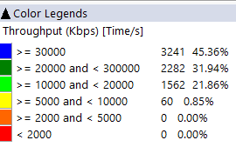
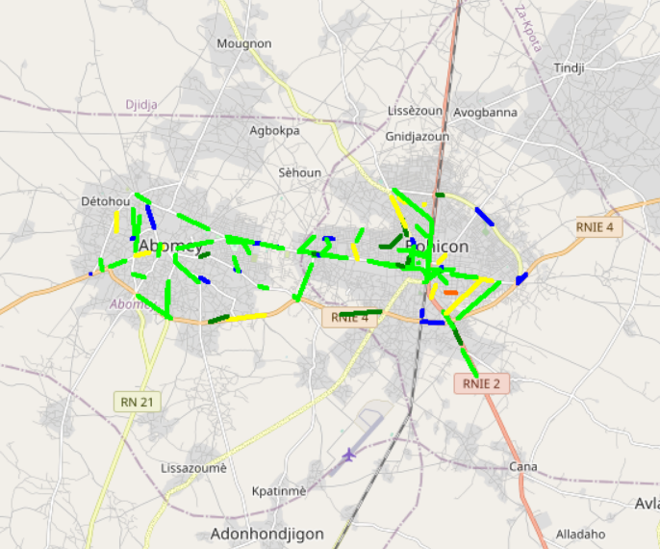
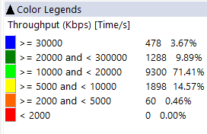
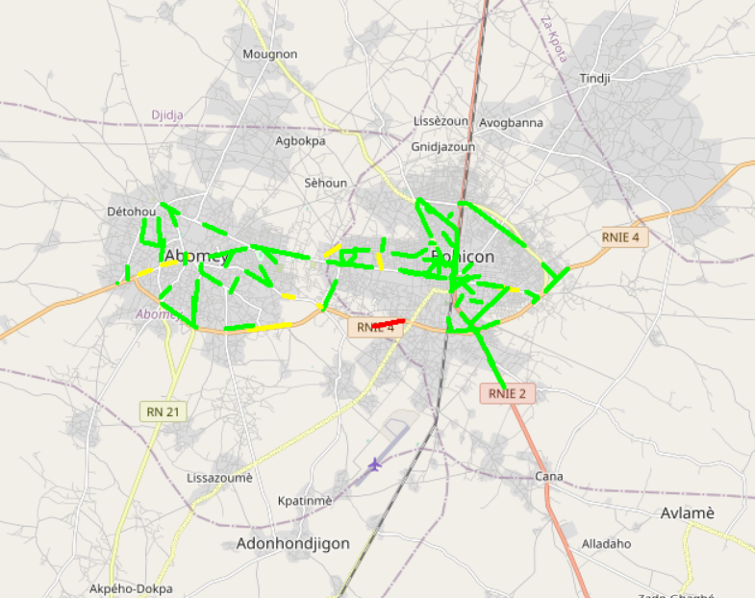
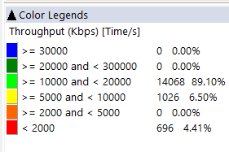
Benchmarking – 4G FTP THROUGHPUT comparison map
MTN Shows the best 4G FTP throughput samples distribution.

Slide 46
Benchmarking – BAND and TECHNOLOGY UTILISATION
Most of MTN LTE samples are in 2600 band.
Most of CELTIS LTE samples are in 1800 band.
Most of MOOV LTE samples are in 2600 band
Usage of 3G U900 is lower for CELTISS

Slide 47
Benchmarking – Data TECHNOLOGY Usage(%)
MTN have the highest LTE CA Carrier Aggregation usage.

Slide 48

Deloitte fait référence à un ou plusieurs cabinets membres de Deloitte Touche Tohmatsu Limited, société de droit anglais (« private company limited by guarantee »), et à son réseau de cabinets membres constitués en entités indépendantes et juridiquement distinctes. Pour en savoir plus sur la structure légale de Deloitte Touche Tohmatsu Limited et de ses cabinets membres, consulter www.deloitte.com/about.
Fort d’un réseau de firmes membres dans plus de 150 pays, Deloitte allie des compétences de niveau international à des expertises locales pointues, afin d’accompagner ses clients dans leur développement partout où ils opèrent. Nos 264 000 professionnels sont animés par un objectif commun, faire de Deloitte la référence en matière d’excellence de service.
Au Bénin, Deloitte mobilise un ensemble de compétences diversifiées pour répondre aux enjeux de ses clients, de toutes tailles et de tous secteurs – des grandes entreprises multinationales aux microentreprises locales, en passant par les entreprises moyennes.
Le présent document et ses annexes sont confidentiels et réservés à l’usage interne exclusif du destinataire. Toute reproduction ou toute divulgation partielle ou totale à des tiers en est interdite, sauf accord écrit préalable de Deloitte Bénin.
© 2023 Deloitte Bénin SARL. Société du réseau Deloitte

