Slide 1


Network QoS
ALLADA Intermediate report
November 22nd, 2023

Slide 2
Summary
Drive tests Activity, Current Status & Progress | 12
Executive Summary | 15
Benchmarking Key Results | 21
Benchmarking Coverage | 26
Benchmarking Voice Service | 33
Benchmarking Data Service | 48
Next Steps | 63

Slide 3
01
Introduction: Scope of Intermediate Report

Slide 4
Intermediate report
Scope of this report
  1. Network benchmarking results for the ALLADA area between MTN, MOOV, and CELTISS from September 9th to September 13th, 2023..

Slide 5
02
Benchmarking Executive Summary

Slide 6
Executive Summary – Benchmarking coverage 2G/3G/4G
TECHNOLOGY
MTN, MOOV, and CELTISS have similar 2G coverage, All of them satisfy the ARCEP requirements
MTN and MOOV failed to satisfy the ARCEP 3G Coverage requirements
Only MOOV reach the ARCEP 4G coverage thresholds. MTN and CELTISS failed in Incar &Indoor 4G coverage
KEY RECOMMENDATIONS
KEY FINDINGS
Coverage 2G/3G/4G
Tune and align power settings mainly in 3G/4G. Actual setting may impact the coverage strength specially at Indoor locations
Review the design at the coverage and quality blackspots
We highlight that 4G ARCEP coverage Thresholds are aggressive

Slide 7
Executive Summary – Benchmarking voice service 2G/3G
TECHNOLOGY
MTN is ranked first in voice accessibility and It’s the only operator that satisfied the blocking rate ARCEP requirement
All operators satisfy the retainability ARCEP thresholds
All operators met the MOS ARCEP thresholds however MOOV and CELTISS have better average MOS
KEY RECOMMENDATIONS
KEY FINDINGS
Voice service 2G/3G
Voice quality is always better in 3G due to its better codec rate , we recommend to push as much as possible the voice traffic to 3G.
Actual selection/reselection/Irat parameters need to be reviewed and aligned.
2G Full Rate/Half Rate settings need to be tuned in order to improve Full rate penetration

Slide 8
Executive Summary – Benchmarking SMS service
TECHNOLOGY
KEY RECOMMENDATIONS
KEY FINDINGS
SMS service 2G/3G
MTN and MOOV fail in SMS service due to the delivery time exceeding 6s
There is no issue in radio accessibility that could be correlated to the SMS high delivery time.
End to End investigation need to be performed to analyses the high delivery time including mainly Core/SMS parts: SM Sserver...

Slide 9
Executive Summary – Benchmarking 4G Data service
Performance is stable in terms of accessibility for 4G data service, and all operators met ARCEP's requirements.
MTN is ranked first in Both DL and UL of 4G ftp tests, with 46.17/16.42Mbps DL/UL Throughput compared to 24.82/13.85 Mbps and 13/11.9 Mbps for MOOV and CELTISS.
TECHNOLOGY
KEY RECOMMENDATIONS
KEY FINDINGS
Data service 4G
MTN spectrum need to be used with a better efficiency, Some features and parameters need to be tuned and aligned
To ensure that no throughput limitation is applied on users profiles

Slide 10
Executive Summary – Benchmarking 3G Data service
Performance is stable in terms of accessibility for 3G data service, and all operators met ARCEP's requirements except MOOV in Web failure Rate
MTN is in 2nd position for 3G DL throughput with 3.5Mbps, compared to 9.46Mbps for CELTISS and 4Mbps for MOOV.
MTN is ranked first in term of 3G UL throughput with 1.78 Mbps against 1.16 Mbps for MOOV and 2.18Mbps for CELTISS,
TECHNOLOGY
KEY RECOMMENDATIONS
KEY FINDINGS
Data service 3G
Its recommended to push as much as possible the data traffic to 4G in order to:
- Improve end user perception, Both DT and stats are showing that users in average are served with up to 700% better throughput in 4G than in 3G
- Offload the 3G network which will improve the 3G throughput and the 3G radio quality
Some features and parameters need to be tuned and aligned
To ensure that no throughput limitation is applied on users profiles

Slide 11
03
Benchmarking Key Results

Slide 12
Benchmarking Key Results – Coverage
MTN, MOOV, and CELTISS have similar2G coverage, All of them satisfy the ARCEP requirements
MTN and MOOV failed to satisfy the ARCEP 3G Coverage requirements
Only MOOV reach the ARCEP 4G coverage thresholds. MTN and CELTISS failed in Incar &Indoor 4G coverage
KPI |  | ARCEP Threshorlds | MTN |  | MOOV |  | CELTISS |  | MTN Ranking
 |  |  | Value | Conformity | Value | Conformity | Value | Conformity
2G Coverage Rate | Incar | More than 90% with Incar: Rxlev >-87 dBm | 99,16% | OK | 99,77% | OK | 99,95% | OK | 3
 | Outdoor | More than 90% with Outdoor: Rxlev >-92 dBm | 99,84% | OK | 100% | OK | 100% | OK | 3
 | Indoor | More than 90% with Outdoor: Rxlev >-74 dBm | 90,80% | OK | 90,02% | OK | 91,41% | OK | 2
3G Coverage Rate | Incar,Indoor,Outdoor | More than 90% with RSCP <-85 dBm | 86,47% | NOK | 84,84% | NOK | 94,74% | OK | 2
4G Coverage Rate | Incar | More than 90% with RSRP <-90 dBm* | 84,48% | NOK | 97,4% | OK | 77,24% | NOK | 2
 | Outdoor | More than 90% with RSRP <-95 dBm* | 96,68% | OK | 99,92% | OK | 92,55% | OK | 2
 | Indoor | More than 90% with RSRP <-78 dBm* | 24,54% | NOK | 81,40% | OK | 44,23% | NOK | 3

Slide 13
Benchmarking Key Results – 2G/3G voice and SMS Summary
MTN is ranked first in voice accessibility and It’s the only operator that satisfied the blocking rate ARCEP requirement
All operators satisfy the retainability ARCEP thresholds
All operators met the MOS ARCEP thresholds however MOOV and CELTISS have better average MOS
MTN and MOOV fail in SMS service due to the delivery time exceeding 6s
KPI | ARCEP Threshorlds | MTN |  | MOOV |  | CELTISS |  | MTN Ranking
 |  | Value | Conformity | Value | Conformity | Value | Conformity
Accesibility: Blocking rate | <1% | 0,61% | OK | 1,29% | NOK | 1,17 | NOK | 1
Retainability: Call drop rate | <1% | 0,71% | OK | 0,84% | OK | 0,41% | OK | 2
Call Completetion Rate (%) | =<99% | 98,87% | NOK | 98,03% | NOK | 98,94% | NOK | 1
Integrity: Voice quality | Note requise> 2,8 | 3,79 | OK | 3,95 | OK | 3,91 | OK | 3
SMS sending success rate % (E2E delivery Time<6 sec) | >99% | 96,34% | NOK | 93,73% | NOK | 99,67% | OK | 2
SMS receving success rate % | >99% | 96,14% | NOK | 91,10% | NOK | 99,36% | OK | 2

Slide 14
Benchmarking Key Results – 3G Data Summary
All operators met the 3G Data ARCEP requirements except MOOV in Web failure Rate
Services | KPI | ARCEP Threshorlds | MTN |  | MOOV |  | CELTISS |  | MTN Ranking
 |  |  | Value | Conformity | Value | Conformity | Value | Conformity
3G HTTP | Successful internet connexion rate | >96% | 97,44% | OK | 98,59% | OK | 97,10% | OK | 2
 | Connexion setup time | <=10sec | 5,35 | OK | 7,01 | OK | 6,49 | OK | 1
 | Web service failure rate | <3% | 0,69% | OK | 3,56% | NOK | 0% | OK | 2
3G FTP | FTP failure rate UL/DL | <3 % | 0%/0,45% | OK | 0,47%/0% | OK | 0,48%/0,5% | OK | 1
 | FTP Data transmission average (DL) | >= 2Mbps | 5,344 | OK | 4,071 | OK | 9,461 | OK | 2
 | FTP Data transmission average (UL) | >= 1Mbps | 2,002 | OK | 1,159 | OK | 2,186 | OK | 2

Slide 15
Benchmarking Key Results – 4G Data Summary
All operators met the 4G Data ARCEP requirements.
MTN is ranked first in 4G FTP DL and UL tests
Services | KPI | Threshorlds* | MTN |  | MOOV |  | CELTISS |  | MTN Ranking
 |  |  | Value | Conformity | Value | Conformity | Value | Conformity
4G HTTP Browsing | Web service failure rate (%) | <3% | 0% | OK | 0% | OK | 0% | OK | 1
 | Connexion setup time | <=3sec | 1,15 | OK | 0,83 | OK | 1,23 | OK | 2
4G FTP | FTP failure rate UL/DL | <3 % | 0%/0,43% | OK | 0%/0% | OK | 0%/0% | OK | 3
 | FTP Data transmission average (DL) | 4G >= 5 Mbps | 46,172 | OK | 24,826 | OK | 12,997 | OK | 1
 | FTP Data transmission average (UL) | 4G: >= 2Mbps | 16,624 | OK | 13,955 | OK | 11,903 | OK | 1

Slide 16
04
Benchmarking 2G/3G/4G coverage

Slide 17
Benchmarking: 2G coverage
MTN, MOOV and CELTISS’s 2G coverage met the ARCEP RxLev thresholds.

Slide 18
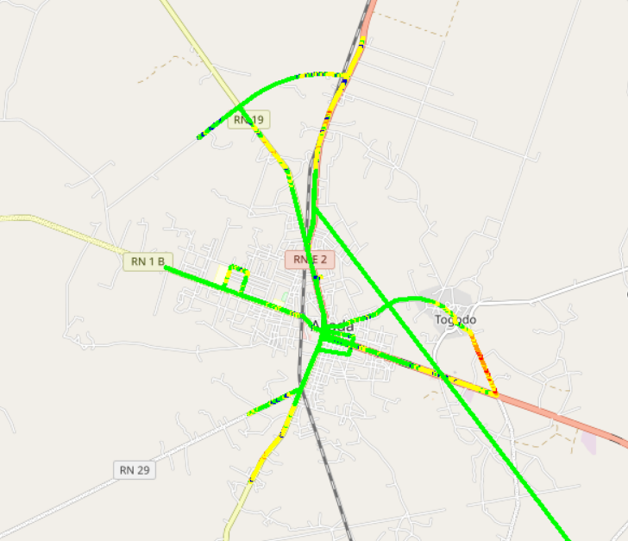
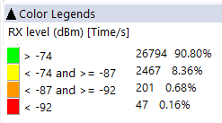


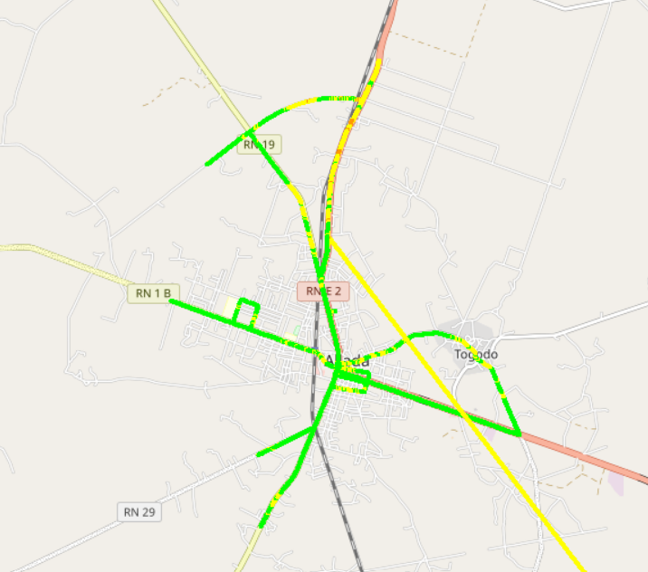
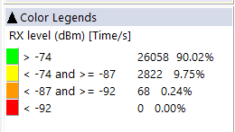

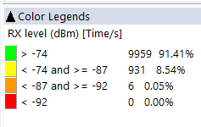
Benchmarking: 2G coverage - Maps
2G coverage plots are quite similar for the 3 operators

Slide 19
Benchmarking: 3G coverage
MTN and MOOV failed to satisfy the ARCEP 3G Coverage requirements

Slide 20
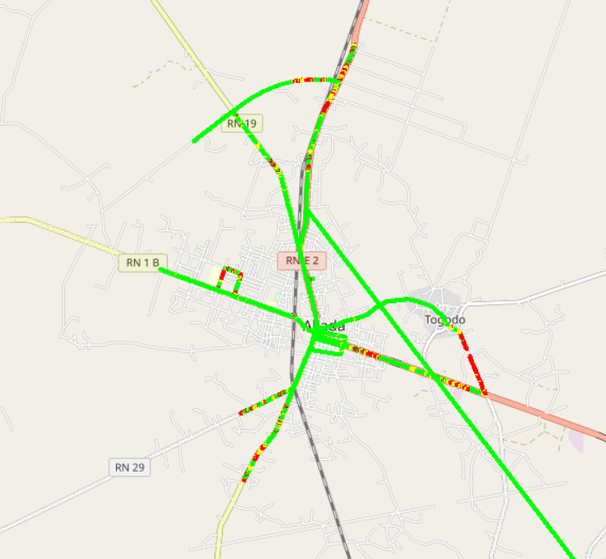

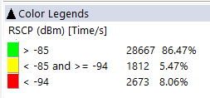
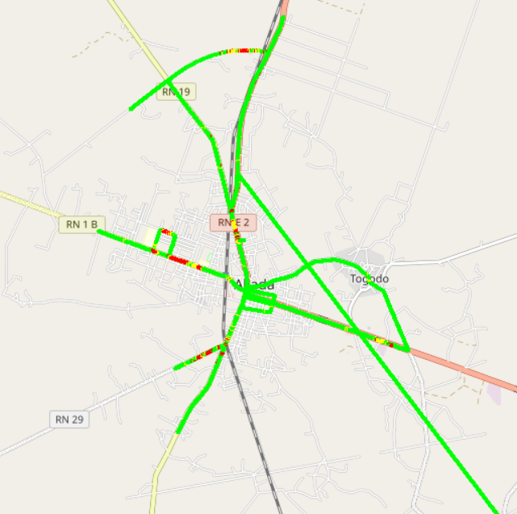
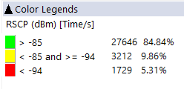
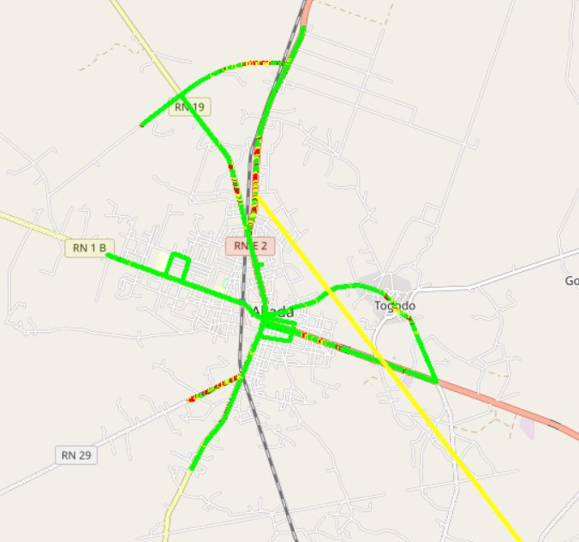
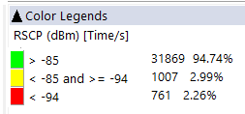
Benchmarking: 3G coverage-Maps
CELLTIS have the best 3G coverage distribution

Slide 21
Benchmarking: 4G coverage
Only MOOV reach the ARCEP 4G coverage thresholds. MTN and CELTISS failed in Incar &Indoor 4G coverage

Slide 22
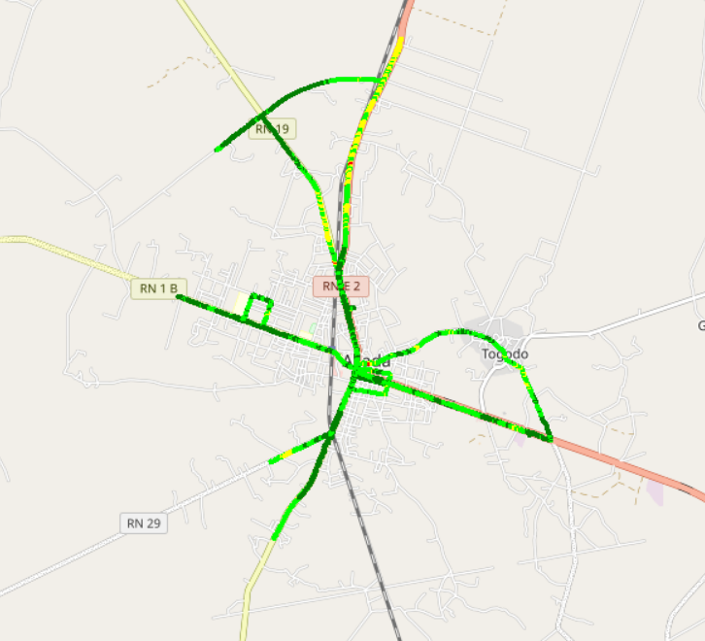
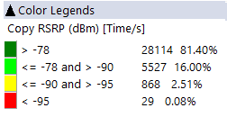
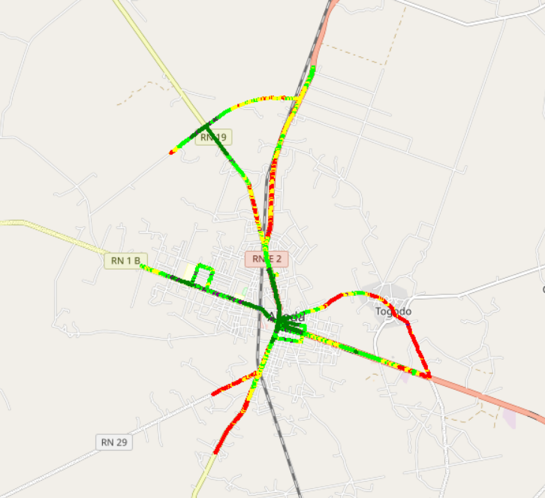
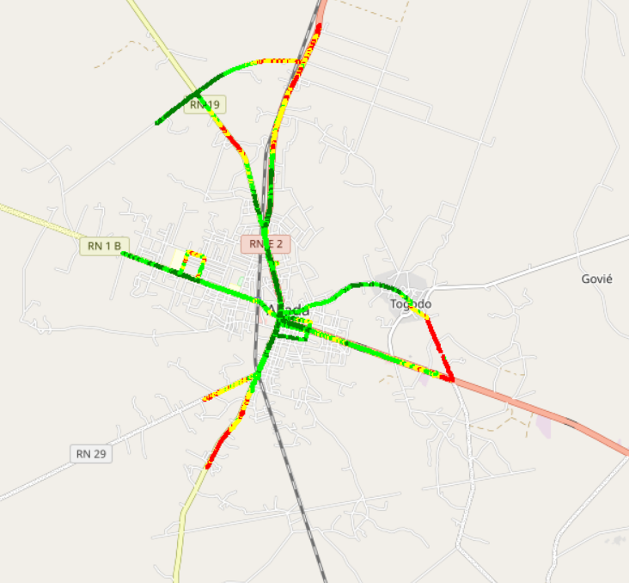
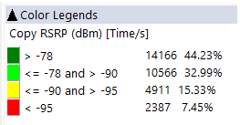

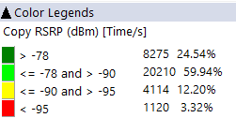
Benchmarking – 4G coverage - Maps
MOOV have the best 4G coverage distribution

Slide 23
05
Benchmarking voice service

Slide 24
Benchmarking: CS Accessibility 2G/3G BLOCKED CALLS
MTN is ranked first in voice accessibility and It’s the only operator that satisfied the blocking rate ARCEP requirement

Slide 25
Benchmarking: CS Integrity Voice quality Mean Opinion Score
MTN have the best ratio of excellent and good Voice Quality samples

Slide 26
Benchmarking: CS Retainability 2G/3G DROPPED CALLS
All operators satisfy the retainability ARCEP thresholds

Slide 27
Benchmarking Voice service Band usage(%)
Voice calls are mainly carried by 3G for all operators.
MTN's 2G band usage: 87,69% GSM 900 and 12,31% DCS 1800 Mhz,
30,1 % of MTN 3G CS traffic is carried on U900 compared to 81,38% and 12,15% for MOOV and CELTISS.

Slide 28

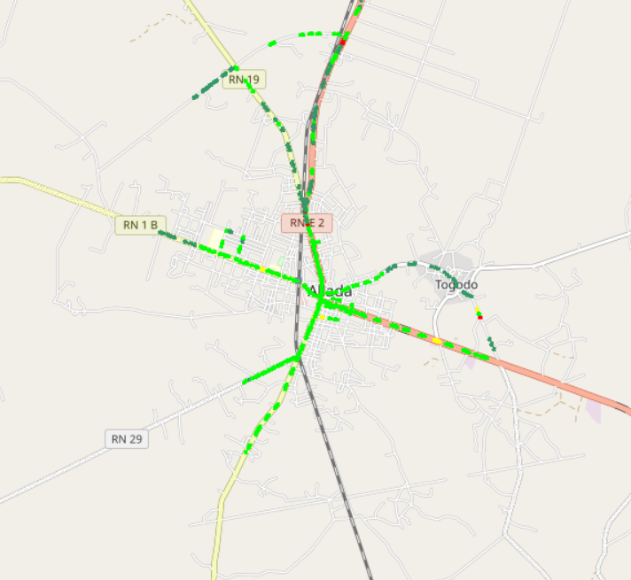
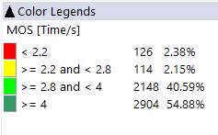
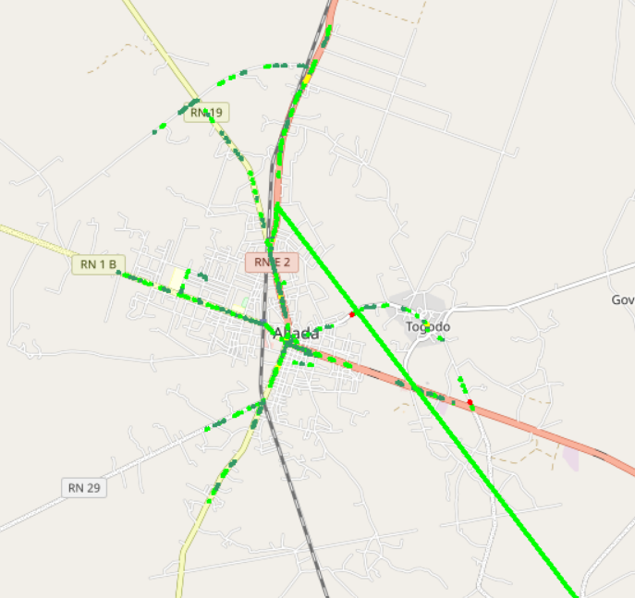
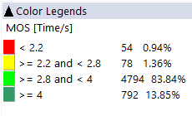
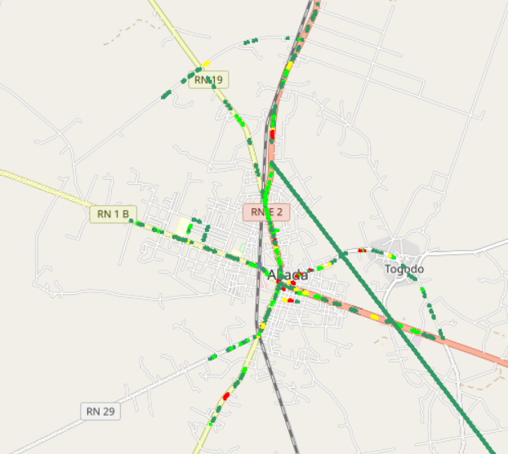
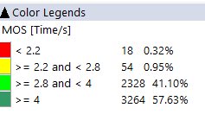
Benchmarking – CS Integrity Voice quality maps (MOS)
MTN have less than 1% of MOS samples lower than 2.2,
Values lower than 2,2 pose risk of bad users perceived voice quality
3d

Slide 29
Benchmarking: Radio parameters EC/NO comparison
CELLTIS have the best 3G EcNo samples within acceptable range

Slide 30
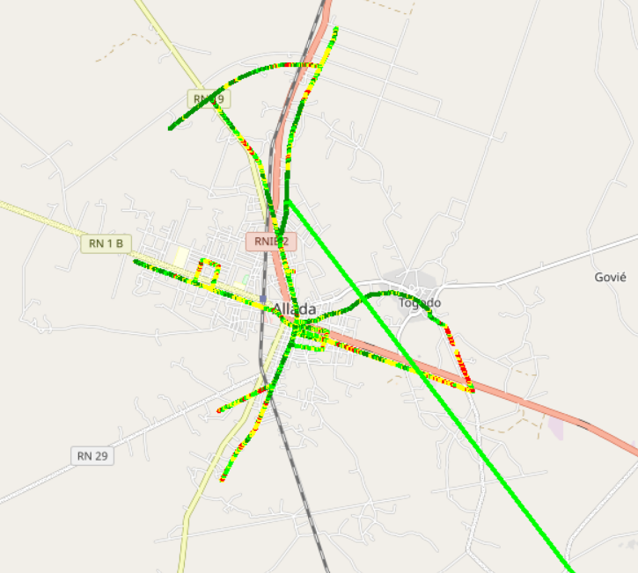
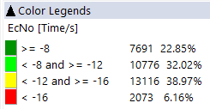
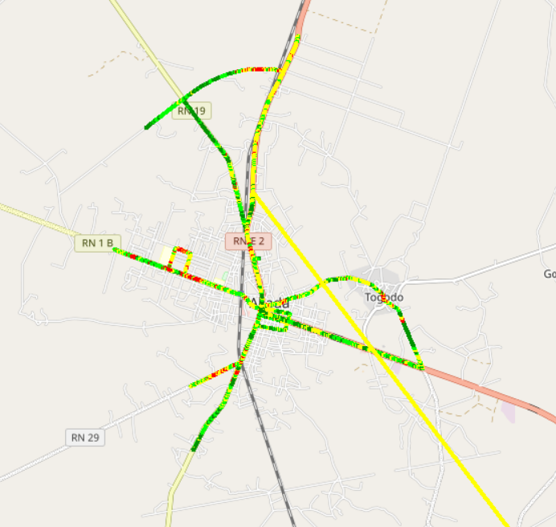
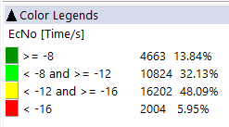
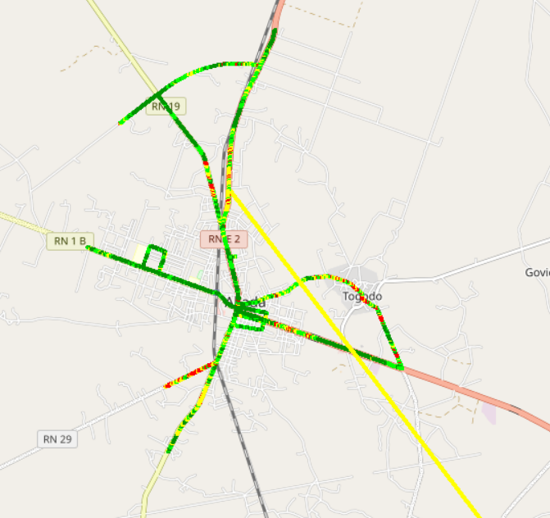
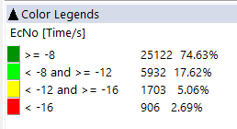
Benchmarking: Radio parameters EC/NO
CELLTIS have the best 3G EcNo samples distribution

Slide 31
Benchmarking – SINR comparison
Drive tests are showing that MTN have the best acceptable level range of SINR

Slide 32
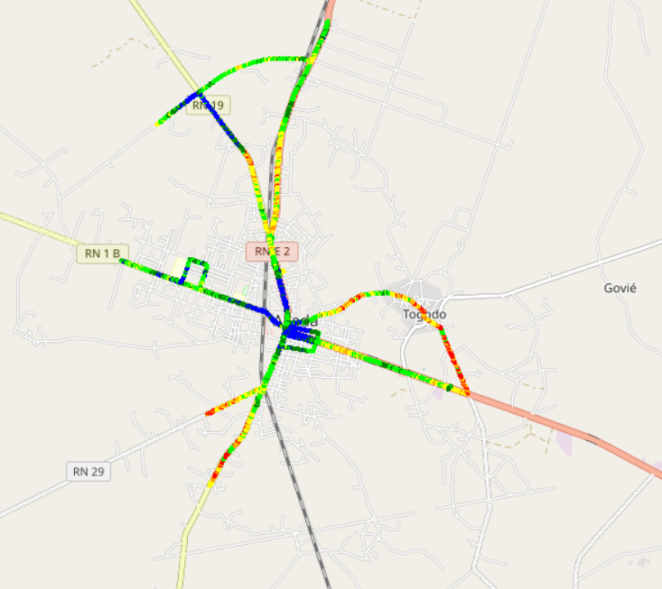
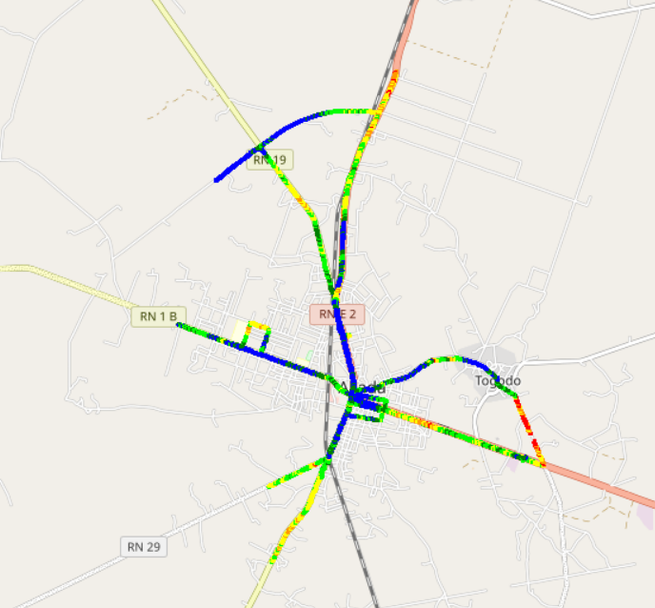
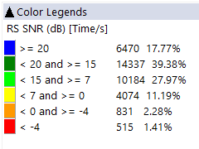

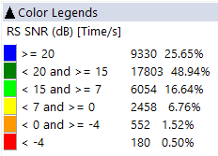
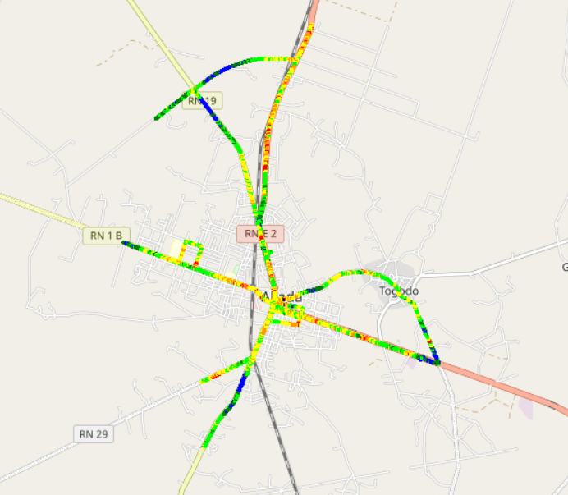
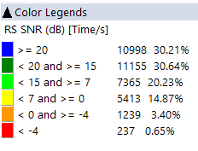
Benchmarking – SNIR comparison map
4G MTN have a better quality of signal compared to CELTISS and MOOV

Slide 33
Benchmarking – 2G/3G CALL SETUP TIME
MTN have the best Call setup time.

Slide 34
Benchmarking – CALL SETUP TIME/Call Mode
MTN have the best 4G CSBF Call setup Time,
Call setup time 2G is higher than in 3G/4G.

Slide 35
Benchmarking – SMS SENDING FAILURE
MTN and MOOV fail in SMS service due to the delivery time exceeding 6s

Slide 36
06
Benchmarking Data service

Slide 37
Benchmarking – DATA 3G
All operators have a acceptable rate of successful Internet connection

Slide 38
Benchmarking – DATA 3G
MOOV failed in http browsing SR

Slide 39
Benchmarking – DATA 3G
All operators have good downlink and uplink FTP success rate

Slide 40
Benchmarking – 3G FTP MEAN THROUGHPUT
All operators met the ARCEP downlink and uplink FTP success rate thresholds
MTN FTP DL AVERAGE Throughout is ranked second
MTN FTP UL AVERAGE Throughout isranked second

Slide 41

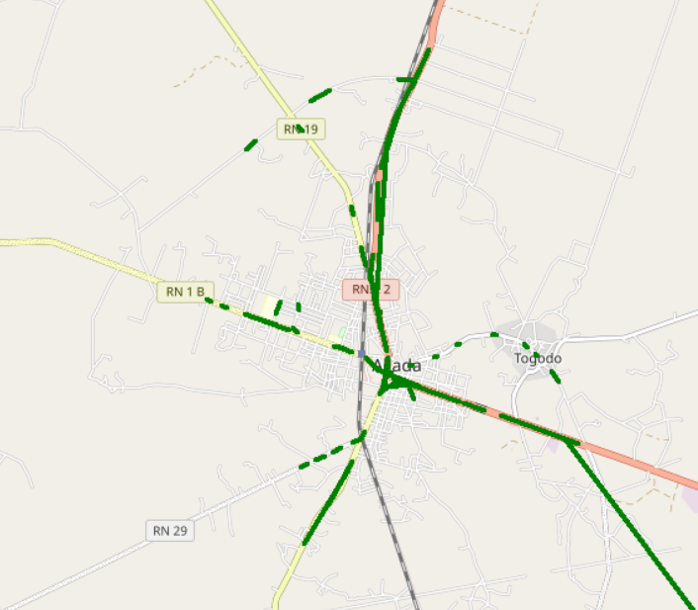
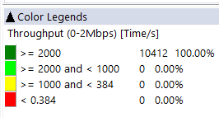
Benchmarking – 3G FTP MEAN THROUGHPUT comparison map
All samples exceed 2Mbps

Slide 42
Benchmarking – 4G HTTP Browsing
All operators have a very good HTTP Browsing success rate.

Slide 43
Benchmarking – 4G FTP THROUGHPUT comparison
All operators have a very good FTP success rate.

Slide 44
Benchmarking – 4G FTP THROUGHPUT comparison
MTN have the best average FTP throuhjpun in both DL and UL.

Slide 45
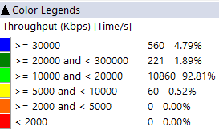
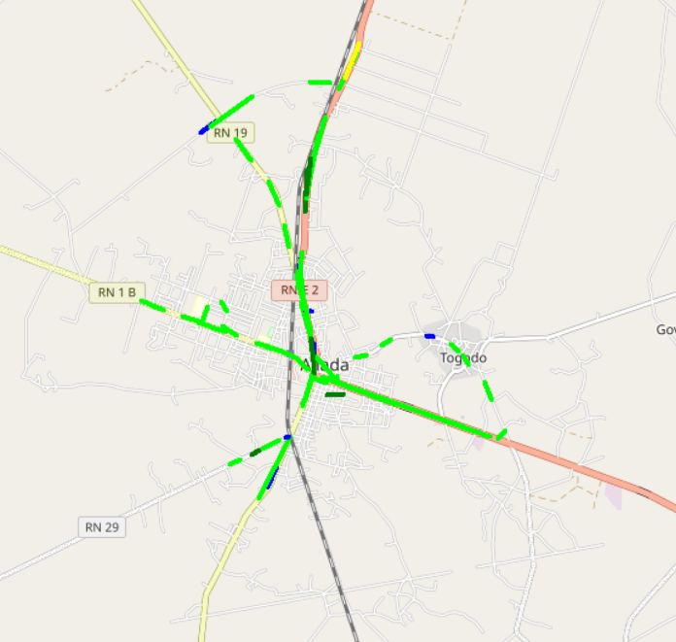
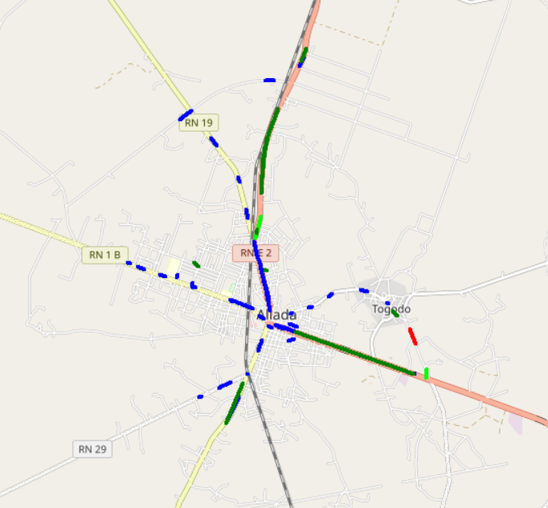
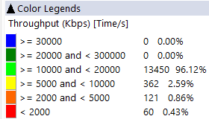
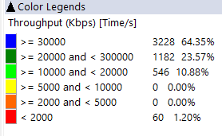
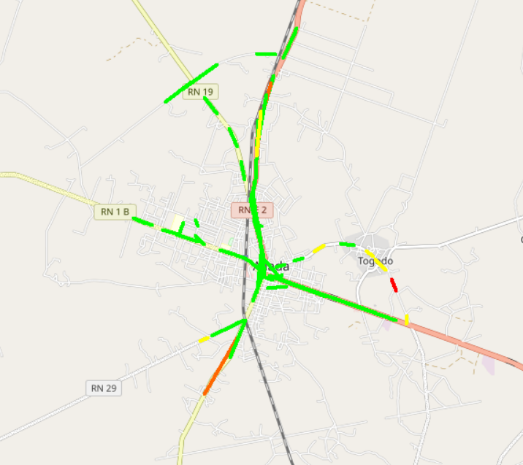
Benchmarking – 4G FTP THROUGHPUT comparison map
MTN Shows the best 4G FTP throughput samples distribution.

Slide 46
Benchmarking – BAND and TECHNOLOGY UTILISATION
Most of MTN LTE samples are in 2600 band.
Most of CELTIS LTE samples are in 1800 band.
Most of MOOV LTE samples are in 800 and 2600 band
Usage of 3G U900 is lower for CELTISS

Slide 47
Benchmarking – Data TECHNOLOGY Usage(%)
MTN have the highest LTE CA Carrier Aggregation usage.

Slide 48

Deloitte fait référence à un ou plusieurs cabinets membres de Deloitte Touche Tohmatsu Limited, société de droit anglais (« private company limited by guarantee »), et à son réseau de cabinets membres constitués en entités indépendantes et juridiquement distinctes. Pour en savoir plus sur la structure légale de Deloitte Touche Tohmatsu Limited et de ses cabinets membres, consulter www.deloitte.com/about.
Fort d’un réseau de firmes membres dans plus de 150 pays, Deloitte allie des compétences de niveau international à des expertises locales pointues, afin d’accompagner ses clients dans leur développement partout où ils opèrent. Nos 264 000 professionnels sont animés par un objectif commun, faire de Deloitte la référence en matière d’excellence de service.
Au Bénin, Deloitte mobilise un ensemble de compétences diversifiées pour répondre aux enjeux de ses clients, de toutes tailles et de tous secteurs – des grandes entreprises multinationales aux microentreprises locales, en passant par les entreprises moyennes.
Le présent document et ses annexes sont confidentiels et réservés à l’usage interne exclusif du destinataire. Toute reproduction ou toute divulgation partielle ou totale à des tiers en est interdite, sauf accord écrit préalable de Deloitte Bénin.
© 2023 Deloitte Bénin SARL. Société du réseau Deloitte

