Slide 1


Volte Drive Test Report

Slide 2
DT Scénario
Short Call (10s)
Long call (2min)
Scanner

Slide 3
Voice Call

Slide 4
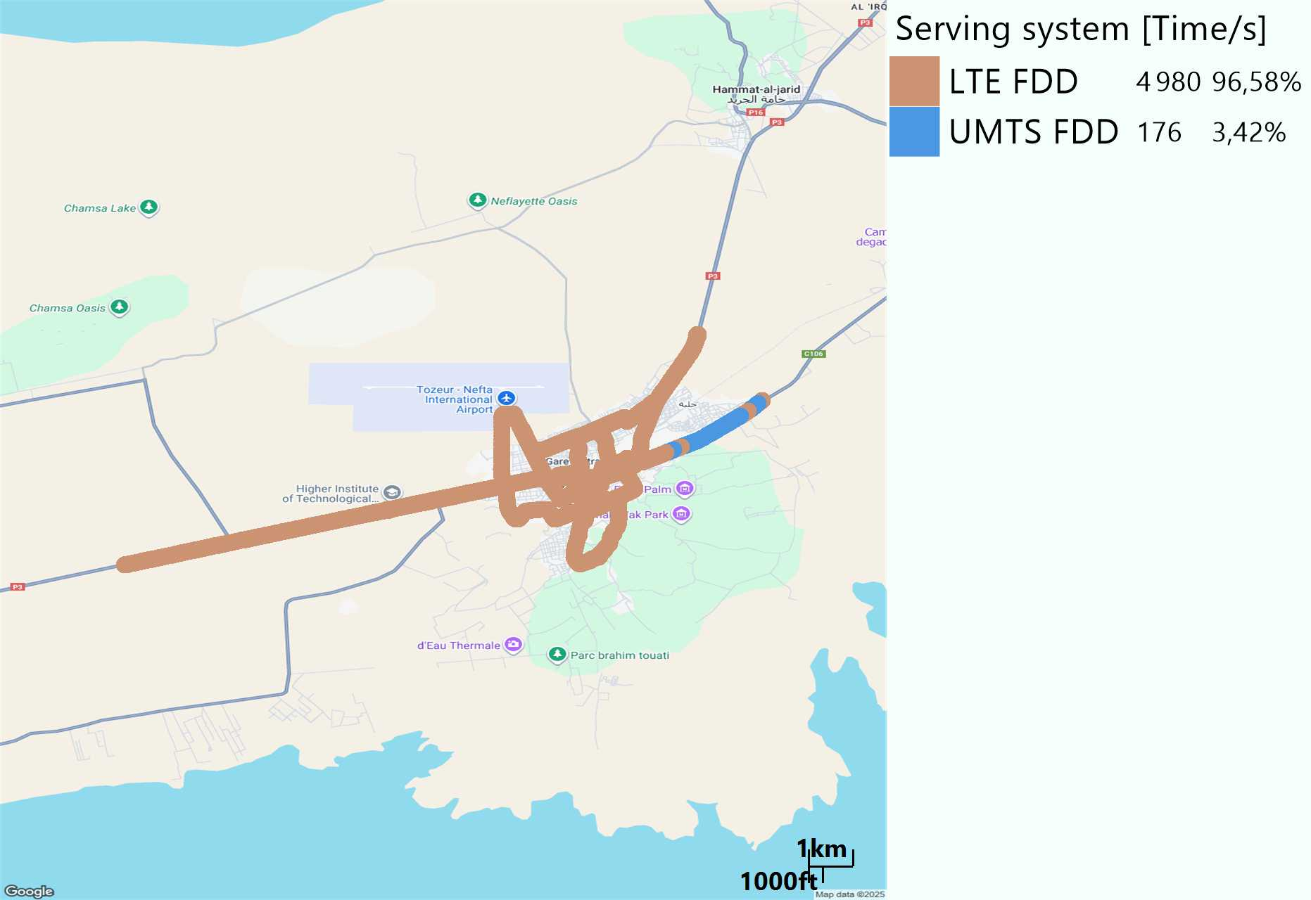
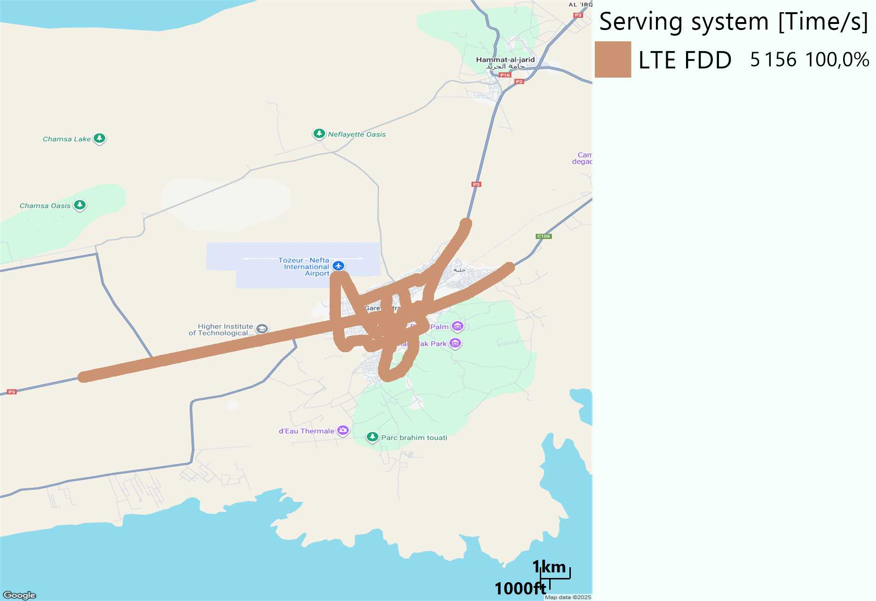
RAT distribution
Long call
Short call

Slide 5
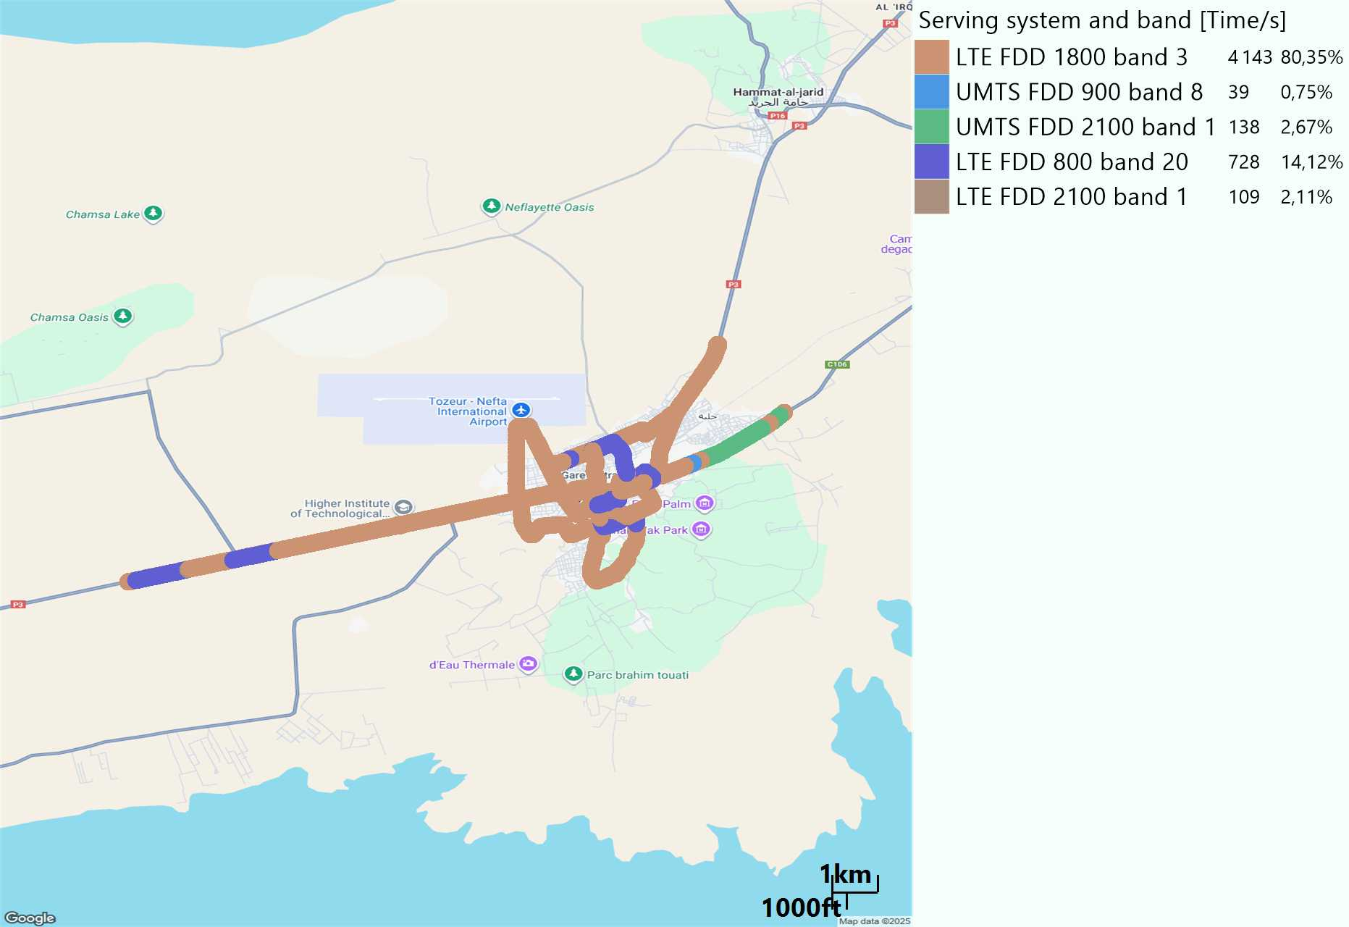
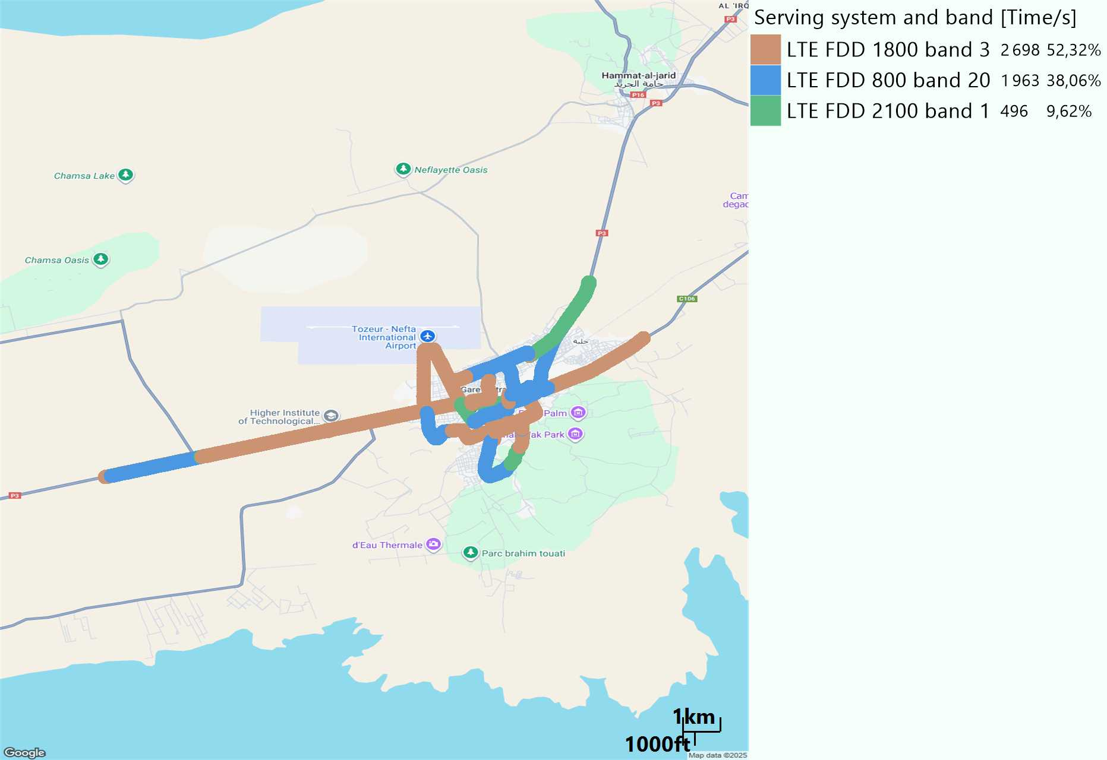
EARFCN distribution
Long call
Short call

Slide 6
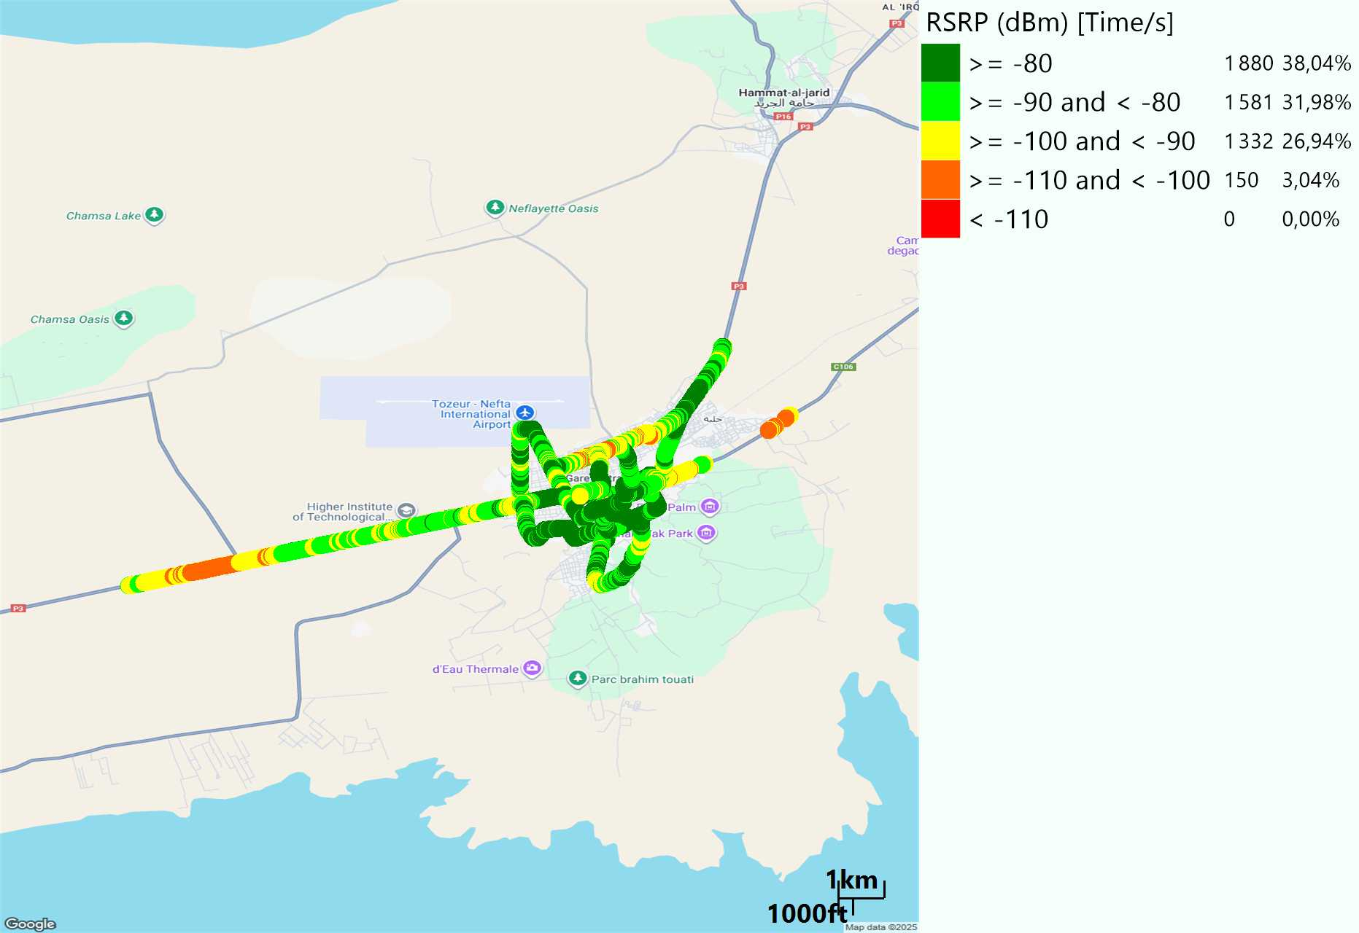
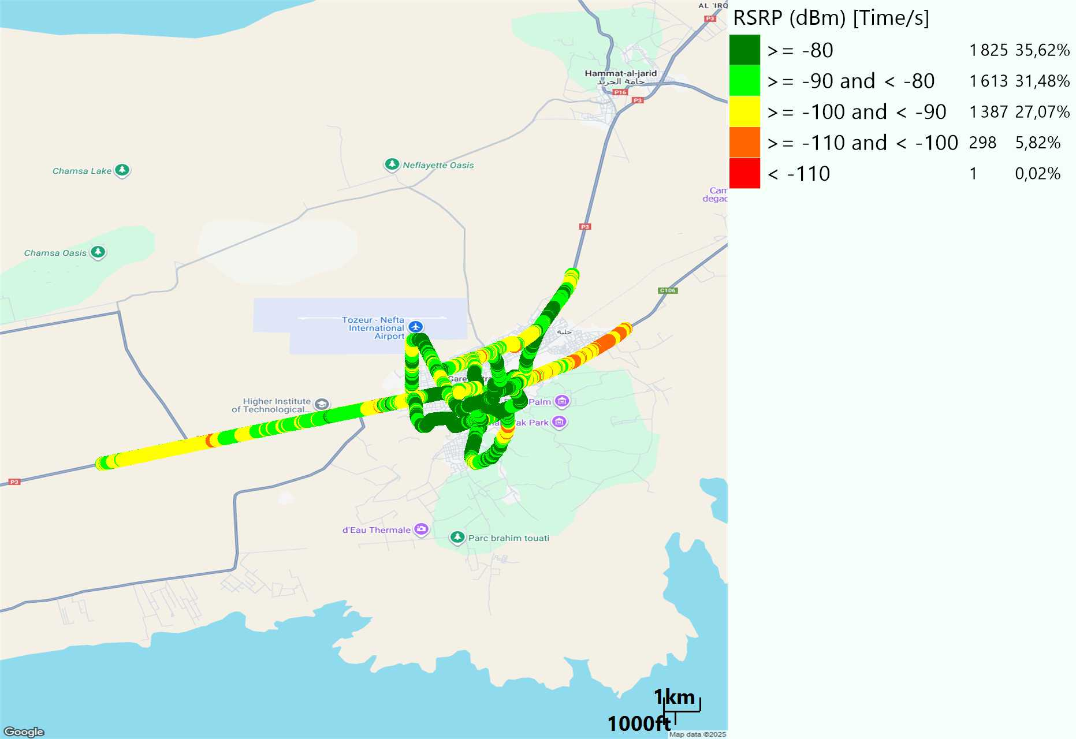
LTE - RSRP
Long call
Short call
Average [dBm]
-83,31
Average [dBm]
-84,06

Slide 7
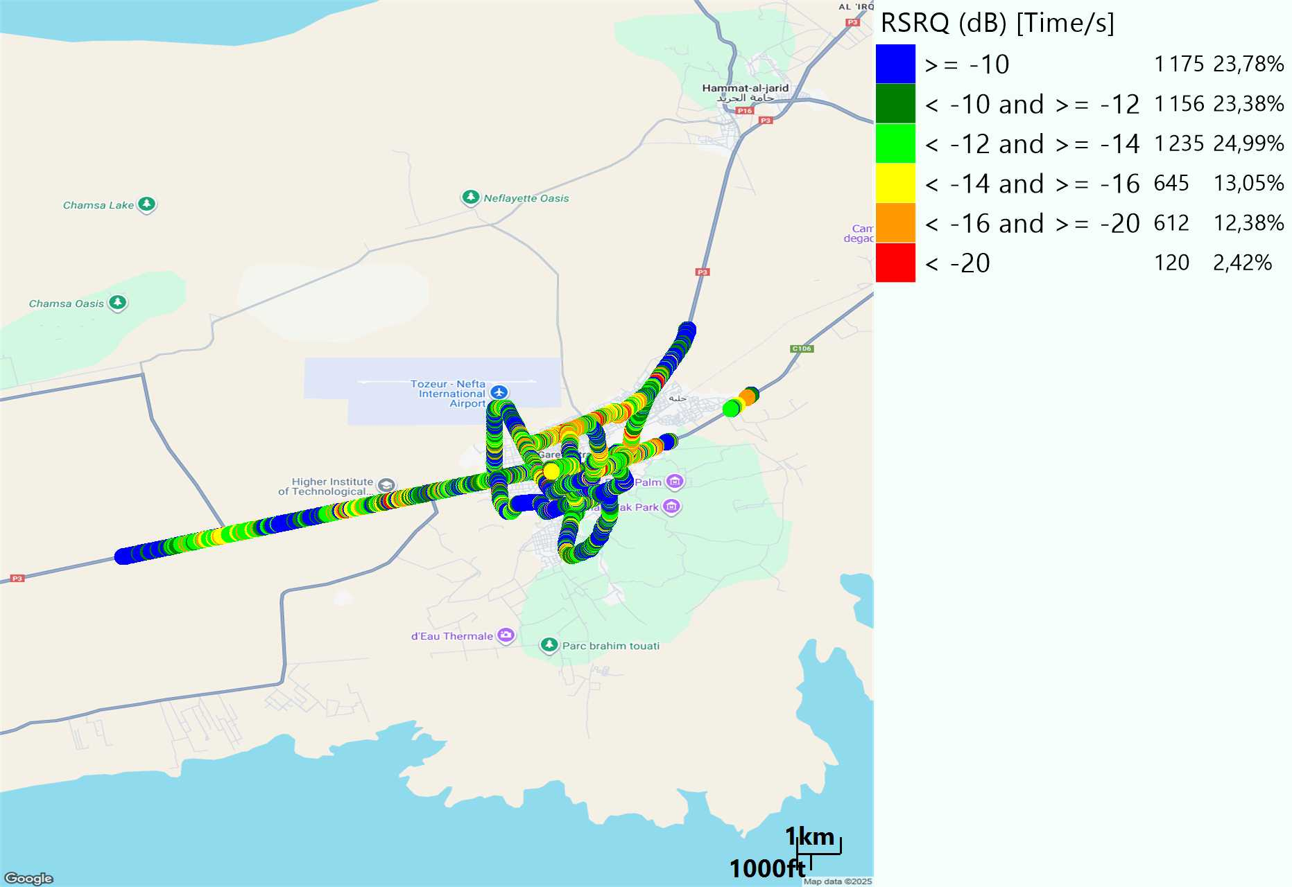

LTE- RSRQ
Long call
Short call

Slide 8
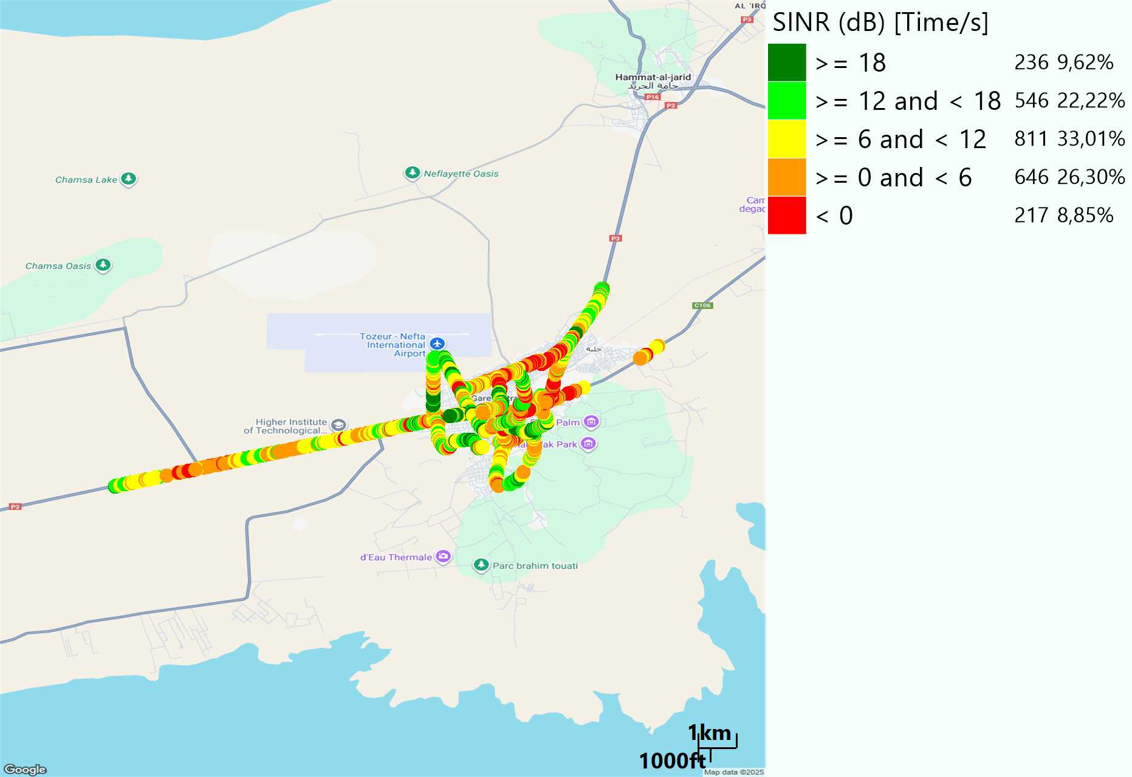
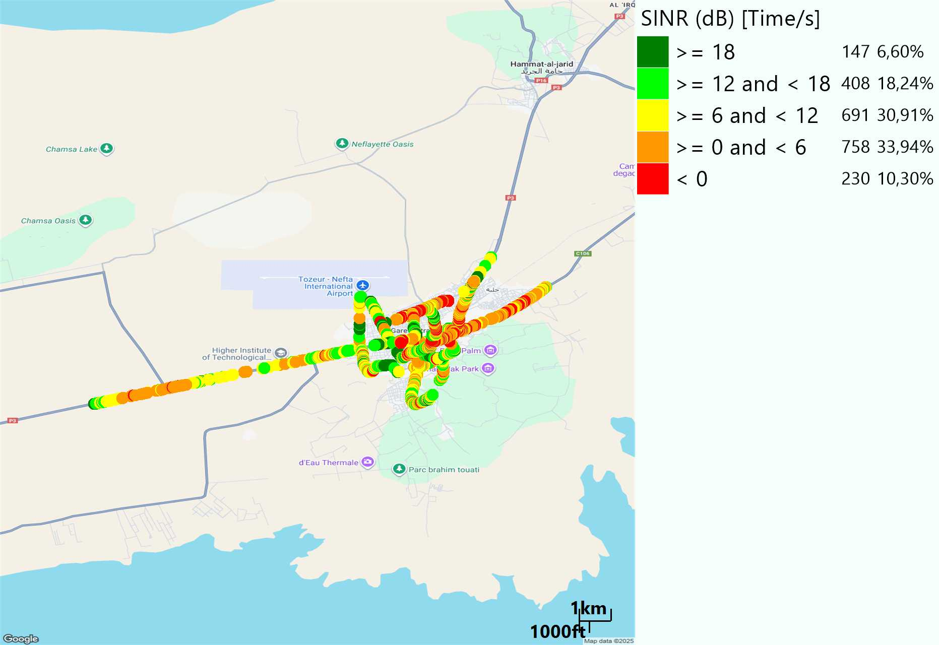
LTE-SINR
Long call
Short call

Slide 9
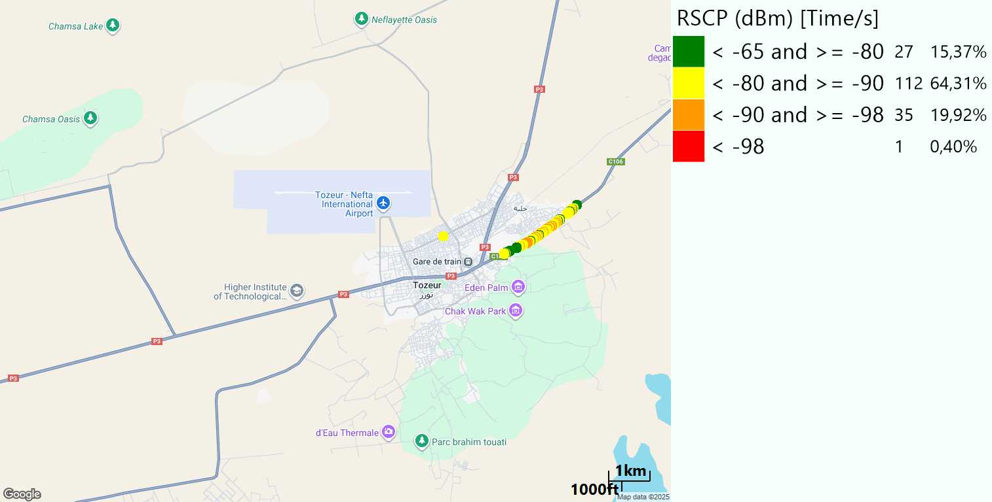
RSCP
Long call

Slide 10
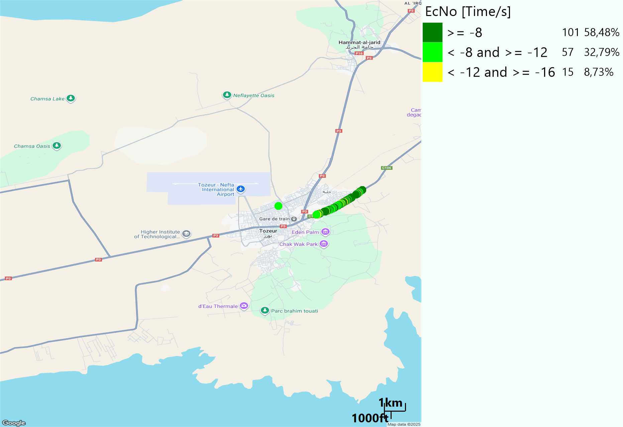
WCDMA-Ec/NO
Long call

Slide 11
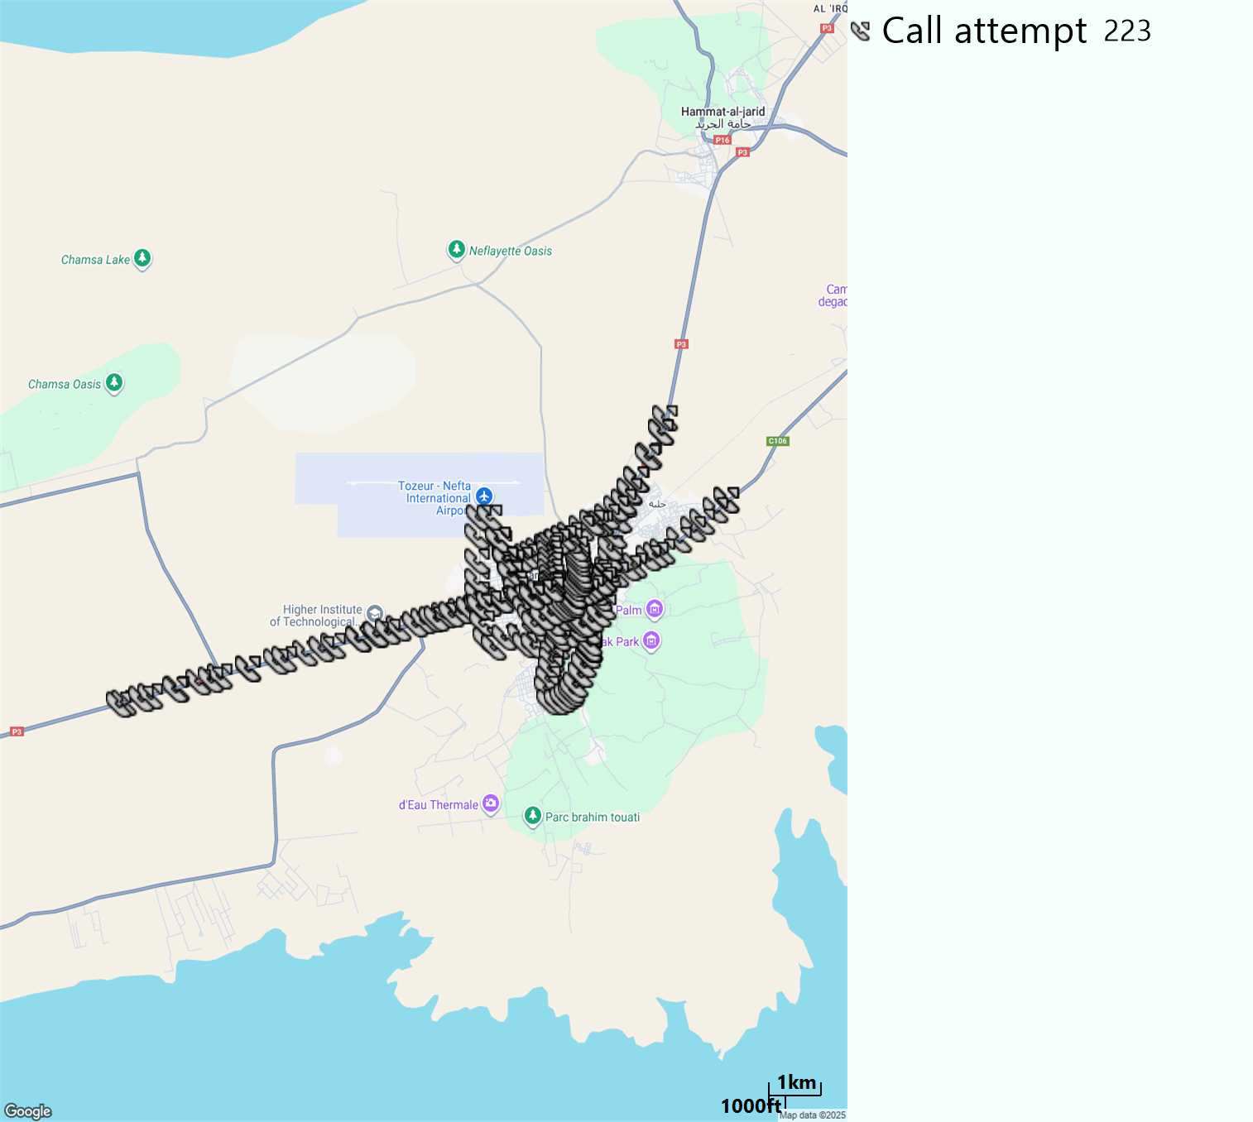
MO Call Setup Time (call setup time in VoLTE)
Short call
Call Setup Time IMS Voice
Average (Sec) | Maximum (Sec) | Minimum (Sec)
2,86 | 8,92 | 1,91

Slide 12
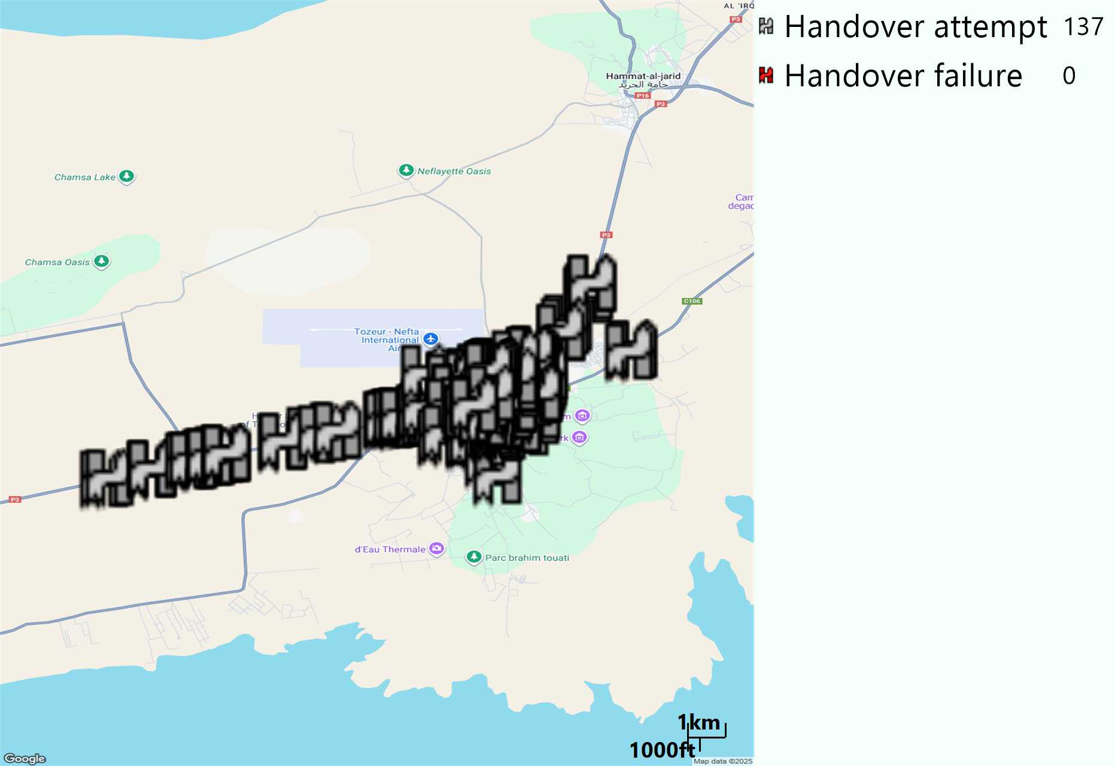
MO Handover Type
Long call
HO Type | Percentage [%]
LTE Inter-Frequency handover | 7,3%
LTE Intra-Frequency handover | 92,7%
Handover KPI’s
Handover Attemps | 137
Handover Success | 137
Handover succès Rate | 100%
Étiquettes de lignes | LTE FDD_1800 | LTE FDD_2100 | LTE FDD_800 | Total général
LTE FDD_1800 | 99 | 1 | 3 | 103
LTE FDD_2100 |  |  | 2 | 2
LTE FDD_800 | 4 |  | 28 | 32
Total général | 103 | 1 | 33 | 137

Slide 13
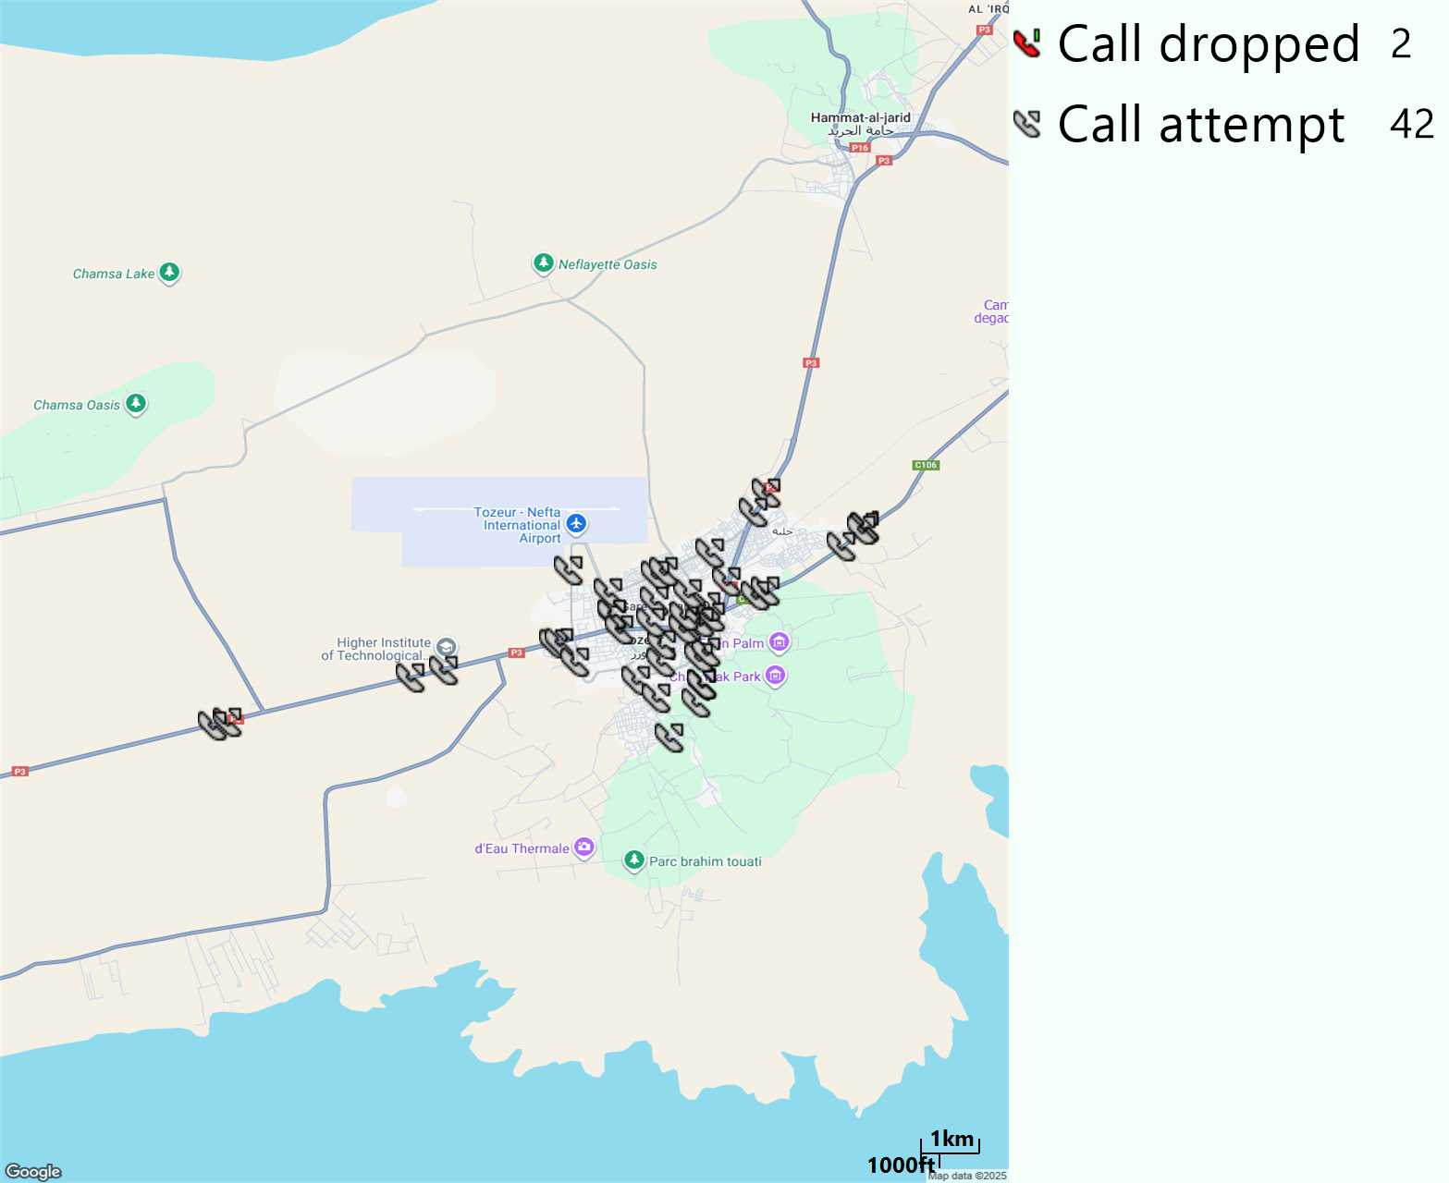
MO Voice Stats (VoLTE call stats)
Long call
Voice KPIs
Number Call Attempts | 42
Number Dropped Calls | 2
Call Drop Rate (%) | 4,76%
HO success rate | 100%

Slide 14
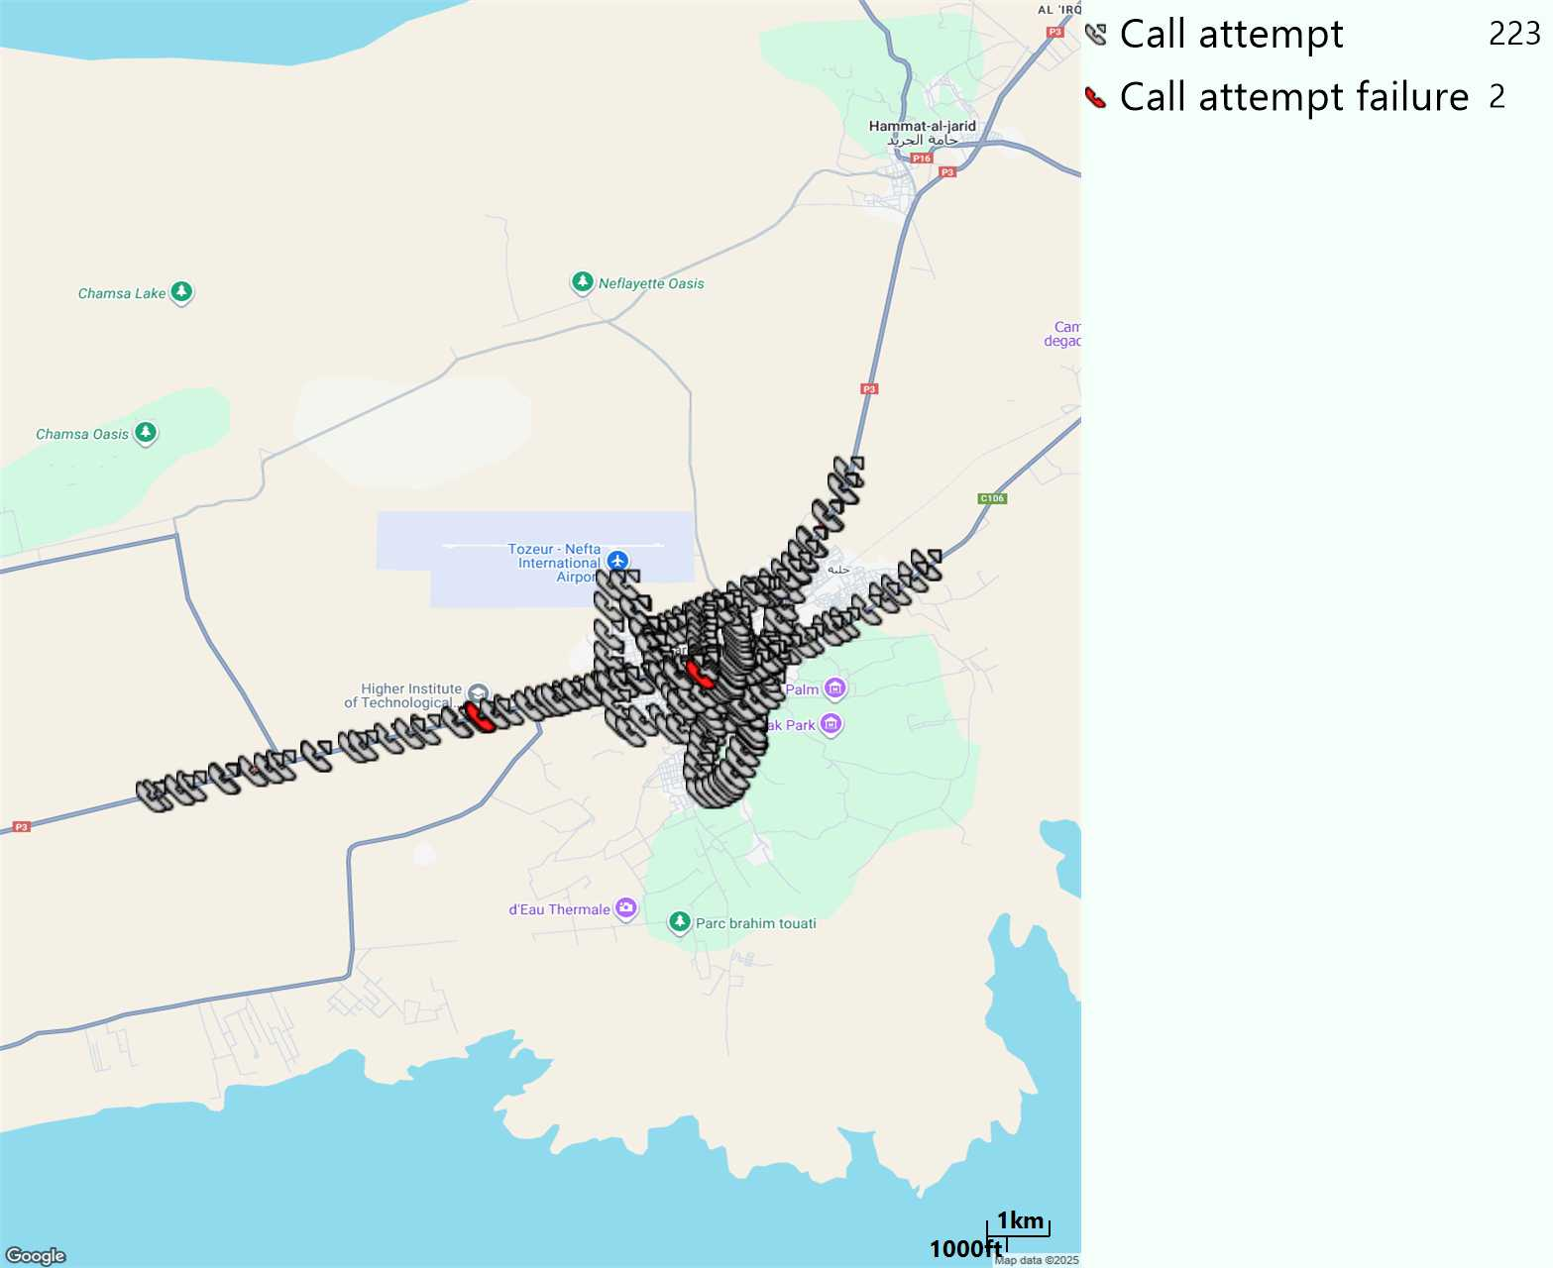
MO Voice Stats (VoLTE call stats)
Short call
Voice KPIs
Number Call Attempts | 223
Number Call Setup | 221
Number Blocked Calls | 2
Setup Succes Rate (%) | 99,1%
Call Block Rate (%) | 0,89%
Call Setup Time IMS Voice Average (Sec) | 2,86

Slide 15
MO Voice Stats (VoLTE call stats)
KPIs
VoLTE Call Setup SR | 99,1%
Call Setup Time | 2,86
VoLTE Drop Call Rate
Speech Quality - MOS (% of the samples >3,5) | 94,44%
Average MOS | 4,19
VoLTE Handover SR | 100%
VoLTE SRVCC SR | -

Slide 16
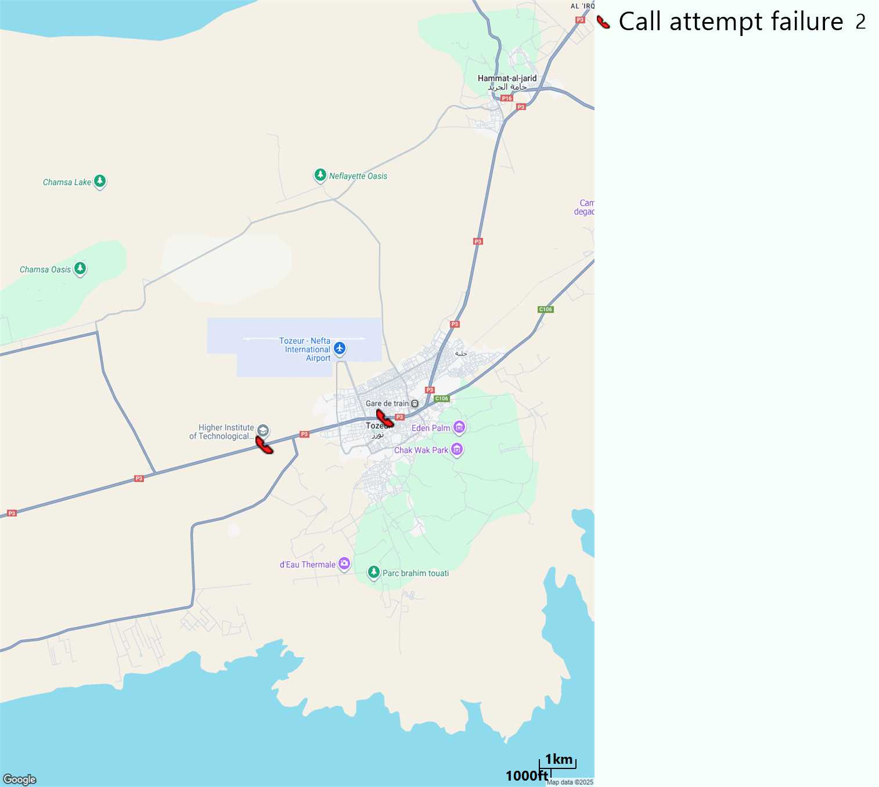
MO Voice Call - Blocked call
Short call

Slide 17
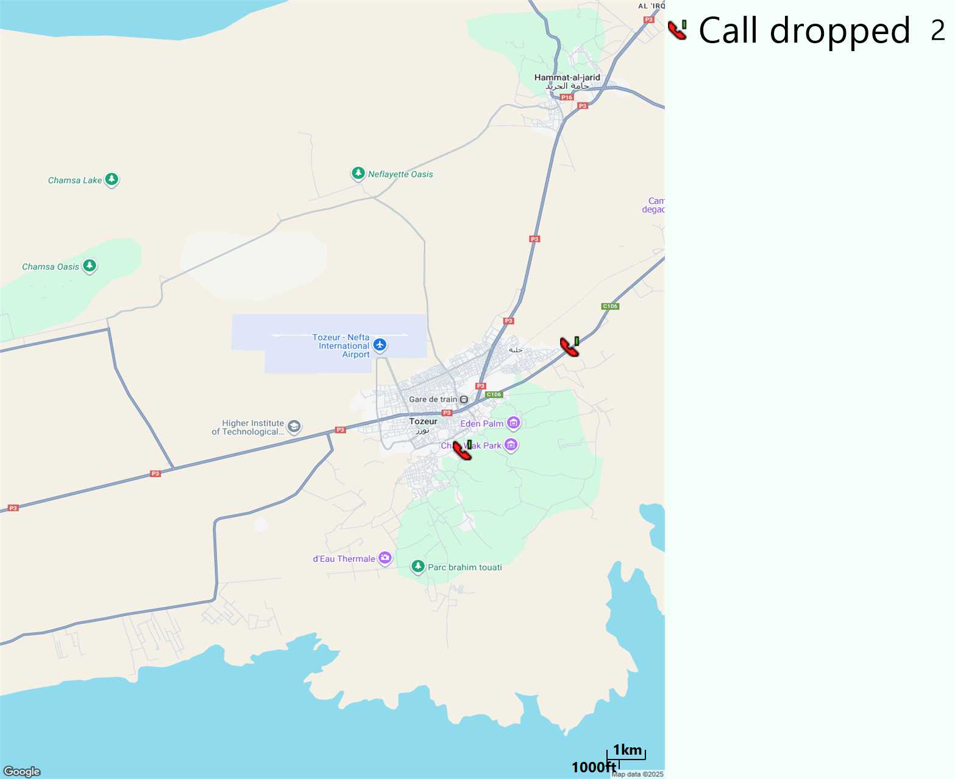
MO Voice Call - Dropped call
Long call

Slide 18
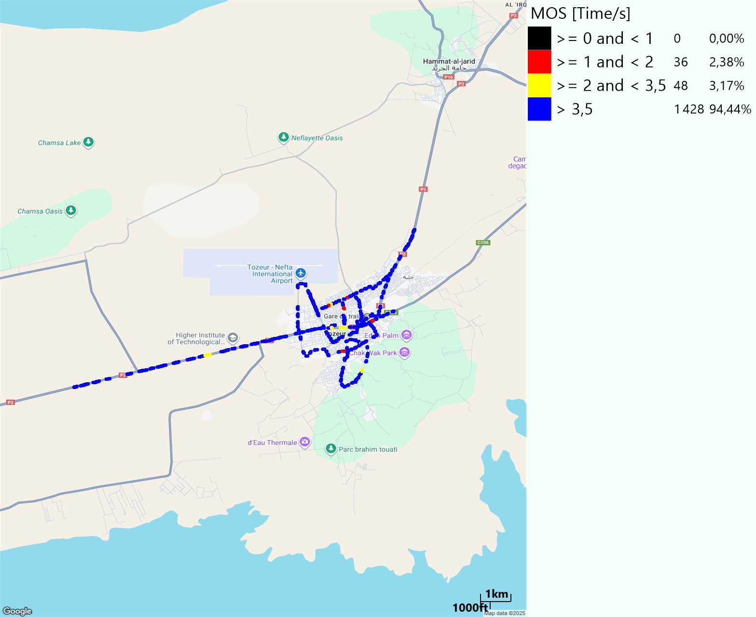
MO Voice Quality Metrics
long Call

Slide 19
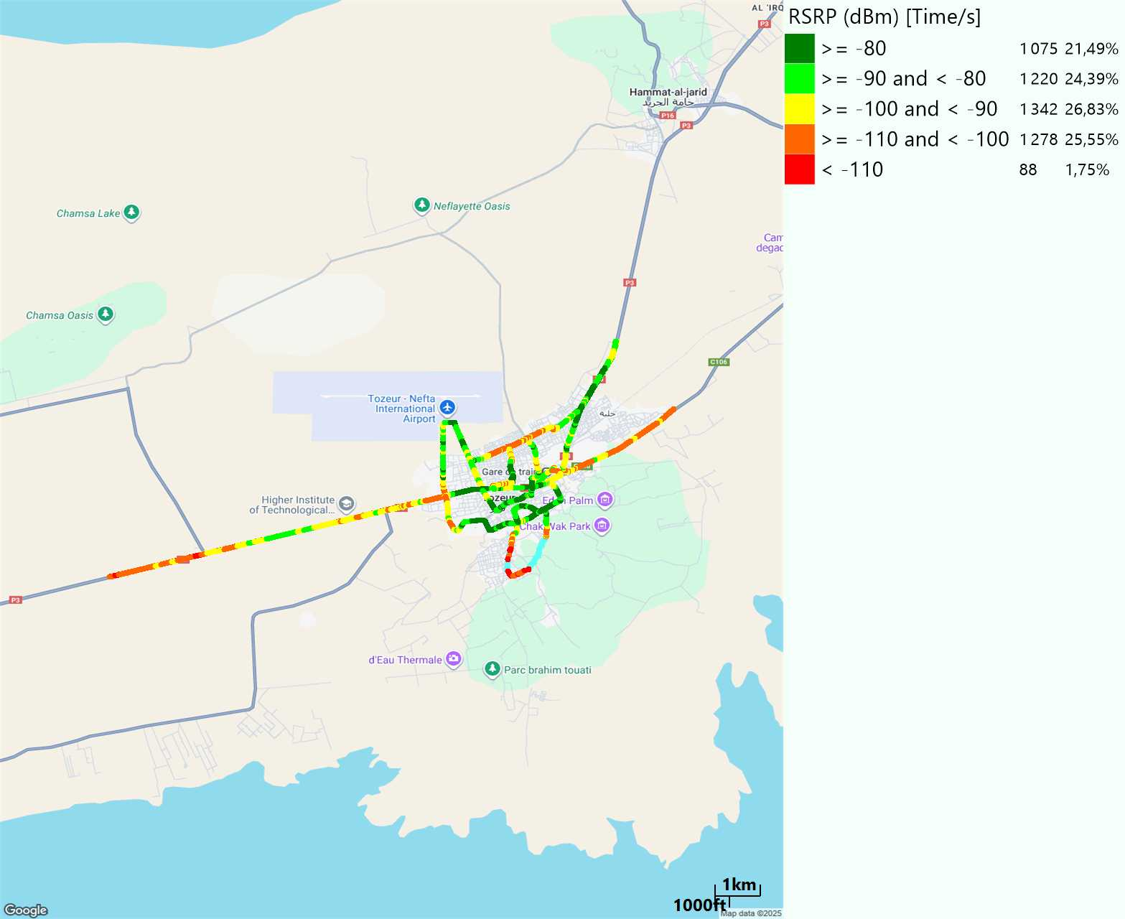
Scanner_RSRP
L2100

Slide 20
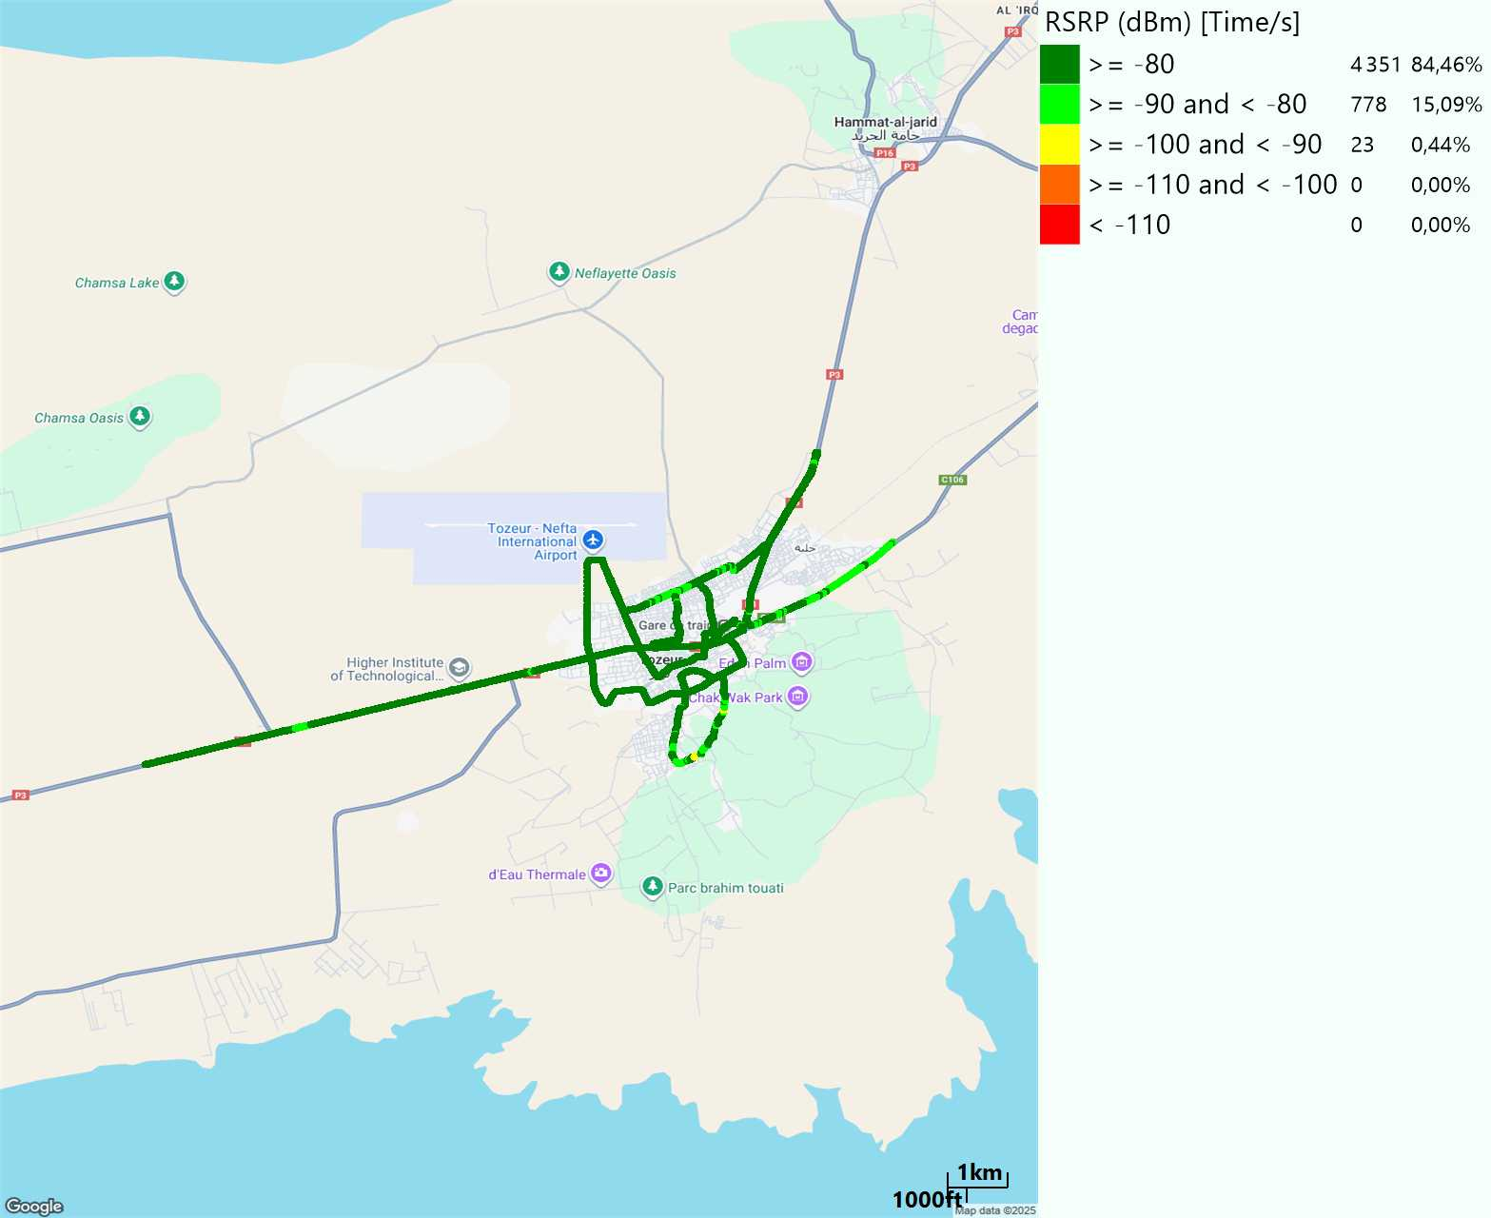
Scanner_RSRP
L800

Slide 21
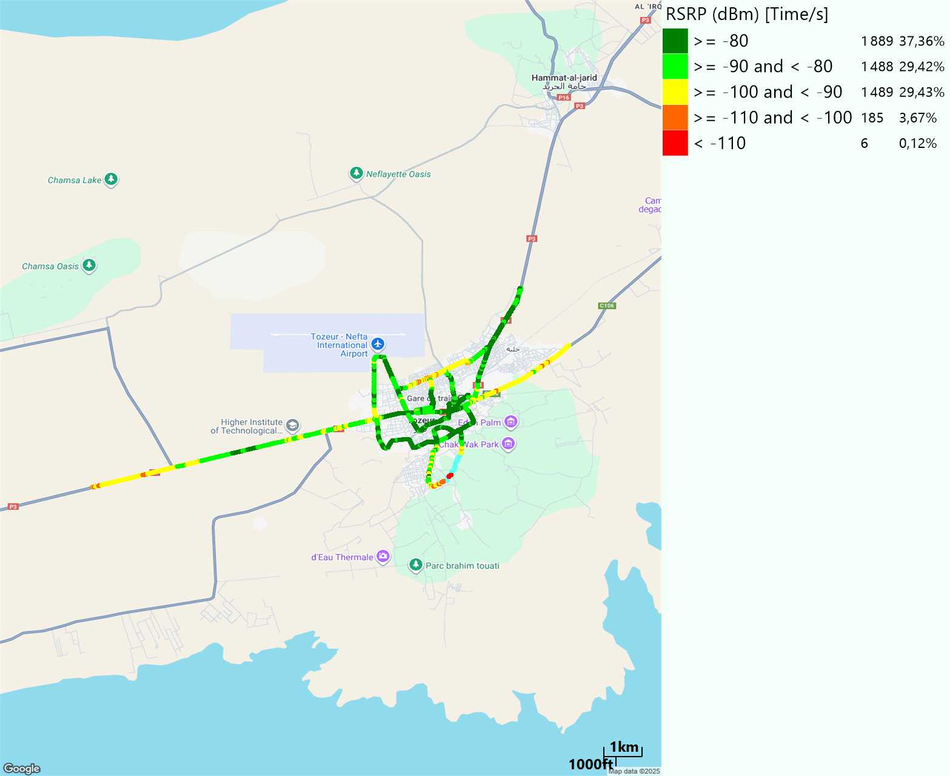
Scanner_RSRP
L1800

Slide 22
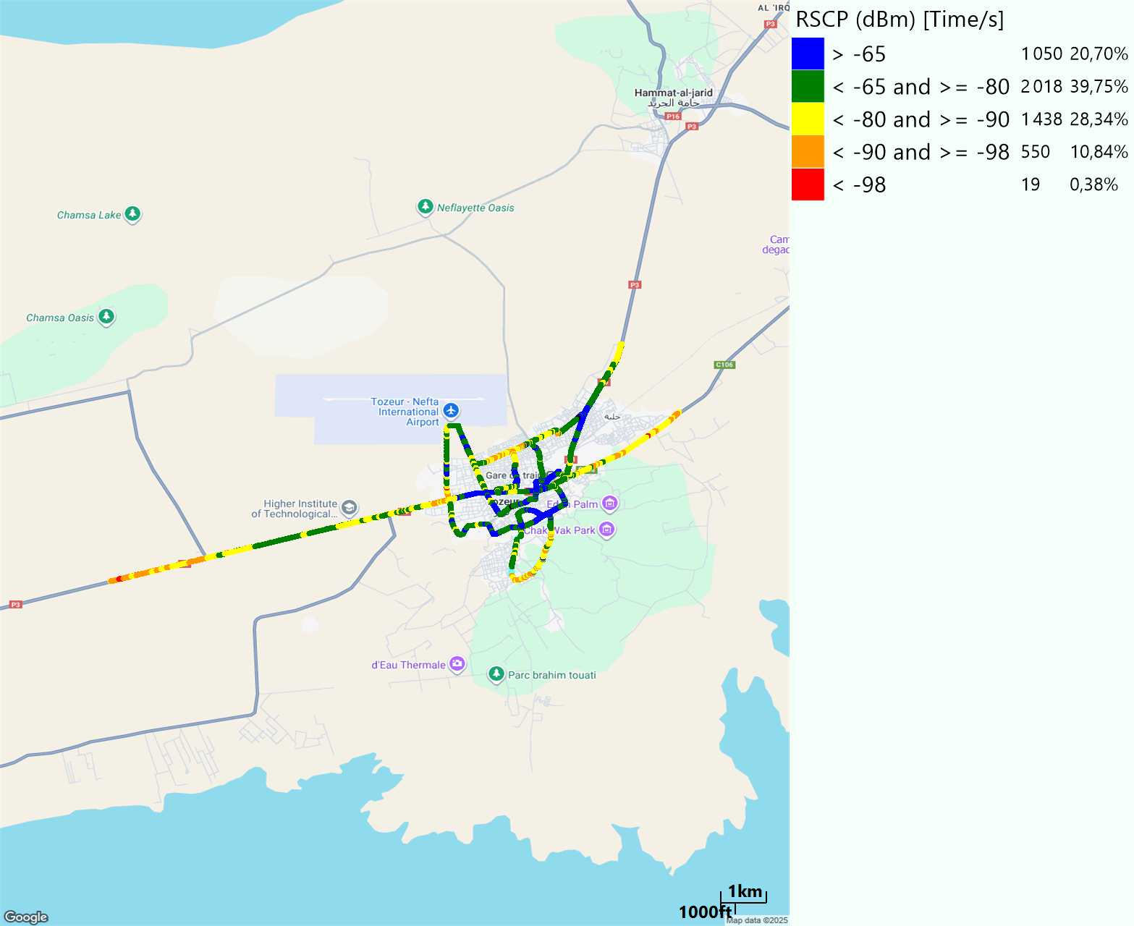
Scanner_RSCP
U2100

Slide 23
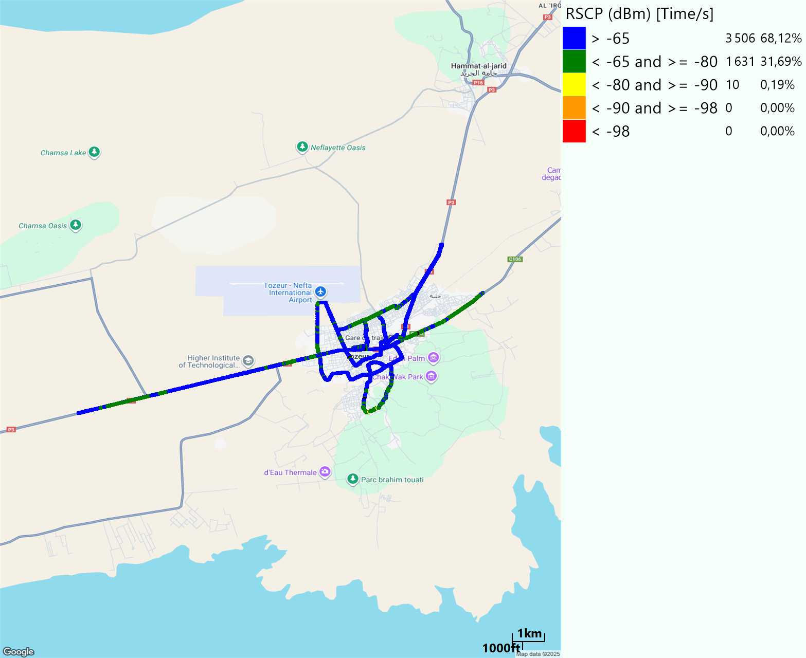
Scanner_RSCP
900

