Slide 1


Volte Drive Test Report

Slide 2
DT Scénario
Short Call (10s)
Long call (2min)
Scanner

Slide 3
Voice Call

Slide 4
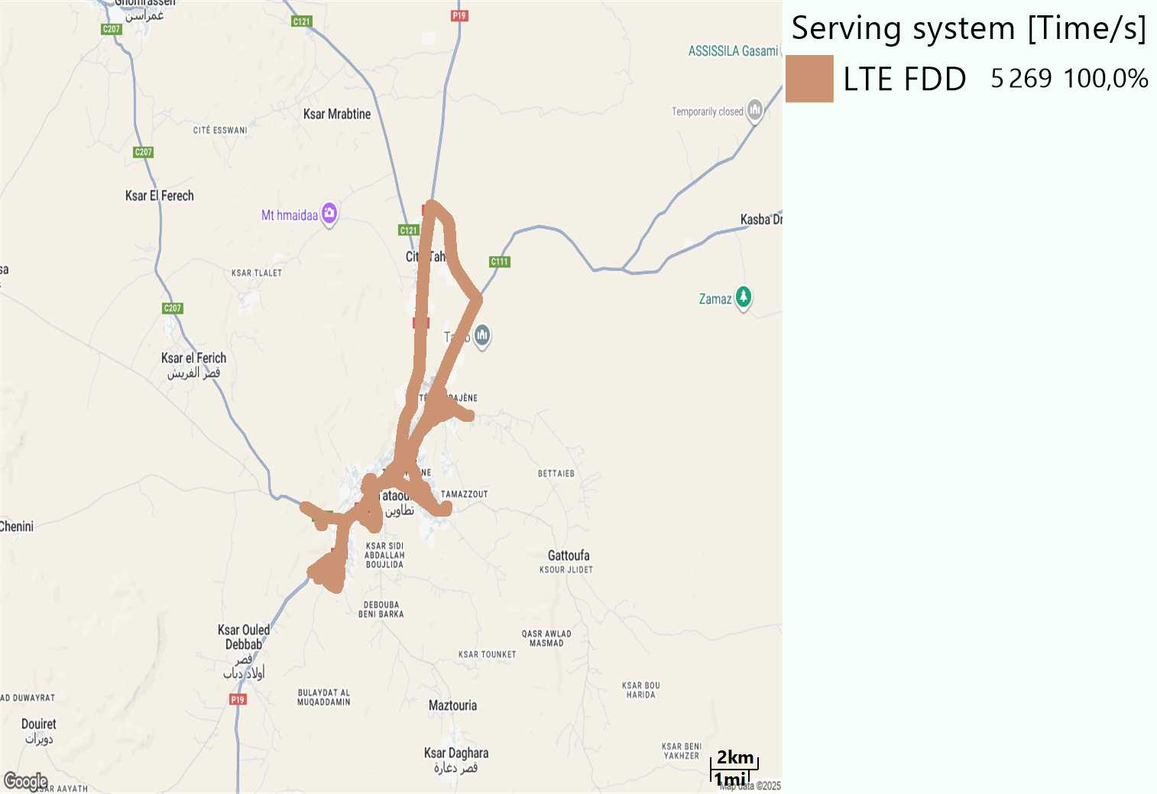
RAT distribution
Long call
Short call

Slide 5
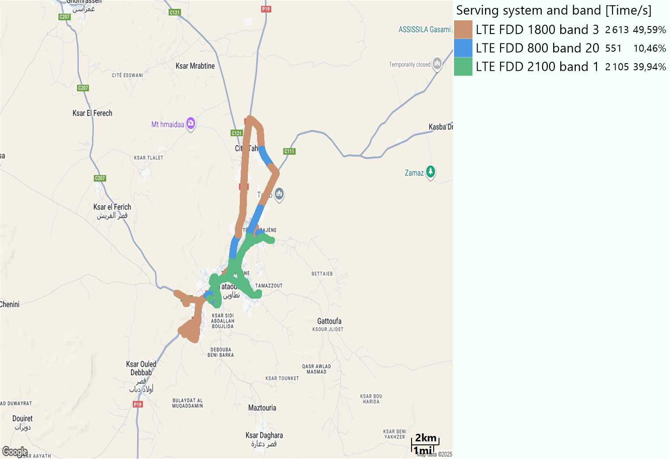
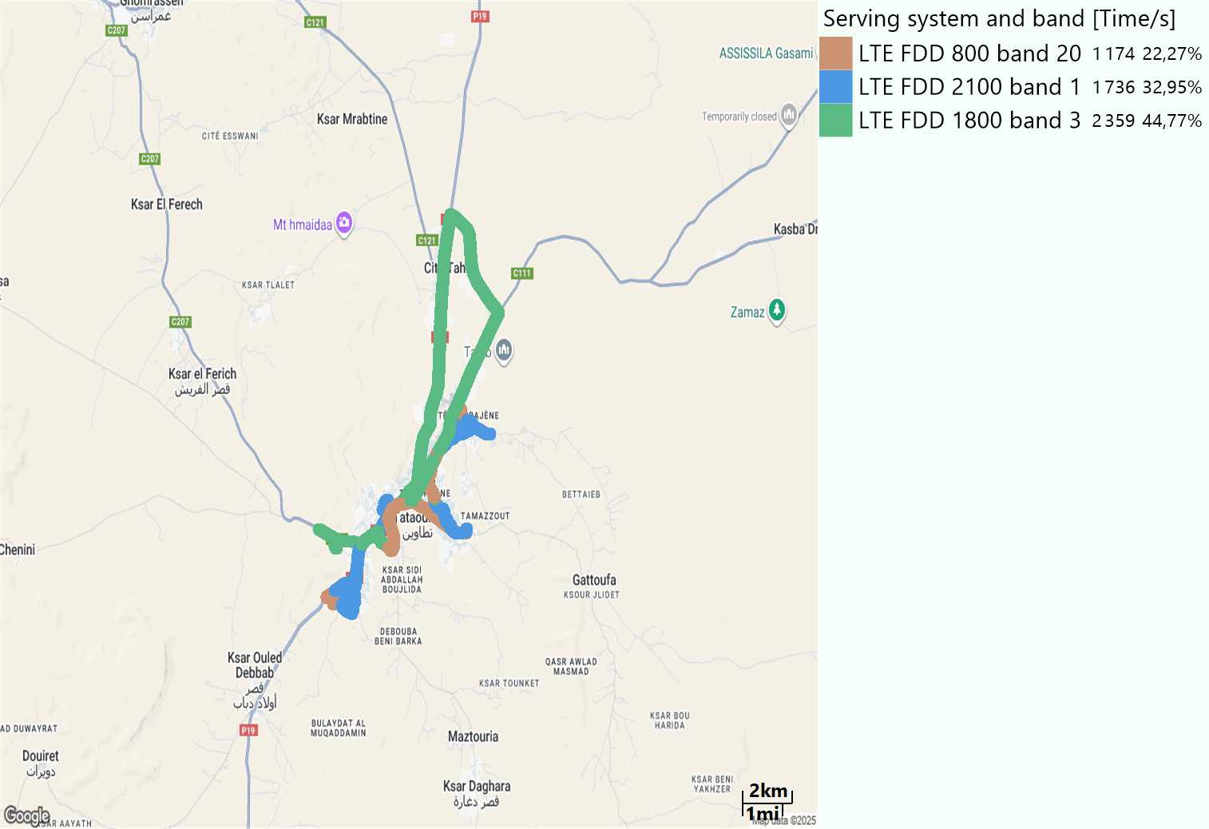
EARFCN distribution
Long call
Short call

Slide 6
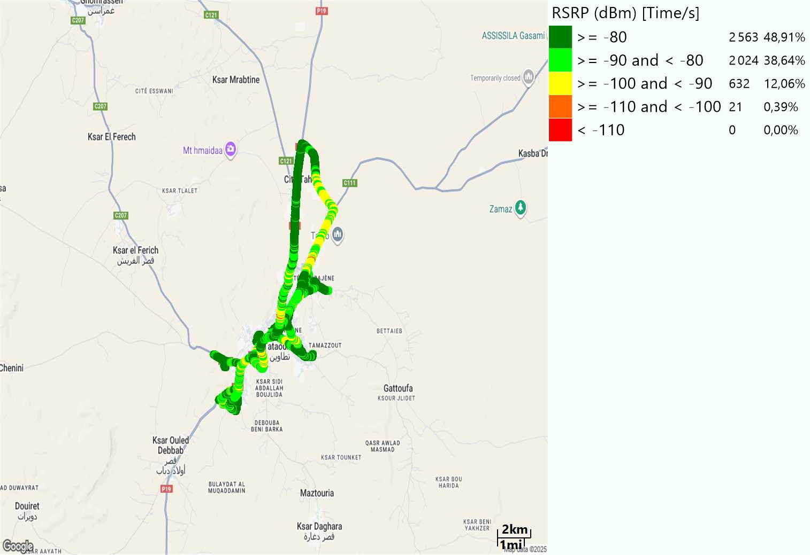
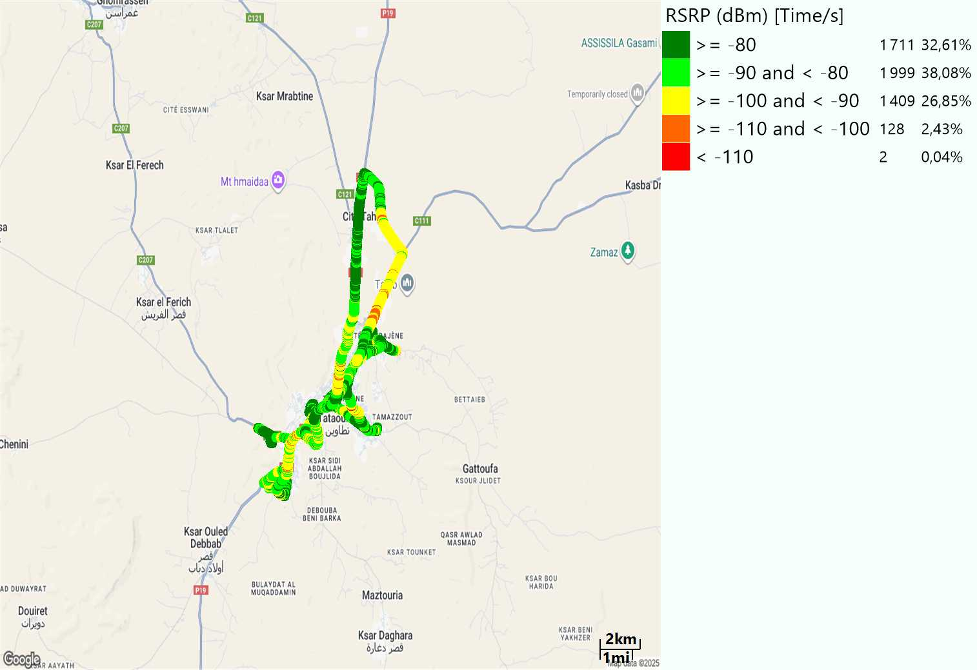
LTE - RSRP
Long call
Short call
Average [dBm]
-79,86
Average [dBm]
-84,34

Slide 7
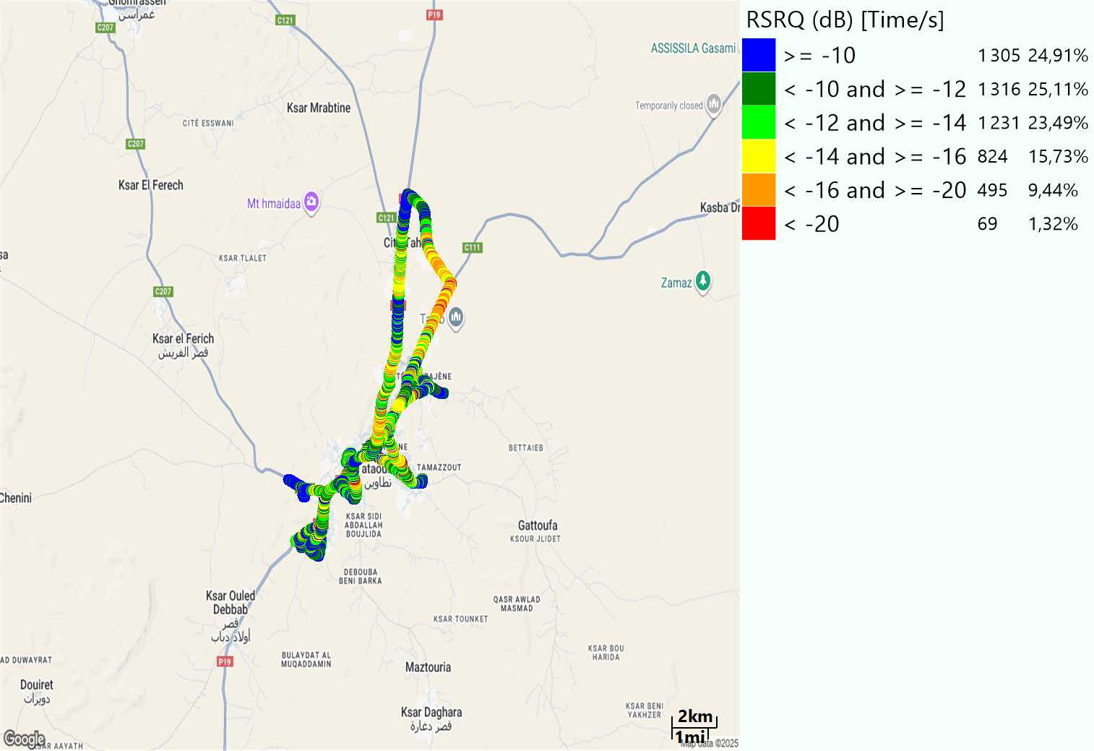
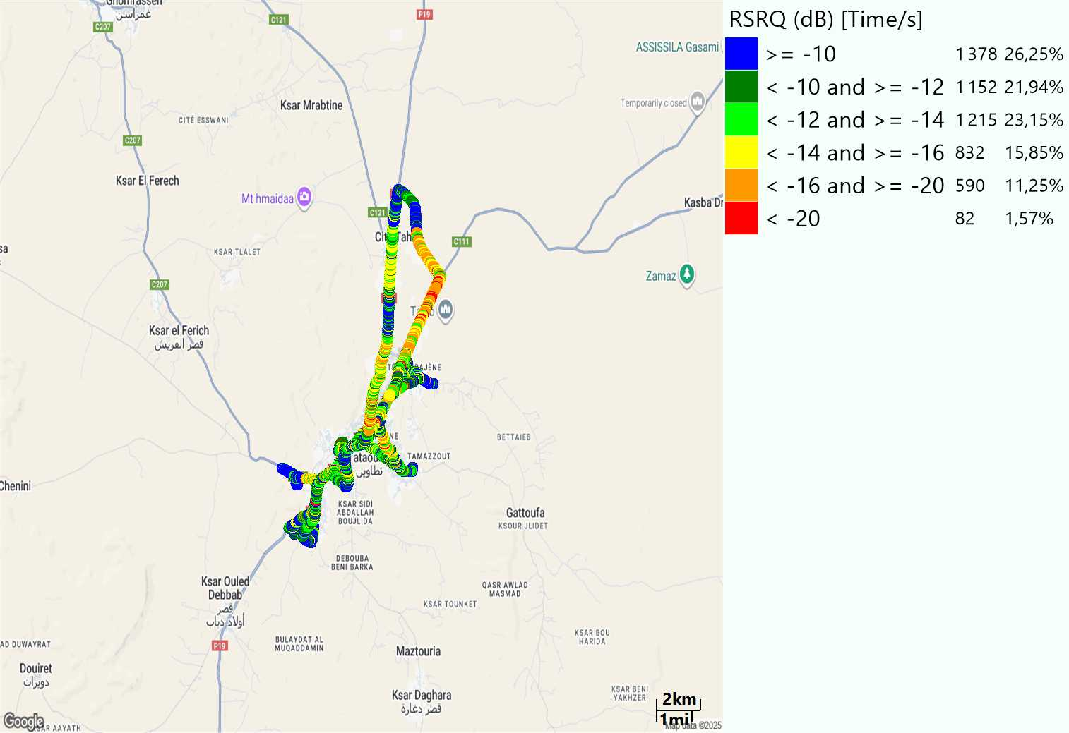
LTE- RSRQ
Long call
Short call

Slide 8
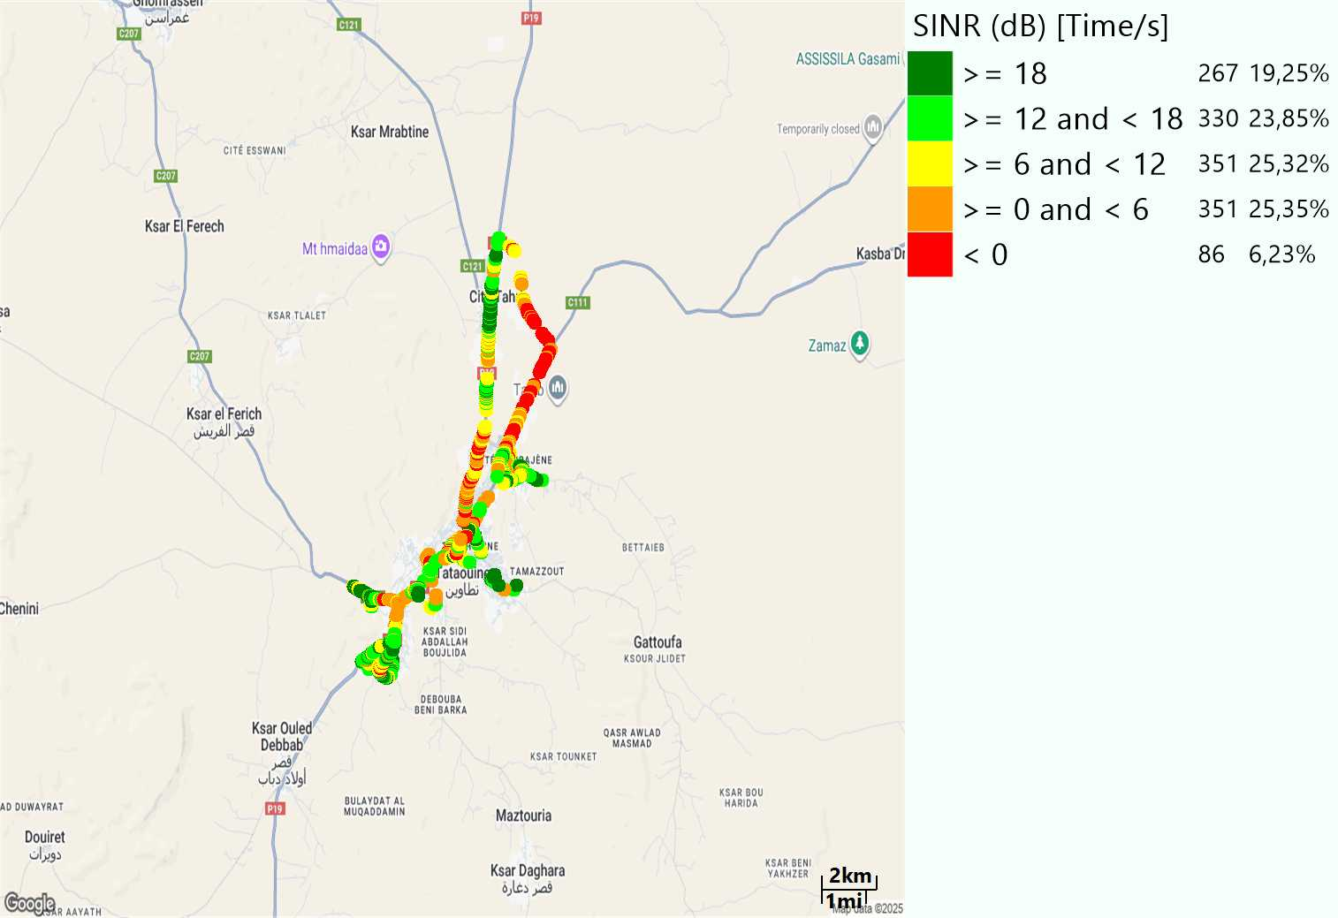
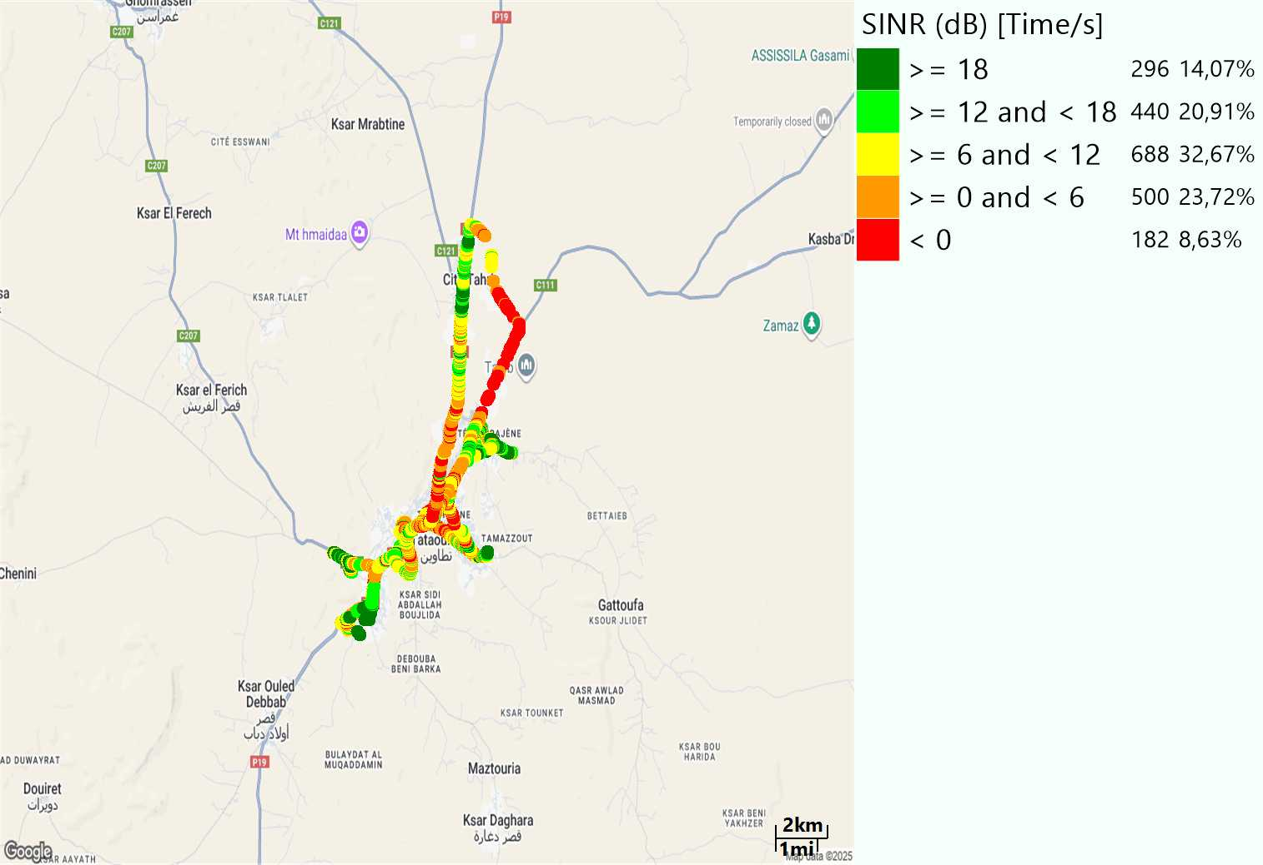
LTE-SINR
Long call
Short call

Slide 9
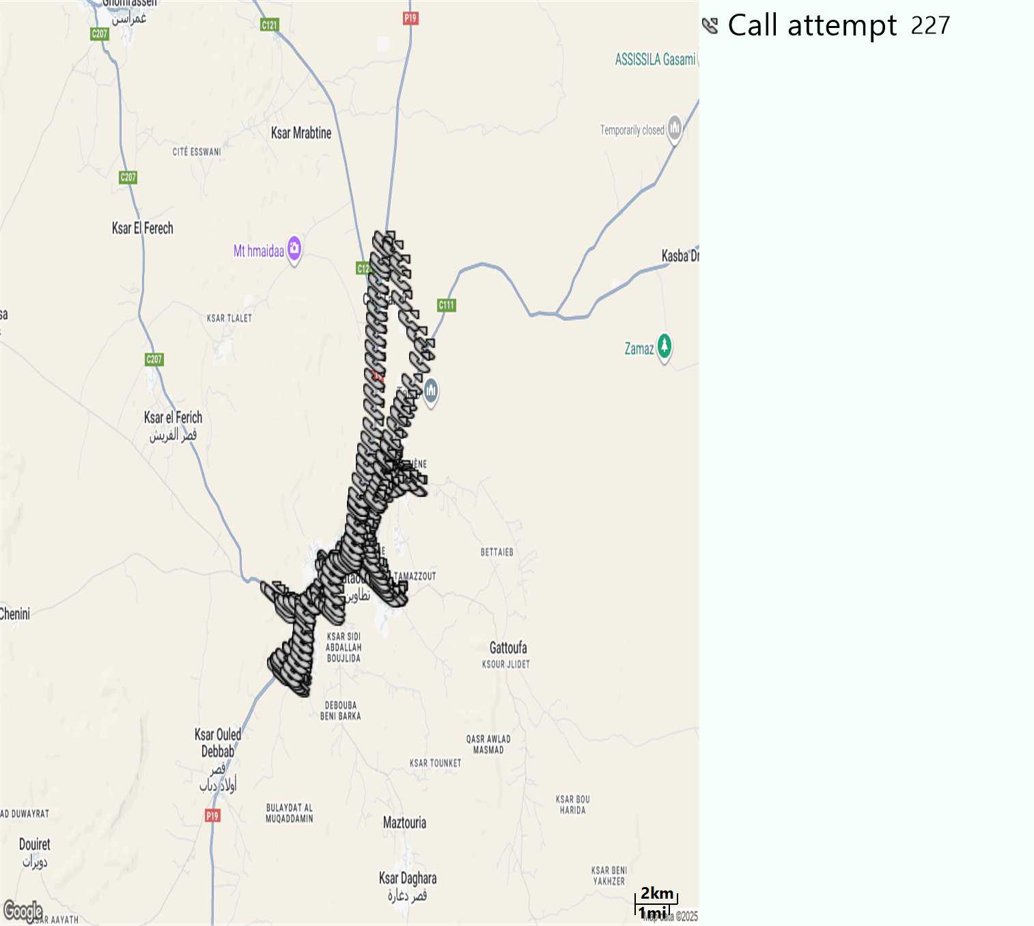
MO Call Setup Time (call setup time in VoLTE)
Short call
Call Setup Time IMS Voice
Average (Sec) | Maximum (Sec) | Minimum (Sec)
2,78 | 12,79 | 1,81

Slide 10
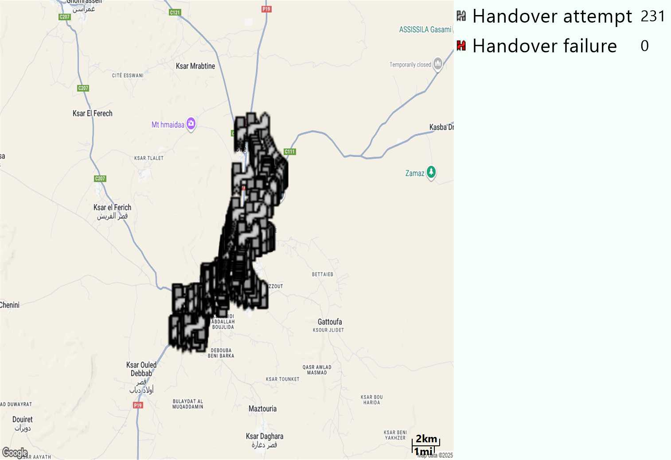
MO Handover Type
Long call
HO Type | Percentage [%]
LTE Inter-Frequency handover | 6,06%
LTE Intra-Frequency handover | 93,94%
Handover KPI’s
Handover Attemps | 231
Handover Success | 231
Handover succès Rate | 100%
Étiquettes de lignes | LTE FDD_1800 | LTE FDD_2100 | LTE FDD_800 | Total général
LTE FDD_1800 | 103 | 3 | 3 | 109
LTE FDD_2100 | 2 | 95 | 3 | 100
LTE FDD_800 | 3 | 1 | 18 | 22
Total général | 108 | 99 | 24 | 231

Slide 11
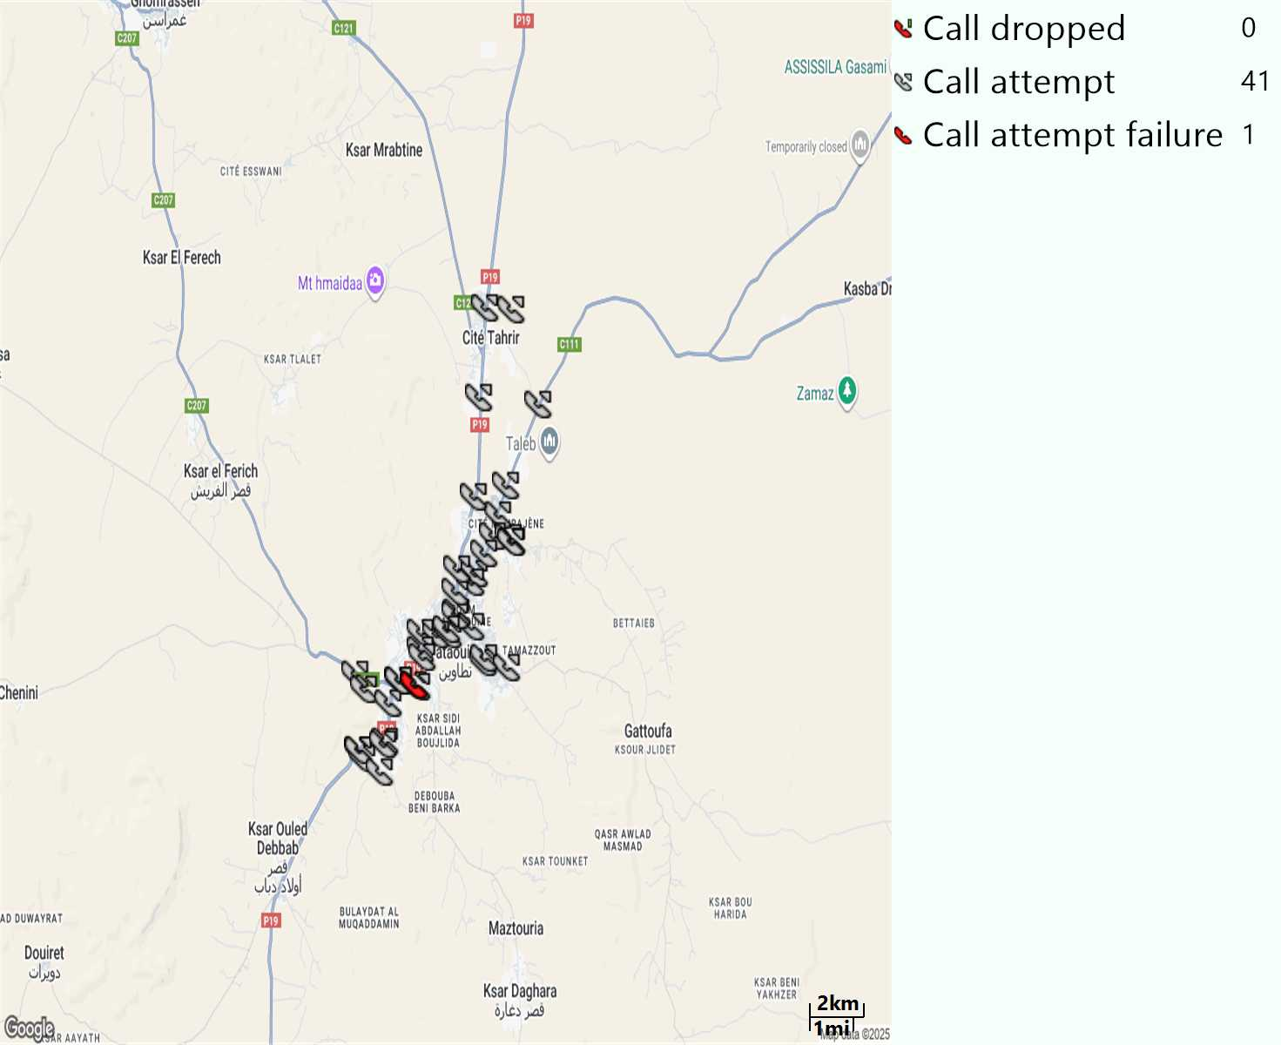
MO Voice Stats (VoLTE call stats)
Long call
Voice KPIs
Number Call Attempts | 41
Number Dropped Calls | 0
Call Drop Rate (%) | 0%
HO success rate | 100%

Slide 12
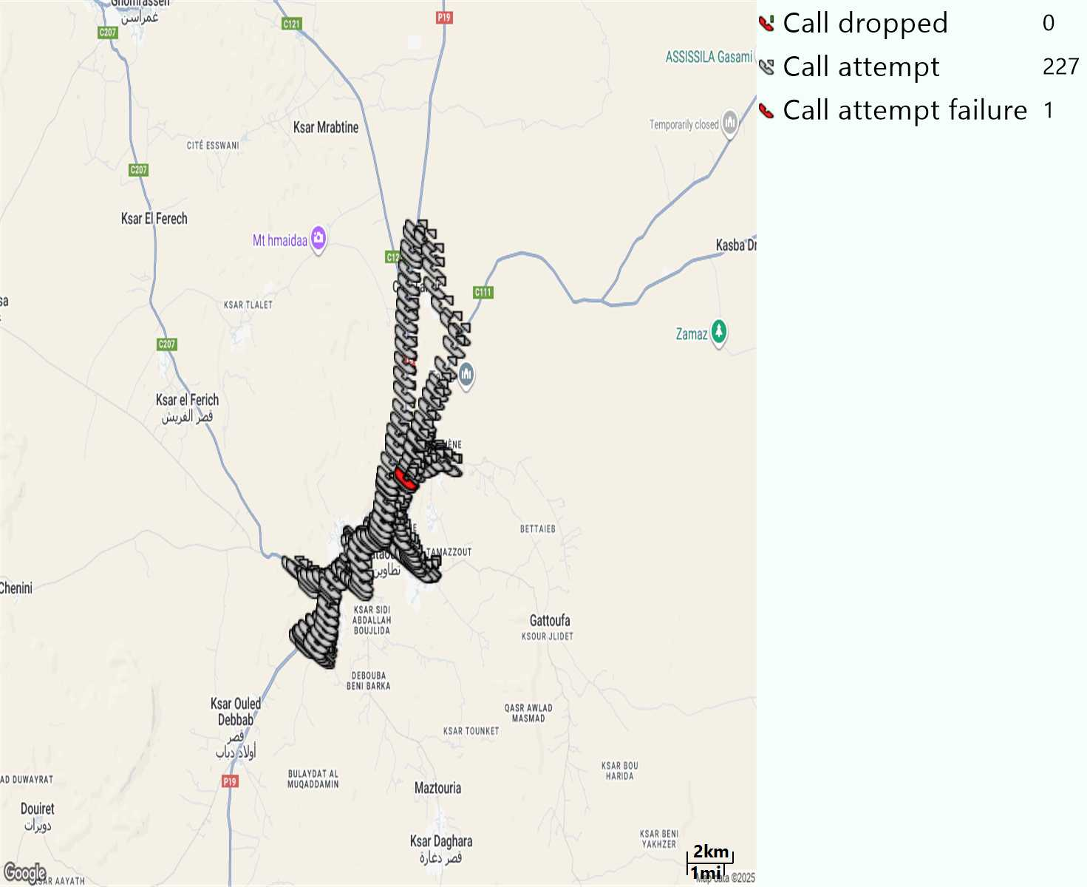
MO Voice Stats (VoLTE call stats)
Short call
Voice KPIs
Number Call Attempts | 227
Number Call Setup | 226
Number Blocked Calls | 1
Setup Succes Rate (%) | 99,55%
Call Block Rate (%) | 0,45%
Call Setup Time IMS Voice Average (Sec) | 2,78

Slide 13
MO Voice Stats (VoLTE call stats)
KPIs
VoLTE Call Setup SR | 99,55%
Call Setup Time | 2,78
VoLTE Drop Call Rate | 0%
Speech Quality - MOS (% of the samples >3,5) | 93,31%
Average MOS | 4,19
VoLTE Handover SR | 100%
VoLTE SRVCC SR | -

Slide 14
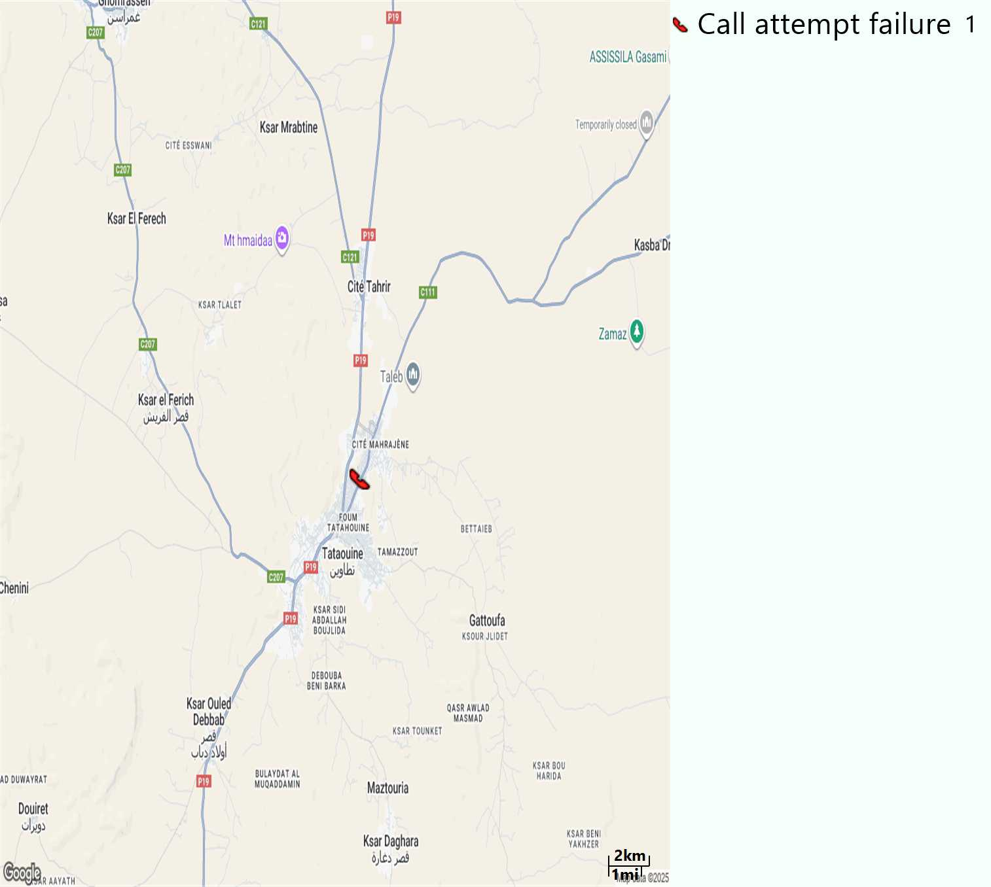
MO Voice Call - Blocked call
Short call

Slide 15
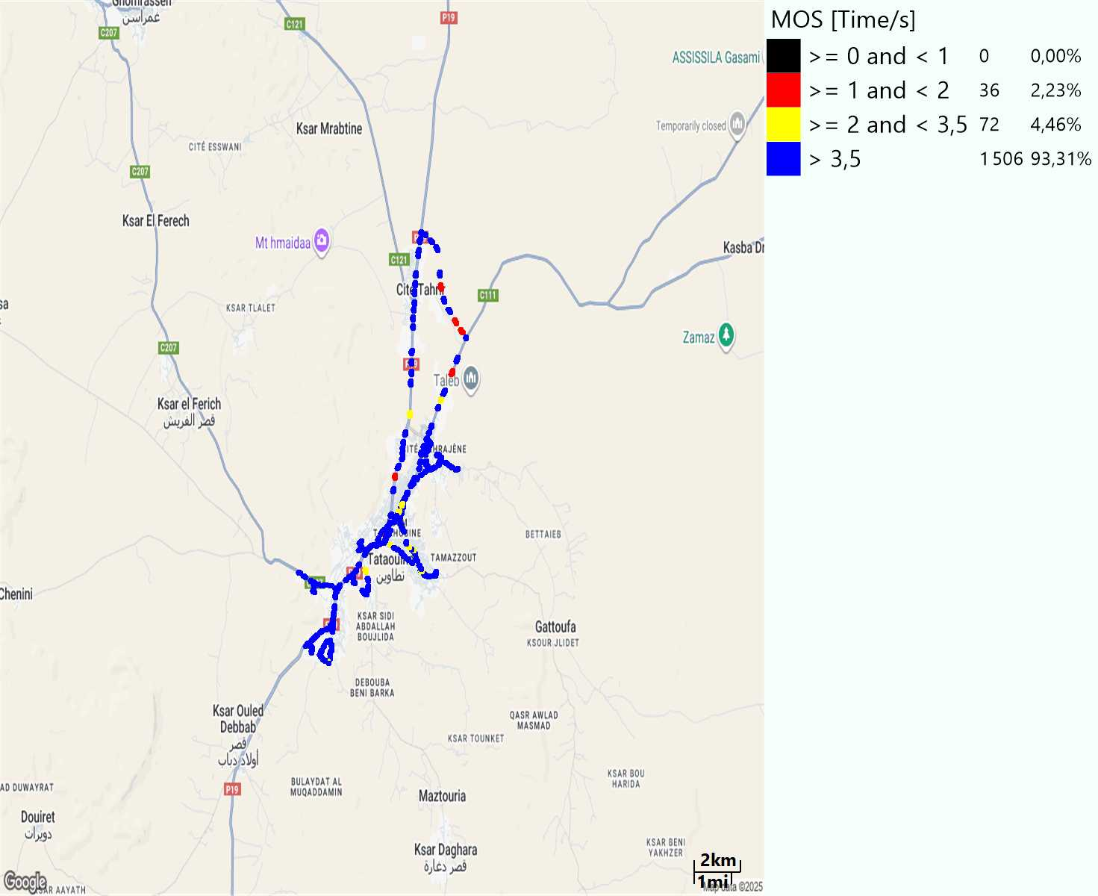
MO Voice Quality Metrics
long Call

Slide 16
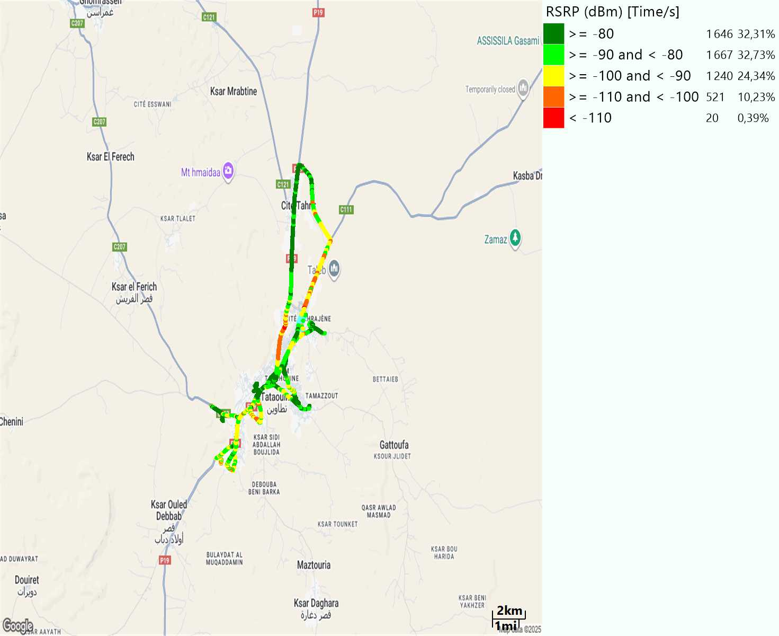
Scanner_RSRP
L2100

Slide 17
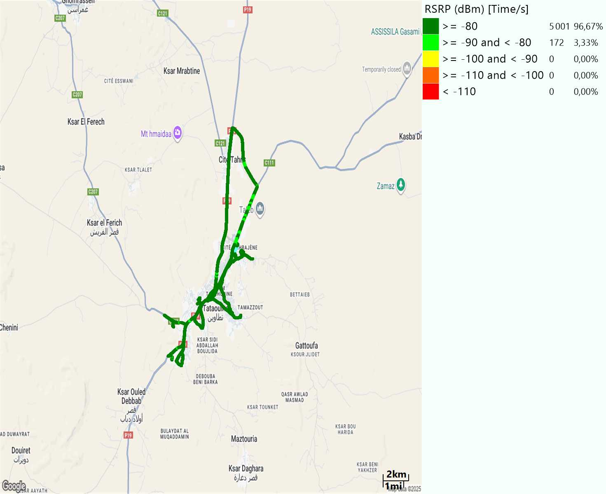
Scanner_RSRP
L800

Slide 18
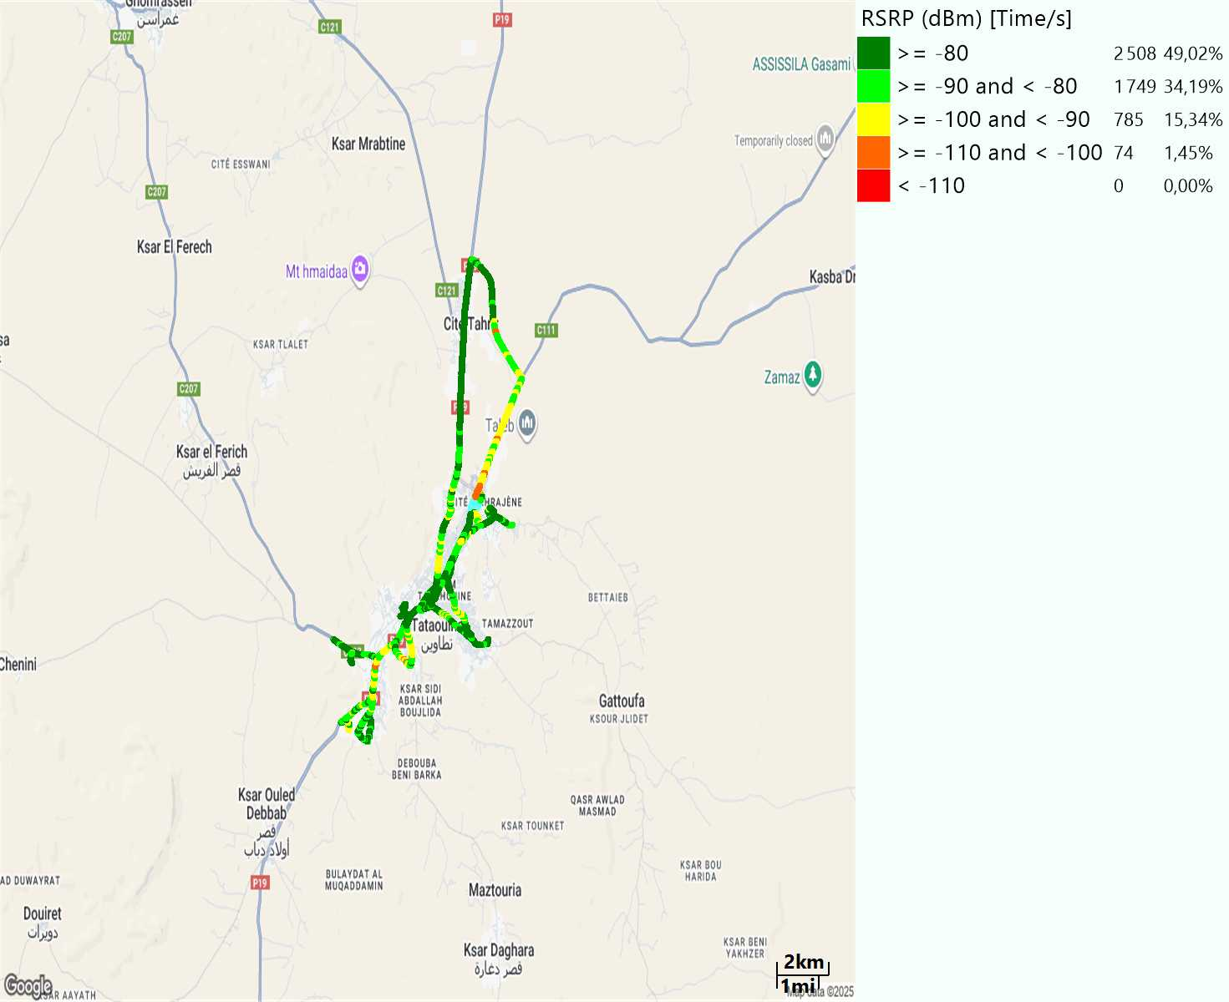
Scanner_RSRP
L1800

Slide 19
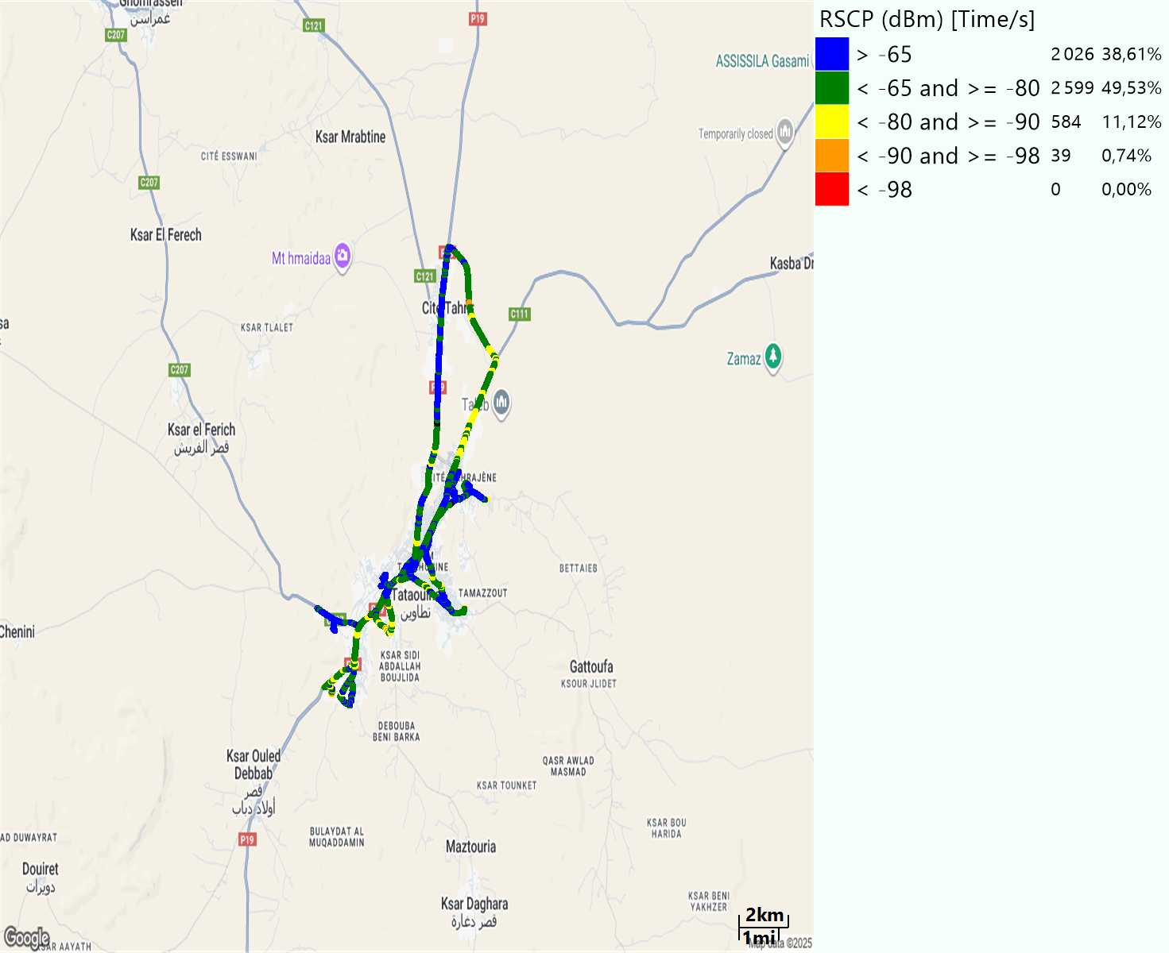
Scanner_RSCP
U2100

Slide 20
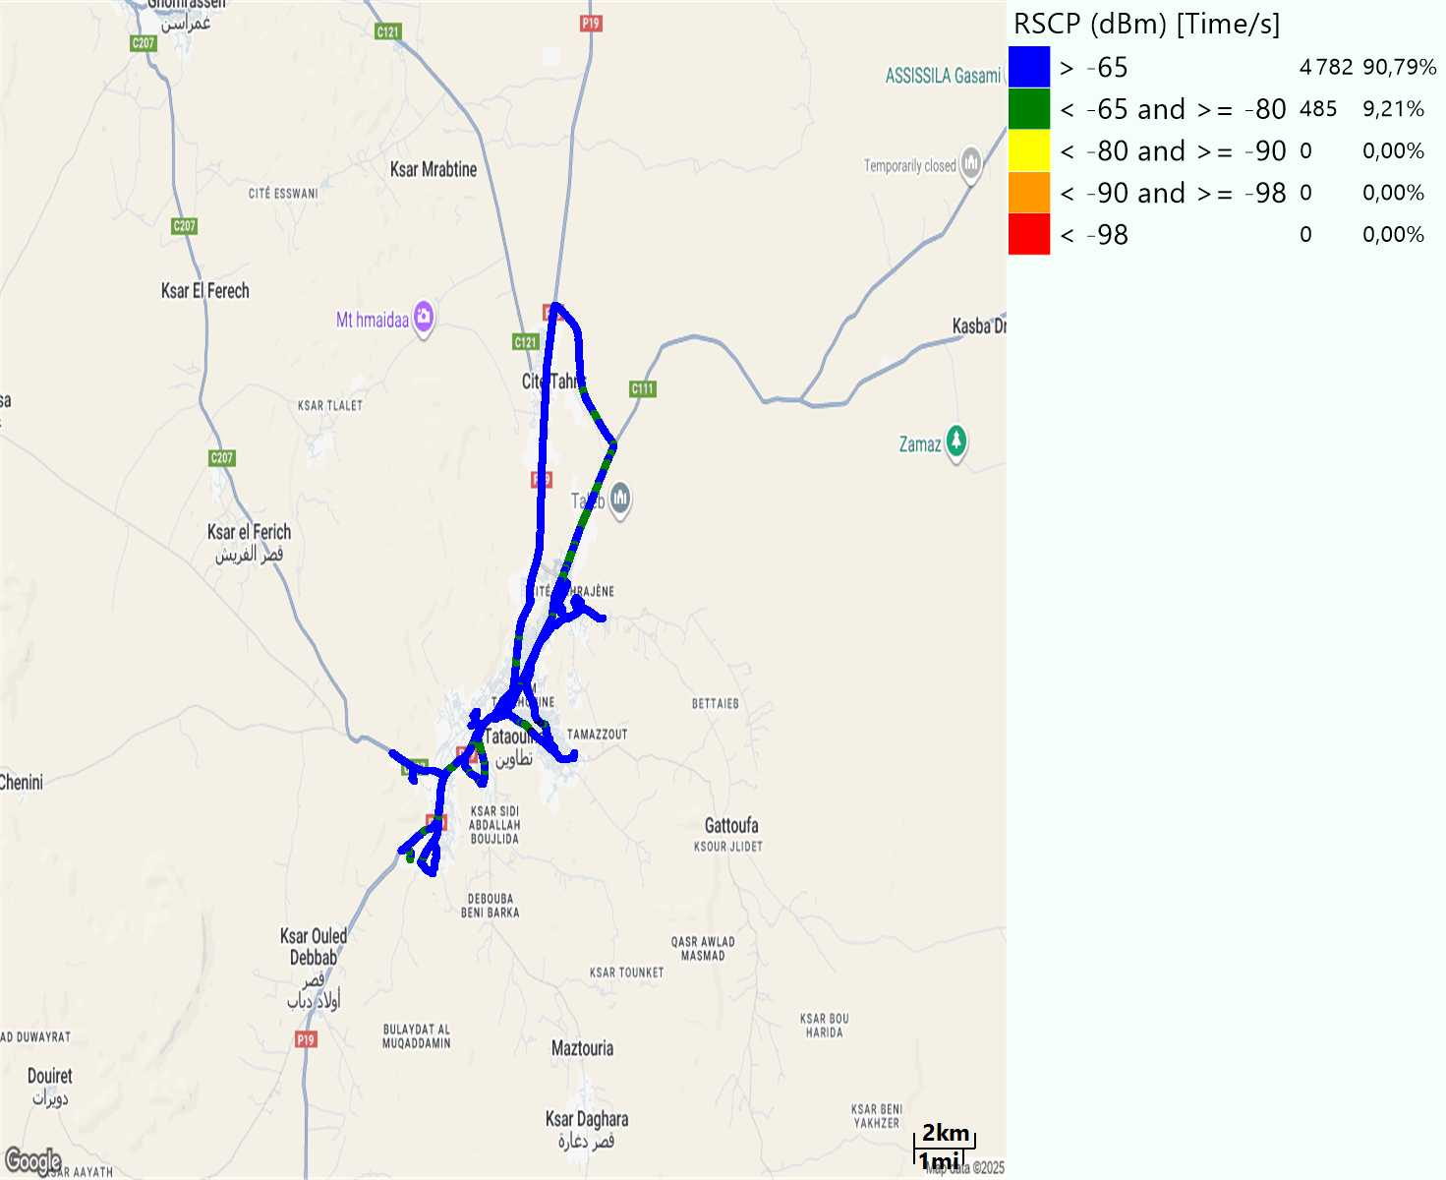
Scanner_RSCP
900

