Slide 1


Volte Drive Test Report

Slide 2
DT Scénario
Short Call (10s)
Long call (2min)
Scanner

Slide 3
Voice Call

Slide 4
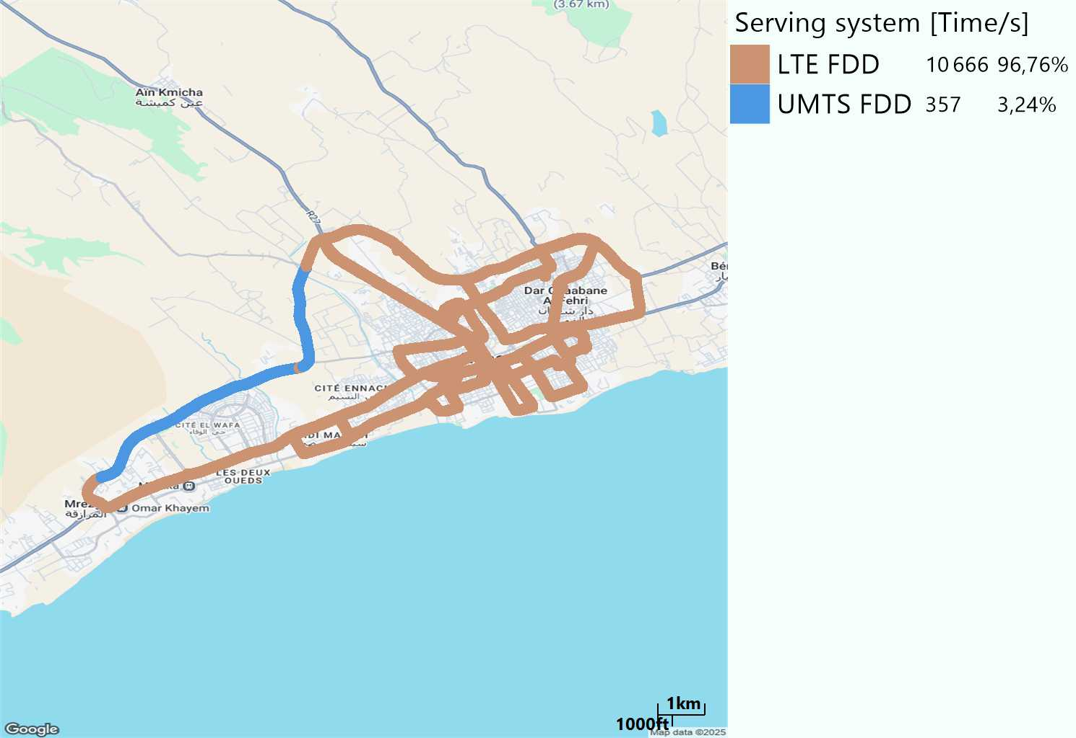
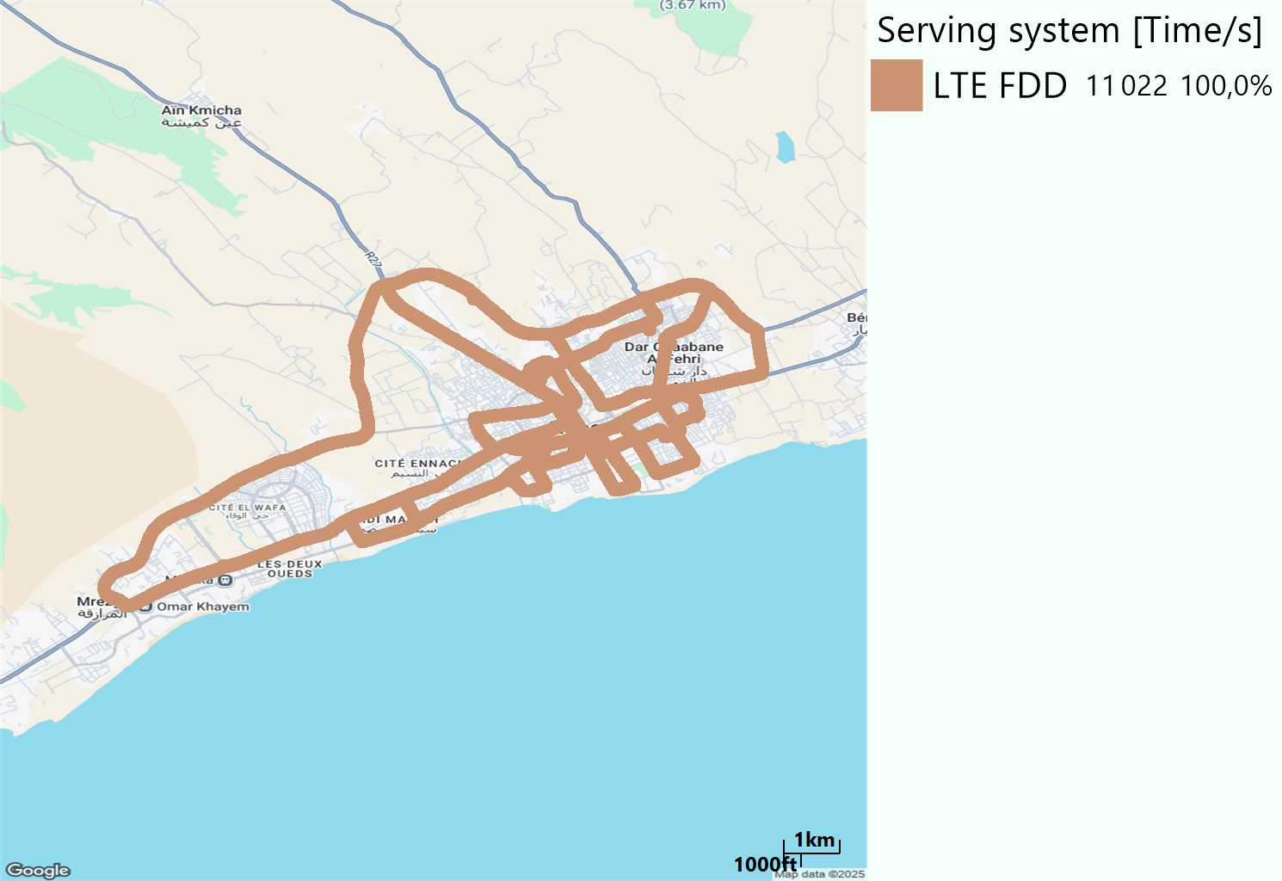
RAT distribution
Long call
Short call

Slide 5
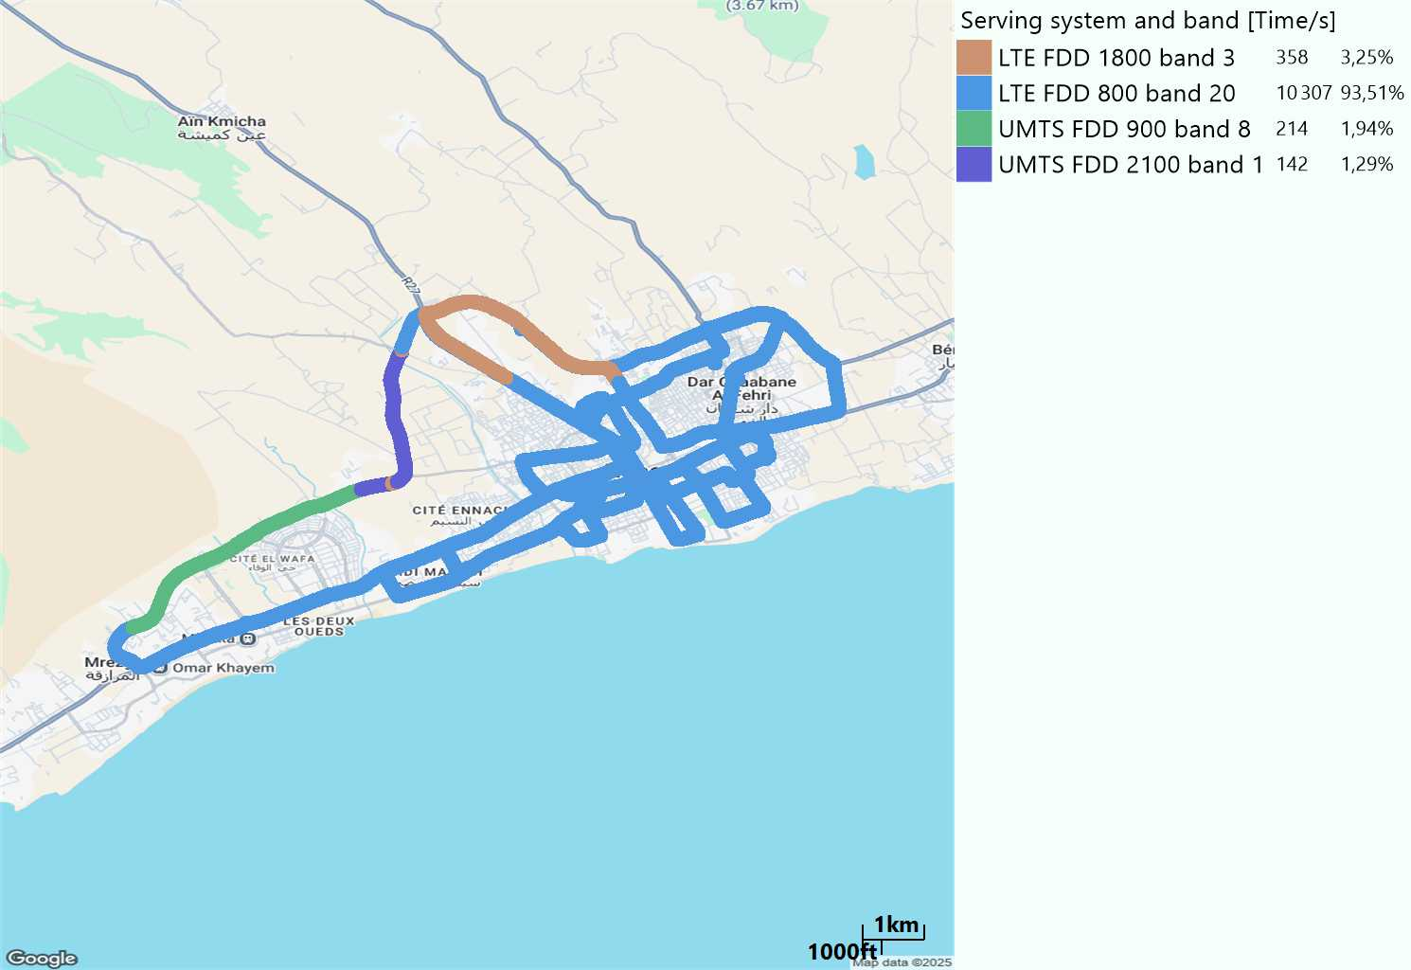
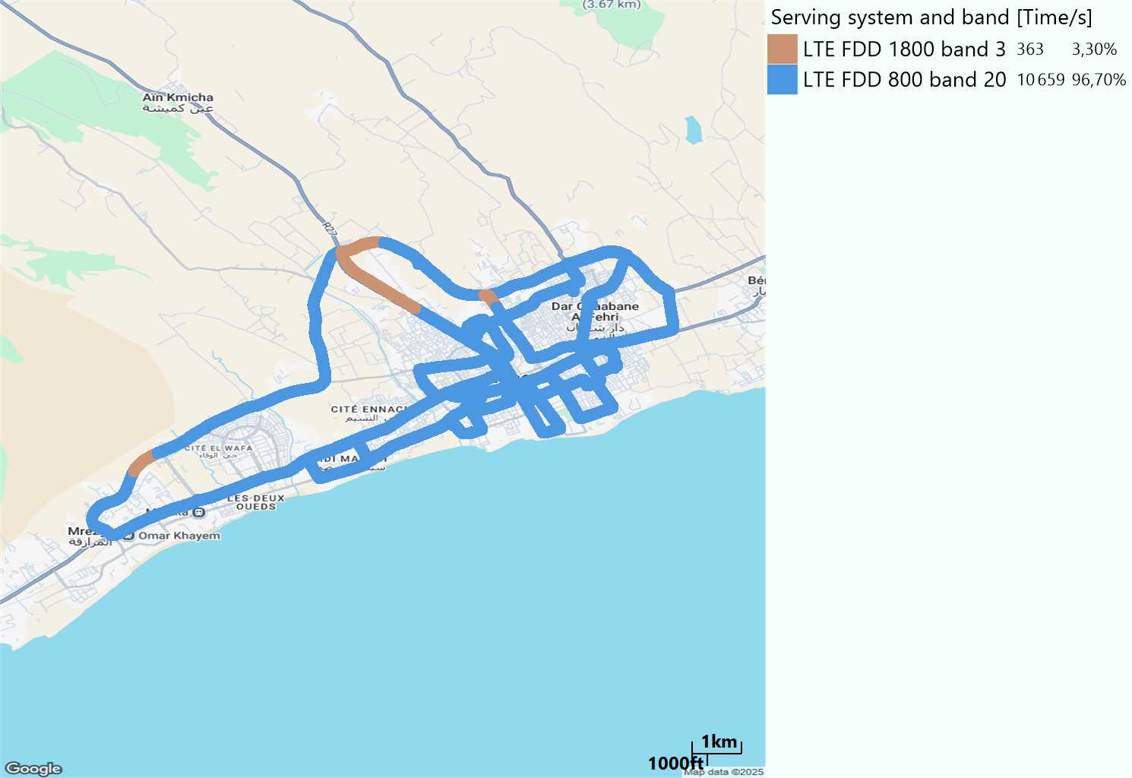
EARFCN distribution
Long call
Short call

Slide 6
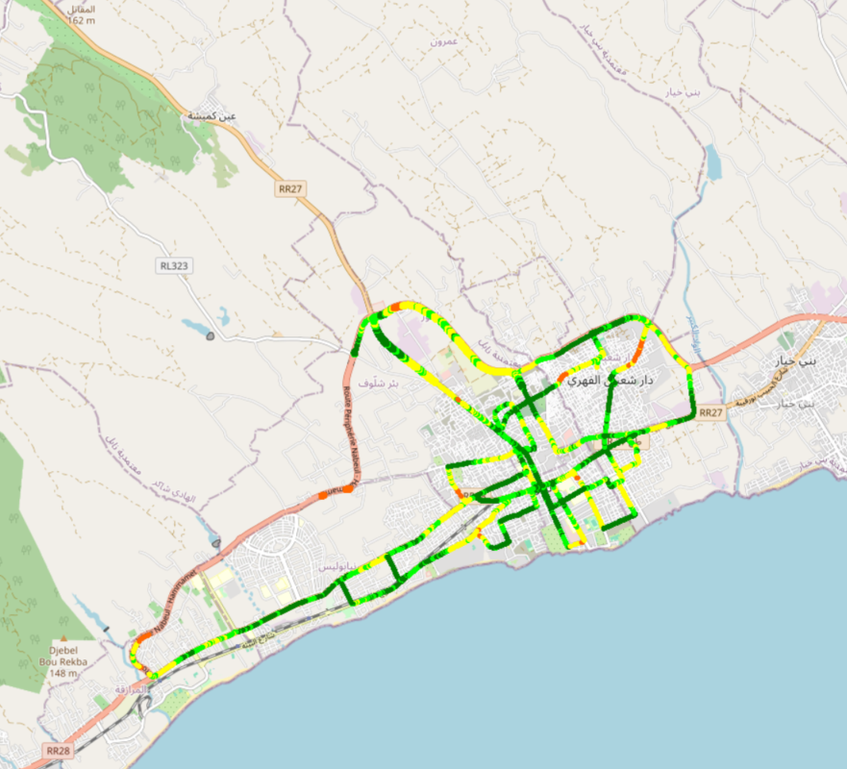
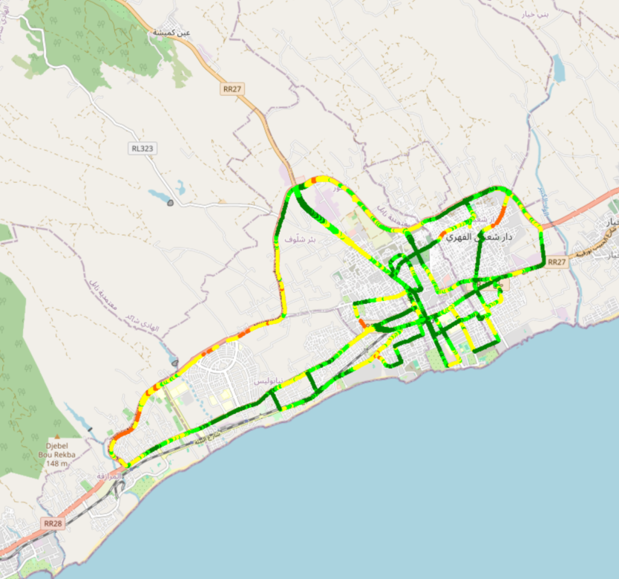
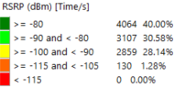
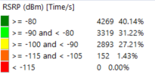
LTE - RSRP
Long call
Short call
Average [dBm]
-83,97
Average [dBm]
-83,30

Slide 7
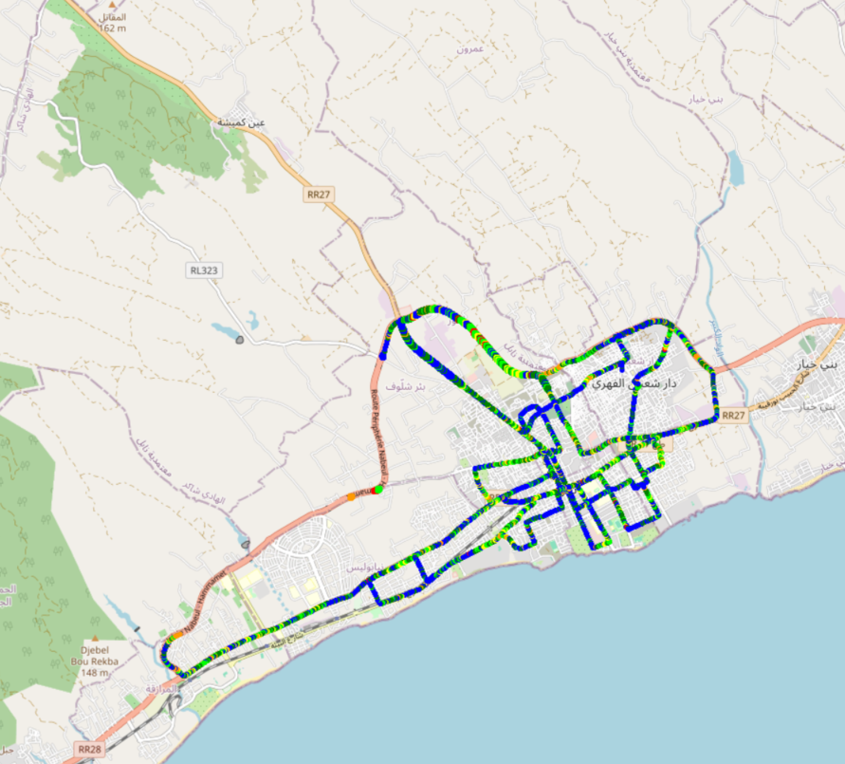
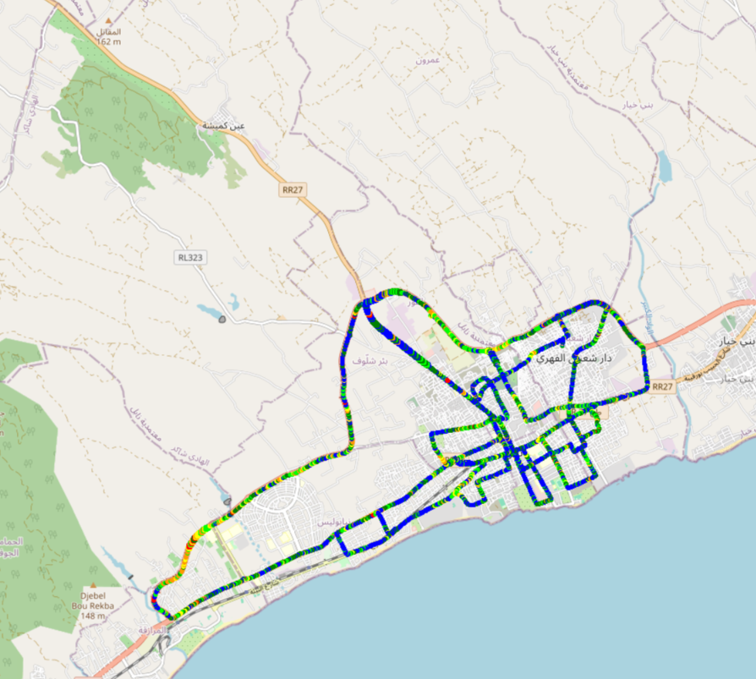
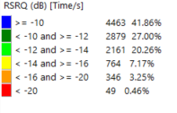
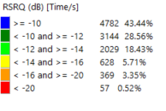
LTE- RSRQ
Long call
Short call

Slide 8
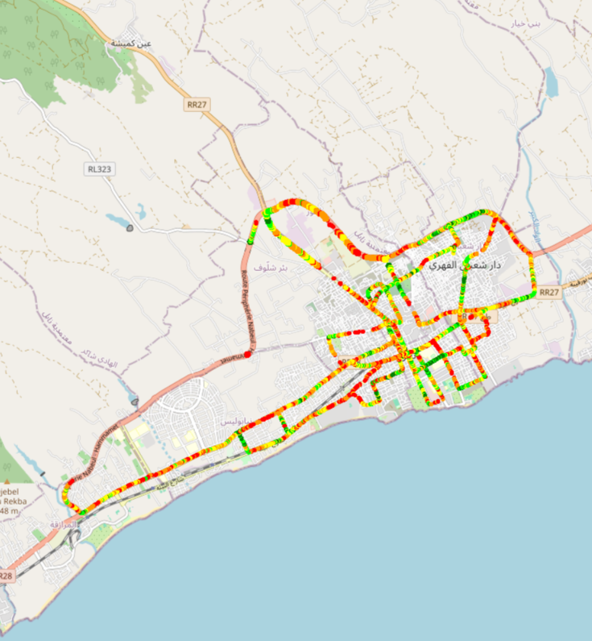
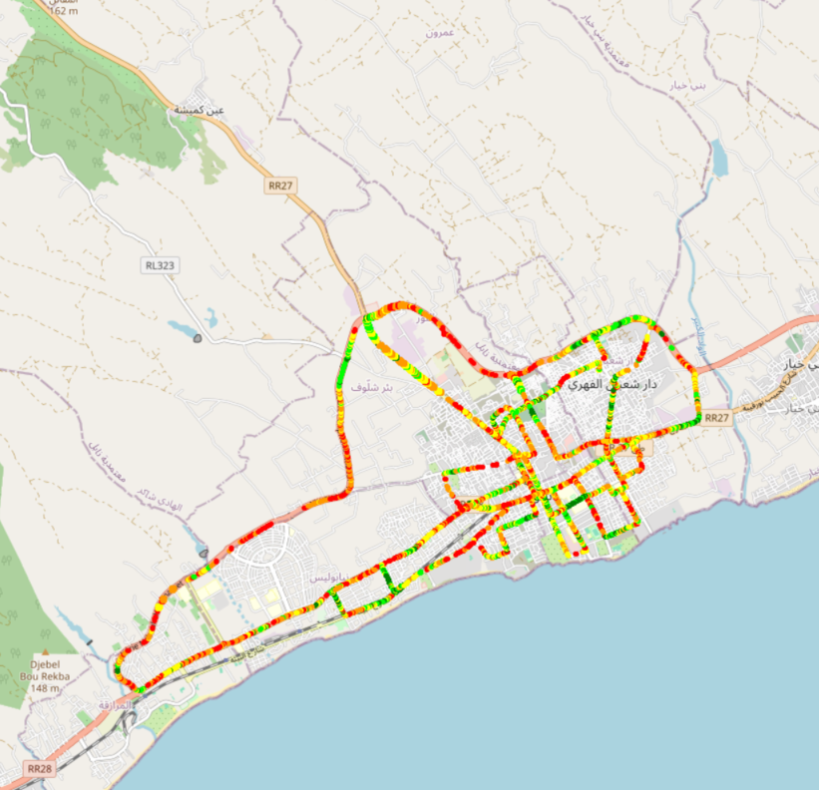
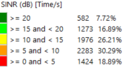
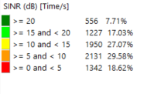
LTE-SINR
Long call
Short call

Slide 9
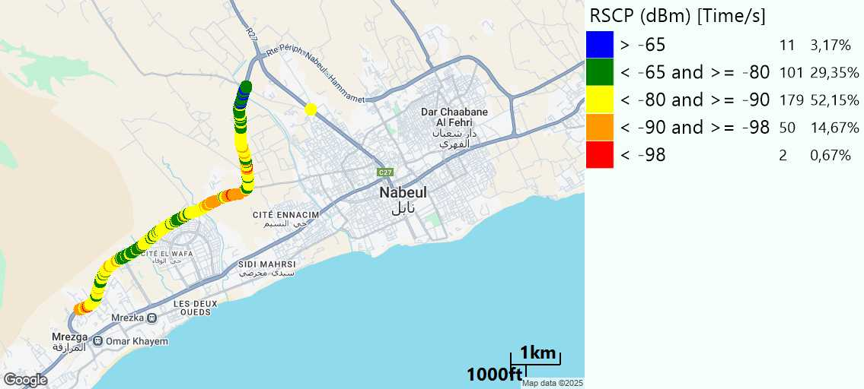
RSCP
Long call

Slide 10
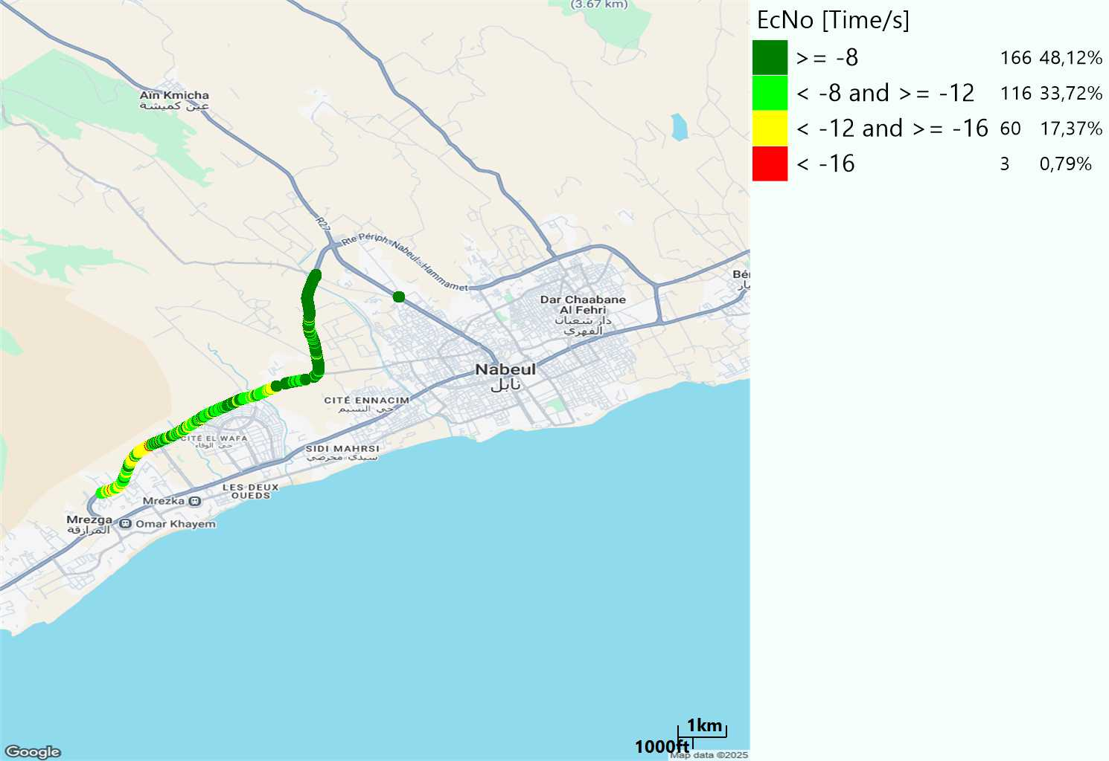
WCDMA-Ec/NO
Long call

Slide 11
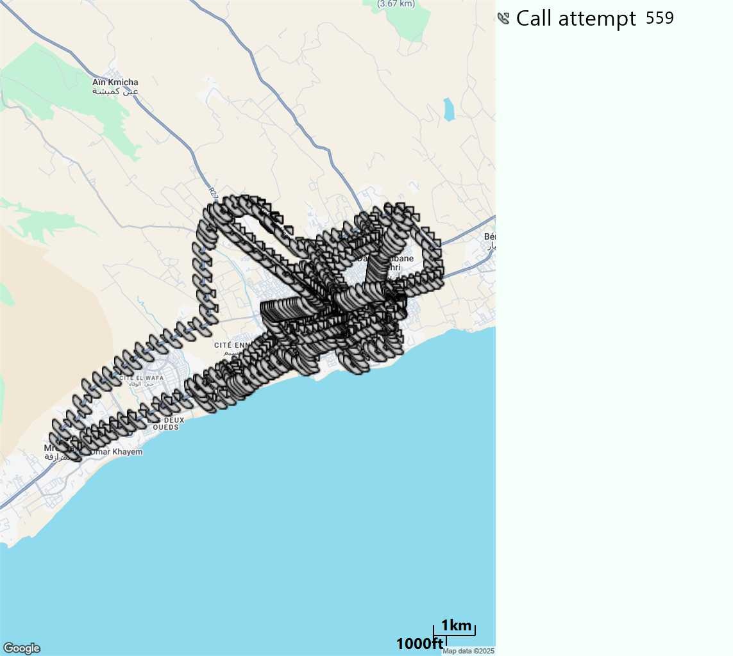
MO Call Setup Time (call setup time in VoLTE)
Short call
Call Setup Time IMS Voice
Average (Sec) | Maximum (Sec) | Minimum (Sec)
2,47 | 6,91 | 2,03

Slide 12
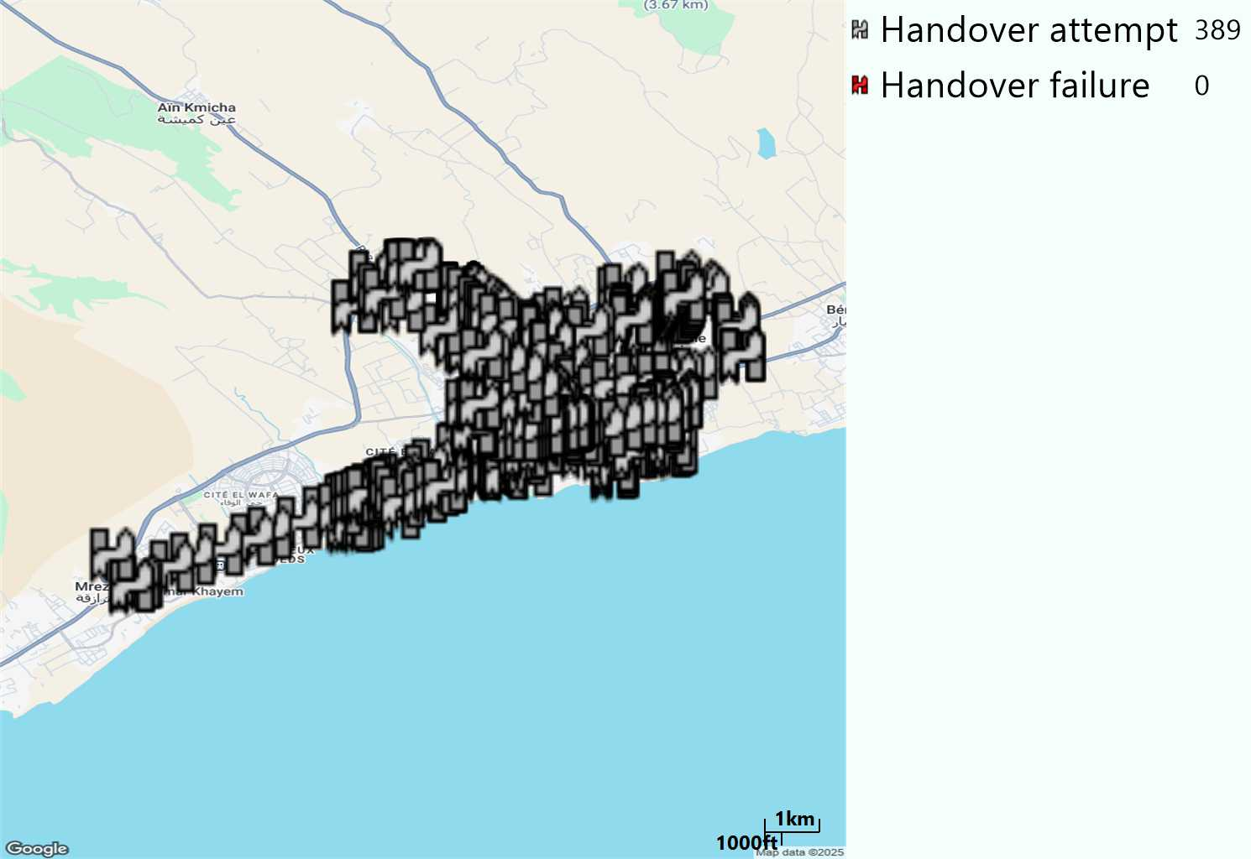
MO Handover Type
Long call
HO Type | Percentage [%]
LTE Inter-Frequency handover | 0,51%
LTE Intra-Frequency handover | 99,22%
UMTS to LTE | 0,25%
Handover KPI’s
Handover Attemps | 389
Handover Success | 389
Handover succès Rate | 100%
Étiquettes de lignes | LTE FDD_1800 | LTE FDD_800 | Total général
LTE FDD_1800 | 16 |  | 16
LTE FDD_800 | 2 | 370 | 372
UMTS FDD_900 |  | 1 | 1
Total général | 18 | 371 | 389

Slide 13
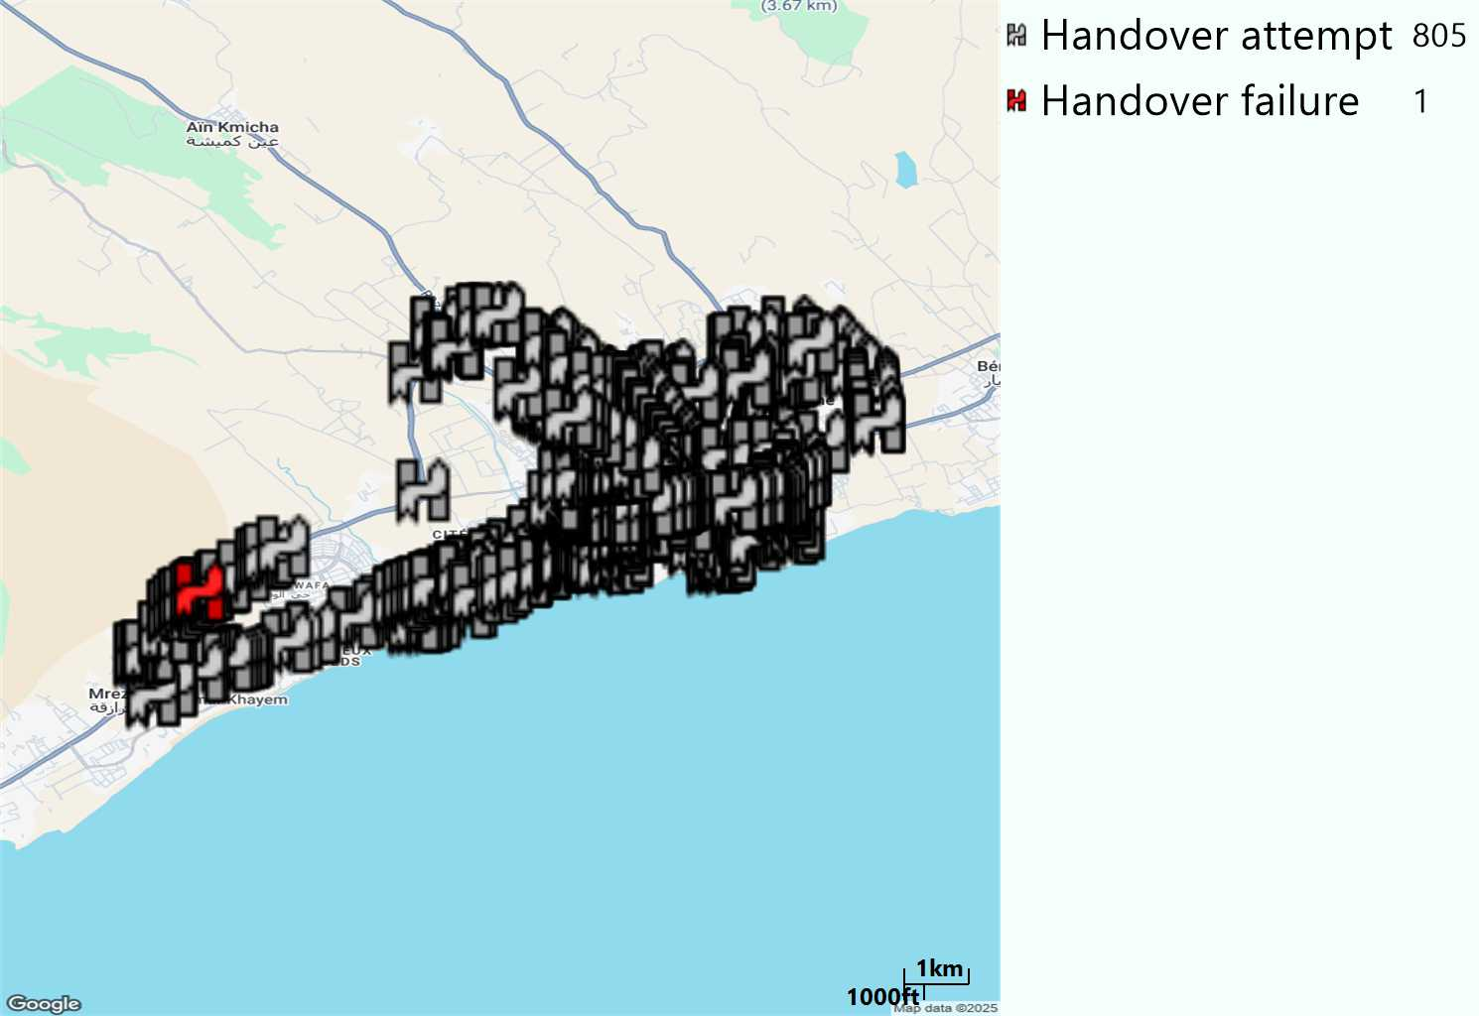
MO Handover Type
Short call
HO Type | Percentage [%]
LTE Inter-Frequency handover | 0,62%
LTE Intra-Frequency handover | 99,38%
Handover KPI’s
Handover Attemps | 805
Handover Success | 804
Handover succès Rate | 99,87%
Étiquettes de lignes | LTE FDD_1800 | LTE FDD_800 | Total général
LTE FDD_1800 | 27 | 2 | 29
LTE FDD_800 | 6 | 770 | 776
Total général | 33 | 772 | 805

Slide 14
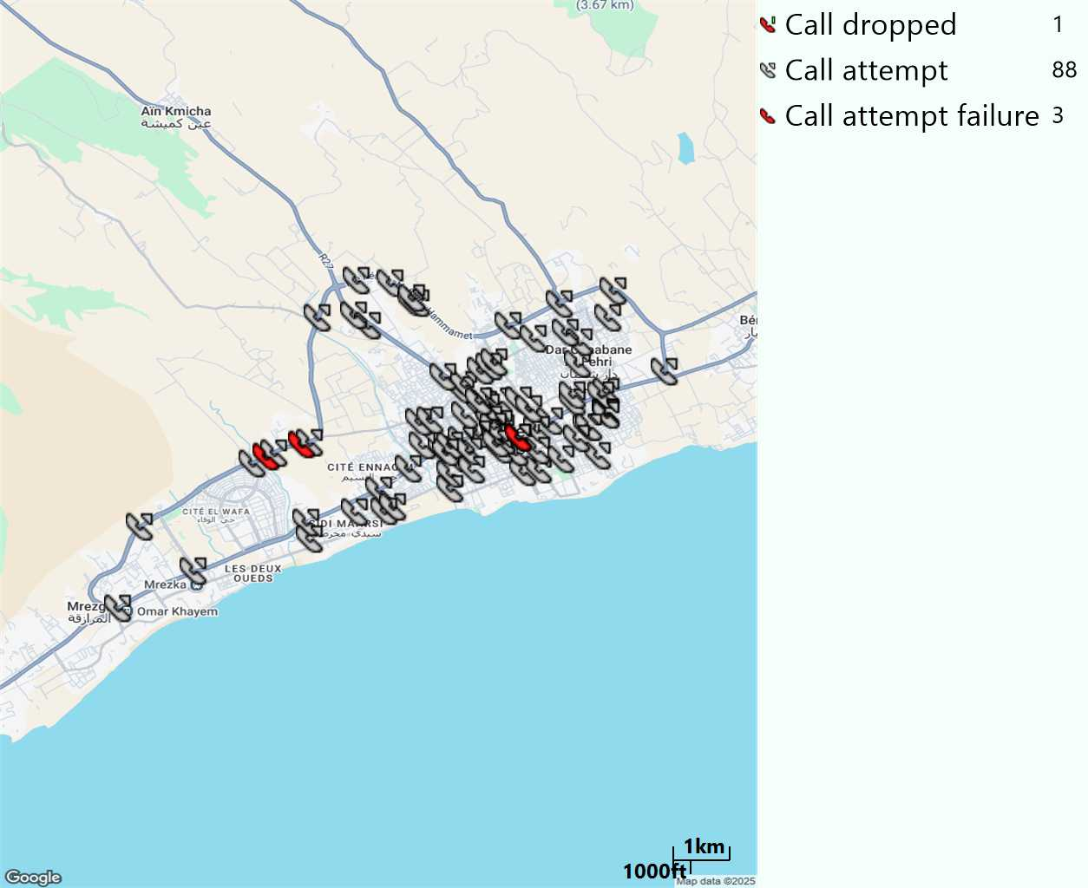
MO Voice Stats (VoLTE call stats)
Long call
Voice KPIs
Number Call Attempts | 88
Number Dropped Calls | 1
Call Drop Rate (%) | 1,14%
HO success rate | 100%

Slide 15
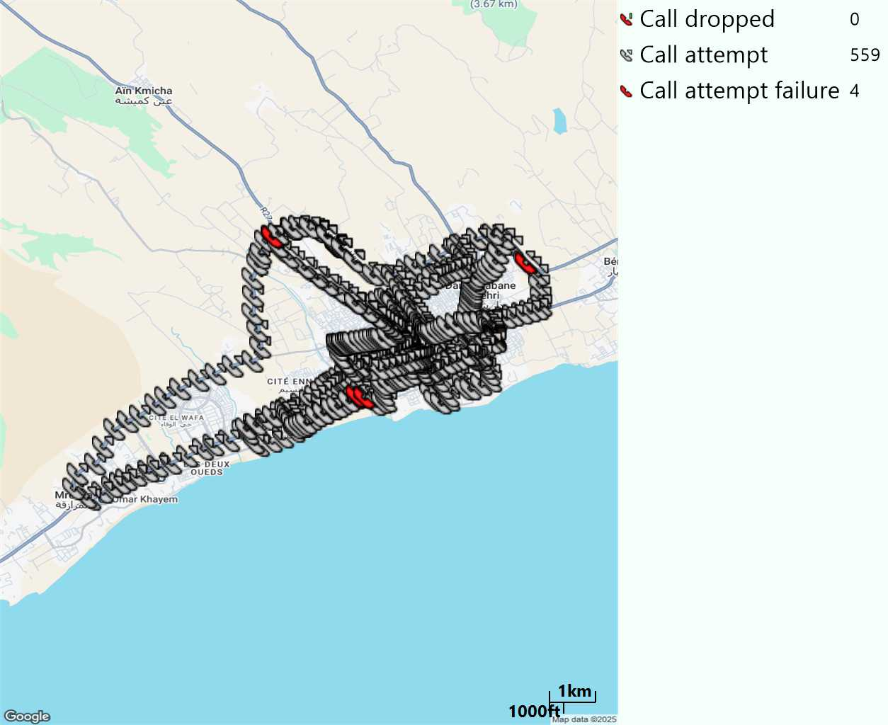
MO Voice Stats (VoLTE call stats)
Short call
Voice KPIs
Number Call Attempts | 559
Number Call Setup | 555
Number Blocked Calls | 4
Setup Succes Rate (%) | 99,28%
Call Block Rate (%) | 0,72%
Call Setup Time IMS Voice Average (Sec) | 2,47

Slide 16
MO Voice Stats (VoLTE call stats)
KPIs
VoLTE Call Setup SR | 99,28%
Call Setup Time | 2,47
VoLTE Drop Call Rate | 1,14%
Speech Quality - MOS (% of the samples >3,5) | 92,27%
VoLTE Handover SR | 100%
VoLTE SRVCC SR | 100%

Slide 17
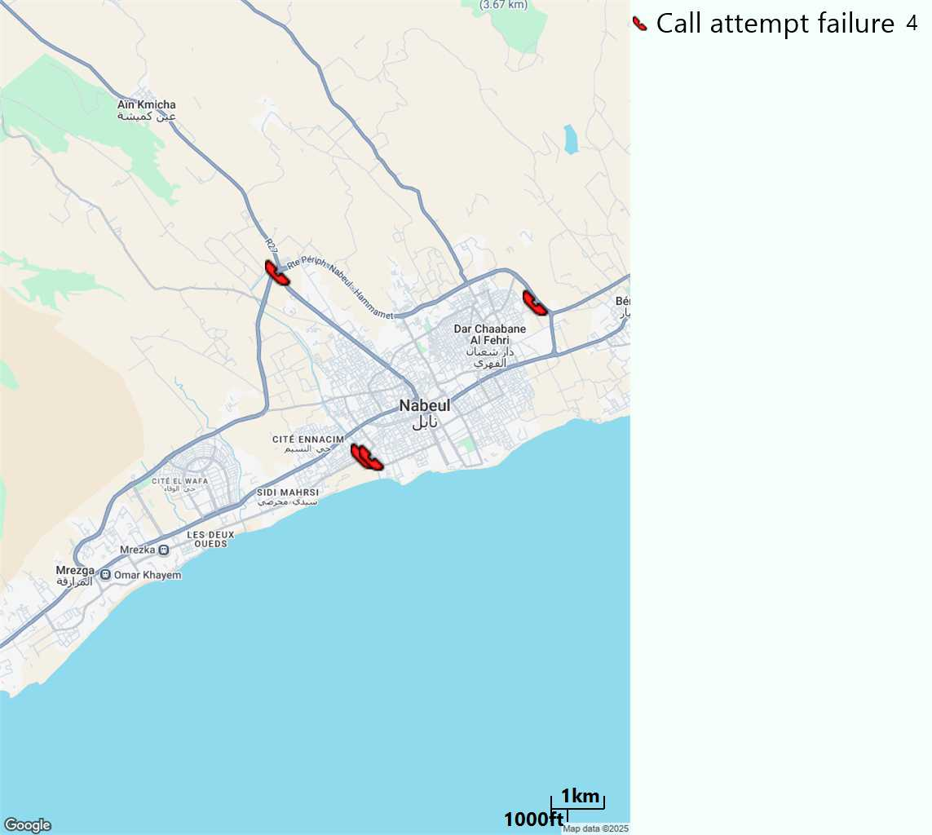
MO Voice Call - Blocked call
Short call

Slide 18
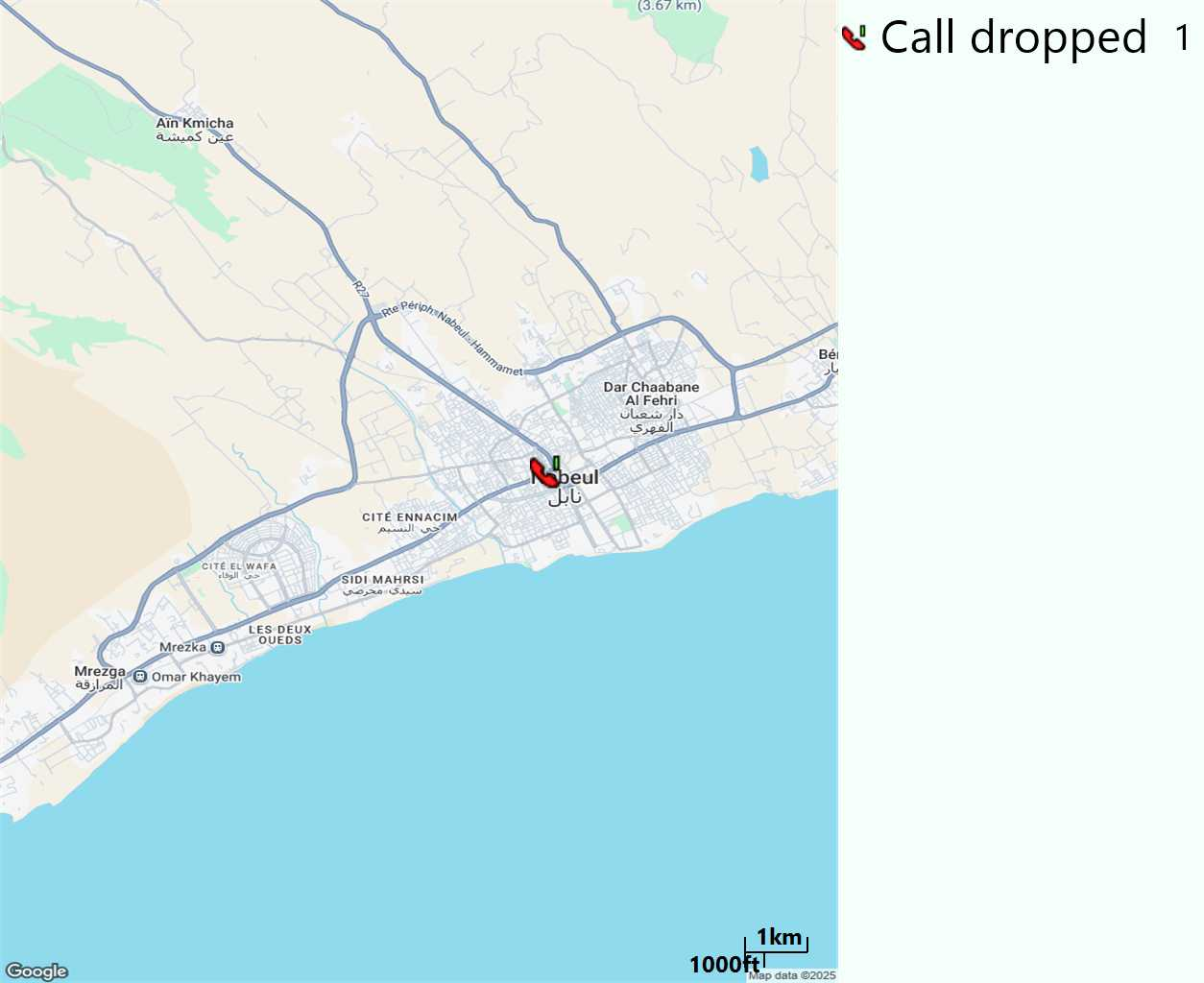
MO Voice Call - Dropped Call
Long call

Slide 19
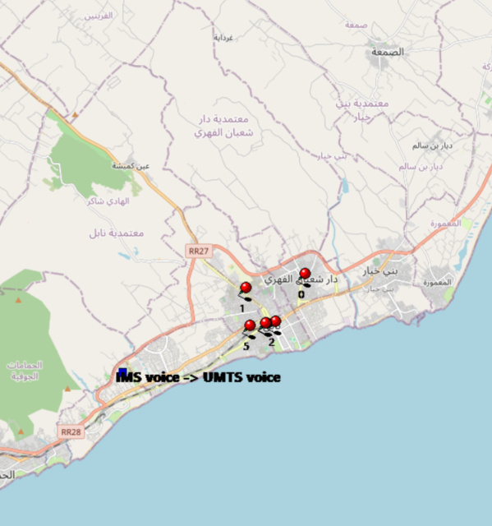
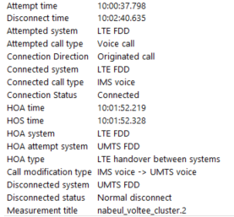
VoLTE SRVCC Success Rate long Call
Attempted system | Attempted call type | Connection Direction | Connected system | Connected call type | Connection Status | HOA time | HOS time | HOA system | HOA attempt system | HOA type | Call modification type | Disconnected system | Disconnected status | Measurement title
LTE FDD | Voice call | Originated call | LTE FDD | IMS voice | Connected | 01:52,2 | 01:52,3 | LTE FDD | UMTS FDD | LTE handover between systems | IMS voice -> UMTS voice | UMTS FDD | Normal disconnect | nabeul_voltee_cluster.2

Slide 20
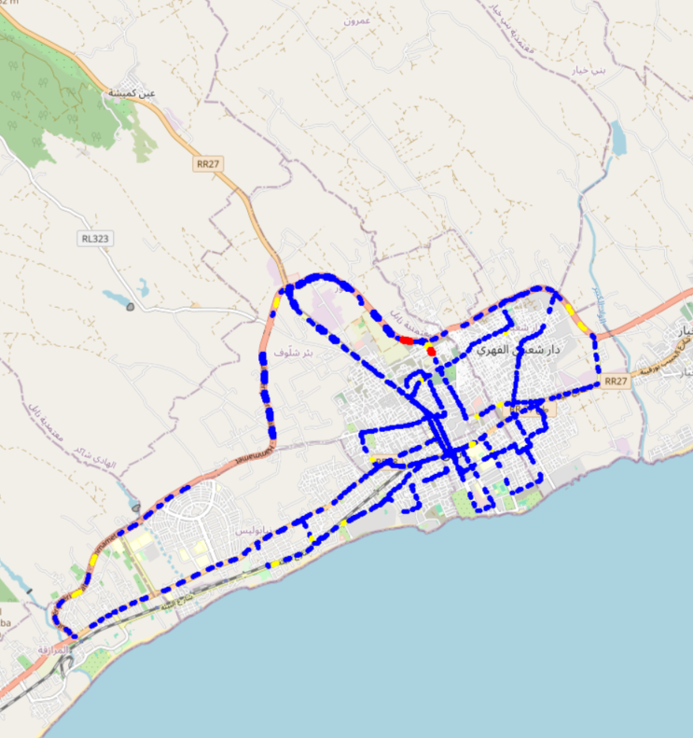
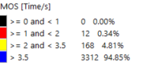
MO Voice Quality Metrics
long Call

Slide 21
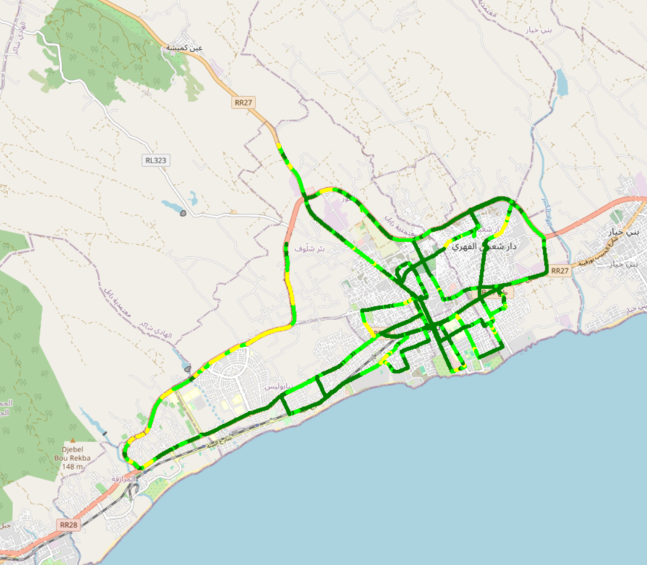
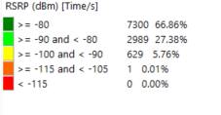
Scanner_RSRP

