Slide 1


Volte Drive Test Report

Slide 2
DT Scénario
Short Call (10s)
Long call (2min)
Scanner

Slide 3
Voice Call

Slide 4
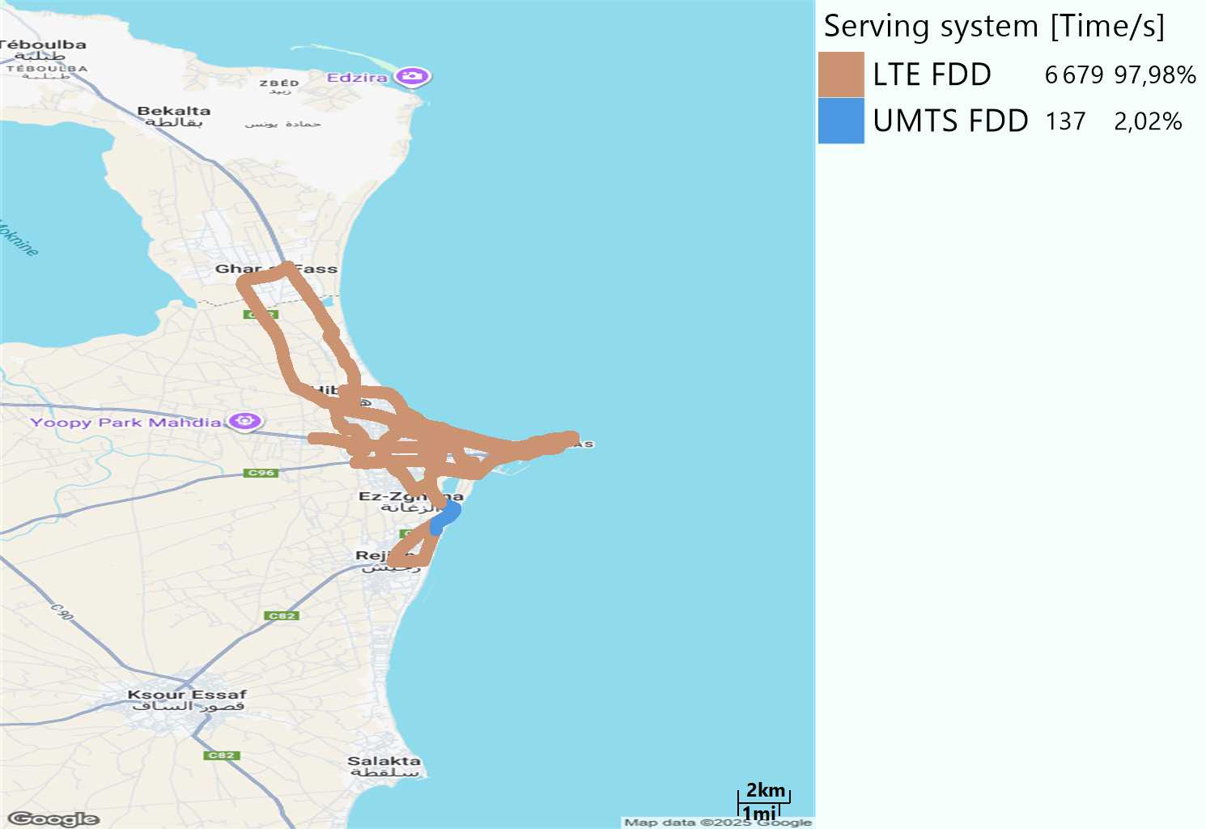
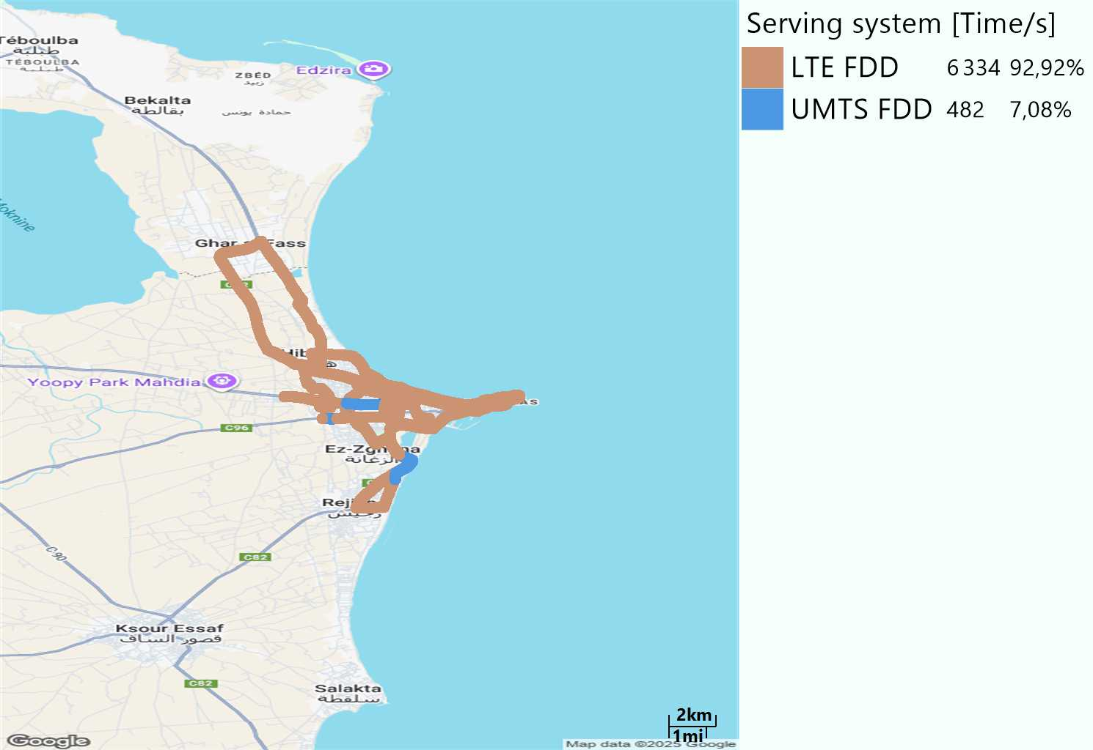
RAT distribution
Long call
Short call

Slide 5
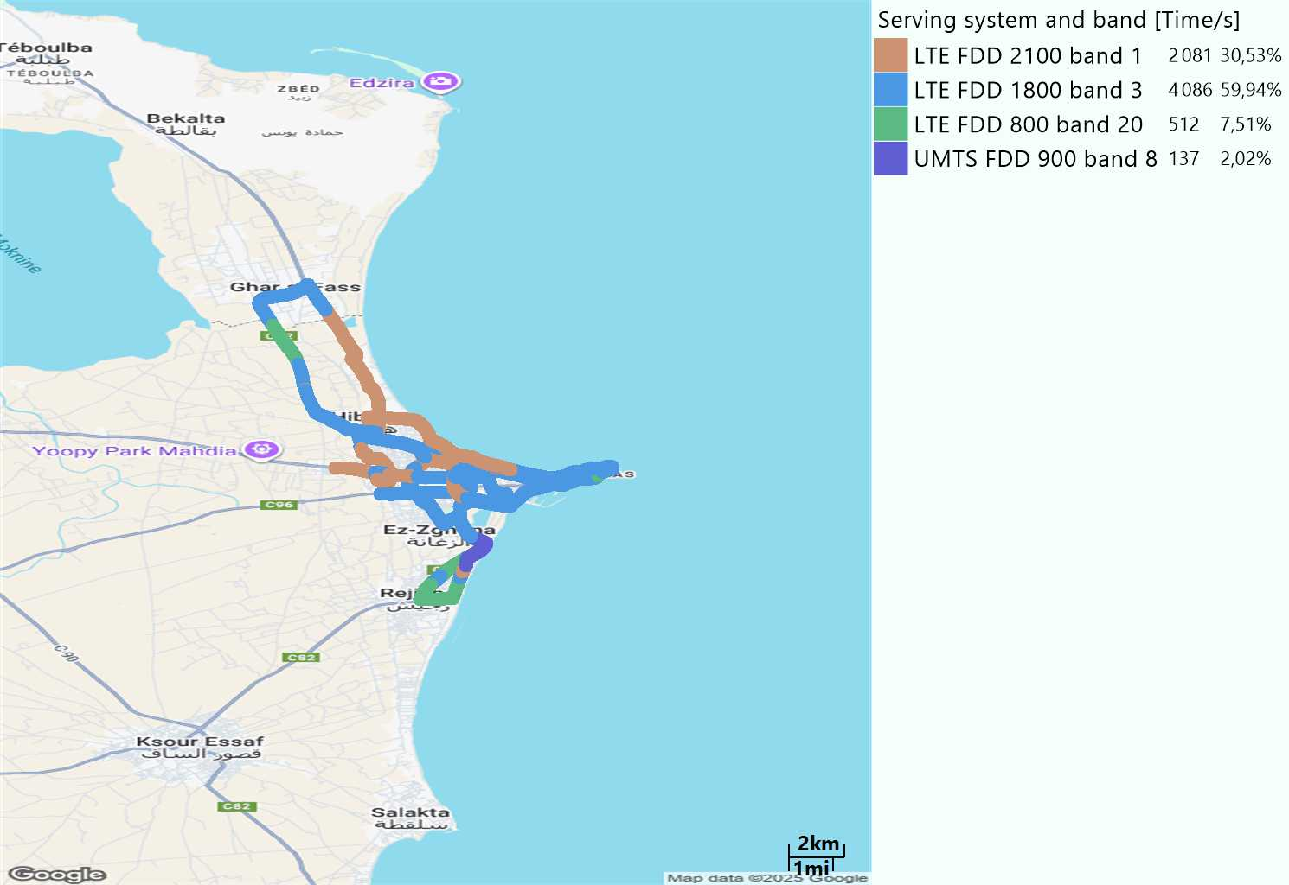
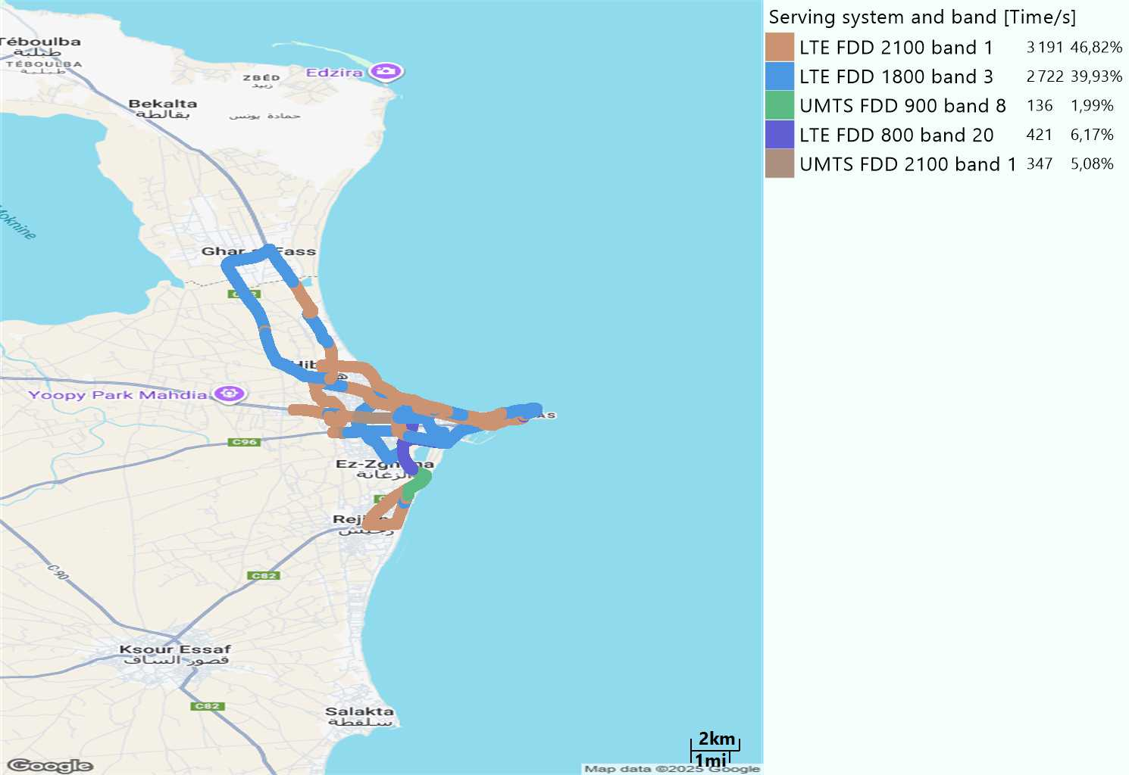
EARFCN distribution
Long call
Short call

Slide 6
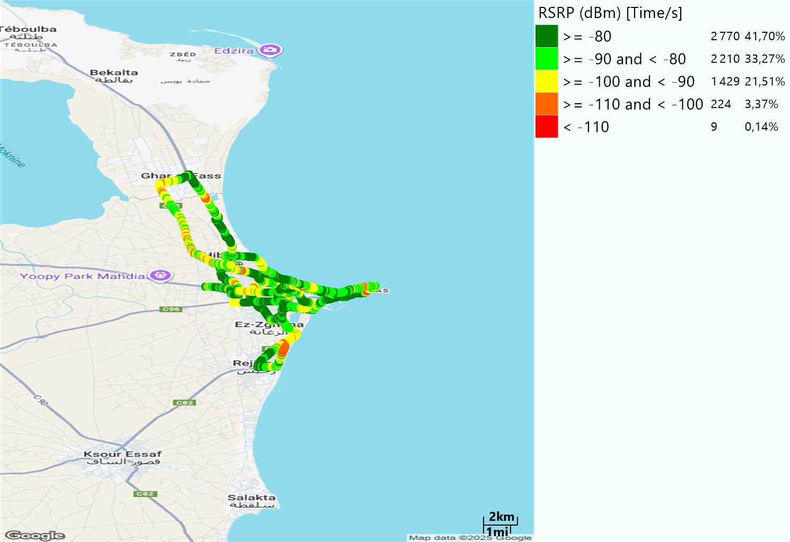
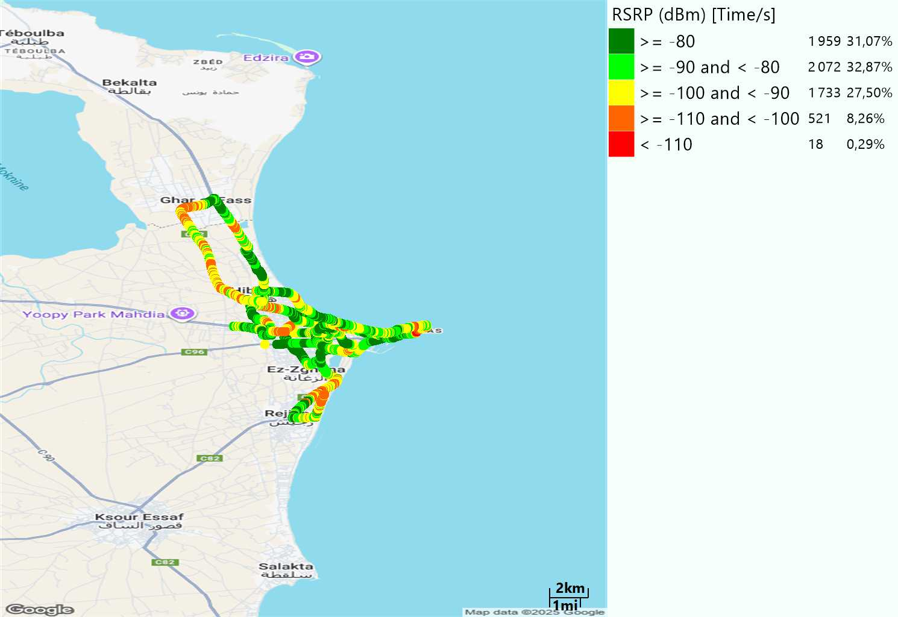
LTE - RSRP
Long call
Short call
Average [dBm]
-82,29
Average [dBm]
-85,76

Slide 7
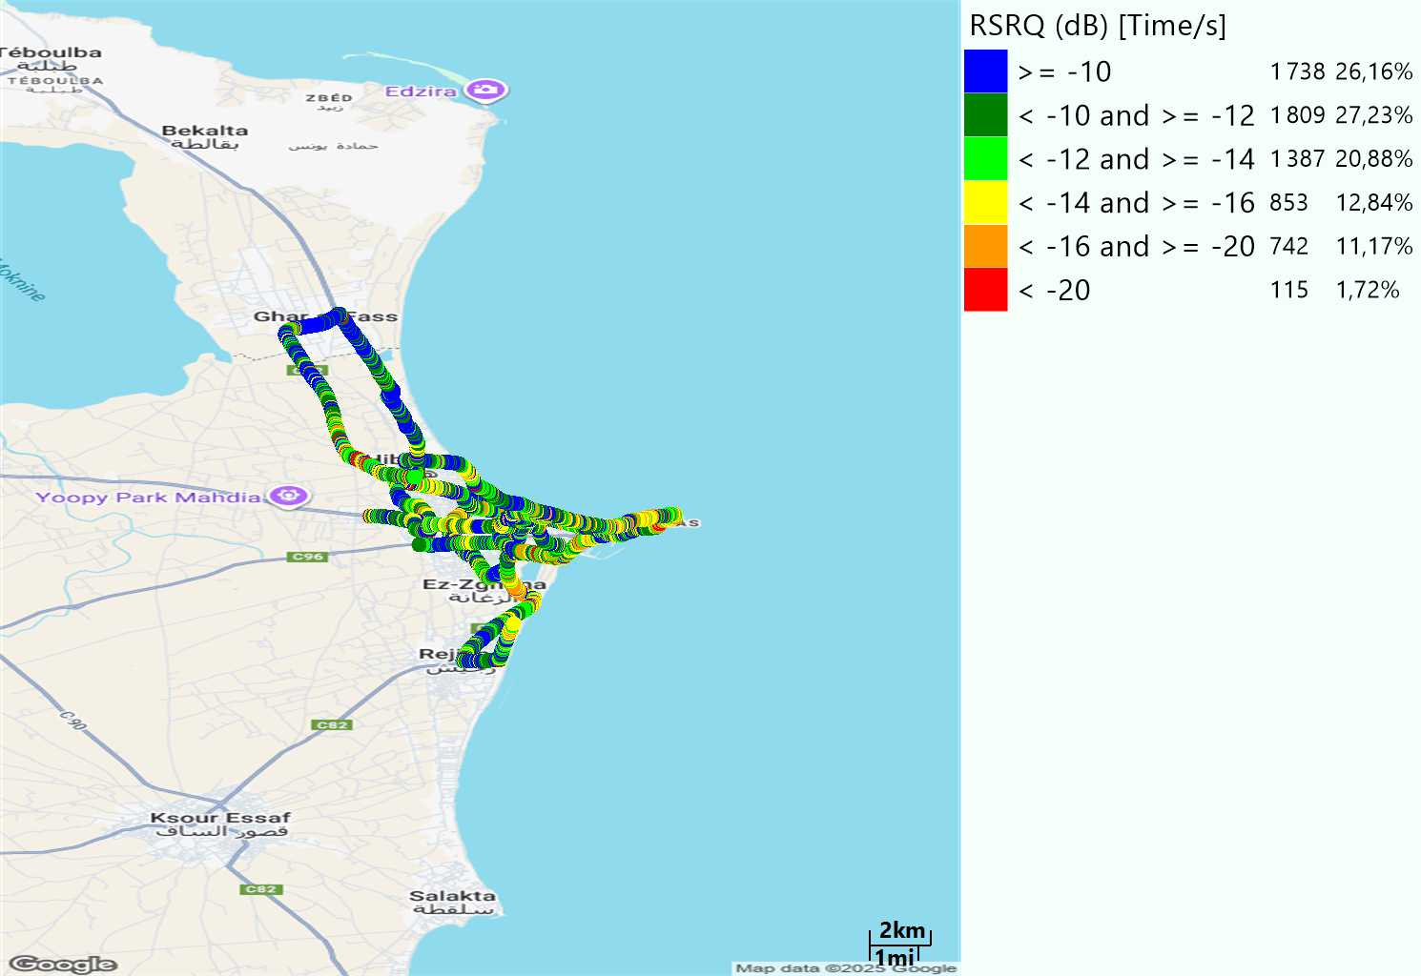

LTE- RSRQ
Long call
Short call

Slide 8
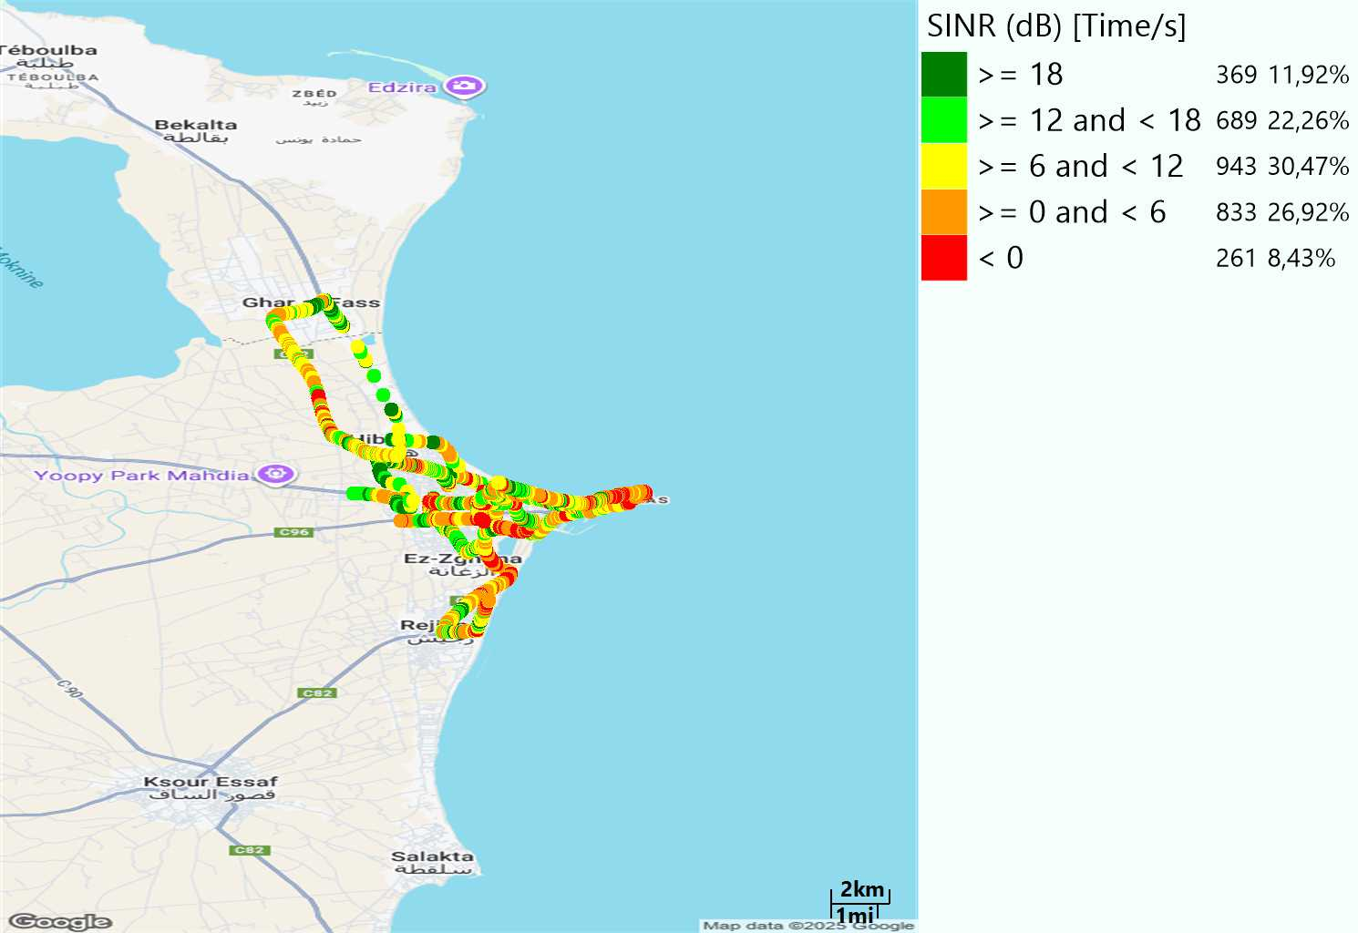
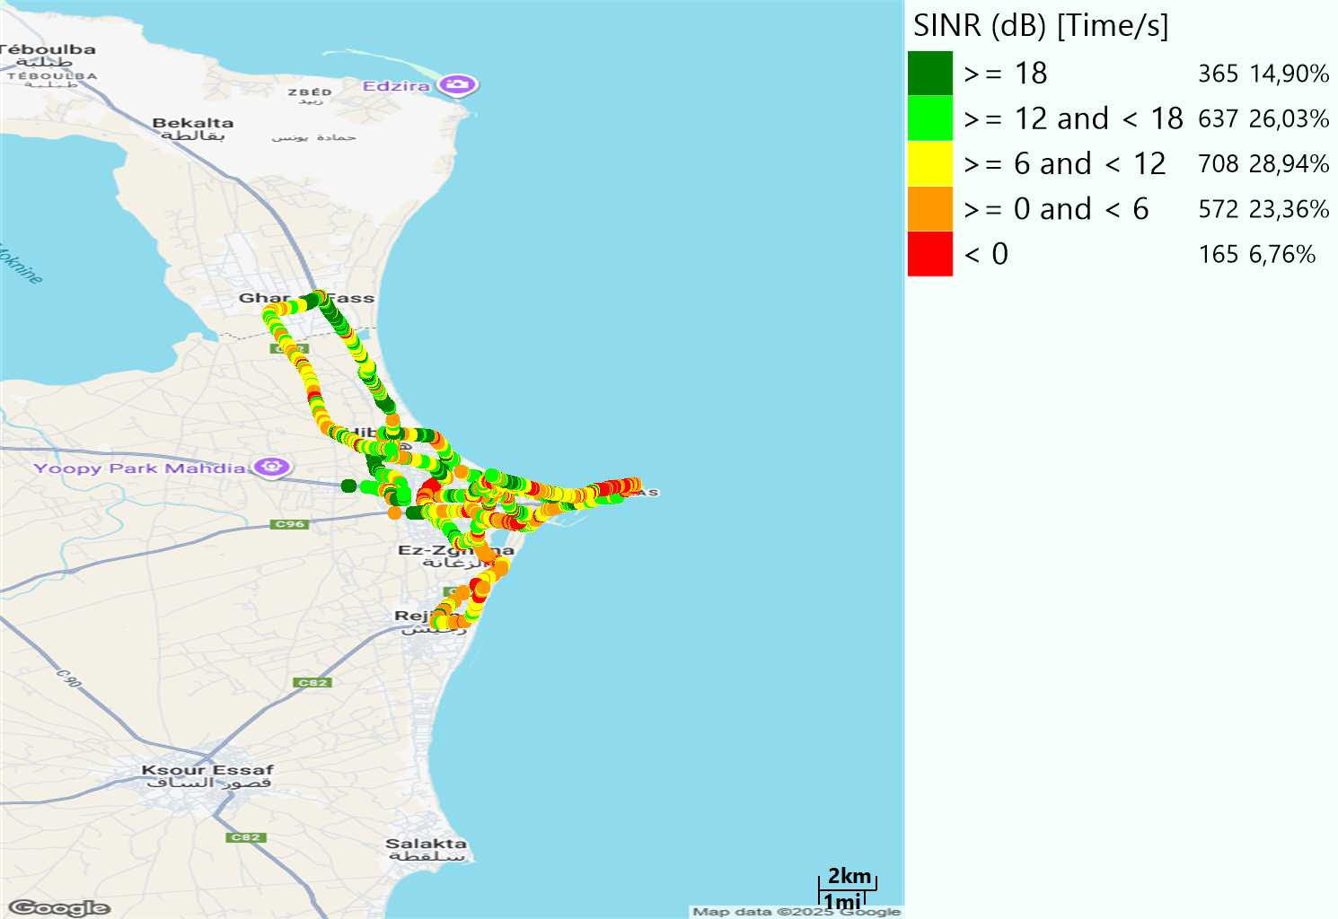
LTE-SINR
Long call
Short call

Slide 9
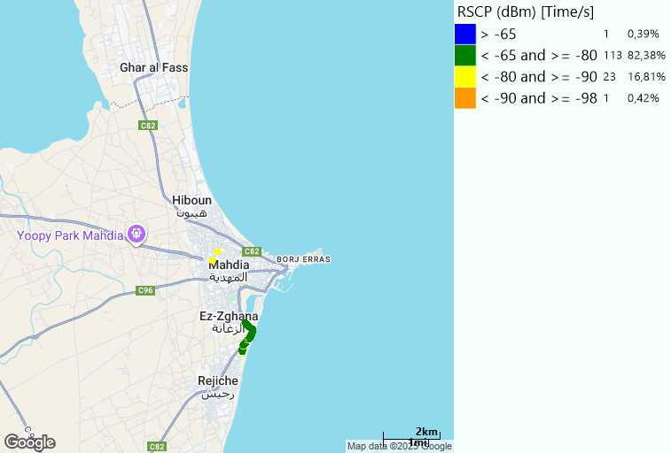
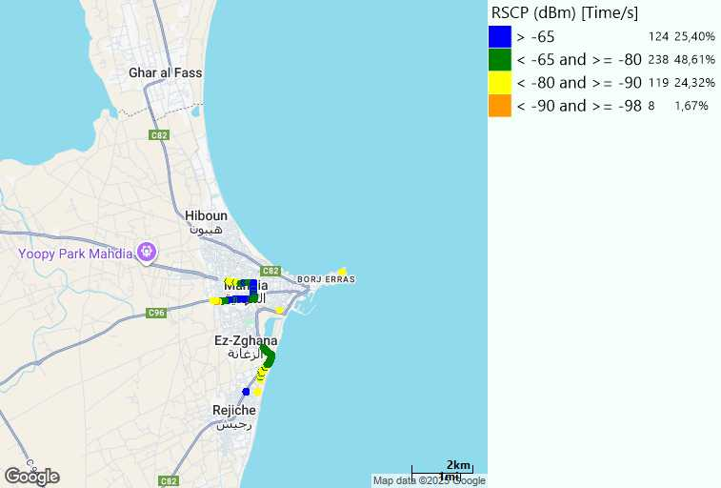
RSCP
Long call
Short call

Slide 10
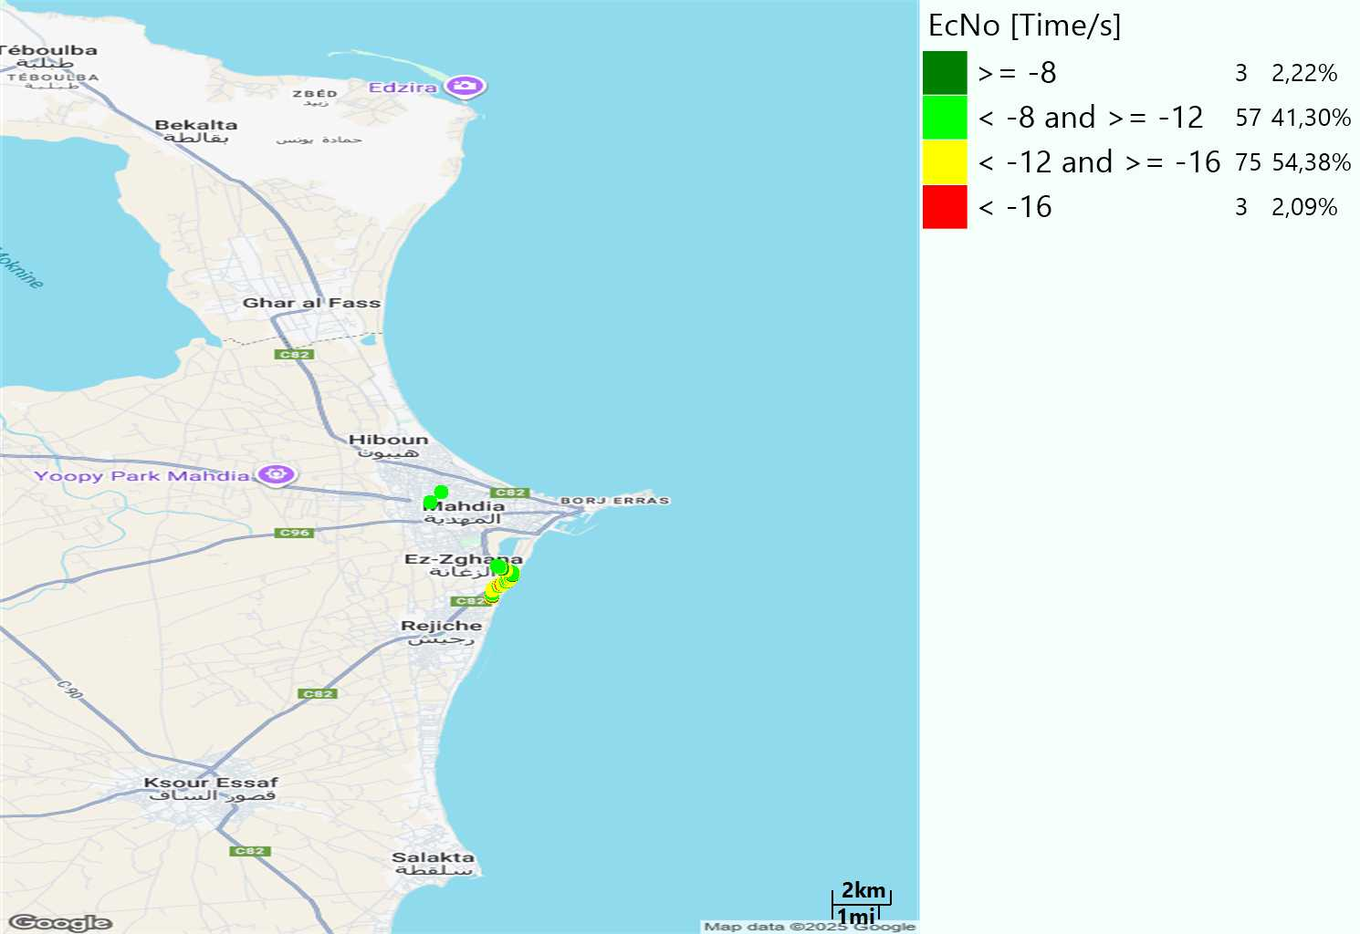
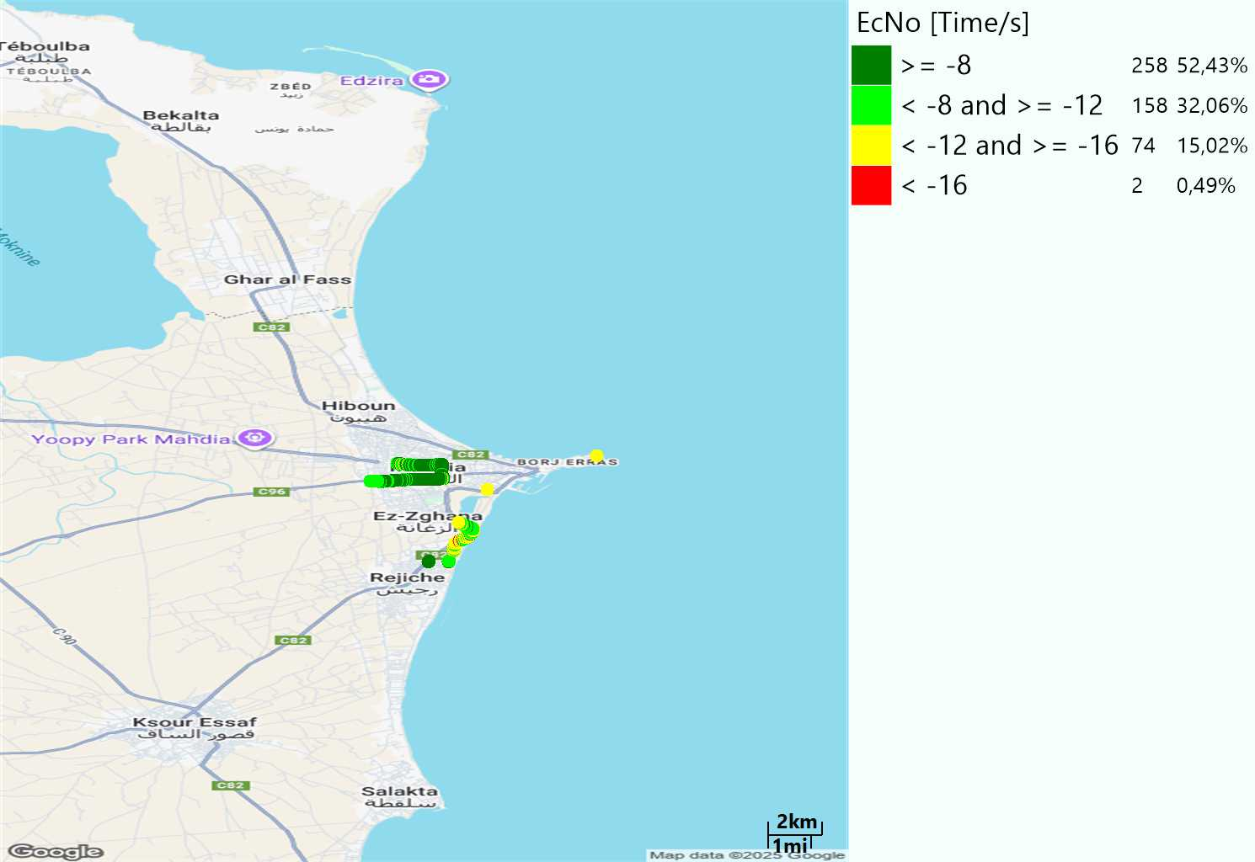
WCDMA-Ec/NO
Long call
Short call

Slide 11
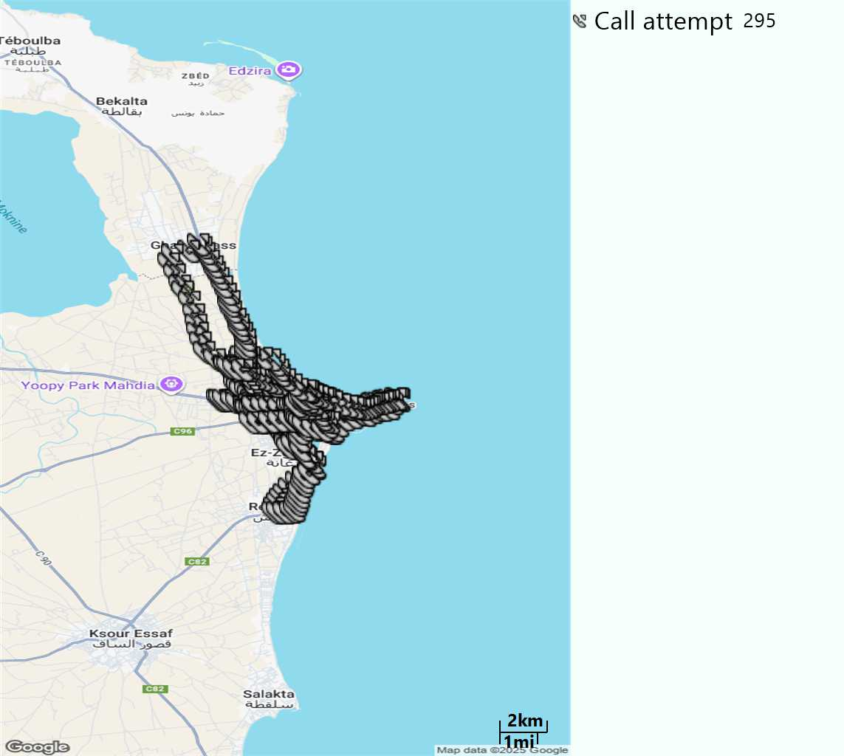
MO Call Setup Time (call setup time in VoLTE)
Short call
Call Setup Time IMS Voice
Average (Sec) | Maximum (Sec) | Minimum (Sec)
2,93 | 11,71 | 1,87

Slide 12
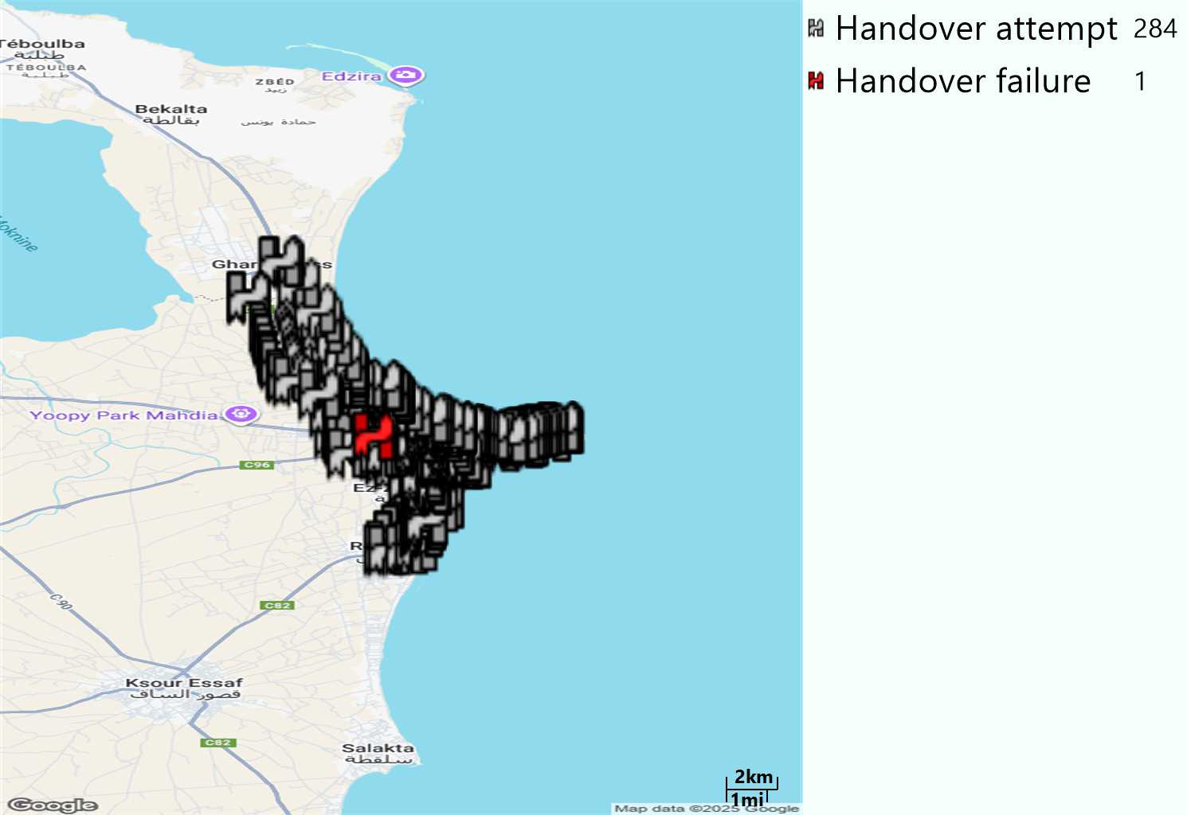
MO Handover Type
Long call
HO Type | Percentage [%]
LTE Inter-Frequency handover | 7,75%
LTE Intra-Frequency handover | 91,90%
UMTS to LTE | 0,35%
Handover KPI’s
Handover Attemps | 284
Handover Success | 283
Handover succès Rate | 99,65%
Étiquettes de lignes | LTE FDD_1800 | LTE FDD_2100 | LTE FDD_800 | Total général
LTE FDD_1800 | 151 | 5 | 3 | 159
LTE FDD_2100 | 10 | 84 |  | 94
LTE FDD_800 | 4 | 1 | 25 | 30
UMTS FDD_900 |  | 1 |  | 1
Total général | 165 | 91 | 28 | 284

Slide 13
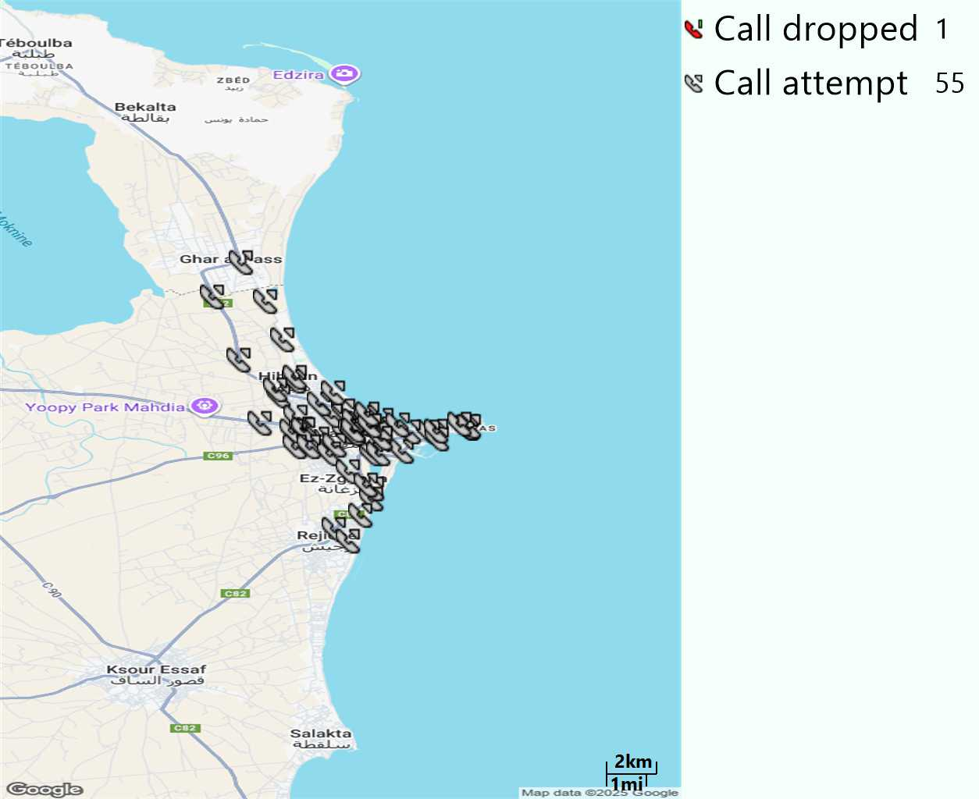
MO Voice Stats (VoLTE call stats)
Long call
Voice KPIs
Number Call Attempts | 55
Number Dropped Calls | 1
Call Drop Rate (%) | 1,82%
HO success rate | 99,65%

Slide 14
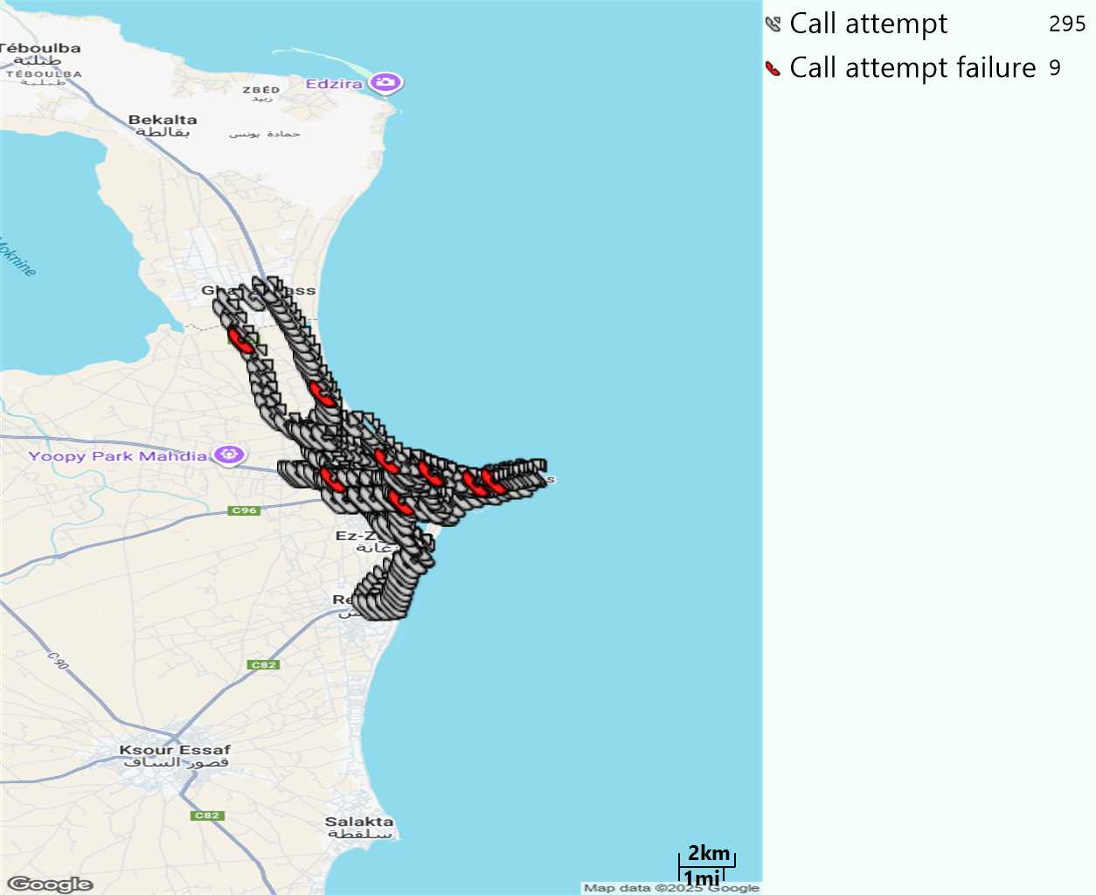
MO Voice Stats (VoLTE call stats)
Short call
Voice KPIs
Number Call Attempts | 295
Number Call Setup | 286
Number Blocked Calls | 9
Setup Succes Rate (%) | 96,95%
Call Block Rate (%) | 3,05%
Call Setup Time IMS Voice Average (Sec) | 2,93

Slide 15
MO Voice Stats (VoLTE call stats)
KPIs
VoLTE Call Setup SR | 96,95%
Call Setup Time | 2,93
VoLTE Drop Call Rate | 1,82%
Speech Quality - MOS (% of the samples >3,5) | 92,47%
Average MOS | 4,17
VoLTE Handover SR | 99,65%
VoLTE SRVCC SR | 100%

Slide 16
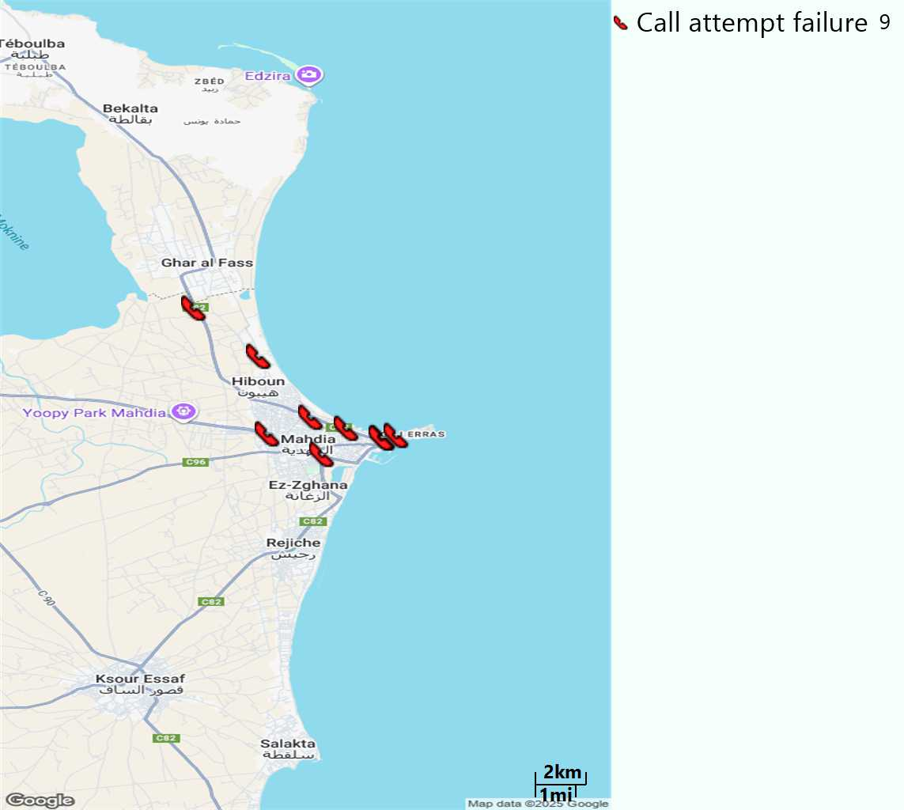
MO Voice Call - Blocked call
Short call

Slide 17
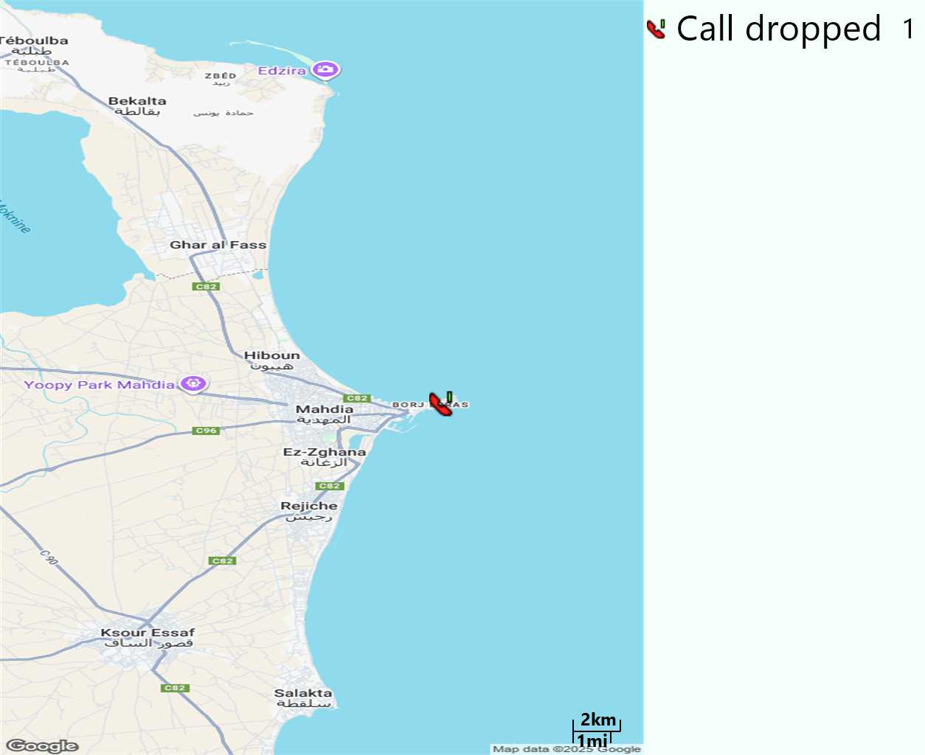
MO Voice Call - Dropped call
Long call

Slide 18
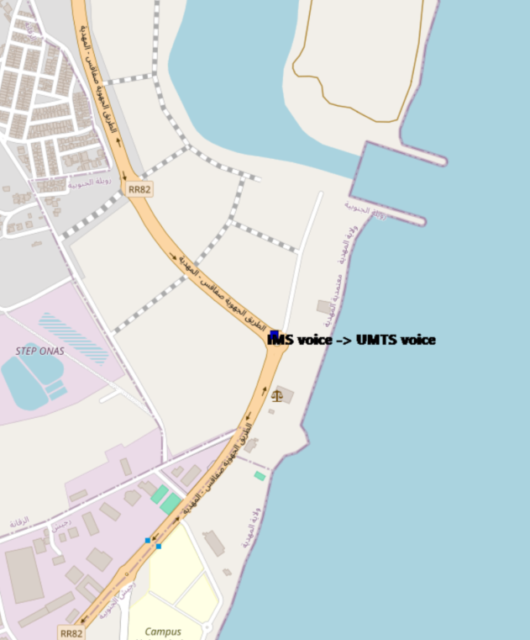
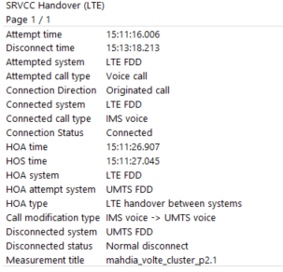
VoLTE SRVCC Success Rate long Call
Connection Direction | Connected system | Connected call type | Connection Status | HOA time | HOS time | HOA system | HOA attempt system | HOA type | Call modification type | Disconnected system | Disconnected status | Measurement title
Originated call | LTE FDD | IMS voice | Connected | 11:26,9 | 11:27,0 | LTE FDD | UMTS FDD | LTE handover between systems | IMS voice -> UMTS voice | UMTS FDD | Normal disconnect | mahdia_volte_cluster_p2.1

Slide 19
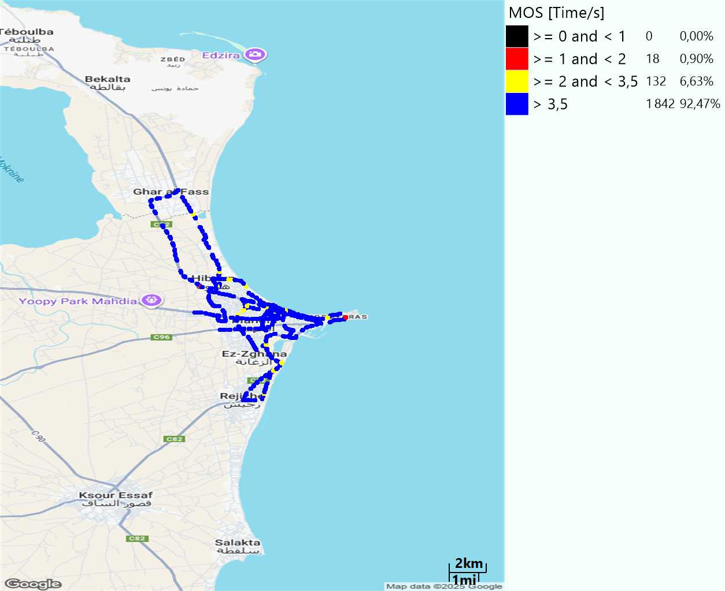
MO Voice Quality Metrics
long Call

Slide 20
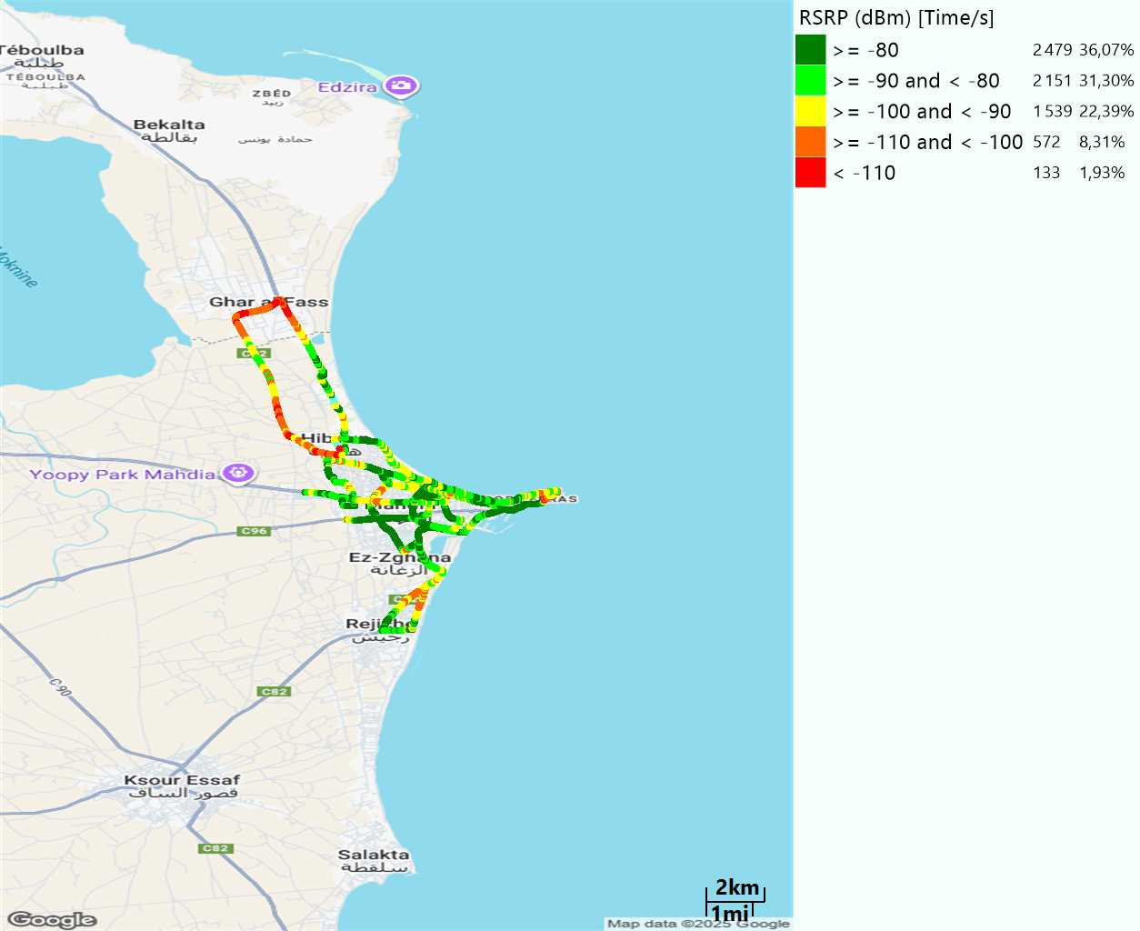
Scanner_RSRP
L2100

Slide 21
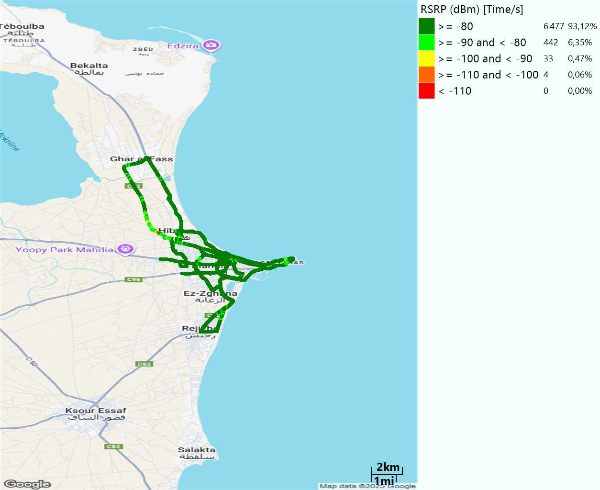
Scanner_RSRP
L800

Slide 22

Scanner_RSRP
L1800

Slide 23
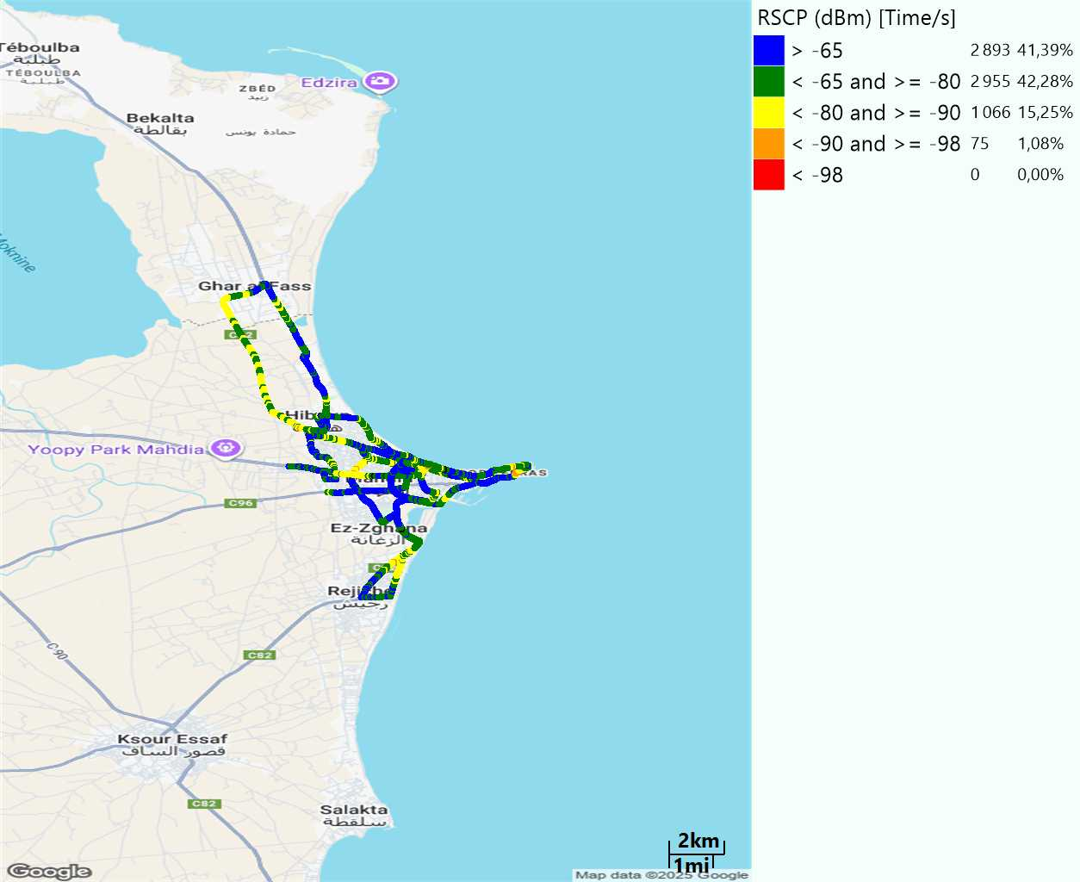
Scanner_RSCP
U2100

Slide 24
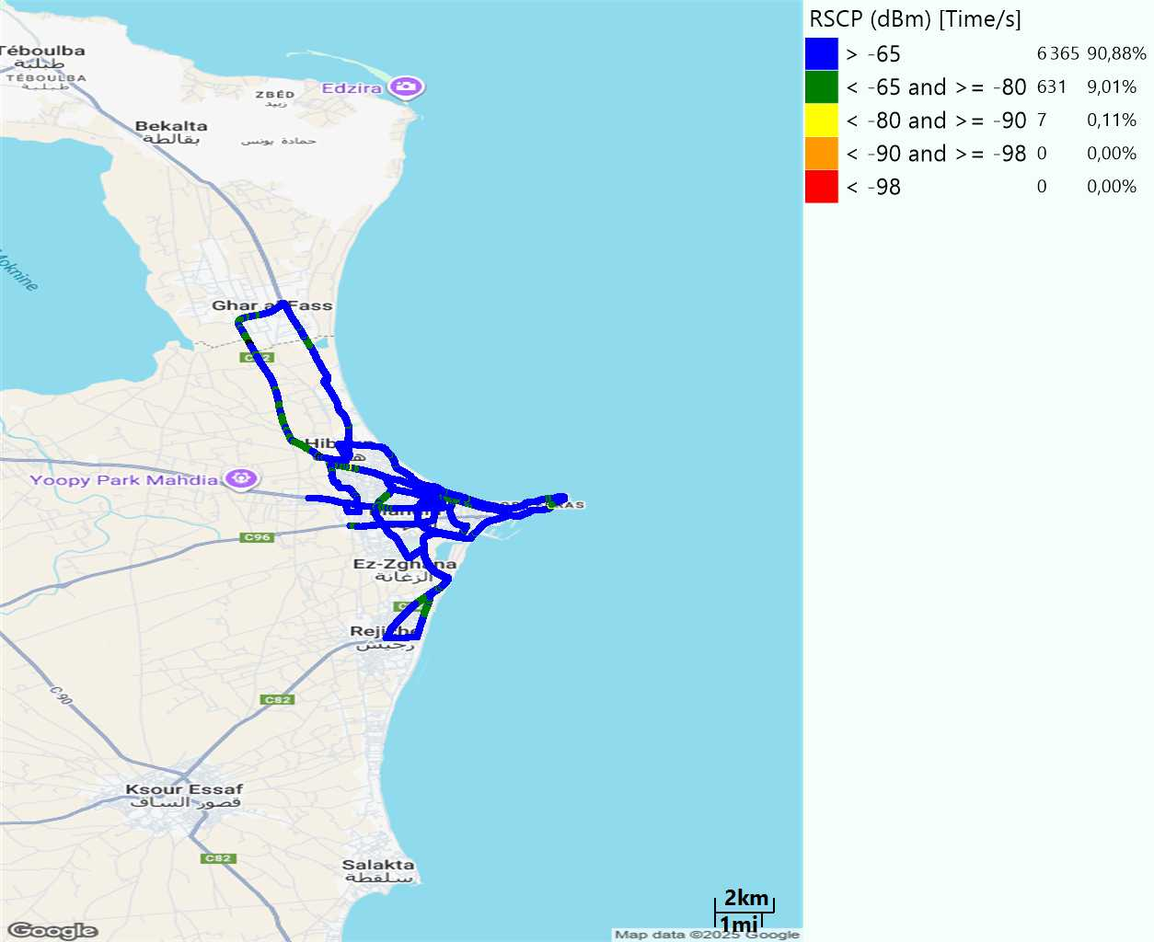
Scanner_RSCP
900

