Slide 1


Volte Drive Test Report

Slide 2
DT Scénario
Short Call (10s)
Long call (2min)
Scanner

Slide 3
Voice Call

Slide 4
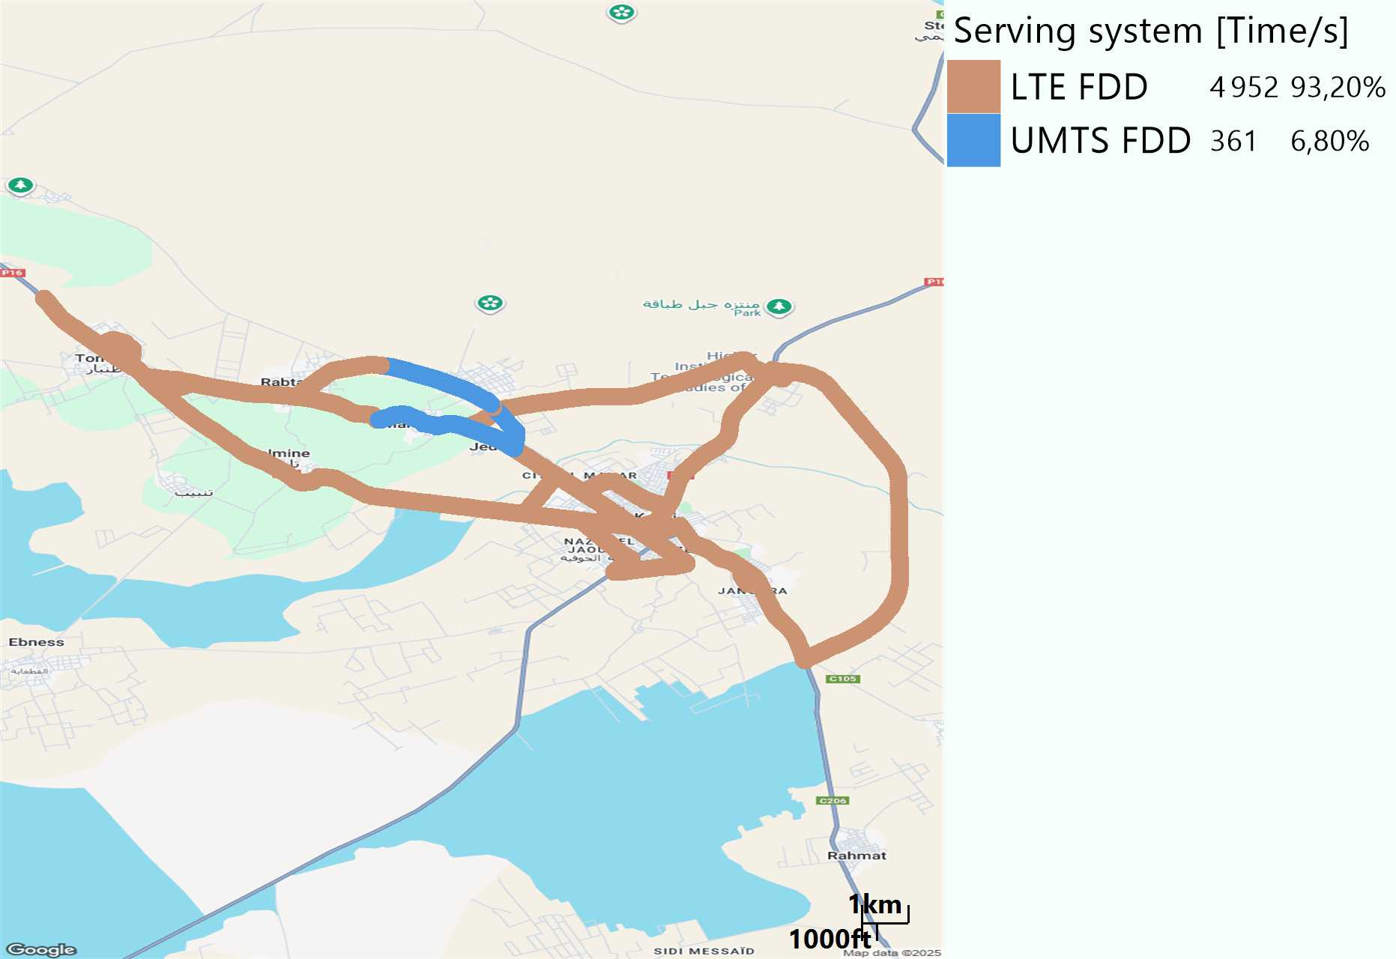
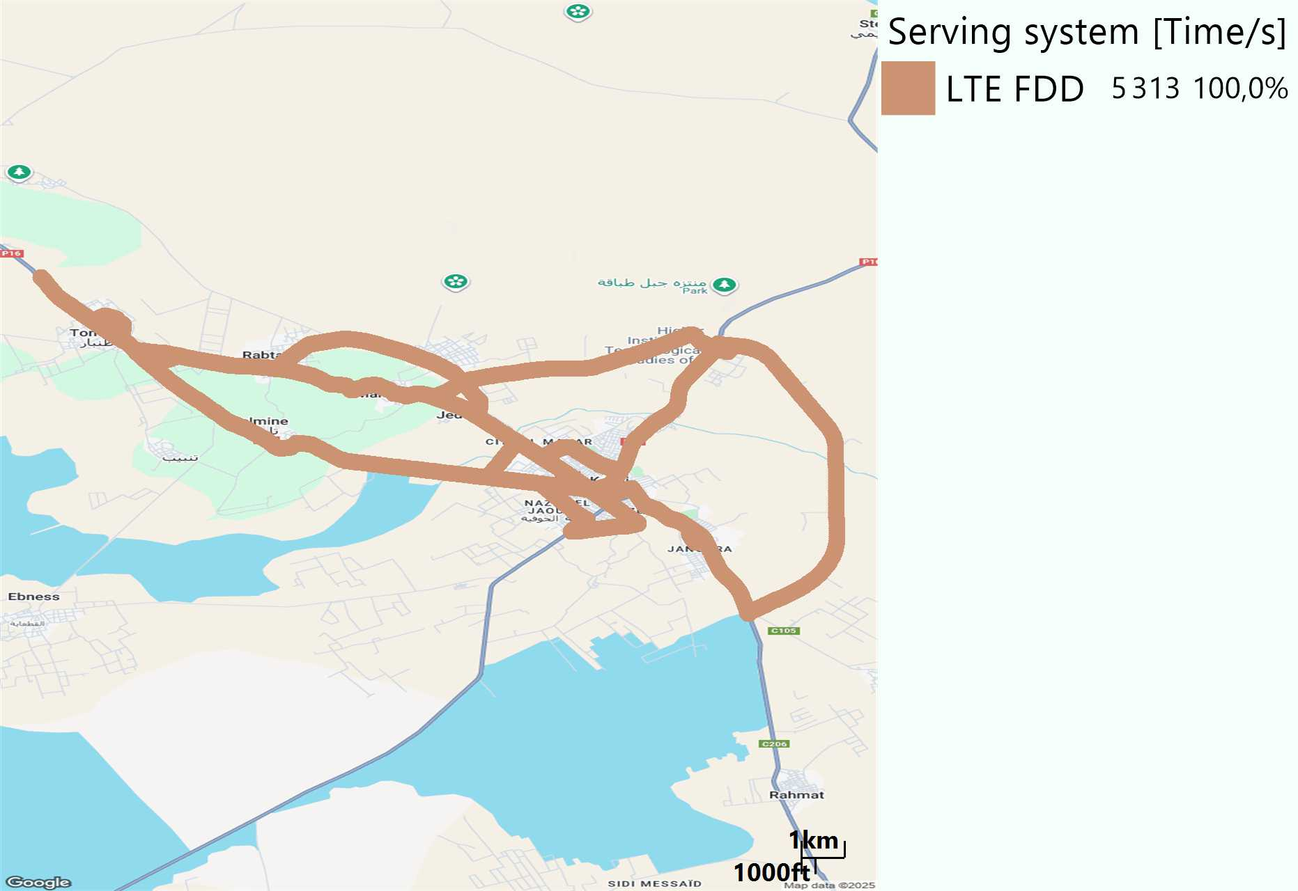
RAT distribution
Long call
Short call

Slide 5
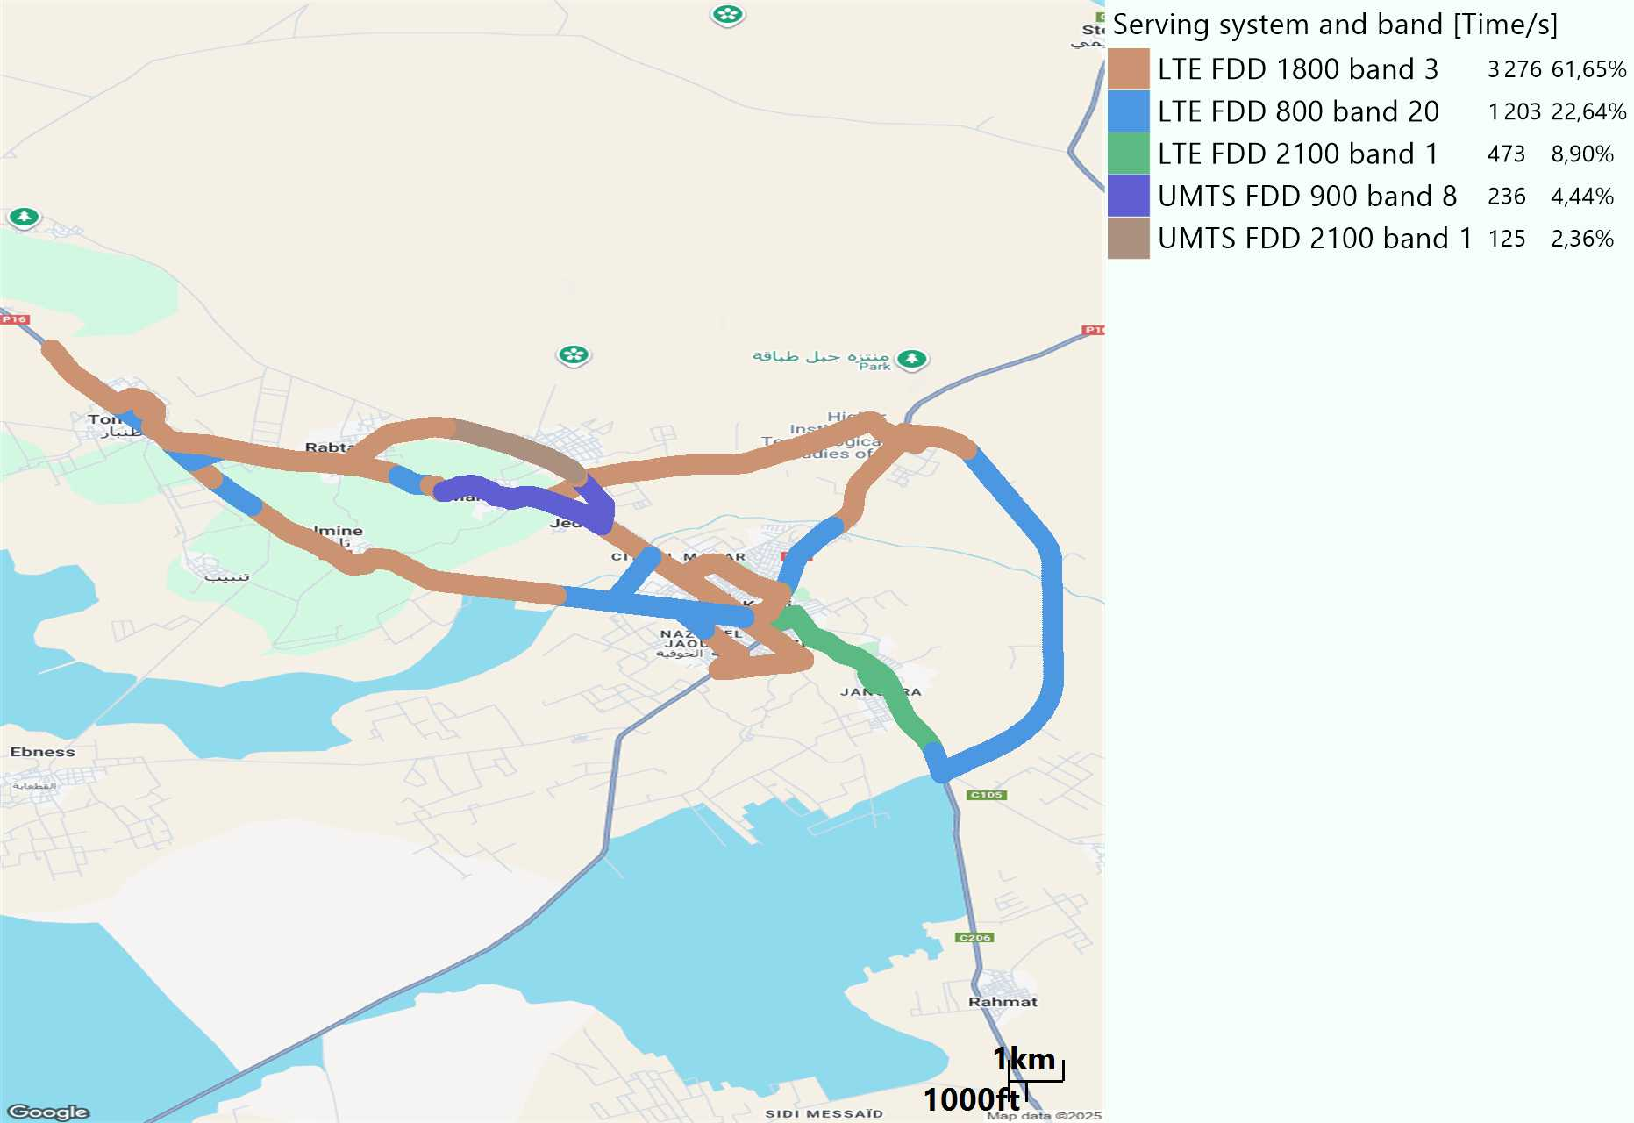
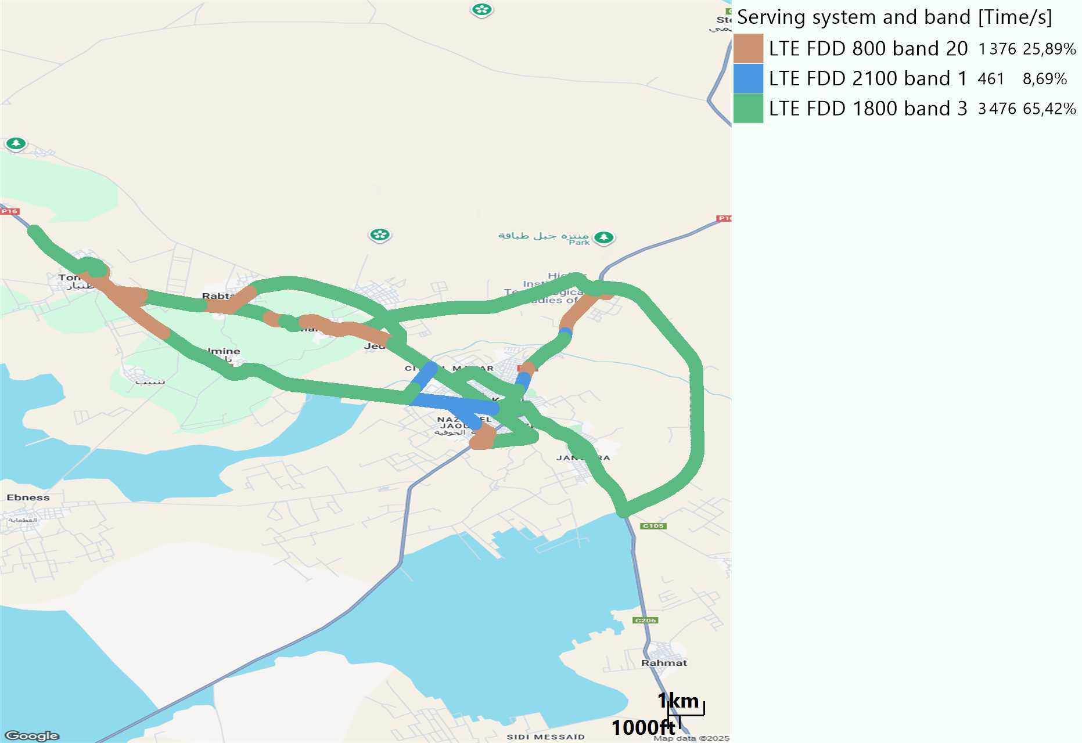
EARFCN distribution
Long call
Short call

Slide 6
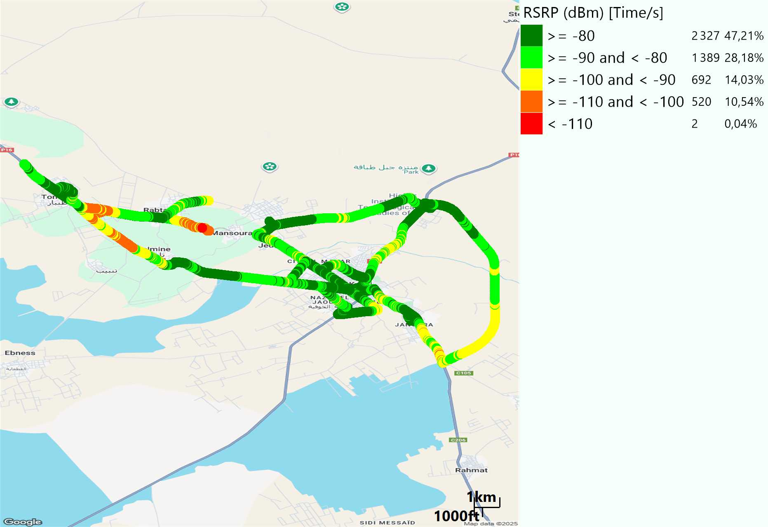
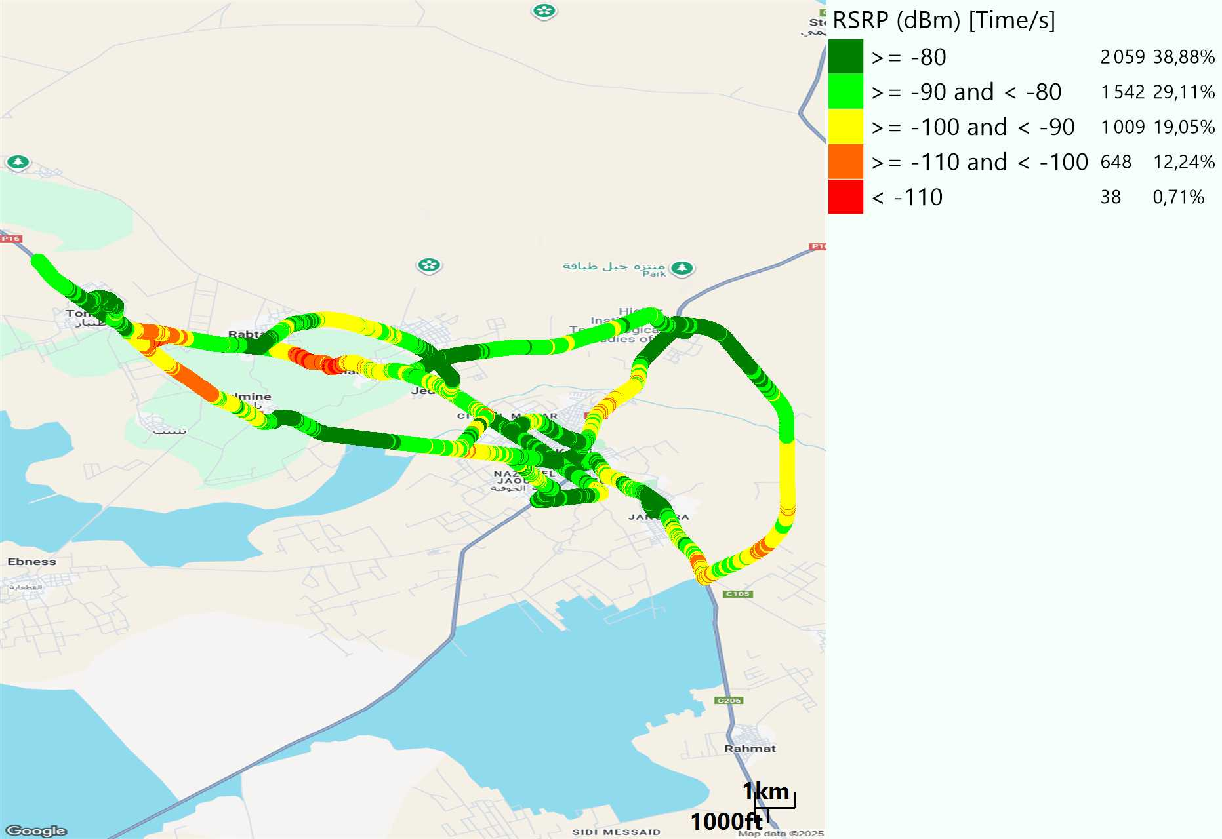
LTE - RSRP
Long call
Short call
Average [dBm]
-81,95
Average [dBm]
-84,66

Slide 7
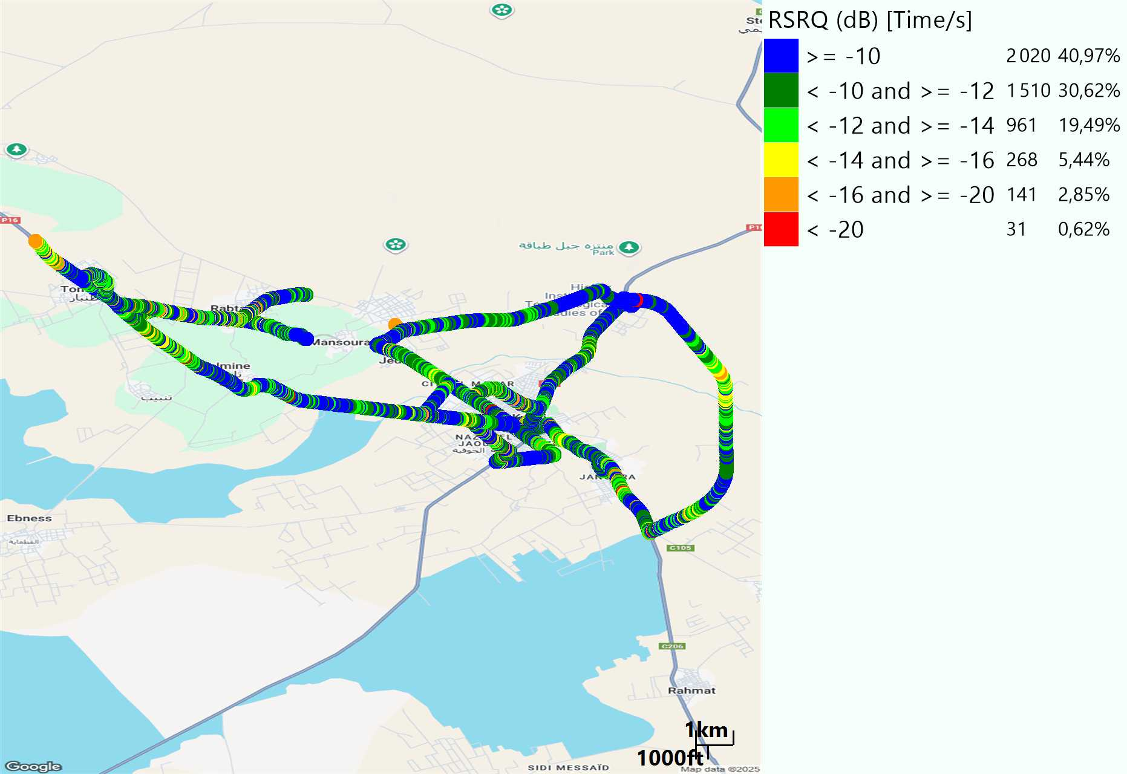
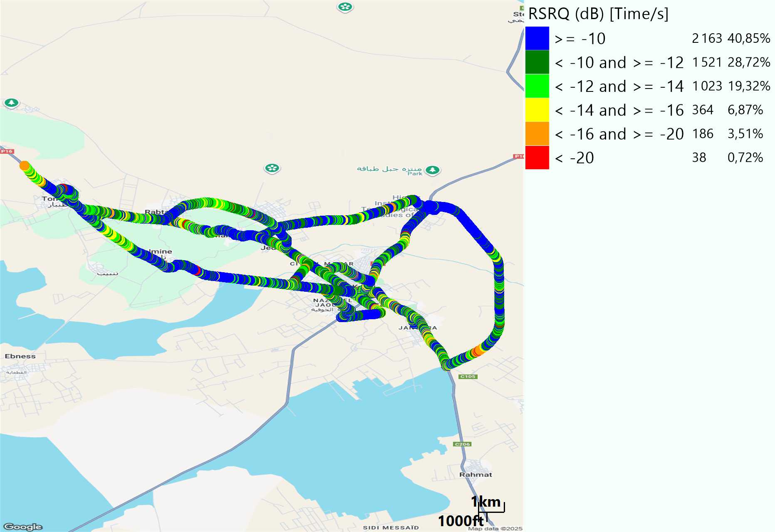
LTE- RSRQ
Long call
Short call

Slide 8
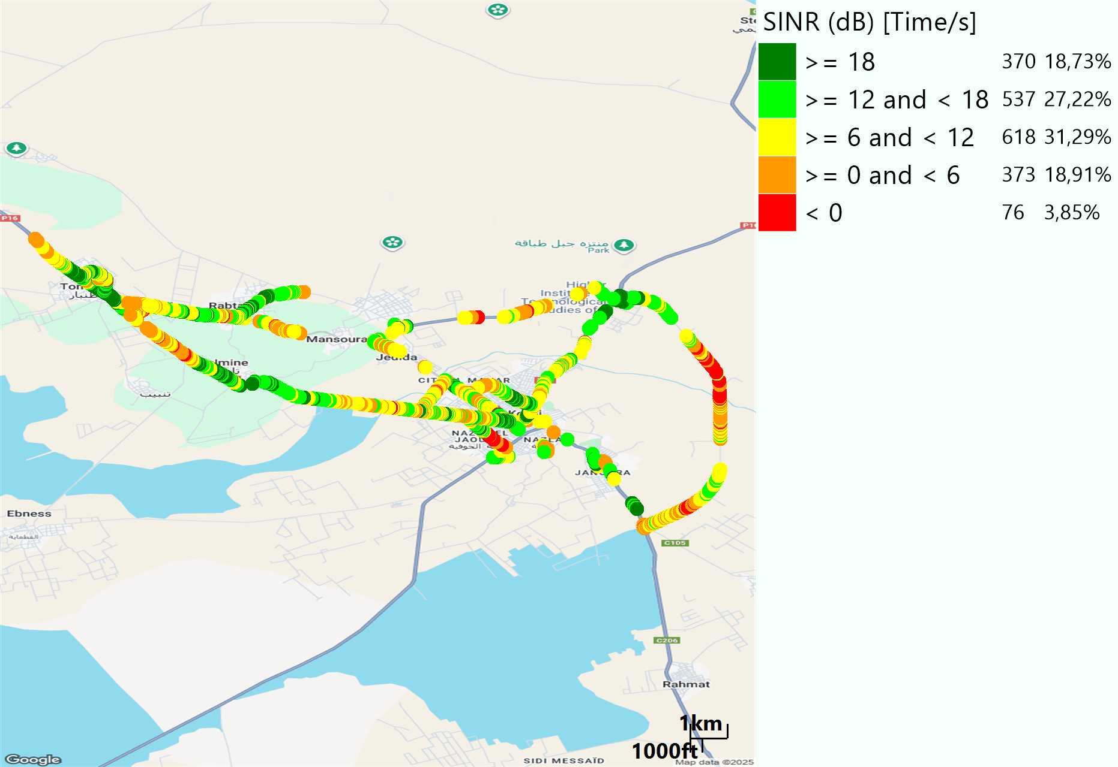
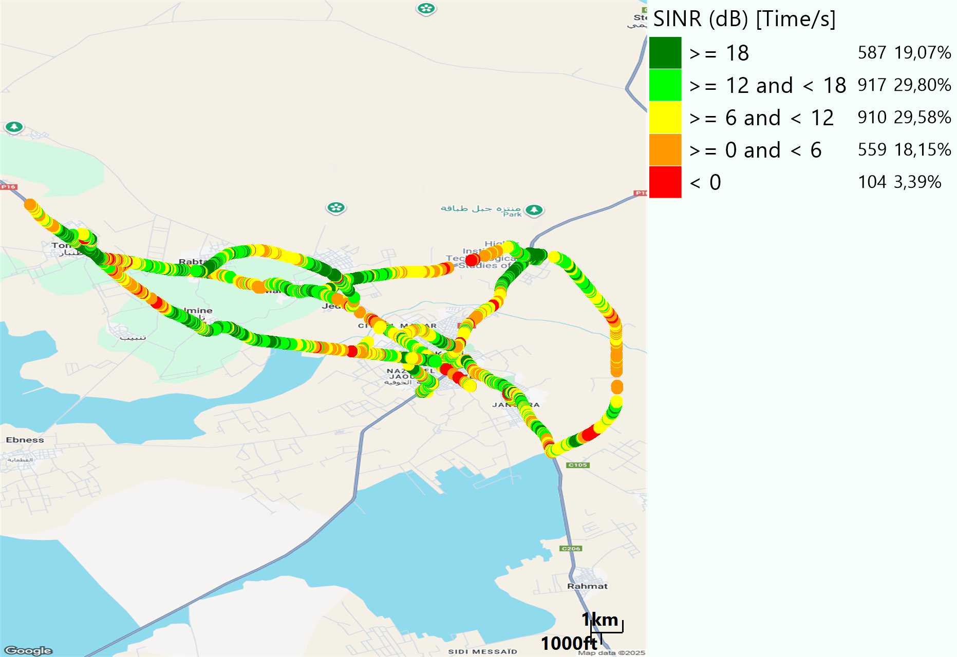
LTE-SINR
Long call
Short call

Slide 9
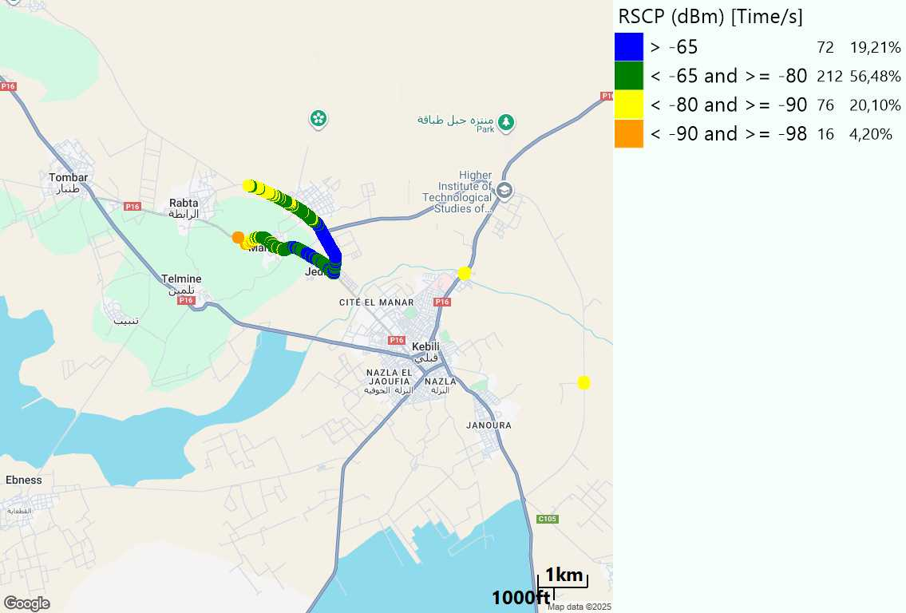
RSCP
Long call

Slide 10
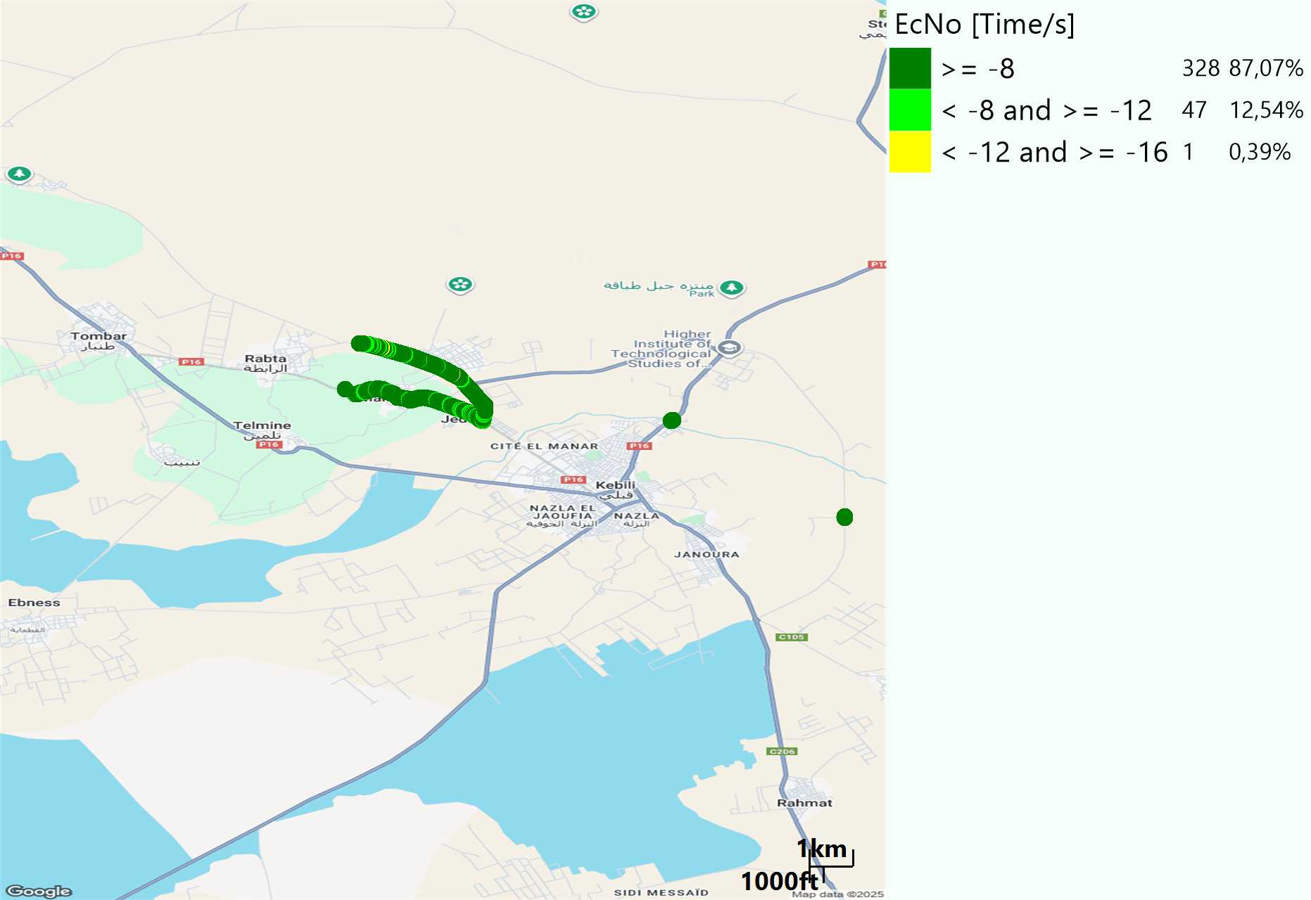
WCDMA-Ec/NO
Long call

Slide 11
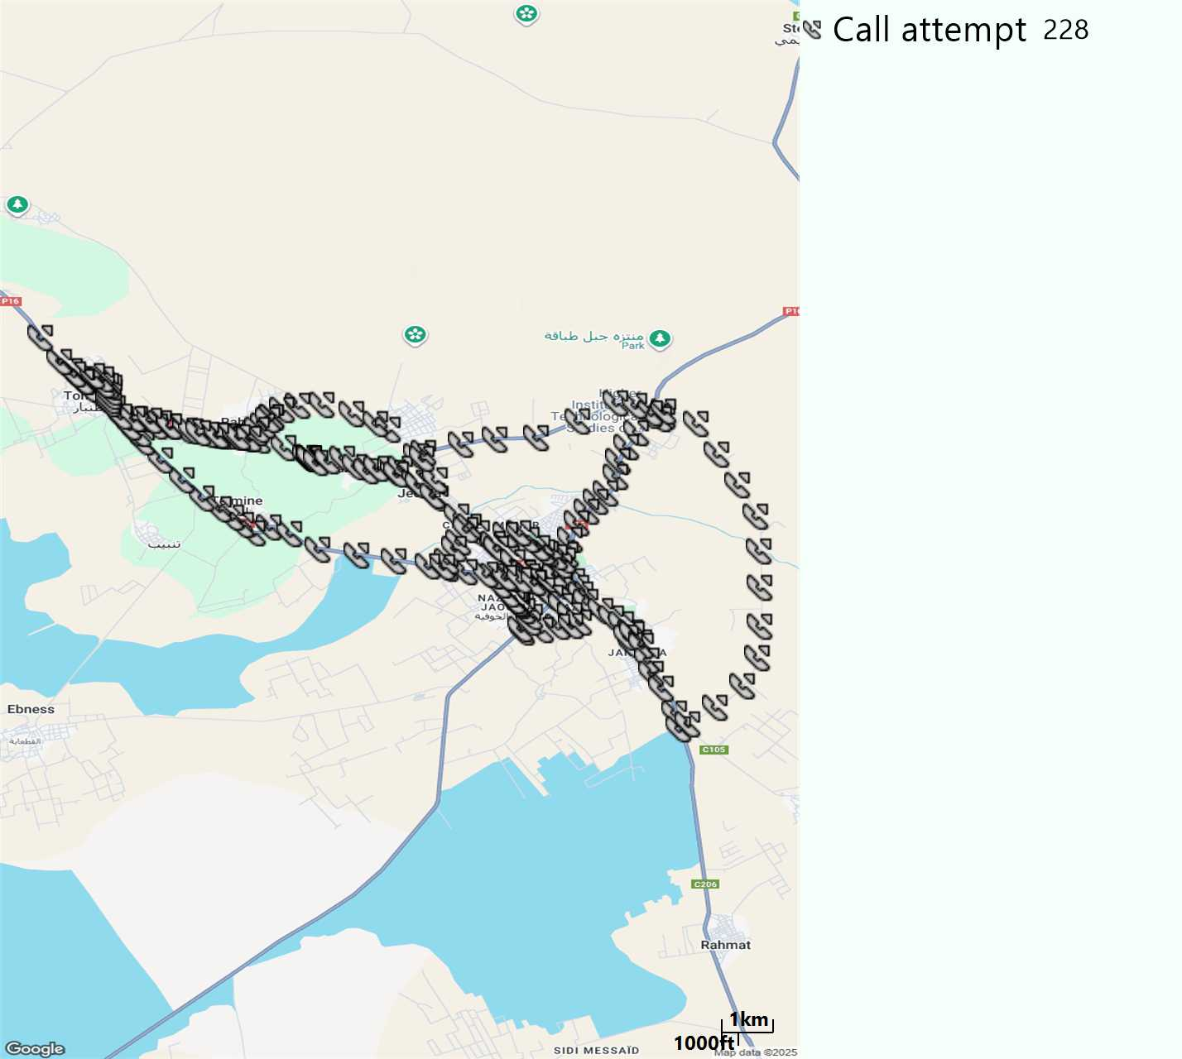
MO Call Setup Time (call setup time in VoLTE)
Short call
Call Setup Time IMS Voice
Average (Sec) | Maximum (Sec) | Minimum (Sec)
3,29 | 9,16 | 2,1

Slide 12
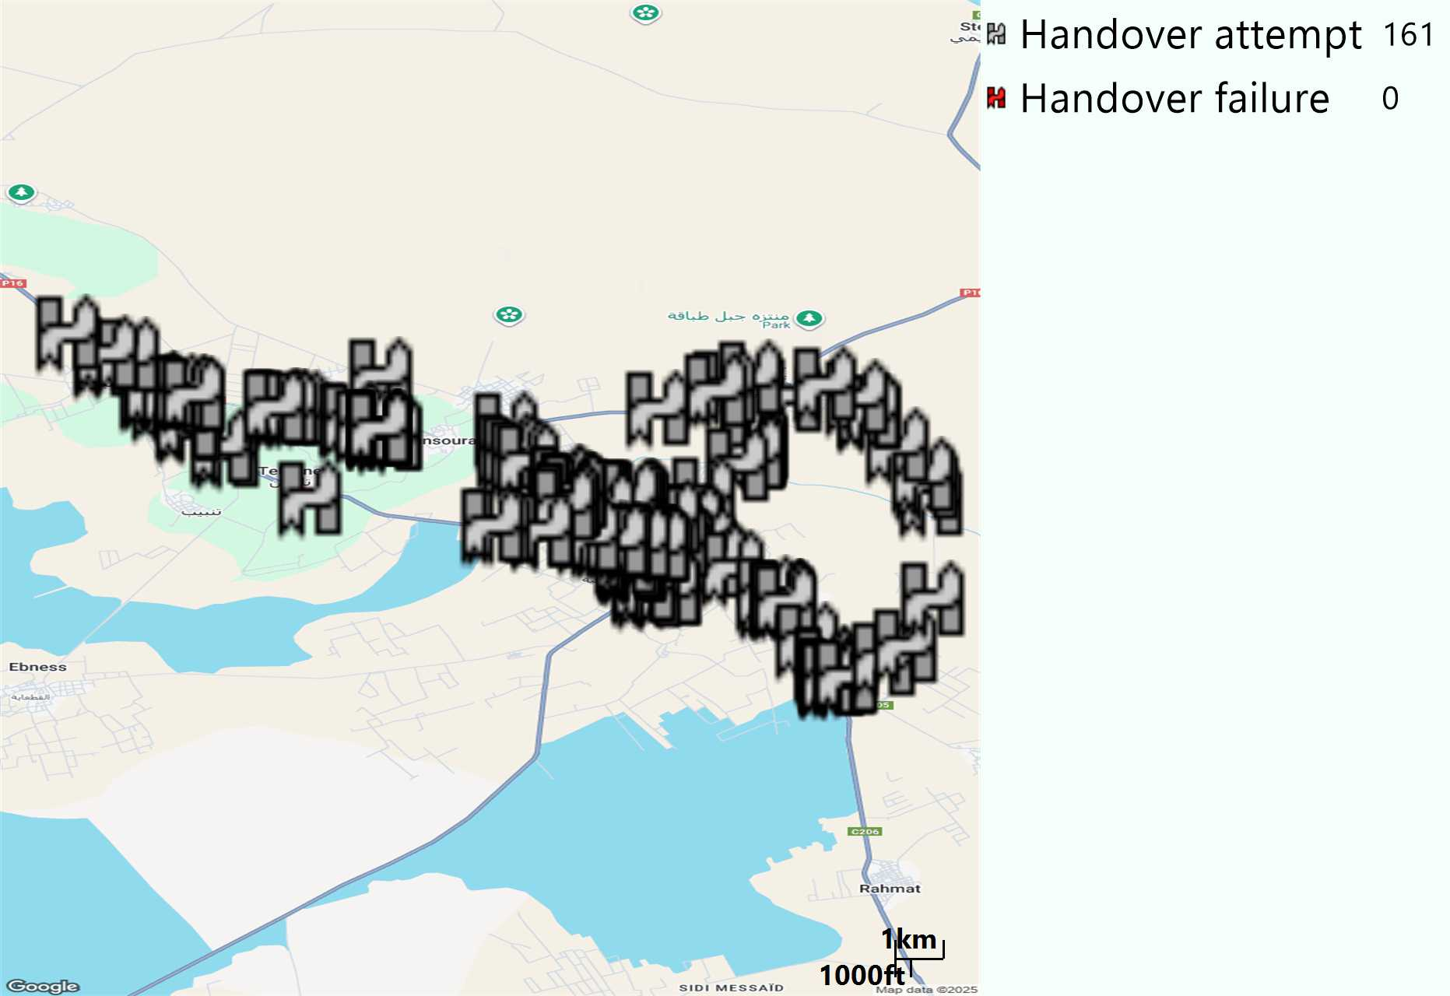
MO Handover Type
Long call
HO Type | Percentage [%]
LTE Inter-Frequency handover | 8,7%
LTE Intra-Frequency handover | 90,68%
UMTS to LTE | 0,62%
Handover KPI’s
Handover Attemps | 161
Handover Success | 161
Handover succès Rate | 100%
Étiquettes de lignes | LTE FDD_1800 | LTE FDD_2100 | LTE FDD_800 | Total général
LTE FDD_1800 | 75 |  | 6 | 81
LTE FDD_2100 |  | 17 | 1 | 18
LTE FDD_800 | 6 | 1 | 54 | 61
UMTS FDD_900 | 1 |  |  | 1
Total général | 82 | 18 | 61 | 161

Slide 13
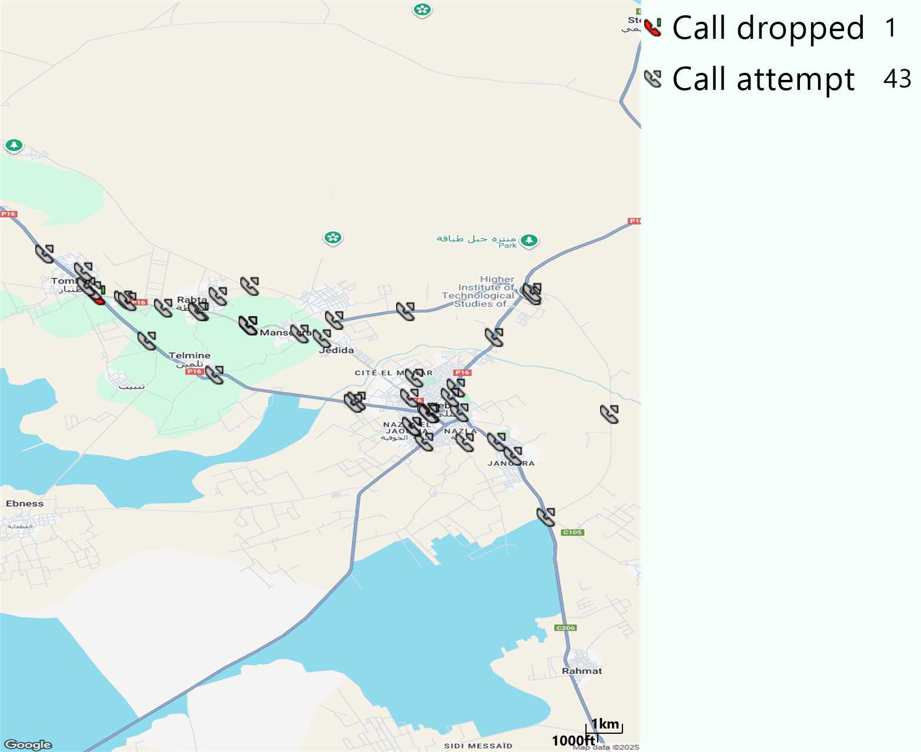
MO Voice Stats (VoLTE call stats)
Long call
Voice KPIs
Number Call Attempts | 43
Number Dropped Calls | 1
Call Drop Rate (%) | 2,33%
HO success rate | 100%

Slide 14
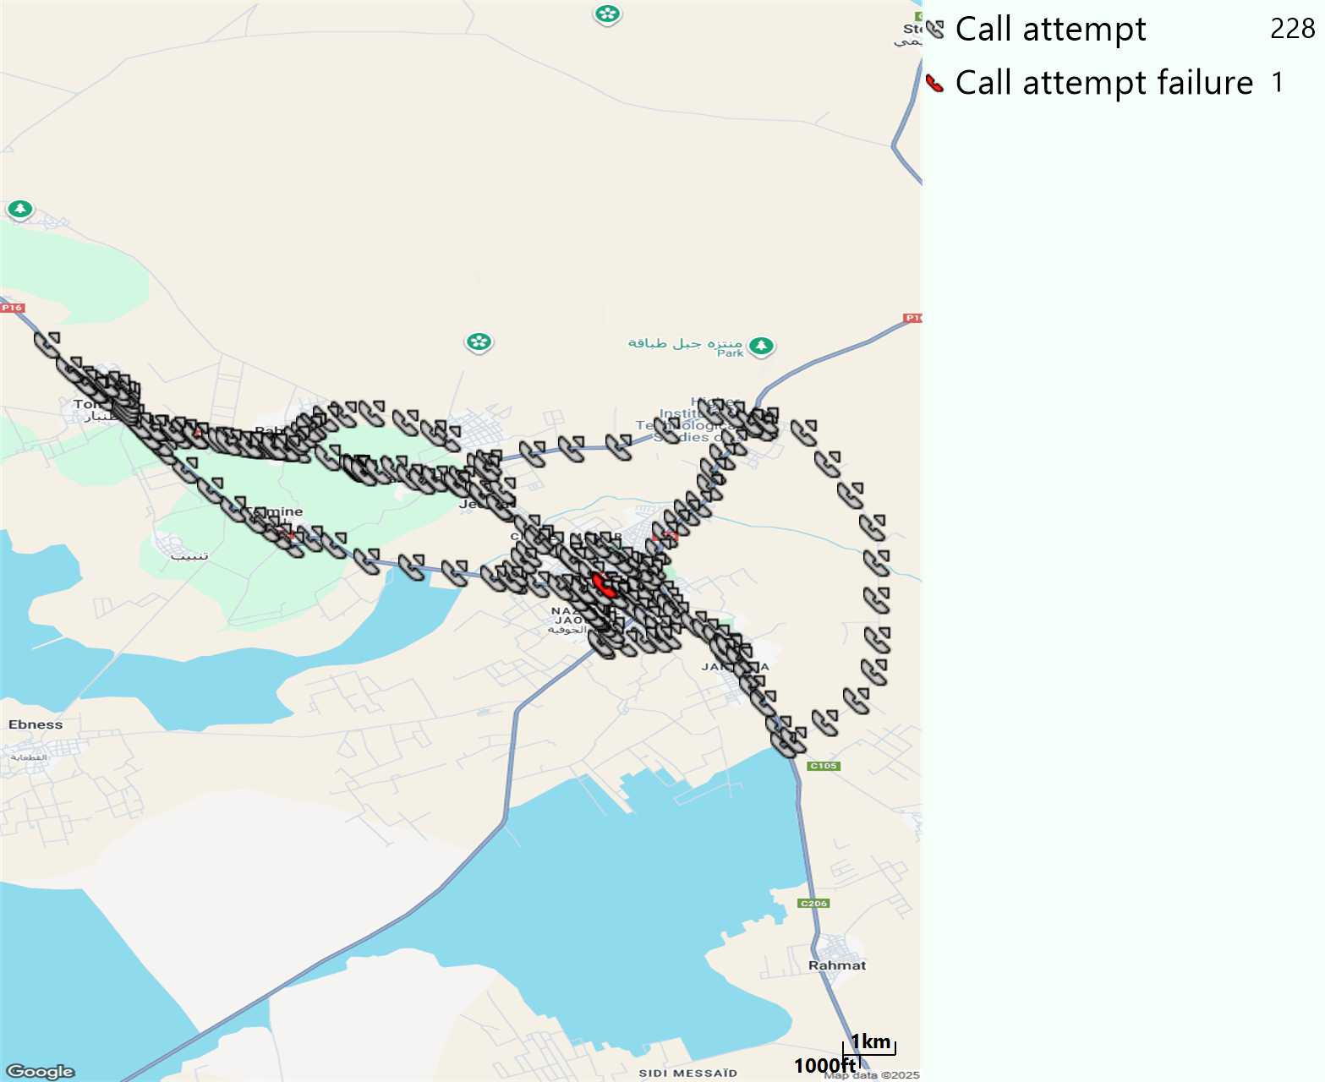
MO Voice Stats (VoLTE call stats)
Short call
Voice KPIs
Number Call Attempts | 228
Number Call Setup | 227
Number Blocked Calls | 1
Setup Succes Rate (%) | 99,56%
Call Block Rate (%) | 0,44%
Call Setup Time IMS Voice Average (Sec) | 3,29

Slide 15
MO Voice Stats (VoLTE call stats)
KPIs
VoLTE Call Setup SR | 99,56%
Call Setup Time | 3,29
VoLTE Drop Call Rate | 2,33%
Speech Quality - MOS (% of the samples >3,5) | 92,25%
Average MOS | 4,14
VoLTE Handover SR | 100%
VoLTE SRVCC SR | 100%

Slide 16
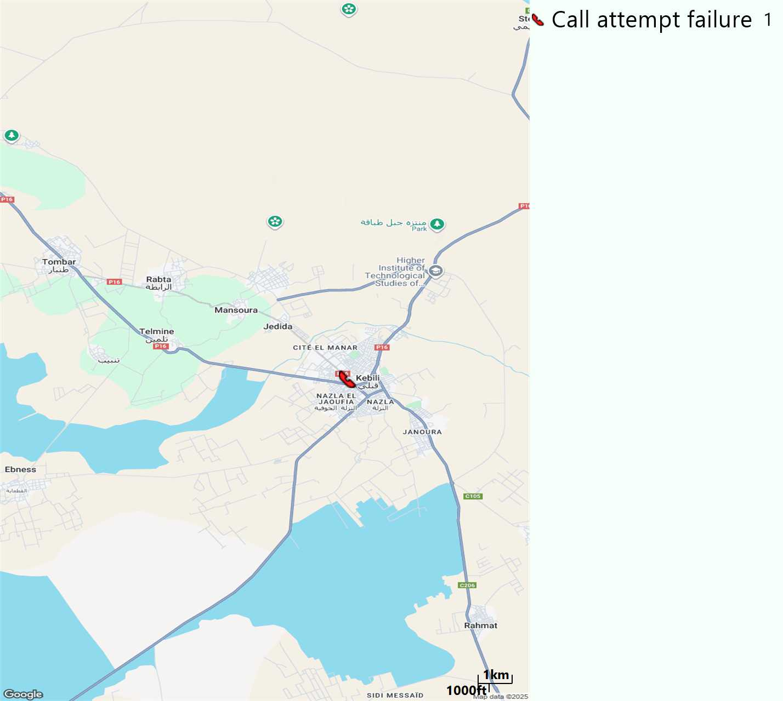
MO Voice Call - Blocked call
Short call

Slide 17
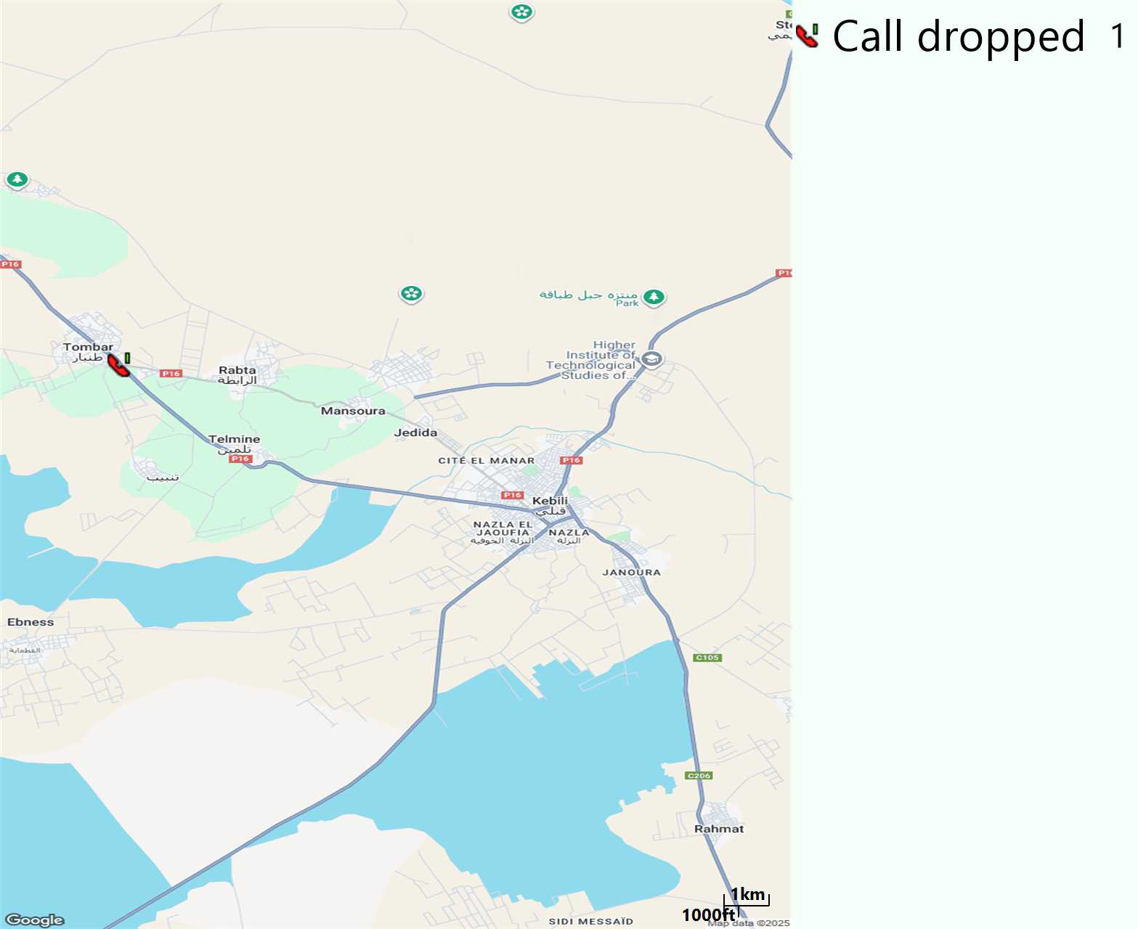
MO Voice Call - Dropped call
Long call

Slide 18
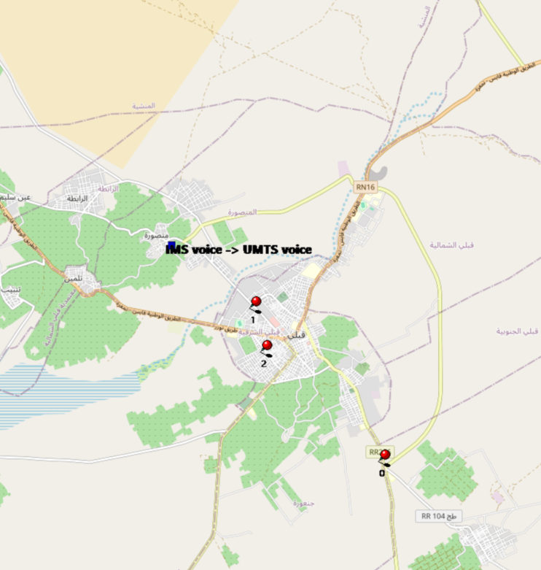
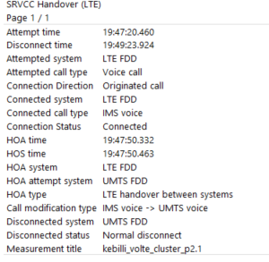
VoLTE SRVCC Success Rate long Call
Attempted system | Attempted call type | Connection Direction | Connected system | Connected call type | Connection Status | HOA time | HOS time | HOA system | HOA attempt system | HOA type | Call modification type | Disconnected system | Disconnected status | Measurement title
LTE FDD | Voice call | Originated call | LTE FDD | IMS voice | Connected | 47:50,3 | 47:50,5 | LTE FDD | UMTS FDD | LTE handover between systems | IMS voice -> UMTS voice | UMTS FDD | Normal disconnect | kebilli_volte_cluster_p2.1

Slide 19
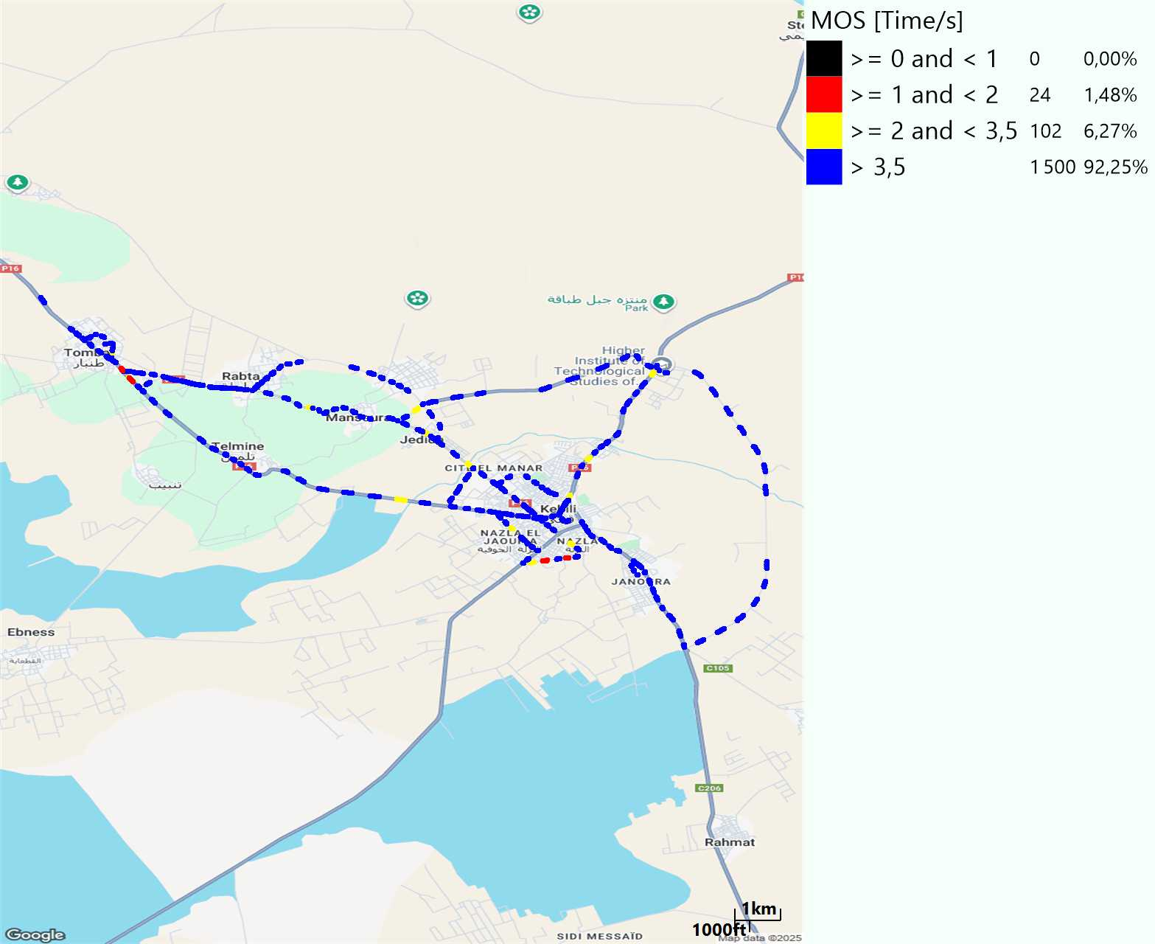
MO Voice Quality Metrics
long Call

Slide 20
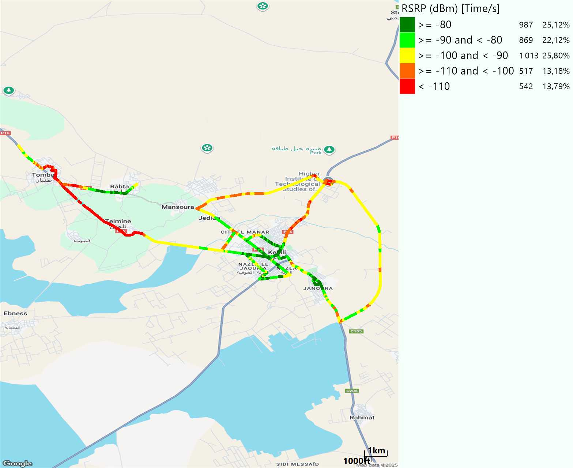
Scanner_RSRP
L2100

Slide 21
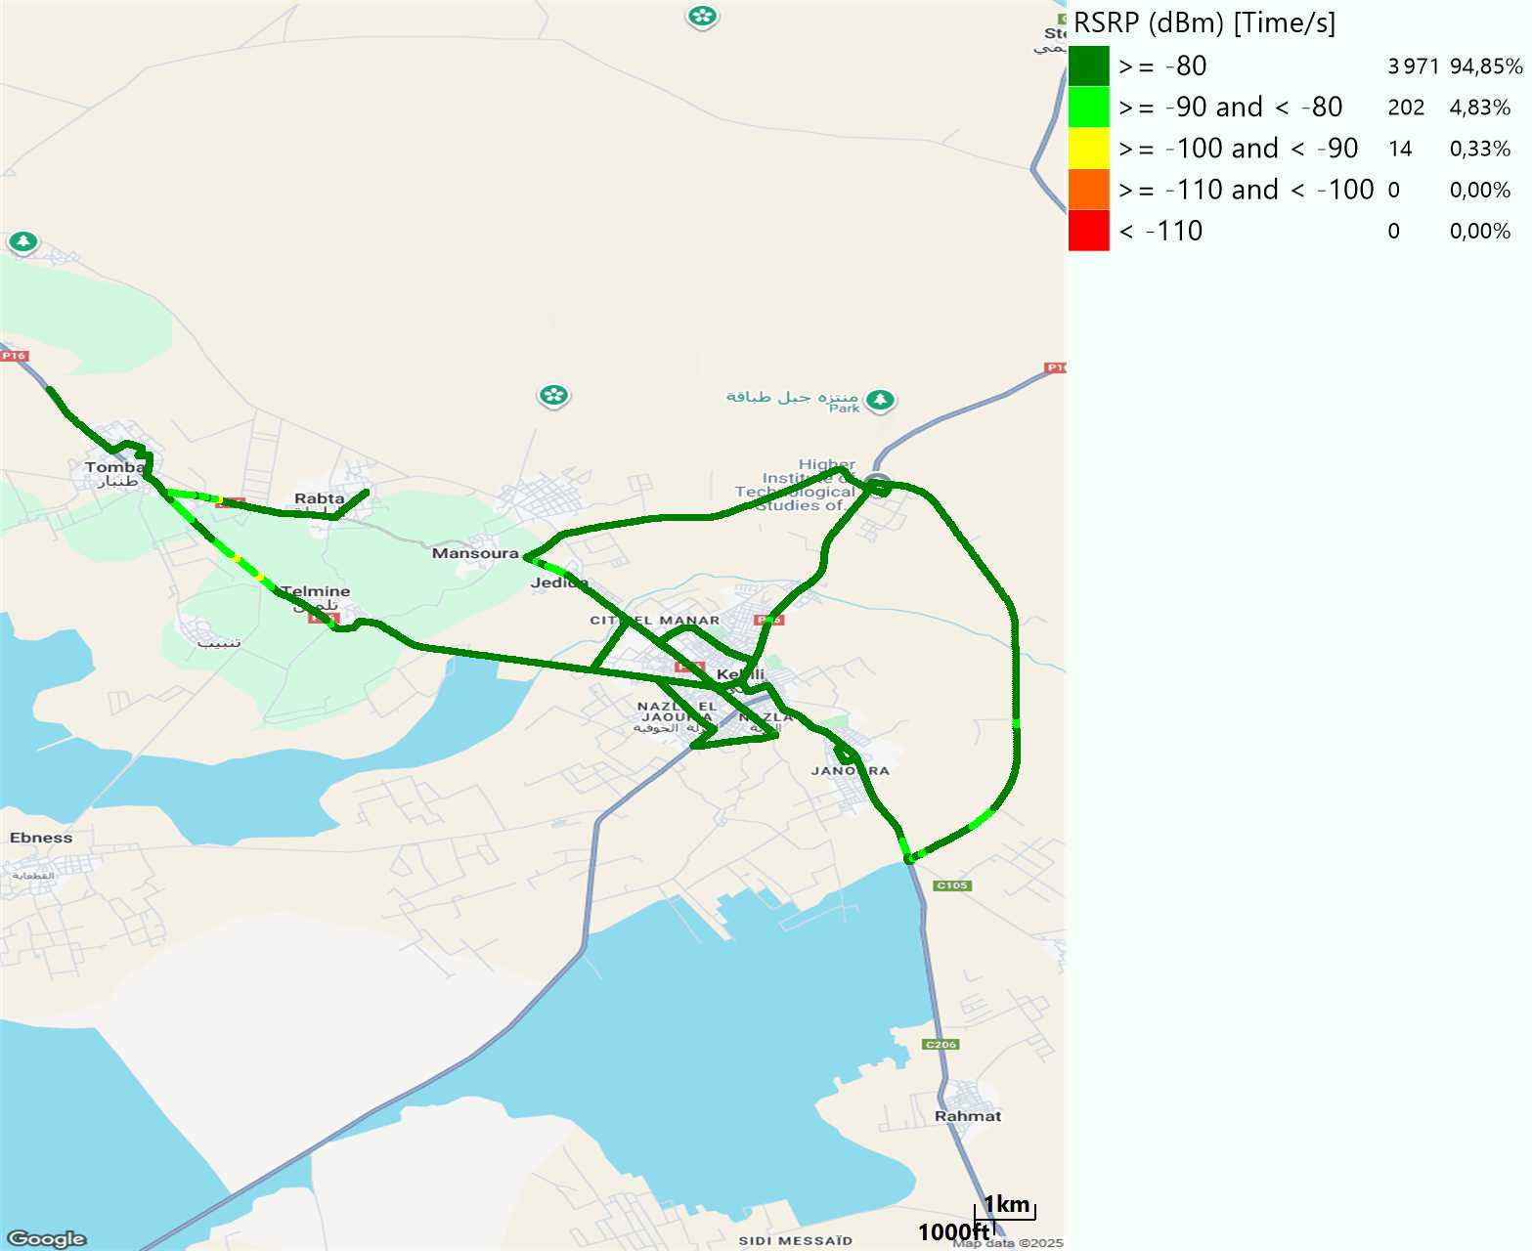
Scanner_RSRP
L800

Slide 22
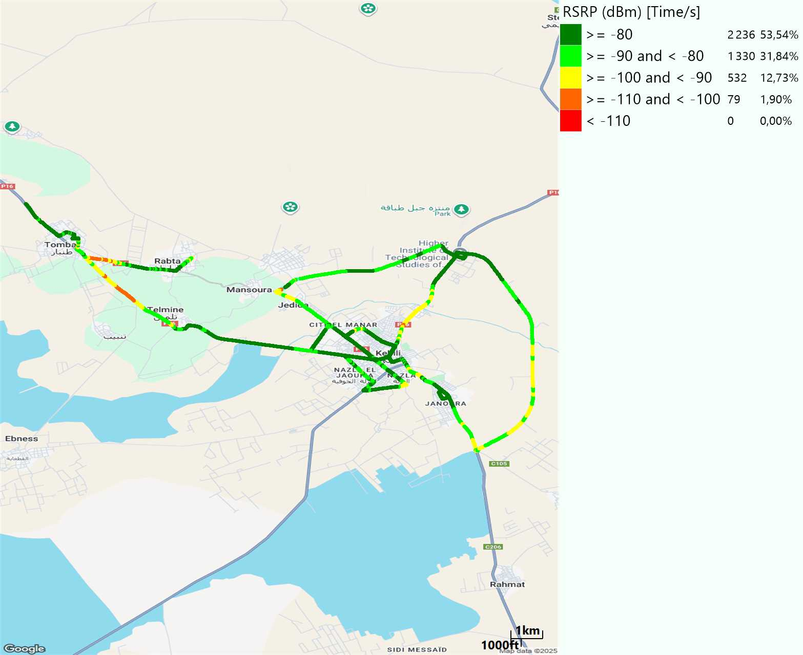
Scanner_RSRP
L1800

Slide 23
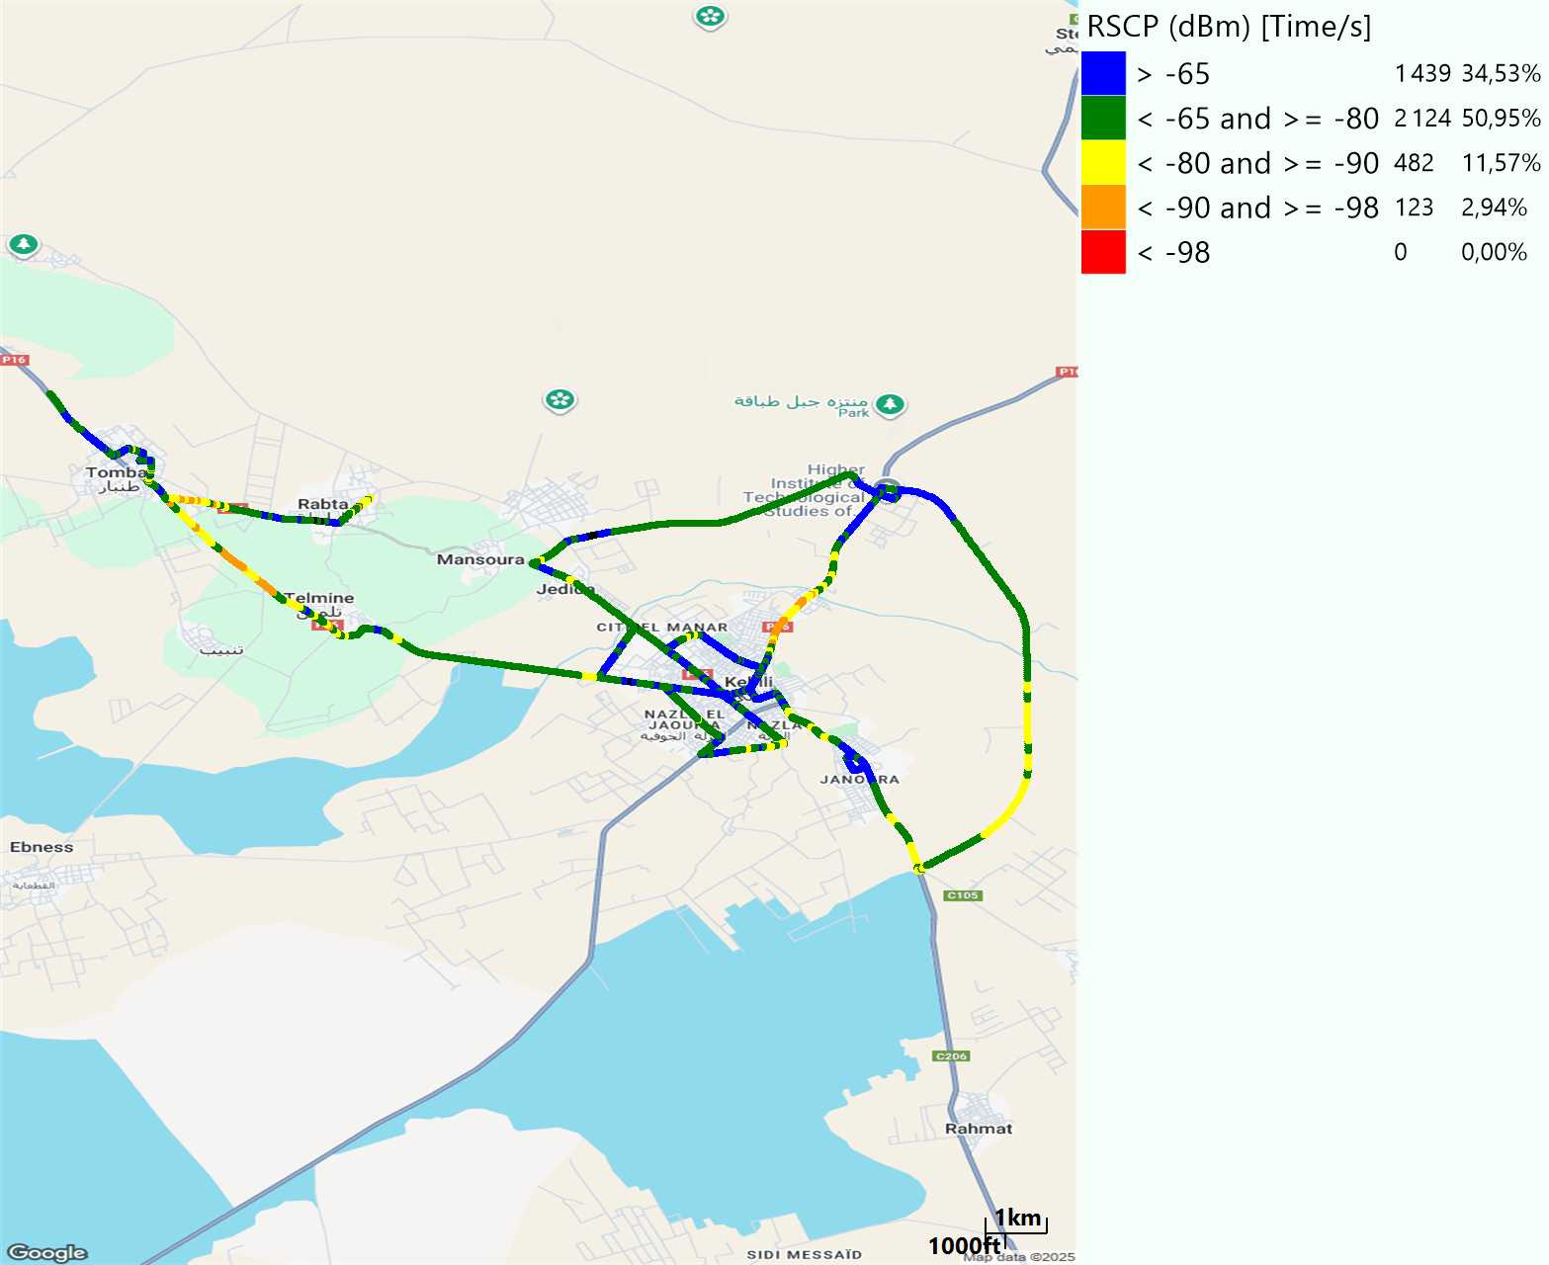
Scanner_RSCP
U2100

Slide 24
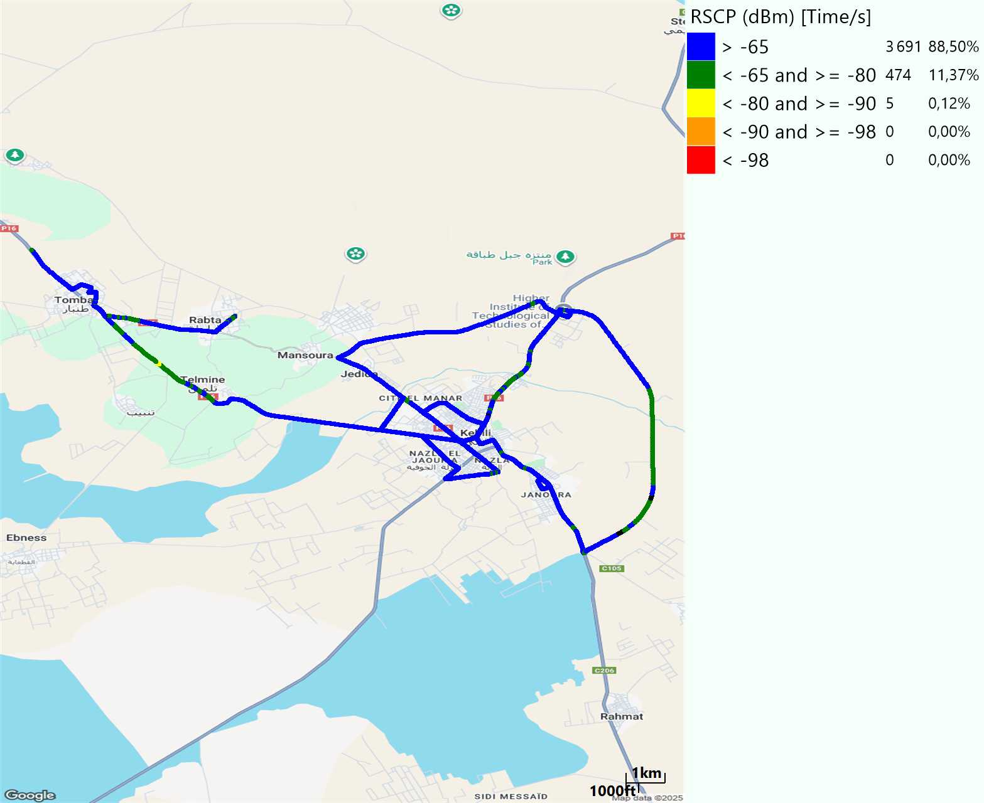
Scanner_RSCP
900

