Slide 1


Volte Drive Test Report

Slide 2
DT Scénario
Short Call (10s)
Long call (2min)
Scanner

Slide 3
Voice Call

Slide 4
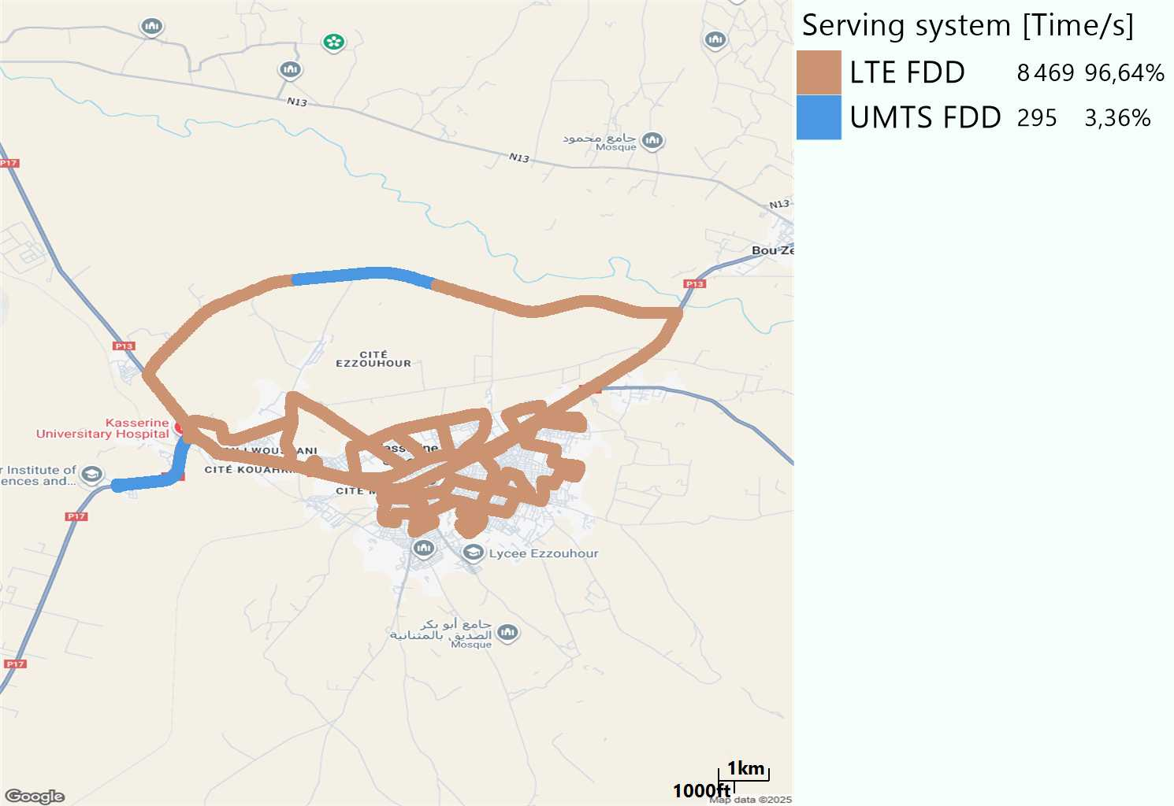
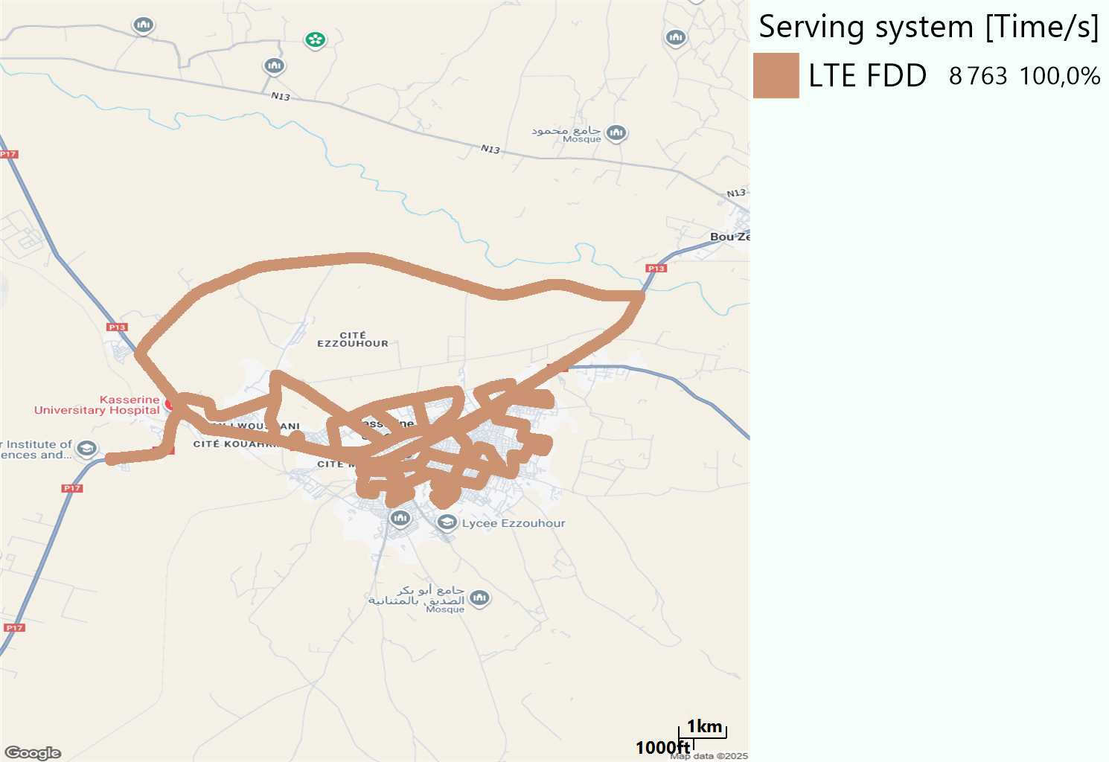
RAT distribution
Long call
Short call

Slide 5
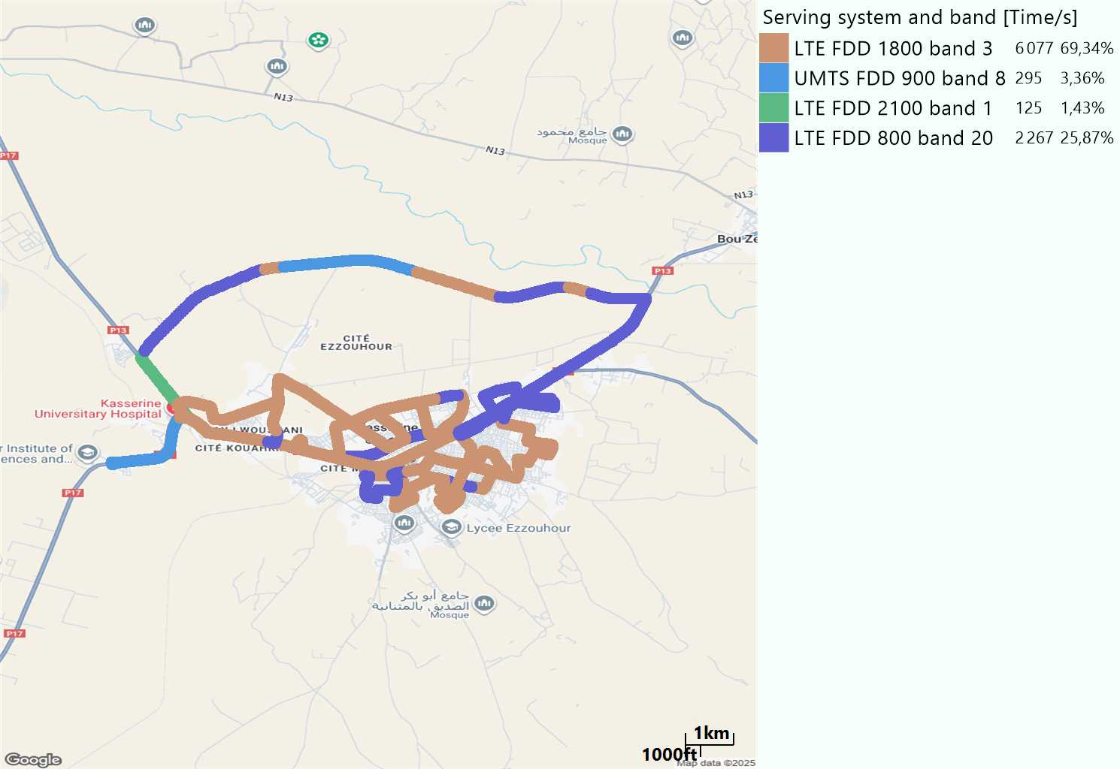
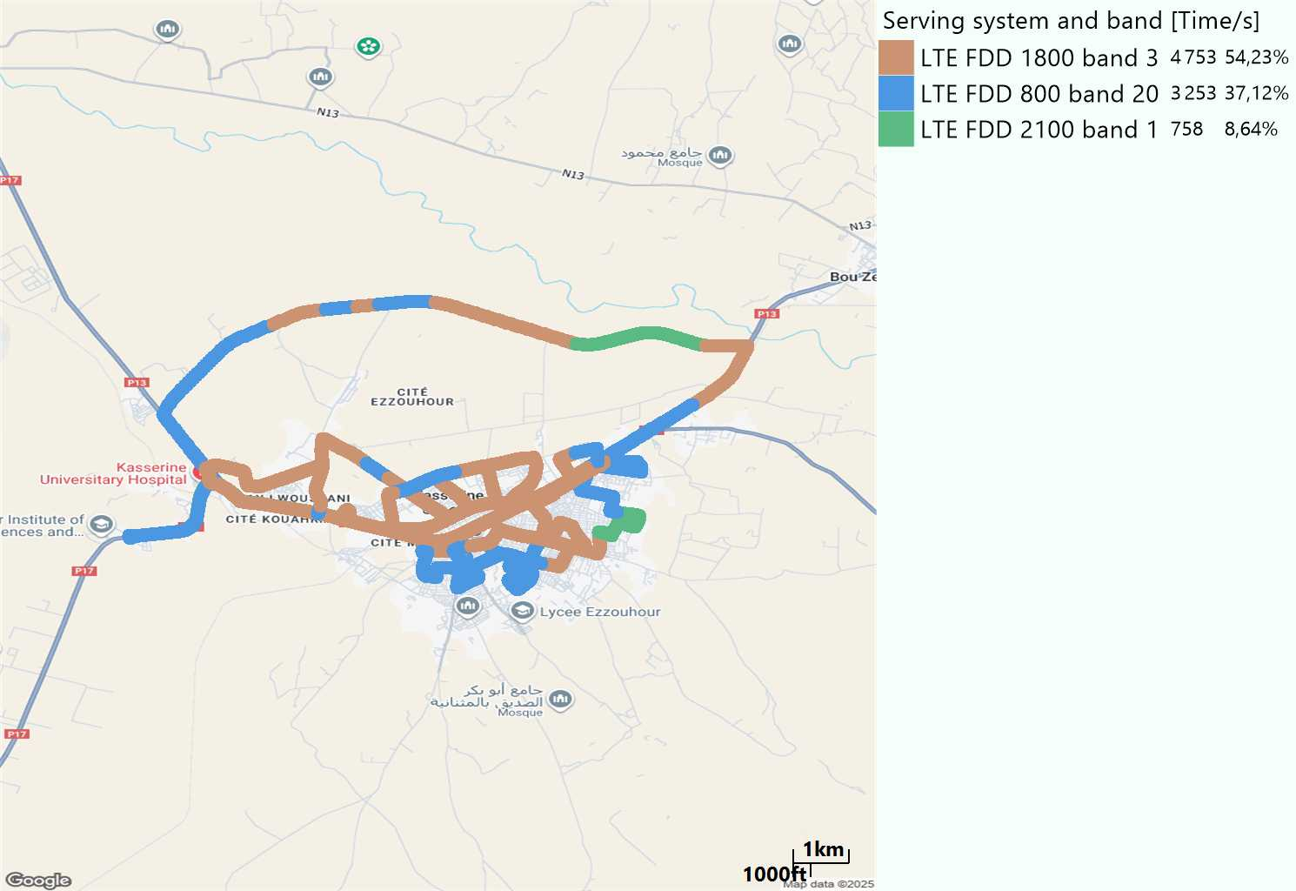
EARFCN distribution
Long call
Short call

Slide 6
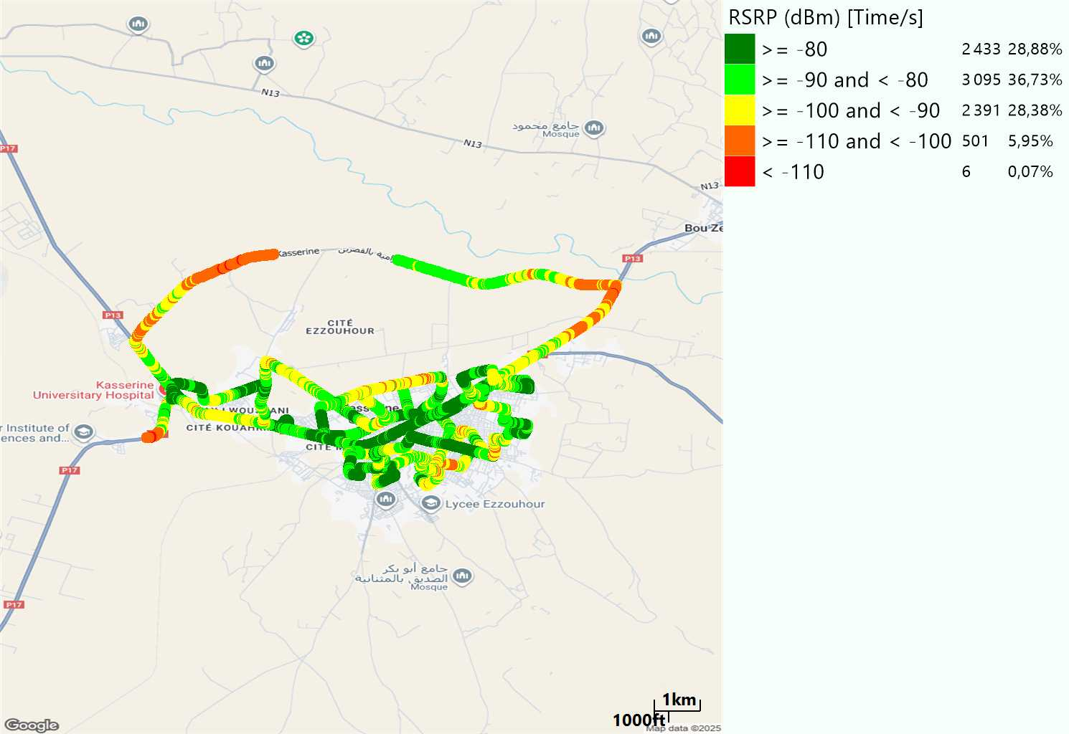

LTE - RSRP
Long call
Short call
Average [dBm]
-85,58
Average [dBm]
-86,14

Slide 7
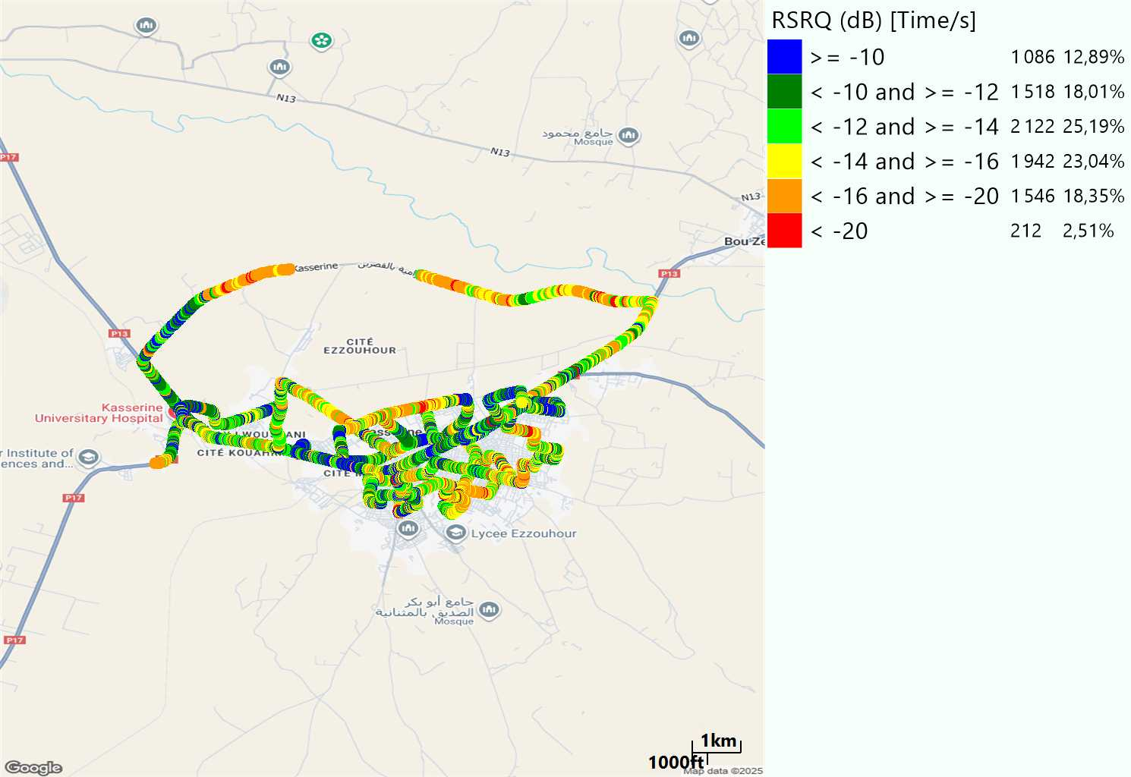

LTE- RSRQ
Long call
Short call

Slide 8
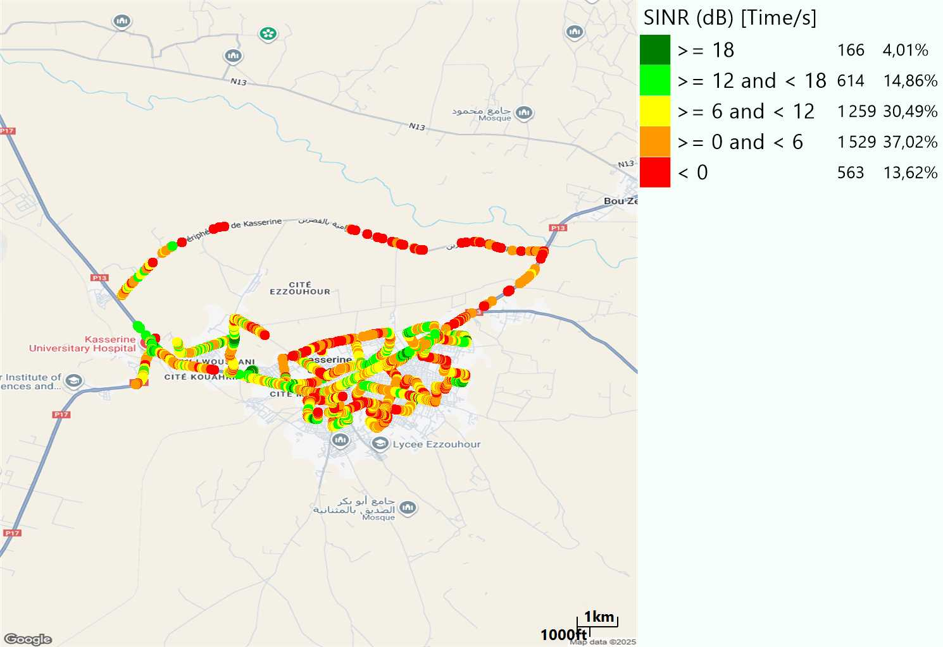
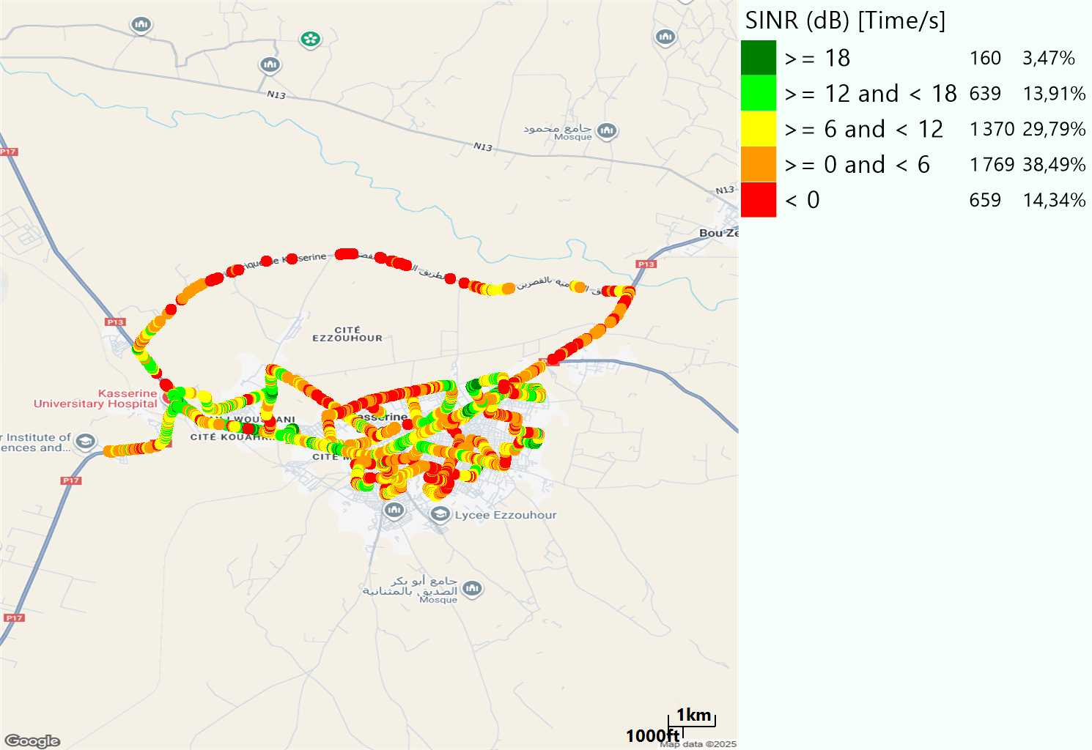
LTE-SINR
Long call
Short call

Slide 9
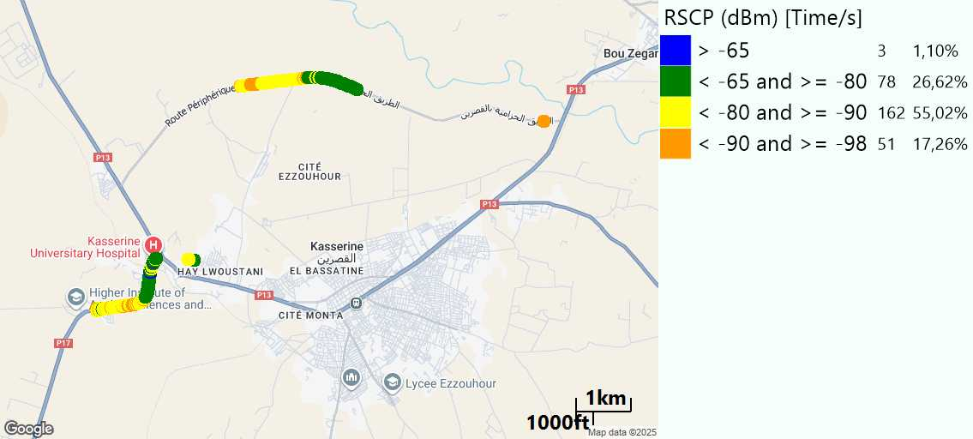
RSCP
Long call

Slide 10
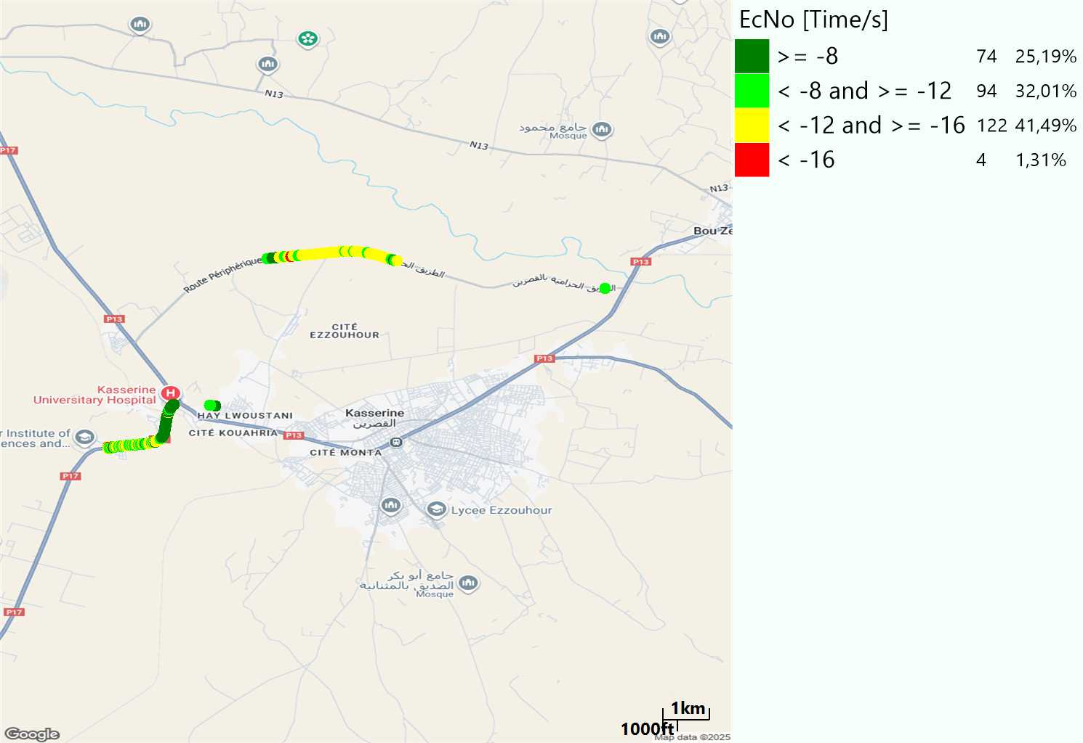
WCDMA-Ec/NO
Long call

Slide 11
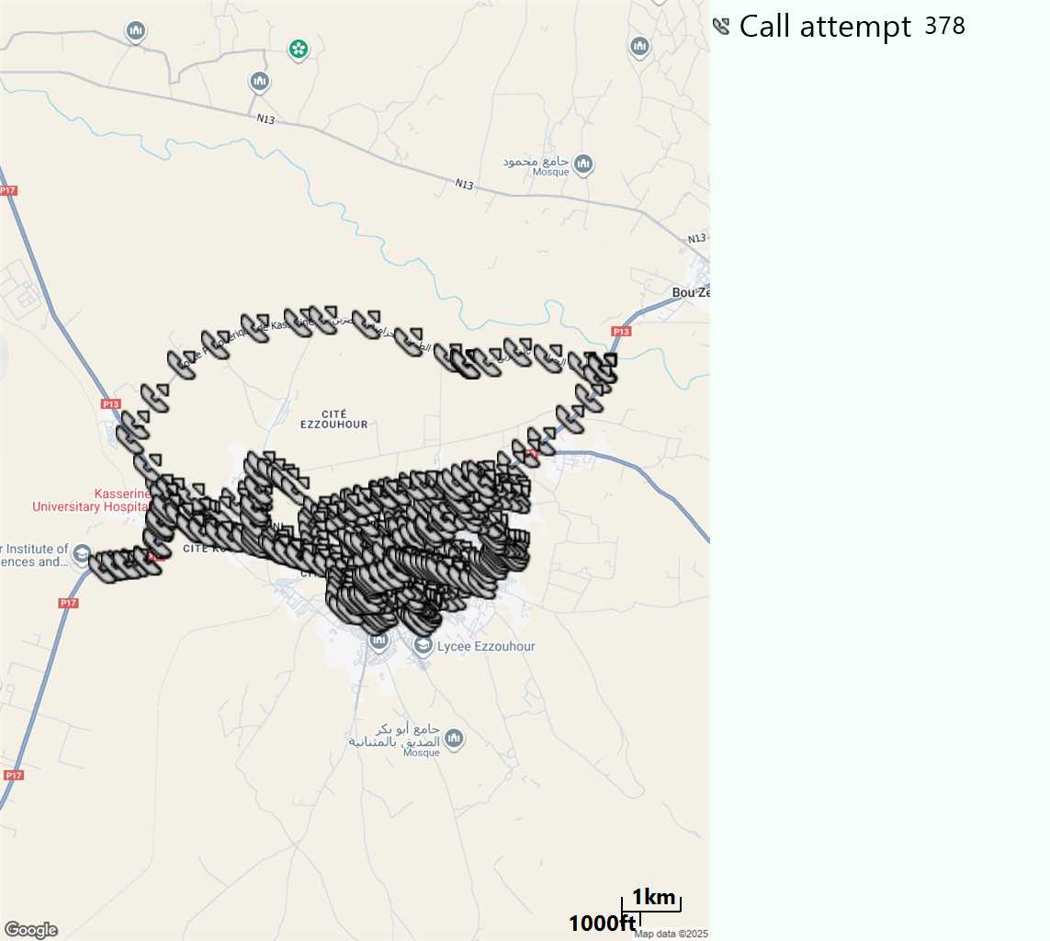
MO Call Setup Time (call setup time in VoLTE)
Short call
Call Setup Time IMS Voice
Average (Sec) | Maximum (Sec) | Minimum (Sec)
3,01 | 12,48 | 2

Slide 12
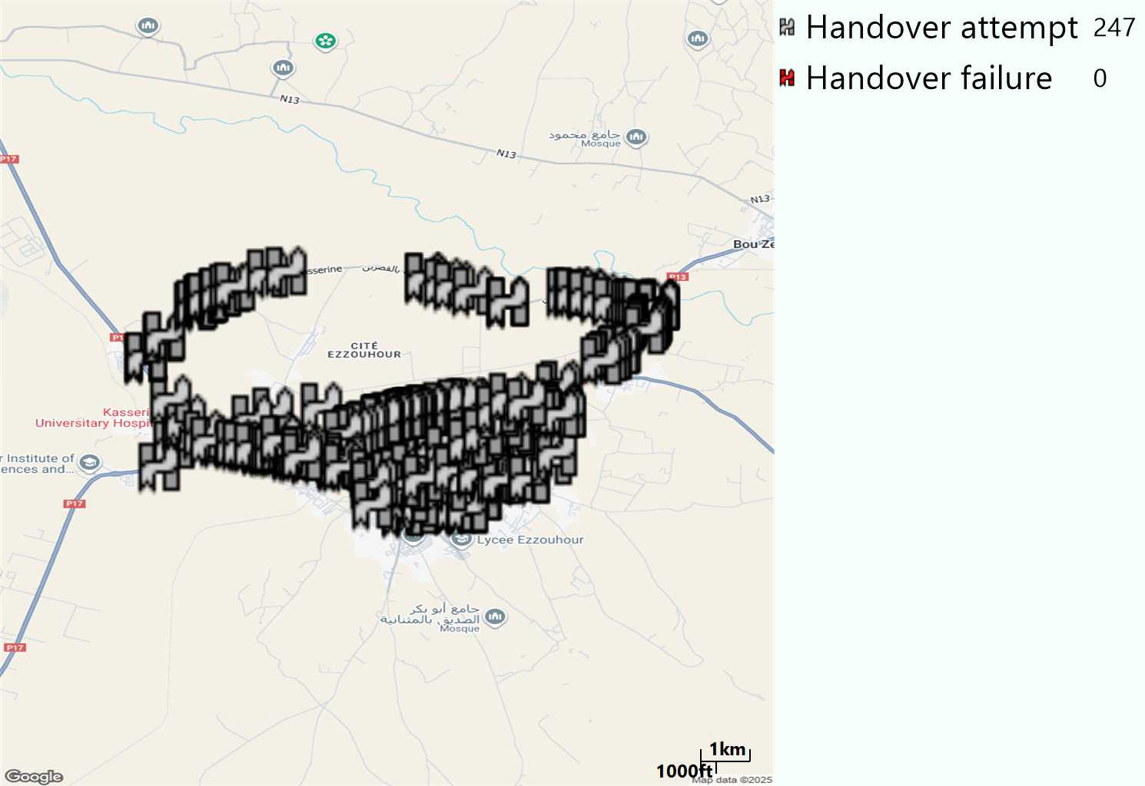
MO Handover Type
Long call
HO Type | Percentage [%]
LTE Inter-Frequency handover | 4,05%
LTE Intra-Frequency handover | 95,14%
UMTS to LTE | 0,81%
Handover KPI’s
Handover Attemps | 247
Handover Success | 247
Handover succès Rate | 100%
Étiquettes de lignes | LTE FDD_1800 | LTE FDD_2100 | LTE FDD_800 | Total général
LTE FDD_1800 | 148 |  | 5 | 153
LTE FDD_2100 | 1 | 3 |  | 4
LTE FDD_800 | 6 | 1 | 81 | 88
UMTS FDD_900 | 2 |  |  | 2
Total général | 157 | 4 | 86 | 247

Slide 13
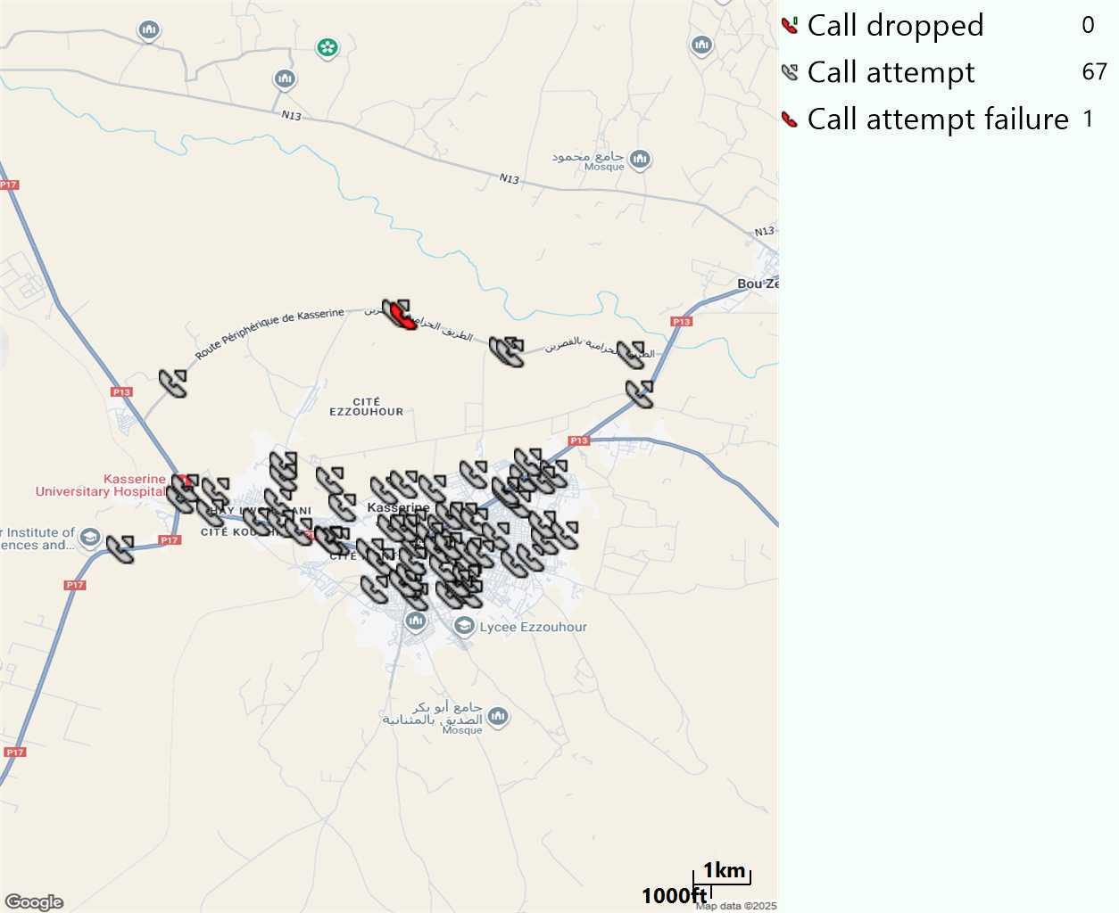
MO Voice Stats (VoLTE call stats)
Long call
Voice KPIs
Number Call Attempts | 67
Number Dropped Calls | 0
Call Drop Rate (%) | 0%
HO success rate | 100%

Slide 14
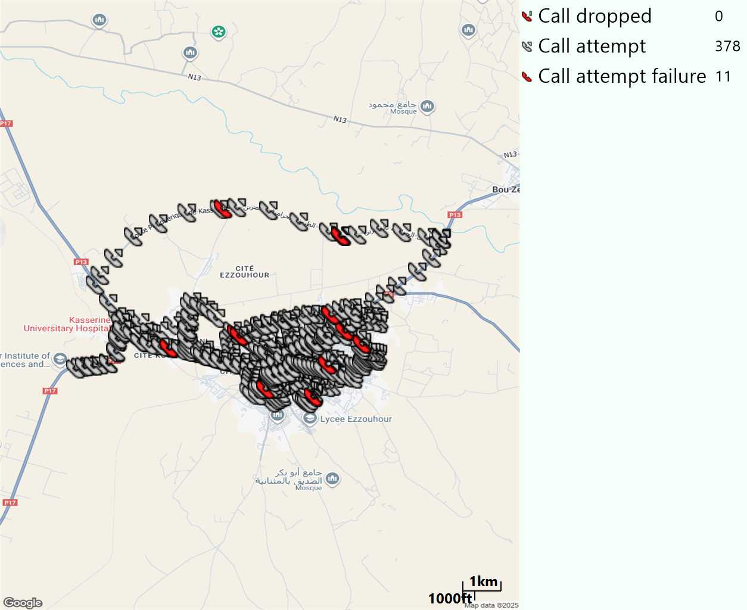
MO Voice Stats (VoLTE call stats)
Short call
Voice KPIs
Number Call Attempts | 378
Number Call Setup | 367
Number Blocked Calls | 11
Setup Succes Rate (%) | 97,08%
Call Block Rate (%) | 2,91%
Call Setup Time IMS Voice Average (Sec) | 3,01

Slide 15
MO Voice Stats (VoLTE call stats)
KPIs
VoLTE Call Setup SR | 97,08%
Call Setup Time | 3,01
VoLTE Drop Call Rate | 0%
Speech Quality - MOS (% of the samples >3) | 89,68%
Average MOS | 4,13
VoLTE Handover SR | 100%
VoLTE SRVCC SR | 100%

Slide 16
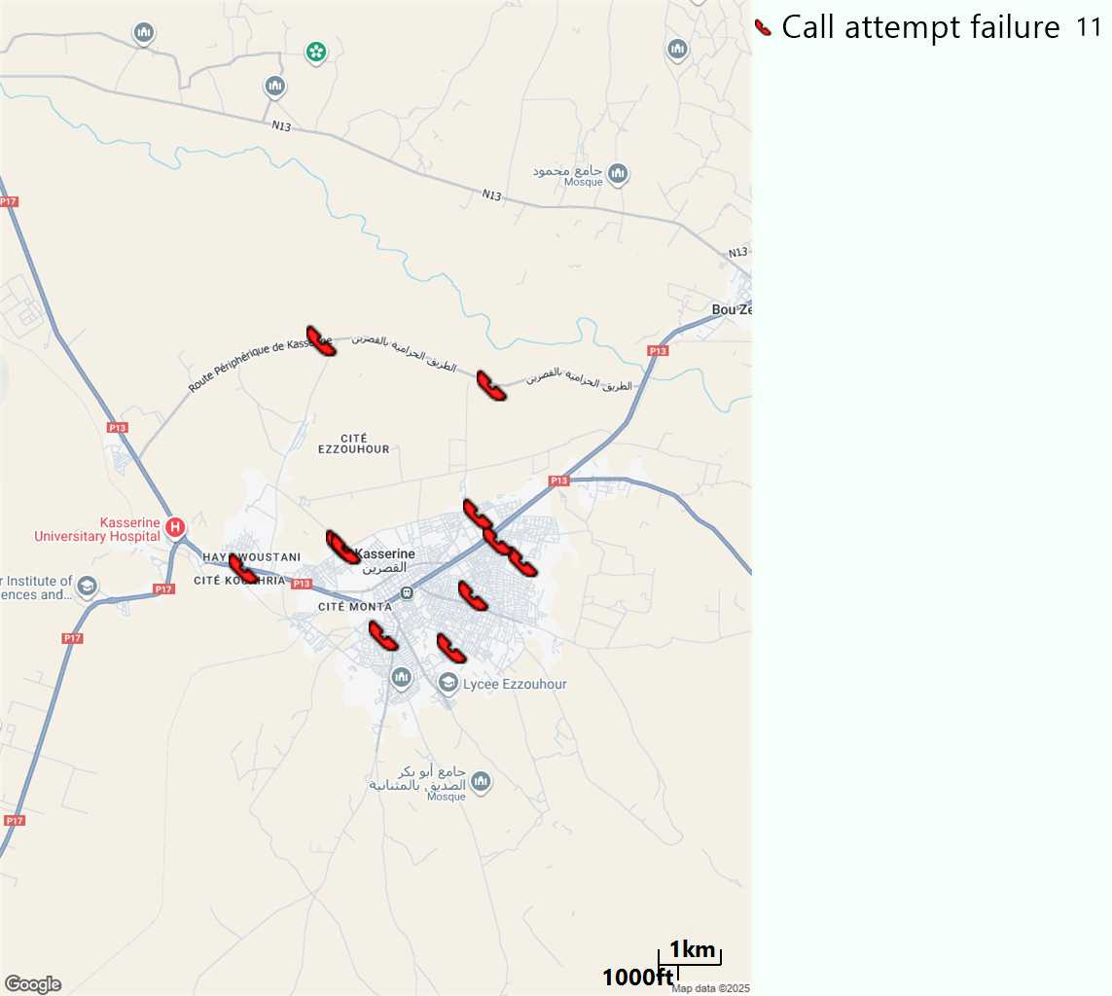
MO Voice Call - Blocked call
Short call

Slide 17
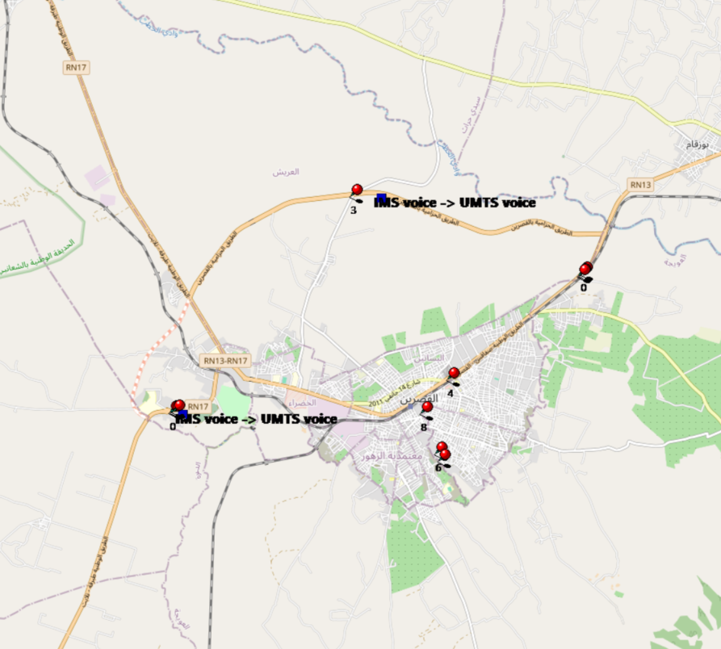
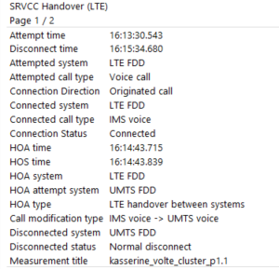
VoLTE SRVCC Success Rate long Call
Attempted system | Attempted call type | Connection Direction | Connected system | Connected call type | Connection Status | HOA time | HOS time | HOA system | HOA attempt system | HOA type | Call modification type | Disconnected system | Disconnected status | Measurement title
LTE FDD | Voice call | Originated call | LTE FDD | IMS voice | Connected | 14:43,7 | 14:43,8 | LTE FDD | UMTS FDD | LTE handover between systems | IMS voice -> UMTS voice | UMTS FDD | Normal disconnect | kasserine_volte_cluster_p1.1
LTE FDD | Voice call | Originated call | LTE FDD | IMS voice | Connected | 22:26,8 | 22:26,9 | LTE FDD | UMTS FDD | LTE handover between systems | IMS voice -> UMTS voice | UMTS FDD | Normal disconnect | kasserine_volte_cluster_p1.1

Slide 18
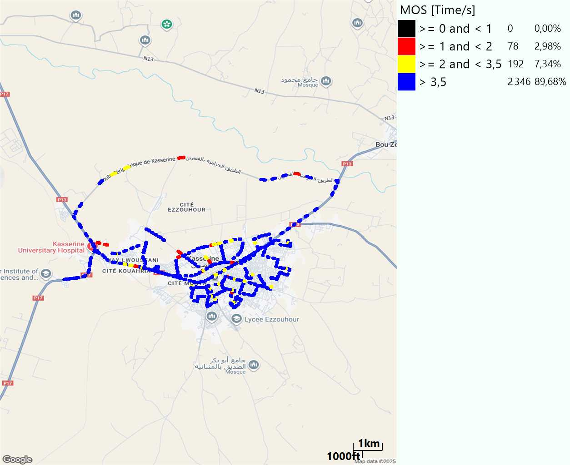
MO Voice Quality Metrics
long Call

Slide 19
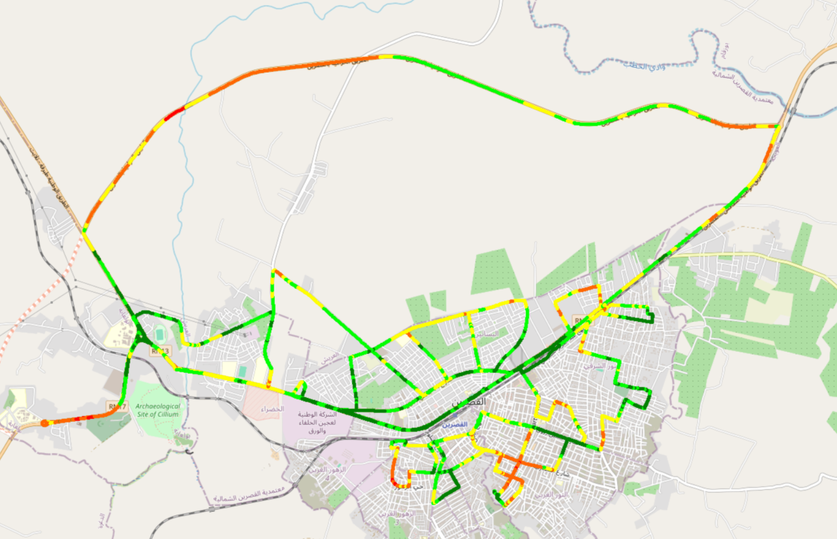
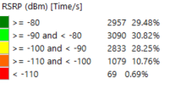
Scanner_RSRP
L2100

Slide 20
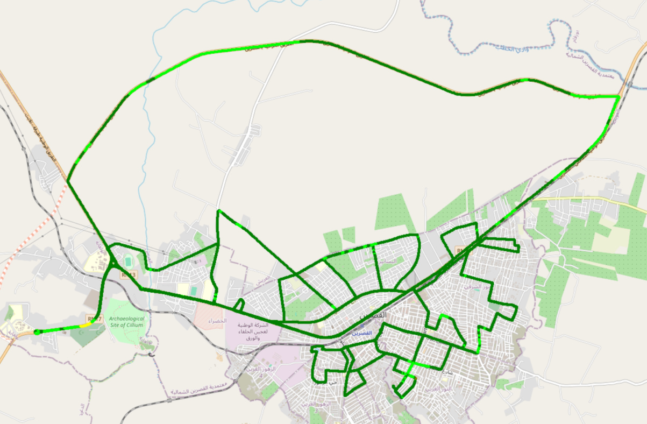
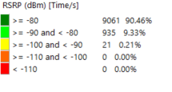
Scanner_RSRP
L800

Slide 21
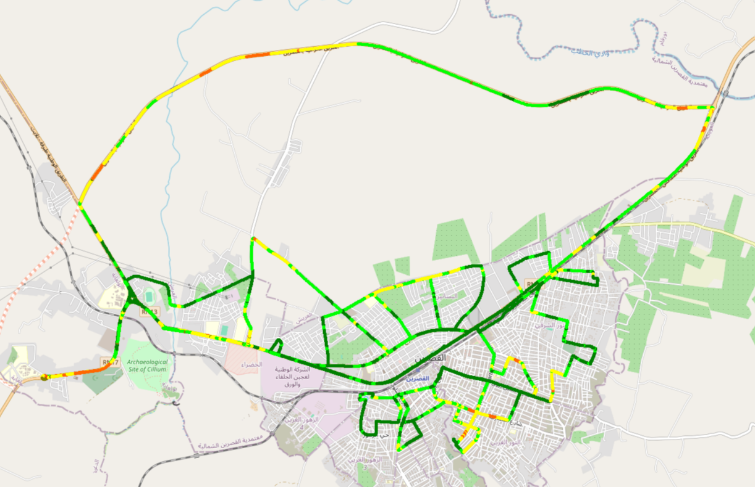
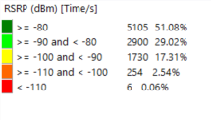
Scanner_RSRP
L1800

Slide 22
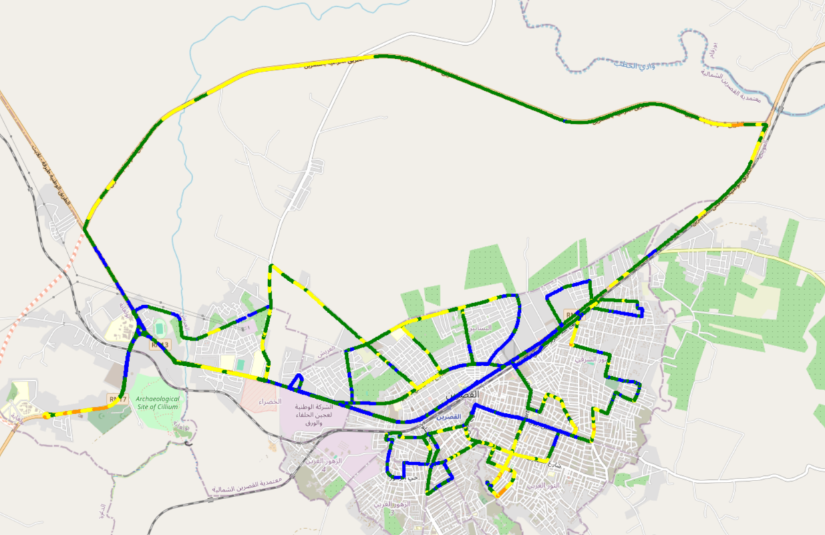
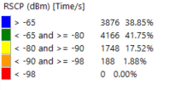
Scanner_RSCP
U2100

Slide 23
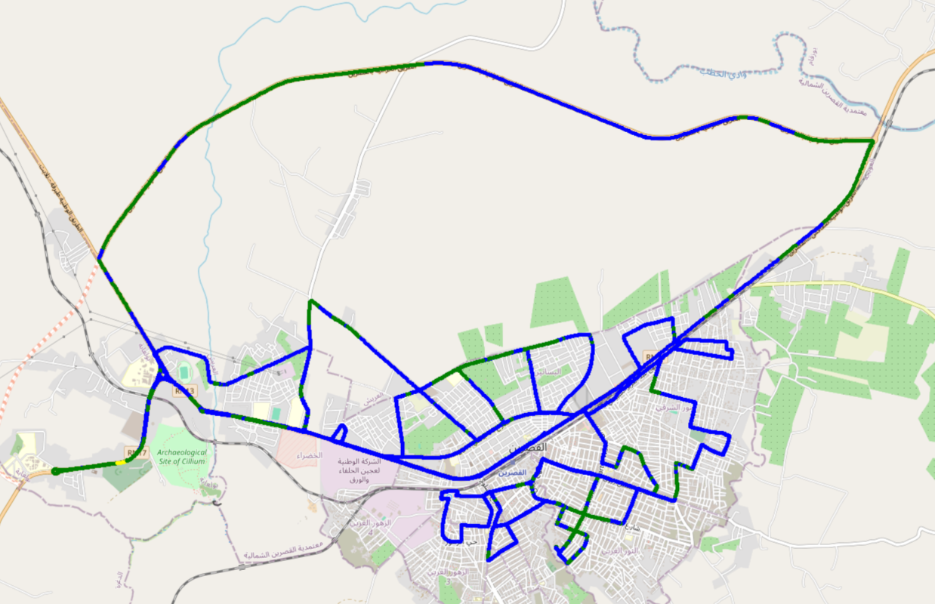
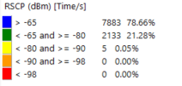
Scanner_RSCP
900

