Slide 1


Volte Drive Test Report

Slide 2
DT Scénario
Short Call (10s)
Long call (2min)
Scanner

Slide 3
Voice Call

Slide 4
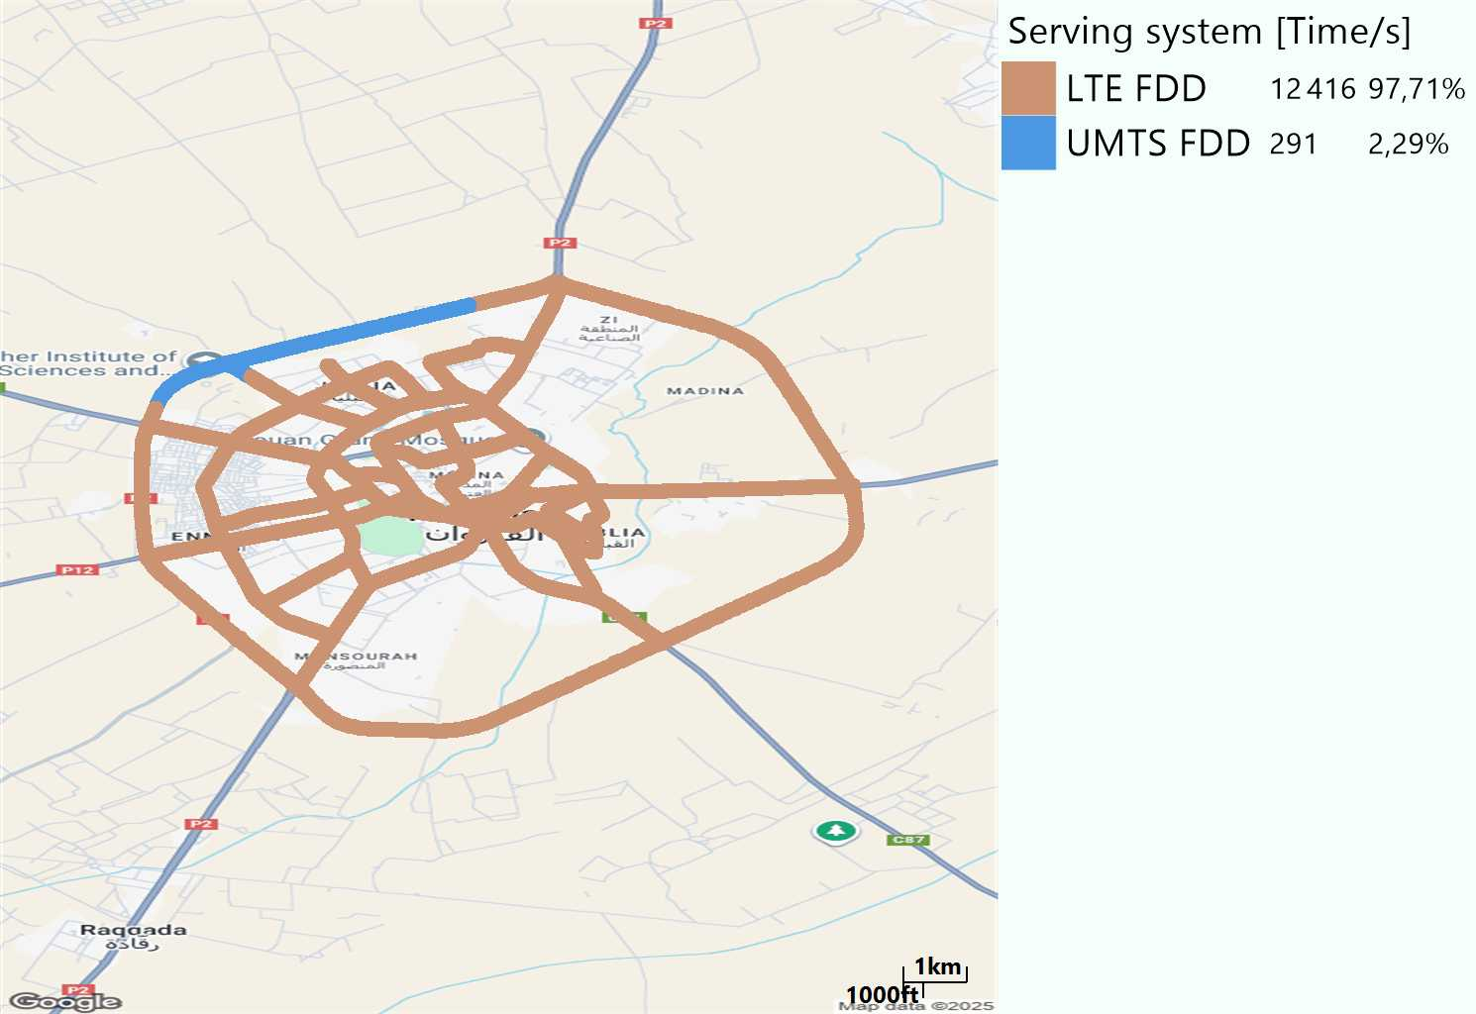
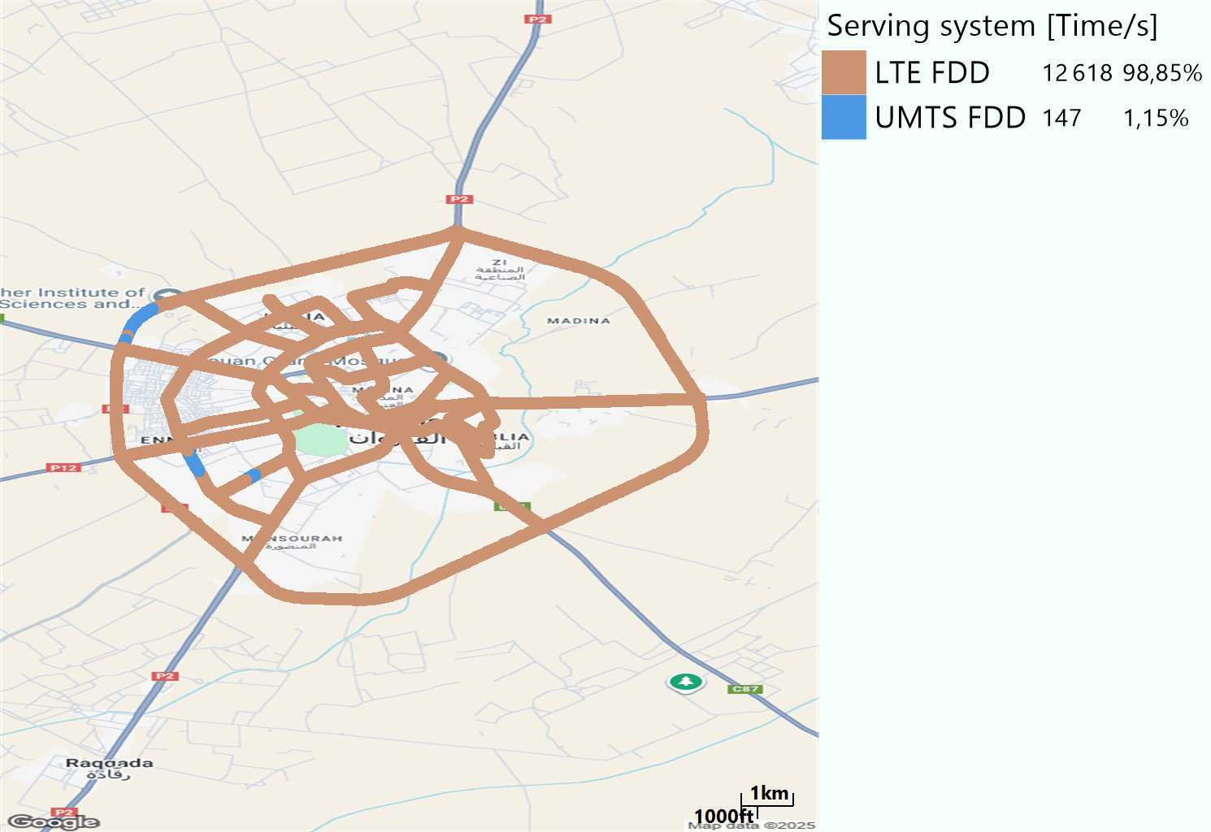
RAT distribution
Long call
Short call

Slide 5
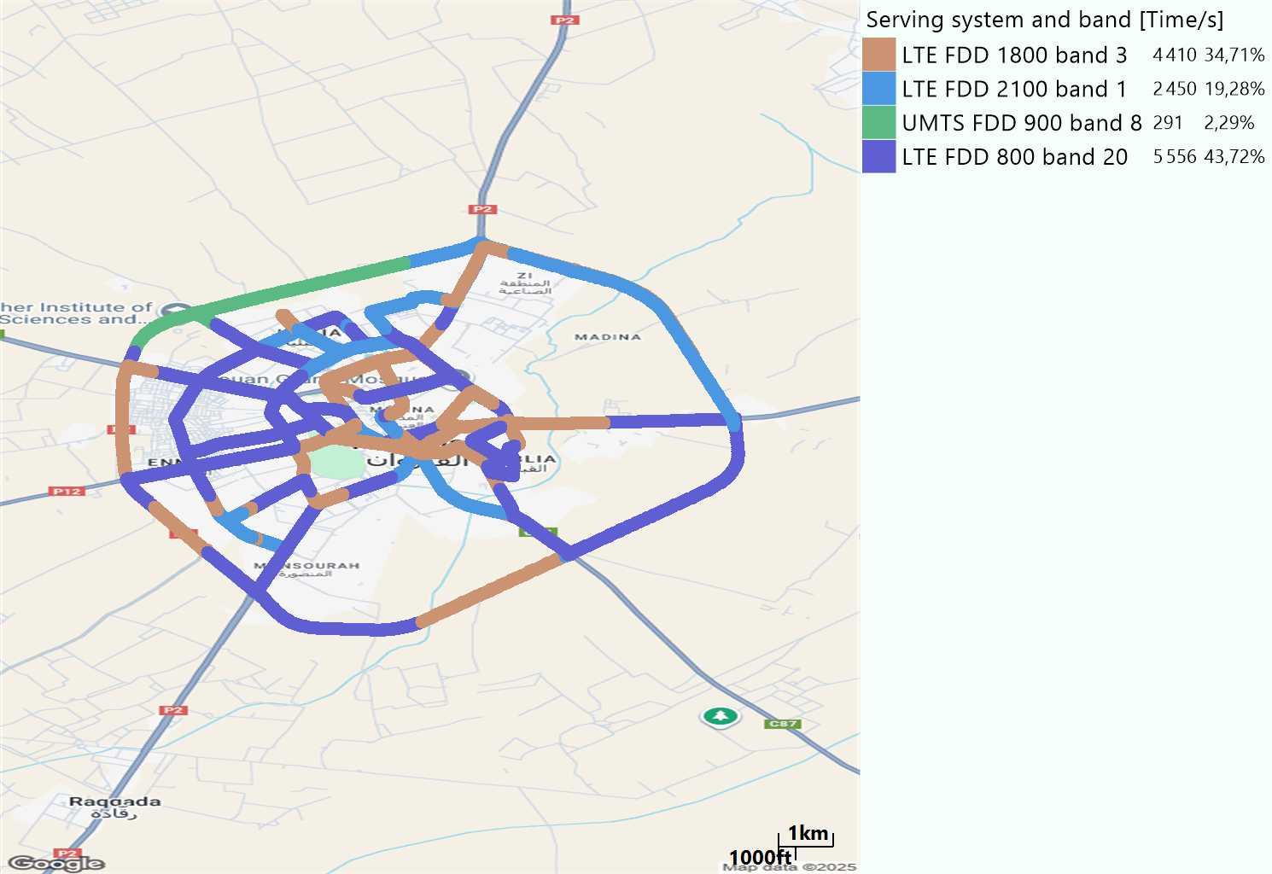
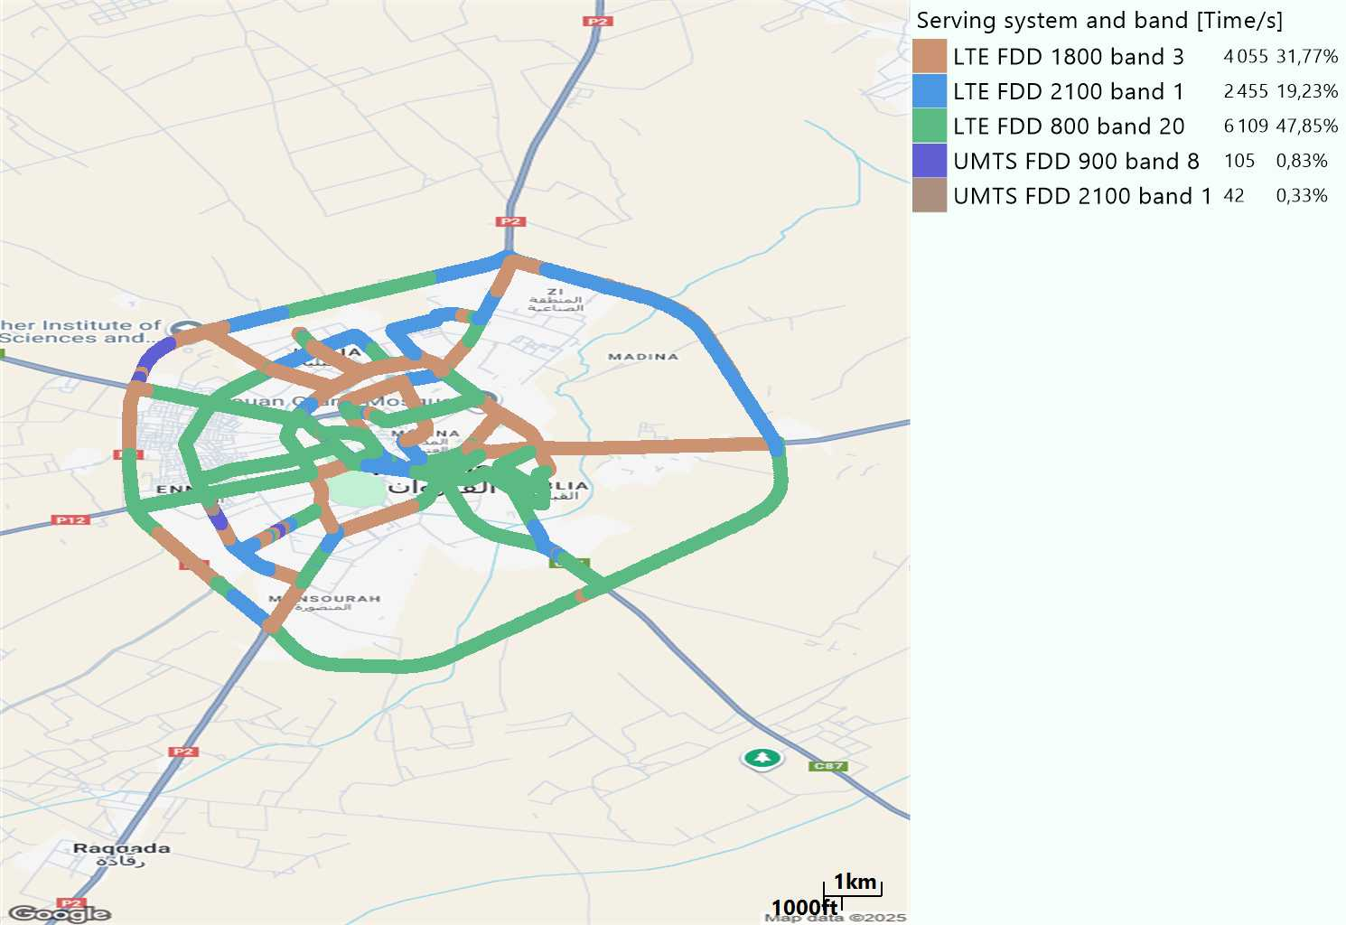
EARFCN distribution
Long call
Short call

Slide 6
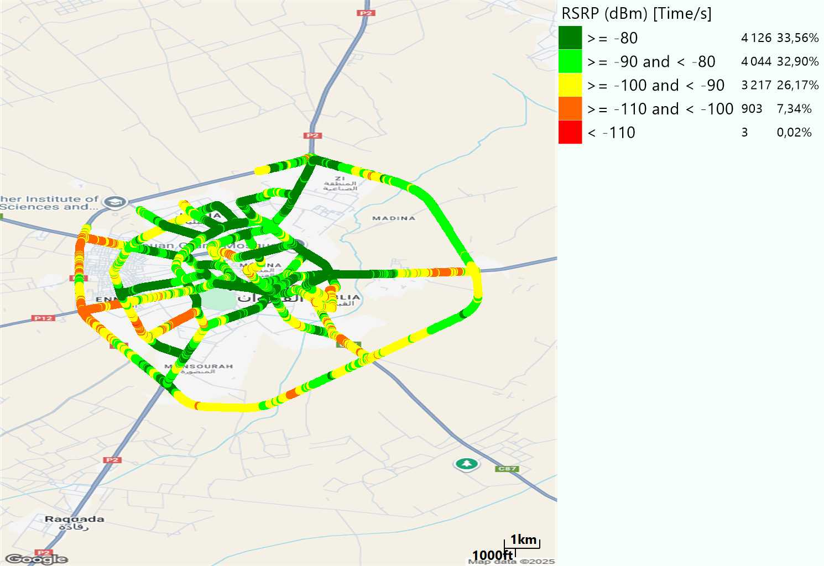
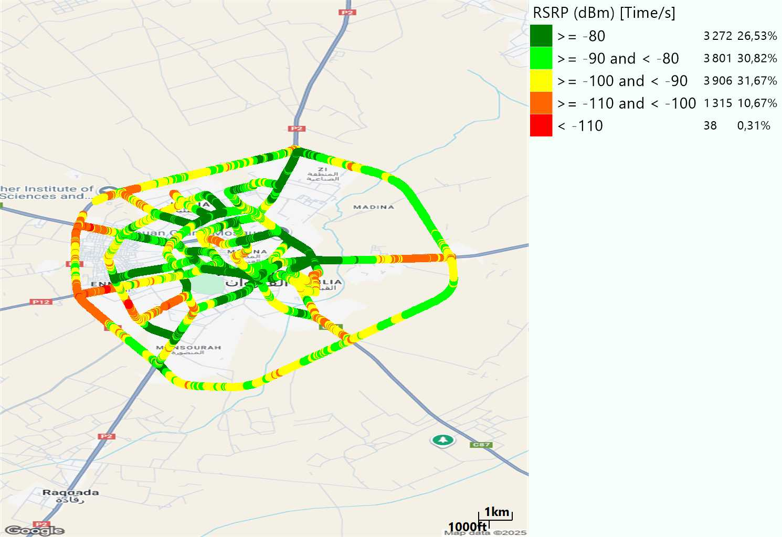
LTE - RSRP
Long call
Short call
Average [dBm]
-84,71
Average [dBm]
-87,27

Slide 7
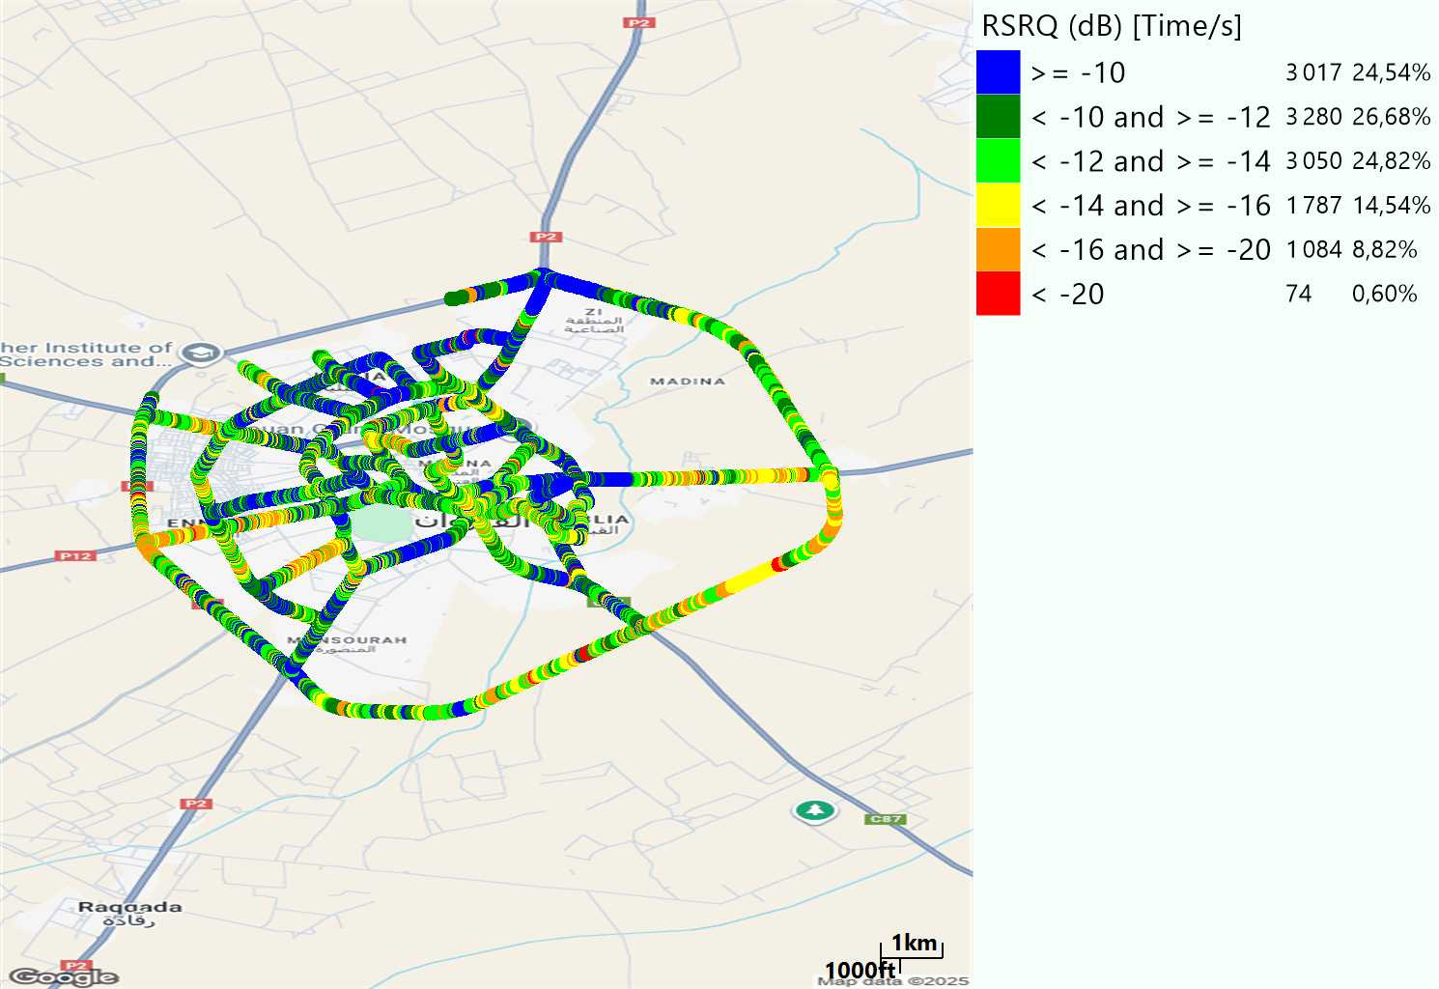
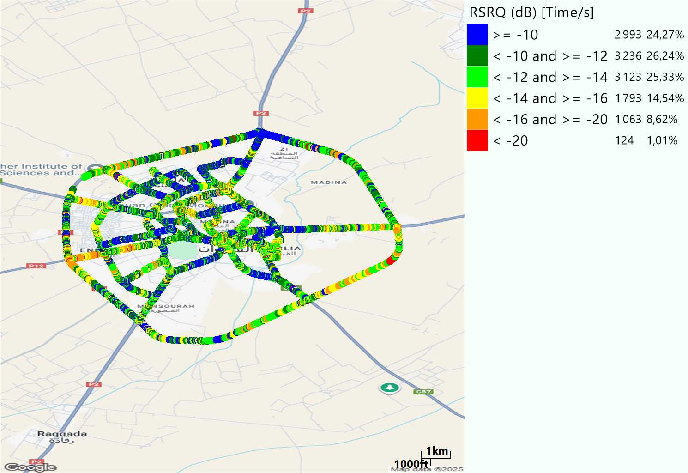
LTE- RSRQ
Long call
Short call

Slide 8
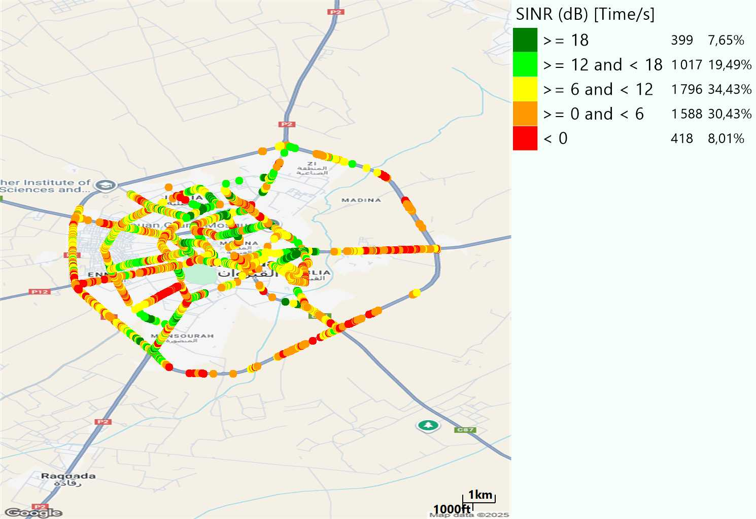
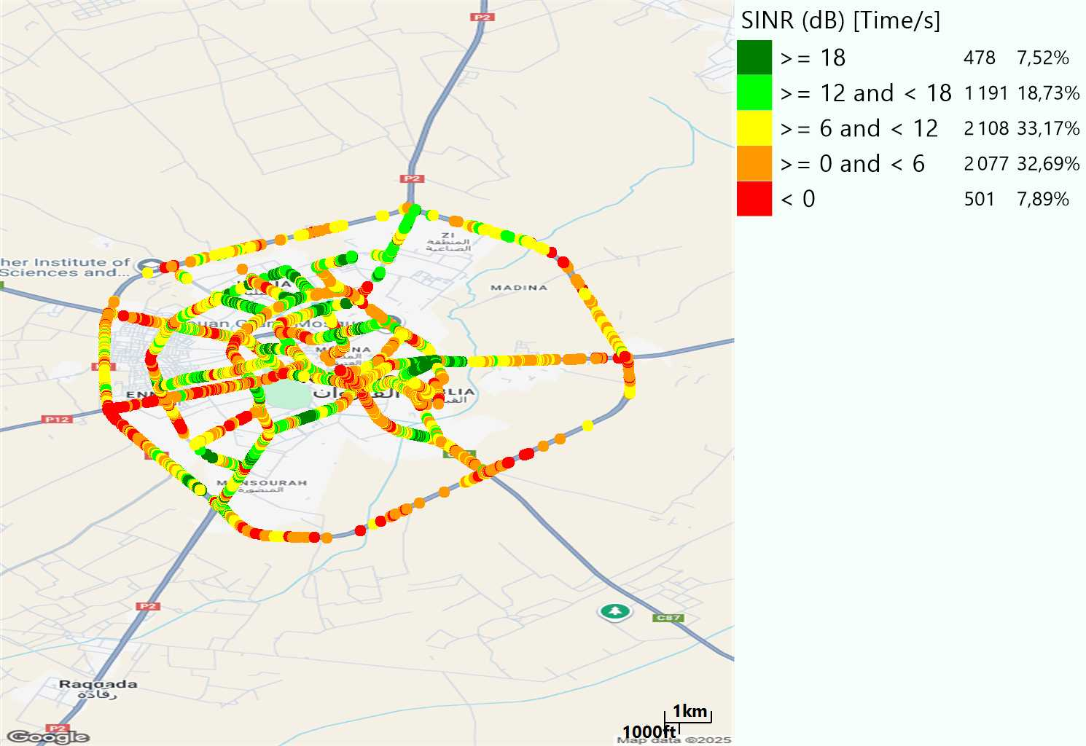
LTE-SINR
Long call
Short call

Slide 9
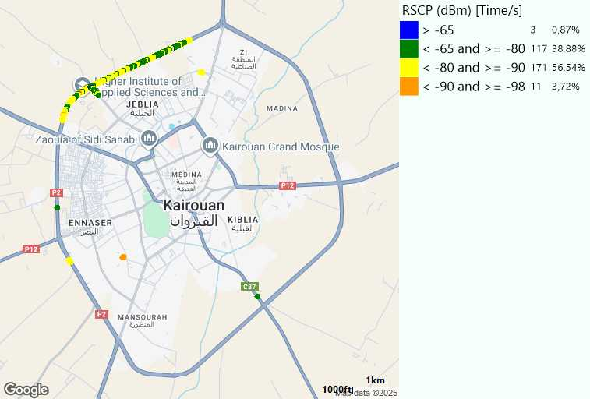
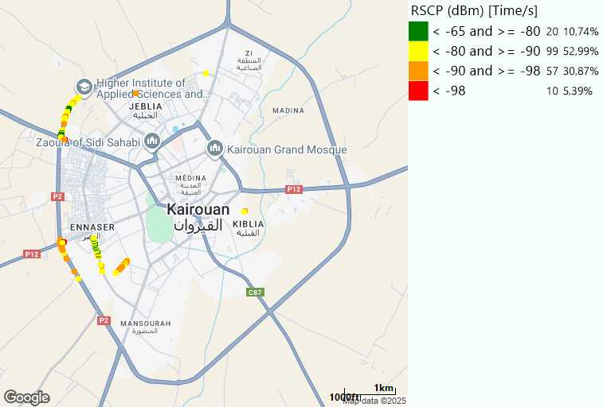
RSCP
Long call
Short call

Slide 10
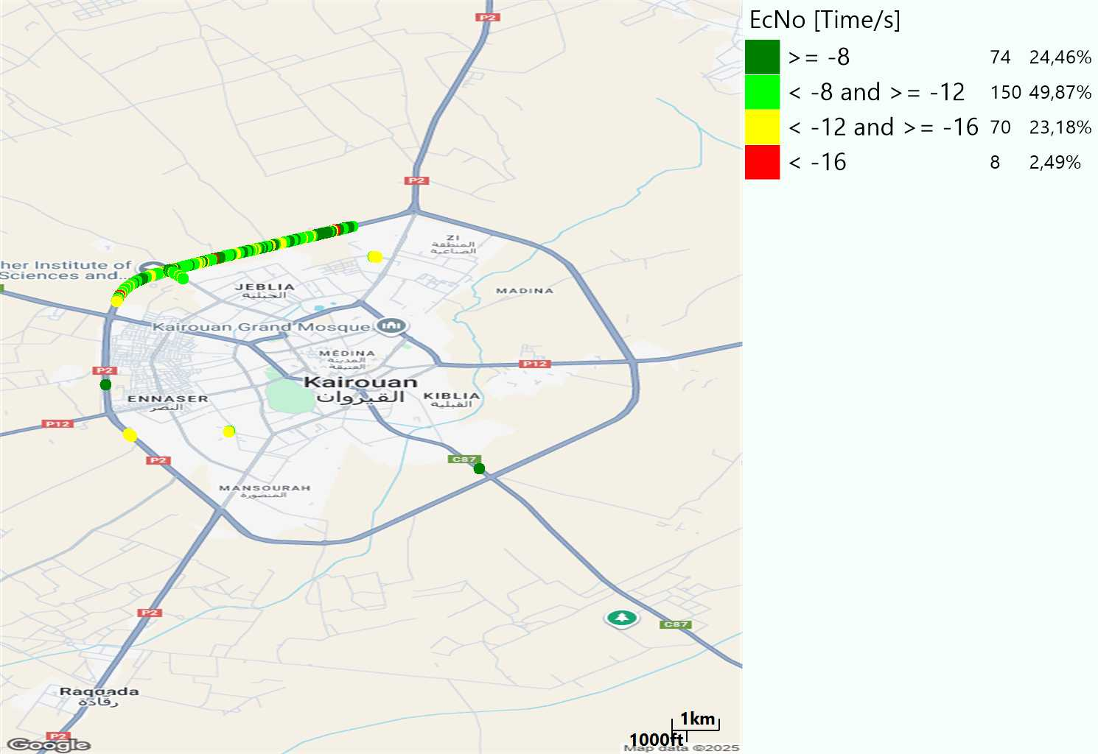
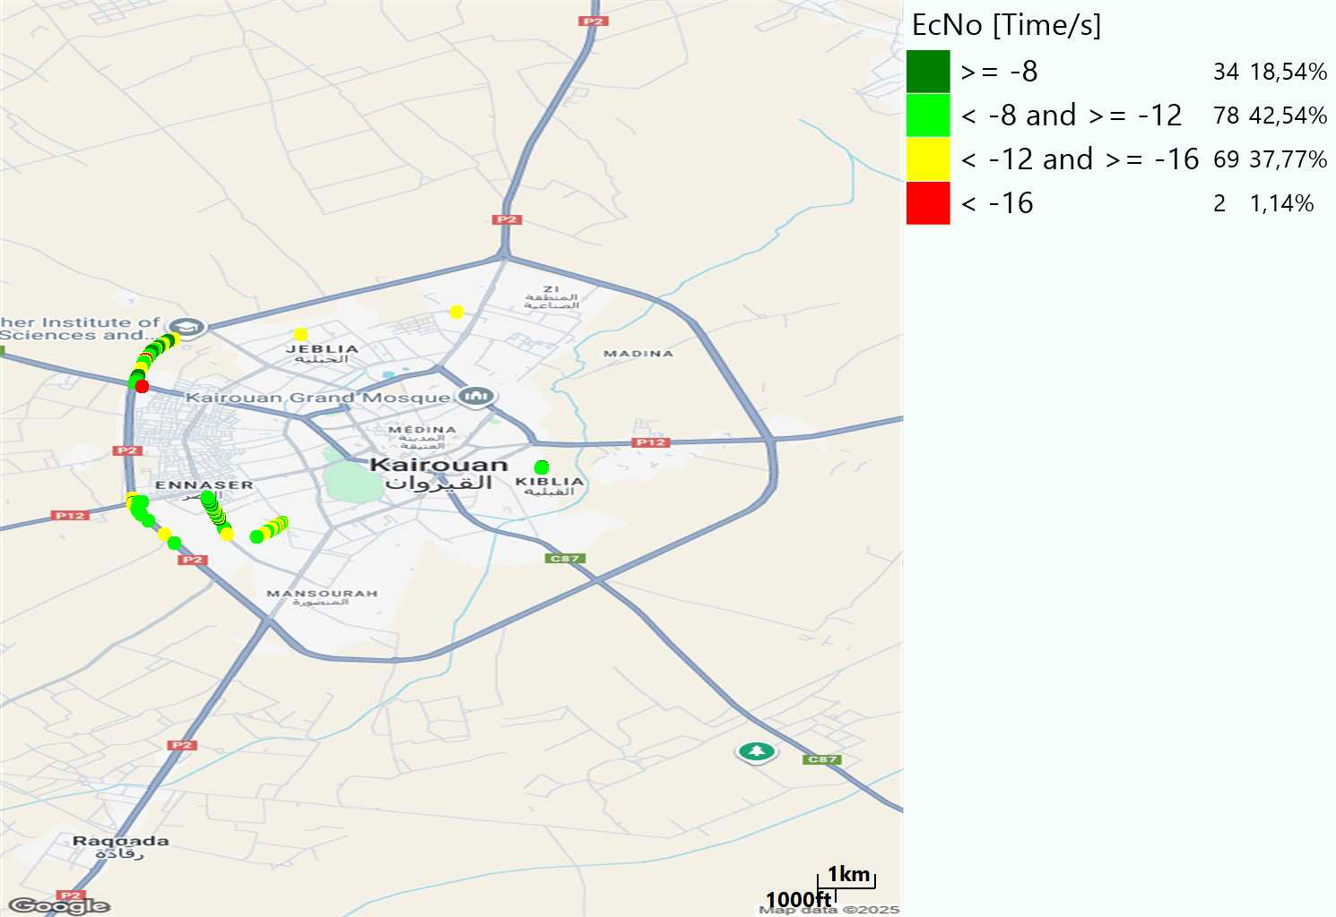
WCDMA-Ec/NO
Long call
Short call

Slide 11
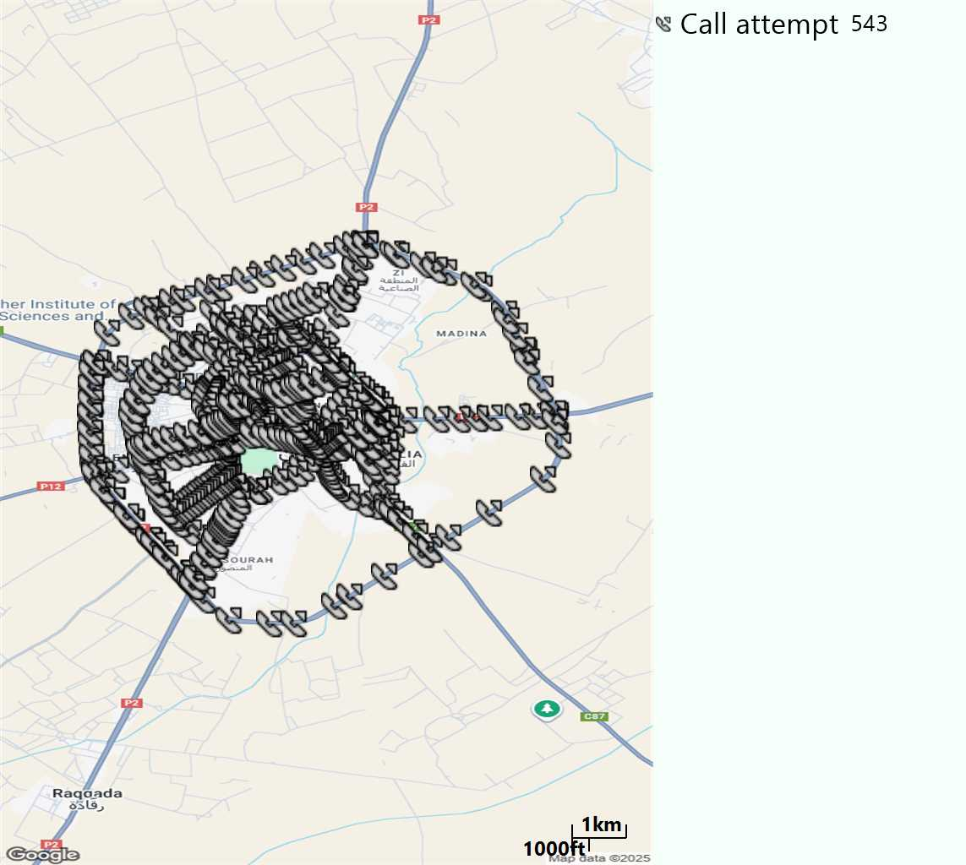
MO Call Setup Time (call setup time in VoLTE)
Short call
Call Setup Time IMS Voice
Average (Sec) | Maximum (Sec) | Minimum (Sec)
2,92 | 24,25 | 1,85

Slide 12
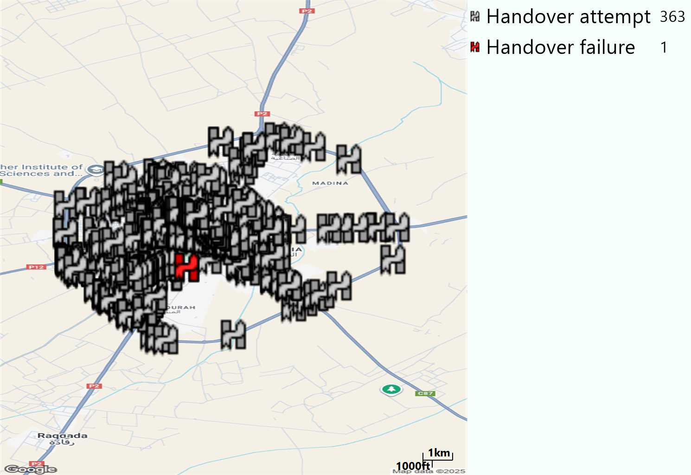
MO Handover Type
Long call
HO Type | Percentage [%]
LTE Inter-Frequency handover | 10,19%
LTE Intra-Frequency handover | 89,26%
UMTS to LTE | 0,55%
Handover KPI’s
Handover Attemps | 363
Handover Success | 362
Handover succès Rate | 99,72%
Étiquettes de lignes | LTE FDD_1800 | LTE FDD_2100 | LTE FDD_800 | Total général
LTE FDD_1800 | 126 | 7 | 4 | 137
LTE FDD_2100 | 12 | 45 | 7 | 64
LTE FDD_800 | 5 | 3 | 152 | 160
UMTS FDD_900 |  | 2 |  | 2
Total général | 143 | 57 | 163 | 363

Slide 13
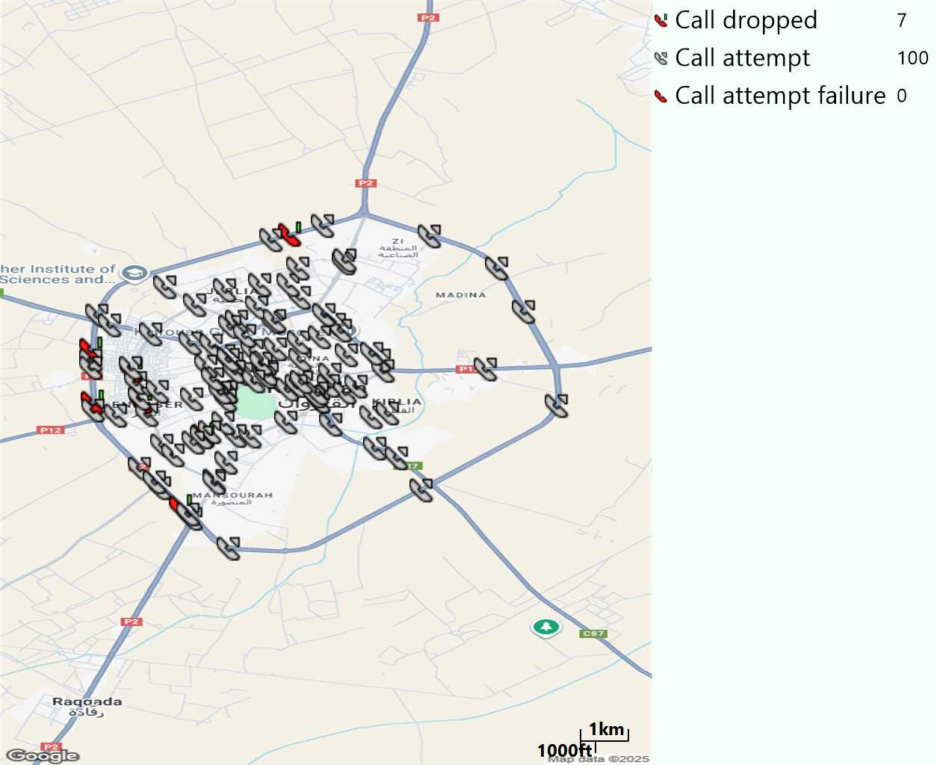
MO Voice Stats (VoLTE call stats)
Long call
Voice KPIs
Number Call Attempts | 100
Number Dropped Calls | 7
Call Drop Rate (%) | 7%
HO success rate | 99,72%

Slide 14

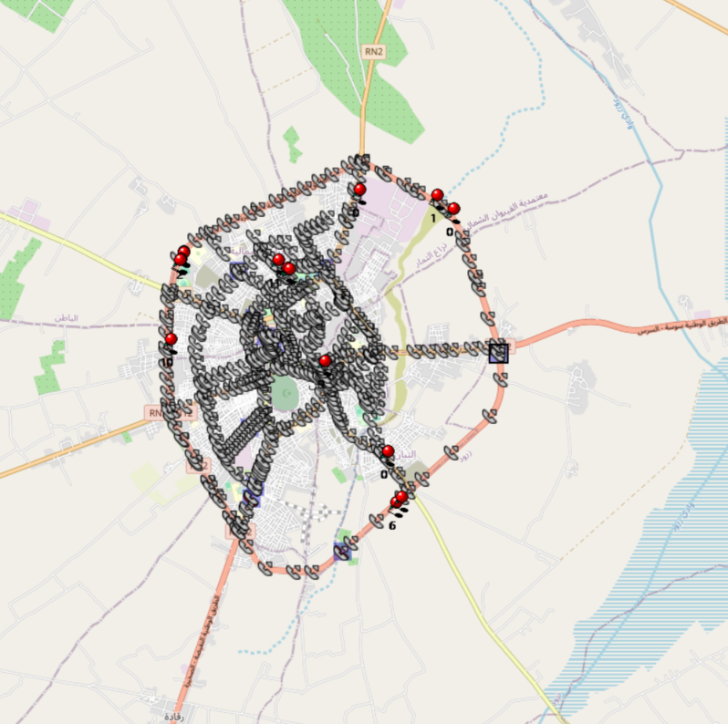
MO Voice Stats (VoLTE call stats)
Short call
Voice KPIs
Number Call Attempts | 542
Number Call Setup | 531
Number Blocked Calls | 11
Setup Succes Rate (%) | 97,97%
Call Block Rate (%) | 2,03%
Call Setup Time IMS Voice Average (Sec) | 2,92

Slide 15
MO Voice Stats (VoLTE call stats)
KPIs
VoLTE Call Setup SR | 97,97%
Call Setup Time | 2,92
VoLTE Drop Call Rate | 7%
Speech Quality - MOS (% of the samples >3,5) | 89,24%
Average MOS | 4,08
VoLTE Handover SR | 99,72%
VoLTE SRVCC SR | 100%

Slide 16
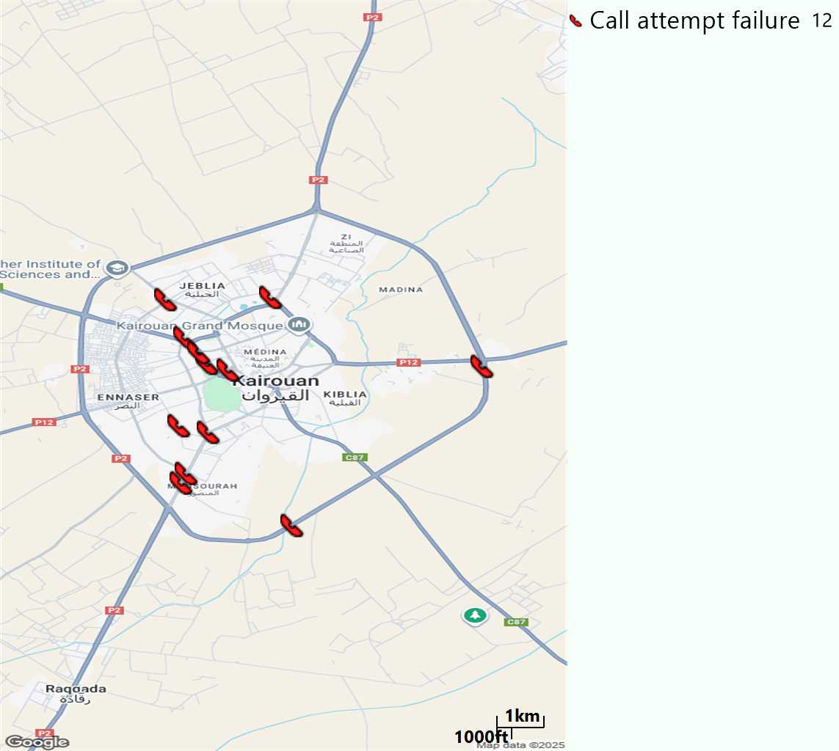
MO Voice Call - Blocked call
Short call

Slide 17
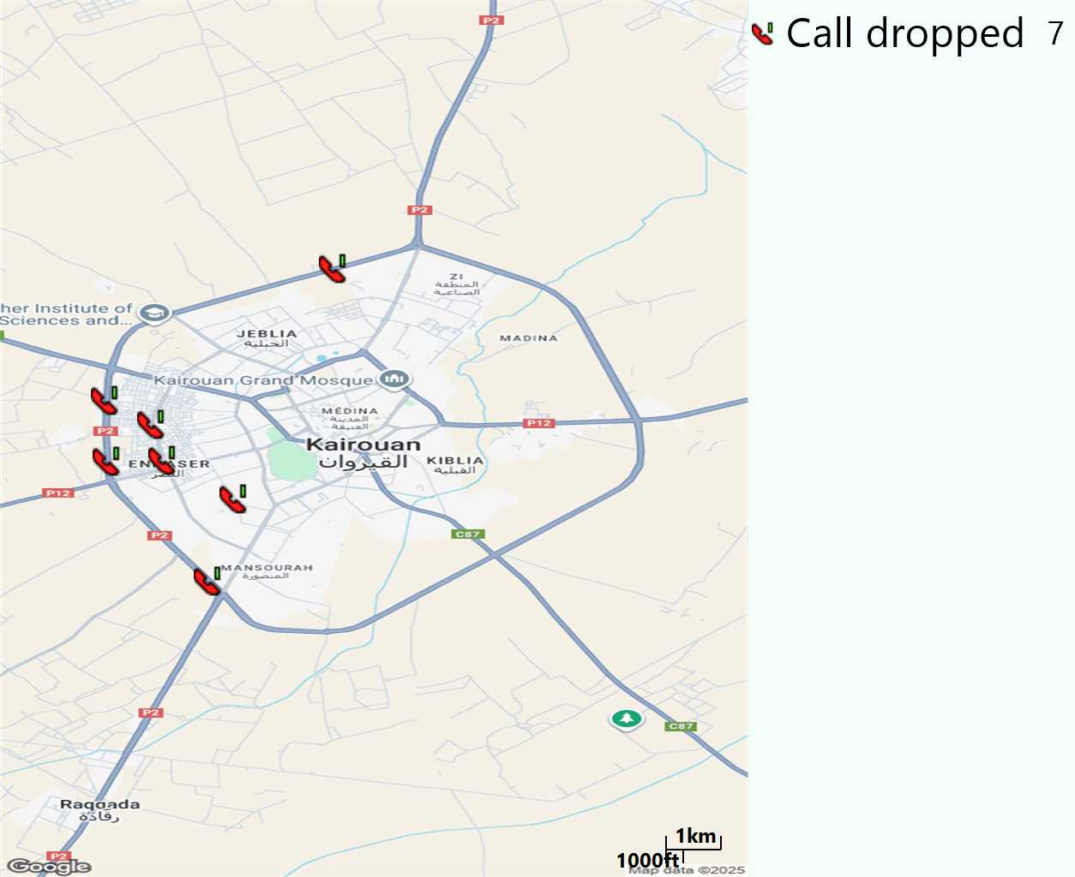
MO Voice Call - Dropped Call
Long call

Slide 18
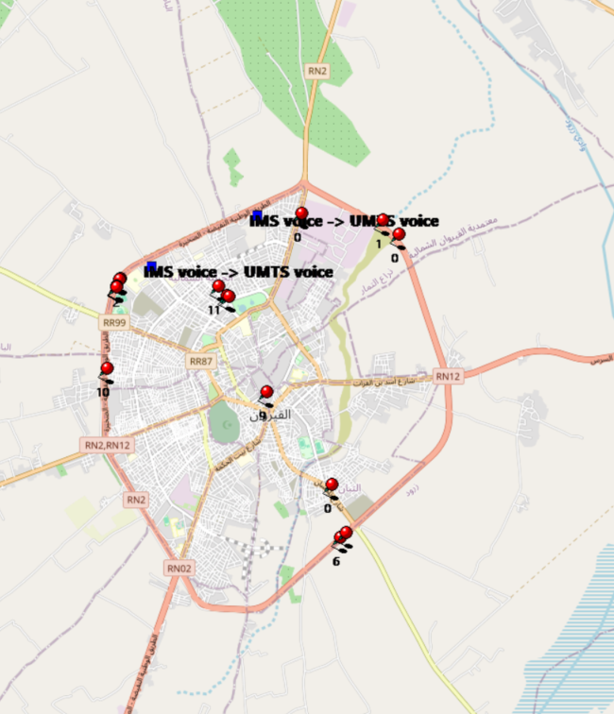
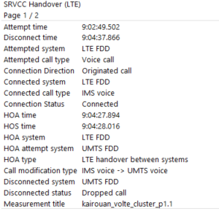
VoLTE SRVCC Success Rate long Call
Attempted system | Attempted call type | Connection Direction | Connected system | Connected call type | Connection Status | HOA time | HOS time | HOA system | HOA attempt system | HOA type | Call modification type | Disconnected system | Disconnected status | Measurement title
LTE FDD | Voice call | Originated call | LTE FDD | IMS voice | Connected | 04:27,9 | 04:28,0 | LTE FDD | UMTS FDD | LTE handover between systems | IMS voice -> UMTS voice | UMTS FDD | Dropped call | kairouan_volte_cluster_p1.1
LTE FDD | Voice call | Originated call | LTE FDD | IMS voice | Connected | 35:22,7 | 35:22,8 | LTE FDD | UMTS FDD | LTE handover between systems | IMS voice -> UMTS voice | UMTS FDD | Normal disconnect | kairouan_volte_cluster_p1.1

Slide 19
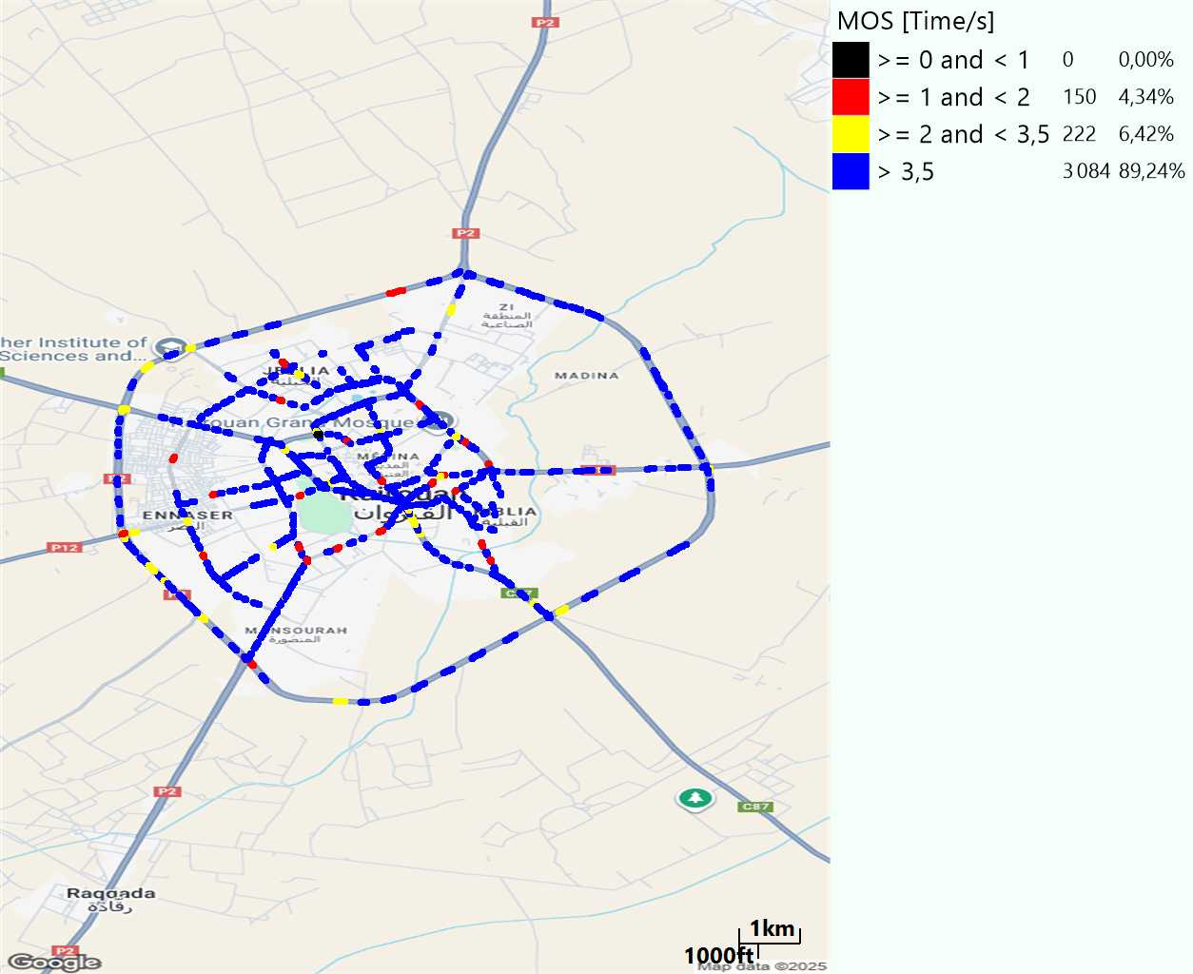
MO Voice Quality Metrics
long Call

Slide 20
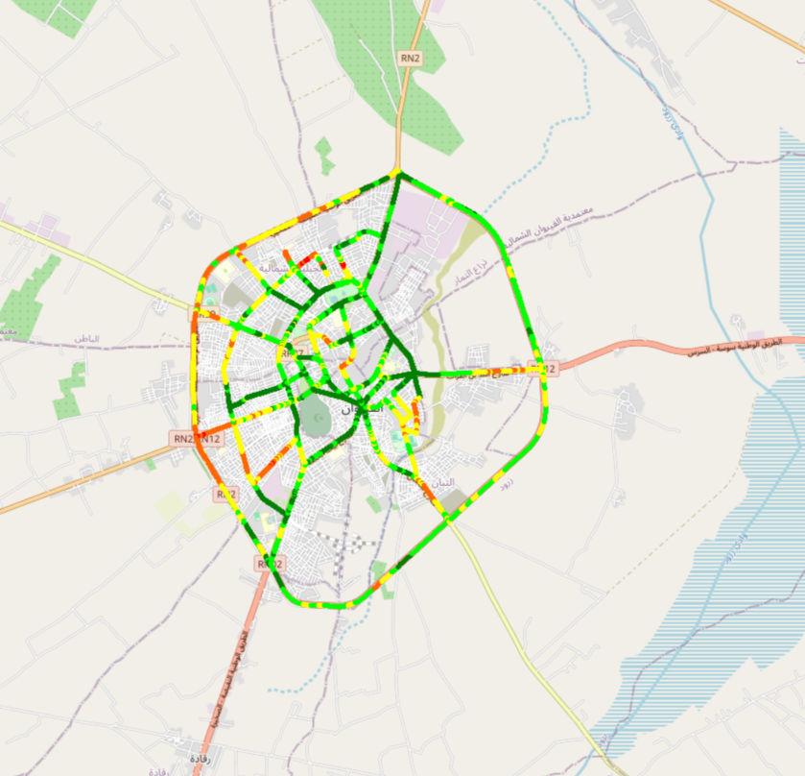
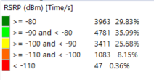
Scanner_RSRP
L2100

Slide 21
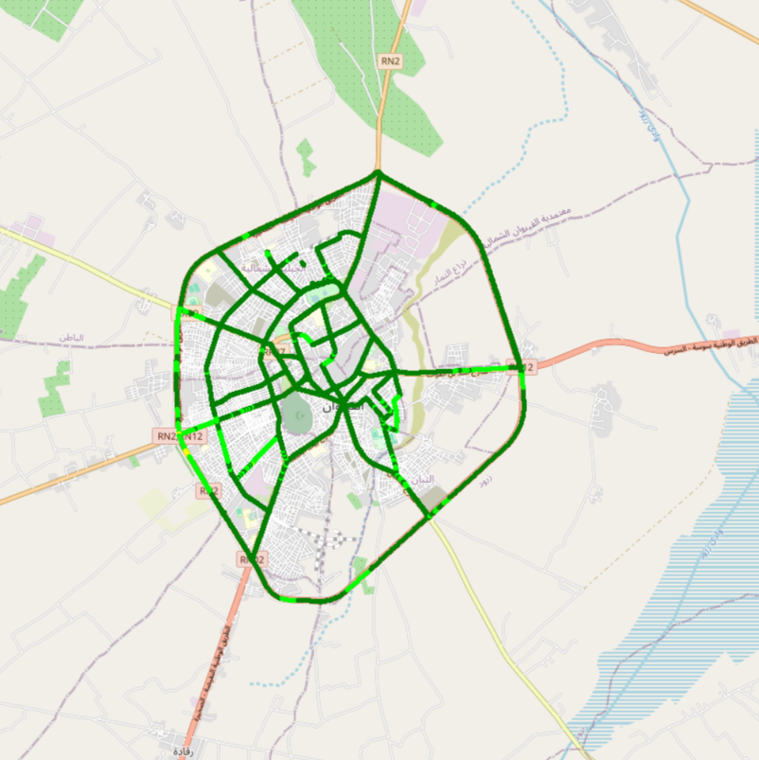
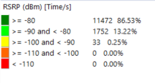
Scanner_RSRP
L800

Slide 22
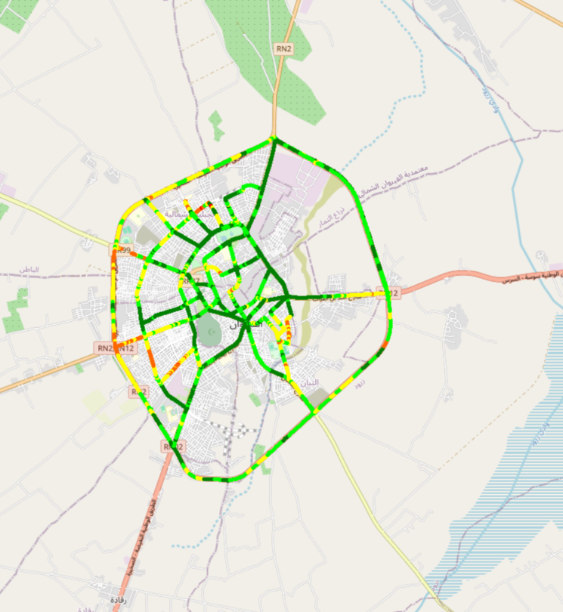
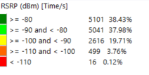
Scanner_RSRP
L1800

Slide 23
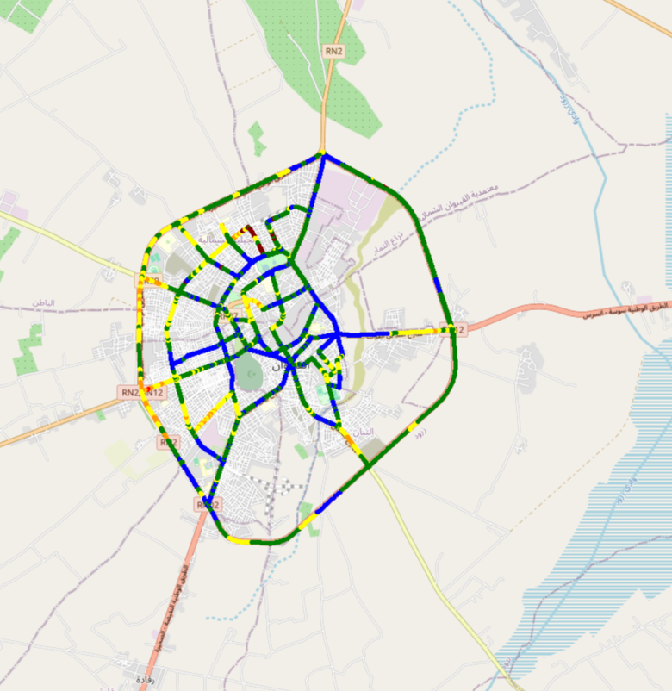
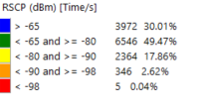
Scanner_RSCP
U2100

Slide 24
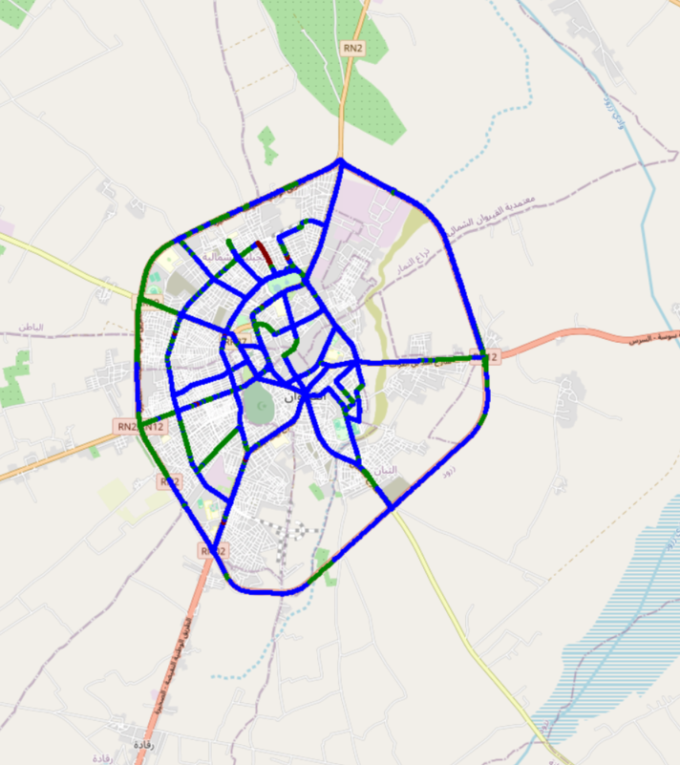
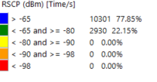
Scanner_RSCP
900

