Slide 1


Volte Drive Test Report

Slide 2
DT Scénario
Short Call (10s)
Long call (2min)
Scanner

Slide 3
Voice Call

Slide 4
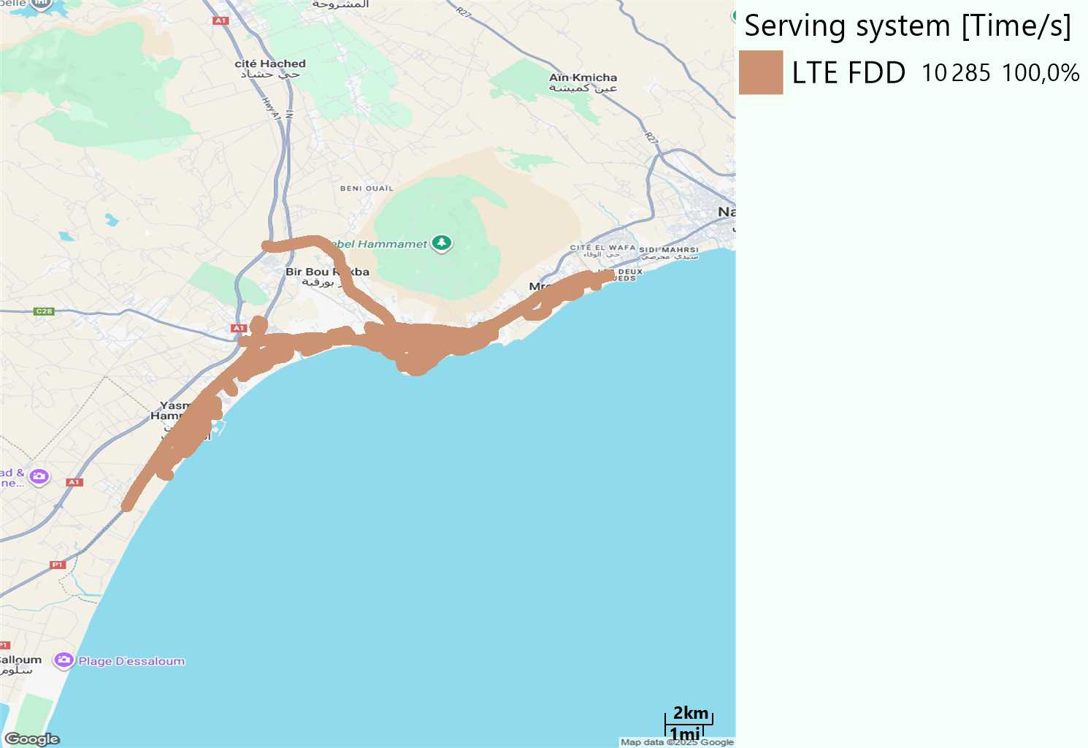
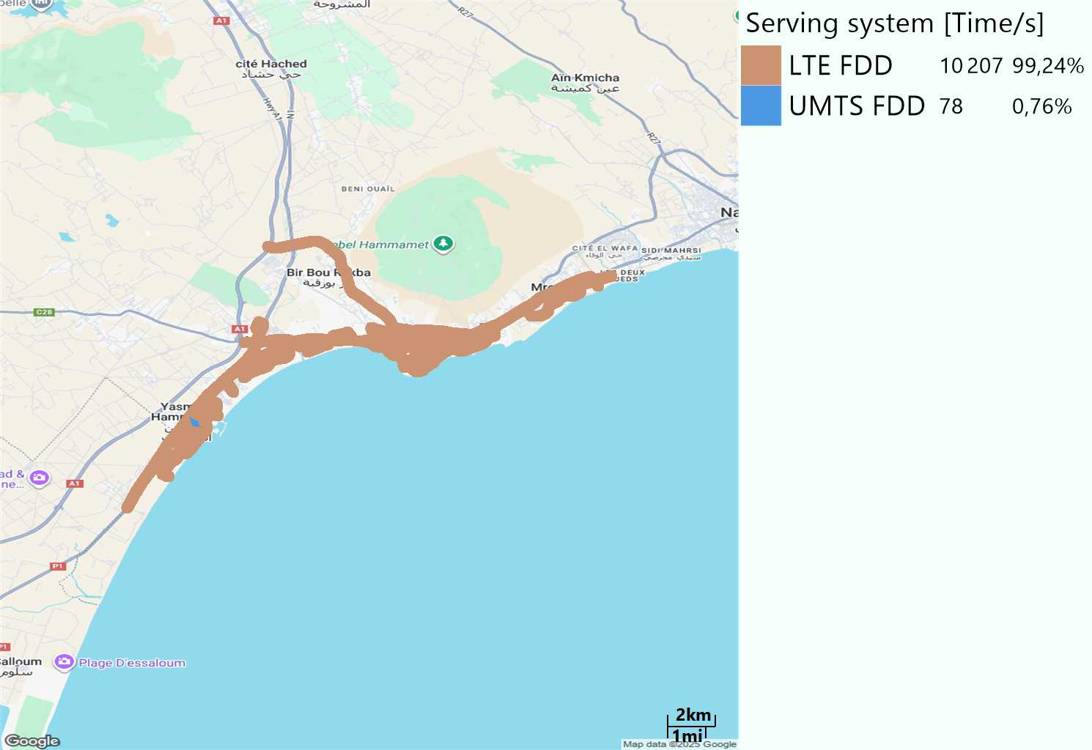
RAT distribution
Long call
Short call

Slide 5
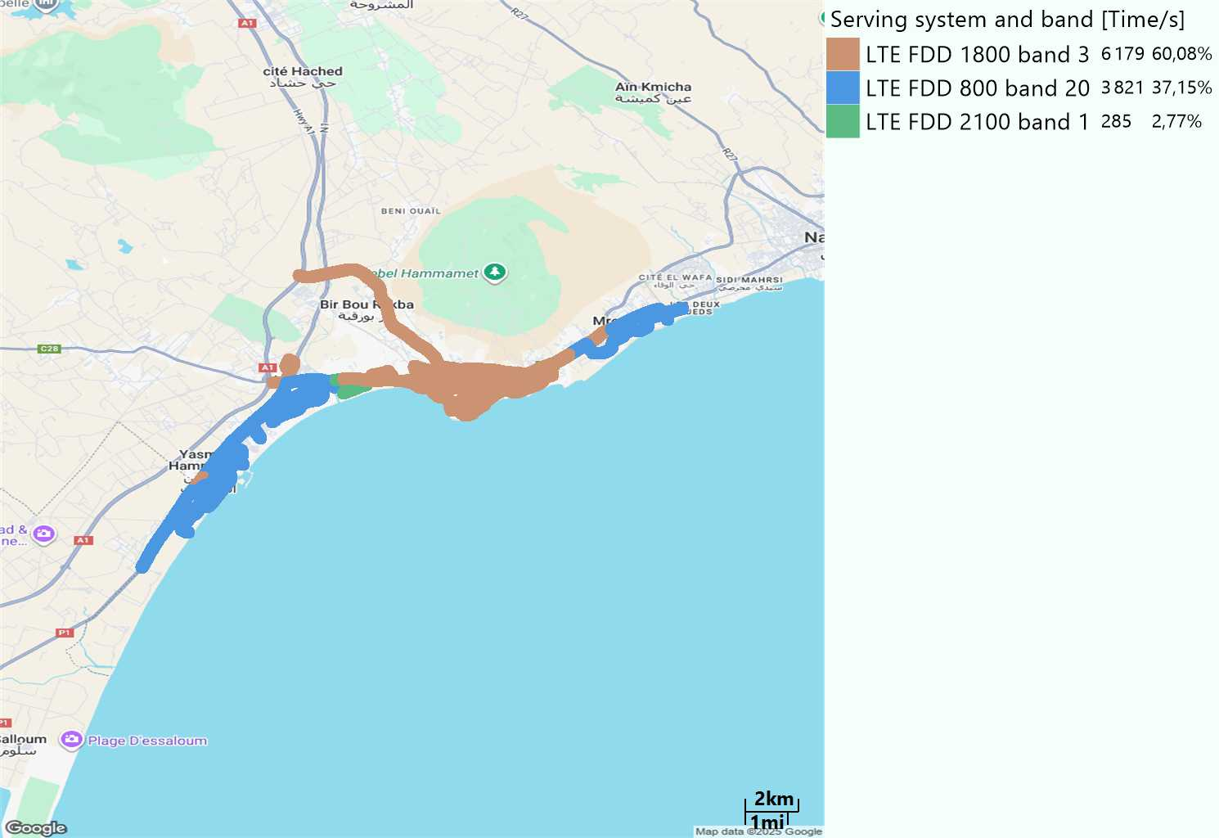
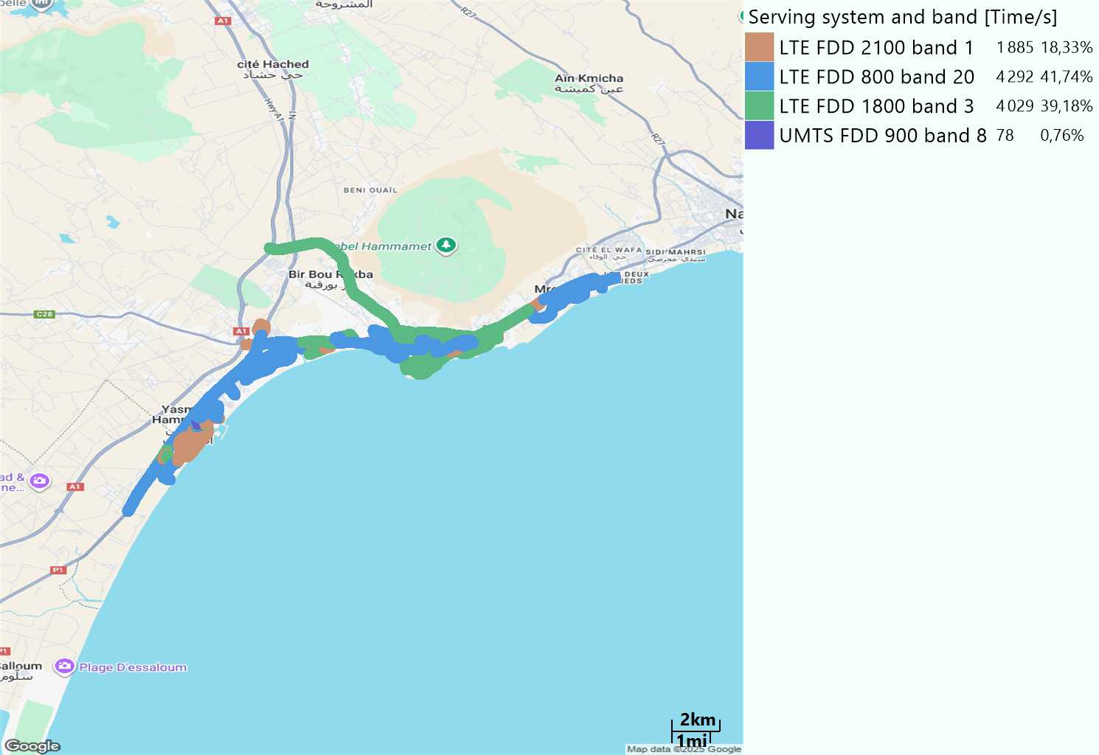
EARFCN distribution
Long call
Short call

Slide 6
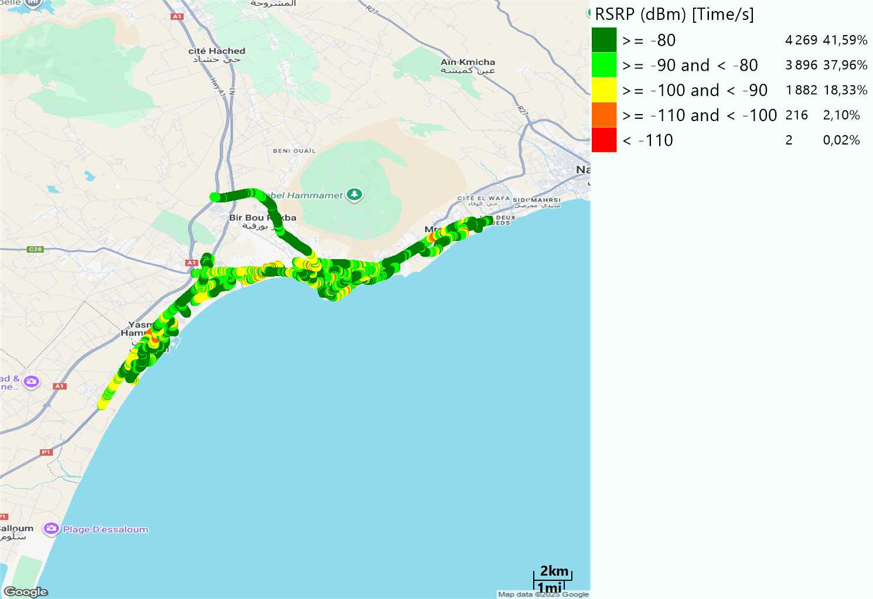
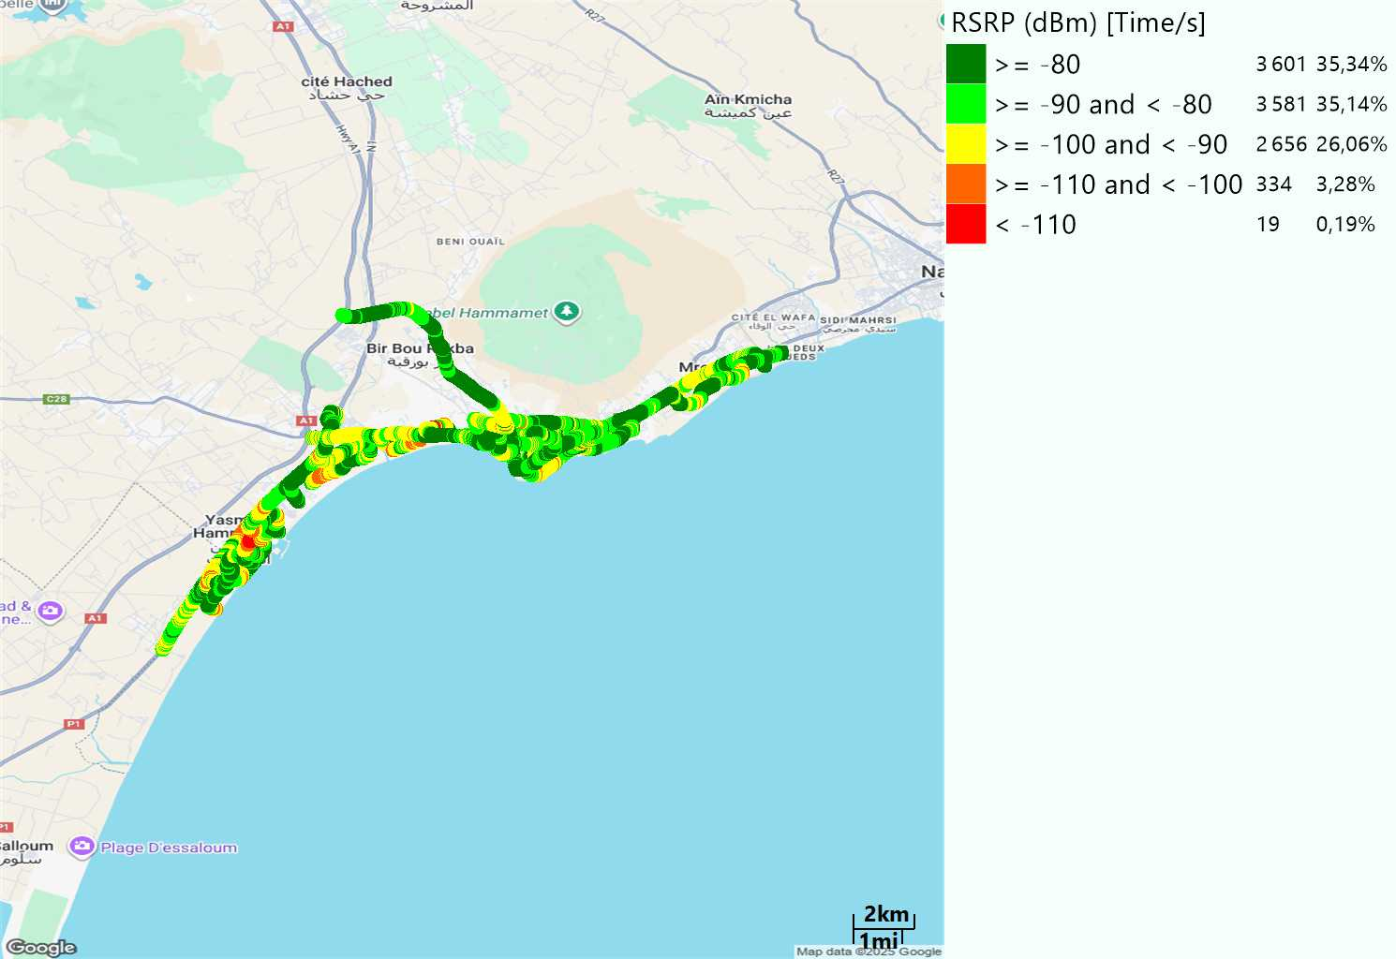
LTE - RSRP
Long call
Short call
Average [dBm]
-81,53
Average [dBm]
-83,57

Slide 7
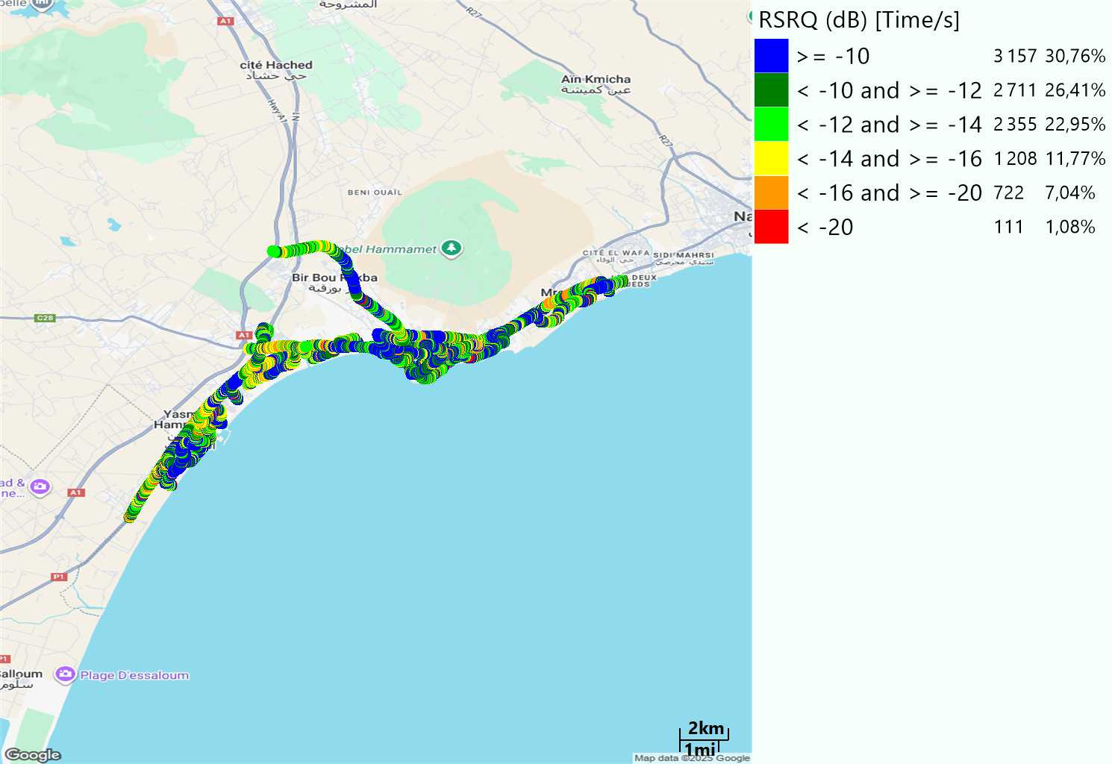
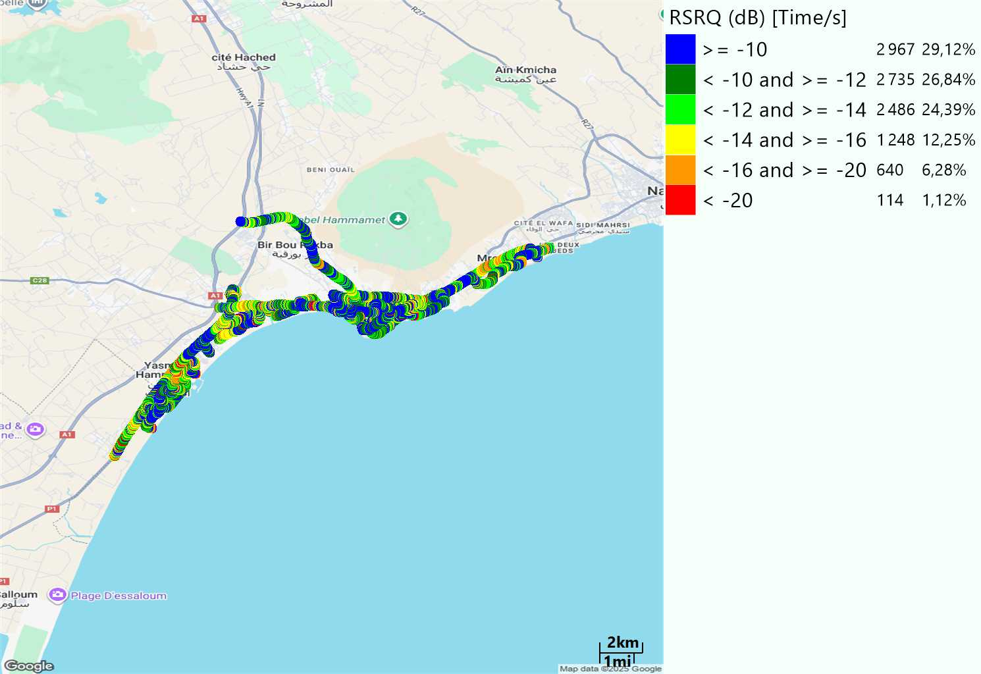
LTE- RSRQ
Long call
Short call

Slide 8
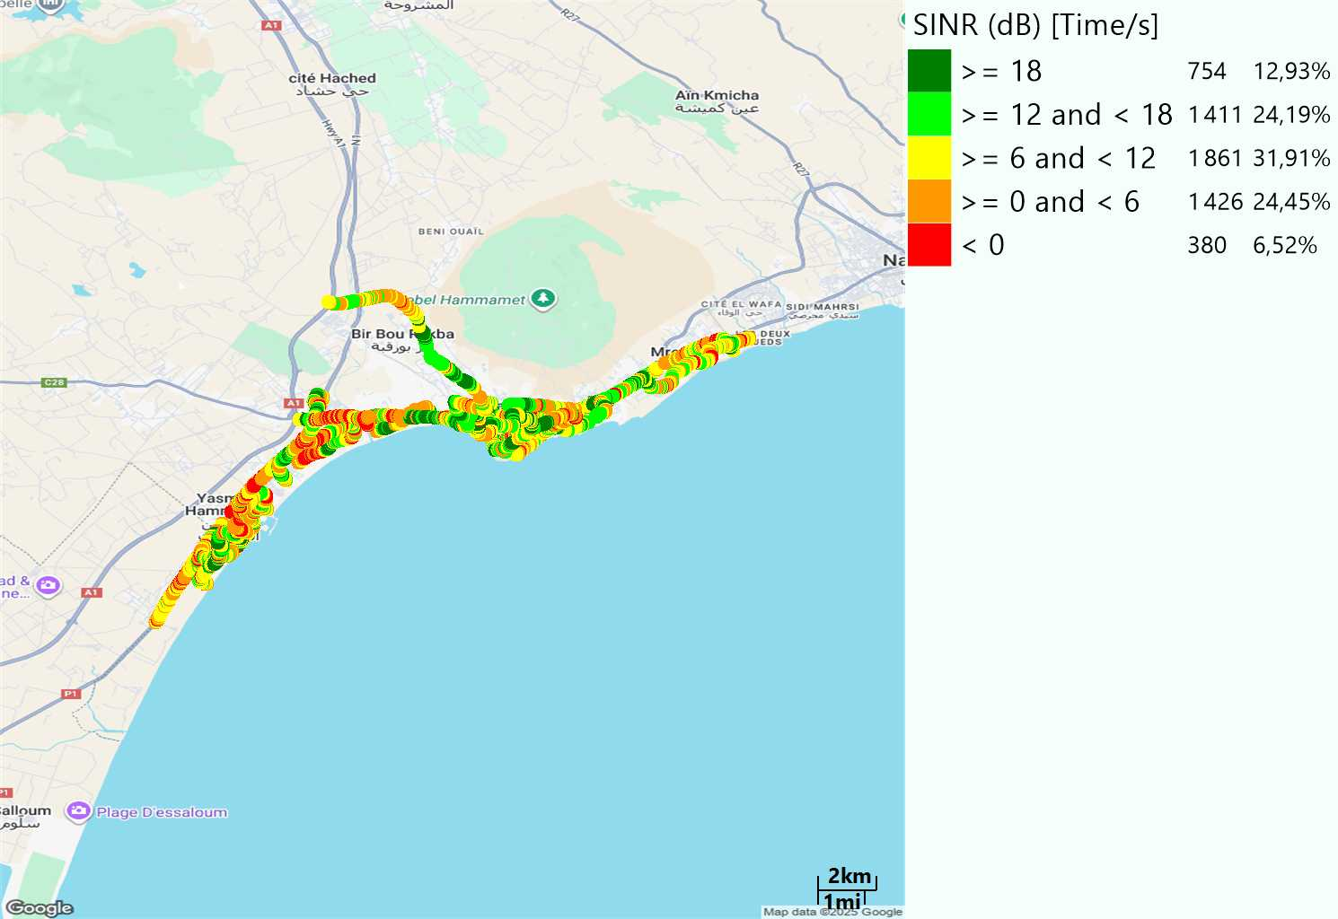
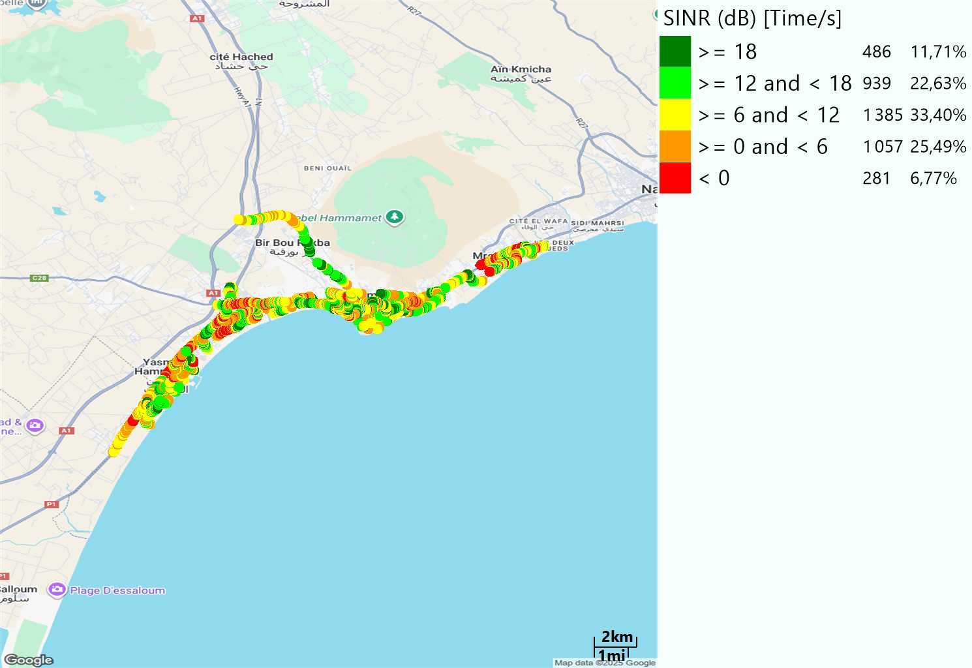
LTE-SINR
Long call
Short call

Slide 9
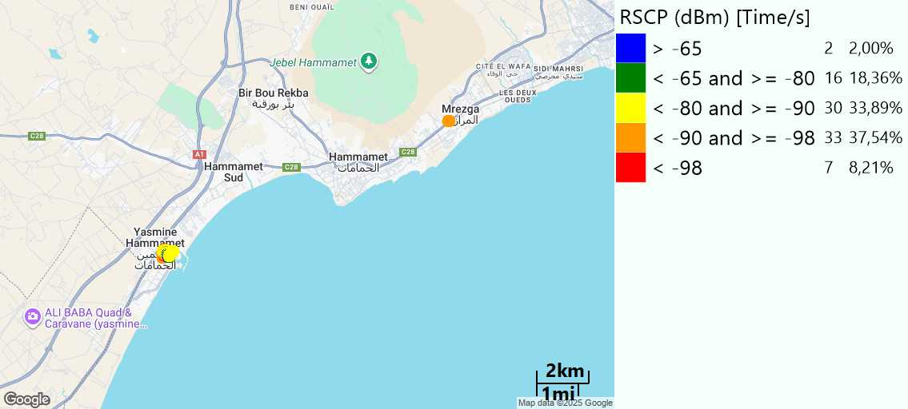
RSCP
Short call

Slide 10
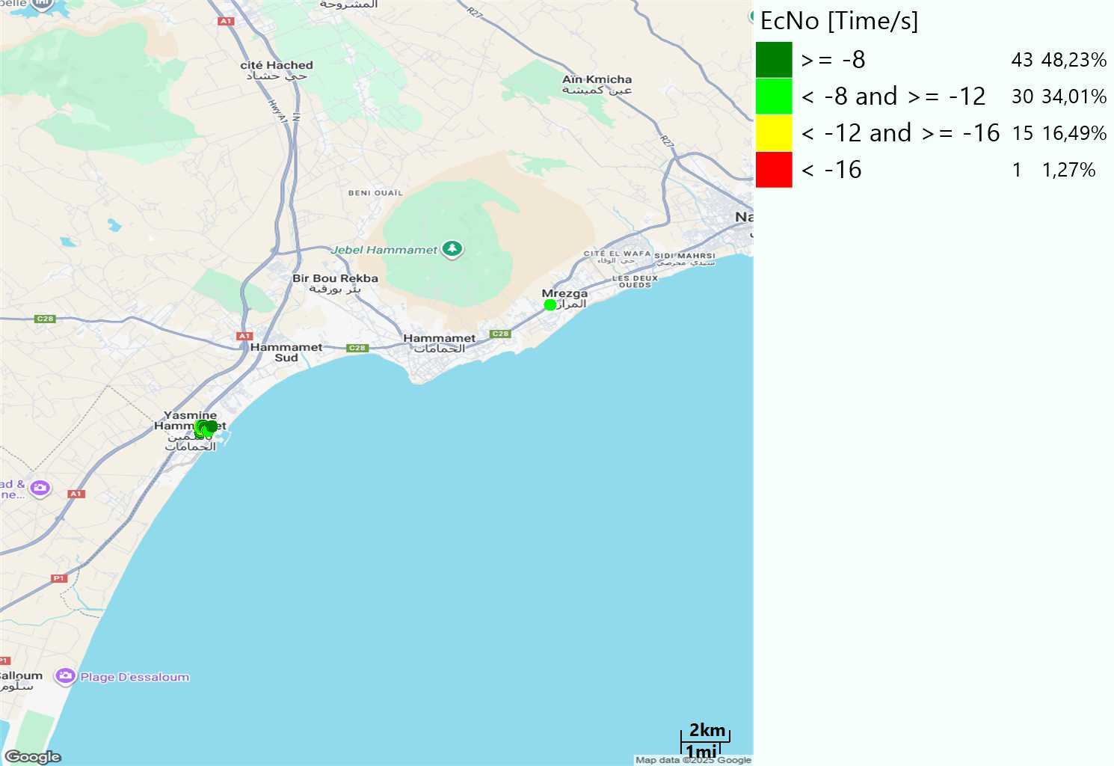
WCDMA-Ec/NO
Short call

Slide 11
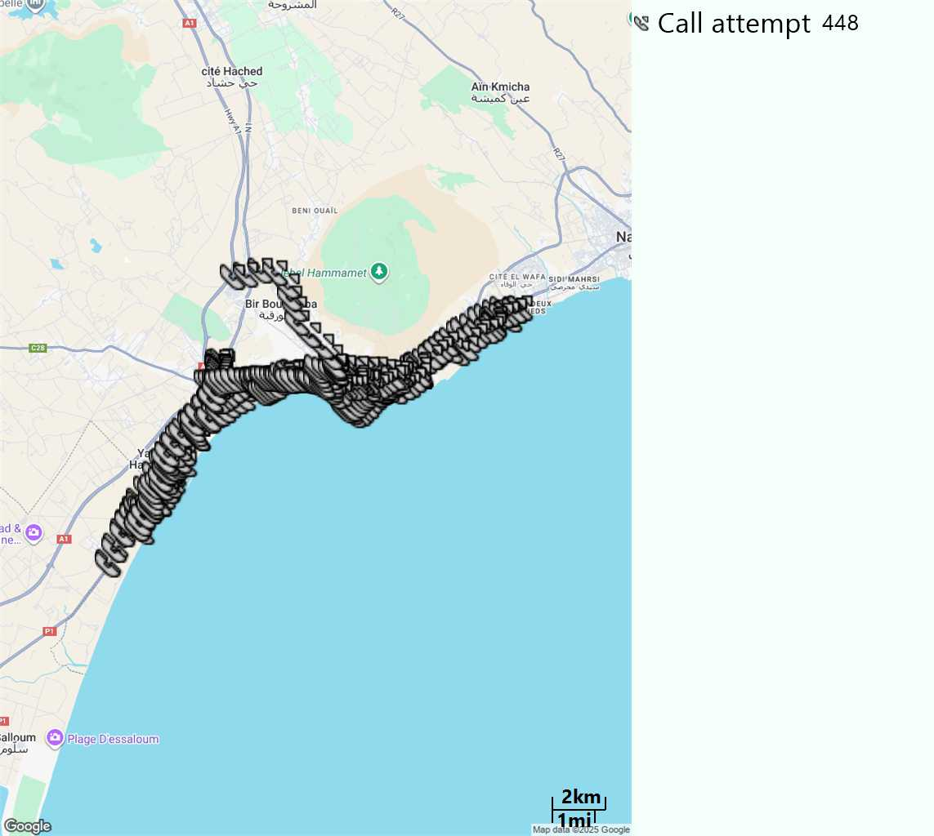
MO Call Setup Time (call setup time in VoLTE)
Short call
Call Setup Time IMS Voice
Average (Sec) | Maximum (Sec) | Minimum (Sec)
2,56 | 21,43 | 1,84

Slide 12
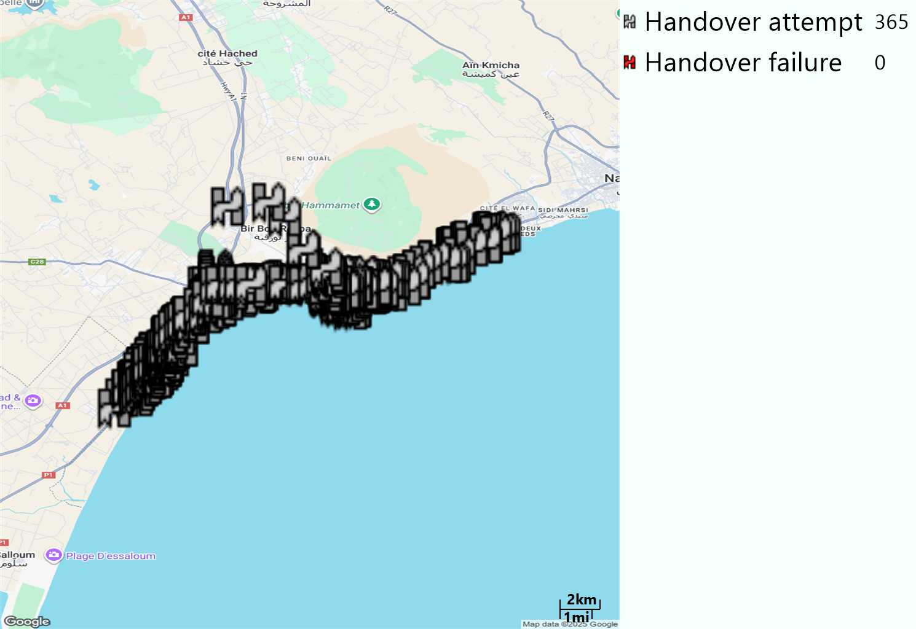
MO Handover Type
Long call
HO Type | Percentage [%]
LTE Inter-Frequency handover | 1,37%
LTE Intra-Frequency handover | 98,63%
Handover KPI’s
Handover Attemps | 365
Handover Success | 365
Handover succès Rate | 100%
Étiquettes de lignes | LTE FDD_1800 | LTE FDD_2100 | LTE FDD_800 | Total général
LTE FDD_1800 | 176 | 1 | 1 | 178
LTE FDD_2100 |  | 10 |  | 10
LTE FDD_800 | 3 |  | 174 | 177
Total général | 179 | 11 | 175 | 365

Slide 13
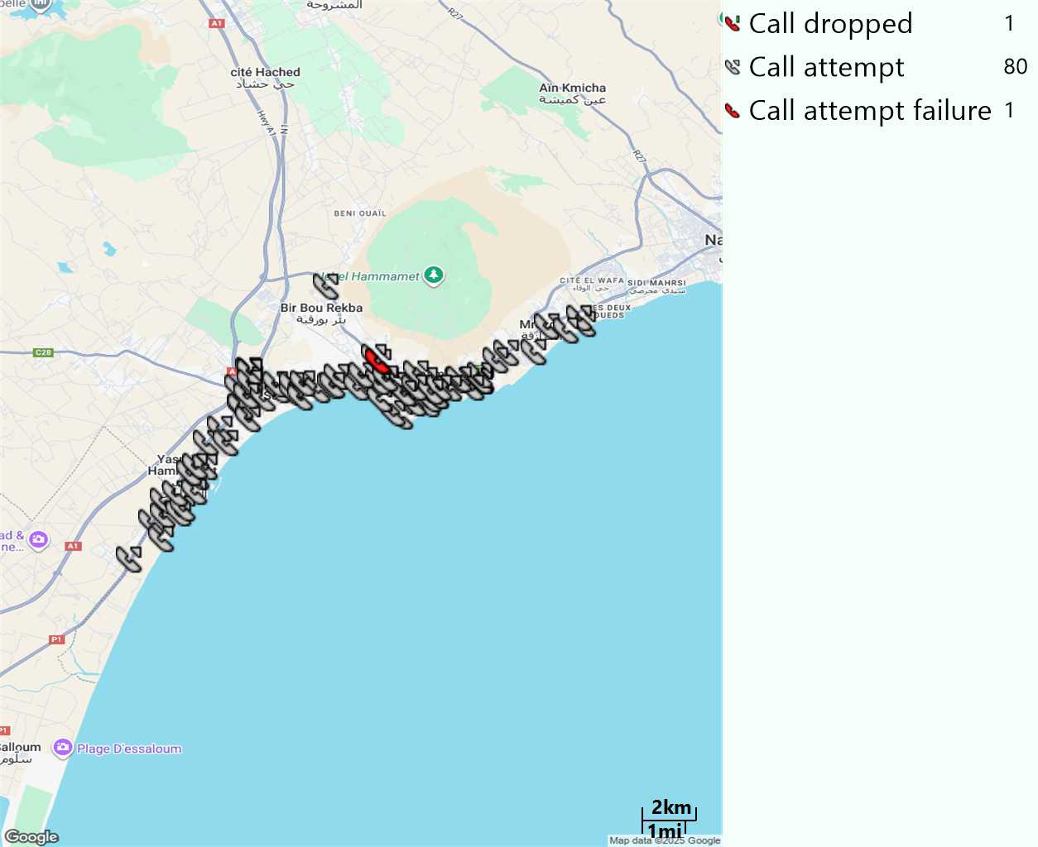
MO Voice Stats (VoLTE call stats)
Long call
Voice KPIs
Number Call Attempts | 80
Number Dropped Calls | 1
Call Drop Rate (%) | 1,25%
HO success rate | 100%

Slide 14
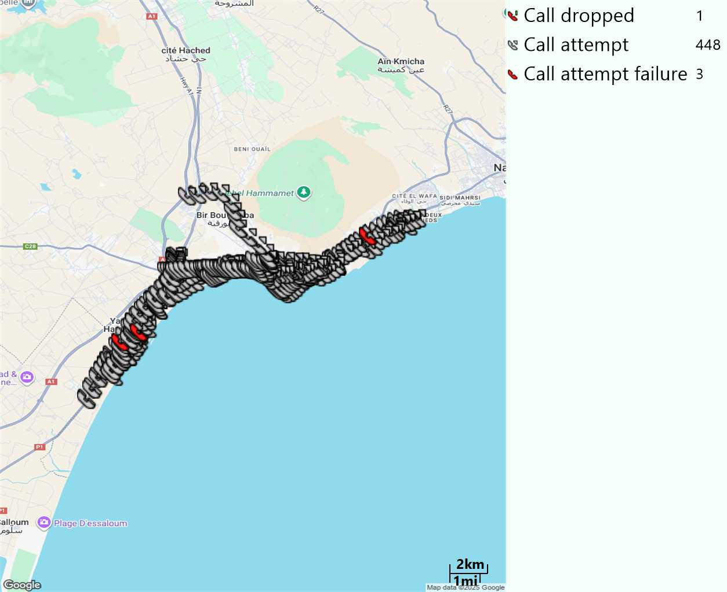
MO Voice Stats (VoLTE call stats)
Short call
Voice KPIs
Number Call Attempts | 448
Number Call Setup | 445
Number Blocked Calls | 3
Setup Succes Rate (%) | 99,33%
Call Block Rate (%) | 0,66%
Call Setup Time IMS Voice Average (Sec) | 2,56

Slide 15
MO Voice Stats (VoLTE call stats)
KPIs
VoLTE Call Setup SR | 99,33%
Call Setup Time | 2,56
VoLTE Drop Call Rate | 1,25%
Speech Quality - MOS (% of the samples >3,5) | 92,90%
Average MOS | 4,19
VoLTE Handover SR | 100%
VoLTE SRVCC SR | -

Slide 16
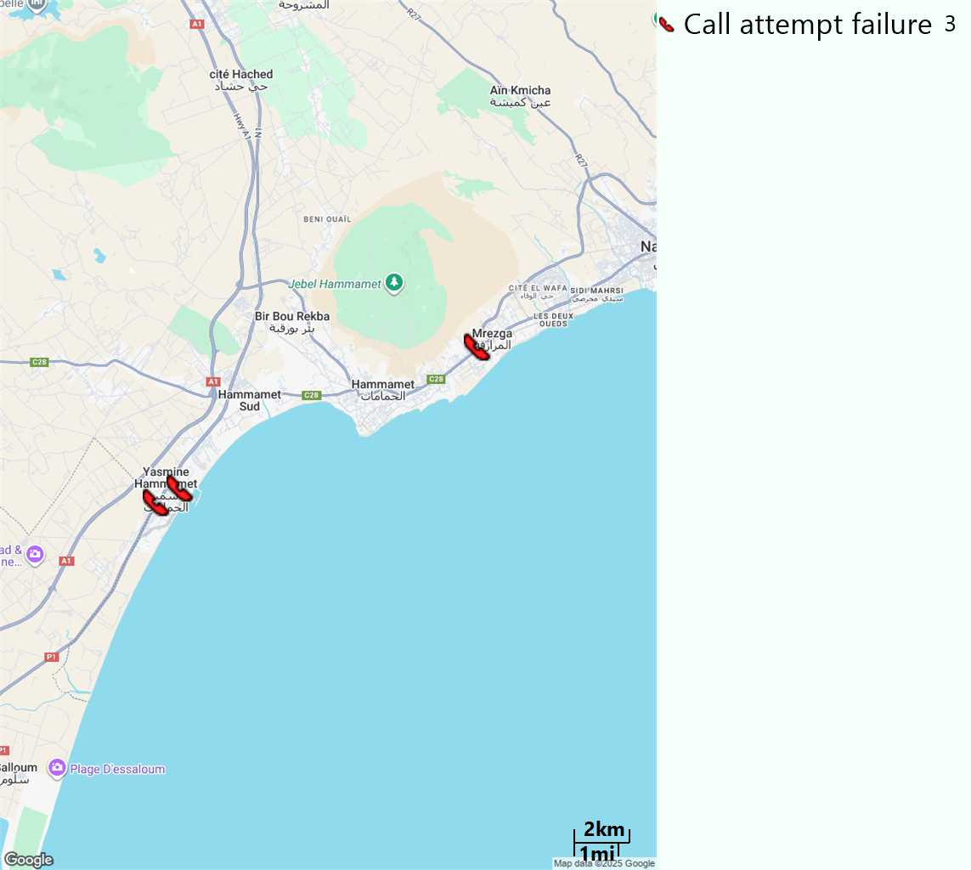
MO Voice Call - Blocked call
Short call

Slide 17
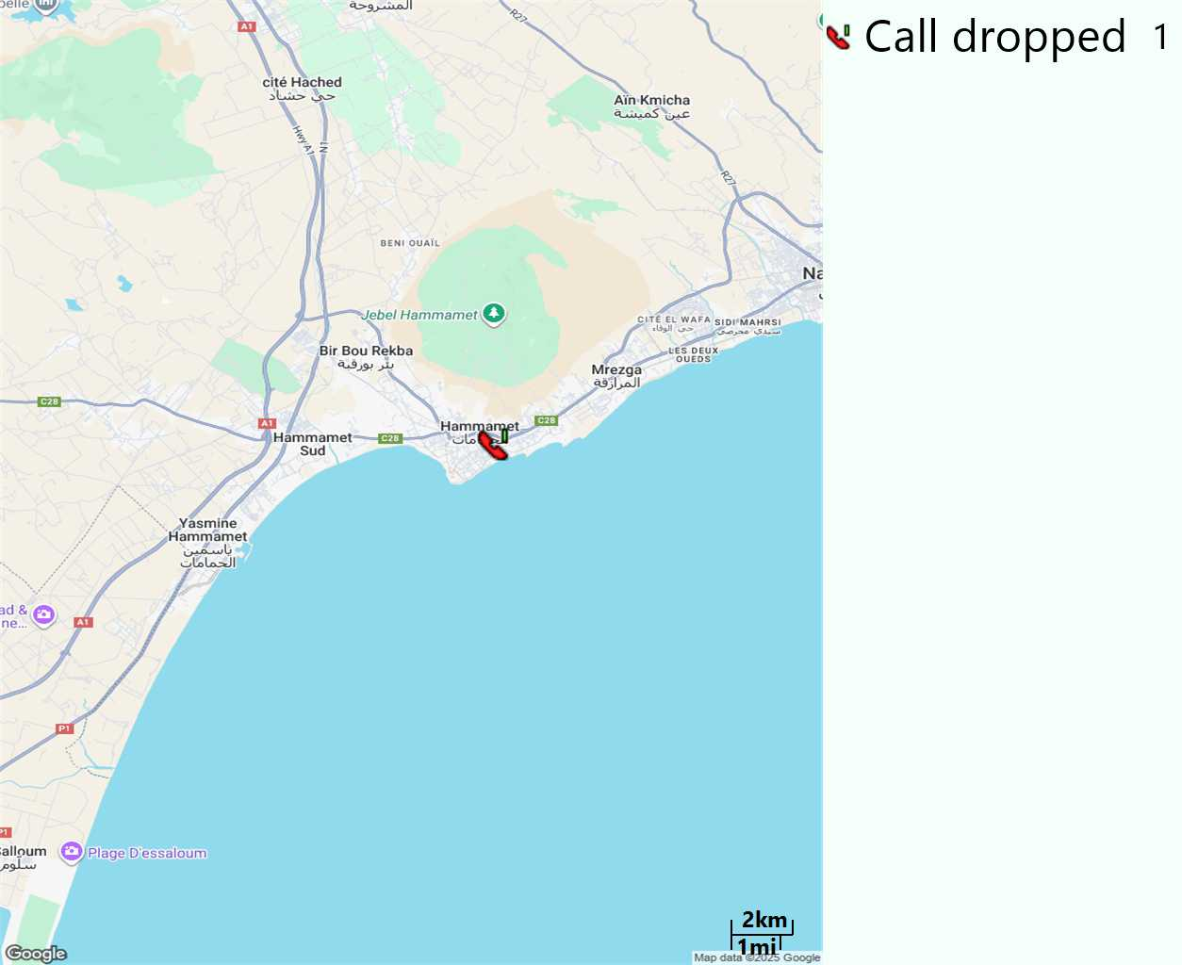
MO Voice Call - Dropped Call
Long call

Slide 18
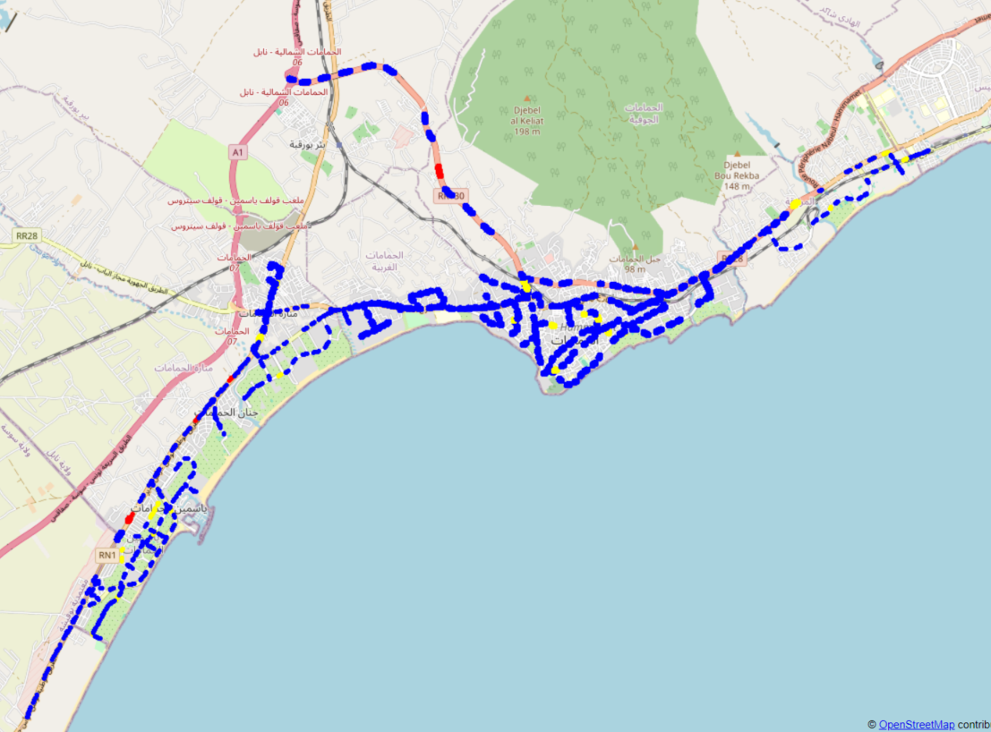
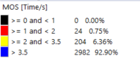
MO Voice Quality Metrics
long Call

Slide 19
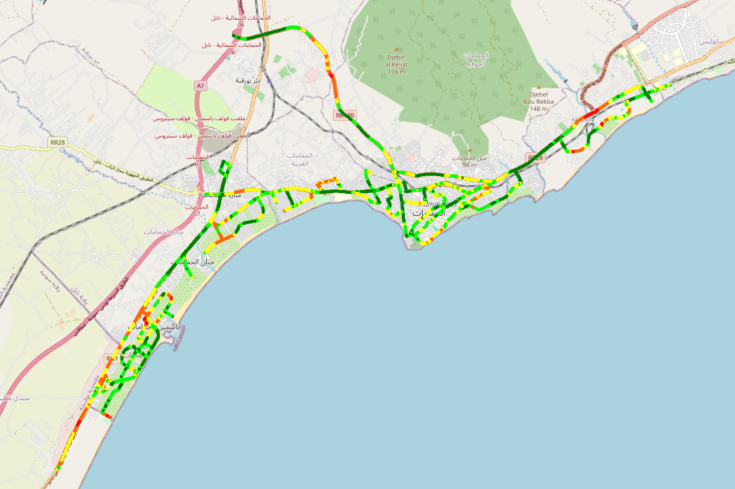
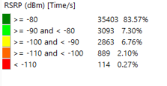
Scanner_RSRP
L2100

Slide 20
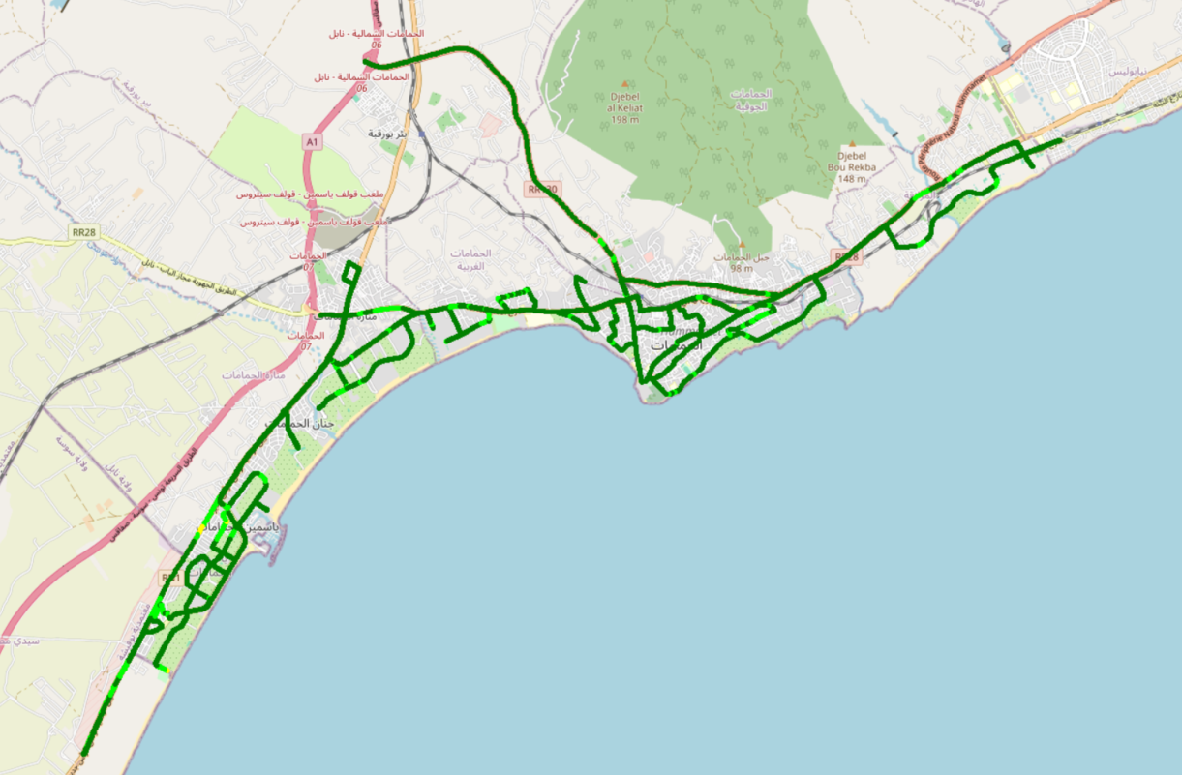
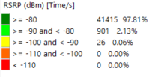
Scanner_RSRP
L800

Slide 21
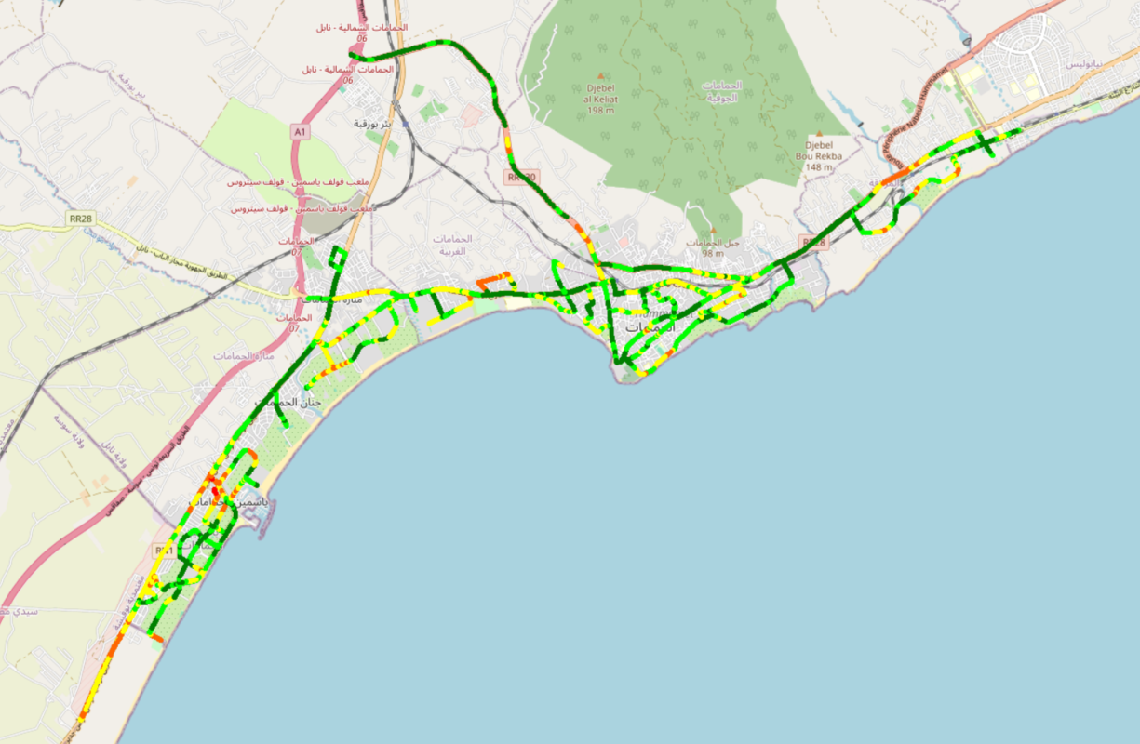
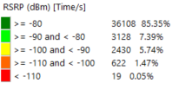
Scanner_RSRP
L1800

Slide 22
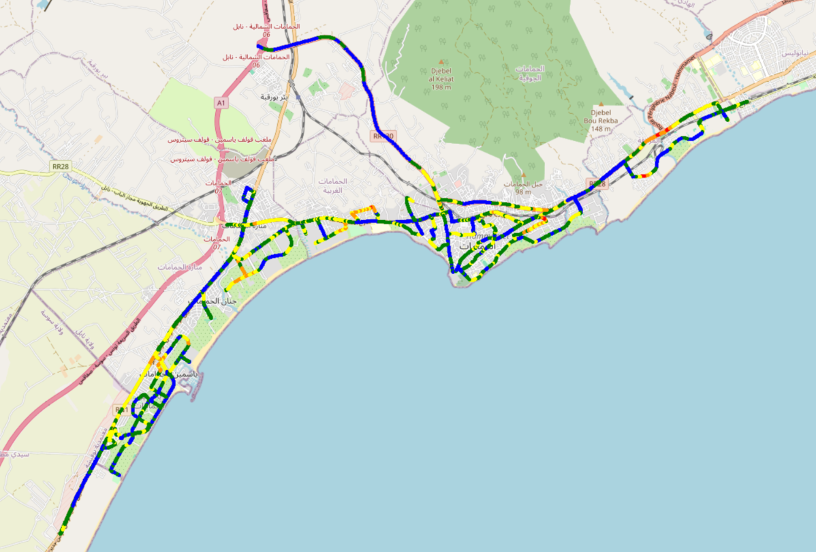
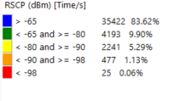
Scanner_RSCP
U2100

Slide 23
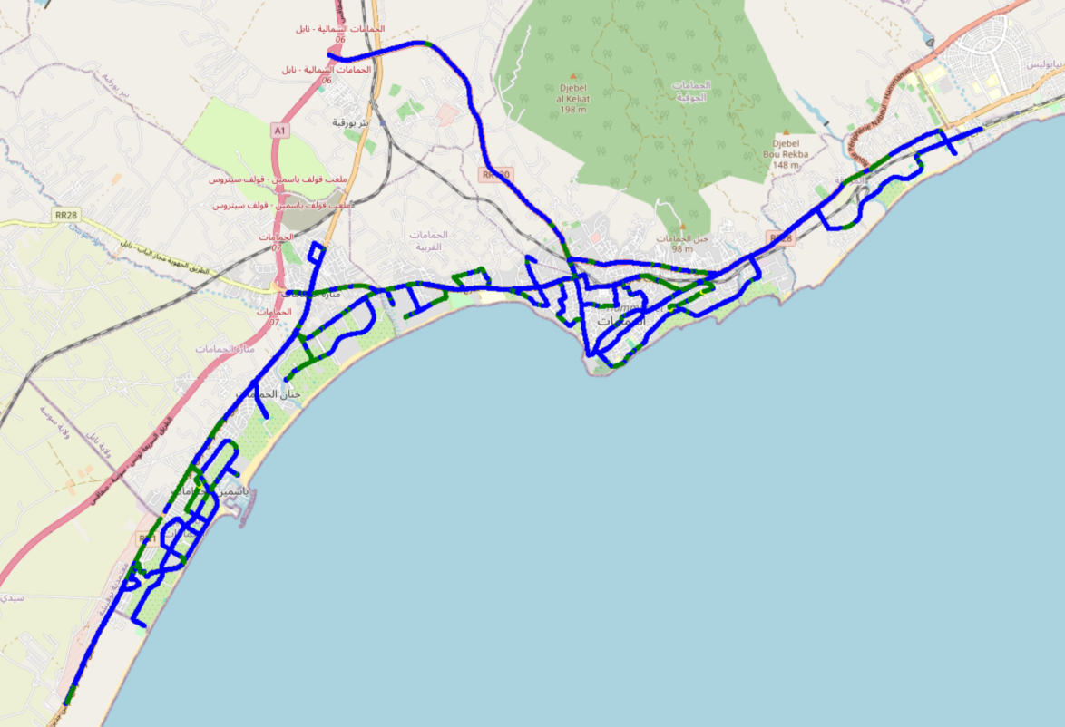
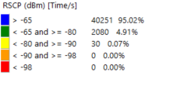
Scanner_RSCP
900

