Slide 1


Volte Drive Test Report

Slide 2
DT Scénario
Short Call (10s)
Long call (2min)
Scanner

Slide 3
Voice Call

Slide 4
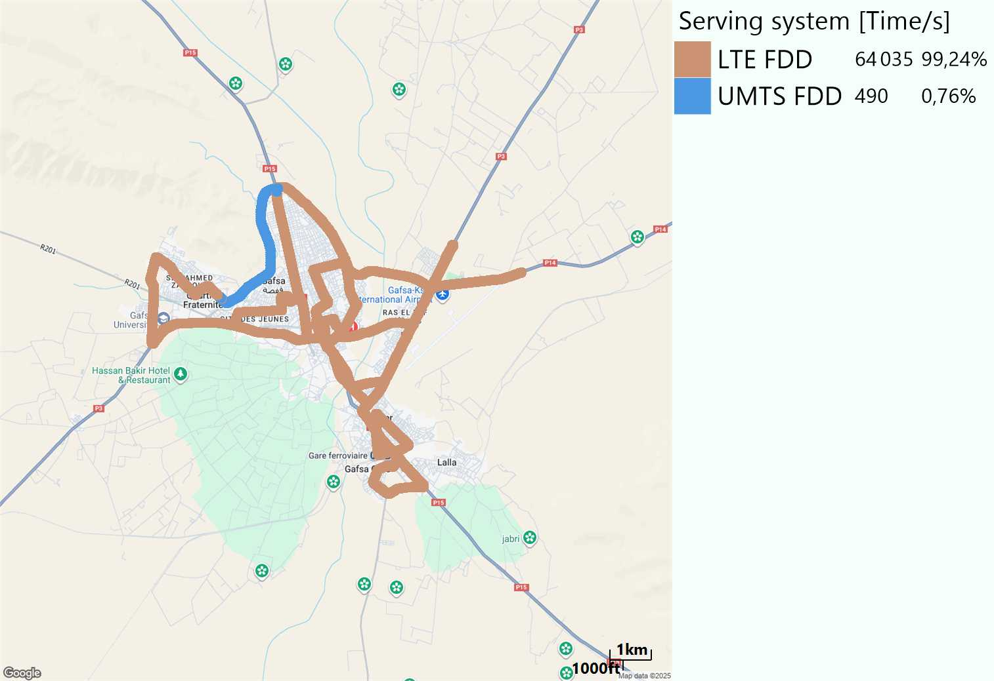
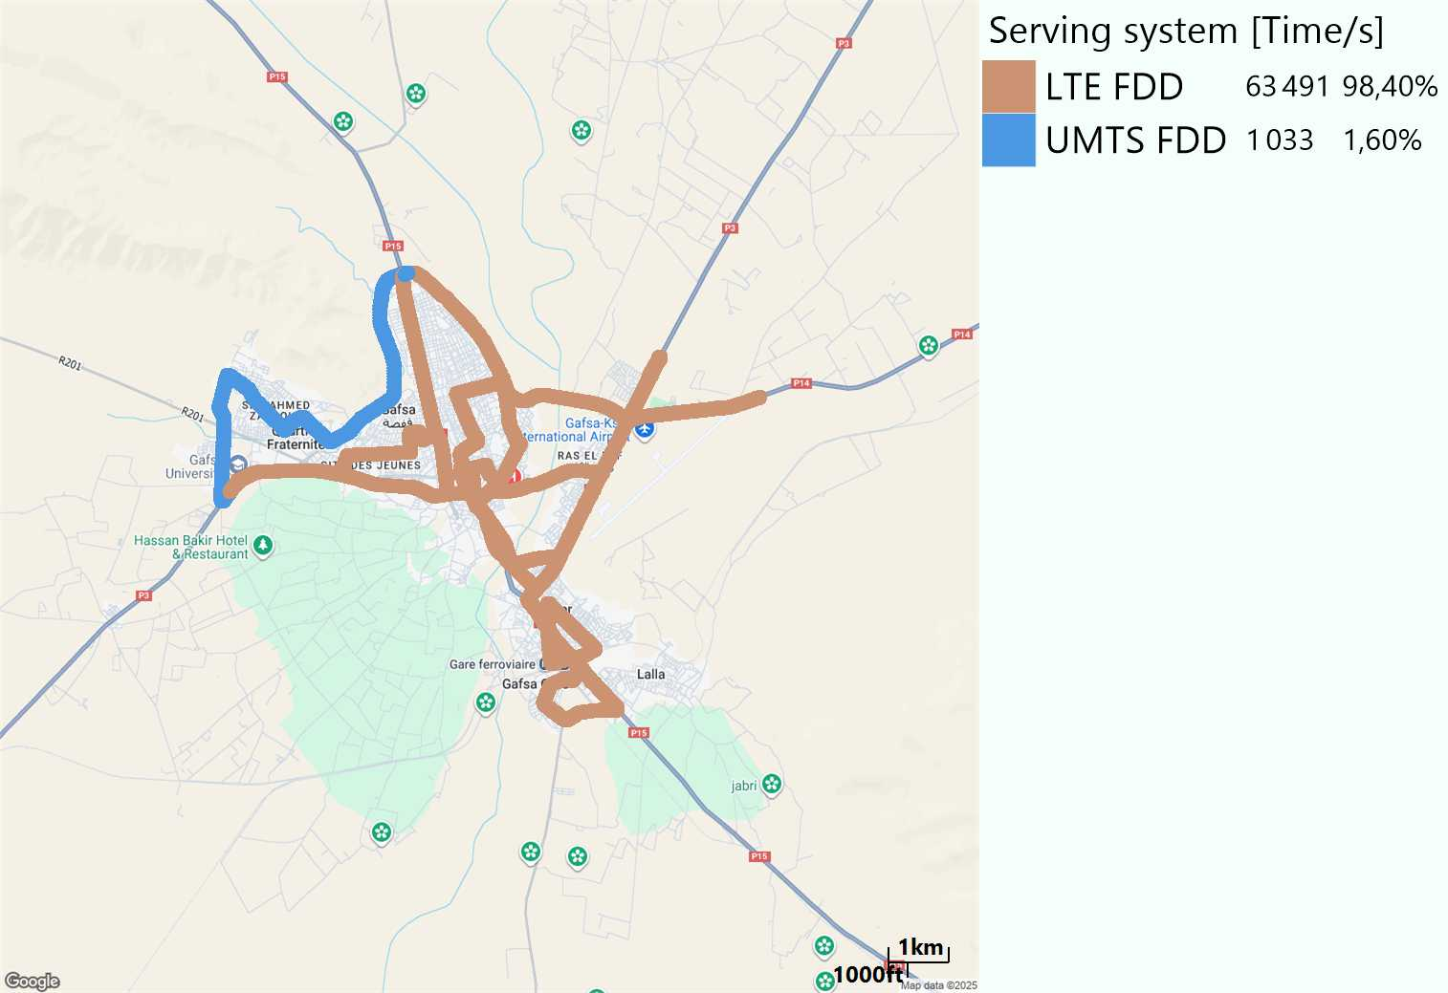
RAT distribution
Long call
Short call

Slide 5
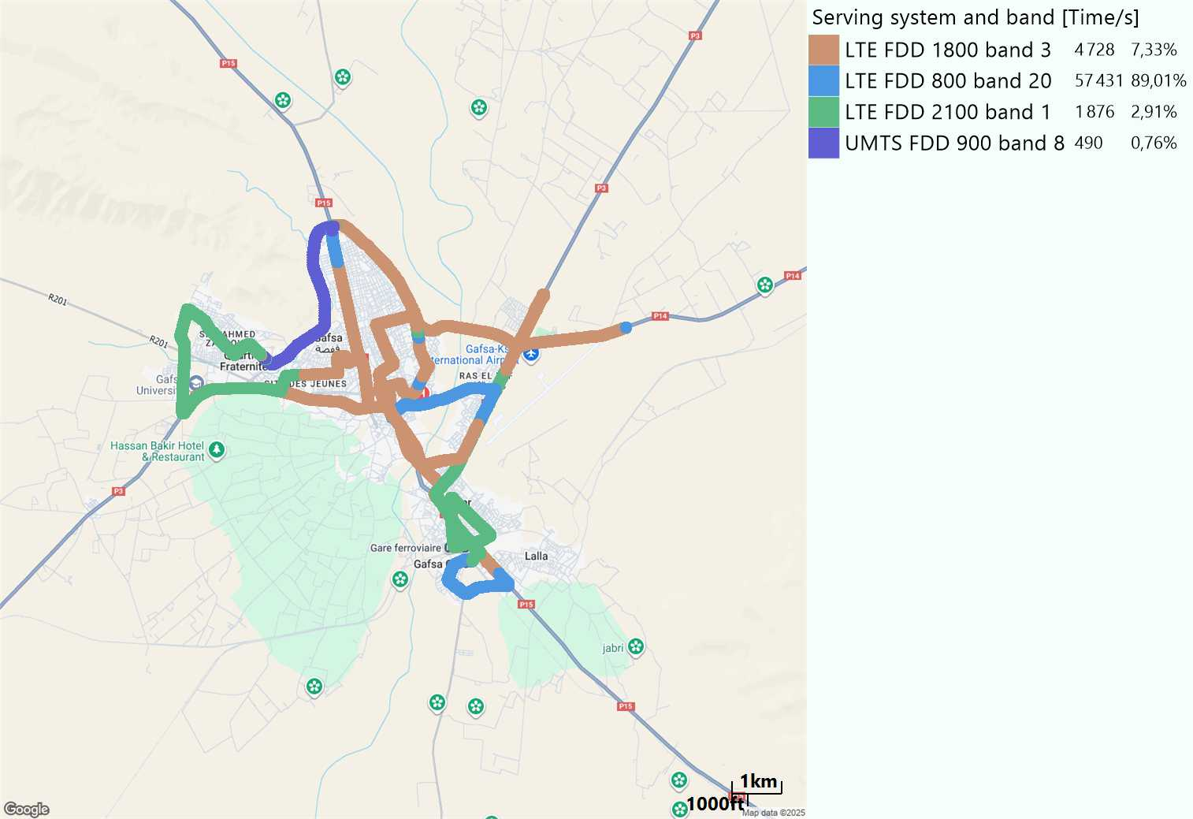
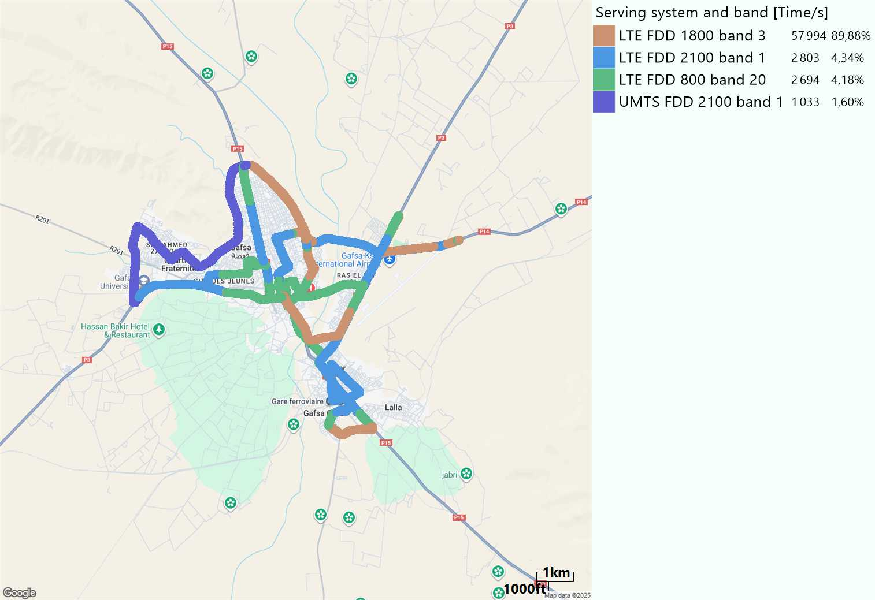
EARFCN distribution
Long call
Short call

Slide 6
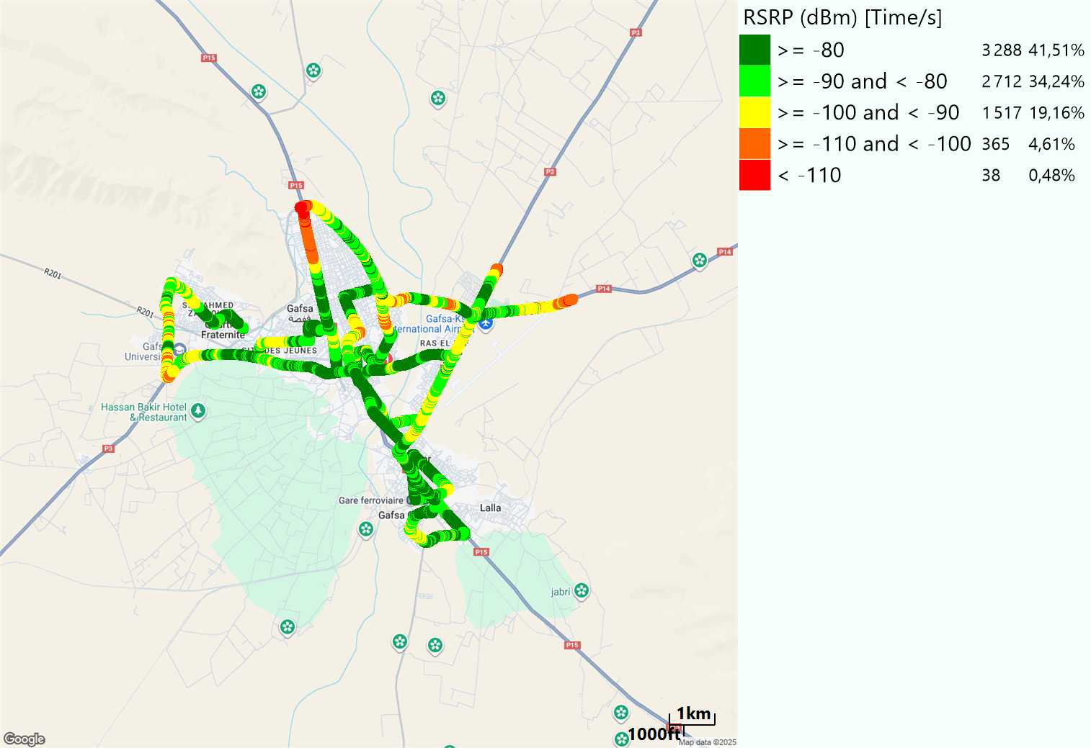
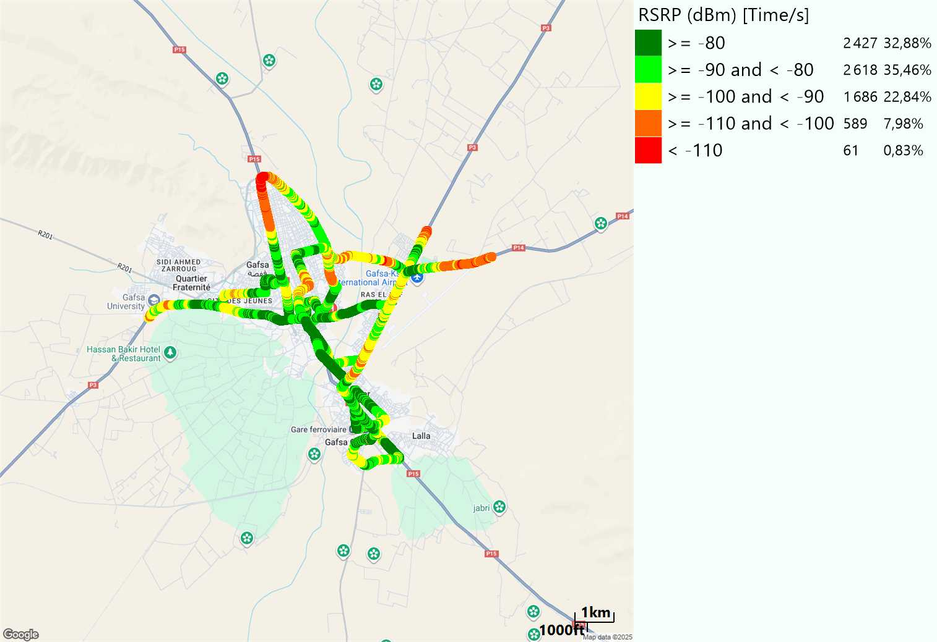
LTE - RSRP
Long call
Short call
Average [dBm]
-82,62
Average [dBm]
-85,22

Slide 7
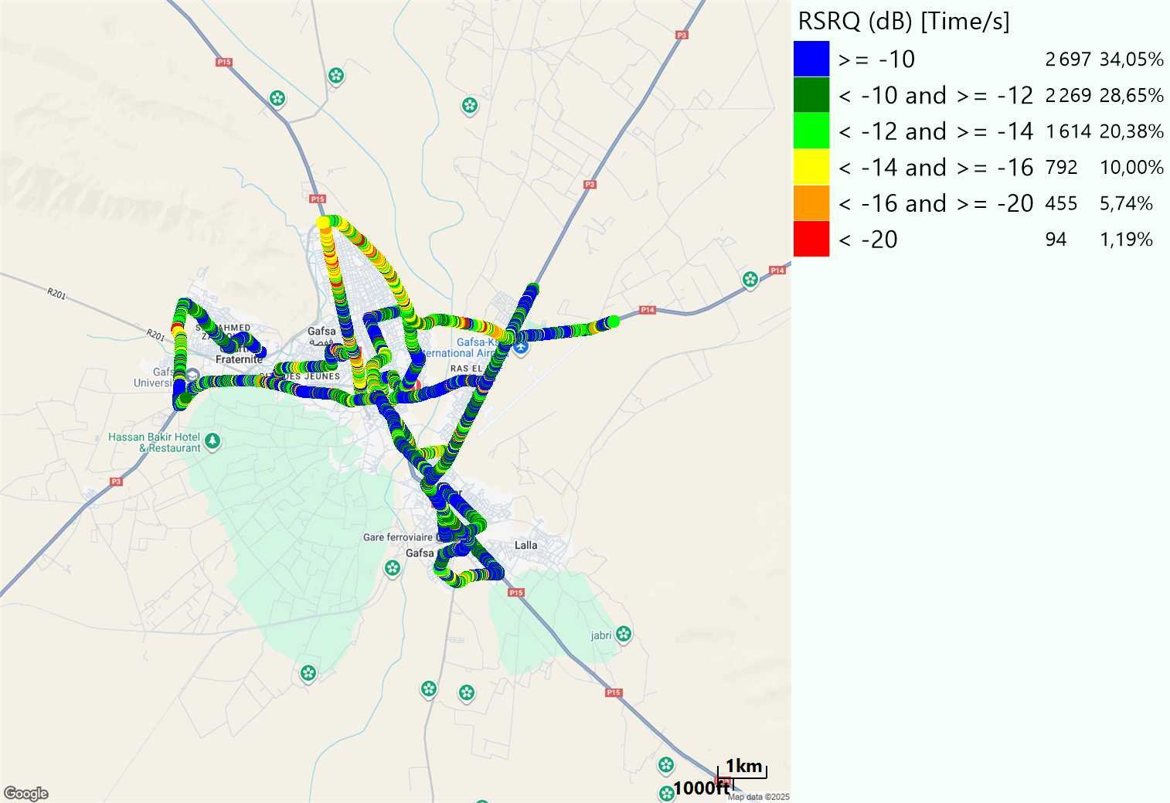
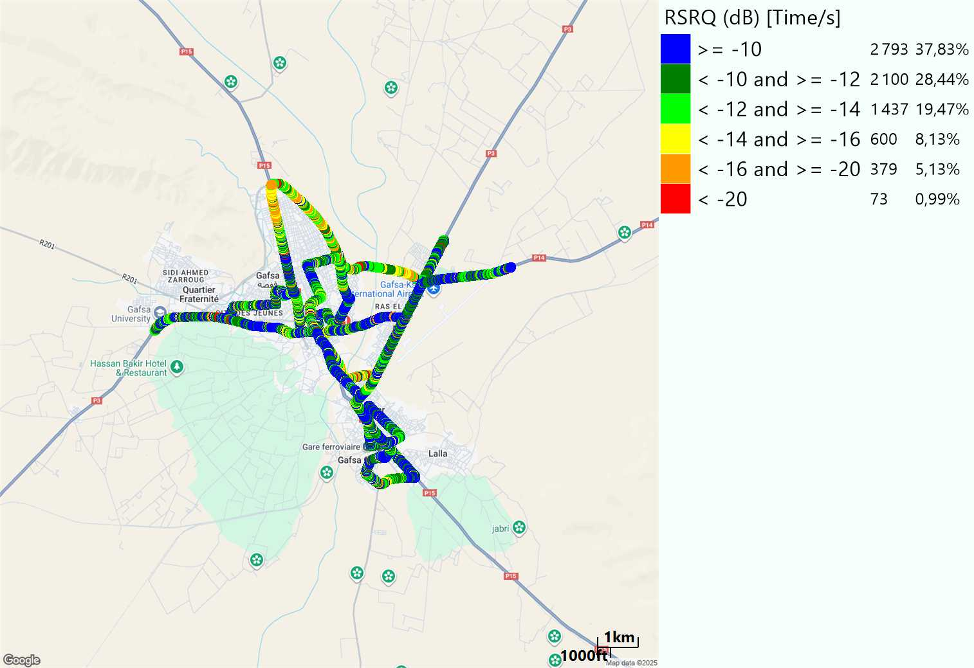
LTE- RSRQ
Long call
Short call

Slide 8
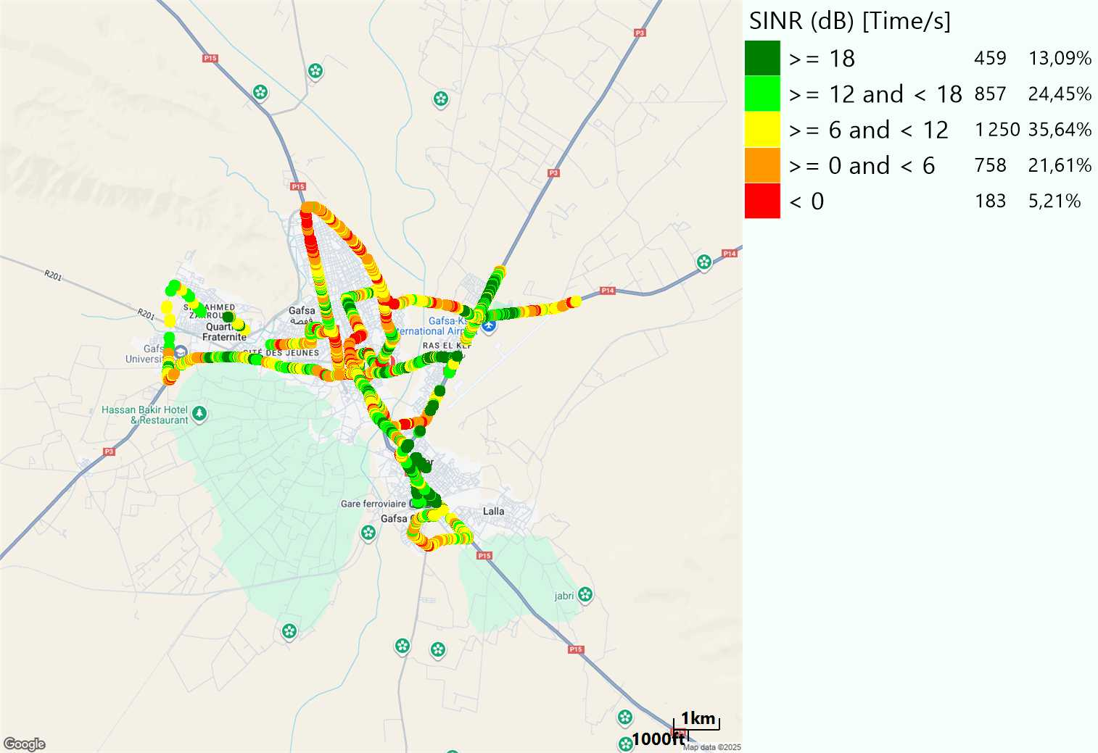
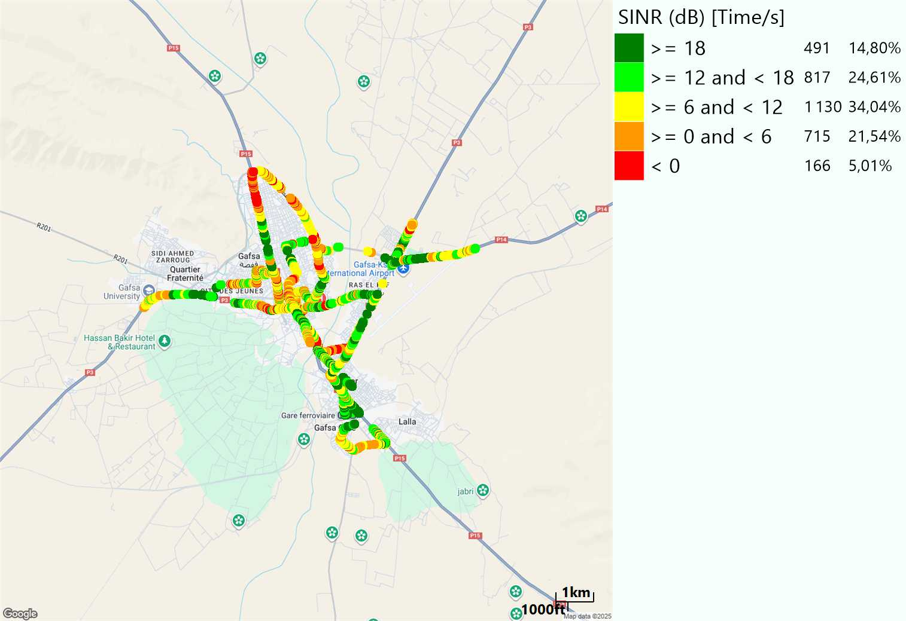
LTE-SINR
Long call
Short call

Slide 9
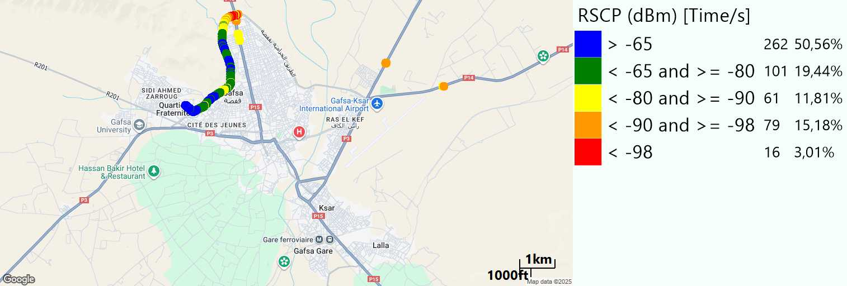
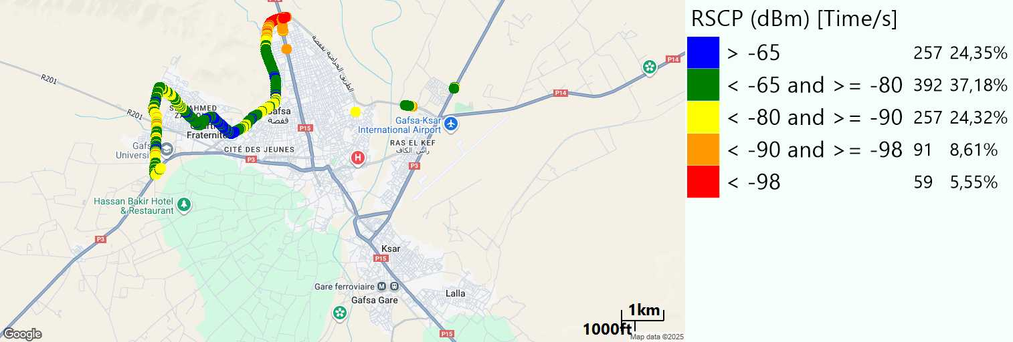
RSCP
Long call
Short call

Slide 10
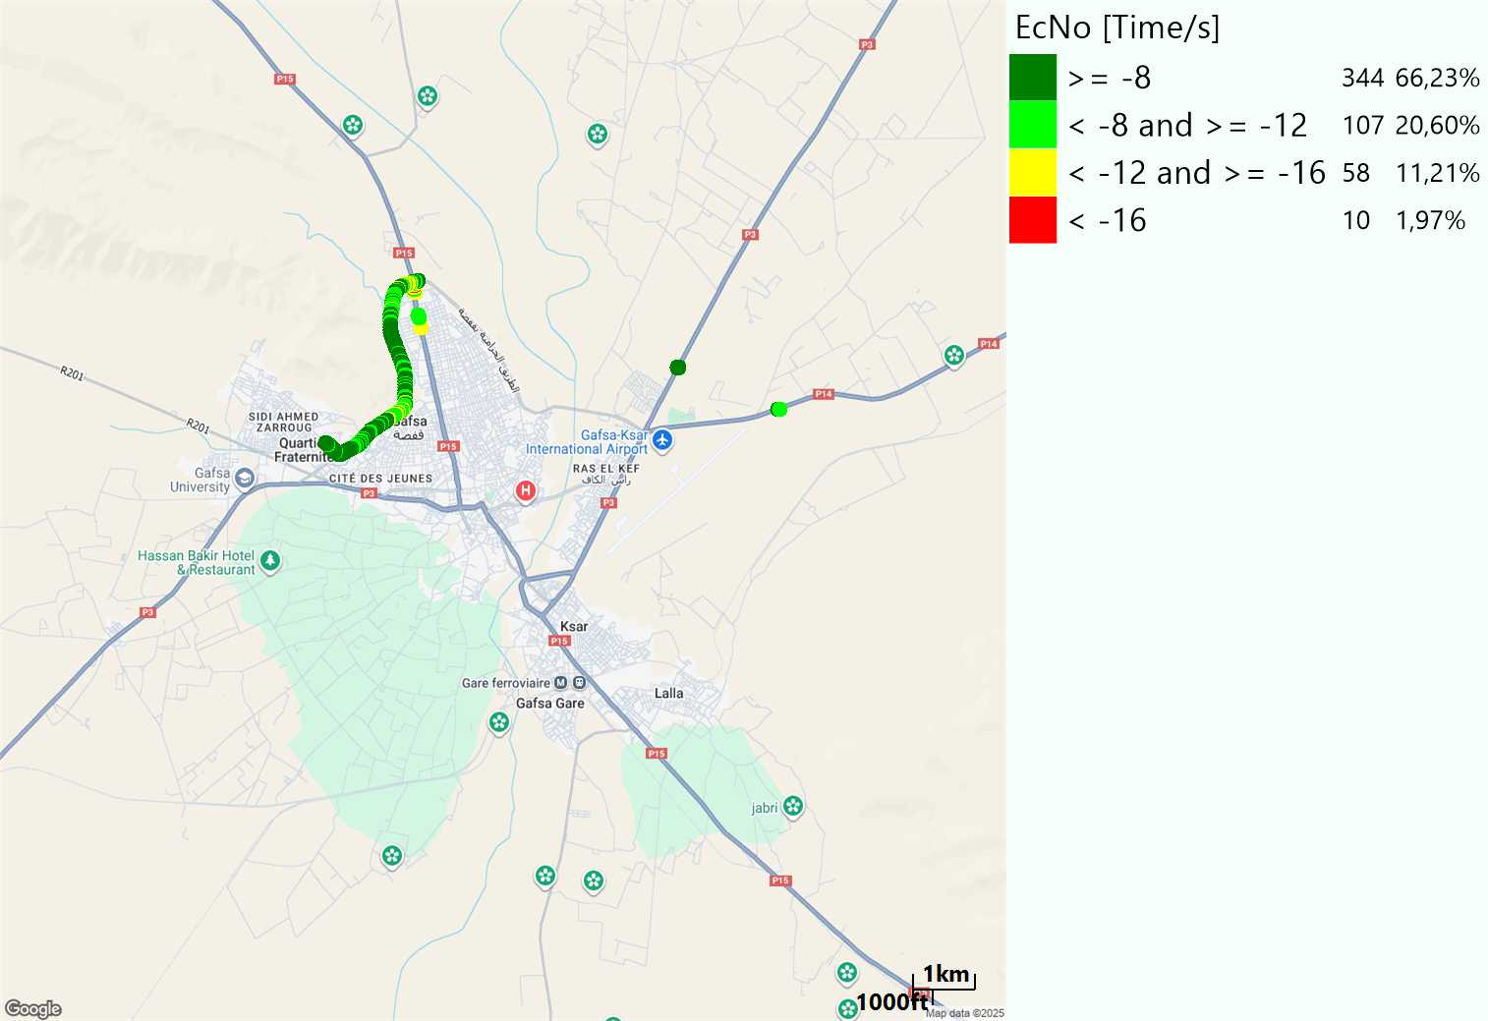
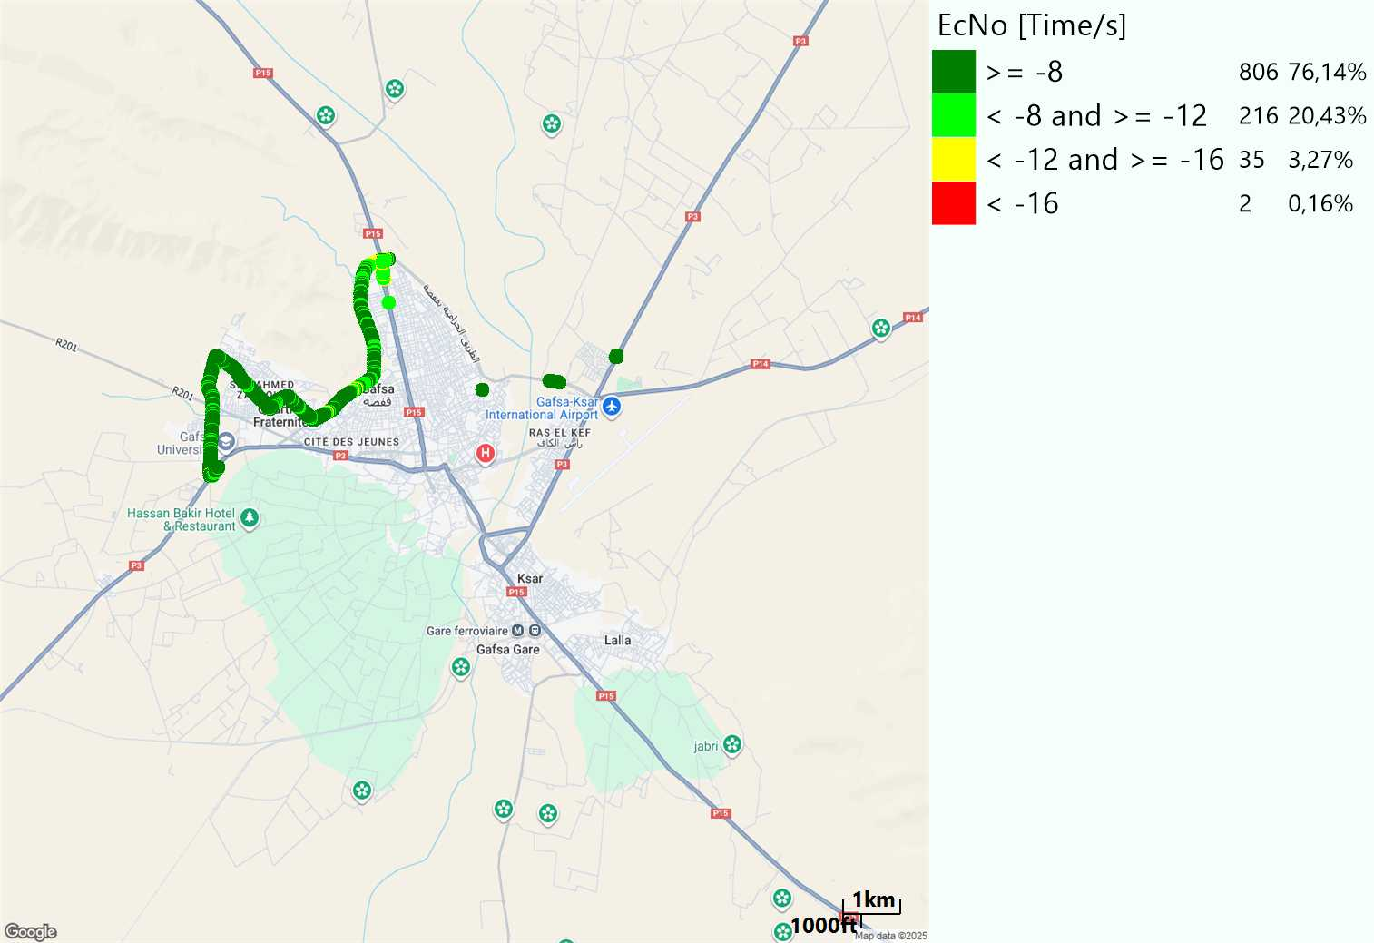
WCDMA-Ec/NO
Long call
Short call

Slide 11
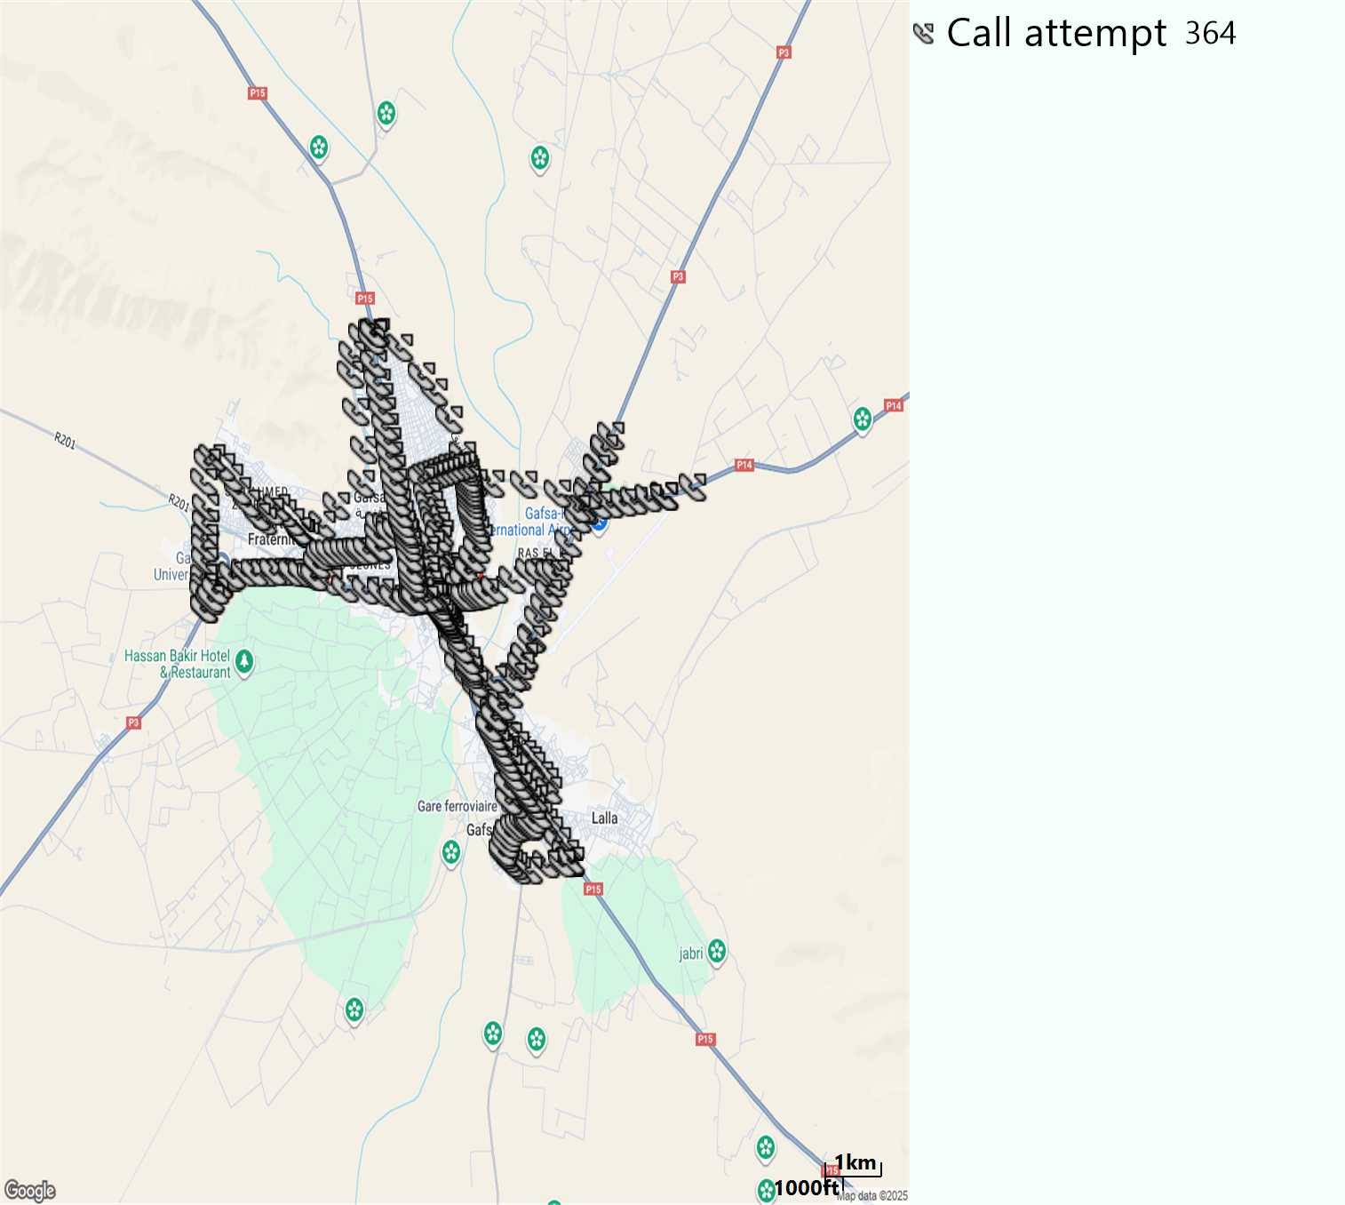
MO Call Setup Time (call setup time in VoLTE)
Short call
Call Setup Time IMS Voice
Average (Sec) | Maximum (Sec) | Minimum (Sec)
3,1 | 8 | 1,9

Slide 12
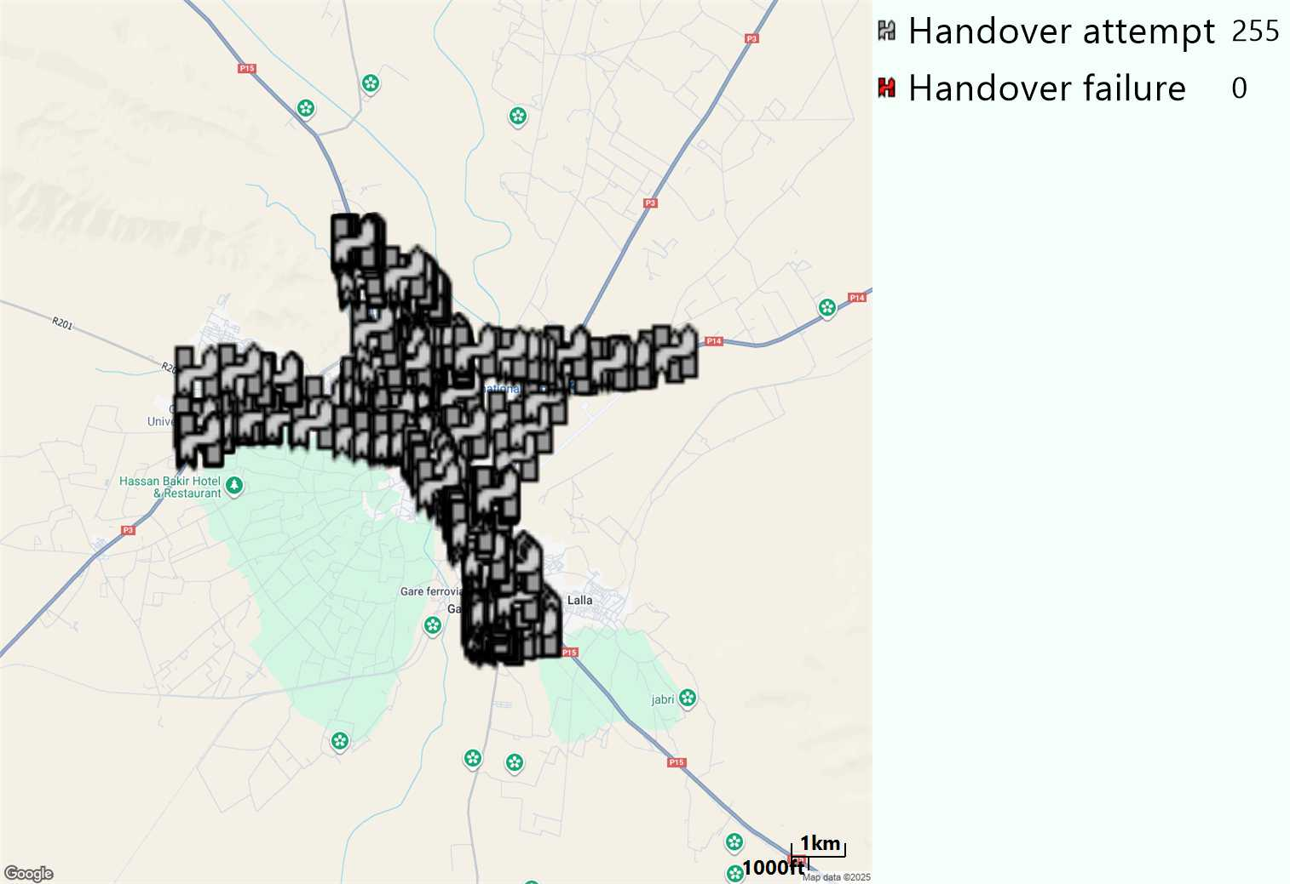
MO Handover Type
Long call
HO Type | Percentage [%]
LTE Inter-Frequency handover | 7,1%
LTE Intra-Frequency handover | 92,15%
UMTS to LTE | 0,78%
Handover KPI’s
Handover Attemps | 255
Handover Success | 255
Handover succès Rate | 100%
Étiquettes de lignes | LTE FDD_1800 | LTE FDD_2100 | LTE FDD_800 | Total général
LTE FDD_1800 | 141 | 5 | 2 | 148
LTE FDD_2100 | 3 | 49 | 2 | 54
LTE FDD_800 | 6 |  | 45 | 51
UMTS FDD_900 |  |  | 2 | 2
Total général | 150 | 54 | 51 | 255

Slide 13
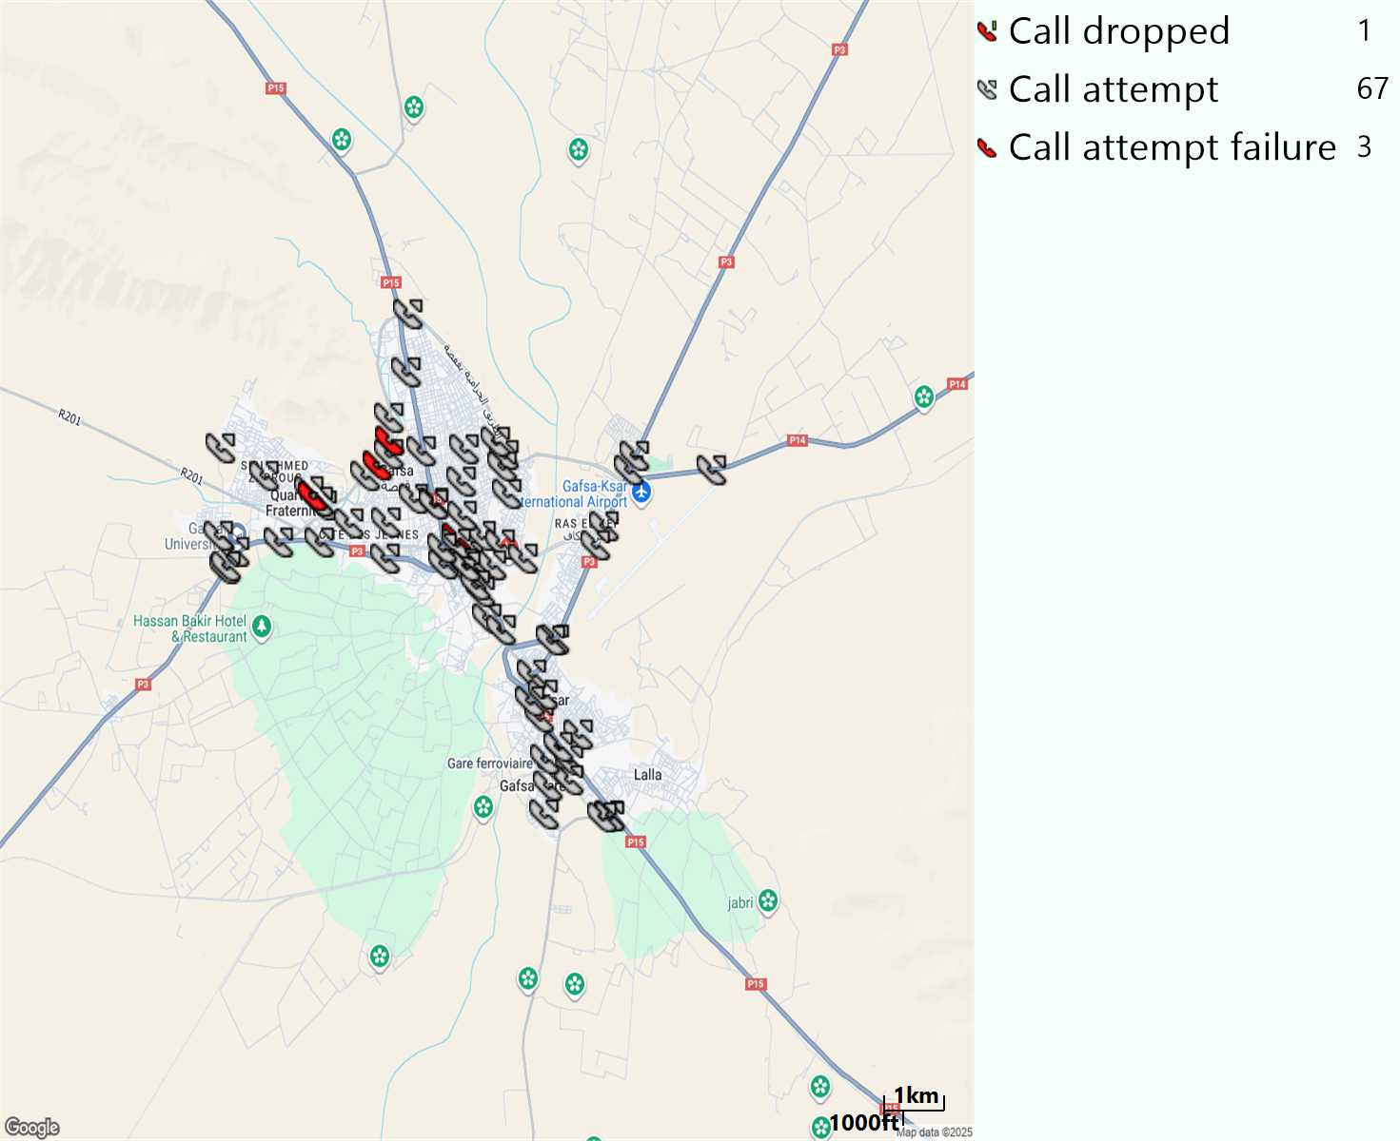
MO Voice Stats (VoLTE call stats)
Long call
Voice KPIs
Number Call Attempts | 67
Number Dropped Calls | 1
Call Drop Rate (%) | 1,49%
HO success rate | 100%

Slide 14
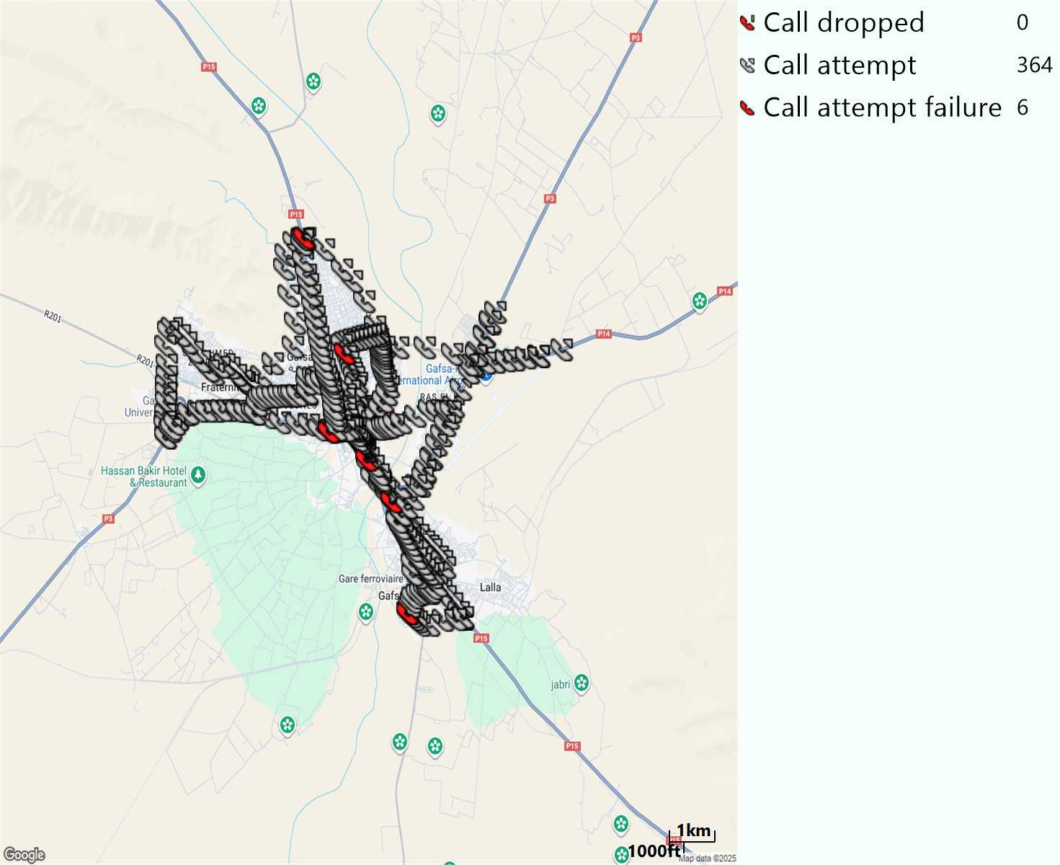
MO Voice Stats (VoLTE call stats)
Short call
Voice KPIs
Number Call Attempts | 364
Number Call Setup | 358
Number Blocked Calls | 6
Setup Succes Rate (%) | 98,35%
Call Block Rate (%) | 1,65%
Call Setup Time IMS Voice Average (Sec) | 3,1

Slide 15
MO Voice Stats (VoLTE call stats)
KPIs
VoLTE Call Setup SR | 98,35%
Call Setup Time | 3,1
VoLTE Drop Call Rate | 1,49%
Speech Quality - MOS (% of the samples >3,5) | 88,74%
Average MOS | 4,11
VoLTE Handover SR | 100%
VoLTE SRVCC SR | 100%

Slide 16
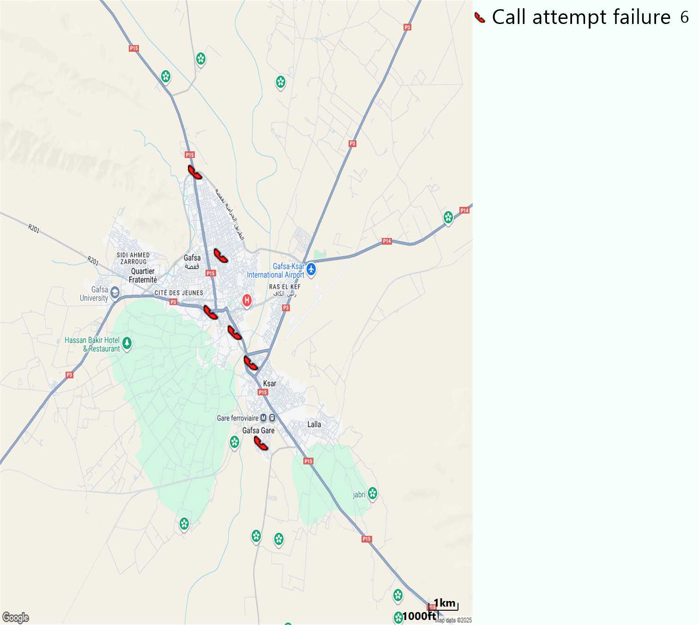
MO Voice Call - Blocked call
Short call

Slide 17
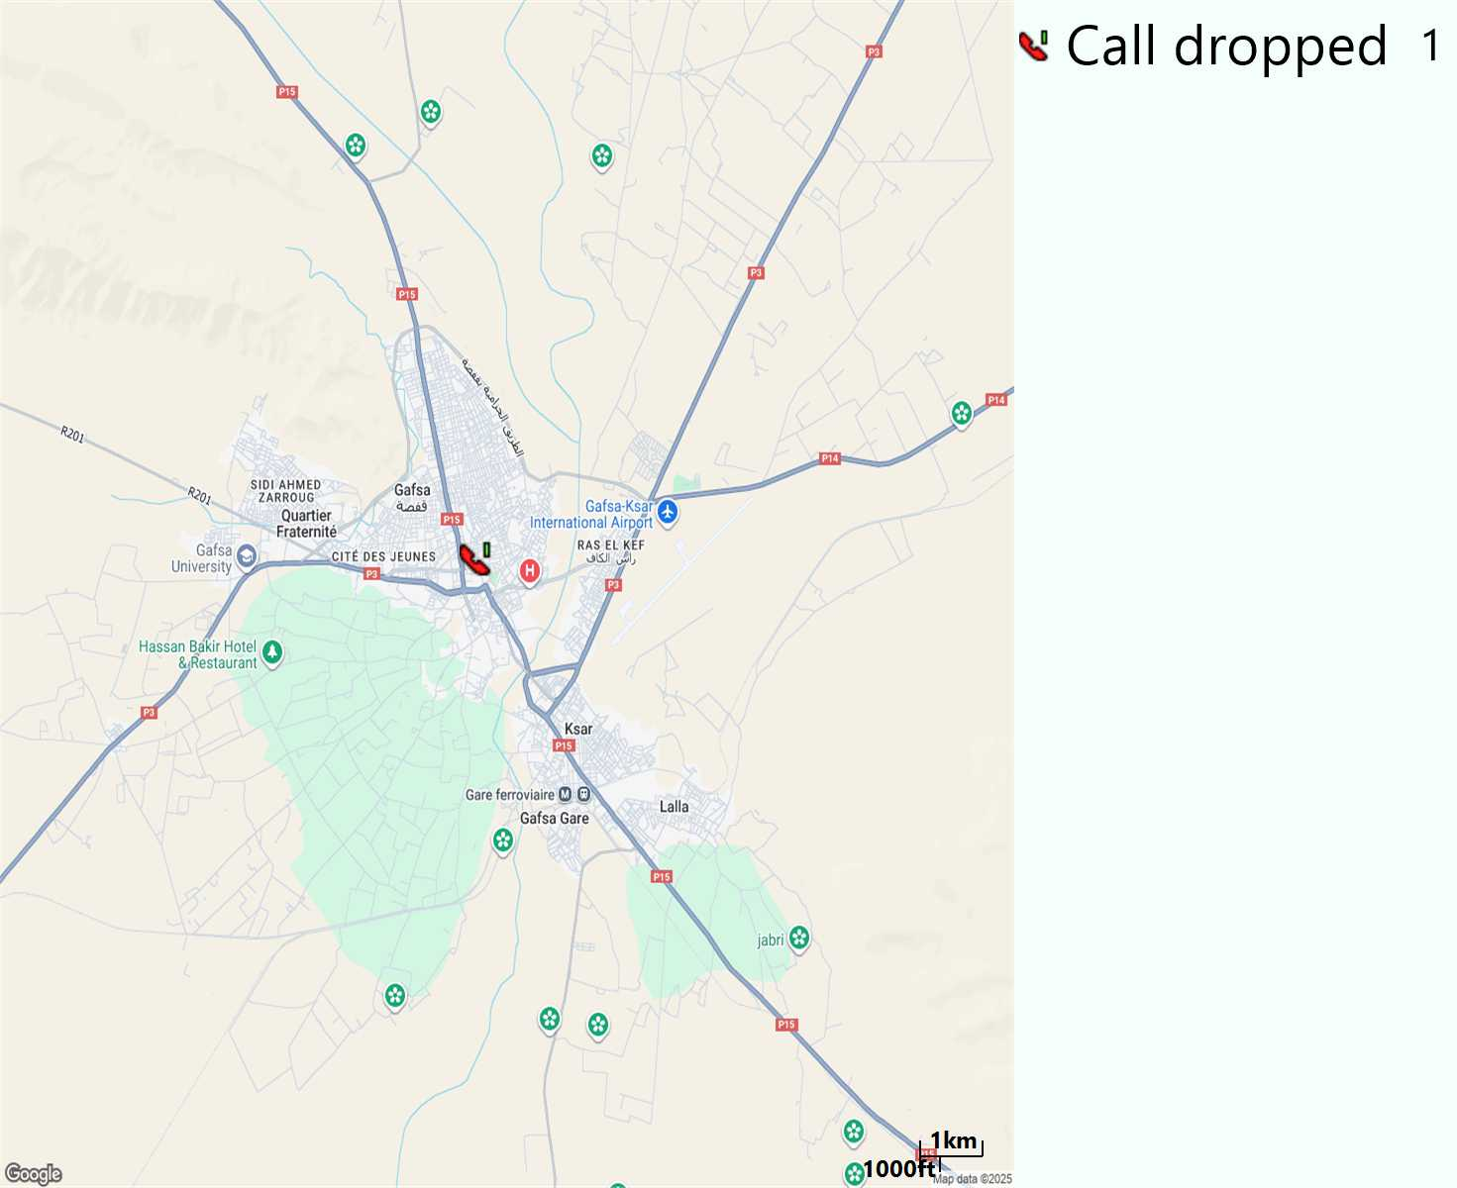
MO Voice Call - Dropped call
Long call

Slide 18
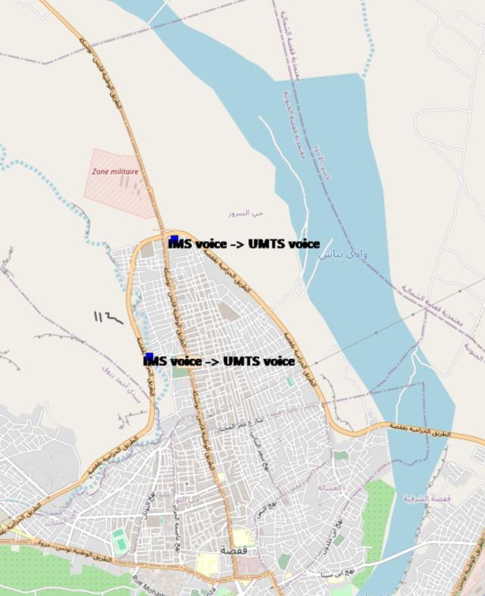
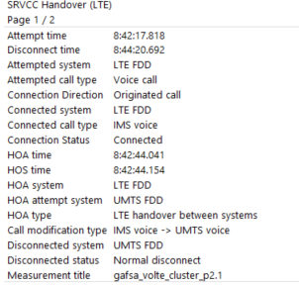
VoLTE SRVCC Success Rate long Call
Attempted system | Attempted call type | Connection Direction | Connected system | Connected call type | Connection Status | HOA time | HOS time | HOA system | HOA attempt system | HOA type | Call modification type | Disconnected system | Disconnected status | Measurement title
LTE FDD | Voice call | Originated call | LTE FDD | IMS voice | Connected | 42:44,0 | 42:44,2 | LTE FDD | UMTS FDD | LTE handover between systems | IMS voice -> UMTS voice | UMTS FDD | Normal disconnect | gafsa_volte_cluster_p2.1
LTE FDD | Voice call | Originated call | LTE FDD | IMS voice | Connected | 06:41,7 | 06:41,8 | LTE FDD | UMTS FDD | LTE handover between systems | IMS voice -> UMTS voice | UMTS FDD | Normal disconnect | gafsa_volte_cluster_p3.1

Slide 19
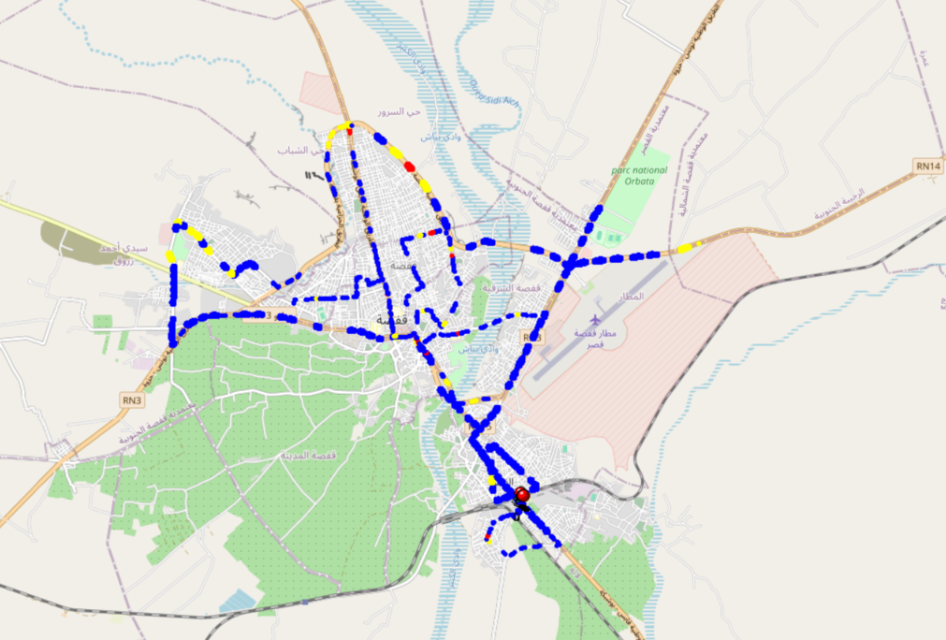

MO Voice Quality Metrics
long Call

Slide 20
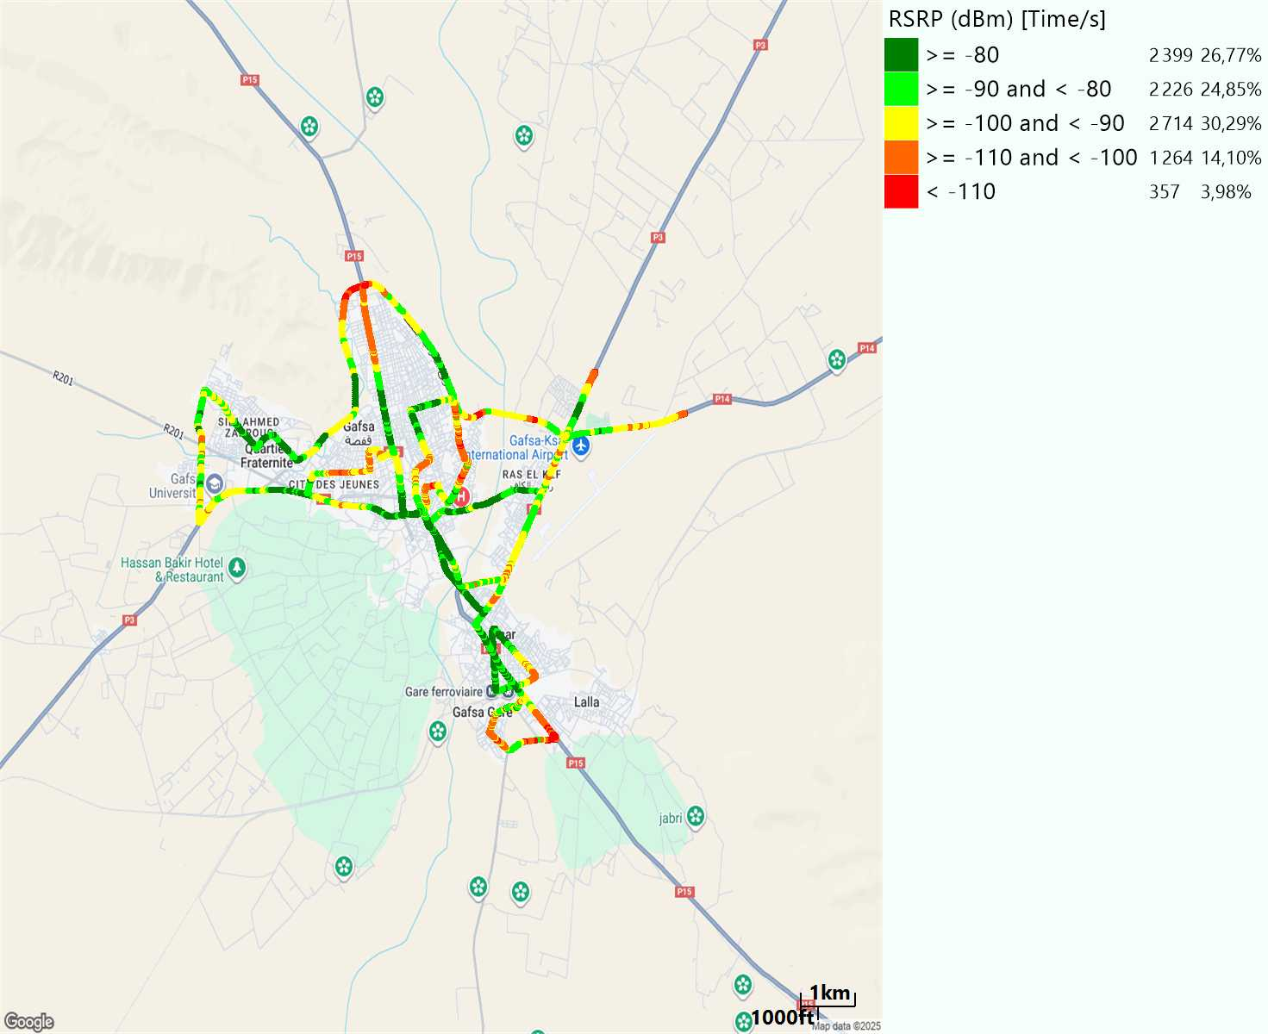
Scanner_RSRP
L2100

Slide 21
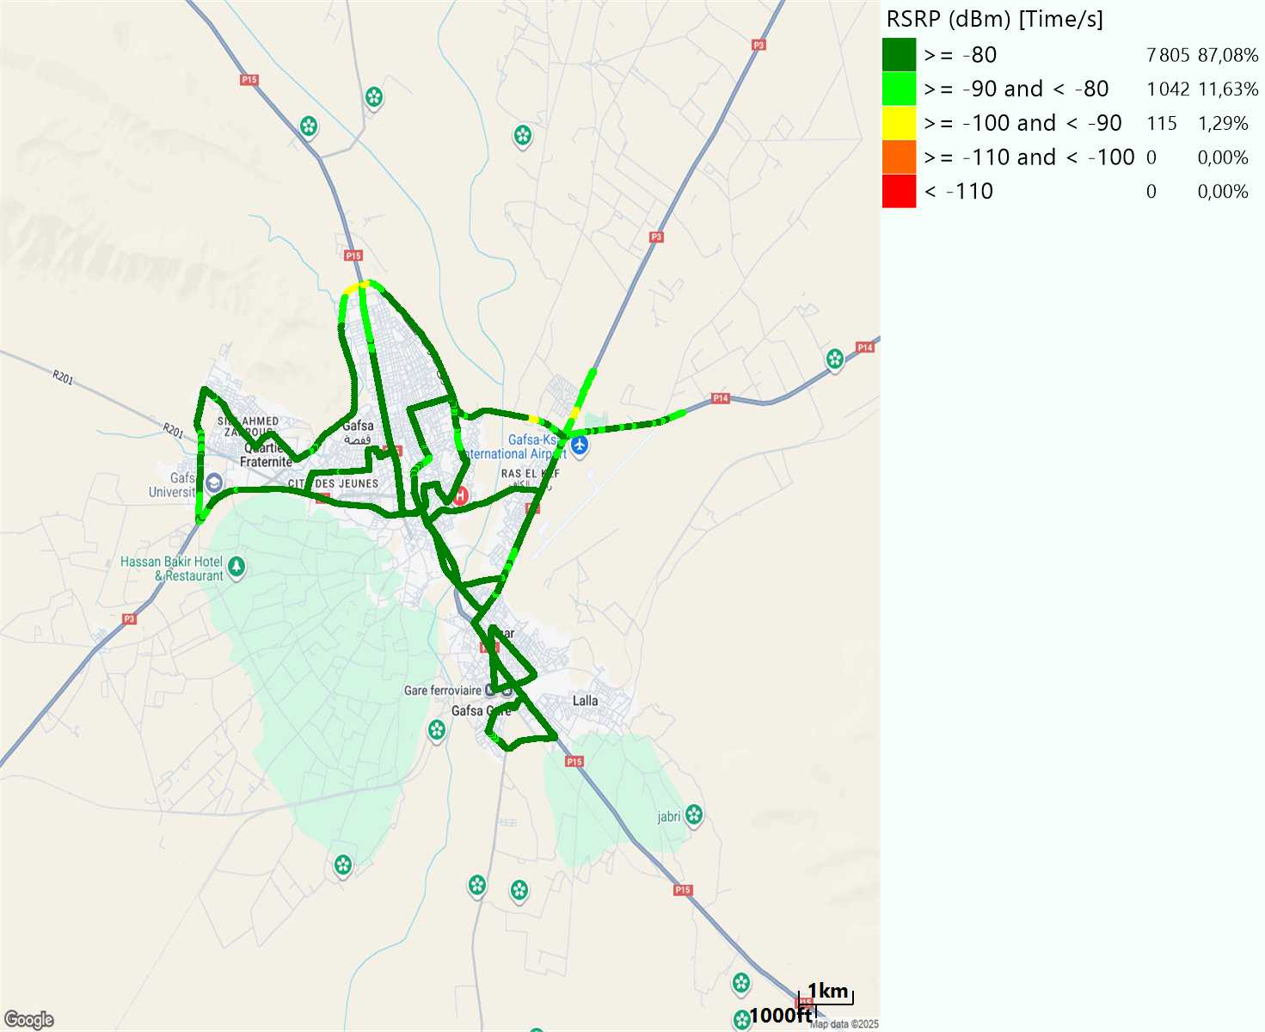
Scanner_RSRP
L800

Slide 22
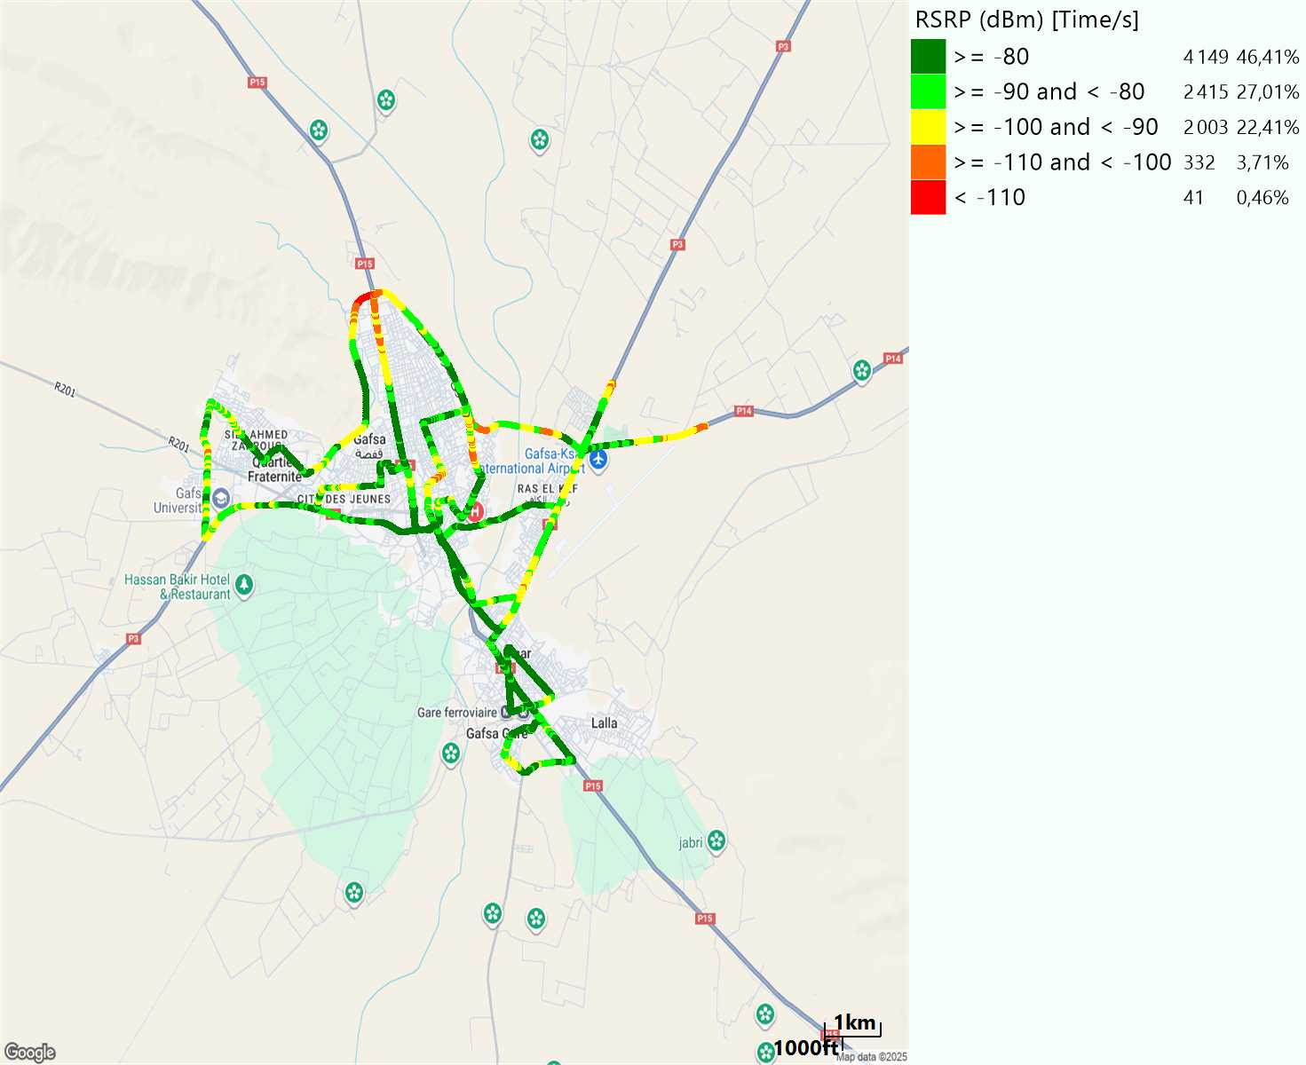
Scanner_RSRP
L1800

Slide 23
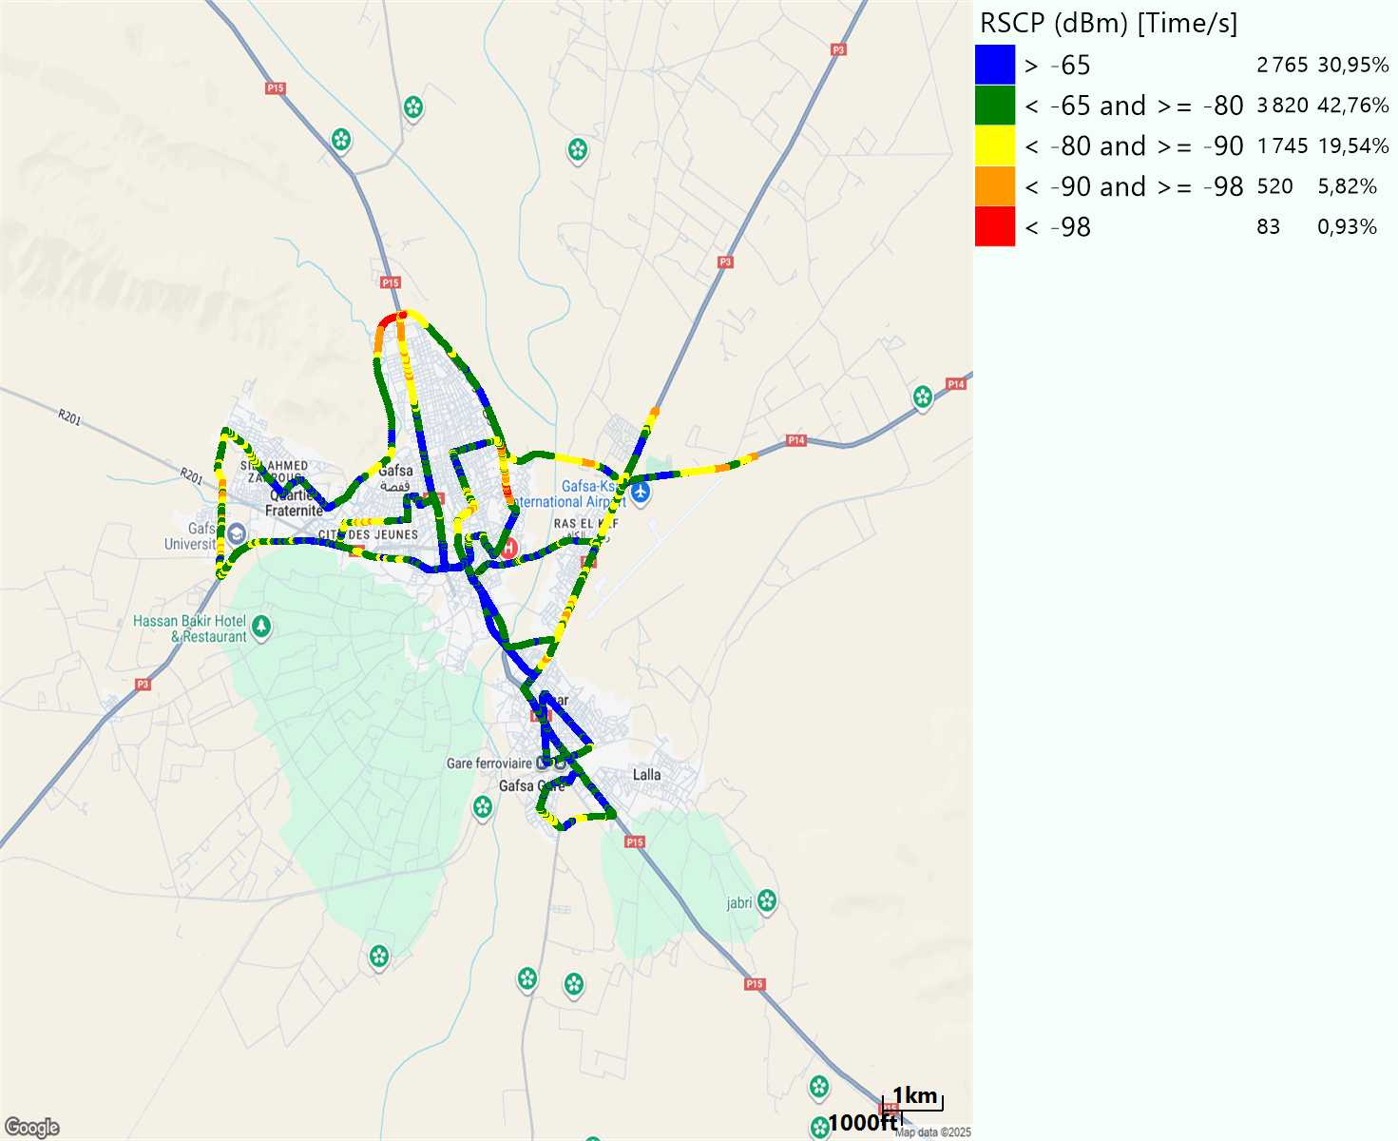
Scanner_RSCP
U2100

Slide 24
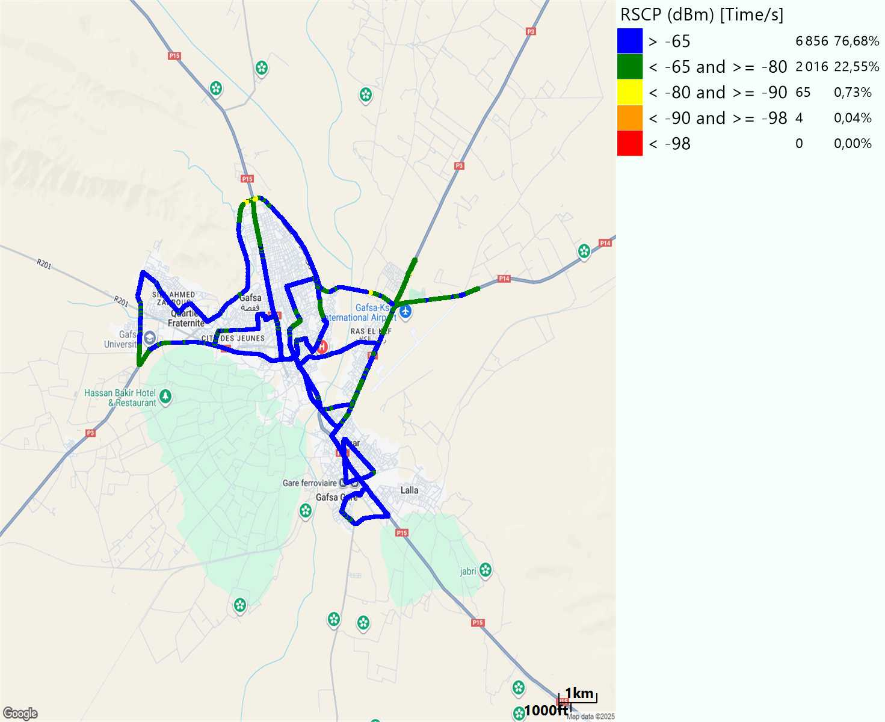
Scanner_RSCP
900

