Slide 1


Volte Drive Test Report

Slide 2
DT Scénario
Short Call (10s)
Long call (2min)
Scanner

Slide 3
Voice Call

Slide 4
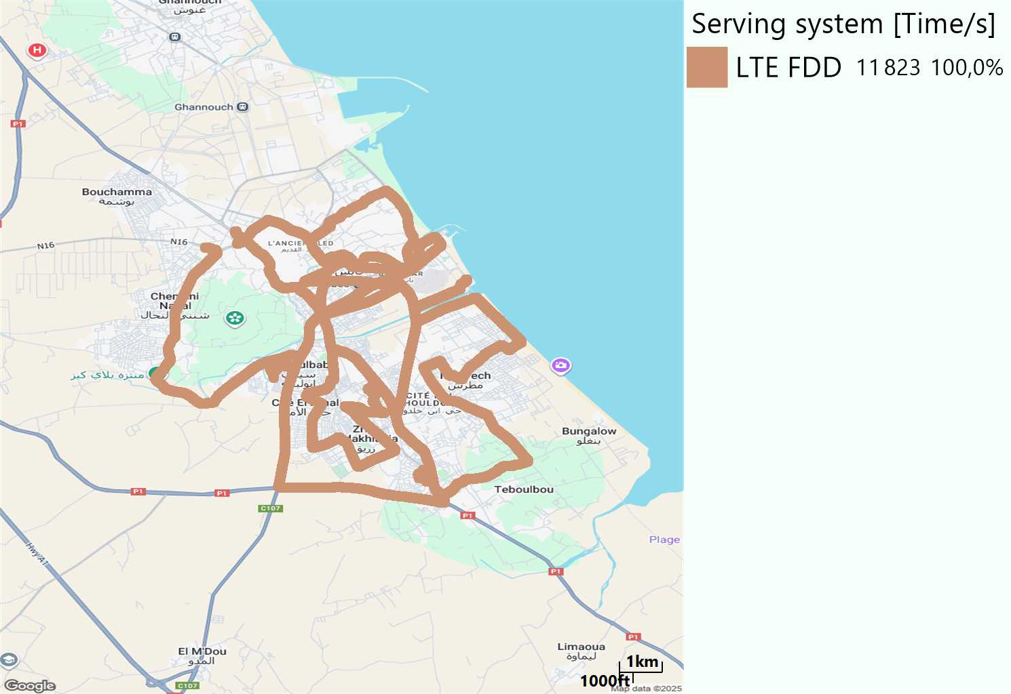
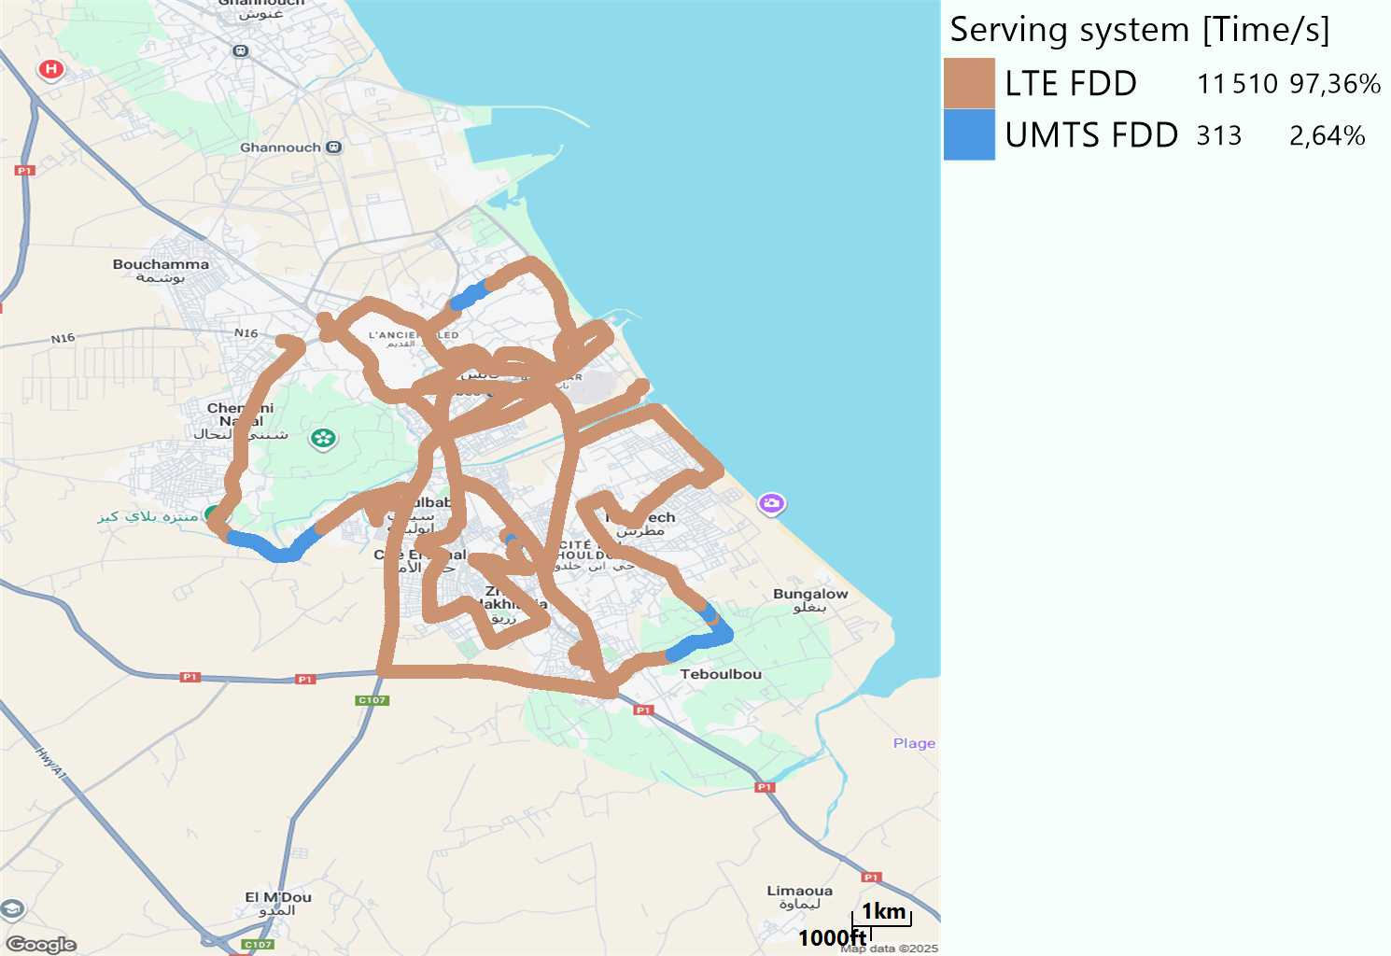
RAT distribution
Long call
Short call

Slide 5
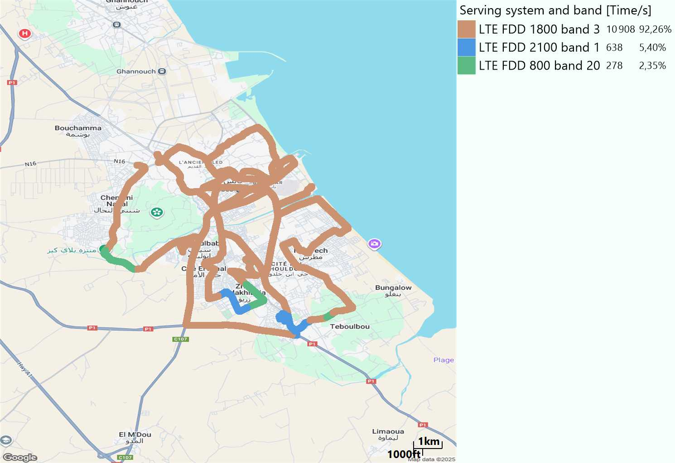
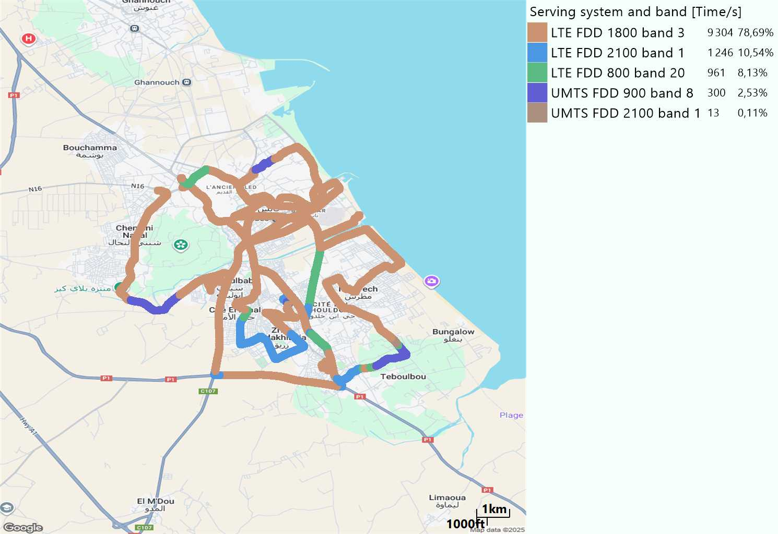
EARFCN distribution
Long call
Short call

Slide 6
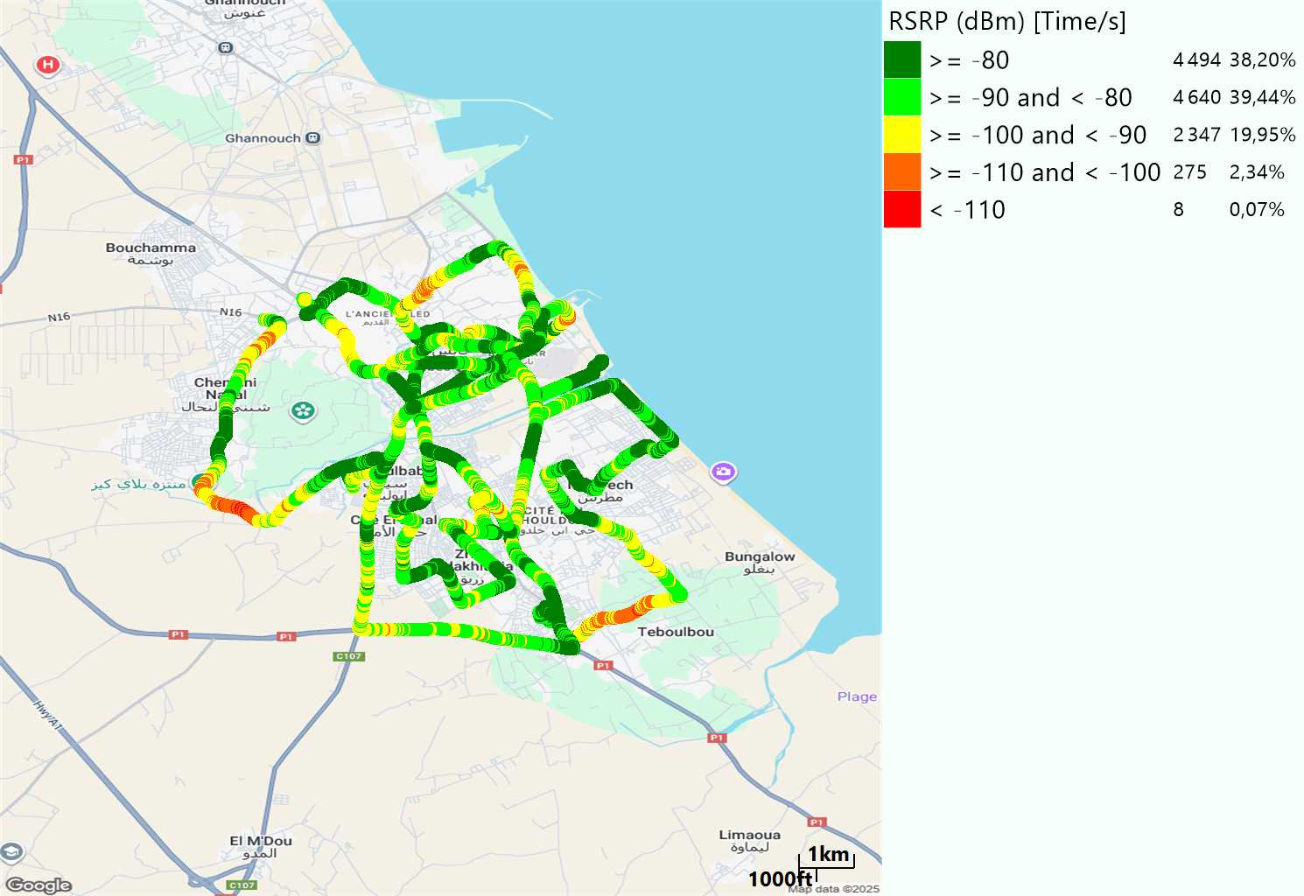

LTE - RSRP
Long call
Short call
Average [dBm]
-82,45
Average [dBm]
-83,76

Slide 7
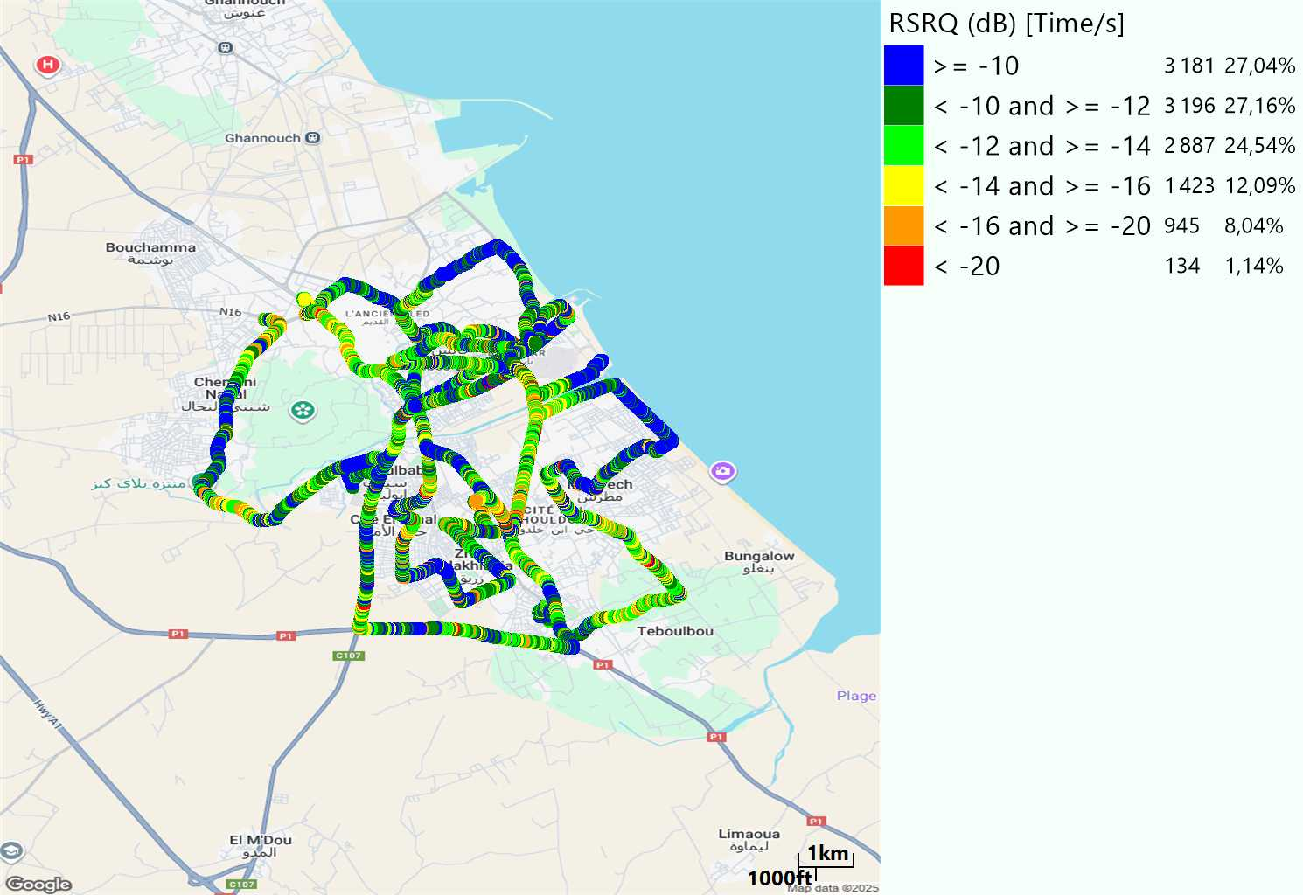
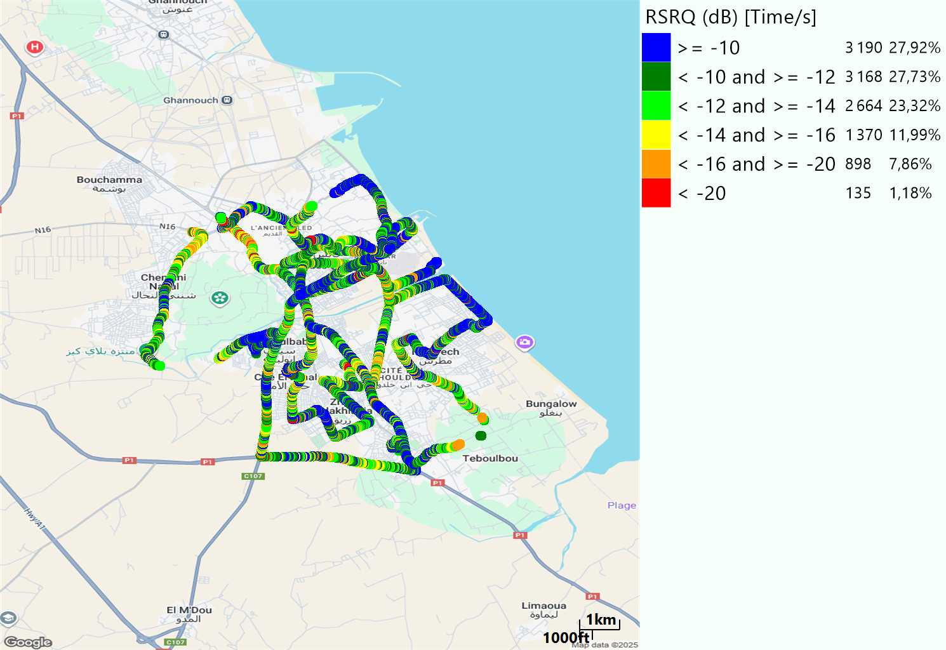
LTE- RSRQ
Long call
Short call

Slide 8
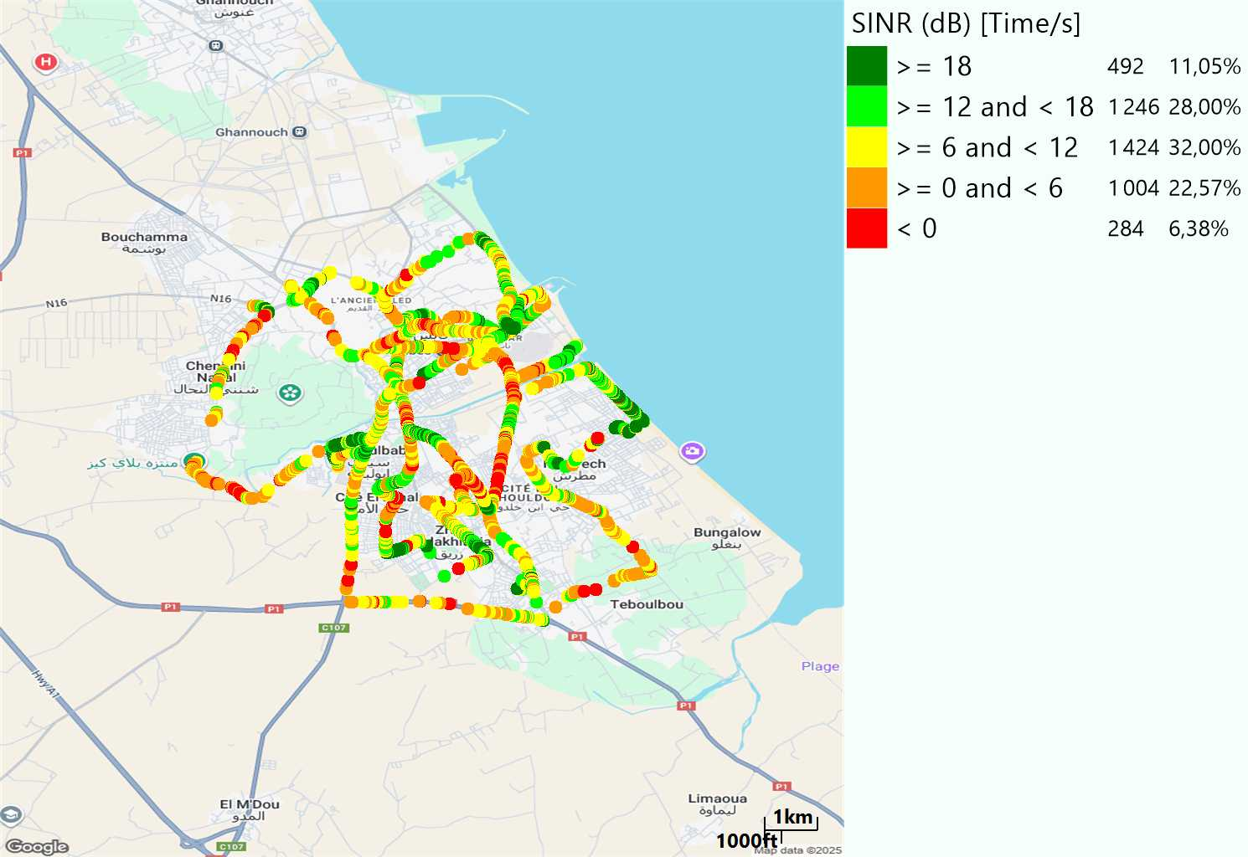
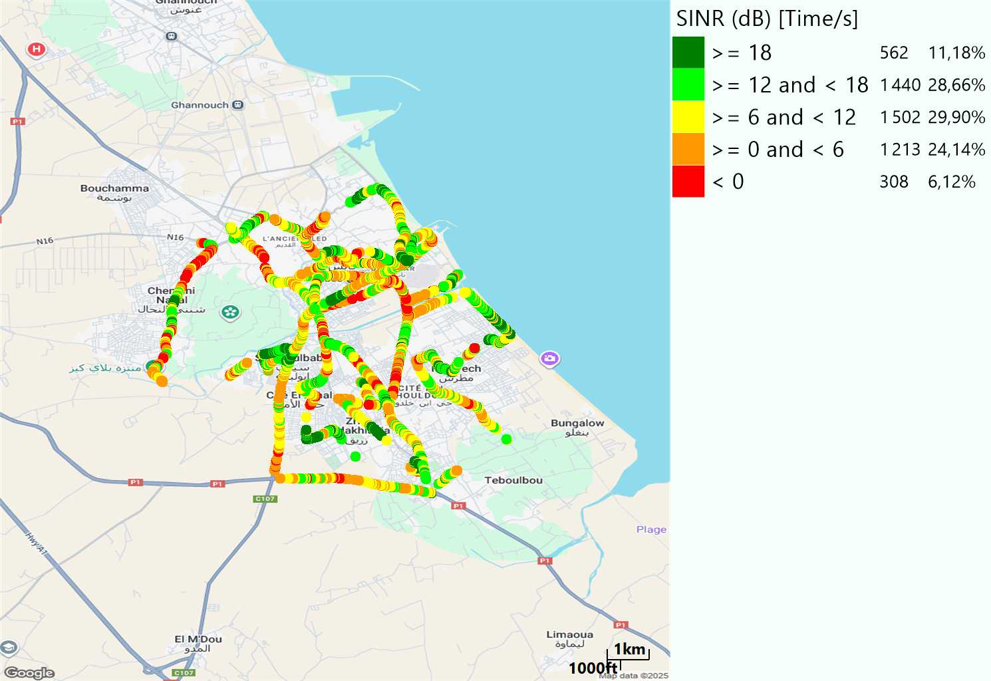
LTE-SINR
Long call
Short call

Slide 9
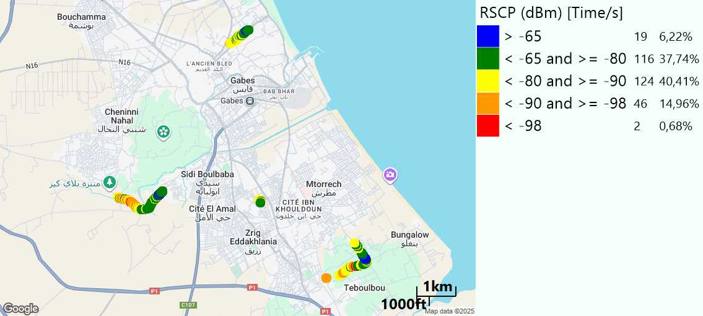
RSCP
Short call

Slide 10
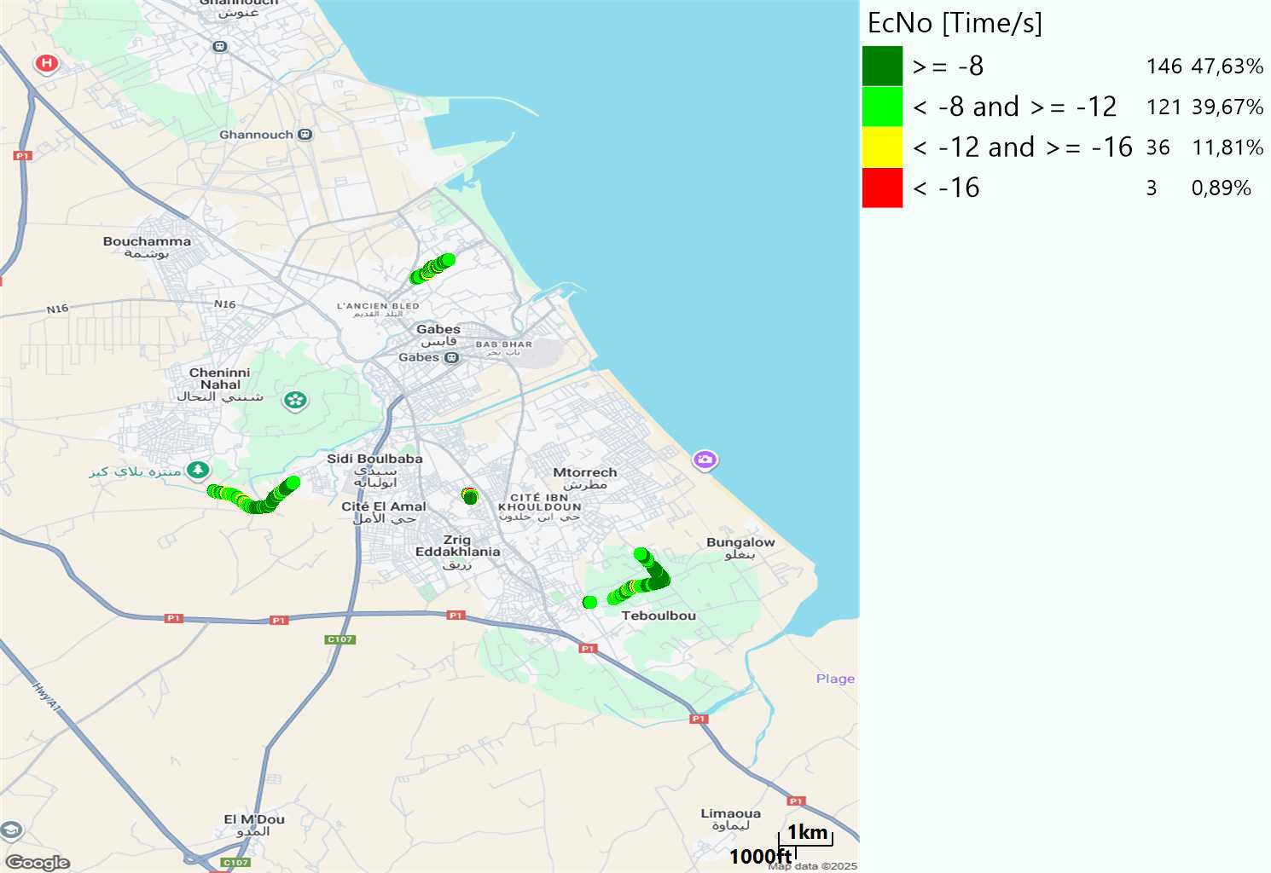
WCDMA-Ec/NO
Short call

Slide 11
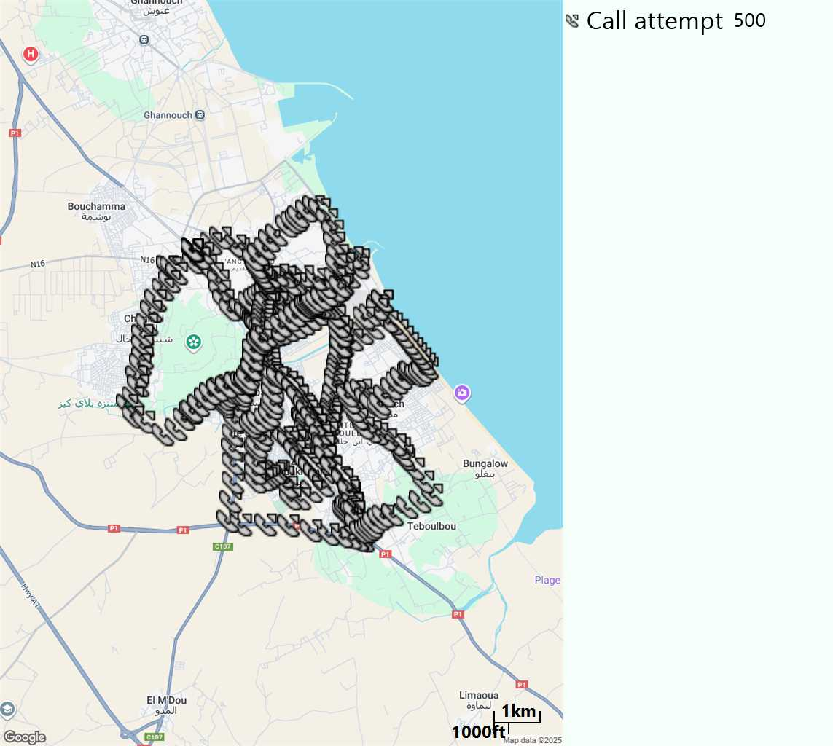
MO Call Setup Time (call setup time in VoLTE)
Short call
Call Setup Time IMS Voice
Average (Sec) | Maximum (Sec) | Minimum (Sec)
3,05 | 18,42 | 1,99

Slide 12
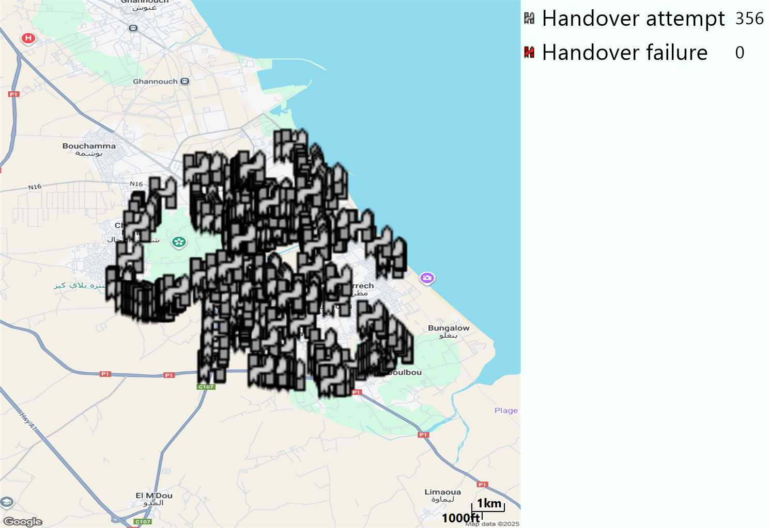
MO Handover Type
Long call
HO Type | Percentage [%]
LTE Inter-Frequency handover | 3,37%
LTE Intra-Frequency handover | 96,62%
Handover KPI’s
Handover Attemps | 356
Handover Success | 356
Handover succès Rate | 100%
Étiquettes de lignes | LTE FDD_1800 | LTE FDD_2100 | LTE FDD_800 | Total général
LTE FDD_1800 | 314 | 3 | 2 | 319
LTE FDD_2100 | 2 | 12 | 1 | 15
LTE FDD_800 | 4 |  | 18 | 22
Total général | 320 | 15 | 21 | 356

Slide 13
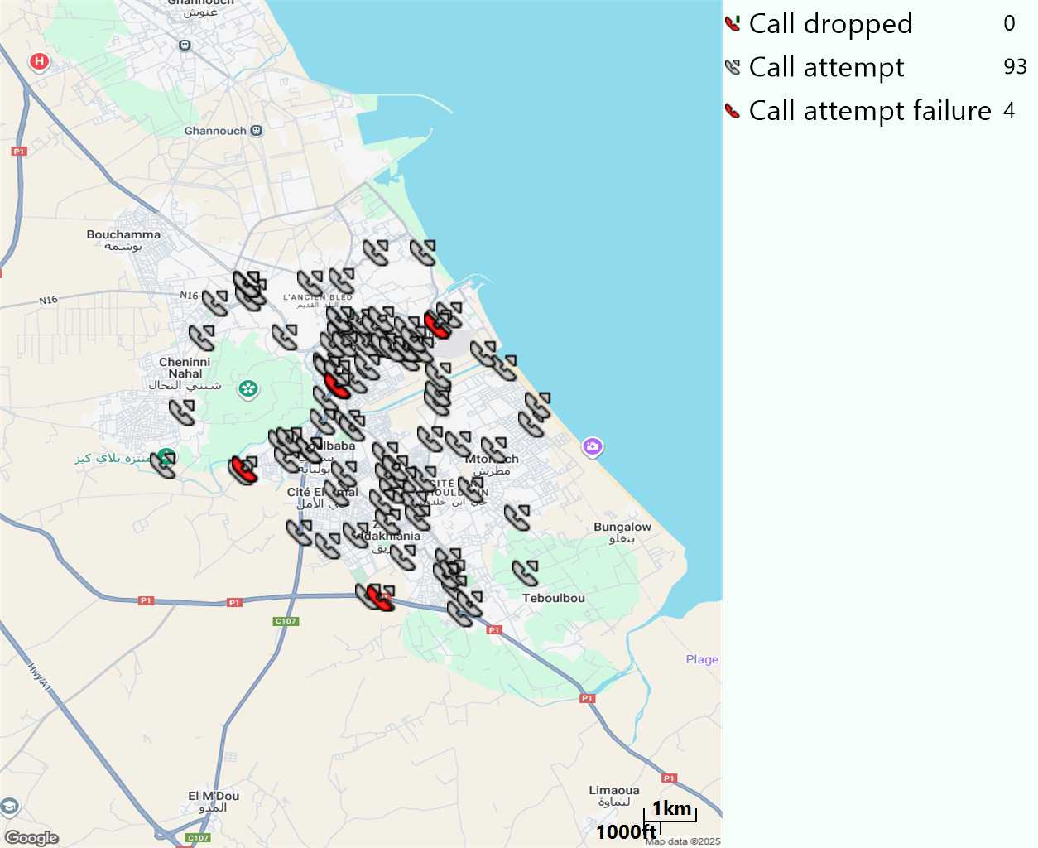
MO Voice Stats (VoLTE call stats)
Long call
Voice KPIs
Number Call Attempts | 93
Number Dropped Calls | 0
Call Drop Rate (%) | 0%
HO success rate | 100%

Slide 14
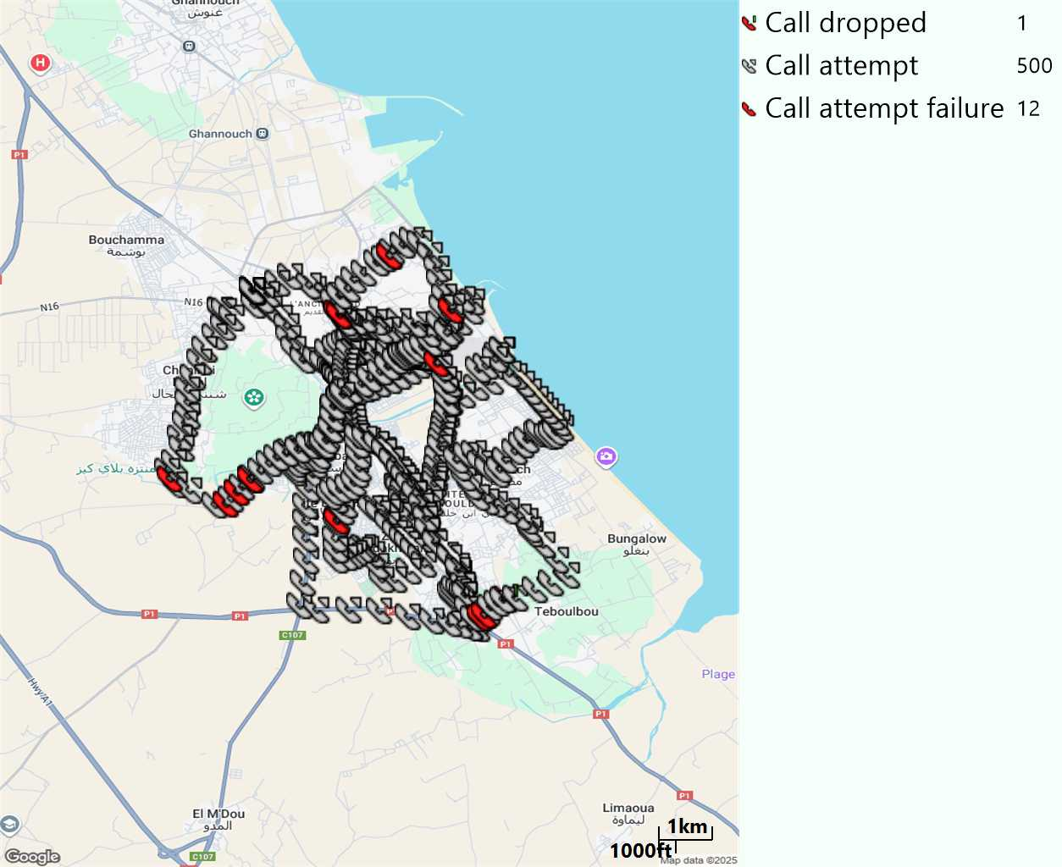
MO Voice Stats (VoLTE call stats)
Short call
Voice KPIs
Number Call Attempts | 500
Number Call Setup | 488
Number Blocked Calls | 12
Setup Succes Rate (%) | 97,6%
Call Block Rate (%) | 2,4%
Call Setup Time IMS Voice Average (Sec) | 3,05

Slide 15
MO Voice Stats (VoLTE call stats)
KPIs
VoLTE Call Setup SR | 97,6%
Call Setup Time | 3,05
VoLTE Drop Call Rate | 0%
Speech Quality - MOS (% of the samples >3,5) | 94,76%
Average MOS | 4,22
VoLTE Handover SR | 100%
VoLTE SRVCC SR | -

Slide 16
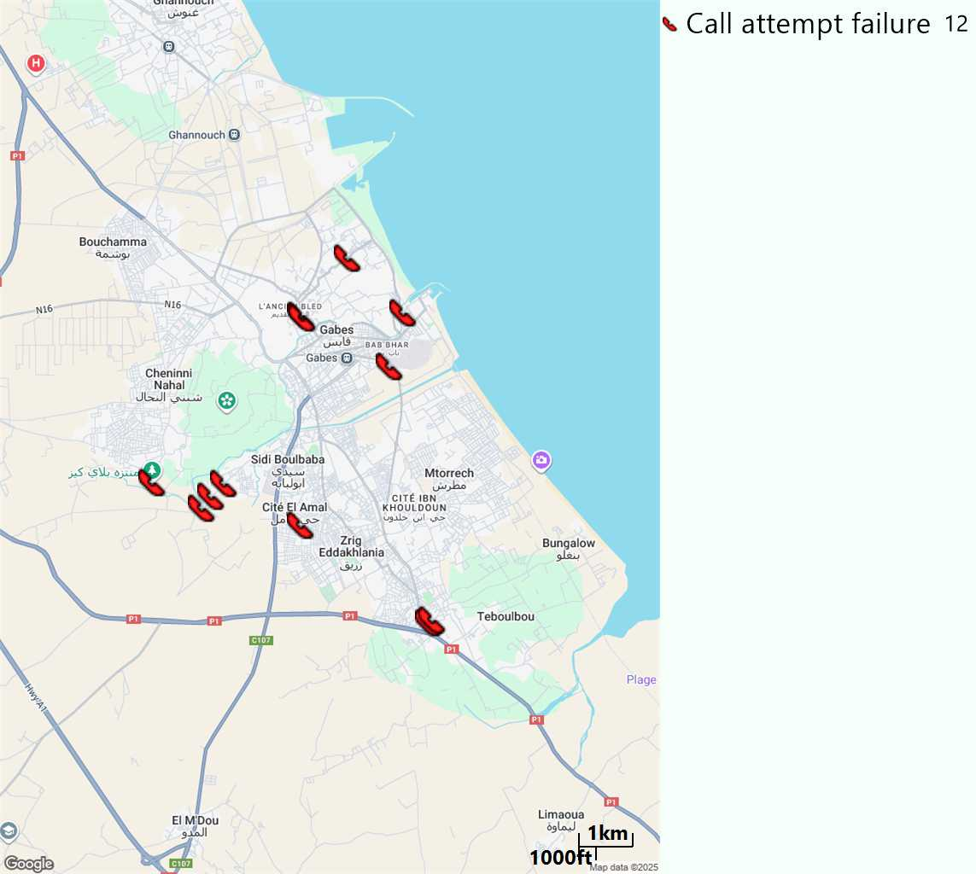
MO Voice Call - Blocked call
Short call

Slide 17
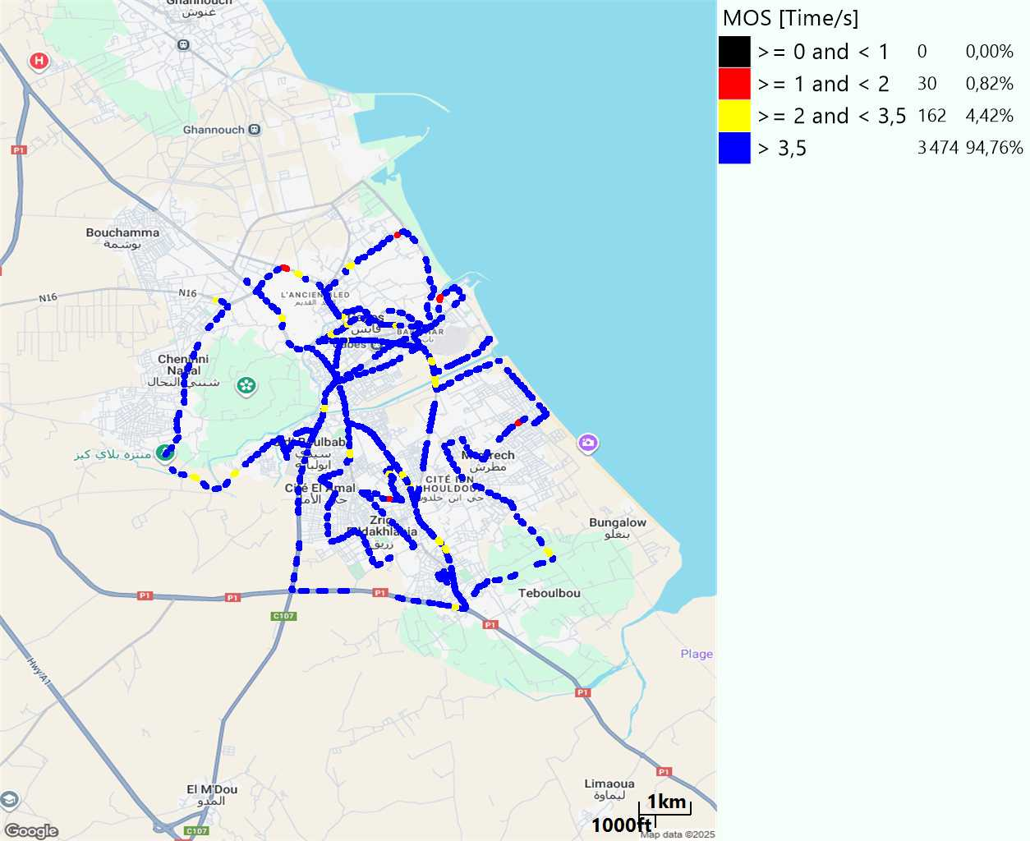
MO Voice Quality Metrics
long Call

Slide 18
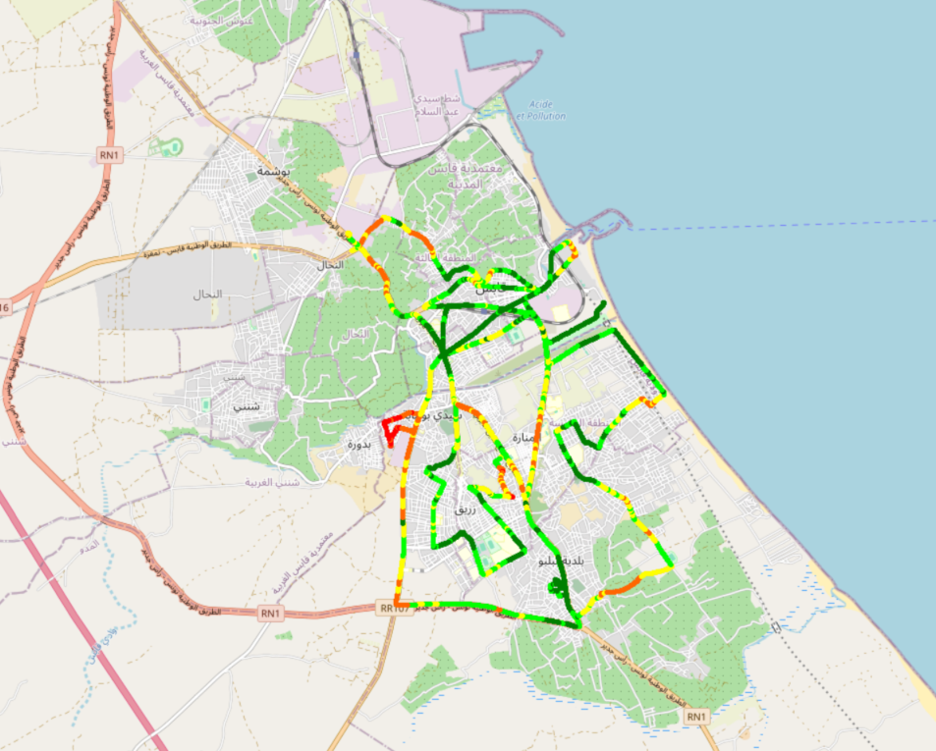
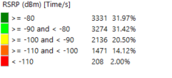
Scanner_RSRP
L2100

Slide 19
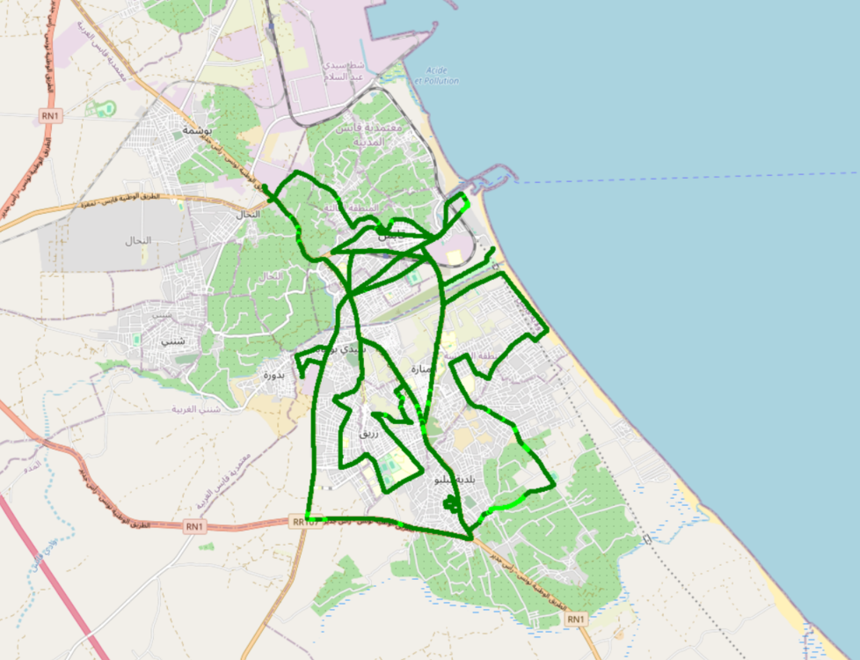
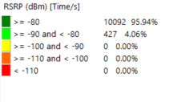
Scanner_RSRP
L800

Slide 20
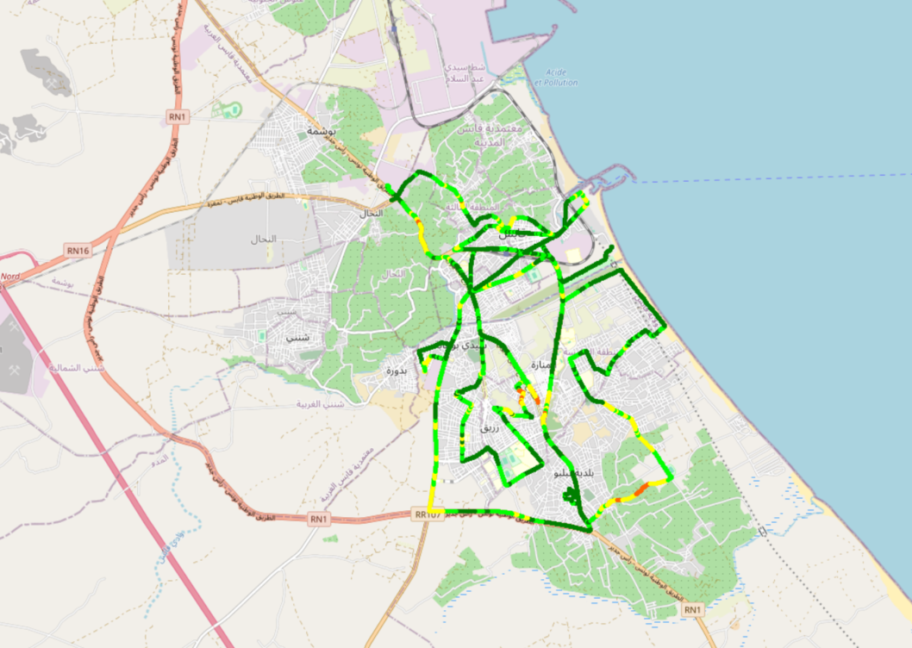
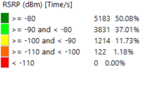
Scanner_RSRP
L1800

Slide 21
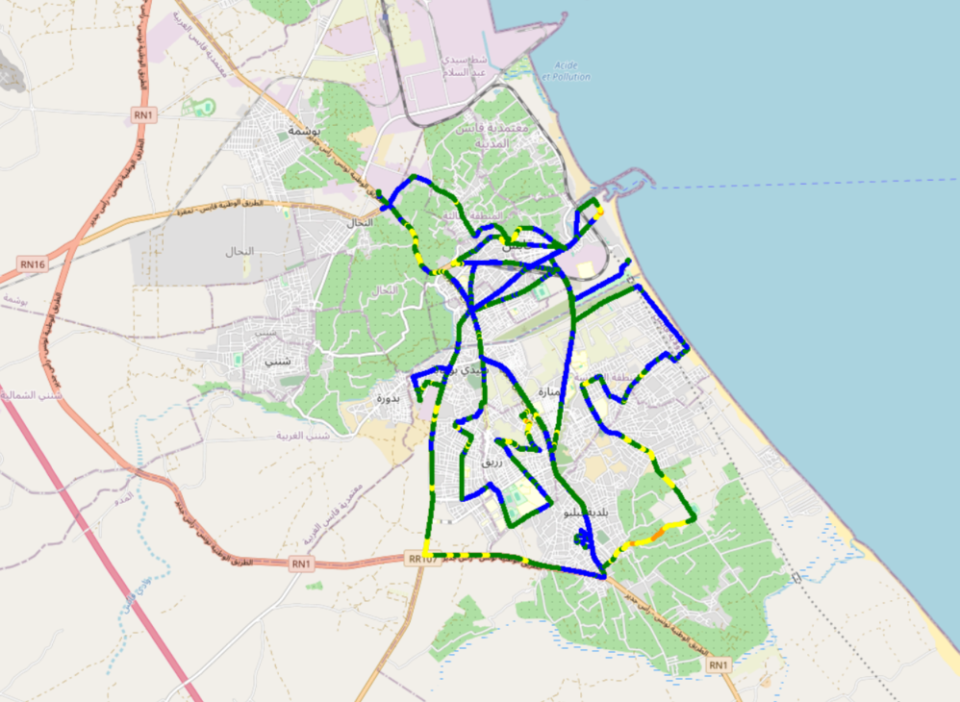
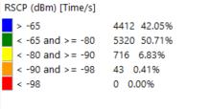
Scanner_RSCP
U2100

Slide 22
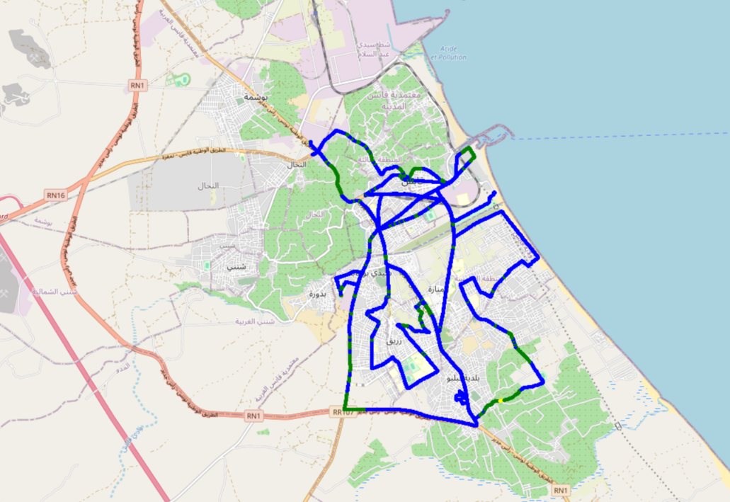
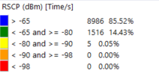
Scanner_RSCP
900

