Slide 1


Volte Drive Test Report

Slide 2
DT Scénario
Short Call (10s)
Long call (2min)
Scanner

Slide 3
Voice Call

Slide 4
Outbound

Slide 5
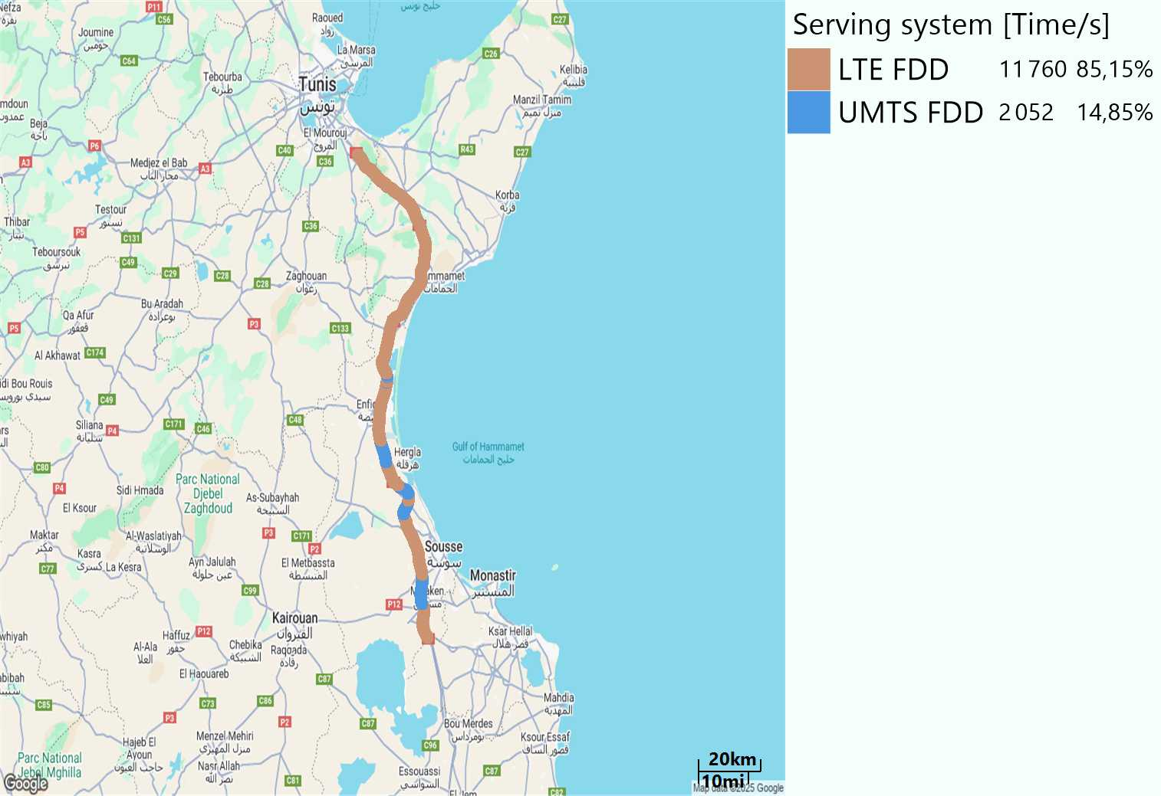
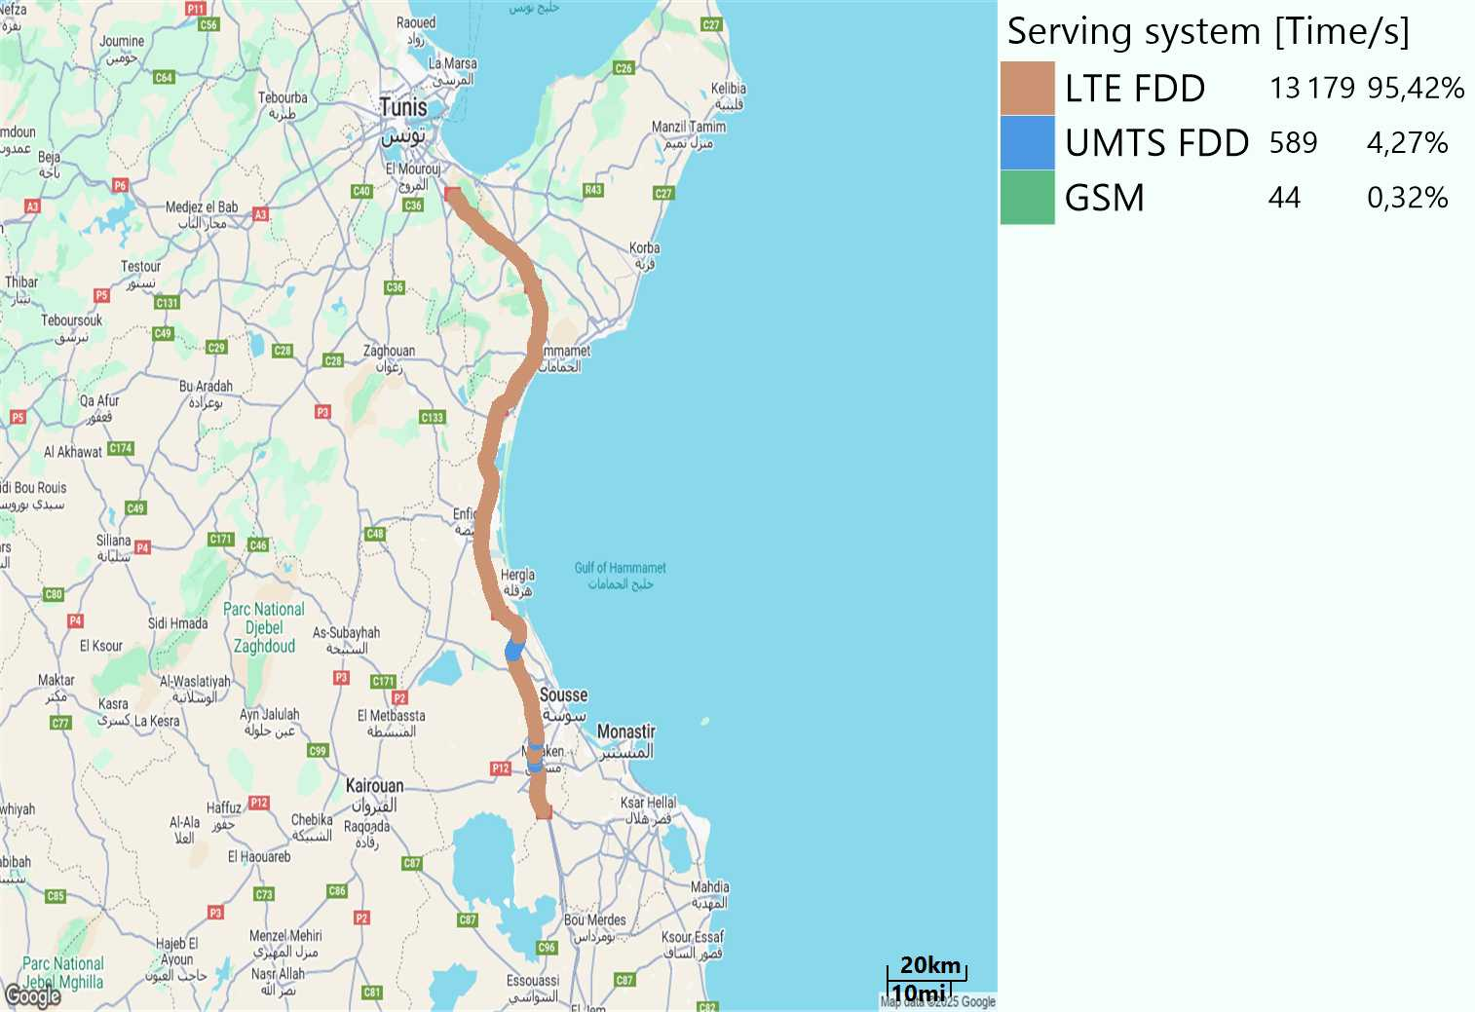
RAT distribution
Long call
Short call

Slide 6
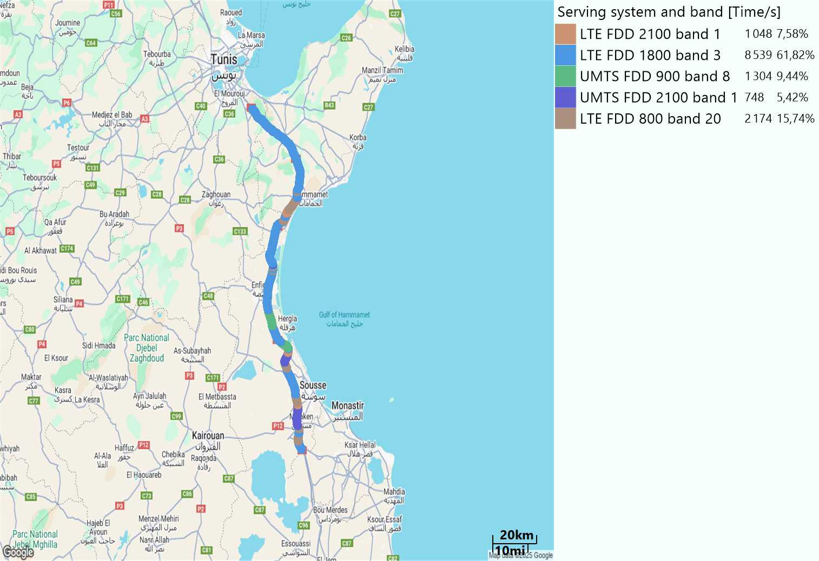

EARFCN distribution
Long call
Short call

Slide 7
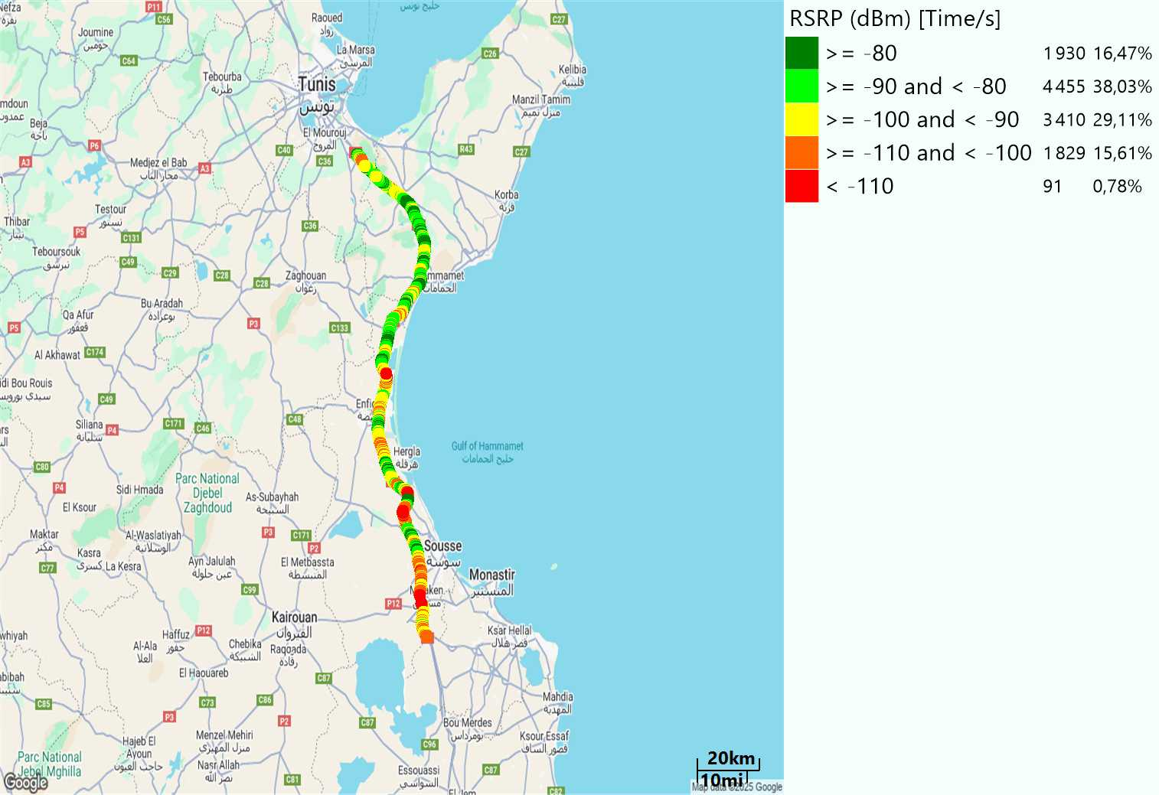
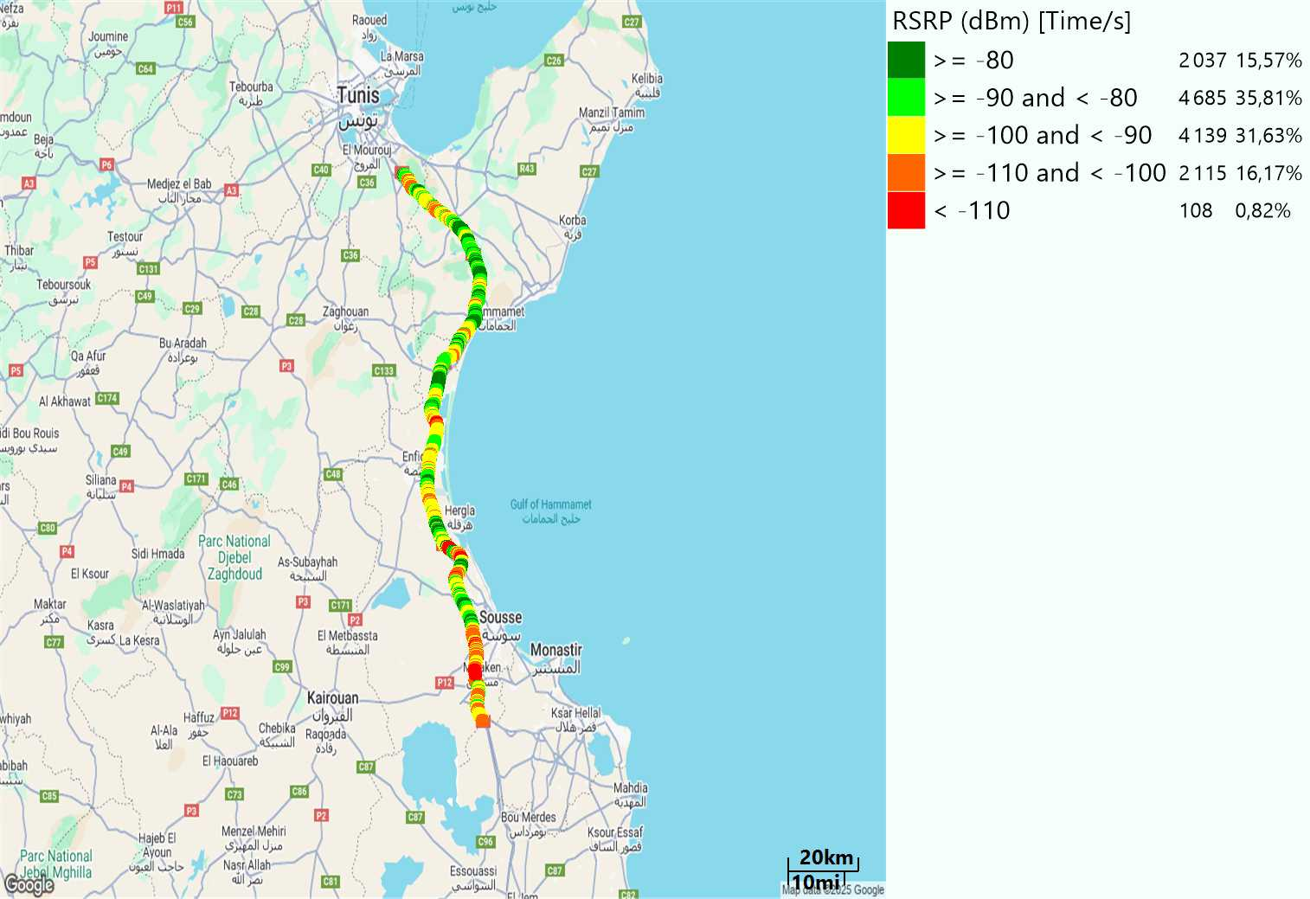
LTE - RSRP
Long call
Short call
Average [dBm]
-89,36
Average [dBm]
-90,06

Slide 8
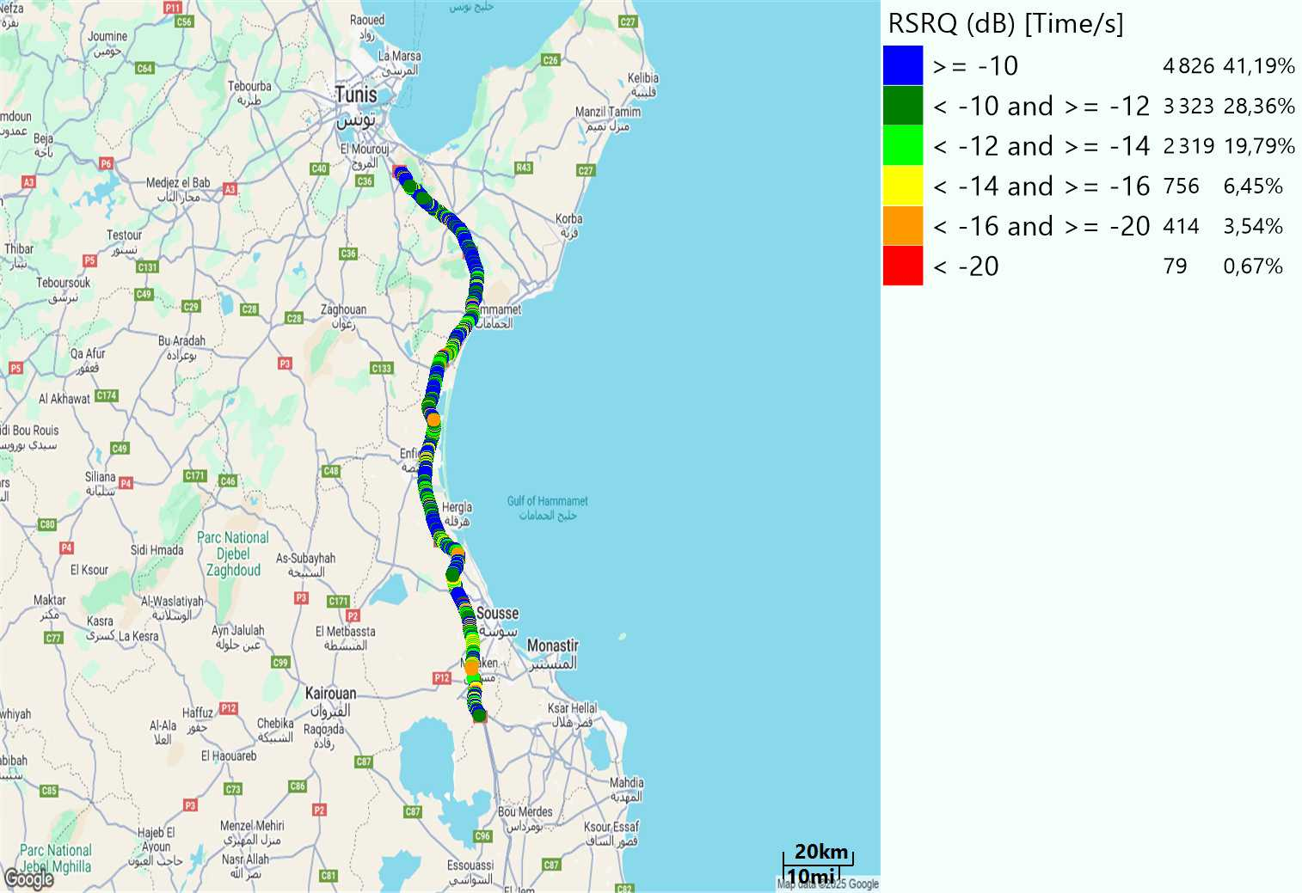
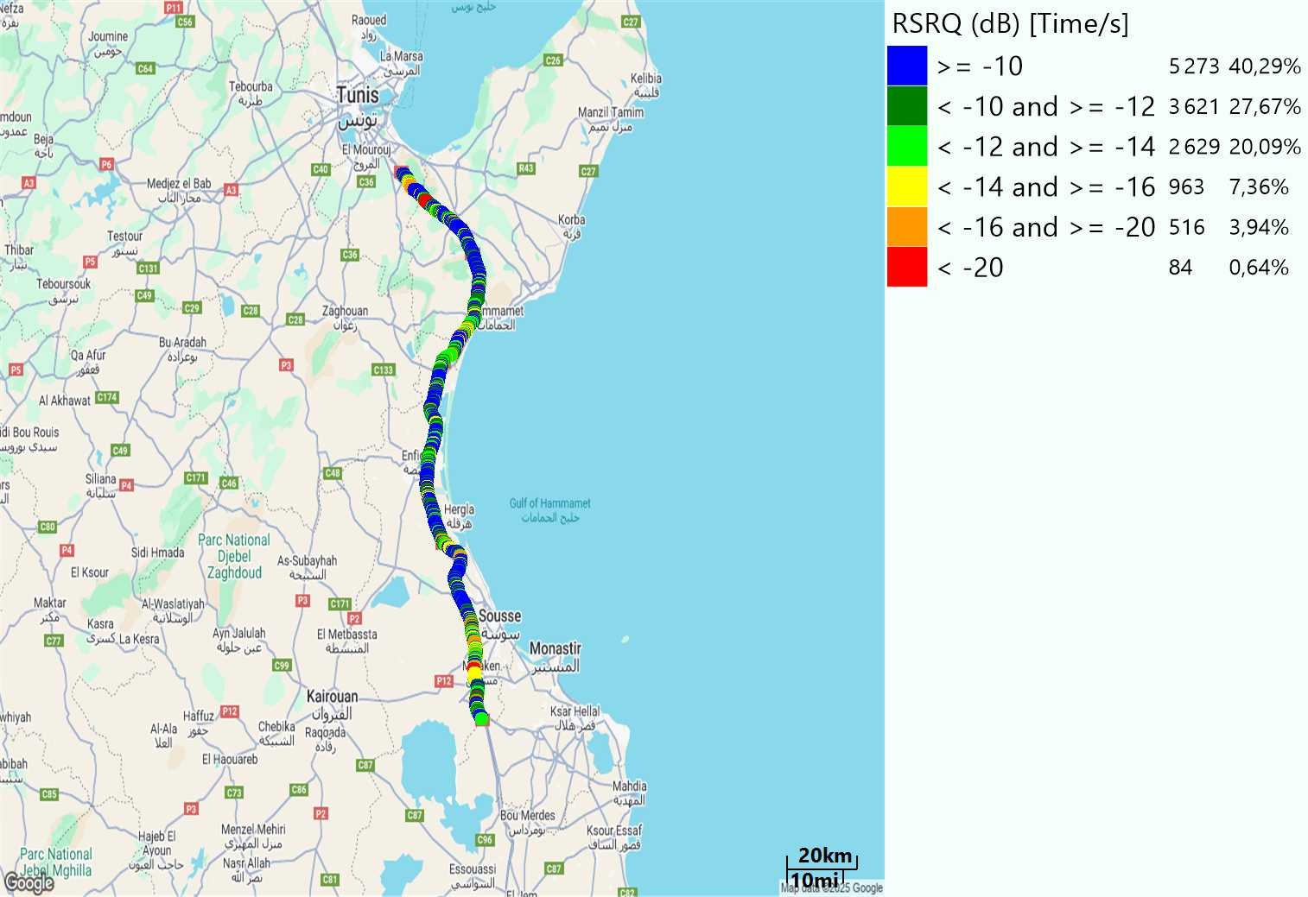
LTE- RSRQ
Long call
Short call

Slide 9
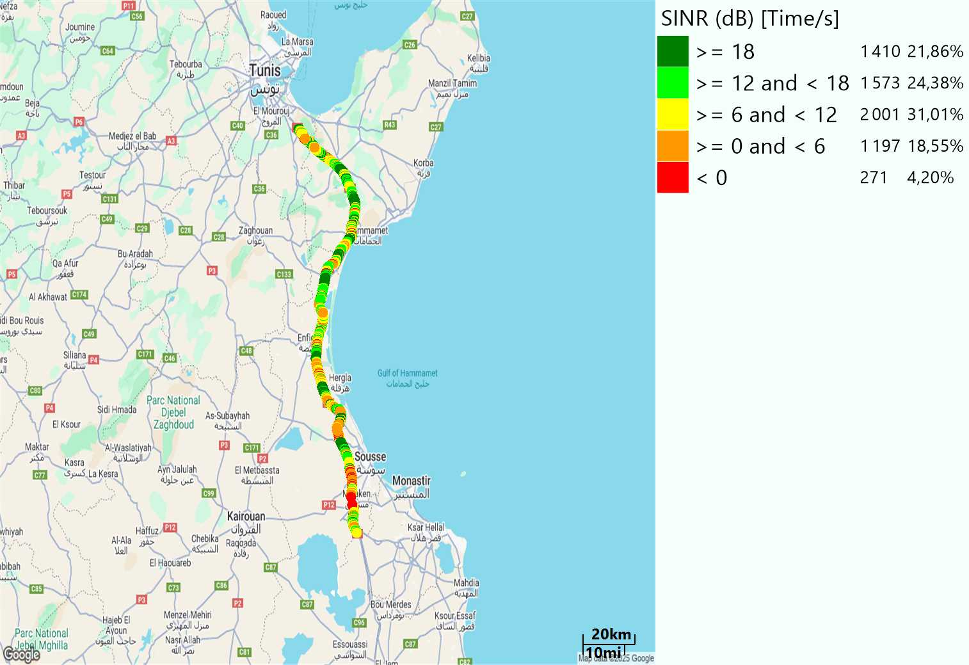

LTE-SINR
Long call
Short call

Slide 10
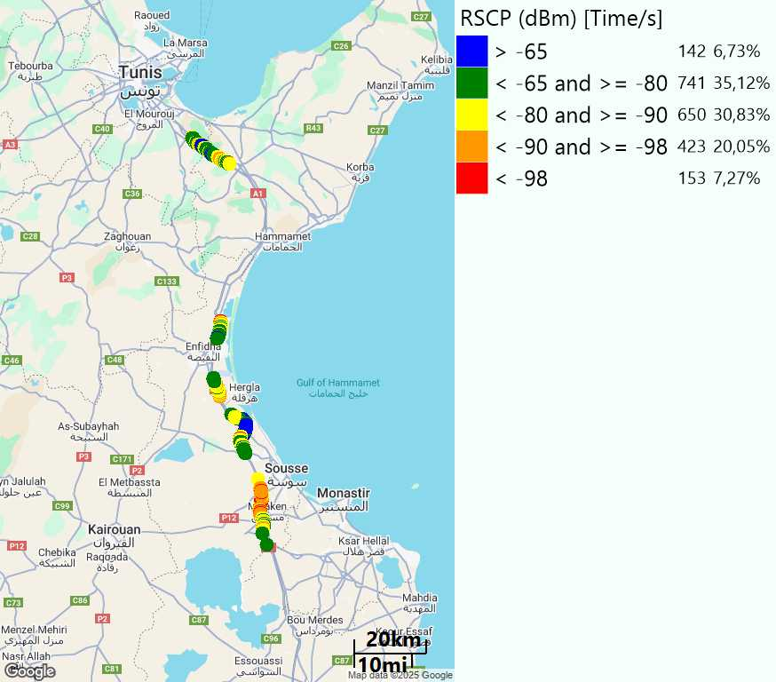
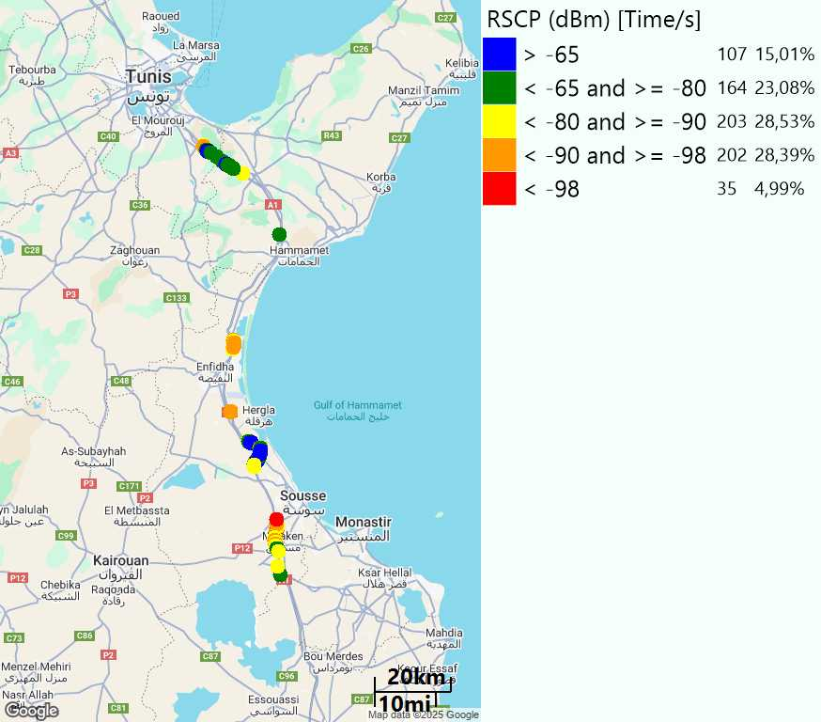
RSCP
Long call
Short call

Slide 11
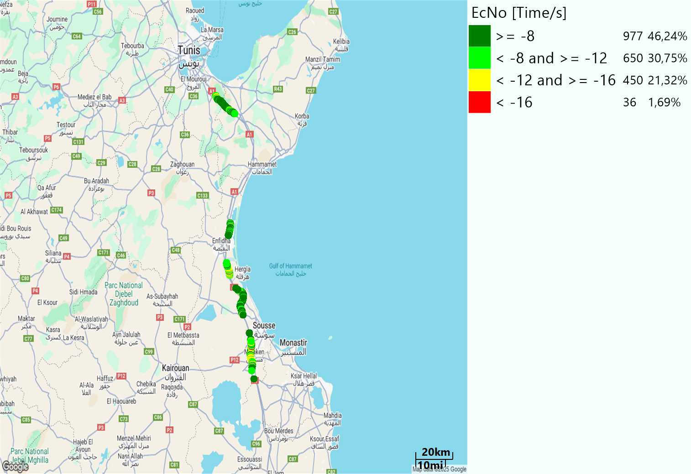
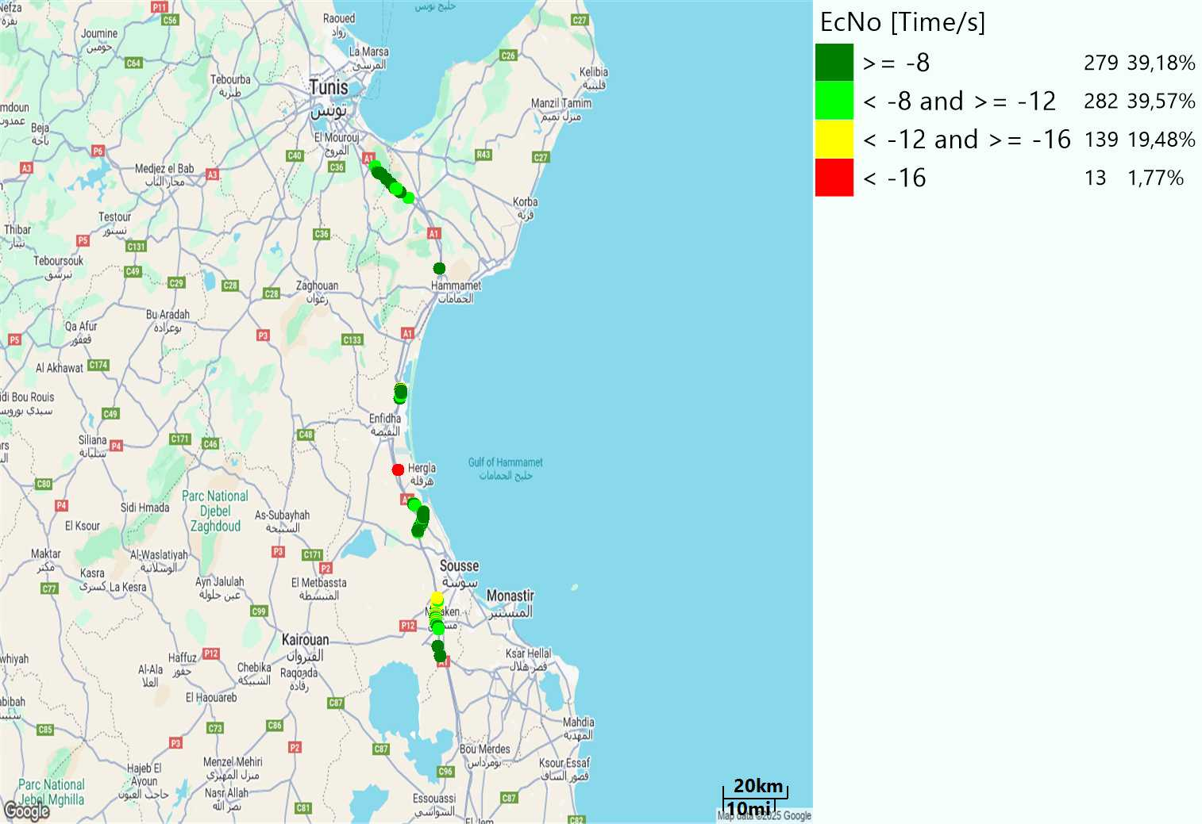
WCDMA-Ec/NO
Long call
Short call

Slide 12
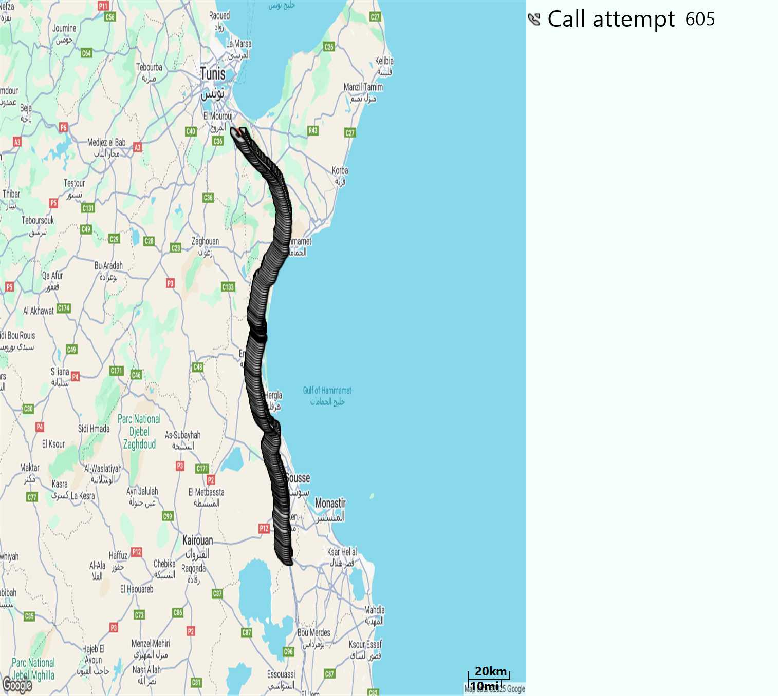
MO Call Setup Time (call setup time in VoLTE)
Short call
Call Setup Time IMS Voice
Average (Sec) | Maximum (Sec) | Minimum (Sec)
2,99 | 23,82 | 1,74

Slide 13
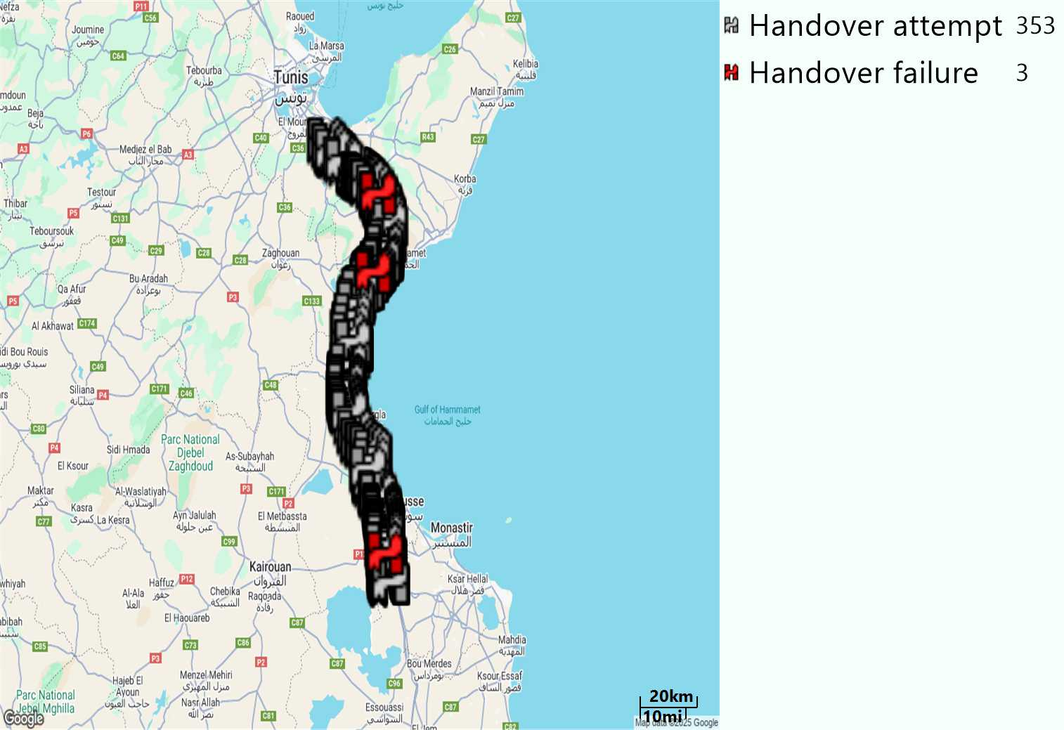
MO Handover Type
Long call
HO Type | Percentage [%]
LTE Inter-Frequency handover | 15,29%
LTE Intra-Frequency handover | 80,73%
UMTS to LTE | 3,96%
Handover KPI’s
Handover Attemps | 353
Handover Success | 350
Handover succès Rate | 99,15%
Étiquettes de lignes | LTE FDD_1800 | LTE FDD_2100 | LTE FDD_800 | Total général
LTE FDD_1800 | 178 | 5 | 18 | 201
LTE FDD_2100 | 6 | 26 | 3 | 35
LTE FDD_800 | 20 | 2 | 81 | 103
UMTS FDD_2100 |  | 1 | 2 | 3
UMTS FDD_900 | 6 | 1 | 4 | 11
Total général | 210 | 35 | 108 | 353

Slide 14
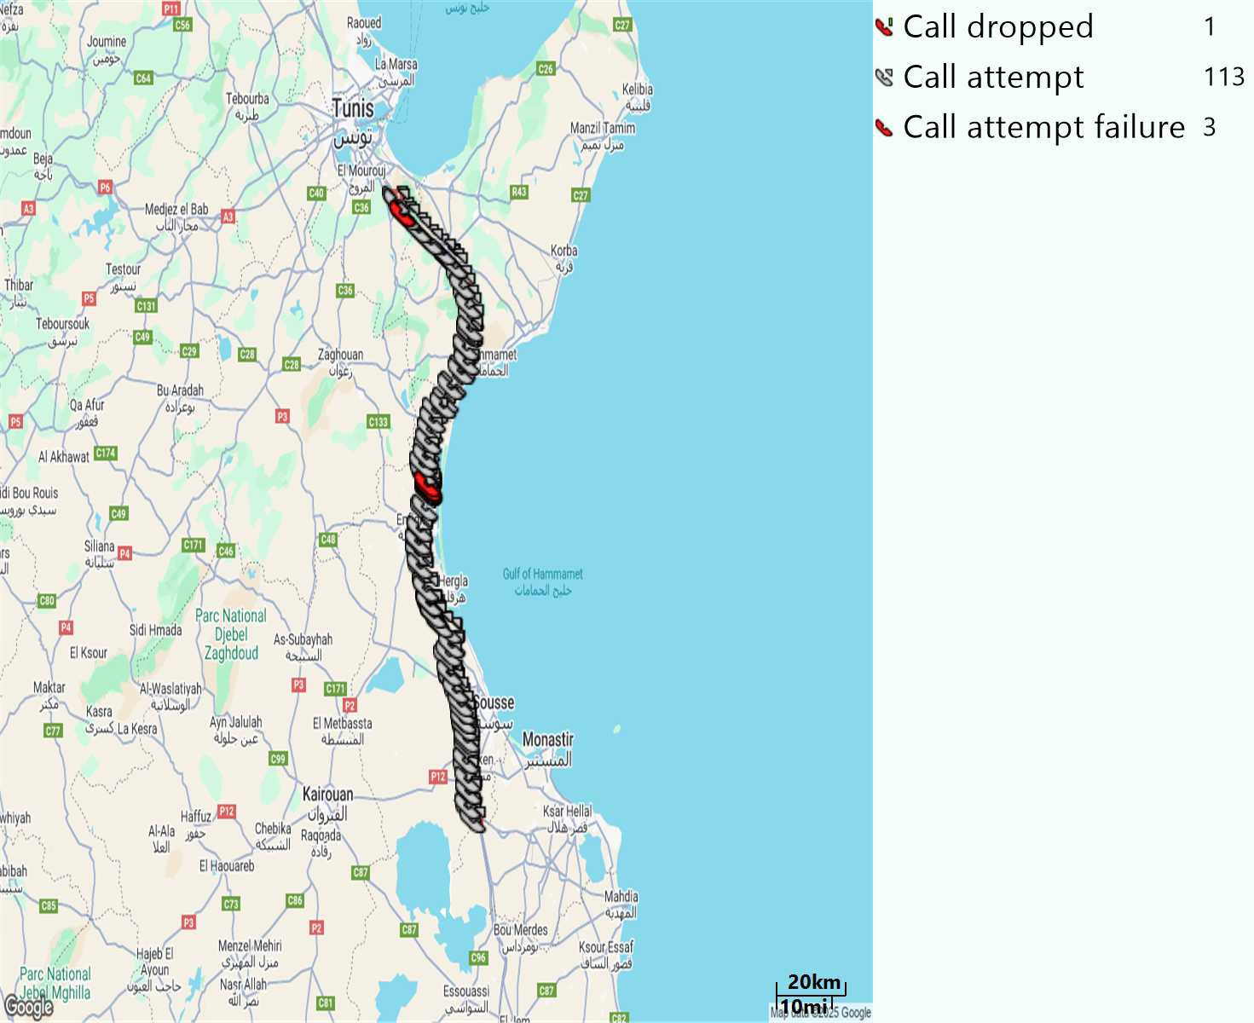
MO Voice Stats (VoLTE call stats)
Long call
Voice KPIs
Number Call Attempts | 113
Number Dropped Calls | 1
Call Drop Rate (%) | 0,88%
HO success rate | 99,15%

Slide 15
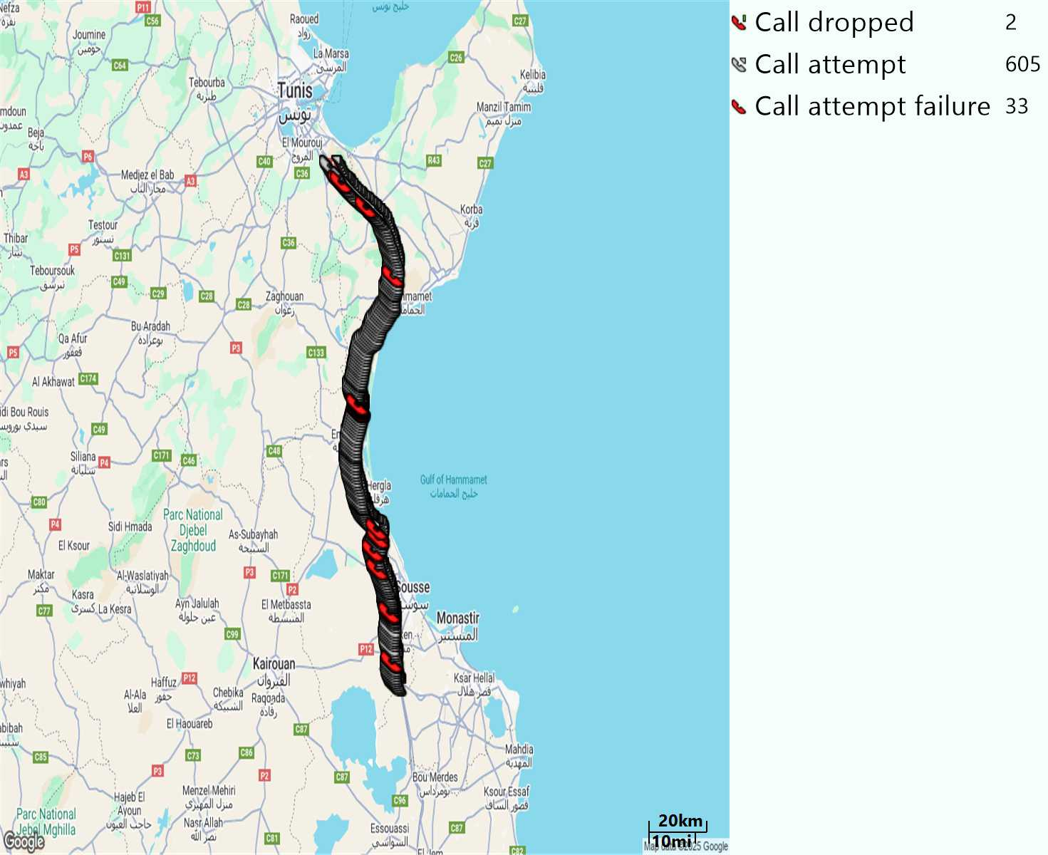
MO Voice Stats (VoLTE call stats)
Short call
Voice KPIs
Number Call Attempts | 605
Number Call Setup | 572
Number Blocked Calls | 33
Setup Succes Rate (%) | 94,54%
Call Block Rate (%) | 5,45%
Call Setup Time IMS Voice Average (Sec) | 2,99
Voice KPIs excluding 17 failures
Number Call Attempts | 605
Number Call Setup | 589
Number Blocked Calls | 16
Setup Succes Rate (%) | 97,36%
Call Block Rate (%) | 2,64%
Call Setup Time IMS Voice Average (Sec) | 2,99

Slide 16
MO Voice Stats (VoLTE call stats)
KPIs
VoLTE Call Setup SR | 94,54%
Call Setup Time | 2,99
VoLTE Drop Call Rate | 0,88%
Speech Quality - MOS (% of the samples >3,5) | 94,01%
Average MOS | 4,19
VoLTE Handover SR | 99,15%
VoLTE SRVCC SR | 100%

Slide 17
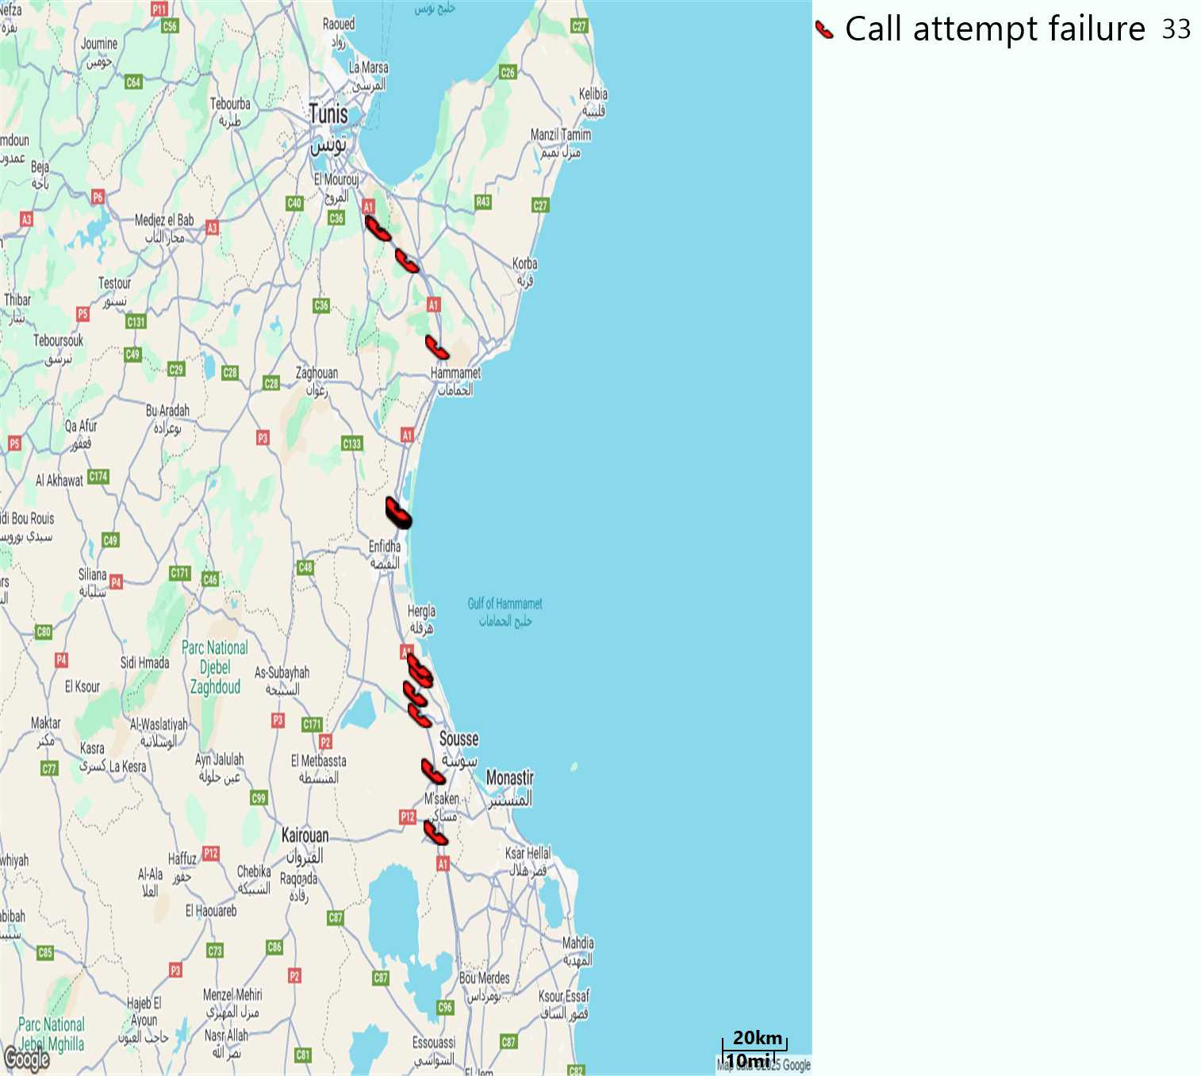
MO Voice Call - Blocked call
Short call

Slide 18
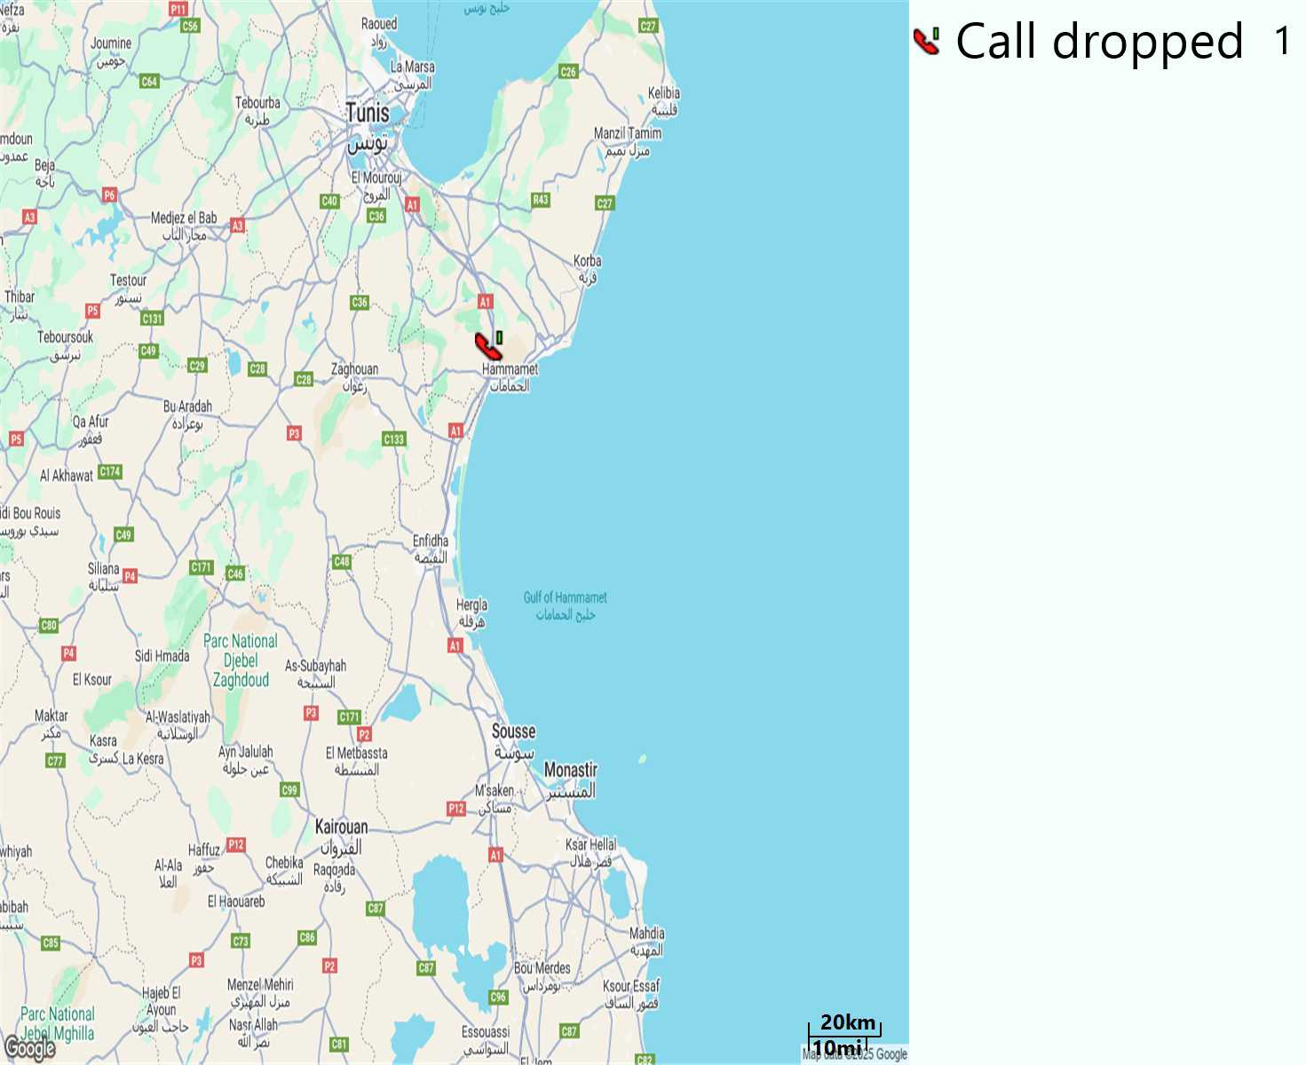
MO Voice Call - Dropped Call
Long call

Slide 19
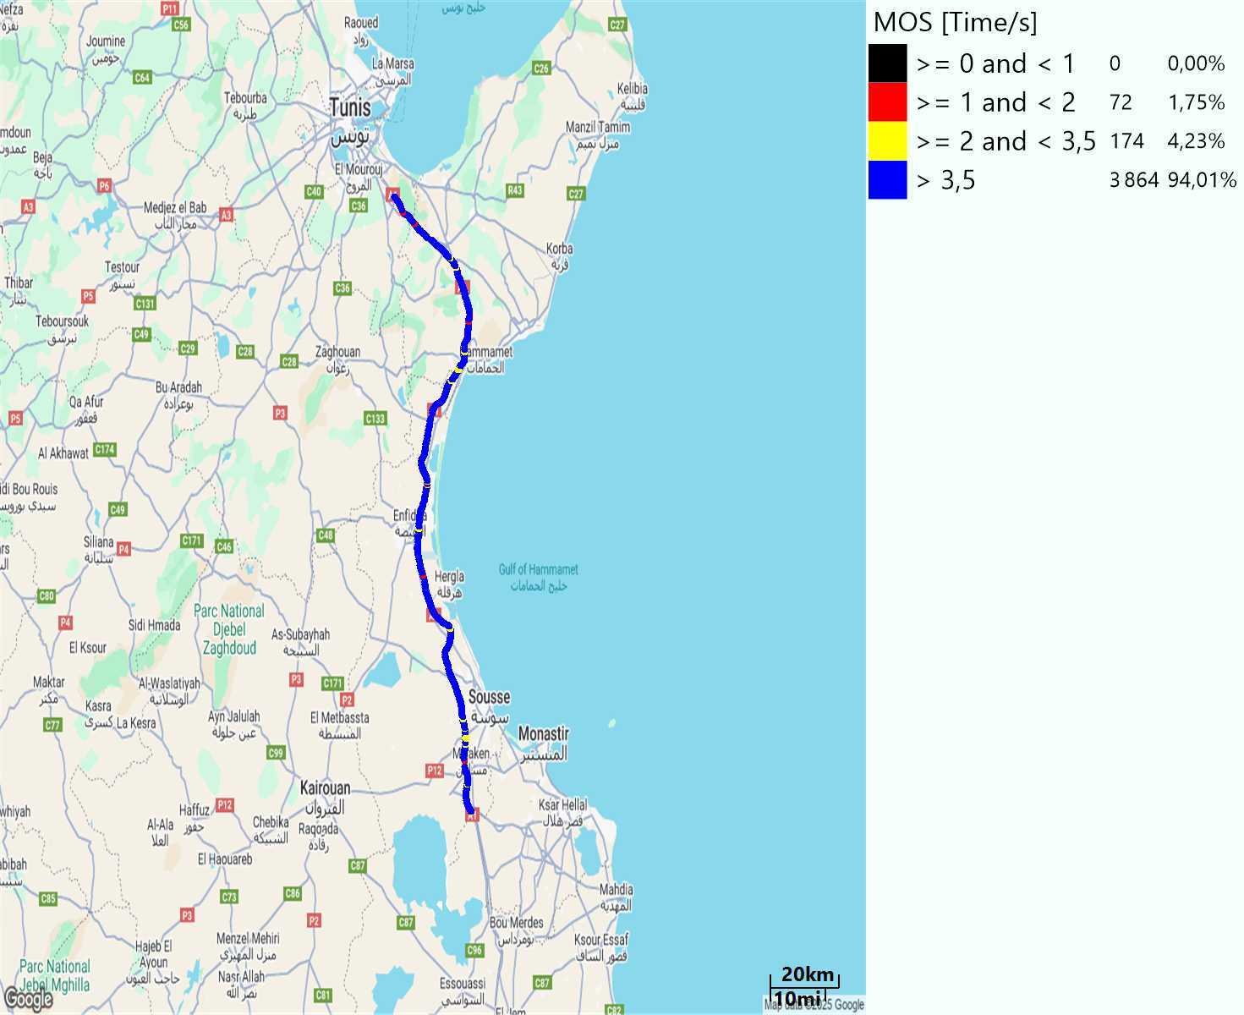
MO Voice Quality Metrics
long Call

Slide 20
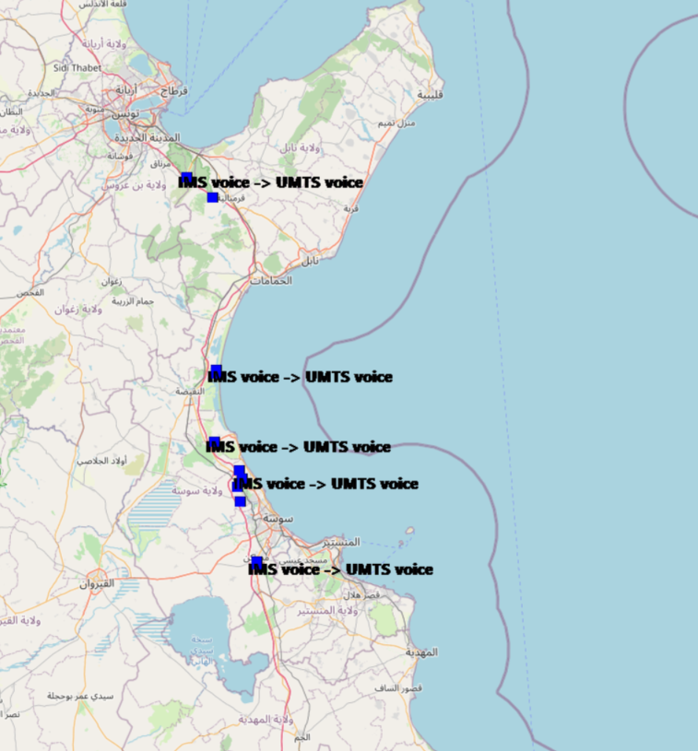
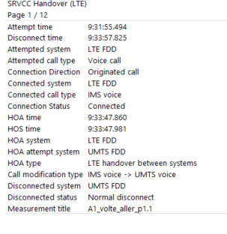
VoLTE SRVCC Success Rate long Call

Slide 21
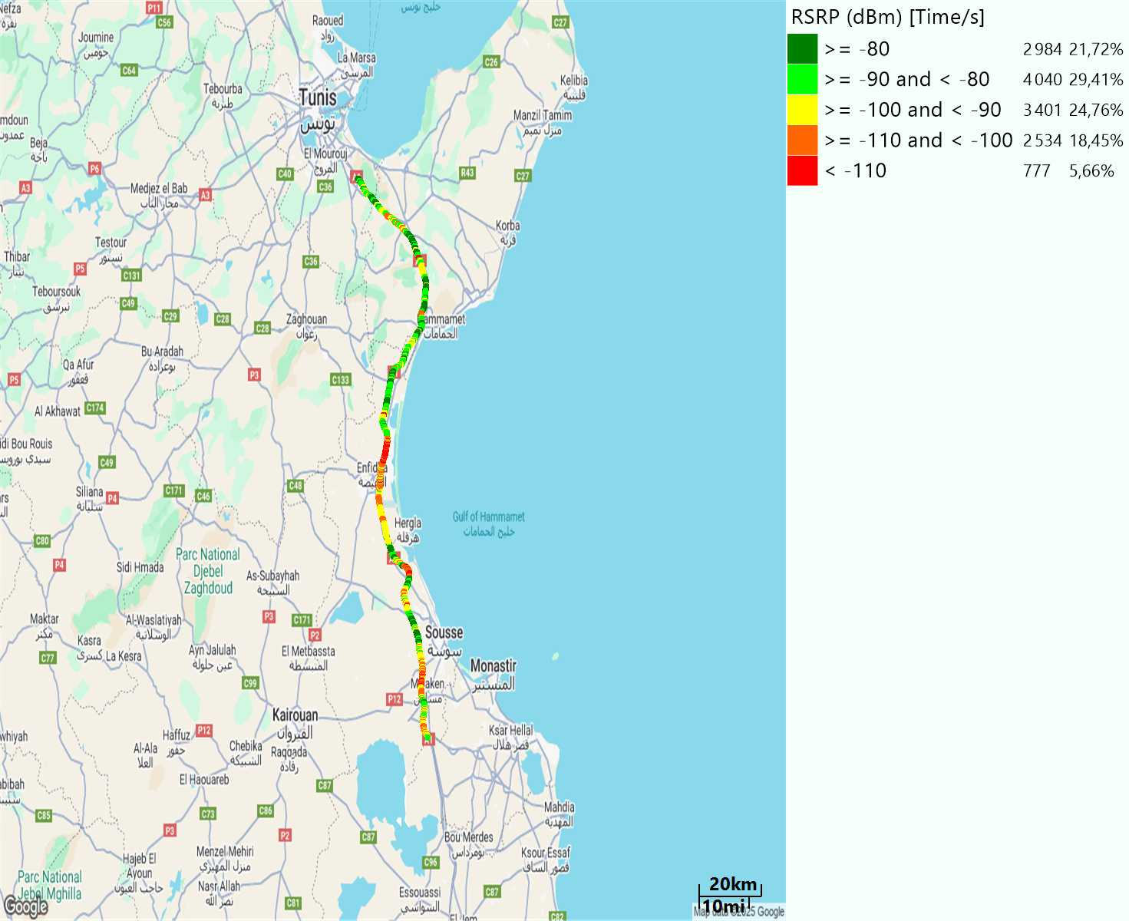
Scanner_RSRP
L2100

Slide 22
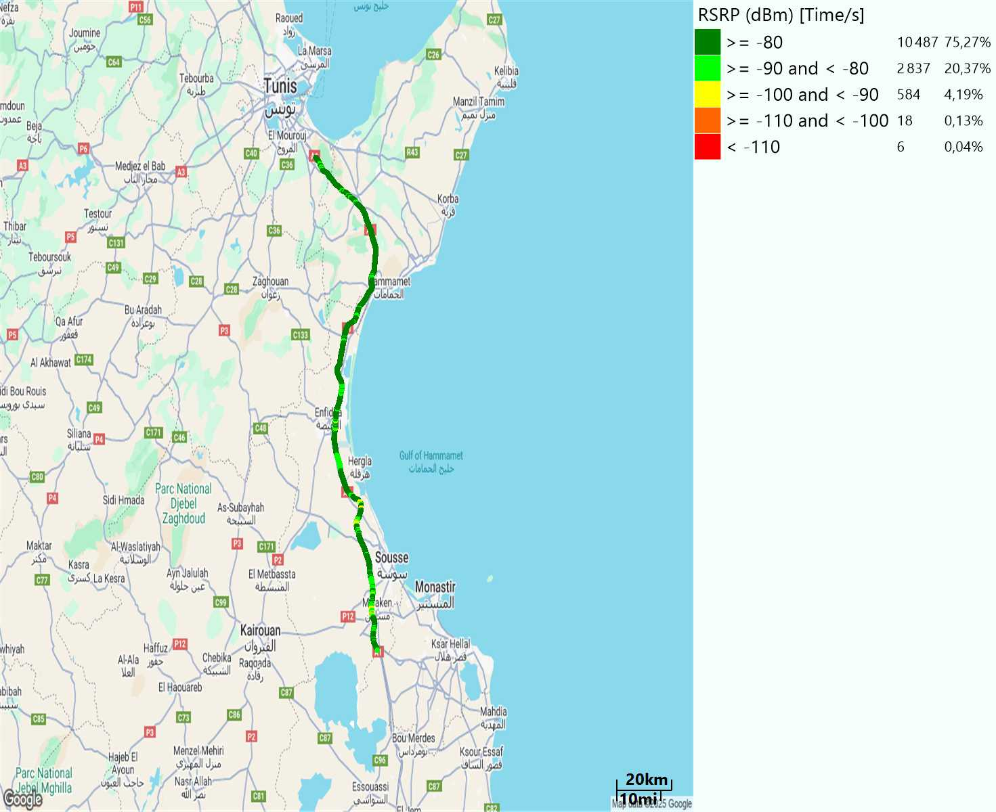
Scanner_RSRP
L800

Slide 23

Scanner_RSRP
L1800

Slide 24
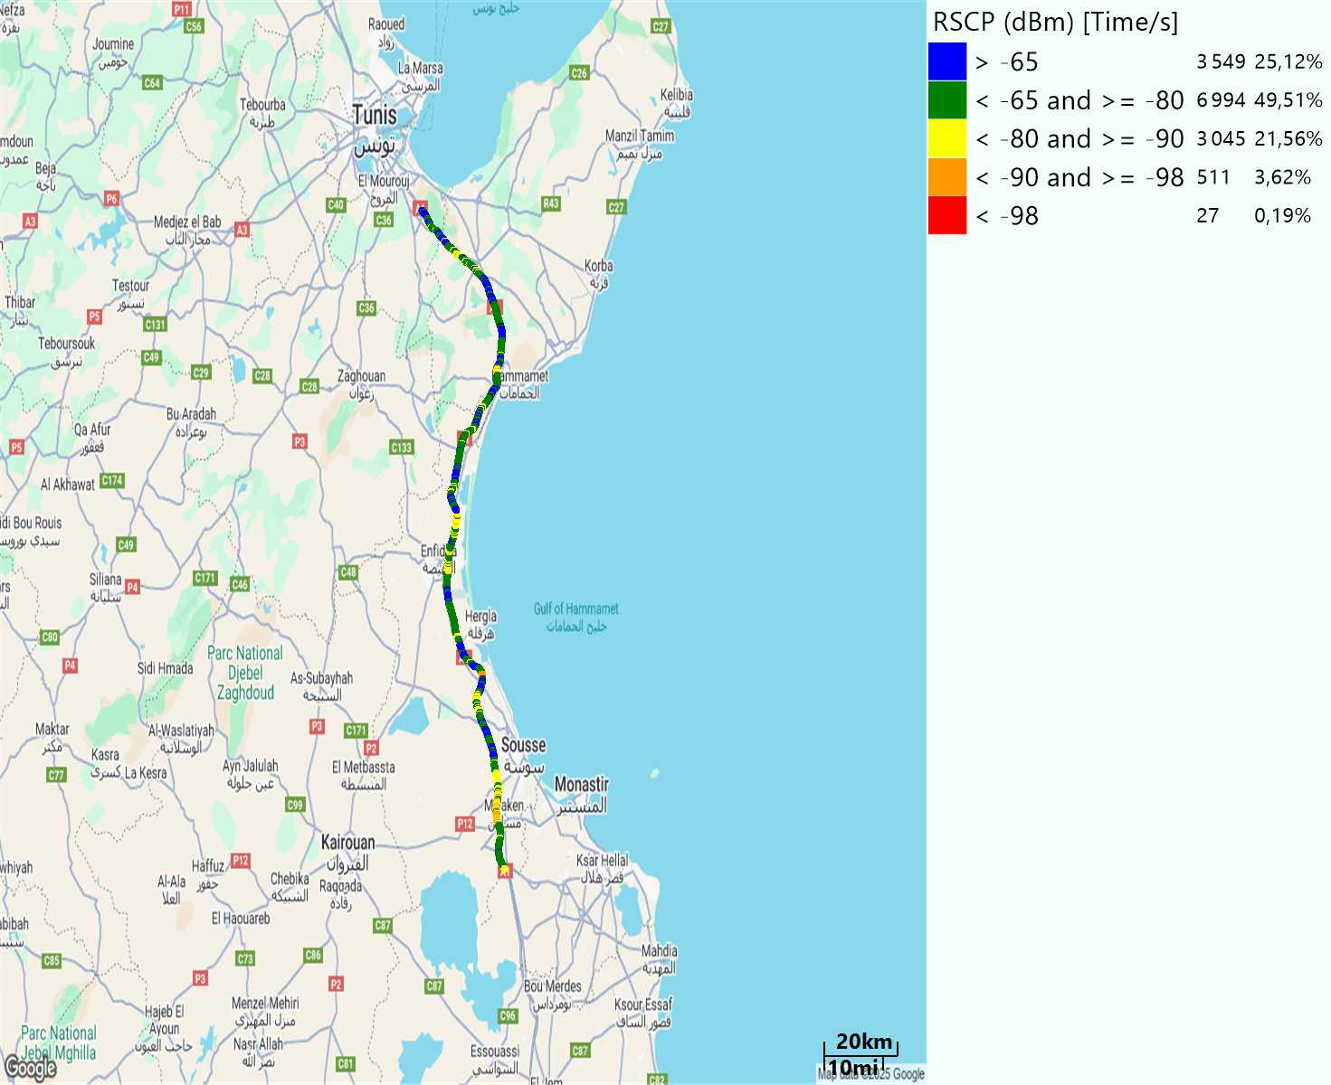
Scanner_RSCP
U2100

Slide 25
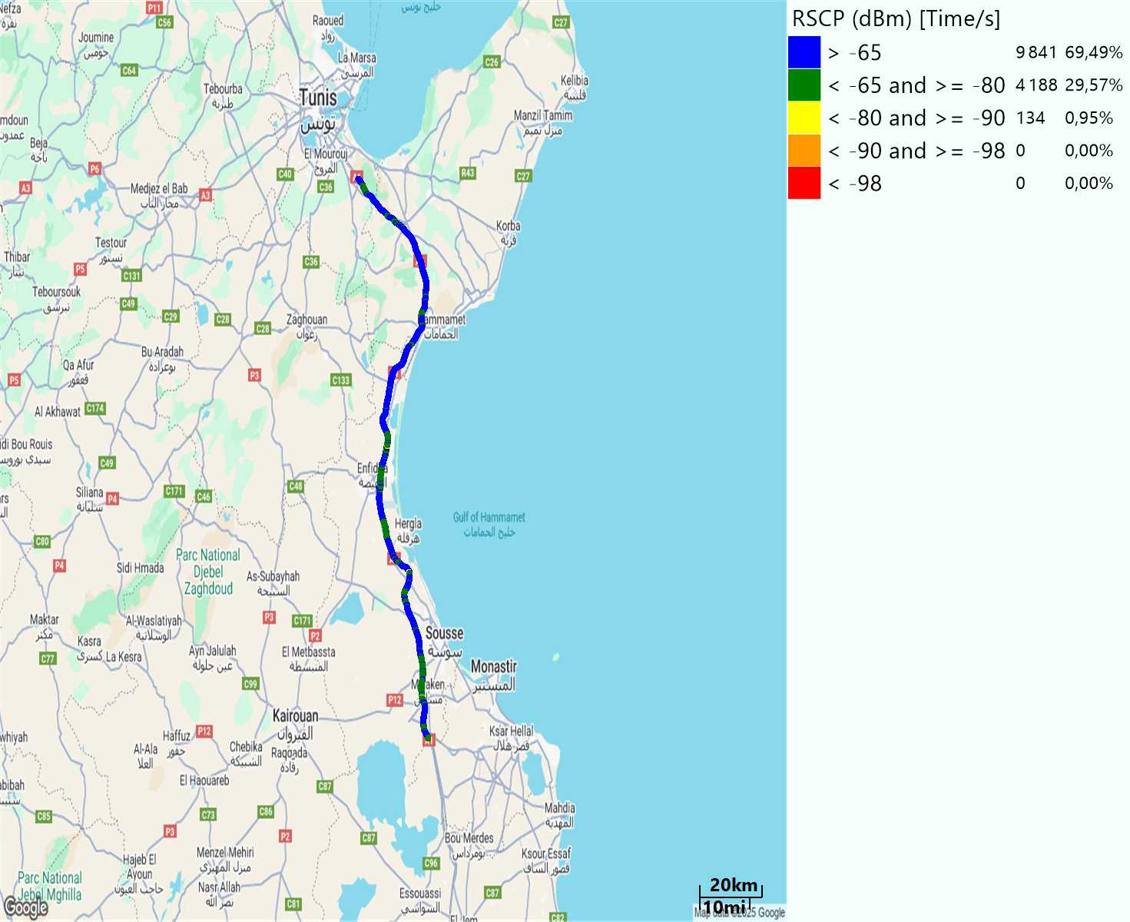
Scanner_RSCP
900

