Slide 1


Volte Drive Test Report

Slide 2
DT Scénario
Short Call (10s)
Long call (2min)
Scanner

Slide 3
Voice Call

Slide 4
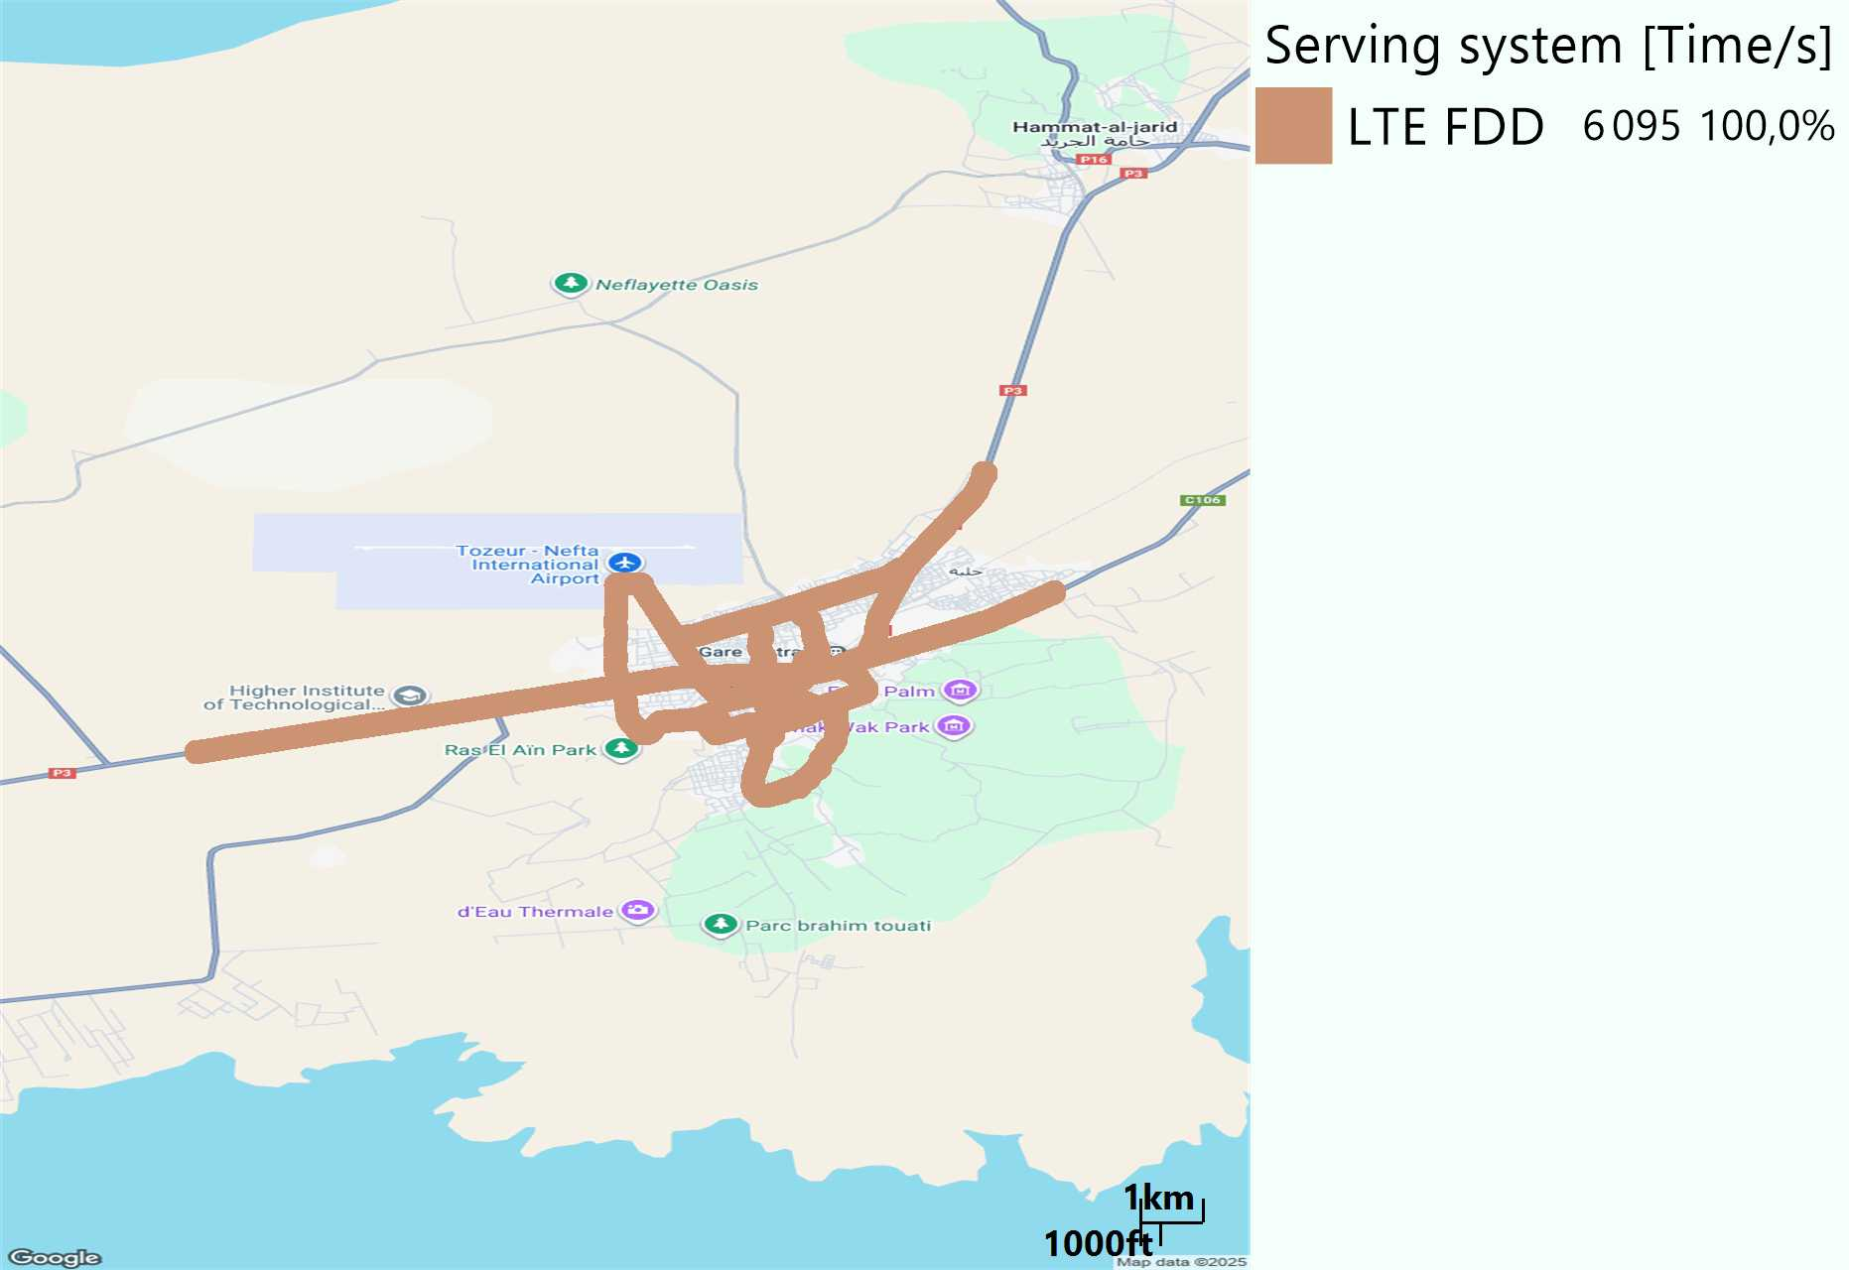
RAT distribution
Long call
Short call

Slide 5
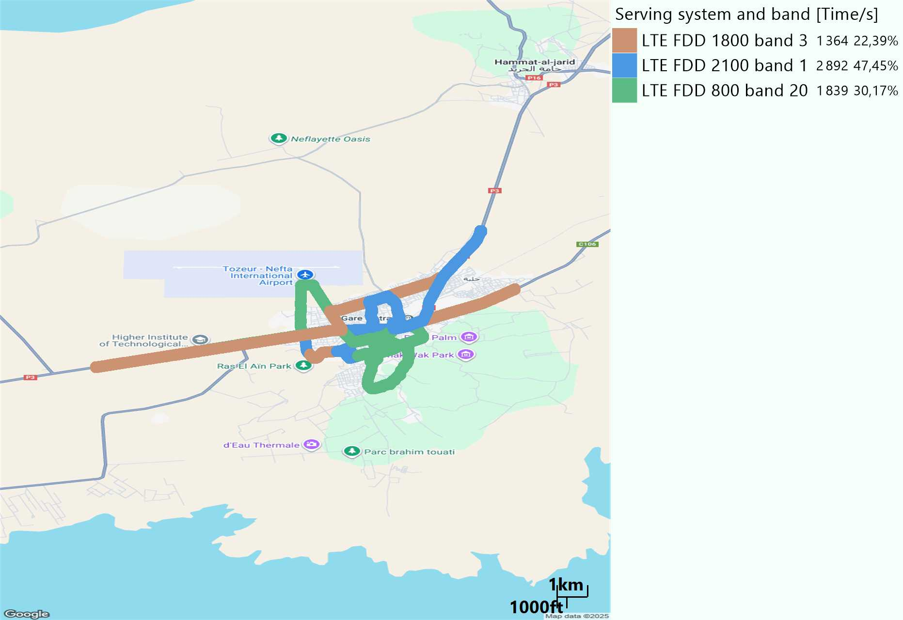
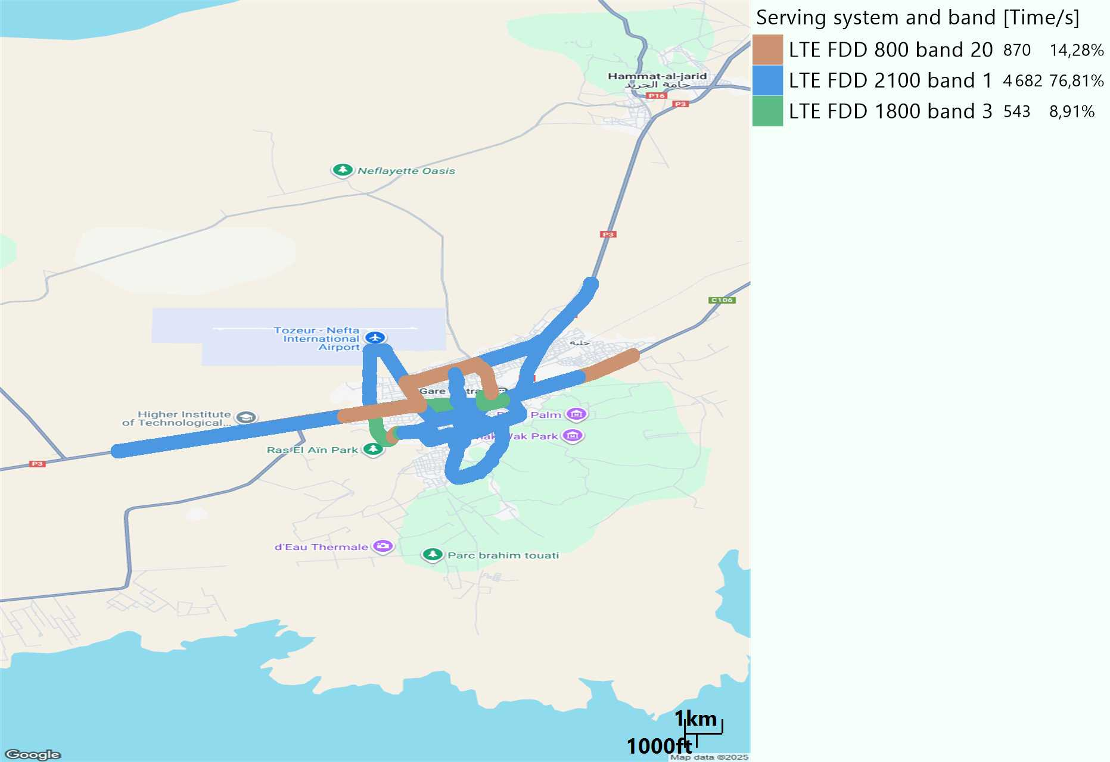
EARFCN distribution
Long call
Short call

Slide 6
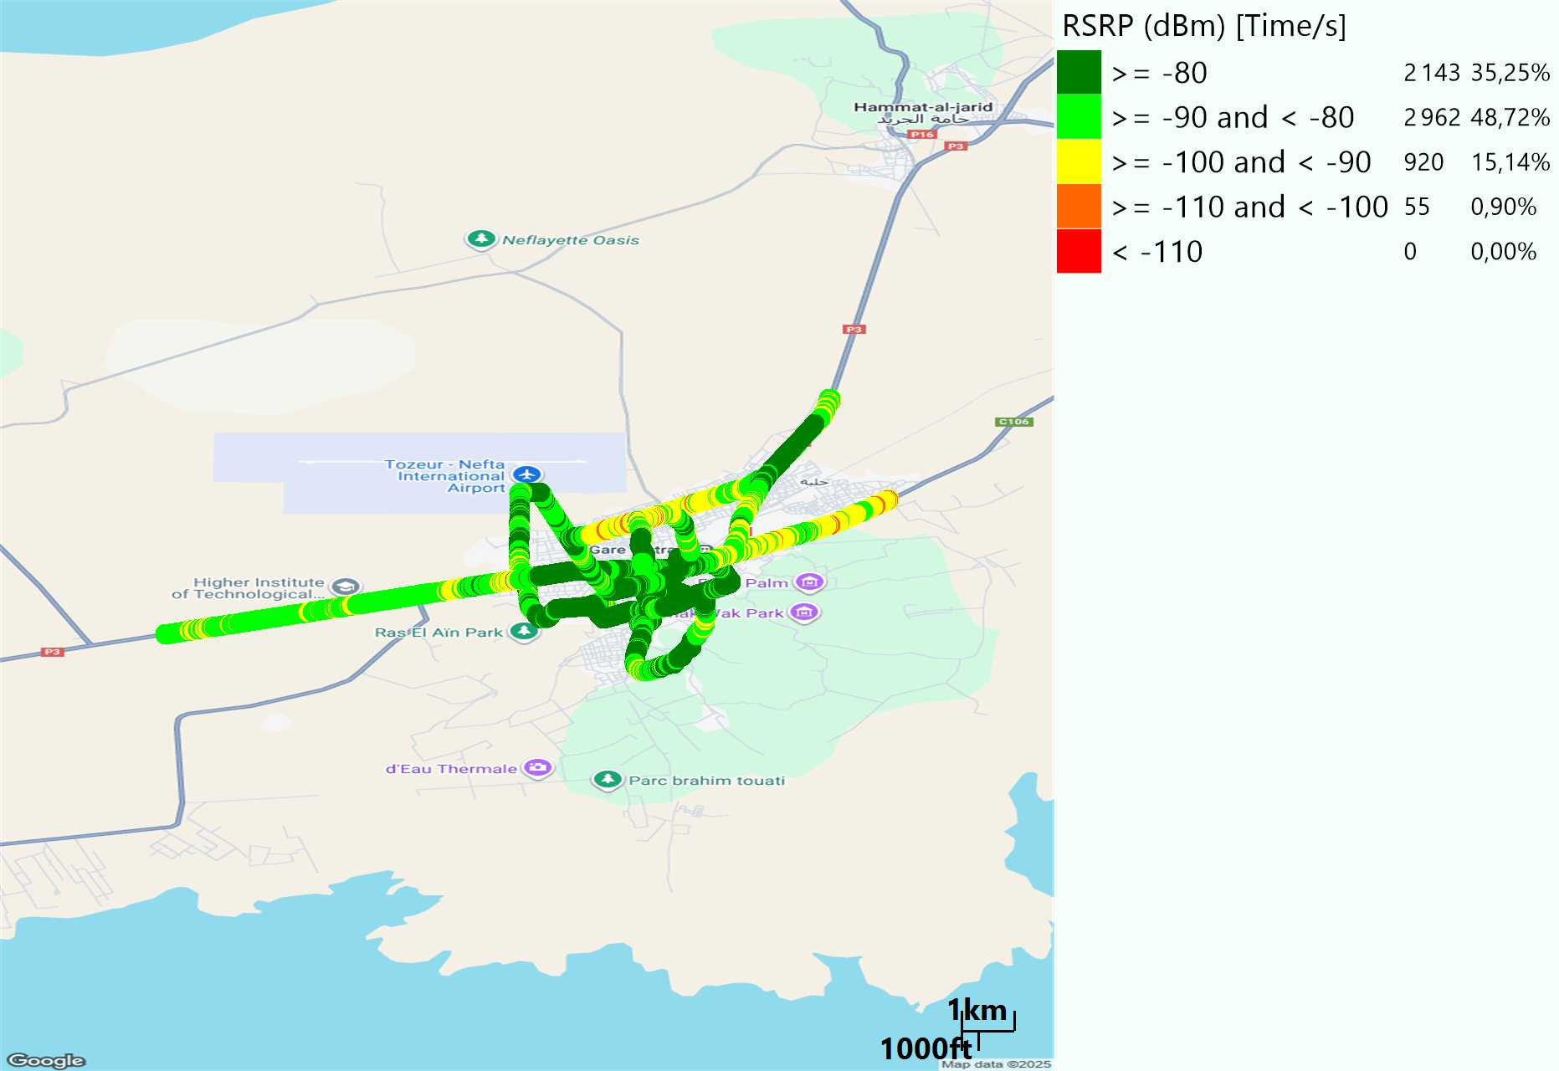
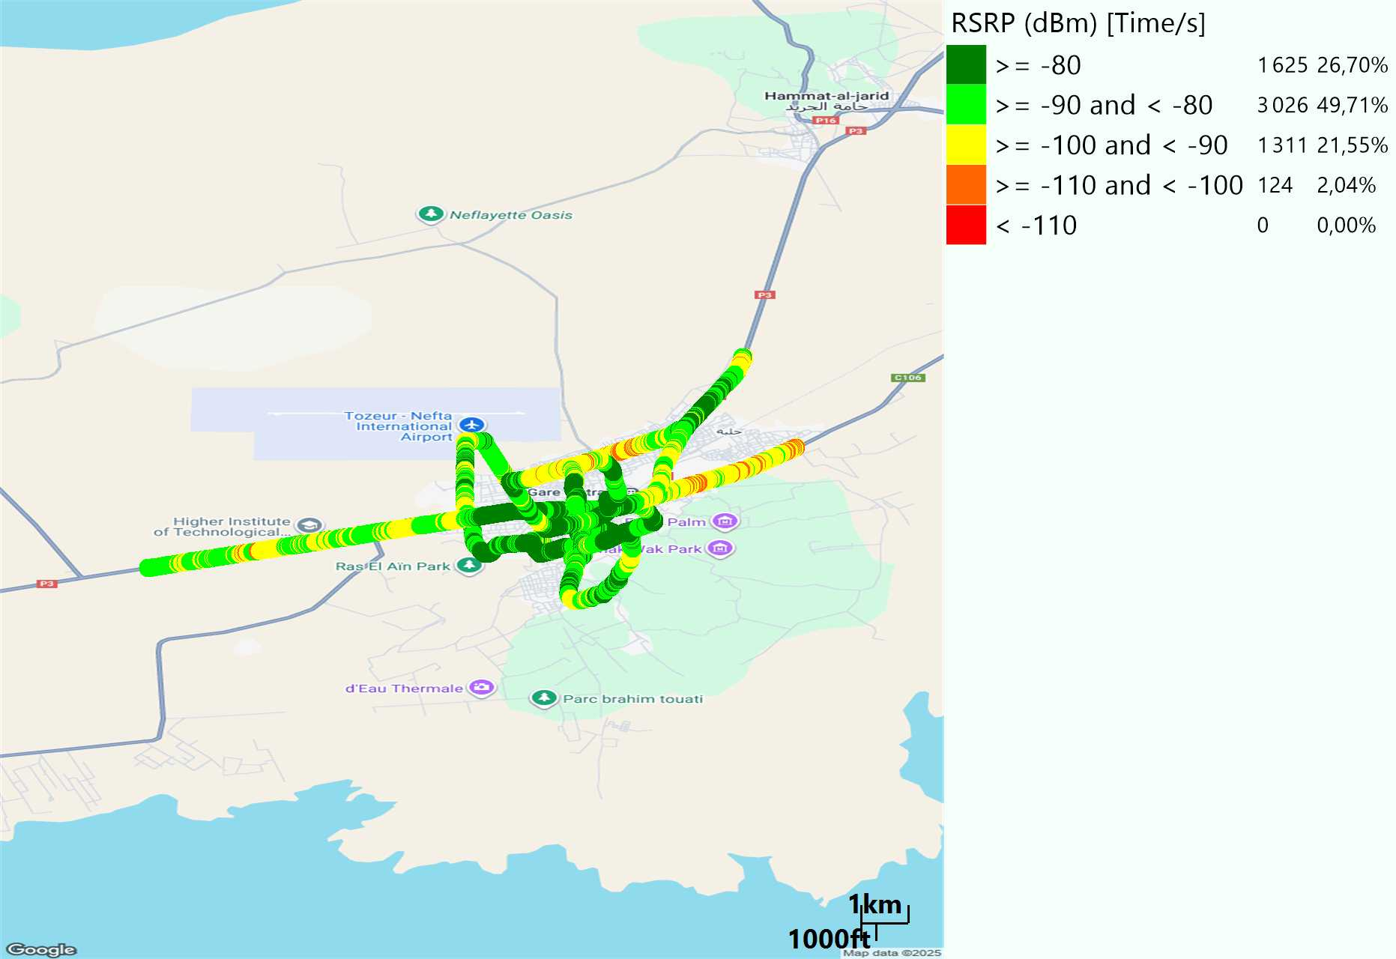
LTE - RSRP
Long call
Short call
Average [dBm]
-81,89
Average [dBm]
-84,44

Slide 7
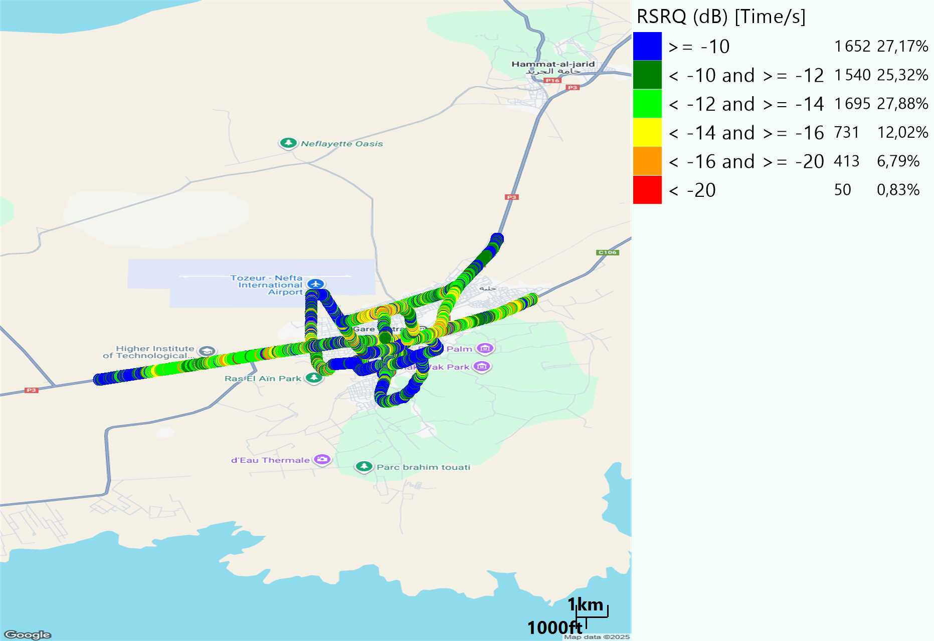
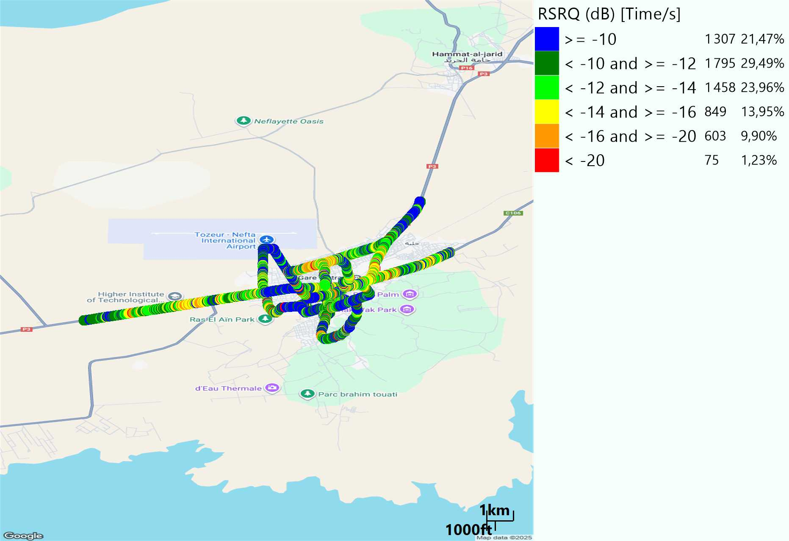
LTE- RSRQ
Long call
Short call

Slide 8
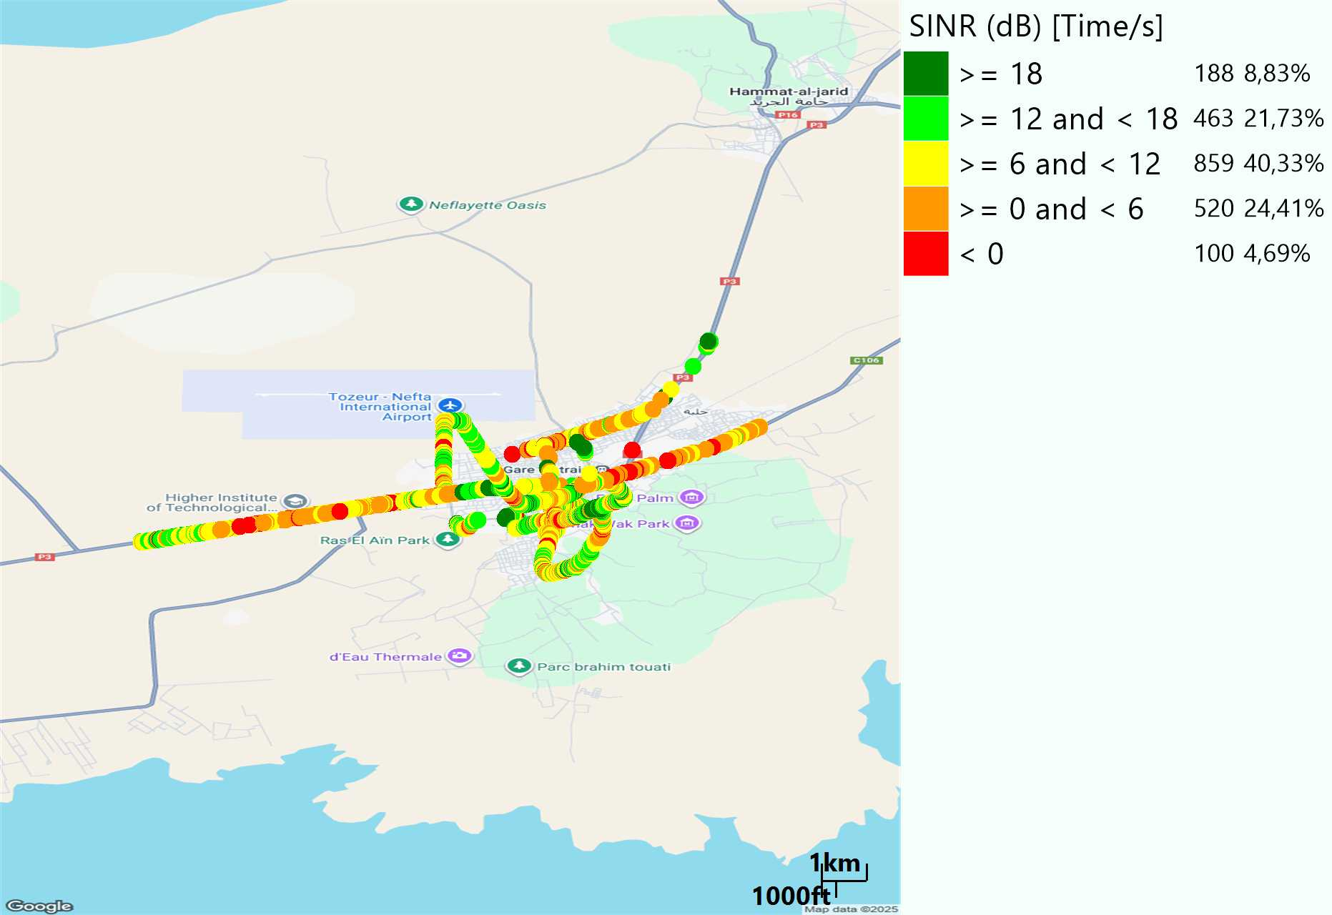
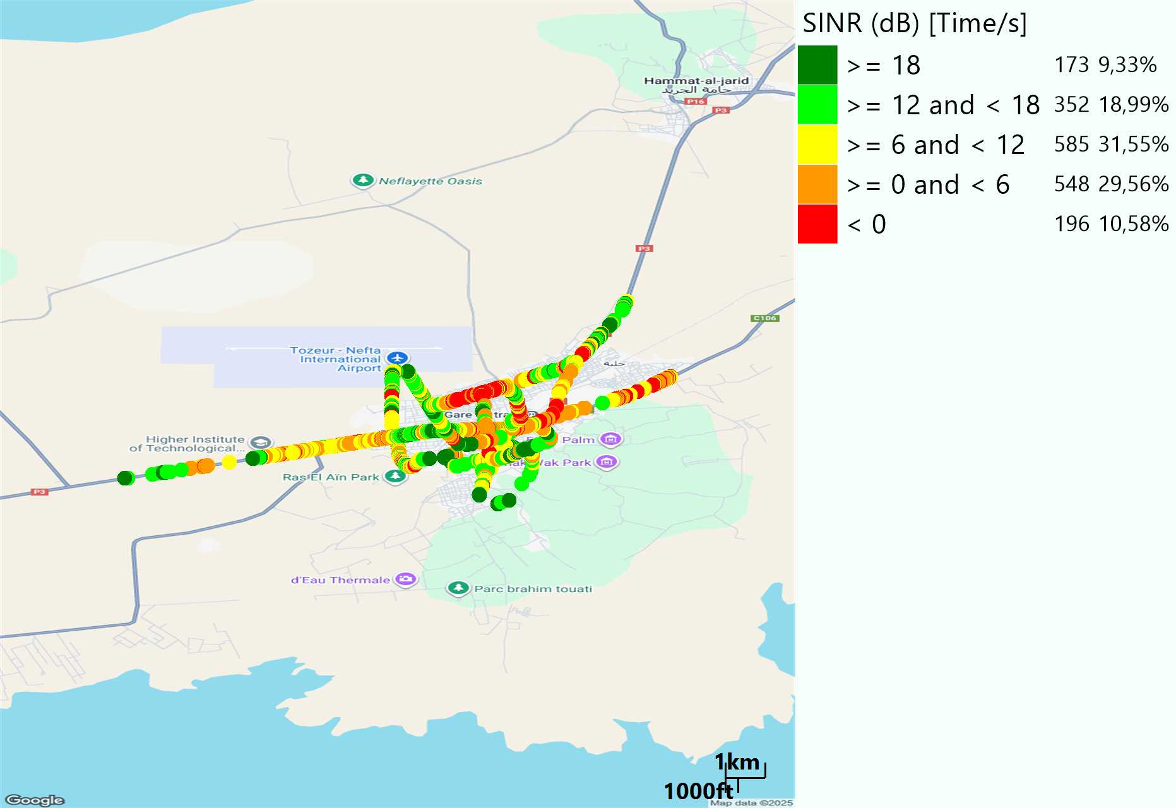
LTE-SINR
Long call
Short call

Slide 9
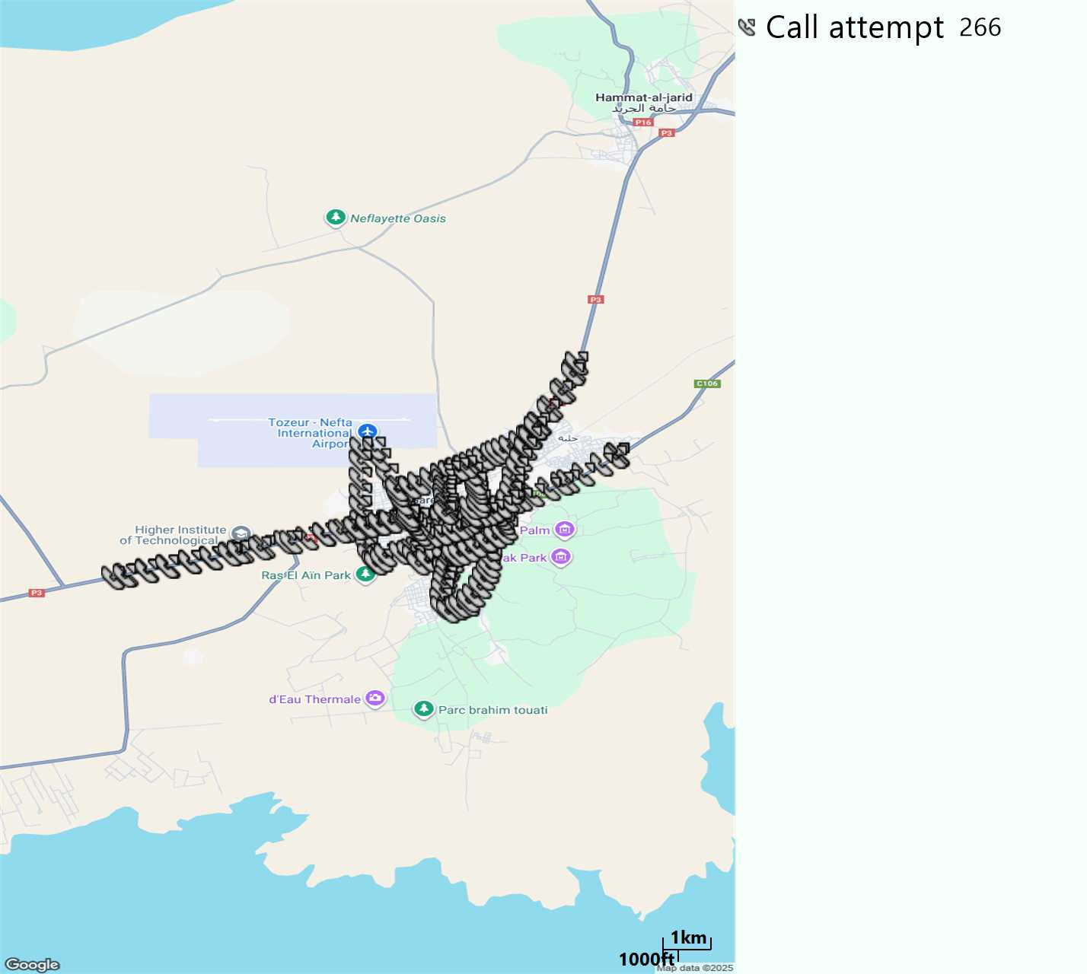
MO Call Setup Time (call setup time in VoLTE)
Short call
Call Setup Time IMS Voice
Average (Sec) | Maximum (Sec) | Minimum (Sec)
2,62 | 5,89 | 2,04

Slide 10
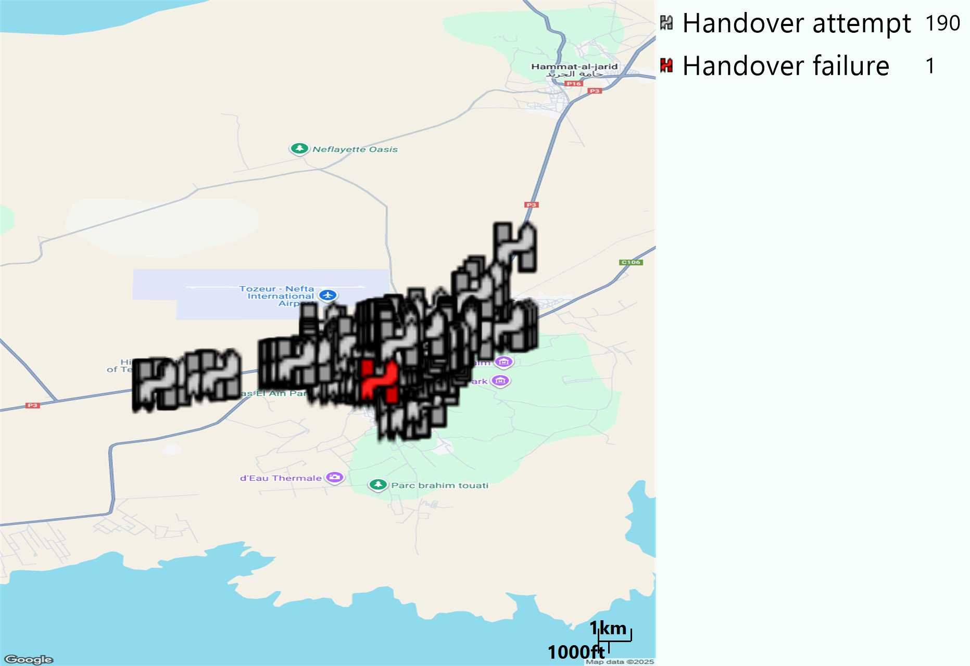
MO Handover Type
Long call
HO Type | Percentage [%]
LTE Inter-Frequency handover | 2,63%
LTE Intra-Frequency handover | 97,37%
Handover KPI’s
Handover Attemps | 190
Handover Success | 189
Handover succès Rate | 99,47%
Étiquettes de lignes | LTE FDD_1800 | LTE FDD_2100 | LTE FDD_800 | Total général
LTE FDD_1800 | 44 | 1 | 1 | 46
LTE FDD_2100 | 3 | 70 |  | 73
LTE FDD_800 |  |  | 71 | 71
Total général | 47 | 71 | 72 | 190

Slide 11
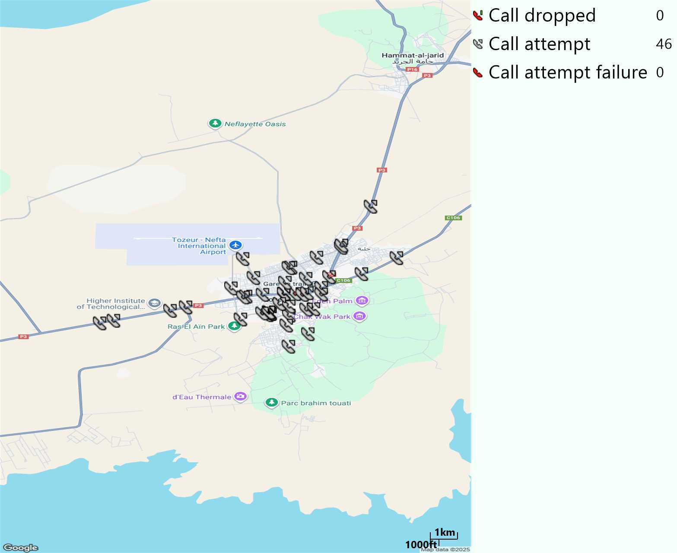
MO Voice Stats (VoLTE call stats)
Long call
Voice KPIs
Number Call Attempts | 46
Number Dropped Calls | 0
Call Drop Rate (%) | 0%
HO success rate | 99,47%

Slide 12
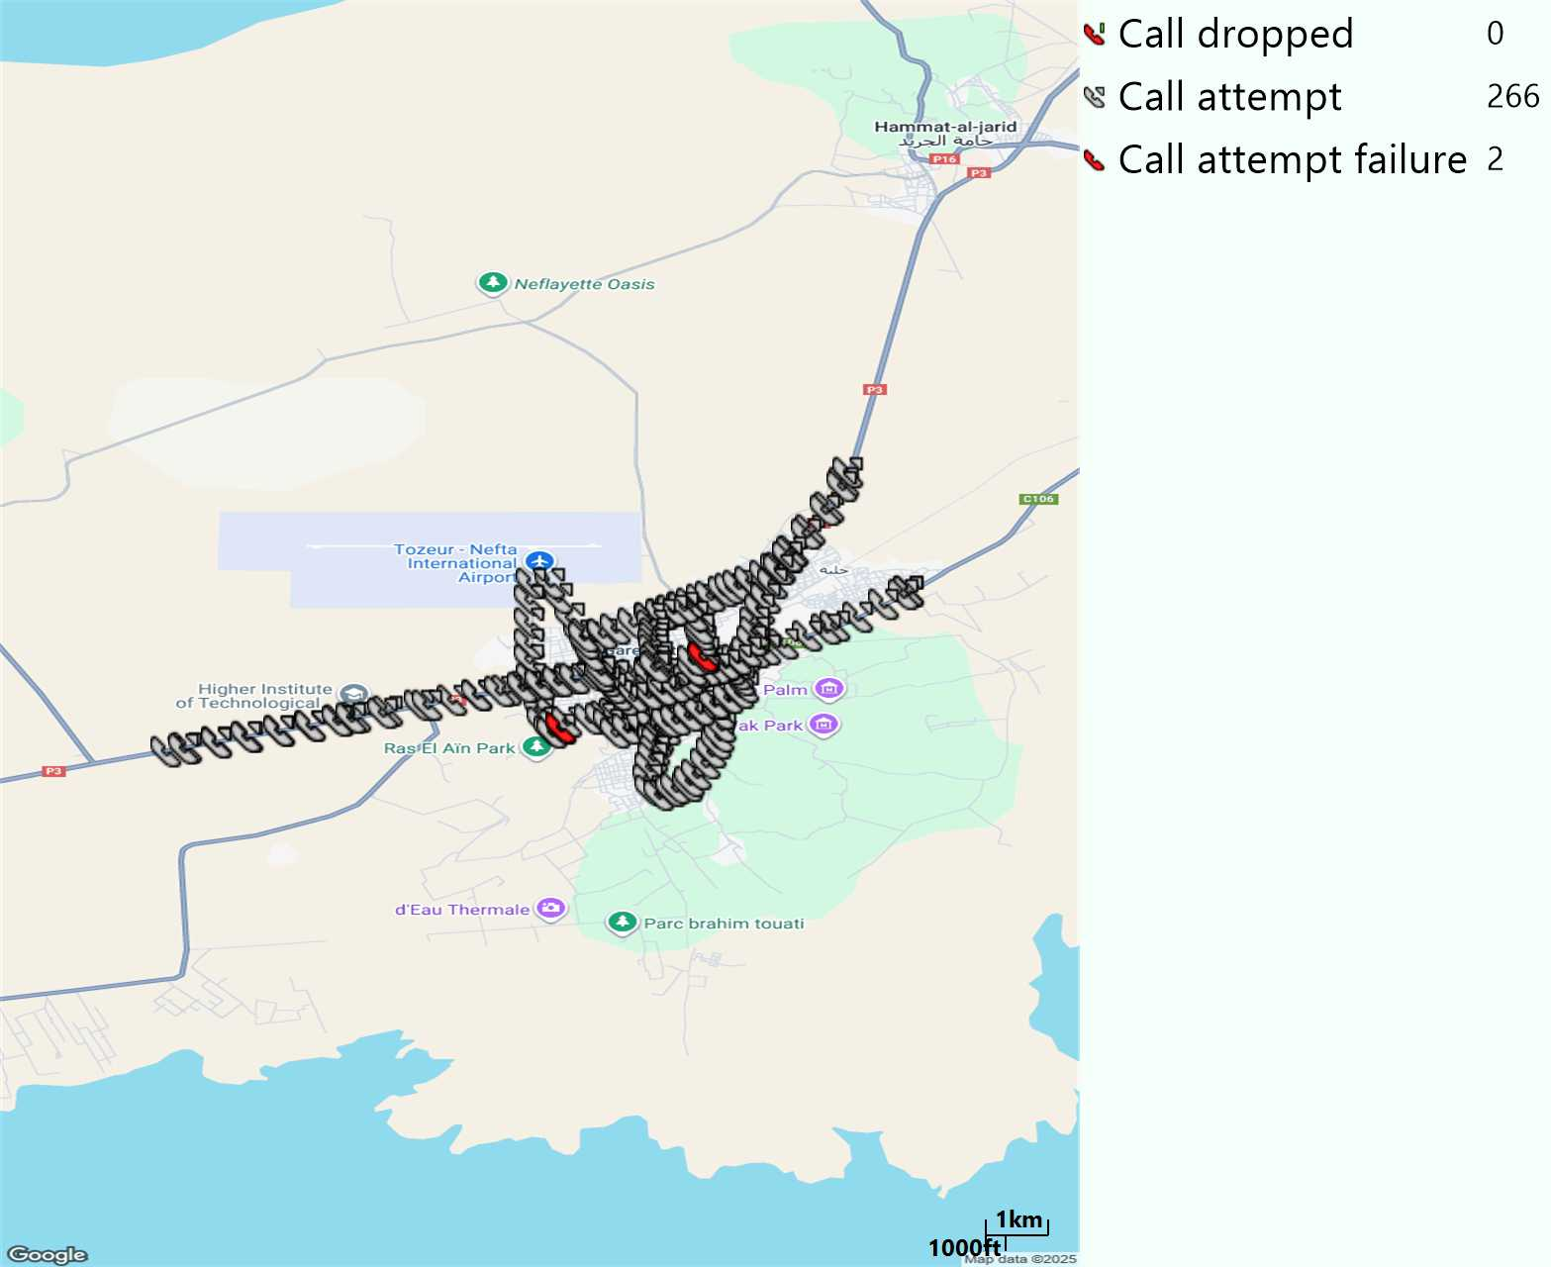
MO Voice Stats (VoLTE call stats)
Short call
Voice KPIs
Number Call Attempts | 266
Number Call Setup | 264
Number Blocked Calls | 2
Setup Succes Rate (%) | 99,25%
Call Block Rate (%) | 0,75%
Call Setup Time IMS Voice Average (Sec) | 2,62

Slide 13
MO Voice Stats (VoLTE call stats)
KPIs
VoLTE Call Setup SR | 99,25%
Call Setup Time | 2,62
VoLTE Drop Call Rate | 0%
Speech Quality - MOS (% of the samples >3,5) | 86,88%
Average MOS | 3,99
VoLTE Handover SR | 99,47%
VoLTE SRVCC SR | -

Slide 14
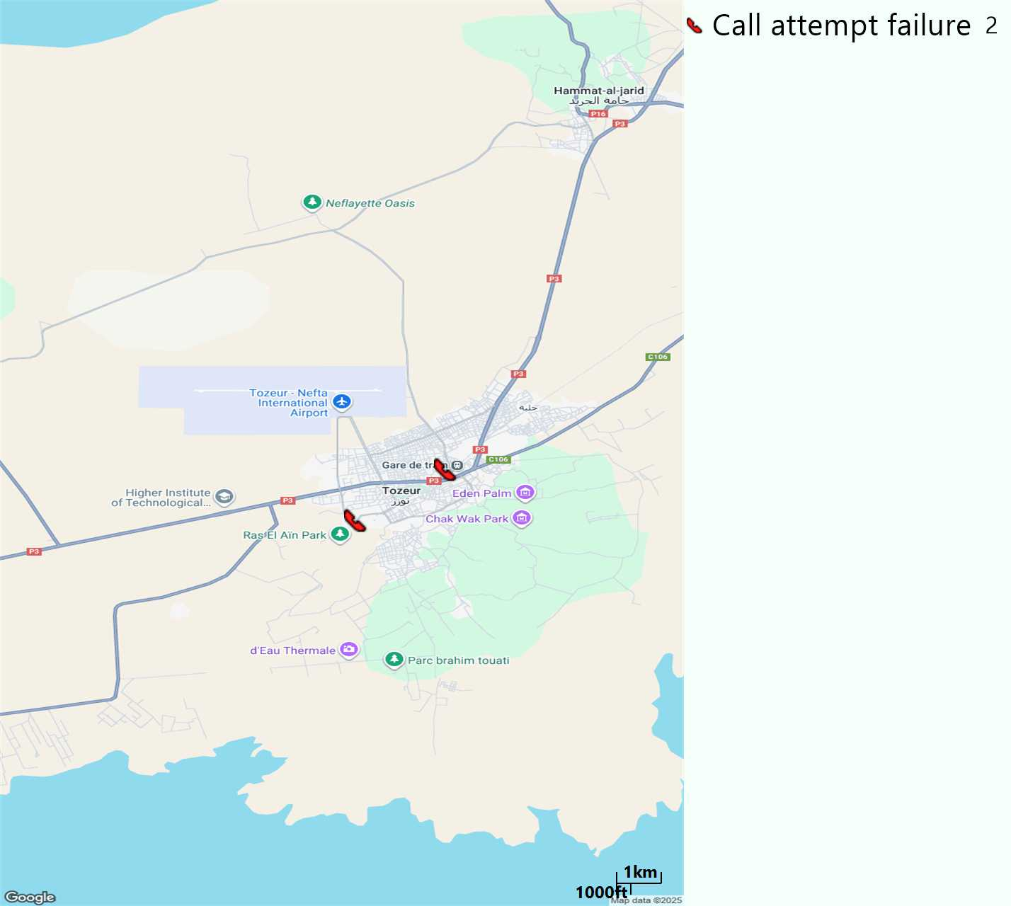
MO Voice Call - Blocked call
Short call

Slide 15
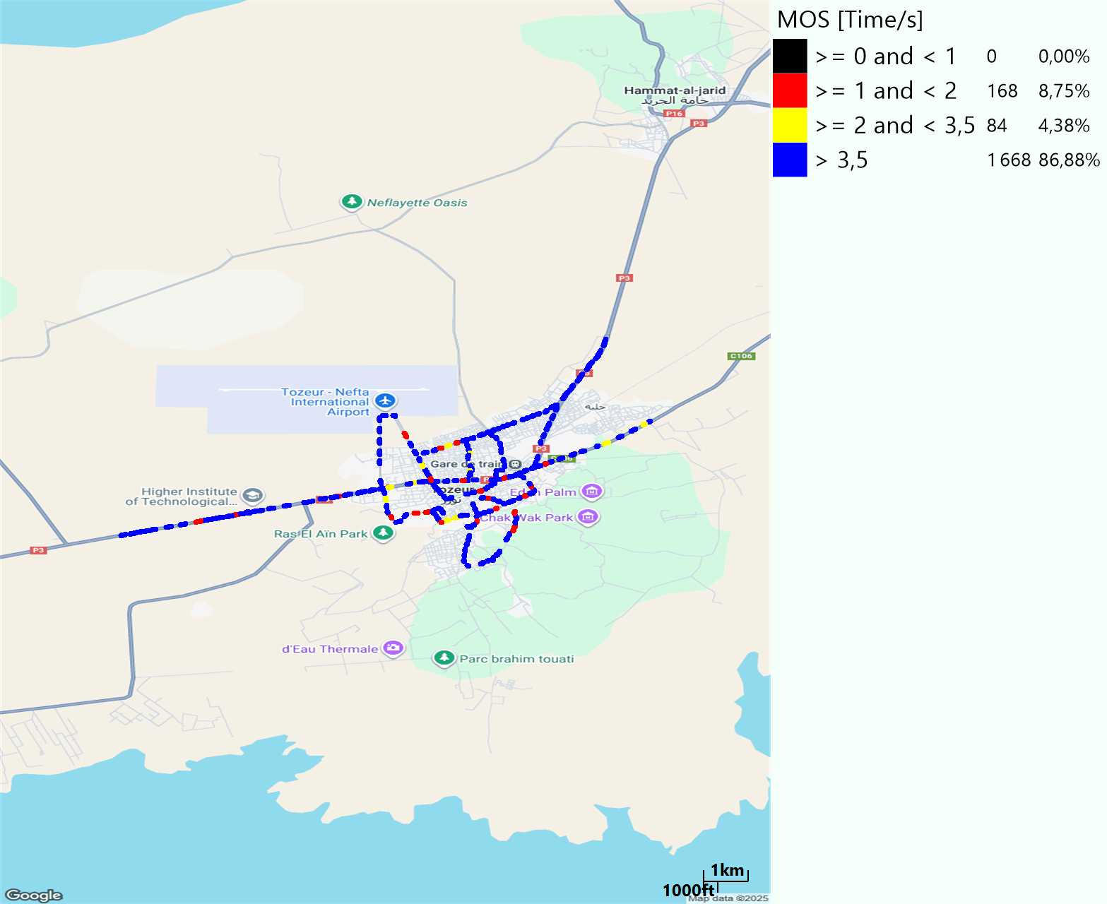
MO Voice Quality Metrics
long Call

Slide 16
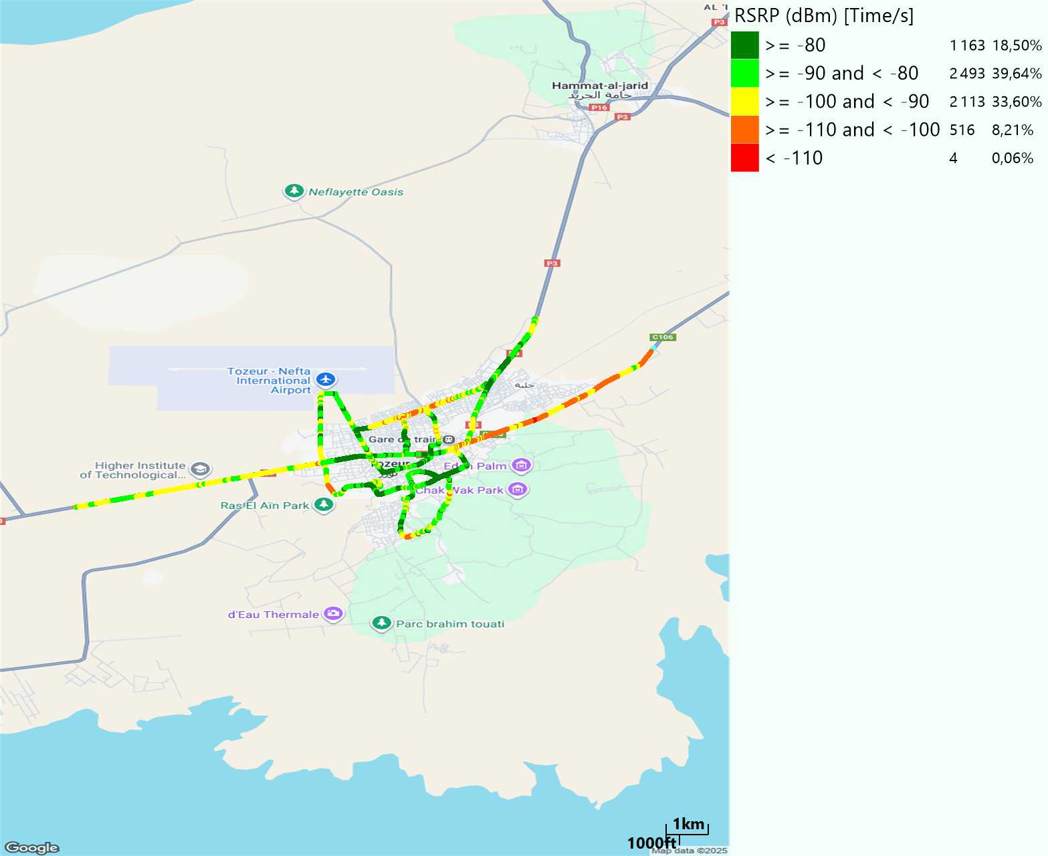
Scanner_RSRP
L2100

Slide 17
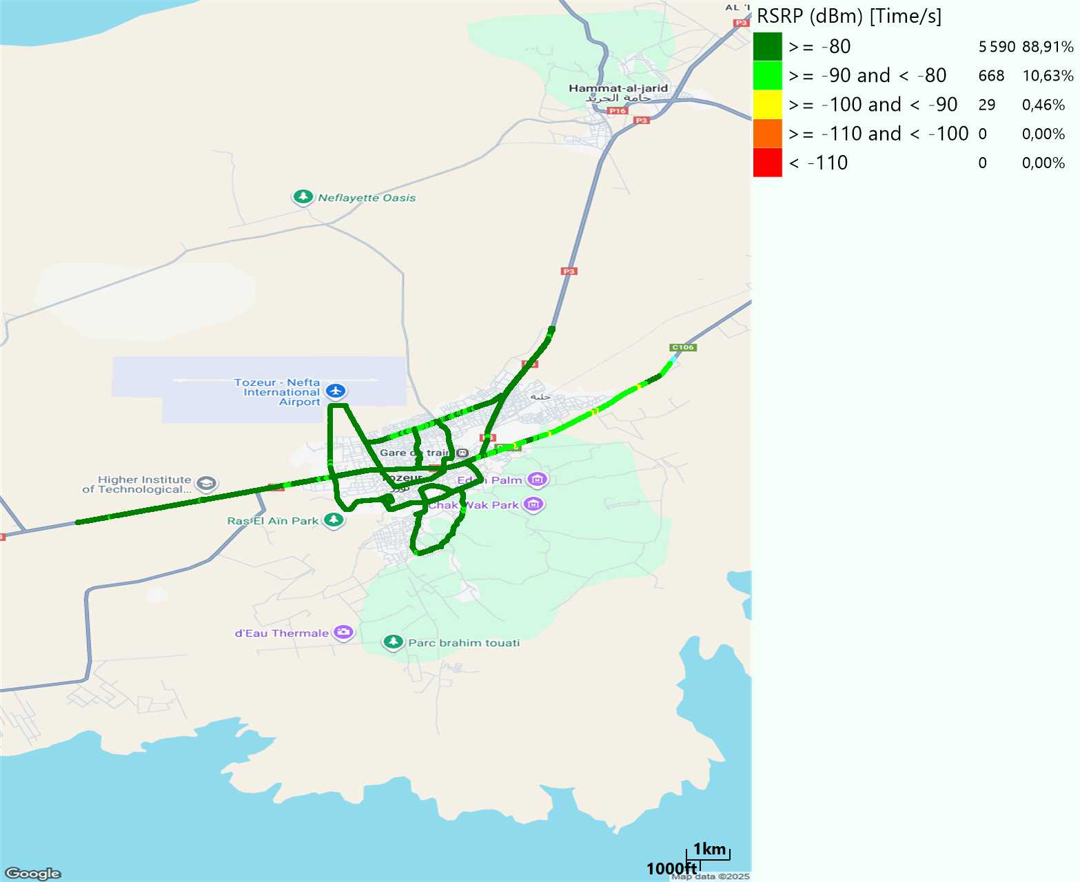
Scanner_RSRP
L800

Slide 18
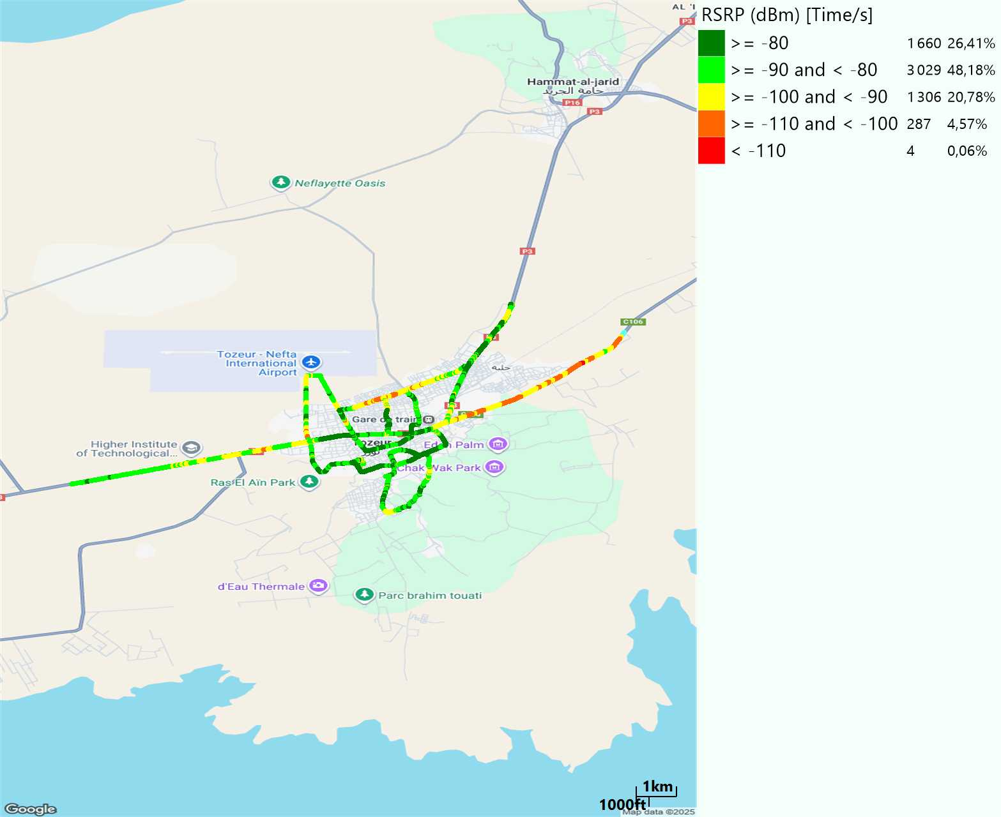
Scanner_RSRP
L1800

Slide 19
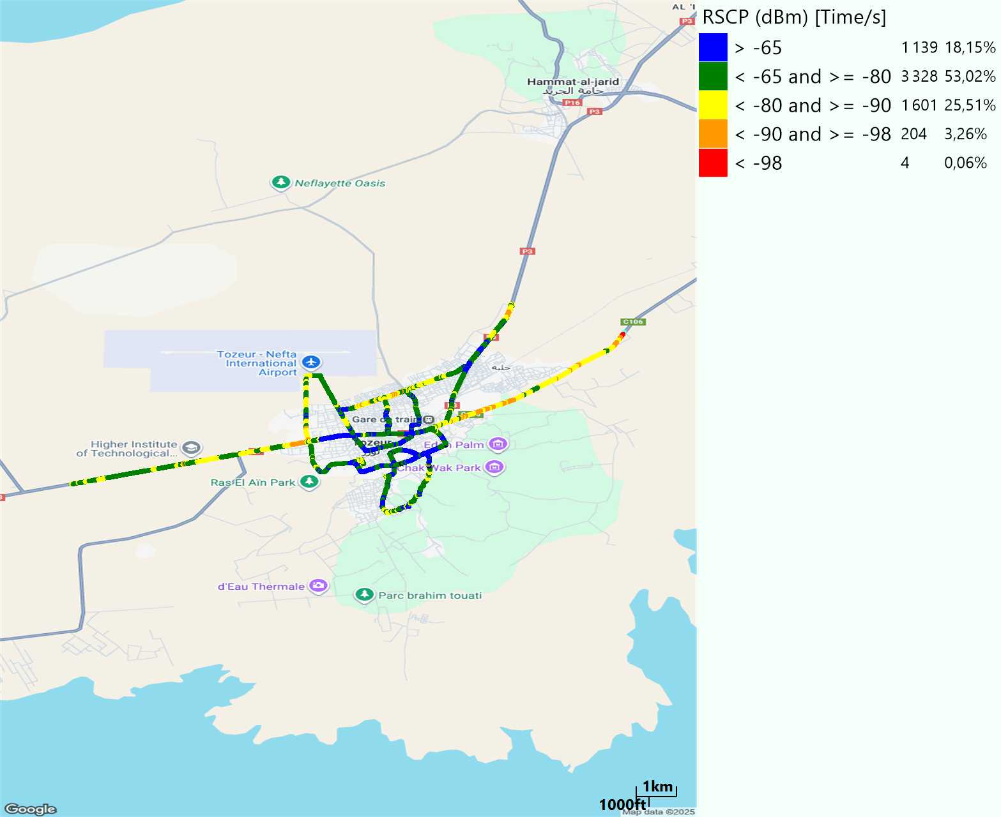
Scanner_RSCP
U2100

Slide 20
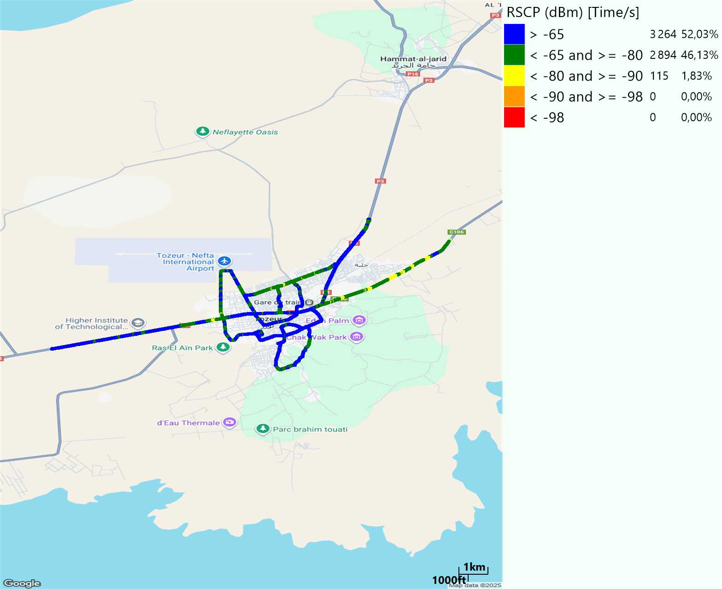
Scanner_RSCP
900

