Slide 1


Volte Drive Test Report

Slide 2
DT Scénario
Short Call (10s)
Long call (2min)
Scanner

Slide 3
Voice Call

Slide 4
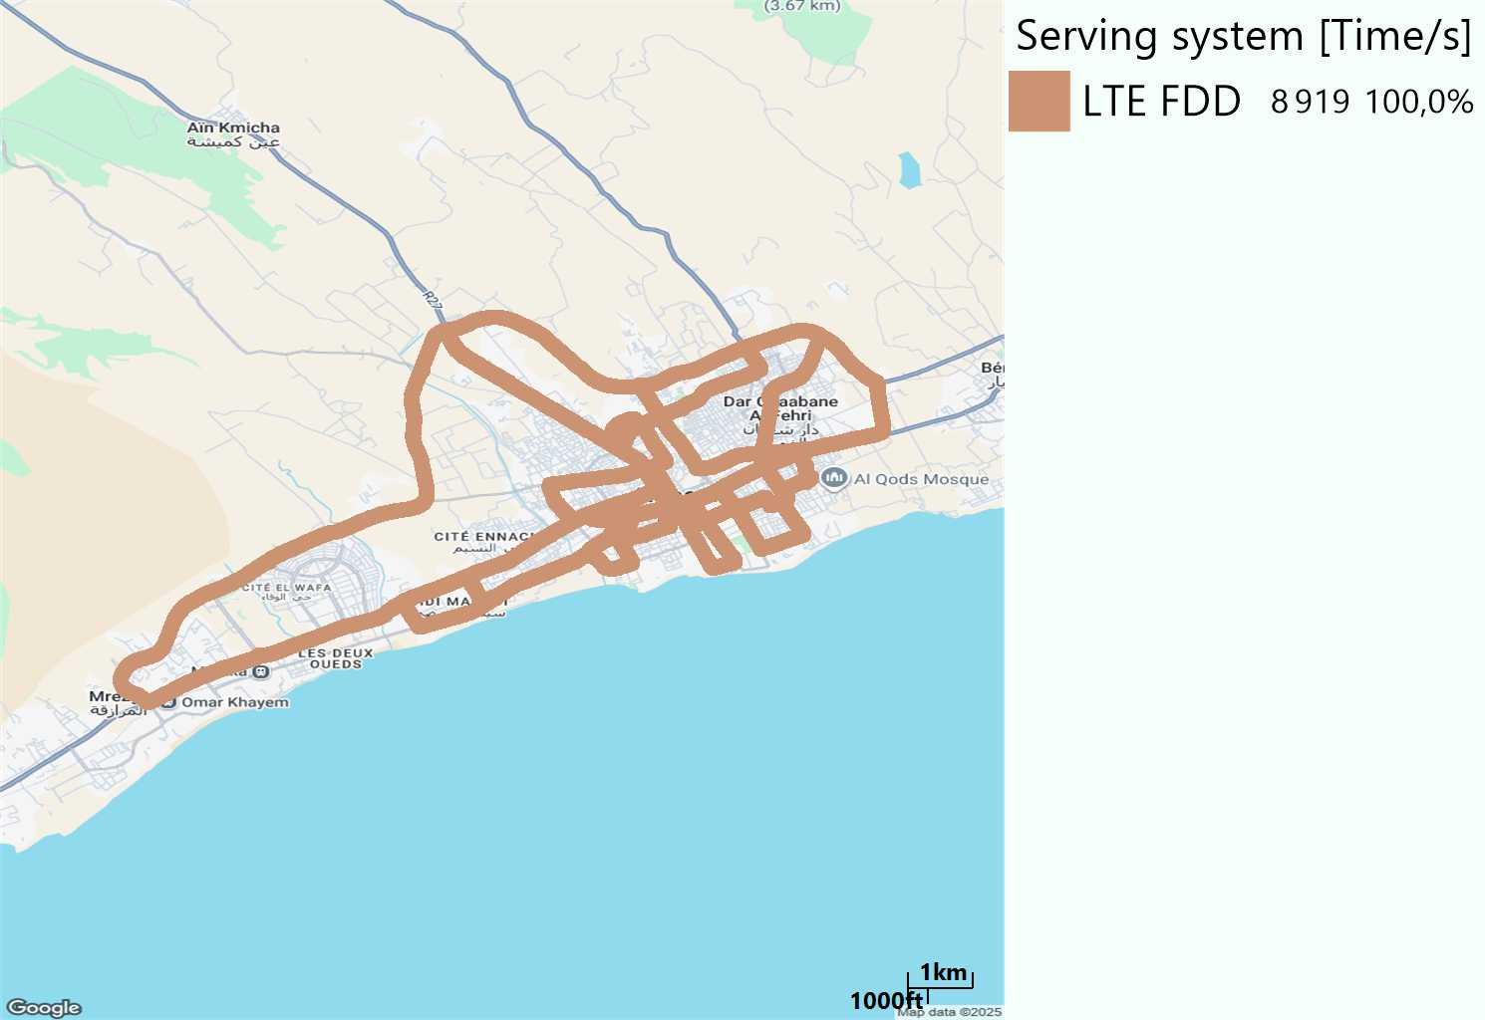

RAT distribution
Long call
Short call

Slide 5
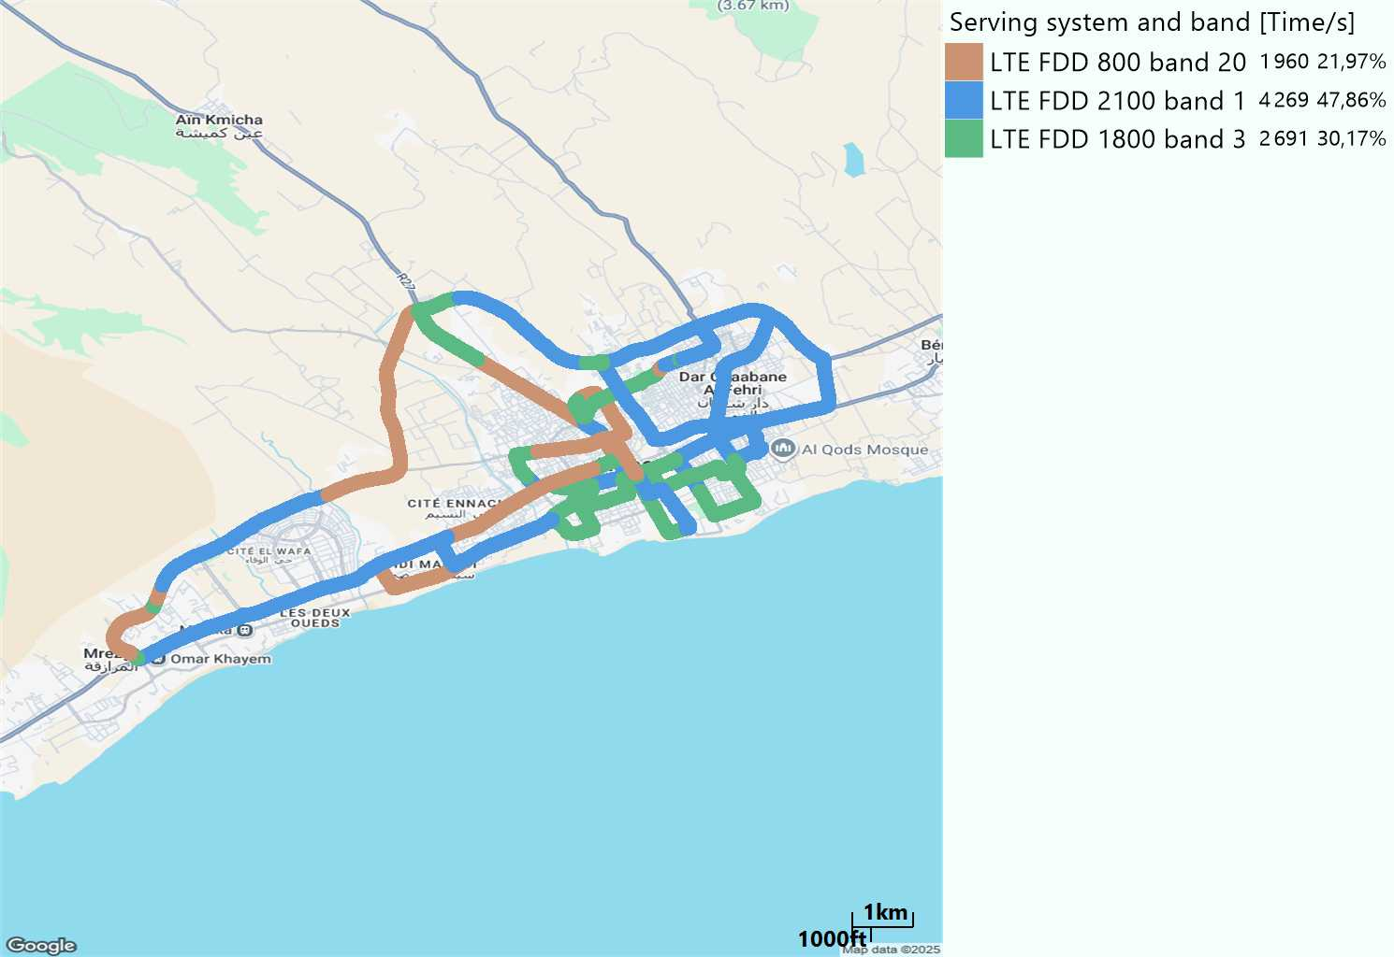
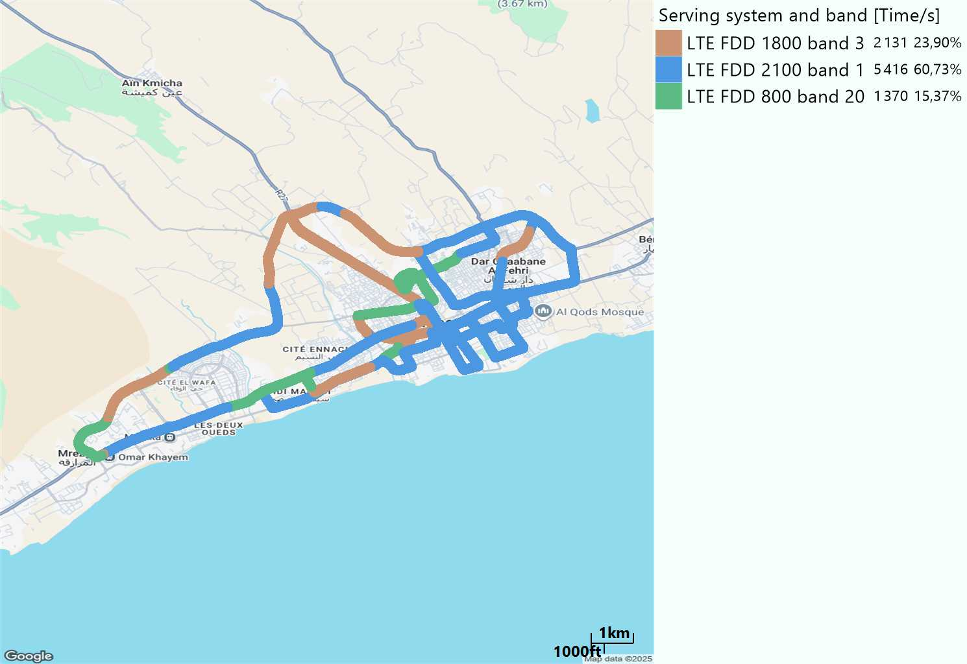
EARFCN distribution
Long call
Short call

Slide 6
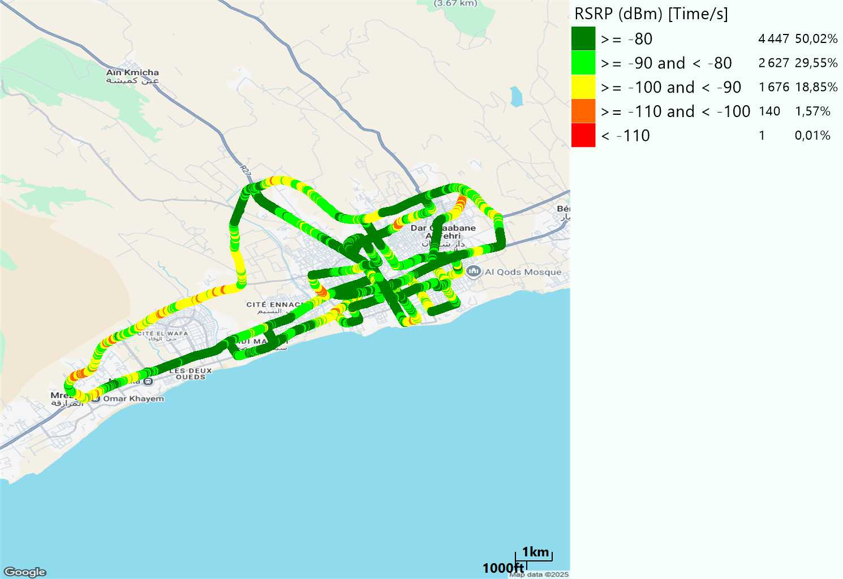

LTE - RSRP
Long call
Short call
Average [dBm]
-79,93
Average [dBm]
-81,11

Slide 7
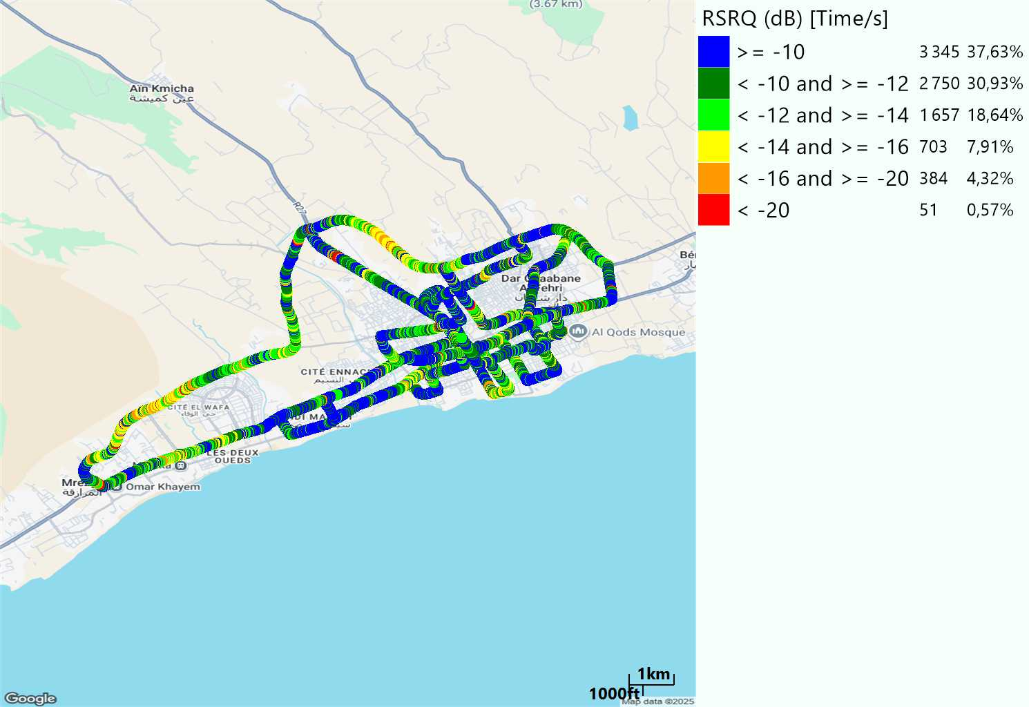

LTE- RSRQ
Long call
Short call

Slide 8
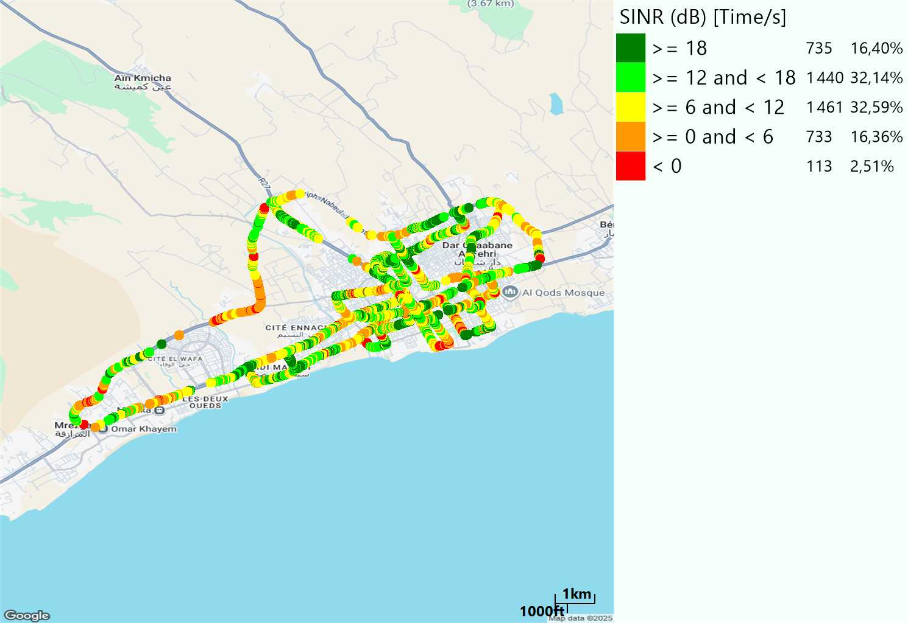
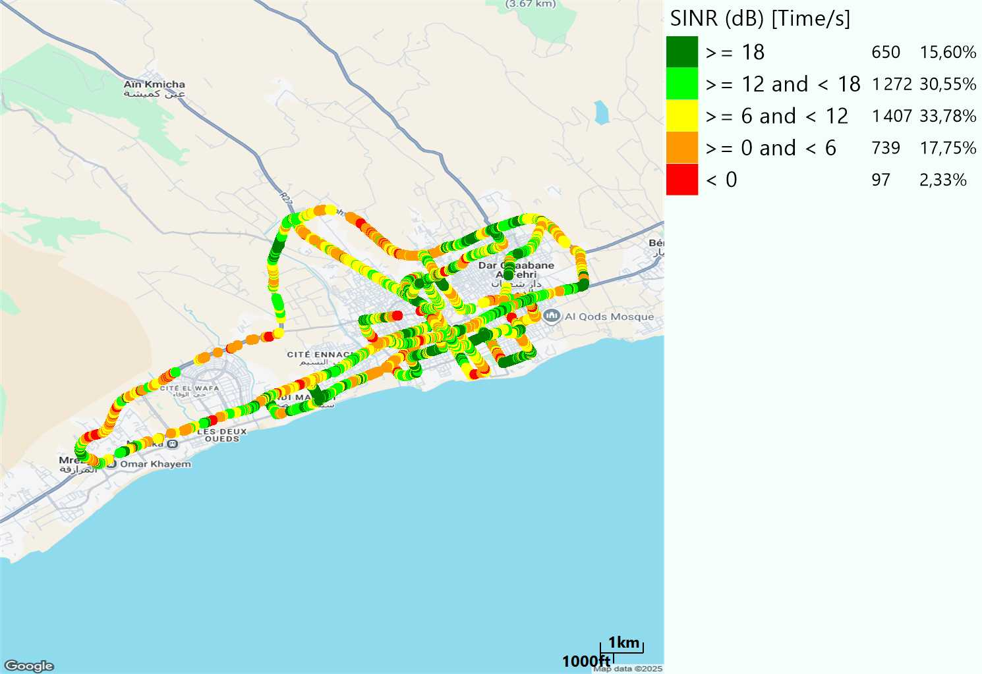
LTE-SINR
Long call
Short call

Slide 9
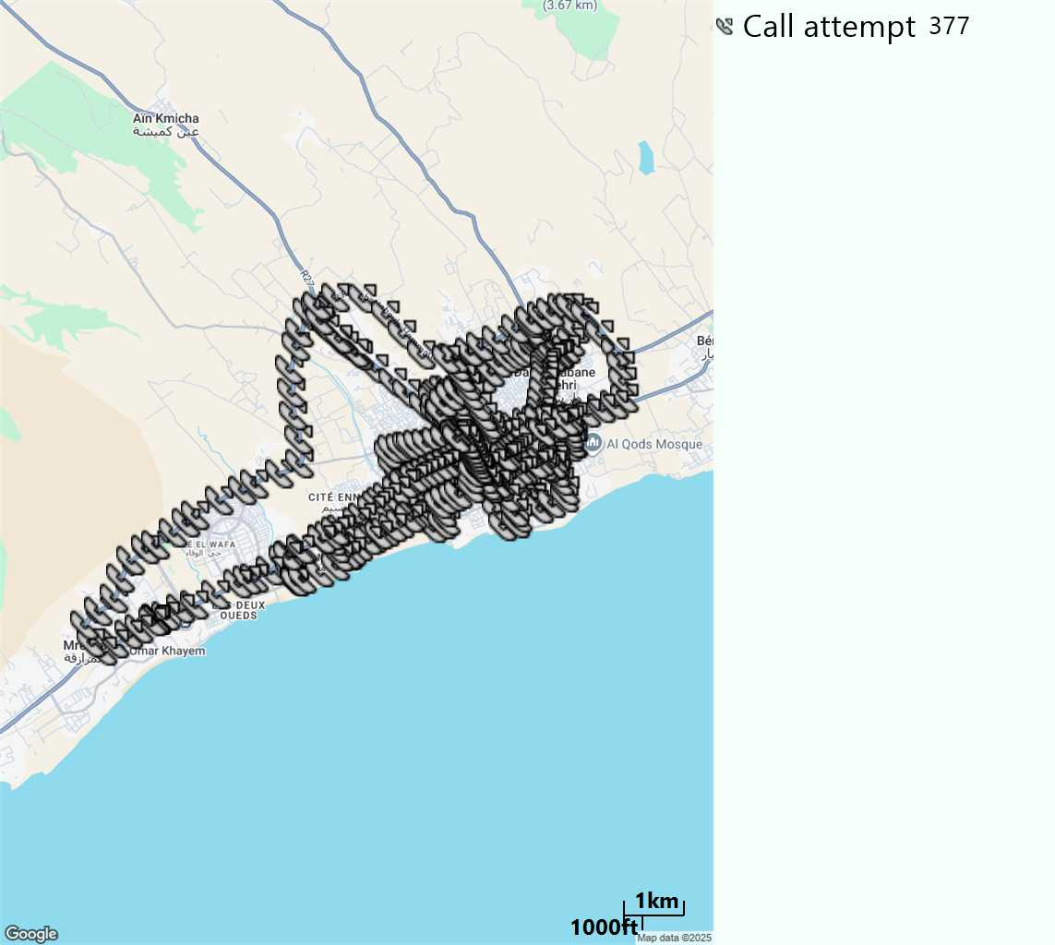
MO Call Setup Time (call setup time in VoLTE)
Short call
Call Setup Time IMS Voice
Average (Sec) | Maximum (Sec) | Minimum (Sec)
2,96 | 14,5 | 2,01

Slide 10
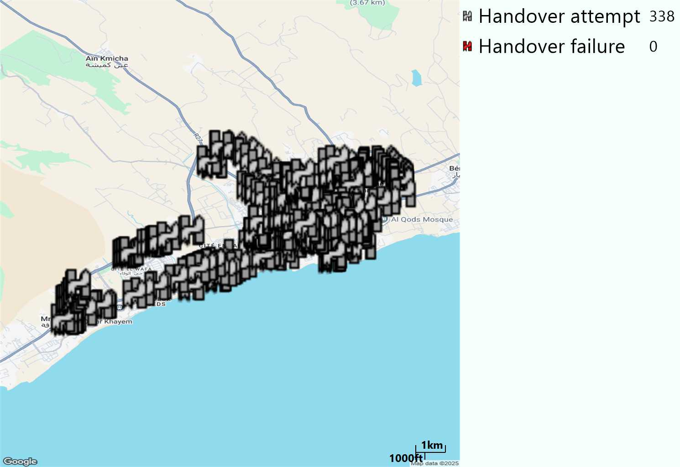
MO Handover Type
Long call
HO Type | Percentage [%]
LTE Inter-Frequency handover | 5,62%
LTE Intra-Frequency handover | 94,38%
Handover KPI’s
Handover Attemps | 338
Handover Success | 338
Handover succès Rate | 100%
Étiquettes de lignes | LTE FDD_1800 | LTE FDD_2100 | LTE FDD_800 | Total général
LTE FDD_1800 | 89 | 5 | 2 | 96
LTE FDD_2100 | 3 | 162 | 4 | 169
LTE FDD_800 | 5 | 1 | 67 | 73
Total général | 97 | 168 | 73 | 338

Slide 11
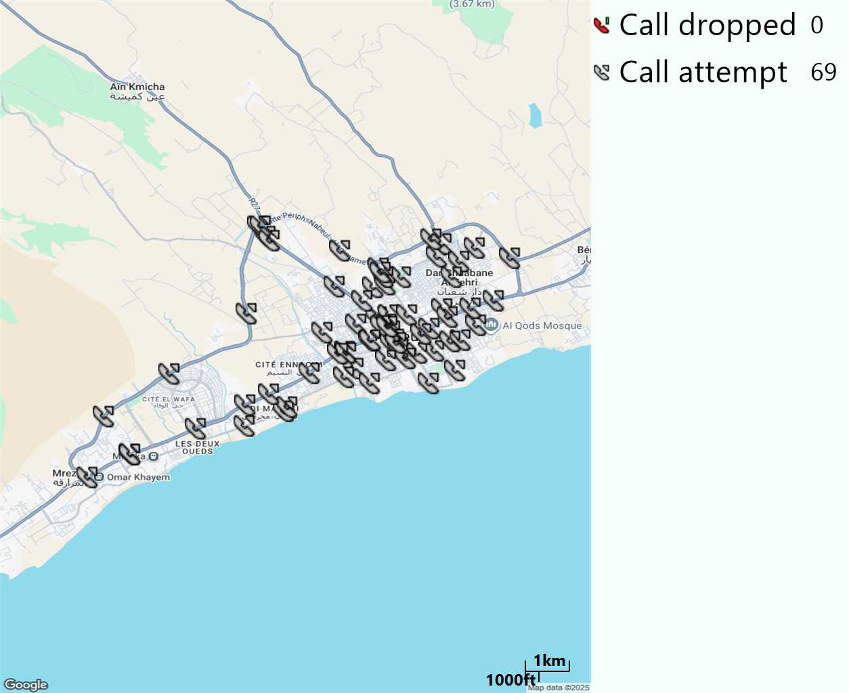
MO Voice Stats (VoLTE call stats)
Long call
Voice KPIs
Number Call Attempts | 69
Number Dropped Calls | 0
Call Drop Rate (%) | 0%
HO success rate | 100%

Slide 12
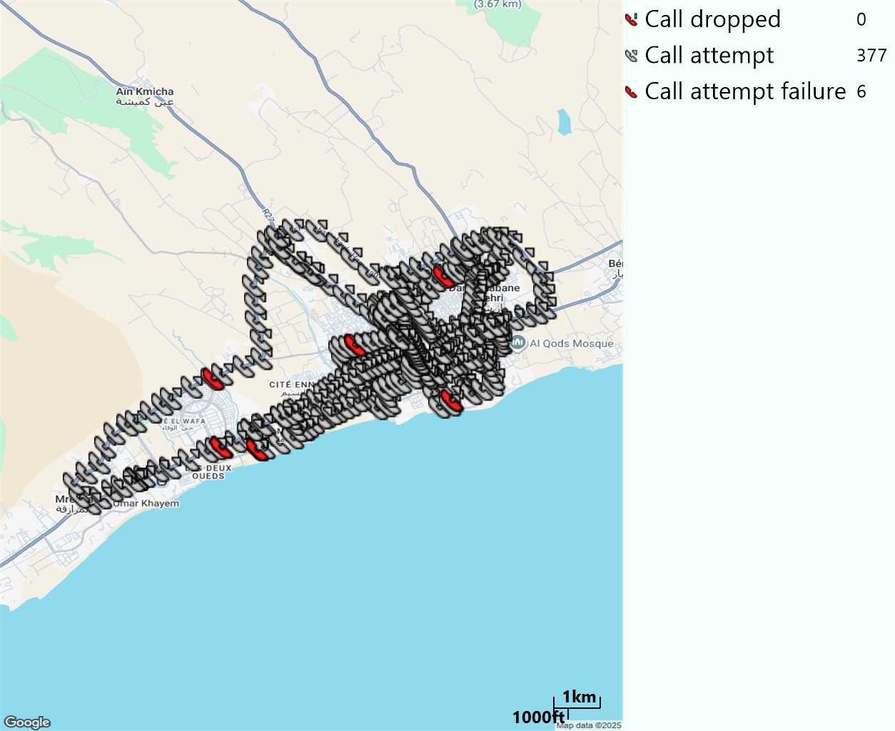
MO Voice Stats (VoLTE call stats)
Short call
Voice KPIs
Number Call Attempts | 377
Number Call Setup | 371
Number Blocked Calls | 6
Setup Succes Rate (%) | 98,41%
Call Block Rate (%) | 1,59%
Call Setup Time IMS Voice Average (Sec) | 2,96

Slide 13
MO Voice Stats (VoLTE call stats)
KPIs
VoLTE Call Setup SR | 98,41%
Call Setup Time | 2,96
VoLTE Drop Call Rate | 0%
Speech Quality - MOS (% of the samples >3,5) | 94,16%
Average MOS | 4,22
VoLTE Handover SR | 100%
VoLTE SRVCC SR | -

Slide 14
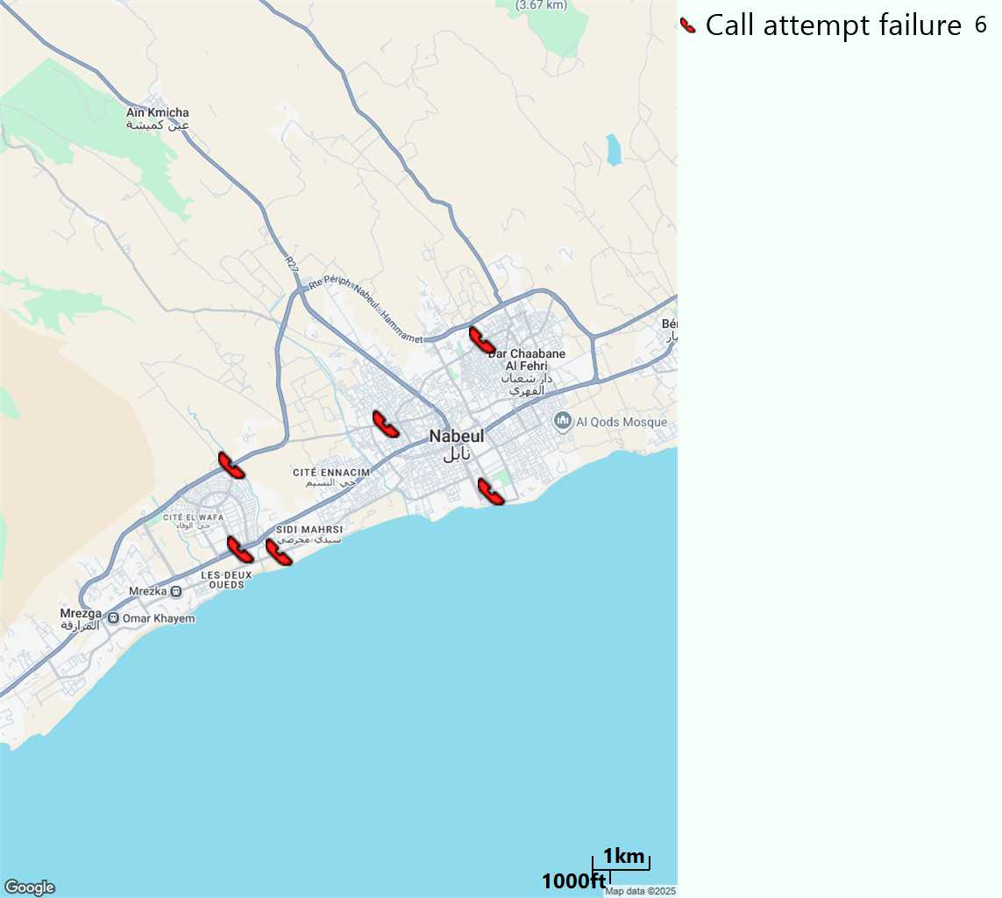
MO Voice Call - Blocked call
Short call

Slide 15
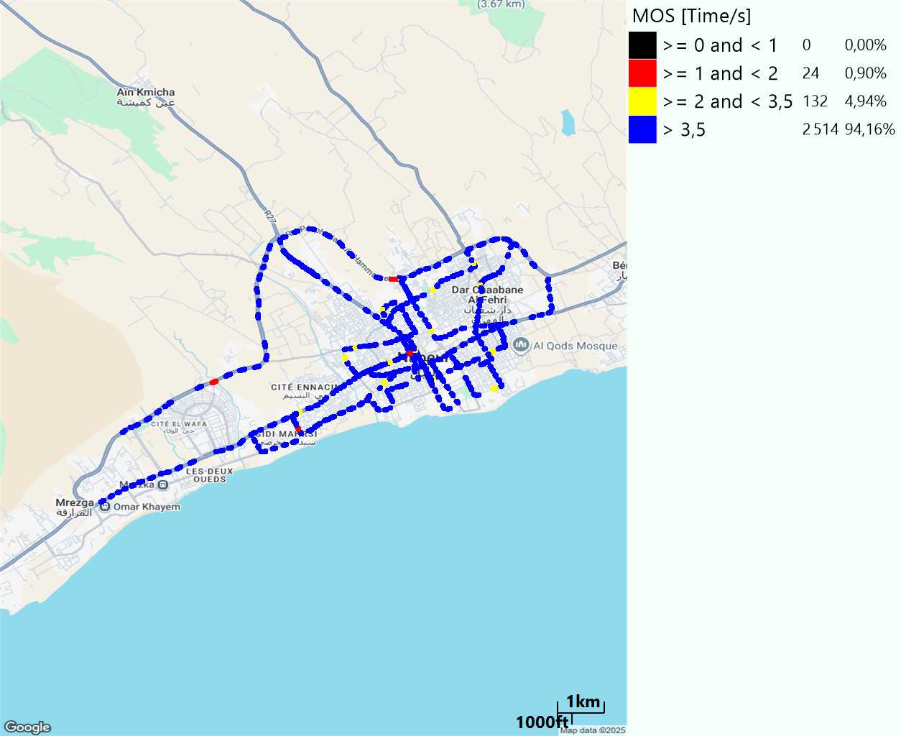
MO Voice Quality Metrics
long Call

Slide 16
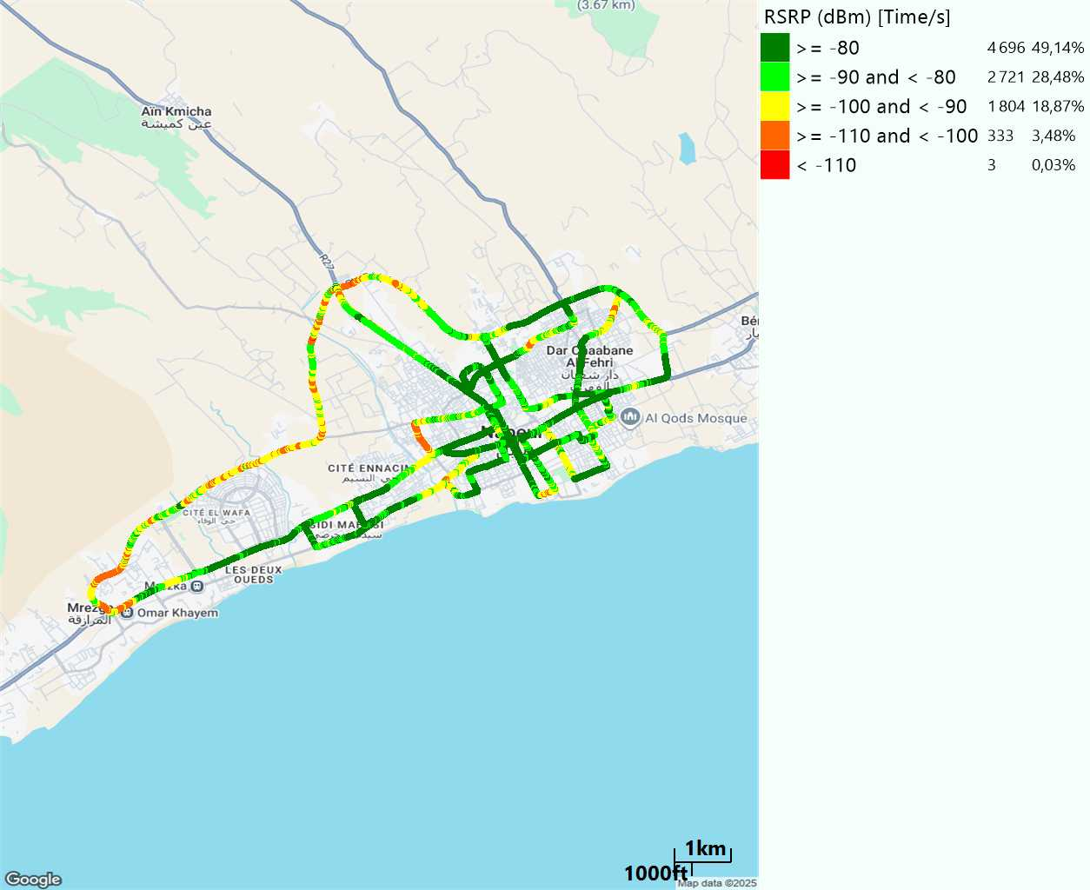
Scanner_RSRP
L2100

Slide 17
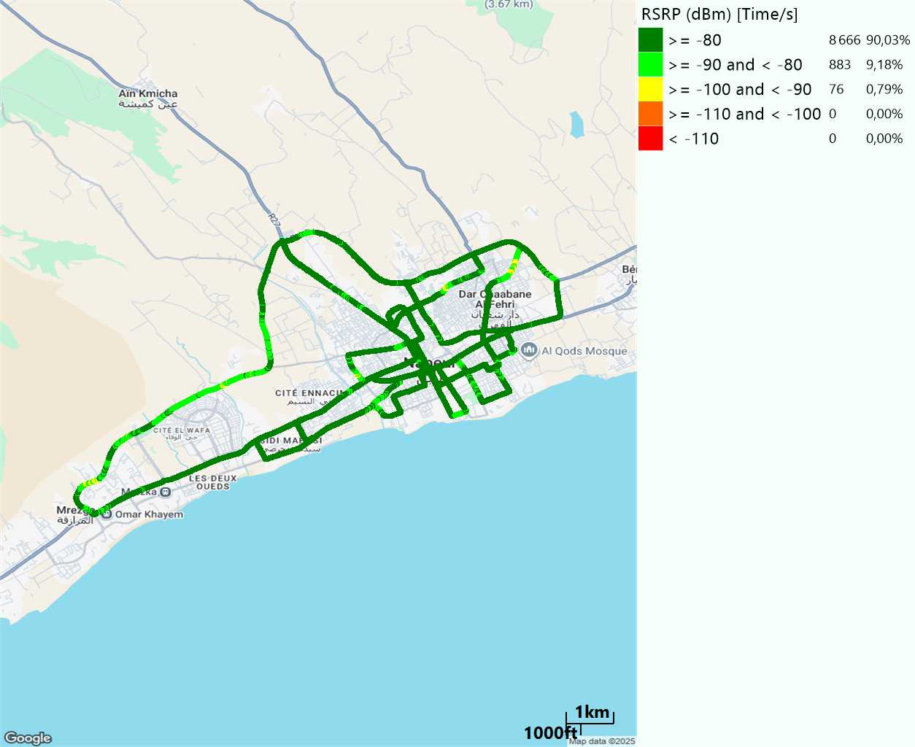
Scanner_RSRP
L800

Slide 18
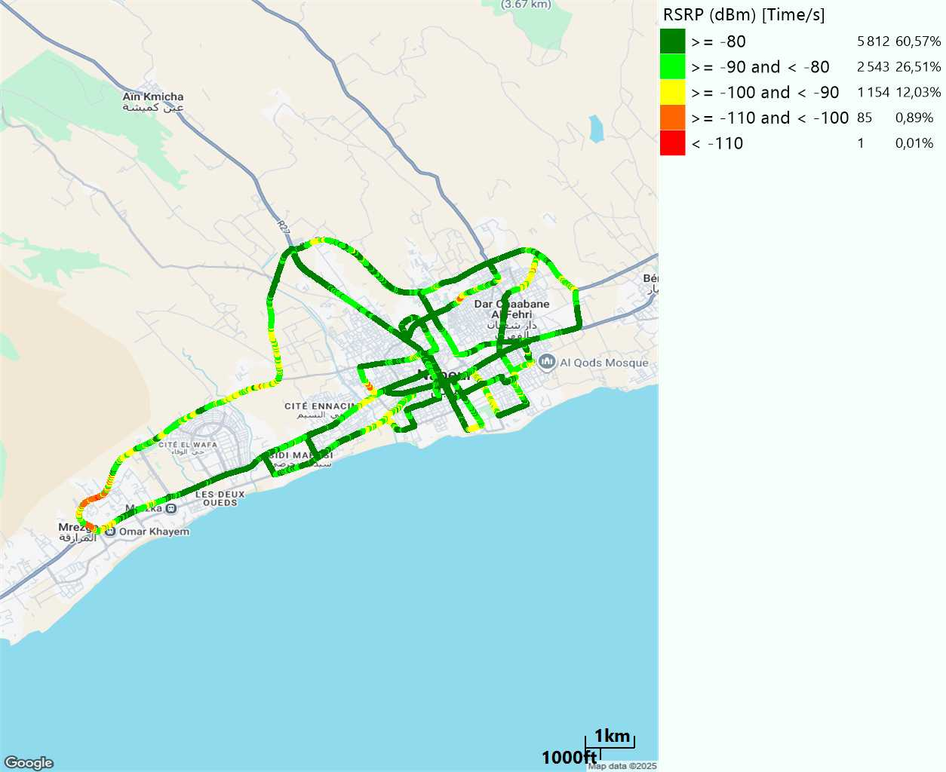
Scanner_RSRP
L1800

Slide 19
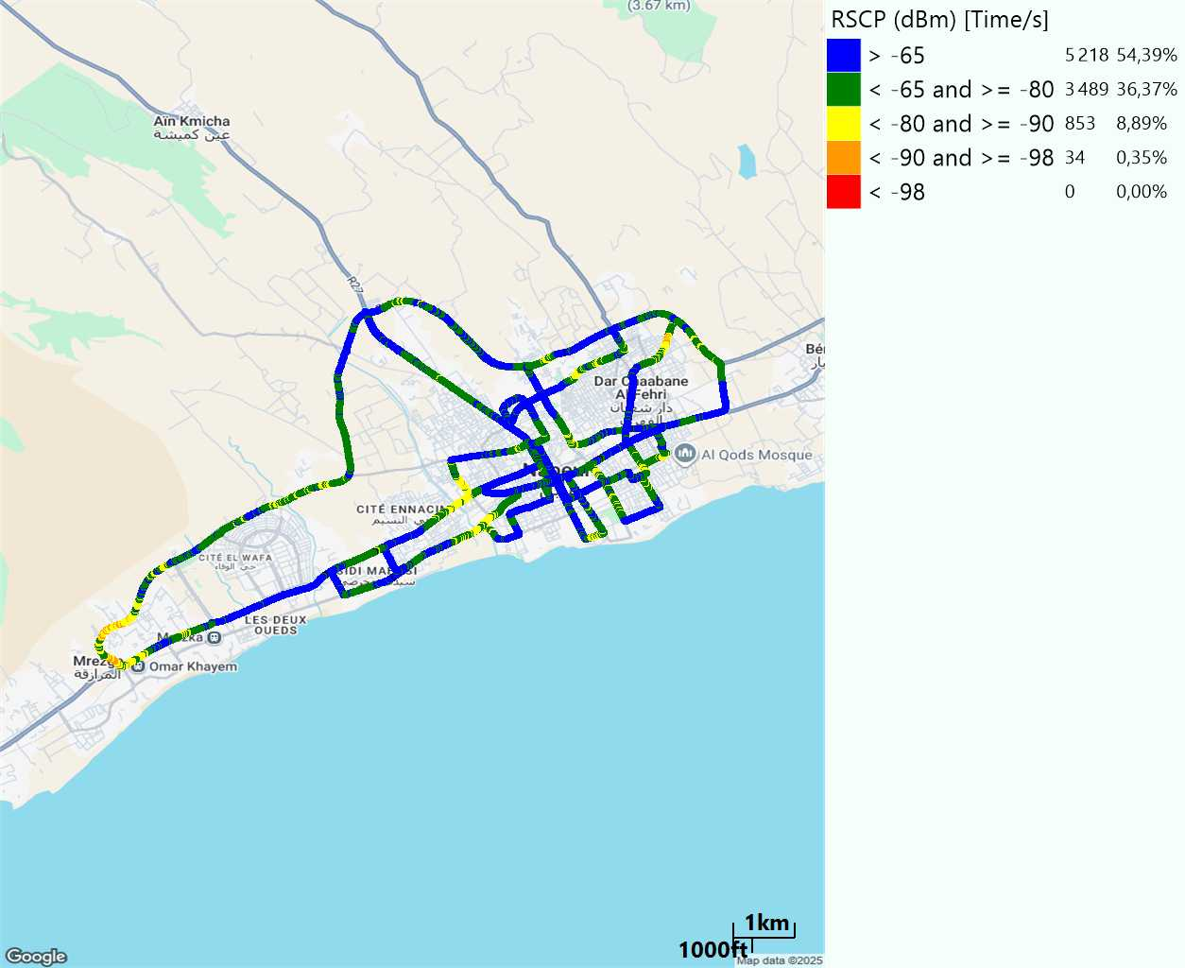
Scanner_RSCP
U2100

Slide 20
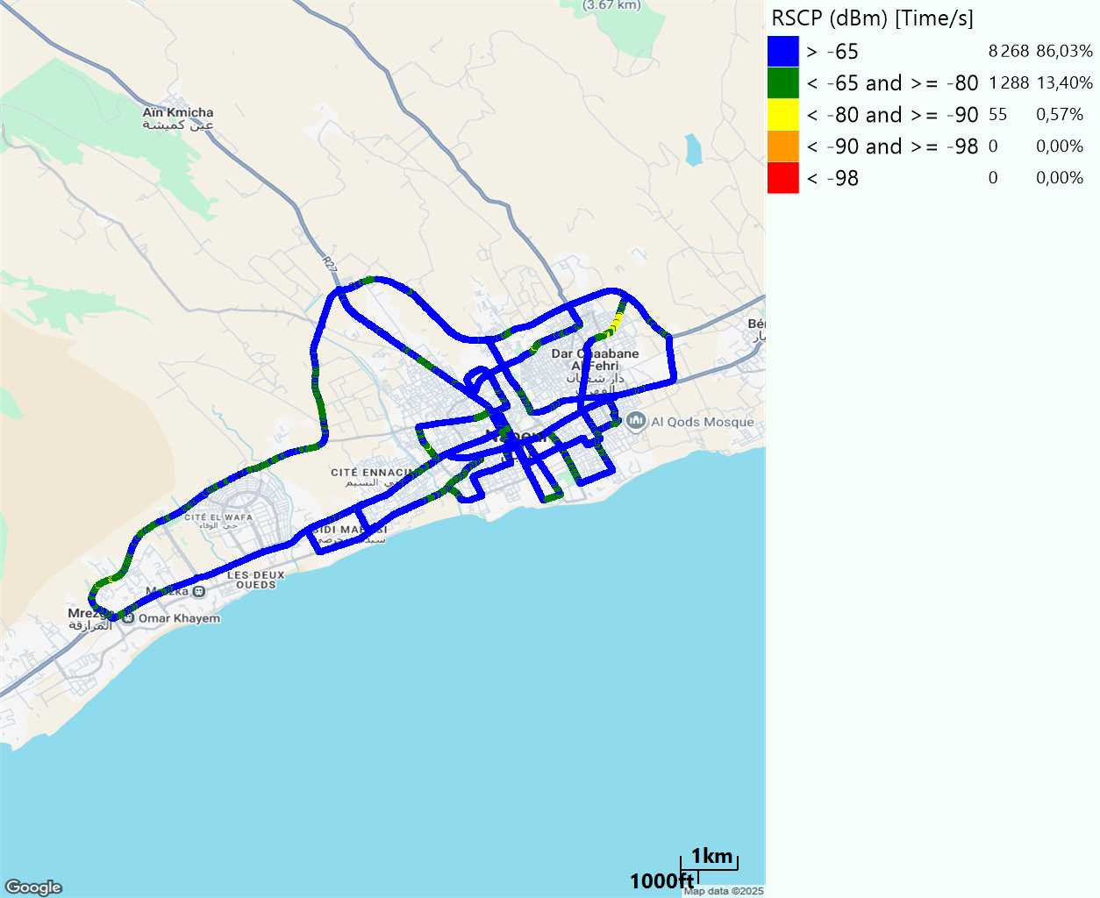
Scanner_RSCP
900

