Slide 1


Volte Drive Test Report

Slide 2
DT Scénario
Short Call (10s)
Long call (2min)
Scanner

Slide 3
Voice Call

Slide 4
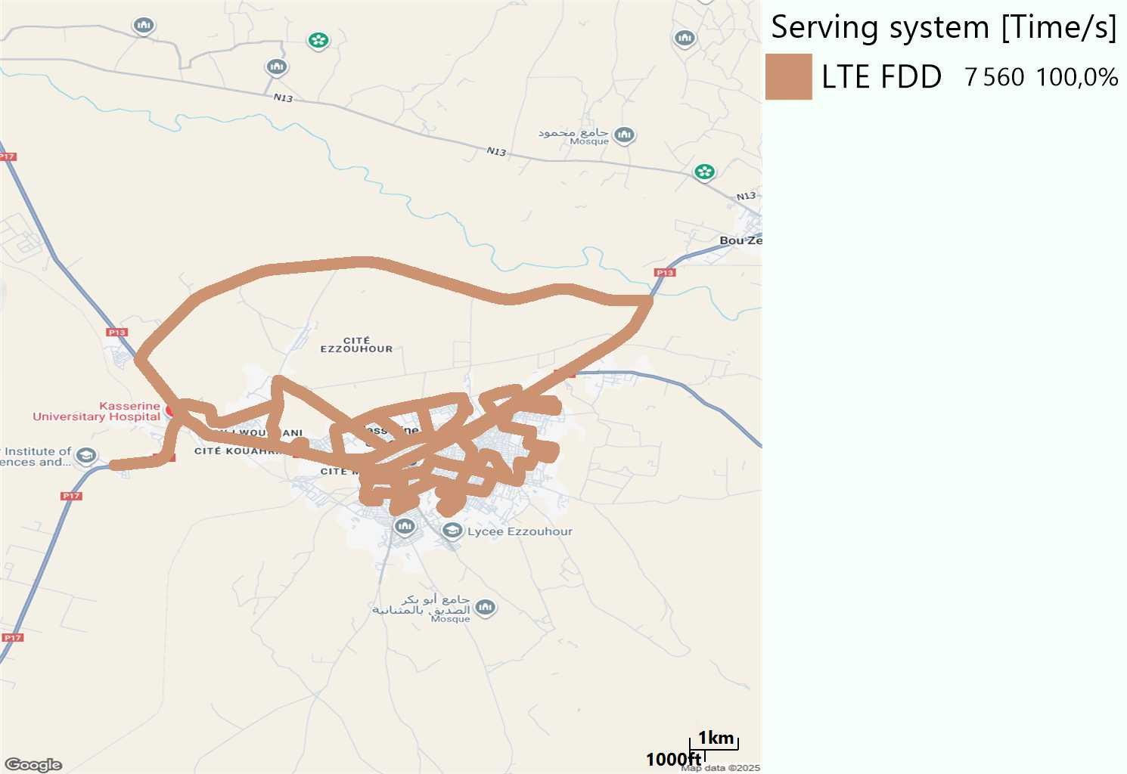
RAT distribution
Long call
Short call

Slide 5
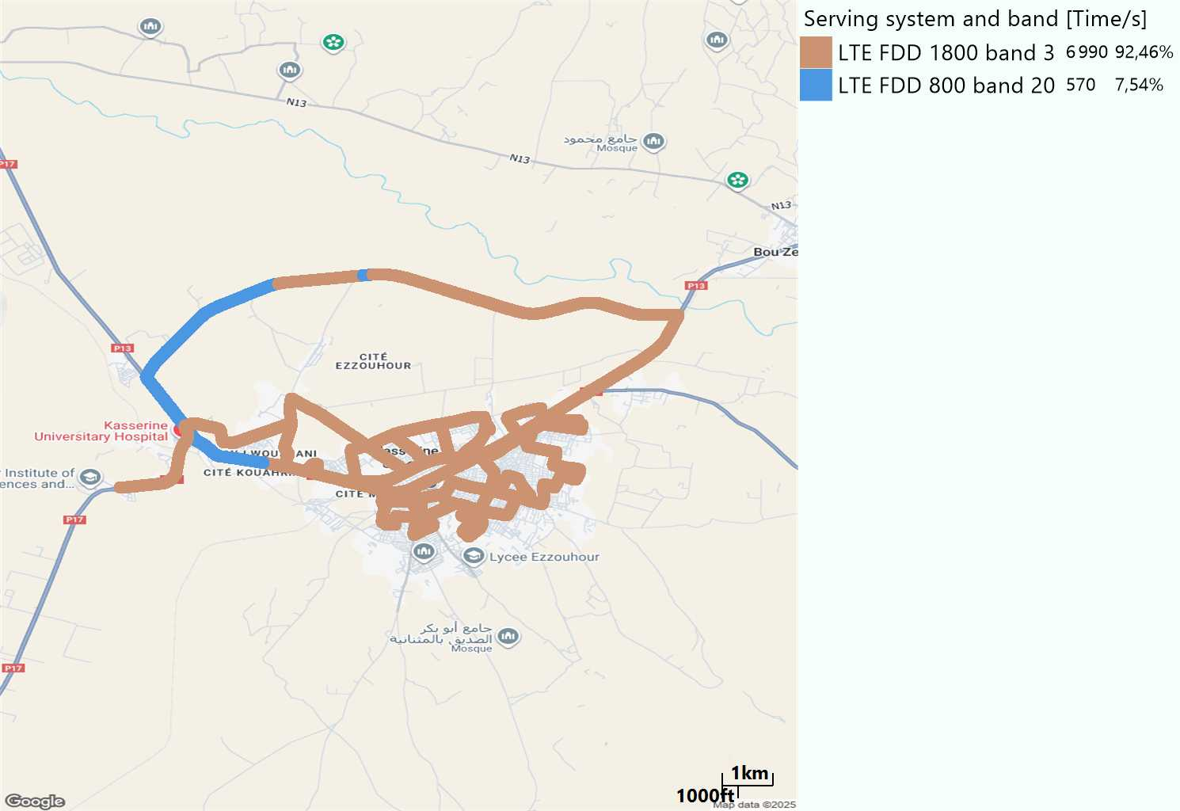
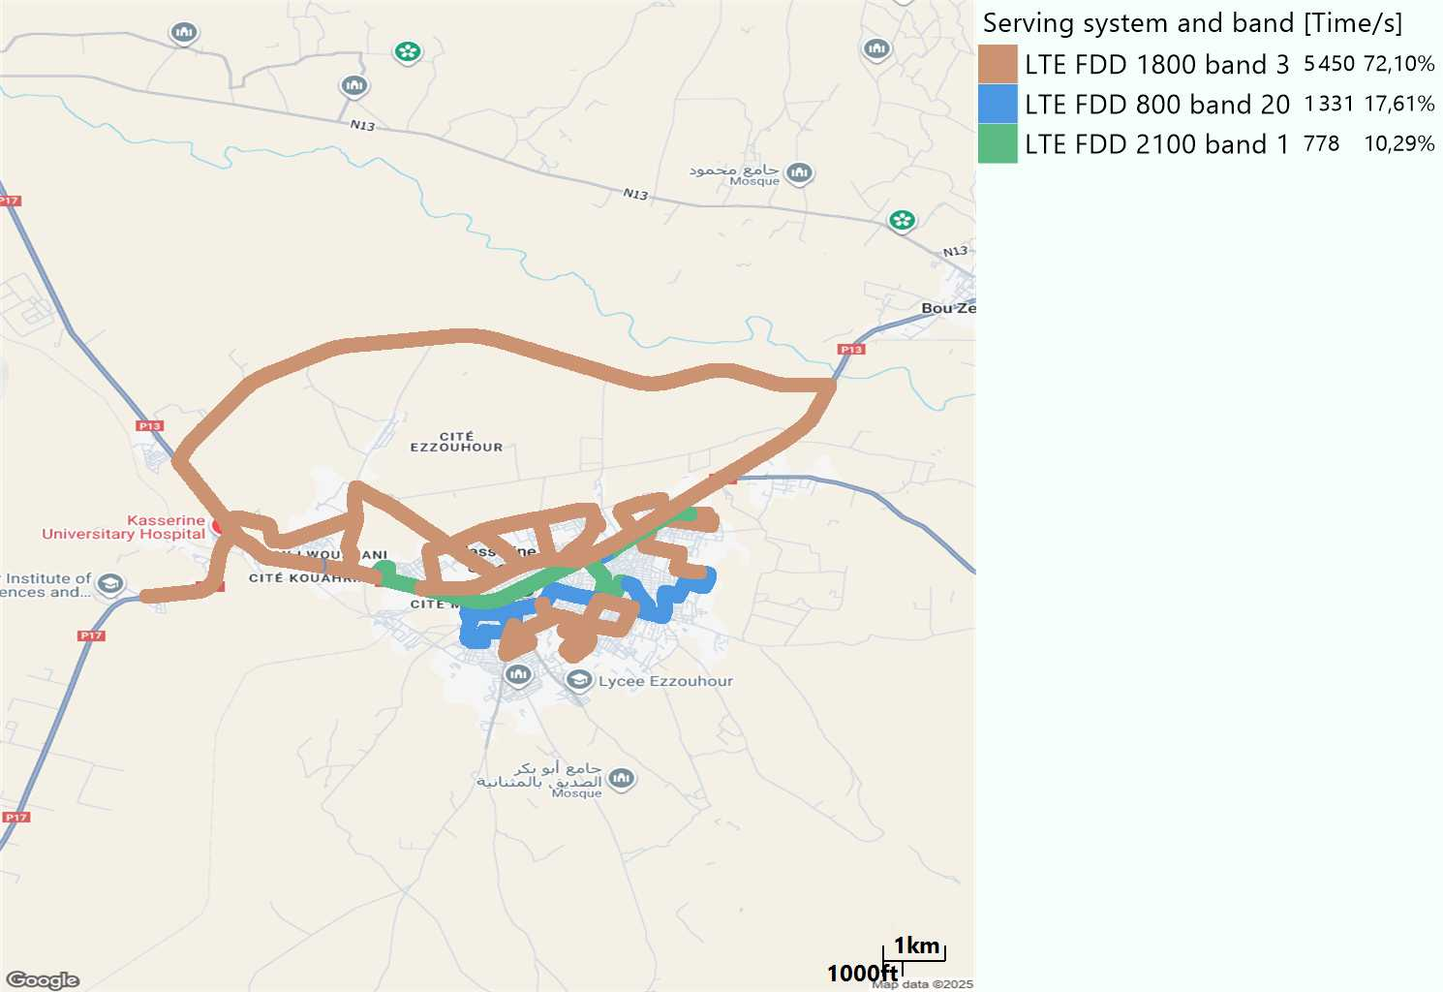
EARFCN distribution
Long call
Short call

Slide 6
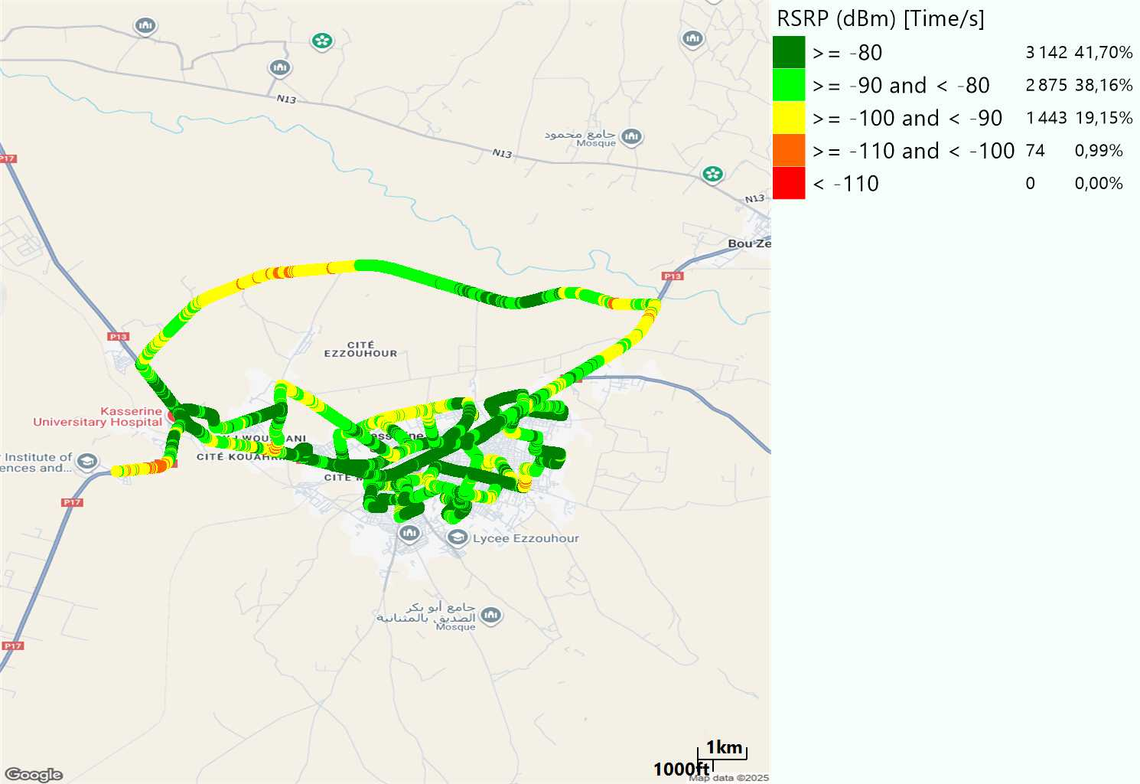

LTE - RSRP
Long call
Short call
Average [dBm]
-81,54
Average [dBm]
-82,49

Slide 7
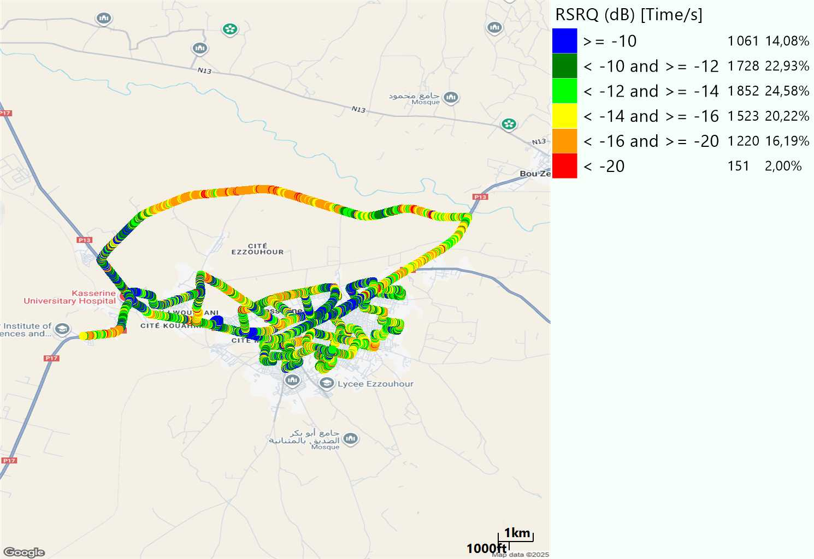
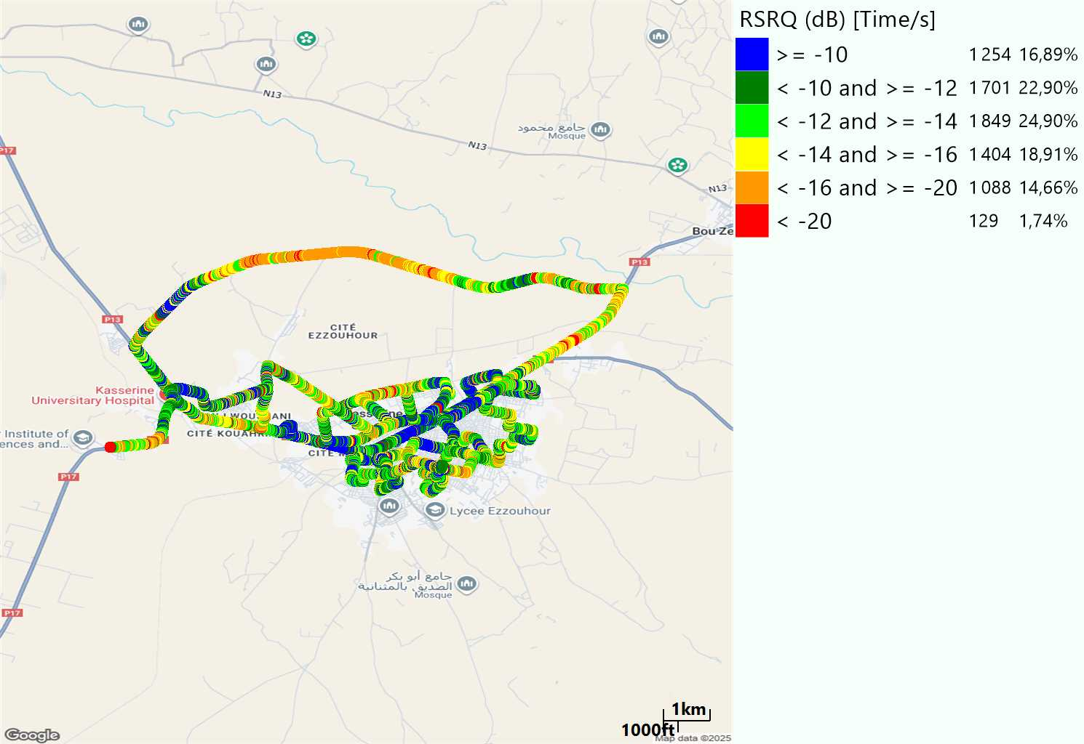
LTE- RSRQ
Long call
Short call

Slide 8
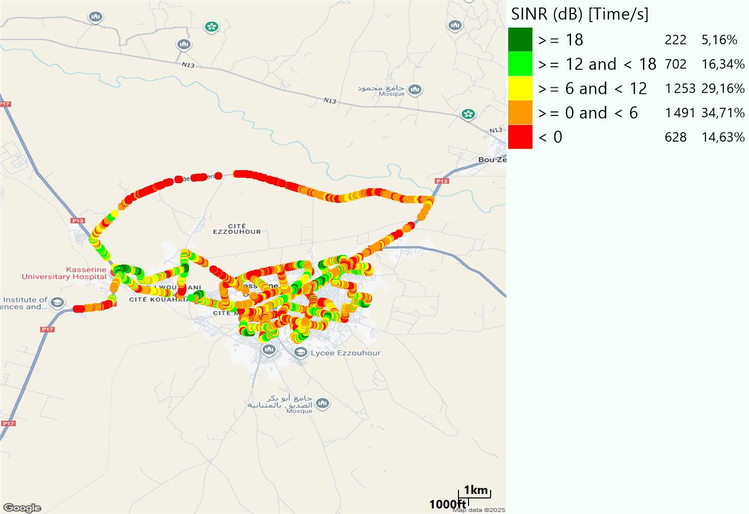
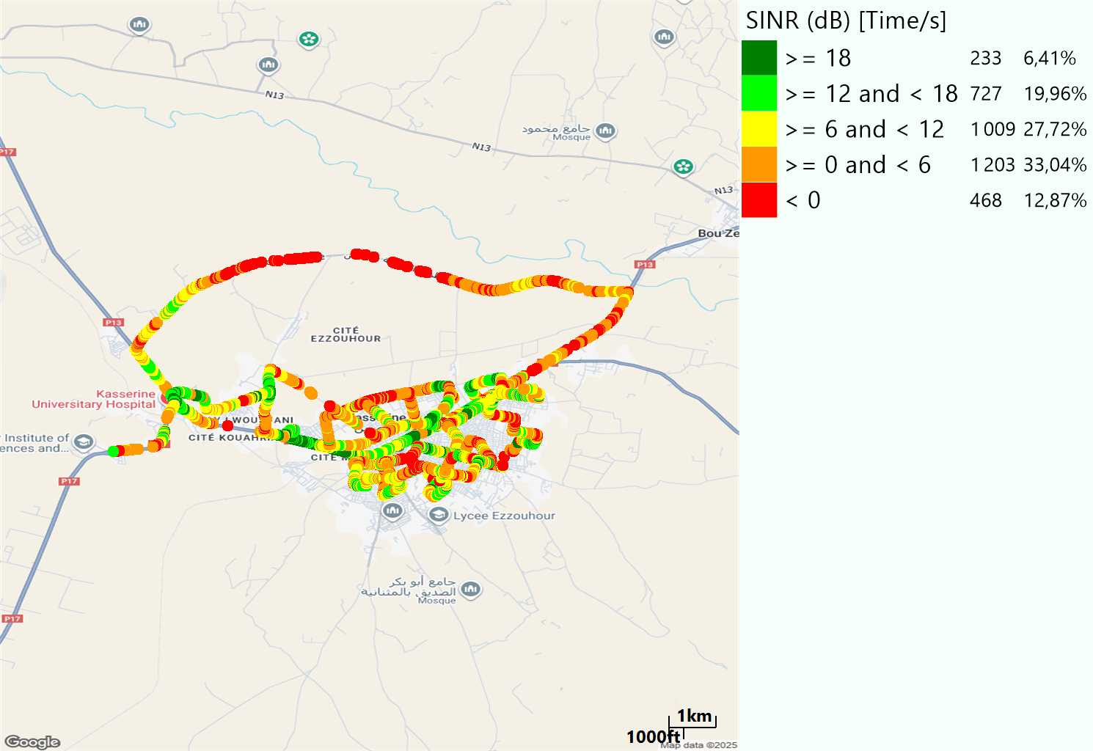
LTE-SINR
Long call
Short call

Slide 9
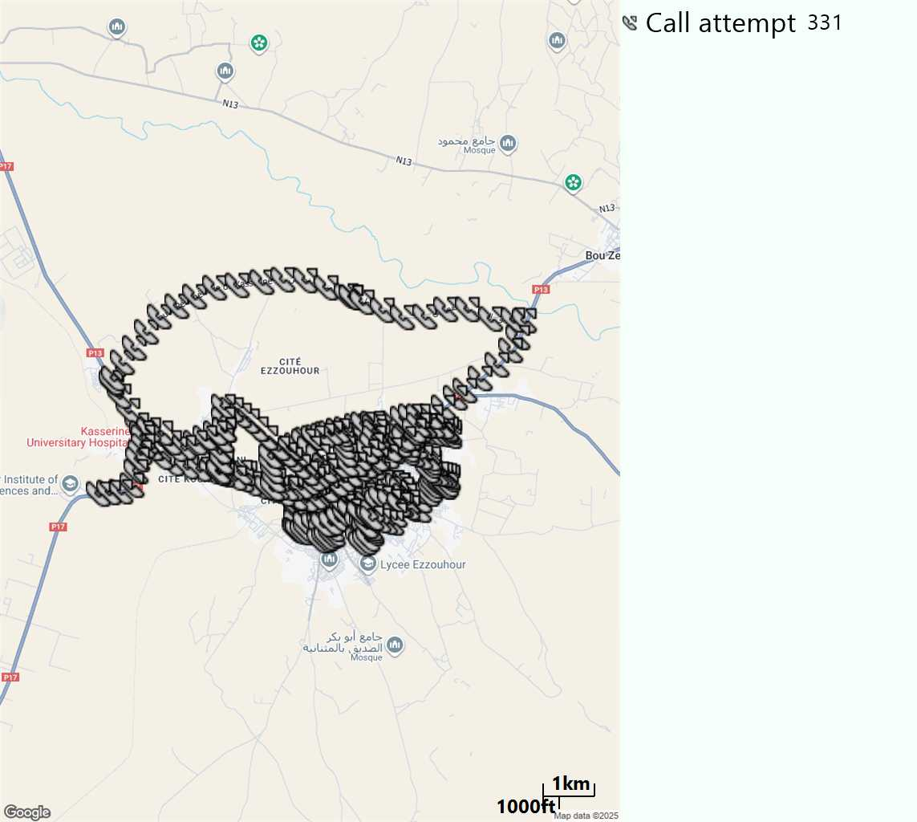
MO Call Setup Time (call setup time in VoLTE)
Short call
Call Setup Time IMS Voice
Average (Sec) | Maximum (Sec) | Minimum (Sec)
2,81 | 12,22 | 1,88

Slide 10
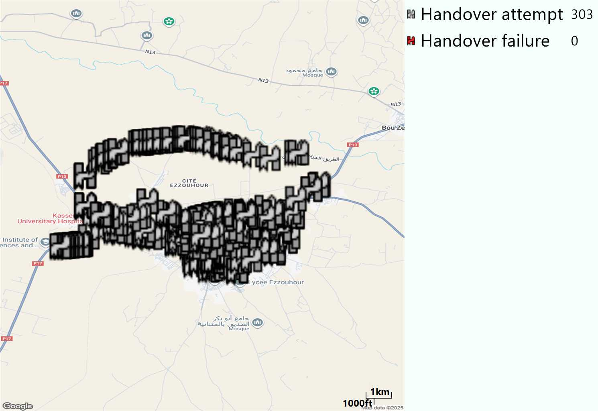
MO Handover Type
Long call
HO Type | Percentage [%]
LTE Intra-Frequency handover | 100%
Handover KPI’s
Handover Attemps | 303
Handover Success | 303
Handover succès Rate | 100%
Étiquettes de lignes | LTE FDD_1800 | LTE FDD_800 | Total général
LTE FDD_1800 | 274 | 2 | 276
LTE FDD_800 | 1 | 26 | 27
Total général | 275 | 28 | 303

Slide 11
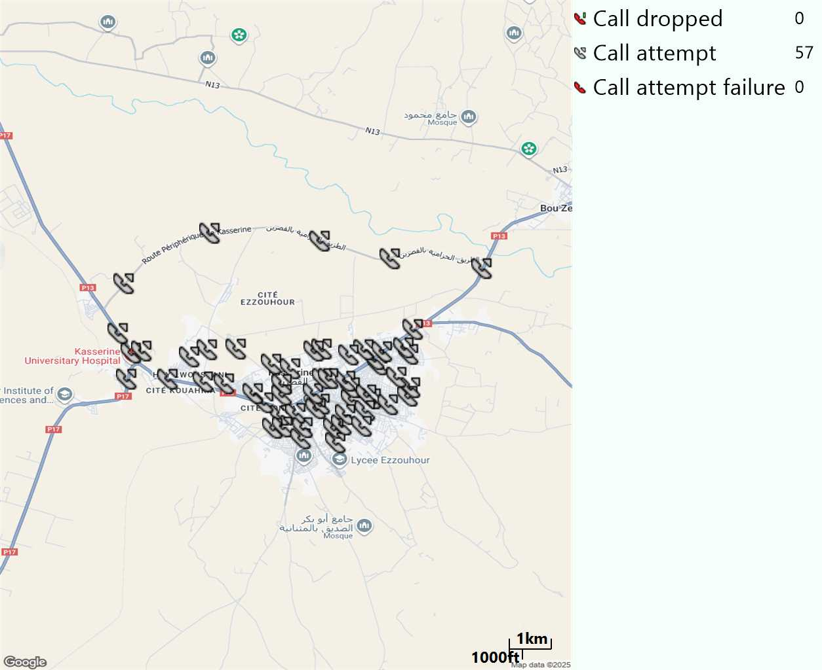
MO Voice Stats (VoLTE call stats)
Long call
Voice KPIs
Number Call Attempts | 57
Number Dropped Calls | 0
Call Drop Rate (%) | 0%
HO success rate | 100%

Slide 12
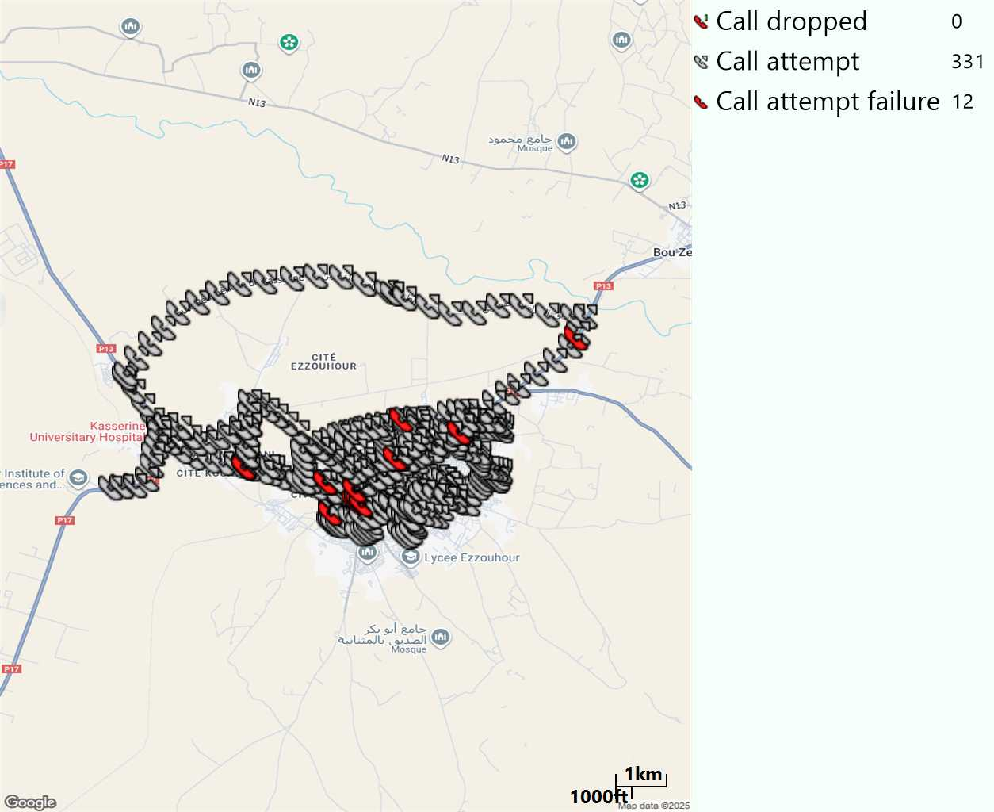
MO Voice Stats (VoLTE call stats)
Short call
Voice KPIs
Number Call Attempts | 331
Number Call Setup | 319
Number Blocked Calls | 12
Setup Succes Rate (%) | 96,37%
Call Block Rate (%) | 3,63%
Call Setup Time IMS Voice Average (Sec) | 2,81

Slide 13
MO Voice Stats (VoLTE call stats)
KPIs
VoLTE Call Setup SR | 96,37%
Call Setup Time | 2,81
VoLTE Drop Call Rate | 0%
Speech Quality - MOS (% of the samples >3,5) | 88,77%
Average MOS | 4,1
VoLTE Handover SR | 100%
VoLTE SRVCC SR | -

Slide 14
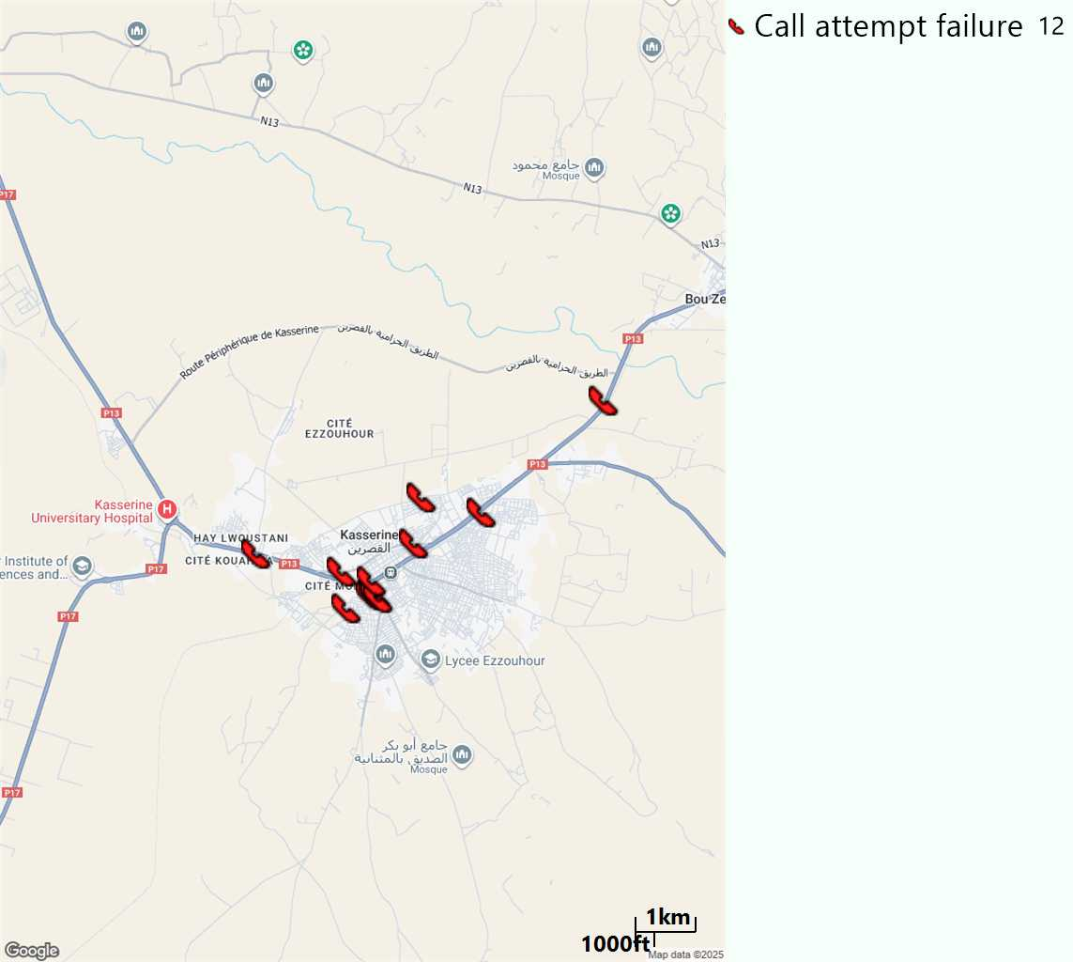
MO Voice Call - Blocked call
Short call

Slide 15
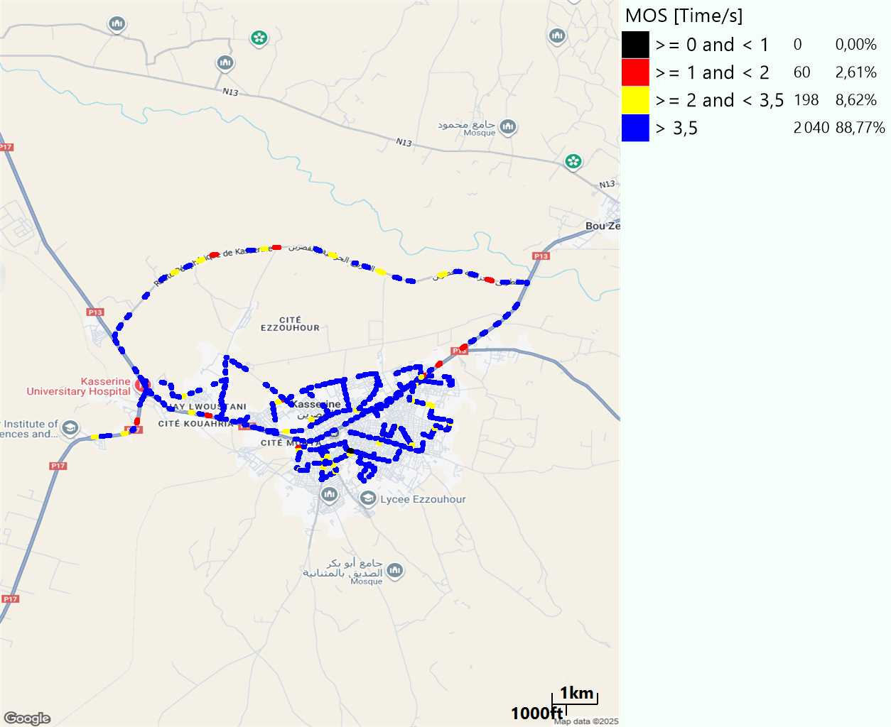
MO Voice Quality Metrics
long Call

Slide 16
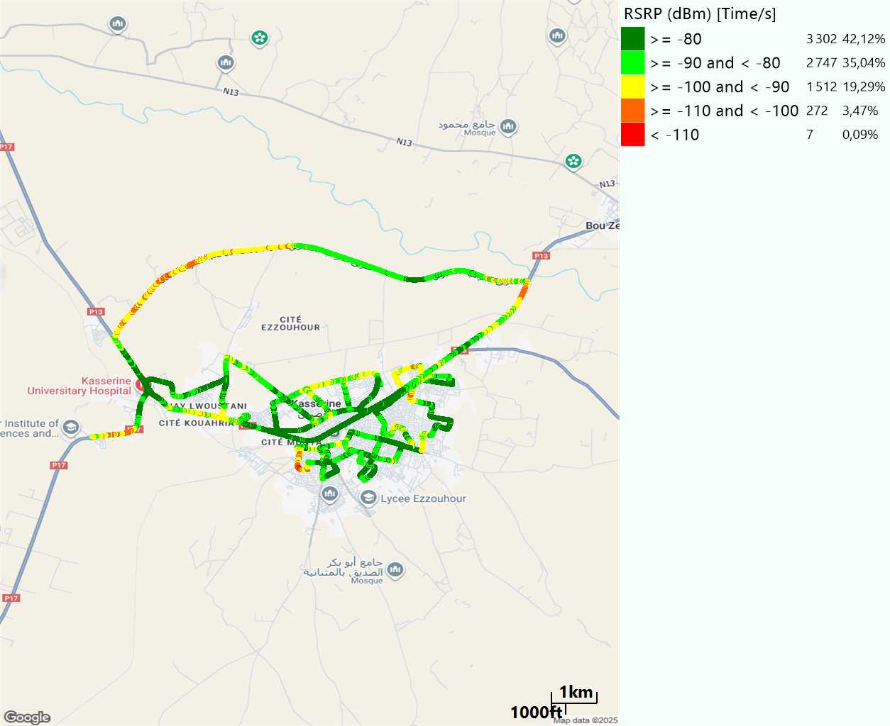
Scanner_RSRP
L2100

Slide 17
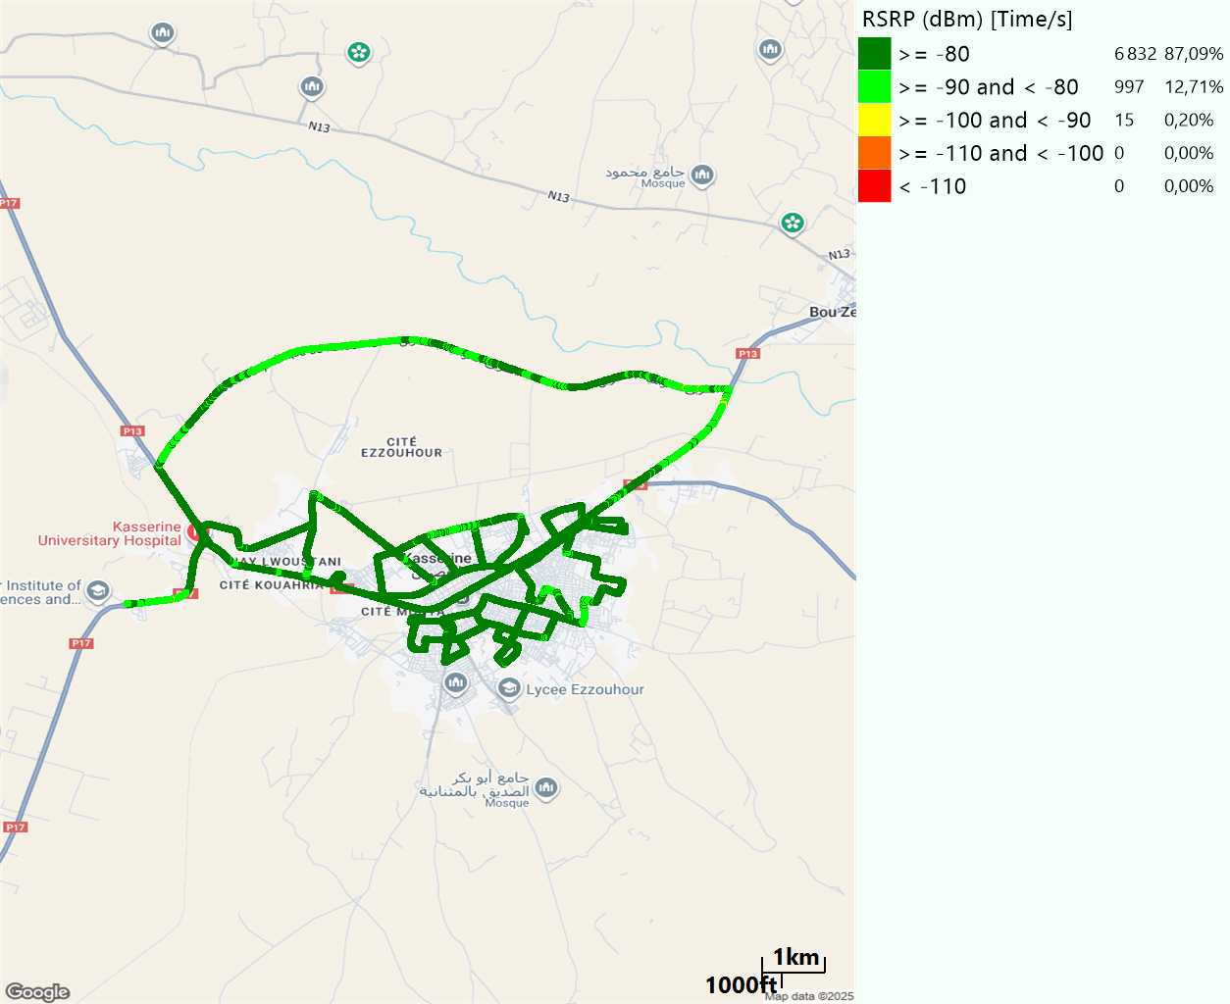
Scanner_RSRP
L800

Slide 18

Scanner_RSRP
L1800

Slide 19
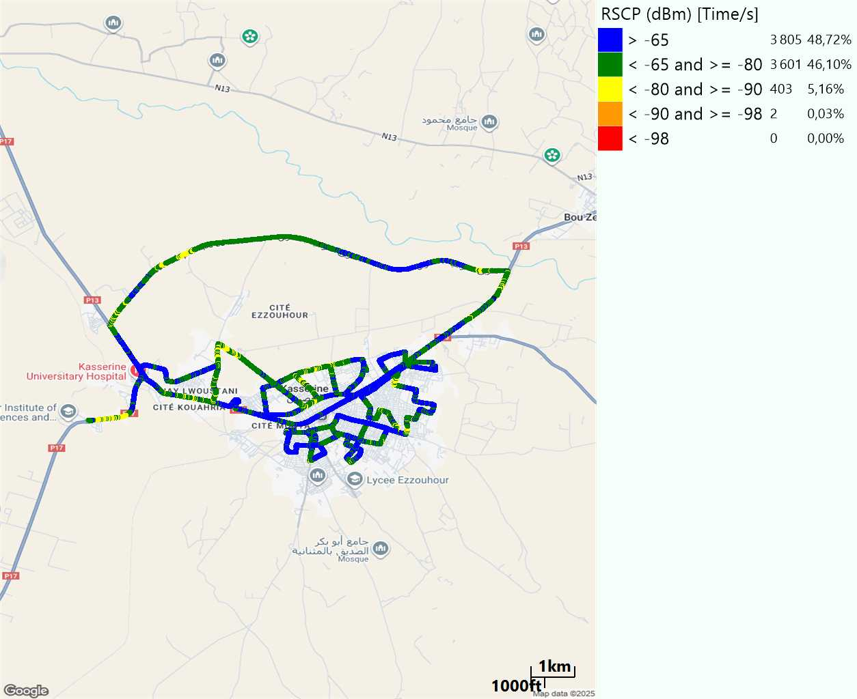
Scanner_RSCP
U2100

Slide 20
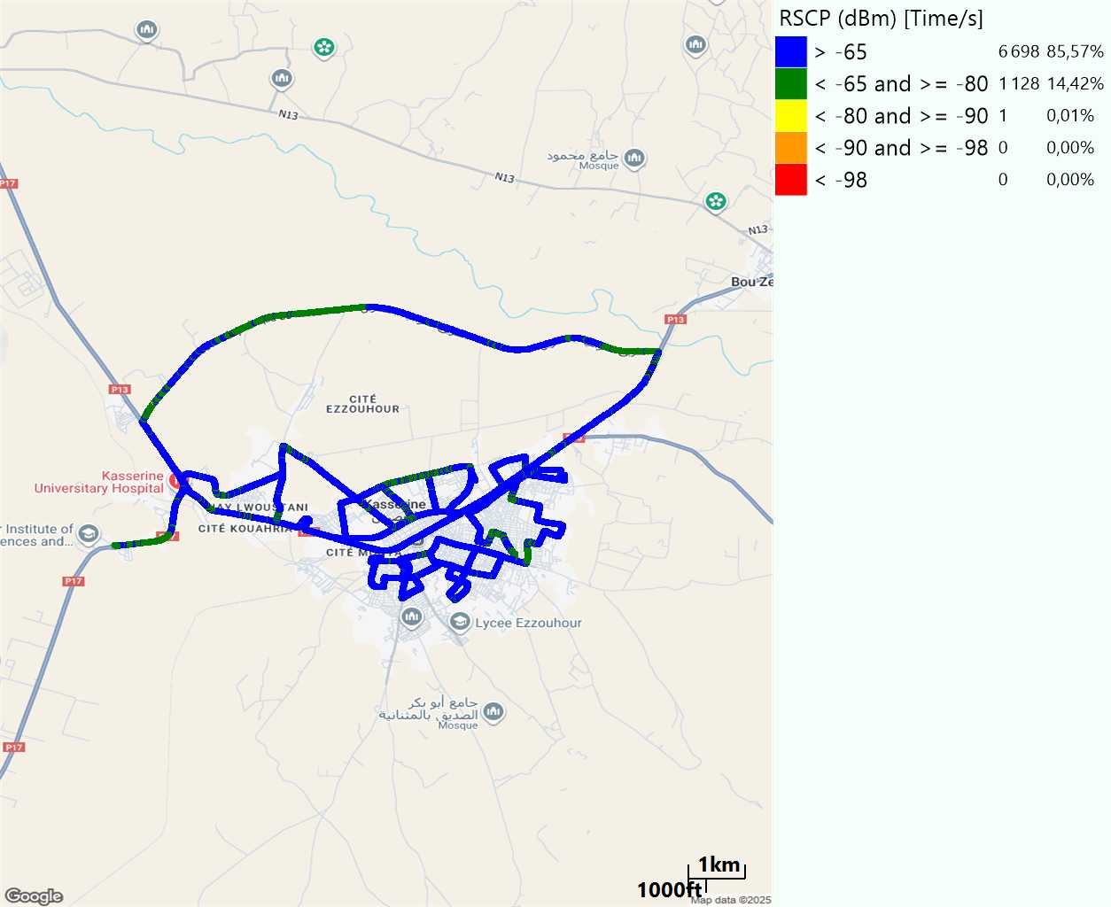
Scanner_RSCP
900

