Slide 1


Volte Drive Test Report

Slide 2
DT Scénario
Short Call (10s)
Long call (2min)
Scanner

Slide 3
Voice Call

Slide 4
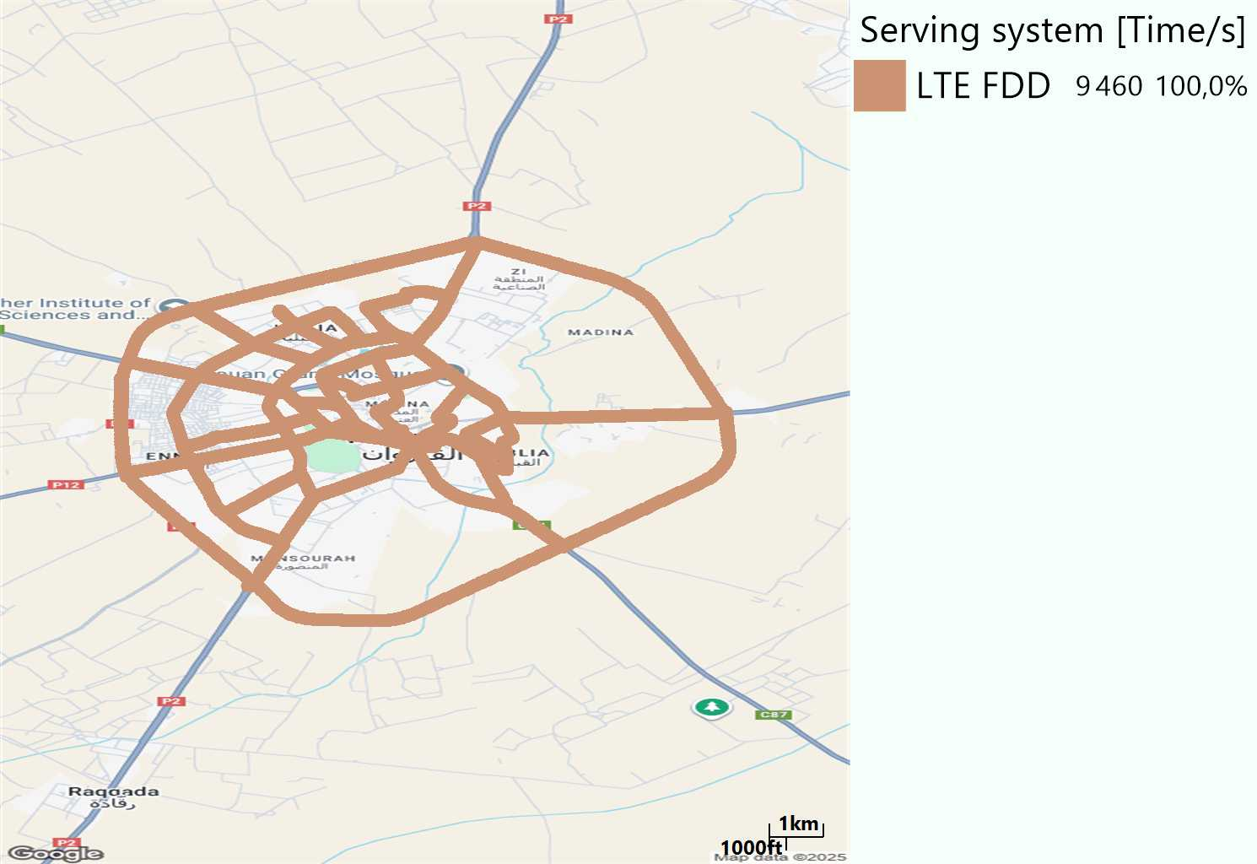
RAT distribution
Long call
Short call

Slide 5
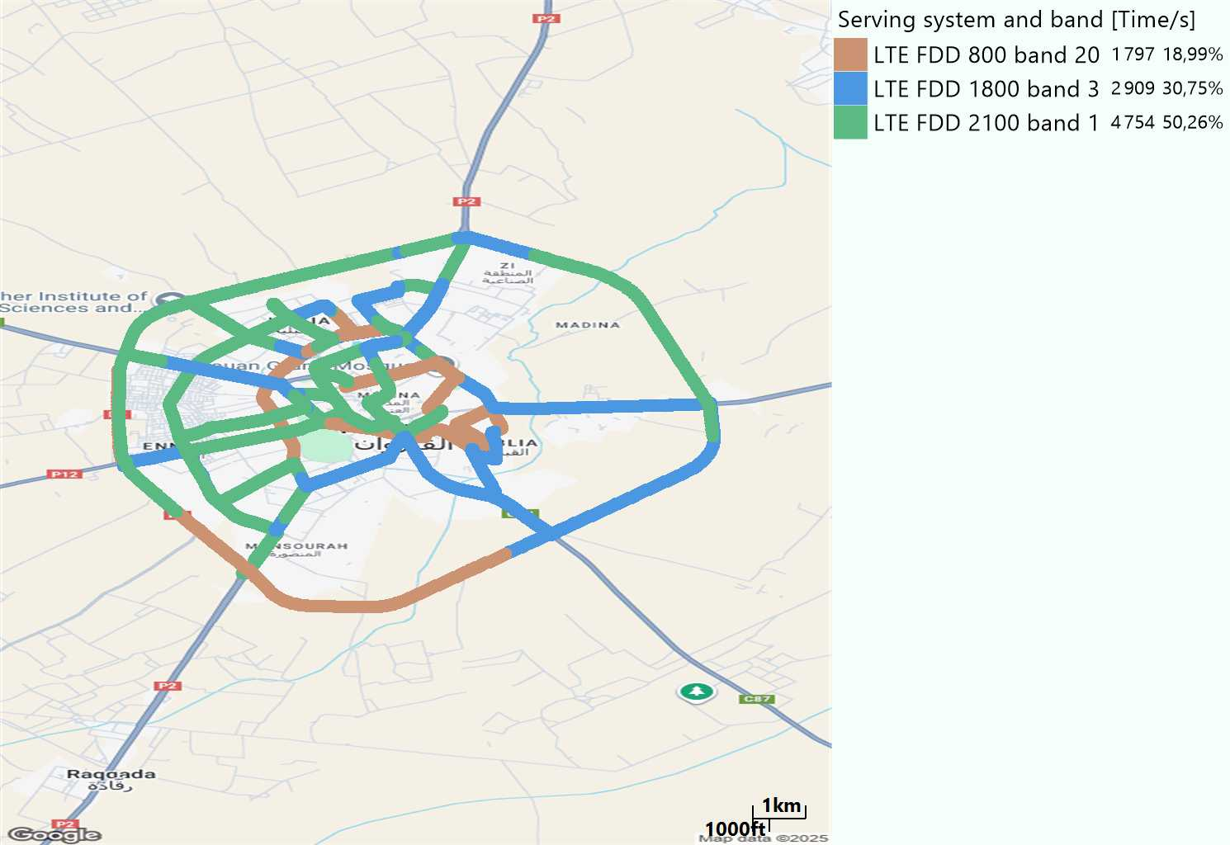
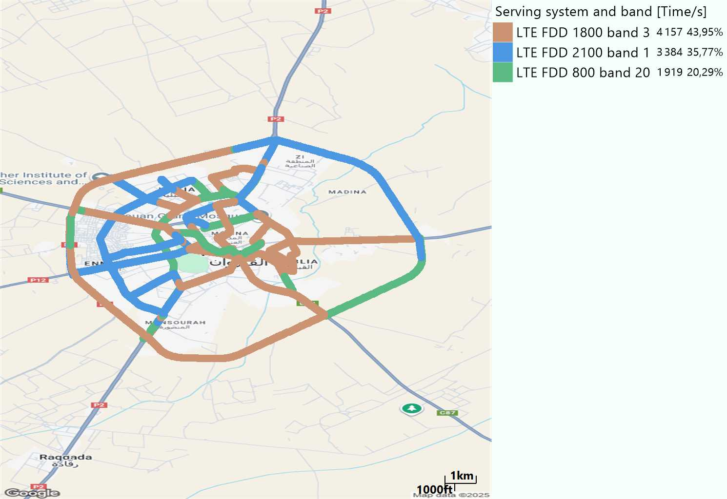
EARFCN distribution
Long call
Short call

Slide 6
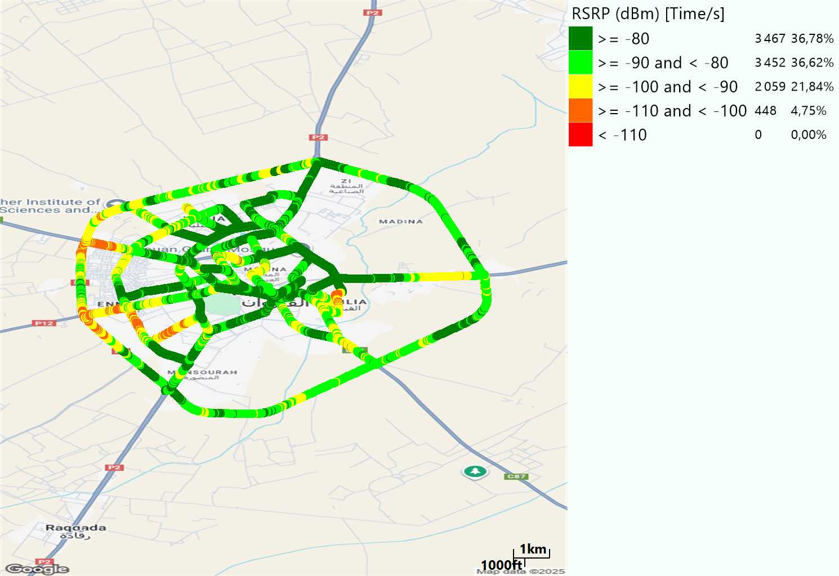

LTE - RSRP
Long call
Short call
Average [dBm]
-82,84
Average [dBm]
-83,74

Slide 7
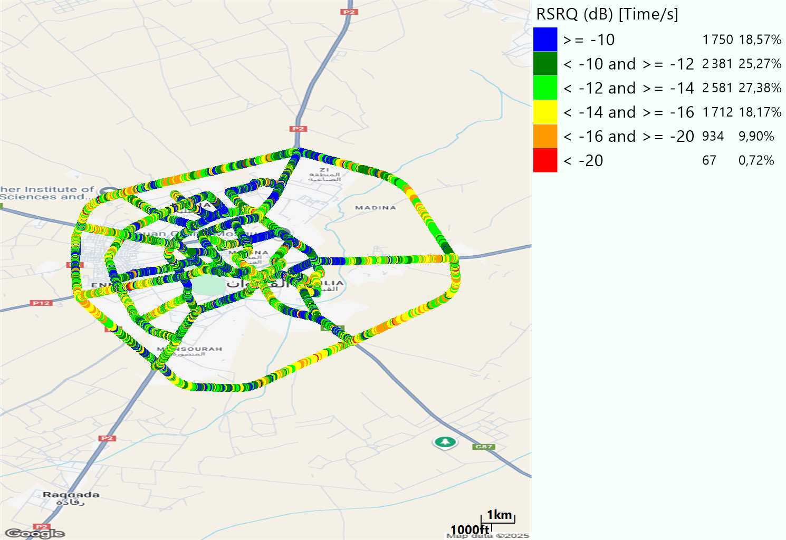

LTE- RSRQ
Long call
Short call

Slide 8
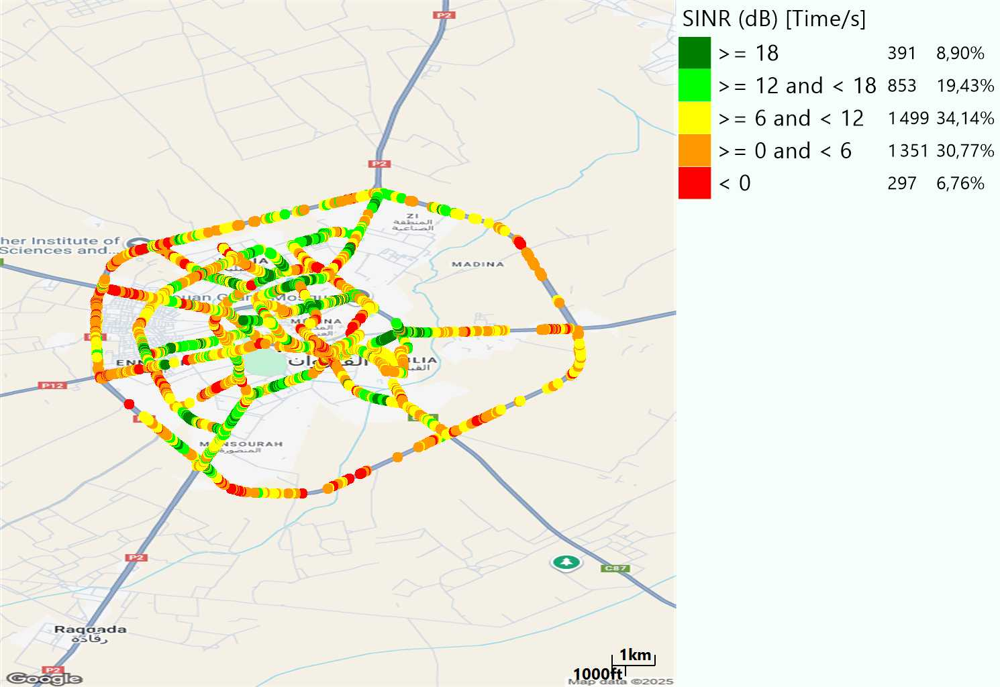
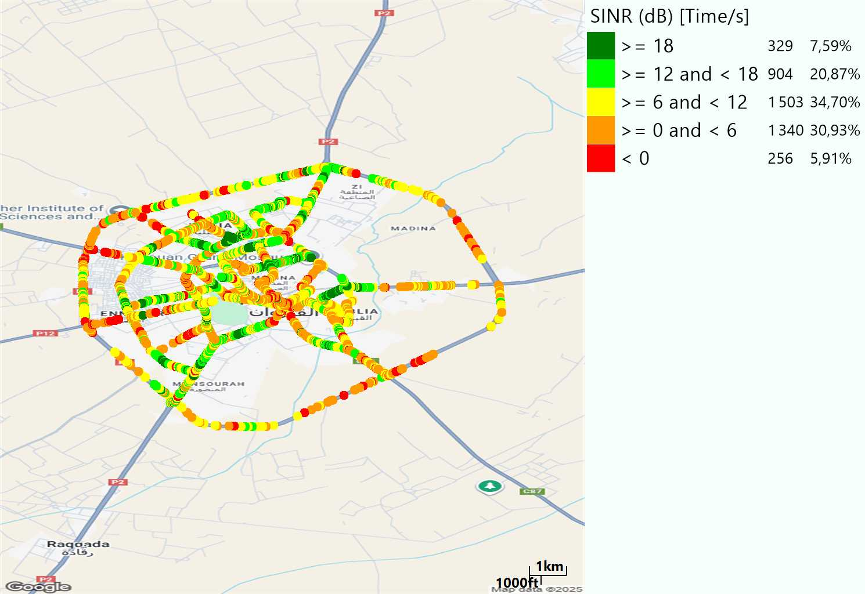
LTE-SINR
Long call
Short call

Slide 9
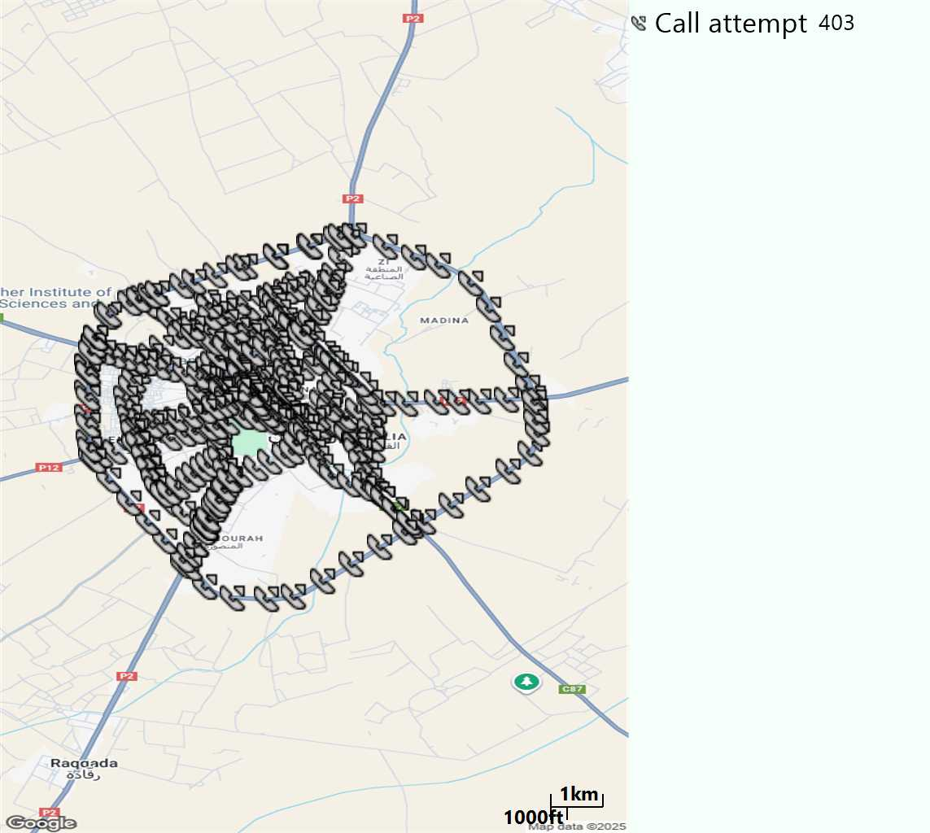
MO Call Setup Time (call setup time in VoLTE)
Short call
Call Setup Time IMS Voice
Average (Sec) | Maximum (Sec) | Minimum (Sec)
3,1 | 8,06 | 2,11

Slide 10
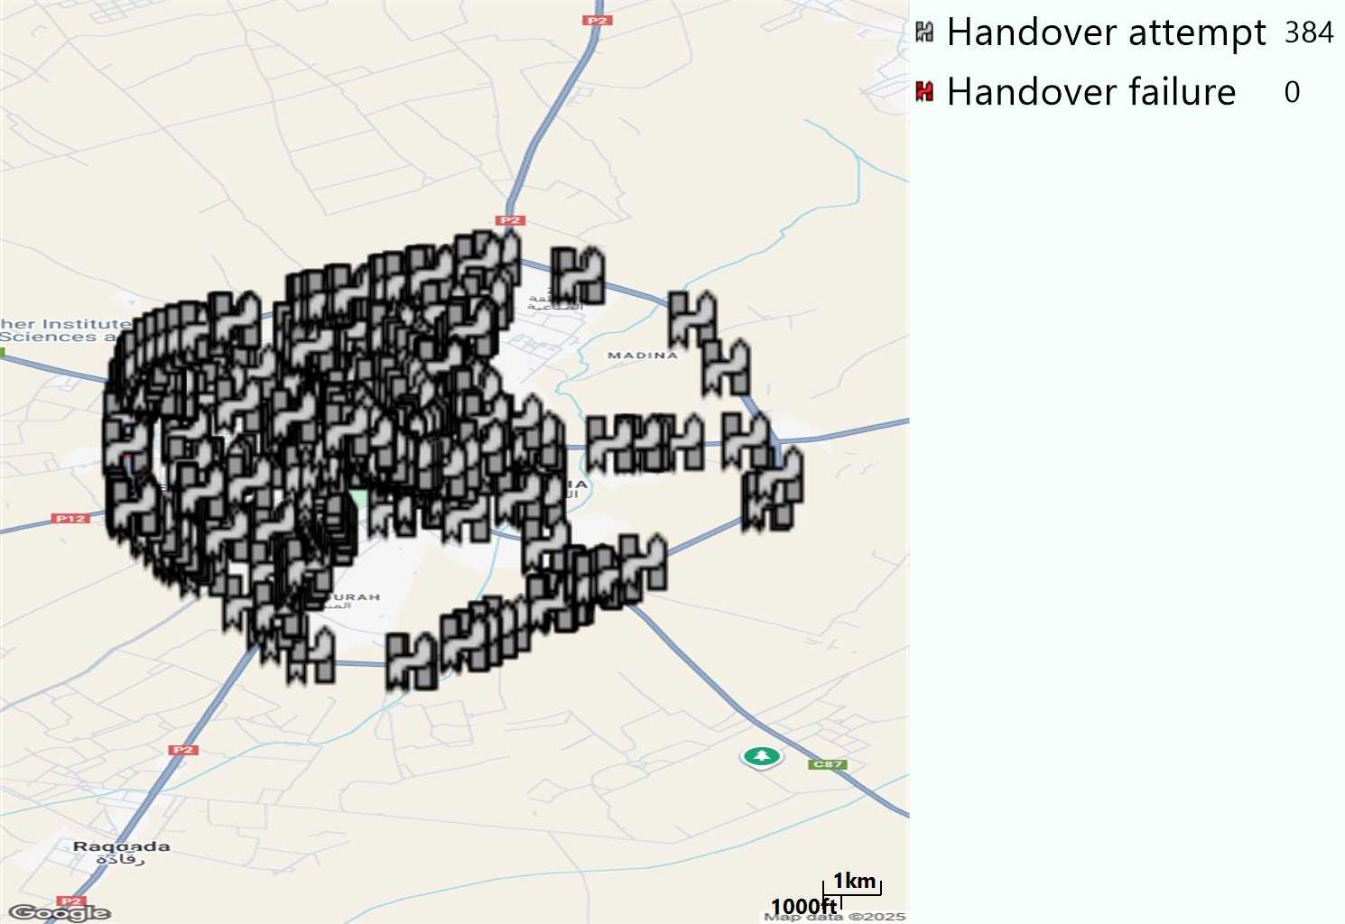
MO Handover Type
Long call
HO Type | Percentage [%]
LTE Inter-Frequency handover | 6,77%
LTE Intra-Frequency handover | 93,23%
Handover KPI’s
Handover Attemps | 384
Handover Success | 384
Handover succès Rate | 100%
Étiquettes de lignes | LTE FDD_1800 | LTE FDD_2100 | LTE FDD_800 | Total général
LTE FDD_1800 | 96 | 7 | 2 | 105
LTE FDD_2100 | 12 | 188 | 4 | 204
LTE FDD_800 | 2 | 1 | 72 | 75
Total général | 110 | 196 | 78 | 384

Slide 11
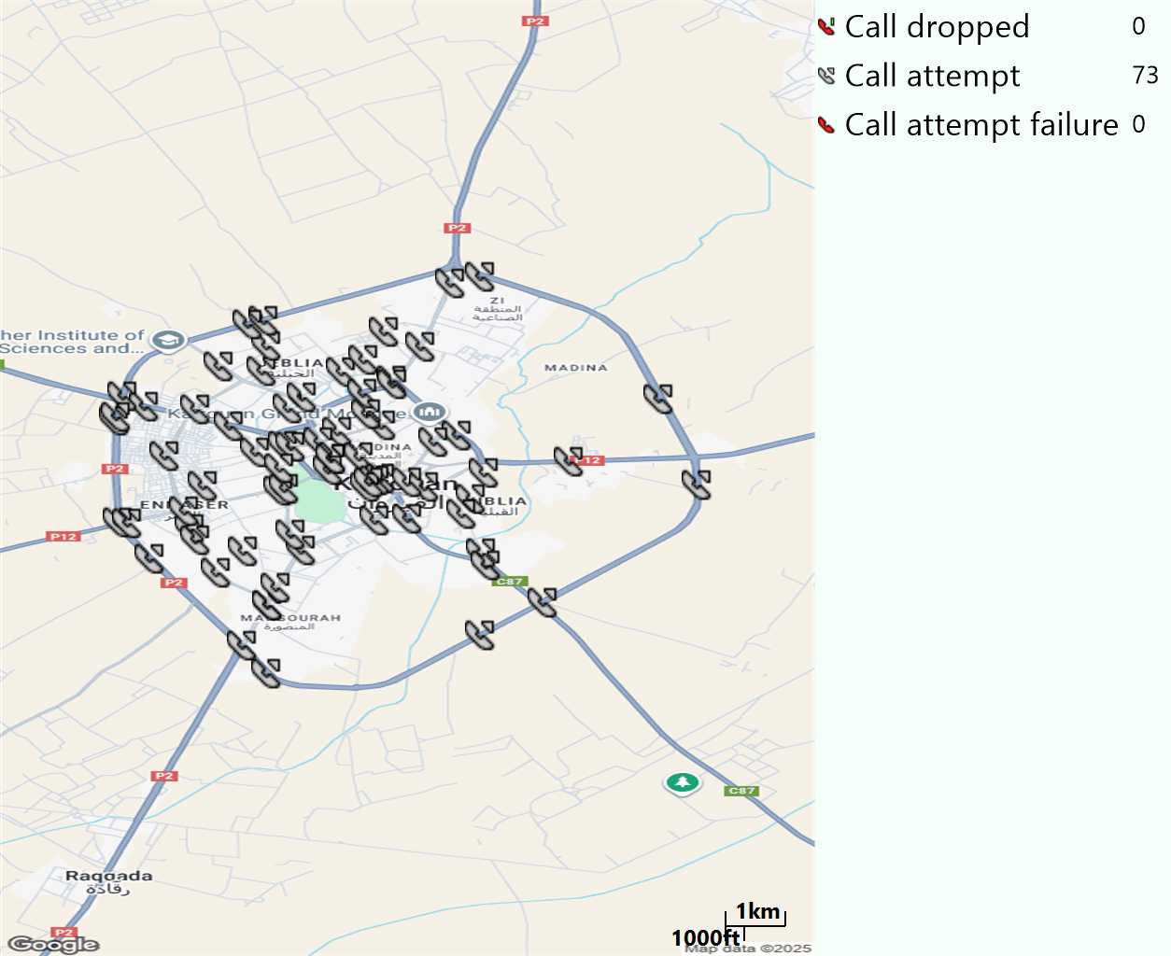
MO Voice Stats (VoLTE call stats)
Long call
Voice KPIs
Number Call Attempts | 73
Number Dropped Calls | 0
Call Drop Rate (%) | 0%
HO success rate | 100%

Slide 12
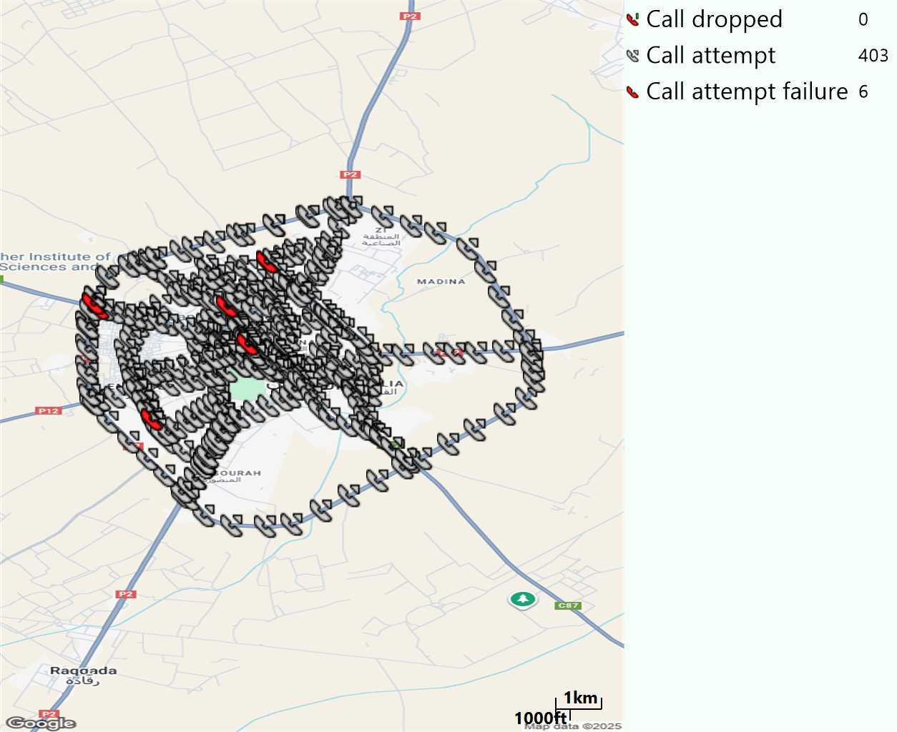
MO Voice Stats (VoLTE call stats)
Short call
Voice KPIs
Number Call Attempts | 403
Number Call Setup | 397
Number Blocked Calls | 6
Setup Succes Rate (%) | 98,51%
Call Block Rate (%) | 1,49%
Call Setup Time IMS Voice Average (Sec) | 3,1

Slide 13
MO Voice Stats (VoLTE call stats)
KPIs
VoLTE Call Setup SR | 98,51%
Call Setup Time | 3,1
VoLTE Drop Call Rate | 0%
Speech Quality - MOS (% of the samples >3,5) | 91,3%
Average MOS | 4,1
VoLTE Handover SR | 100%
VoLTE SRVCC SR | -

Slide 14
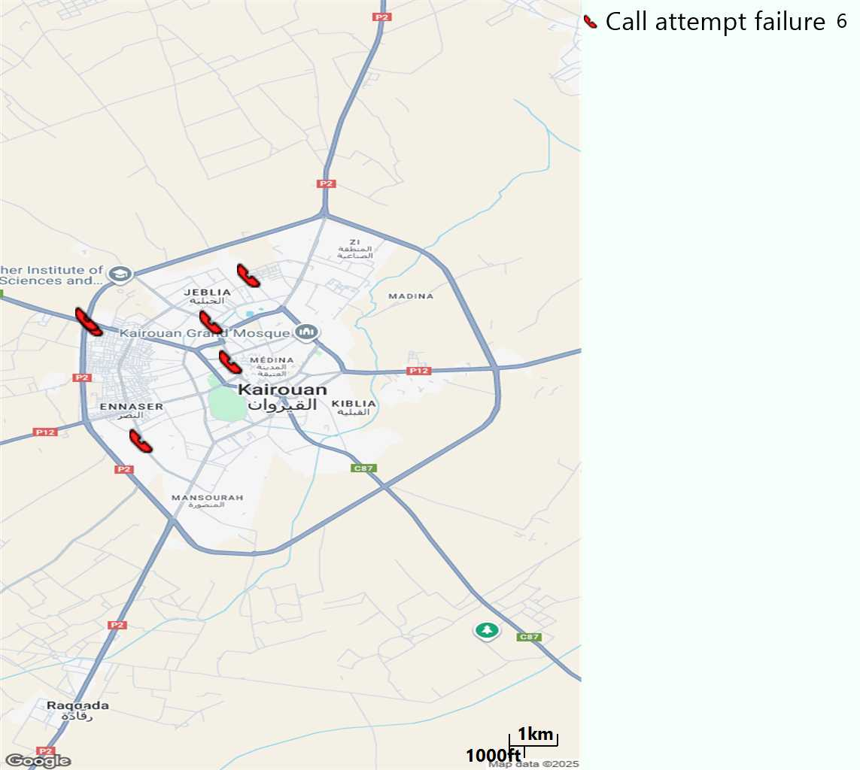
MO Voice Call - Blocked call
Short call

Slide 15
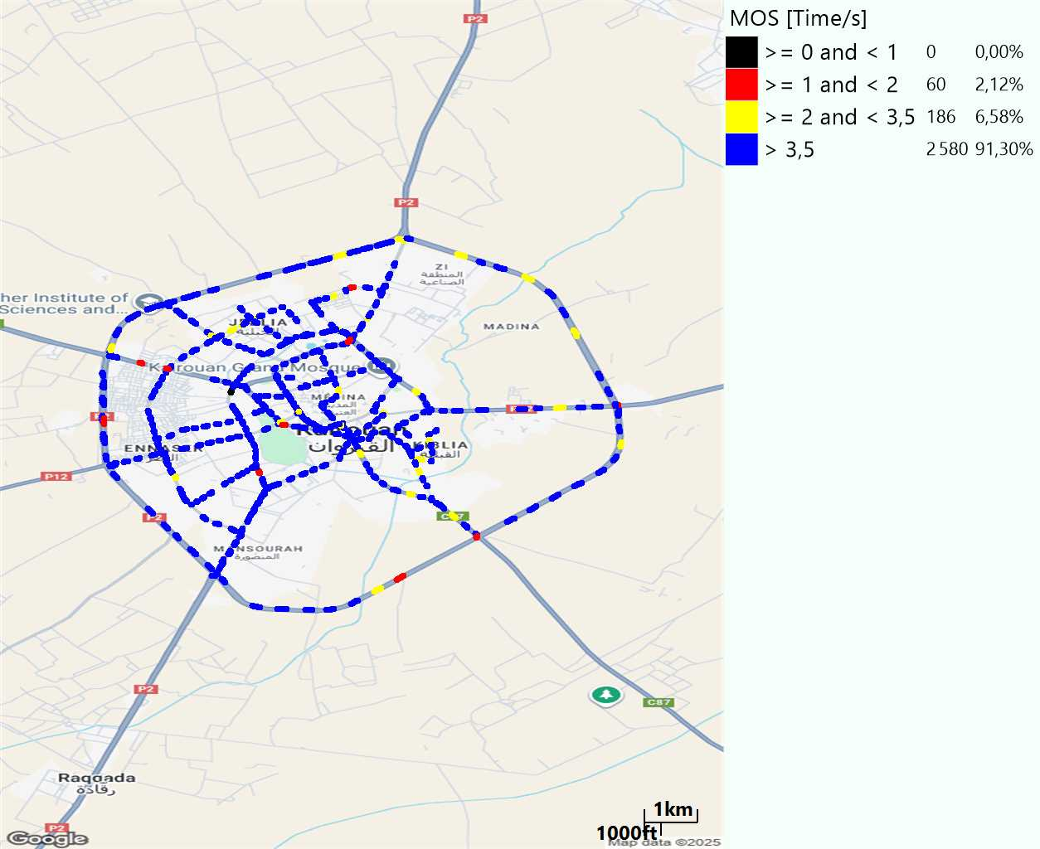
MO Voice Quality Metrics
long Call

Slide 16
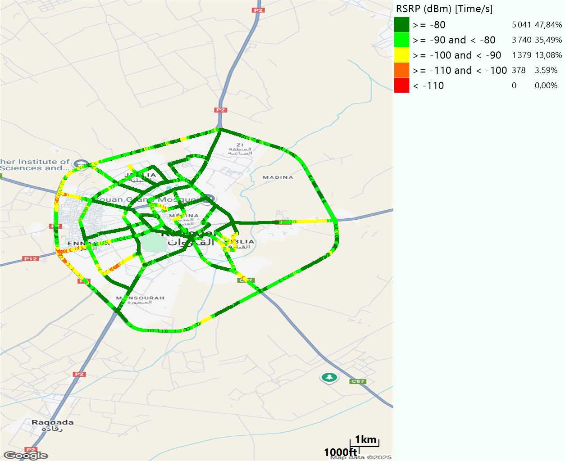
Scanner_RSRP
L2100

Slide 17
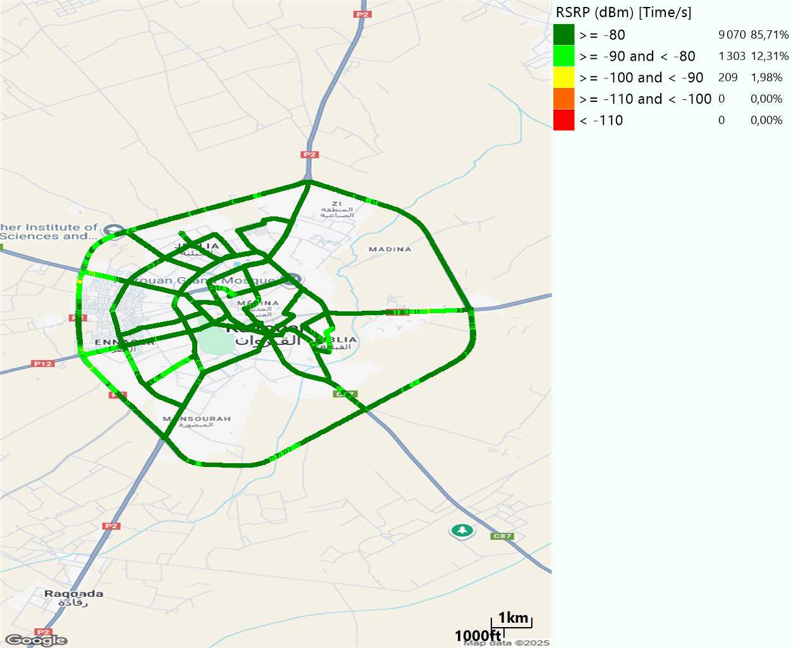
Scanner_RSRP
L800

Slide 18
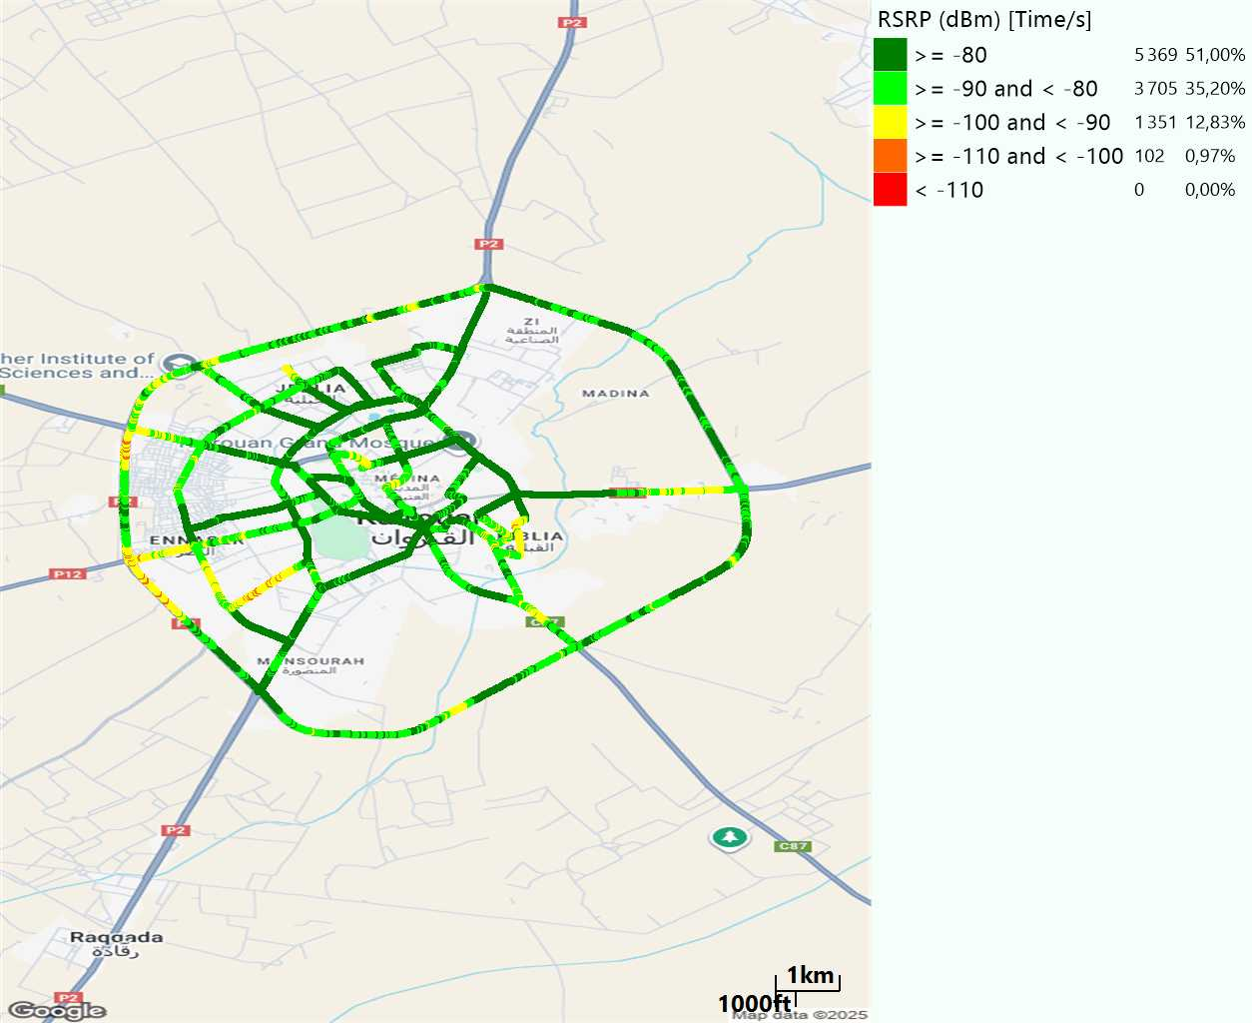
Scanner_RSRP
L1800

Slide 19
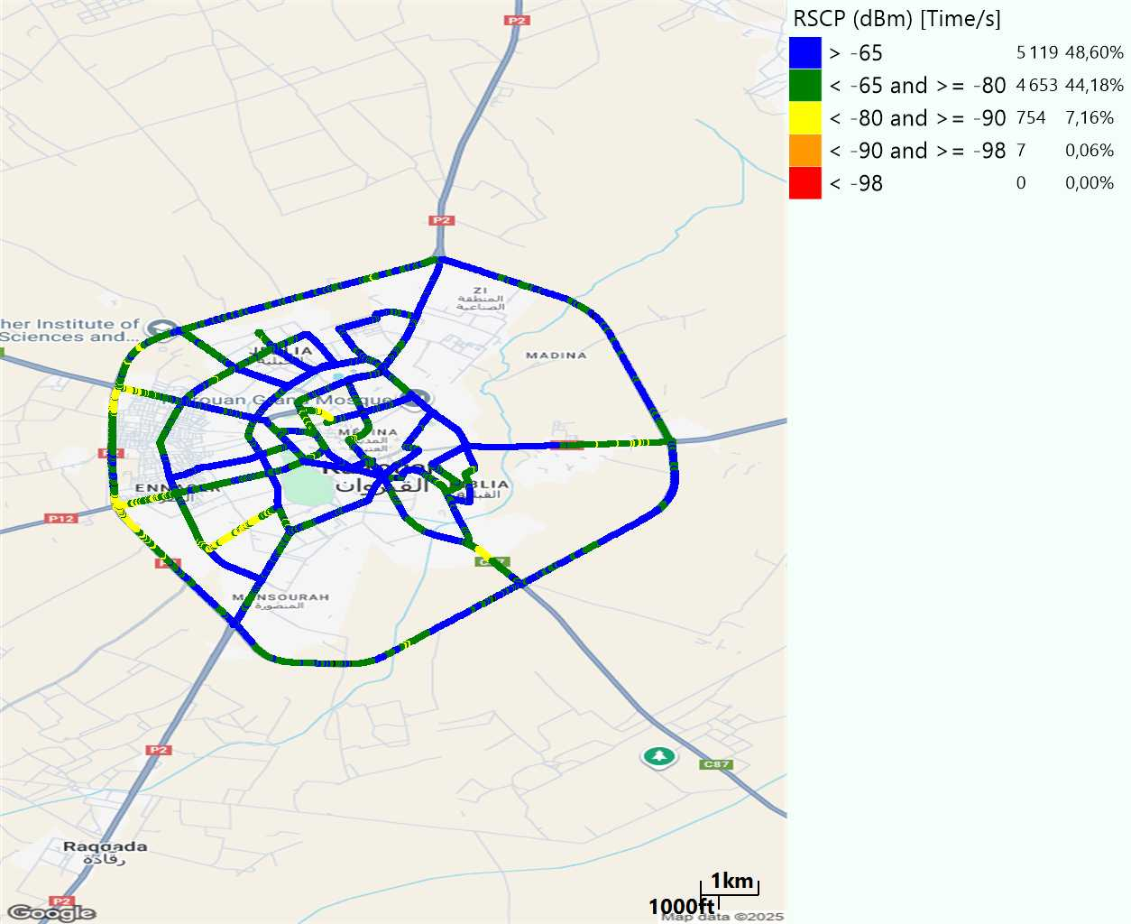
Scanner_RSCP
U2100

Slide 20
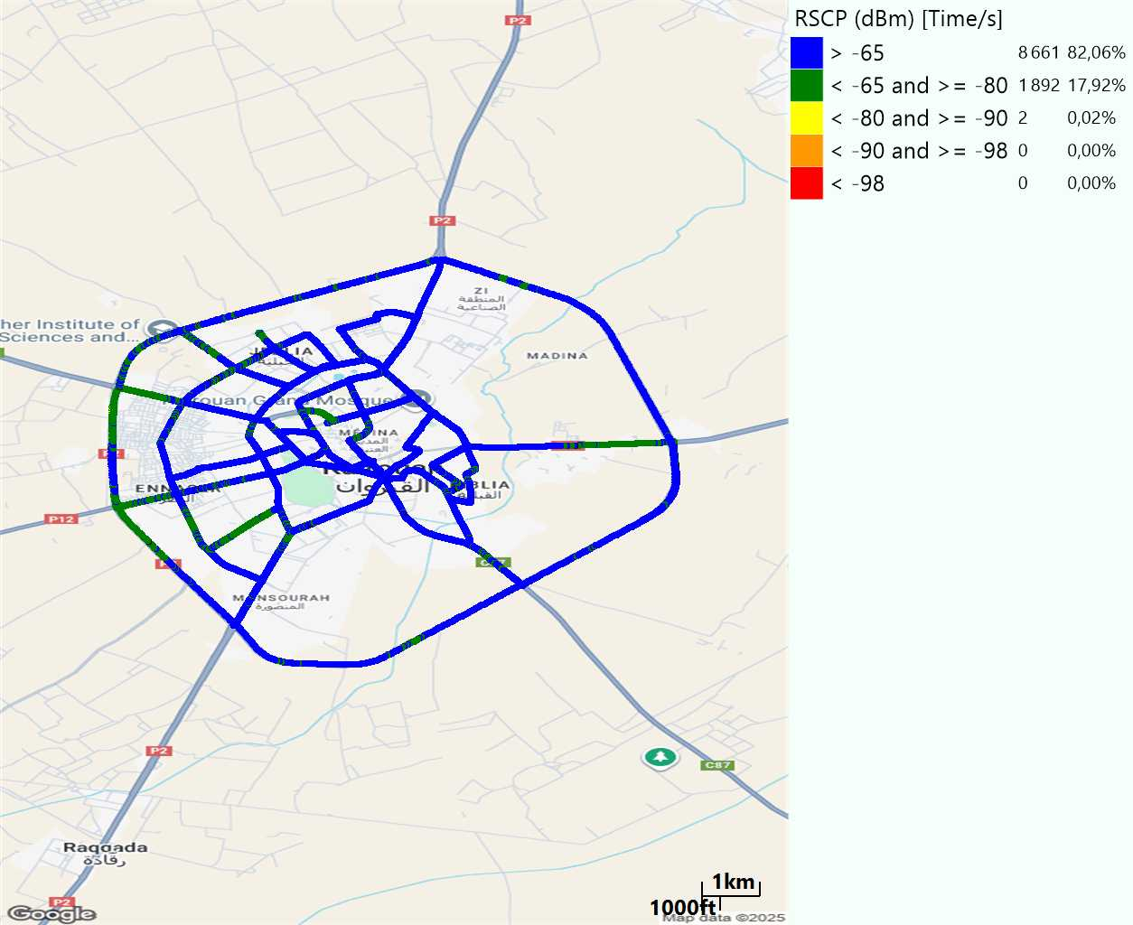
Scanner_RSCP
900

