Slide 1


Volte Drive Test Report

Slide 2
DT Scénario
Short Call (10s)
Long call (2min)
Scanner

Slide 3
Voice Call

Slide 4
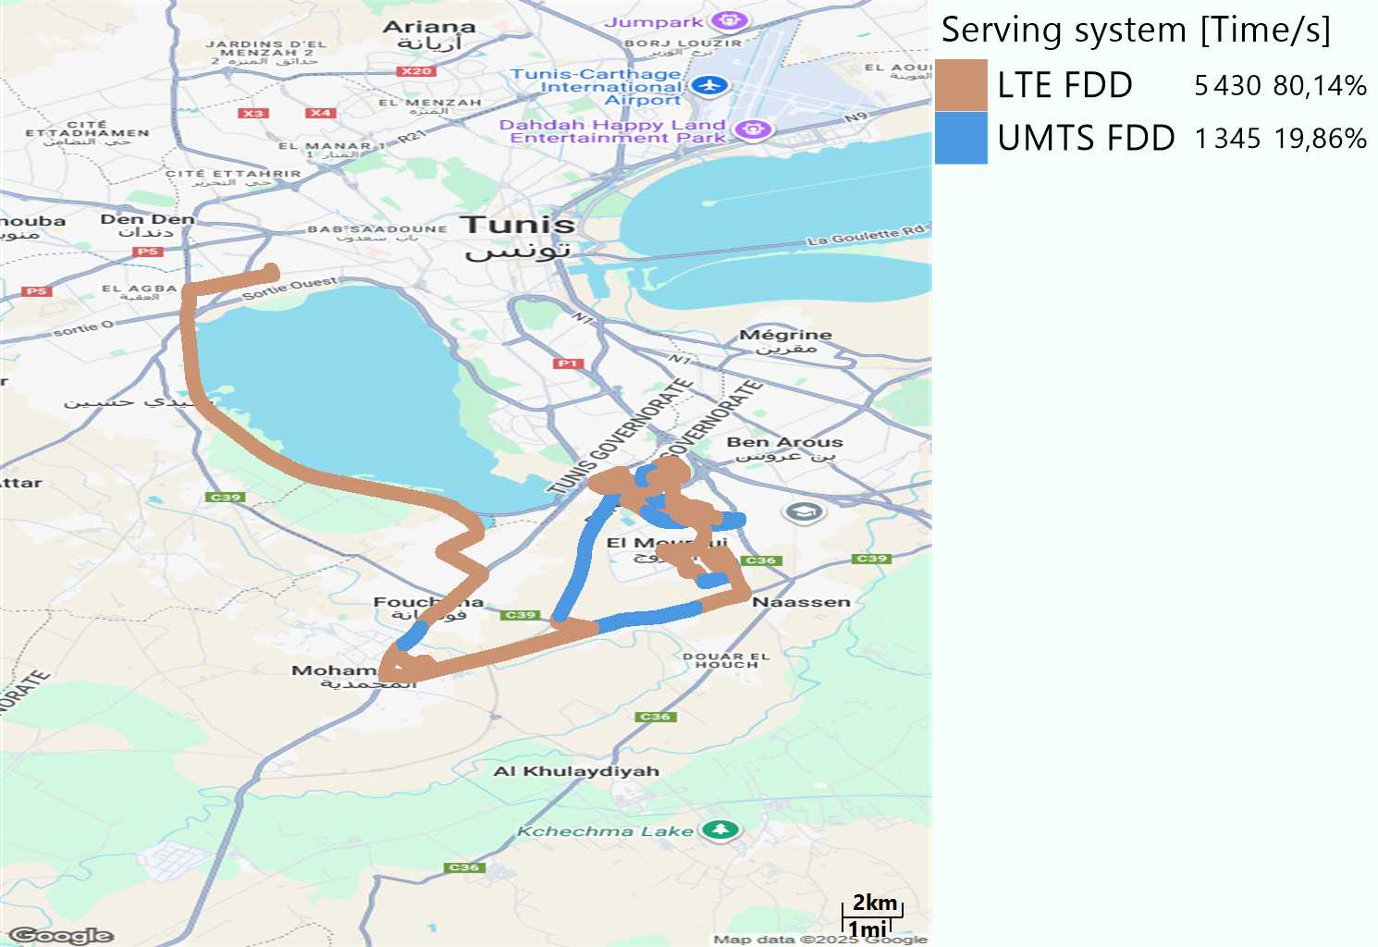
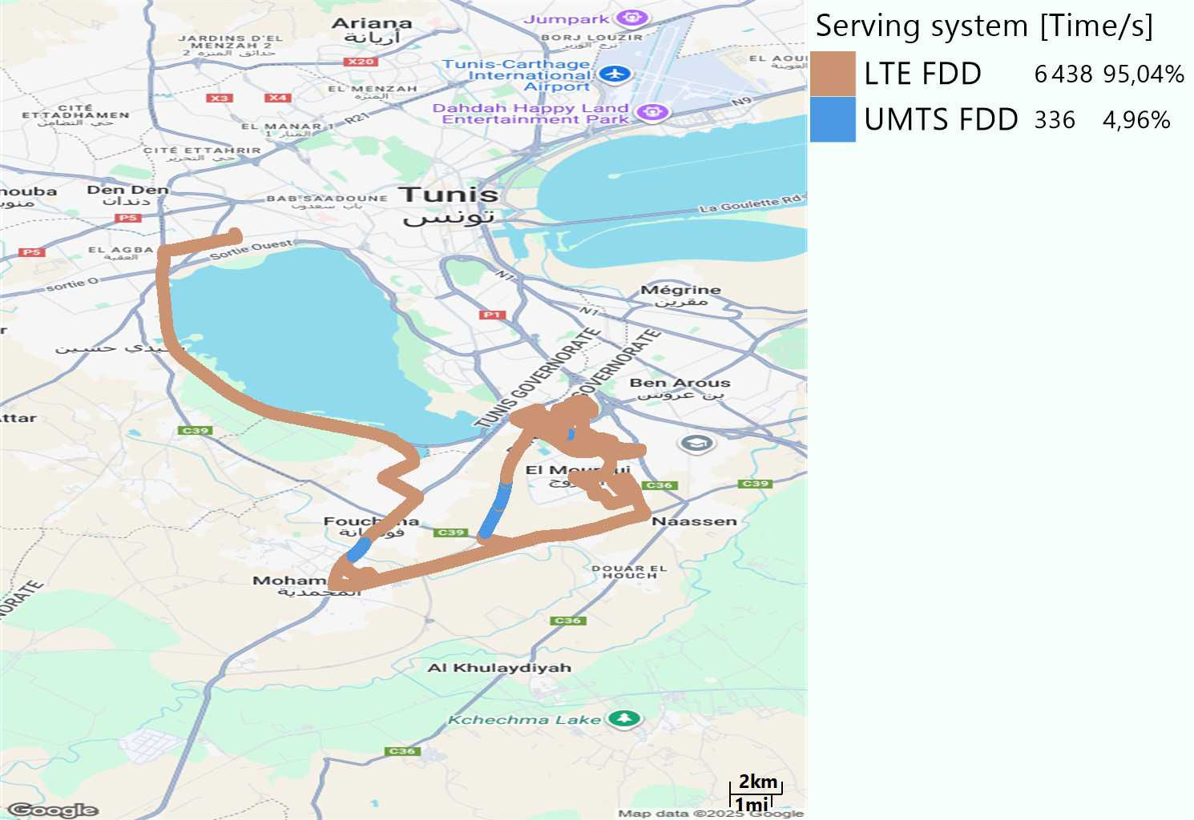
RAT distribution
Long call
Short call

Slide 5
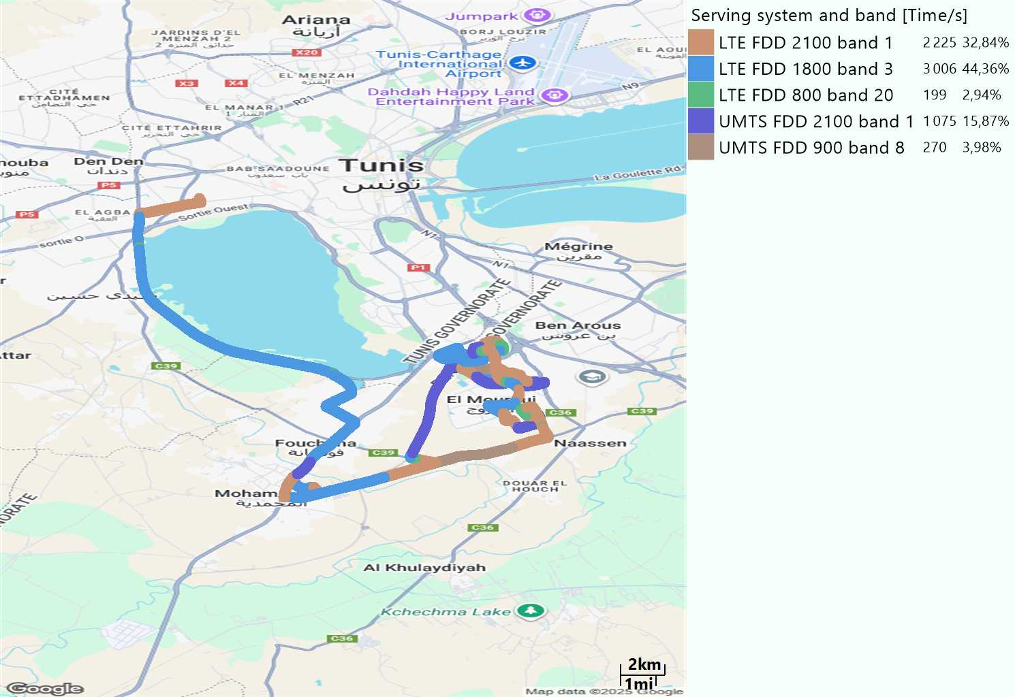
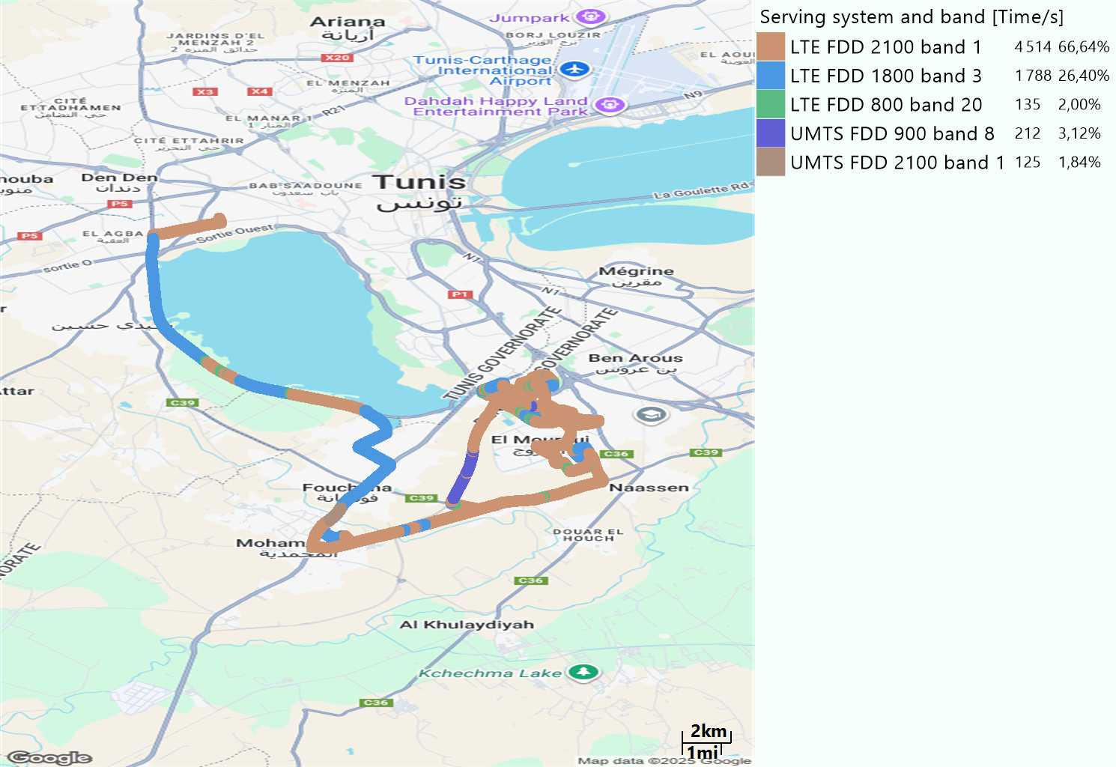
EARFCN distribution
Long call
Short call

Slide 6
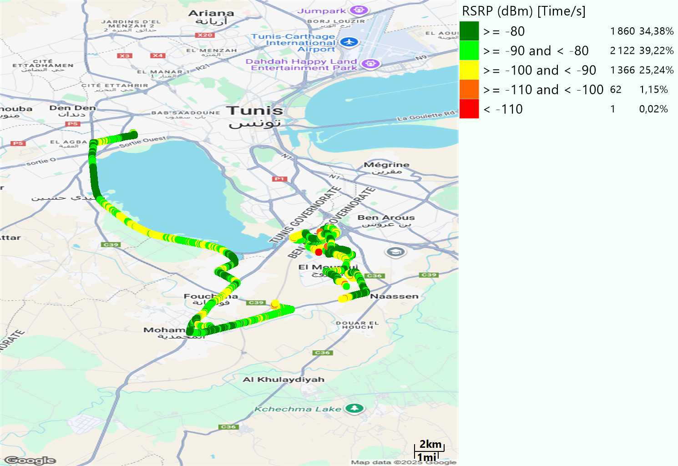
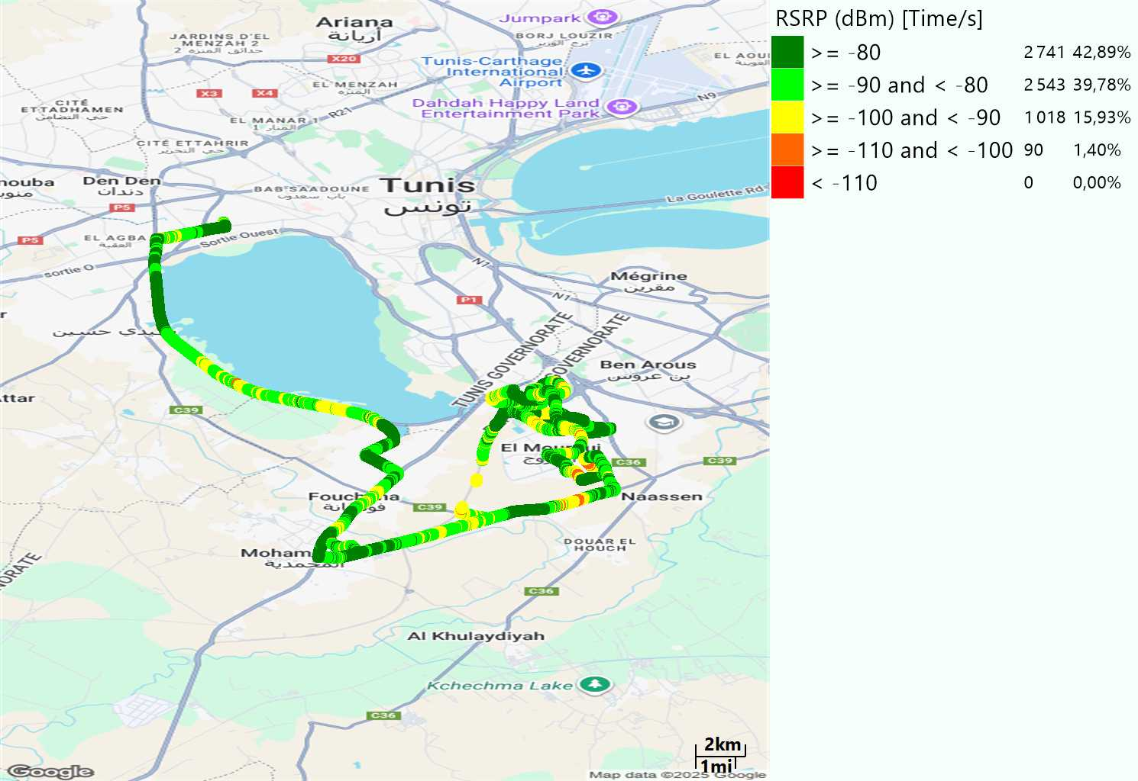
LTE - RSRP
Long call
Short call
Average [dBm]
-83,59
Average [dBm]
-80,86

Slide 7
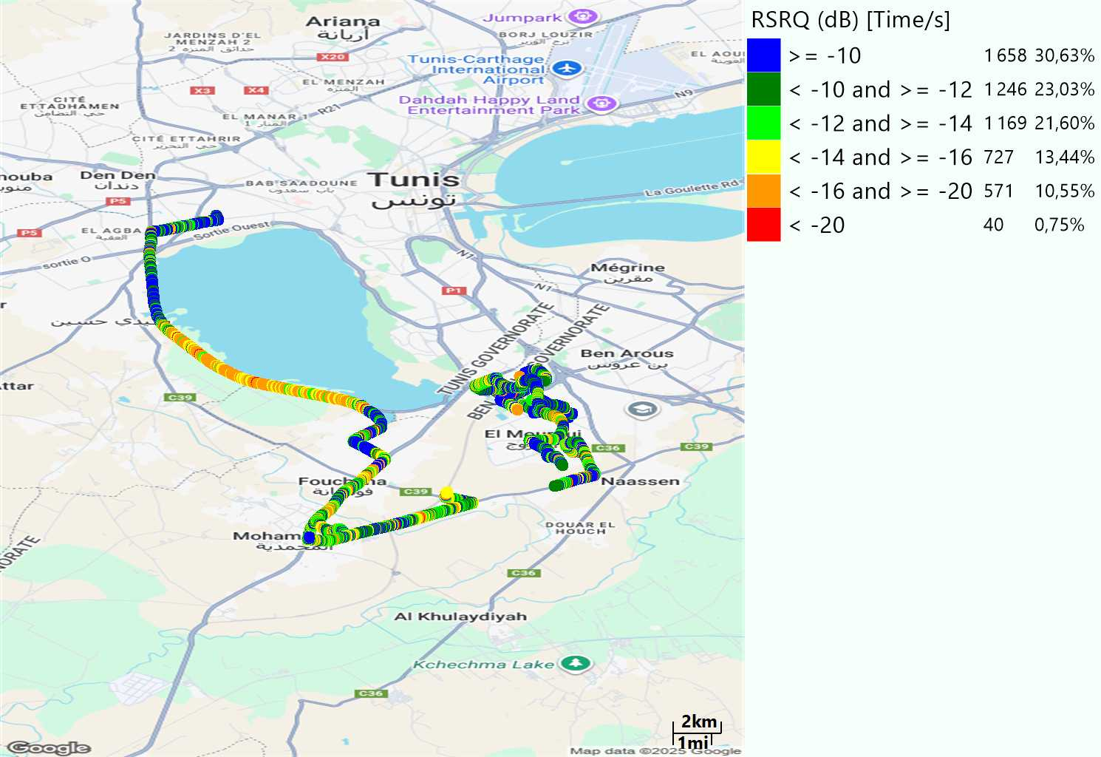
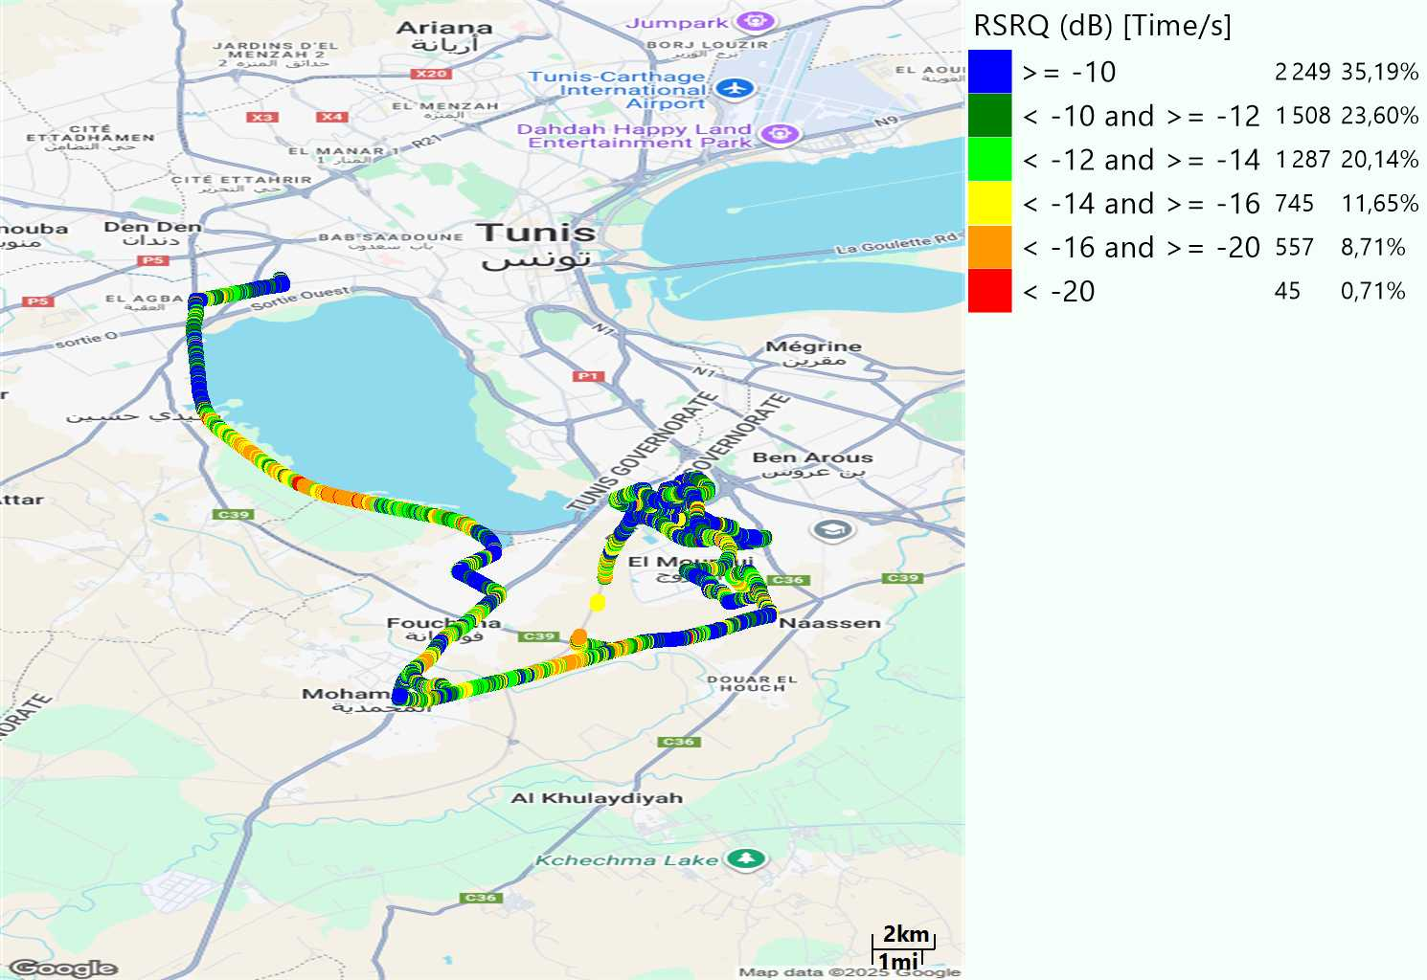
LTE- RSRQ
Long call
Short call

Slide 8
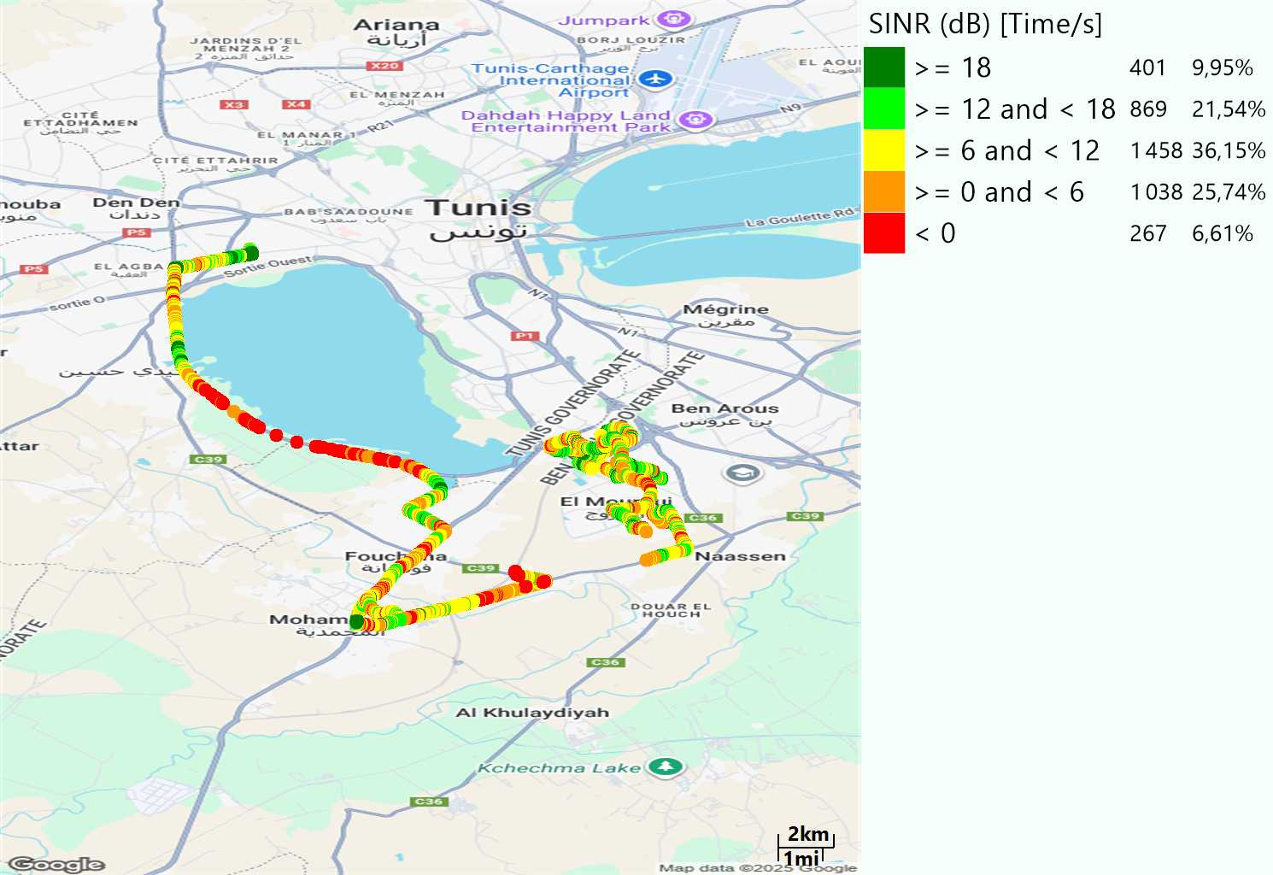

LTE-SINR
Long call
Short call

Slide 9
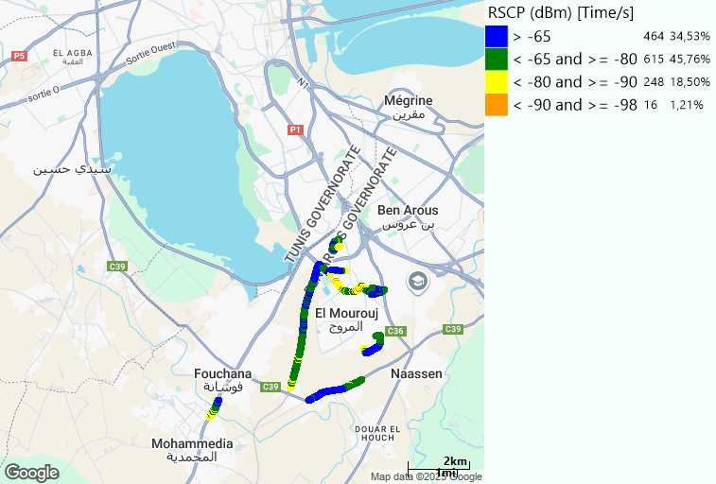
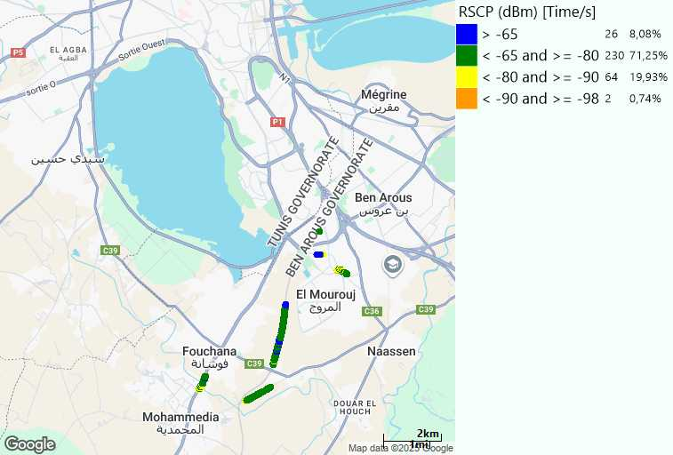
RSCP
Long call
Short call

Slide 10
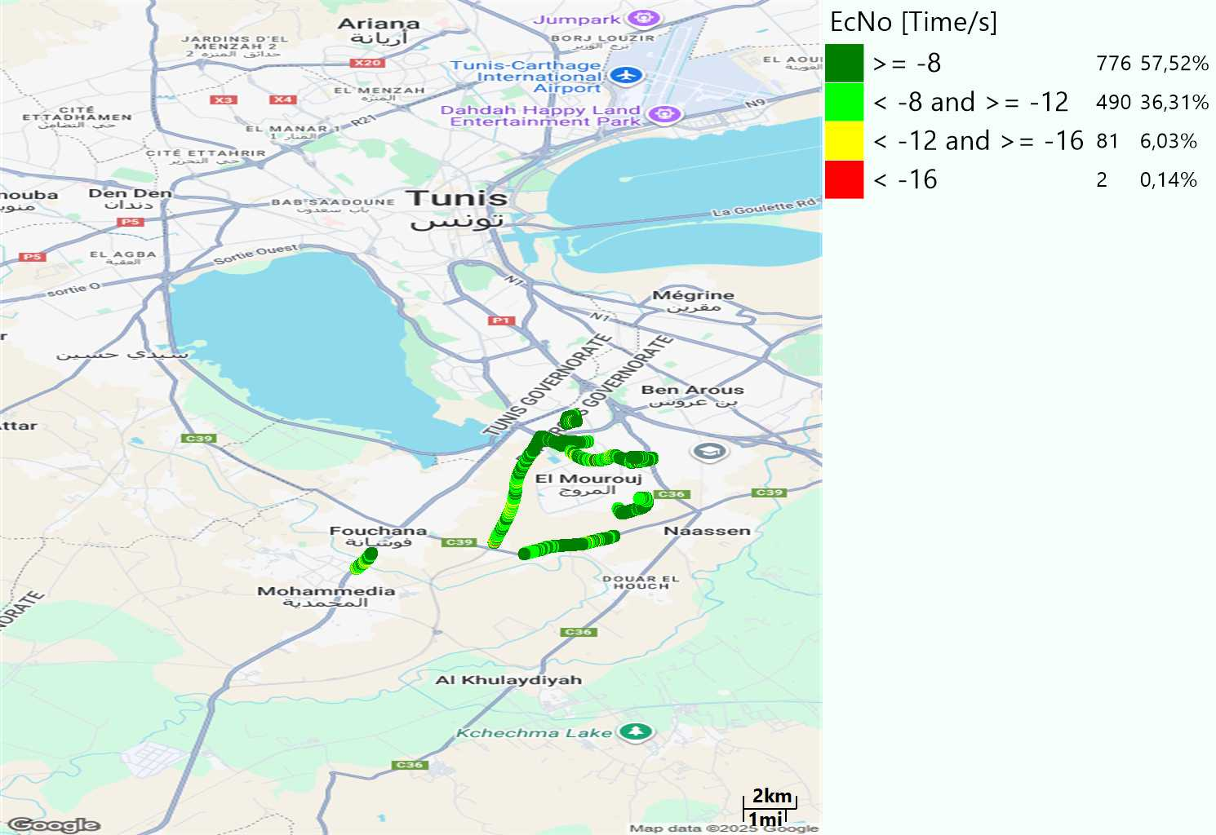
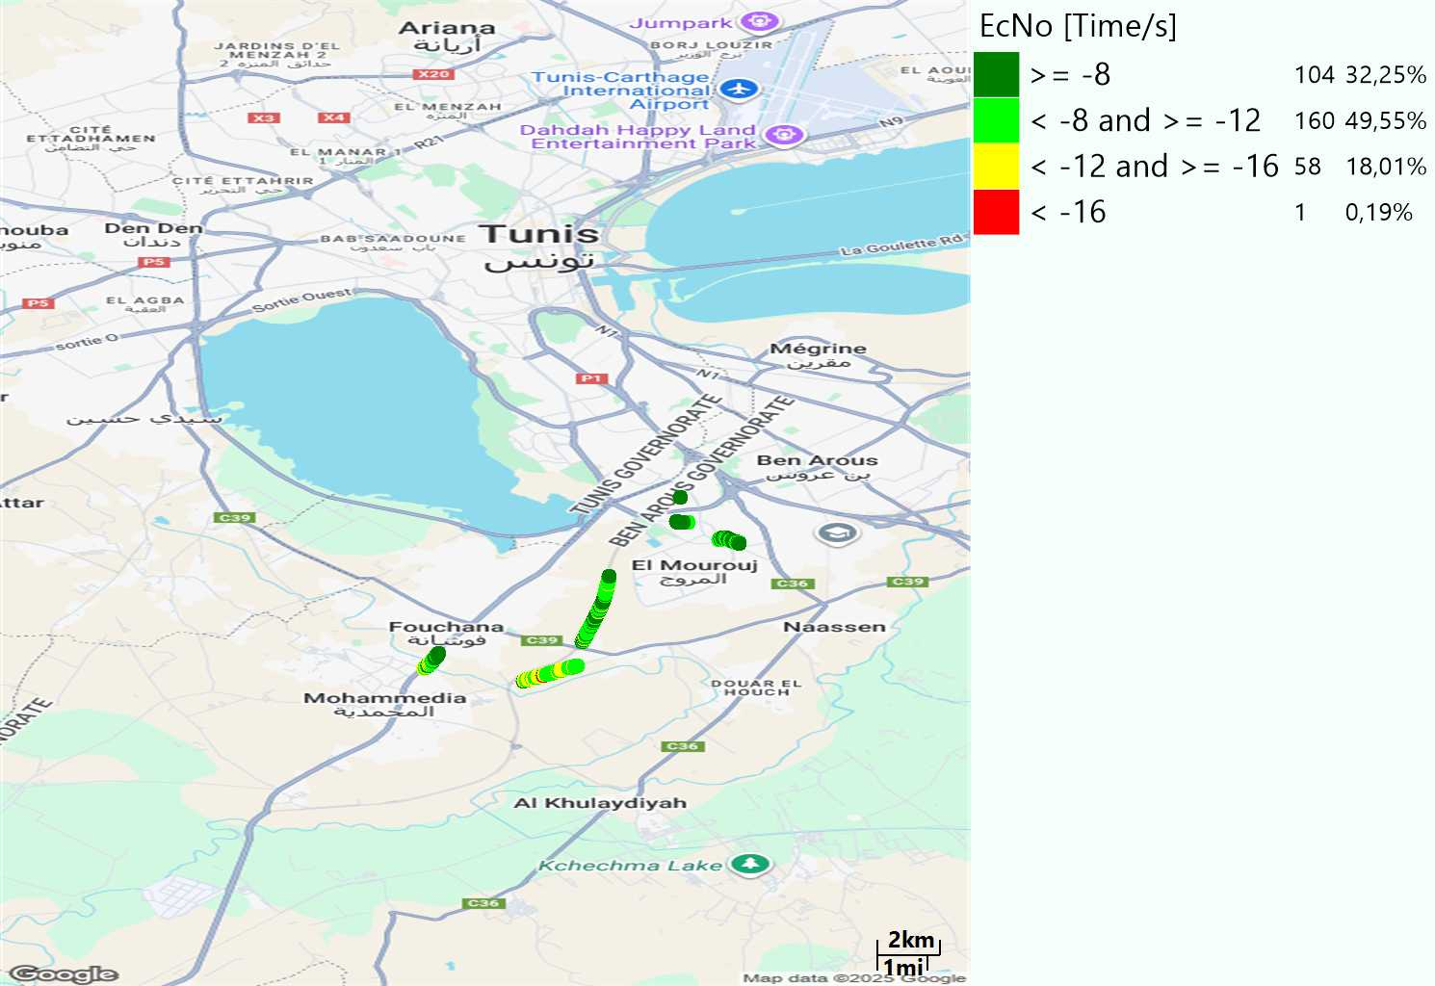
WCDMA-Ec/NO
Long call
Short call

Slide 11
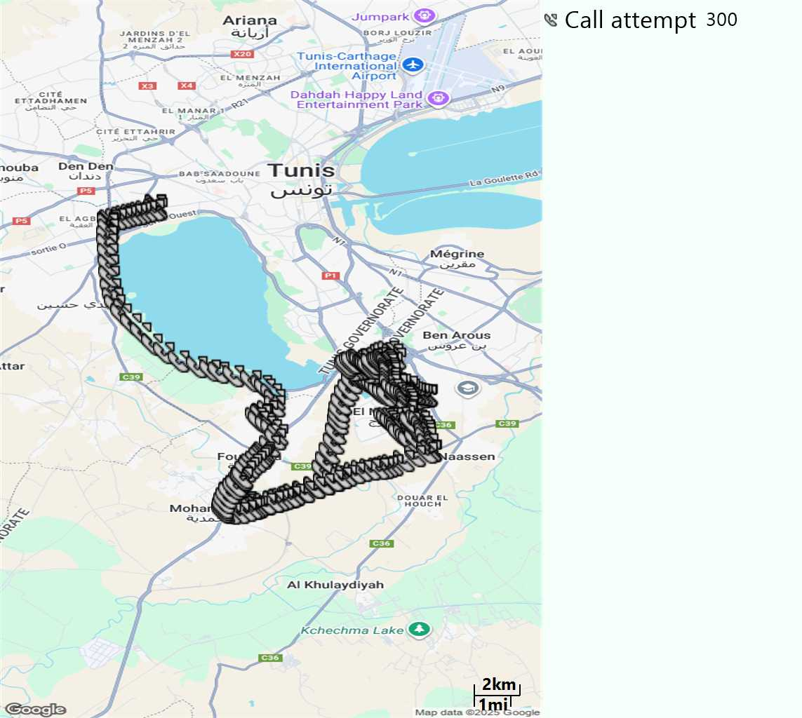
MO Call Setup Time (call setup time in VoLTE)
Short call
Call Setup Time IMS Voice
Average (Sec) | Maximum (Sec) | Minimum (Sec)
2,65 | 14,17 | 1,67

Slide 12
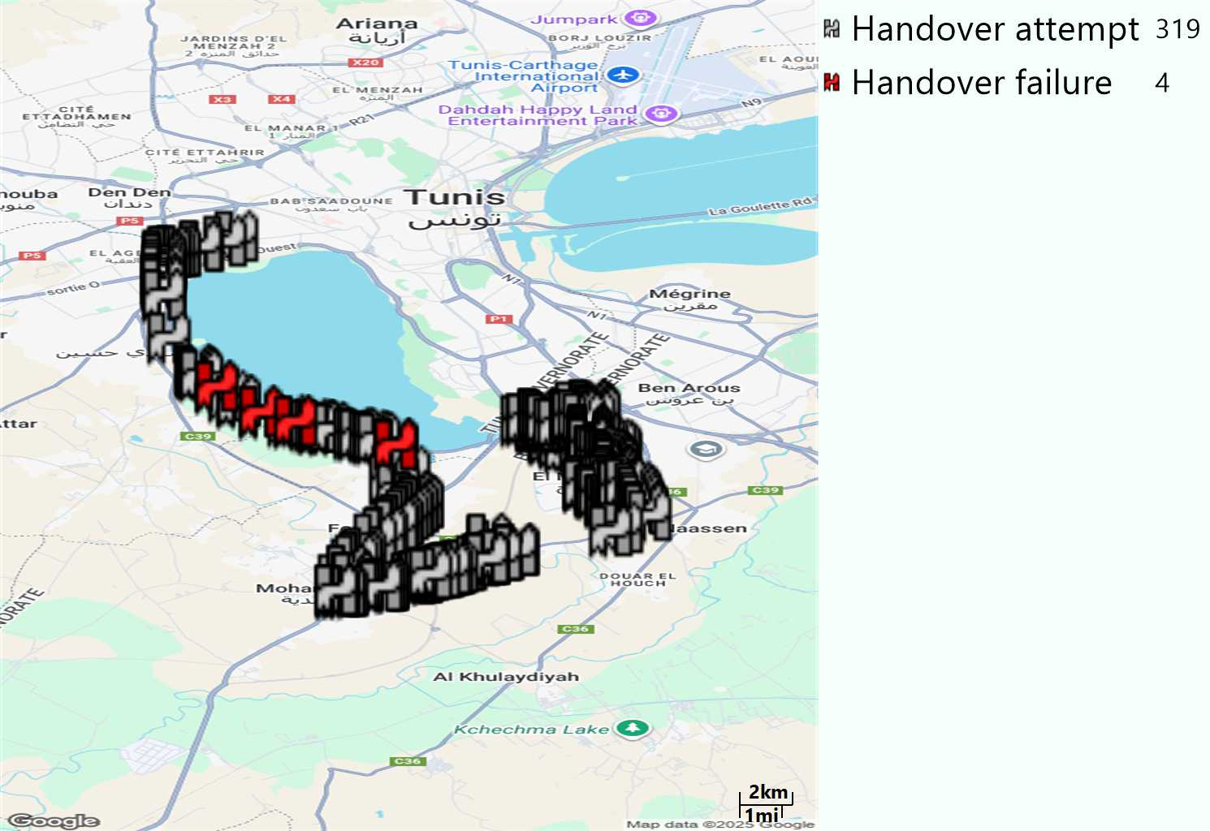
MO Handover Type
Long call
HO Type | Percentage [%]
LTE Inter-Frequency handover | 10,65%
LTE Intra-Frequency handover | 87,46%
UMTS to LTE | 1,88%
Handover KPI’s
Handover Attemps | 319
Handover Success | 315
Handover succès Rate | 98,75%
Étiquettes de lignes | LTE FDD_1800 | LTE FDD_2100 | LTE FDD_800 | Total général
LTE FDD_1800 | 167 | 1 | 7 | 175
LTE FDD_2100 | 9 | 97 | 5 | 111
LTE FDD_800 | 3 | 9 | 15 | 27
UMTS FDD_2100 | 2 | 2 |  | 4
UMTS FDD_900 |  | 2 |  | 2
Total général | 181 | 111 | 27 | 319

Slide 13
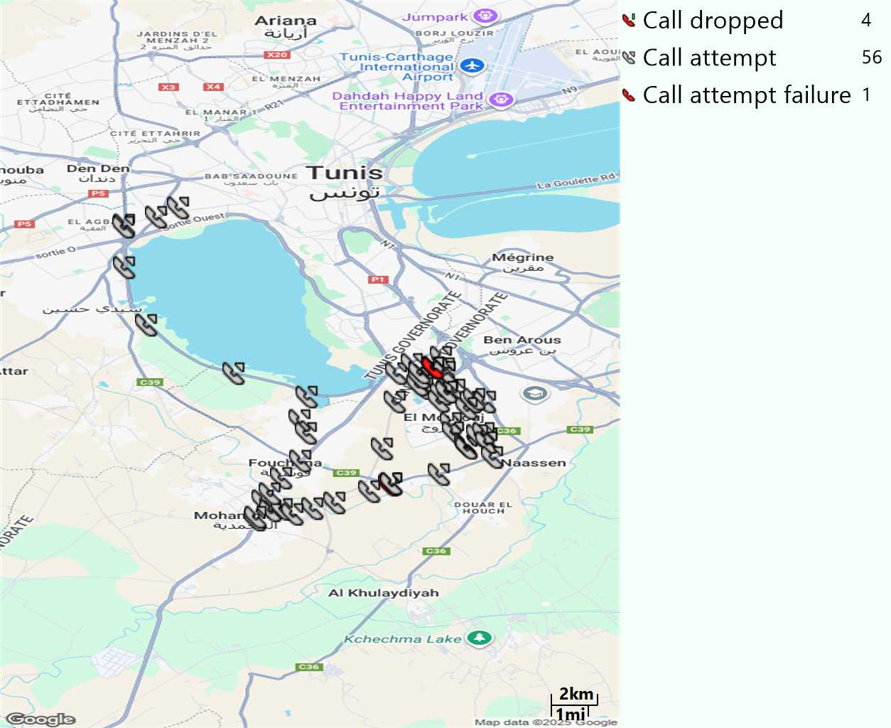
MO Voice Stats (VoLTE call stats)
Long call
Voice KPIs
Number Call Attempts | 56
Number Dropped Calls | 4
Call Drop Rate (%) | 7,14%
HO success rate | 98,75%

Slide 14
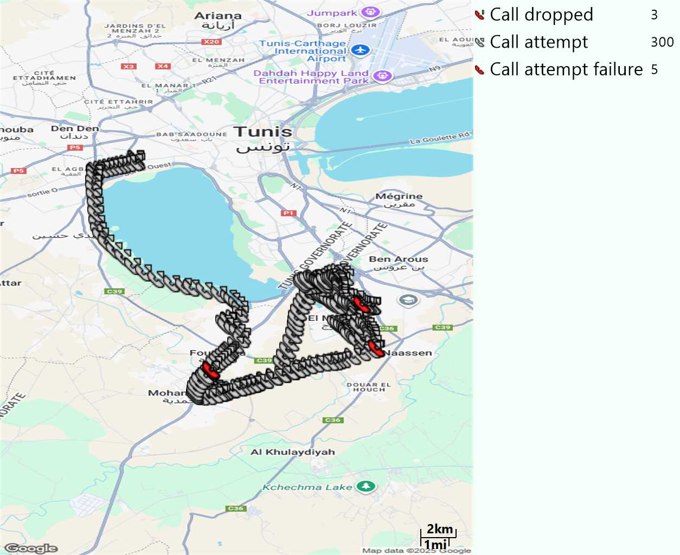
MO Voice Stats (VoLTE call stats)
Short call
Voice KPIs
Number Call Attempts | 300
Number Call Setup | 295
Number Blocked Calls | 5
Setup Succes Rate (%) | 98,33%
Call Block Rate (%) | 1,67%
Call Setup Time IMS Voice Average (Sec) | 2,65

Slide 15
MO Voice Stats (VoLTE call stats)
KPIs
VoLTE Call Setup SR | 98,33%
Call Setup Time | 2,65
VoLTE Drop Call Rate | 7,14%
Speech Quality - MOS (% of the samples >3,5) | 87,07%
Average MOS | 4,04
VoLTE Handover SR | 98,75%
VoLTE SRVCC SR | 100%

Slide 16
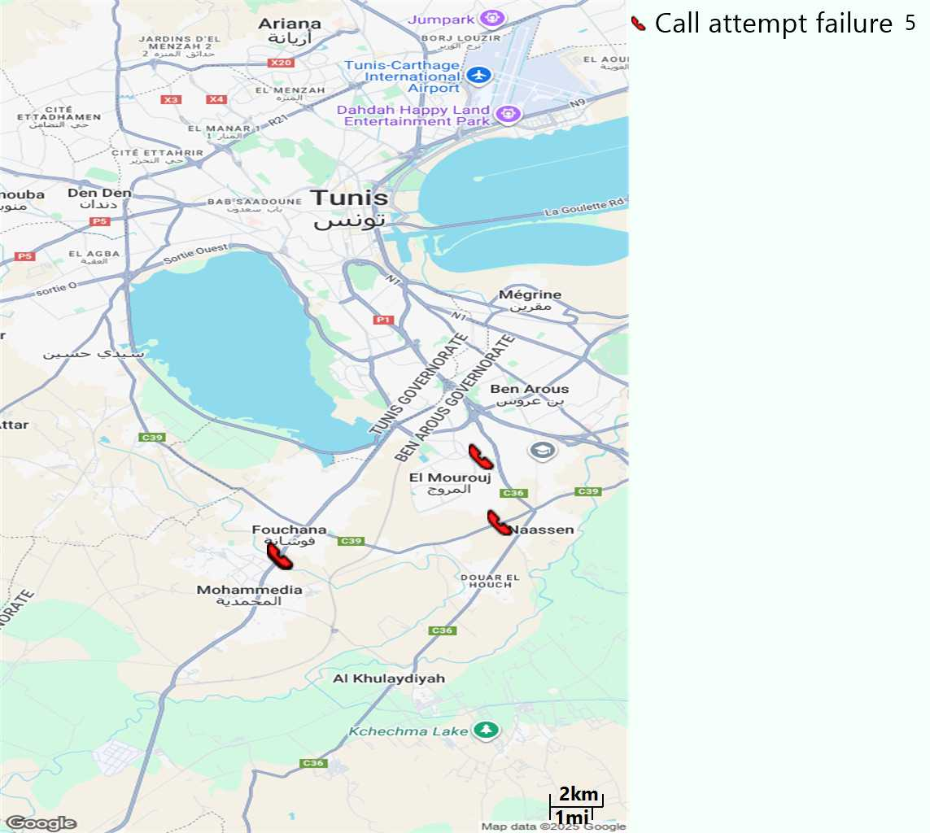
MO Voice Call - Blocked call
Short call

Slide 17
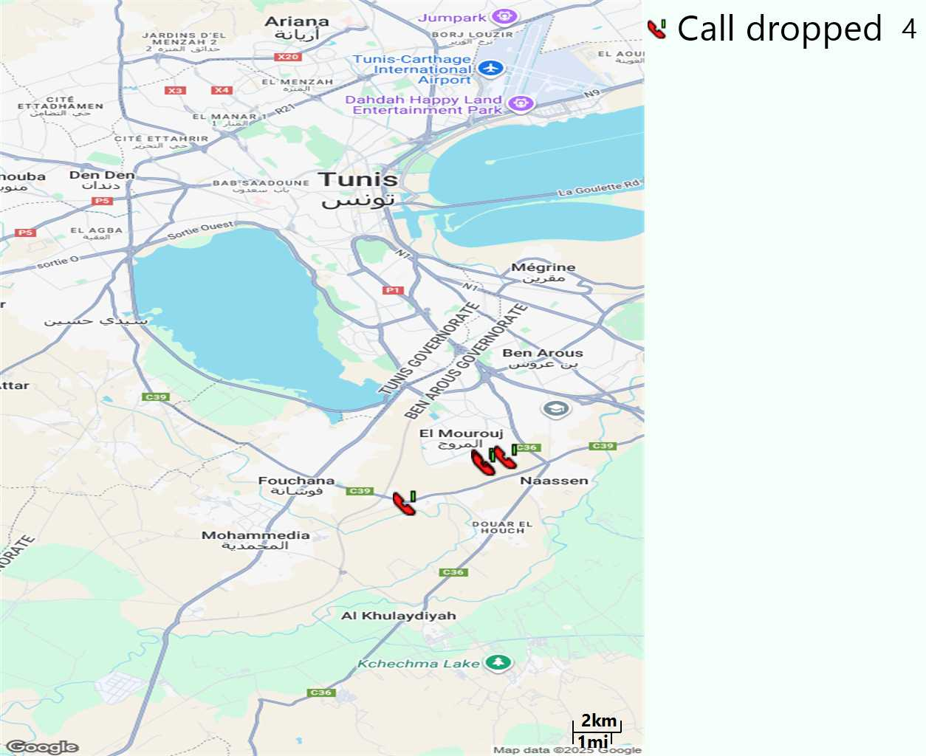
MO Voice Call - Dropped call
Long call

Slide 18
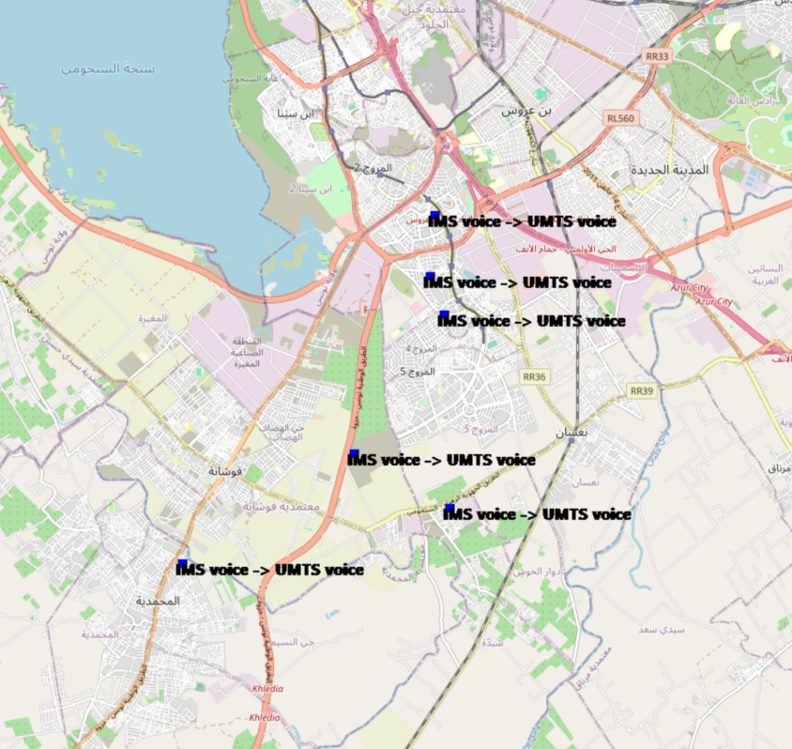
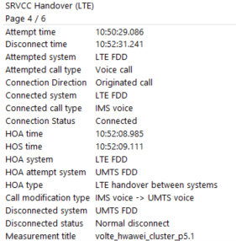
VoLTE SRVCC Success Rate long Call

Slide 19
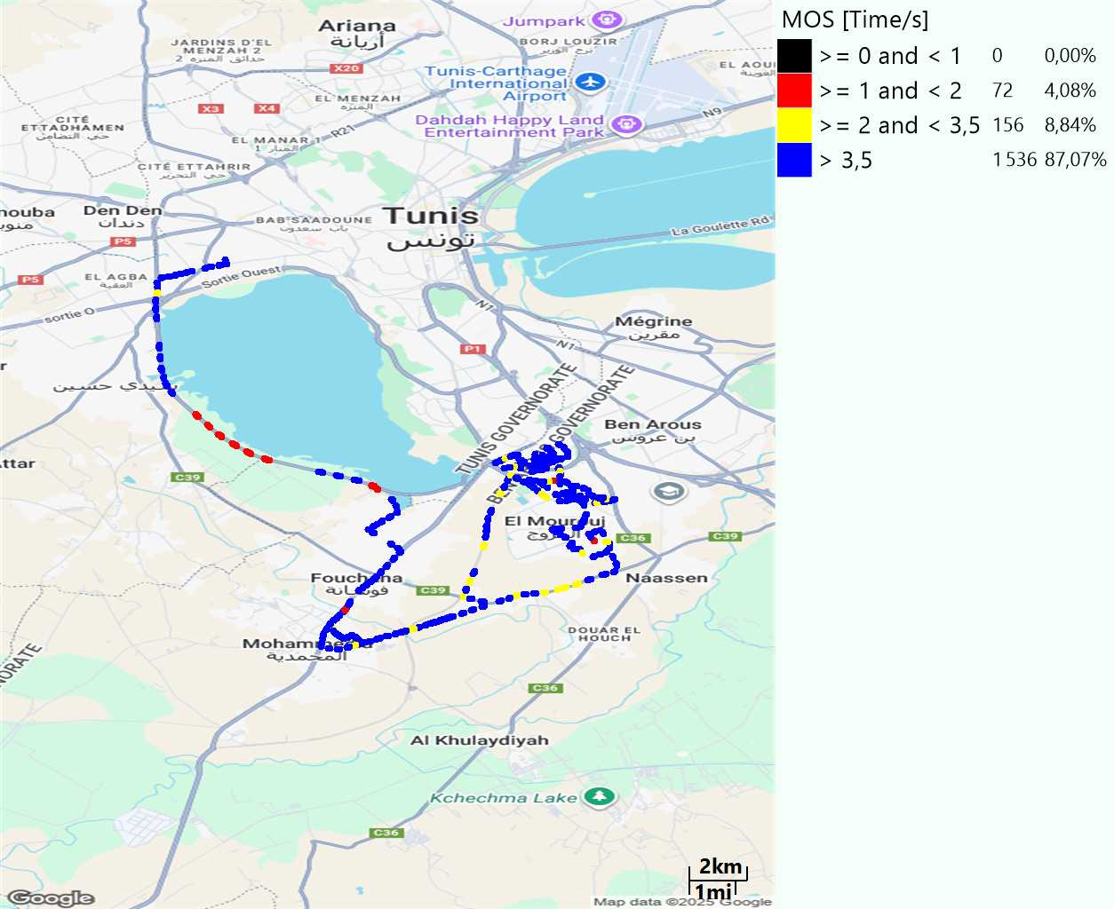
MO Voice Quality Metrics
long Call

