Slide 1


Volte Drive Test Report

Slide 2
DT Scénario
Short Call (10s)
Long call (2min)
Scanner

Slide 3
Voice Call

Slide 4
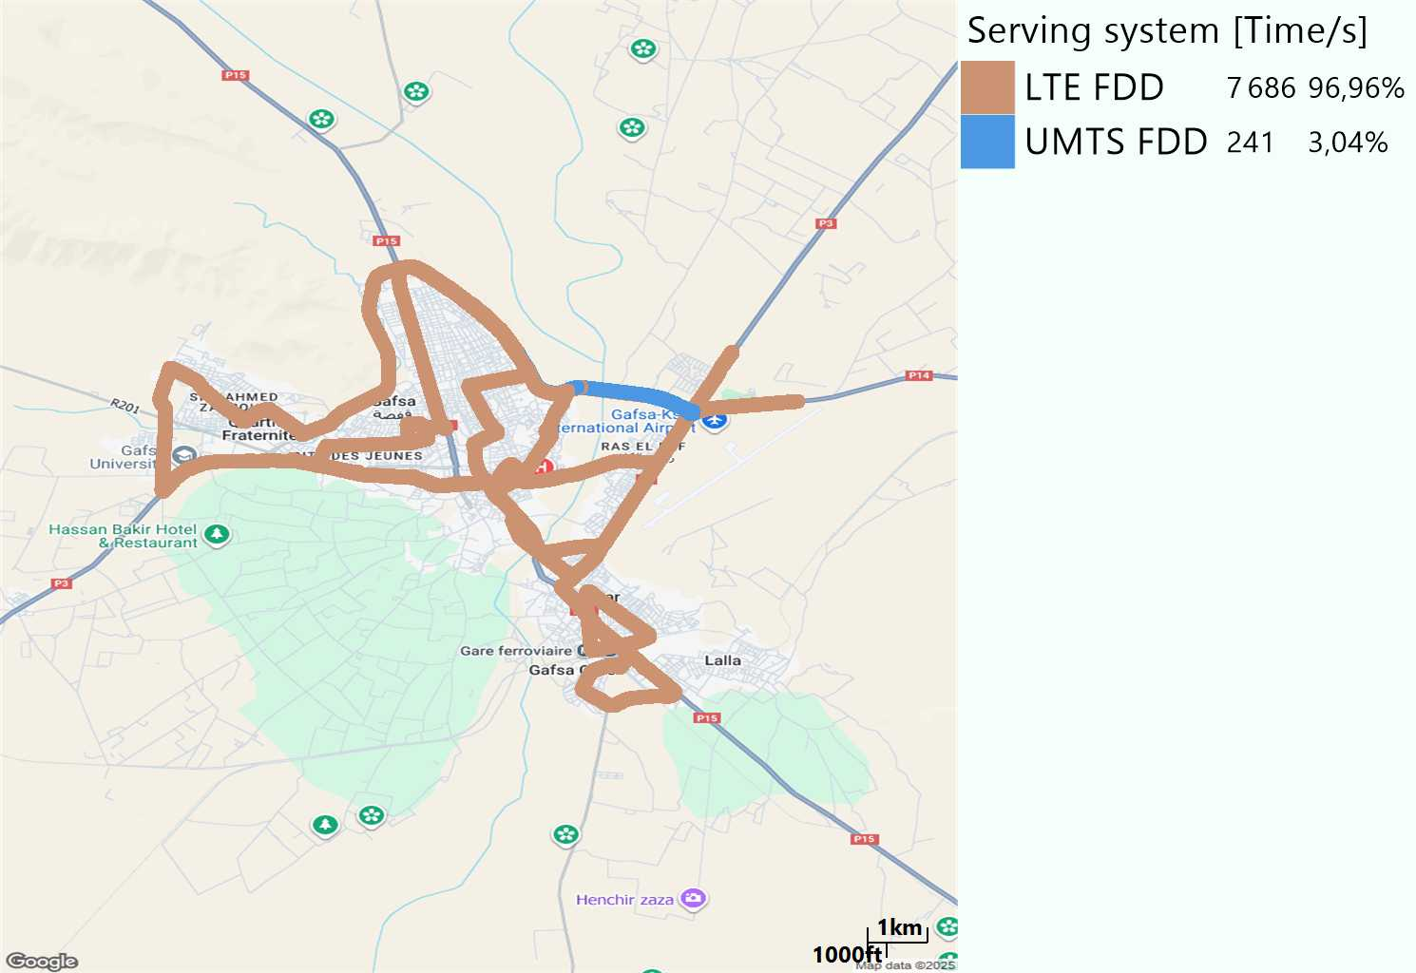
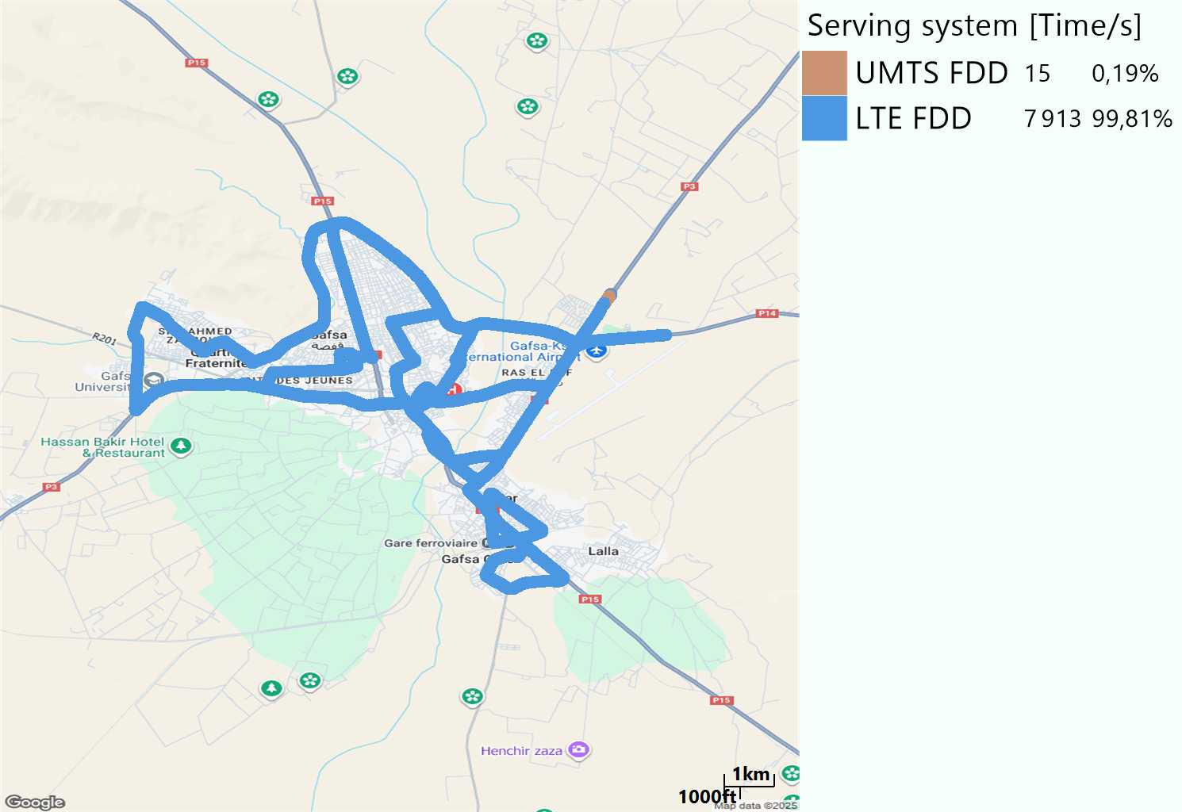
RAT distribution
Long call
Short call

Slide 5
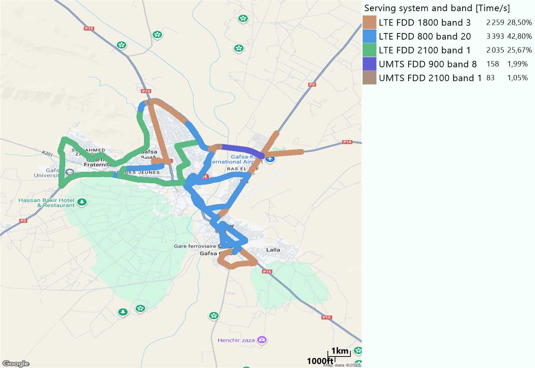
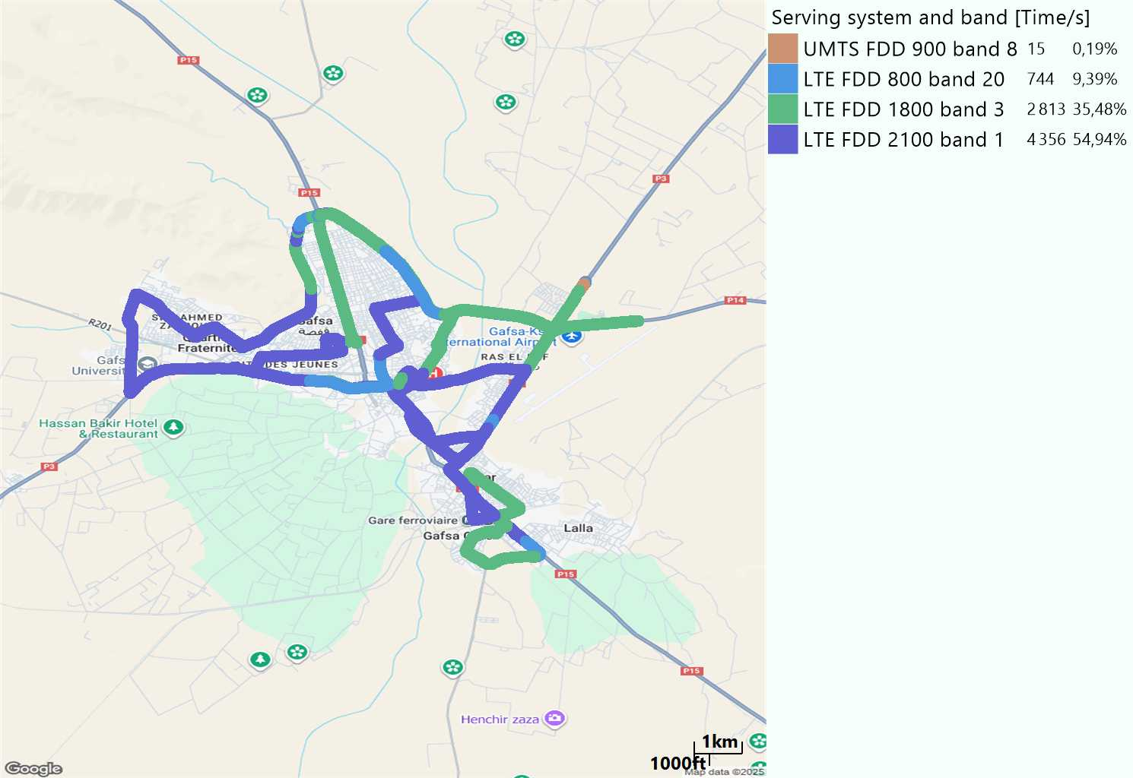
EARFCN distribution
Long call
Short call

Slide 6
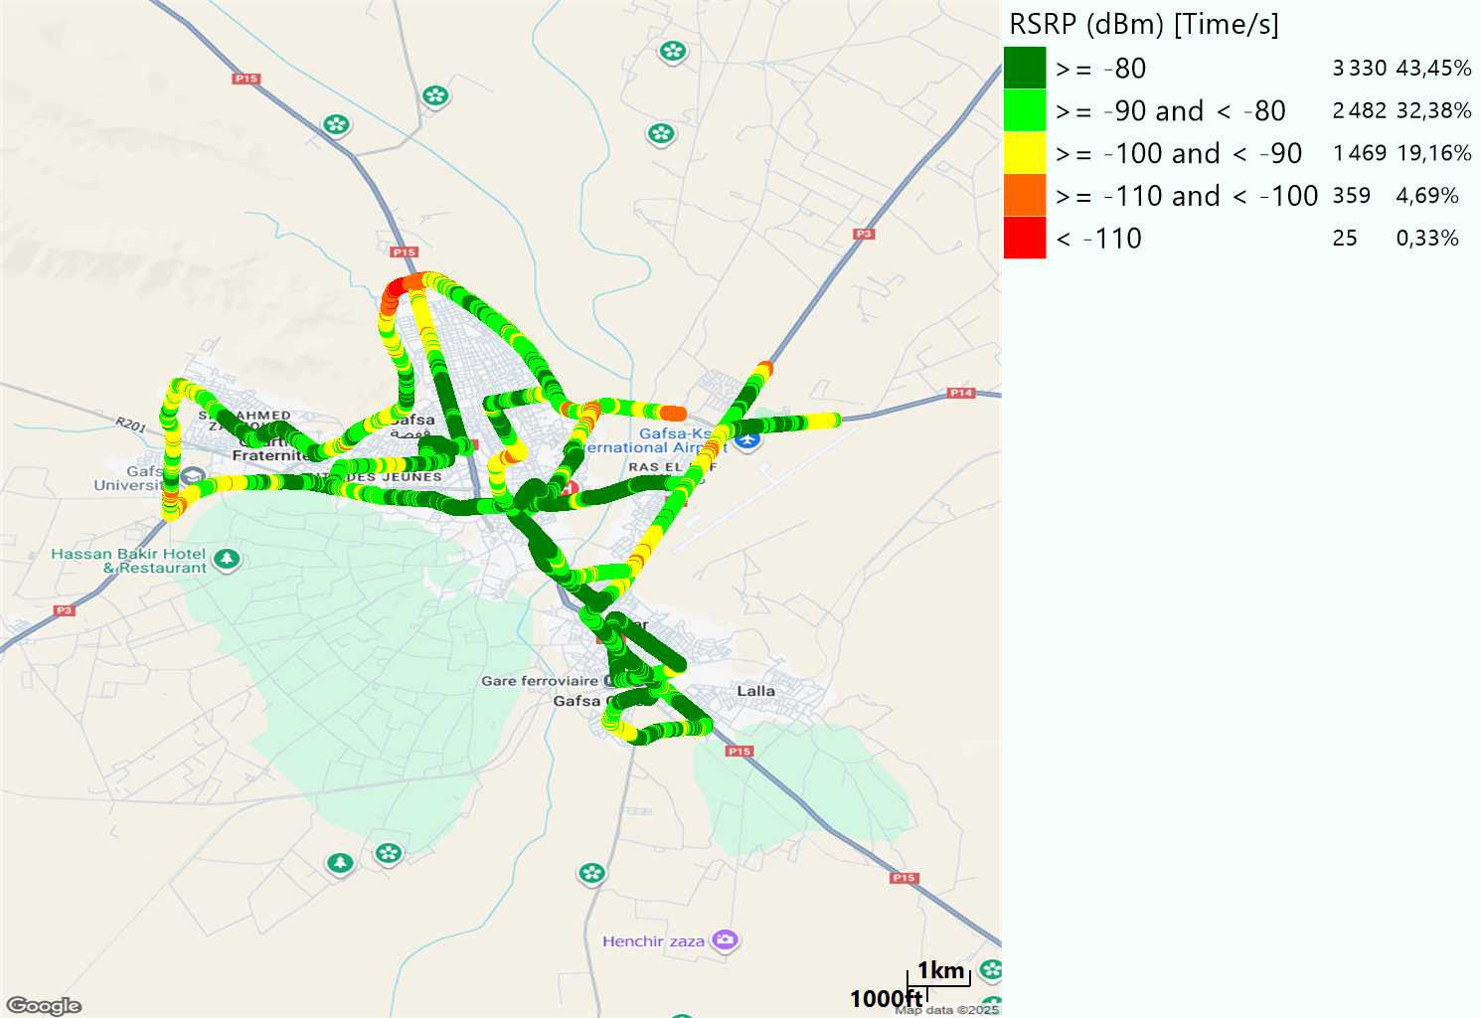
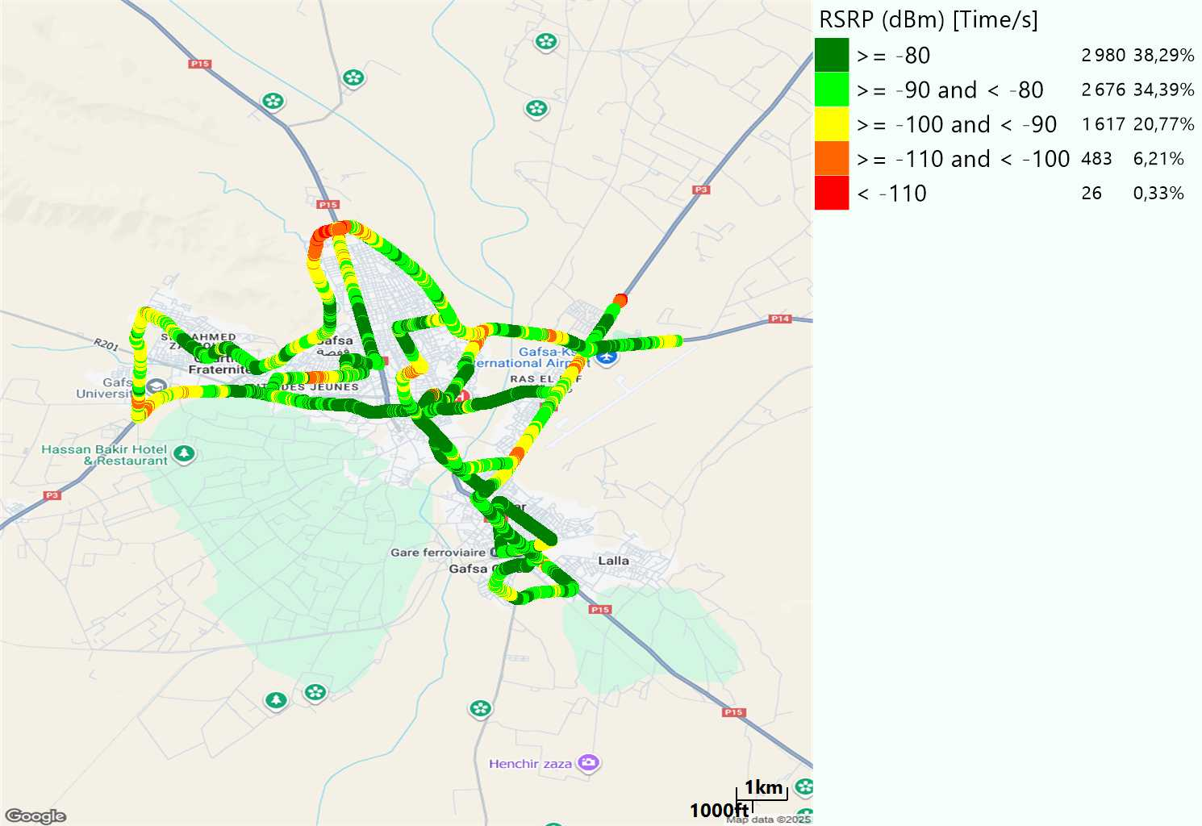
LTE - RSRP
Long call
Short call
Average [dBm]
-82,4
Average [dBm]
-83,57

Slide 7
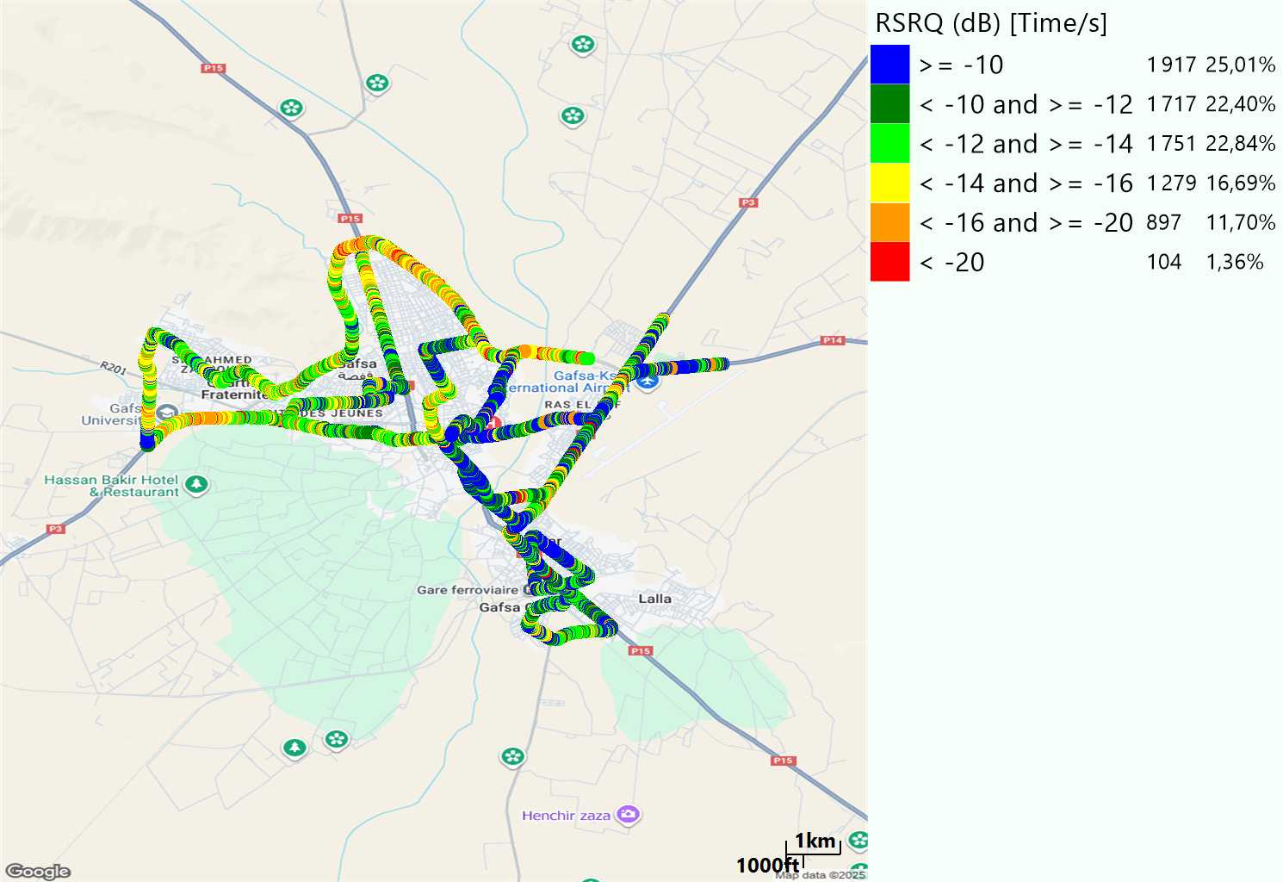
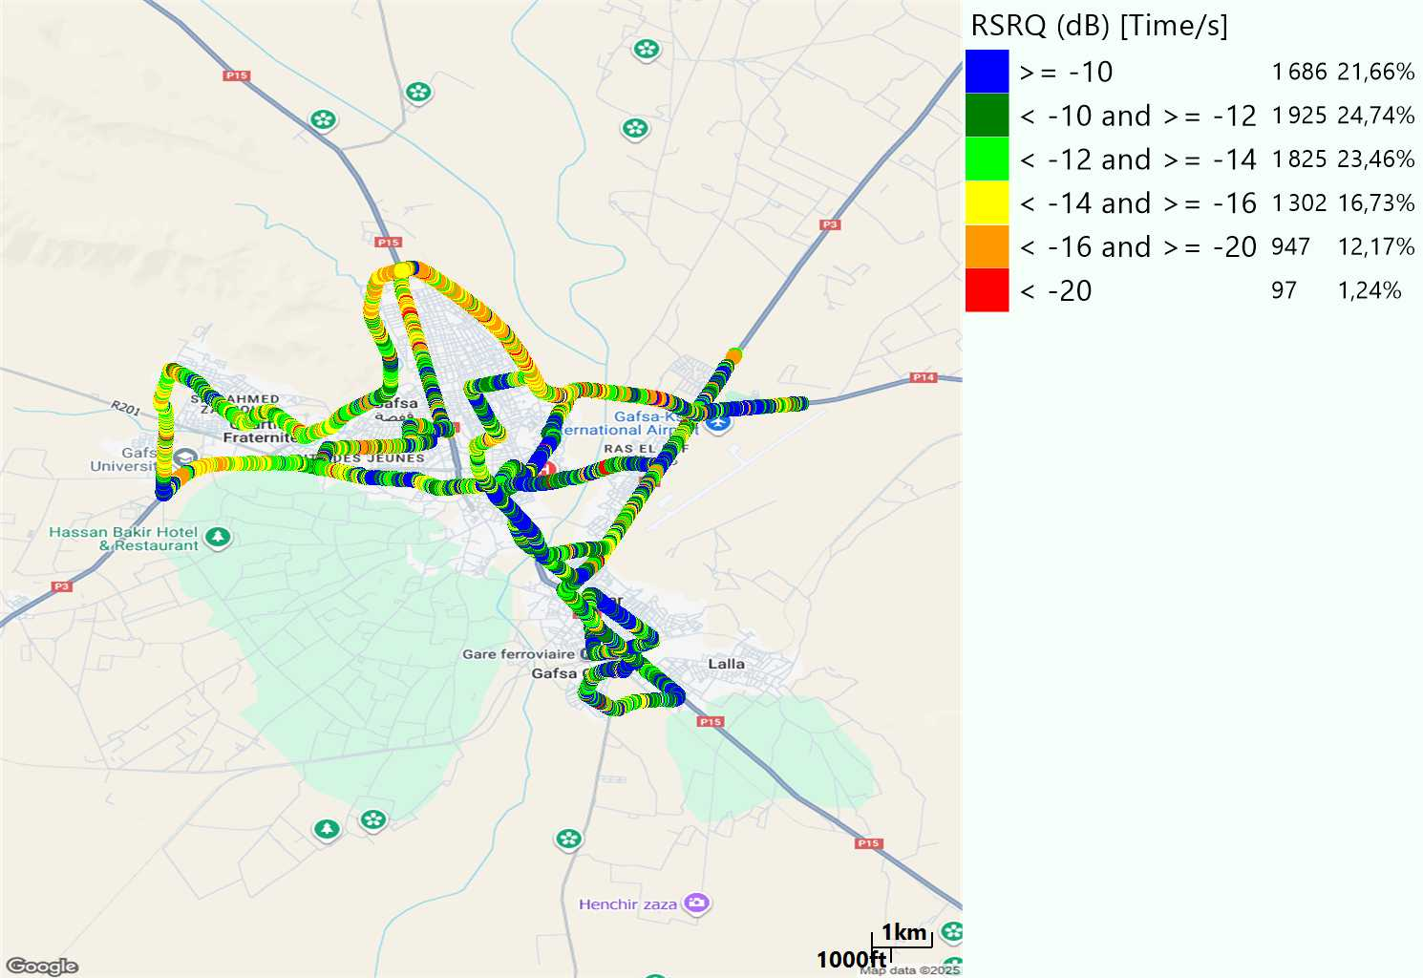
LTE- RSRQ
Long call
Short call

Slide 8
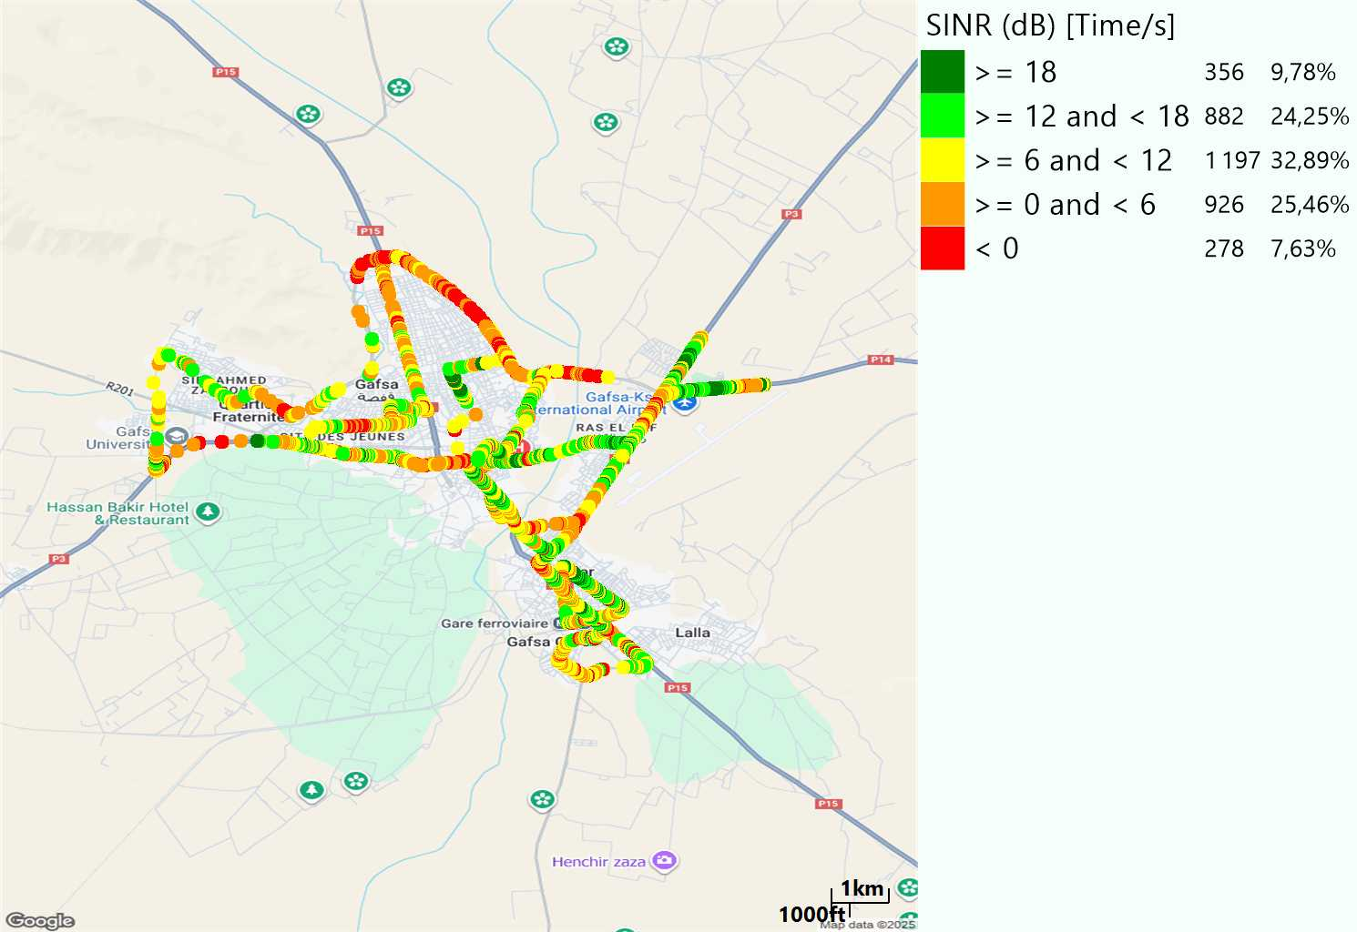
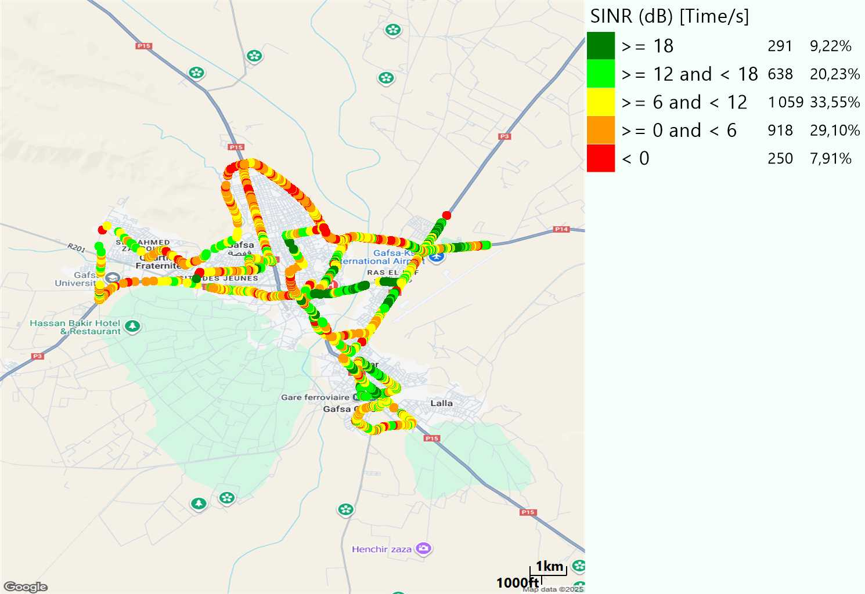
LTE-SINR
Long call
Short call

Slide 9
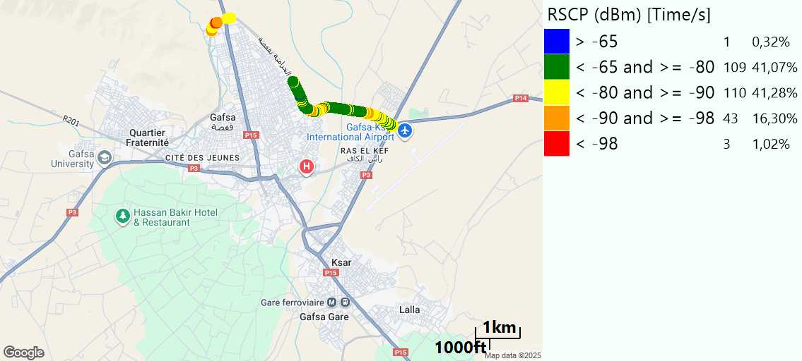
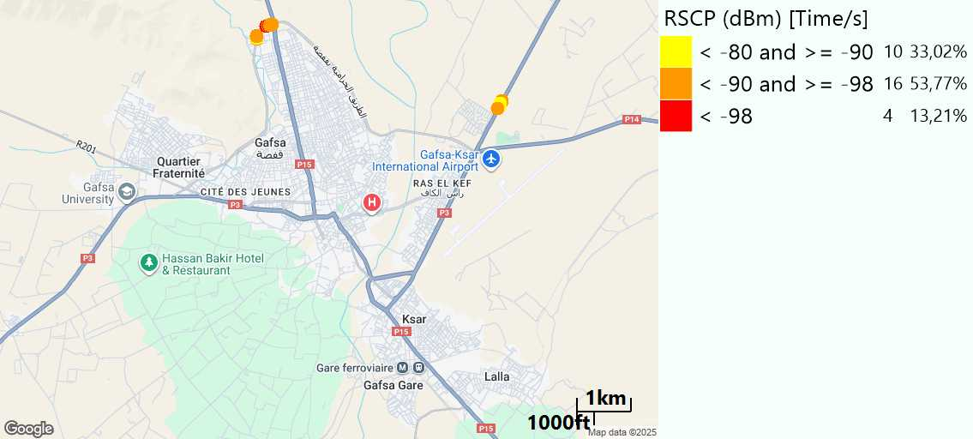
RSCP
Long call
Short call

Slide 10
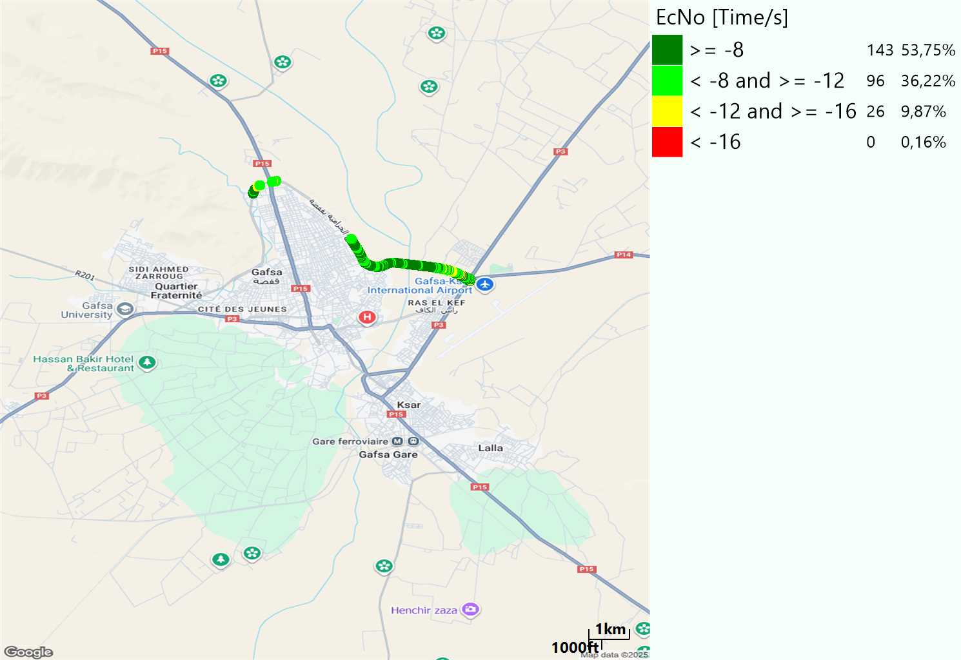
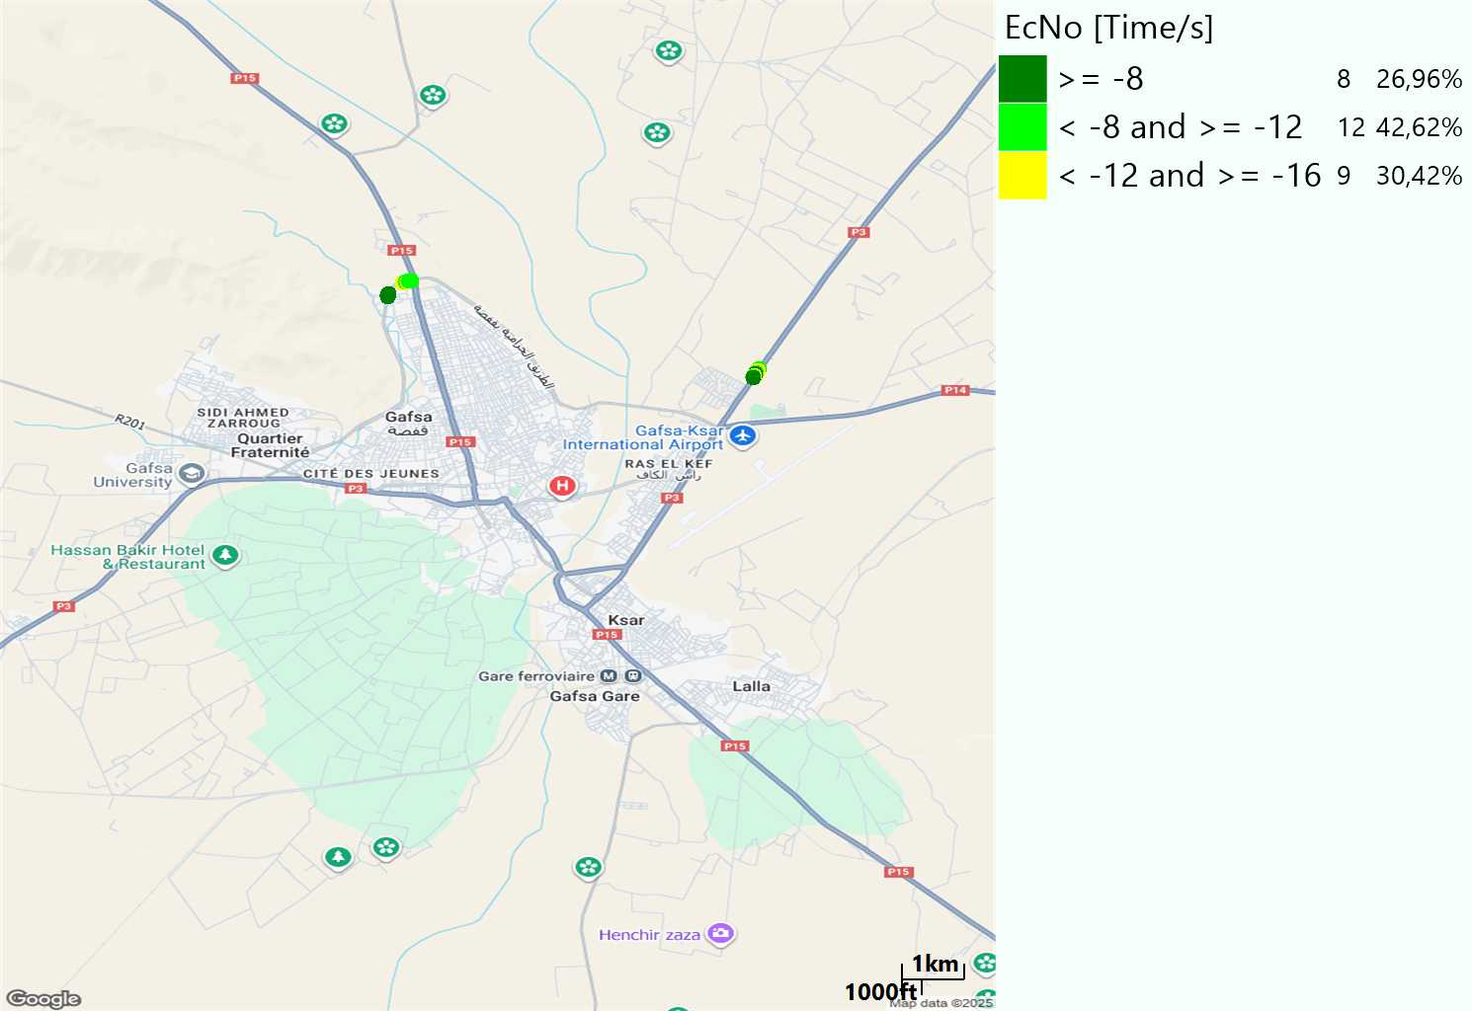
WCDMA-Ec/NO
Long call
Short call

Slide 11
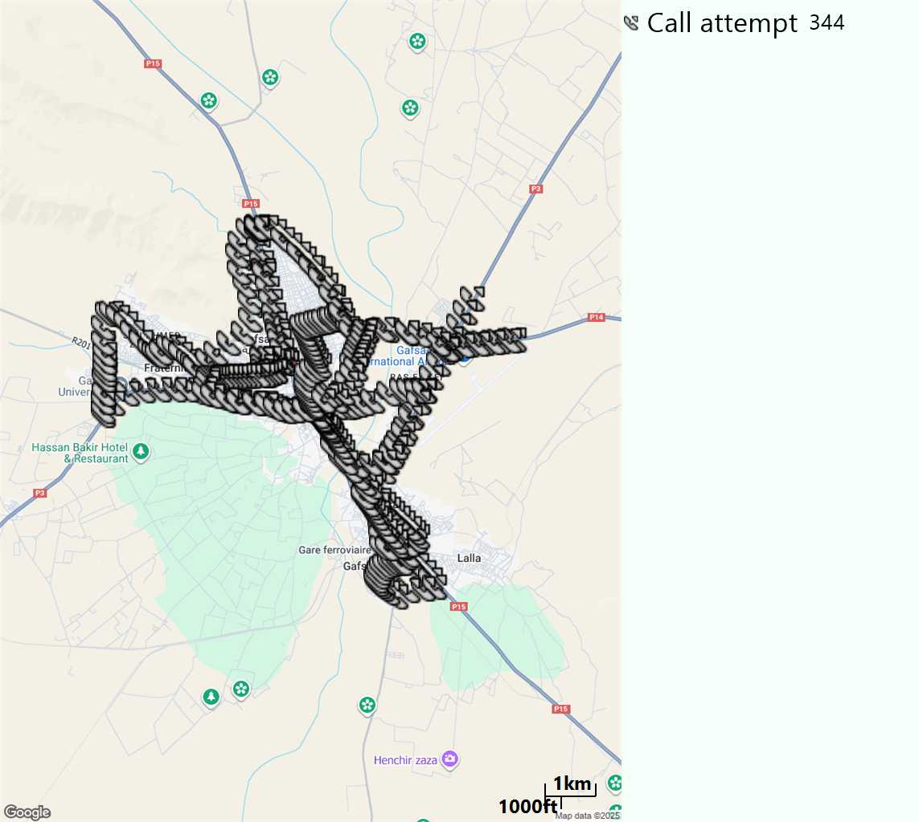
MO Call Setup Time (call setup time in VoLTE)
Short call
Call Setup Time IMS Voice
Average (Sec) | Maximum (Sec) | Minimum (Sec)
2,75 | 7,88 | 1,94

Slide 12
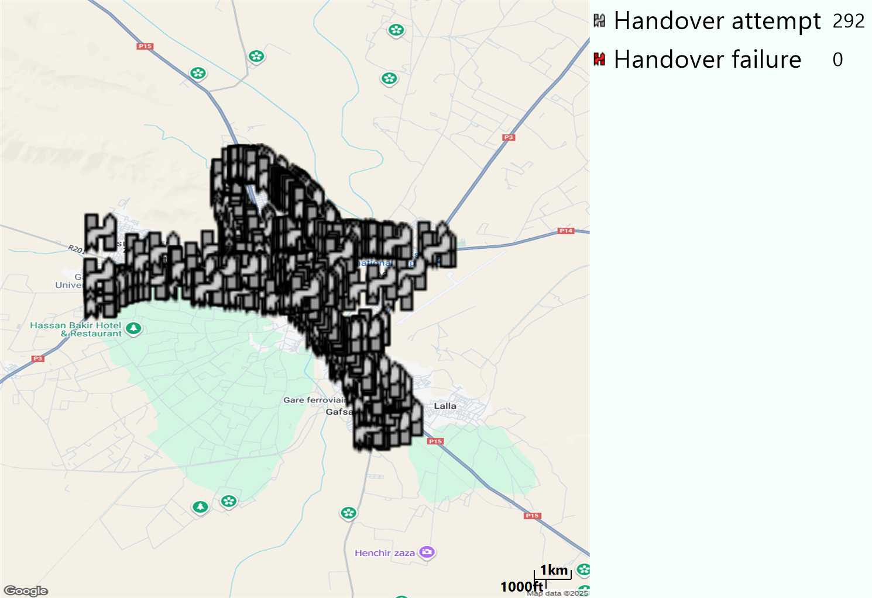
MO Handover Type
Long call
HO Type | Percentage [%]
LTE Inter-Frequency handover | 2,4%
LTE Intra-Frequency handover | 96,92%
LTE handover between frequencies | 0,34%
UMTS to LTE | 0,34%
Handover KPI’s
Handover Attemps | 292
Handover Success | 292
Handover succès Rate | 100%
Étiquettes de lignes | LTE FDD_1800 | LTE FDD_2100 | LTE FDD_800 | Total général
LTE FDD_1800 | 72 |  | 2 | 74
LTE FDD_2100 |  | 80 | 2 | 82
LTE FDD_800 | 5 | 1 | 129 | 135
UMTS FDD_900 |  |  | 1 | 1
Total général | 77 | 81 | 134 | 292

Slide 13
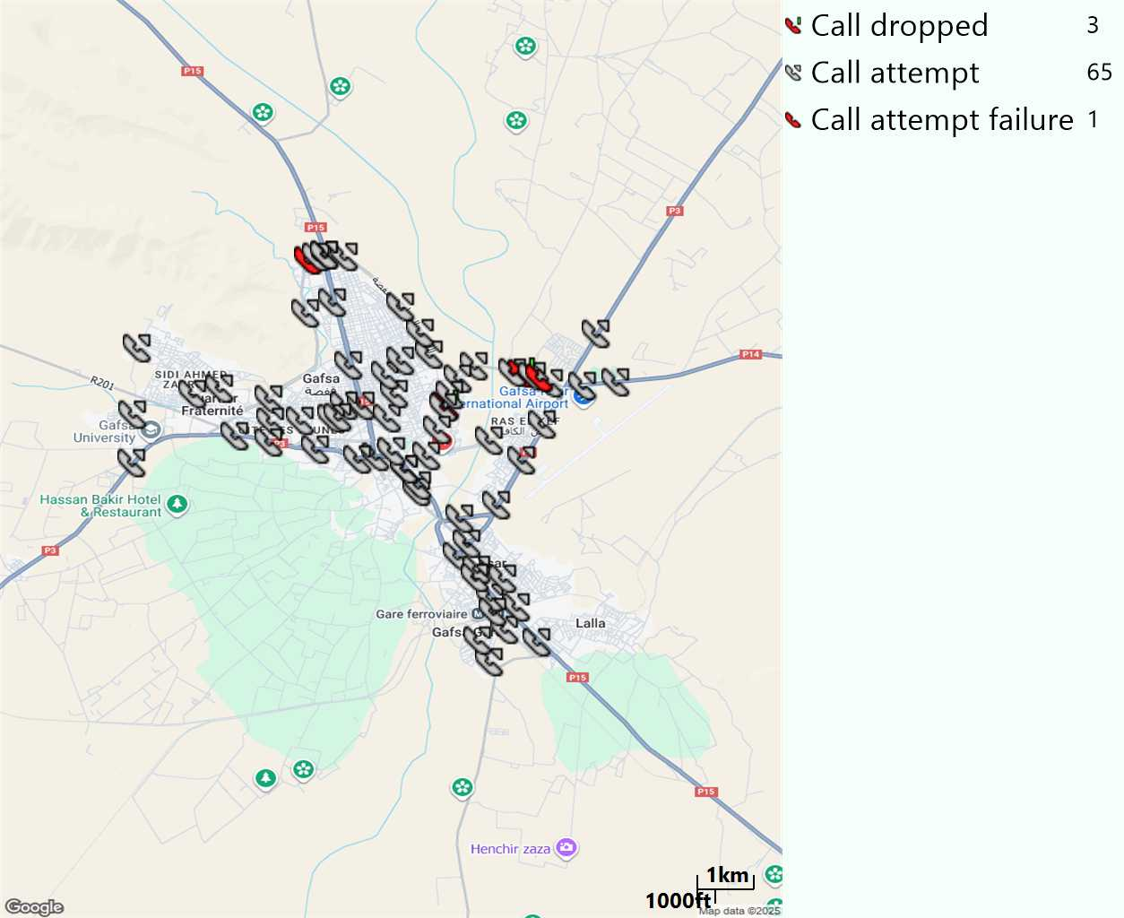
MO Voice Stats (VoLTE call stats)
Long call
Voice KPIs
Number Call Attempts | 65
Number Dropped Calls | 3
Call Drop Rate (%) | 4,62%
HO success rate | 100%

Slide 14
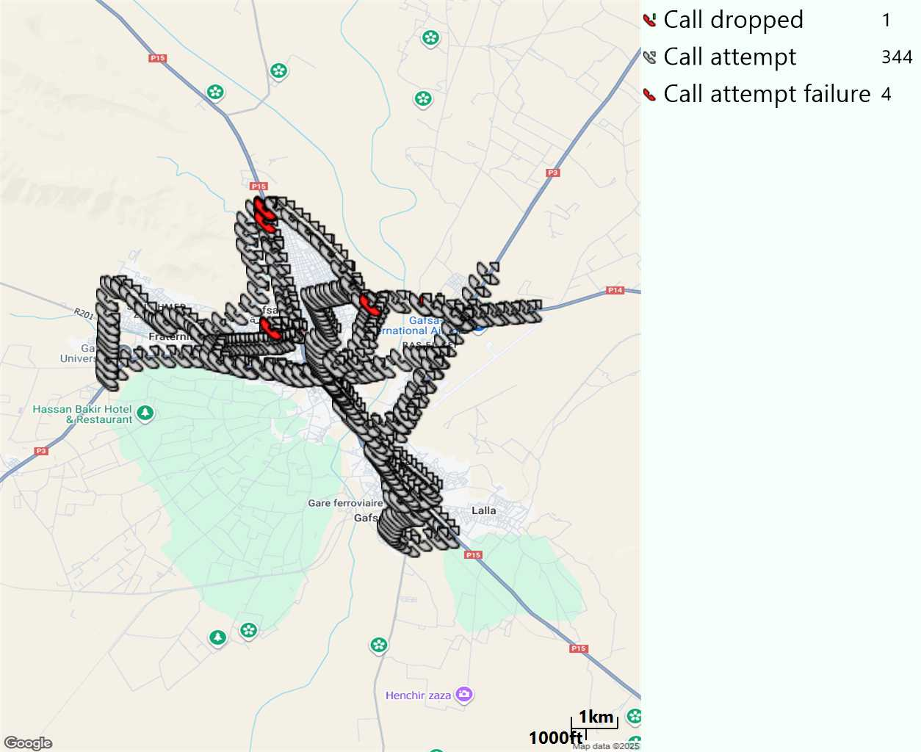
MO Voice Stats (VoLTE call stats)
Short call
Voice KPIs
Number Call Attempts | 344
Number Call Setup | 340
Number Blocked Calls | 4
Setup Succes Rate (%) | 98,84%
Call Block Rate (%) | 1,16%
Call Setup Time IMS Voice Average (Sec) | 2,75

Slide 15
MO Voice Stats (VoLTE call stats)
KPIs
VoLTE Call Setup SR | 98,84%
Call Setup Time | 2,75
VoLTE Drop Call Rate | 4,62%
Speech Quality - MOS (% of the samples >3,5) | 80,96%
Average MOS | 3,76
VoLTE Handover SR | 100%
VoLTE SRVCC SR | -

Slide 16
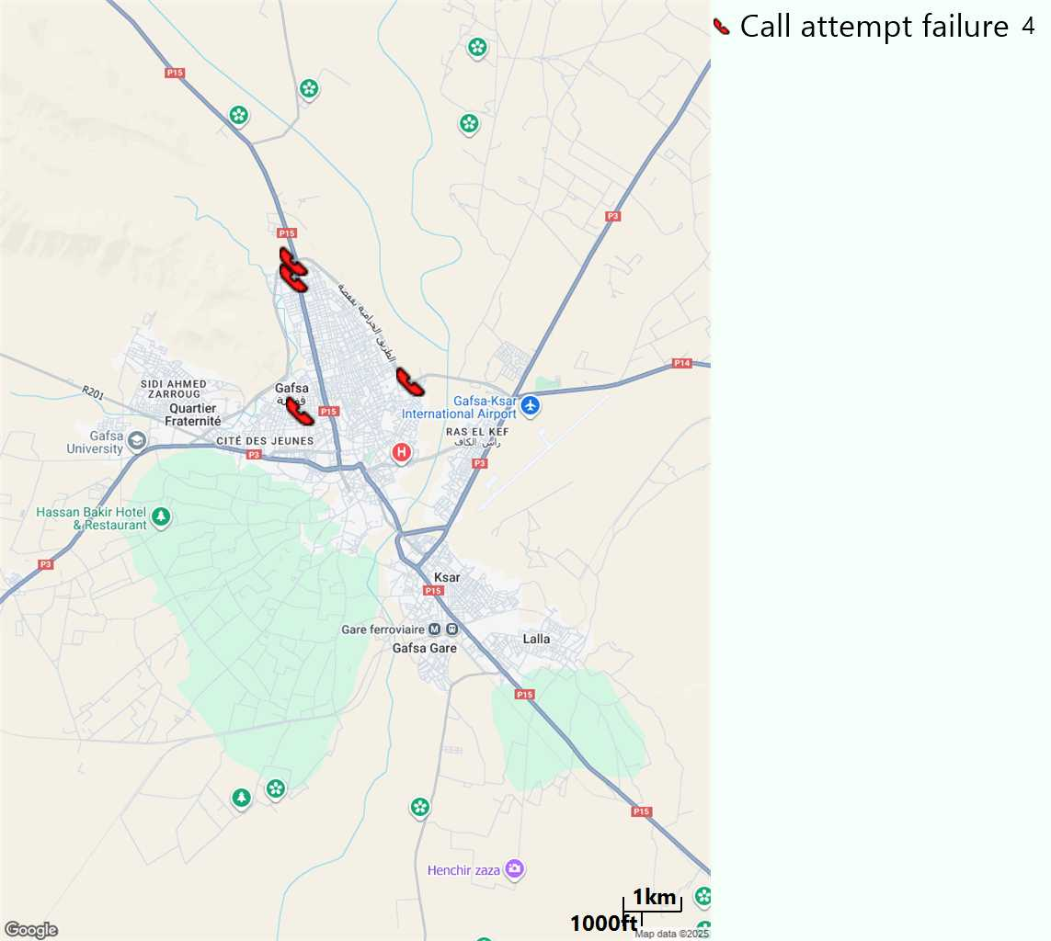
MO Voice Call - Blocked call
Short call

Slide 17
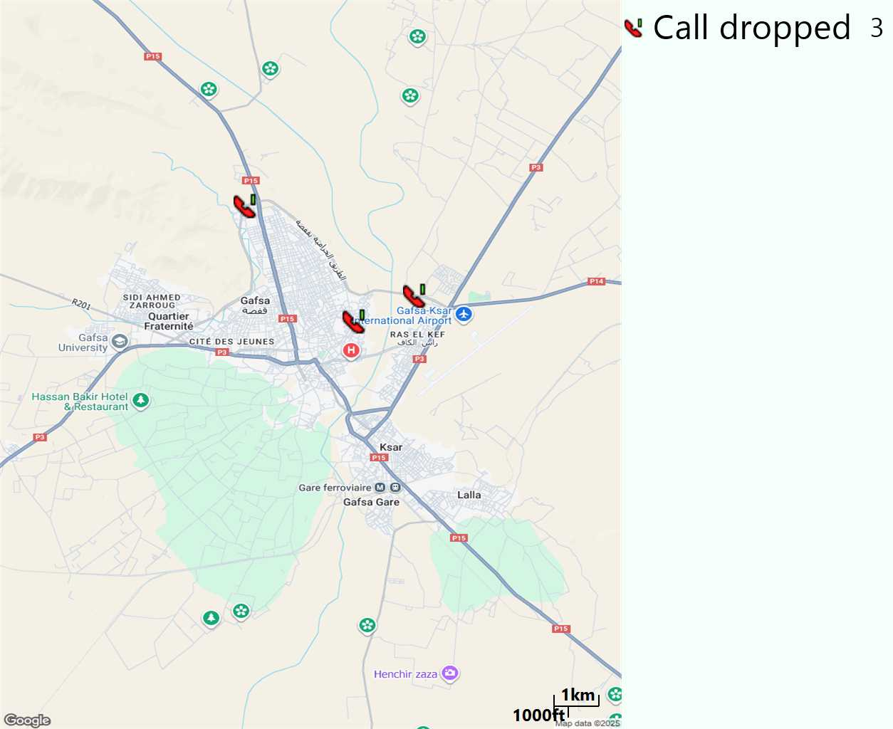
MO Voice Call - Dropped call
Long call

Slide 18
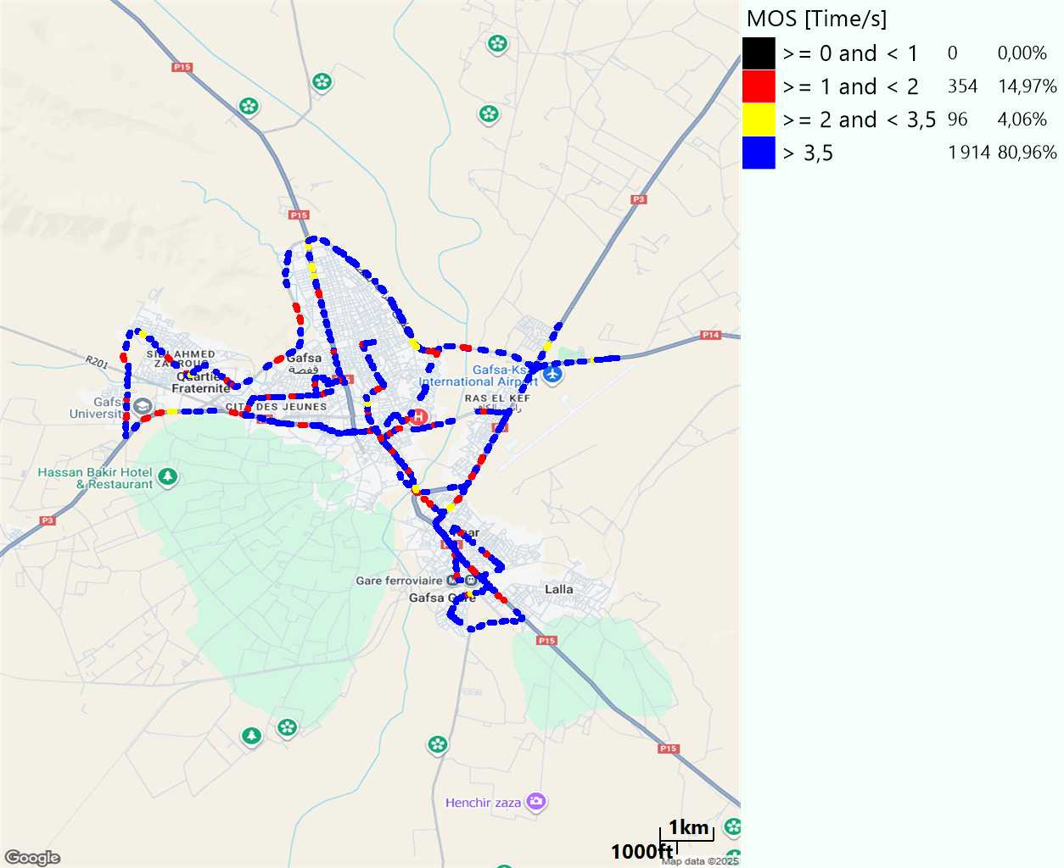
MO Voice Quality Metrics
long Call

Slide 19
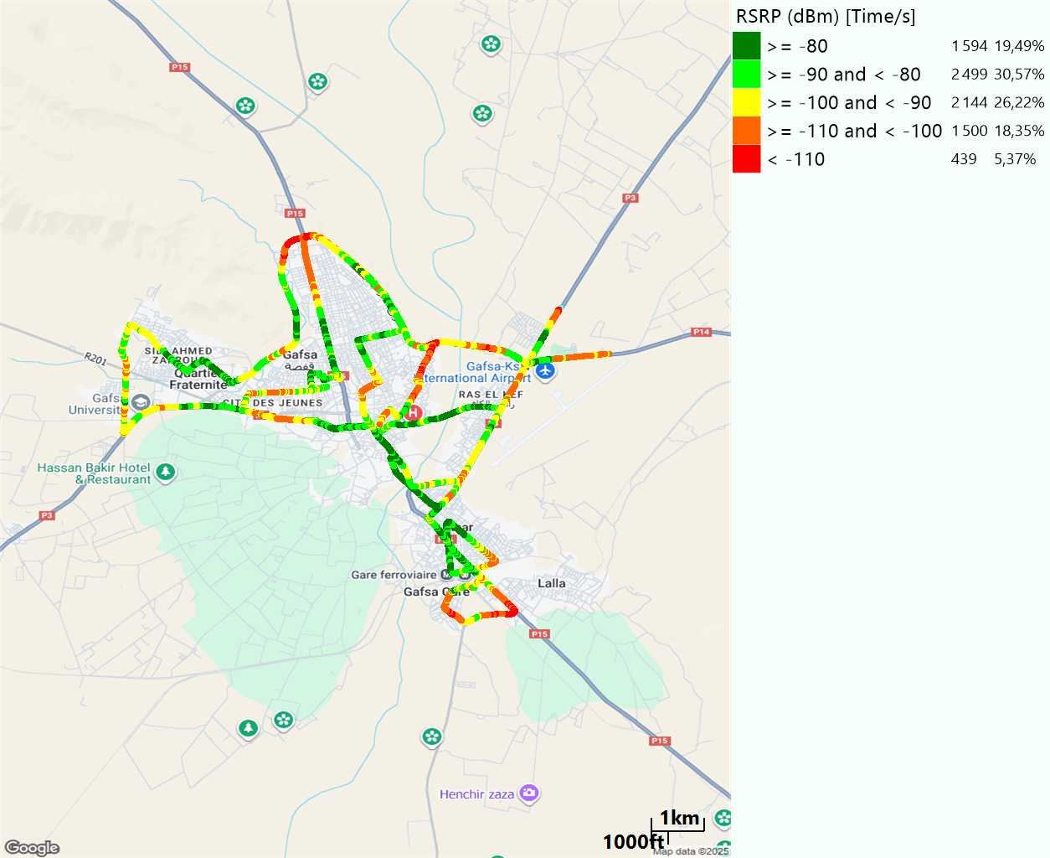
Scanner_RSRP
L2100

Slide 20
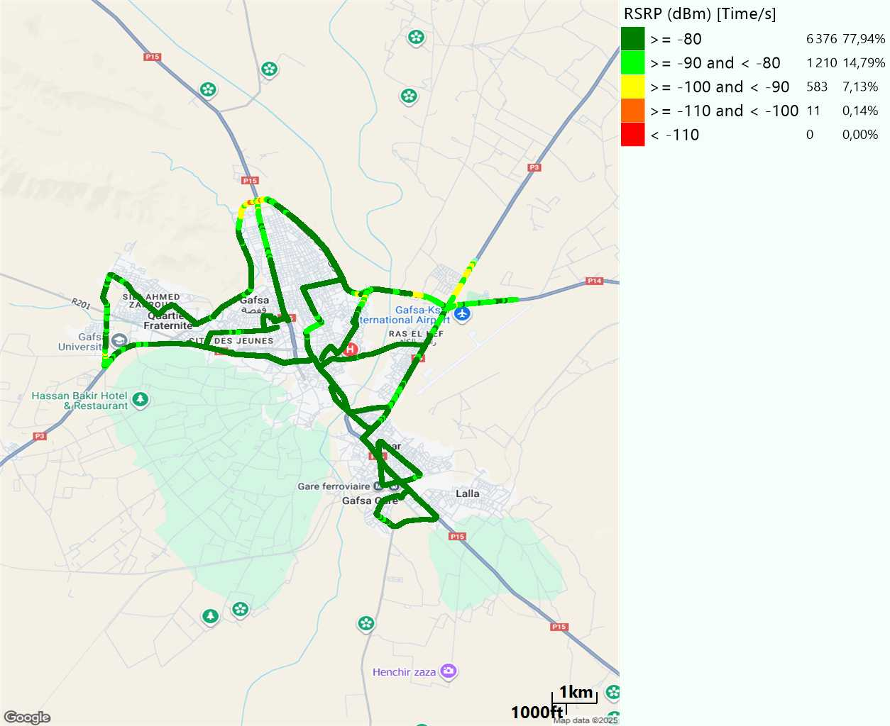
Scanner_RSRP
L800

Slide 21
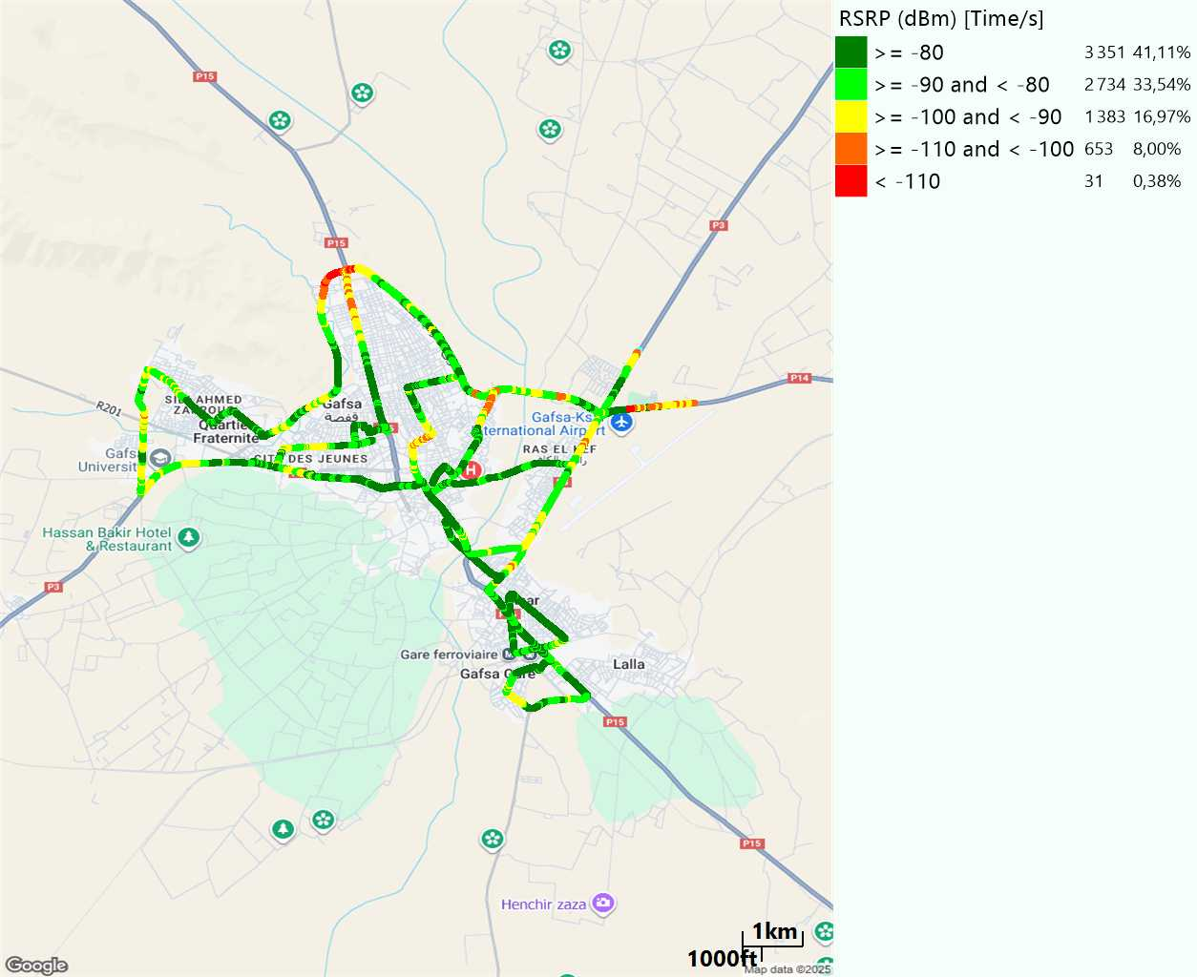
Scanner_RSRP
L1800

Slide 22
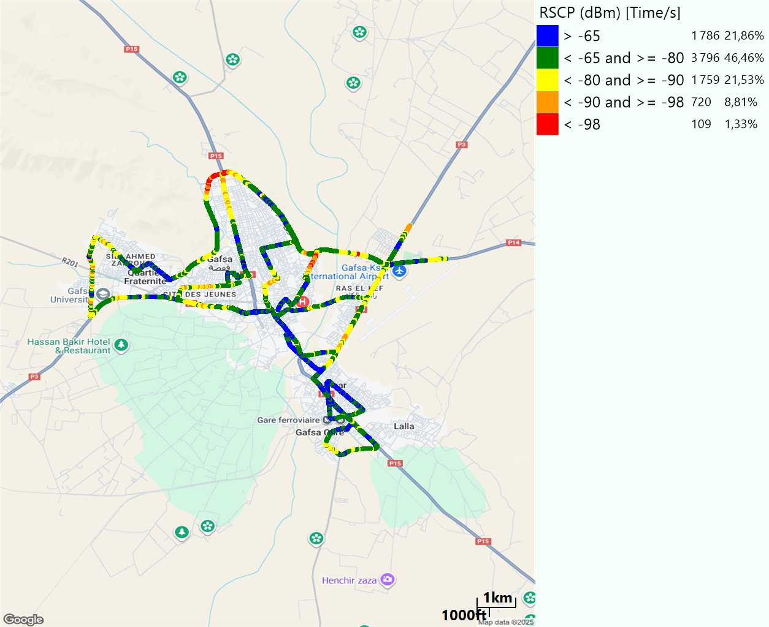
Scanner_RSCP
U2100

Slide 23
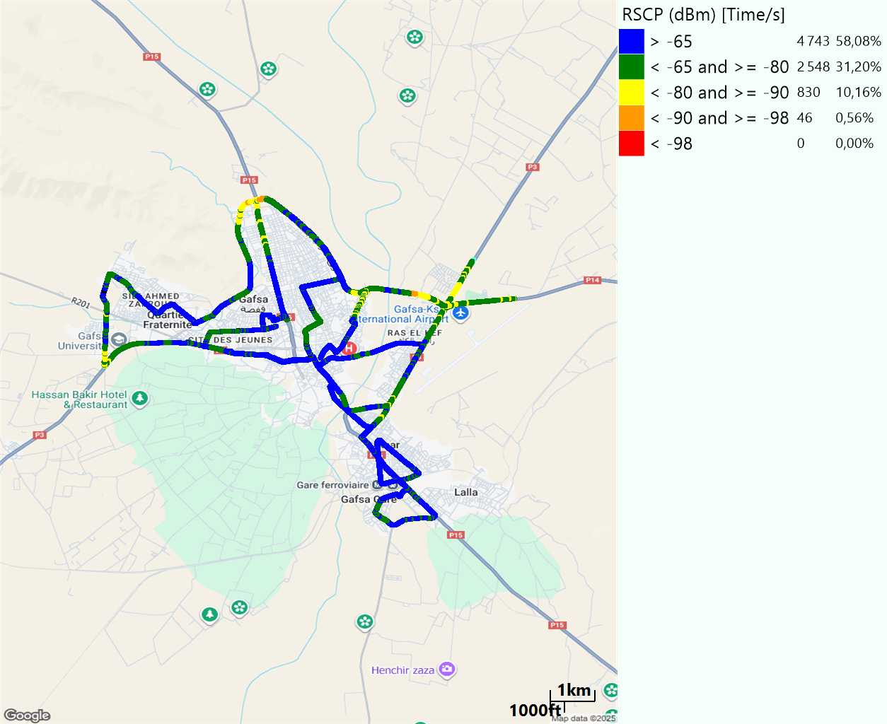
Scanner_RSCP
900

