Slide 1


Volte Drive Test Report

Slide 2
DT Scénario
Short Call (10s)
Long call (2min)
Scanner

Slide 3
Voice Call

Slide 4
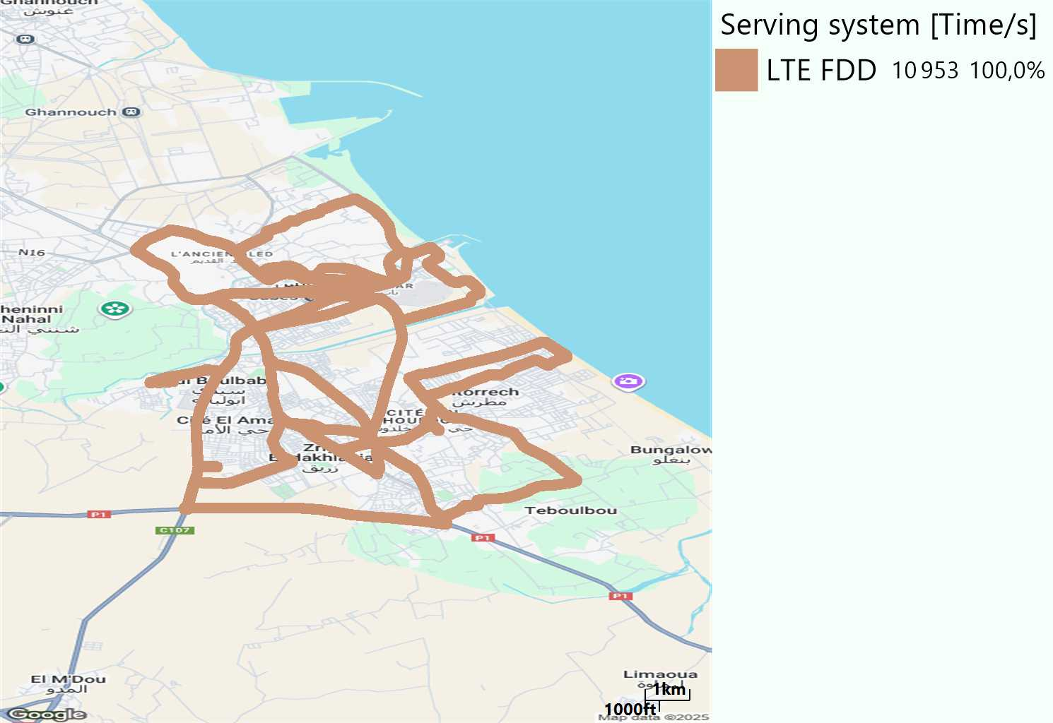
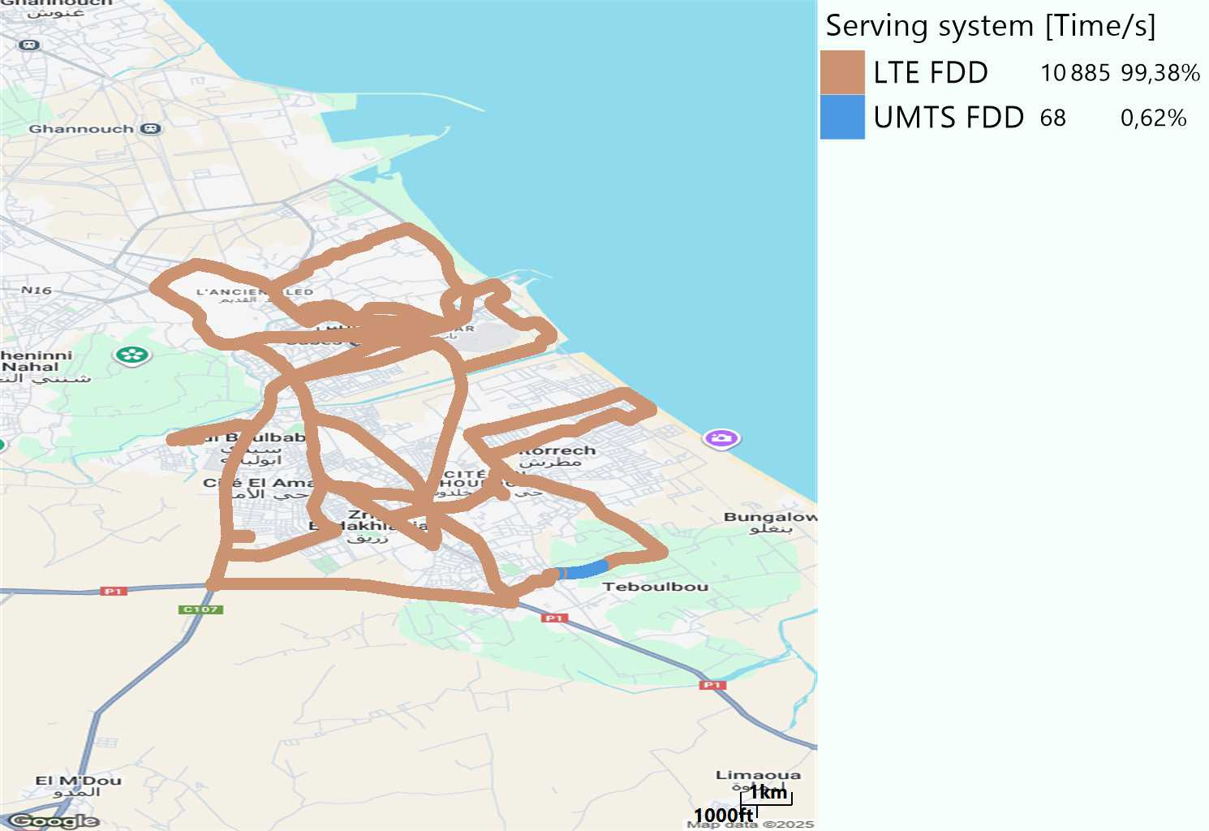
RAT distribution
Long call
Short call

Slide 5
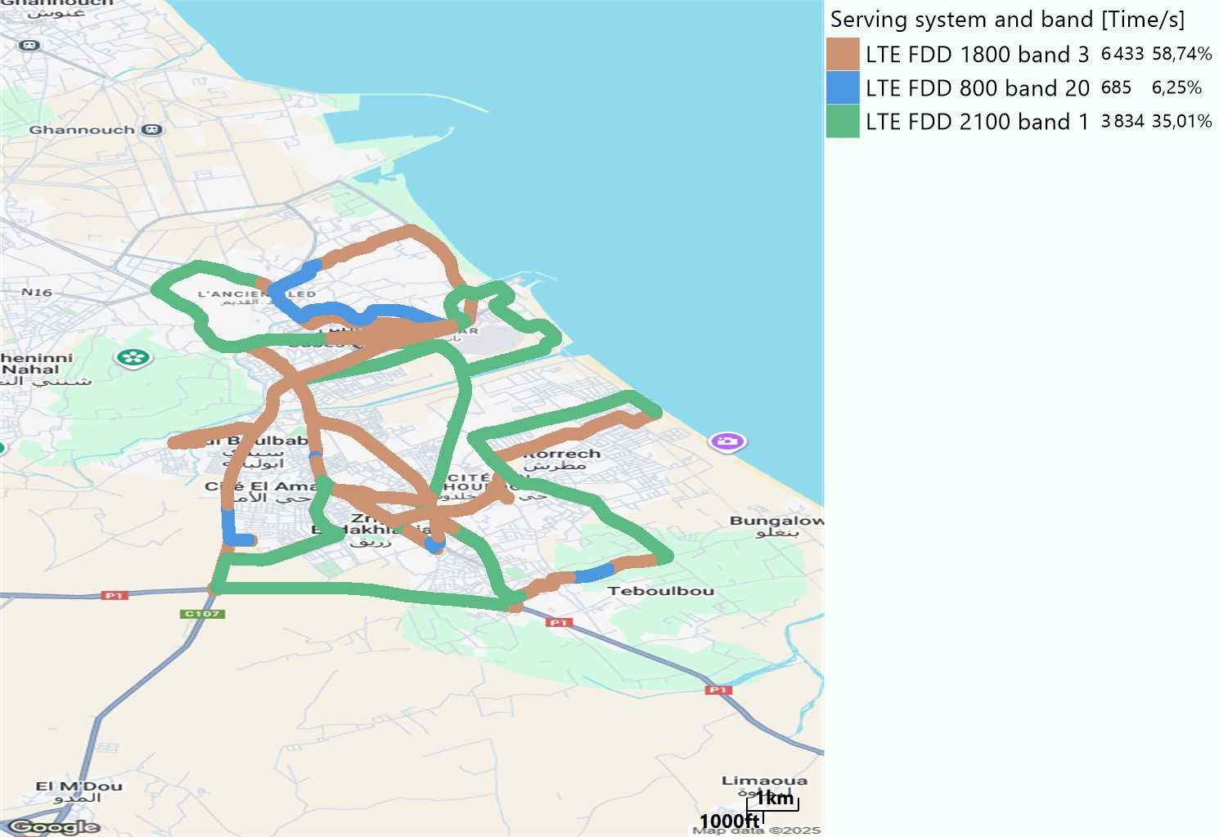
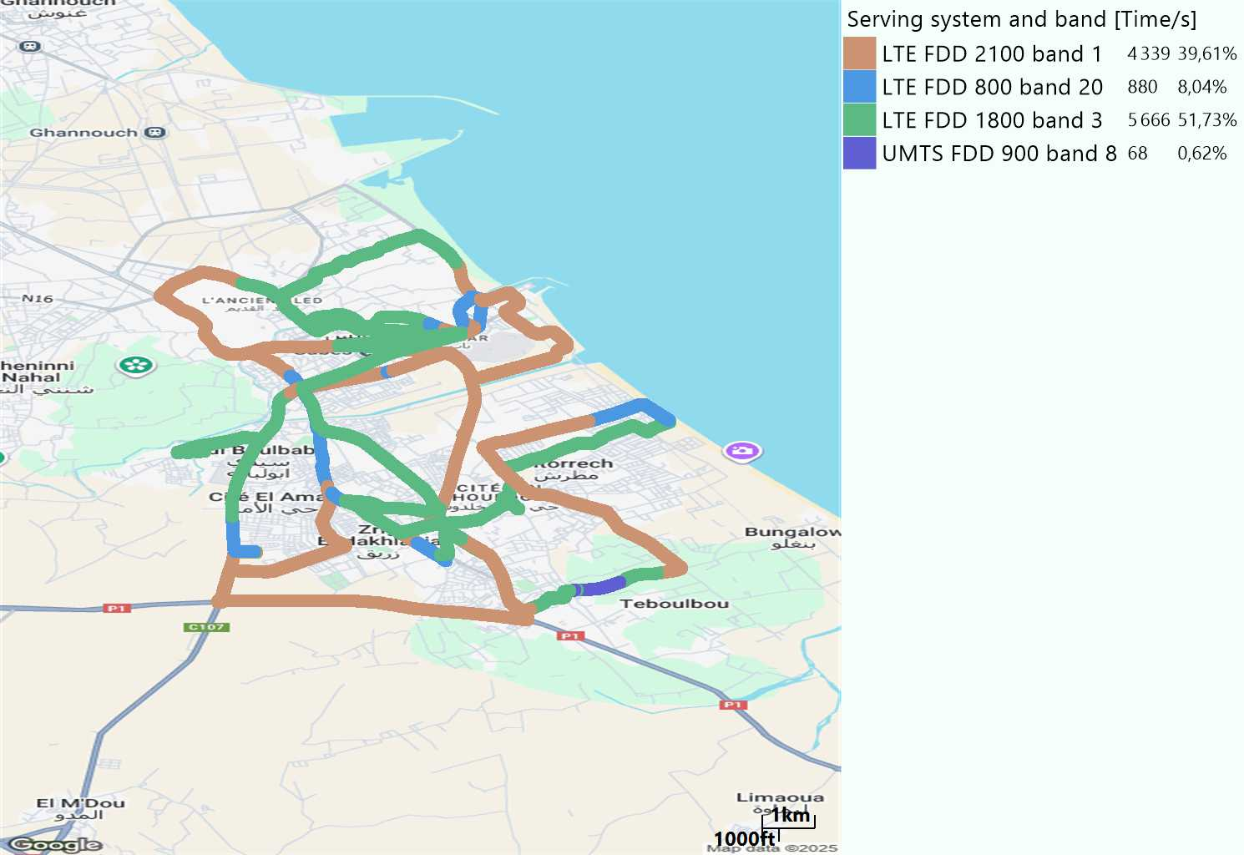
EARFCN distribution
Long call
Short call

Slide 6
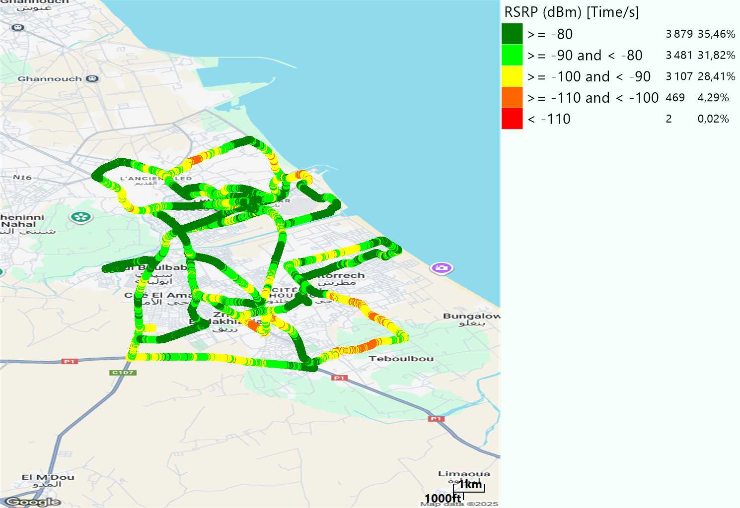
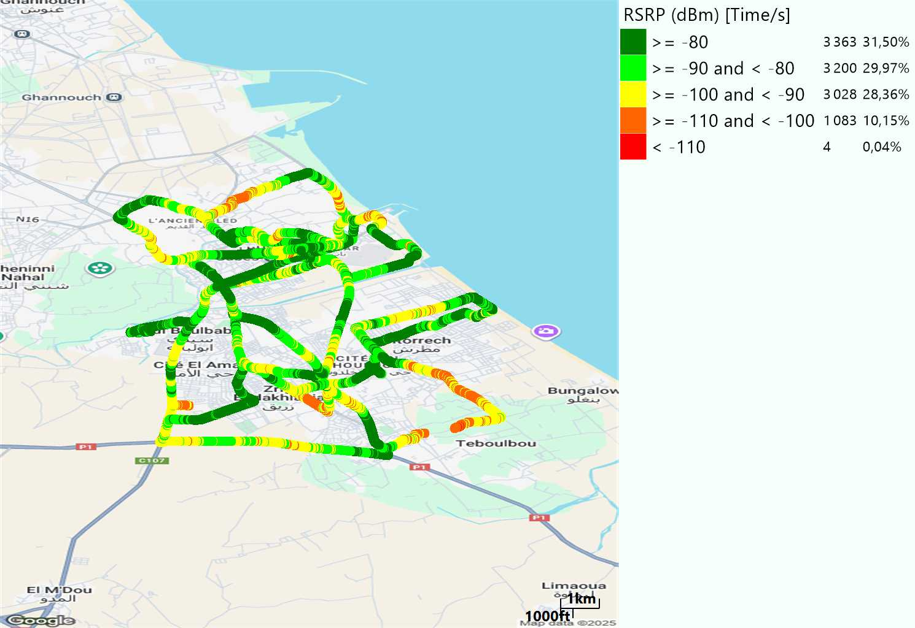
LTE - RSRP
Long call
Short call
Average [dBm]
-84,2
Average [dBm]
-85,76

Slide 7
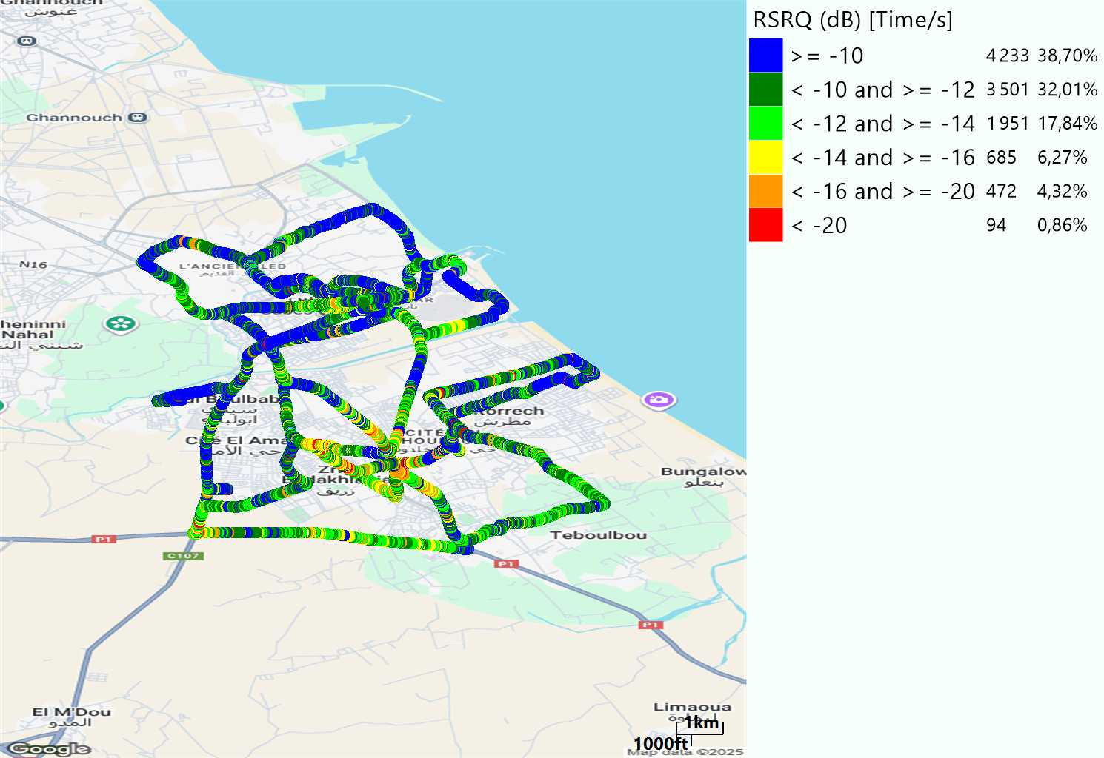
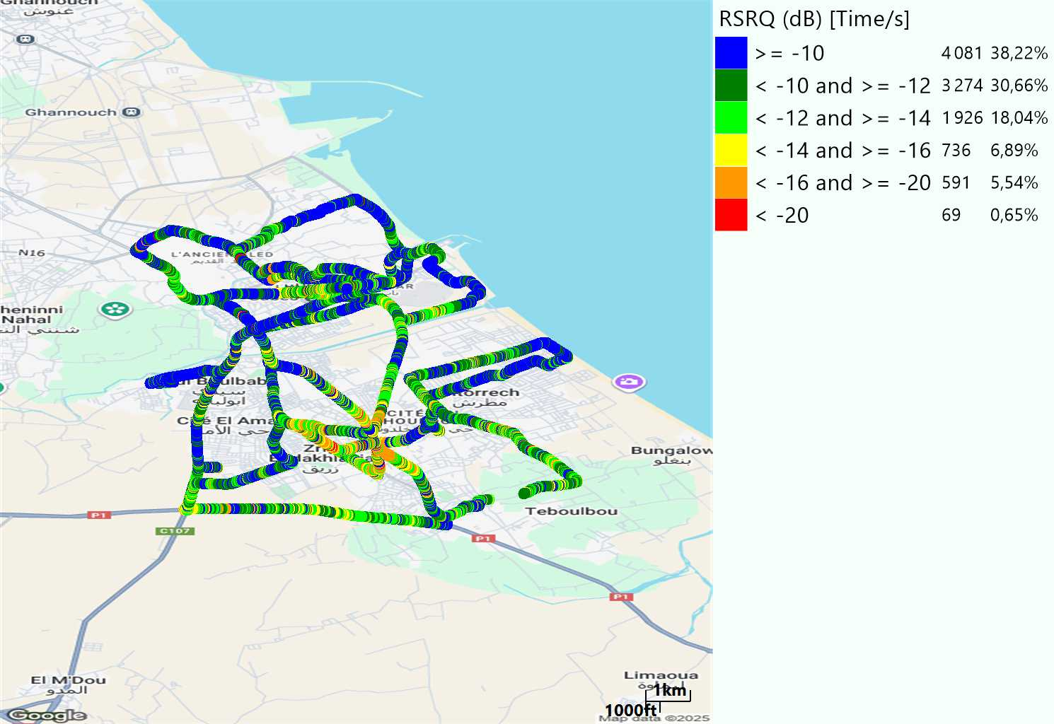
LTE- RSRQ
Long call
Short call

Slide 8
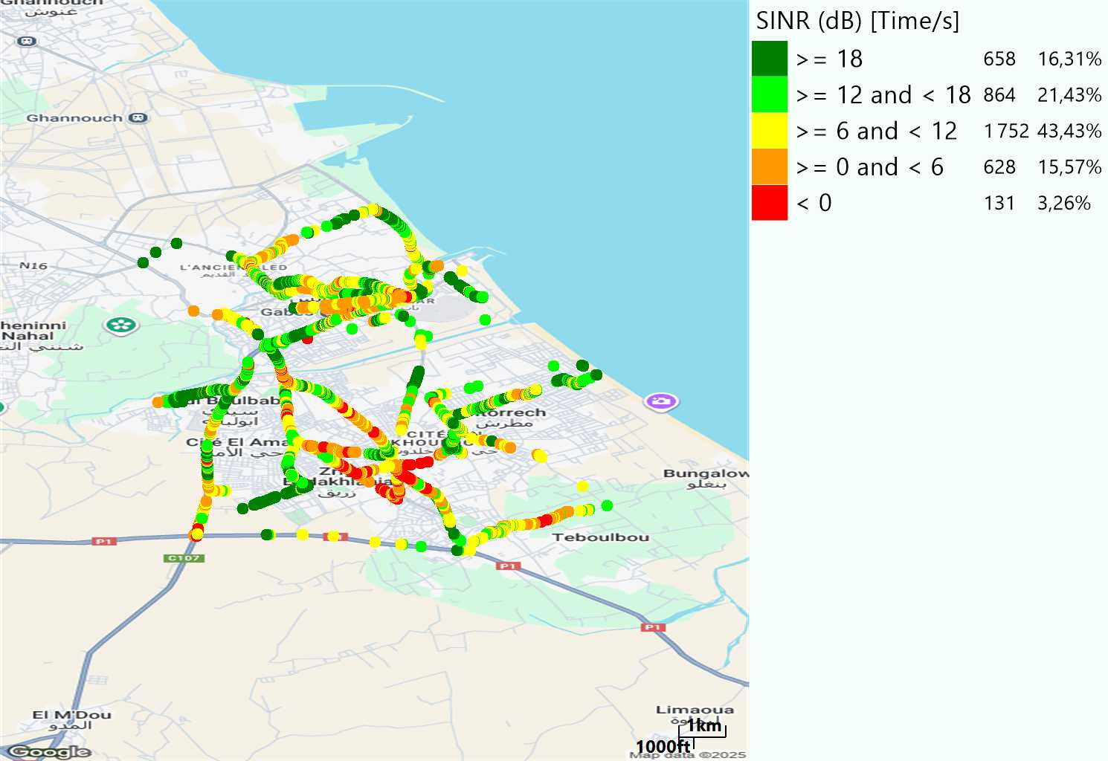
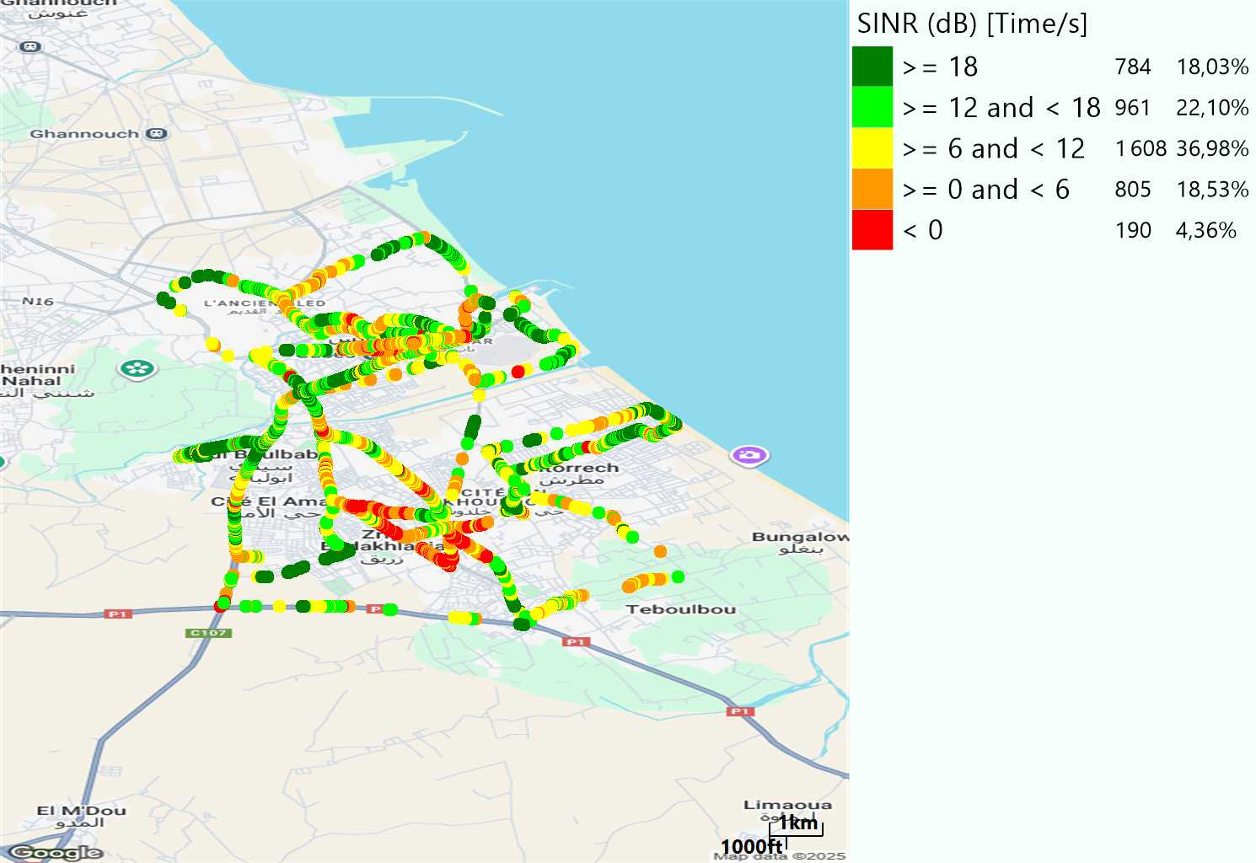
LTE-SINR
Long call
Short call

Slide 9
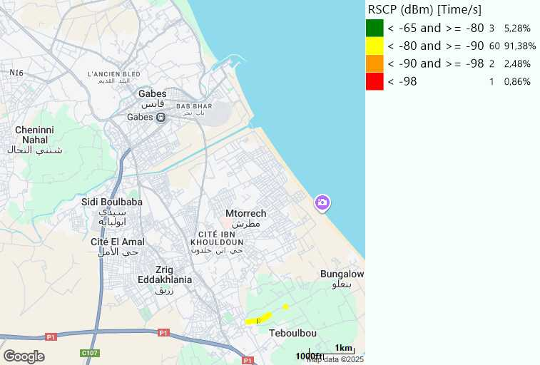
RSCP
Short call

Slide 10
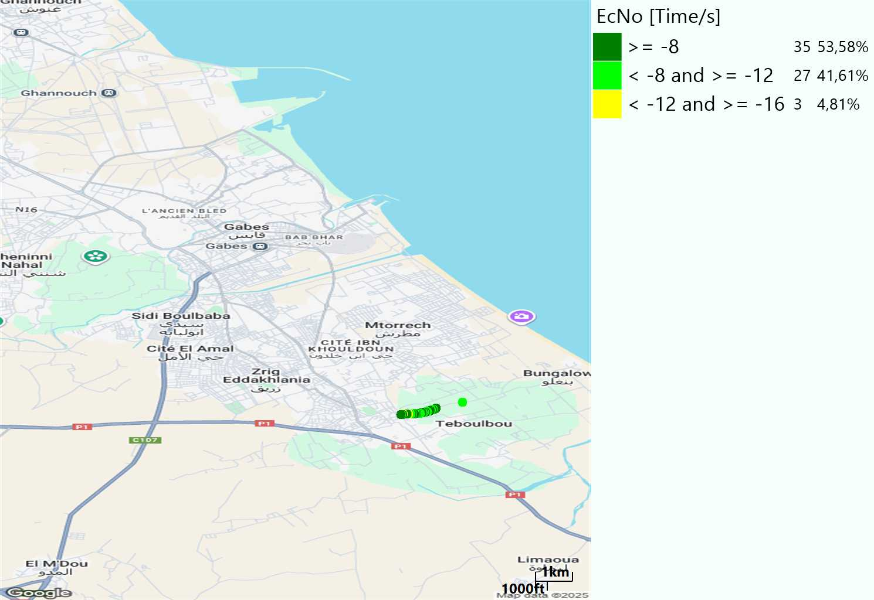
WCDMA-Ec/NO
Short call

Slide 11
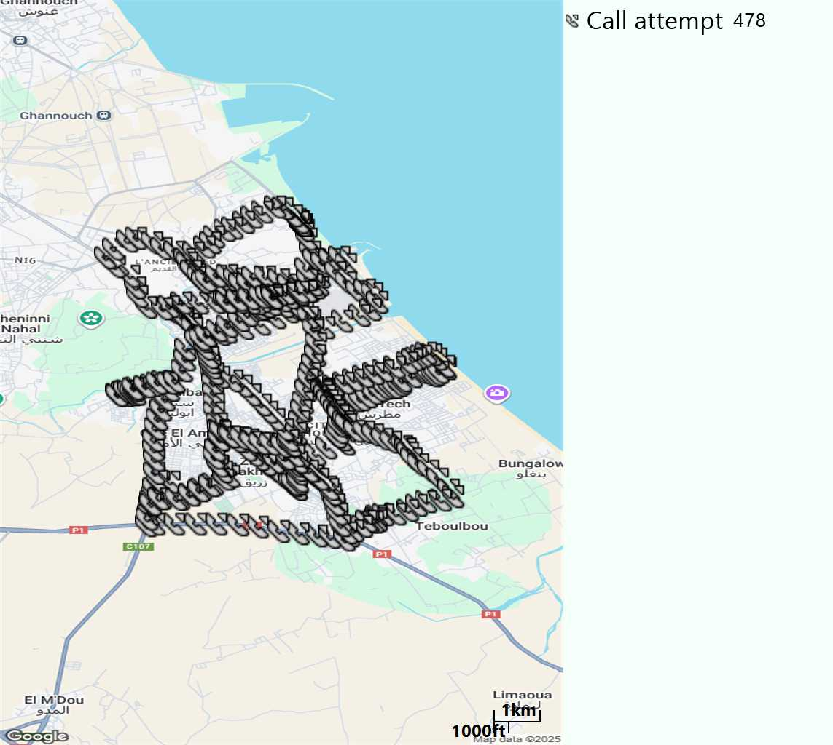
MO Call Setup Time (call setup time in VoLTE)
Short call
Call Setup Time IMS Voice
Average (Sec) | Maximum (Sec) | Minimum (Sec)
2,57 | 6,18 | 1,86

Slide 12
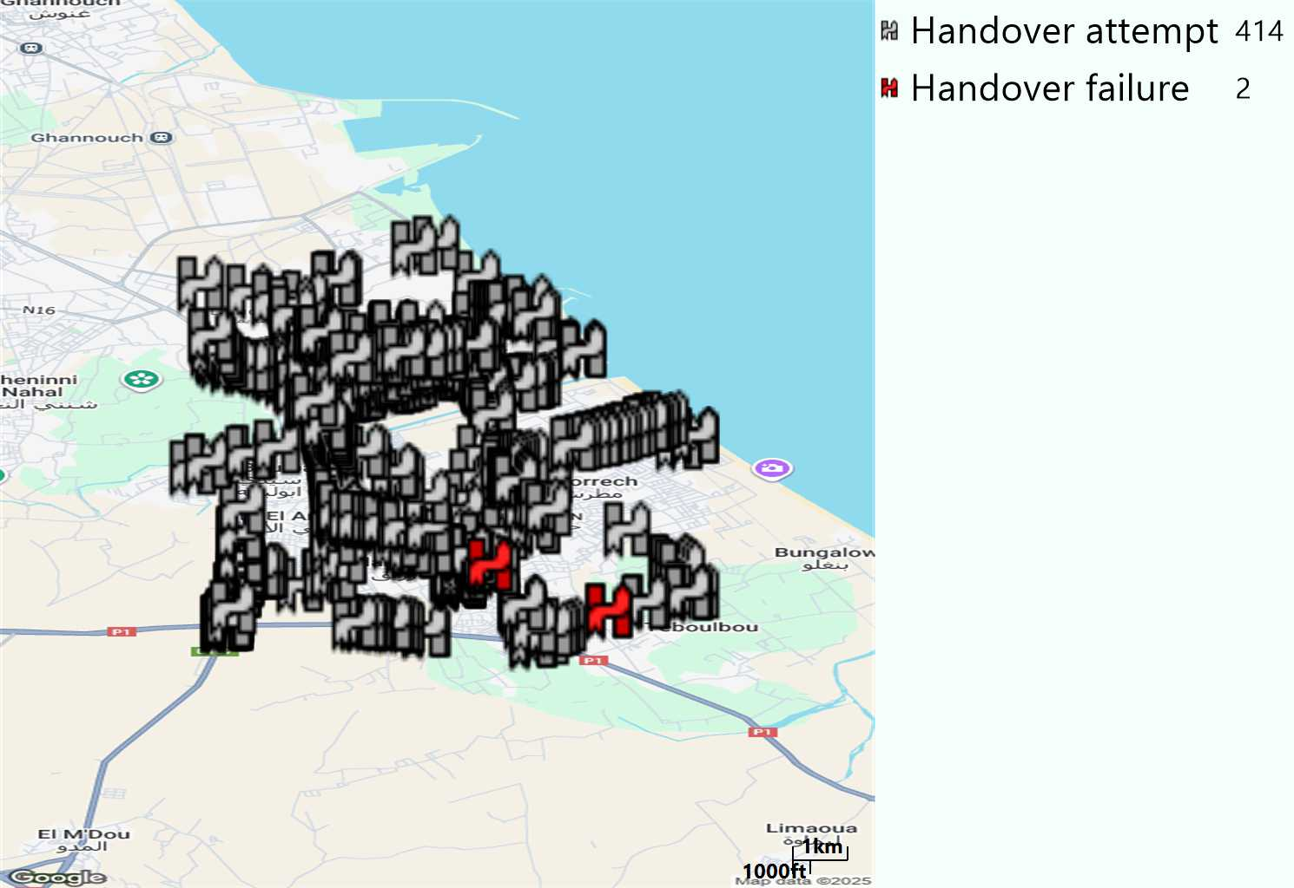
MO Handover Type
Long call
HO Type | Percentage [%]
LTE Inter-Frequency handover | 4,83%
LTE Intra-Frequency handover | 95,17%
Handover KPI’s
Handover Attemps | 414
Handover Success | 412
Handover succès Rate | 99,52%
Étiquettes de lignes | LTE FDD_1800 | LTE FDD_2100 | LTE FDD_800 | Total général
LTE FDD_1800 | 166 | 5 | 3 | 174
LTE FDD_2100 | 4 | 194 | 3 | 201
LTE FDD_800 | 6 | 1 | 32 | 39
Total général | 176 | 200 | 38 | 414

Slide 13
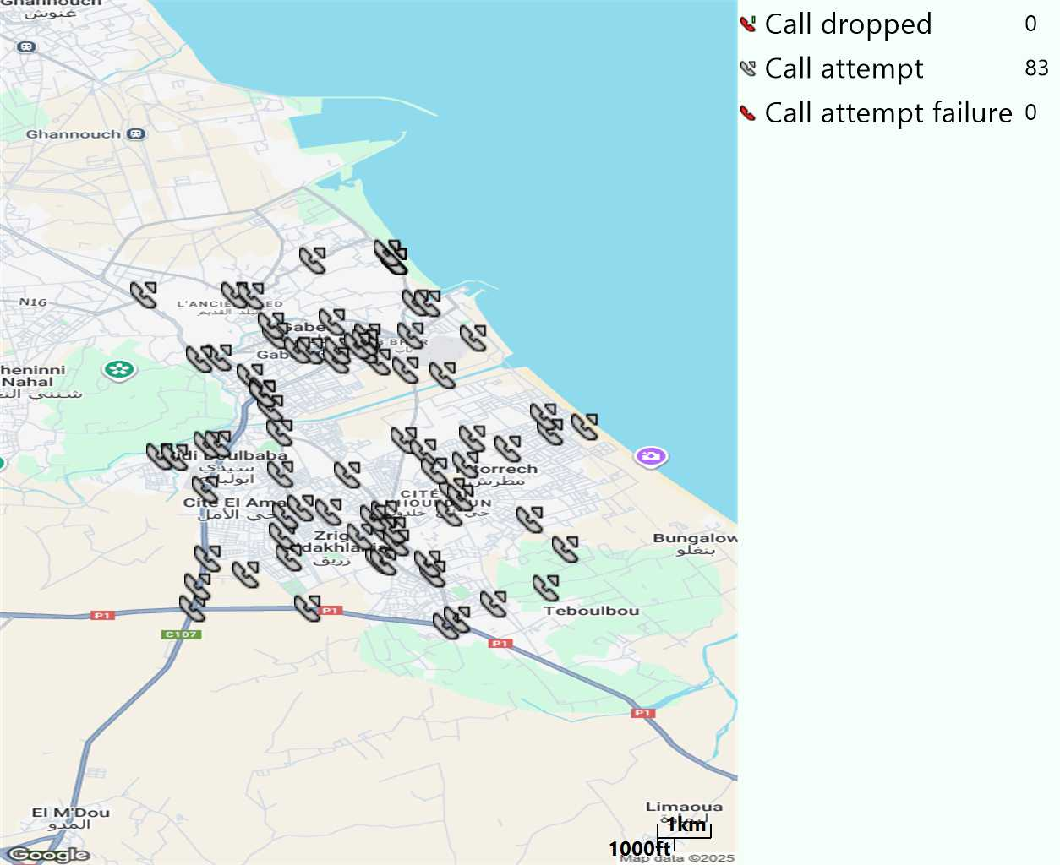
MO Voice Stats (VoLTE call stats)
Long call
Voice KPIs
Number Call Attempts | 83
Number Dropped Calls | 0
Call Drop Rate (%) | 0%
HO success rate | 99,52%

Slide 14
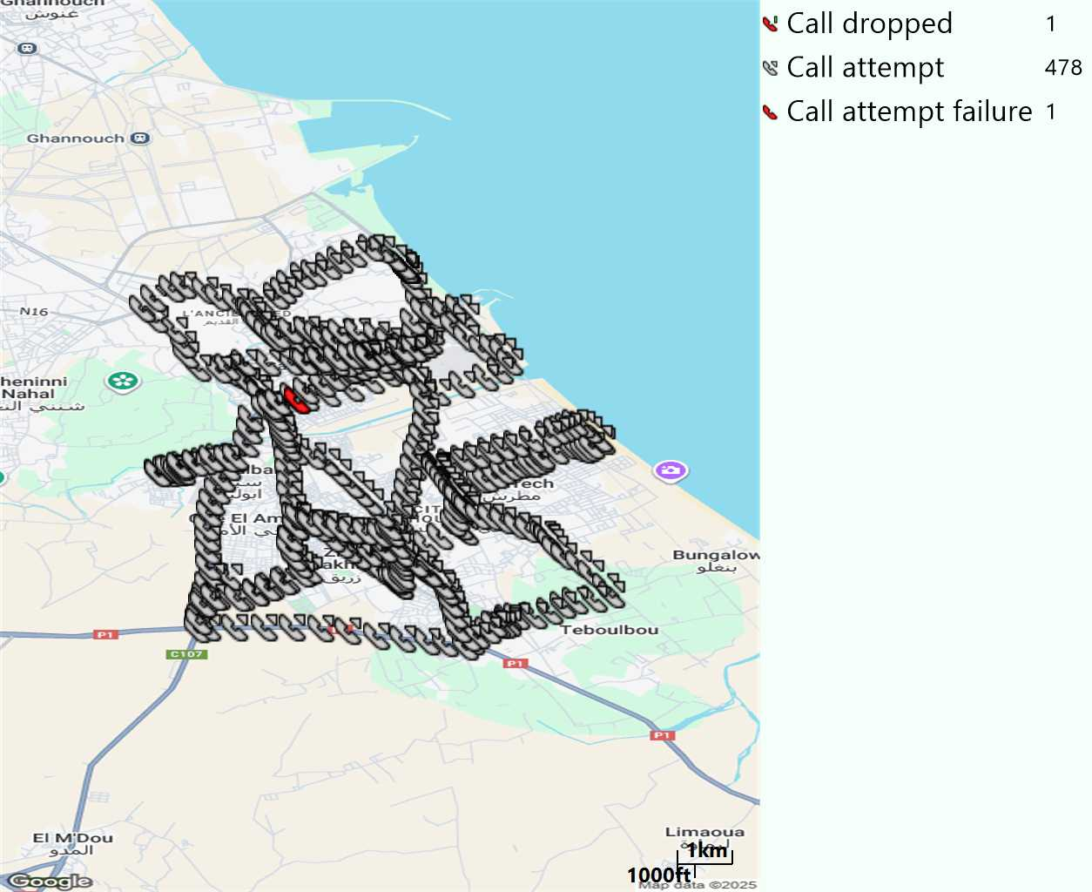
MO Voice Stats (VoLTE call stats)
Short call
Voice KPIs
Number Call Attempts | 478
Number Call Setup | 477
Number Blocked Calls | 1
Setup Succes Rate (%) | 99,79%
Call Block Rate (%) | 0,21%
Call Setup Time IMS Voice Average (Sec) | 2,57

Slide 15
MO Voice Stats (VoLTE call stats)
KPIs
VoLTE Call Setup SR | 99,79%
Call Setup Time | 2,57
VoLTE Drop Call Rate | 0%
Speech Quality - MOS (% of the samples >3,5) | 91,96%
Average MOS | 4,17
VoLTE Handover SR | 99,52%
VoLTE SRVCC SR | -

Slide 16
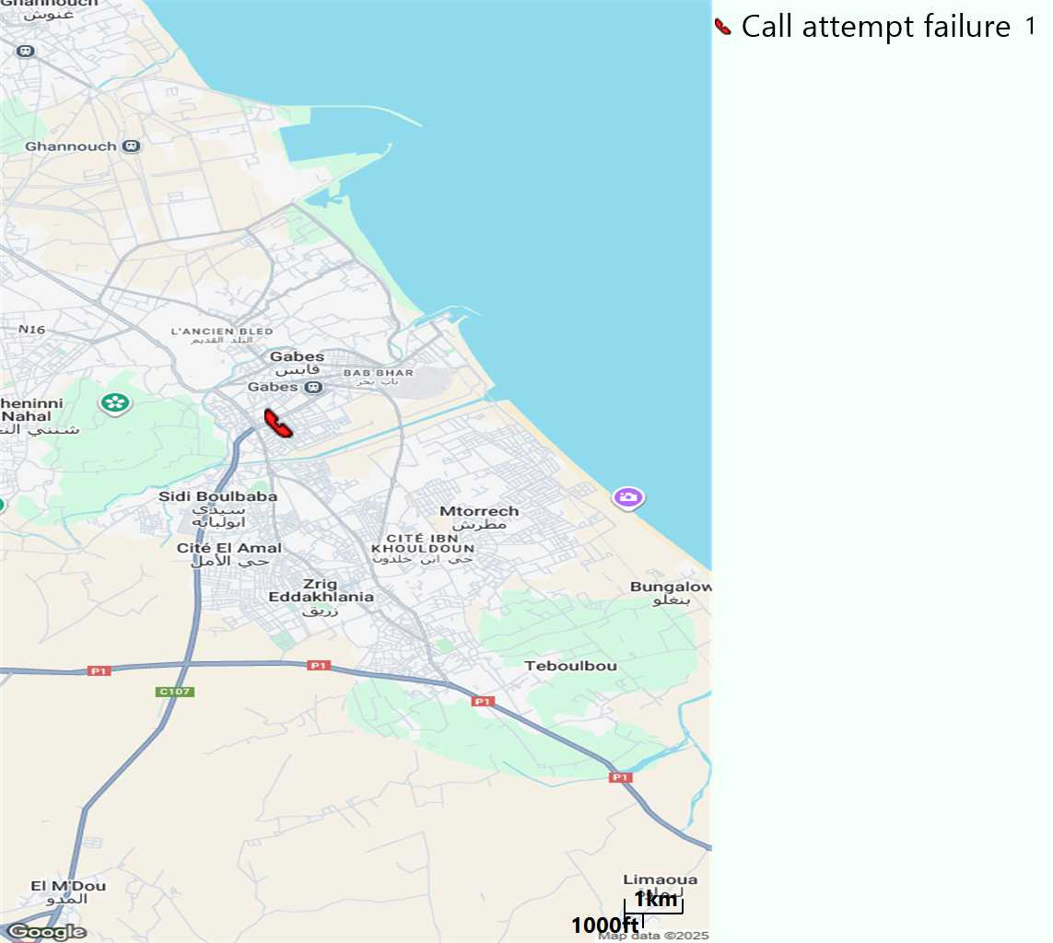
MO Voice Call - Blocked call
Short call

Slide 17
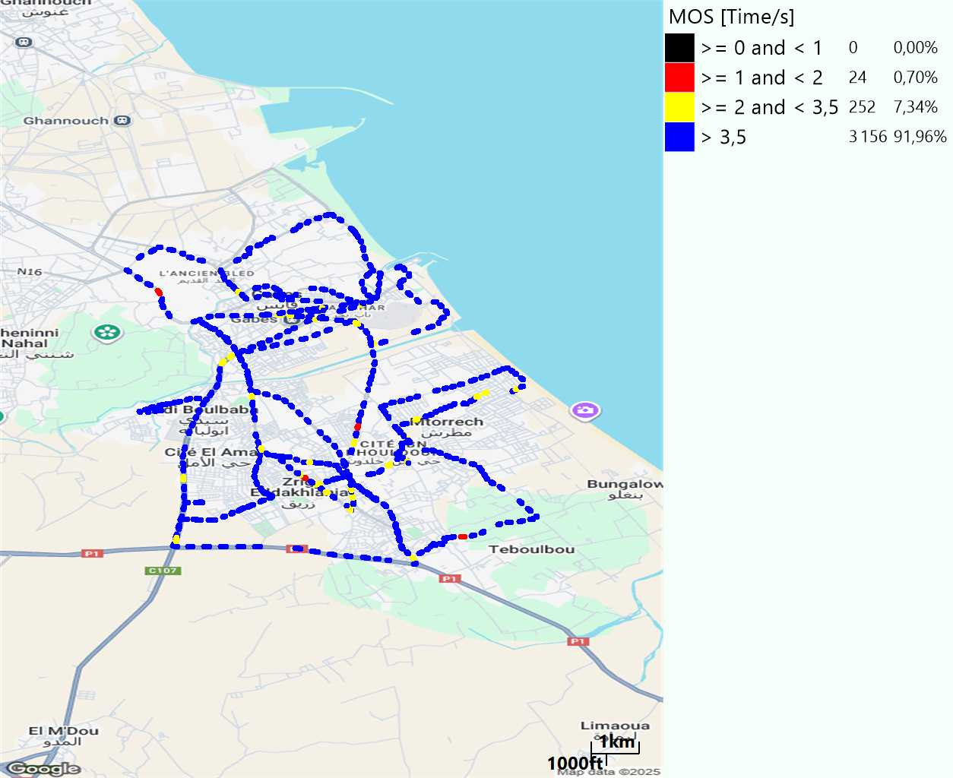
MO Voice Quality Metrics
long Call

Slide 18
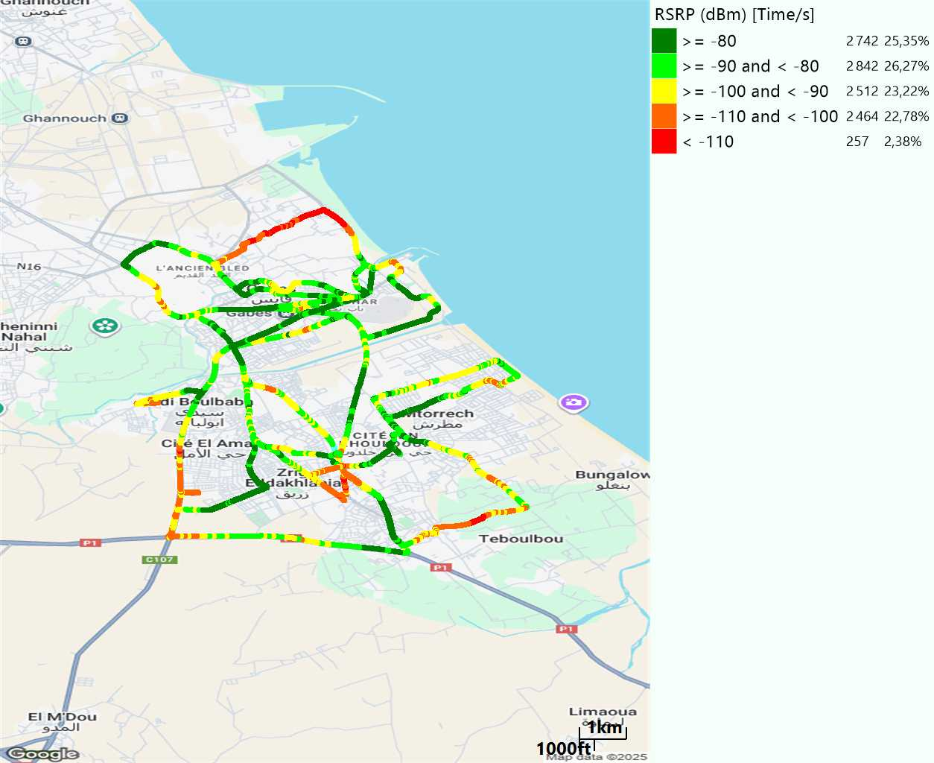
Scanner_RSRP
L2100

Slide 19
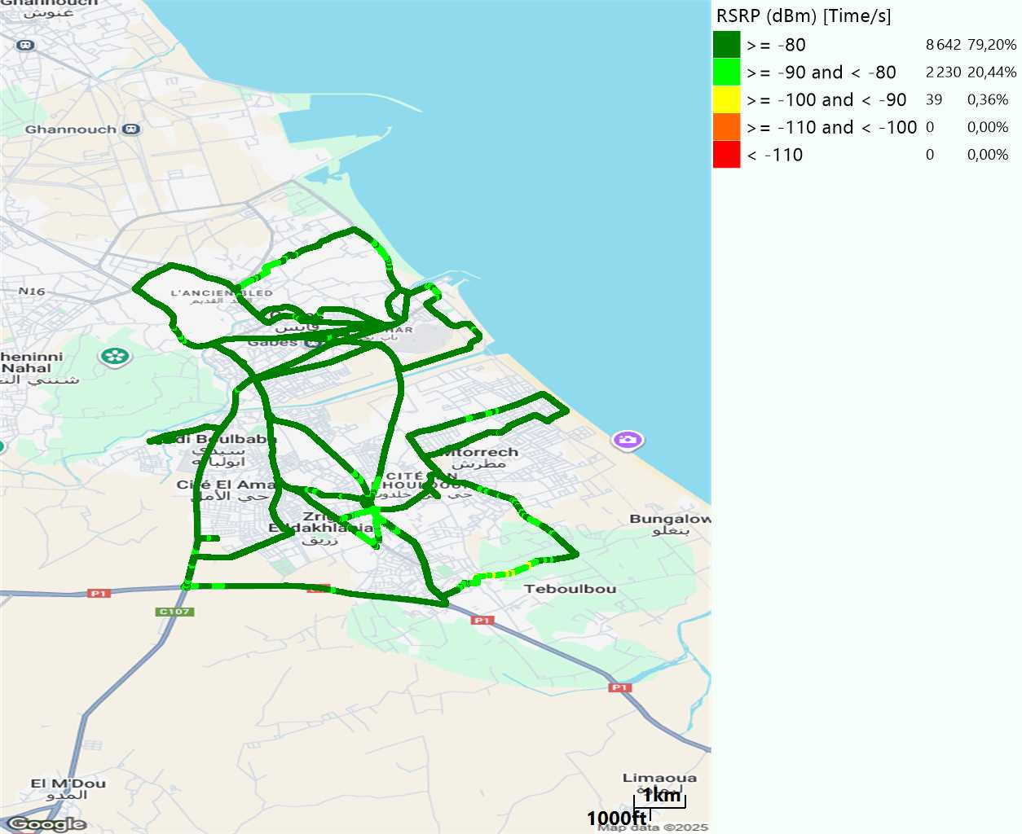
Scanner_RSRP
L800

Slide 20
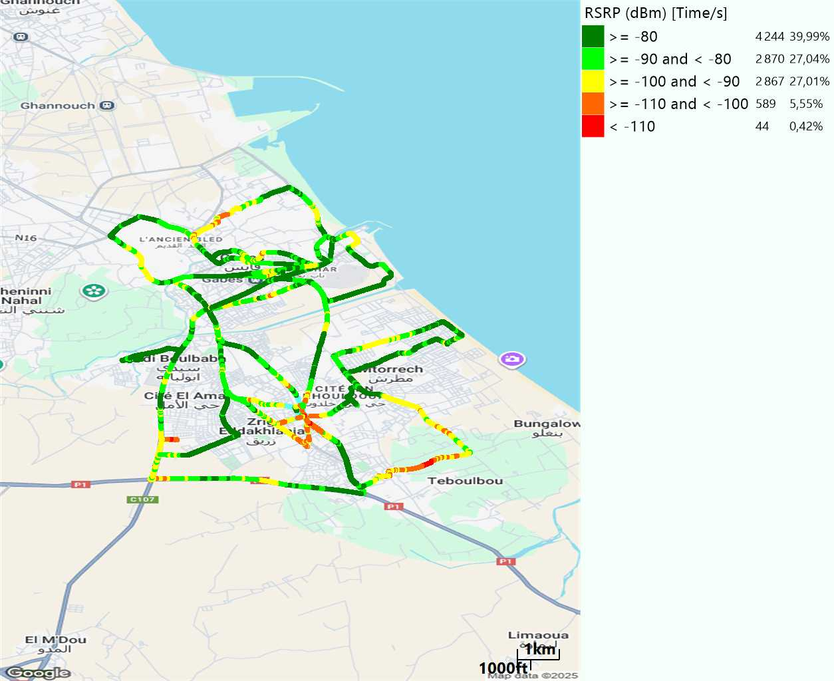
Scanner_RSRP
L1800

Slide 21
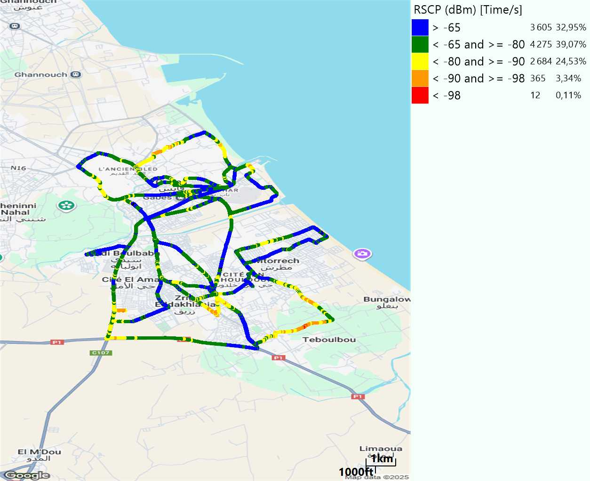
Scanner_RSCP
U2100

Slide 22
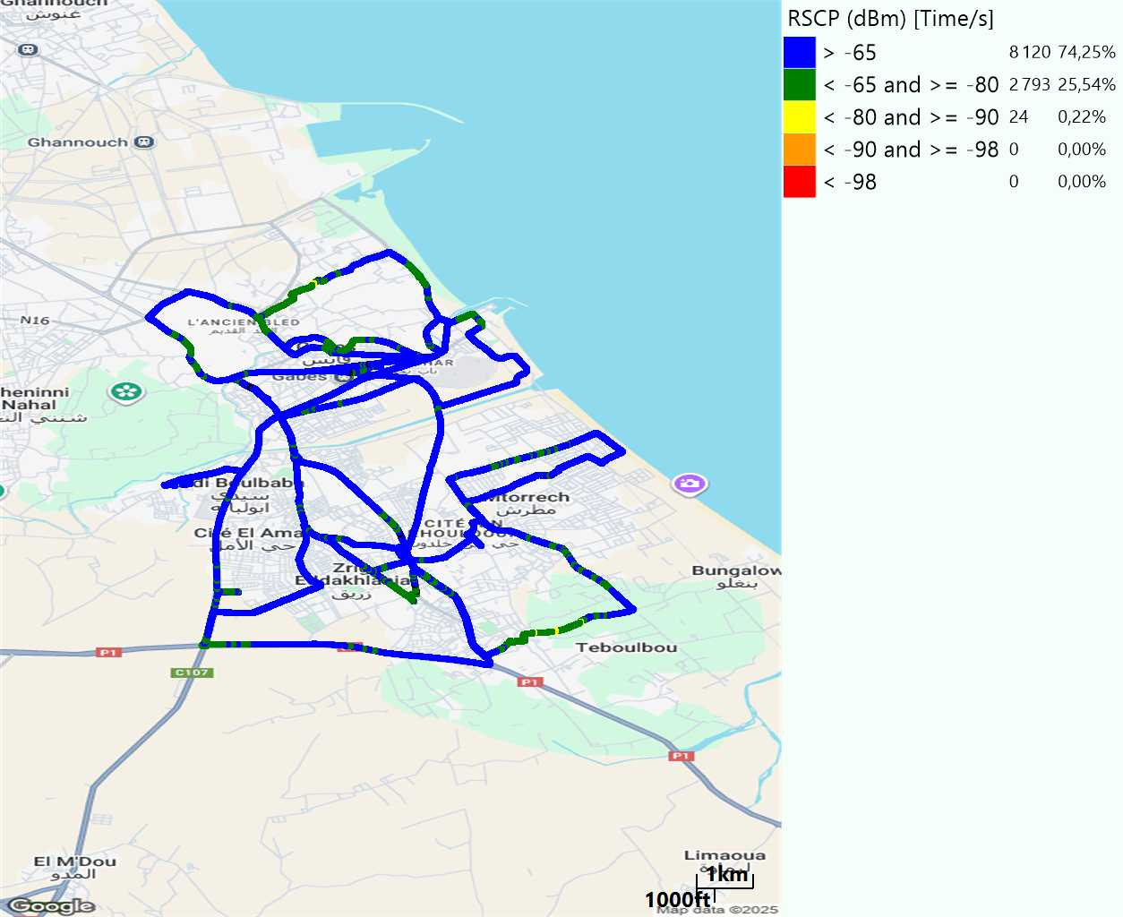
Scanner_RSCP
900

