Slide 1


Drive_Test Report
Autoroute-Jammel-Tunis
November 18th 2024

Slide 2
DT Scénario
Un mobile CS continuos call mode free 2G/3G/4G

Slide 3
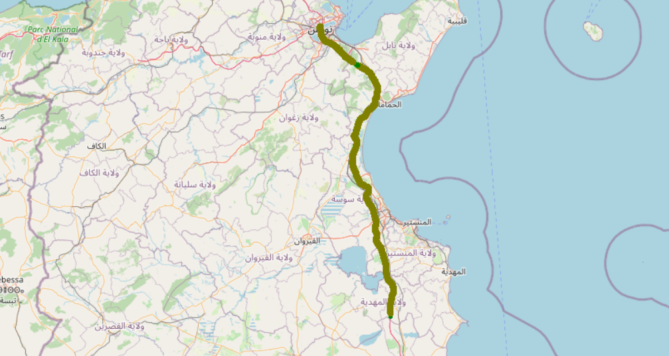

Serving Band

Slide 4
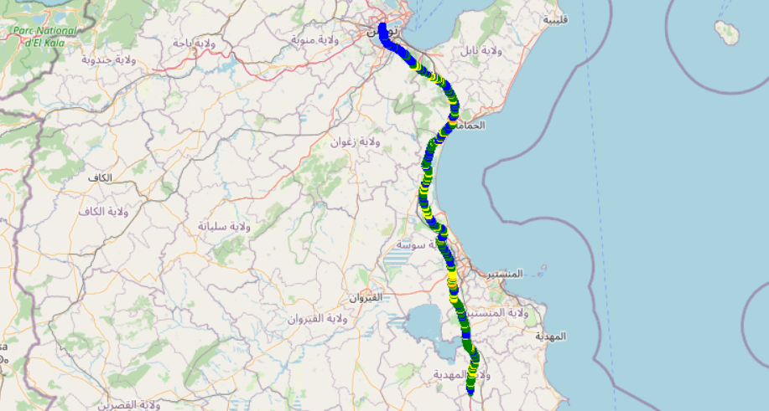
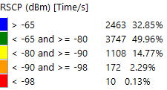
RSCP
Parameter | 1. CS continious call
RSCP active set measurement average (en dBm) | -69,85

Slide 5
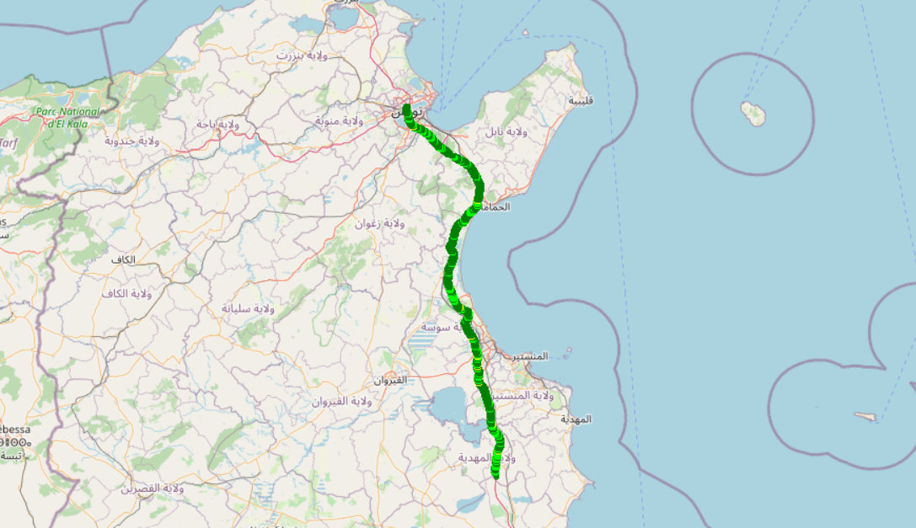
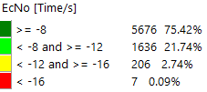
EC/N0
Parameter | 1. CS continious call
EC/N0 measurement average (en dBm) | -9,5

Slide 6

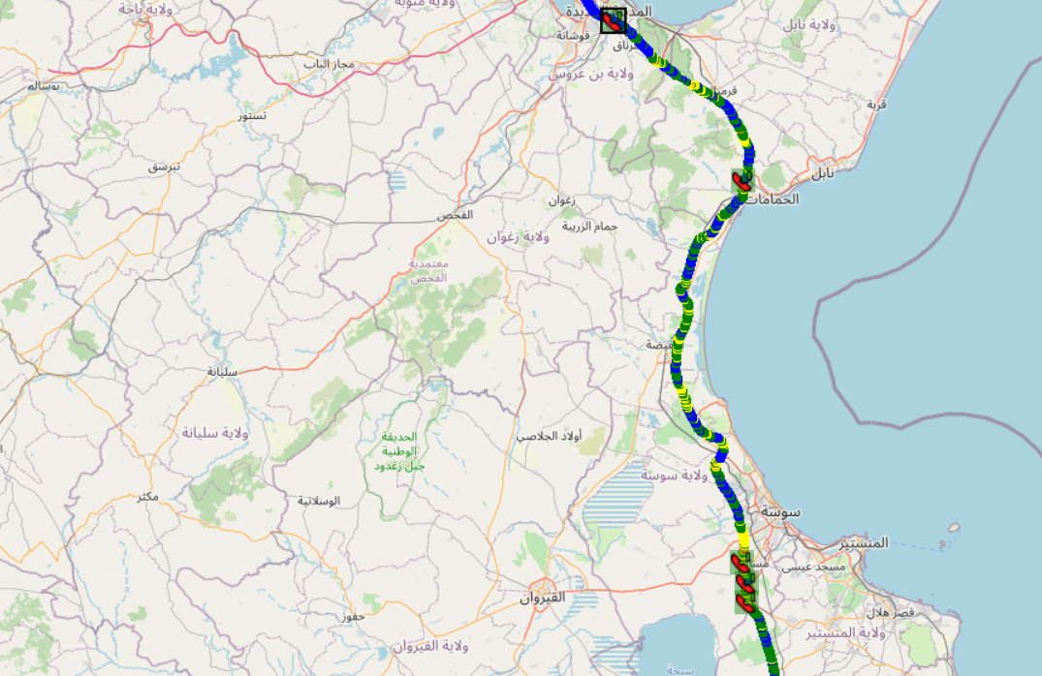
Voice Call Drop + RSCP

Slide 7
Call Drop Position
Event | Network cause | Event | Time | System | Serving band | Call type | Call direction | CS call dur. | Call duration (s) | Lon. | Lat. | Cell ID
Call dropped | undefined | 1 | 51:51,8 | UMTS FDD | 2100 | Voice call | Originated call | 28:51,5 | 1731 | 10,56337 | 35,6577 | 21095
Call dropped | undefined | 2 | 55:23,8 | UMTS FDD | 2100 | Voice call | Originated call | 02:47,3 | 167 | 10,56408 | 35,69302 | 21145
Call dropped | Normal, unspecified | 3 | 58:25,4 | UMTS FDD | 2100 | Voice call | Originated call | 02:54,2 | 174 | 10,55288 | 35,73187 | 21146
Call dropped | undefined | 4 | 50:33,5 | UMTS FDD | 2100 | Voice call | Originated call | 52:00,8 | 3120 | 10,55536 | 36,43075 | 20273
Call dropped | undefined | 5 | 17:38,5 | UMTS FDD | 2100 | Voice call | Originated call | 26:57,7 | 1617 | 10,26139 | 36,722 | 306

