Slide 1


TT OPTIMIZATION PROJECT REPORT
2G 3G 4G OPTIMIZATION AREA :
SOUSSE
MONASTIR
MAHDIA
KAIROUAN
ERICSSON RAN TEAM
ERICSSON TUNISIA
2023-12-20

Slide 2
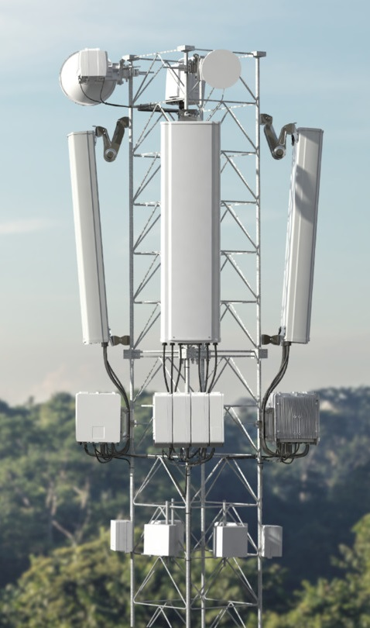
Agenda
WORKING ZONE
PROJECT ORGANIZATION
WHAT WAS DONE ( Week 38 ,Week 48,Week 49,Week 50)
COMMENTS AND RECOMMENDATIONS
CONTRACTUAL KPIS
KPIs PROGRESS IMPROVEMENT
CELL AVAILABILITY & HW ISSUE STATUS
AUDIT SAMPLE ACTION RESULT
PERFORMANCE ACTIONS
CR STATUS
NEXT ACTION PLAN
QUESTIONS

Slide 3
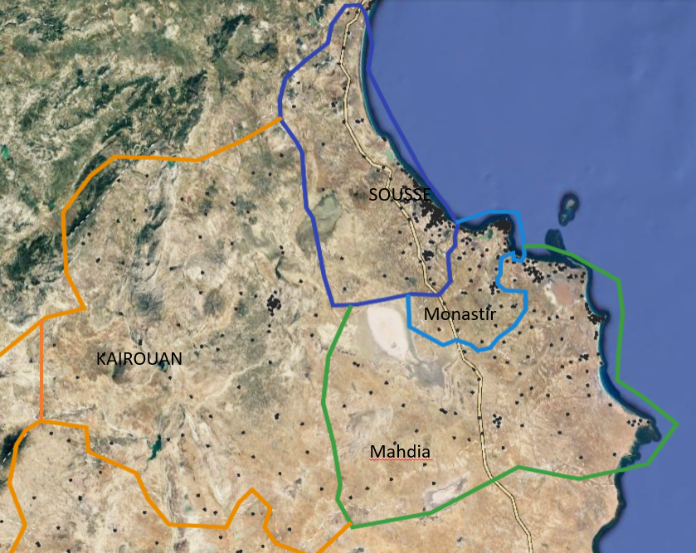
WORKING ZONE
Region/sites | 2G | 3G | 4G | Total sites | AREA KM2
Sousse | 161 | 171 | 156 | 488 | 2 669 km²
Monastir | 137 | 147 | 123 | 407 | 1 019 km²
Mahdia | 92 | 100 | 80 | 272 | 2 966 km²
Kairouan | 97 | 95 | 88 | 280 | 6 712 km²

Slide 4
PROJECT ORGANIZATION
CPM RAN
ZIED BARKIA
Technical Lead
Khader Nader (SPOC)
On site
Local Optimization Support
Driss Tahiri
3G 2G OPTIMIZER
Saptono Gunawan
4G OPTIMIZER
Vladimir Zalomov
Drive test Team
On demand
Local Integration Team (CR) +Rollout TEAM
Bilal Laatat/Mahdi Kzadri (CR/Troubleshooting/ Support)
Samih Akremi (IM)
Mahemd Louizir (Support)
Remote Team :
2G OPT Nikola Lunko
3G OPT Vedran Kovacic
3G2G OPT Silvestar Kamber
4G OPT Bozidar Lupic/David Krizmanic
3G OPT Zrinoslav Martic
3G OPT Marko Glavas
Remote

Slide 5
WHAT WAS DONE
Network Planning Audit :
RF DESIGN AUDIT ( 3G PSC , 4G PCI , 2G BCCH ,LAC,RAC,TAC : Correction of collision and conflict)
2G 3G 4G neighboring Plan Audit (493 2G to 3G ,340 3G to 3G, 4G ANR tuning)
Audit CGI CORE BC definition
Network HW/Transmission Issues :
Identify Top Worst cells Due HW/Transmission/Synchro/Power_outage issues ( Continuous Activity)
Features & Parameters Alignment :
2G 3G 4G Optional Features Activation Plan
2G 3G 4G features Audit (basic and optional)
2G 3G 4G Parameters Alignment and Audit
Mobility Strategy :
2G 3G 4G IDLE/Mobility Strategy Proposal ( shared & meeting organized)

Slide 6
WHAT WAS DONE
WHAT WAS DONE ON WEEK 46:
Tuning parameter 2G and 3G related Mobility and Retainability partially done on W46, will continue based on Worst performing cells analysis.
Add NB adjacencies 2G-2G, 2G-3G, 3G-3G partially done to improve HOSR and DCR due to HO on BSOUEVO, BMOKEVO. Will continue based on worst performing cells.
Optimize Parameter related Retainability, accessibility and mobility (BsRXMIN, MSRXMIN, HoType, usedFreqThresh2dEcno, usedFreqThresh2dRscp, HoType) based on worst performing analysis.
Optimize Idle Parameter/Selection Re-selection to improve Accessibility CS and PS.
Escalated IUB Congestion on several sites to customer (detail sites on the last slide).
Escalated sites have HW iisues, alarm related HW.
3G PS Drop initial analysis, with result need to improve availability issues in Kairouan(Reducing celldowntime), Transport congestion will reduced RAB Failures and RRC Failures.
2G Re-dimensioning SDCCH included SDCCH shifted to better Rxqual.
Optimize Irat parameter, Isho parameter, Shoft Handover Parameter to improve Mobility.
Tunning BCCH for several cells in Sousse and Kairouan to improve accessibility and retainability.
Tuning T313, Maxactiveset, RadioLinktimeout to improve accessibility and retainability
Changing configuredMaxTxPower for alignment LTE RS RE Power on Urban area on cells with high DCR
Reactivating features Accelerated Inter-Frequency Load Balancing in Sousse
Tuning parameters for improving Accessibility and Retainability on worst cells
Adding internal G2G relations for sousse area
Adding F2 10738 frequncy in 2G report measurement for fast returning to 3G in Sousse
Msrxmin and Bsrxmin tuning for top worst cell in term of number of TCH drops in SOUSSE area
Lte Eutran Cell Relations blacklisting and Offsets setting tuning for Sousse and Kairouan

Slide 7
WHAT WAS DONE
WHAT WAS DONE ON WEEK 47:
Changing configuredMaxTxPower for alignment LTE RS RE Power on Urban area on cells with high DCR
Reactivating features Accelerated Inter-Frequency Load Balancing in Sousse
Tuning parameters for improving Accessibility and Retainability on worst cells
Tuning parameter 2G and 3G related Mobility and Retainability partially done on W47, will continue based on Worst performing cells analysis.
Add NB adjacencies 2G-2G, 2G-3G, 3G-3G partially done to improve HOSR and DCR due to HO on BSOUEVO, BMOKEVO. Will continue based on worst performing cells.
Optimize Parameter related Retainability, accessibility and mobility (BsRXMIN, MSRXMIN, HoType, usedFreqThresh2dEcno, usedFreqThresh2dRscp, HoType, Gamma, SAS, RET, PSC) based on worst performing analysis.
Optimize Idle Parameter/Selection Re-selection to improve Accessibility CS and PS.
Escalated sites have HW iisues, alarm related HW.
Optimize Irat parameter, Isho parameter, Shoft Handover Parameter to improve Mobility(continuing).
Tunning BCCH, BSIC and DCHNO for several cells in Sousse and Kairouan to improve accessibility and retainability partially done, will continue.
Deactivate Feature CtrlFDpchSrbOnHsdpa, CtrlHsdpaMcInactCtrl .
Tuning parameter standAloneSrbSelector.

Slide 8
WHAT WAS DONE
WHAT WAS DONE ON WEEK 48:
3G :
Add NB adjacencies 3G-3G done to improve HOSR and DCR due to HO on 4 regions .
Deactivate feature CtrlFDpchSrbOnHsdpa, CtrlHsdpaMcInactCtrl for Monastir and Mahdia
Tuning parameter ReleaseRedirectEutraTriggers for Monastir, Sousse Mahdia.
Uerc adjustment in accordance with E// recommendations.
Tuning Call Reestablishment to be aligned with recommended value for MOKEVO1 RNC.
Optimize Irat parameter, Isho parameter, Shoft Handover Parameter to improve Mobility(continuing, cell level).
Optimize Idle Parameter/Selection Re-selection to improve Accessibility CS and PS.
2G:
2G Codec Tunning in Sousse, Monastir, Kairouan. ( BSC level)
GPRS DL Power Control algorithm) based on worst performing analysis.
Tunning BCCH, BSIC and DCHNO for several cells in Sousse, Monastir and Kairouan to improve accessibility and retainability partially done,
Optimize Idle Parameter/Selection Re-selection to improve Accessibility CS and PS.
4G:
Activating Multiple Frequency Band Indicators, Prioritized SR Scheduling and Downlink Coordinated Multi-Point on the sites in all regions (CR raised)
Tuning parameters a5Threshold2Rsrq and a5Threshold2Rsrq for improving Lte mobility on the worst cells.

Slide 9
WHAT WAS DONE
WHAT WAS DONE ON WEEK 49:
3G :
Add 3G-3G missing NB Relation in SOURNC1, MOKEVO1.
Corrected 2G and 3G External Cell in 2G, Tuning parameter related IRAT.
Tuning IRAT parameter (threshold 2d, priorityrelation)
Tuning SF_Adm in KRNRNC1.
Tuning UeRC parameter, releaseRedirectEutraTriggers in Sousse, Monastir, Mahdia and Kairouan.
Tuning CPICH Power in Sousse, Monastir and Mahdia.
Tuning Parameter Utrancell in Sousse, Monastir, Mahdia and Kairouan.
Tuning Parameter dlcodepowercmenabled in Worst Cell List Sousse.
2G:
Add 2G missing NB to 3G And 2G-2G missing NB in Monastir, Sousse, Mahdia.
Implement 2G Features Advance UL Power Control in Kairouan and Sousse
Tuning 2G and 3G RET in Monastir, Mahdia.
Tuning 2G Idle Mode Parameter for Worst Cell list.
Activated feature ReducedPowerLevelAfterHandover in Sousse.
4G:
Activating features Prioritized SR Scheduling, Downlink Coordinated Multi-Point, Dynamic Uplink Resource Allocation, Dynamic Pucch on the sites in all regions
Tuning parameters a5Threshold2Rsrq, cellIndividualOffsetEUtran, isHoAllowed for improving Mobility on the worst cells
Changing parameters electricalantennaTilt, configuredMaxTxPower for improving DCR on the worst cells.

Slide 10
WHAT WAS DONE
WHAT WAS DONE ON WEEK 50:
2G:
Tuning DCHNO parameter in Monastir.
Implement 2G Features Advance UL Power Control in Mahdia.
Trial Feature GPRS/EGPRS DL Power Control in Mahdia.
Trial Feature Efficiency Packet Data & Expanded_PDCH_address_space in Kairouan..
Tuning ChannelGroup parameter related GPRS in SOUSSE.
3G:
Add 3G-2G missing NB Relation in SOURNC1, MOKEVO1, KRNRNC1, SOUEVO1.
Tuning IRAT parameter (threshold 2d, priorityrelation, hotype).
Tuning Parameter Utrancell in Sousse.
Tuning RET and parameter in SOUEVO1 and MOKEVO1.
Delete 3G-2G un-necessary relation in Monastir.
4G:
Alignment features ThreeDlCarrierAggregation, Prioritized SR Scheduling, Dynamic Uplink Resource Allocation, Dynamic Pucch, AnrFunction on the sites in all regions
Alignment parameters isHoAllowed, isRemoveAllowed, loadBalancing, sCellCandidate on EUtranCellRelations
Added missing frequency on EUtranFreqRelation
Audit EUtranCellFDD parameters

Slide 11
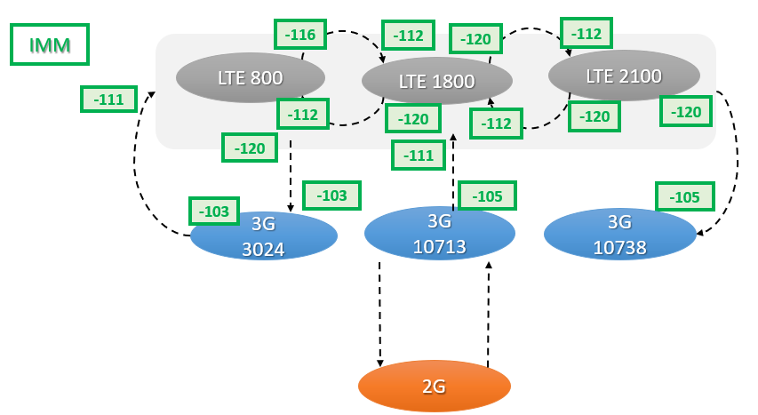
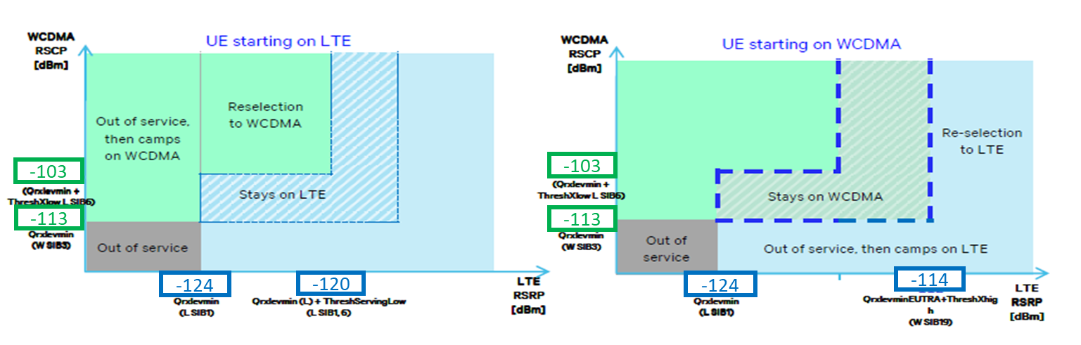
WHAT WAS DONE
Testing New Idle Mobility Strategy in the Test Cluster
CR 4G_039, 20231102_CR_4G_IdleMM_Test_zone_Kairouan - changing 4G <-> 4G parameters, implemented on 11/02/2023.
CR 4G_046, 20231106_CR_4G_IdleMM_Test_zone_part2_Kairouan – changing 4G -> 3G parameters, implemented on 11/07/2023.
CR 4G_051, 20231110_CR_4G_configuredMaxTxPower_Test_zone_Kairouan – aligning LTE RS RE Power to BaseLine value, implemented on 11/13/2023.
CR 4G_054, 20231115_CR_4G_configuredMaxTxPower_Test_zone_part2_Kairouan – aligning LTE RS RE Power in Urban/suburban sites between different bands, implemented on 11/20/2023.

Slide 12
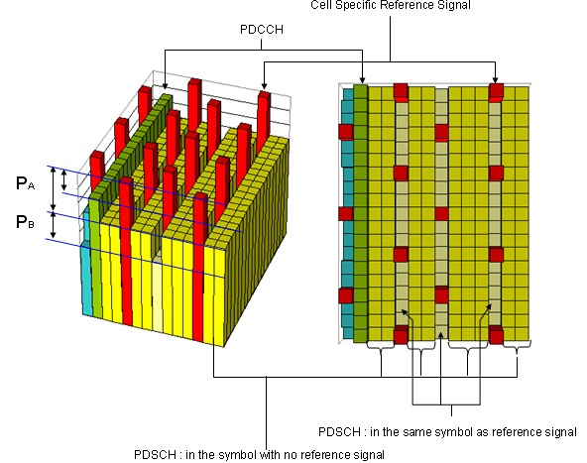
COMMENTS & RECOMMENDATION
4G LTE RS RE Power
Current value LTE RS RE Power on the Network
EARFCN/Bandwidth | MIMO | configuredMaxTxPower | Power per Port, W | LTE RS RE Power, dBm
6200 (10MHz) | 2X2 | 60000 | 30 | 19.9897
 |  | 80000 | 40 | 21.2391
 |  | 100000 | 50 | 22.2082
251 (10MHz) | 2X2 | 40000 | 20 | 18.2288
1350 (20MHz) | 2X2 | 120000 | 60 | 19.9897
 |  | 140000 | 70 | 20.6592
 |  | 160000 | 80 | 21.2391
251 (10MHz) | 4X4 | 80000 | 20 | 18.2288
 |  | 120000 | 30 | 19.9897
 |  | 160000 | 40 | 21.2391
1350 (20MHz) | 4X4 | 160000 | 40 | 18.2288
 |  | 180000 | 45 | 18.7403
Better has the similar LTE RS RE Power on cells
EARFCN/Bandwidth | MIMO | configuredMaxTxPower | Power per Port, W | LTE RS RE Power, dBm
6200 (10MHz) | 2X2 | 40000 | 20 | 18.2288
 |  | 60000 | 30 | 19.9897
251 (10MHz) | 2X2 | 40000 | 20 | 18.2288
1350 (20MHz) | 2X2 | 80000 | 40 | 18.2288
 |  | 120000 | 60 | 19.9897
251 (10MHz) | 4X4 | 80000 | 20 | 18.2288
1350 (20MHz) | 4X4 | 160000 | 40 | 18.2288
For example the same LTE RS RE Power for cells in Urban/suburban, and Rural areas

Slide 13
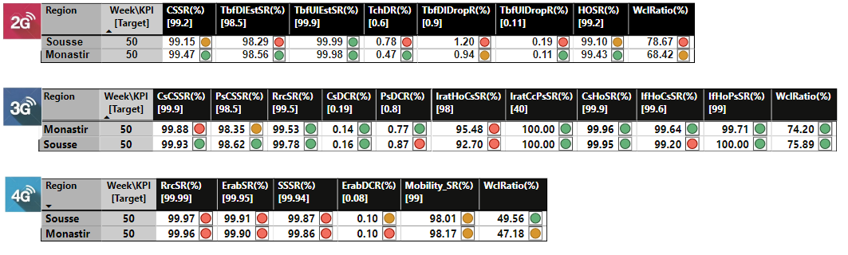
CONTRACTUAL KPIS
Major bottlenecks :
2G Availability issue impacting many sites in different dates during week from different regions is mainly contributing in bad 2G KPI performance of region. (check attached excel file for cell with avail problem)
High LTE UL RSSI in L800 affecting 4G KPI performance in Sousse and Monastir (check attached email)
Notes:
UL RSSI due external interference in sousse/Monastir nearby sites to jails

Slide 14
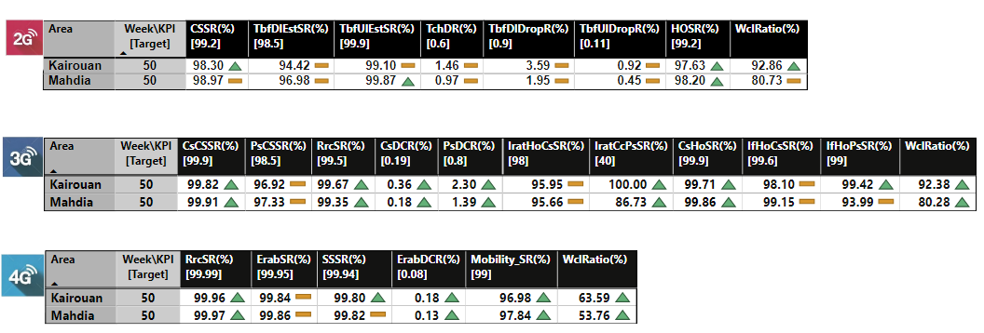
KPIs PROGRESS IMPROVEMENT
Major bottlenecks :
2G Availability issue impacting many sites in different dates during week from different regions is mainly contributing in bad 2G KPI performance of regions. (check attached excel file for cell with avail problem)
Limitation in transport bandwidth (observed by high Iub congestion) is impacting global KPI mainly in Mahdia region.

Slide 15
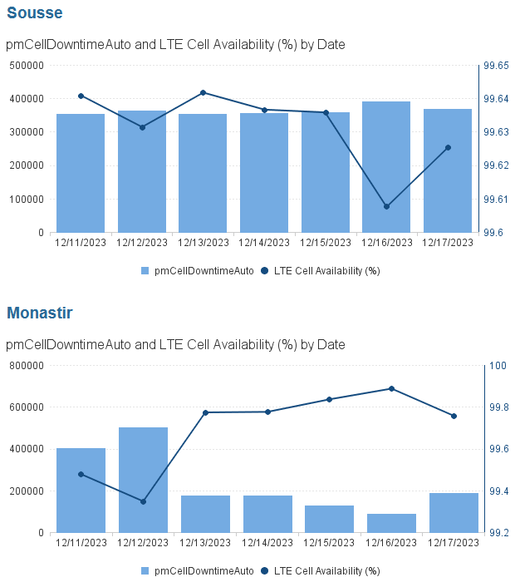
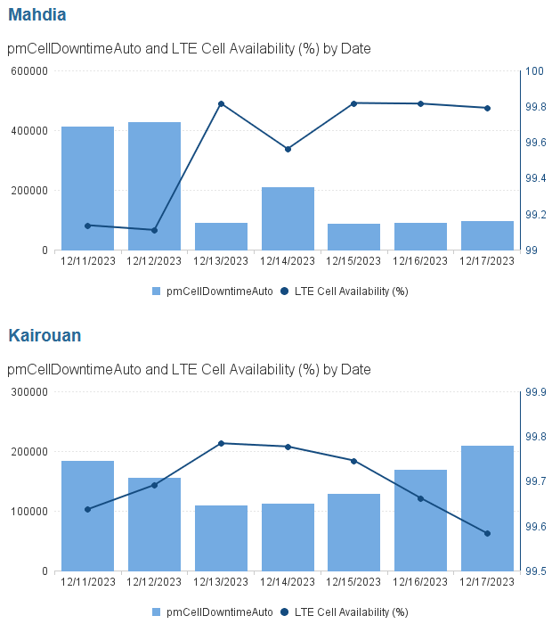
LTE Cell Availability and HW/RET issue

Slide 16
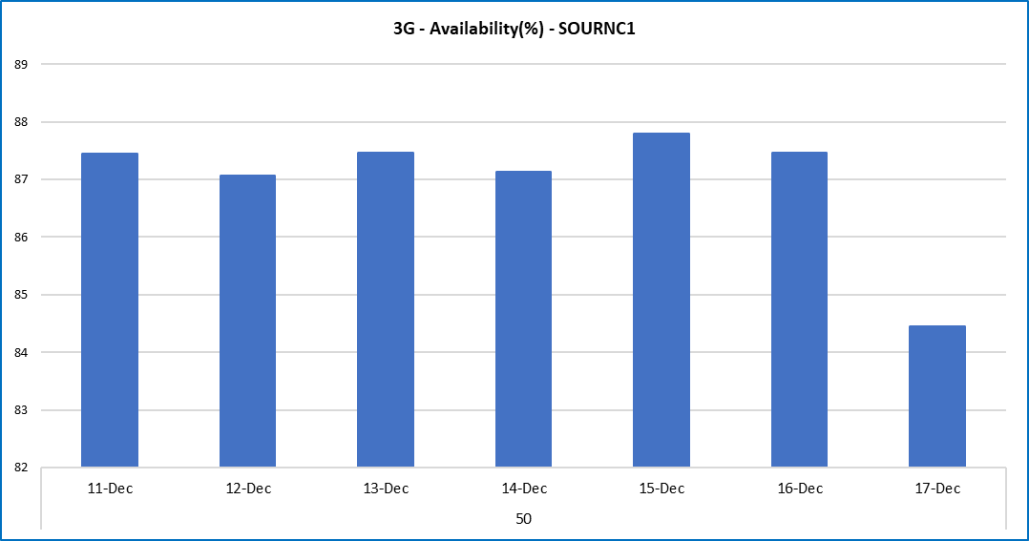
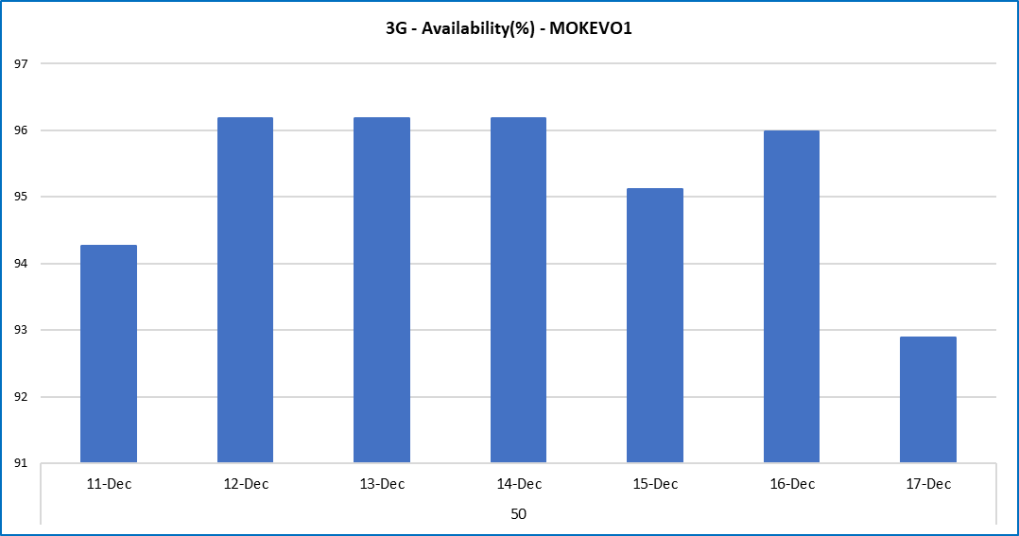
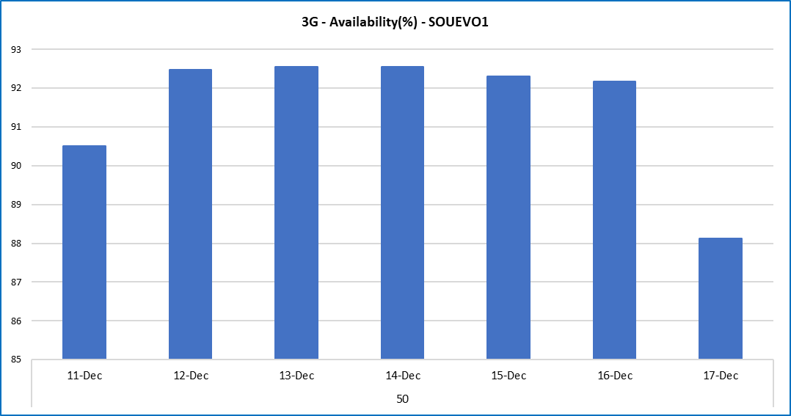
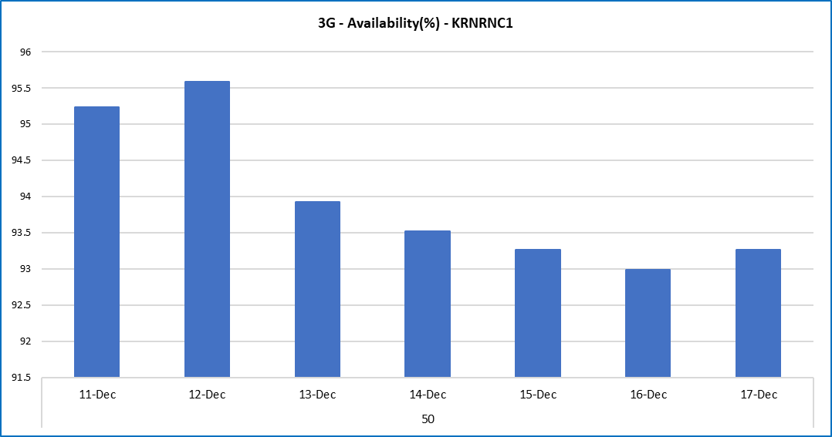
3G Cell Availability ,CellDownTime & alarm
Need to reduce Availability Issues to improve KPI

Slide 17
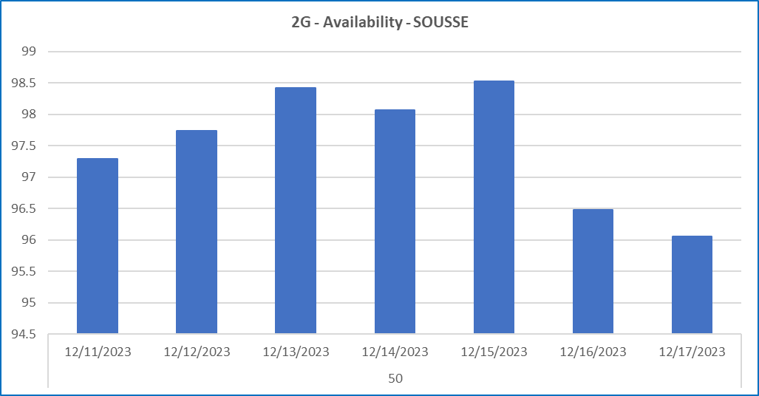
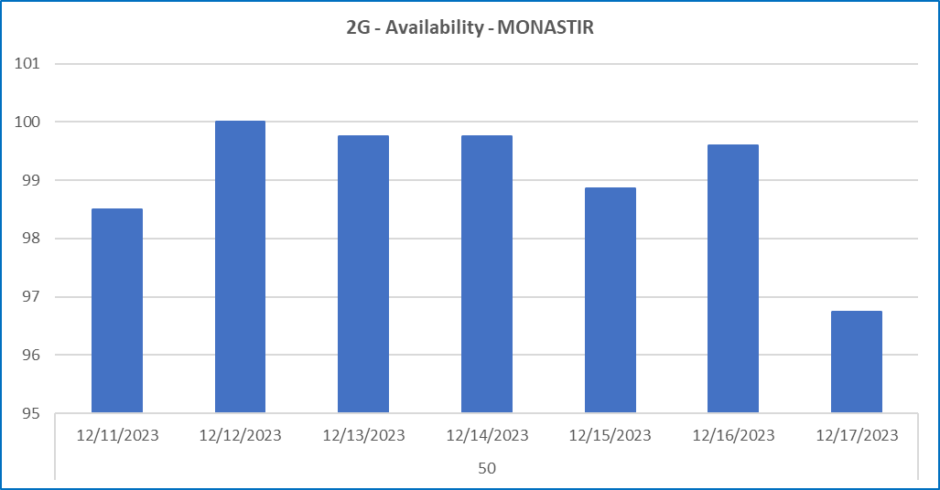
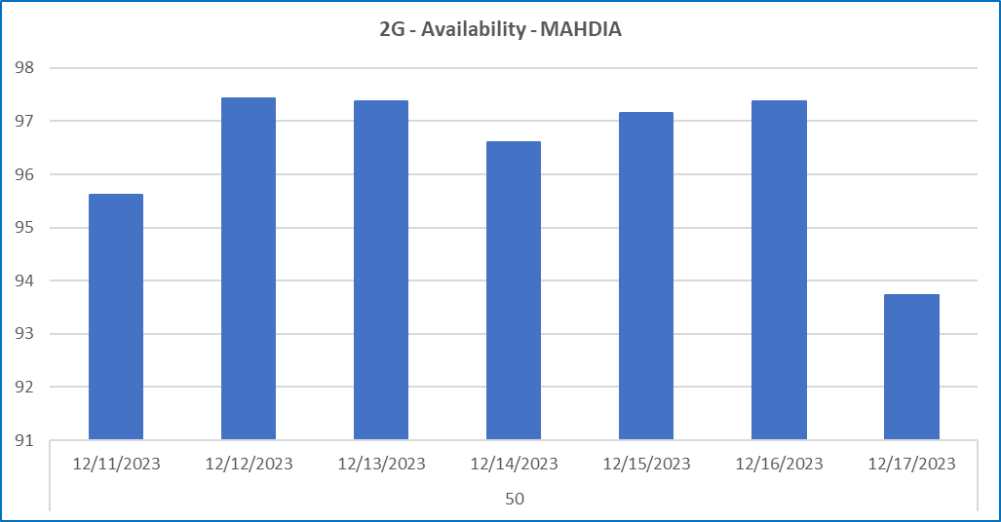
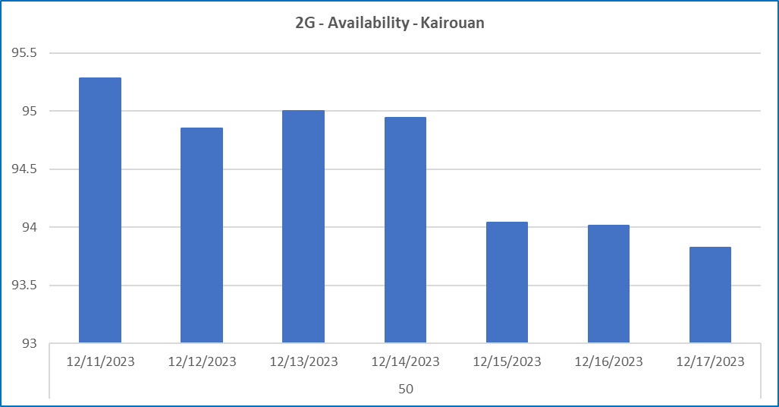
2G Cell Availability, CellDownTime & Alarm
Need to reduce Availability Issue/Cell down time to improve KPI

Slide 18
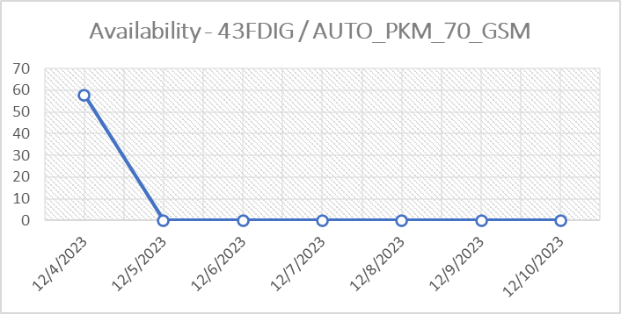
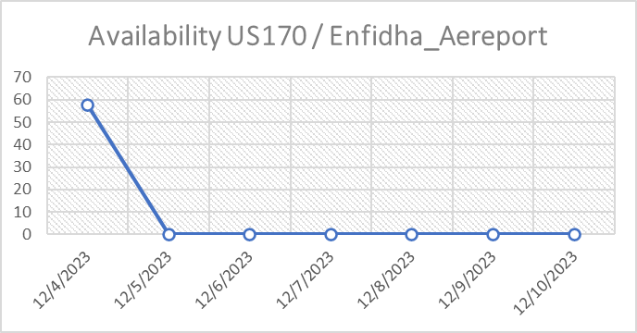
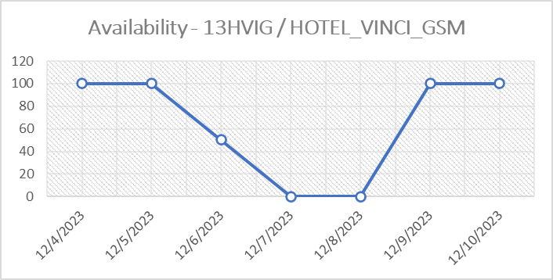
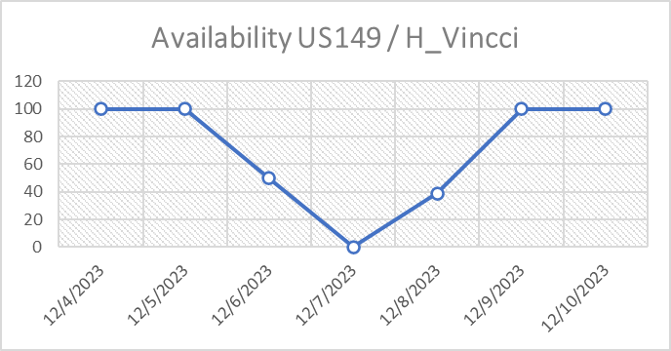
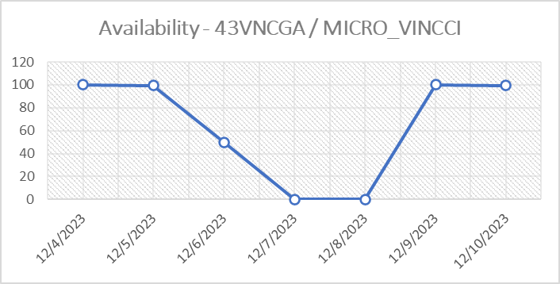
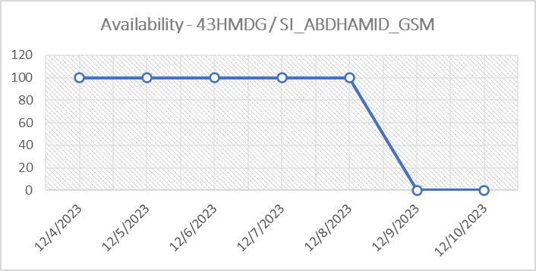
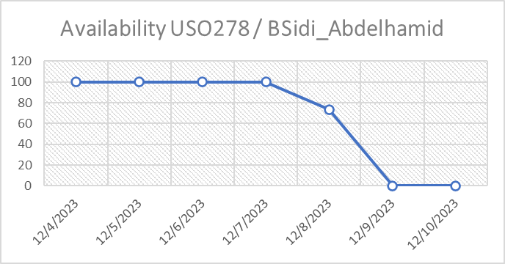
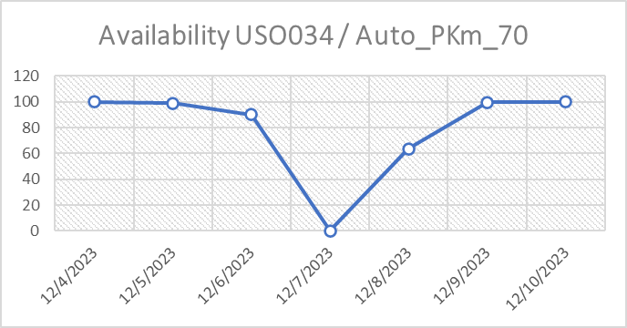
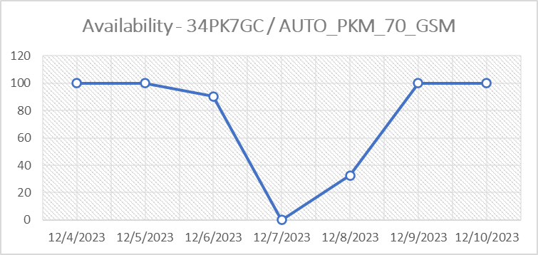
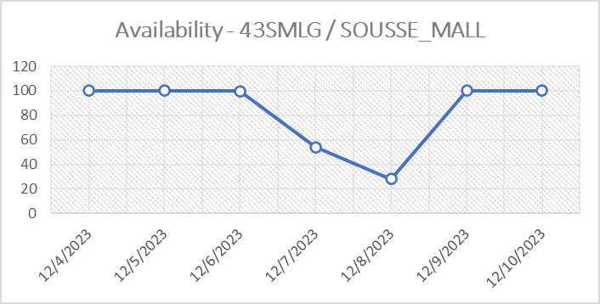
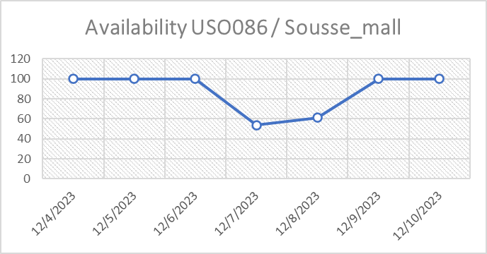
2G-4G_Availability in Sousse
SIDI_khlifa
down due Power outage

Slide 19
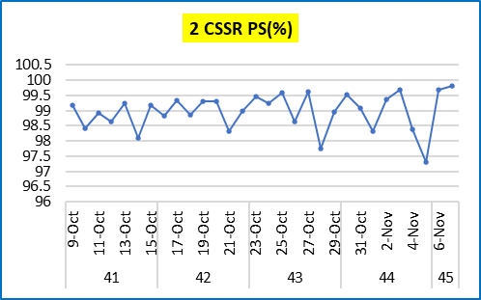
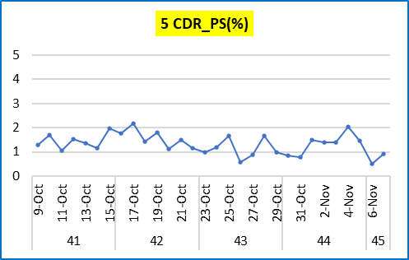
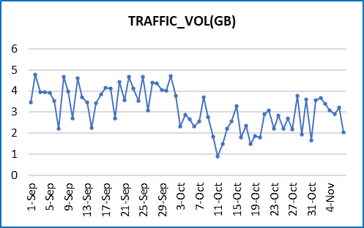
Sample Action Tilt and reduce CPICH Power :
CR implemented on 25 October 2023, during monitoring KPI, KPI (CSSR, CDR, Traffic) showing spike on 28 Oct, 1 Nov and 5nov (not due to CR implementation), suspected due to transmission flicker. Site location on the rural area. Traffic not impact action Downtilting, traffic keep maintain or slightly increase.

Slide 20
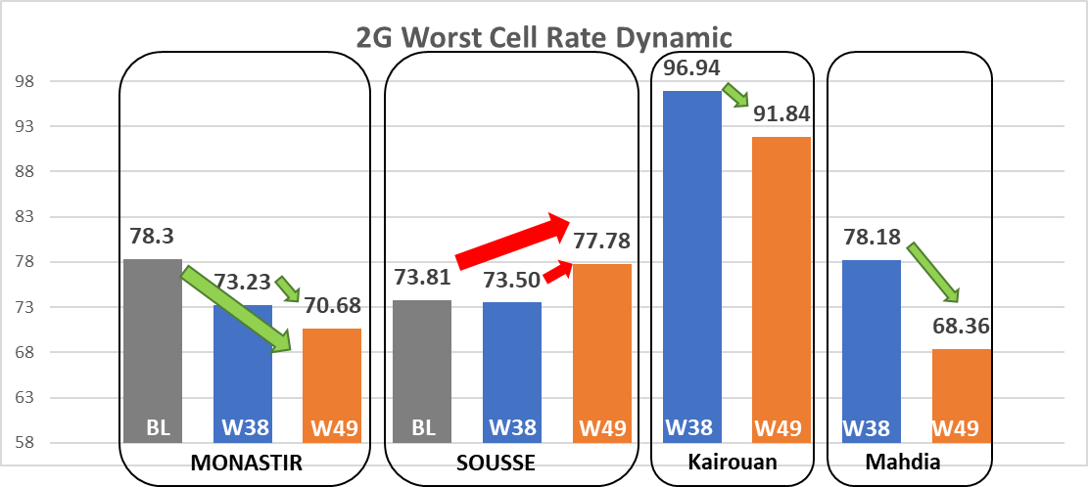
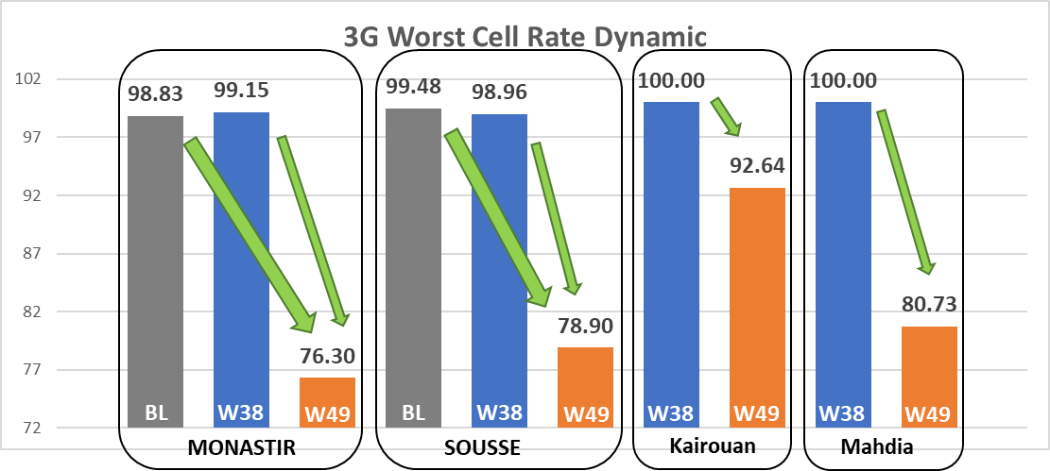
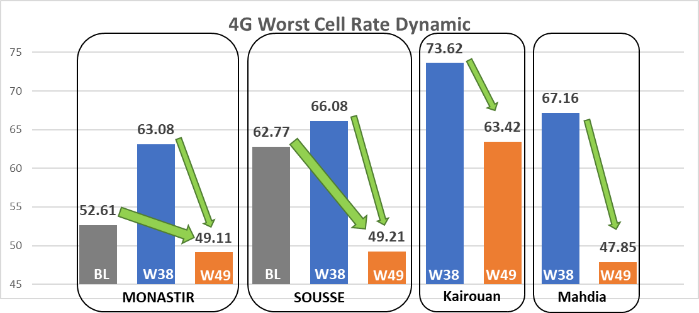
PERFORAMCE ACTIONS
Worst Cell Rate KPI’s Dynamic
Improvement of the count of 2G WorstCells in the Monastir, Mahdia and Kairouan regions
Improvement of the count of 3G WorstCells in all four regions
Improvement of the count of 4G WorstCells in all four regions
2G Availability in sousse affecting the improvement of Worst cells ratio

Slide 21
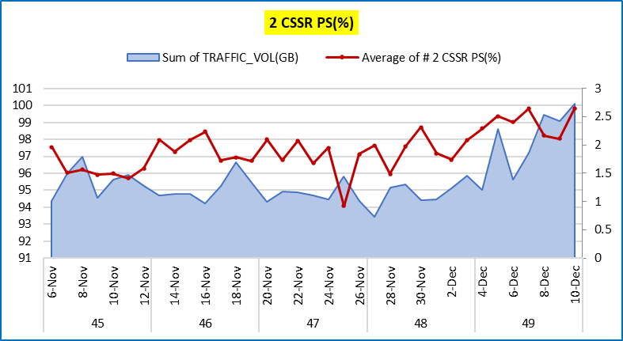
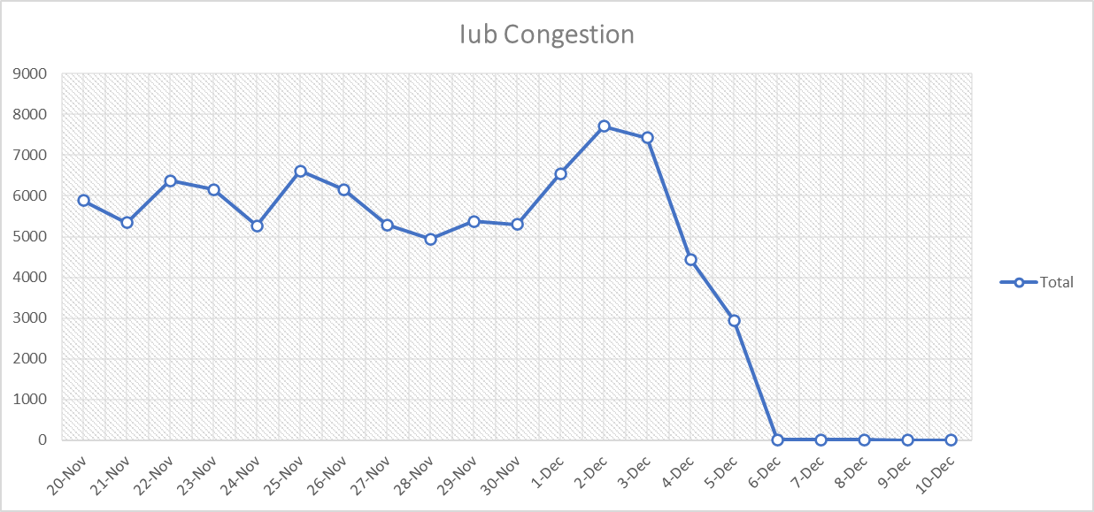
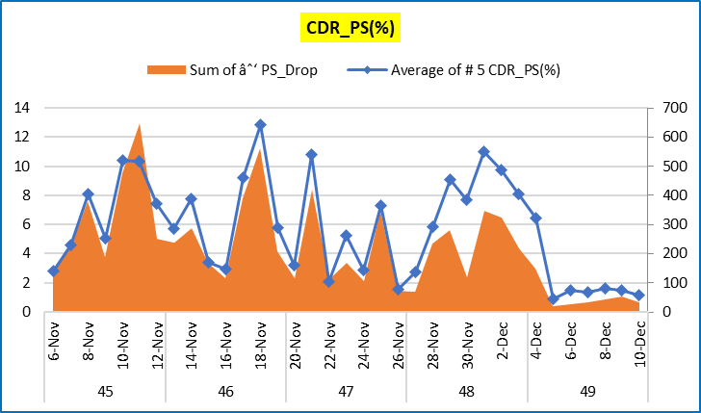
PERFORAMCE ACTIONS : IUB Upgraded in USO085 / 3G_Chgarnia
KPI improved after Upgraded Iub.

Slide 22
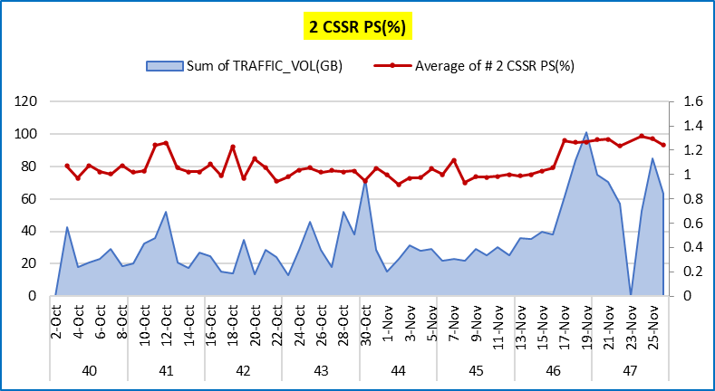
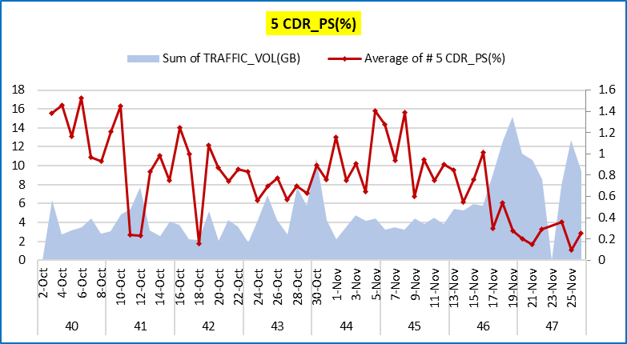
PERFORMANCE ACTIONS IUB Update on W47
IUB Congestion Update : IUB USO076 already upgraded on 17 Nov 2023
IUB Upgraded
Just after Iub upgrade, a good KPIs improvement taken place.

Slide 23
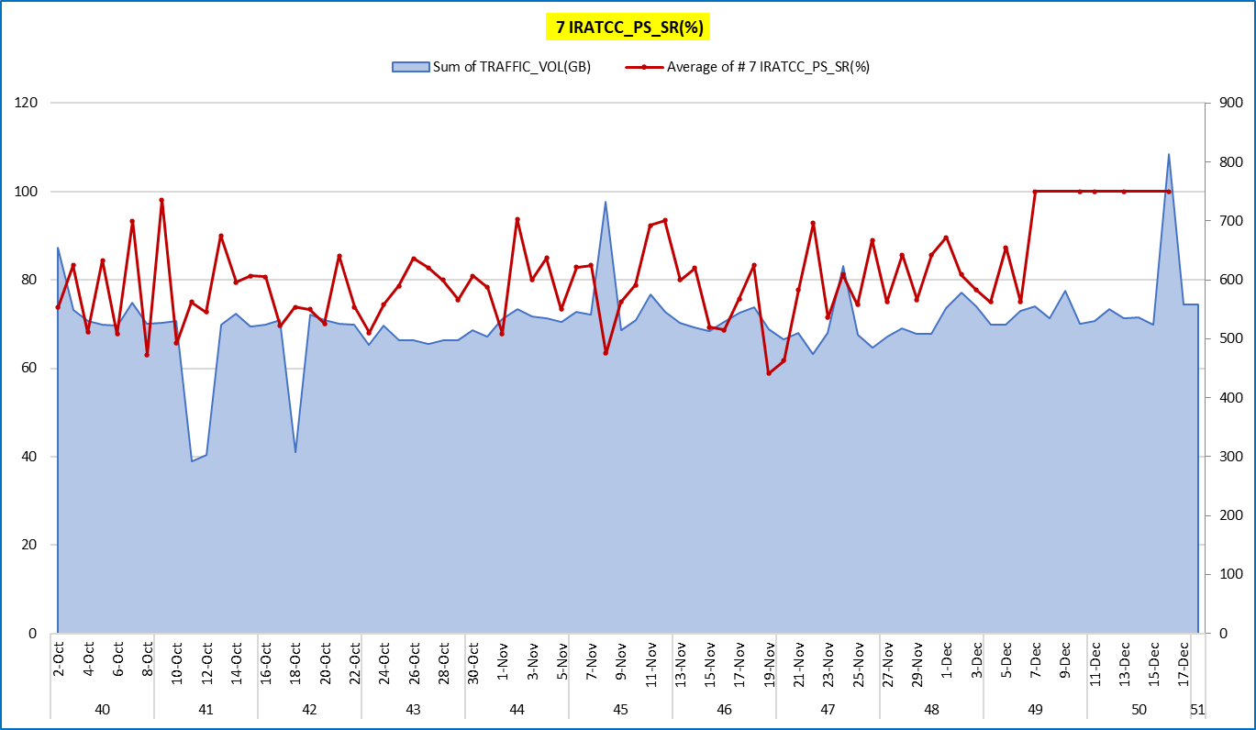
PERFORMANCE ACTIONS
3G KPI PERFORMANCE RNC KAIROUAN_IRAT_PS_SR
1,2,3
CR IMPLEMENTED :
20231201_CR_3G_Kairouan_Ch_ifIratHoPsIntHsEnabled_Utrancell_WorstCellList. (7Dec).
12072023_Uerc_UeRcTrCh_KRN_RNC_CR.(8Dec)
12072023_releaseRedirectEutraTriggers_tuning_KRN. (8Dec)
IRAT_PS_SR improved after implement CRs.

Slide 24
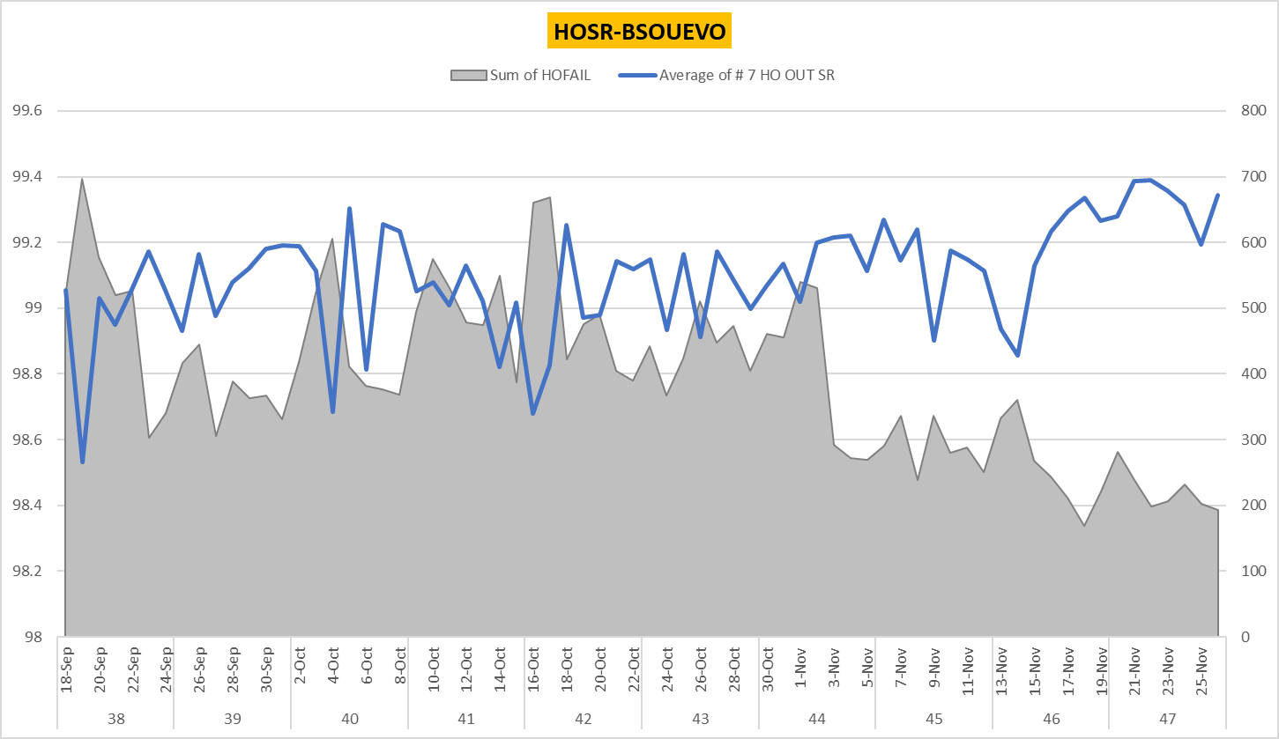
PERFORMANCE ACTIONS
2G KPI PERFORMANCE BSC SOUSSE HOSR
CR Implemented :
1.220231031_CR_2G_Sousse_Add_del_NB_Relations_2G_2G_for_HOSR REV1 (2nov)
2. 20231114_CR_2G_PwrCtl_Uplink_changes_TWPC_Sousse(15Nov)
3. 20231114_CR_2G_Sousse_Add_del_NB_Relations_2G_2G V1(16nov)
3
1
2
CR already implemented on BSC SOUSSE (detail CR implementation on chart above), with result improvement on HOSR. Activity done, have added Relation and Delete unnecessary relation, then
tuning BSRXmin and MsRxmin to improve HOSR as above chart . On 19, degraded due to 1 site problem (2G Knais)

Slide 25
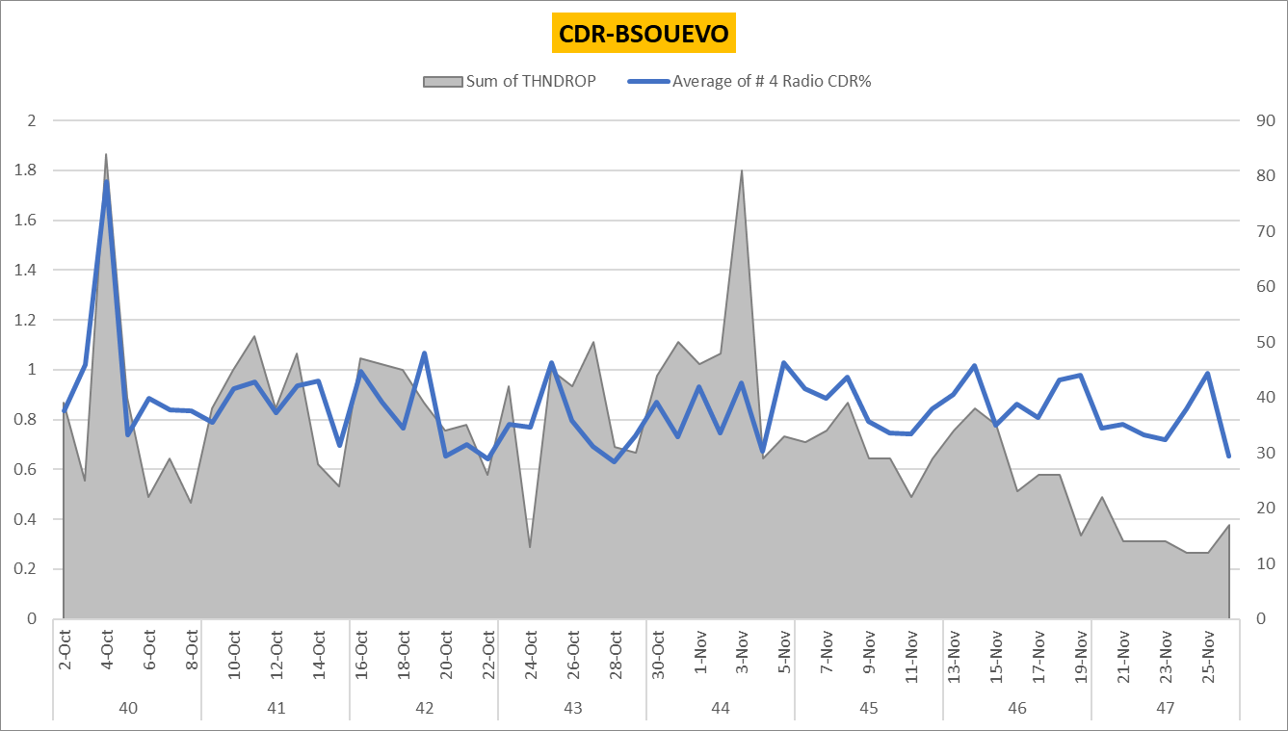
PERFORMANCE ACTIONS
2G KPI PERFORMANCE BSC SOUSSE DCR
CR Implemented :
1.220231031_CR_2G_Sousse_Add_del_NB_Relations_2G_2G_for_HOSR REV1 (2nov)
2. 20231114_CR_2G_PwrCtl_Uplink_changes_TWPC_Sousse(15Nov)
3. 20231114_CR_2G_Sousse_Add_del_NB_Relations_2G_2G V1(16nov)
1
3
2
CR already implemented on BSC SOUSSE (detail CR implementation on chart above), Showing Reducing number of drop and reducing DCR (%). Drop call from HO reduced after increasing
Bsrxmin and Msrxmin then continuing deletion un-necessary NB Relation.

Slide 26
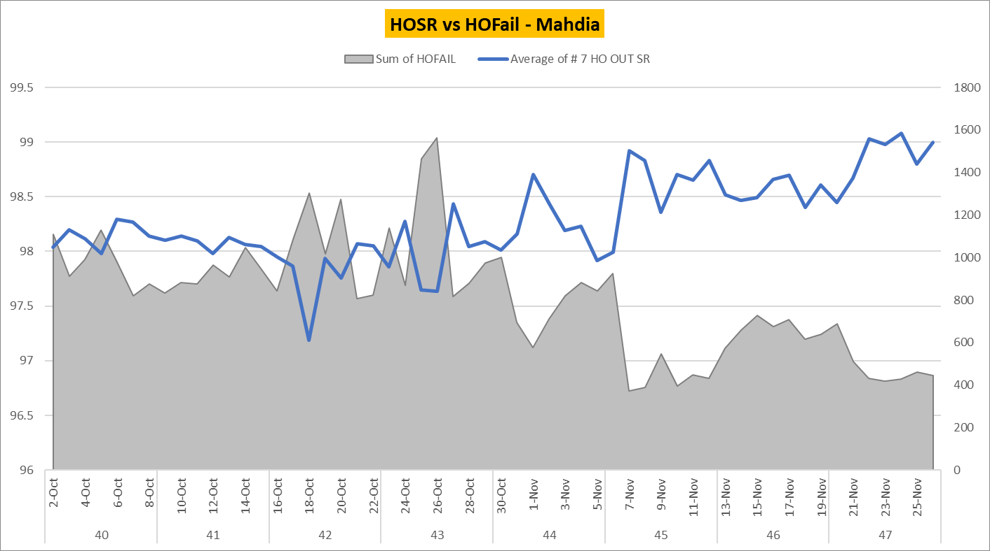
PERFORMANCE ACTIONS
2G KPI PERFORMANCE HOSR _Mahdia
CR Implemented :
1. 20231102_CR_2G_BCCH_collisions_retune_Monastir_Mahdia(3nov)
2. 20231106_CR_2G_Neighbour_relation_addition_deletion_Monastir_Mahdia(7Nov)
1
2
Above chart showing improvement in Mahdia Region after first step tuning BCCH in Mahdia, then continuing addition and deletion NB Relation improving HOSR.

Slide 27
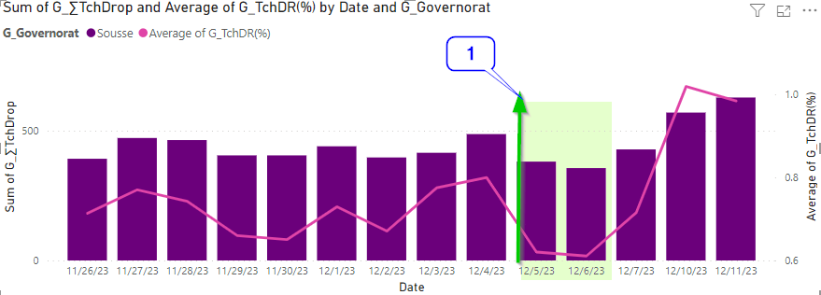
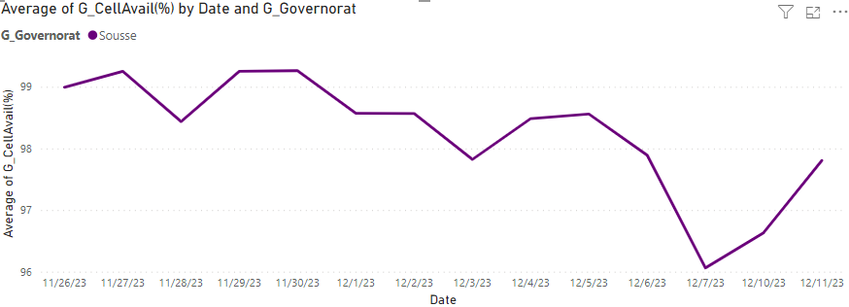
PERFORMANCE ACTIONS
2G KPI PERFORMANCE SOUSSE REGION : TCH DROP(%)
1:ReducedPowerLevelAfterHandover feature_Activation_Sousse
Above TCH DCR trend is showing great improvement in Sousse just after “Reduced Power Level After Handover” feature Activation, degradation seen after 7th Dec
was caused by availability fluctuation issue as seen on small chart on the right side , on the date 8th and 9th : statistics are not available due to synch issue btw
BSOUEVO and ENM.
Results : TCH DCR has improved by 24 % from 0.80% to 0.61%, with #TCH Drop considerably reduced.

Slide 28
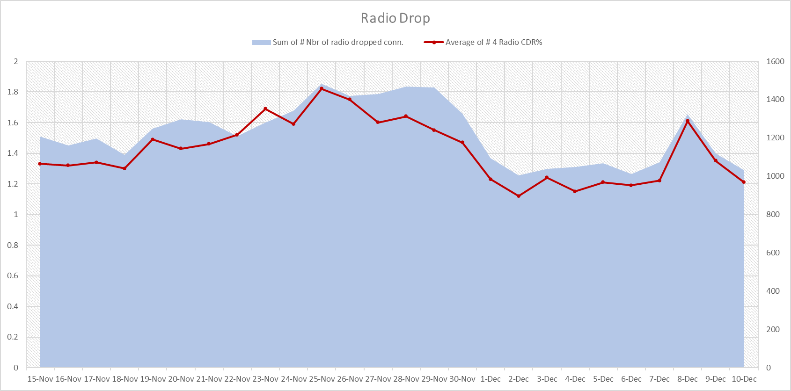
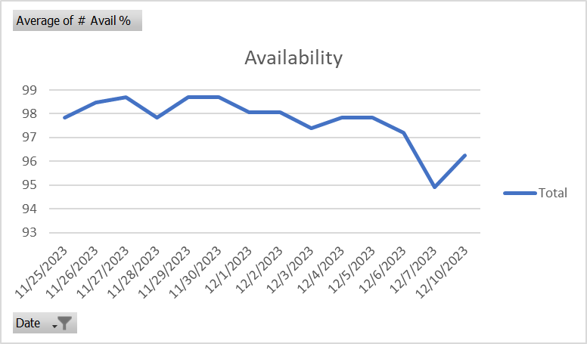
PERFORMANCE ACTIONS
2G KPI PERFORMANCE BSC Kairouan Radio Drop
CR Implemented :
1. 11302023_Codec_fine_Tuning (1Dec)
1
Radio Drop in 2G showing improvement in Kairouan after implement CR codec fine tuning. There are degradation on weekend (8-9 Dec) due to availability issue.
As the result : 2G_CDR has improved by 0.17% in avg from 1.47% to 1.22%
with #Radio Drop reduced 6% from 1095 to 1031.

Slide 29
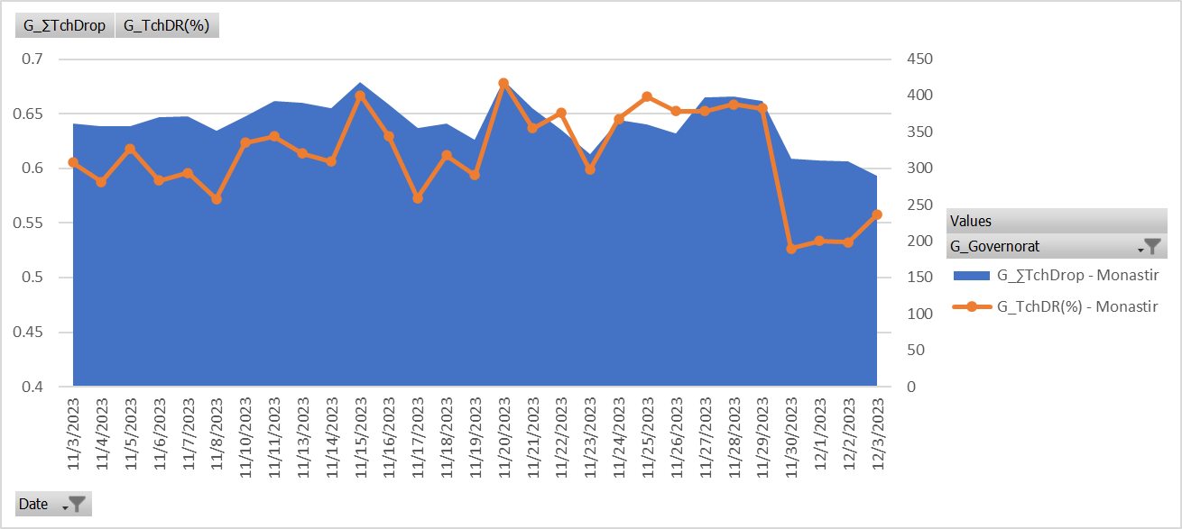
PERFORMANCE ACTIONS
2G KPI PERFORMANCE MONASTIR REGION : TCH DROP(%)
1
CR Implemented :
1. AMR_Codec_fine_Tuning (30 Nov)
20% of improvement
Above TCH DCR trend is showing great improvement in Monastir after implement CR AMR codec fine tuning.
As the result : TCH DCR has improved by 20% from 0.75% to 0.62%
with #TCH Drop considerably reduced.

Slide 30
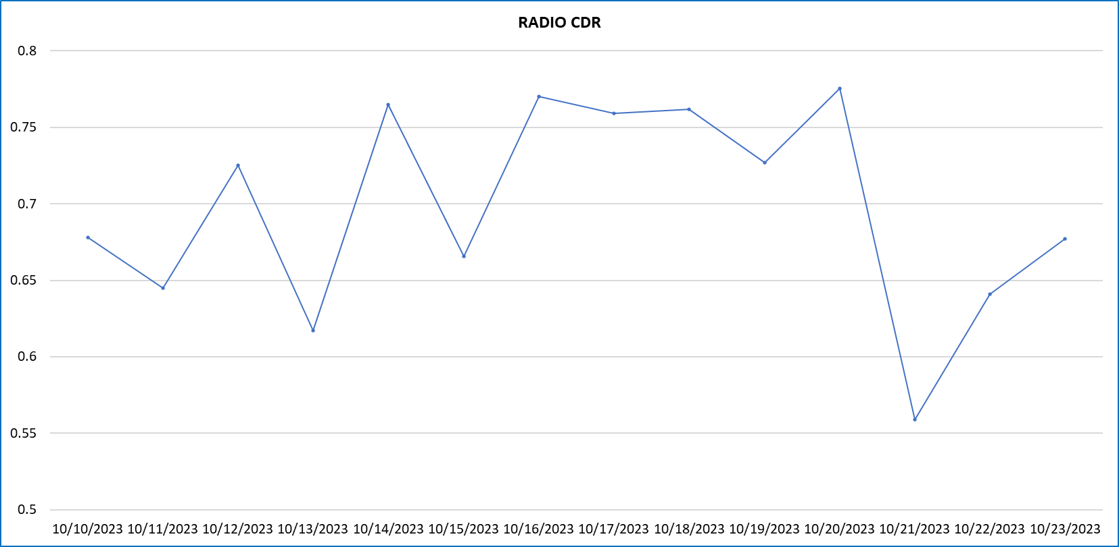
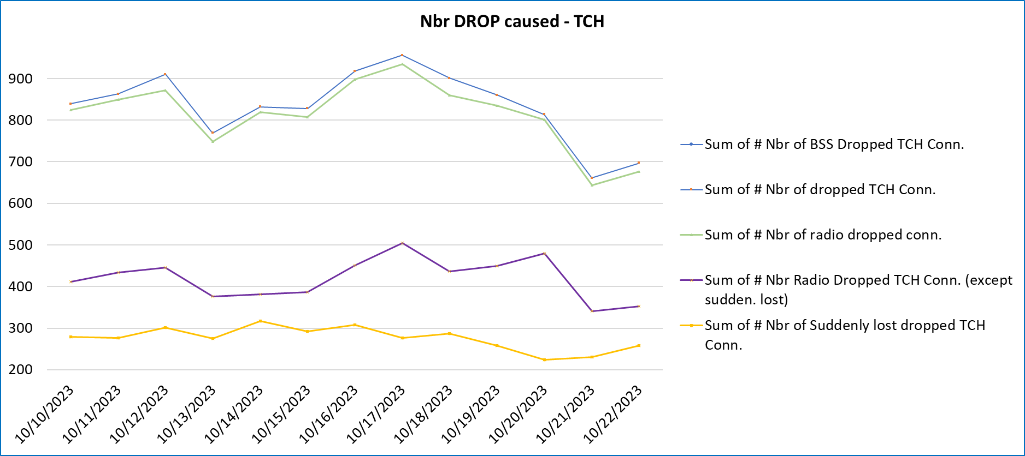
PERFORAMCE ACTIONS
Activate IRC in 325 cells
CR 2G_010 – 20231017_CR_2G_MONASTIR_Change_Parameter_Gerancell IRC (325 cells)
Activated IRC, is affected on quality of the Radio, it showing that drop call improved with reducing Number of drop due to Radio.
Implementation date
Implementation date
17.7% Improved
Improved

Slide 31

PERFORMANCE ACTIONS
2G KPI PERFORMANCE BSC SOUSSE CSSR
4, 6, 18
CR Implemented :
1. 20231017_CR_2G_SOUSSE_MONASTIR_BA_List_Correction_DEL&ADD(18 Oct)
2. 20231019_CR_Sousse_Monastir_2G_Parameter_Change(25 Oct)
3. 20231019_2GCR_Sousse_Monastir_Add_oneway_NB_Adj (19 Oct)
4. 20231019_CR_2G_audit_Sousse_Monastir_Parameter Changed (25Oct)
5. 20231019_CR_2G_Parameter_Change (19 Oct)
6. 20231023_CR_2G_MONASTIR&SOUSSE_Change _Parameter_Mobility
for_Handover(25Oct)
7. 20231023_CR_2G_MONASTIR&SOUSSE_Change _Parameter_Locating_ConnectionRelease_RLink_timeout (24 Oct)
8. 20231025_CR_2G_021_SOUSSE_Worst_TBF_DL_SR_Ch_Parameter (25 Oct)
9. 220231103_CR_2G_Sousse_Ch_Parameter_Power_Control_Uplink (3 Nov)
1
3, 5
7
9
Trending Improved
CR already implemented on BSC SOUSSE (detail CR implementation on chart above), with result Improvement on CSSR.

Slide 32

PERFORMANCE ACTIONS
2G KPI PERFORMANCE BSC MONASTIR HOSR
5, 6, 8
10
16
12, 13, 17
CR IMPLEMENTED :
1. 20231013_CR_2G_MONASTIR&SOUSSE_gerancellrelation
_create_NB (16 Oct)
2. 20231017_CR_2G_SOUSSE_MONASTIR_BA_List_
Correction_DEL&ADD (18 Oct)
3. 20231017_CR_2G_MONASTIR_Change_Parameter_Gerancell (18 Oct)
4. 20231019_CR_Sousse_Monastir_2G_Parameter_Change(25 Oct)
5. 20231019_2GCR_Sousse_Monastir_Add_oneway_NB_Adj (19 Oct)
6. 20231019_2GCR_Sousse_Monastir_Add_oneway_NB_Adj (19 Oct)
7. 20231019_CR_2G_audit_Sousse_Monastir_Parameter Changed (25 Oct)
8. 20231019_CR_2G_Parameter_Change (19 Oct)
9. 20231023_CR_2G_MONASTIR&SOUSSE_Change _Parameter_Mobility_for_Handover (25 Oct)
10. 20231023_CR_2G_MONASTIR&SOUSSE_Change _Parameter_Locating_ConnectionRelease_RLink_timeout (24 Oct)
11. 20231026_CR_2G_FastReturnToLTE_Sousse_Monastir (26 Oct).
12. 20231027_CR_2G_electricalAntennaTilt_Monastir_Mahdia (3 Nov)
13. 220231027_CR_2G_Monastir_Mahdia_Worst_Cells_Ch_Parameter PC Handover (3 Nov).
14. 20231030_CR_2G_Neighbour_relation_deletion_Monastir_Mahdia (31 Oct)
15. 20231031_CR_2G_Monastir_Mahdia_NCCPERM_update (31 Oct)
16. 20231031_CR_2G_Neighbour_relation_addition_deletion_Monastir
_Mahdia (1 Nov).
17. 20231102_CR_2G_BCCH_collisions_retune_Monastir_Mahdia (3 Nov)
1
2, 3
4, 7,9
14, 15
11
Trending Improved
CSSR Region Monastir, since W42, Have trending increased. Detail CR implemented, shown in above table.
HOSR improved after add relation, correction NCCPERM.

Slide 33

PERFORAMCE ACTIONS
3G KPI PERFORMANCE BSC MONASTIR IF_ HO_CS_SR
CR IMPLEMENTED on Monastir:
1. CR_3G_9.10 param_ch UtRel_COSITED_INTRA_missing Coverage_Rel_not_def_Souse_Monastir
20231013_CR_3G_Sousse&Monastir_UtranRelation_Add_NB(16 Oct)
2. 20231012_CR_3G_MONASTIR_UtranRelation_Nbr_ADD_
and_DEL(16 Oct)
3. 20231016_CR_3G_MONASTIR_CHANGE Parameter_gsmrelation (23 Oct)
4. 20231017_CR_3G_Monastir_Activate_Features (17 Oct)
5. 20231018_CR_3G_SOUSSE_MONASTIR_parameter_
and_feature_alignment (25 Oct)
6. 20231023_CR_3G_SOUSSE_MONASTIR_Worst_Cell__
param_ch_antenna_tilt (24 Oct)
1, 2
1, 2
6
5
3
IRATCC_PS_SR, keep improving since W42 improved after activity add GSM NB adj, corrected parameter on 2G and tuning some parameter related Irat HO.

Slide 34

PERFORMANCE ACTIONS
3G KPI PERFORMANCE BSC MONASTIR HS_Avg_User_Thp(kbps)
1, 2
3
6, 7
8
CR IMPLEMENTED on Monastir:
1. 20231013_CR_3G_Sousse&Monastir_UtranRelation_Add_NB(16 Oct)
2. 20231012_CR_3G_MONASTIR_UtranRelation_Nbr_ADD_
and_DEL(16 Oct)
3. 20231017_CR_3G_Monastir_Activate_Features (17 Oct)
4. 20231018_CR_3G_SOUSSE_MONASTIR_parameter_
and_feature_alignment (25 Oct)
5. 20231023_CR_3G_SOUSSE_MONASTIR_Worst_Cell__
param_ch_antenna_tilt (24 Oct).
6. 20231027_CR_3G_Feature_CallReEstablishmentIur_rnc_all (30 oct)
7. 20231027_CR_3G_parameter_and_feature_alignment_Monastir
_Mahdia (30 oct)
8. 20231031_CR_3G_param_ch_antenna_tilt (1 Nov)
5
4
1, 2
6
5
3
Trending Improved
HS-Avg_User_Thp(kbps) increased after alignment parameter and features in Monastir.

Slide 35

PERFORMANCE ACTIONS
3G KPI PERFORMANCE RNC KAIROUAN_IF_HO_HS_SR
CR IMPLEMENTED :
12072023_releaseRedirectEutraTriggers_tuning_KRN.(8Dec)
12072023_Sf_Adm_Adjust_KRN (8Dec)
12072023_Uerc_UeRcTrCh_KRN_RNC_CR (8Dec)
1,2,3
IF HO_HS_SR in Kairouan improved after tuning parameter .

Slide 36

PERFORMANCE ACTIONS
3G KPI PERFORMANCE MONASTIR REGION : PS DROP(%)
CR IMPLEMENTED :
3G_featCtrlFDpchSrbOnHsdpa_to_OFF(29Nov).
3G_UeRc_UeRcTrC (30Nov)
3G_ReleaseRedirectEutraTriggers_param(30Nov)
1
2,3
43% of improvement
Great improvement in Monastir after implementing CRs related to deactivated featCtrFDpchSrbOnHsdpa, releaseRedirectEutraTrigger_tunning andTuning UeRC Setting.
As the result : CDR_PS has improved by 43% from 1.19% to 0.67%.
#PS Drop considerably reduced.

Slide 37

PERFORMANCE ACTIONS
3G KPI PERFORMANCE RNC SOURNC1_IRATCC_PS_SR(%)
1
CR IMPLEMENTED :
1. 220231121_CR_3G_Sousse_Act_Feat_DlCodePowerCm
Irat PS SR improved after implement DlCodePowerCm in Sousse.

Slide 38

PERFORMANCE ACTIONS
3G KPI PERFORMANCE RNC Monastir CDR CS
CR IMPLEMENTED :
1.20231107_CR_3G_param_ch_feat_act_Monastir(7Nov)
DCR CS Region Monastir Improved on 10 November 2023 after Implement Radio Link Parameter from 10 to 20, Active set change from 3 to 4 in RNC MOKEVO1. Then continuing tuning CPICH Power, RET.

Slide 39

PERFORMANCE ACTIONS
3G KPI PERFORMANCE RNC EVO IRATCC_PS_SR
2
4
CR IMPLEMENTED on Monastir:
1. 20231016_CR_3G_MONASTIR_CHANGE Parameter_gsmrelation(23Oct)
2. 20231023_CR_3G_SOUSSE_MONASTIR_Worst_Cell__param_ch_
antenna_tilt(24Oct)
3.20231031_CR_UMO302_3G_Nbr_ADD_param_ch_antenna_tilt(31Oct)
4. 20231031_CR_3G_param_ch_antenna_tilt(1Nov)
5.20231103_CR_UMO061_3G_Nbr_ADD_param_ch_antenna_tilt(6Nov)
6.20231106_CR_3G_Nbr_Add_Coverage_Rel_add_param_ch_Monastir(6Nov)
7.20231106_CR_3G_Nbr_ADD_and_Param_CH_and_AntennaTilt(7Nov)
8.20231107_CR_3G_param_ch_feat_act_Monastir(7Nov)
9.20231108_CR_UMO362_3G_Nbr_ADD_param_ch_antenna_tilt(8Nov)
1
3
IRATCC_PS_SR, keep improving since W42 improved after activity add GSM NB adj, corrected parameter on 2G and tuning some parameter related Irat HO (HoType). Basically for irat is to audit NB Relation with GSM cells , parameter HO Type and RSCP and ECNO threshold parameter have to set correctly.

Slide 40


PERFORMANCE ACTIONS
3G_Feature_NwInitCallReest_SOURNC1
CR 3G_013 – 20231018_CR_3G_Feature_NwInitCallReest_soussernc.
CR 3G Feature implement on Oct 18, 2023. This feature decreases system releases at some of the failure cases appearing in RAN. Some of these cases are then saved from dropping with an end-to-end benefit of continued calls. Call Re-establishment feature by triggering call re-establishment at some failure cases that end with dropped call.
Below chart showing improvement on pmNoSystemRabReleaseSpeech, reflected to CDR CS.
Implementing Date
22 % Improved
4194
From 17 days monitoring, showing Improvement CDR CS around 5-22% in RNC level.
Currently this features already implemented on all RNC, only SOURNC1 just implemented.
For other RNC’s need to tuning some parameter same or equal with SOURNC1.
From pm counter pmNoSystemRABReleaseSpeech / Number drop reduced around 12-37.7%.
3266

Slide 41

PERFORMANCE ACTIONS
CR 4G Activating features Dynamic Uplink Resource Allocation and Dynamic Pucch
CR 4G_107, CR 4G_108 – Activating features Dynamic Uplink Resource Allocation (45 sites) and Dynamic Pucch (7 sites) for increasing UL PRB Utilization, implemented 12/14/2023.
After activation increased percentage of LTE UL Air interface Utilization 14,7% -> 16%

Slide 42

PERFORMANCE ACTIONS
CR 4G Activating feature Prioritized SR Scheduling
CR 4G_077 – Activating feature Prioritized SR Scheduling (25 sites), implemented 12/04/2023.
After activation a little improve in DCR

Slide 43


PERFORMANCE ACTIONS
CR 4G Activate Multi-Target RRC Connection Re-Establishment
The feature Multi-Target RRC Connection Re-Establishment was activated on the sites B4G3G_Karker and B4G3G_Moknine_Stade.
Activation doesn’t affect the KPI RRC_SR, only reducing the number of counter pmRrcConnReestFailLicMtReest.
Activation feature recommended together with activating VoLTE

Slide 44

PERFORMANCE ACTIONS :
In Sousse area, 2 CRs (1 and 2) related to Eutrancellrelation setting were implemented to improve Lte Mobility.
As a results : - Lte HOSR has improved by 1% in avg from 97.2% to 98.2%.
- Lte HO Exec fails have reduced by 60% in avg from 25K to 10K.

Slide 45

PERFORMANCE ACTIONS :
In Kairouan area, 2 CRs (1 and 2) related to Eutrancellrelation setting were implemented to improve Lte Mobility.
As a results : - Lte HOSR has improved by 1.2% in avg from 96.40% to 97.60%.
- Lte HO Exec fails have reduced by 50% in avg from 8K to 4K.

Slide 46

PERFORAMCE ACTIONS
20231027_CR_4G_IshoAllowed_Offset_EutranCellRelation_ALL bring good improvement for Lte Mobility KPI.

Slide 47

PERFORAMCE ACTIONS
CR 4G Testing IFLB parameters in the Test Cluster
CR 4G_011 – 20231016_CR_4G_IFLB_Test_zone_Msaken
First part - changing IFLB parameters on the Testing Cluster Msaken, implemented 10/19/2023. Second part – activating additional IFLB features (Accelerated IFLB, Carrier Aggregation-Aware IFLB, UE Throughput-Aware IFLB), implemented on 10/26/2023.
The chart below shows improvement on HO_Success_Rate after the implementation.
1st
2nd
98.34%
97.99%

Slide 48


CR STATUS
Charts here ( Raised/Approved/Implemented/Not Implemented/Partially Implemented)

Slide 49
ACTION PLAN
Continue activities to improve KPI RRC_SR, Erab_SR, HO_SR and DCR in 4G
Tuning parameters for improving Mobility and Retainability on worst cells
Alignment features Variable SR and CQI Periodicity and Downlink\Uplink Coordinated Multi-Point on the sites in all regions
Tuning parameters for improving Accessibility and Retainability on worst cells
Continue Add NB and delete unnecessary adj to improve KPI HOSR and DCR in 2G and 3G.
Continue Tuning Idle mode/Cell selection, Re-selection parameter to improve 2G accessibility and retainability based on worst performing cells.
Continue Tuning freq BCCH, DCHNO to improve Accessibility and Retainability.
Optimize parameter related Mobility 3G (HoType, usedFreqThresh2dEcno, usedFreqThresh2dRscp, Event 1b), include parameter IRAT, IFHO, ISHO and Cell Change on PS Handover.
3G CPICH and RET OPTIMIZATION ON DENSE URBAN ZONES (continue) to improve Retainability, Accessibility and reduce pilot pollution.
Continue optimization activity based on Worst performing cells to improve accessibility, retainability and mobility.
Continue Tunning RET in 2G, 3G to improve KPI.
Tuning parameters for improving PRB Utilization
Testing ScelldynamicCA_Candidate Feature in Kantawi Cluster sousse to maximum CA UE penetration in the network and improve DL Throughput
Keep Testing Dynamic PUCCH Feature
Trial Feature GPRS/EGPRS DL Power Control in Mahdia
Trial Feature Efficiency Packet Data & Expanded_PDCH_address_space in Kairouan
Activated feature ReducedPowerLevelAfterHandover in all regions.
Deep Analysis of Drive test After in Sousse/Monastir/Mahdia/Kairouan with ensuring 0 drops in highway and main roads.

Slide 50

QUESTIONS

Slide 51
https://www.ericsson.com/en/network-automation/network-optimization

